Slide 1

Welcome to wetcf.com
እንኳን ወደ wetcf.com በደህና መጡ
Our website, our member portal, and our library
ዛሬ ይጀምራሉ
Warsaw Ethiopian Christian Fellowship
Notes:
Welcome everyone. Today is a big day for our fellowship — we are launching three things at once: our public website, the members portal, and our library service. Let me walk you through each one.

Slide 2



Three Things, Launching Today
ዛሬ የሚጀምሩ ሦስት ነገሮች
Our Website
Members Portal
Fellowship Library
ድረ-ገጻችን
የአባላት ፖርታል
ቤተ-መጻሕፍት
A public home at wetcf.com — who we are and when we meet.
A private space for members — groups, teams and meetings.
Our books, open for borrowing. Reserve online, collect here.
Notes:
Three launches in one. Say a sentence about each, then tell them we will look at each in turn.

Slide 3




Our Public Website
ይፋዊ ድረ-ገጻችን
wetcf.com — anyone can visit, no account needed
Home & About
Programs & Events
ስለ እኛ
ዝግጅቶች
Visit Us
Follow Us
ይጎብኙን
ይከታተሉን
Notes:
This is the front door. Anyone can visit without an account — a friend, a family member, someone new to Warsaw looking for a church. Share wetcf.com freely.

Slide 4




Inside the Members Portal
በአባላት ፖርታል ውስጥ
Announcements
Events
BUS Groups
ማስታወቂያዎች
ዝግጅቶች
BUS ቡድኖች
Serving Teams
Library
Notifications
የአገልግሎት ቡድኖች
ቤተ-መጻሕፍት
ማሳወቂያዎች
Notes:
Six things waiting for every member once they sign in. We will look at the most important ones now.

Slide 5
Stay in the Loop
ዜናዎችን ይከታተሉ
Announcements
Events
ማስታወቂያዎች
ዝግጅቶች
· Posted by leaders
· Each has its own page
· Prayer and praise
· Photos and video
· Reaches you at once
· Reminder the day before
Notes:
Leaders post once and it reaches everyone instantly. Events now have full pages with photos and video.

Slide 6


BUS Groups
BUS ቡድኖች
Group Chat
Video Meetings
Shared Tasks
የቡድን ውይይት
ቪዲዮ ስብሰባ
የጋራ ተግባሮች
A private room for your group
One tap to meet from anywhere
Agree who does what, together
Notes:
Every member belongs to a BUS group. Each one now has its own chat, video room and task list.

Slide 7




Serving Teams
የአገልግሎት ቡድኖች
Worship
Prayer
Evangelism
Social Affairs
Social Media
Library
አምልኮ
ጸሎት
ወንጌል ስርጭት
ማህበራዊ ጉዳይ
ሶሻል ሚዲያ
ቤተ-መጻሕፍት
Its own chat
Video meetings
Shared files
Talk without crowding the main group
Plan without everyone travelling
Song lists and rotas in one place
Notes:
If you serve on any of these teams, the portal now gives your team its own space. Speak to a leader if you would like to join one.

Slide 8


Our Library Opens Today
ቤተ-መጻሕፍታችን ዛሬ ይከፈታል
Christian books to borrow — free for every member.
1. Browse
2. Reserve
3. Collect
4. Return
ያስሱ
ያስይዙ
ይውሰዱ
ይመልሱ
See what is on the shelf
We hold it for you
Pick it up at fellowship
We remind you in time
Please return them on time so others can read them too.
Notes:
This is the part that is brand new. We have a shelf of Christian books and from today anyone can borrow them. Reserve on the portal, collect at fellowship, return by the due date. The portal reminds you.

Slide 9
Never Miss a Thing
ምንም ነገር አያመልጥዎ
A new announcement is posted
An event starts tomorrow
Someone writes in your group
Your book is due back soon
New books reach the library
Turn these on in Profile → Notifications
Notes:
These arrive on your phone even when the app is closed. Turn them on once and you will not miss anything.

Slide 10
Put It On Your Phone
በስልክዎ ላይ ያስቀምጡት
No app store. It installs from your browser in seconds.
iPhone · Safari
Android · Chrome
1. Open wetcf.com
1. Open wetcf.com
2. Tap Share
2. Tap the ⋮ menu
3. Add to Home Screen
3. Add to Home screen
4. Tap Add
4. Tap Add
It then behaves like a normal app — full screen, with notifications
Notes:
Worth doing this together in the room — it takes ten seconds and makes everything else easier.

Slide 11


Your Information Is Safe
መረጃዎ የተጠበቀ ነው
Members only
Not open to the public. A leader approves every account.
Properly protected
Encrypted, and passwords stored so even we cannot read them.
Yours to remove
Delete your account and details any time, from your profile.
Never sold
We do not sell or share your information. Ever.
Notes:
People will ask about this. Be direct: members only, encrypted, deletable, never sold.

Slide 12
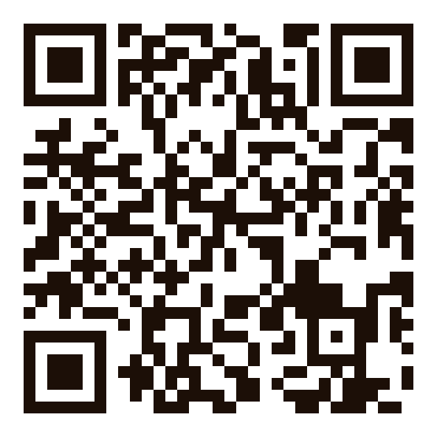
Join Us — Right Now
አሁኑኑ ይቀላቀሉን
Scan to join
1
Scan the code
Point your phone camera at it
2
Create your account
Under two minutes
3
Add it to your phone
One tap away next time
wetcf.com/register
No phone with you?
Speak to one of our leaders.
4
Turn on notifications
Profile → Notifications
Notes:
Hold this slide up and give people a full minute to scan. Walk around and help anyone who is stuck. Anyone without a phone on them can speak to a leader afterwards.

Slide 13


Find Us Online
በኦንላይን ያግኙን
wetcf.com
YouTube
Instagram
Our website — share it with anyone
@warsawethiopianfellowship
@warsaw_fellowship
Invite someone this week · በዚህ ሳምንት አንድ ሰው ይጋብዙ
Notes:
Ask them to follow both accounts today, and to send wetcf.com to one person this week.

Slide 14
"And let us consider how we may spur one another on
toward love and good deeds, not giving up meeting together,
but encouraging one another."
Hebrews 10:24–25
"እርስ በርሳችን ፍቅርን እና መልካም ሥራን ለማነሳሳት እንተጋ፤
መሰብሰብን ሳንተው እርስ በርሳችን እናበረታታ።"
ዕብራውያን 10:24–25
wetcf.com
Thank you · እናመሰግናለን
Notes:
Close on the verse the logo carries. Thank them, and invite anyone with questions to come and find you.

