Slide 1


AGILE DEVELOPMENT

Slide 2

Explaining agile Roles
Product Owner
Optimizes the value of the development team's effort and the product.
Scrum Master
Offres instruction on Agile Principles
The servant-leader reports to the Product Owner.
Organizes Scrum events
Development Team
Making up the team are developers and testers
independently structured
Multi-functional

Slide 3
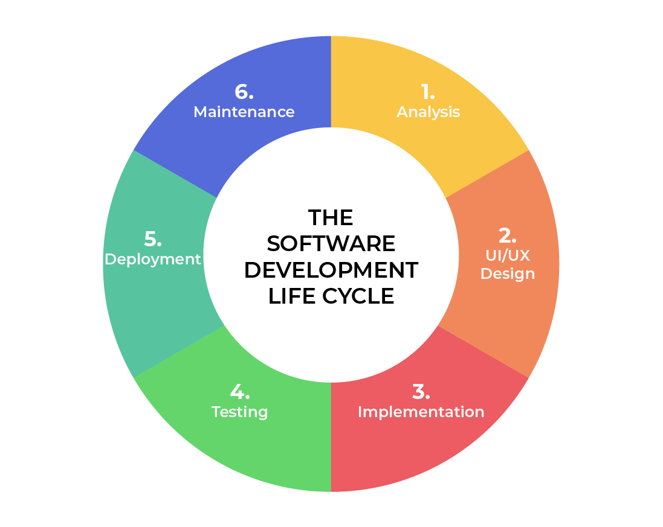
SOFTWARE DEVELOPMENT LIFECYCLE
Analysis
Work together with interested parties.
Compile the necessary information.
Design
Describe in fully the functionality's process.
Identify the technology, constraints, budget, and time frames.
Implementation
Work starts on it.
Smaller amounts of functionality make up the whole.
Testing
Takes Place in cooperation with Development.
Procedure for tracking issues and finding and fixing reported flaws..
Deployment
After testing, the product is made available for purchase.
Maintenance
Merchandise in a manufacturing area.
When NEW features and bug fixes become available, developers need to be prepared to implement them.
Notes:
Analysis – This is the fundamental component of the lifecycle of software development. Here, the project's leadership works with a range of stakeholders to gather the needs.
Design – The functionality is thoroughly defined at this stage. There is also discussion of the technology employed, project resources, constraints, timelines, and budgets.
Development – This stage is when development starts. The project will determine which programming language is utilized. Because value-based code development is made possible by breaking each functionality down into smaller increments, this is the longest step of the SDLC.
Testing – Alongside development, testing is also frequently done. occurs at all stages but is designated for tracking bugs and issues with the current code base.
Deployment – At this point, the product is prepared for release onto the market because testing is finished. Before going on sale, UAT (User Acceptance Testing) may be carried out in a restricted setting.
Maintenance – The product has been introduced to the market at this point. When consumers request new features and bug fixes, developers need to be prepared and equipped to handle those requests in production.

Slide 4

vs
There's no need to specify every need.
While functionality may change over time, major criteria can be specified.
No deadline to the market
Every prerequisite needs to be specified.
Negotiation of Contracts.
Linear and sequential steps.
Ideal for straightforward, static projects
Notes:
A waterfall technique would have made it challenging to finish the SNHU Travel project. Considering the level of uncertainty, any alterations would have been detrimental to the project. Despite the significant degree of uncertainty associated with agile, any problems found would necessitate an expensive modification order to the agreement.

Slide 5
References
“Charles G. Cobb. (2015). The Project Manager’s Guide
to Mastering Agile : Principles and Practices for an Adaptive Approach. Wiley. Software Development Life Cycle (SDLC). (2021, May 19). Retrieved February 2022, from
linkedin.com: https://www.linkedin.com/pulse/software-development-life-
cycle-sdlc-tutorial-richard-harris/”

