Slide 1
Black Hole Presentation
Johnson

Slide 2
introductory
There is one place in the universe that even light cannot escape from, and it is a black hole.
Today I'll explain what black holes are, how they form, and why they are important.

Slide 3
What's a black hole?
The essence of a black hole is the huge gravitational pull of its huge mass. Black holes possess a distinct boundary, an “event horizon.” After crossing that boundary, gravity distorts space completely, and light cannot escape the black hole not because it is not fast enough, but because it lacks an “outward” direction within the black hole.

Slide 4
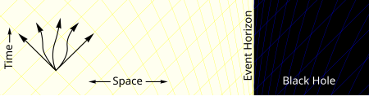
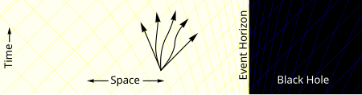
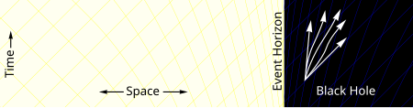
What's a black hole?
As one gets closer to the black hole, fewer and fewer possible paths lead away from it. After entering the limits of the field of view, all paths can only move inward.

Slide 5

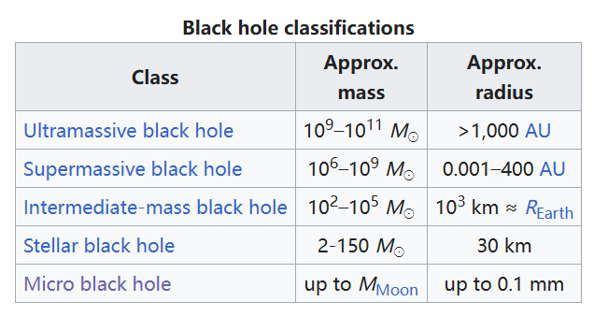
What's a black hole?
Black holes are generally sorted according to their mass. The size of a black hole is determined by its radius because of the formula , which is proportional to the mass M.
Here’s a table about it.
(Base of M is mass of sun)

Slide 6
What's a black hole?
For micro black holes, it is dominated by quantum theory, while larger black holes are dominated by general relativity.

Slide 7
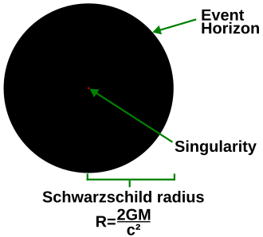
What's a black hole?
As a result, the larger the black hole the less dense it will be instead, and if you turn the entire Milky Way into a black hole, it will be even less dense than some of the things you see around you.
Mass and radius are linearly related, while radius and volume are cubically related.

Slide 8
How do black holes form?
The most significant source of black holes is gravitational collapse. When a massive star nears the end of its life, it will not be able to support itself enough to collapse into a black hole.
There are also tiny black holes that may be created in high-energy particle collisions, but they disappear small very quickly(really quick!)

Slide 9
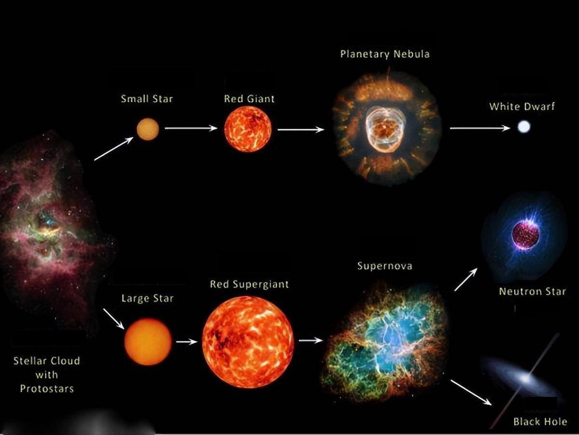
How do black holes form?

Slide 10
How do black holes form?
Because black holes require extremely high densities to form at this level (the radius formula mentioned earlier), for stars that fail to collapse they will become neutron stars or white dwarfs, not black holes.

Slide 11
How do black holes form?
Once a black hole is formed, it continues to grow by absorbing more matter. Any black hole will continue to absorb the gas.
At the same time, the black hole doing heat radiation continuously and loses its own energy(mass). So there's no need to worry about the entire universe being filled with black holes :)

Slide 12
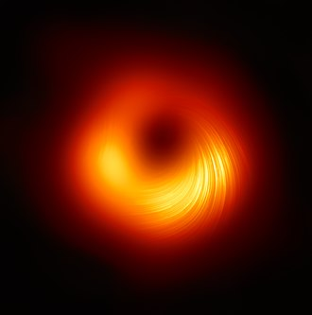
Why is black hole important?
Observing black holes can be used to verify general relativity, gravitational waves can also be detecting from merging black holes.
There's also a big part of the reason
humans study black holes is to satisfy
curiosity.

Slide 13
THANK YOU FOR LISTENING

Slide 14
reference
https://zh.wikipedia.org/wiki/%E9%BB%91%E6%B4%9E
https://plato.stanford.edu/entries/spacetime-singularities/lightcone.html
https://zh.wikipedia.org/wiki/%E5%BB%A3%E7%BE%A9%E7%9B%B8%E5%B0%8D%E8%AB%96

