Slide 1
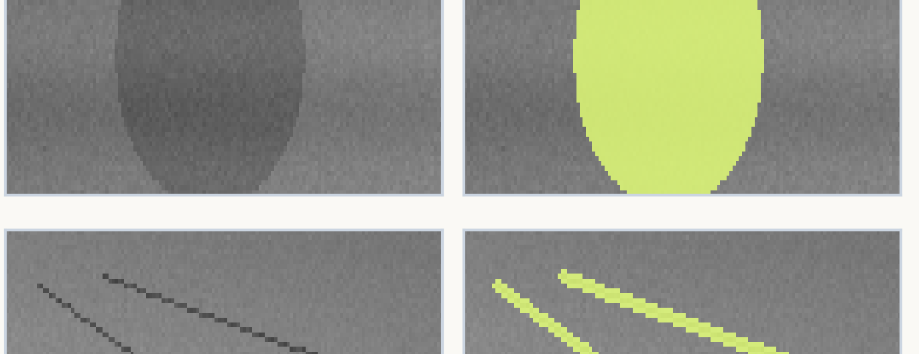
M.TECH (AIML) RESEARCH SEMINAR
MSBA-Net: Multi-Scale Feature Enhancement and Boundary-Aware Learning for Small and Low-Contrast Steel Surface Defect Segmentation
A Boundary-Preserving Deep Semantic Segmentation Architecture for Automated Metallurgical Inspection
PRESENTER & CANDIDATE
Amen Parmar | Roll No: 2502010010 | M.Tech (AIML)
PAPER CO-AUTHORS: Amit Kumar Bairwa, Varun Kumar
AFFILIATION: Department of Computer Science & Engineering, Manipal University Jaipur
Metallurgical Defect Challenge: Hairline Crazing & Faint Contrast (<1% Area)

Slide 2
M.TECH (AIML) RESEARCH SEMINAR
Objective
Core Research Goals of the MSBA-Net Framework
• Accurate Segmentation: Develop an effective segmentation framework specifically engineered for small and low-contrast steel surface defects.
• Multi-Scale Preservation: Preserve fine-grained structural defect features that are commonly lost during conventional downsampling and pooling stages.
• Boundary Localization: Improve spatial boundary localization to eliminate border bleeding around faint, low-contrast, and blurred defect contours.
• Benchmark Validation: Rigorously evaluate the proposed MSBA-Net on the benchmark NEU surface defect database against current state-of-the-art architectures.
Core Research Focus: Accurate pixel-level segmentation of microscopic defect structures without sacrificing boundary contour precision.

Slide 3
M.TECH (AIML) RESEARCH SEMINAR
Brief Overview
Importance of Automated Visual Inspection in Steel Manufacturing
• Automated Inspection: Automated visual inspection is critical in steel strip manufacturing to prevent catastrophic structural failures in downstream automotive and structural applications.
• Micro-Scale Flaws: Surface defects such as hairline crazing cracks and pit depressions frequently occupy less than 1% of the entire image area.
• Low Intensity Contrast: Subtle gray-level differences between defect regions and surrounding rolled steel textures make pixel-level delineation extremely challenging.
• Downsampling Dilemma: Conventional encoder-decoder networks wash away fine spatial details during successive pooling stages, leading to missed flaws.
Representative Challenge from NEU Dataset:
Top-left: Raw Crazing steel surface (weak intensity contrast).
Top-right: Ground truth mask isolating micro-scale branching cracks (<1% of total image pixels).

Slide 4
M.TECH (AIML) RESEARCH SEMINAR
Problem Statement
Critical Technical Obstacles in Steel Surface Defect Segmentation
• Micro-Scale Defect Footprint: Defect regions frequently occupy less than 1% of the image area (<655 pixels at 256×256 resolution). Standard receptive fields aggregate background texture, diluting tiny defect signals.
• Low-Contrast Boundaries: Subtle gray-level transitions (often only 5–15 intensity levels difference) between defect edges and the steel surface cause severe boundary bleeding in standard models.
• Downsampling Feature Loss: Repeated striding and pooling operations in deep convolutional encoders discard high-frequency spatial gradients, destroying hairline fissures before reaching deep layers.
• Extreme Class Imbalance: Over 98% of pixels belong to defect-free steel background, heavily skewing standard loss functions and causing models to ignore micro-scale defect pixels.
Key Problem: Standard segmentation backbones optimize for macro-regions, leading to severe feature loss and blurred boundaries on microscopic metallurgical flaws.

Slide 5
M.TECH (AIML) RESEARCH SEMINAR
Research Gap
Limitations of Existing Segmentation Architectures & The Research Need
LIMITATIONS OF EXISTING METHODS
• Spatial Detail Loss: Standard CNN and Transformer backbones sacrifice fine spatial details for broad semantic context during aggressive pooling.
• Implicit Boundary Handling: Edge information is relied upon solely through standard skip connections, causing blurred contours and border bleeding.
• Tiny-Defect Performance Drop: While models report high overall mIoU, tiny-defect mIoU degrades by 10%–25%, masking failure on safety-critical flaws.
THE UNMET RESEARCH NEED
• Native Multi-Scale Preservation: Preserve high-resolution spatial features across multiple receptive fields simultaneously without downsampling loss.
• Explicit Boundary Guidance: Incorporate a dedicated auxiliary boundary stream to guide feature fusion and sharpen contour boundaries.
• Industrial Real-Time Efficiency: Maintain lightweight parameters (<10M) and high frame rates (>40 FPS) suitable for high-speed rolling-mill deployment.
Core Research Need: Multi-scale feature preservation + explicit boundary-aware guidance in a lightweight real-time architecture.

Slide 6
M.TECH (AIML) RESEARCH SEMINAR
Proposed Approach — MSBA-Net
Dual-Stream Architecture: Multi-Scale Semantic Backbone + Boundary Guidance
Input Image
256×256×1
Stage 1 + MSFP
256×256 (64ch)
Stage 2 + MSFP
128×128 (128ch)
Bottleneck
Stages 3 & 4
Decoder Stages
Upsampling + Skip
Defect Mask
256×256 Output
Boundary-Aware Stream (BAS)
Auxiliary Edge Supervision (L_bound)
Boundary-Guided Feature Fusion (BGFF)
Spatial Attention Gating A_spat
• MSFP Integration: Multi-Scale Feature Preservation modules in encoder stages extract multi-scale spatial details at native resolution.
• Boundary-Aware Stream (BAS): Branches off early high-resolution stages to learn explicit defect boundary contours via auxiliary supervision.
• Boundary-Guided Feature Fusion (BGFF): Generates spatial attention gating maps from boundary features, sharpening decoder contours and suppressing background noise.

Slide 7
M.TECH (AIML) RESEARCH SEMINAR
Multi-Scale Feature Preservation (MSFP)
Capturing Multi-Scale Defect Morphs at Native Resolution Without Downsampling
• Parallel Dilated Depthwise Convolutions: MSFP splits incoming features across three parallel branches with dilation rates r ∈ {1, 2, 4}, expanding receptive fields without spatial pooling.
• Multi-Scale Defect Coverage: Branch 1 captures hairline crazing cracks; Branch 2 captures pit depressions and inclusions; Branch 3 captures broad patches and rolled-in scale sheets.
• HDC Condition Compliance: Dilation rates {1, 2, 4} strictly satisfy the Hybrid Dilated Convolution condition, eliminating checkerboard gridding artifacts common in dilated networks.
• Zero Downsampling Loss: Operates at native spatial resolution, ensuring microscopic defect structures are fully retained for downstream feature fusion.
Input Feature Map F_in
Dimensions: H × W × C
Branch 1
3×3, r=1 (RF 3×3)
Hairline Cracks
Branch 2
3×3, r=2 (RF 5×5)
Pits & Inclusions
Branch 3
3×3, r=4 (RF 9×9)
Patches & Scale
Concatenation & 1×1 Pointwise Conv
Output Feature Map F_out (H × W × C)

Slide 8
M.TECH (AIML) RESEARCH SEMINAR
Boundary-Aware Learning — BAS & BGFF
Explicit Boundary Extraction & Spatial Attention Feature Calibration
• Dedicated Edge Extraction (BAS): Taps early encoder features where spatial detail is freshest, learning geometric defect perimeters via dedicated auxiliary boundary loss.
• Direct Gradient Injection: Injects edge-supervision gradients directly into shallow layers, preventing boundary gradients from vanishing in deep semantic layers.
• Spatial Attention Calibration (BGFF): Dynamically boosts feature gain along defect perimeters while dampening uniform steel background response.
• Elimination of Border Bleeding: Produces clean, leak-free defect contours around weak, low-contrast boundaries that confuse standard thresholding.
Early Encoder Features (Stages 1 & 2)
High Spatial Resolution (256×256 & 128×128)
Boundary-Aware Stream (BAS)
Auxiliary Edge Supervision (L_bound on 1-px defect contours)
Boundary-Guided Feature Fusion (BGFF)
Spatial Attention Map: A_spat = σ(Conv1×1([F_bound ; F_dec]))
Refinement: F_out = F_dec ⊙ (1 + A_spat)

Slide 9
M.TECH (AIML) RESEARCH SEMINAR
Experimental Work — Dataset
NEU Surface Defect Database Specifications & Defect Class Taxonomy
• Benchmark Standard: NEU Surface Defect Database developed by Northeastern University (recognized benchmark in metallurgical vision research).
• Image Volume & Balance: 1,800 grayscale industrial steel strip images, perfectly balanced with exactly 300 images per defect category.
• Resolution & Resizing: Original images captured at 200×200 resolution; standardized to 256×256 pixels for deep neural network training.
• Rigorous Data Split: 70% Training (1,260 images), 15% Validation (270 images), and 15% Independent Testing (270 images).
Defect Category | Morphological Characteristics
Crazing (Cr) | Thin, branching network of micro-cracks (<1% area)
Inclusion (In) | Non-metallic slag particles embedded into surface
Patches (Pa) | Localized surface oxidation & discoloration sheets
Pitted Surface (PS) | Small point-like pit depressions & indentations
Rolled-in Scale (RS) | Mill oxide scale mechanically pressed into strip
Scratches (Sc) | Linear mechanical abrasive grooves along rolling line

Slide 10
M.TECH (AIML) RESEARCH SEMINAR
Experimental Setup
Hardware Environment, Training Hyperparameters, and Model Complexity
TRAINING PROTOCOL
• Deep Learning Framework: PyTorch 2.1 implementation using CUDA 12.1 acceleration.
• Compute Hardware: Single NVIDIA GeForce RTX 4090 GPU with 24GB high-speed GDDR6X VRAM.
• Optimizer & Weight Decay: AdamW optimizer (β1=0.9, β2=0.999, weight decay 1×10⁻⁴).
• Learning Rate Schedule: Initial learning rate 1×10⁻³ with Cosine Annealing decay down to 1×10⁻⁶.
• Batch Size & Epochs: Batch size of 16 images; trained for 100 epochs until full convergence.
MODEL COMPLEXITY & REAL-TIME EFFICIENCY
• Parameter Count: 9.38 Million parameters (highly compact footprint for edge deployment).
• Computational Cost: 14.2 GFLOPs per single-image forward inference pass.
• Inference Latency: 24.3 milliseconds per 256×256 input image.
• PyTorch FP32 Speed: 41.1 Frames Per Second (comfortably exceeds the 30 FPS real-time threshold).
• TensorRT FP16 Speed: 88.5 Frames Per Second (enables high-speed online rolling-mill inspection).

Slide 11
M.TECH (AIML) RESEARCH SEMINAR
Evaluation Metrics
Standard Overlap Metrics and Dedicated Micro-Defect Assessment
• mIoU (Mean Intersection over Union): Primary benchmark metric assessing spatial overlap between predicted mask P and ground truth G: mIoU = |P ∩ G| / |P ∪ G|.
• Dice Similarity Coefficient: Measures harmonic mean of precision and recall (2|P ∩ G| / (|P| + |G|)); scale-invariant region overlap indicator.
• Precision & Recall: Precision (TP / (TP + FP)) verifies predicted defect pixel correctness; Recall (TP / (TP + FN)) ensures zero missed defect regions.
• Tiny-Defect mIoU (Key Innovation): Specifically evaluates performance exclusively on defect regions occupying less than 1% of the total image area (<655 pixels at 256×256).
Why Tiny-Defect mIoU Matters: Overall mIoU is area-weighted; high scores on large patches can easily mask catastrophic detection failures on hairline cracks.

Slide 12
M.TECH (AIML) RESEARCH SEMINAR
Results — Comparison with Existing Methods
Benchmarking MSBA-Net Against State-of-the-Art Segmentation Networks on NEU
Model | mIoU | Dice | Tiny mIoU
DAMF-Net [2024] | 91.65% | 93.40% | 85.20%
DMS-UNet [2026] | 94.20% | 95.80% | 88.40%
MSBA-Net (Ours) | 97.01% | 98.48% | 92.48%
• State-of-the-Art mIoU: MSBA-Net achieves 97.01% mIoU, outperforming the previous 2026 leader DMS-UNet by +2.81%.
• Exceptional Region Overlap: Dice coefficient reaches 98.48%, with 97.57% Precision and 99.41% Recall.
• Dominant Tiny-Defect Gain: Tiny-Defect mIoU reaches 92.48% (+4.08% over DMS-UNet), confirming micro-structure preservation.

Slide 13
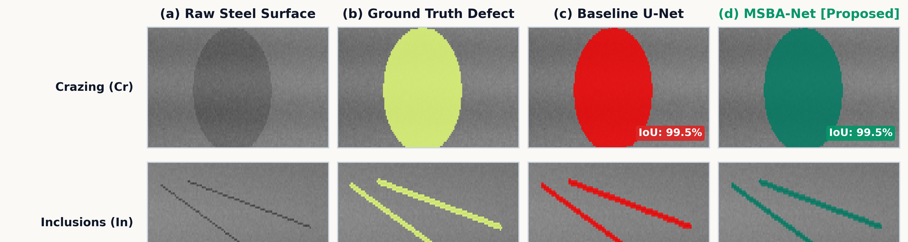
M.TECH (AIML) RESEARCH SEMINAR
Results — Per-Class Analysis
Category-Wise Segmentation Performance Across the Six Defect Categories
Defect Category | MSBA-Net mIoU (%)
Patches (Pa) | 97.85%
Inclusions (In) | 97.15%
Scratches (Sc) | 97.12%
Pitted Surface (PS) | 96.80%
Rolled-in Scale (RS) | 96.72%
Crazing (Cr) | 96.42%
• Uniform Excellence: Performance remains consistently above 96.4% across all six industrial categories.
• Highest Class Score: Patches reach 97.85% mIoU due to homogeneous and continuous regional defect area.
• Challenging Morphology: Crazing is relatively most demanding (96.42%) due to complex branching hairline fissures.
Qualitative Comparison: Crazing & Inclusions
Columns: (a) Input Steel Image | (b) Ground Truth Mask | (c) Baseline U-Net | (d) MSBA-Net (Ours)
Key Finding: Baseline U-Net suffers severe boundary bleeding and misses disconnected crack segments. MSBA-Net captures fine hairline branches with razor-sharp boundary alignment.

Slide 14
M.TECH (AIML) RESEARCH SEMINAR
Limitations & Robustness
Stress-Testing Under Simulated Environmental Shop-Floor Degradations
Degradation Condition | MSBA-Net mIoU (%)
Normal Clean Benchmark | 97.01%
Low Contrast (Faint Edge Contrast) | 39.67%
Defocus Blur (Out-of-Focus Optics) | 26.29%
Gaussian Noise (Thermal Sensor Noise, σ=25) | 2.33%
• Noise Vulnerability: Gaussian noise causes severe performance collapse (2.33% mIoU); high-frequency random thermal fluctuations are amplified by boundary convolutions into thousands of spurious false edges.
• Optical Defocus Blur: Defocus blur softens already weak gray-level gradients, reducing boundary attention gating effectiveness (26.29% mIoU).
• Industrial Remediation: Evaluation is primarily based on simulated NEU degradations; factory rolling-mill deployment strictly requires front-end bilateral denoising filters and high-intensity LED strobe lighting.

Slide 15
M.TECH (AIML) RESEARCH SEMINAR
Conclusion & Future Work
Summary of Research Contributions and Future Directions
RESEARCH CONCLUSIONS
• Dual-Stream Synergy: MSBA-Net combines multi-scale feature preservation (MSFP) with explicit boundary learning (BAS + BGFF).
• Fine-Feature Retention: MSFP successfully preserves micro-scale flaws occupying <1% area without downsampling dilution.
• Benchmark Superiority: Achieves state-of-the-art results on NEU: 97.01% mIoU, 98.48% Dice, and 92.48% Tiny-Defect mIoU.
• Industrial Real-Time Speed: Operates at 41.1 FPS (FP32) and 88.5 FPS (TensorRT FP16) with only 9.38M parameters.
FUTURE RESEARCH DIRECTIONS
• Spatio-Temporal Video Attention: Extend MSBA-Net to continuous line-scan video feeds, exploiting temporal defect continuity across moving steel coils.
• Self-Supervised Pre-Training: Pre-train masked autoencoders on large volumes of uncurated industrial steel images before supervised fine-tuning.
• Embedded Edge Quantization: Implement INT8 post-training quantization for deployment on embedded edge boards (e.g., NVIDIA Jetson AGX Orin) at >100 FPS.
• Front-End Adaptive Denoising: Integrate learned edge-preserving denoising to harden boundary convolutions against shop-floor thermal noise.

Slide 16
M.TECH (AIML) RESEARCH SEMINAR
Thank You
Questions & Discussion
Amen Parmar
M.Tech in Artificial Intelligence & Machine Learning | Roll No: 2502010010
Department of Computer Science and Engineering
Manipal University Jaipur

