Slide 1


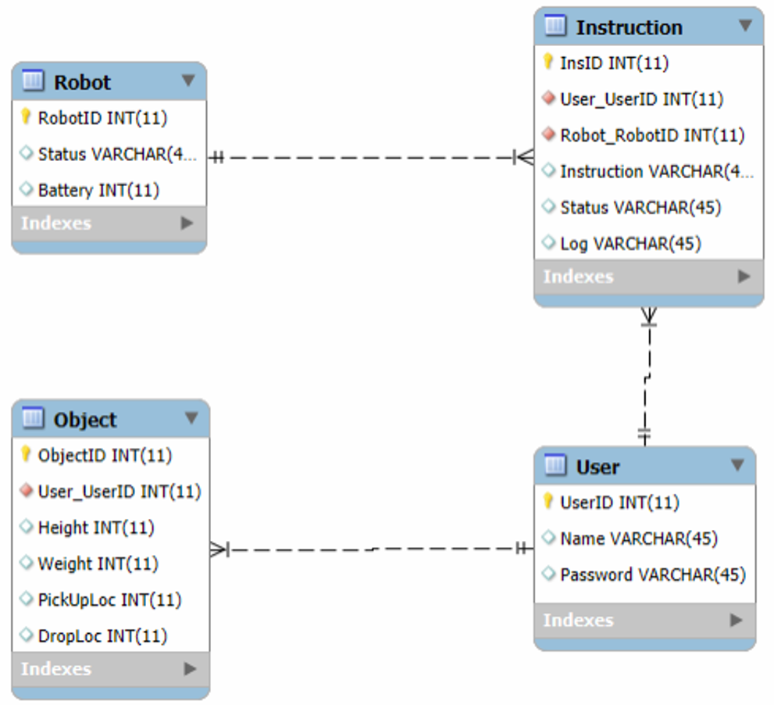

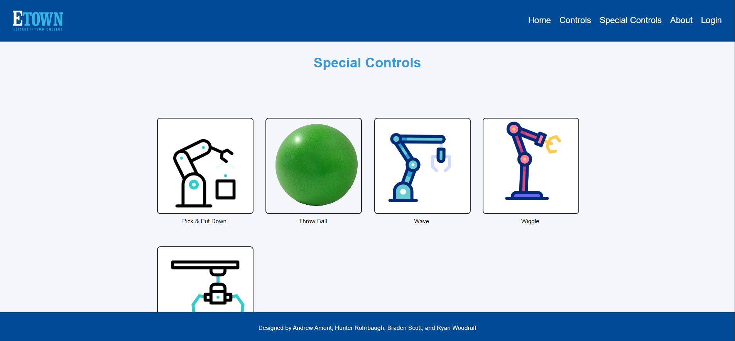
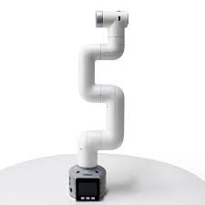
Robot Simulation
Andrew Ament, Hunter Rohrbaugh, Braden Scott, Ryan Woodruff
Professor Nancy Reddig
Introduction/Purpose
The MyCobot robotic arm and our website serve as an example of what perspective students can expect to work on while attending Elizabethtown College.
ERD MODEL
DESIGN SPECIFICATIONS & SYSTEM REQUIREMENTS
The website connects to the robotic arm by using a MySQL database to hold instructions.
The robotic arm’s instructions are coded with MyBlockly code and translated into python.
The website utilizes multiple coding languages including HTML, PHP, CSS, and JavaScript.
Key Features
The project’s main feature on the website is located on the Special Controls page. The robotic arm is loaded with five preprogrammed instructions to perform. Each image on the page can be clicked to send directions to the robot to perform in real time based on its corresponding caption.
IMPACT
The live interactive demonstration displays the academic opportunities that the Engineering and Computer Science department at Elizabethtown College provides for perspective students.
LESSONS LEARNED
REFERENCES & ACKNOWLEDGEMENTS
Database-Driven Robot Control: We learned how to use a database and a website to communicate with an external machine.
Identifying Potential Improvements: We learned how to accurately identify when something could end up becoming a problem later in the project lifecycle, and how to fix these potential issues sooner rather than later.
Working in a Team: Teamwork is one of the most important skills someone can have. Through this project we had to communicate effectively with each other so that our CS people can understand the engineering side of our project, and the engineers understand the CS side of our project
Every member of our team made great contributions and was dedicated help in any way that they could.
Thank you to Prof. Reddig for allowing us access to the robot and guiding us through the project when we got stuck,
Thank you Dr. Wang for teaching Hunter the knowledge needed for designing and making a functioning website
[1] Elephant Robotics, "MyCobot 280 Pi - 6 DOF Collaborative Robot," Elephant Robotics, Shenzhen, China. [Online]. Available: https://www.elephantrobotics.com/en/mycobot-280-pi-2023/
[2] The PHP Group, "PHP: Hypertext Preprocessor," version 7.0+, 2025. [Online]. Available: https://www.php.net/
[3] Oracle Corporation, "MySQL Database," 2025. [Online]. Available: https://www.mysql.com/
[4] "mysql-connector-python: MySQL driver written in Python," PyPI, 2025. [Online]. Available: https://pypi.org/project/mysql-connector-python/
[5] WinSCP, "WinSCP - Free SFTP, SCP, S3 and FTP client for Windows," 2025. [Online]. Available: https://winscp.net/
Software Engineering Project 2023
EDUCATE FOR SERVICE. ENGINEER FOR SOCIETY.
Notes:
Introduction. Include the student name, company name, internship location, internship position, and internship dates. Also note the course rubric and number, course title, and instructor(s). In addition, describe how you secured the internship.
Abstract. The abstract should provide a concise summary of what was done and learned in the internship and the course.
Learning Objectives. List 2 to 5 learning objectives that you had planned to achieve by completing the internship.
Description of Key Responsibilities. Summarize the major responsibilities, activities, and project(s) completed during the internship.
Application of VWU courses to the internship. Explain how your coursework helped with the internship. Link relevant courses, theories, and concepts to their applications within the internship.
Lessons Learned. Explain what you learned about the industry, the company, the career process, and yourself through the internship experience.
Acknowledgements. Recognize the people who helped you, including the internship site supervisor, the course instructor, and mentors. Include full titles in the acknowledgements. In addition, acknowledge funding sources.
Visuals. Incorporate visual aids to illustrate key points. Be sure to label all visuals. Include: names, dates, locations, and photographers. Do not include photographs of children unless you have secured approval from your site supervisor to use the children’s images.

