Slide 1
IoT Network Traffic Generator
A Modular, Multi-Protocol Simulation Framework
SUBMITTED BY
Amjad Khan CS & Engineering Student
SUPERVISED BY
Dr. Bhale Pradeepkumar Gajendra IIITDM Kancheepuram
PROGRAM
AICTE Smarthan Internship 2026-2027
HOST INSTITUTION
IIITDM Kancheepuram Chennai, India

Slide 2
Agenda & Outline
02 / 12
01
Introduction (Background & Motivation)
05
System Design & Architecture Diagram
02
Problem Statement & Objectives
06
Testing, Results & Performance Evaluation
03
Related Work & Literature Review
07
Discussion & Load Impact Analysis
04
Proposed Work & Implementation Details
08
Conclusion, Future Scope & References

Slide 3
Introduction
03 / 12
Background & Motivation
With the exponential rise of IoT devices across smart homes, industrial complexes, and medical infrastructures, networks face massive scaling demands. Simulating network traffic enables testing infrastructures before actual deployment.
• Heterogeneous Protocols
IoT simulation demands supporting diverse application layer protocols: UDP (low latency), TCP (reliable streams), HTTP (REST interfaces), and MQTT (publish-subscribe telemetry).
• Variable Traffic Dynamics
Device traffic profiles fluctuate between standard telemetry routines, critical event bursts, and malware-driven floods.
KEY RESEARCH FACTOR
Software-defined network simulation offers a highly scalable, zero-dependency, cost-effective alternative to deploying physical hardware loops.

Slide 4
Problem Statement
04 / 12
Cost & Logistics
Physical verification of setups using hundreds of distinct IoT devices is cost-prohibitive and difficult to automate or configure.
Traffic Diversity
Standard simulators utilize homogeneous, static patterns, failing to model compound multi-protocol payloads or sudden state changes.
Security Stress Testing
IoT units are vulnerable to botnets like Mirai. Security researchers require dynamic DDoS workloads to verify firewall rules.
RESEARCH GAP
There is a critical lack of zero-dependency, Python-only simulators capable of shifting device profiles dynamically from normal periodic updates to burst alerts and botnet attack loads during runtime.

Slide 5
Internship Objectives
05 / 12
• Protocol Exploration
Deep dive into framing constraints, packet structures, and transfer protocols (UDP, TCP, HTTP, MQTT).
• Concurrency Simulation
Implement a robust multi-threaded client model in Python that manages concurrent device loops.
• Multi-Profile Traffic Modeling
Formulate realistic schedules for Normal, Burst, and DDoS Attack traffic types.
• Low-Level socket implementation
Code raw byte-level MQTT CONNECT and PUBLISH packets to bypass third-party library requirements.
• Aggregation and Statistics Tracker
Build a receiver server that aggregates socket buffers, tracks packets, and prints network performance metrics.

Slide 6
Related Work & Literature Review
06 / 12
Standards & RFC Documentation
• RFC 768 (UDP)
Connectionless structure, packet headers, MTU limits, and transmission mechanics.
• RFC 2616 (HTTP/1.1)
REST methods, headers, payload framing, and TCP socket persistence.
• MQTT v3.1.1 (OASIS)
Binary wire format protocol, publish/subscribe schemas, control bytes, and topic parsing.
Literature & Simulators
Botnet Traffic Emulation
Research on the Mirai Botnet (IEEE S&P, 2017) details how vulnerable IoT units form coordinate swarms. This informs our HTTP/TCP flood logic.
Simulators Comparison
Standard tools like NS3, Mininet, or PcapPlay require hypervisors or custom operating environments, lacking lightweight cross-platform scripts.

Slide 7
Proposed Work & Implementation Details
07 / 12
Python-Based Client-Server Architecture
• Multi-threading Model
Each device runs in a separate thread monitoring real-time configuration overrides.
• Dynamic JSON Config Tracker
A checker loop re-reads `config.json` dynamic parameters without system reboots.
• Raw Byte MQTT Packing
Custom socket buffer methods create MQTT payloads directly at byte level without importing complex packages.
# Raw MQTT packet assembler
def make_mqtt_publish_packet(topic, message):
topic_bytes = topic.encode('utf-8')
topic_len = len(topic_bytes).to_bytes(2, 'big')
msg_bytes = message.encode('utf-8')
payload = topic_len + topic_bytes + msg_bytes
rem_len = encode_remaining_length(len(payload))
# 0x30 = PUBLISH Control Type
return bytes([0x30]) + rem_len + payload

Slide 8
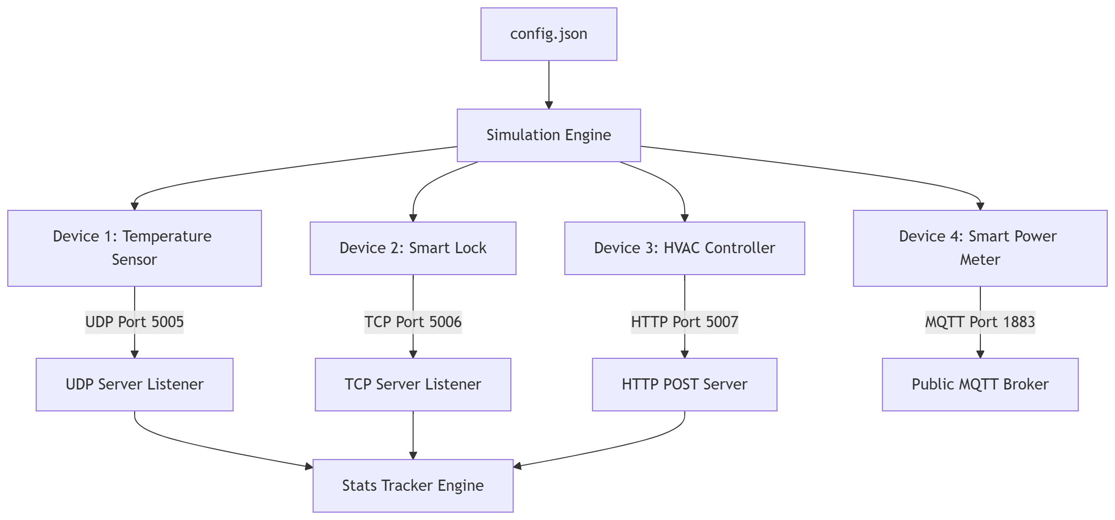
System Architecture
08 / 12

Slide 9
Testing & Results
09 / 12
Traffic Profile | Packets Received | Total Bytes | Avg Byte Rate | Server Status
Normal | 108 | 18,360 | ~306 B/s | Stable (Zero Loss)
Burst | 432 | 75,168 | ~1.25 KB/s | Stable (Low Latency)
Attack (DDoS) | 14,210 | 4,263,000 | ~71.05 KB/s | High Load (Delayed)

Slide 10
Discussion
10 / 12
Socket Level Optimization
Bypassing third-party modules enabled the Python interpreter to assemble network headers with close-to-zero memory and process footprint overheads.
Dynamic Adaptability
The local config tracking logic reacted in milliseconds. Transitioning nodes to Burst triggered immediate message frequency multipliers.
DDoS EVALUATION & ATTACK THRESHOLDS
Under the Attack Profile (14,210 packets sent over 60s), the receiver server threads encountered message queue delays. This validated the simulator's ability to trigger network stress states, providing a cost-effective, zero-dependency environment for testing system resilience and log analyzer rules.

Slide 11
Conclusion & Future Scope
11 / 12
• Multi-Protocol Simulation Engine
Successfully built a robust traffic generator capable of HTTP, TCP, UDP, and MQTT emulation.
• Active IDS/IPS Firewall Engine
Implemented real-time DDoS rate limiting (>12 pkt/s) and signature-based packet dropping.
• Pure-Python PCAP Logging
Engineered byte-level PCAP header construction for Wireshark inspection without external C dependencies.
• Machine Learning IDS
Replace the rule-based rate limiter with an ML model (e.g., Isolation Forest) for adaptive anomaly detection.
• Real Device Integration
Extend the generator to communicate with actual hardware IoT sensors (Raspberry Pi, ESP32).
• Cloud Deployment & IPv6
Deploy the receiver on a cloud VM and upgrade the PCAP logger to construct IPv6 headers.

Slide 12
References
12 / 12
[1] Python Foundation, Python 3 Docs: socket, threading, struct, http.server modules.
[2] OASIS Standard, MQTT Version 3.1.1 Specification: Publish/Subscribe Messaging Protocol for IoT.
[3] IETF (RFC 791, 793, 768), Internet Protocol (IPv4), TCP, and UDP Specifications.
[4] Wireshark Foundation, Libpcap File Format and PCAP Header Encoding Standards.
[5] V. Chandola et al., Anomaly Detection: A Survey, ACM Computing Surveys, 2009.

