Slide 1

Simulation of V2I-Based Advance Detection Using Gipps’ Car-Following Model
William Alexander
Michael Dunn
CE 391F
Fall 2017

Slide 2
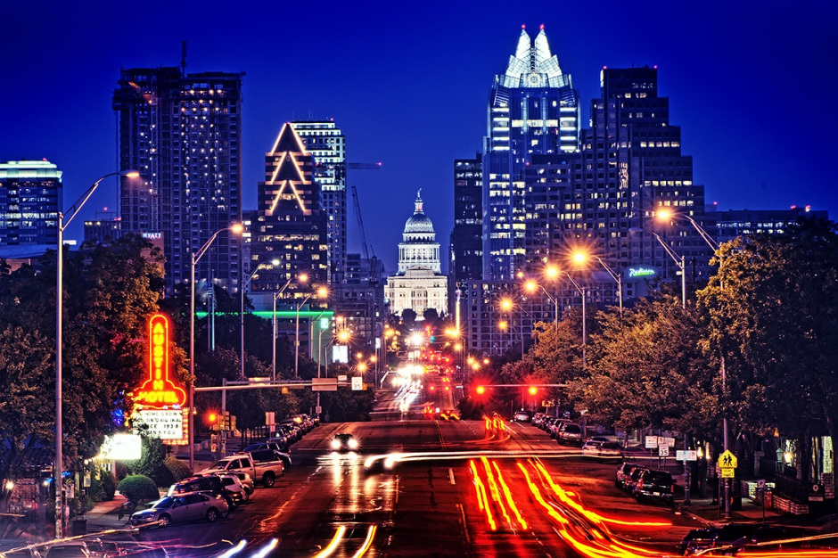
Overview
Introduction
Car-following models
Gipps’ Model
Methodology
Results
Conclusions
Source: Greg Klar

Slide 3
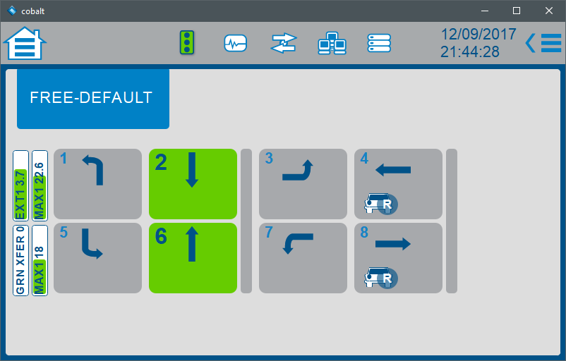
Introduction
Advance detection
Min, max, and extension timers
What is V2I communication?
Will’s previous research
V2I-based signal priority
How effective is V2I advance detection at decreasing travel time through an intersection?

Slide 4
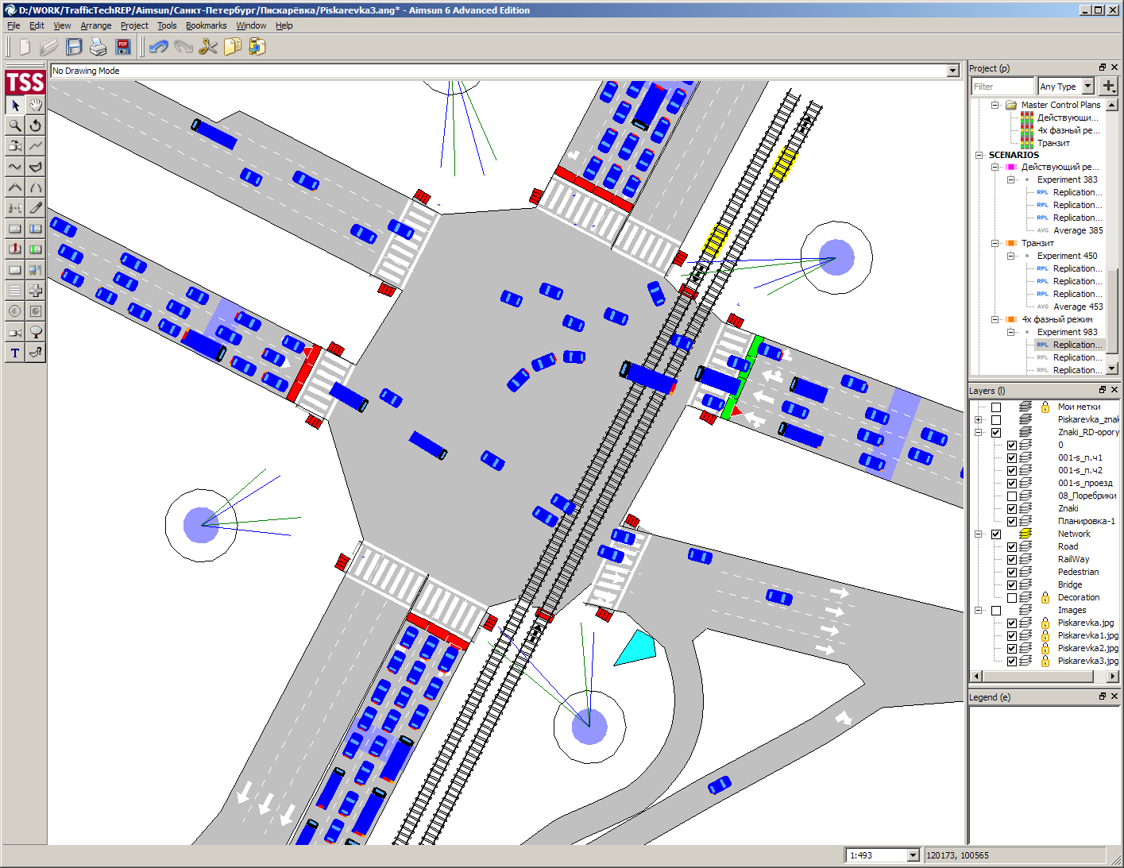

Car-Following Models
Subset of microscopic traffic flow models
Focus at the single vehicle level
Drivers follow each other by adopting a velocity based on the vehicle(s) in front of them
Estimating headway, velocity, etc.
Basis of many simulation software
AIMSUN uses Gipps’ Model
Source: AIMSUN

Slide 5

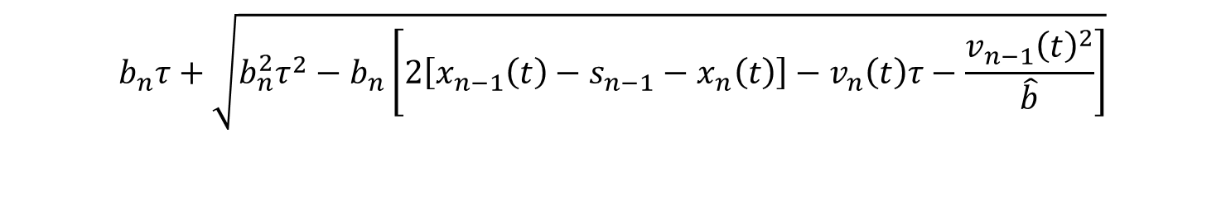


Gipps’ Model
Peter Gipps, 1981
Specifies following vehicle by speed
Uses timestep = reaction time ($τ$)$⁡$
Free regime and following regime
$$v_{n}\left(t\right)+2.5a_{n}τ\left(1−\frac{v_{n}\left(t\right)}{V_{n}}\right){\left(0.025+\frac{v_{n}\left(t\right)}{V_{n}}\right)}^{\frac{1}{2}}$$
$$v_{n}\left(t+τ\right)=min$$
$$b_{n}τ+\sqrt{b_{n}^{2}τ^{2}−b_{n}\left[2\left[x_{n−1}\left(t\right)−s_{n−1}−x_{n}\left(t\right)\right]−v_{n}\left(t\right)τ−\frac{v_{n−1}{\left(t\right)}^{2}}{\hat{b}}\right]}$$

Slide 6
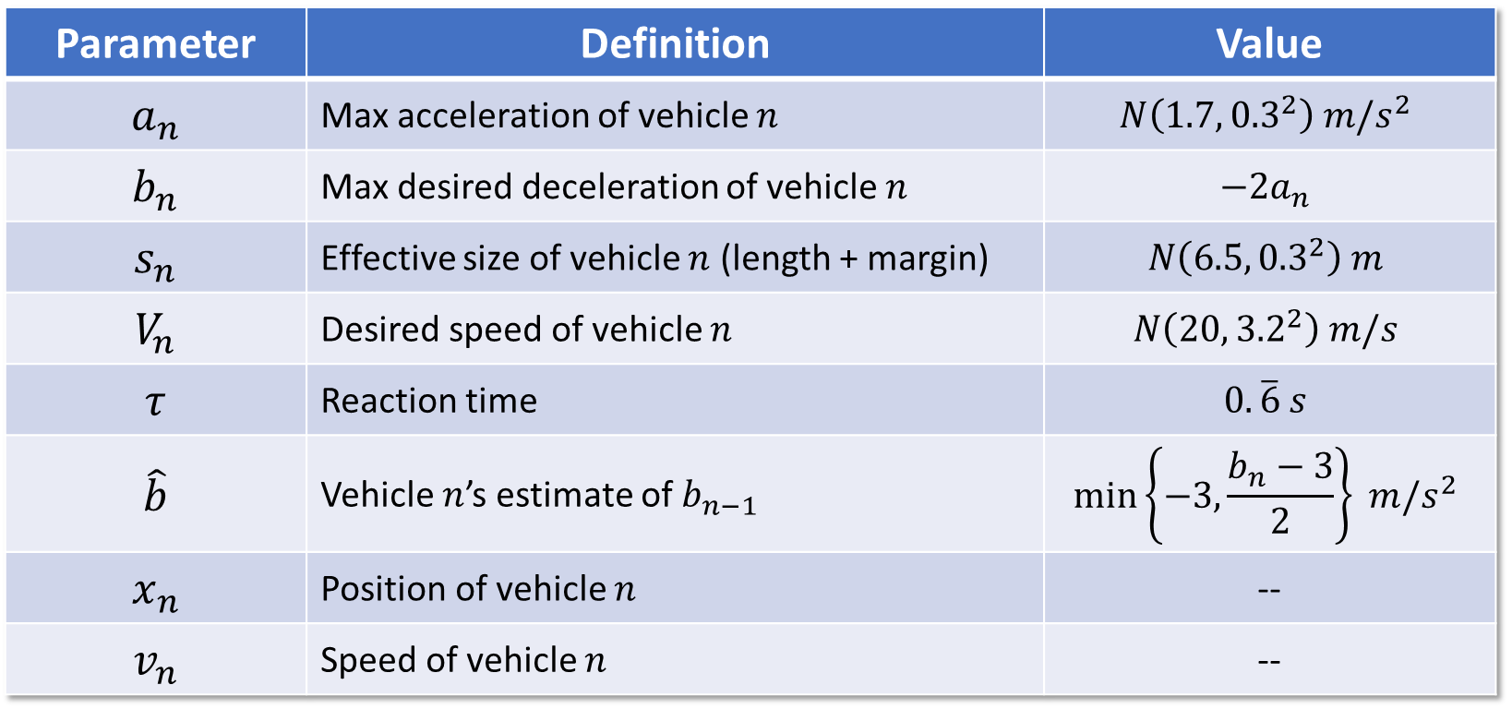
Gipps’ Model Inputs
Parameter | Definition | Value
$$a_{n}$$ | Max acceleration of vehicle $n$ | $$N\left({1.7, 0.3}^{2}\right) m/s^{2}$$
$$b_{n}$$ | Max desired deceleration of vehicle $n$ | $$−2a_{n}$$
$$s_{n}$$ | Effective size of vehicle $n$ (length + margin) | $$N\left({6.5, 0.3}^{2}\right) m$$
$$V_{n}$$ | Desired speed of vehicle $n$ | $$N\left({20, 3.2}^{2}\right) m/s$$
$$τ$$ | Reaction time | $$0.\overline{6} s$$
$$\hat{b}$$ | Vehicle $n$’s estimate of $b_{n−1}$ | $$\min\left\{−3,\frac{b_{n}−3}{2}\right\} m/s^{2}$$
$$x_{n}$$ | Position of vehicle $n$ | --
$$v_{n}$$ | Speed of vehicle $n$ | --

Slide 7

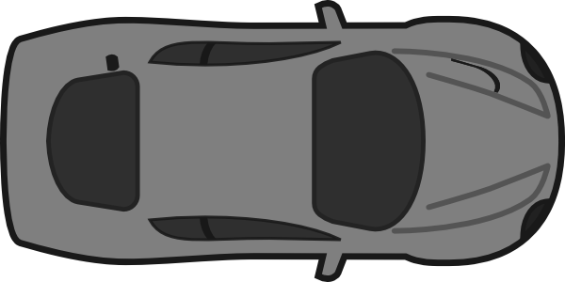
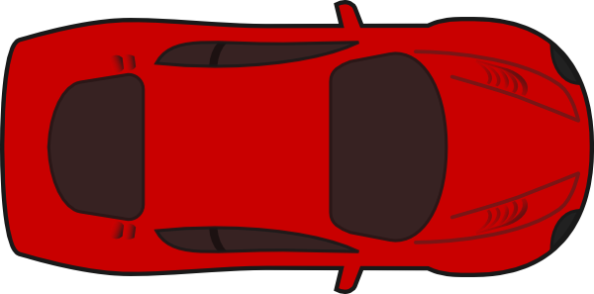

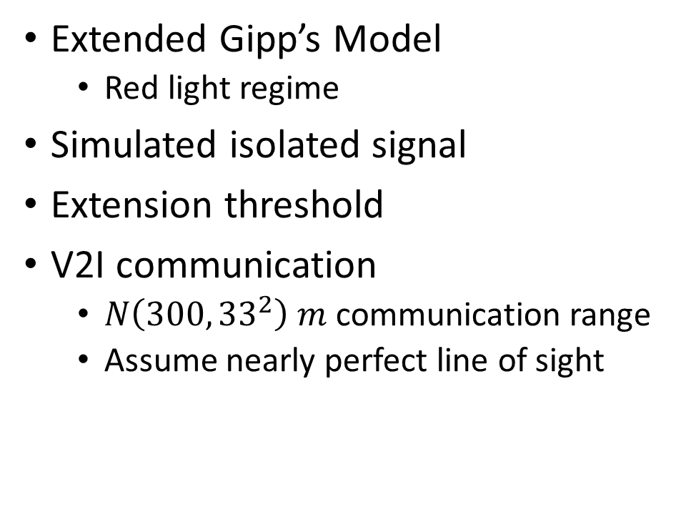
Methodology and Assumptions
Extended Gipp’s Model
Red light regime
Simulated isolated signal
Extension threshold
V2I communication
$N\left(300, {33}^{2}\right) m$ communication range
Assume nearly perfect line of sight
One way traffic
Extension threshold
Loop magnetometer advance detector
One way traffic

Slide 8
Experiment Parameters
Total intersection demand 800 veh/hour
Min green = 30 s, max green = 50 s
Advance detection only on primary corridor
Three configurations:
Fixed-time
Traditional advance detection
V2I advance detection
Five cases, varying demand ratio
30 experimental trials per case

Slide 9
Results
Mean Main-Line Travel Time

Slide 10
Results
Percent Change in Main-Line Travel Time
Percent Change in Side-Street Travel Time

Slide 11
Results
Percent Change in Standard Deviation of Mainline Travel Time

Slide 12
Conclusions
Building a microsimulation is not easy!
Clear improvement in main-line travel time with V2I
Net system travel time improvement
Next steps:
Expand and diversify network
Explore and compare other car-following models
Integrate with professional-grade microsimulator
Mix connected and disconnected vehicles

Slide 13
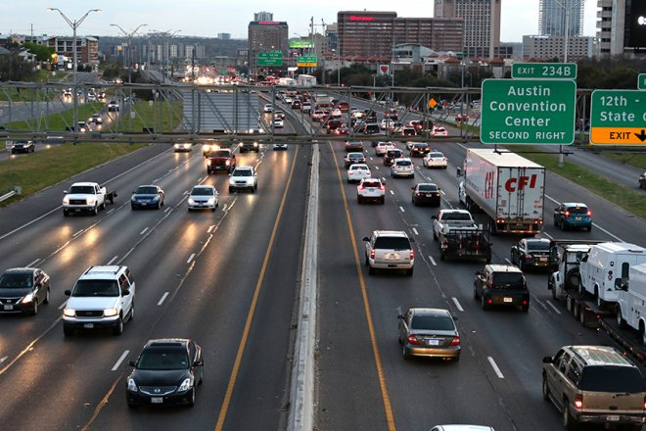
Questions?
Source: The Daily Texan

Slide 14
Sources
Daniel, Hannah. “2016 Brings Fewer Traffic Fatalities, Road Improvements to Austin.” The Daily Texan, 14 Sept. 2016. www.dailytexanonline.com/2016/09/14/2016-brings-fewer-traffic-fatalities-road-improvements-to-austin.
Day, C. M., D. M. Bullock, H. Li, S. M. Remias, A. M. Hainen, R. S. Freije, A. L. Stevens, J. R. Sturdevant, and T. M. Brennan. Performance Measures for Traffic Signal Systems: An Outcome-Oriented Approach. Purdue University, West Lafayette, Indiana, 2014.
Gipps, P.G. “A Behavioural Car-Following Model for Computer Simulation.” Transportation Research Board Part B, 15. 1981
Koesling, Sonja. “PTV Vissim 6 Is Now Available.” Traffic-Inside, PTV Group, 8 Aug. 2013.
www.traffic-inside.com/2013/08/05/long-awaited-ptv-vissim-6-version-is-now-available/
Olstam, Johann J, and Andreas Tapani. “Comparison of Car-Following Models.” Swedish National Road and Transportation Institute, vol. 960A, 2004.
“RIPAS Integrates Aimsun Microsimulation.” AIMSUN.
www.aimsun.com/russia-ripas-integrates-aimsun-microsimulation-and-spektr-controllers/.

