Slide 1

Simulation of Advance Vehicle Detection Using V2I Communication and Gipps’ Car-Following Model
William Alexander
Michael Dunn
CE 391F
Fall 2017

Slide 2
Overview
Introduction
Car-following models
Gipps’ Model
Methodology
Results
Conclusions

Slide 3
Introduction
Advance detection
V2V and V2I
Will’s previous research
How effective is V2I advance detection at decreasing travel time through an intersection?
Place holder for diagram of intersection

Slide 4
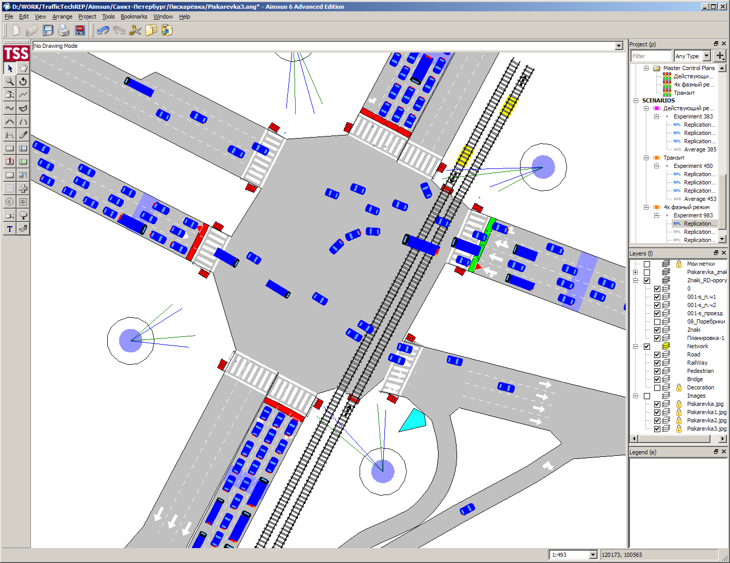

Car-Following Models
Subset of microscopic traffic flow models
Focus at the single vehicle level
Drivers follow each other by adopting a velocity based on the vehicle(s) in front of them
Estimating headway, velocity, etc.
Basis of many simulation software
AIMSUN

Slide 5

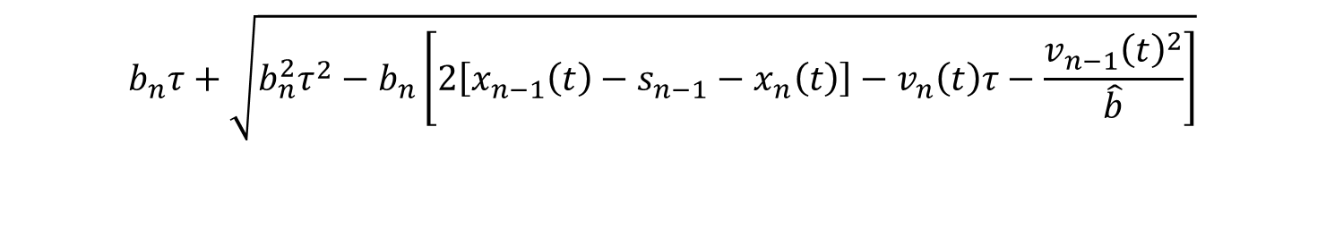


Gipps’ Model
Peter Gipps, 1981
Specify following vehicle by speed
Use timestep = reaction time ($τ$)$⁡$
Free regime and following regime
$$v_{n}\left(t\right)+2.5a_{n}τ\left(1−\frac{v_{n}\left(t\right)}{V_{n}}\right){\left(0.025+\frac{v_{n}\left(t\right)}{V_{n}}\right)}^{\frac{1}{2}}$$
$$v_{n}\left(t+τ\right)=min$$
$$b_{n}τ+\sqrt{b_{n}^{2}τ^{2}−b_{n}\left[2\left[x_{n−1}\left(t\right)−s_{n−1}−x_{n}\left(t\right)\right]−v_{n}\left(t\right)τ−\frac{v_{n−1}{\left(t\right)}^{2}}{\hat{b}}\right]}$$

Slide 6
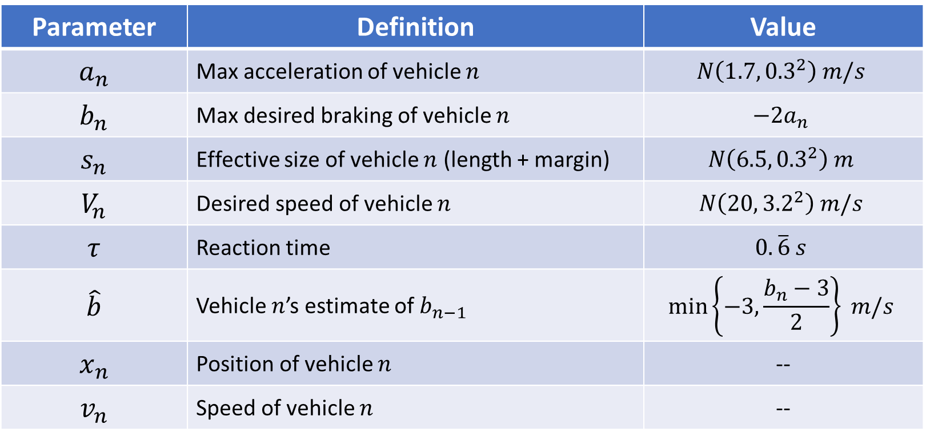
Gipps’ Model
Parameter | Definition | Value
$$a_{n}$$ | Max acceleration of vehicle $n$ | $$N\left({1.7, 0.3}^{2}\right) m/s$$
$$b_{n}$$ | Max desired braking of vehicle $n$ | $$−2a_{n}$$
$$s_{n}$$ | Effective size of vehicle $n$ (length + margin) | $$N\left({6.5, 0.3}^{2}\right) m$$
$$V_{n}$$ | Desired speed of vehicle $n$ | $$N\left({20, 3.2}^{2}\right) m/s$$
$$τ$$ | Reaction time | $$0.\overline{6} s$$
$$\hat{b}$$ | Vehicle $n$’s estimate of $b_{n−1}$ | $$\min\left\{−3,\frac{b_{n}−3}{2}\right\} m/s$$
$$x_{n}$$ | Position of vehicle $n$ | --
$$v_{n}$$ | Speed of vehicle $n$ | --

Slide 7
Methodology
Built simulation in Python
Altered Gipp’s Model
Red light regime
V2I communication
Perfect within 300m
Assume nearly perfect line of sight

Slide 8
Results
^Without V2I advance detection (base case)
(will have graphs comparing travel time on segment with and without v2i)
180
249
318
387
456
525
594
663
732
801
Travel Time (s)

Slide 9
Conclusions

Slide 10
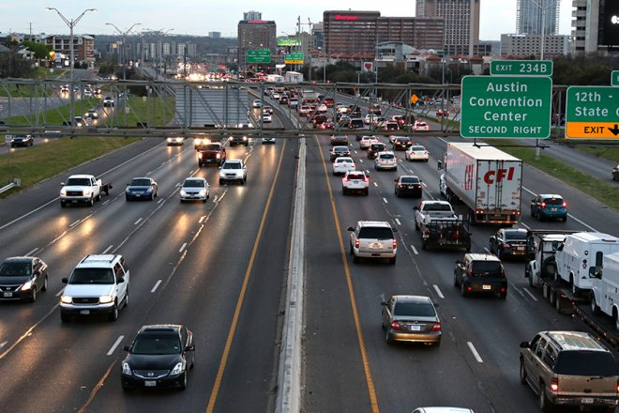
Questions?
Source: The Daily Texan

Slide 11
Sources
Daniel, Hannah. “2016 Brings Fewer Traffic Fatalities, Road Improvements to Austin.” The Daily Texan, 14 Sept. 2016. www.dailytexanonline.com/2016/09/14/2016-brings-fewer-traffic-fatalities-road-improvements-to-austin.
Gipps, P.G. “A Behavioural Car-Following Model for Computer Simulation.” Transportation Research Board Part B, 15. 1981
Koesling, Sonja. “PTV Vissim 6 Is Now Available.” Traffic-Inside, PTV Group, 8 Aug. 2013.
www.traffic-inside.com/2013/08/05/long-awaited-ptv-vissim-6-version-is-now-available/
Olstam, Johann J, and Andreas Tapani. “Comparison of Car-Following Models.” Swedish National Road and Transportation Institute, vol. 960A, 2004.
“RIPAS Integrates Aimsun Microsimulation.” AIMSUN.
www.aimsun.com/russia-ripas-integrates-aimsun-microsimulation-and-spektr-controllers/.

