Slide 1
Dynamic Programming
0-1 Knapsack
These notes are taken from the notes by Dr. Steve Goddard at
http://www.cse.unl.edu/~goddard/Courses/CSCE310J/Lectures/Lecture8-DynamicProgramming.pdf

Slide 2
Recall: Dynamic Programming
Basic idea:
  Optimal substructure: Optimal solution to problem consists of optimal solution to subproblems
  Overlapping subproblems: Few subproblems in total, many recurring instances of each
  Memoization: Solve bottom-up, building a table of solved subproblems that are used to solve larger ones
Variations
  “Table” could be 3D, triangular, a tree, etc

Slide 3
0-1 Knapsack Problem
Given a knapsack with maximum capacity W, and a set S consisting of n items
Each item i has some weight w_{i} and value v_{i}
Problem: solve a version of 0-1 Knapsack where W, w_{i}, and v_{i} are all integer values
  How to pack the knapsack to achieve maximum total value of packed items.

Slide 4
Brute Force Approach
Since there are n items, there are 2^{n} possible combination of items
Go through all combinations and find the one with maximum value and total weight less than or equal to W
Running time is Ο(2^{n})

Slide 5
Can We Do Better?
Use an algorithm based on dynamic programming
We need to carefully identify the subproblem
Try this:
  If items are labeled 1,…,n, then a subproblem would be to find an optimal solution for
  S_{k} = {items labeled 1,…,k}

Slide 6
Defining a Subproblem
If items are labeled 1,…,n, then a subproblem would be to find an optimal solution for
S_{k} = {items labeled 1,…,k}
This is a reasonable subproblem definition
The question:
  Can we define the final solution (S_{n}) in terms of subproblems (S_{k})?
Unfortunately, we can’t do that

Slide 7
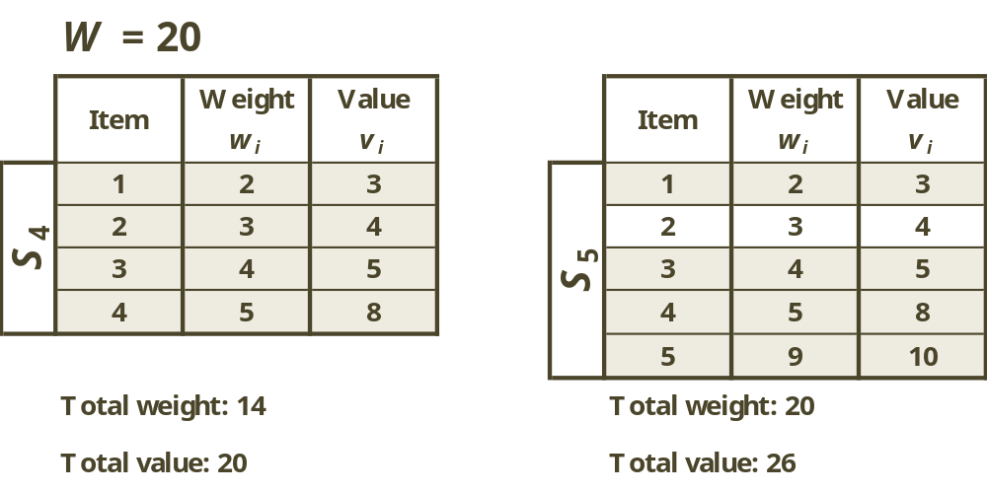
Defining a Subproblem
Solution for S₄ is not part of the solution for S₅

Slide 8
Defining a Subproblem
So our definition of a subproblem is flawed and we need another one!
Let’s add another parameter: w, which will represent the weight for each subset of items
The subproblem then will be to compute V[k,w]

Slide 9
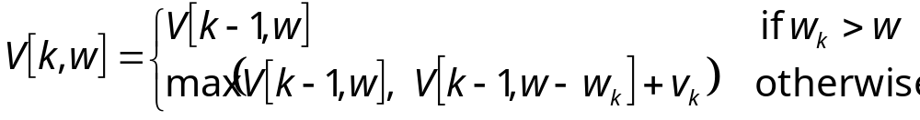
Recursive Formula for Subproblems
It means that the best subset of S_{k} that has total weight w is:
  The best subset of S_{k-1} that has total weight w OR
  The best subset of S_{k-1} that has total weight w - w_{k} plus the item k

Slide 10
Recursive Formula
The best subset of S_{k} that has the total weight w either contains item k or not
First case: w_{k} > w
  Item k can’t be part of the solution since if it was, the total weight would be > w, which is unacceptable
Second case: w_{k} ≤ w
  Then the item k can be in the solution, and we choose the case with greater value

Slide 11
Optimal substructure:
The 0-1 Knapsack Problem exhibits optimal substructure
  Consider the most valuable load weighing at most W pounds
    If we remove item k from the load, what do we know about the remaining load?
    Answer: The remaining load must be the most valuable load weighing at most W – w_{k} that the thief could take, excluding item k

Slide 12
How many possible subproblems?

Slide 13
How many possible subproblems?
nW
Use a table of size (n+1) * (W+1)

Slide 14
0-1 Knapsack Algorithm
for w = 0 to W
V[0,w] = 0
for k = 1 to n
V[k,0] = 0
for k = 1 to n
for w = 0 to W
if w[k] <= w // item k can be part of the solution
if v[k] + V[k-1,w-w[k]] > V[k-1,w]
V[k,w] = v[k] + V[k-1,w- w[k]]
else
V[k,w] = V[k-1,w]
else V[k,w] = V[k-1,w] // w[k] > w

Slide 15
Example
Let’s try this on the following data
  n = 4 (number of items)
  W = 5 (maximum weight knapsack can hold)
  Items (weight, value)
    (2, 3)
    (3, 4)
    (4, 5)
    (5, 6)

Slide 16
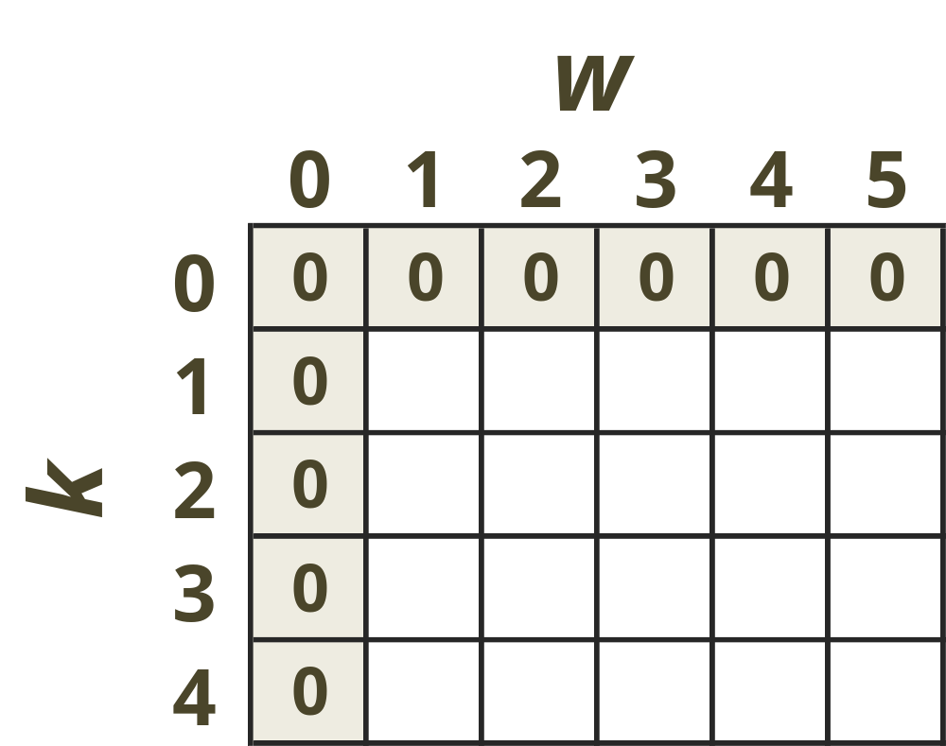
Example (2)
Initialization

Slide 17
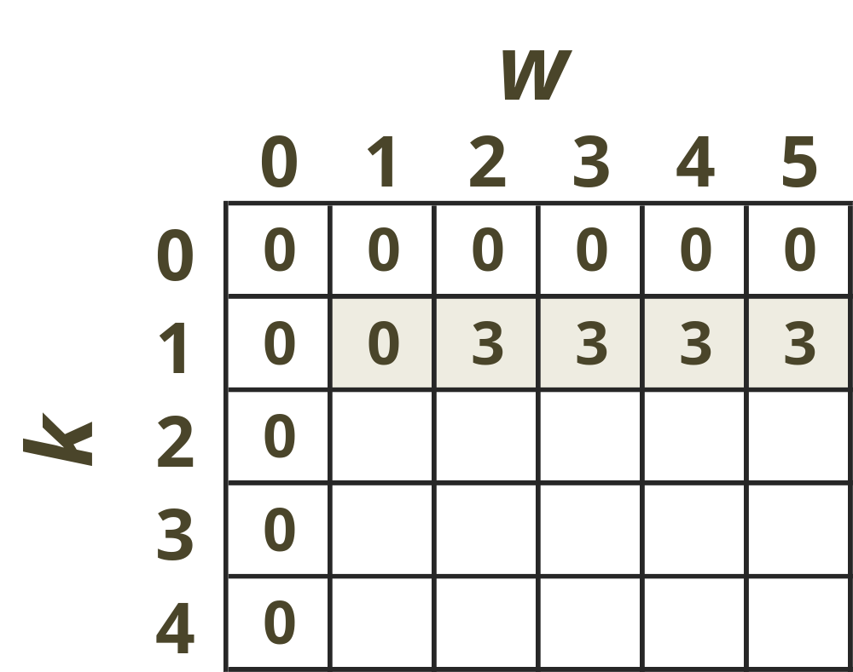
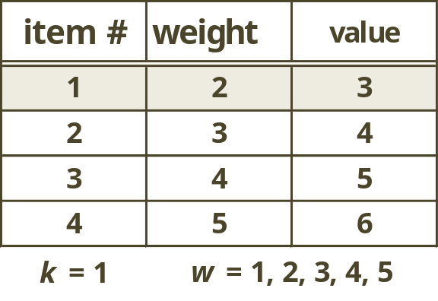
Example (3)

Slide 18
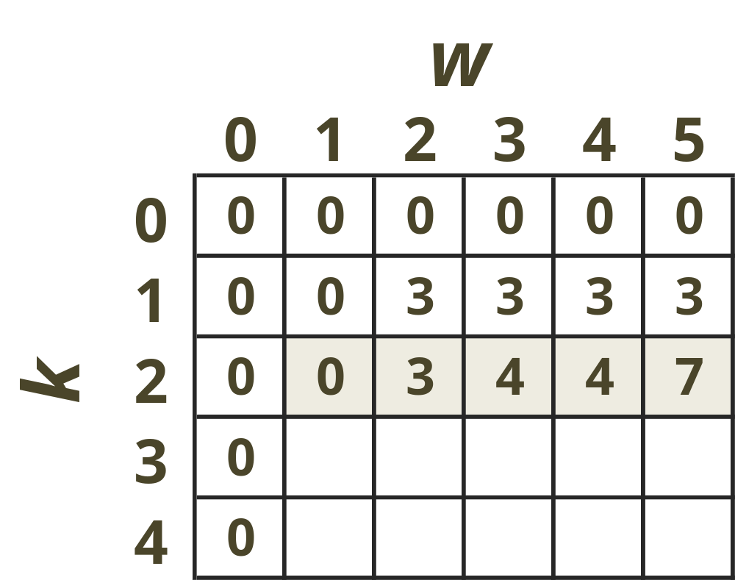
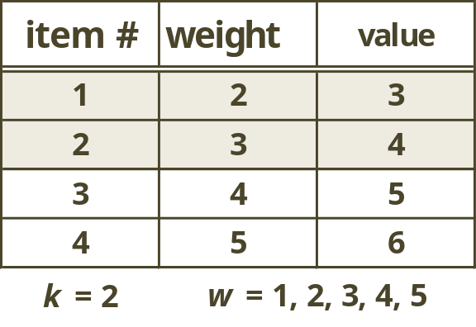
Example (4)

Slide 19
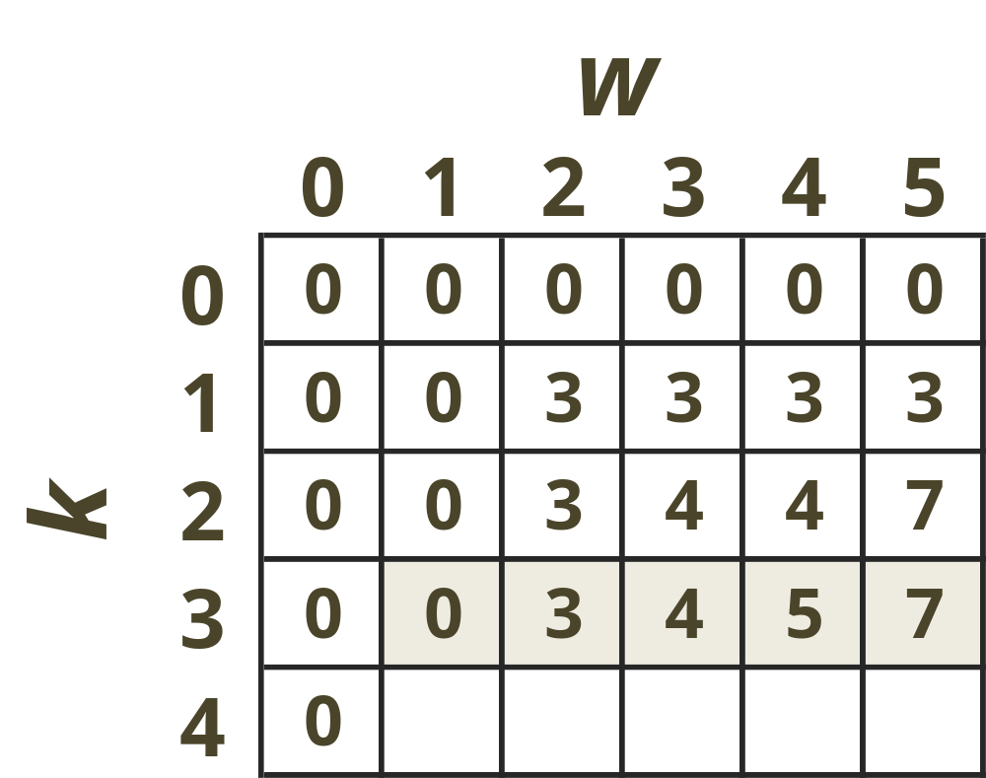
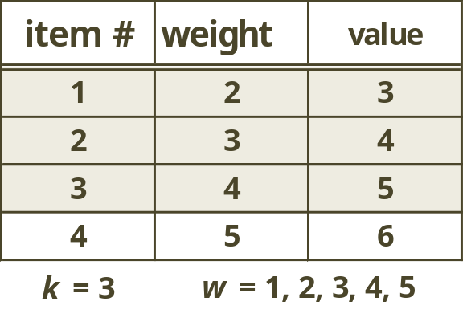
Example (5)

Slide 20
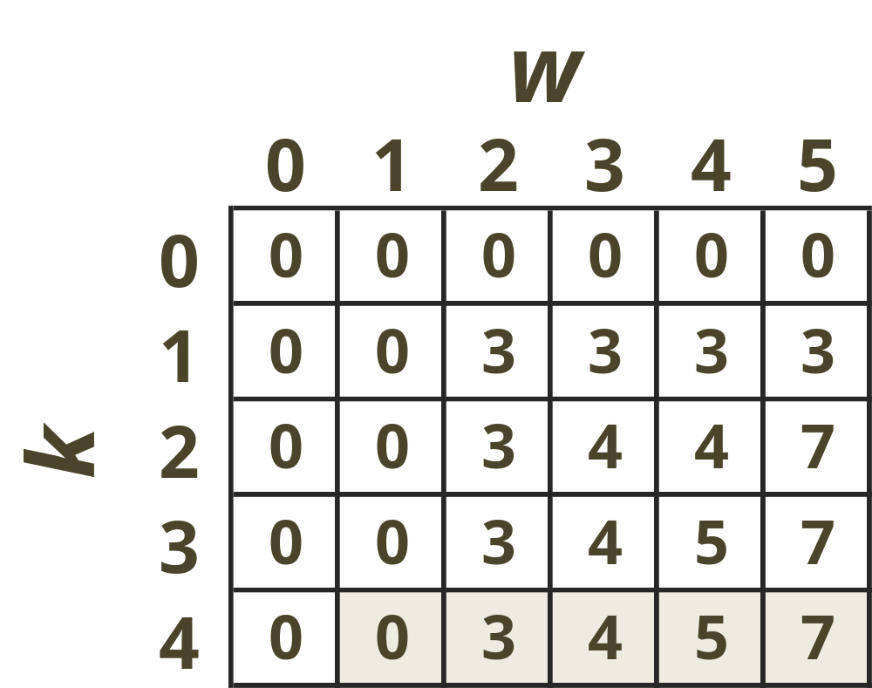
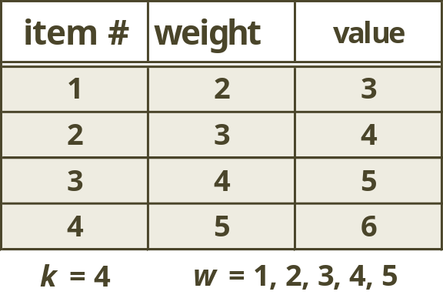
Example (6)

Slide 21
Comments
This algorithm finds only the max possible value that can be carried in the knapsack
  I.e. The value V[n, W]
To know the items that make this maximum value, we need to back track through the table
  Remember, we did the same thing with LCS

Slide 22
How to Find Actual Items
Let k = n and w = W
If V[k, w] ≠ V[k-1, w] then
  Mark the k^{th} item as in the knapsack
  w = w – w_{k} , k = k – 1
Else
  k = k – 1 // Assume the kth item in not in the
  // knapsack

Slide 23
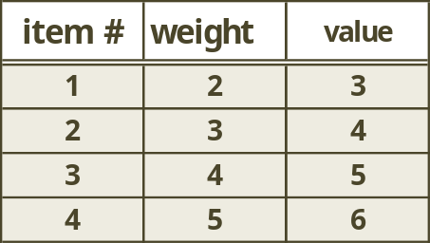
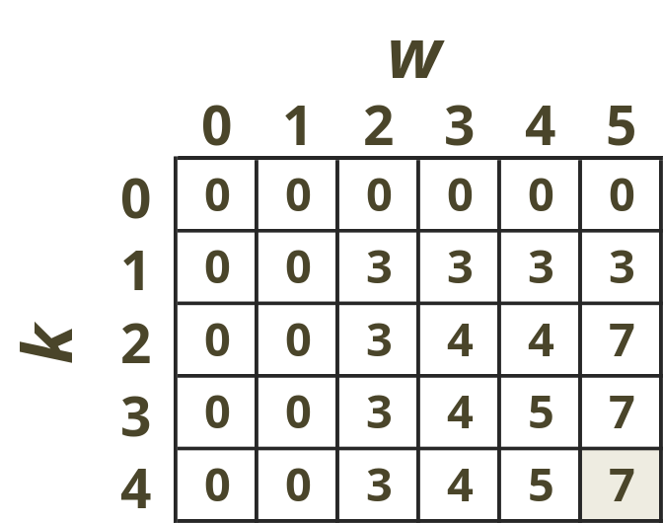
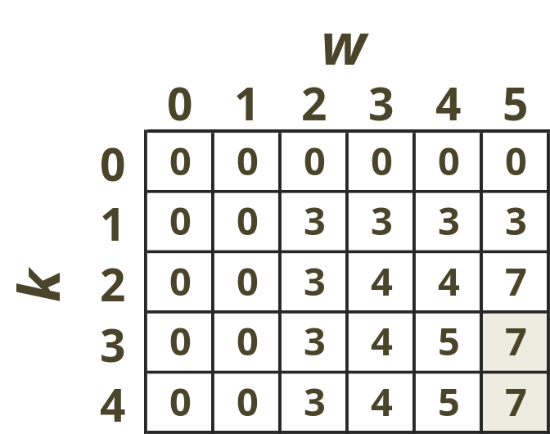
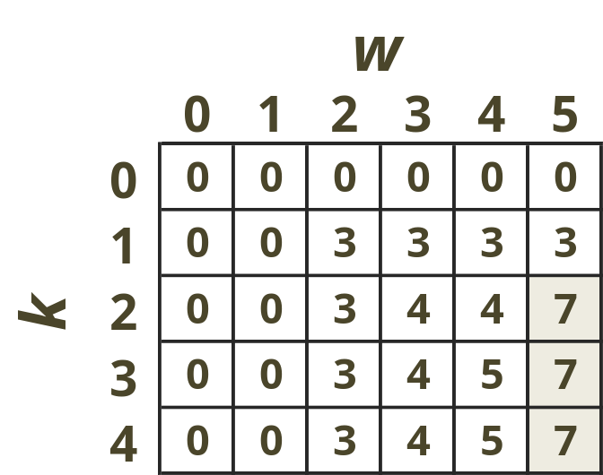
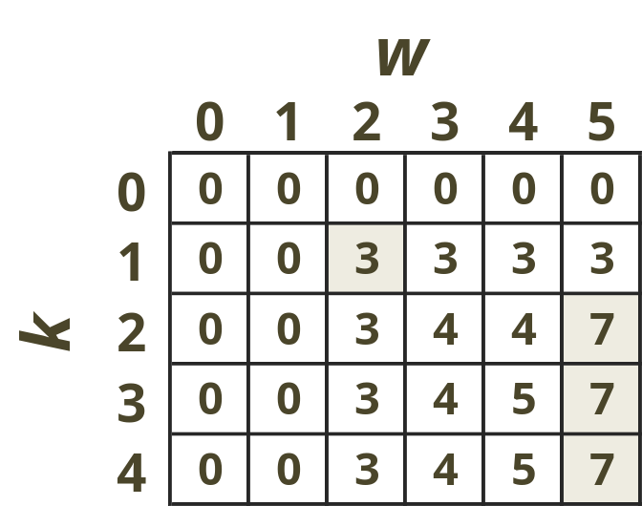
Finding the Items

Slide 24
Running time?
O(nW)
  pseudo-polynomial
  O(nW) complexity does not contradict the fact that the 0-1 knapsack problem is NP-complete, since W, unlike n, is not polynomial in the length of the input to the problem.
  Also remember the DP solution only works if the weights are integers!

