Slide 1
QuickSort
Randomized Algorithm
Worst time: θ(n²)
Expected time: θ(nlgn)
  Constants in the expected time are small
Sorts in place
Better locality of reference compared to other sorting algorithms (thus, faster)
Method used in most stand library sorting algorithms
Design & Analysis of Algorithms Suzan Köknar-Tezel

Slide 2
QuickSort (cont)
Divide:
  Select a random element x from the array, called the pivot
  Partition A[p..r] into two subarrays A[p..q-1] and A[q+1..r] such that those elements A[p..q-1] ≤ x, A[q] = x, and each element of A[q+1..r] >= x
Conquer: Sort the two subarrays by recursive calls to Quicksort
Combine: Since subarrays are sorted in place, they are already sorted
Design & Analysis of Algorithms Suzan Köknar-Tezel

Slide 3
Randomized QuickSort (cont)
Randomized-QuickSort( A, p, r )
if p < r
q ← Randomized-Partition( A, p, r )
Randomized-QuickSort( A, p, q-1 )
Randomized-QuickSort( A, q+1, r )
Design & Analysis of Algorithms Suzan Köknar-Tezel

Slide 4
To sort entire array:
Randomized-QuickSort( A, 1, length(A) )
Design & Analysis of Algorithms Suzan Köknar-Tezel

Slide 5
Randomized QuickSort (cont)
Randomized-Partition( A, p, r )
i ← Random( p, r )
Exchange( A[ p ], A[ i ] )
return Partition( A, p, r )
Design & Analysis of Algorithms Suzan Köknar-Tezel

Slide 6
QuickSort (cont)
Partition( A, p, r )
1. x ← A[ p ]
2. i ← p
3. for j ← p+1 to r
4. if A[ j ] ≤ x
5. i ← i + 1
6. Exchange( A[ i ], A[ j ] )
7. Exchange( A[ p ], A[ i ] )
8. return i
Design & Analysis of Algorithms Suzan Köknar-Tezel

Slide 7
Performance of QuickSort
Partition function’s running time - θ(n)
Running time of QuickSort depends on the balance of the partitions
  If balanced, QuickSort is asymptotically as fast as MergeSort
  If unbalanced, it is asymptotically as bad as Insertion Sort
Design & Analysis of Algorithms Suzan Köknar-Tezel

Slide 8
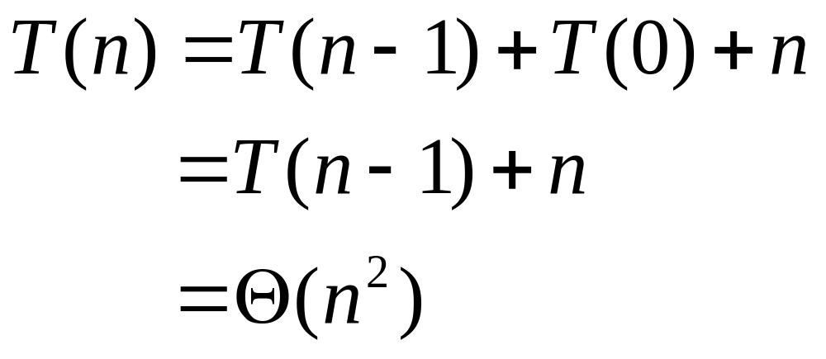
Performance of QuickSort (cont)
Worst-case Partitioning
  Partitions always of size n-1 and 0
  Occurs when array is already sorted
  Recurrence for the running time:
Design & Analysis of Algorithms Suzan Köknar-Tezel

Slide 9
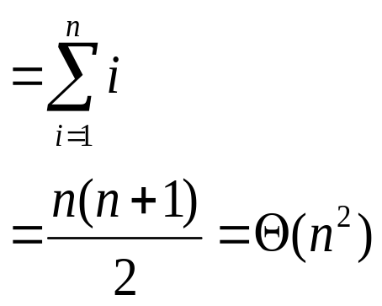
Performance of QuickSort (cont)
n
n
(n-1)
(n-1)
n
(n-2)
(n-2)
.
.
.
1
Total: θ(n²)
Design & Analysis of Algorithms Suzan Köknar-Tezel

Slide 10
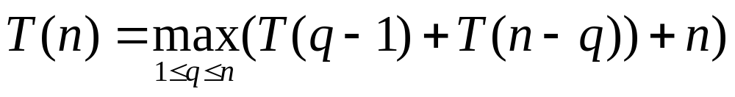
Worst-case Analysis of QuickSort
A more rigorous analysis
We intuited that worst-case running time is Θ(n²)
Use substitution method to show this is true
Design & Analysis of Algorithms Suzan Köknar-Tezel

Slide 11
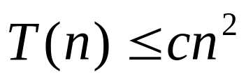
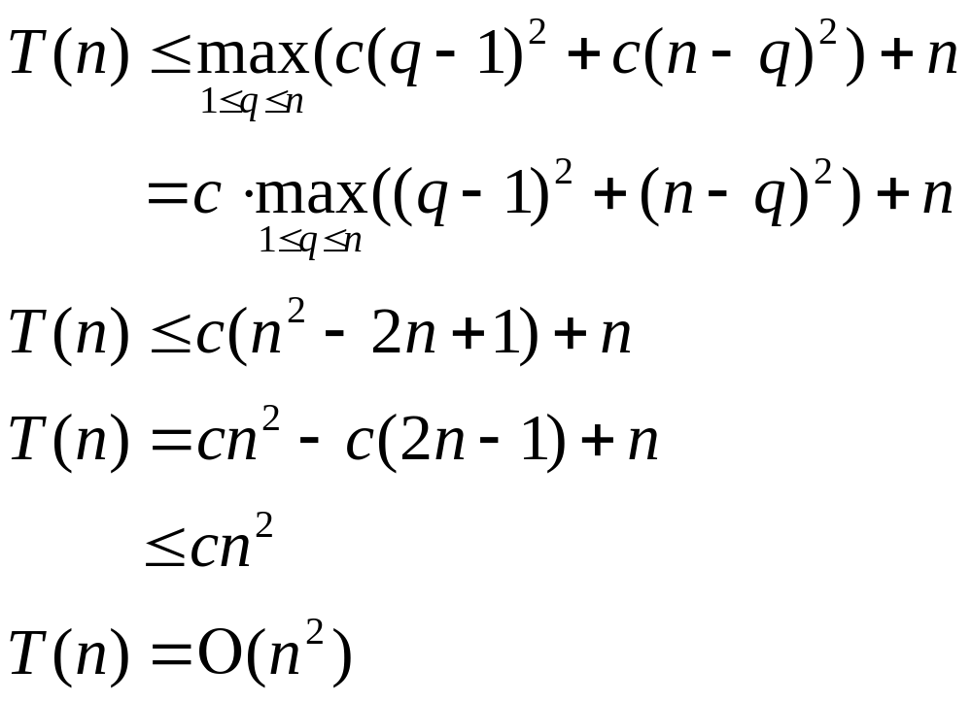
Wors-case Analysis of QuickSort (cont)
  Guess: Ο(n²)
  Show: for some c > 0
  Substitute:
(q-1)²+(n-q)² is max at endpoints of range. Therefore it is
(n-1)²
= n² – 2n +1
Design & Analysis of Algorithms Suzan Köknar-Tezel

Slide 12
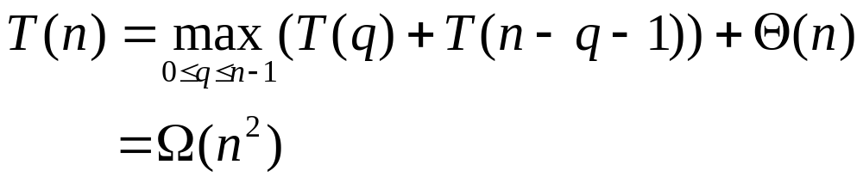
Worst-case Analysis of QuickSort (cont)
  Problem 7.4-1 has you show that
  Thus the worst-case running time of QuickSort is Θ(n²)
Design & Analysis of Algorithms Suzan Köknar-Tezel

Slide 13
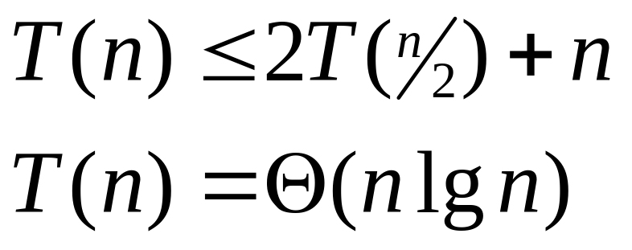
Performance of QuickSort
Best-case Partitioning
  Partitions always of size ⎣n/2⎦ and ⎡n/2⎤-1
  The recurrence for the running time:
Case 2 of Master Method
Design & Analysis of Algorithms Suzan Köknar-Tezel

Slide 14
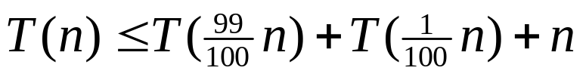
Performance of QuickSort (cont)
  Consider any split of constant proportionality (say 99 to 1)
  It will have a running time of Ο(nlgn)
    The recurrence will be
    Because it yields a recursion tree of depth θ(lgn), where cost at each level is Ο(n)
    See page 151 (new book) for picture
      Or next slide
Design & Analysis of Algorithms Suzan Köknar-Tezel

Slide 15
Performance of QuickSort (cont)
n
n
log₁₀₀n
(n/100)
(99n/100)
n
(n/10000)
(99n/10000)
(99n/10000)
(9801n/10000)
n
T(1)
n
T(1)
T(1)
T(1)
log_{100/99}n
≤ n
Total: Ο(nlgn)
Design & Analysis of Algorithms Suzan Köknar-Tezel

Slide 16
Expected Case
Expected case similar to best case
Intuition for the expected case
  Recall from the analysis of Selection
  Define good split: n/4 <= rank of the pivot <= 3n/4
  Bad split otherwise
  Probability of a bad split = Probability of a good split = 1/2
Design & Analysis of Algorithms Suzan Köknar-Tezel

Slide 17
Expected case (cont’d)
  In a recursion tree for an expected-case, there are roughly equal number of “good” and “bad” splits
  If we have a good split at a node of input size m, the size of input at either child node is <= 3m/4
Design & Analysis of Algorithms Suzan Köknar-Tezel

Slide 18
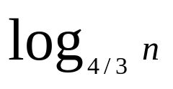
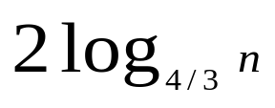
Expected case (cont’d)
  The length of the path from root (input size n) to an external node (input size 1) is at most the number of recursion levels to achieve
  good splits. That is recursion levels.
  Thus, the expected height of the recursion tree is O(logn)
Design & Analysis of Algorithms Suzan Köknar-Tezel

Slide 19
Expected case (cont’d)
  At each level O(n) work
  Total work O(nlogn)
Design & Analysis of Algorithms Suzan Köknar-Tezel

