Slide 1
All Pairs Shortest Paths and Floyd-Warshall Algorithm
CLRS 25.2

Slide 2
All-pairs shortest paths
Given a weighted directed graph, G(V, E) with a weight function w that maps edges to real-valued weights.
  w(u,v) denote the weight of an edge (u,v)
For every pair of vertices u, v, find a shortest path from u to v, where the weight of a path is the sum of the weights of the edges along the path.
  Run Dijkstra’s algorithm V times?
  O(V E log V) if no negative weights

Slide 3
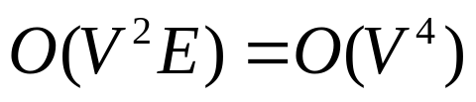
All-pairs shortest paths
If we allow negative edge weights but no negative-weight cycles
  Cannot use Dijkstra’ algorithm
  Run Bellman-Ford (the one we did not cover) once for each vertex, which leads to a running time of
  for a dense graph.

Slide 4


All-pairs shortest paths
Instead, we will use a dynamic programming solution:
  Floyd-Warshall Algorithm
  Running time:
Let denote the weight of the shortest path from u to v

Slide 5
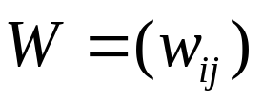
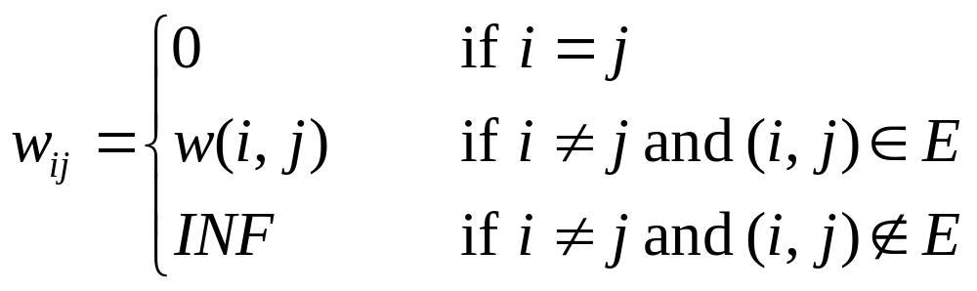
Input: adjacency matrix representing G
Assume an adjacency matrix representation
  Assume vertices are numbered 1,2,…,n
  The input is a n x n matrix representing the edge weights of an n-vertex directed graph

Slide 6
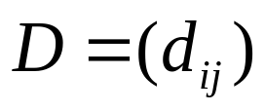
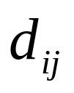
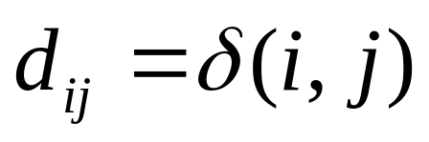
Output?
n x n matrix
Entry will contain the weight of the shortest path from vertex i to vertex j, that is

Slide 7
Example: input
2
W
4
3
1 2 3 4 5
1
2
3
4
5
0 | 3 | 8 | ∞ | -4
∞ | 0 | ∞ | 1 | 7
∞ | 4 | 0 | ∞ | ∞
2 | ∞ | -5 | 0 | ∞
∞ | ∞ | ∞ | 6 | 0
1
8
3
2
-4
1
-5
7
5
4
6

Slide 8
Example: output
2
D
4
3
1 2 3 4 5
1
2
3
4
5
0 | 1 | -3 | 2 | -4
3 | 0 | -4 | 1 | -1
7 | 4 | 0 | 5 | 3
2 | -1 | -5 | 0 | -2
8 | 5 | 1 | 6 | 0
1
8
3
2
-4
1
-5
7
5
4
6

Slide 9
Example: output
2
D
4
3
1 2 3 4 5
1
2
3
4
5
0 | 1 | -3 | 2 | -4
3 | 0 | -4 | 1 | -1
7 | 4 | 0 | 5 | 3
2 | -1 | -5 | 0 | -2
8 | 5 | 1 | 6 | 0
1
8
3
2
-4
1
-5
7
5
4
6

Slide 10
Example: output
2
D
4
3
1 2 3 4 5
1
2
3
4
5
0 | 1 | -3 | 2 | -4
3 | 0 | -4 | 1 | -1
7 | 4 | 0 | 5 | 3
2 | -1 | -5 | 0 | -2
8 | 5 | 1 | 6 | 0
1
8
3
2
-4
1
-5
7
5
4
6

Slide 11
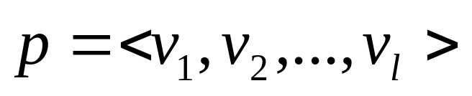
DP Formulation
Intermediate vertices: on a path
any vertex other than the first and the last vertices is called and intermediate vertex.
Let vertices of G be V={1,2,….,n}
Consider a subset {1,2,…,k} of these vertices for some k
Subproblems: limit the set of intermediate vertices on a path from i to j to subset {1,2,…,k}
  The path is allowed to pass through only vertices 1 through k

Slide 12
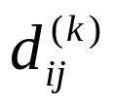

DP Formulation
In the original problem: For any pair of vertices i and j, the intermediate vertices could be drawn from the set {1,…,n}
Define to be the shortest path from i to j such that intermediate vertices on the path are drawn from the set {1,2,…,k}
  Matrix

Slide 13
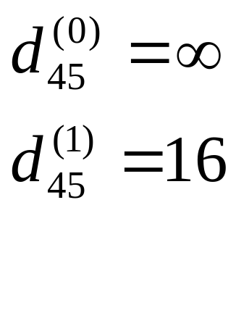
Example
2
4
3
1
8
3
2
14
1
-5
7
5
4
6

Slide 14
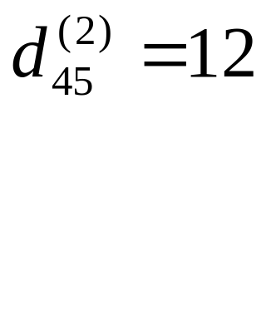
Example
2
4
3
1
8
3
2
14
1
-5
7
5
4
6

Slide 15
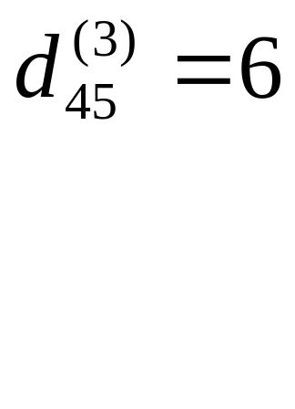
Example
2
4
3
1
8
3
2
14
1
-5
7
5
4
6

Slide 16
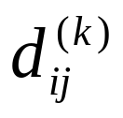

DP Formulation
How to reduce to smaller problems? i.e. how to compute assuming we have already computed ?

Slide 17
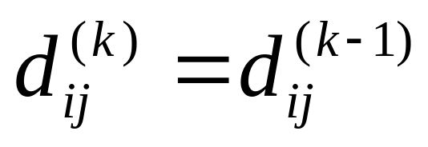
DP Formulation
How to reduce to smaller problems? i.e. how to compute assuming we have already computed ?
Two cases:
  Case 1: Vertex k is NOT among the intermediate vertices on the shortest path from i to j

Slide 18
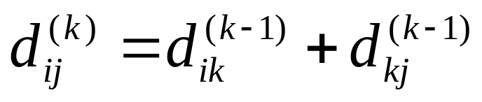
DP Formulation
Case 2: Vertex k is an intermediate vertex on the shortest path from i to j
  First take the shortest path from i to k using intermediate vertices from the set {1,2,…,k-1}
  Then take the shortest path from k to j using intermediate vertices from the set {1,2,…,k-1}
k
i
j

Slide 19
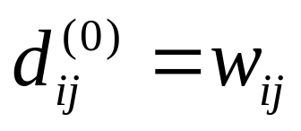
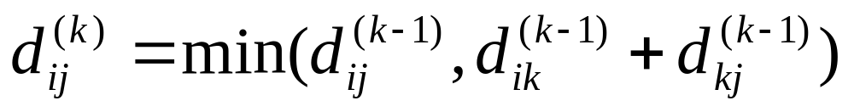
DP Formulation
Base case:
Recursive definition (for k > 0)

Slide 20


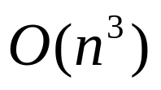
Floyd-Warshall Algorithm
Floyd-Warshall(W) {
n = rows[W]
for k=1 to n do
for i=1 to n do
for j=1 to n do
return
}

Slide 21
Example
2
4
3
1 2 3 4 5
1
2
3
4
5
0 | 3 | 8 | ∞ | -4
∞ | 0 | ∞ | 1 | 7
∞ | 4 | 0 | ∞ | ∞
2 | ∞ | -5 | 0 | ∞
∞ | ∞ | ∞ | 6 | 0
1
8
3
2
-4
1
-5
7
5
4
6

Slide 22

Example
2
4
3
1 2 3 4 5
1
2
3
4
5
0 | 3 | 8 | ∞ | -4
∞ | 0 | ∞ | 1 | 7
∞ | 4 | 0 | ∞ | ∞
2 | 5 | -5 | 0 | -2
∞ | ∞ | ∞ | 6 | 0
1
8
3
2
-4
1
-5
7
5
4
6

Slide 23

Example
2
4
3
1 2 3 4 5
1
2
3
4
5
0 | 3 | 8 | 4 | -4
∞ | 0 | ∞ | 1 | 7
∞ | 4 | 0 | 5 | 11
2 | 5 | -5 | 0 | -2
∞ | ∞ | ∞ | 6 | 0
1
8
3
2
-4
1
-5
7
5
4
6

Slide 24

Example
2
4
3
1 2 3 4 5
1
2
3
4
5
0 | 3 | 8 | 4 | -4
∞ | 0 | ∞ | 1 | 7
∞ | 4 | 0 | 5 | 11
2 | -1 | -5 | 0 | -2
∞ | ∞ | ∞ | 6 | 0
1
8
3
2
-4
1
-5
7
5
4
6

Slide 25

Example
2
4
3
1 2 3 4 5
1
2
3
4
5
0 | 3 | -1 | 4 | -4
3 | 0 | -4 | 1 | -1
7 | 4 | 0 | 5 | 3
2 | -1 | -5 | 0 | -2
8 | 5 | 1 | 6 | 0
1
8
3
2
-4
1
-5
7
5
4
6

Slide 26

Example
2
4
3
1 2 3 4 5
1
2
3
4
5
0 | 1 | -3 | 2 | -4
3 | 0 | -4 | 1 | -1
7 | 4 | 0 | 5 | 3
2 | -1 | -5 | 0 | -2
8 | 5 | 1 | 6 | 0
1
8
3
2
-4
1
-5
7
5
4
6

Slide 27
Space Requirement
Do we need n matrices, each of n x n?
  One n x n matrix for D is enough!
  In phase k, it is okay to overwrite the D from the previous phase (k-1)
  Why?

Slide 28
Floyd-Warshall(W) {
n = rows[W]
for i=1 to n do
for j = 1 to n do
D[i,j] = W[i,j]
for k=1 to n do
for i=1 to n do
for j=1 to n do
if (D[i,k]+D[k,j] < D[i,j])
D[i,j]=D[i,k}+D[k,j]
return D
}

Slide 29
Homework: How to extract the path?
How should we modify the algorithm to store additional information which then can be used to extract the path?

