Slide 1
Matrix Chain Multiplication
CLRS 15.2

Slide 2
Matrix Chain Multiplication
Given a sequence of n matrices, we wish to compute the product A₁A₂A₃A₄ …A_{n}
  using the fewest number of operations.

Slide 3
Matrix Chain Multiplication
How do we compute this product?
  Multiply pairs of matrices after fully parenthesizing
Matrix multiplication is associative
Example: 5 different ways of computing the product of A₁A₂A₃A₄
  ((A₁ (A₂A₃))A₄)
  (A₁ (A₂(A₃A₄)))
  (A₁ ((A₂A₃) A₄))
  ((A₁A₂)(A₃A₄))
  (((A₁A₂)A₃) A₄)

Slide 4
The way we parenthesize can have a dramatic effect on the cost of this product!

Slide 5
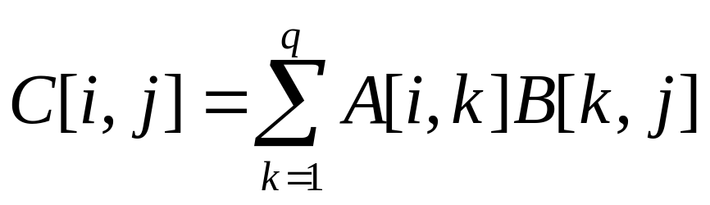
Let’s recall: Matrix Multiplication
Let A be a p x q matrix
  Represent with an array A[1..p, 1..q]
Let B be a q x r matrix
  Represent with an array B[1..q, 1..r]
Let C denote the product of A and B
  C is a p x r matrix where

Slide 6
Cost of matrix multiplication
Dominated by number of scalar multiplications:
  pqr multiplications to multiply A and B

Slide 7
Example
A₁ : 10 x 100
A₂ : 100 x 5
A₃: 5 x 50
((A₁ A₂) A₃)
  requires 5000 + 2500 = 7500 multiplications
(A₁(A₂A₃))
  requires 25000 + 50000 = 75000 multiplications

Slide 8
Matrix Chain Multiplication: restated
Given a sequence of <A₁, A₂, A₃,A₄ ,…,A_{n} >
of n matrices, where matrix A_{i} has dimensions
p_{i-1 X} p_{i,} fully parenthesize the product A₁A₂A₃…A_{n}
in a way that minimizes the number of scalar multiplications

Slide 9
DP Formulation
What are the subproblems?
How can the global problem be solved using solutions of subproblems?

Slide 10
Subproblems: subsequences of matrices
Matrices can not be reordered
Let A_{i..j} denote the result of multiplying matrices i through j
  What are the dimensions of this matrix?
Global Problem: A_{1..n}

Slide 11
Subproblems
Problem: A_{i..j}
How do we break this problem into subproblems of similar structure?
  Consider the highest level of parenthesization
  A_{i..j =} (A_{i..k} A_{k+1..j} ) for some integer k in range i <= k < j

Slide 12
Subproblems
Problem: A_{i..j}
  A_{i..j =} A_{i..k} A_{k+1..j} for some integer k in range i <= k < j
Optimal substructure:
  We need to optimally compute A_{i..k} and A_{k+1..j}

Slide 13
But what is k?
Need to try all possible choices, and take the best of them
We will need to compute the optimal for all possible subsequences A_{i..j} :
  How many are there? (how many possible ways to choose i and j, where 1<= i,j <=n, i!=j)

Slide 14
But what is k?
Need to try all possible choices, and take the best of them
We will need to compute the optimal for all possible subsequences A_{i.j} :
  How many are there? (how many possible ways to choose i and j, where 1<= i,j <=n, i!=j)
  n(n-1)/2

Slide 15
Memoization
Store results in a table
Let m[i,j] denote the minimum number of multiplications needed to compute A_{i..j}

Slide 16
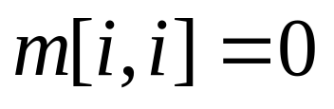
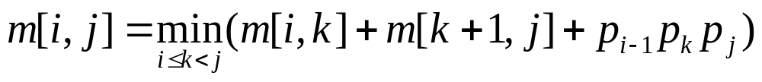
DP Formulation
Basis: if i=j then cost is 0
If i < j

Slide 17
In what order should we compute the table?
When computing m[i,j], which entries do we need?

Slide 18
In what order should we compute the table?
When computing m[i,j], which entries do we need?
The entries for which the subsequence length is less than j-i+1

Slide 19
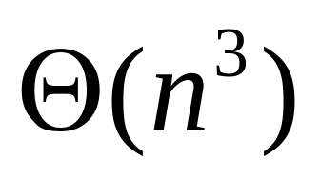
Matrix-Chain-Order(p[1..n]) {//p stores the dimensions of matrices
for i = 1 to n do
m[i,i] = 0;
for L = 2 to n do
for i=1 to n-L+1 do
j= i+ L-1;
m[i,j] =INFINITY;
for k=i to j-1 do
q = m[i,k]+m[k+1,j]+p[i-1]*p[k]*p[j];
if q < m[i,j] then
m[i,j] = q
s[i,j] = k //to keep track of which k we chose
return m and s; //m[1,n] stores the final cost
}

Slide 20
Example
P=[3, 6, 4, 2, 5]
That is:
  A₁ : 3x6
  A₂ : 6x4
  A₃ : 4x2
  A₄ : 2x5

Slide 21
m[i,i] =0
i
m
1 2 3 4
4
3
2
1
0
0
j
0
0

Slide 22
L = 2 P=[3, 6, 4, 2, 5]
i
i
m
1 2 3 4
s
1 2 3
4
3
2
1
40 0
3
4
3
2
48 0
2
j
j
72 0
1
0
m[1,2] = m[1,1]+m[2,2]+p[0]*p[1]*p[2] = 72
m[2,3] = m[2,2]+m[3,3]+p[1]*p[2]*p[3] = 48
m[3,4] = m[3,3]+m[4,4]+p[2]*p[3]*p[4] = 40

Slide 23
L = 3 P=[3, 6, 4, 2, 5]
i
i
1 2 3 4
s
1 2 3
4
3
2
1
108 40 0
3 3
4
3
2
84 48 0
1 2
j
j
72 0
1
0
m[1,3] = min { m[1,1]+m[2,3]+p[0]*p[1]*p[3], m[1,2]+m[3,3]+p[0]*p[2]*p[3] } = min {84, 96} = 84
m[2,4] = min { m[2,2]+m[3,4]+p[1]*p[2]*p[4], m[2,3]+m[4,4]+p[1]*p[3]*p[4] } = min {180, 108} = 108

Slide 24
L = 4 P=[3, 6, 4, 2, 5]
i
i
1 2 3 4
s
1 2 3
4
3
2
1
114 108 40 0
3 3 3
4
3
2
84 48 0
1 2
j
j
72 0
1
0
m[1,4] = min { m[1,1]+m[2,4]+p[0]*p[1]*p[3],
m[1,2]+m[3,4]+p[0]*p[2]*p[4],
m[1,3]+m[4,4]+p[0]*p[3]*p[4] } = min {144, 172, 114} = 114

Slide 25
print-optimal-parens(s, i, j)
if i = j then
  print “A_{i}”
else print “(”
print-optimal-parens(s, i, s[i,j]);
print-optimal-parens(s, s[i,j]+1, j);
print “)”

Slide 26
  ((A₁ (A₂A₃)) A₄)

