Slide 1
Greedy Algorithms
Interval Scheduling and Fractional Knapsack
These slides are based on the Lecture Notes by David Mount for the course CMSC 451 at the University of Maryland. The Copyright notice is as follows:
Copyright, David M. Mount, 2008 Dept. of Computer Science, University of Maryland, College Park, MD, 20742. These lecture notes were prepared by David Mount for the course CMSC 451, Design and Analysis of Computer Algorithms, at the University of Maryland. Permission to use, copy, modify, and distribute these notes for educational purposes and without fee is hereby granted, provided that this copyright notice appear in all copies.

Slide 2
Greedy Algorithms
A simple design technique for optimization problems
  a series of selections need to be made
Builds a solution by repeatedly selecting the best (locally optimal) alternative at every step
Never unmakes a decision
Simple and efficient however not very powerful
  May not reach the optimal for every problem
  Even then, finds good approximations by using fast heuristics

Slide 3
Problem 1: Interval Scheduling
Given R={1,2,…,n} of n activity requests
  To be scheduled to use some resource
  i-th request should start at time s[i] and end at time f[i]
    Request for interval [ s[i], f[i] )
Some intervals may overlap
  Not all requests may be granted
two activities i and j are non-interfering if their start-finish intervals do not overlap
Select a maximum size set of mutually non-interfering activities

Slide 4
A few approaches
Earliest activity first?
  Counterexample: a single very long activity with an early start time

Slide 5
A few approaches
Shortest activity first?
Counterexample:
1
2
3
4
5

Slide 6
A few approaches
Lowest conflicting activity first
  First schedule the activity that overlaps the samllest number of other activities
  Then eliminate it and all overlapping tasks, and update the overlap counts.
  Repeat until no more tasks remain.
  Counterexample?

Slide 7
A few approaches
Lowest conflicting activity first
  Counterexample?

Slide 8
None of the previous three strategies give the optimal solution.
Do not give up!
Here is a greedy strategy that works:
  Select the activity that finishes first and schedule it.
  Then skip the ones interfering with that one, and repeat the process
  Assume the activities are sorted on finish time, i.e.
    f[1] <= f[2] <= f[3] <=…<= f[n]

Slide 9
Schedule(R) { //R holds all activity requests
Sort R in ascending order of finish times
S = empty // S holds the schedule
while (R is nonempty) {
r = the request of R having the smallest finish time
Append r to the end of S
Delete from R all requests that overlap r until reaching a request whose start time > the finish time of r
}
return S
}

Slide 10
Schedule(R) { //R holds all activity requests
Sort R in ascending order of finish times
S = empty // S holds the schedule
while (R is nonempty) {
r = the request of R having the smallest finish time
Append r to the end of S
Delete from R all requests that overlap r until reaching a request whose start time > the finish time of r
}
return S
}
Total: O(n log n) + O(n) = O (n log n)
O(n log n)
O(n)

Slide 11
1
2
3
4
5
6
7
8

Slide 12
1
Scheduled 1, skipped 2 and 3
2
3
4
5
6
7
8

Slide 13
1
Scheduled 4, skipped 5 and 6
2
3
4
5
6
7
8

Slide 14
1
Scheduled 7, skipped 8
2
3
4
5
6
7
8

Slide 15
Proof of Optimality
General strategy for proof of optimality of greedy algorithms:
  Suppose you have a nongreedy solution
  Show that its cost can be reduced by being greedier at some point in the solution
For the interval scheduling problem: show that any schedule that is not greedy can be made more greedy without decreasing the number of activities

Slide 16
Consider any optimal schedule A that is not the greedy schedule
Construct a new optimal schedule B that is greedier than A

Slide 17
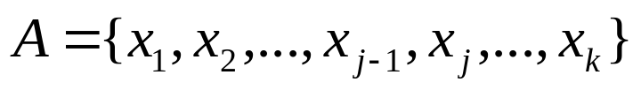
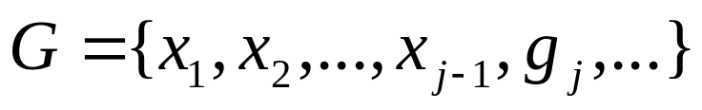
Order the activities in in increasing order of finish time.
Let
Let G denote the greedy schedule and let A ang G differ at activity j
Note that k >= j, since otherwise G would have more activities than the optimal schedule which would be a contradiction.

Slide 18


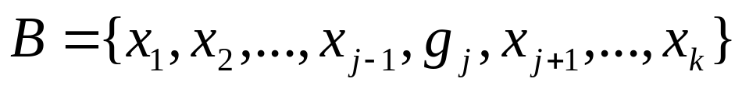
does not conflict with any earlier activity and finishes before
Consider the modified greedier schedule B that results by replacing with in schedule A
This is a feasible schedule
  Note that cannot conflict with later activities
B is greedier and has same number of activities as A.
  B is also optimal.
By repeating this process we convert A into G.
  G is also optimal.

Slide 19
Problem 2: Fractional Knapsack
Classical 0-1 knapsack
  n items
  i-th item weighs w[i] pounds and worth v[i] dollars
  Knapsack can hold at most W pounds
  Which items to take to maximize the value of the load

Slide 20
60
40
30
20
10
5
$30
$20
$100
$90
$160

Slide 21
Problem 2: Fractional Knapsack
Classical 0-1 knapsack
  NP-complete (there probably is not an efficient solution)

Slide 22
Problem 2: Fractional Knapsack
Fractional knapsack
  n items
  i-th item weighs w[i] pounds and worth v[i] dollars
  Knapsack can hold at most W pounds
  Which items to take to maximize the value of the load? But this time taking fractions of an item is allowed.

Slide 23
Good to have high value and low weight
Value per pound ratio: p[i] = v[i]/w[i]
Sort on decreasing p[i]
Add in this order
  If it fits, take it all
  The last item may not fit in the remaining space as a whole—take a fraction

Slide 24
35
(out of 40)
60
40
30
20
20
10
5
$30
$20
$100
$90
$160
5
$270

Slide 25
Proof of optimality
Suppose greedy selection G is not optimal
  There is an alternate selection A that is optimal
Sort A in decreasing p values
Consider the first item i on which G and A differ
  G takes more than A takes from item i (greedy takes as much as it can)
  Say G takes x more units of item i
  All subsequent items in A have a lesser unit value than p[i]
  By replacing x units of any such items with x units of item i, we would increase the total value of A—hence a contradiction.

Slide 26
Greedy solution to 0-1 knapsack: not optimal
30
60
20
40
30
20
10
5
5
$30
$20
$100
$90
$160
$220

Slide 27
optimal solution to 0-1 knapsack
40
60
40
30
20
20
10
5
$30
$20
$100
$90
$160
$260

