Slide 1
Greedy Algorithms
Huffman Coding
Credits: Thanks to Dr. Suzan Koknar-Tezel for the slides on Huffman Coding.

Slide 2
Huffman Codes
Widely used technique for compressing data
  Achieves a savings of 20% - 90%
Assigns binary codes to characters

Slide 3
Fixed-length code?
Consider a 6-character alphabet {a,b,c,d,e,f}
  Fixed-length: 3 bits per character
  Encoding a 100K character file requires 300K bits

Slide 4
Variable-length code
Suppose you know the frequencies of characters in advance
Main idea:
  Fewer bits for frequently occurring characters
  More bits for less frequent characters

Slide 5
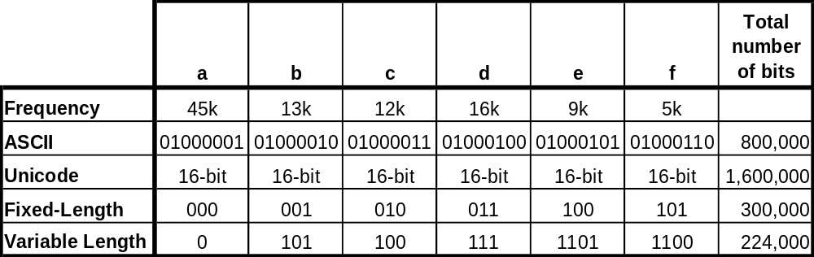
Variable-length codes
Savings compared to:
ASCII – 72%
Unicode – 86%
Fixed-Len – 25%
An example: Consider a 100,000 character file with only 6 different characters:

Slide 6
Another way to look at this:
Relative probability of character ‘a’: 45K/100K = 0.45
Expected encoded character length:
0.45 *1 + 0.12 *3 + 0.13 * 3 + 0.16 * 3+0.09*4 + 0.05 *4 = 2.24
If we have string of n characters
  Expected encoded string length = 2.24 * n

Slide 7
How to decode?
Example:
a = 0, b = 01, c = 10
  Decode 0010
    Does it translate to “aac” or “aba”
    Ambiguous

Slide 8
How to decode?
Example:
a = 0, b = 101, c = 100
  Decode 00100
    Translates to “aac”

Slide 9
What is the difference between the previous two codes?

Slide 10
What is the difference between the previous two codes?
The second one is a prefix-code!

Slide 11
Prefix Codes
In a prefix code, no code is a prefix of another code
Why would we want this?
  It simplifies decoding
    Once a string of bits matches a character code, output that character with no ambiguity
      No need to look ahead

Slide 12
Prefix Codes (cont)
We can use binary trees for decoding
If 0, follow left path
If 1, follow right path
Leaves are the characters

Slide 13
Prefix Codes (cont)
0
1
a
45
0
1
0
0
1
0
1
c
12
b
13
14
d
16
101
0
1
111
100
f
5
e
9
1100
1101
Notes:
Design & Analysis of Algorithms
Suzan Köknar-Tezel

Slide 14
Prefix Codes (cont)
Given tree T (corresponding to a prefix code), compute the number of bits to encode the file
  C = set of unique characters in file
  f(c) = frequency of character c in file
  d_{T}(c) = depth of c’s leaf node in T
  = length of code for character c

Slide 15
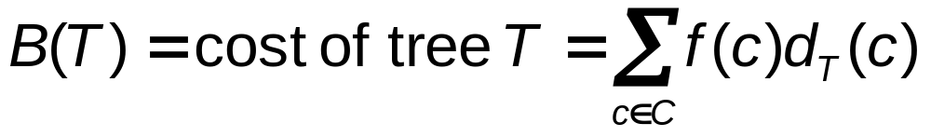
Prefix Codes (cont)
Then the number of bits required to encode a file B(T) is

Slide 16
Huffman Codes (cont)
Huffman's algorithm determines an optimal variable-length code (Huffman Codes)
  Minimizes B(T)

Slide 17
Greedy Algorithm for Huffman Codes
Merge the two lowest frequency nodes x and y (leaf or internal) into a new node z until every leaf has been considered
  Set f(z) = f(x)+f(y)
  You can also view this as replacing x & y with a single character z in the alphabet, and after the process is completed, the code for z is determined , say 11, then the code for x is 110 and for y is 111.
Use a priority queue Q to keep nodes ordered by frequency

Slide 18
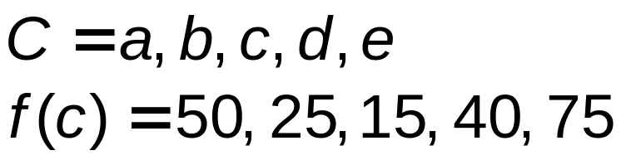
Example of Creating a Huffman Code
i = 1
i = 2
c
15
b
25
d
40
a
50
e
75
40
d
40
a
50
e
75
0
1
c
15
b
25

Slide 19
Example of Creating a Huffman Code (cont)
i = 3
80
a
50
e
75
0
1
40
d
40
0
1
c
15
b
25

Slide 20
Example of Creating a Huffman Code (cont)
i = 4
80
125
0
1
0
1
40
d
40
a
50
e
75
0
1
c
15
b
25

Slide 21
Example of Creating a Huffman Code (cont)
i = 5
205
0
1
80
125
0
1
0
1
40
d
40
a
50
e
75
0
1
c
15
b
25

Slide 22
Huffman Algorithm
Total run time: Ο(nlgn)
Huffman(C)
n = |C|
Q = C // Q is a binary Min-Heap; Ο(n) Build-Heap
for i = 1 to n-1
z = Allocate-Node()
x = Extract-Min(Q) // Ο(lgn), Ο(n) times
y = Extract-Min(Q) // Ο(lgn), Ο(n) times
left(z) = x
right(z) = y
f(z) = f(x) + f(y)
Insert(Q, z) // Ο(lgn), Ο(n) times
return Extract-Min(Q) // return the root of the tree

Slide 23
Correctness
Claim: Consider the two characters x and y with the lowest frequencies. Then there is an optimal tree in which x and y are siblings at the deepest level of the tree.

Slide 24
Proof
  Let T be an arbitrary optimal prefix code tree
  Let a and b be two siblings at the deepest level of T.
  We will show that we can convert T to another prefix tree where x and y are siblings at the deepest level without increasing the cost.
    Switch a and x
    Switch b and y

Slide 25
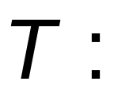
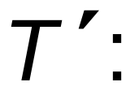
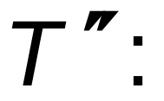
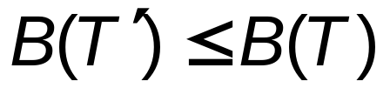
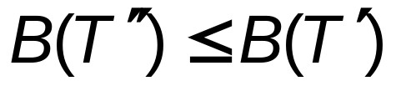
x
a
a
y
y
b
a
b
x
b
x
y

Slide 26
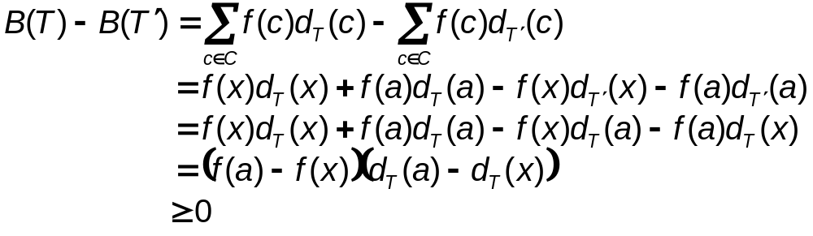
Assume f(x) ≤ f(y) and f(a) ≤ f(b)
We know that f(x) ≤ f(a) and f(y) ≤ f(b)
Non-negative because a is at the max depth
Non-negative because x has (at least) the lowest frequency

Slide 27
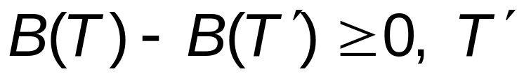
Since is at least as good as T
But T is optimal, so T’must be optimal too
Thus, moving x to the bottom (similarly, y to the bottom) yields a optimal solution

Slide 28
The previous claim asserts that the greedy-choice of Huffman’s algorithm is the proper one to make.

Slide 29
Claim: Huffman’s algorithm produces an optimal prefix code tree.
Proof (by induction on n=|C|)
  Basis: n=1
    the tree consists of a single leaf—optimal
  Inductive case:
    Assume for strictly less than n characters, Huffman’s algorithm produces the optimal tree
    Show for exactly n characters.

Slide 30
(According to the previous claim) in the optimal tree, the lowest frequency characters x and y are siblings at the deepest level.
Remove x and y replacing them with z, where f(z)= f(x)+ f(y),
  Thus, n-1 characters remain in the alphabet.

Slide 31
Let T’be any tree representing any prefix code for this (n-1) character alphabet. Then, we can obtain a prefix-code treeT for the original set of n characters by replacing the leaf node for z with an internal node having x and y as children. The cost of T is
  B(T) = B(T’) – f(z)d(z)+f(x)(d(z)+1)+f(y)(d(z)+1)
  = B(T’) – (f(x)+f(y))d(z) + (f(x)+f(y))(d(z)+1)
  = B(T’) + f(x) + f(y)
To minimize B(T) we need to build T’ optimally—which we assumed Huffman’s algorithm does.

Slide 32


z
x
y

