Slide 1
Flux Training
Emanuele Della Valle
Prof. @ Politecnico di Milano &
Partner @ Quantia Consulting
Marco Balduini
Founder & CEO @ Quantia Consulting

Slide 2

Emanuele Della Valle
Assistant Professor at DEIB | Politecnico di Milano
Founder & Partner at Quantia Consulting
Expert in semantic technologies and stream computing
Brander of stream reasoning: an approach to master the velocity and variety dimension of Big Data
+20 years experience in innovation and research projects
Contact
emanuele.dellavalle@quantiaconsulting.com
@manudellavalle
http://www.quantiaconsulting.com
http://emanueledellavalle.org
http://streamreasoning.org

Slide 3
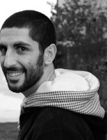
Marco Balduini
PhD in CS | Politecnico di Milano on stream reasoning
Founder & CEO at Quantia Consulting
Expert in data processing, data integration and data science technologies
~10 years experience in innovation and research projects
Contact
marco.balduini@quantiaconsulting.com
@balducci85
http://www.quantiaconsulting.com

Slide 4
Agenda

