Slide 1
Lattice Cryptography (1. Public Key Encryption)
Vadim Lyubashevsky
IBM Research Europe, Zurich

Slide 2

Cryptography
Allows for secure communication in the presence of malicious parties
Notes:
Security depends on the power of the adversary.

Slide 3
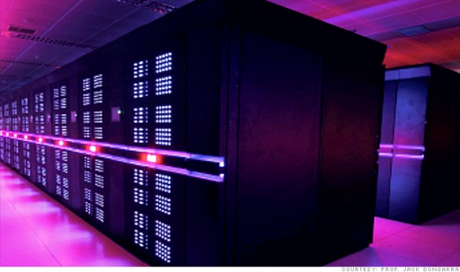
Cryptography
Large increase in the adversary’s computing power
requires only a small increase in the key size
Notes:
As adversaries use more powerful computers, cryptographic keys need to increase in size. Adversary twice as powerful, increase key by 1 bit.

Slide 4
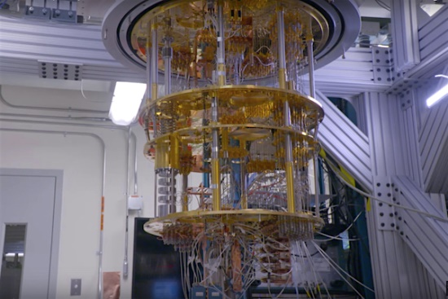
Cryptography
A quantum computer is outside the standard
model of computation for efficiency purposes

Slide 5


Symmetric-Key Cryptography
Secret key = s

Slide 6
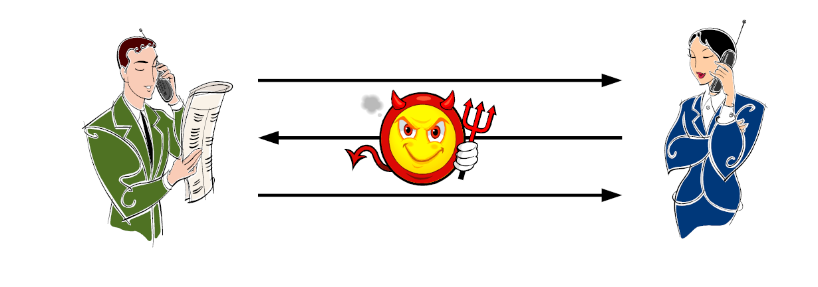
Symmetric-Key Cryptography
Will still exist if quantum computers are built
Secret Key = s
Secret Key = s

Slide 7
Public-Key Cryptography
Secret Key = s
Public Key = p

Slide 8
Public-Key Cryptography
Public Key = p
Secret Key = s
Public Key = p
Public Key = p

Slide 9
Mathematical Assumptions for Public-Key Cryptography
Computing discrete logs is hard
Factoring is hard
g^{x}=y mod p
N=pq
Mostly problems from number theory
All broken once a quantum computer is built

Slide 10



Consequence of quantum computing
Current public key schemes will be broken
Quantum computers will recover all of today’s secrets
+
=
Notes:
I will only talk about public key cryptography since there is not much to do for symmetric

Slide 11
Do not need quantum to defend against quantum
Quantum computers are not all-powerful.
They simply solve some problems faster.
Base cryptography on problems they don’t solve.
How do we know that (quantum) computers don’t solve a problem?
We don’t … all we can say is that researchers tried to solve the problem for X decades and failed.

Slide 12
Effect of quantum computers
Symmetric Cryptography
Mostly fine
Public-Key Cryptography
Everything used today – broken!
Timeline for change to Quantum-Safe (post-quantum) Crypto:
Algorithm Selection: 2017 – 2022
Writing Standards: 2022 – 2024
Transition should be complete (NSA): 2030-2035

Slide 13
Public-Key Encryption
Public Key = p
Secret Key = s
Public Key = p
Public Key = p
p

Slide 14
Public-Key Encryption
Public Key = p
Secret Key = s
Public Key = p
Message m
c=Enc(p,m)
Public Key = p
m=Dec(s,c)
c

Slide 15
What is Secure Encryption?
?????
MEET ME IN ICELAND
MEET ME IN ICELAND
AWYXUEOEOPEPEK

Slide 16


Slide 17
Public Key Cryptography
MEET ME IN ICELAND
MEET ME IN ICELAND
MEET ME IN ICELAND
AWYXUEOEOPEPEK

Slide 18
Formal Definition
For any two messages m₁ and m₂ of the adversary’s choosing, he cannot distinguish between
c₁ = Enc(m₁)
c₂ = Enc(m₂)
Encryption needs to be randomized

Slide 19
Building Cryptography
Mathematical Problem
Cryptographic Scheme
Proof that breaking the cryptographic scheme implies solving the mathematical problem

Slide 20
Lattice Cryptography
NIST had a competition to create new quantum-safe cryptographic standards
RSA / Discrete Log / Elliptic Curve cryptography will be phased out by 2033 (at least in the US government)
Main 2 standards - encryption and digital signature - selected are lattice-based
(CRYSTALS-Kyber, CRYSTALS-Dilithium)

Slide 21
Learning with Errors Problem

Slide 22
Hard Problem Intuition
A
y
z
mod p
Given (A,z), find y
Easy! Just invert A and multiply by z

Slide 23
Hard Problem Intuition
A
y
e
z
mod p
Small coefficients
Given (A,z), find (y,e)
Seems hard.

Slide 24
Hard Problem Intuition (Learning With Errors)
mod p
Small coefficients to enforce uniqueness
Given (A,z), find (y,e)
Seems hard.

Slide 25
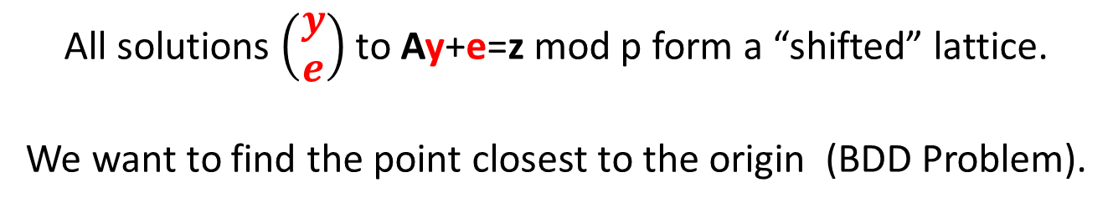
Why is this “Lattice” Crypto?

Slide 26
Distinguishing from Random is also Hard
Search LWE Problem: Given (A,t=As+e mod p), find s
Decision LWE Problem: Given either (A, t=As+e mod p) or (A,u), where u is random mod p, figure out which tuple you have
A
y
e
z
mod p
Looks Random mod p

Slide 27
Public Key Encryption from LWE

Slide 28
“Column” LWE is Pseudorandom
4 6 7 9
3 9 0 7
8 4 6 5
1 6 4 3
1
1
0
1
1
1
1
0
0
9
8
0
+
=

Slide 29
“Row” LWE is also Pseudorandom
1 0 0 1
4 6 7 9 0
3 9 0 7 9
8 4 6 5 8
1 6 4 3 0
pseudorandom
+
1 1 1 0 0
=
6 3 2 2 0

Slide 30
Encryption Scheme
Secret Key
A
s
t
r
A
t
+
=
Small
Coeffs.
+
Z_{q}^{n x n}
Small
Coeffs.
+
Public Key
A is random
0
m
=
u
v

Slide 31
Encryption Scheme
A
s
t
r
A
t
+
=
+
+
0
m
=
Is pseudo-random based on the hardness
of the Learning with Errors Problem
u
v

Slide 32
Encryption Scheme
A
s
t
r
A
t
+
=
+
+
0
m
=
v
=
A
+
+
A
s
r
s
r
m
+
u
v
=
A
+
+
A
s
r
s
m

Slide 33
Encryption Scheme
A
s
t
r
A
t
+
=
+
+
0
m
=
u
s
=
r
A
+
s
u
v
=
+
≈
v
-
m
r
A
s

Slide 34
Encryption Scheme
A
s
t
r
A
t
+
=
+
+
0
m
=
-
=
+
v
u
s
m
u
v
represent 0 by m=0
represent 1 by m=(p-1)/2
Encrypts only 1 bit – large ciphertext expansion
1 bit requires n elements in Z_{p}

Slide 35
Decryption Error
Public Key: A, t = As+e
Ciphertext: u = rA+e₁, v= rt + e₂ + m(p/2)
Decryption: v - us = r(As+e) + e₂ + m(p/2) – (rA+e₁)s
= re + e₂ + m(p/2) - e₁s
Need the total error re +e₂ - e₁s to be < p/4
(let’s ignore e₂, since it’s just an integer)
Say each coefficient of s, r, e, e₁, e₂ is uniformly random in {-1,0,1},
how do you make sure that the inequality is satisfied?

Slide 36
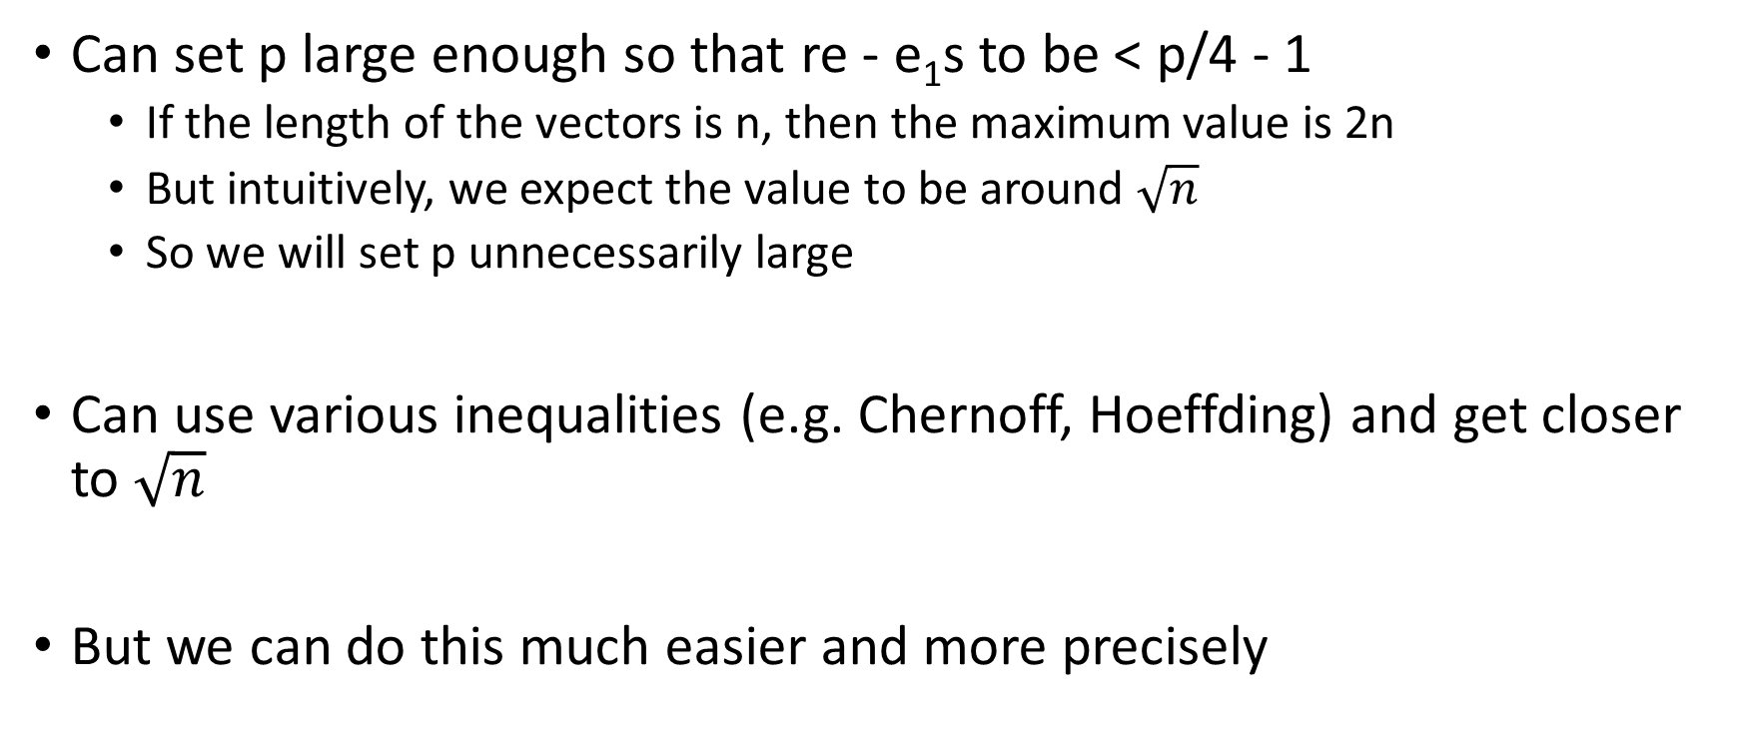
Decryption Error
Can set p large enough so that re - e₁s to be < p/4 - 1
If the length of the vectors is n, then the maximum value is 2n
But intuitively, we expect the value to be around $\sqrt{n}$
So we will set p unnecessarily large
Can use various inequalities (e.g. Chernoff, Hoeffding) and get closer to $\sqrt{n}$
But we can do this much easier and more precisely

Slide 37
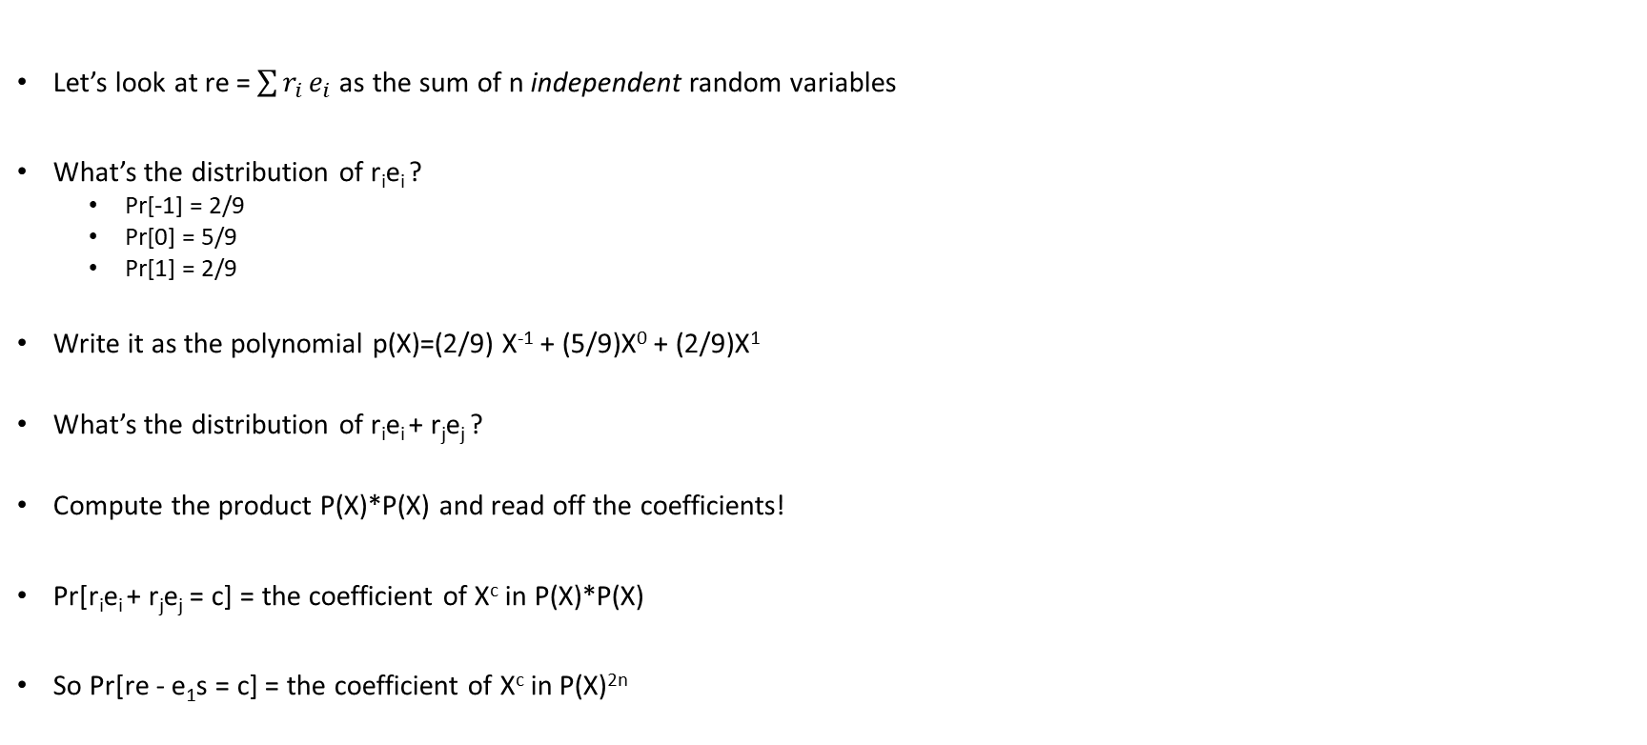
Decryption Error via Convolution
Let’s look at re = $\sum{r_{i}}e_{i}$ as the sum of n independent random variables
What’s the distribution of r_{i}e_{i} ?
Pr[-1] = 2/9
Pr[0] = 5/9
Pr[1] = 2/9
Write it as the polynomial p(X)=(2/9) X⁻¹ + (5/9)X⁰ + (2/9)X¹
What’s the distribution of r_{i}e_{i} + r_{j}e_{j} ?
Compute the product P(X)*P(X) and read off the coefficients!
Pr[r_{i}e_{i} + r_{j}e_{j} = c] = the coefficient of X^{c} in P(X)*P(X)
So Pr[re - e₁s = c] = the coefficient of X^{c} in P(X)^{2n}

Slide 38
Problem Session
Implement the Encryption scheme:
p=257
Dimensions of A = 64 x 64
distribution of s,e,r,e₁,e₂ is Binomial: i.e. each coefficient is b₀ + b₁ – b₂ – b₃ (b_{i} are bits)
Write a script to compute the decryption error

Slide 39
Encrypting More Bits
A
S
T
R
A
T
k
+
=
+
k
+
0
M
Encrypting k² bits requires nk elements in Z_{p}
i.e. n/k elements in Z_{p} per bit
=
U
V

Slide 40
Source of Inefficiency of LWE
2
8
7
3
1
+
2
=
1
Getting just one extra random-looking number requires n random numbers and a small error element.
*
0
2
1
Wishful thinking: get n random numbers and produce n pseudo-random numbers in “one shot”
2
1
8
0
*
+
=
7
2
3
1

Slide 41
Plan for the Week
Improve efficiency by working with polynomial rings
Number Theory Transform (like FFT)
Intro to Zero-Knowledge Proofs
Digital Signatures
Connection of these Constructions to Geometric Lattices

Slide 42
Supplementary Reading
https://github.com/VadimLyubash/LatticeTutorial/
(Today covered pages 1- 8)

