Slide 1
Body Fat Percentage Model
STAT 628 Module 2 - Group 6
Yifan Zhang, Chenyu Jiang, Amy Merkelz

Slide 2
Motivation
Background: Body fat percentage can be used as a metric for overall health and fitness
Problem: High-accuracy estimates of body fat percentage tend to be complex to measure or require specialized tools:
Skin-fold calipers
Measuring body density via water displacement
Goal: Determine a model for estimating body fat percentage in men that is:
Simple
Accurate
Robust

Slide 3
Data Cleaning
Imputation:
Height : We impute due to mismatches between data and BMI formula
Body Fat : We impute due to the laws of the human body
Final Cleaned Data: n = 252 with p = 14 predictors
Predictors : ADIPOSITY, HEIGHT, WEIGHT, NECK, CHEST, ABDOMEN, HIP, THIGH, KNEE, ANKLE, BICEPS, FOREARM, WRIST
Individual (IDNO) | Original Obs. (m) | Imputed Obs.(m) | Imputation Method
42 | 0.74 | 1.76 | BMI = WEIGHT(kg)/HEIGHT(m)^2
Individual (IDNO) | Original Obs. (%) | Imputed Obs.(%) | Imputation Method(where SEX is 0 for female and 1 for male)
182 | 0 | 14.72 | Body fat=(1.2 x BMI)+(0.23 x AGE)-(10.8 x SEX)-5.4

Slide 4
Model Trade-offs
Simplicity: Linear models with no more than 2 parameters
Simplicity scoring will favor 1-parameter models
Accuracy: Correlation Coefficient (R²)
Measures strength of linear relationship between body fat percentage and the parameter(s)
Robustness: Check sum of squares for 4 points against a prior model: US Navy Method
US Navy method uses abdomen, height, and neck measurements
Calculator used: https://www.calculator.net/body-fat-calculator.html

Slide 5
Model Evaluation
Model | R² | Number of Parameters | Sum of Squares with US Navy Method
ABDOMEN | 0.67 | 1 | 16.78
ABDOMEN + WEIGHT | 0.69 | 2 | 7.98
ABDOMEN + HEIGHT | 0.67 | 2 | 16.63

Slide 6
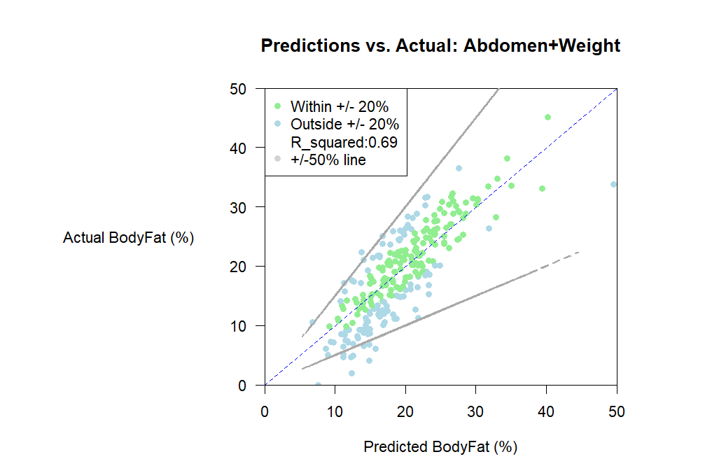
Observations
Number of points within 20% of the true value: 147/252

Slide 7
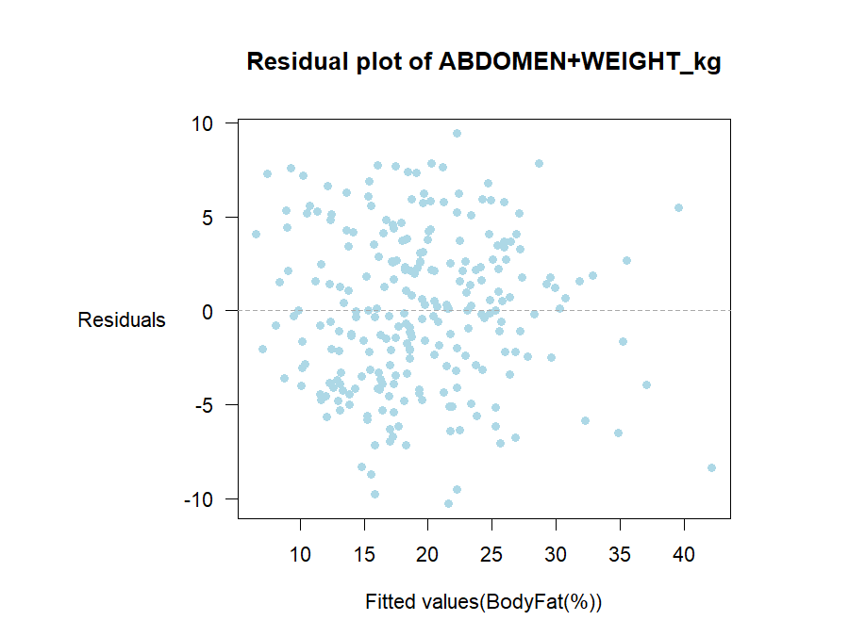
Observations
No clear pattern in residuals: supports linearity and homoscedasticity.

Slide 8
Model Strengths and Weaknesses
Final Model: Body Fat ~ -36.92+ 0.88*ABDOMEN-0.31*WEIGHT
Strengths
Explains 69% of the variation in body fat percentage.
Simplicity: Only 2 predictors
Robustness: Lowest Sum of Squared Differences compared with prior model & residual plots
Weaknesses
Prediction accuracy:
Only 58% of predictions fall within ±20% of the true value.
Only 91% of predictions fall within ±50% of the true value.

Slide 9
Shiny App Demo
https://amerkelz.shinyapps.io/module2_app/

Slide 10
References
Bailey, Covert (1994). Smart Exercise: Burning Fat, Getting Fit, Houghton-Mifflin Co., Boston, pp. 179-186.
Durnin, J. V. G. A., and Womersley, J., (1974). “Body Fat Assessed from Total Body Density and Its Estimation from Skinfold Thickness: Measurements on 481 Men and Women Aged from 16 to 72 Years.” British Journal of Nutrition 32.1 pp. 77–97. Web.
Siri, W.E. (1956), "Gross composition of the body", in Advances in Biological and Medical Physics, vol. IV, edited by J.H. Lawrence and C.A. Tobias, Academic Press, Inc., New York.
“Body Fat Calculator.” Calculator.Net, www.calculator.net/body-fat-calculator.html. Accessed 16 Oct. 2024.
Akinwande, M. , Dikko, H. and Samson, A., (2015). “Variance Inflation Factor: As a Condition for the Inclusion of Suppressor Variable(s) in Regression Analysis.” Open Journal of Statistics, 5, pp. 754-767. Web.

Slide 11
Thank you!

Slide 12
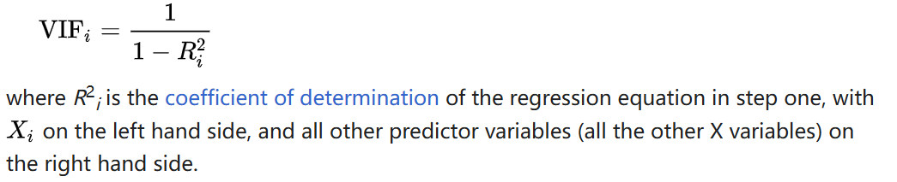
Appendix
Model | ABDOMEN+WEIGHT | ABDOMEN+HEIGHT
VIF value | 4.73 | 1.04
Table 1: VIF values for the 2 factor models

Slide 13
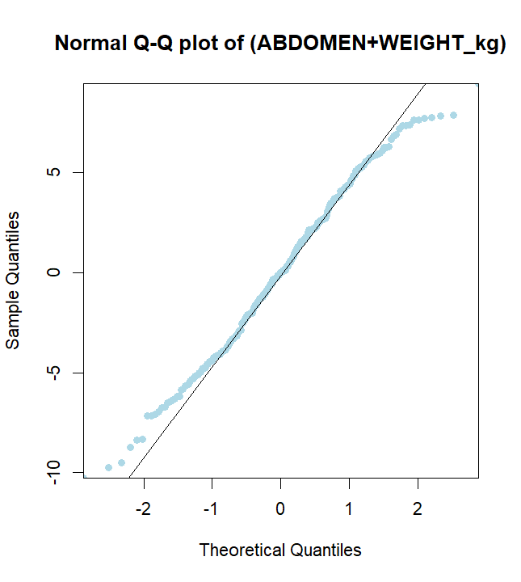
Appendix

