Slide 1
Flight Delays and Cancellations - Trends and Predictions
STAT 628 Module 3 - Group 6
Yifan Zhang, Chenyu Jiang, Amy Merkelz

Slide 2
Motivation
Background: During the holiday season, the number of flights increases significantly, but then there are even more weather extremes that can exist in the winter.
Problem: Airline delays and cancellations cause a great inconvenience to passengers.
Goal: Determine a model that can help the passengers recognize important patterns in flight delays and cancellations to:
Avoid canceled flights
Arrive early or on time
Predict the gate arrival time

Slide 3
Initial Datasets
Flight Data:
Provided by the Bureau of Transportation Statistics
Flights in Nov., Dec., Jan. from 2018 - 2024, excluding Nov. 2020 - Jan. 2021 due to Covid-19
Considered only flights from the top 100 airports by 2023 passenger volume, plus Madison
Weather Data:
Provided by the National Centers for Environmental Information (NCEI)
Match the nearest weather station for each airport and obtained hourly weather data

Slide 4
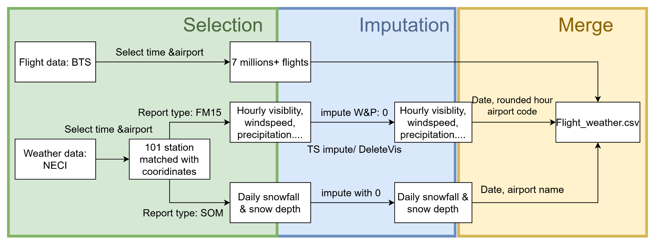
Data Processing

Slide 5
Final Cleaned Dataset
Includes over 7 million flight records with corresponding weather data
Have 66 parameters
Total 10 airlines
Cancellation rate: 1.88%
Late arrivals rate: 34%

Slide 6
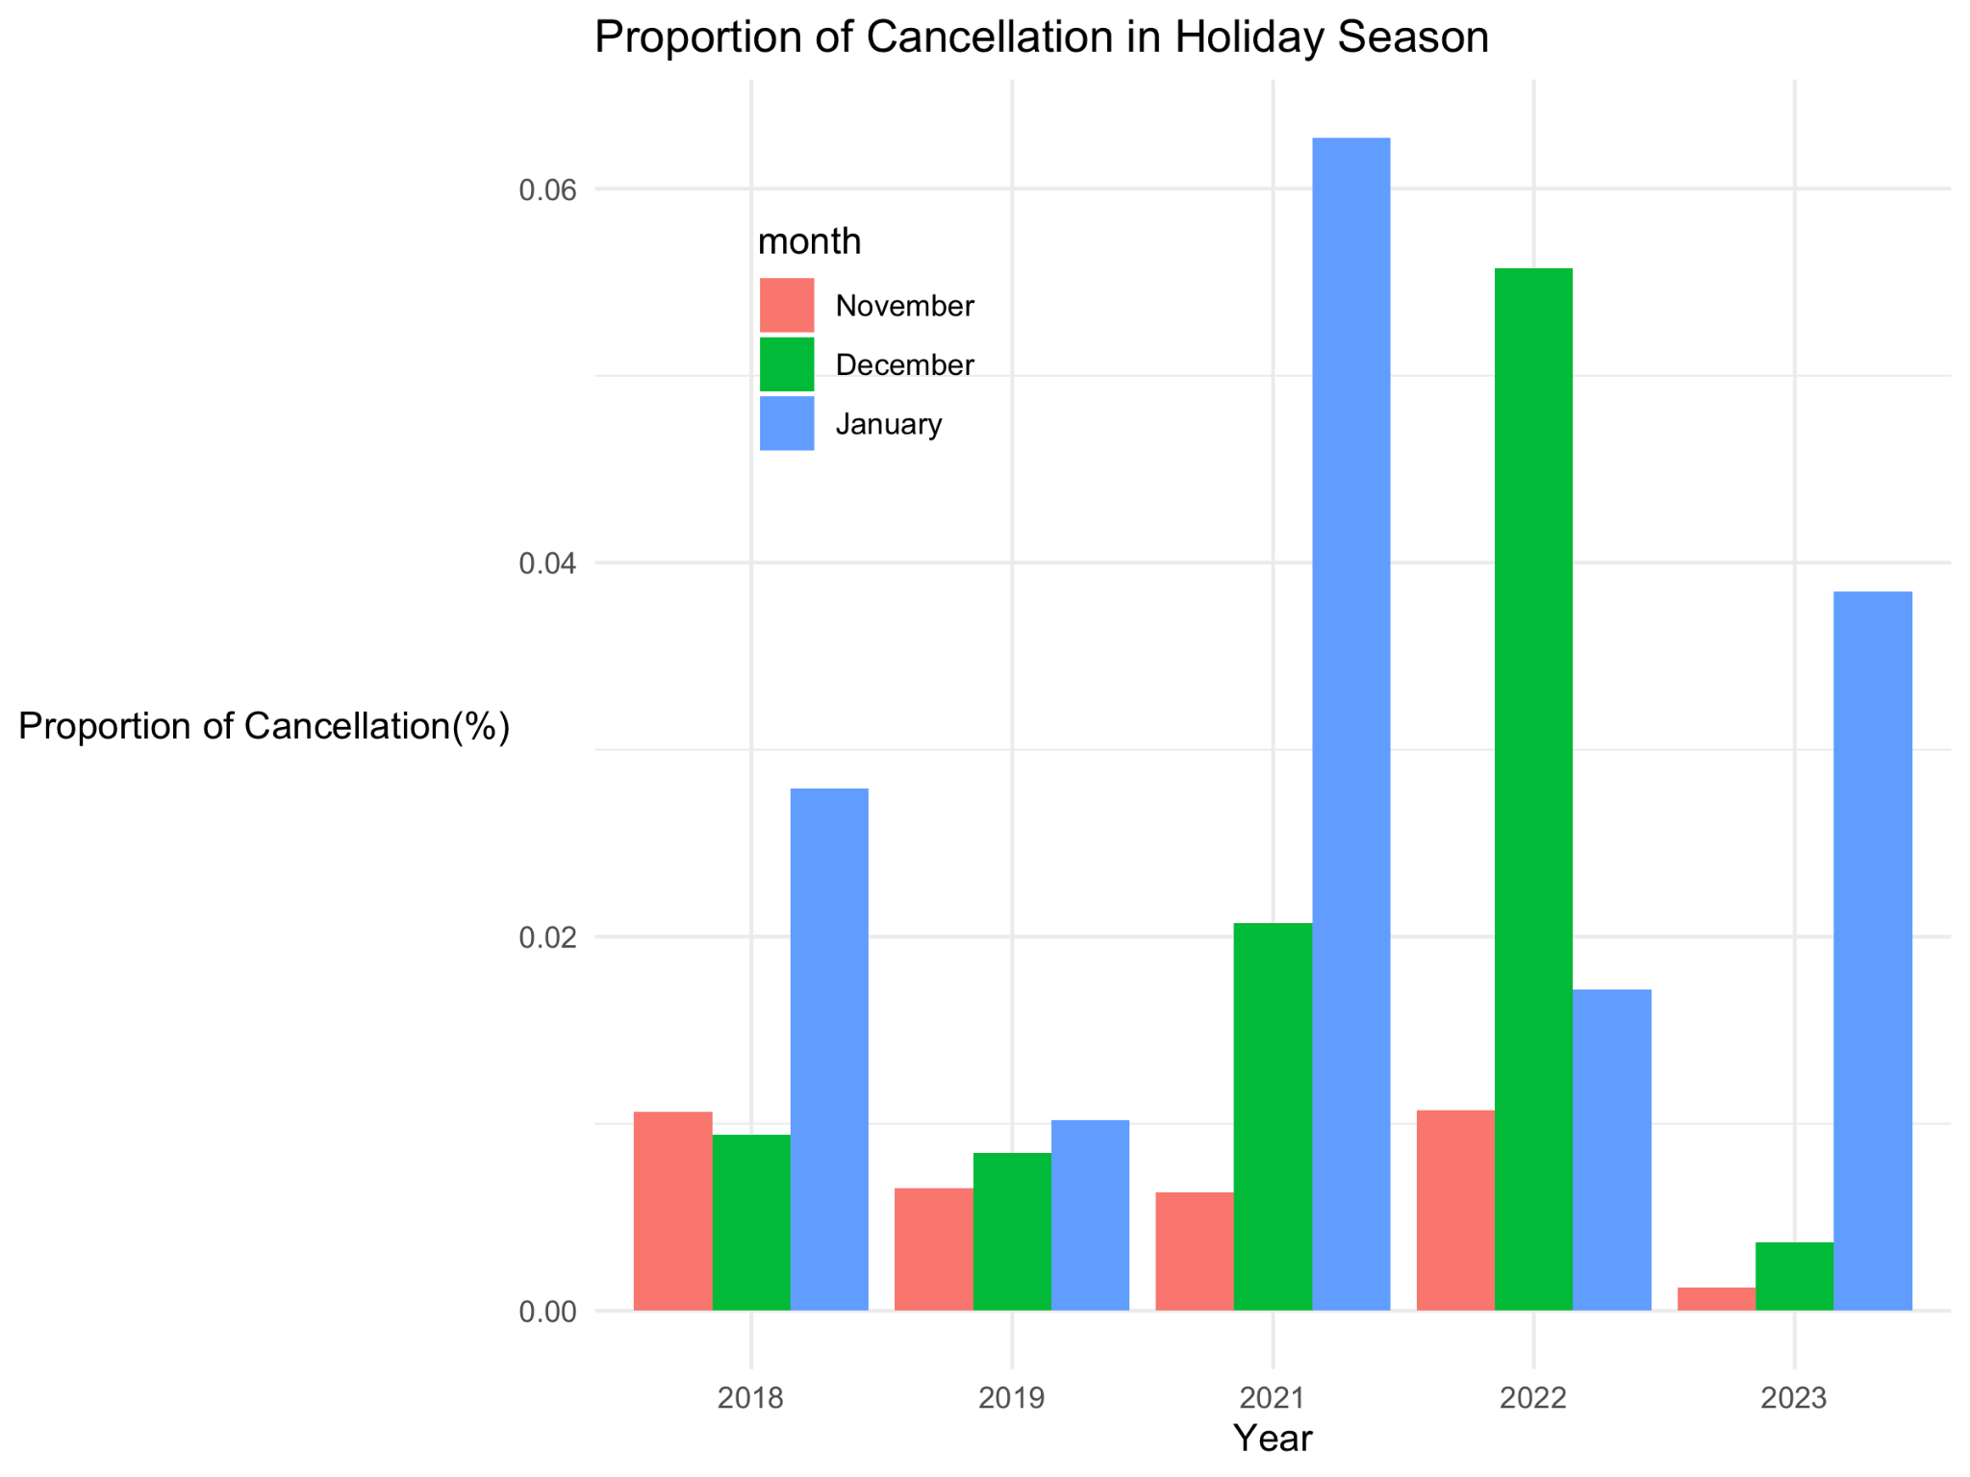
Observations
We could see the high cancellation rate in January for most years.

Slide 7
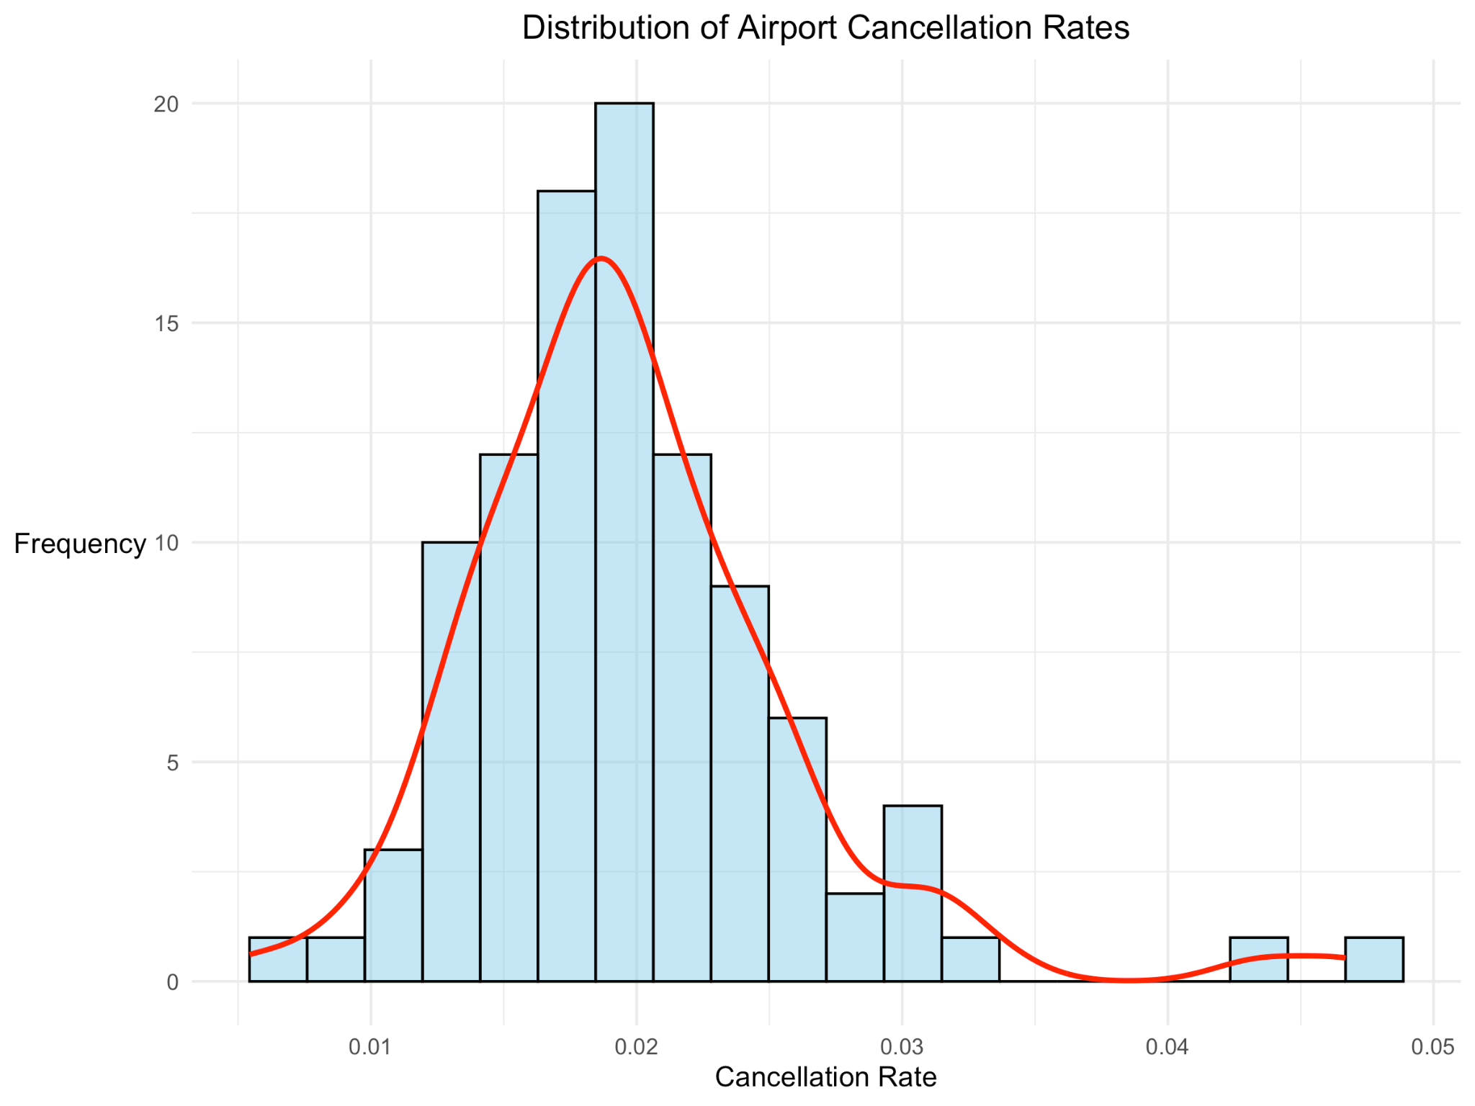
Observations
Two outliers for cancellation rate
Midway: a Southwest Airlines hub that was disproportionately impacted by the 2022 meltdown
Buffalo: the major airport for upstate NY, with an average yearly snowfall of 68.8 inches
MDW
BUF

Slide 8
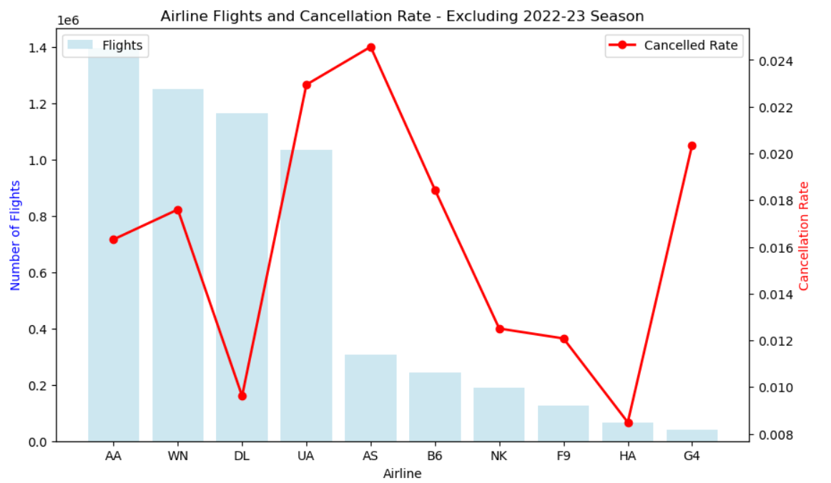
Observations
Cancellation rate over all flights (excluding 2022-23): 1.66%
United Airlines has the highest cancellation rate (2.2%) of the 4 major airlines.
Delta has the least cancellations of the 4 major airlines (0.9%)
Delta also has the shortest average delay as well.

Slide 9
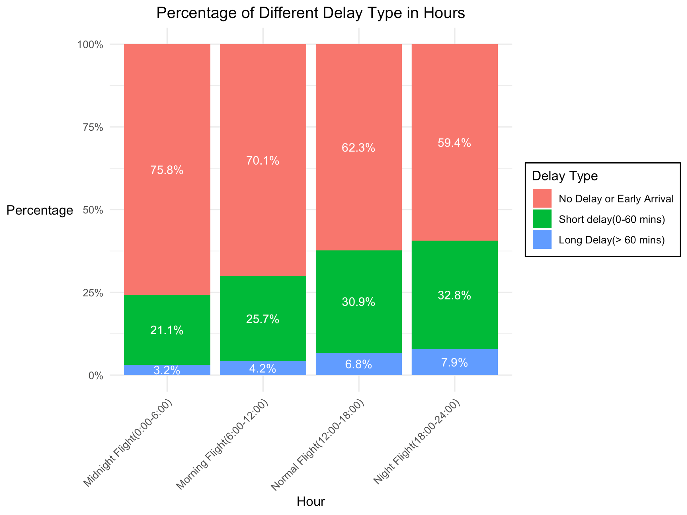
Observations
Flights departing after 6 pm have the lowest percentage of on time arrivals.
Early morning flights departing before 6 am have lowest percentage of delayed flights.

Slide 10
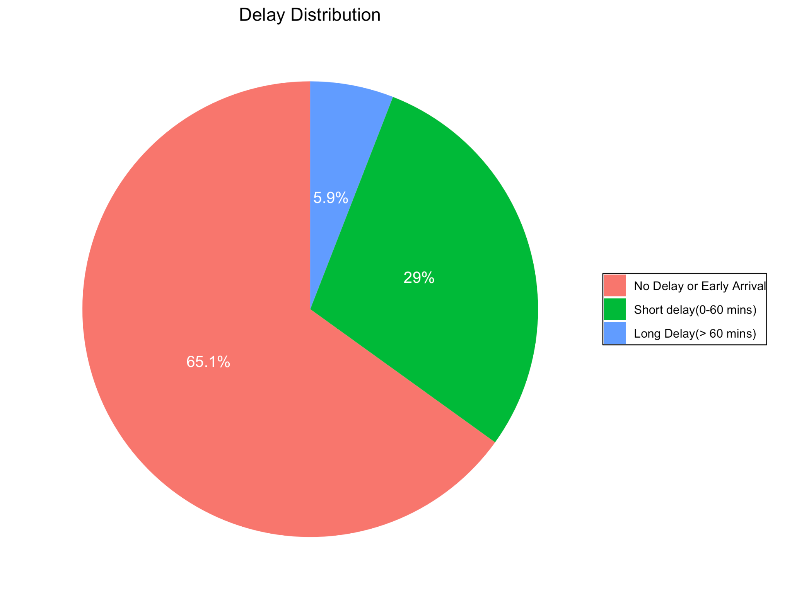
Observations
Most flights are on time or have less than 1 hour delay.

Slide 11
Recommendations
To avoid having a cancelled flight:
Avoid traveling through airports with high cancellation rates (e.g., Buffalo) when possible.
Avoid traveling in January, which has higher cancellation rates than November or December.
Fly Delta! Lowest cancellation rate of the 4 major airlines.
To arrive on time:
Try to have 60+ minutes between flights, to avoid delays causing a missed connection.
Avoid evening flights- only 59.4% are early or on time. Instead, take flights that depart before 6 am.
Fly Delta! Lowest average arrival delay (< 1 minute).

Slide 12
Model Selection
Logistic Regression for both model: Simplicity, interpretability and computational complexity.
Undersampling on both datasets to balance the dataset to a 1:1 or 1:1:1 ratio.
Training :testing=8:2.
Compared with other models( Decision Tree, Random forest…)
Evaluated by accuracy and F1-score.

Slide 13
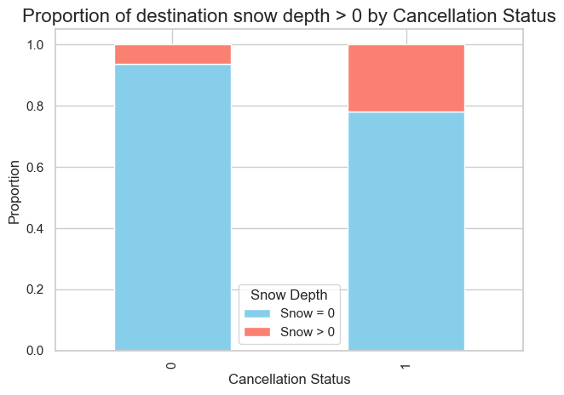
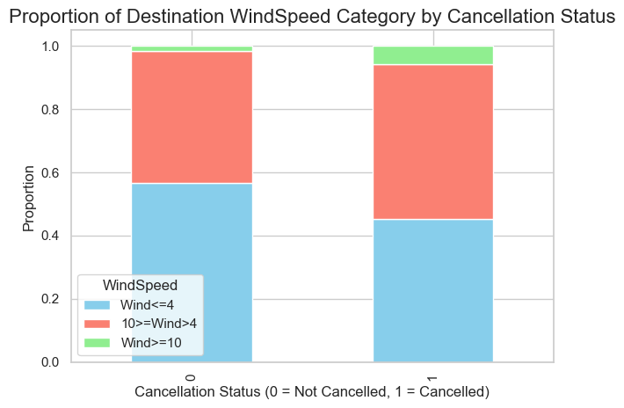
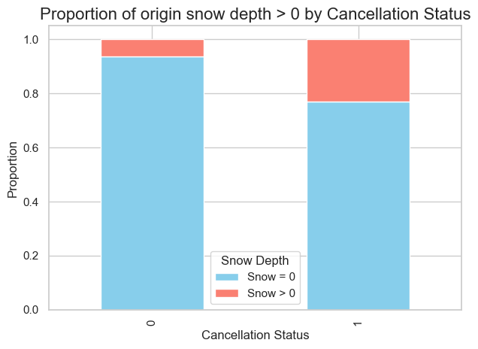
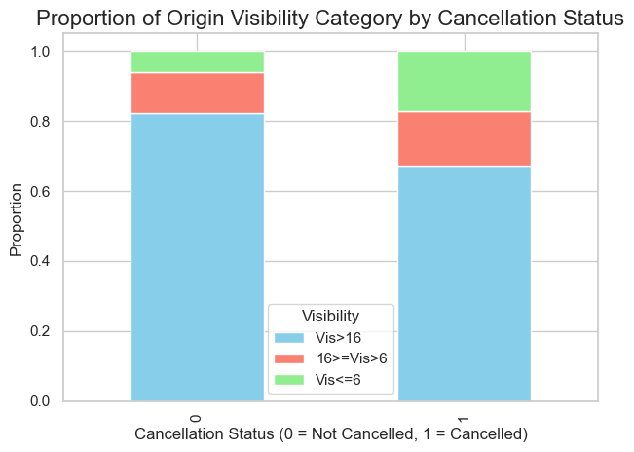
Model Selection
Focused on weather-related cancellations.
Binary classification model:canceled (1) or not canceled (0).
5 features: month, visibility at origin airport, wind speed at destination, daily snow depth at origin and destination.
A greater proportion of flights are cancelled when there is snow on the ground at origin & destination

Slide 14
Model Selection
Cancellation Model
Model | Accuracy | F1 Score | Number of Parameters
Logistic Regression | 0.753 | 0.757 | 5
Decision Tree | 0.762 | 0.762 | 5

Slide 15
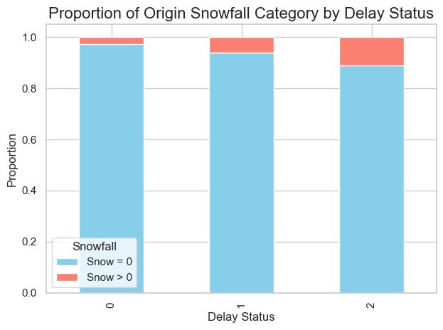
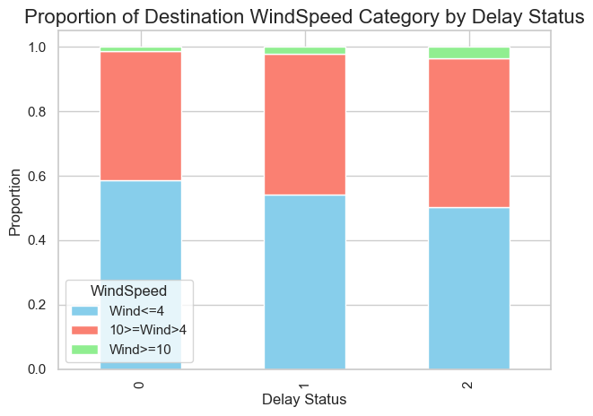
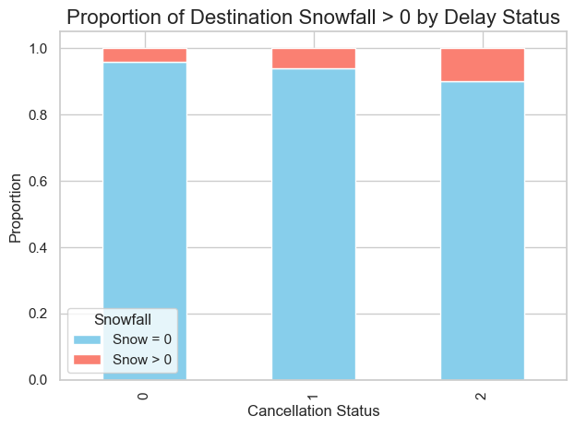
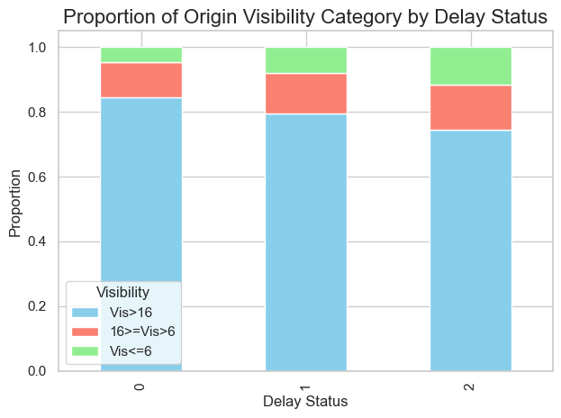
Model Selection
Three-class classification model:
more realistic and better captures the different levels of delay:
0:on time or early , no need to worry
1:<1 hour delay , need to hurry
2:>1 hour delay , require rescheduling
might be more helpful for passengers.
6 features: month, schedule departure hour, visibility at origin airport, wind speed at destination, daily snowfall at origin and destination.

Slide 16
Model Selection
Delay Model
Model | Accuracy | F1 Score | Number of Parameters
Logistic Regression | 0.412 | 0.395 | 6
Decision Tree | 0.420 | 0.411 | 6
Random Forest | 0.417 | 0.403 | 6
Gradient Boosting | 0.413 | 0.386 | 6

Slide 17
Model Strengths and Weaknesses
Strengths:
Both models use few features - easy to build a user-friendly tool to predict flight delay/cancellation.
Logistic regression models are interpretable - easy to understand how each feature influences the prediction
Weaknesses:
Limited dataset: Only considered 101 airports out of ~1000 airports
Unimportance of airline in final models, despite seeing trends in exploratory data analysis
Possible confounders: an airline’s ‘hub’ locations and typical snowfall there

Slide 18
Shiny App Demo
https://amerkelz.shinyapps.io/628_module3_group6/
(if the app does not load quickly, try pausing and refreshing the page)

Slide 19
References
Choi, S., Kim, Y. J., Briceno, S., & Mavris, D. (2016). Prediction of weather-induced airline delays based on machine learning algorithms. 2016 IEEE/AIAA 35th Digital Avionics Systems Conference (DASC). https://doi.org/10.1109/dasc.2016.7777956
Travelmag. (2024, June 26). The biggest 100 US airports by passenger traffic - Travelmag. Travelmag. https://www.travelmag.com/articles/biggest-us-airports/#google_vignette
Kim S, Park E. Prediction of flight departure delays caused by weather conditions adopting data-driven approaches[J]. Journal of Big Data, 2024, 11(1): 11.
Kiliç K, Sallan J M. Study of delay prediction in the US airport network[J]. Aerospace, 2023, 10(4): 342.
Giblin, P. (2023, January 19). WIVT - News 34. WIVT - News 34.. www.binghamtonhomepage.com/news/the-snowiest-cities-in-the-u-s/

Slide 20
Thank you!

Slide 21
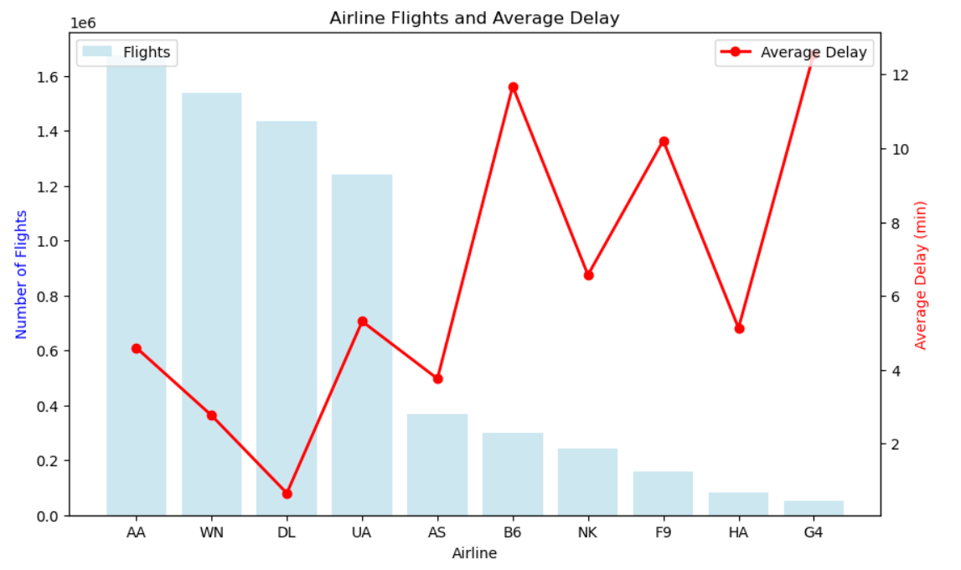
Appendix: Airline Delay Rates

