Slide 1
Azure Backup Service
Diana Gonzalez

Slide 2
Overview
Azure Backup Service Overview
Key Benefits of using Azure Backup
About SQL Server Backup in Azure VMs
Prerequisites for SQL Server Backup
DEMO

Slide 3

Azure Backup Service
Cloud-First Approach
Notes:
With the recent major shifts in IT infrastructure we are seeing companies become more open to evaluating alternative backup solutions that offer significant values tied to the infrastructure shift. In the 2000s we saw virtualization infrastructure which allowed companies to significantly reduce their IT costs with the consolidation and portability benefits offered by virtualization. This allowed new backup players to emerge and the ones that delivered significant value ties to virtualization became successful. Now the new inflection is the shift to the public cloud and azure backup service has taken a cloud-first approach to deliver maximum value for backup scenarios in a cloud-transformed IT environment.

Slide 4
Azure Backup Service Overview
On-Premises-backup files,folders.
Azure VMs- backup entire Windows/Linux VMs (using backup extensions)
Azure Files Shares – backup files shares to a storage account
SQL Server databases running in Azure VMs
SAP Hana databases running in Azure VMs
Notes:
-Azure backup service has a built in backup service doesn’t require any infrastructure . Provides simple, secure and cost-effective solutions to backup your data and recover it from Azure Cloud.
-currently you are able to use azure backup service for (read through lists)
Notes:
-something deleted on accident they retain data for up to two weeks
-protects from ransomware
-can enable multi-factor authentication security pin for authorized users
-Monitoring

Slide 5
Benefits of Using Azure Backup Service
Offload On-premise backup
Scale Easily
Unlimited Data Transfer
Keep Data Secure
Centralized Monitoring & Management
App-Consistent Backups
Automatic Storage Management
Notes:
Offload On-Premise Backups, files-
Azure Backup offers a simple solution for backing up your on-premises resources to the cloud. Get short and long-term backup without the need to deploy complex on-premises backup solutions.
Scale Easily:
Azure Backup uses the underlying power and unlimited scale of the Azure cloud to deliver high-availability with no maintenance or monitoring overhead.
Unlimited Data Transfer:
Azure Backup doesn't limit the amount of inbound or outbound data you transfer, or charge for the data that is transferred.
Keep Data Secure:
Azure Backup provides solutions for securing data in transit and at rest.
Centralized Monitoring & Management:
Azure Backup provides built-in monitoring and alerting capabilities in a Recovery Services vault. These capabilities are available without any additional management infrastructure. You can also increase the scale of your monitoring and reporting by using Azure Monitor.
App-Consistent Backups:
An application-consistent backup means a recovery point has all required data to restore the backup copy. Azure Backup provides application-consistent backups, which ensure additional fixes aren't required to restore the data. Restoring application-consistent data reduces the restoration time, allowing you to quickly return to a running state.
Automatic Storage Management:
Azure Backup, there's no cost for using on-premises storage devices. Azure Backup automatically allocates and manages backup storage, and it uses a pay-as-you-use model. So you only pay for the storage you consume. Learn more about pricing.

Slide 6
About SQL Server Backup in Azure VMs
SQL Marketplace Azure VMs and non-Marketplace (SQL Server manually installed) VMs are supported.
SQL 2008 & up supported. This includes Enterprise, Standard, web, dev, express
Workload aware backups that support all backup types – full, differential, and log
15-min RPO with frequent log backups
Point-in-time recovery up to a second
Individual database level backup and restore
Notes:
Azure Backup provides the following advantages specifically for SQL Server:
Read through points..
Support Matrix:
https://docs.microsoft.com/en-us/azure/backup/sql-support-matrix#scenario-support

Slide 7
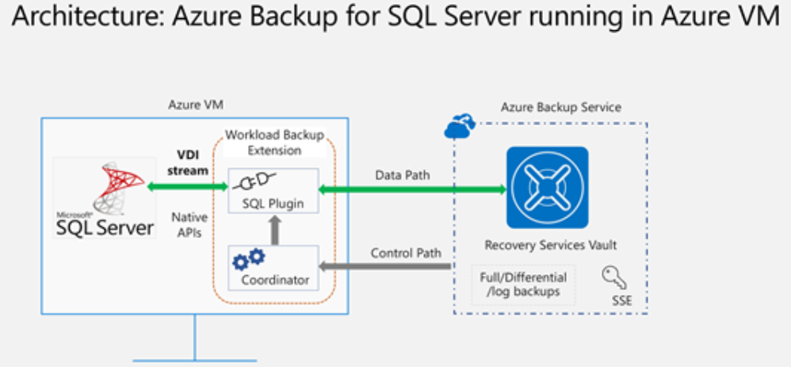
Backup Process
Notes:
Leverages SQL native APIs to take backups of your sql databases:
Once you specify the sql vm you want to protect and query for the databases within it, azure backup service will install a workload backup extension(AzureBackupWindowsWorkload) on the vm.
The extension consists of a coordinator and a SQL plugin.
Coordinator-responsible for triggering workflows for the configure backup, backup and restore operations.
Plugin-is responsible for actual data flow.
Once you trigger configure protection on the selected databases, the backup service sets up the coordinator with the backup schedules and other policy details, which the extension caches locally on the vm.
At the scheduled time the coordinator communicates with the plugin and it starts streaming the backup data from sql server using the VDI.
The plugin sends the data directly to the recover services vault. (this eliminates the need for a staging location). Data is encrypted and stored by azure backup service in storage accounts.
When data transfer is complete, coordinator confirms the commit with the backup service.
Notes:
To be able to discover databases on this VM, Azure Backup creates the account NT SERVICE\AzureWLBackupPluginSvc. This account is used for backup and restore and requires SQL sysadmin permissions. The NT SERVICE\AzureWLBackupPluginSvc account is a Virtual Service Account, and therefore does not require any password management. Azure Backup leverages the NT AUTHORITY\SYSTEM account for database discovery/inquiry, so this account needs to be a public login on SQL. If you didn't create the SQL Server VM from the Azure Marketplace, you might receive an error UserErrorSQLNoSysadminMembership. If this occurs follow these instructions.
https://docs.microsoft.com/en-us/azure/backup/backup-azure-sql-database

Slide 8
Prerequisites
Identify or create a Recovery Services vault in the same region and subscription as the VM hosting the SQL Server instance.
Verify that the VM has network connectivity.
Make sure that the SQL Server databases follow the database naming guidelines for Azure Backup.
Check that you don't have any other backup solutions enabled for the database. Disable all other SQL Server backups before you back up the database.
Notes:
Before you back up a SQL Server database, check the following criteria:
Make sure your RSV in same region
SQL VM requires connectivity to azure public IP addresses to be able to perform the VM backup operations. Establish this by:
Allow the azure datacenter IP ranges
Allow access using NSG tags to allow outbound access to azure backup and use rules for azure AD and azure storage.
Naming Guidelines: eliminate trailing and leading spaces, trailing exclamation marks, closing square brackets, semicolons, forward slash. (has to do with the Table Service Data Model structure and unsupported characters)
https://docs.microsoft.com/en-us/azure/backup/backup-sql-server-database-azure-vms

Slide 9
Demo

