Slide 1
Coursera Capstone Final Project
Amer Nureddin 10 Aug 2020

Slide 2
Introduction
When someone is planning to open a café restaurant in the city of Istanbul, the question is, where would you suggest that they open it? The backdrop to the issue is that in order for a café to be competitive, there must be enough customers and it is not worth opening up a café in the immediate proximity of existing ones to have enough customers.
Let us also make sure that the audience is clearly identified as Istanbul's local restaurant businessmen and they should be concerned about this problem as the position of the new café has a big effect on the planned returns.

Slide 3
Data
Data description: Geolocation data obtained from FourSquare is the data used to solve this problem. Adequate description and summary of the results is as follows, with illustrations. Data is a single data frame which includes at least one café location. The positioning data is described as a regular tuple (lat, lng), where lat stands for latitude and lng for longitude.
This also gathers some other metadata such as name, postal code and so on, but let us discuss that they are not relevant for the study. following table shows example of data used in the analysis.

Slide 4
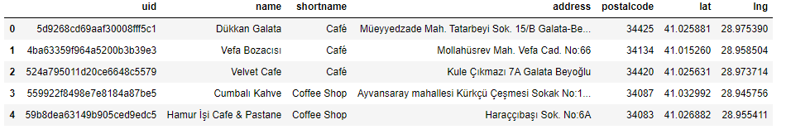
Five first rows of data used in the machine learning algorithm.

Slide 5
Data can be used as follows: by understanding where already existing cafes are located, it is possible to use unsupervised learning techniques such as kernel density estimation (KDE) to assess the area of influence of existing cafes and to launch new cafés that are not in the area of influence.

Slide 6
Methodology
Estimation of kernel density based on heatmap was employed. Heatmap has already been deployed as a Folium plugin and was used to visualize mapping data. Visualization as shown in the following figure.

Slide 7
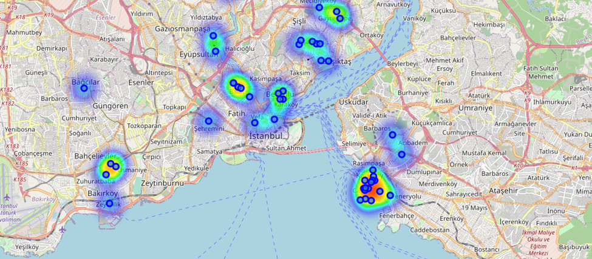
The Data visualized to the map of Istanbul, including heatmap-based kernel density estimation

Slide 8
Results
Based on the preliminary results, on the seaside of Kdikoy area, as seen in the following figure, could be a good place for the new Cafe.

Slide 9
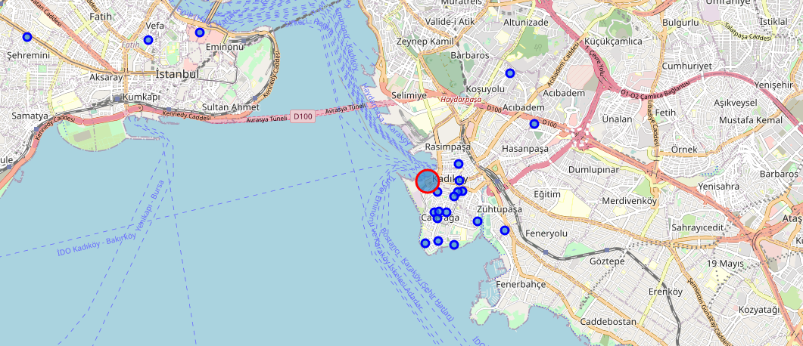
Proposed site for a new café restaurant.

Slide 10
Discussion
Some more data analysis of the optimum position of the shop may be needed before starting the business. Because choosing the best location is a crucial factor for the success of the business.

Slide 11
Conclusion
Based on data from FourSquare, optimal location for a new coffee shop in central Istanbul was estimated.

