Slide 1
All Pakistan Marble Industries Association

Slide 2
Background
Most Deposit along Border areas
Lack of Socio Economic Conditions
No organize Business activity
Industrialization was never taken seriously
Lack of Education Facilities
No body identified the potential of the areas which is full of mineral resources and particularly dimensional stone.

Slide 3
Potential of Pakistan
  More than 200 types of Marble & Granite
  More than 1225 Operational Quarries
More than 4000 processing Units
  Over 300 billion tons (estimated) reserves

Slide 4
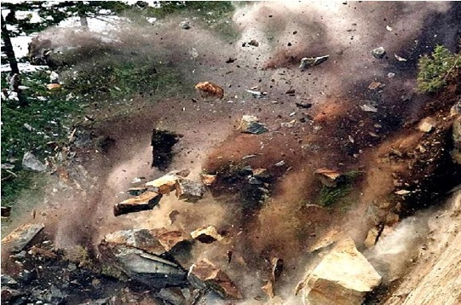
Marble Quarrying by Blasting -85 % Wastage

Slide 5
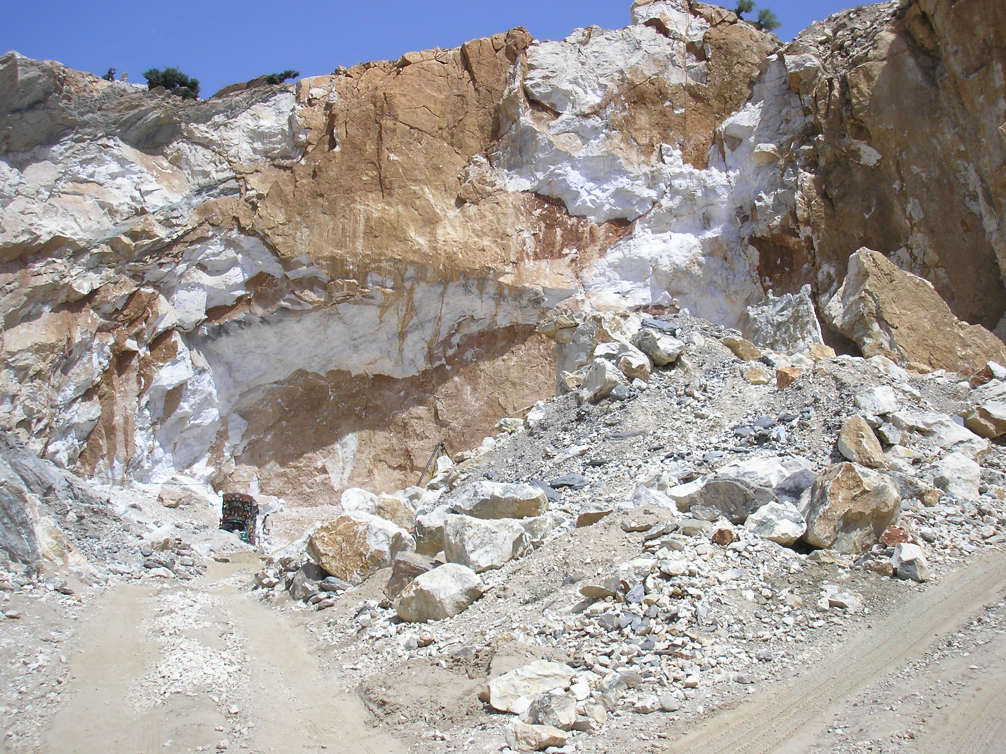
85% Wastage

Slide 6
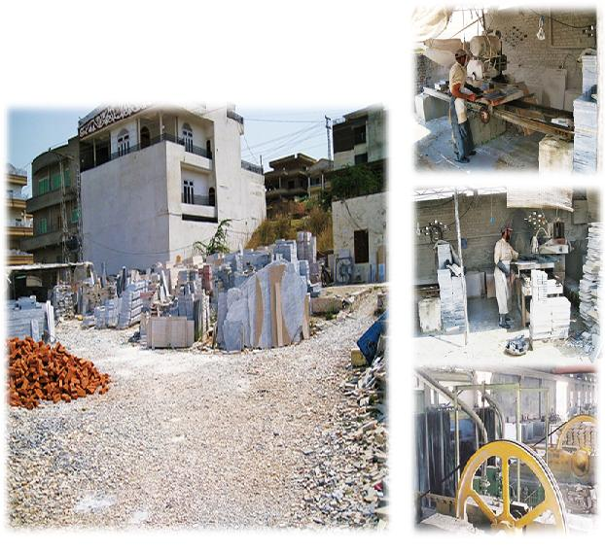
Old Methods of Processing- 85% Wastage

Slide 7
International Standards

Slide 8
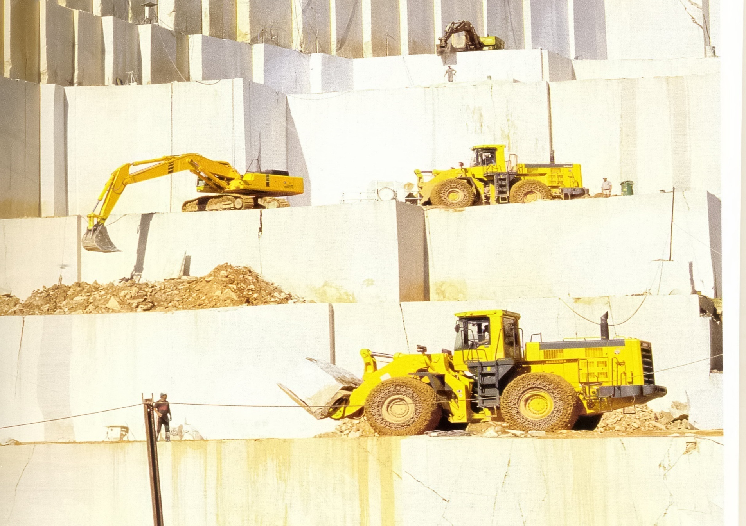
International Quarrying Practices

Slide 9
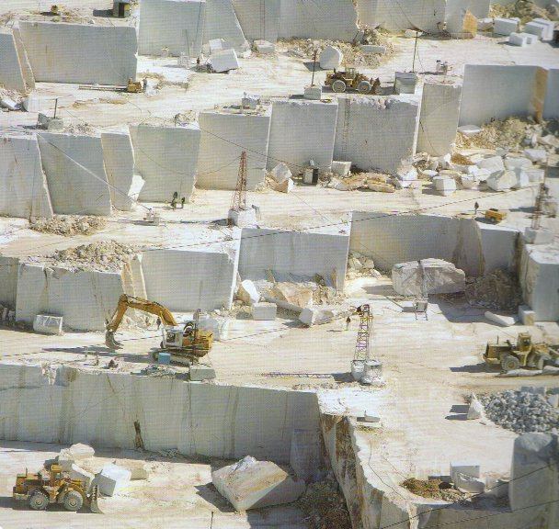
International Quarrying Practices

Slide 10
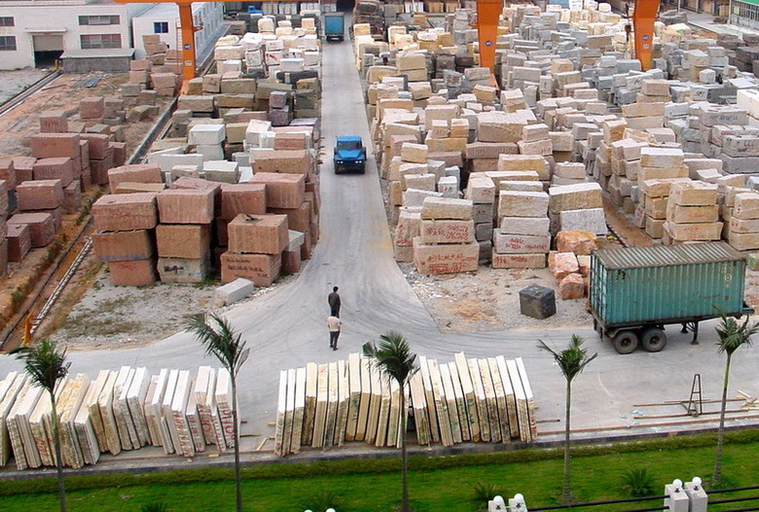
Supply Management Warehouse
Supply Management Warehouse

Slide 11
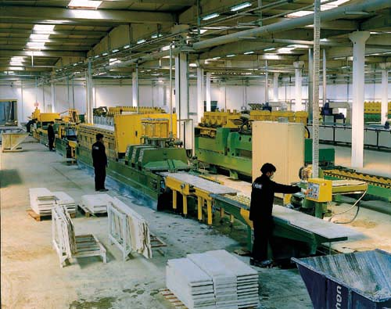
International Processing Unit

Slide 12
Province Wise Potential
ITS TIME TO TAPE POTENTIAL OF AREA

Slide 13
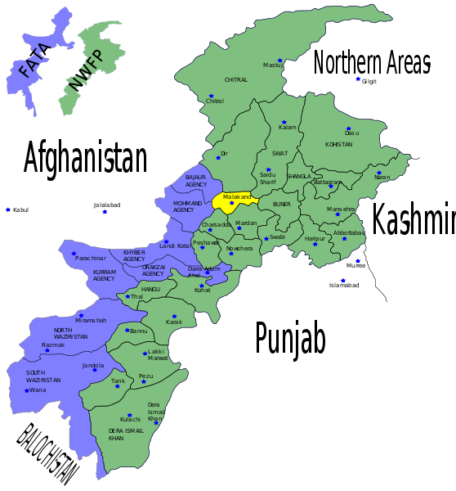

KPK & FATA MAP
KPK & FATA MAP
Marble & Granite Potential Areas
Existing Cluster
Summary
Summary

Slide 14
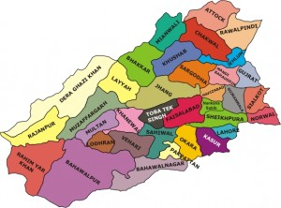
Map of Punjab
Marble & Granite Potential Areas
Existing Cluster
Summary

Slide 15
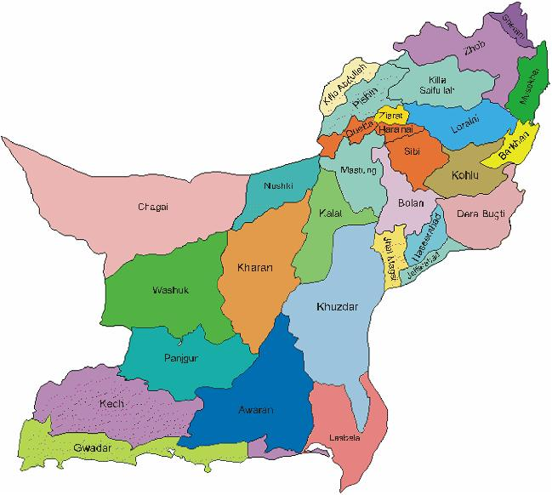
District Map Baluchistan
Marble & Granite Potential Areas
Existing Cluster
Summary

Slide 16
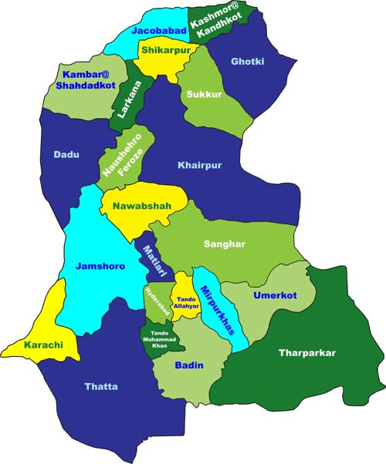
Map of Sindh
Marble & Granite Potential Areas
Existing Cluster
Summary

Slide 17
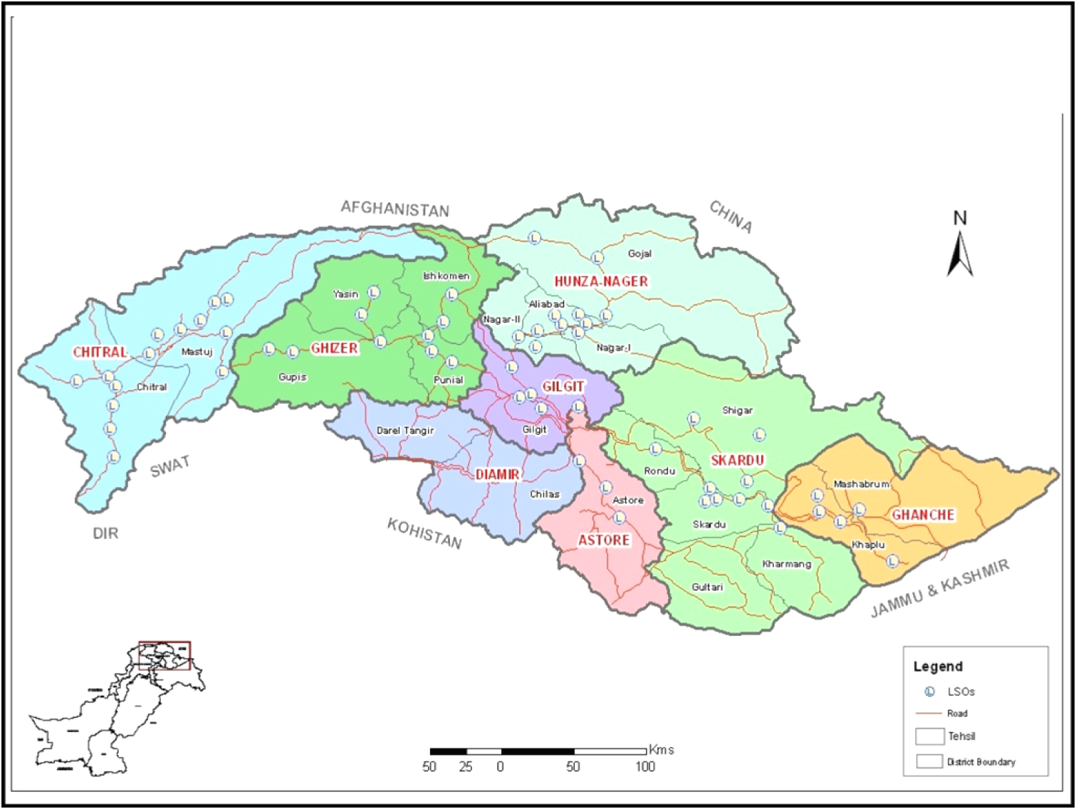
Gilgit Baltistan Map
Gilgit Baltistan Map
Marble & Granite Potential Areas
Existing Cluster
Out of Box Solution
Summary

Slide 18
SWOT Analysis
Strength | Weakness
-80% Marble & Granite Reserves -Population -Already in Marble Business -High Value Marble Deposits High Local Demand High International Demand | -M& G Bearing Areas are underdeveloped -Unemployment -Lack of Economic Activity -Lack of education Faculties -Non existence of Skilled Labor -No Business Environment -Electricity Shortage -Lack of Infrastructure
Opportunities | Threats
-China is the Biggest importer of M& G -Fast Mine to Market Transportation -Easy Assess to Chinese Markets -Investment Opportunities from world -Development of New Clusters -Industrialization in remote areas -Socio-Economic Development -Environmental Up gradation -Link to Mainland -Community development | -Law and Order Situation -Insurgency -Depletion of Resources -Continued Alienation to International market -Loss of Value able foreign exchange

Slide 19
Potential of Some Areas

Slide 20
District Wise Potential of GB
District | Area (km²) | Population (1998) | Most Potential
Ghanche | 6,400 | 88,366 | Marble & Granite
Skardu | 15,000 | 214,848 | Marble & Granite
Astore | 8,657 | 71,666 | Marble & Granite
Diamer | 10,936 | 131,925 | Marble & Granite
Ghizer | 9,635 | 120,218 | Marble & Granite
Gilgit | 1155 | 243,324 | Marble & Granite
Hunza–Nagar | 25,145 | 165,355 | Marble & Granite
Gilgit Baltistan | 72971 | 1,800,000

Slide 21
Gilgit /Baltistan
Marble Potential (million tons) | 2000
Granite Potential (million tons) | 2000
Population | 1800000
No of Quarries | 2
No of Processing units | 1
Existing Employment | 225

Slide 22
Chitral -KPK
Marble Potential (million tons) | 180
Granite Potential (million tons) | 200
Population | 318689
No of Quarries | 18
No of Processing units | 12
Existing Employment | 750

Slide 23
SWAT -KPK
Marble Potential (million tons) | 300
Granite Potential (million tons) | 2ooo
Population | 1257602
No of Quarries | 3
No of Processing units | 25
Existing Employment | 1250

Slide 24
Buner -KPK
Marble Potential (million tons) | 1700
Granite Potential (million tons) | 1500
Population | 506048
No of Quarries | 200
No of Processing units | 250
Existing Employment | 22500

Slide 25
Manshera/Abbotabad/Hazara -KPK
Marble Potential (million tons) | 400
Granite Potential (million tons) | 1600
Population | 1152839
No of Quarries | 20
No of Processing units | 50
Existing Employment | 3500

Slide 26
Mardan -KPK
Marble Potential (million tons) | 200
Granite Potential (million tons) | 50
Population | 1460100
No of Quarries | 20
No of Processing units | 300
Existing Employment | 16000

Slide 27
Peshawar -KPK
Marble Potential | -
Granite Potential | -
Population
No of Quarries | -
No of Processing units | 120
Existing Employment | 6000

Slide 28
Sawabi -KPK
Marble Potential (million tons) | 500
Granite Potential (million tons)
Population
No of Quarries | 20
No of Processing units | 30
Existing Employment | 2500

Slide 29
Cherat -KPK
Marble Potential (million tons) | 400
Granite Potential (million tons)
Population | 874373
No of Quarries | 2
No of Processing units | 45
Existing Employment | 3500

Slide 30
DIR -KPK
Marble Potential (million tons) | 200
Granite Potential (million tons) | 2200
Population | 575858
No of Quarries | 4
No of Processing units | 25
Existing Employment | 1450

Slide 31
Malakand -KPK
Marble Potential (million tons) | 500
Granite Potential (million tons) | 1000
Population | 452291
No of Quarries | 2
No of Processing units | 2
Existing Employment | 300

Slide 32
Shangala -KPK
Marble Potential/Surpentinite (million tons) | 300
Granite Potential (million tons) | -
Population | 434563
No of Quarries | 4
No of Processing units | -
Existing Employment | 200

Slide 33
Mohamand Agency FATA
Marble Potential (million tons) | 2000
Granite Potential (million tons) | -
Population | 334453
No of Quarries | 400
No of Processing units | 700
Existing Employment | 55000

Slide 34
Bajore Agency -FATA
Marble Potential (million tons) | 500
Granite Potential (million tons) | -
Population | 595227
No of Quarries | 10
No of Processing units | 50
Existing Employment | 3000

Slide 35
Khyber Agency -FATA
Marble Potential (million tons) | 1000
Granite Potential (million tons) | -
Population | 546730
No of Quarries | 10
No of Processing units | 325
Existing Employment | 16750

Slide 36
South Waziristan /North Waziristan
Marble Potential (million tons) | 300
Granite Potential (million tons) | -
Population | 664924
No of Quarries | 2
No of Processing units | 2
Existing Employment | 50

Slide 37
Khuzdar –Baluchistan
Marble Potential (million tons) | 100
Granite Potential (million tons) | -
Population | 417466
No of Quarries | 200
No of Processing units | 30
Existing Employment | 11500

Slide 38
Loralai/Duki–Baluchistan
Marble Potential (million tons) | 4500
Granite Potential (million tons) | -
Population | 297555
No of Quarries | 10
No of Processing units | 25
Existing Employment | 1750

Slide 39
Lasbella/Winder–Baluchistan
Marble Potential (million tons) | 50000
Granite Potential (million tons) | -
Population | 312695
No of Quarries | 100
No of Processing units | 100
Existing Employment | 3000

Slide 40
Quetta –Baluchistan
Marble Potential (million tons) | 30000
Granite Potential (million tons) | -
Population | 769941
No of Quarries | 10
No of Processing units | 40
Existing Employment | 2500

Slide 41
Mastung-Balochistan
Marble Potential (million tons) | 300
Granite Potential (million tons) | -
Population | 179784
No of Quarries | 10
No of Processing units
Existing Employment | 500

Slide 42
Noshki/Gidder,Sor Kach, Babri–Baluchistan
Marble Potential (million tons) | 13000
Granite Potential (million tons) | -
Population
No of Quarries | 30
No of Processing units | 5
Existing Employment | 1750

Slide 43
Chaghai- Baluchistan
Onyx Potential (million tons) | 2000
Granite Potential (million tons) | -
Population | 202564
No of Quarries | 40
No of Processing units | 10
Existing Employment | 2500

Slide 44
Karachi -Sindh
Marble Potential (million tons)
Granite Potential (million tons) | -
Population | 21,000,000
No of Quarries
No of Processing units | 1000
Existing Employment | 50000

Slide 45
Thatta /Dadu-Sindh
Marble Potential (million tons) | 300
Granite Potential (million tons) | -
Population | 2802005
No of Quarries | 20
No of Processing units | 5
Existing Employment | 1250

Slide 46
Nagarparkar -Sindh
Marble Potential (million tons) | 10000
Granite Potential (million tons) | -
Population | 914291
No of Quarries | 2
No of Processing units | -
Existing Employment | 100

Slide 47
Khushab /Mianwali -Sindh
Marble Potential (million tons) | 300
Granite Potential (million tons) | -
Population | 1962331
No of Quarries | 5
No of Processing units | 5
Existing Employment | 500

Slide 48
Lahore -Punjab
Marble Potential (million tons) | -
Granite Potential (million tons) | -
Population | 6318745
No of Quarries | -
No of Processing units | 400
Existing Employment | 20000

Slide 49
Rawalpindi -Punjab
Marble Potential (million tons) | -
Granite Potential (million tons) | -
Population | 3363911
No of Quarries | -
No of Processing units | 400
Existing Employment | 20000

Slide 50
Gujaranwala -Punjab
Marble Potential (million tons) | -
Granite Potential (million tons) | -
Population | 3400940
No of Quarries | -
No of Processing units | 150
Existing Employment | 7500

Slide 51
Sahiwal -Punjab
Marble Potential (million tons) | -
Granite Potential (million tons) | -
Population | 1843194
No of Quarries | -
No of Processing units | 50
Existing Employment | 2005

Slide 52
Multan -Punjab
Marble Potential (million tons) | -
Granite Potential (million tons) | -
Population | 31168851
No of Quarries | -
No of Processing units | 150
Existing Employment | 5000

Slide 53
DG khan -Punjab
Marble Potential (million tons) | 10
Granite Potential (million tons) | -
Population | 1643118
No of Quarries | -
No of Processing units | 5
Existing Employment | 250

Slide 54
Attock -Punjab
Marble Potential (million tons) | -
Granite Potential (million tons) | -
Population | 1274935
No of Quarries | -
No of Processing units | 30
Existing Employment | 900

Slide 55
Faisal -Punjab
Marble Potential (million tons) | -
Granite Potential (million tons) | -
Population | 3000000
No of Quarries | -
No of Processing units | 100
Existing Employment | 5000

Slide 56
Reason for Special procedure
FATA &PATA Exempted from Tax
Un organized sector
Huge improvement in last couples of years
Around 20% growth in Export for last 8 years
Sector has moved from unorganized to semi organized
Potential of Pakistan on surface

Slide 57
        Reason for Special procedure
Impact in most backward areas
Local raw material based industry
Baluchistan Exempted/ no go area
No go area in some part of Karachi
Non traditional Sector
GST Collected by govt. is negative

Slide 58
Settle area vs. Tribal/B area
S.no | Tax | Settle Area | Tribal /B areas
1 | Electricity | Full Bill | No Bill/Fix Bill
2 | Income Tax | Yes | No
3 | Social security | Yes | No
4 | Old age benefits | Yes | No
5 | Labor Department | Yes | No
6 | Labor | Expensive | Cheap
7 | Access to mine | Difficult | Easy
8 | Raw mat.Selection | Risk | Easy
9 | Carriage | High | Low
10 | Cost of living | High | Low

Slide 59
Settle area vs. Tribal/B area
Fundamental right of equality
Equality in Taxation
Equal business opportunity
Free market economy
Right of fair competition

Slide 60
Cost Analysis
      Input
Electricity 35% ………………………….GST paid
Consumable 10%........................... GST Paid
Raw material 35%...... ....can not be claimed
Profit 10% …………………………………income Tax
Labor & mis. . 10% ………………………Social Security

Slide 61
Out of Box Solution
  Electricity Bill Example
Factory Total Electricity Bill 300921
Sale tax paid 39105
Other taxes 30365
Bill amount after deduction 231451
Total units consumed 14194

Slide 62
Out of Box Solution
If Per Unit increase is ………………………1.25
Average Units consumed is………………14194
GST increase per month………….......17742
Total GST…….. …………………………… .56847
Per year increase…...........................212904

Slide 63
Out of Box Solution
Most bill are between 500 to 50000
Average Units consumed is………………20000
Per consumer increase at avg…………...25000
Factory Register in first year …………...3000
Per month GST increase ………………75000000
Per Year Increase………………………….900 million
Sale tax paid 39105
Other taxes 30365
Bill amount after deduction 231451
Total units consumed 14194

Slide 64
Out of Box Solution
If we consider that no increase in register entity
Total GST increase 900 million
Growth in industry 20%
Next year 1080 million
Five year projection….……..2070million

Slide 65
Win. Win Situation
APMIA
Respect Govt. initiative in areas specially FATA.
Is for incentives in under developed areas .
BUT
Wants to protects its member’s business.
Against de-employment of workers
Smooth relation with government.
Encourage FBR efforts in tax collection

Slide 66
Win. Win Situation
APMIA request is based on ground realities
Wants to increase govt. revenue
Out of box solution
Fair game
No interference of some anti business mindset

Slide 67
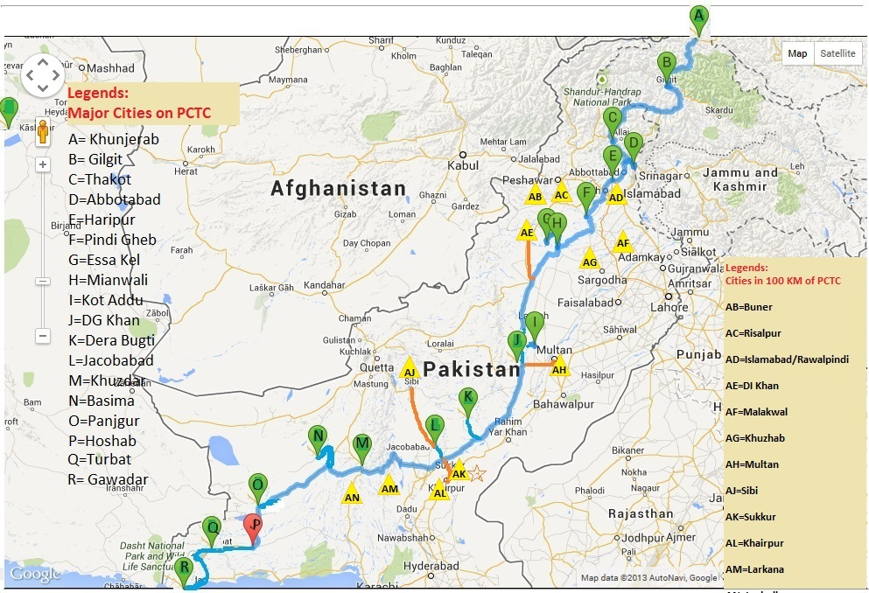
Root Map for PCTC

