Slide 1
cleanTMLE
Software layer for an outcome-blind staged workflow with plasmode DQ stress testing Andrew Mertens

Slide 2
The headline
cleanTMLE is an R package that helps researchers analyse observational health data more carefully. It records every analytic decision before the comparative results are seen, runs realistic simulations to choose between candidate methods, and quietly stress-tests those methods against the kinds of data-quality problems real datasets carry. The point is to make the analysis easier for a reviewer to trust.

Slide 3
What this talk covers
Why this matters. Observational studies have a credibility problem; this is one piece of the fix.
How the package works. A short tour of the workflow, in plain language.
What the simulations told us. Where the methods are reliable, where they need help, and where they should stop.
A real case study. Walking through an analysis of ambulance-transport outcomes in Nairobi.
How this improves on what’s already out there, including comparison with similar packages.
A function-by-function walkthrough is in the appendix.

Slide 4
1. Why this matters

Slide 5
The credibility problem in observational research
When researchers analyse routine health data to estimate the effect of a treatment, they have to make many decisions: who is in the cohort, how to define exposure, which covariates to adjust for, how to handle missing outcomes, and which statistical method to use.
In a typical study, these decisions are written down in three separate documents. A reviewer cannot easily tell whether the chosen method still makes sense once the analyst has seen the data, or what would happen if any of those decisions had been made differently.

Slide 6
Two specific weaknesses
Decisions made after seeing the results. Even with a written analysis plan, problems show up during execution (sparse events, model convergence issues, missingness) that force choices. If those choices are made after the analyst has glimpsed the treatment-outcome association, the analysis is no longer fully prespecified.
Standard diagnostics tell you about design, not about your estimator. Propensity-score overlap, balance, and effective sample size tell you whether the comparison is feasible. They do not tell you whether the specific method you plan to use will produce a reliable answer on your data.

Slide 7
What we want, before we look at the comparative answer
We want to be able to tell a reviewer four things:
The cohort, treatment, outcome, and time horizon were all defined before any comparative analysis.
The method choice was prespecified.
The method was checked against plausible data-quality problems specific to this study.
Every decision and every check was recorded.
cleanTMLE produces a single artefact, a pre-outcome study dossier, that contains all four.

Slide 8
Where the package fits
cleanTMLE is the software layer of a broader idea, sometimes called a “clean room”, in which the analytic team, the data managers, and the reviewers are kept separate and decisions are documented as the analysis unfolds.
The software cannot enforce the institutional side of that arrangement (it cannot stop someone with raw data access from peeking at the outcome). But it can record everything the software side does and make that record auditable.

Slide 9
2. How the package works

Slide 10
A short tour of the workflow
cleanTMLE runs the analysis in stages. Each stage produces a record. The comparative analysis only runs after all the records show that the prespecified checks have been passed.
Set up. Write down the question, the cohort, the outcome, and the time horizon.
Lock the plan. Choose the candidate methods. The plan is fingerprinted so any later change is detectable.
Check the cohort. Are there enough people? Enough events?
Design diagnostics. Does the treatment group look comparable to the comparison group on measured baseline variables?
Compare candidate methods. Run realistic simulations using the real covariate structure but a synthetic outcome to see how each candidate method behaves.
Stress test. Repeat the simulations under realistic data-quality problems (measurement error, missingness, hidden confounders).
Decide. Apply a prespecified rule: GO, FLAG, or STOP.
Run the locked analysis. Only after the previous step authorises it.
Sensitivity analyses and reporting.

Slide 11
The targeted-learning method, in one slide
The package uses a method called TMLE (targeted maximum likelihood estimation). The plain-English idea:
TMLE separates the question (what is the treatment effect?) from the prediction tasks (predicting who got treatment, predicting the outcome).
The prediction tasks can use flexible machine learning. The treatment-effect estimate is then nudged (“targeted”) so that it is properly calibrated for the question, not just for prediction.
The result is a treatment-effect estimate with a standard error and confidence interval you can interpret in the usual way.
For our purposes, the important thing is that every part of the TMLE recipe (which machine-learning models, how the predictions are stabilised, how the targeting step is run) can be written down before the analysis is run.

Slide 12
The pre-outcome study dossier
Component | What it shows
Protocol and target-trial timing | The cohort, treatment, outcome, time zero, follow-up
Cohort flow | Who was eligible, who was excluded, why
Event-process classification | What is an outcome, what is a competing event, what is missingness
Covariate and missingness summary | Baseline characteristics and where data are missing
Overlap and balance | Do the two groups look comparable?
Weight diagnostics | Are the propensity-score weights well-behaved?
Baseline plasmode results | How do the candidate methods perform under a realistic synthetic outcome?
Data-quality stress test | How do they hold up under realistic threats?
Negative controls | Probes for residual confounding
Pre-outcome decision (GO / FLAG / STOP) | The reviewer’s verdict
Decision and audit logs | Everything that happened
The dossier is the document the reviewer reads before authorising the comparative analysis.

Slide 13
The three decision labels
Label | Meaning
GO | Proceed to the locked comparative analysis.
FLAG | Proceed, but document a concern that the report should address.
STOP | Do not run the comparative analysis as planned. Redesign, narrow the question, or document an override.

Slide 14
A GO decision is not a guarantee that the answer is correct. It says: under the assumptions we wrote down, the checks did not fail.

Slide 15
What the software does, and does not, control
The package can:
Record every decision and check.
Refuse to run a comparative analysis until the dossier is complete.
Apply a prespecified GO / FLAG / STOP rule on a common quantitative scale.
The package cannot:
Stop someone with raw-data access from looking at the outcome outside the package.
Validate that an exposure or outcome was measured correctly.
Replace independent review.
These remaining safeguards have to come from the institution running the study.

Slide 16
3. Simulation results

Slide 17
What the simulations are for
We simulated three contrasting scenarios on a small dataset (2,000 people, 200 repetitions each), then ran the same six estimators in each:
Scenario A. Easy: treatment groups overlap well, no hidden confounders.
Scenario B. Harder: groups overlap only partially.
Scenario C. Hardest: there is a hidden confounder the analyst cannot measure.
We also re-ran each scenario under four kinds of data-quality stress: covariate missingness, exposure measurement error, outcome measurement error, and unmeasured confounding.

Slide 18
The six methods, in plain language
Method | What it does
Crude | Compare outcome rates in the two groups; ignore baseline differences.
Propensity-score matching | Pair each treated person with an untreated person who looks similar at baseline.
IPTW (inverse-probability weighting) | Re-weight people so the two groups look balanced on baseline variables, then compare.
TMLE | Use flexible models for who got treatment and who has the outcome, then nudge the estimate so it is properly calibrated for the treatment effect.
CV-TMLE | TMLE with cross-fitting; gives more honest standard errors when the models are flexible.
Matched TMLE | Match first, then run TMLE on the matched subset.

Slide 19
The first three are “traditional” methods. The last three are targeted-learning methods.

Slide 20
Result 1 — under good overlap, everything works
In Scenario A, all the adjusted estimators recover the true effect. Bias is well under the 0.02 threshold we set, and the 95 % confidence intervals cover the truth about 95 % of the time. The unadjusted comparison has substantial leftover confounding.
Reviewer summary: the workflow says GO. This is the benchmark check that the machinery is correctly wired.

Slide 21
Result 2 — under marginal overlap, TMLE holds up; some standard errors don’t
In Scenario B, the harder of the two structural scenarios:
TMLE and cross-validated TMLE keep bias small relative to the spread of the estimates.
Inverse-probability weighting (IPTW) shows confidence intervals that are too wide. The reason is technical (the variance formula assumes the propensity score is known when in fact it was estimated). A bootstrap variance is the standard fix.
Matched TMLE has the same issue, for the same reason. The standard error roughly doubles the actual spread of the estimates.
Reviewer summary: the workflow says GO with a FLAG noting that IPTW and matched-TMLE confidence intervals need a bootstrap variance before they are reported as primary.

Slide 22
Result 3 — under unmeasured confounding, the workflow correctly stops
In Scenario C, where there is a confounder the analyst cannot measure:
Every estimator is biased in the same direction. TMLE is the least biased, but it is still biased.
The baseline plasmode coverage sits at the lower edge of the acceptable range; what makes the failure unambiguous is the unmeasured-confounder stress-test row, where bias exceeds the prespecified threshold.
Reviewer summary: the workflow says STOP. The locked analysis should not be run as planned; the study needs redesign, a narrower question, additional validation, or a documented override.
The takeaway is not that the software “detects” hidden confounding (it cannot). The takeaway is that the prespecified rule was willing to return STOP when a built-in identification failure was present — which is what we want.

Slide 23
Result 4 — the stress test is most useful for identification and measurement, not for variance
The four kinds of stress behaved differently:
Covariate missingness produced a flat gradient — the workflow handles MCAR + median imputation correctly, but this is a weak test (MAR / MNAR variants are on the 0.2 roadmap).
Exposure measurement error attenuated the estimate toward “no effect”, as expected.
Outcome measurement error produced the largest bias of the three measurement threats, especially when error rates differed between treatment groups.
Unmeasured confounding produced the largest degradation overall, and was the only threat that pushed RMSE more than 50 % above the baseline plasmode.
Reviewer summary: the data-quality stress test is most informative when the threat targets either how well variables were measured or whether identification holds. It is less informative for ordinary sampling variability, which is already covered by the baseline simulation.

Slide 24
Two operational lessons for any applied user
IPTW standard errors are conservative when the propensity score was estimated. This is a well-known property of the influence-function-based variance. If IPTW is primary, bootstrap the standard error.
Matched-TMLE standard errors are also conservative. The post-match TMLE step ignores the matching draw. A block bootstrap fixes this.

Slide 25
Traditional approach vs the outcome-blind workflow
Scenario | What a traditional analyst would see | What the outcome-blind workflow does
A. Good overlap | PS diagnostics look good; pick a method; report. | Same diagnostics, plus plasmode confirms all candidates behave well. GO.
B. Marginal overlap | PS overlap shows the strain; weights are heavy. An attentive analyst will widen the truncation or switch methods. Many do not. | Plasmode quantifies that IPTW SE/SD ratio runs > 1 and matched-TMLE doubles it. GO with a FLAG explicitly recommending bootstrap variance.
C. Unmeasured confounding | All adjusted estimates agree on a non-null effect. Without an external probe, the analyst would likely proceed and report. | The prespecified unmeasured-confounding row of the DQ stress test pushes bias above the locked threshold. STOP.

Slide 26
The contrast is sharpest in Scenario C: a traditional careful analyst can pass the standard PS diagnostics and still proceed with a biased estimator. The outcome-blind workflow flags the candidate as fragile under a prespecified threat before unblinding.

Slide 27
Method recommendations for colleagues
Situation | Primary recommendation | Why
Good overlap, well-measured covariates | CV-TMLE as primary; report IPTW + PS matching as concordance checks | Robust across all three scenarios; interpretable CIs; doubly robust
Marginal overlap | CV-TMLE as primary; bootstrap the SE if you ever report IPTW or matched TMLE as primary | TMLE bias is well controlled; IPTW/matched SE formulas are too conservative
Heavy truncation needed for positivity | Reconsider the estimand, not just the estimator | Heavy truncation changes the target population from “everyone eligible” to “everyone plausibly treatable”
Suspected unmeasured confounder | Collect it, narrow the question, or accept bounded sensitivity analysis | No statistical method on measured covariates can rescue you

Slide 28
A baseline plasmode before unblinding is cheap and high-information. A DQ stress test is informative when you have specific concerns about measurement, missingness, or unmeasured confounding.

Slide 29
What the simulation does and does not show
Does show: - The candidate-selection machinery recovers the truth on synthetic outcomes when assumptions hold. - TMLE / CV-TMLE bias is well controlled under marginal overlap; IPTW and matched-TMLE SE calibration is not. - When a hidden confounder is built into the data-generating process, the prespecified stress-test row catches the resulting bias and the locked rule returns STOP. - The prespecified rule arrives at the right verdict in all three scenarios without ever inspecting the realised treatment-outcome association.
Does not show: - That the outcome-blind workflow detects an unmeasured confounder a traditional analyst would have missed. The workflow does not “detect” confounders; it scores prespecified threats. - That cleanTMLE delivers a numerical advantage over a careful traditional analysis on the same dataset. The workflow’s value is operational (prespecification, auditability, gating), not a different point estimate. - That the small DGP used here generalises to all RWE settings. The case study exercises real-data behaviour separately.

Slide 30
4. Case study: Rescue.Co, Nairobi

Slide 31
The question
Rescue.Co operates a network of motorcycle-based emergency ambulances in Nairobi. Patients arriving by Rescue.Co versus by other ambulance services were compared on whether they had a “good functional outcome” six months after their injury.
Cohort: 1,693 ambulance arrivals at participating hospitals, 2018–2024.
Treatment: Rescue.Co versus other ambulance services (point exposure at arrival).
Outcome: GOSE > 4 at 6 months (a standard scale of functional recovery).
Missing outcomes: 24.6 % of the cohort.
This is a workflow demonstration on real data; it is not intended as evidence about whether Rescue.Co transport works.

Slide 32
Walking through the dossier
Before any comparative analysis was run:
Cohort flow. From 1,693 eligible patients to 1,277 with a complete 6-month outcome; 615 in the matched subset.
Design diagnostics. Propensity scores were well within the acceptable range. Standardised mean differences were balanced after weighting. Effective sample size retained 78 % of observations.
Baseline plasmode candidate selection. Two candidates (different propensity-score truncation levels) both passed.
Data-quality stress test. A minimax rule selected the candidate that performed best across worst-case threats.
Negative controls. Five negative-control outcomes were planned in the protocol. Three failed an automatic data-cleaning filter and were dropped; the two that remained both passed. The audit log records the drops as a documented limitation.
The prespecified rule returned GO with a documented FLAG about the narrower negative-control panel. The comparative analysis was then run.

Slide 33
What the comparative analysis showed
Method | Target population | N | Risk difference | 95 % CI
Unadjusted comparison | Complete-outcome | 1,277 | 0.037 | (0.003, 0.071)
Propensity-score matching | Matched subset | 615 | 0.027 | (−0.020, 0.074)
IPTW | Full cohort | 1,693 | 0.037 | (0.002, 0.071)
Full-cohort TMLE (primary) | Full cohort | 1,693 | 0.031 | (−0.001, 0.062)
Matched-cohort TMLE | Matched subset | 1,230 | 0.026 | (−0.015, 0.067)
Complete-outcome TMLE with IPCW weights | Full-cohort target | 1,277 | 0.033 | (−0.000, 0.066)

Slide 34
All six methods agree on direction. The prespecified primary estimate (full-cohort TMLE) just crosses zero. The data are consistent with a small, possibly real, possibly null, effect.

Slide 35
Matched vs full cohort: what the gap means
Comparison | Risk difference
PS matching (n = 615) | 0.027
Matched-cohort TMLE (n = 1,230) | 0.026
IPTW, full cohort (n = 1,693) | 0.037
Full-cohort TMLE, primary (n = 1,693) | 0.031

Slide 36
Under standard assumptions (no effect modification by baseline covariates, adequate overlap), the matched and full-cohort estimators target the same marginal treatment effect and should agree in expectation. The 0.005 to 0.011 gap here is most plausibly sampling noise, with the matched confidence intervals roughly 50 % wider because matching throws away controls (which is also an efficiency cost, not a bias signal).
They would target different causal parameters in two specific situations:
Effect modification by baseline covariates. If the Rescue.Co effect were genuinely different in the overlap subset than in the full cohort, the two estimators would converge to different numbers in expectation.
Positivity strain. If propensity scores for some patients were near 0 or 1, the marginal full-cohort ATE would not be identifiable without model-based extrapolation, and the matched estimator would be the more conservative target.
In rescueCo, propensity scores stayed inside [0.21, 0.81] and the gap is within roughly one standard error of each estimate, so the most parsimonious reading is sampling noise plus the efficiency cost of matching. The prespecified primary is the full-cohort TMLE because the protocol question is about all eligible ambulance patients; the matched-cohort row is a sensitivity analysis showing the answer is robust to the narrower target population.

Slide 37
How a reviewer would read this
Every analytic decision was recorded before the comparative numbers above were produced.
Six methods that make different assumptions all point the same way.
The primary confidence interval crosses zero by a small amount; the workflow does not “confirm” the signal under prespecified diagnostics.
The audit log shows the three negative controls that were dropped and the reason.
The reviewer can reconstruct the entire analysis from the dossier and the lock fingerprint.

Slide 38
5. How cleanTMLE improves on existing tools

Slide 39
What was already available
Many parts of this workflow already exist as separate tools:
The TMLE method has had implementations in R for over a decade (tmle, tmle3, lmtp, survtmle, targeted).
The clean-room / staged-analysis idea is described in published guidance papers (Muntner et al. 2024; McGrath et al. 2021), but as a workflow, not as software.
The causalRisk package (Brookhart, Breskin, Eledath) provides a cohort-specification grammar, cumulative-risk reporting, and weight diagnostics for time-to-event observational studies. It is the closest related R package and is the right point of comparison for the cumulative-risk reporting components.
Propensity-score diagnostics (overlap plots, balance tables, Love plots) are standard in most epidemiological pipelines.

Slide 40
Where cleanTMLE adds something new
The contribution is integrative rather than methodological. cleanTMLE provides:
A fingerprinted analysis lock, audit log, and decision log, so the prespecification is a code artefact, not a separate document.
A pre-outcome plasmode candidate selector that uses the real covariate and treatment structure but a synthetic outcome to compare candidate methods before unblinding.
A data-quality stress test that turns qualitative concerns about measurement error, missingness, and unmeasured confounding into quantitative reruns of the same simulation, on the same metrics.
A prespecified GO / FLAG / STOP rule that the workflow checks before allowing the comparative analysis.
An outcome-access gate inside the package: comparative-analysis functions refuse to run on an unauthorised lock.

Slide 41
Side-by-side comparison
Feature | TMLE-only packages | causalRisk | clean-room papers | cleanTMLE
Targeted-learning estimation | ✓ | – | – | ✓
Cohort-specification grammar | – | ✓ | – | ✓
Cumulative-risk reporting | partial | ✓ | – | ✓
Weight diagnostics | – | ✓ | – | ✓
Fingerprinted analysis lock | – | – | guidance | ✓
Audit + decision logs | – | – | guidance | ✓
Outcome-blind plasmode candidate selection | – | – | – | ✓
Data-quality stress test | – | – | – | ✓
Prespecified GO / FLAG / STOP rule | – | – | guidance | ✓
Software outcome-access gate | – | – | – | ✓

Slide 42
cleanTMLE shares the cohort-specification and cumulative-risk reporting concepts with causalRisk, then adds the prespecification, simulation, stress-test, and gate machinery on top.

Slide 43
When to use cleanTMLE
Methods development around outcome-blind workflows.
Outcome-blind estimator selection for observational studies.
Protocol and statistical-analysis-plan development for real-world evidence projects.
Exploratory or lower-stakes RWE analyses where structured pre-outcome review is useful.
For high-stakes confirmatory studies, cleanTMLE should be embedded inside external governance — role separation, credentialed data access, an independent review team — that the software cannot provide.

Slide 44
What it does not do
It does not automate study design.
It does not validate the source data or the phenotypes.
It does not guarantee that the assumptions hold.
It does not replace negative controls or post-outcome sensitivity analyses.
It does not control raw-data access outside the package.

Slide 45
Open questions for collaborators

Slide 46
Where I want input
Severity ranges. How should we elicit and document the (sensitivity, specificity), missingness, and unmeasured-confounding ranges for a new study so that a reviewer accepts them?
Decision thresholds. Are the current defaults reasonable, or should they scale with the size of the effect being estimated and the Type-I error budget?
Role separation. What minimum personnel structure should sit on top of the software workflow for submission-grade studies?
Plasmode faithfulness. Is the synthetic outcome model rich enough, or do we need richer data-generating processes (effect modification, time-varying treatment)?
Negative-control policy. When the automatic data-cleaning filter drops some of the prespecified negative controls, should we re-elicit before unblinding or accept a narrower panel and document it?
Publication venue. Methods journal, applied RWE journal, or both?

Slide 47
Resources
Package: https://github.com/amertens/cleanTMLE
Manuscript draft: reports/manuscript_outcome_blind_dq.qmd
Case study: rescueCo/reports/rescueco_clean_room_case_study.qmd
Vignette: cleanTMLE/vignettes/cleanTMLE-staged-analysis.qmd
Thank you. Questions and pushback welcome.

Slide 48
Appendix A: Conceptual tables and roadmap

Slide 49
Conceptual layers in the staged workflow
Layer | Description
Causal question | Clinical or policy question framed as a target trial or causal contrast.
Causal estimand | Counterfactual treatment effect of interest (e.g. marginal risk difference).
Identification assumptions | Conditions under which the causal estimand can be expressed as an observed-data parameter.
Statistical estimand | Observed-data parameter identified under the assumptions above.
Estimator | Algorithm used to estimate the statistical estimand (e.g. TMLE, IPTW, matching).
Pre-outcome diagnostic | Quantity used for design checks: simulated bias, RMSE, coverage, ESS, balance, NC performance.
Governance decision | Whether prespecified criteria support proceeding, require review, or require stopping.

Slide 50
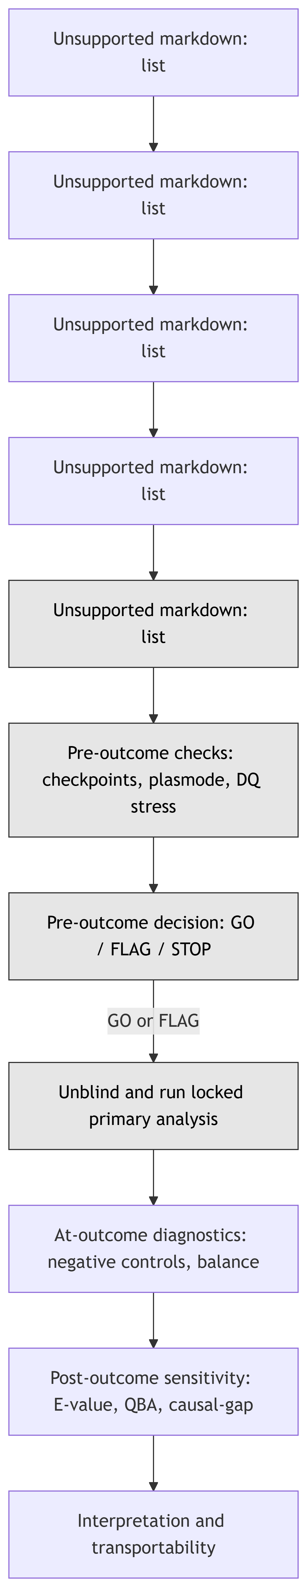
Causal roadmap and where cleanTMLE sits

Slide 51
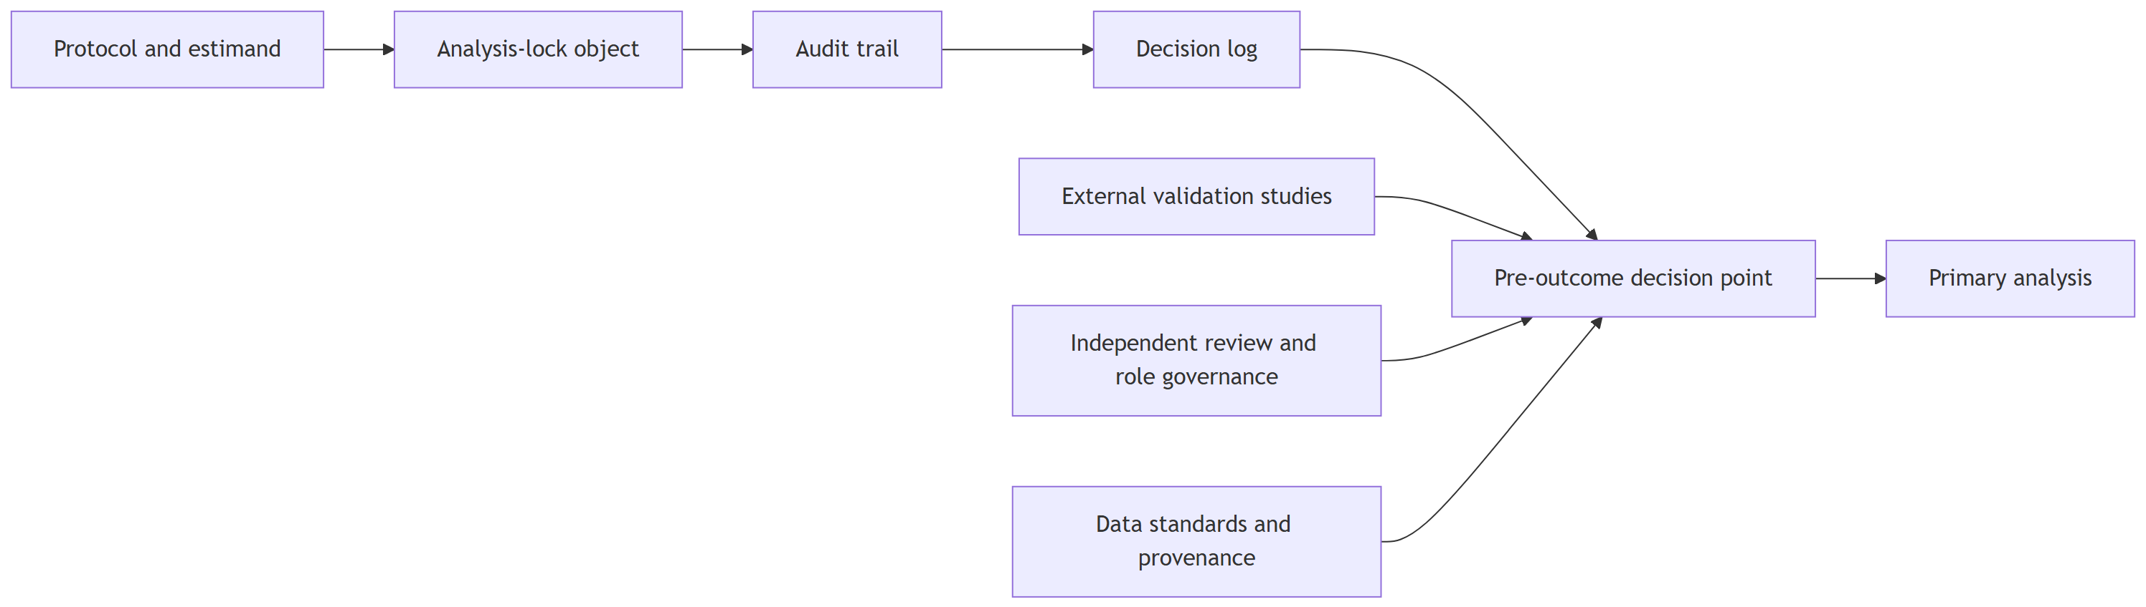
Governance stack

Slide 52
Regulatory alignment (excerpt)
Roadmap component | FDA / EMA / ICH anchor | What cleanTMLE operationalises
Causal question | Hernán target-trial framework; FDA RWE Framework; ICH M14 | Locked estimand, target trial timing
Statistical estimand | ICH E9(R1); FDA RWE Considerations | attach_estimand(), lock fingerprint
Estimator selection | FDA non-interventional studies; ICH M14 | tmle_candidate(), lock_primary_tmle_spec()
Pre-outcome DQ stress | Source reliability (FDA/EMA); validation evidence | run_plasmode_dq_stress()
Stage gate (GO/FLAG/STOP) | Internal protocol governance | gate_all(), authorize_outcome_analysis()
Post-outcome sensitivity | FDA non-interventional; ICH E9(R1) | compute_evalue(), tipping_point_sensitivity()

Slide 53
DQ threats and parameter inputs
Threat | Mechanism | Severity parameters
Covariate missingness | MCAR on a covariate subset, median impute | proportion missing
Exposure misclassification | Flip A with given (sens, spec) | (sens, spec) pairs
Outcome misclassification | Flip Y with given (sens, spec), optional differential | (sens, spec) pairs
Unmeasured confounding | Latent U shifts both A and Y | $β_{UA}$, $β_{UY}$

Slide 54
Threat-to-assumption matrix
Scenario | Assumption nominally probed | What it does NOT probe
Covariate MCAR | Some forms of missing-data robustness | MAR / MNAR; phenotype validity
Exposure misclassification | Treatment-measurement validity | Differential misclassification by outcome
Outcome misclassification | Outcome-measurement validity | Time-varying outcome ascertainment
Unmeasured confounding | Exchangeability | Multiple unmeasured Us; effect modification by U

Slide 55
Appendix B: Case-study setup (Rescue.Co)

Slide 56
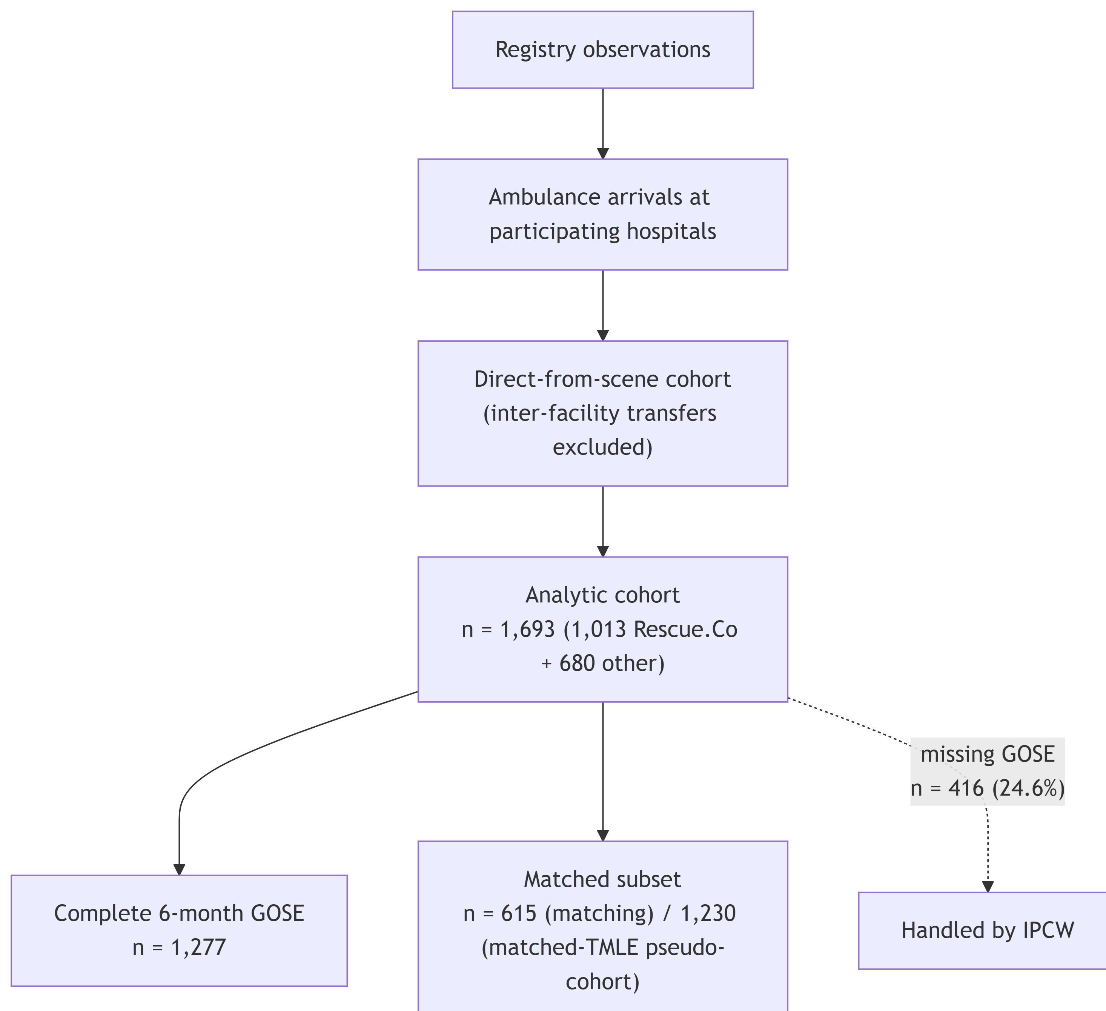
Cohort flow

Slide 57
Estimand grid (case-study estimators)
# | Estimator | Outcome | Cohort
A | PS-matched logistic regression | Binary | Matched
B | PS-matched TMLE | Binary | Matched
C | Outcome-blind plasmode candidate selection | – | –
D | Full-cohort TMLE | Binary | Full
E | IPTW (stabilised) | Binary | Full
F | Complete-outcome TMLE with IPCW weights | Binary | Complete-outcome
G | Survival TMLE (experimental) | Survival | Full
H | Cox PH (sensitivity) | Survival | Full

Slide 58
Target-trial timing table
Design element | Rescue.Co implementation | Pre-outcome status
Index date / time zero | Trauma-related ambulance arrival at participating hospital | Locked in identify_interval()
Treatment definition | Rescue.Co EMS (A=1) vs other ambulance (A=0) at index | Locked in identify_treatment()
Reference group | Other ambulance services, same hospitals + period | Locked
Eligibility window | 2018-2024 trauma transports, direct-from-scene only | Locked
Covariate window | At or before index | Locked
Outcome window | 6 months from index | Locked
Outcome definition | GOSE > 4 at 6 months | Locked
Missingness / censoring | Missing 6-month GOSE; primary complete-outcome + IPCW sensitivity | Locked
Switching / discontinuation | Not applicable (point exposure at scene) | Locked
Administrative end of FU | Fixed at 6 months | Locked
Excluded intercurrent events | Inter-facility transfers excluded; recorded as is_transfer | Locked

Slide 59
Event-process table
Event-like quantity | Class | Handling
GOSE > 4 at 6 months | Event of interest (outcome) | Estimand: marginal RD on this binary outcome
GOSE missing at 6 months | Missingness | Primary: complete-outcome; IPCW sensitivity
In-hospital death before 6-month GOSE | Outcome component / intercurrent event | Coded as GOSE = 1 (worst-rank)
Inter-facility transfer at index | Exclusion | Excluded from analytic cohort
Treatment switching / crossover | Not applicable | Point exposure at scene
6-month follow-up window end | Administrative end of FU | Fixed at 6 months

Slide 60
Target-population table
Procedure | Target population
Crude (complete-case) | Complete-outcome subset (n = 1,277)
PS matching | Matched overlap subset (n = 615)
IPTW (stabilised) | Full eligible cohort (n = 1,693)
Full-cohort TMLE | Full eligible cohort (n = 1,693)
Matched-cohort TMLE | Matched overlap subset (n = 1,230)
Complete-outcome TMLE w/ IPCW weights | Complete-outcome rows, weighted to full-cohort target

Slide 61
Weight-diagnostics table
Weight type | Source | Reporting | Prespecified instability flag
Treatment weights (stabilised) | fit_ps_superlearner() | Mean, SD, 99th pct, max, Kish ESS | Max > 10 or > 1 % above 5
IPCW weights | run_ipcw_tmle() | Mean, SD, 99th pct, max | Max > 10
Combined | Product of treatment + IPCW | Mean, SD, max, ESS | Max > 15 or ESS < 30 % of n

Slide 62
Estimator-estimand pairs
Candidate | Library | Truncation | Missingness | Status
Crude | n/a | n/a | Complete case | Reference
PS matching | GLM PS | n/a | Complete case | Secondary
IPTW (stabilised) | GLM PS | 0.01 | Complete case | Secondary
Full-cohort TMLE | SL ensemble | 0.01 | Complete case | Primary
Matched-cohort TMLE | SL ensemble (matched) | n/a | Complete case | Sensitivity (target pop)
Complete-outcome TMLE w/ IPCW | SL ensemble + SL IPCW | 0.01 | IPCW | Sensitivity (missingness)

Slide 63
Checkpoint dashboard (case study)
Stage | Evidence | Threshold | Decision
Stage 0 protocol/setup | Target-trial timing, SAP, lock fingerprint | All design elements specified before data access | GO
Stage 1b cohort adequacy | checkpoint_cohort_adequacy(), attrition table | min_n_per_arm = 200; min_events = 50 | GO
Stage 2a overlap / balance | PS in [0.21, 0.81]; balanced SMDs; ESS 78 % | PS in [0.01, 0.99]; SMD <= 0.10; max wt <= 10 | GO
Stage 2b baseline plasmode | bias < 0.001; coverage 0.94 | bias <= 0.01; coverage >= 0.90; SE/SD in (0.8, 1.2) | GO
Stage 2c DQ stress | Minimax rule selects glm_t01 | Each scenario within thresholds across severities | GO
Stage 3 negative controls | 2 of 5 NCs survived NZV; both pass | All analysed NCs pass at α = 0.05 | GO with FLAG
Gate authorisation | authorize_outcome_analysis() | All preceding GO or documented FLAG | GO

Slide 64
Decision-log example
Timestamp | Stage | Issue | Decision | Y visible?
2026-01-12 09:14 | 2a | Three NCs failed NZV filter | FLAG | No
2026-01-12 11:02 | 2c | DQ stress at n_sims = 3 (fast demo) | FLAG | No
2026-01-12 14:45 | Gate | All checkpoints GO or documented FLAG | GO | No

Slide 65
Sensitivity analyses mapped to assumptions
Assumption | Sensitivity analysis or diagnostic
Exchangeability | Negative-control outcomes; E-value on primary estimate
Positivity | Truncation-grid sensitivity; weight + ESS reporting
Consistency | Documented exposure phenotype; direct-from-scene restriction
Dependent censoring | IPCW-TMLE on binary outcome
Missing outcome | IPCW-TMLE vs complete-case TMLE comparison
Composite / competing | Coherence check via clean_check_event_processes()

Slide 66
Stage 2b feasibility plasmode metrics
Candidate | Bias | RMSE | Coverage | SE/SD
glm_t01 | < 0.001 | 0.018 | 0.94 | 1.01
glm_t05 | < 0.001 | 0.018 | 0.94 | 1.01

Slide 67
Stage 3 negative-control TMLE
Negative control | Estimate | SE | p-value | Pass
chronic hypertension | 0.00248 | 0.0072 | 0.73 | ✓
household urban | -0.00077 | 0.0071 | 0.91 | ✓

Slide 68
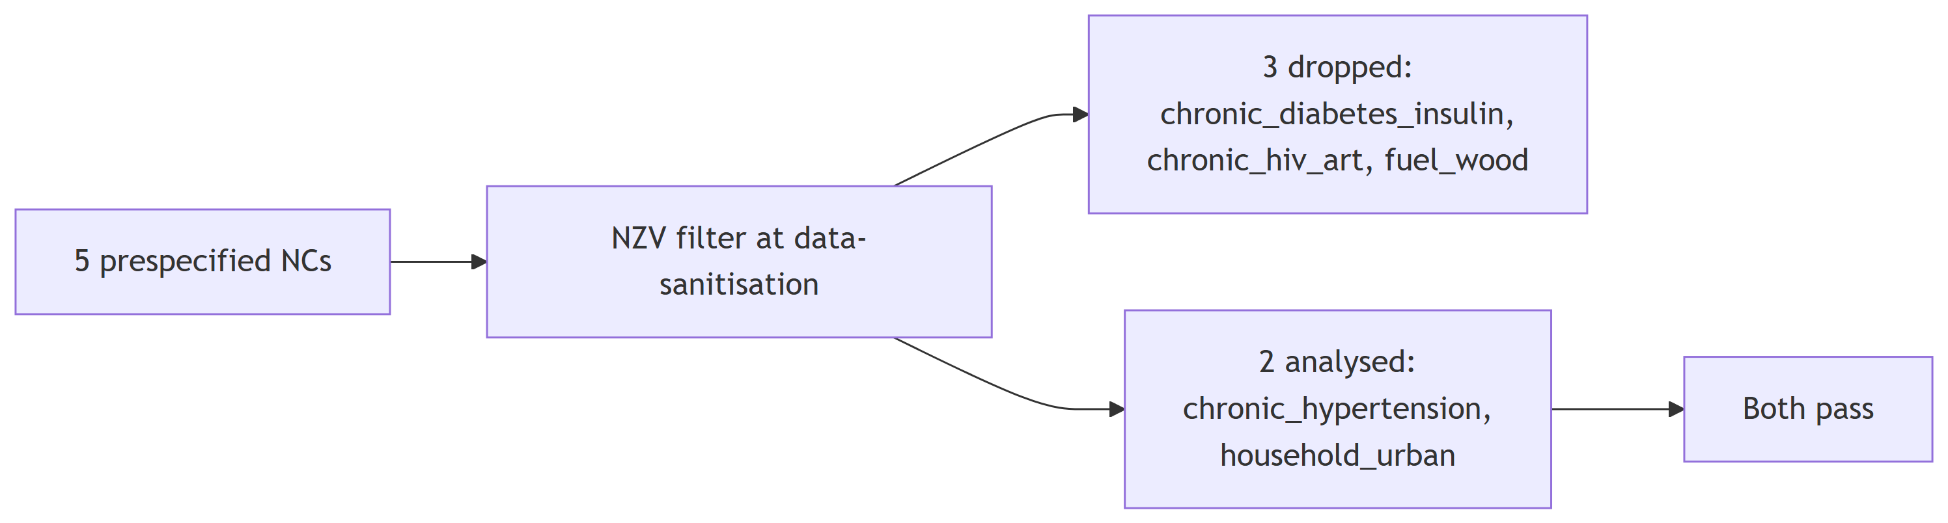
Negative-control attrition

Slide 69
Rescue.Co binary-outcome estimates (six estimators)
Method | Target population | N | RD | 95% CI
Crude | Complete-outcome subset | 1,277 | 0.0370 | (0.003, 0.071)
PS matching | Matched subset | 615 | 0.0272 | (-0.020, 0.074)
IPTW (stabilised) | Full eligible cohort | 1,693 | 0.0366 | (0.002, 0.071)
Full-cohort TMLE | Full eligible cohort | 1,693 | 0.0306 | (-0.001, 0.062)
Matched-cohort TMLE | Matched subset | 1,230 | 0.0259 | (-0.015, 0.067)
Complete-outcome TMLE w/ IPCW | Complete-outcome rows, weighted to full-cohort | 1,277 | 0.0326 | (-0.000, 0.066)

Slide 70
Appendix C: Case-study diagnostic figures

Slide 71
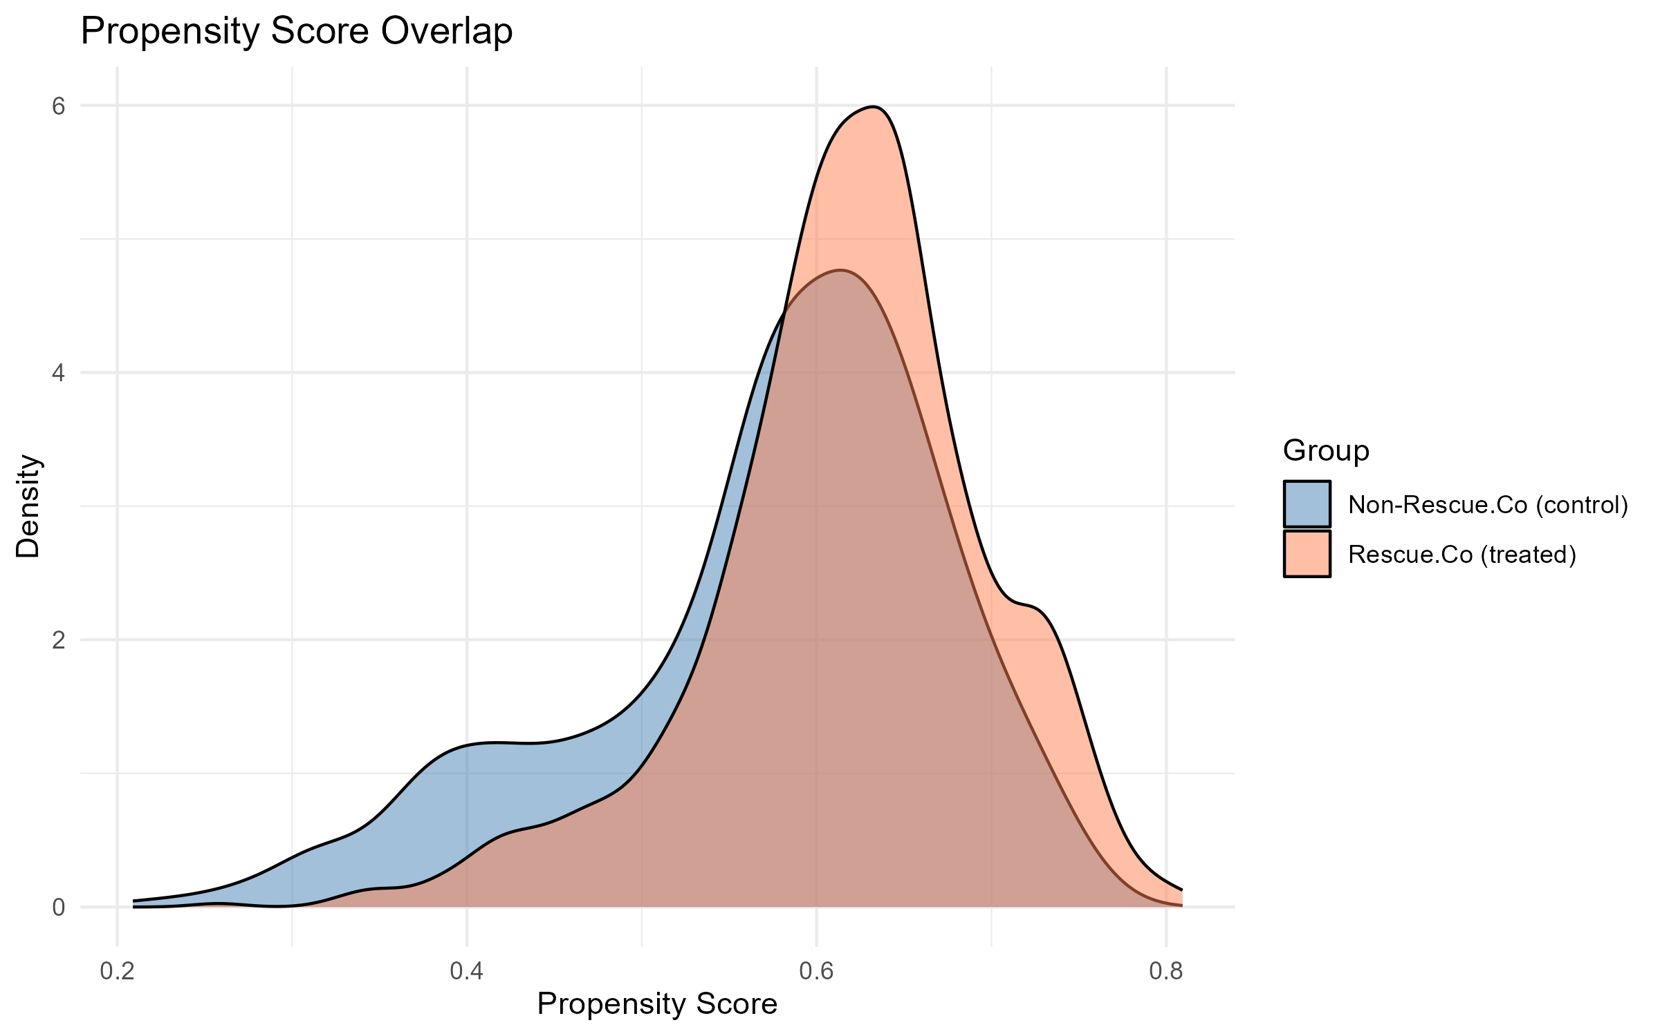
PS overlap density
Propensity-score density by treatment group with truncation cutoffs marked.

Slide 72
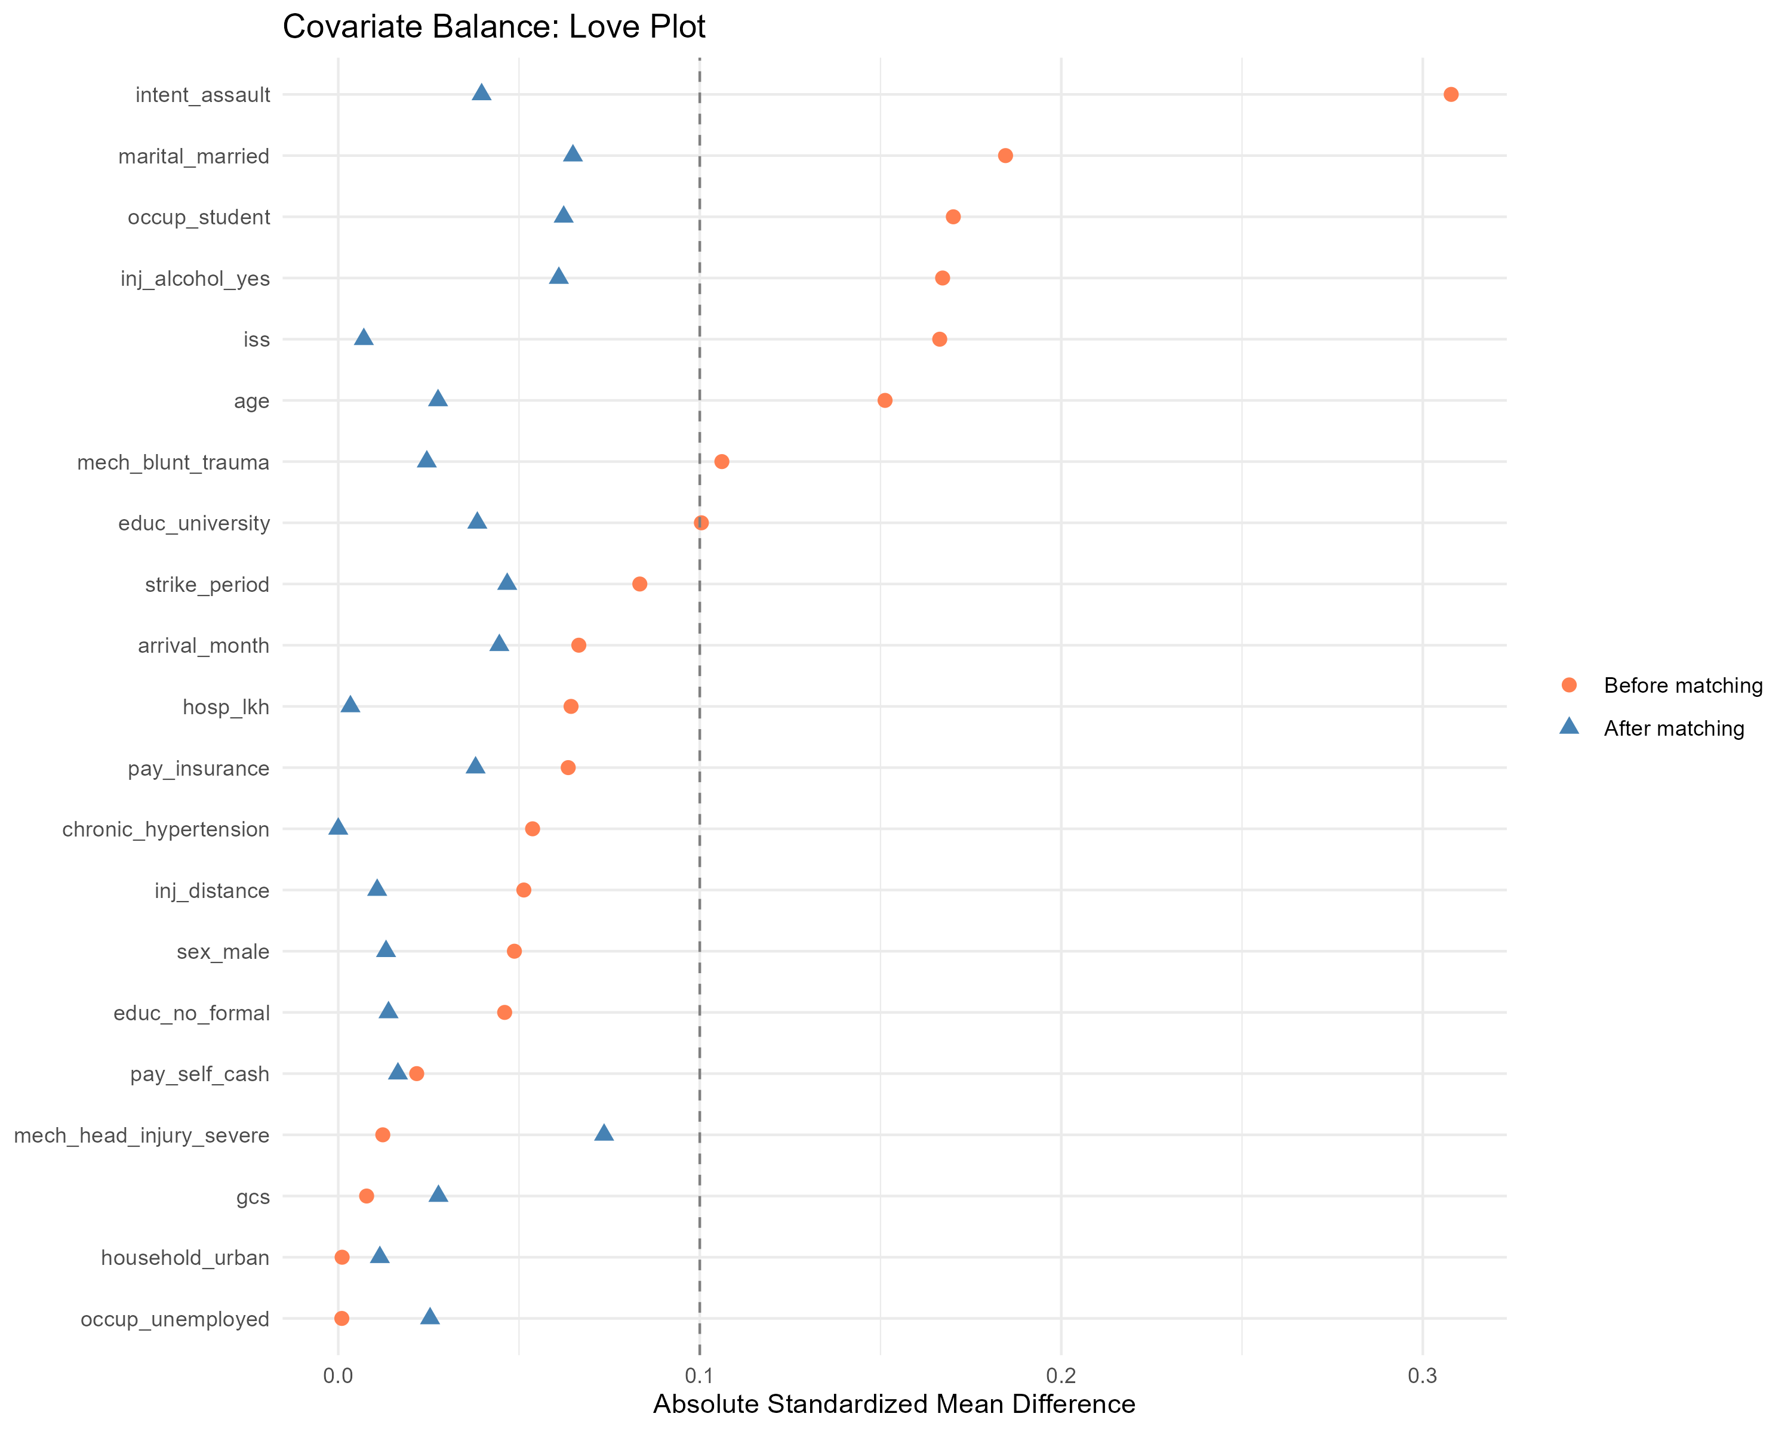
Love plot: matched vs unweighted
Standardised mean differences for retained covariates before and after PS matching.

Slide 73
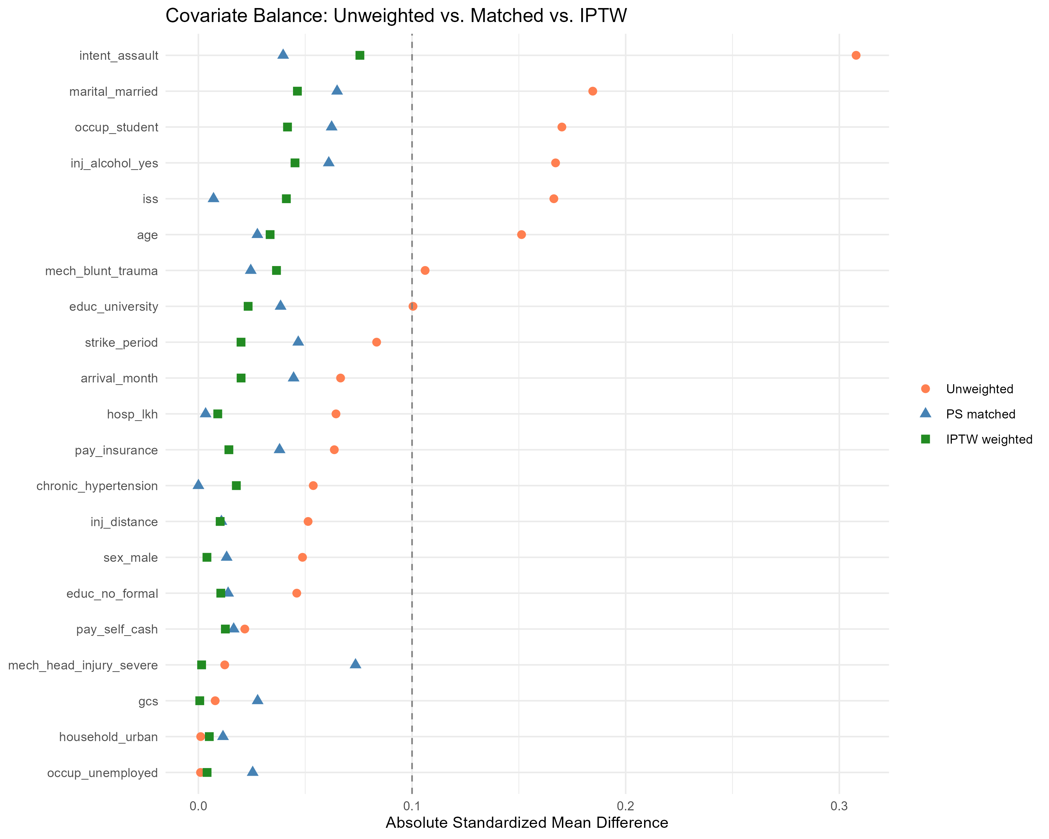
Three-way Love plot: unweighted vs matched vs IPTW
Three-way balance: unweighted, after matching, and after stabilised IPTW.

Slide 74
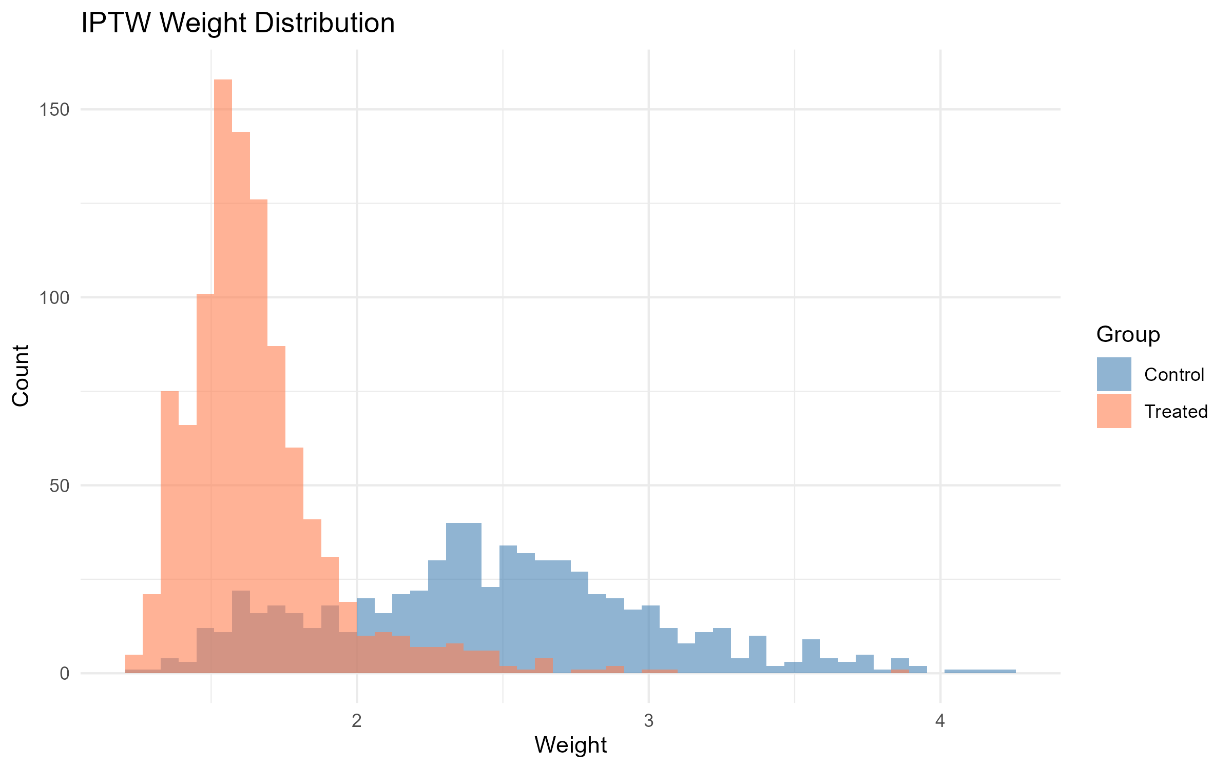
IPTW weight distribution
Distribution of stabilised IPTW weights by treatment group.

Slide 75
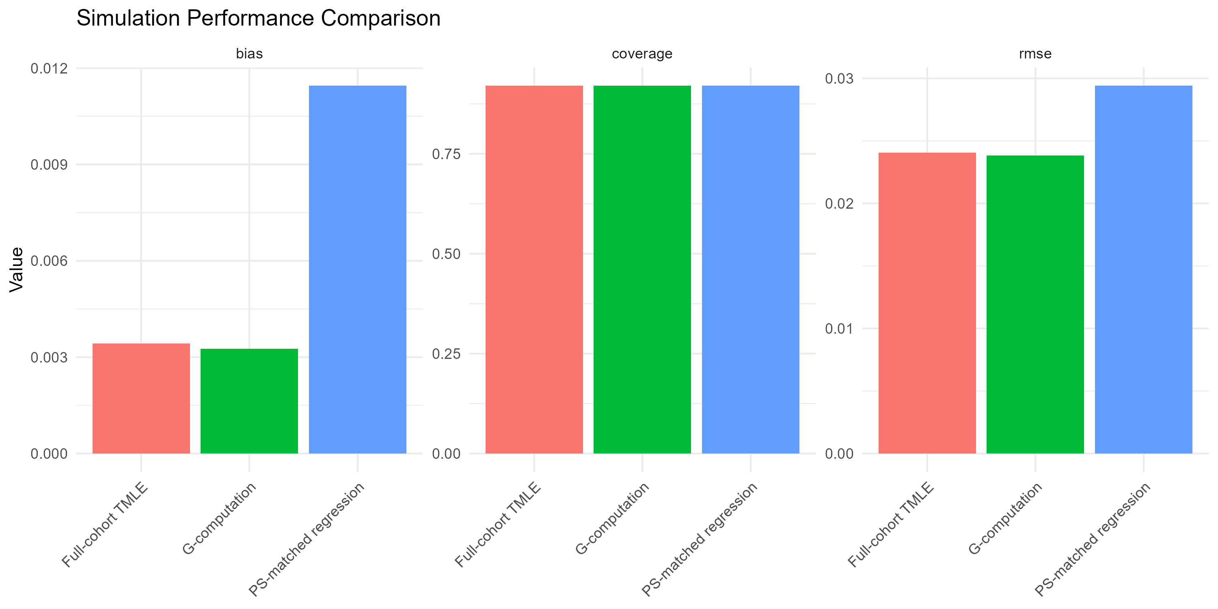
Plasmode simulation performance
Plasmode performance across candidate estimators (true ATE = 0).

Slide 76
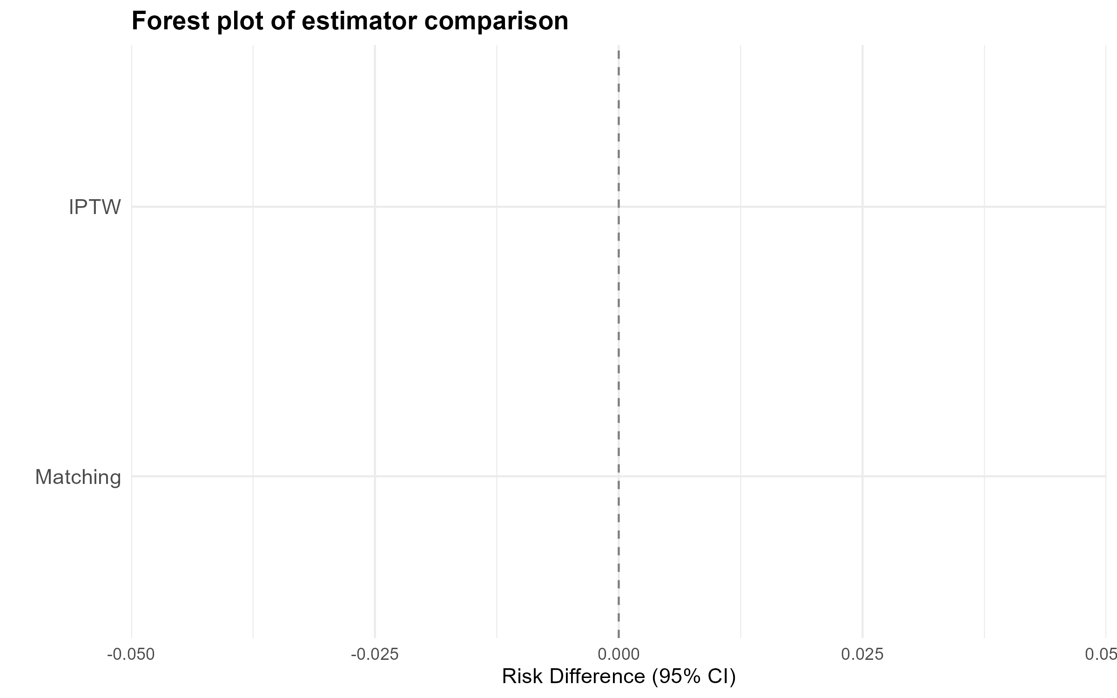
Binary-outcome estimator forest plot
Forest plot of binary-outcome risk differences across the six prespecified estimators.

Slide 77
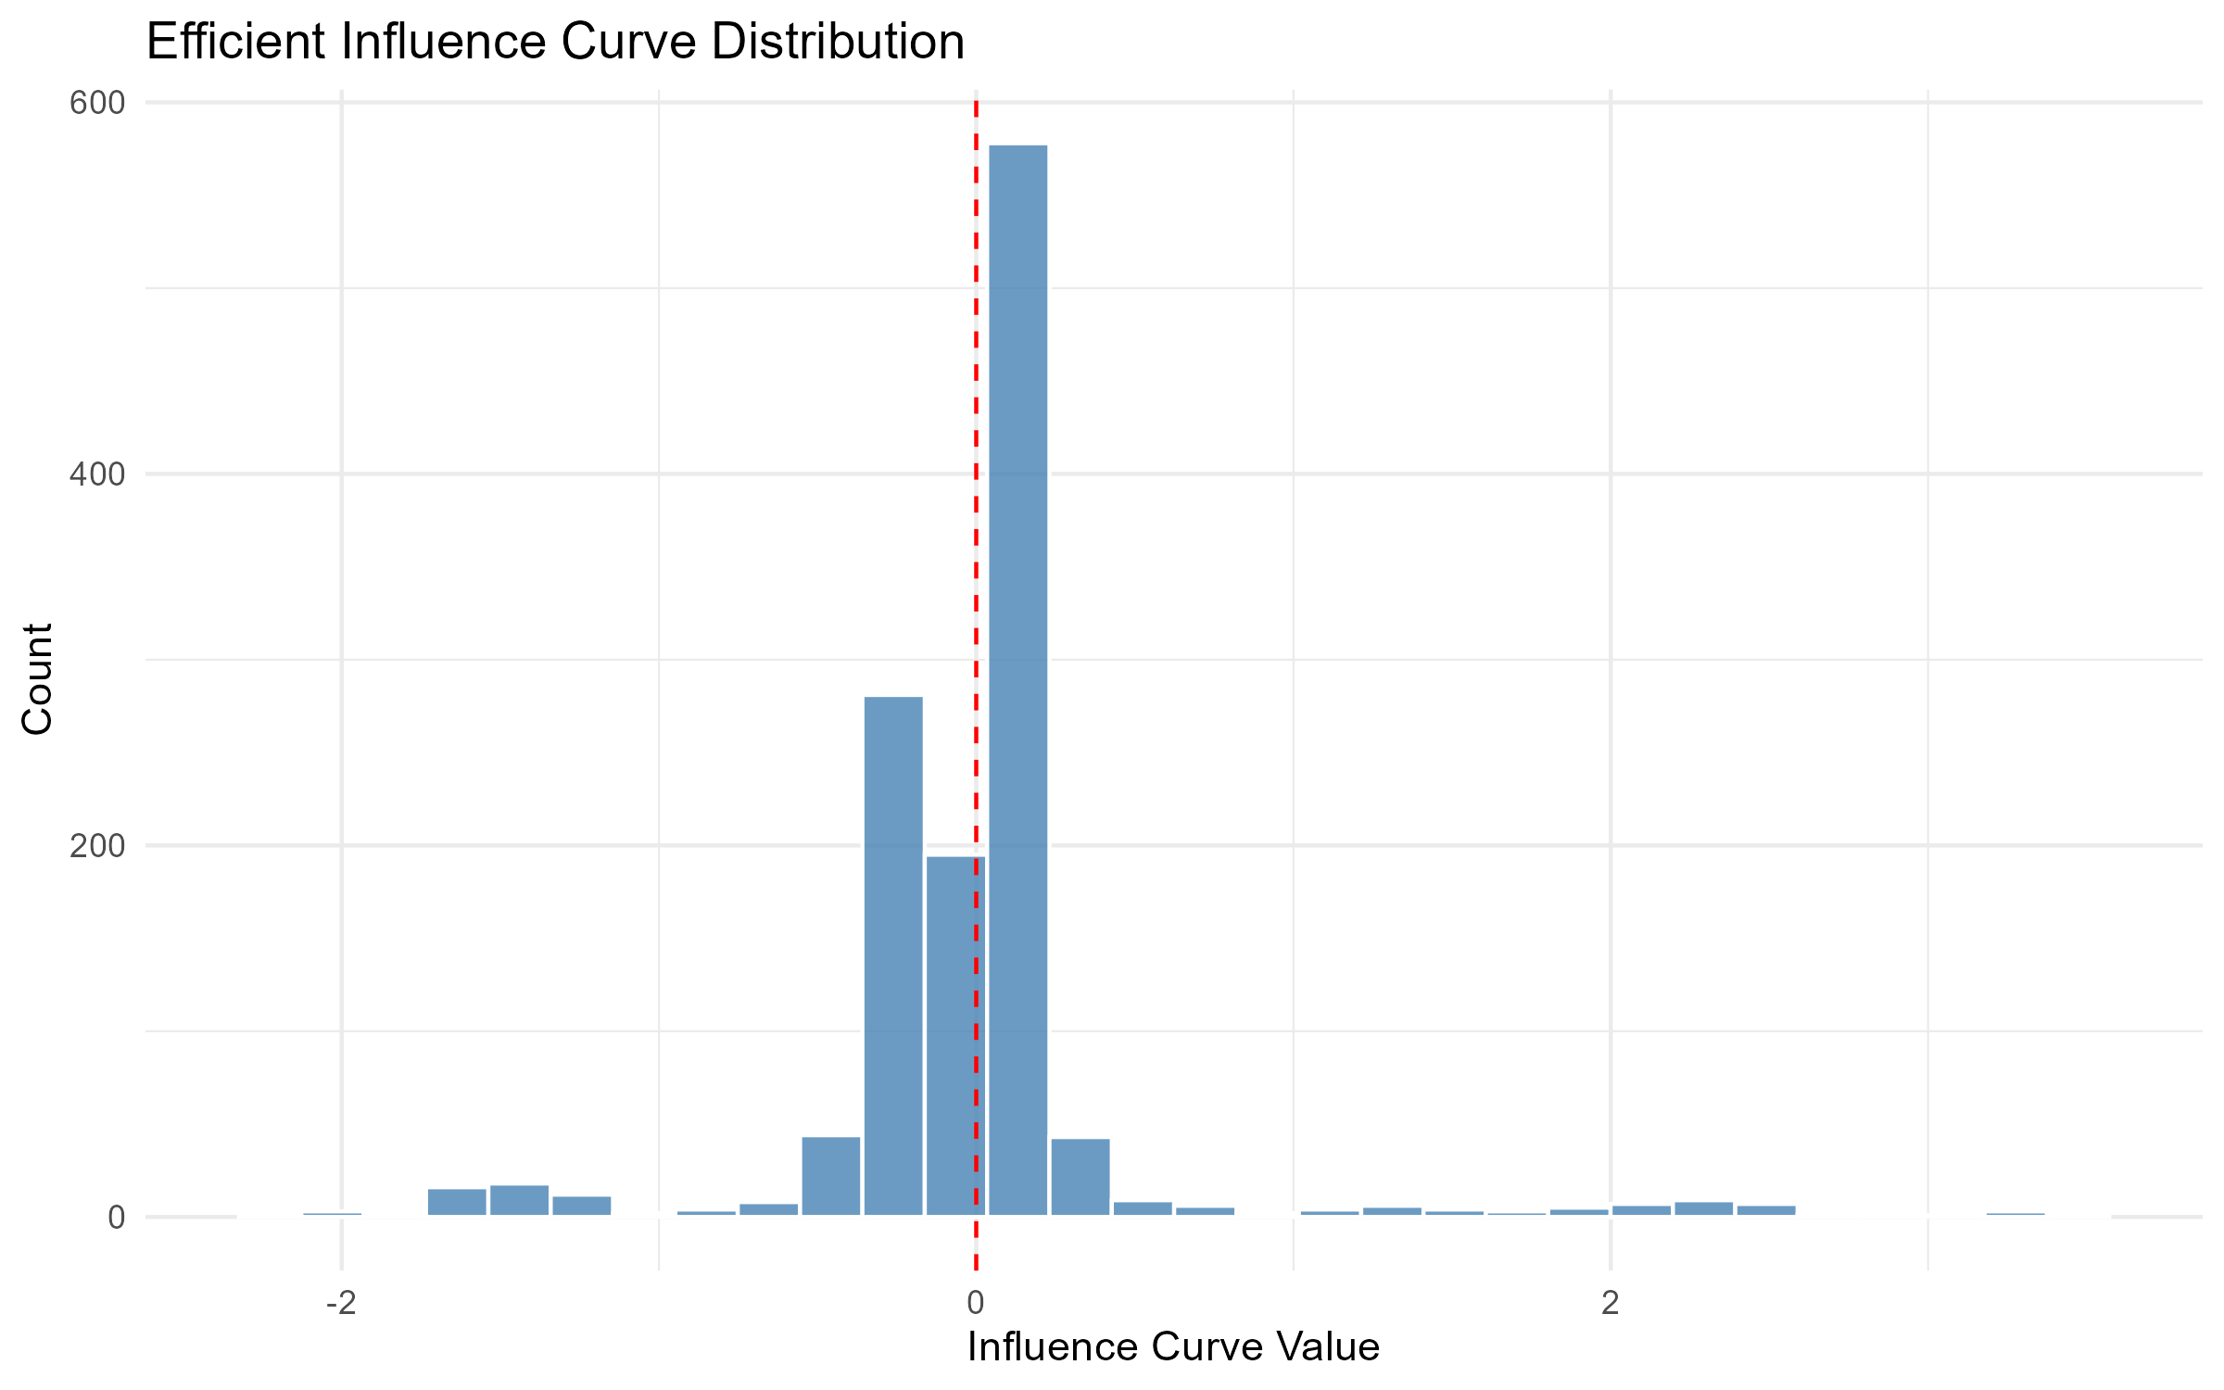
Influence-curve distribution (full-cohort TMLE)
Influence-curve distribution for the full-cohort TMLE primary estimator.

Slide 78
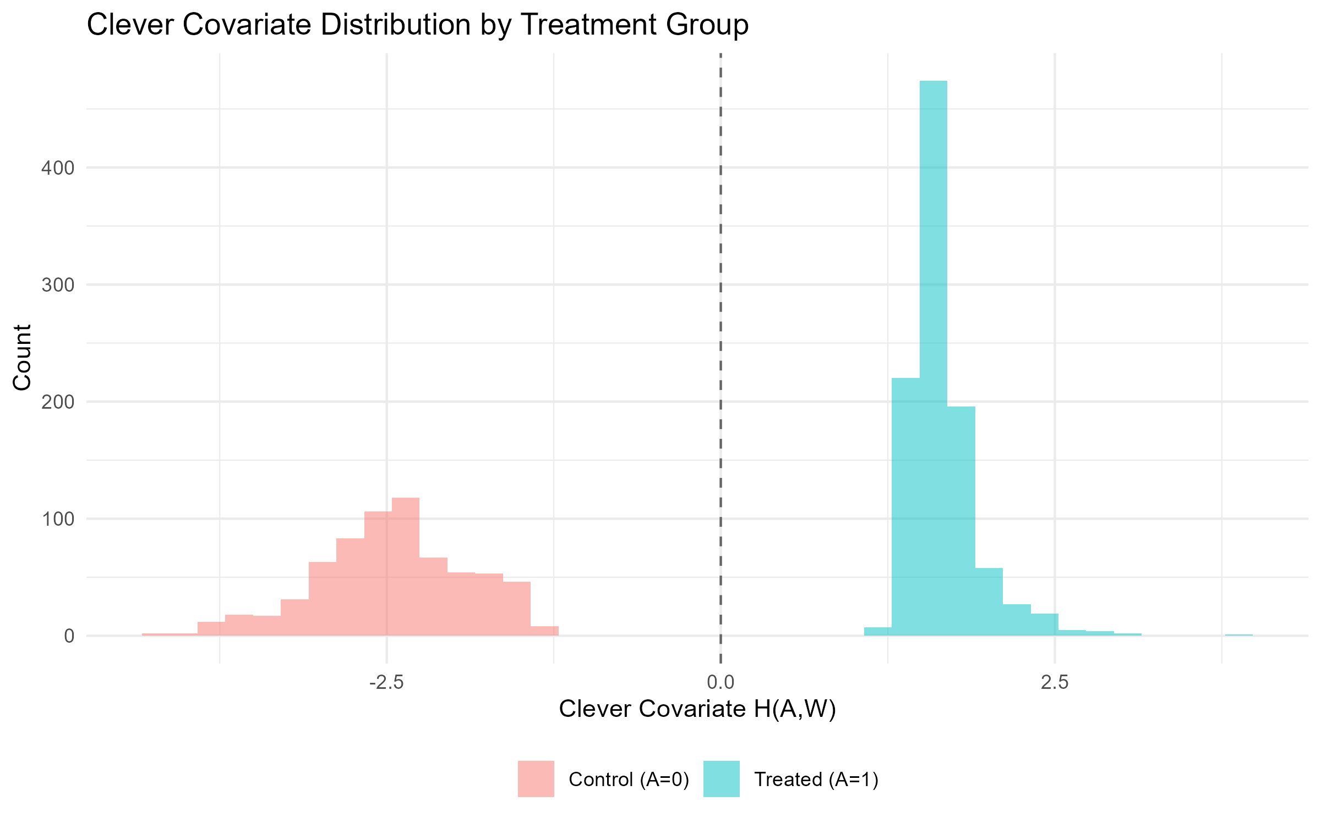
Clever covariate H_n by treatment arm
Clever covariate H_n by treatment arm (full-cohort TMLE).

Slide 79
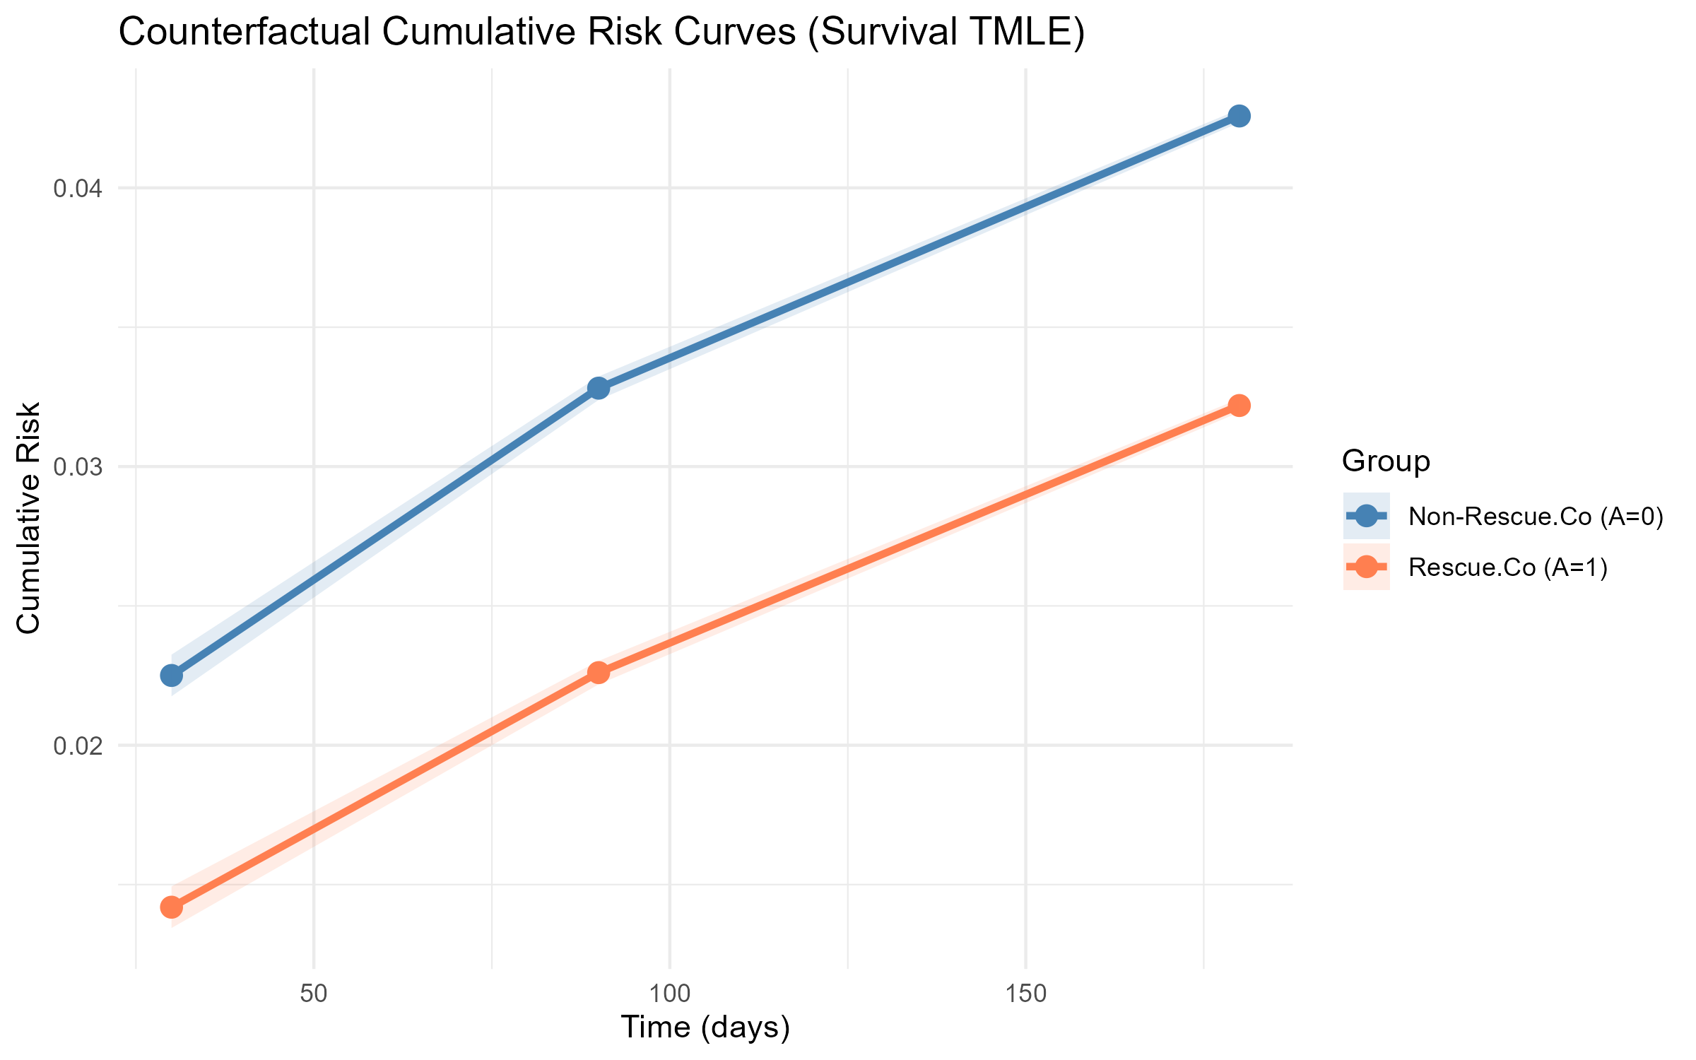
Counterfactual cumulative-risk curves (full-cohort TMLE)
Counterfactual cumulative-risk curves with CI bands, full-cohort TMLE.

Slide 80
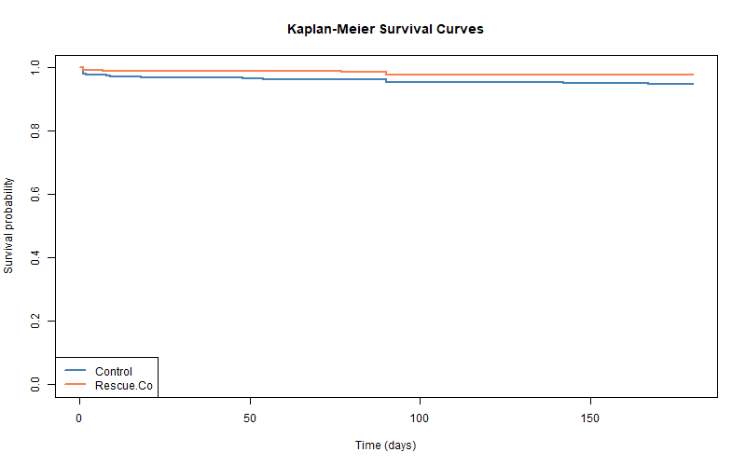
Kaplan-Meier curves by treatment arm (descriptive)
KM survival curves by treatment arm; descriptive only.

Slide 81
Appendix D: Helpers and outcome-access taxonomy

Slide 82
Outcome-access taxonomy
Label | Definition
No Y access | Function uses W, A, metadata, lock objects, synthetic outcomes, or diagnostics not involving Y
Marginal Y only | Function uses event counts or marginal outcome support, not the A-Y association
Synthetic Y only | Function uses plasmode-generated outcomes
Negative-control Y only | Function uses prespecified NC outcomes, not the primary outcome
Primary Y | Function uses the observed primary outcome for treatment-effect estimation

Slide 83
These labels describe what cleanTMLE exported functions use internally. They do not prevent a user with raw data access from inspecting outcomes outside the package.

Slide 84
Helper functions by dossier component
Dossier component | cleanTMLE artefact | Outcome access
Protocol and target-trial timing | attach_estimand() | No Y
Cohort flow / attrition | attrition_table() | No Y
Event-process classification | clean_event_process_table(), clean_check_event_processes() | No Y
Covariate and missingness summary | make_table1(), missingness checks | No Y
PS overlap and balance | compute_ps_diagnostics(), love_plot(), love_plot_threeway() | No Y
Weight diagnostics | clean_weight_diagnostics(), extreme_weights() | No Y
Event-count adequacy | checkpoint_cohort_adequacy() | Marginal Y only
Baseline plasmode | run_plasmode_feasibility(), select_tmle_candidate() | Synthetic Y only
DQ stress test | run_plasmode_dq_stress(), summarize_dq_degradation() | Synthetic Y only
Negative controls | run_residual_confounding_stage() | Negative-control Y only
Composite gate | gate_all() (+ planned checkpoint_dashboard()) | No Y
Decision and audit logs | export_decision_log(), save_decision_log() | No Y
Authorisation | authorize_outcome_analysis() | No Y
Primary analysis | run_clean_tmle(), fit_tmle_*() family, run_ipcw_tmle() | Primary Y

Slide 85
Appendix E: Step-by-step Rescue.Co walkthrough

Slide 86
How to read this appendix
This appendix walks through the cleanTMLE analysis of the Rescue.Co data, function by function. Each slide shows one step: what we are trying to learn, the cleanTMLE function that does it, what comes back, and what the reviewer would see.
You can run these in order on your own data. The full reproducible version is in rescueCo/reports/rescueco_clean_room_case_study.qmd.

Slide 87
Step 1 — Write down the question
Before any code runs, the team writes down the question in target-trial language: the cohort, the treatment, the comparison group, the outcome, and the follow-up window. This becomes the estimand attached to the analysis lock.
lock <- attach_estimand( lock, description = "Effect of Rescue.Co transport on 6-month GOSE > 4", population = "Adults arriving by ambulance, direct-from-scene", treatment_strategies = c("Rescue.Co", "Other ambulance"), outcome_label = "GOSE > 4 at 6 months", followup = "6 months", contrast = "risk_difference" )

Slide 88
Step 2 — Lock the analytic plan
The analytic plan is captured as a single object that gets a sha256 fingerprint. Any later change to the plan changes the fingerprint, which is visible to the reviewer.
lock <- create_analysis_lock( data = rescueco_cohort, treatment = "is_rescueco", outcome = "gose_good", covariates = c("age", "sex", "iss", "gcs", "distance", "..."), sl_library = c("SL.glm", "SL.glmnet", "SL.ranger"), seed = 2026 )
The lock records the data shape, the covariate list, the learner library, and the seed.

Slide 89
Step 3 — Build a cohort-flow ledger
attrition_table() records each inclusion and exclusion as a row, so the cohort flow is a code artefact rather than a separately maintained CONSORT figure.
attr_tbl <- attrition_table( raw_data, rules = list( "All trauma transports" = ~ TRUE, "Ambulance arrivals" = ~ arrival_mode == "ambulance", "Direct-from-scene" = ~ !is_transfer, "Within eligibility window" = ~ between(date, "2018-01-01", "2024-12-31"), "Analytic cohort" = ~ !missing_baseline ) )

Slide 90
Step 4 — Classify the event process
clean_event_process_table() writes down what each event-like quantity is: the outcome, a competing event, censoring, an exclusion, an intercurrent event, or the administrative end of follow-up.
events <- clean_event_process_table( outcome = "gose_good", missingness = "gose_missing", intercurrent = list("in-hospital death" = "worst-rank coded as GOSE = 1"), exclusions = list("inter-facility transfer" = "is_transfer"), admin_end_fu = "180 days from index" )

Slide 91
Step 5 — Cohort adequacy check
Before any modelling, check that the cohort has enough people and enough events to support the estimand. This is the first software-enforced checkpoint.
audit <- create_audit_log(lock) cp1 <- checkpoint_cohort_adequacy( lock, min_n_per_arm = 200, min_events = 50 ) audit <- record_checkpoint(audit, cp1)
If the threshold is missed, the checkpoint returns FLAG or STOP and the reviewer sees it.

Slide 92
Step 6 — Design diagnostics (propensity score)
Fit the propensity score and produce overlap and balance diagnostics. The fit uses the locked SuperLearner library.
ps <- fit_ps_superlearner(lock) ps_diag <- compute_ps_diagnostics(ps) plot(ps_diag) # overlap density love_plot_threeway(lock, ps$weights) # SMDs: unweighted vs matched vs IPTW
The reviewer sees the overlap density and the three-way Love plot before authorisation.

Slide 93
Step 7 — Weight diagnostics
Standardised treatment weights and IPCW weights are reviewed for stability and effective sample size. This is the weight equivalent of the cohort-adequacy check.
weight_diag <- clean_weight_diagnostics( weights = ps$weights, treatment = lock$data[[lock$treatment]], covariates = lock$data[, lock$covariates] ) extreme_weights(ps$weights, top_n = 10) cp2 <- checkpoint_balance(ps_diag, max_smd = 0.10, lock_hash = lock$lock_hash) audit <- record_checkpoint(audit, cp2)

Slide 94
Step 8 — Baseline plasmode candidate selection
Two candidate TMLE specifications are compared on a synthetic outcome generated from the real covariate and treatment structure. The candidate-selection rule is locked in advance.
candidates <- list( tmle_candidate("glm_t01", "GLM PS, trunc = 0.01", truncation = 0.01), tmle_candidate("glm_t05", "GLM PS, trunc = 0.05", truncation = 0.05) ) plas <- run_plasmode_feasibility( lock, tmle_candidates = candidates, effect_sizes = c(0.03, 0.05), reps = 200 )
This is the first place where a “results-like” number appears, but the outcome involved is synthetic, not the real outcome.

Slide 95
Step 9 — Data-quality stress test
Repeat the same simulation under prespecified data-quality threats. The minimax rule chooses the candidate that performs best in its worst-case scenario.
dq_results <- run_plasmode_dq_stress( lock, tmle_candidates = candidates, scenarios = default_dq_scenarios(), # missingness, exposure & outcome misclass, latent U n_reps = 200 ) selected <- select_tmle_candidate(plas, rule = "min_max_rmse", dq_results = dq_results)
selected is the locked primary specification.

Slide 96
Step 10 — Negative-control screen
A small panel of pre-treatment outcomes that should not be affected by the exposure. This is a different probe of residual confounding from what plasmode or stress testing can give.
nc_results <- run_residual_confounding_stage( lock, negative_controls = c("chronic_hypertension", "household_urban", "chronic_diabetes_insulin", "chronic_hiv_art", "fuel_wood") ) cp3 <- checkpoint_residual_bias(nc_results) audit <- record_checkpoint(audit, cp3)
Three of the five NCs failed the automatic data-cleaning filter and were dropped. The drops are recorded in the audit log.

Slide 97
Step 11 — Decision log entry
At each stage the analyst writes a short structured decision entry. The reviewer reads these alongside the checkpoint records.
audit <- log_decision_entry( audit, stage = "Stage 3 NC", decision = "FLAG", rationale = "Three NCs dropped by NZV filter; residual-confounding probe rests on 2 of 5", reviewer = "lead_analyst", y_visible = FALSE )

Slide 98
Step 12 — Pre-outcome gate
gate_all() aggregates the recorded checkpoints into a single GO / FLAG / STOP decision against the prespecified thresholds.
gate <- gate_all(cp1, cp2, cp3, allow_flag = TRUE) # gate$decision -> "GO with FLAG"
authorize_outcome_analysis() then turns that decision into an authorisation record that downstream estimators can verify.
auth <- authorize_outcome_analysis(lock, gate)

Slide 99
Step 13 — Locked primary analysis
The primary-analysis function refuses to run on an unauthorised lock. With the authorisation in place, the locked specification is now permitted to access the real outcome.
fit_primary <- run_clean_tmle(lock, spec = selected, ps_fit = ps, authorization = auth) fit_ipcw <- run_ipcw_tmle(lock, ps_fit = ps, authorization = auth)
The matched-cohort and IPTW comparators are run from the same authorised lock.

Slide 100
Step 14 — Cumulative-risk report
The package emphasises absolute risks at a clinically meaningful time point alongside the contrast.
risk_table <- clean_risk_report_table( list( "Rescue.Co" = fit_primary$risk_treated, "Other ambulance" = fit_primary$risk_control, "Difference (RD)" = fit_primary$estimate ), time_point = "6 months" )

Slide 101
Step 15 — Sensitivity analyses
After the primary analysis runs, prespecified sensitivity analyses are added: a tipping-point sensitivity, an E-value, and a truncation-grid sweep.
tipping <- tipping_point_sensitivity(fit_primary$estimate, fit_primary$ci_lower, fit_primary$ci_upper) evalue <- compute_evalue(fit_primary$estimate, fit_primary$ci_lower) trunc_s <- sensitivity_truncation(lock, trunc_grid = c(0.01, 0.025, 0.05, 0.10))

Slide 102
Step 16 — Export the dossier
Every checkpoint, every decision entry, the lock, the authorisation, and the final estimates can be exported as a single bundle for an external reviewer.
export_decision_log(audit, "rescueco_decision_log.csv") save_audit(audit, "rescueco_audit.rds") save_lock(lock, "rescueco_lock.rds")
The reviewer reads these in alongside the manuscript.

Slide 103
Summary of the walkthrough
Step | Function | What it does | Y access
1 | attach_estimand() | Records the target-trial question | No
2 | create_analysis_lock() | Fingerprints the plan | No
3 | attrition_table() | Records cohort flow | No
4 | clean_event_process_table() | Classifies event processes | No
5 | checkpoint_cohort_adequacy() | Checks N and events | Marginal
6 | fit_ps_superlearner(), compute_ps_diagnostics() | PS + overlap + balance | No
7 | clean_weight_diagnostics(), extreme_weights() | Weight stability | No
8 | run_plasmode_feasibility() | Baseline candidate selection | Synthetic
9 | run_plasmode_dq_stress() | Stress test under threats | Synthetic
10 | run_residual_confounding_stage() | Negative-control probe | NC outcomes only
11 | log_decision_entry() | Records each analytic decision | No
12 | gate_all(), authorize_outcome_analysis() | Pre-outcome decision | No
13 | run_clean_tmle(), run_ipcw_tmle() | Locked primary analysis | Yes
14 | clean_risk_report_table() | Cumulative-risk report | Yes
15 | tipping_point_sensitivity(), compute_evalue() | Sensitivity analyses | Yes
16 | export_decision_log(), save_audit(), save_lock() | Export the dossier | No

