Slide 1
cleanTMLE
Deciding the estimand before outcomes
Andrew Mertens

Slide 2
The problem this package works on
Two failures poison comparative analyses of routine health data. The first is analyst degrees of freedom: when the person choosing the model can see how each choice moves the answer, the estimate carries those peeks. The second is quieter and worse. Some comparisons are not estimable at all, and the estimator does not say so.
A clean-room design fixes the first. cleanTMLE also answers the second, during the blind phase: is this comparison estimable, and with which estimand?

Slide 3
This talk
The two failures, and a real analysis that fell into the second one.
The design stage, in five verbs.
What the simulations showed.
Five ambulance-transport contrasts in Nairobi, and what the design stage refused to estimate.
Where this sits among existing tools.

Slide 4
1. Why this matters

Slide 5
Peeking
Even with a written analysis plan, execution forces choices: sparse events, convergence failures, unexpected missingness. If those choices are made after the analyst has glimpsed the treatment-outcome association, the analysis is no longer prespecified, however honest the analyst.
The clean-room design of Muntner et al. (2024) addresses this. A design team builds the cohort, the propensity model, and the diagnostics without seeing the outcome. Only then does an outcome team estimate.

Slide 6
The failure blinding cannot touch
The average treatment effect asks what would happen if everyone received treatment versus no one. Answering it requires every kind of patient to have had a real chance of landing in either arm.
When a whole stratum essentially never receives one treatment, the estimator does not refuse. It extrapolates. Truncating the weights caps the variance without restoring information.
A perfectly blinded team can still promise an estimand the data cannot deliver, and the lock makes the promise binding.

Slide 7
We know because it happened to us
An earlier analysis of time to ambulance arrival, on a cohort where some patients essentially never receive the studied service:
estimated effect +14,637 minutes, tight confidence interval
crude difference about 7 hours the other way
Nothing in the estimator’s own output flagged it.

Slide 8
What the blind phase should establish
The cohort, treatment, outcome, and time horizon were fixed in advance.
The declared comparison is estimable. If not, which neighbouring estimand is.
The estimator was prespecified and screened against realistic data problems.
Any switch of estimand followed a rule declared before outcome access, and everything is on the record.
design_report() bundles the evidence for all four into the document a review team reads before outcomes are unlocked.

Slide 9
2. How the package works

Slide 10
Five verbs
lock <- create_analysis_lock(data, "treatment", "outcome", covariates,
negative_controls = ncs, mask = TRUE)
lock <- declare_estimand_ladder(lock, primary = "ATE",
fallbacks = c("trimmed_ATE", "ATT", "ATO"),
trigger = "SEVERE")
ps <- fit_ps(lock) # SuperLearner, GLM, or external
sup <- assess_support(ps) # graded overlap verdict
fea <- estimand_feasibility(ps) # which estimands survive this fit
sim <- simulate_support(lock, ps) # the outcome-blind support map
design_report(lock, sup, fea, simulation = sim)
fit <- run_estimand_ladder(lock, ps) # outcomes join only here
Everything above the last line runs with no outcome access.

Slide 11
The support assessment
assess_support() grades the overlap on the fitted propensity score. Share of the sample outside the band, largest implied weight, effective sample size, and the c-statistic, whose discrimination is bad news here. A stratum scan and a shallow tree search catch pockets where treatment is nearly deterministic.
The verdict is PASS, FLAG, SEVERE, or FAIL, and its caveat sentence travels with every downstream estimate.

Slide 12
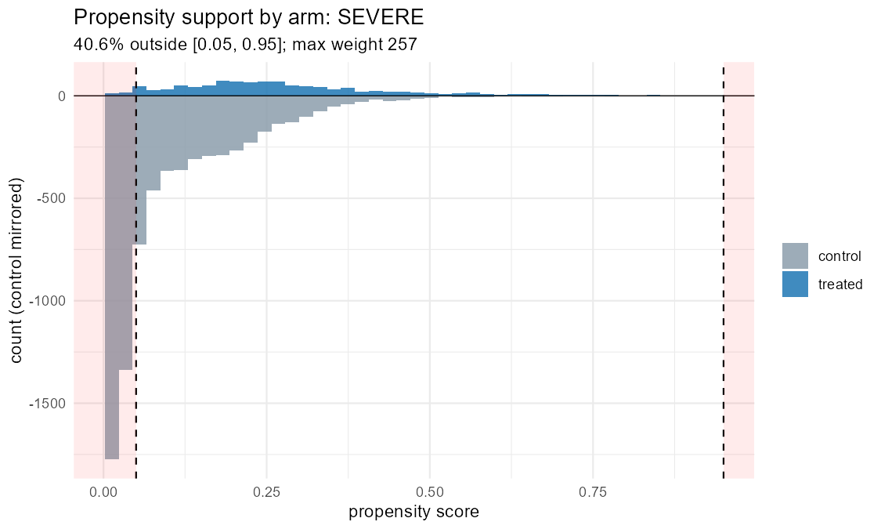
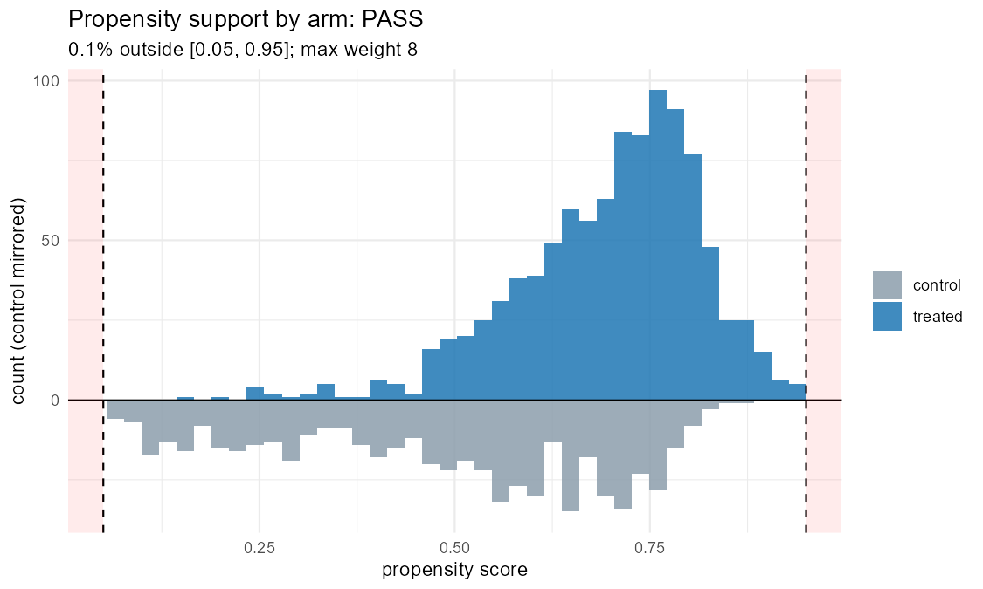
What severe non-overlap looks like
Protocol contrast: SEVERE
Primary cohort: PASS

Slide 13
Treated above the axis, controls below, band shaded.

Slide 14
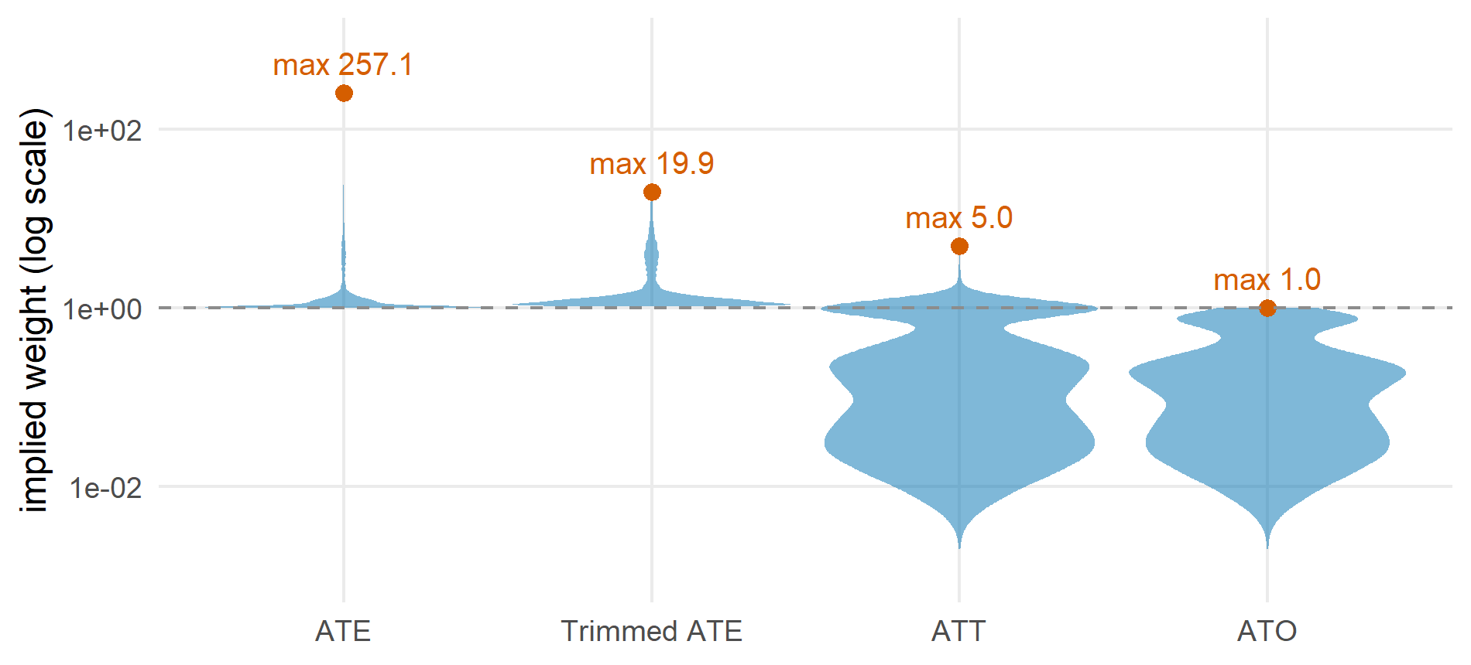
One fitted score, four estimands, very different weights
Figure 1: Implied weights on the protocol contrast, one point per patient, log scale. The ATE needs weights up to 257; the effect among the treated (ATT) is bounded at 5 by the largest propensity; the overlap-weighted ATO never exceeds 1.

Slide 15
The estimand ladder
Switching estimands after seeing results is a garden of forking paths. Refusing ever to switch wastes designs that can answer a neighbouring question.
So the switch rule is pre-registered. The lock records the primary, the ordered fallbacks, and the verdict that triggers a move. Estimation runs the primary when feasible plus every feasible fallback, labels each row with its estimand and verdict, and refuses an infeasible primary unless an override reason is supplied and logged.

Slide 16
The outcome-blind support map
Static weight diagnostics cannot say how much the extrapolation will hurt. That depends on how the outcome behaves in the region only one arm inhabits, and the design team is blind to the outcome.
So the package simulates: covariates resampled, treatment redrawn from the fitted propensity, synthetic outcomes drawn from a prespecified family of surfaces. The truth is known on every replicate, separately per estimand. The map shows where each estimand holds a bias tolerance at near-nominal coverage.

Slide 17
Redraw treatment, or keep it?
Plasmode studies commonly keep each subject’s observed treatment. Shaw et al. (2025) showed that this builds a positivity violation into the simulation itself: all-treated regions stay all-treated in every replicate, whatever the generating propensity.
For a support map that is disqualifying, because the violation is the thing under study. cleanTMLE redraws treatment from the fitted propensity. The case study puts the two designs side by side on real data.

Slide 18
The same loop stress-tests the estimator
Candidate TMLE specifications are compared on synthetic outcomes, then re-run under prespecified data-quality threats: covariate missingness (MCAR, MAR, MNAR), exposure and outcome misclassification, near-positivity, unmeasured confounding.
Each candidate gets a degradation gradient on the same bias, RMSE, and coverage scale as the baseline. A minimax rule can lock the candidate with the best worst case rather than the best clean-data average.

Slide 19
What the software controls, and what it cannot
It can keep the outcome masked or physically absent from the design stage, log every declaration and switch inside the fingerprinted lock, and flag estimates that violate bounds the raw data impose.
It cannot stop someone with raw-data access from peeking outside the package, validate how variables were measured, or see past the measured covariates. A propensity model missing the separating covariate will not warn. Those safeguards stay institutional.

Slide 20
3. What the simulations showed

Slide 21
Three scenarios, six estimators
2,000 people, 200 repetitions each. Scenario A has good overlap; B has marginal overlap; C hides a confounder the analyst cannot measure. Estimators: crude, propensity matching, IPTW, TMLE, cross-validated TMLE, matched TMLE.
Under good overlap every adjusted estimator recovers the truth, and the workflow proceeds. That is the wiring check.

Slide 22
Marginal overlap strains the variance, not the bias
TMLE and CV-TMLE keep bias small relative to the spread of the estimates.
IPTW confidence intervals come out too wide, because the variance formula treats an estimated propensity score as known. Matched TMLE has the same problem, roughly doubling the true spread. Both are fixable with a bootstrap variance, and the workflow says so before unblinding, as a documented qualification.

Slide 23
Built-in confounding stops the workflow
In Scenario C every estimator is biased in the same direction; TMLE is the least biased and still biased. The unmeasured-confounding row of the stress test pushes bias past the locked threshold, and the prespecified rule returns stop before any outcome is read.
The software does not detect hidden confounders. It was simply willing to stop when a prespecified threat scenario failed, which is the behaviour a reviewer needs to trust the proceed decisions.

Slide 24
Same fits, different pipeline
Scenario | Traditional analyst | Outcome-blind workflow
Good overlap | Diagnostics look fine; report. | Same, plus simulation confirms the candidates. Proceed.
Marginal overlap | An attentive analyst adapts. Many do not. | Variance miscalibration quantified before unblinding. Proceed with qualification.
Unmeasured confounding | All adjusted estimates agree; analyst likely publishes a misleading null. | Prespecified stress row breaches the threshold. Stop.

Slide 25
4. Case study: Rescue.Co, Nairobi

Slide 26
Five contrasts, one registry
Lock | Comparison | N | Treated
C1 | Rescue.Co vs everyone else (protocol comparator) | 8,323 | 1,039
C2 | Rescue.Co vs non-ambulance | 7,165 | 1,039
C3 | Any ambulance vs non-ambulance | 8,323 | 2,197
C4 | Rescue.Co vs other ambulance, transfers included | 2,197 | 1,039
Primary | Rescue.Co vs other ambulance, transfers and prior care excluded | 1,616 | 1,003
8,323 trauma patients with known transport mode, three Nairobi hospitals, 2018 to 2024. Each contrast gets its own lock on the shared cohort, 90 design columns, and the same declared ladder. Outcomes: six-month mortality, and time to arrival, the outcome behind the +14,637-minute failure. The outcome columns live in a separate store until estimation.

Slide 27
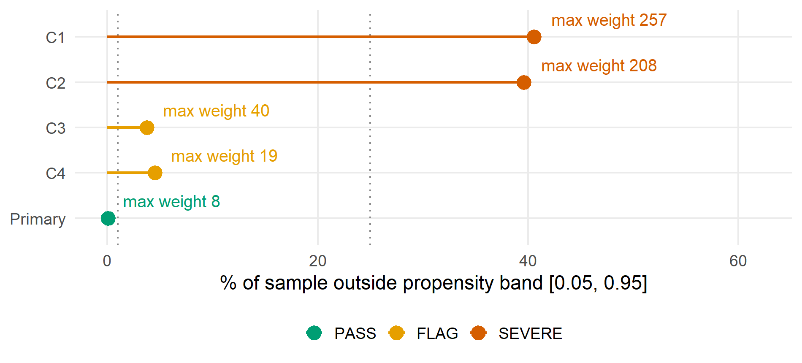
The support verdicts
Figure 2: Share of each contrast outside the propensity band [0.05, 0.95]. Dotted lines mark the verdict thresholds: FLAG above 1%, SEVERE above 25%. Labels give the largest implied ATE weight.

Slide 28
The protocol comparison places two-fifths of the sample outside the band. The declared trigger is met on C1 and C2 before any outcome is joined.

Slide 29
Who never gets a Rescue.Co ambulance?
The tree search puts names on the C1 violation:
injured at a private home, 1,386 patients, 1.4% treated
other non-street injury places, 1,438 patients, 2.5% treated
assault victims elsewhere, 1,062 patients, 4.2% treated
For these patients, “what if everyone were transported by Rescue.Co” has no answer in the data. A trimmed analysis removes 3,377 people, nearly all controls, and the design report describes them: 40% home injuries against 1% of those retained, more assaults, younger, farther away.

Slide 30
Which estimands survive the C1 fit
Estimand | Max weight | Verdict
ATE | 257 | SEVERE, infeasible
Trimmed ATE | 20 | PASS, population changes
ATT | 5.0 | PASS
ATO | 1.0 | PASS
Matched ATT | 1.0 | PASS, 95% of treated matched

Slide 31
The design supports an answer. Just not the one the protocol named.

Slide 32
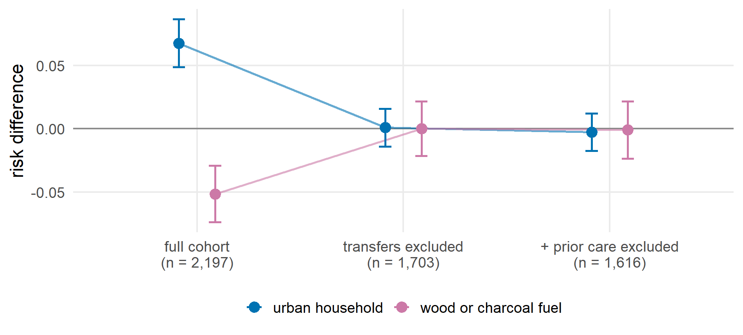
The exclusions, not the adjustment, removed the confounding
Figure 3: Two socioeconomic negative controls on the transfers-included contrast, refit on each nested cohort. Points are unadjusted risk differences with 95% intervals.

Slide 33
Both controls fail on the full cohort and turn null after the pre-registered transfer exclusion. On C1, the urban-household control fails and no restriction repairs it. Two rare controls are labelled inestimable rather than dropped.

Slide 34
Care processes stay out of the adjustment set
Vitals recorded within an hour, and blood-pressure missingness, are predicted by treatment on three of the five contrasts (standardised differences up to 0.34). Transport mode changes the care process.
Conditioning on them would open collider paths through in-hospital care, so the locks keep them out, and the check documents why.

Slide 35
The pre-outcome decisions
Contrast | Recommendation
Primary | Proceed
C3, C4 | Proceed, FLAG caveat attached
C1, C2 | Proceed with qualification. The ATE is not supported; the ladder moves to trimmed ATE, then ATT, then ATO, and the switch is logged with the SEVERE verdict as its trigger

Slide 36
All fixed before the outcome store was joined.

Slide 37
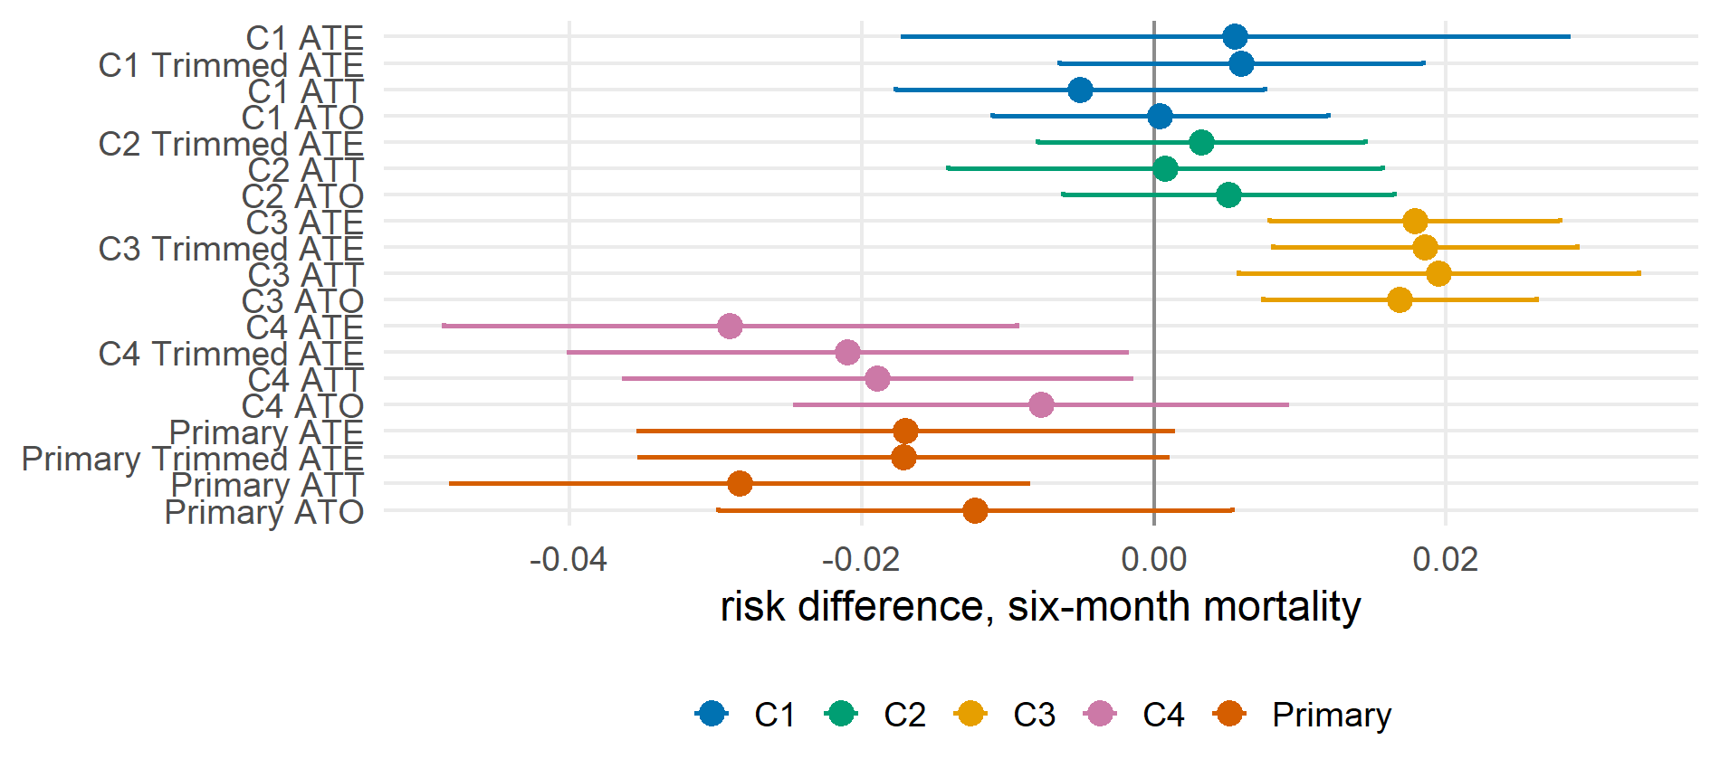
Six-month mortality, down the ladder
Figure 4: Risk differences with 95% intervals, one row per feasible estimand per contrast. Negative favours Rescue.Co.

Slide 38
C2 reports no ATE at all. The C1 ATE appears once, as a logged override kept so the two pipelines can be reconciled; it carries its SEVERE label and a standard error several times larger than the bounded rows beside it.

Slide 39
The disaster outcome, re-analysed
Contrast | Estimand | Minutes | CI lower | CI upper | Flagged
C1 | ATE | -183.5 | -400.4 | 33.5 | FALSE
C1 | trimmed_ATE | -270.4 | -313.4 | -227.4 | FALSE
C1 | ATT | -219.0 | -268.1 | -170.0 | FALSE
C1 | ATO | -198.8 | -255.3 | -142.3 | FALSE
C2 | trimmed_ATE | -278.8 | -346.7 | -210.8 | FALSE
C2 | ATT | -272.4 | -328.8 | -215.9 | FALSE
C2 | ATO | -250.1 | -315.5 | -184.7 | FALSE
C3 | ATE | -244.8 | -320.5 | -169.1 | FALSE
C3 | trimmed_ATE | -242.1 | -312.2 | -171.9 | FALSE
C3 | ATT | -295.8 | -381.6 | -210.0 | FALSE
C3 | ATO | -248.2 | -316.7 | -179.7 | FALSE
C4 | ATE | -204.7 | -284.0 | -125.3 | FALSE
C4 | trimmed_ATE | -134.3 | -220.6 | -48.0 | FALSE
C4 | ATT | -99.7 | -158.9 | -40.5 | FALSE
C4 | ATO | -89.7 | -165.8 | -13.6 | FALSE
PRIMARY | ATE | -0.1 | -31.6 | 31.5 | FALSE
PRIMARY | trimmed_ATE | -2.8 | -34.4 | 28.7 | FALSE
PRIMARY | ATT | -4.0 | -35.1 | 27.1 | FALSE
PRIMARY | ATO | 2.6 | -34.4 | 39.6 | FALSE

Slide 40
Time to arrival once returned +14,637 minutes. Down the ladder, the bounded estimands agree that Rescue.Co arrives three to four and a half hours sooner, the override-only ATE row shows its strain in the interval width, and the implausibility guard checks every row against the raw arm summaries. Any one of its checks would have caught the original failure.

Slide 41
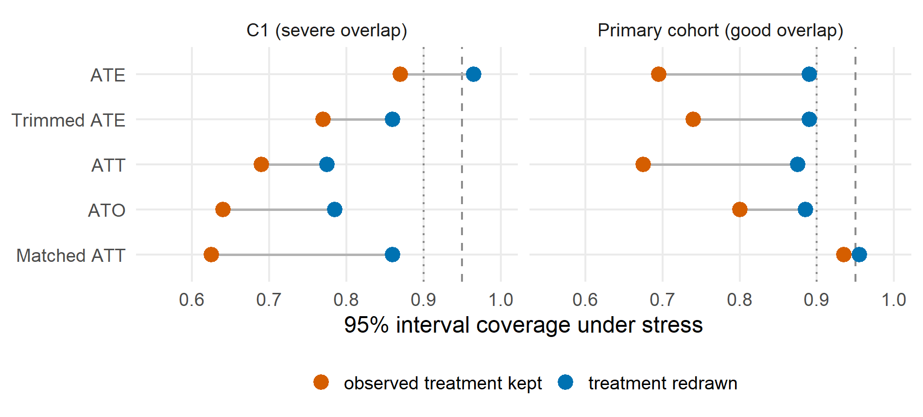
The simulation trap, on real data
Figure 5: Coverage under the stressed outcome surface, 200 replicates per design. Keeping the observed treatment degrades every estimand, on the sound design too.

Slide 42
A support map built on the kept-treatment design would declare sound designs infeasible. It manufactures the failure it was asked to detect.

Slide 43
The workflow audited its own earlier mistake
The earlier single-contrast run had a design flaw. Its primary outcome was the common category of a 92%-prevalence dichotomy, the cohort-adequacy check recorded a stop, and the pipeline proceeded through an unlogged override.
The rebuild’s reconciliation surfaced this because the record kept both entries, the stop and the estimate, with nothing between them. The fix went to the design: mortality became the primary outcome, and overrides now require a logged reason. The record makes gaps findable, including the workflow’s own.

Slide 44
How a reviewer reads the case study
Every verdict, declaration, and switch was fixed and logged before the outcome store was joined.
The protocol’s primary comparison was refused on the record, with the evidence attached, and the reported estimands are labelled with the populations they describe.
Where the two pipelines are comparable, the clean-room estimates agree with the parallel unblinded analysis to within fractions of a standard error, tracked row by row in a released reconciliation table.

Slide 45
5. Where this sits

Slide 46
Side by side
Feature | TMLE packages | causalRisk | Clean-room papers | cleanTMLE
Targeted-learning estimation | yes | – | – | yes
Cohort grammar, cumulative-risk reporting | partial | yes | – | yes
Graded support verdict, per-estimand feasibility | – | – | – | yes
Pre-registered estimand ladder, logged switching | – | – | – | yes
Outcome-blind support map | – | – | – | yes
Plasmode candidate selection, DQ stress test | – | – | – | yes
Fingerprinted lock and design log | – | – | guidance | yes

Slide 47
TMLE estimation is a decade old; the staged idea is published guidance. The new part is answering the estimability question inside the blind phase, with the record to prove when it was answered.

Slide 48
When to use it, and its limits
Use it when a reviewer will ask whether a decision was made before you saw the answer: estimator and estimand choices in observational studies, SAP development, real-world evidence work.
It does not automate design, validate data or phenotypes, guarantee assumptions, or replace negative controls and post-outcome sensitivity analysis. For confirmatory studies it belongs inside institutional governance, with role separation and independent review. An enforce = TRUE mode withholds estimation until a recorded design review, where institutions want that in software.

Slide 49
Where I want input
The harshest support-map surfaces behave like strong unmeasured confounding, so a whole-grid pass rule conflates two threats. How should the plausible region be elicited and pre-registered?
Is SEVERE the right default trigger, and trimmed ATE, ATT, ATO the right default order?
How should severity ranges for the stress test be documented so a reviewer accepts them?
The matched ATT is the most robust rung on every map here and the least interpretable population. Sensitivity analysis, or candidate primary?

Slide 50
Resources
Package: https://github.com/amertens/cleanTMLE (v0.2.0)
Manuscript draft: reports/manuscript_outcome_blind_dq.qmd
Case-study artifacts: rescueCo/results/multiarm/
Vignettes: staged workflow, and the function reference
Thank you. Questions and pushback welcome.

Slide 51
Appendix A: Concepts and alignment

Slide 52
Conceptual layers in the staged workflow
Layer | Description
Causal question | Clinical or policy question framed as a target trial.
Causal estimand | Counterfactual effect of interest, e.g. marginal risk difference.
Identification assumptions | Conditions under which the estimand equals an observed-data parameter.
Statistical estimand | That observed-data parameter.
Estimand ladder | Pre-registered fallbacks and the verdict that triggers a switch.
Estimator | TMLE, IPTW, matching.
Pre-outcome diagnostic | Support verdict, feasibility, simulated bias and coverage, balance, negative controls.
Governance decision | Proceed, proceed with qualification, or stop (Muntner et al. 2024).

Slide 53
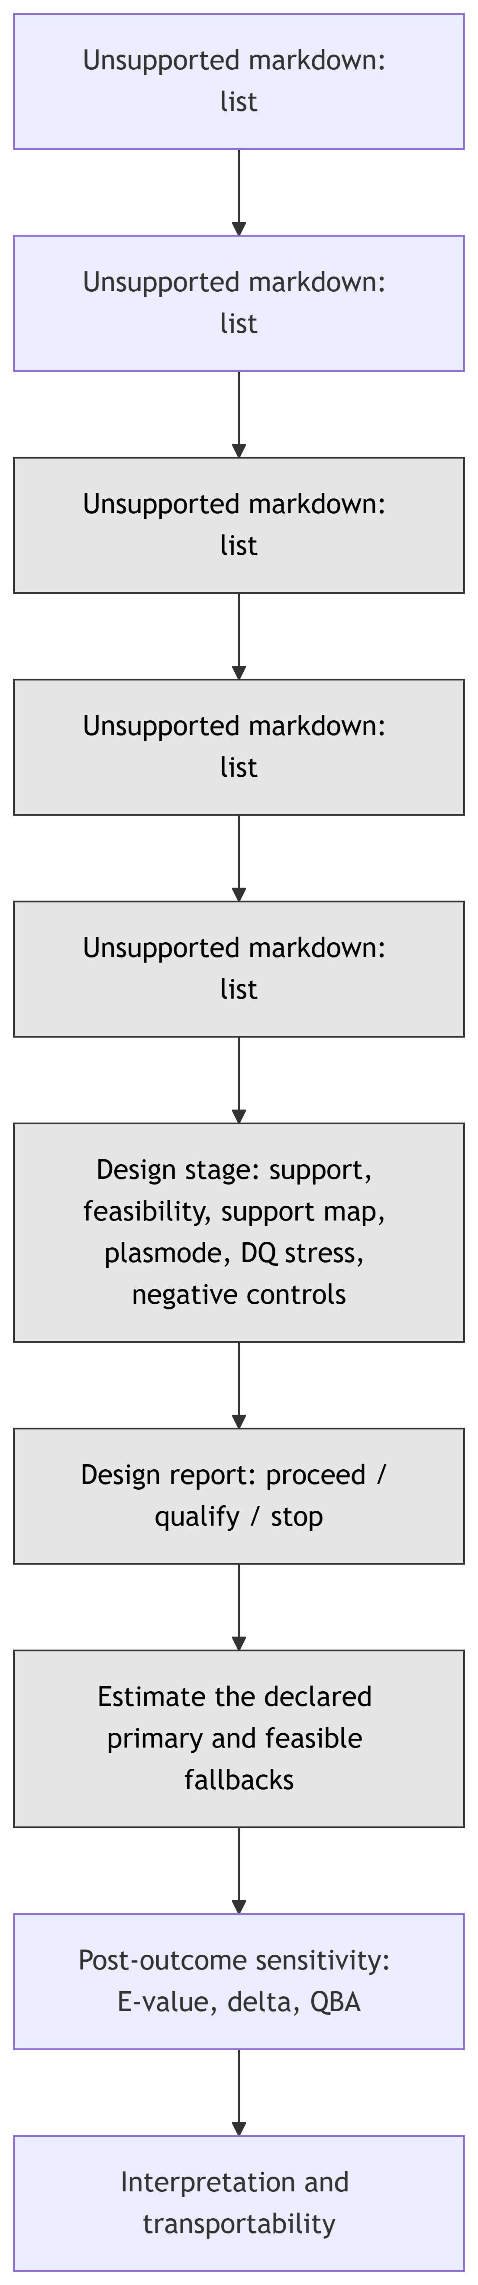
The causal roadmap, and what the package covers

Slide 54
Regulatory alignment (excerpt)
Roadmap component | FDA / EMA / ICH anchor | cleanTMLE
Causal question | Target-trial framework; FDA RWE Framework; ICH M14 | Lock record; design_report(protocol = ...) emulation table
Identification (positivity) | ICH E9(R1) | assess_support(), estimand_feasibility()
Statistical estimand | ICH E9(R1); FDA RWE Considerations | declare_estimand_ladder(), run_estimand_ladder()
Estimator selection | FDA non-interventional studies; ICH M14 | tmle_candidate(), select_tmle_candidate()
Pre-outcome DQ stress | Source reliability (FDA, EMA) | run_plasmode_dq_stress(), simulate_support()
Post-outcome sensitivity | FDA non-interventional; ICH E9(R1) | compute_evalue(), run_delta_sensitivity()

Slide 55
The stress-test threat families
Threat | Mechanism | Probes | Does not probe
Covariate missingness | MCAR, MAR, MNAR masks; median impute | Imputation robustness | Phenotype validity
Exposure misclassification | Flip A at given sens and spec | Treatment measurement | Differential error by outcome
Outcome misclassification | Flip Y, optionally per arm | Outcome measurement | Time-varying ascertainment
Near-positivity | Amplify covariate-treatment association | Estimator strain | The realised design’s support
Unmeasured confounding | Latent U shifts A and Y | Exchangeability | Multiple latent confounders

Slide 56
Appendix B: Case-study detail

Slide 57
The declared ladder, per lock
Identical across the five locks, declared before outcome access: primary ATE with IPCW for missing outcomes; fallbacks trimmed ATE [0.05, 0.95], then ATT, then ATO; trigger SEVERE. The matched ATT is assessed in the feasibility table and support map as a design-stage sensitivity, not estimated on the ladder.
Propensity library: the build_sl_library() preset for wide registry designs (penalised logistic learners, PCA-reduced GLMs, marginal mean; no tree learners, which can separate arms on wide indicator sets), ten folds.

Slide 58
Negative-control ladder, exact rows
Contrast | Cohort | Urban household | Wood or charcoal fuel
C4 | Full (n = 2,197) | +0.068 | -0.052
C4 | Transfers excluded (n = 1,703) | +0.001 | +0.000
C4 | Prior care also excluded (n = 1,616) | -0.003 | -0.001
C1 | Full (n = 8,323) | +0.013 | -0.006

Slide 59
Hypertension is null on every rung. Insulin-treated diabetes and HIV on ART are inestimable (a cell below 5 events) and labelled as such. A TMLE-adjusted variant is released with a caveat: on restricted rungs it conditions on design columns that are near-copies of the socioeconomic controls.

Slide 60
The support-map reading rule, from the design log
Recorded before estimation: the maps are read over the moderate-confounding region (synthetic strength up to 1), with the whole-grid pass reported as a conservative bound.
The harshest rung stresses every weighting-based estimand at once, including on the PASS-verdict primary cohort, so a whole-grid rule conflates support failure with confounding stress. The signature used instead: failure at the mildest surface means a support problem (C1’s ATE, coverage 0.87 before any synthetic confounding); failure only under stress, hitting all unmatched estimands together, means stress (the primary cohort at strength 2, where the matched ATT holds 0.93 to 0.96).

Slide 61
Candidate selection under stress (earlier single-contrast lock)
Four TMLE candidates varying propensity library and truncation tie on the clean baseline (RMSE within 0.0002), where the minimum-RMSE rule would lock glm_t01. Under the five-threat sweep the worst-case RMSE ratios separate: 1.82, 1.73, 1.53, and 1.27 for ensemble_t05.
The minimax rule locks ensemble_t05. The candidate selected for clean-data efficiency was the most exposed under prespecified stress. Reported at 50 replicates as a workflow illustration; 200 is the inferential bar.

Slide 62
Effect estimates, exact rows
Contrast | Estimand | N | RD | CI lower | CI upper | p | Support
C1 | ATE | 8323 | 0.006 | -0.017 | 0.028 | 0.633 | SEVERE
C1 | trimmed_ATE | 4946 | 0.006 | -0.006 | 0.018 | 0.349 | PASS
C1 | ATT | 6557 | -0.005 | -0.018 | 0.008 | 0.434 | PASS
C1 | ATO | 6557 | 0.000 | -0.011 | 0.012 | 0.945 | PASS
C2 | trimmed_ATE | 4327 | 0.003 | -0.008 | 0.014 | 0.570 | PASS
C2 | ATT | 5632 | 0.001 | -0.014 | 0.016 | 0.918 | PASS
C2 | ATO | 5632 | 0.005 | -0.006 | 0.016 | 0.376 | PASS
C3 | ATE | 8323 | 0.018 | 0.008 | 0.028 | 0.000 | FLAG
C3 | trimmed_ATE | 8009 | 0.019 | 0.008 | 0.029 | 0.000 | PASS
C3 | ATT | 6557 | 0.019 | 0.006 | 0.033 | 0.005 | PASS
C3 | ATO | 6557 | 0.017 | 0.007 | 0.026 | 0.000 | PASS
C4 | ATE | 2197 | -0.029 | -0.049 | -0.009 | 0.004 | FLAG
C4 | trimmed_ATE | 2098 | -0.021 | -0.040 | -0.002 | 0.031 | PASS
C4 | ATT | 1704 | -0.019 | -0.036 | -0.002 | 0.033 | PASS
C4 | ATO | 1704 | -0.008 | -0.025 | 0.009 | 0.367 | PASS
PRIMARY | ATE | 1616 | -0.017 | -0.035 | 0.001 | 0.068 | PASS
PRIMARY | trimmed_ATE | 1615 | -0.017 | -0.035 | 0.001 | 0.062 | PASS
PRIMARY | ATT | 1227 | -0.028 | -0.048 | -0.009 | 0.005 | PASS
PRIMARY | ATO | 1227 | -0.012 | -0.030 | 0.005 | 0.172 | PASS

Slide 63
Appendix C: Figures

Slide 64
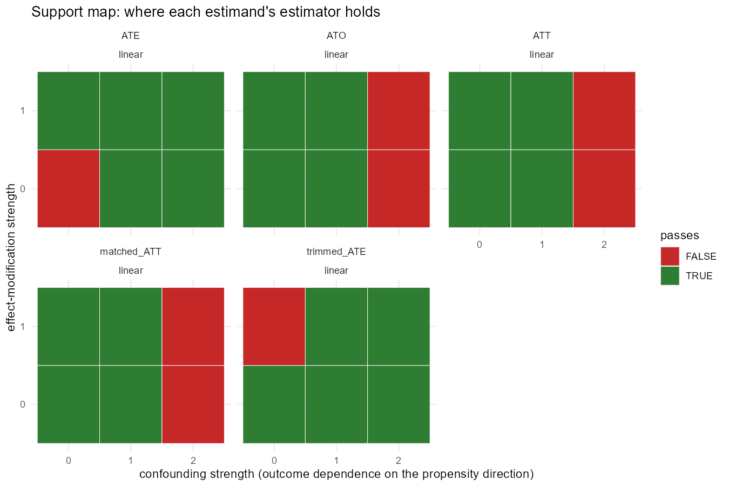
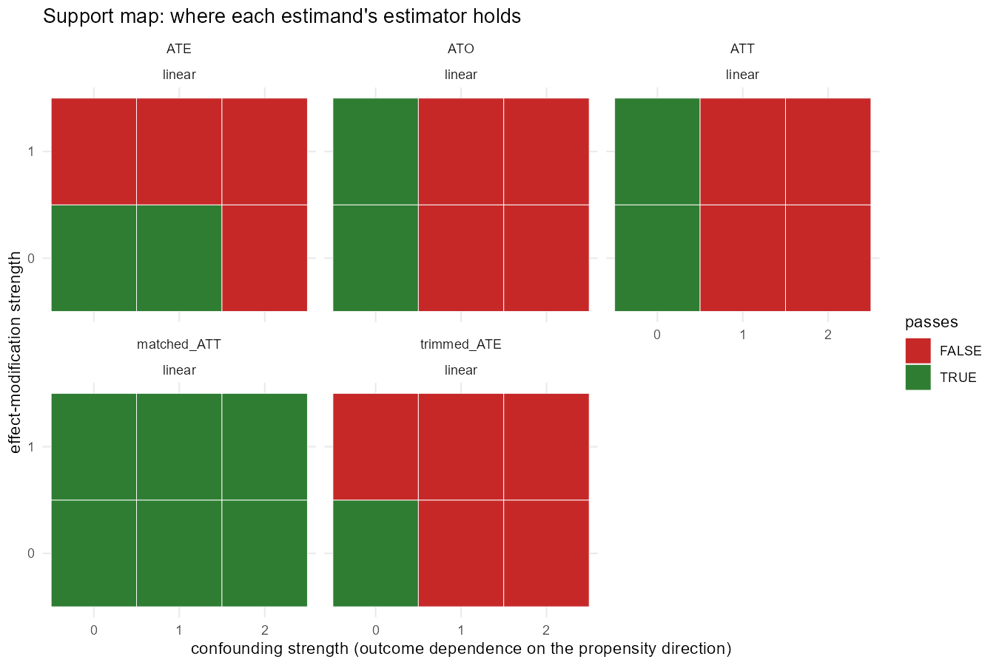
Support maps
C1: the ATE fails at the mildest surface
Primary cohort: degradation arrives only with stress

Slide 65
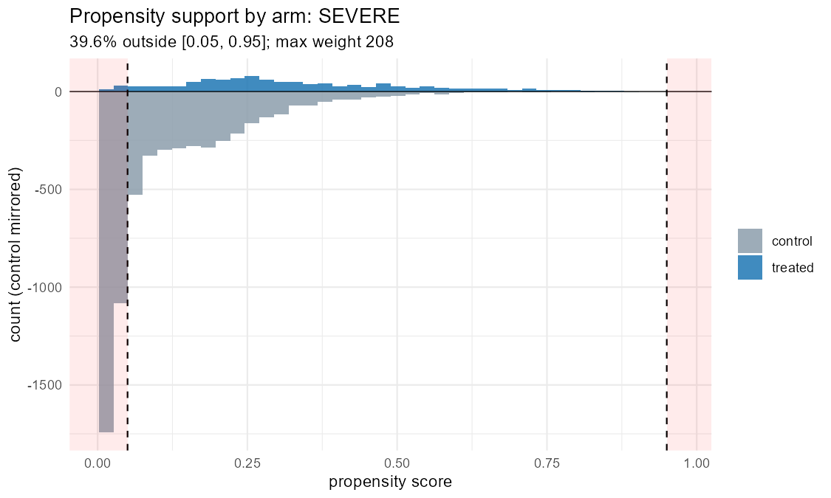
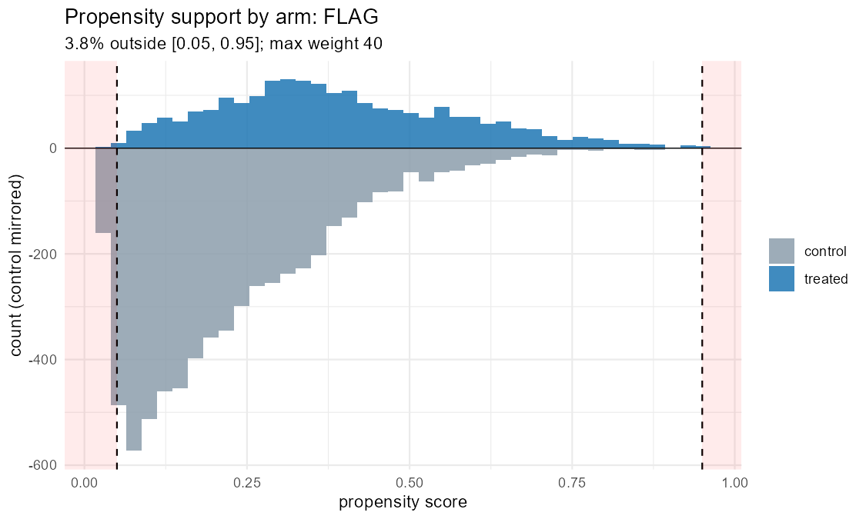
Support histograms, flagged contrasts
C2: SEVERE
C3: FLAG

Slide 66
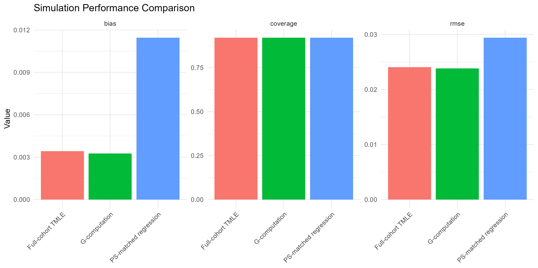
Earlier single-contrast diagnostics
Plasmode candidate performance
DQ degradation gradient

Slide 67
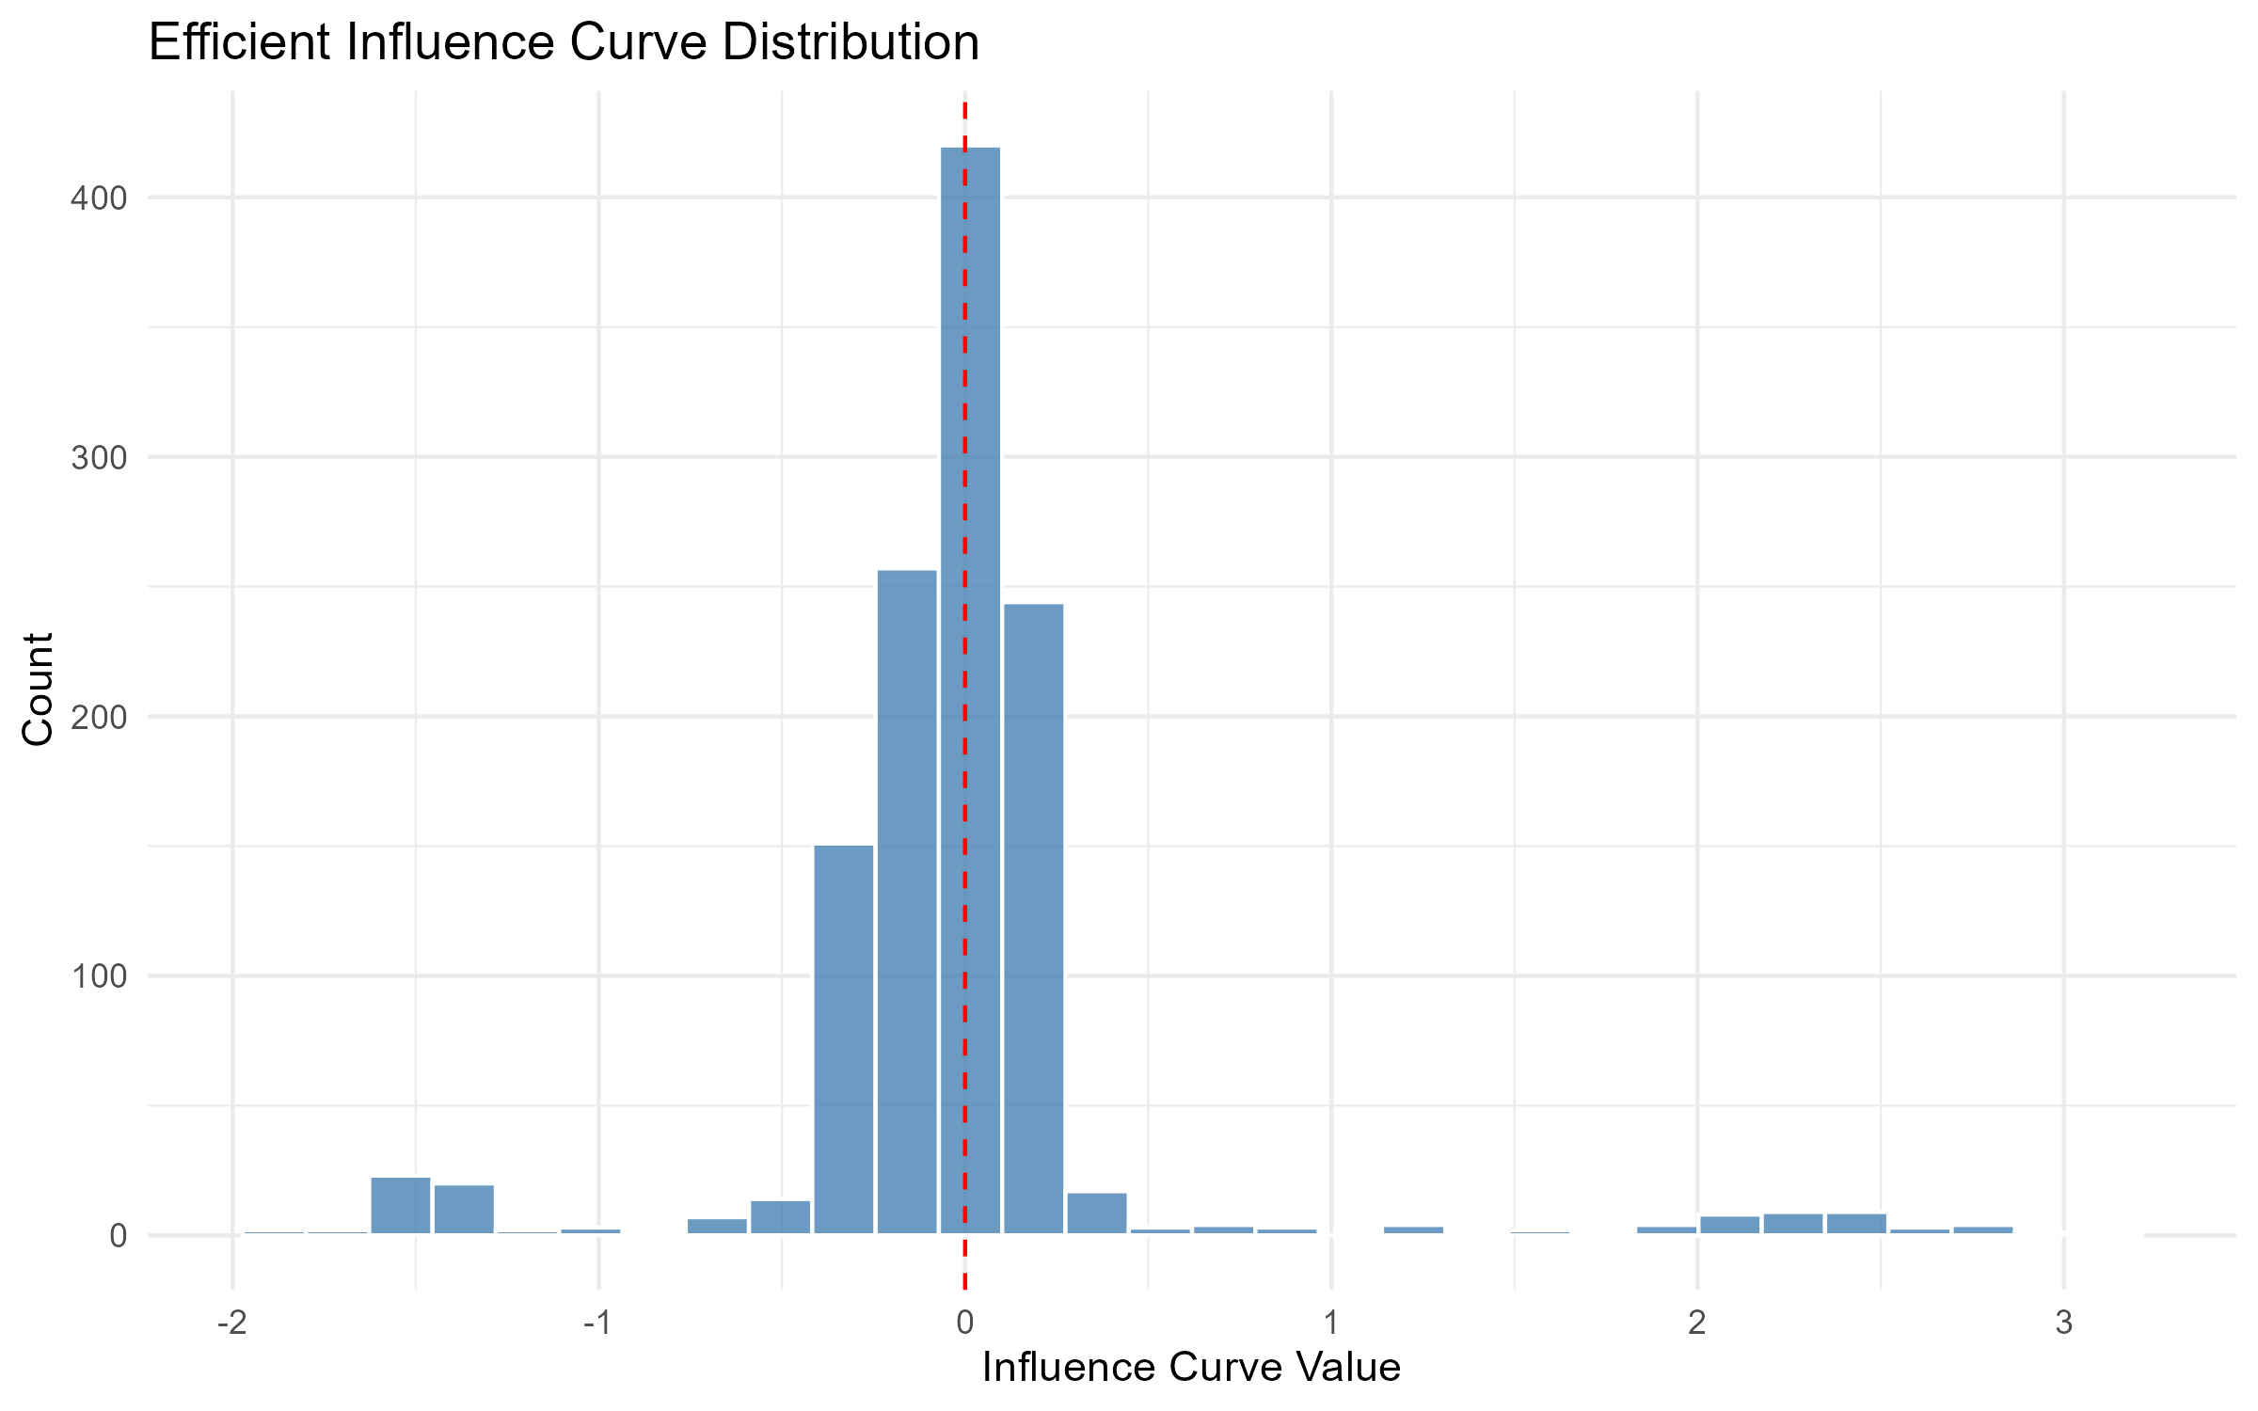
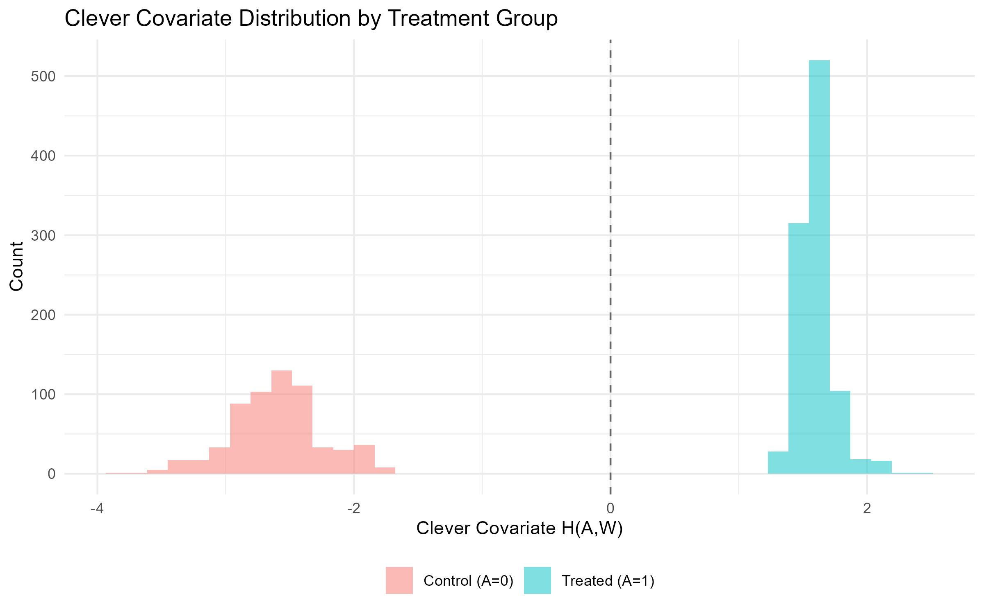
TMLE internals (earlier lock)
Influence-curve distribution
Clever covariate by arm

