Slide 1



Proxy dataset creation
Andrew Mertens (University of California, Berkeley)
We are grateful for the funding support by the Gates Foundation

Slide 2
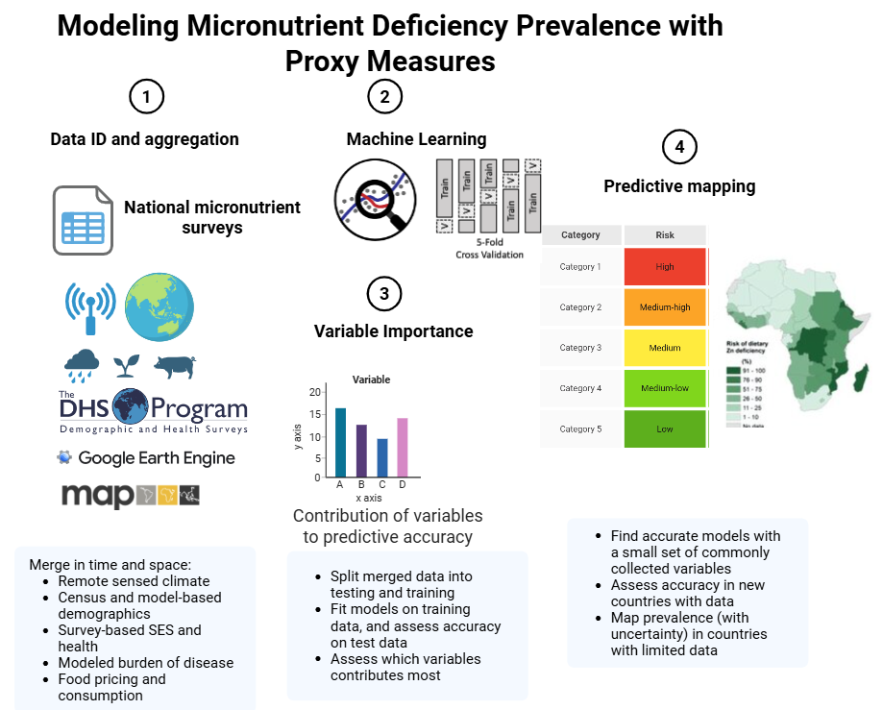

Goals
To generate national and sub-national prevalence estimates for micronutrient deficiency using a wide range of proxy indicators and validated against the prevalence of these same vitamin and mineral deficiencies (VMD) determined by biomarker assessment
To identify subnational regions at greatest risk of deficiency
To engage with national stakeholders and decision-makers throughout project

Slide 3
Proxy requirements
Available for every district of every country, surveyed or not, from a non-DUA source
Independent of the outcome but plausibly related to the outcomes
Placed at the survey year, or as close to it as the source allows, with the gap recorded.
Using any type of data: direct survey responses, calculated indices, remote sensed layers, and modeled estimates
Notes:
This talk is about the right-hand side of the model: where the 570 columns come from, how each one gets from its native form to a district value, how we line them up with four surveys taken in four different years, and which of them the model leans on. The analysis deck covers what the ranking achieves; this one covers what it is made of. The leakage rule is the second bullet: a district aggregate of the same survey instance we score is excluded (docs/findings, LK-02), and where a MICS or DHS was fielded inside the biomarker survey’s own clusters those clusters are dropped from the aggregate (The Gambia 2018: 70 MICS clusters; Malawi 2015-16: 105 DHS clusters). The record behind the fourth bullet is the shared metadata file and results/tables/protocol_v2/variable_sheet.csv. One consequence of the first bullet: 45 of the 570 columns are national series with one value per country, and a value that is the same in every district cannot rank districts, so the models drop them when they are fitted.

Slide 4
Predictor sources: land, climate, agriculture
Source | What it is
Earth Engine: TerraClimate | Monthly climate (rain, temperature, evapotranspiration, soil moisture), 4 km; survey year and 1991-2020 normals
Earth Engine: MODIS | Land-surface temperature (1 km), NDVI and EVI (250 m) at the survey year, plus climatology and anomaly
Earth Engine: land cover, lights, built-up | Copernicus land-cover fractions, night lights, GHSL built-up surface, human modification
Earth Engine: productivity | MODIS NPP and GPP, WaPOR evapotranspiration, leaf area, grassland cover
AlphaEarth | Google’s 64-number satellite embedding of a year of imagery, 10 m, 2017
SoilGrids / iSDA | Soil nutrients at two depths, pH, texture, organic carbon (iSDA 30 m, SoilGrids 250 m)
Koppen / AEZ | Climate classes and agro-ecological zones: class shares and purity
JRC Surface Water / LSIB | Distance to permanent and seasonal water and to the coast
MapSPAM | Crop area and production by crop, 10 km, 2010
Gridded Livestock of the World | Cattle, sheep, goats, pigs and poultry per km2, 10 km, 2015
WorldPop / GHSL / GPW / RWI | Population, age-sex structure and density; Meta’s relative wealth index

Slide 5
Predictor sources: health, food, households
Source | What it is
IHME modelled surfaces | 5 km modelled surfaces: child growth, anaemia, WASH, education, ORS, HIV, malaria, measles vaccination
Malaria Atlas Project | Parasite rate, incidence, mortality, net use and spraying, 5 km, at the survey year
WHO ESPEN | Helminth endemicity and mass-treatment coverage by implementation unit
WHO anaemia; UNICEF VAS; WHO FluNet | National series: anaemia prevalence, vitamin A supplementation, influenza counts
WFP market prices; World Bank RTFP | Monthly market food prices, distance-weighted to districts over the survey year (RTFP: Gambia, Malawi)
FAOSTAT; HFID | National food balance sheets; FEWS NET / IPC food-security phases and indicators
GFDx | Fortification standards and coverage by food vehicle, mostly national
MIMI (Tang et al. 2026) | Modelled dietary micronutrient inadequacy from GLSS7, Ghana regions
DHS | 150 district indicators from the paired round, cluster spatial model
MICS microdata; MICS via WHO HEAT | 30 indicators from the public microdata (WASH, wealth, education, child feeding, health); 19 regional indicators via WHO HEAT
Household budget surveys (HCES) | Food share, own production, consumption level, 7-day food groups (IHS, GLSS7, IHS4, SLIHS)
Global Data Lab | Subnational human development index

Slide 6
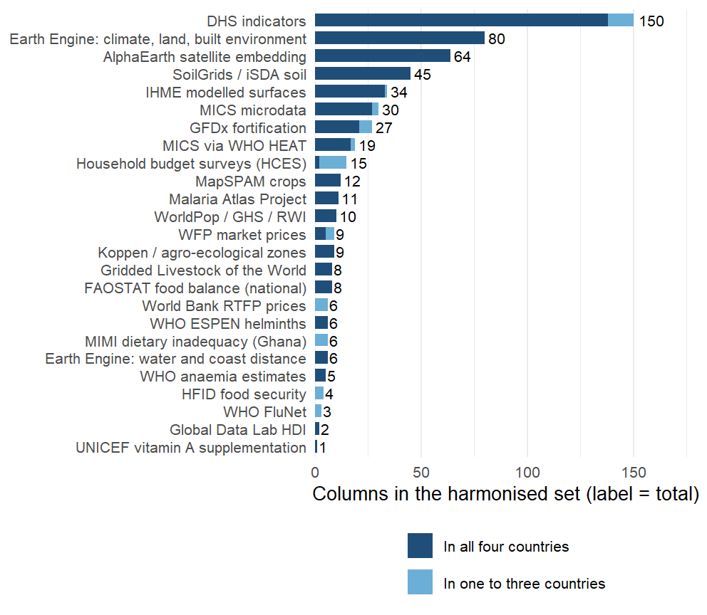
Proxy predictor counts
570 harmonized variables from 28 sources. 510 exist in all four countries and can serve a model for a new country; the other 60 exist in one to three and are used inside the countries that have them.
Notes:
Read the bar chart from the top. One harmonised set feeds every model: the in-country models use whatever a country has, the cross-country models the columns all four share, so the light segment (household budget survey diet items for two countries, RTFP prices for two, MIMI for Ghana, MICS items missing from one round, a few IHME surfaces) works at home and not abroad. Behind the set sits a larger extraction: about 740 columns per country in the raw files (1,968 distinct names across the four, mostly the same quantity under country-specific names), harmonised to a common vocabulary; what did not harmonise was used only in the pre-protocol models. The Earth Engine block is climate (TerraClimate at the survey year and as 30-year normals), land cover, night lights, built-up surface, vegetation and evapotranspiration, night-time land surface temperature; the satellite embedding is Google’s AlphaEarth, 64 numbers per district that summarise a year of imagery; soil is iSDA and SoilGrids, ten nutrient concentrations at two depths plus texture and pH; crops are MapSPAM’s 2010 allocation; livestock is GLW4. The health and nutrition surfaces are IHME’s modelled estimates (anaemia, child growth, WASH, education, ORS, HIV, malaria, vaccination) and the Malaria Atlas layers; ESPEN gives helminth endemicity. Prices come from WFP markets, the World Bank’s RTFP panel and FAOSTAT balances; fortification from GFDx. The public microdata blocks are new since 15 September: 30 indicators from the MICS files for all four countries and 15 diet and consumption indicators from the household budget surveys (IHS 2015/16, GLSS7, IHS4, SLIHS 2018). The DHS block is 150 district aggregates from the round paired with each survey (Ghana 2014, Malawi 2015-16, Sierra Leone 2013, The Gambia 2019-20), estimated with a cluster-level spatial model so every district has a value. Everything here is listed with its source, year and definition in results/tables/protocol_v2/variable_sheet.csv and in the dashboard’s catalogue.

Slide 7
Types of data
Raw form | Examples | To a district | Time
Gridded raster (30 m to 10 km) | Climate, soil, satellite, IHME and MAP surfaces, population | Zonal mean over the district polygon, area- or population-weighted | Survey year, nearest year, or 30-year normal plus anomaly
Survey with GPS clusters | DHS; MICS 2018 in The Gambia, 2017 in Sierra Leone | DHS: cluster spatial model (BYM2) so every district has a value; MICS: clusters inside the polygon, minimum 30 households | The round paired with the biomarker survey
Survey identified to region or district | MICS in Ghana and Malawi; household budget surveys | Value of the smallest survey unit that contains the district, flagged as the parent’s value | The round nearest the survey
National series | FAOSTAT balances, GFDx programme fields, FluNet | Constant within a country; dropped when the model is fitted | Survey year
Notes:
Rasters are the easy case: exactextractr over the GADM polygon, weighting by WorldPop where the quantity is about people (the IHME surfaces) and by area where it is about land (climate, soil, greenness). Twelve of the IHME columns were still joined by district name until this week; the tabular files predate Ghana’s 2019 district splits and left 56 percent of Ghana empty, so they were re-extracted from the 5 km GeoTIFFs. Survey microdata with GPS goes point-in-polygon after the leakage clusters are removed, with a minimum of 30 households and 5 clusters per district before a district gets its own value; below that it takes the parent region’s value and is flagged. Ghana’s MICS 2017-18 identifies the ten old regions and Malawi’s MICS 2013-14 the 27 districts, so those blocks vary at that level only and every column carries a subnational flag saying so. National series are kept in the set for documentation and completeness, but a constant cannot rank districts; the fit-time policy removes 45 of them (FAOSTAT, most GFDx fields, WHO anaemia national estimates, VAS, FluNet).

Slide 8
Linking in space
554 districts on GADM 4.1: Gambia 37, Ghana 260, Malawi 243, Sierra Leone 14.
Every unit carries its GADM code, HASC code and the OCHA p-code, so a join is by code where the source has one.
Names are matched only as a last resort, through a reviewed alias table with a distance cap, and always on the region-district pair
Ghana: 260 districts on the 2019 boundaries; sources on the 2012 boundaries (216) or the ten old regions
Malawi: 243 Traditional Authorities; sources at district level (28) are broadcast down and flagged.
The Gambia: 37 districts
Sierra Leone: 14 districts.
Notes:
The spine is metadata/admin2_spine.csv; the helpers in R/admin2_keys.R do every join in the pipeline and a lint test (tests/testthat/test-admin2-join-lint.R) reads every script for a join on a bare Admin2 name. The p-codes came from OCHA’s COD-AB for all four countries this week, both directions, so an OCHA-coded source (IPC, ACLED, cluster surveys) joins without any matching. Fuzzy matching, where it is still needed, is Jaro-Winkler with a 0.15 cap and a review file that lists every non-exact match for a human to accept. The population defect: the dashboard’s population table had been deduplicated by district name, so Chikwawa’s TA Lundu and Nsanje’s TA Ngabu, Salima’s TA Pemba and Zomba’s TA Malemia lost one member each, two of them surveyed districts, and every population-weighted figure silently excluded them. Fixed 15 September from WorldPop density, and the population table is now asserted complete in the tests.

Slide 9
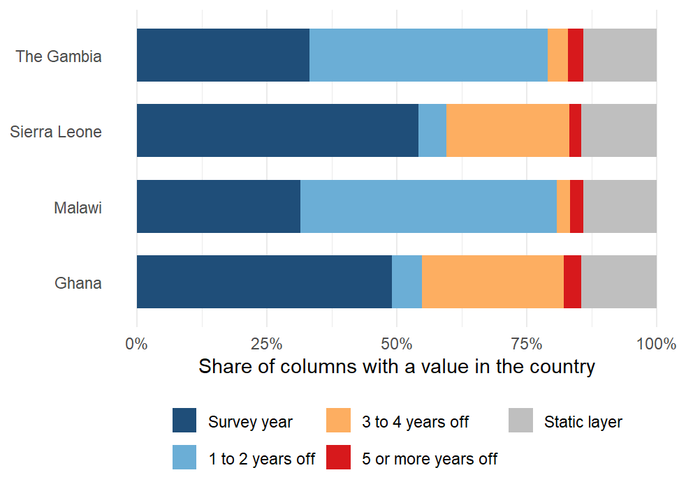
Linking in time
Surveys: The Gambia 2018, Ghana 2017, Malawi 2016, Sierra Leone 2013.
131 variables are from the survey year in every country and 78 are static layers.
306 are three or more years off in at least one country:
  the DHS round paired with Ghana’s 2017 survey is from 2014
  Sierra Leone’s 2013 survey predates the satellite embedding and its nearest MICS by four years
  MapSPAM’s 2010 crop map is the oldest layer everywhere.
Notes:
The rules live in metadata/covariates/temporal_alignment.csv, 45 of them, one regular expression each: survey_year where an annual series exists (TerraClimate, MODIS NDVI, MAP, WorldPop density, WFP prices, RTFP windows), nearest available year where a series ends early (IHME’s child growth, education and WASH stop at 2017, anaemia and malaria at 2019), a fixed vintage where there is only one (AlphaEarth 2017, MapSPAM 2010, GLW 2015, RWI 2019), a per-country round for the household surveys, and static for soil, terrain, climate normals and zones. Climate and greenness enter as a 30-year normal plus the survey-year anomaly in standard-deviation units, which is what transports; the calendar-year series that lagged the survey by up to eight years were retired. Sierra Leone’s 2013 survey is the awkward one: AlphaEarth starts in 2017, Copernicus land cover in 2015, and the MICS round nearest it is 2017, so its gaps are the orange and red bands. Ghana’s are the DHS block: the round paired with the 2017 survey is the 2014 DHS, three years off for 140 columns. The gaps that apply everywhere are the single-vintage products: MapSPAM 2010, GLW 2015, WorldPop’s 2020 age-sex structure. The stamp is per column and per country (results/tables/predictor_alignment_2026-09-16.csv), and the audit lists everything three or more years off.

Slide 10
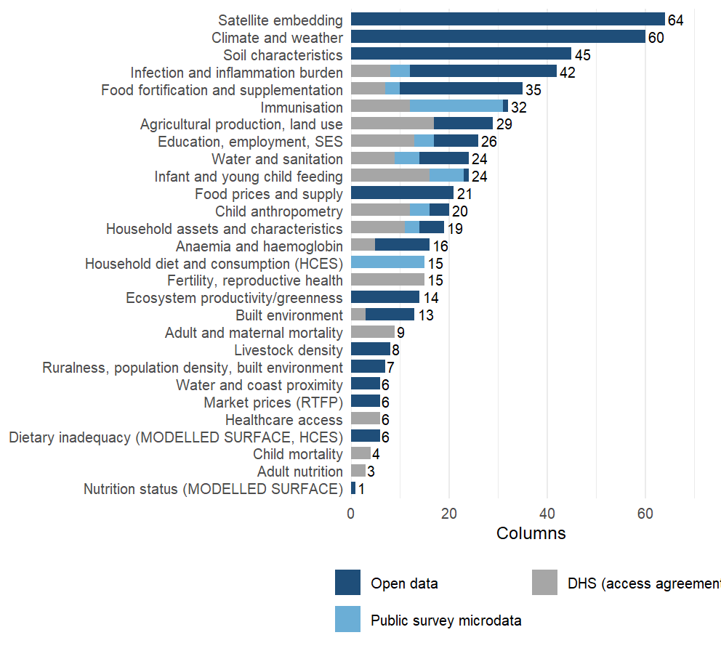
Variable domains
28 domains.
Each domain enters our best model as its leading principal components, to 80% of variance and at most twelve, learned on the training districts only.
Notes:
Why domains: 570 columns against 14 to 87 districts per country cannot be fitted column by column, and the columns are heavily correlated within a source. Grouping them by what they measure and taking principal components inside each group keeps most of the variance of each group, treats a source with 64 columns and a source with 3 as one construct each, and keeps the outcome out of the representation: the rotations are learned from the training districts’ predictors alone, so nothing is selected on the biomarker. The grouping is written down: each source block brings a label, and 10 override rules in metadata/covariates/domain_overrides.csv regroup columns by construct (infection and inflammation burden, immunisation, anaemia, child anthropometry, infant feeding, supplementation, water and sanitation, education, child mortality, assets), so that MAP, IHME, DHS and MICS versions of the same thing are weighed together. Two things went wrong this week and are now guarded. A domain’s first twelve characters are its key inside the model; two labels that shared them (“Food prices (RTFP)” and “Food prices and supply”) were silently merged in two analyses until a check caught it on 16 September. The other is in the exclusions, on the next slide. One more point for questions: climate alone or soil alone transports better than all domains together, the analysis deck’s climate-and-soil result.

Slide 11
Proxy dataset CONSORT
Step | What happens | Columns
Assemble | Base extraction on the spine, food environment, extra sources, add-back sources
Append blocks | Household budget surveys, MICS microdata, RTFP prices, MODIS NDVI, climate normals | 614
Exclude | Rules with a written reason: data defects, superseded layers, redundant twins | 570
Stamp | Access tier, within-country variation, alignment rule, year used and gap, modelled-surface flag | 570
Fit-time policy | Drop national constants and leakage columns | 525
Transport matrix | Per country: coverage of at least 70% and some variation; then the four-country intersection | 464
Notes:
One shell script runs the chain (scripts/covariates/rebuild_shared_tail.sh) and ends in an audit that fails the build on a domain-key collision, a column declared subnational that does not vary, or a join that fans out. The exclusion file has 22 rules and every rule states its evidence: a nitrogen layer whose medians differ thirtyfold between countries, an NDVI product declared available only to 2013, calendar-year series superseded by survey-year values. This week’s most instructive mistake was in the exclusions. A review labelled the soil dispersion bands and the 20-50 cm depth means “redundant” on a mechanistic argument, and the climate-and-soil result fell from 0.37 to 0.34 across districts and from 0.45 to 0.40 across regions. The bands correlate only 0.03 to 0.69 with the depth means, so the label was wrong; restoring them brought both numbers back. We now hold to one rule: nothing is added or regrouped because a score likes it, an exclusion whose stated premise fails on its own metric is reverted, and every set change is checked against the transport arms before a run. What a model can see is the last two rows: 525 columns vary within a country, of which 464 have a value in all four countries and so can be used to predict a new one. The rest are per-country data gaps: household budget diet indicators pending for Ghana and Sierra Leone, RTFP for The Gambia and Malawi only, MICS items absent from one round.

Slide 12



Ensemble Machine Learning
Competition” of algorithms
Combinations of simple regressions and more complex machine learning models to allow interactions and nonlinear associations.
Best “team” wins
Weighted combination of algorithms
Performance judged on independent data
V-fold cross validation (Internal data splits) to avoid overfitting
Library:
Simple mean
Penalized regressions
Random forest models
Gradient Boosting models
PCA-HAL
Bayesian Additive and Regression trees
Bayesian Geostatistical Models
Notes:
No penalty other than computation time to add more algorithms
Ensemble strengths:
Diversity
Redundancy
Synergy

Slide 13
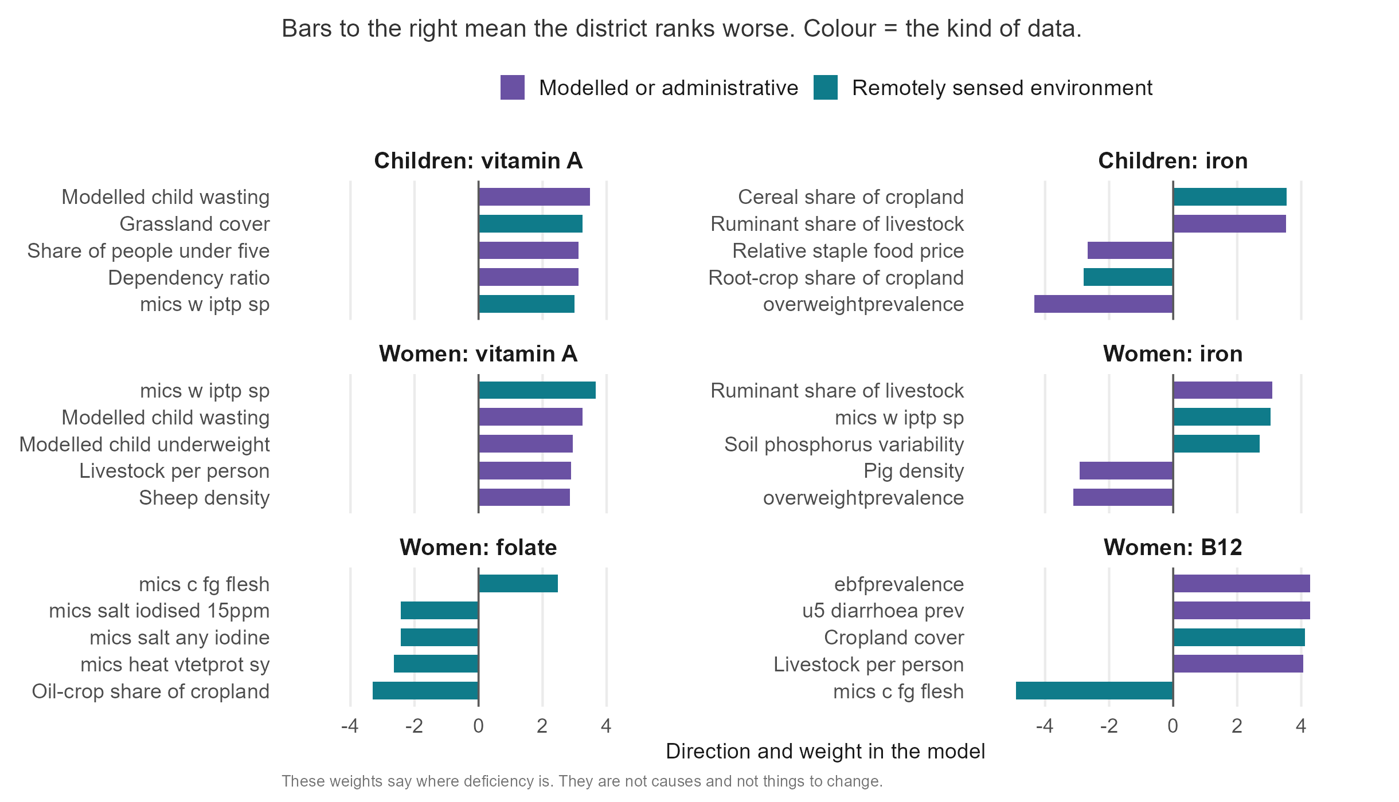
Variable importance
Notes:
The five largest weights per outcome in the pooled four-country fit, biomarker level, from results/tables/protocol_v2/index_importance_top.csv. These are individual columns, but the model is fitted at the district level: each weight is a column’s standardised contribution to the district index, projected back from the domain components (R/protocol_v2_importance.R), not a person-level effect. One gradient runs through all six outcomes: districts that are drier and grassier, less productive, more pastoral, poorer and with more stunted children rank worse on every deficiency. The groups behind it are the physical environment: satellite imagery, climate and soil carry 40% to 54% of the index inside a country depending on the outcome. The weights locate deficiency; they do not say what to change. Livestock density ranking positive for iron and B12 is the ecology of dry, poor, pastoral zones rather than a dietary effect of cattle. The twenty-layer list for child iron, in the appendix, is the same story as a list a country could rebuild itself; all twenty keep their direction in every leave-one-country-out fit.

Slide 14
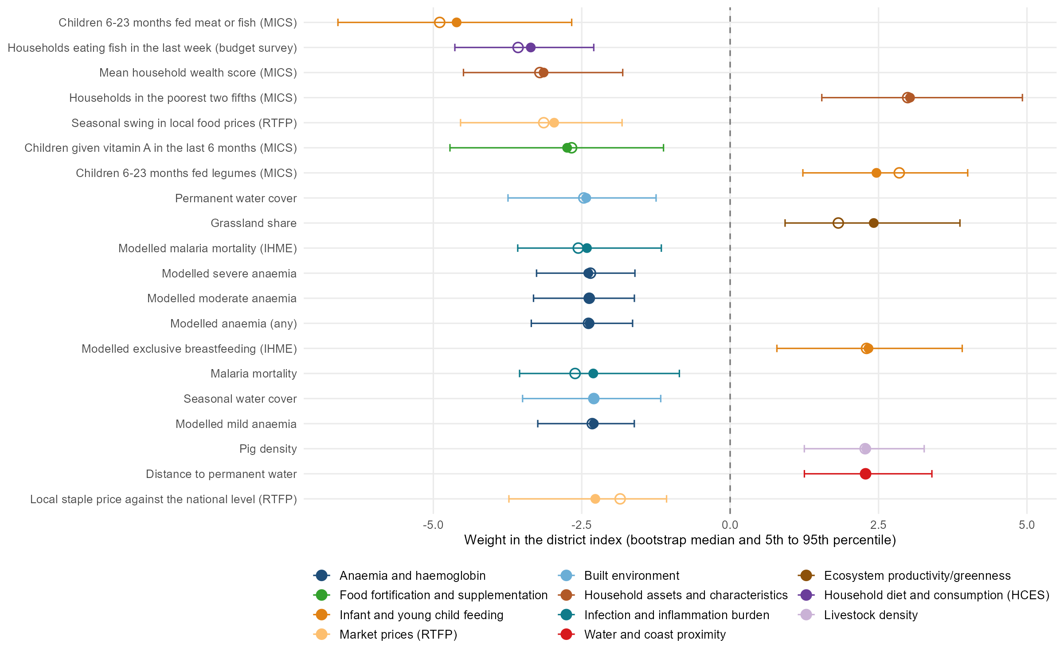
Variable importance: Malawi B12 concentrations in women
Notes:
Malawi, women’s B12, biomarker level: the cell with the best in-fill ranking of the 24 (Spearman 0.70; The Gambia child vitamin A is next at 0.69). The index is linear in the rank-normalised columns, so every column has a standardised weight in a fit; the twenty largest are shown. Intervals: the index was refitted on 300 bootstrap resamples of Malawi’s 87 surveyed districts, with the domain components re-oriented and the weights re-learned each time; the bar is the 5th to 95th percentile and the hollow marker the weight in the full fit. Every one of the twenty keeps its sign in at least 95 percent of refits. The level target is the negated log concentration, so a positive weight means worse status. Read the signs as district-level associations in Malawi: districts where more infants are fed meat or fish, more households ate fish last week and the wealth score is higher have better B12 status, and districts that are poorer, grassier, further from permanent water and with more pigs have worse. The diet items point the way a nutritional story would expect; the anaemia and malaria surfaces run the other way (more anaemia and malaria, better B12), which is the lakeshore and the south against the uplands, and a reminder that these are ecological associations, not effects. Script: scripts/policy_deck/09_vim_forest_example.R, which takes any country, outcome and target through environment variables. B12 is measured in three of the four surveys, so this cell does not enter the cross-country transport figures.

Slide 15
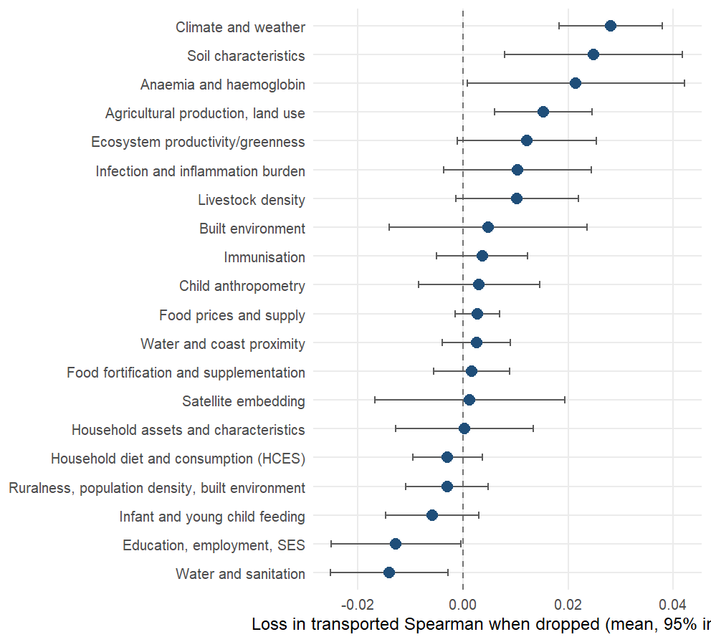
Variable importance- cross country models
Notes:
Source: domain_ablation_loco.csv, leave-one-country-out, biomarker level. Positive means the domain is load-bearing for a country the model has never seen. Climate (+0.03) and soil (+0.03) carry most; the anaemia surfaces, agriculture and greenness are behind them. The survey-derived constructs sit at or below zero: water and sanitation and education help inside a country and not across borders, and by source the MICS microdata block is the one whose removal improves transport (-0.02). The physical environment carries the signal, and it is also what a country without a survey can download. The two-domain climate-and-soil index reaches 0.38 across districts; it was found on these four countries and is pre-registered for the fifth. These ablations are scored on the open and public-microdata columns, the set the analysis deck’s headline models use; that deck also reports the arms with the DHS block in and with the open layers alone.

Slide 16
What works in the cross-country transport models
The landscape gradient: grassland and cropland cover, the share of ruminants in the herd (top twenty in 14 of the 22 held-out fits), cattle and sheep density, cereal-heavy cropping, and low plant productivity. Dry, grassy, pastoral, unproductive districts rank worse on every outcome.
The modelled child-growth and anaemia surfaces: wasting, underweight and anaemia point to worse status; overweight points the other way and behaves as a wealth proxy.
The food economy: the local staple price relative to the national level appears in 13 fits across 5 outcomes.
Remoteness and demography: distance to the coast and the dependency ratio, in about a third of the fits.
Malaria intensity recurs, with the sign a nutritional story would not predict: the high-malaria zones are the wetter, more productive ones. Single household-survey items rarely recur; malaria treatment in pregnancy and infant feeding of legumes are the exceptions.
Notes:
Source: results/tables/protocol_v2/index_importance_columns.csv, scope “loco”: the index fitted on three countries, projected back to columns, for each of the 22 held-out country and outcome combinations on the biomarker level; a column counts once per fit in which it is among the twenty largest standardised weights. Every column named on the slide keeps the same sign in every fit where it appears (33 of the 39 columns that recur in five or more fits are unanimous). The pattern is the one on the previous two slides seen from the other side: what a model trained elsewhere reaches for in a new country is the physical environment and the modelled nutrition surfaces built from it, not the country’s own survey items. The staple-price and malaria signs are worth saying aloud: relatively expensive staples mark market-integrated, better-off districts, and high malaria transmission marks the wet, productive lowlands where diets are more diverse; neither is a mechanism to act on.

Slide 17
Appendix

Slide 18
Sources and time-alignment
Source | Columns | Tier | Domains | Year rule | Largest gap (years)
DHS indicators | 150 | DHS (access agreement) | 16 | dhs_round | 3
Earth Engine: climate, land, built environment | 80 | Open data | 4 | access_2019, ccnl_2013, clim_anomaly, clim_normals, gee_t… | 6
AlphaEarth satellite embedding | 64 | Open data | 1 | alphaearth_2017 | 4
SoilGrids / iSDA soil | 45 | Open data | 1 | soil_static | static
IHME modelled surfaces | 34 | Open data | 7 | ihme_to_2017, ihme_to_2018, ihme_to_2019 | 1
MICS microdata | 30 | Public survey microdata | 7 | mics_microdata | 4
GFDx fortification | 27 | Open data | 3 | gfdx_ntd_2015, gfdx_survey_year, gfdx_who_anaemia_2011, g… | 6
MICS via WHO HEAT | 19 | Public survey microdata | 1 | mics_heat_round | 3
Household budget surveys (HCES) | 15 | Public survey microdata | 1 | hces_year | 5
MapSPAM crops | 12 | Open data | 1 | spam_2010 | 8
Malaria Atlas Project | 11 | Open data | 1 | map_blood_2012, map_survey_year | 6
WorldPop / GHS / RWI | 10 | Open data | 3 | ghsl_epoch, rwi_2019, wpop_2020, wpop_density_sy | 7
Koppen / agro-ecological zones | 9 | Open data | 1 | aez_static, koppen_static | static
WFP market prices | 9 | Open data | 1 | fprice_window | 0
FAOSTAT food balance (national) | 8 | Open data | 1 | fao_supply | 0
Gridded Livestock of the World | 8 | Open data | 1 | glw4 | 3
Earth Engine: water and coast distance | 6 | Open data | 1 | water_static | static
MIMI dietary inadequacy (Ghana) | 6 | Open data | 1 | mimi_glss7 | 1
WHO ESPEN helminths | 6 | Open data | 1 | espen_mda, espen_nearest | 3
World Bank RTFP prices | 6 | Open data | 1 | rtfp_window | 0
WHO anaemia estimates | 5 | Open data | 1 | who_anaemia_sy | 0
HFID food security | 4 | Open data | 1 | fsec_window | 0
WHO FluNet | 3 | Open data | 1 | flunet_sy | 0
Global Data Lab HDI | 2 | Open data | 1 | gdl_sy | 0
UNICEF vitamin A supplementation | 1 | Open data | 1 | vas_sy | 0
Notes:
Tier: open means downloadable by anyone; public survey microdata means a registration with the survey programme; DHS means the DHS Program’s access agreement. Year rule names are the rule identifiers in metadata/covariates/temporal_alignment.csv. The largest gap is the worst case over the four countries; static layers have none.

Slide 19
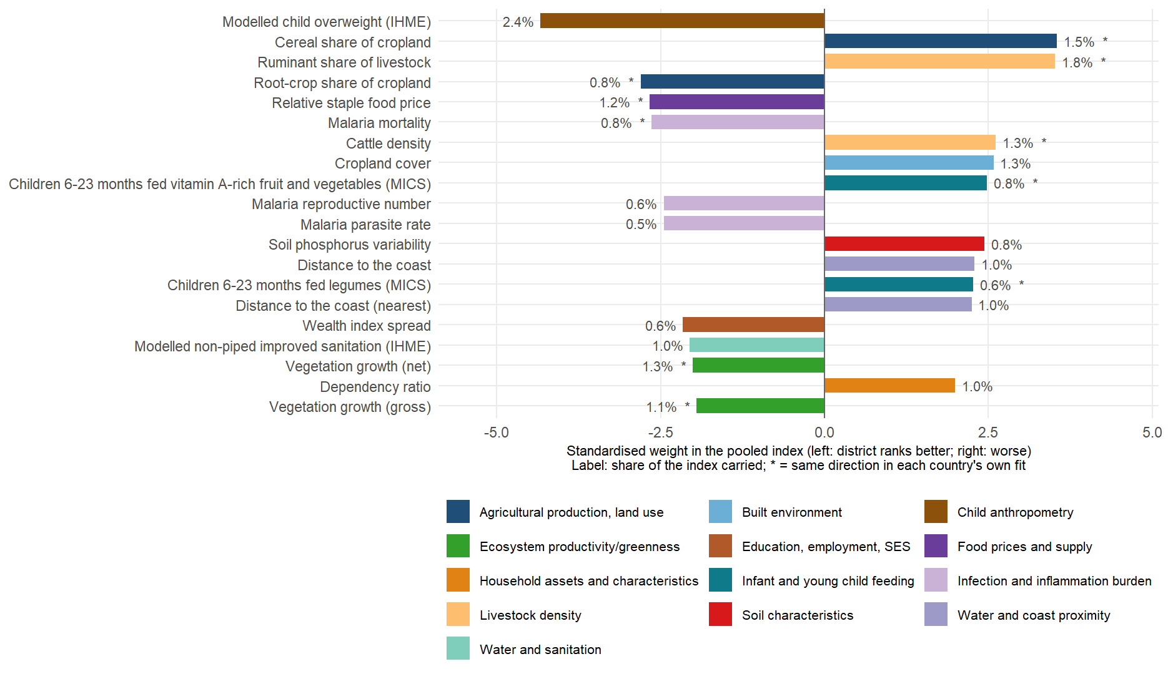
Variable importance for child iron.
Notes:
index_importance_top.csv, child iron, biomarker level, the twenty largest weights in the pooled fit. All twenty keep the same direction in every leave-one-country-out fit; ten of the twenty also keep it in each country’s own fit, the stricter test. None requires a blood sample. The twenty-layer equal-weight composite scores about the same as the full index for a new country, so a short auditable list loses nothing.

Slide 20
Predictor set by domain and tier
Domain | Columns | Open | Public microdata | DHS | Vary within country | Modelled surfaces
Satellite embedding | 64 | 64 | 0 | 0 | 64 | 0
Climate and weather | 60 | 60 | 0 | 0 | 60 | 0
Soil characteristics | 45 | 45 | 0 | 0 | 45 | 0
Infection and inflammation burden | 42 | 30 | 4 | 8 | 39 | 10
Food fortification and supplementation | 35 | 25 | 3 | 7 | 10 | 0
Immunisation | 32 | 1 | 19 | 12 | 32 | 1
Agricultural production, land use | 29 | 12 | 0 | 17 | 29 | 0
Education, employment, SES | 26 | 9 | 4 | 13 | 26 | 4
Infant and young child feeding | 24 | 1 | 7 | 16 | 24 | 1
Water and sanitation | 24 | 10 | 5 | 9 | 24 | 10
Food prices and supply | 21 | 21 | 0 | 0 | 12 | 0
Child anthropometry | 20 | 4 | 4 | 12 | 20 | 4
Household assets and characteristics | 19 | 5 | 3 | 11 | 19 | 0
Anaemia and haemoglobin | 16 | 11 | 0 | 5 | 9 | 11
Fertility, reproductive health | 15 | 0 | 0 | 15 | 15 | 0
Household diet and consumption (HCES) | 15 | 0 | 15 | 0 | 15 | 0
Ecosystem productivity/greenness | 14 | 14 | 0 | 0 | 14 | 0
Built environment | 13 | 10 | 0 | 3 | 13 | 0
Adult and maternal mortality | 9 | 0 | 0 | 9 | 9 | 0
Livestock density | 8 | 8 | 0 | 0 | 8 | 0
Ruralness, population density, built environment | 7 | 7 | 0 | 0 | 7 | 0
Dietary inadequacy (MODELLED SURFACE, HCES) | 6 | 6 | 0 | 0 | 6 | 6
Healthcare access | 6 | 0 | 0 | 6 | 6 | 0
Market prices (RTFP) | 6 | 6 | 0 | 0 | 6 | 0
Water and coast proximity | 6 | 6 | 0 | 0 | 6 | 0
Child mortality | 4 | 0 | 0 | 4 | 4 | 0
Adult nutrition | 3 | 0 | 0 | 3 | 3 | 0
Nutrition status (MODELLED SURFACE) | 1 | 1 | 0 | 0 | 0 | 1
Notes:
Modelled surfaces are estimates produced by someone else’s model (IHME, MAP, the MIMI dietary inadequacy estimates); they are included by default and the protocol has a switch (V2_DROP_MODELLED=1) to score without them. Columns that do not vary within a country are the national constants dropped at fit time.

