Slide 1



Predicting Micronutrient Deficiency Prevalence in Sub-Saharan Africa Using Proxy Indicators: A Multi-country Machine Learning Framework
Andrew N. Mertens (University of California, Berkeley) and Sonja Y. Hess (University of California, Davis)
We are grateful for the funding support of the Gates Foundation.

Slide 2




Goals
Estimate deficiency prevalence, nationally and by district
From a wide range of proxy indicators, validated against the prevalence measured by biomarker assessment in national surveys.
Identify the subnational regions at greatest risk
A ranking a program can act on, and a level once anchored to a national number.
Engage national stakeholders throughout
Ghana as the worked example; the dashboard and country briefs as the shared product.
Notes:
The three project goals as stated in the proposal: district and national prevalence estimates from proxies, validated against biomarker surveys; the districts at greatest risk; engagement with national stakeholders throughout. The map is Ghana child iron deficiency from the 2017 survey, the worked example that recurs through the talk.

Slide 3
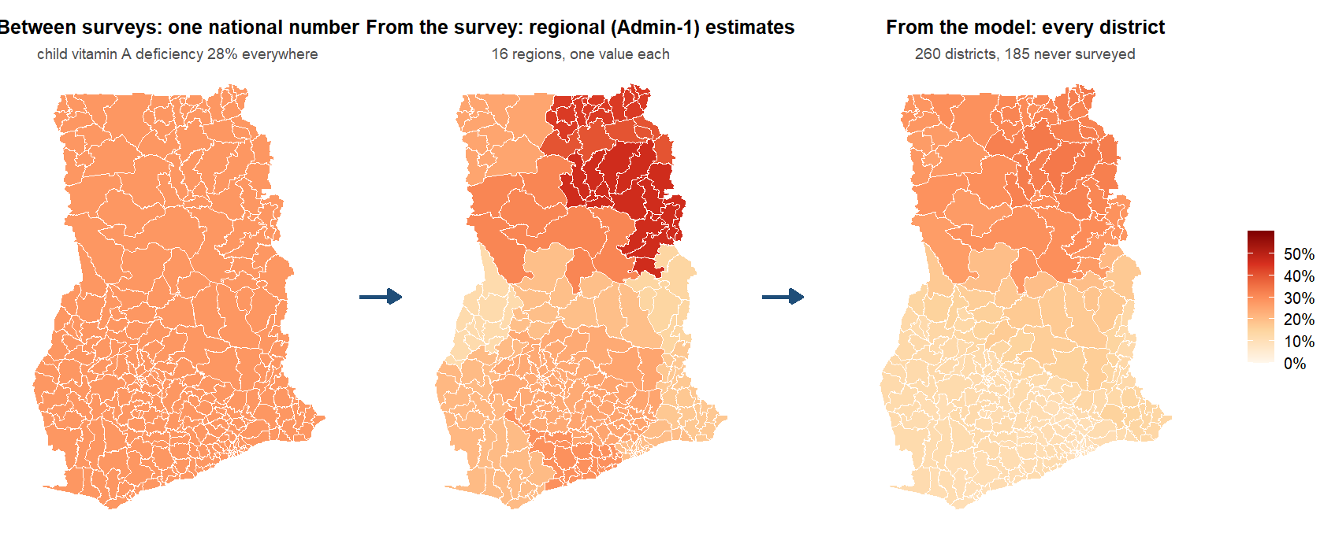
What does a country have today, and what does the model add?
Notes:
SAY: This is the whole talk in one picture, using child vitamin A deficiency in Ghana. Between surveys a program has one national number. The survey itself gives an estimate per region, which is what it was designed to do. The model gives a value for every district, including the 185 the survey never reached. The rest of the talk is about how far that right-hand map can be trusted.
DETAIL: Left: the national prevalence from the 2017 survey applied everywhere. Middle: respondent-weighted averages over the 16 regions on the 2019 boundaries (the survey was designed for the 10 old regions). Right: the index fitted on the 75 surveyed districts and applied to all 260 — the deployed map, level-calibrated and anchored to the national figure (the exceedance slide’s table, CP-01). The national surveys do give Admin-1 estimates; what they cannot give is every Admin-2, which is the model’s job. Warm palette on a shared 0-60% scale.

Slide 4

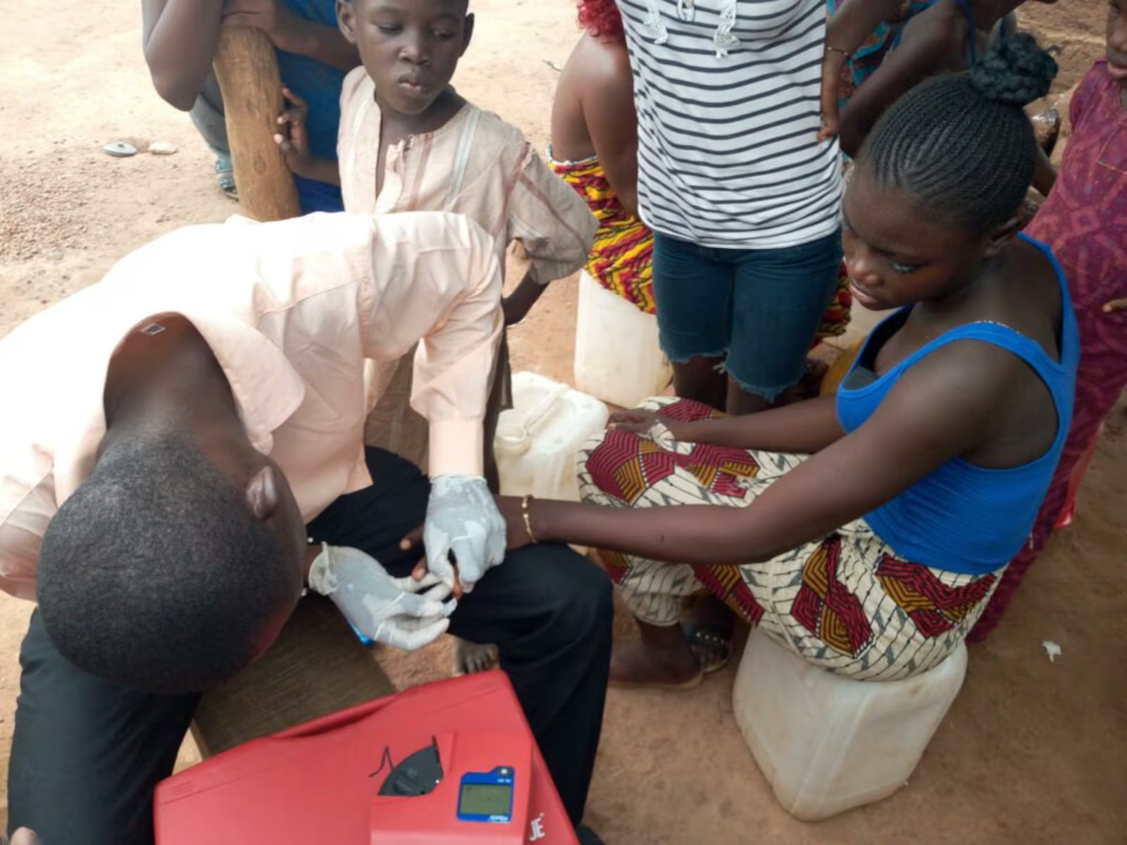


Surveys are rare; the proxies are everywhere
Biomarker surveys are rare and costly
About one national survey per country and decade; programs need district estimates between them.
575 district-level proxies
Open gridded layers and public survey microdata, linked to four national biomarker surveys.
Predict deficiency by district
Iron, vitamin A, folate, B12 and zinc, in surveyed and unsurveyed districts.
Notes:
Photo credit: Latter-day Saint Charities. GMS 2017 collaborators: University of Ghana, GroundWork, University of Wisconsin-Madison, KEMRI-Wellcome Trust; with UNICEF and Global Affairs Canada.

Slide 5


Both a big-data opportunity and a small-data problem
Big data: the predictors
Small data: the outcome
575 columns from 28 sources
Rasters at 30 m to 10 km summarized over 554 districts; a 64-dimension satellite embedding; four household surveys aggregated from microdata.
One biomarker survey per country per decade
Four surveys, 24 country-outcome cells, 206 surveyed districts in all.
Reduced to 29 domains
Leading principal components per domain, learned on training districts only; nothing chosen on the outcome.
14 to 87 districts per country
The effective sample size of every model; a tuned estimator shrinks to the constant, so the index tunes nothing.
All of it public
The headline set has no DHS in it; a country without a recent DHS can rebuild it.
Honest folds and a reliability ceiling
Folds cut by district, region and country; the survey's own district noise sets the ceiling any model can reach.
Notes:
SAY: The same project is both. The opportunity: hundreds of public layers covering every district. The problem: the thing we predict is measured once a decade, in 14 to 87 districts per country. Everything in the protocol follows from holding both at once.
DETAIL: The same sentence describes both halves. Big: 575 columns from 28 sources, most of them rasters at 30 m to 10 km summarized over 554 districts, four household surveys aggregated from their microdata, a satellite embedding with 64 dimensions per district. Small: the thing being predicted is measured in one biomarker survey per country per decade, at 206 surveyed districts over four countries, 24 country-outcome outcome-country combinations, and 14 to 87 districts per country, which is the effective sample size of every model. Everything in the protocol follows from holding both at once: predictors are reduced to domain components with nothing chosen on the outcome, the estimator has no tuned parameter, the folds are cut by district, region and country, and the reliability ceiling says how much of the survey signal is noise at district level. Likely question: why not fit at the person level. That was the January approach; a person-level classifier under district-blocked folds is a coin toss on proxies alone, and shrinking its predictions biases area means (individual-level slide in the appendix).

Slide 6
Surveys and outcomes

Slide 7
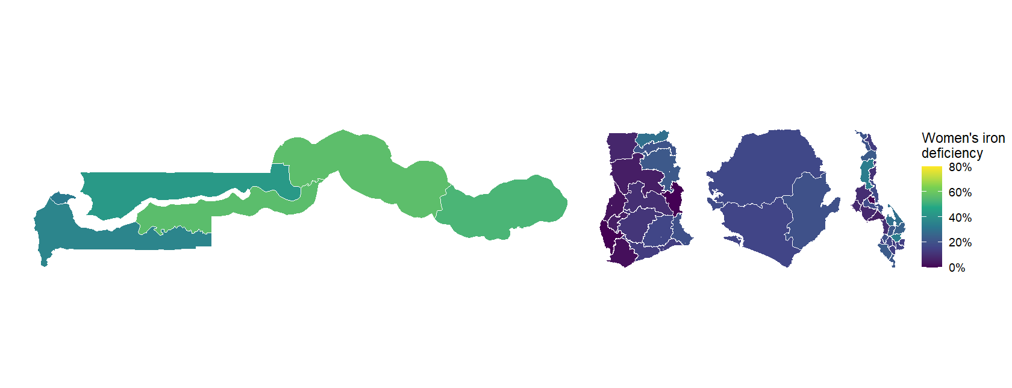
Which surveys did we learn from?
Notes:
SAY: Four national micronutrient surveys, one per country, each with blood biomarkers and GPS clusters: The Gambia 2018, Ghana 2017, Sierra Leone 2013, Malawi 2015-16. The maps show women’s iron deficiency by region as the surveys report it; the districts and clusters under each map are what the model learns from.
DETAIL: Region-level respondent-weighted prevalence of women’s iron deficiency from targets_v2.csv, on the GADM 4.1 regions. Counts per country from the same table and the cluster file (Sierra Leone: 14 districts, 60 clusters; The Gambia 30 and 70; Ghana 75 and 90; Malawi 87 and 103). All four measured iron and vitamin A in children and women; folate and B12 in three (not The Gambia); zinc in Malawi only. Fieldwork dates recovered for every cluster; three surveys ran in the dry season and Malawi in the lean season. Likely question: why districts rather than regions. Districts are the program unit; they sit below the surveys’ design resolution, which is why the reliability ceiling slide reports what a perfect predictor could reach.

Slide 8





Which deficiencies do we predict?
Iron
Vitamin A
Folate
B12
Zinc
Who: children under five; non-pregnant women
Where: all four countries
Biomarker: ferritin, adjusted for inflammation
Cut-off: ferritin below 12 (children) or 15 (women) ug/L
Who: children under five; non-pregnant women
Where: all four countries
Biomarker: retinol-binding protein, adjusted for inflammation
Cut-off: RBP below 0.70 umol/L
Who: non-pregnant women
Where: Ghana, Sierra Leone, Malawi
Biomarker: serum folate
Cut-off: below 10 nmol/L
Who: non-pregnant women
Where: Ghana, Sierra Leone, Malawi
Biomarker: serum B12
Cut-off: below 150 pmol/L
Who: children under five; non-pregnant women
Where: Malawi only
Biomarker: serum zinc
Cut-off: IZiNCG thresholds
Notes:
SAY: Five deficiencies, each defined once, the same way in every country, reconciled against the survey reports: iron, vitamin A, folate, B12 and zinc. Children under five and non-pregnant women.
DETAIL: Two targets per outcome-country combination: the deficiency prevalence, and the district mean of the negated log biomarker concentration (higher means worse), which carries more signal than the dichotomy and is reported alongside it. Definitions were reconciled against the four survey reports and the 21 papers that re-analyze them on 15 September 2026 (docs/survey_report_reconciliation.md): every iron, zinc, folate and B12 national estimate now reproduces its report to the decimal, and the Gambia LGA estimates track the report at r = 0.98 to 0.99. What changed then: the iron binaries had been the surveys’ iron-deficiency-ANAEMIA columns in three countries (ferritin plus hemoglobin), Malawi’s iron flag came from a mis-specified local BRINDA that under-counted by half, pregnant women and children outside 6 to 59 months were being kept, and vitamin A had been converted to retinol-equivalents with each survey’s own RBP-to-retinol line. That conversion is now the sensitivity analysis, not the primary: the four lines were fitted in different directions on 14 to 300 specimens, and Malawi’s has R-squared 0.13, which manufactures near-zero deficiency by construction; the survey’s own re-analysis (Likoswe 2021) recommends exactly BRINDA-adjusted RBP below 0.70, the estimand used here. Call it low RBP rather than vitamin A deficiency: Ghana’s MRDR found 6.7 percent depleted and Malawi’s none. Two caveats to say if asked. Sierra Leone’s child file as supplied holds only the survey’s anaemic children (532 of 654 assayed), so its child outcome-country combinations are anaemic-subgroup estimates until the full file arrives. Folate is not comparable across the two assays (Malawi’s microbiologic assay reads higher than the Roche immunoassay), so its cross-border numbers are indicative only. Iodine (The Gambia, Sierra Leone) is analyzed within country only; a one- or two-country outcome has no cross-border test.

Slide 9
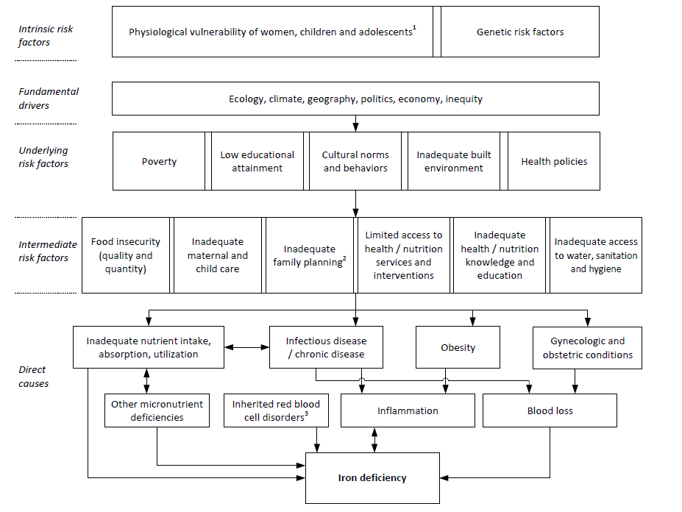
What causes iron deficiency?
Notes:
SAY: The conceptual framework for iron deficiency: distal drivers at the top (ecology, climate, geography, economy), intermediate ones (food environment, care, infection), and the immediate causes at the bottom. The next slide colors the same boxes by whether we have a public proxy for them.
DETAIL: Adapted from Hess et al., Ann N Y Acad Sci 2023. The framework is unchanged; the ablation slides show which of its pathways the data can see.

Slide 10
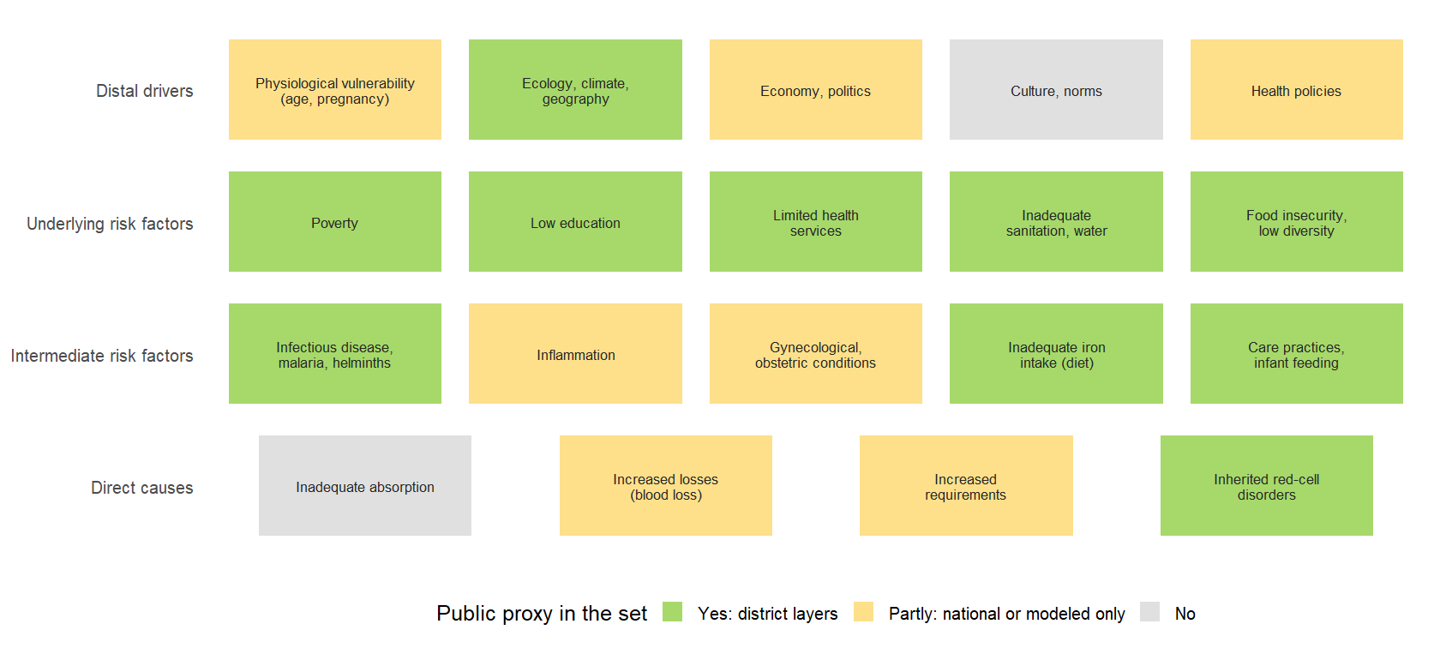
Where do we have proxy data for those causes?
Notes:
SAY: The same boxes, colored by whether the 575 public predictors cover them. Green: we have district-level layers (climate, soil, poverty, water, malaria, diet from budget surveys). Yellow: only a national figure or a modeled surface. Gray: nothing public reaches it, which is culture, absorption and the individual physiology. The model can only see the green and yellow pathways.
DETAIL: Coverage judged from the domain list: ecology and climate (GEE, SoilGrids, AlphaEarth), poverty and education (MICS, HCES, GDL, RWI), sanitation and water (MICS, IHME WASH), food insecurity and diet (HCES food groups, HFID, FEWS, RTFP prices, MapSPAM, livestock), infection (Malaria Atlas, ESPEN helminths, IHME), care practices (MICS infant feeding), inherited red-outcome-country combination disorders (Malaria Atlas HbS, HbC, G6PD allele surfaces). Partly: physiological vulnerability and gynecological conditions (fertility and age structure from MICS/WorldPop), economy and policy (national constants, fortification standards), inflammation (only through malaria and diarrhea surfaces), losses and requirements (fertility, helminths). No: culture and norms, absorption. Likely question: is the lack of a culture proxy why the model plateaus. Possibly; it is one reason the deck says the vocabulary is saturated with respect to what is public.

Slide 11
The proxy dataset

Slide 12

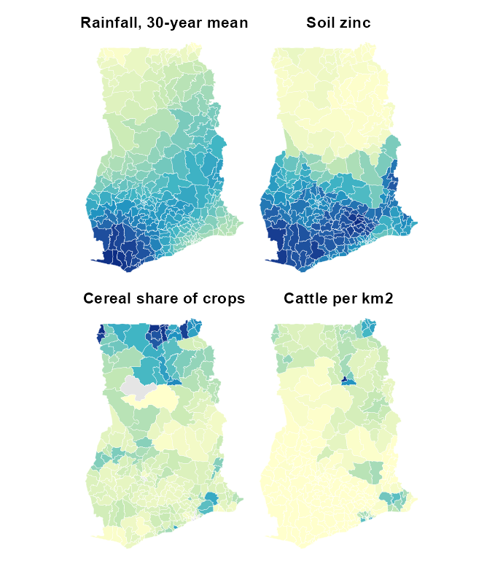
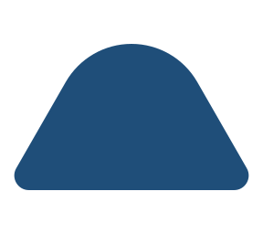



What do the land, climate and agriculture layers look like?
Climate
Monthly rainfall and temperature at the survey year and as 30-year normals; drought and evaporation (TerraClimate, MODIS).
Soil
pH, organic carbon, texture and nutrients such as zinc and iron, at two depths (SoilGrids, iSDA).
Crops and livestock
What is grown and how much, cattle, goats, sheep, pigs and poultry per square kilometer (MapSPAM, Gridded Livestock).
Land cover and satellite embedding
Cropland, grassland, built-up area, night lights, plant productivity, and a 64-number summary of a year of satellite images (AlphaEarth).
Water and terrain
Distance to permanent water and the coast; elevation and slope.
Notes:
SAY: The land side of the data: what the satellites and soil surveys see. Rainfall and temperature normals, soil chemistry, crops, livestock, land cover and a satellite embedding, every one of them public and covering every district. The maps are Ghana, so you can see the north-south gradient most of these layers share.
DETAIL: Sources: Earth Engine TerraClimate (monthly climate, 4 km, survey year and 1991-2020 normals), MODIS (land-surface temperature, NDVI, EVI), Copernicus land cover, night lights, GHSL built-up, MODIS productivity, AlphaEarth 64-band satellite embedding, SoilGrids and iSDA soil chemistry at two depths, Koppen and agro-ecological zones, JRC surface water and coast distance, MapSPAM 2010 crop production and area, Gridded Livestock of the World 4, WorldPop, GHSL and GPW population, Meta relative wealth index. What a proxy has to be: This talk is about the right-hand side of the model: where the 575 columns come from, how each one gets from its native form to a district value, how we line them up with four surveys taken in four different years, and which of them the model leans on. The analysis deck covers what the ranking achieves; this one covers what it is made of. The leakage rule is the second bullet: a district aggregate of the same survey instance we score is excluded (docs/findings, LK-02), and where a MICS or DHS was fielded inside the biomarker survey’s own clusters those clusters are dropped from the aggregate (The Gambia 2018: 70 MICS clusters; Malawi 2015-16: 105 DHS clusters). The record behind the fourth bullet is the shared metadata file and results/tables/protocol_v2/variable_sheet.csv. One consequence of the first bullet: 42 of the 575 columns are national series with one value per country, and a value that is the same in every district cannot rank districts, so the models drop them when they are fitted.

Slide 13

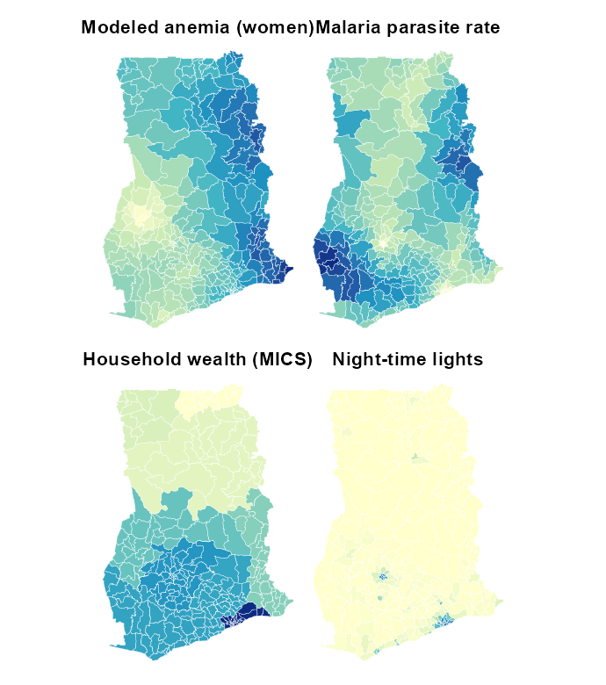




What do the health, food and household layers look like?
Modeled health surfaces
Malaria, anemia, child growth, diarrhea, sanitation and vaccination, mapped at 5 km by IHME and the Malaria Atlas; helminths from WHO.
Food prices and supply
Local staple prices against the national level (WFP, World Bank), food security phases, fortification standards.
Public household surveys
MICS and the national budget surveys, aggregated to districts: wealth, schooling, water, infant feeding, what households ate last week.
People and access
Population and density, travel time to health care and markets, a relative wealth index from satellite and phone data.
What is kept out
The DHS aggregates exist for all four countries and are used only as a check; the headline models use open and public data alone.
Notes:
SAY: The people side: modeled health surfaces from IHME and the Malaria Atlas, helminths from WHO, food prices from WFP and the World Bank, and the public household surveys, MICS and the budget surveys, aggregated to districts. These are public too; the DHS is kept out of the headline models on purpose.
DETAIL: Sources: IHME 5 km modeled surfaces (child growth, anemia, WASH, education, ORS, HIV, measles vaccination), Malaria Atlas (parasite rate, incidence, mortality, nets, spraying, blood-disorder allele frequencies), WHO ESPEN helminth treatment coverage, WHO anemia and UNICEF vitamin A supplementation national series, WFP and World Bank real-time market prices, FAOSTAT balances and HFID food security, GFDx fortification standards, MIMI dietary inadequacy for Ghana, MICS microdata aggregated to districts, household budget surveys (IHS 2015/16, GLSS7, IHS4, SLIHS 2018) for diet, Global Data Lab HDI. DHS aggregates exist for all four countries and are a sensitivity arm only.

Slide 14
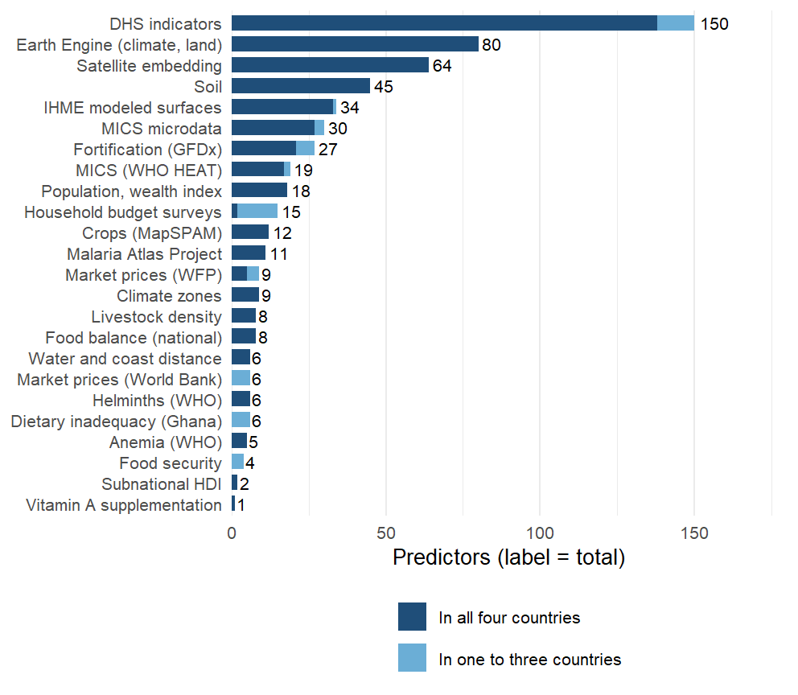
Where do the 575 predictors come from?
575 predictors from 28 sources, every one matched to the same list of 554 districts.
518 exist in all four countries, so they can serve a model for a new country.
The other 57 exist in one to three and are used only inside those countries.
Notes:
SAY: Twenty-eight sources, 575 predictors, one district list. Most are satellite and modeled surfaces; the public household surveys, MICS and the budget surveys, are the rest. The dark part of each bar exists in all four countries and can travel to a new one.
DETAIL: Read the bar chart from the top. One harmonized set feeds every model: the in-country models use whatever a country has, the cross-country models the columns all four share, so the light segment (household budget survey diet items for two countries, RTFP prices for two, MIMI for Ghana, MICS items missing from one round, a few IHME surfaces) works at home and not abroad. Behind the set sits a larger extraction: about 740 columns per country in the raw files (1,968 distinct names across the four, mostly the same quantity under country-specific names), harmonized to a common vocabulary; what did not harmonize was used only in the pre-protocol models. The Earth Engine block is climate (TerraClimate at the survey year and as 30-year normals), land cover, night lights, built-up surface, vegetation and evapotranspiration, night-time land surface temperature; the satellite embedding is Google’s AlphaEarth, 64 numbers per district that summarize a year of imagery; soil is iSDA and SoilGrids, ten nutrient concentrations at two depths plus texture and pH; crops are MapSPAM’s 2010 allocation; livestock is GLW4. The health and nutrition surfaces are IHME’s modeled estimates (anemia, child growth, WASH, education, ORS, HIV, malaria, vaccination) and the Malaria Atlas layers; ESPEN gives helminth endemicity. Prices come from WFP markets, the World Bank’s RTFP panel and FAOSTAT balances; fortification from GFDx. The public microdata blocks are new since 15 September: 30 indicators from the MICS files for all four countries and 15 diet and consumption indicators from the household budget surveys (IHS 2015/16, GLSS7, IHS4, SLIHS 2018). The DHS block is 150 district aggregates from the round paired with each survey (Ghana 2014, Malawi 2015-16, Sierra Leone 2013, The Gambia 2019-20), estimated with a cluster-level spatial model so every district has a value. Everything here is listed with its source, year and definition in results/tables/protocol_v2/variable_sheet.csv and in the dashboard’s catalog.

Slide 15



How are the layers matched to districts in space and time?
Space: one list of 554 districts
Every layer is joined to it by a district code, never by a district's name, so a renamed or split district cannot silently drop out.
Time: every layer at the survey year, or the nearest
Climate enters as a 30-year normal plus the survey year's anomaly; household surveys as the round nearest the biomarker survey.
The gap is recorded for every column
136 columns sit exactly on the survey year in every country, 78 are static layers; where a source is years off, the gap travels with the column.
Notes:
SAY: Two rules. In space: one list of districts, and every layer is joined to it by a code, never by a district’s name, so a renamed or split district cannot silently drop out. In time: every layer is taken at the year of the country’s survey or the nearest year available, climate as a 30-year normal plus that year’s anomaly, and the gap between the layer’s year and the survey’s is recorded for every column.
DETAIL: Space: The spine is metadata/admin2_spine.csv; the helpers in R/admin2_keys.R do every join in the pipeline and a lint test (tests/testthat/test-admin2-join-lint.R) reads every script for a join on a bare Admin2 name. The p-codes came from OCHA’s COD-AB for all four countries this week, both directions, so an OCHA-coded source (IPC, ACLED, cluster surveys) joins without any matching. Fuzzy matching, where it is still needed, is Jaro-Winkler with a 0.15 cap and a review file that lists every non-exact match for a human to accept. The population defect: the dashboard’s population table had been deduplicated by district name, so Chikwawa’s TA Lundu and Nsanje’s TA Ngabu, Salima’s TA Pemba and Zomba’s TA Malemia lost one member each, two of them surveyed districts, and every population-weighted figure silently excluded them. Fixed 15 September from WorldPop density, and the population table is now asserted complete in the tests. Time: The rules live in metadata/covariates/temporal_alignment.csv, 45 of them, one regular expression each: survey_year where an annual series exists (TerraClimate, MODIS NDVI, MAP, WorldPop density, WFP prices, RTFP windows), nearest available year where a series ends early (IHME’s child growth, education and WASH stop at 2017, anemia and malaria at 2019), a fixed vintage where there is only one (AlphaEarth 2017, MapSPAM 2010, GLW 2015, RWI 2019), a per-country round for the household surveys, and static for soil, terrain, climate normals and zones. Climate and greenness enter as a 30-year normal plus the survey-year anomaly in standard-deviation units, which is what transports; the calendar-year series that lagged the survey by up to eight years were retired. Sierra Leone’s 2013 survey is the awkward one: AlphaEarth starts in 2017, Copernicus land cover in 2015, and the MICS round nearest it is 2017, so its gaps are the orange and red bands. Ghana’s are the DHS block: the round paired with the 2017 survey is the 2014 DHS, three years off for 140 columns. The gaps that apply everywhere are the single-vintage products: MapSPAM 2010, GLW 2015, WorldPop’s 2020 age-sex structure. The stamp is per column and per country (results/tables/predictor_alignment_2026-09-16.csv), and the audit lists everything three or more years off.

Slide 16



29 conceptual domains of proxy variables
Environment from satellite (144)
AlphaEarth embedding; temperature, rainfall, drought index; NDVI and productivity; distance to water and coast
Soil (45)
SoilGrids and iSDA: pH, organic carbon, texture, nutrient availability
Agriculture and livestock (37)
MapSPAM crop mix and cropland; cattle, goat and poultry density
Food, prices and diet (83)
WFP and World Bank prices; budget-survey diets; fortification and supplementation coverage
Infection and disease (84)
Malaria, helminths, inflammation; child morbidity and mortality; immunisation coverage
Nutrition status (64)
Stunting and wasting; anemia surfaces; infant and young child feeding
Households and economy (90)
Assets, schooling, employment; water and sanitation; fertility; access to care
Settlement, access and security (28)
Night lights, population density, travel time, built-up area; conflict events
Grouped into eight for the slide; number of predictors in brackets. The 29 domains: satellite embedding; climate and weather; soil; ecosystem productivity; water and coast proximity; agricultural production and land use; livestock density; food prices and supply; market prices; household diet (HCES); dietary inadequacy; fortification and supplementation; infection and inflammation; malaria; helminths; infant and child morbidity and mortality; child mortality; adult and maternal mortality; immunization; child anthropometry; adult nutrition; nutrition status surfaces; anemia and hemoglobin; infant and young child feeding; household assets; education, employment and SES; water and sanitation; fertility and reproductive health; healthcare access; built environment; ruralness and population density; conflict.
Notes:
SAY: Twenty-nine domains, grouped here into eight for the slide, with the number of predictors in each. Each domain enters the model as its leading principal components rather than as raw columns, because 575 columns against 14 to 87 districts cannot be fitted one by one.
DETAIL: Why domains: 575 columns against 14 to 87 districts per country cannot be fitted column by column, and the columns are heavily correlated within a source. Grouping them by what they measure and taking principal components inside each group keeps most of the variance of each group, treats a source with 64 columns and a source with 3 as one construct each, and keeps the outcome out of the representation: the rotations are learned from the training districts’ predictors alone, so nothing is selected on the biomarker. The grouping is written down: each source block brings a label, and 10 override rules in metadata/covariates/domain_overrides.csv regroup columns by construct (infection and inflammation burden, immunisation, anemia, child anthropometry, infant feeding, supplementation, water and sanitation, education, child mortality, assets), so that MAP, IHME, DHS and MICS versions of the same thing are weighed together. Two things went wrong this week and are now guarded. A domain’s first twelve characters are its key inside the model; two labels that shared them (“Food prices (RTFP)” and “Food prices and supply”) were silently merged in two analyzes until a check caught it on 16 September. The other is in the exclusions, on the next slide. One more point for questions: climate alone or soil alone transports better than all domains together, the analysis deck’s climate-and-soil result.

Slide 17



How is the district table built?
1. Clean and merge the surveys
2. Link gridded layers
3. Aggregate household surveys
Four surveys, one definition per nutrient.
Each layer averaged over each district.
MICS and budget-survey microdata averaged to districts.
4. Align in time
5. Open data only
6. Rank-normalize and reduce
Every layer at the survey year or the nearest year available.
Headline models use open layers and public microdata.
Rank within country; each of the 29 domains to its leading components. Nothing chosen on the outcome.
Notes:
SAY: Six steps: clean the surveys to one definition per nutrient; link the gridded layers to districts; aggregate the household surveys; align everything in time; keep only open data in the headline models; then rank-normalize within country and reduce each domain to its leading components. Nothing in the last step looks at the outcome.
DETAIL: Why 28 sources but 29 domains: a source is where a layer comes from (IHME, the Malaria Atlas, MICS), a domain is what it measures; several sources feed one domain (malaria columns from MAP, IHME and MICS sit together) and one source feeds several domains (IHME supplies anemia, child growth and WASH). The column counts at each step are in the appendix CONSORT table.

Slide 18
Models and protocol

Slide 19








Which algorithms did we compare?
The candidate library
How they were compared, and who won
Simple mean and penalized regressions
The floor, and the elastic net on domain components or on all columns.
Same honest folds for every algorithm
Cut by district, region and country; no district split between training and test.
Random forest, gradient boosting, additive trees
Flexible learners that can find interactions.
The index wins: 0.29 against 0.28 for the ensemble
Random forest 0.27; the smoother ties inside a country and cannot cross a border.
Spatial smoother and geostatistical model
Neighbors only, or a spatial field plus covariates (the DHS Program's method).
Why the simplest wins
With 14 to 87 districts, every algorithm that tunes a parameter shrinks toward the constant; the index has none.
Principal-component index
Domain components weighted by their training-fold rank correlation; nothing tuned.
Notes:
SAY: A library of candidate algorithms, from a simple mean through penalized regressions, random forests, gradient boosting and spatial and geostatistical models, to the one that won: a principal-component index with nothing tuned. All are compared on the same honest folds.
DETAIL: The comparison run (SL-01 to SL-05, rerun on the current set): on identical district-blocked folds the PC index scores 0.29 against 0.28 for the rank-loss SuperLearner ensemble, 0.27 for random forest, 0.25 for the squared-error ensemble, 0.22 for the principal-component highly adaptive ridge and 0.19 for the elastic net (mean of outcome-country combination medians over 17 outcome-country combinations, prevalence, in-fill). Why the simplest wins: with 14 to 87 districts every estimator that tunes a parameter shrinks toward the constant under squared-error cross-validation; the index has no tuned parameter.

Slide 20



How do we choose among algorithms?
A competition of algorithms
Simple regressions and more complex machine learning models side by side, to allow interactions and nonlinear associations.
The best team wins
A weighted combination of algorithms; the weights come from performance on data the algorithms did not see.
V-fold cross-validation
Internal data splits by district, so that no district is in both training and validation; guards against overfitting.
The library
Simple mean, penalized regressions, random forest, gradient boosting, additive trees, geostatistical models, and the principal-component index that wins.
Notes:
SAY: By ensemble machine learning, SuperLearner: every algorithm in the library is scored on data it did not see, with folds cut by district so no district is split between training and validation, and the best one, or the best weighted combination, is chosen. The principal-component index is one candidate in that library, and it is the one that wins.
DETAIL: No penalty other than computation to add a learner: diversity, redundancy, synergy. Library: mean, penalized regressions, random forest, gradient boosting, PCA-HAL, BART, geostatistical models, the PC index. Discrete SuperLearner picks the single best learner by cross-validated loss; the weighted version combines them. The figure on the right is the V-fold scheme.

Slide 21


How does the best-performing model work?
1. Rank-normalize within country
2. Domain components
3. Weight by rank correlation
4. Sum and rescale
Every predictor becomes a within-country rank, so a level offset between surveys cannot act as signal.
Leading principal components of each of the 29 domains, to 80% of variance, learned on the training districts only.
Each component is weighted by its Spearman correlation with the outcome in the training fold; sign and size, nothing else is fitted.
The weighted sum, rescaled to the training outcome's spread; the infinite-penalty limit of a ridge regression on the components.
Notes:
SAY: Four steps, none of which looks at a held-out district: rank every predictor within its country; take the leading components of each domain; weight each component by how well it tracks the outcome in the training districts; add them up. It is a weighted sum with the weights read off the data, nothing tuned.
DETAIL: Four steps, none of which looks at a held-out district. (1) Rank-normalize every predictor within country, so a level offset between surveys cannot act as signal. (2) Take the leading principal components of each of the 29 domains, to 80% of variance and at most twelve, on the training districts. (3) Weight each component by its rank correlation with the outcome in the training fold, sign and size; nothing else is fitted. (4) Sum, and rescale to the training outcome spread. The index is the infinite-penalty limit of a ridge regression on the components (weighting slide in the appendix), and because it is linear in the rank-normalized columns every column has an exact back-projected weight, which is what the importance slides show.

Slide 22


Three levels of prediction
District in-fill
Region extrapolation
Cross-country transport
Question: a district the survey missed, in a country it visited
Folds: 5-fold by district, 10 draws
Compared with: the region's average (without that district); a spatial smoother
Question: a whole unsurveyed region
Folds: leave-one-region-out
Compared with: a spatial smoother
Question: a country with no biomarker survey
Folds: leave-one-country-out
Compared with: chance (permutation with countries kept whole)
Notes:
SAY: Three questions a program might ask, each tested by holding out the right thing. District in-fill: a district the survey missed in a country it did visit. Region extrapolation: a whole region the survey never reached. Cross-country transport: a country with no biomarker survey at all. Each is compared with the best thing you could do without the model.
DETAIL: In-fill folds are 5-fold by district repeated ten times; the baseline is the survey’s own regional average computed without the held-out district (jackknifed) and a spatial smoother. Region extrapolation holds out one region at a time; baseline a spatial smoother. Transport holds out one country and trains on the other three; the baseline is a permutation null with country blocks kept intact. The earlier leaderboard compared transport-style models against an in-fill baseline that had seen the district’s own respondents; that comparison is withdrawn. 16 of 22 combinations are positive at the 95th percentile of the null with no transport at all, so the mean correlation is what is compared with its null (0.08 district, 0.18 regional).

Slide 23
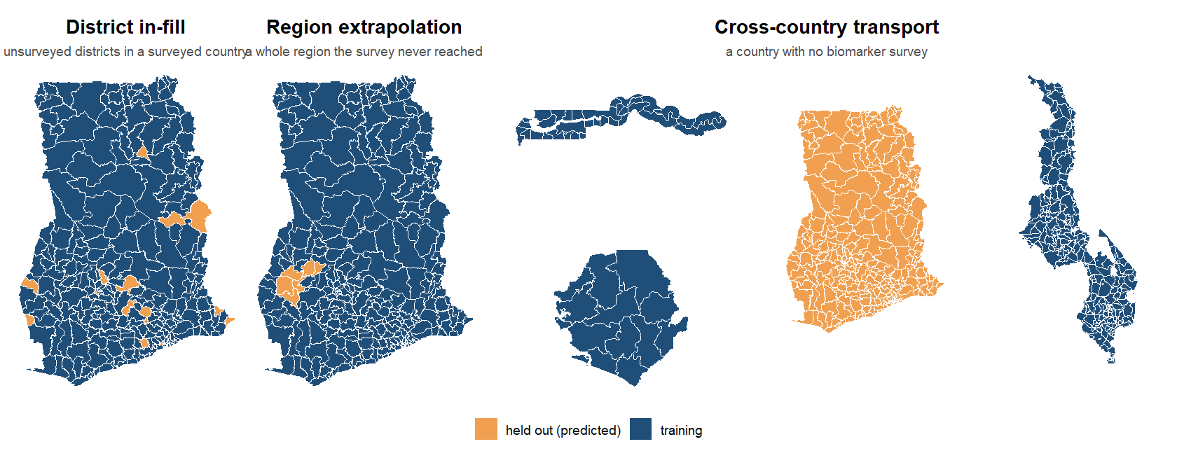
What is held out at each level?
Notes:
SAY: The same three levels as pictures: orange is predicted from blue. A few districts held out inside Ghana; a whole region of Ghana; then all of Ghana, predicted from the other three countries.
DETAIL: In-fill holds out districts one fold at a time (5-fold by district, ten draws); region extrapolation holds out a whole region; transport holds out a whole country and trains on the other three. Every fold is cut at the district or above, never through a district’s respondents.

Slide 24
Results

Slide 25
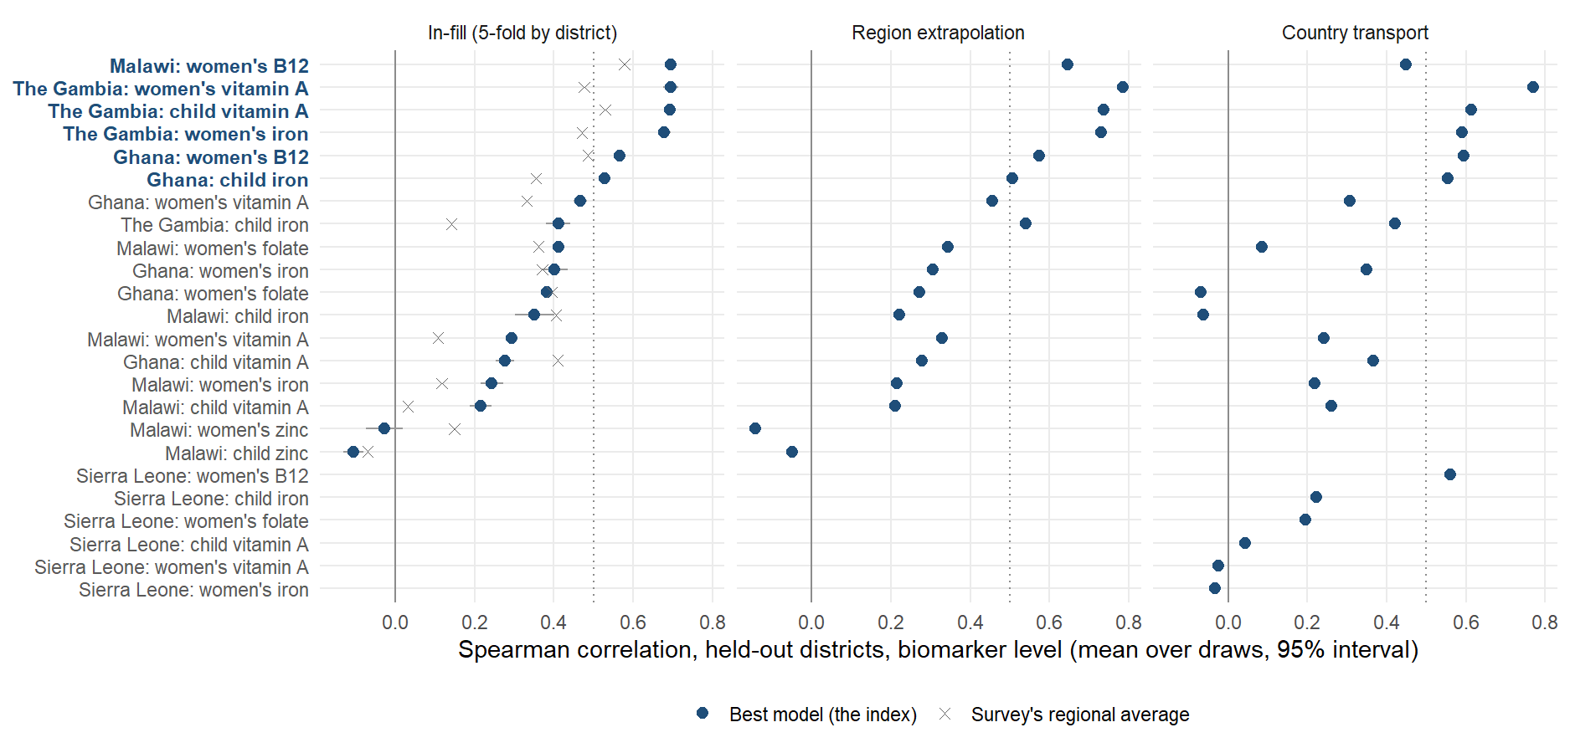
Where does the ranking work, outcome by outcome and country by country?
Notes:
SAY: The average hides a spread. Each row is one outcome in one country; the filled point is the model, the cross the survey’s own regional average. Six of the eighteen combinations clear 0.5 and average 0.64, in bold; the rest average 0.28. The failures are rare outcomes, zinc, and single-cluster districts; The Gambia, with several clusters per district, is strong on three of four outcomes.
DETAIL: Sierra Leone has no in-fill row: with 14 districts a 5-fold split leaves eleven to train on, below the twelve the protocol requires, so its in-fill score is NA and it is scored under region and country transport only. The averages elsewhere in this deck hide a spread that matters: 6 of the 18 in-country outcome-country combinations reach a held-out Spearman of 0.5 or more on the biomarker level (mean 0.64, bold on the axis), the rest average 0.28. Rows are the country-outcome outcome-country combinations sorted by the index’s in-fill ranking; the filled point is the deployed model with its interval over the ten fold draws, the cross is the survey’s own regional average (the number a ministry would use), the hollow circle is the best of the other arms (spatial smoother, smoother plus covariates, elastic nets) picked on the same held-out score, so it is optimiztic and shown only to say how much a different estimator could have added: little. The middle and right panels are the region and country estimands for the same outcome-country combinations. The weak outcome-country combinations are of two kinds: outcomes too rare to measure at district level (Malawi’s vitamin A outcome-country combinations at under 1% national prevalence: 2 outcome-country combinations, mean 0.26) and zinc (Malawi only, mean -0.07), where the survey’s own district estimates carry almost no signal to recover; The Gambia, with 30 large districts and several clusters in each, clears the line on 3 of its 4 outcomes and scores 0.41 on the fourth (child iron), above the other countries’ average; the next slides show the same outcome-country combinations on the prevalence and concentration scales, and the scatter after them puts the weak outcome-country combinations against their prevalence. Sierra Leone’s 14 districts are not scored in-fill.

Slide 26
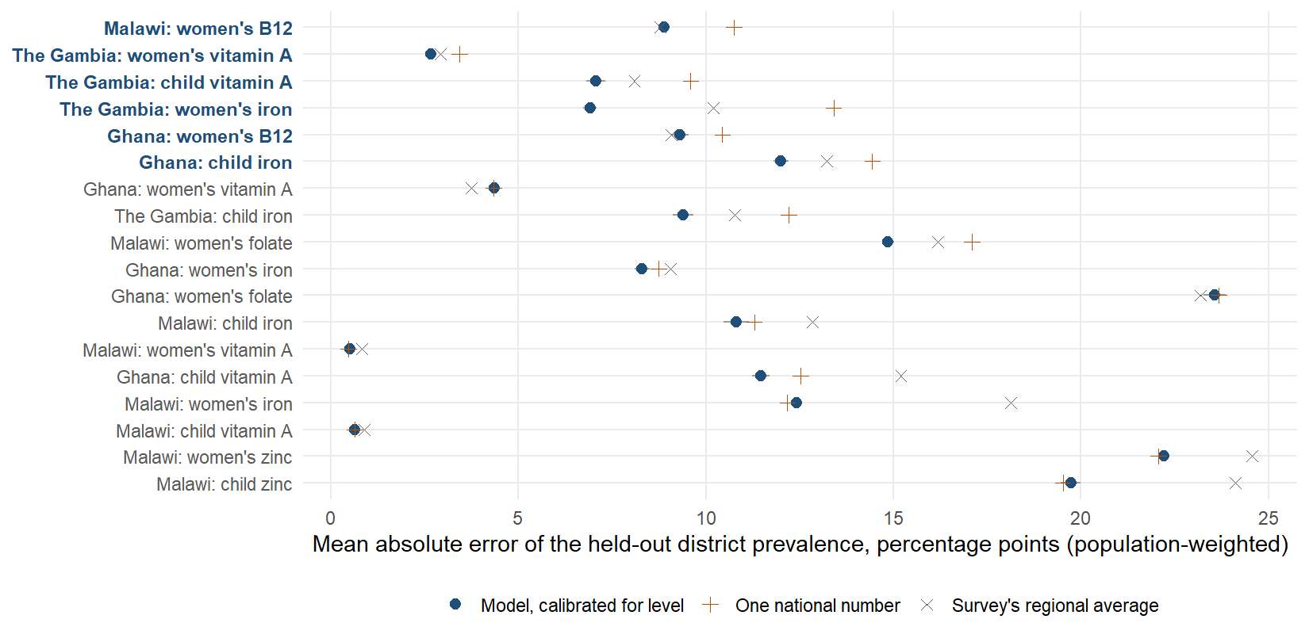
How far off is the predicted prevalence, outcome by outcome?
Notes:
SAY: Same combinations, now the level: how many percentage points each district’s predicted prevalence is from the survey’s. Read this slide as the limit of what any of us has today. At district level nobody has a level: the survey’s own regional breakdown is no better than writing one national number on every district. The model, once it is shrunk for this job, is slightly better than both — and that is all. It is built to order districts, not to measure them.
DETAIL: Same combinations, same order, prevalence scale: the population-weighted mean absolute error of each district’s held-out prevalence, in percentage points, for three arms — the calibrated index, the survey’s own jackknifed regional average, and one national number for every district (the status quo where no sub-national estimate exists). Means over the 18 scored cells: calibrated index 10.74, regional average 11.77, national number 11.49, spatial smoother 10.93. The arm this slide used to plot, the DEPLOYED ranking (domain_index), scores 14.25 and is worse than the national number in 13 of 18 cells: it is rescaled to the training districts’ spread, so its predictions carry the full between-district variance while correlating about 0.28 with the truth, and refusing to shrink inflates absolute error. Shrinking it costs ranking (level 0.40 to 0.35, prevalence 0.28 to 0.21), so the two arms are two products: domain_index for the order, domain_index_cal for any level, MAE or bias. Both are in benchmarks_v2_cells.csv; no rerun is needed. Read the error against the outcome: 10 points on an outcome at 40% is a different thing from 3 points on one at 4%, which is why the rare-outcome combinations look accurate here and useless on the ranking slide. The geostatistical comparator slide shows what a model built to estimate a level does to absolute error (9.2 against 10.7). Where a level has to be defended, this slide plus the national anchor is the argument, not the ranking correlation.

Slide 27
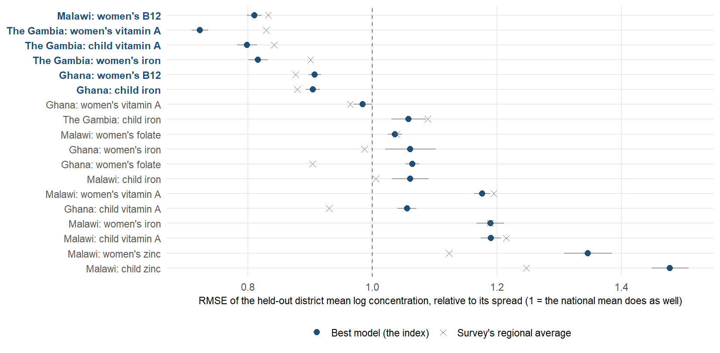
How far off is the predicted mean concentration, outcome by outcome?
Notes:
SAY: The same on the biomarker concentration scale, as error relative to how much districts differ: one means no better than the national mean. The model sits near one in most combinations even where it ranks well, which is the same message: order, not level.
DETAIL: Same combinations, mean concentration scale: the district mean of the log biomarker concentration (ferritin, RBP, folate, B12, zinc), predicted with the district held out, scored as root-mean-square error divided by the spread of the observed district means, so that 1.0 means no better than giving every district the national mean and anything below it is skill. The index is a ranker rescaled to the training spread, so its squared error is often at or above 1 even in combinations where it ranks well; the spatial smoother, which shrinks toward neighbors, is usually the best other arm on this loss. That is the honest division of labour the geostatistical slide draws: the index for the order, a shrinking estimator for the level. Cells whose index error sits well below 1 (the strong combinations in bold) are the ones where the proxies carry enough signal to predict the concentration itself, not only its order.

Slide 28
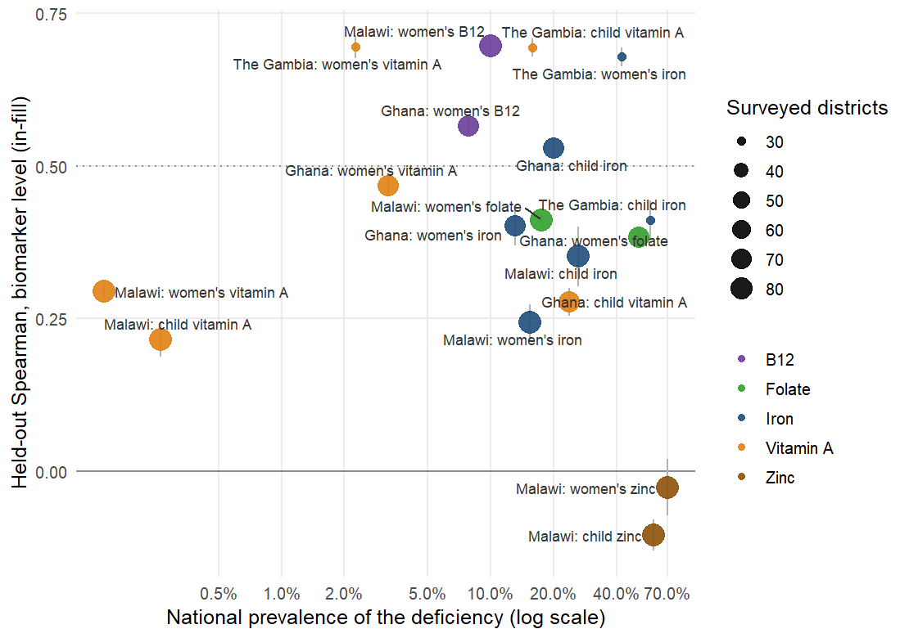
Where do the rankings work?
Where it works: iron, B12 and vitamin A where the deficiency is common, and everywhere the survey has several clusters per district.
Why not elsewhere: an outcome under 1% prevalence has nothing to rank, zinc carries no district signal, and a single-cluster district gives the survey too little to be compared with.
Notes:
SAY: Each point is one outcome in one country against how common the deficiency is. Above the line: iron, B12 and vitamin A where they are common enough to measure, and The Gambia everywhere. Below: the very rare outcomes, zinc, and the single-cluster countries. The model needs a survey that can see districts before it can be shown to rank them.
DETAIL: Each point is a country-outcome outcome-country combination: the index’s in-fill ranking accuracy against how common the deficiency is nationally. Rarity hurts at the extreme: below 1% prevalence (Malawi’s two vitamin A combinations, mean 0.26) the survey finds a handful of deficient respondents per district and its district estimates are mostly zero, so no predictor can recover an order; at 2 to 4% (The Gambia’s and Ghana’s women’s vitamin A) the ranking still works. Above that, the spread is about the survey more than the nutrient: The Gambia’s 30 districts with several clusters each score 0.41 to 0.70 (3 of above the line), Ghana’s and Malawi’s single-cluster districts are mixed (3 of ). Zinc (Malawi only, -0.07) is the other failure and is not a rarity problem: serum zinc is unadjusted, drawn under fasting rules that vary by cluster, and the survey’s own district means are close to noise. Everything the deck claims about ranking rests on the combinations above the dotted line: 6 of 18, iron, vitamin A where it is common, folate and B12, in three countries. Likely question: why not just report those. Because the cut is chosen on the same held-out scores, so the strong-outcome-country combination mean of 0.64 is a description, not a promise; the promise for a new country is the transport slide’s pre-registered climate-and-soil index.

Slide 29
The strongest outcome-country combinations
Malawi: women's B12
The Gambia: women's vitamin A
The Gambia: child vitamin A
The Gambia: women's iron
Ranking, held out: 0.70 (prevalence target 0.57)
District prevalence error: 10.6 points (the region's average does as well)
National prevalence: 10%
Ranking, held out: 0.70 (prevalence target 0.43)
District prevalence error: 2.4 points
National prevalence: 2%
Ranking, held out: 0.69 (prevalence target 0.58)
District prevalence error: 10.3 points
National prevalence: 16%
Ranking, held out: 0.68 (prevalence target 0.74)
District prevalence error: 9.7 points
National prevalence: 42%
Notes:
SAY: The four best: Malawi B12 and three of The Gambia’s outcomes, all at or near 0.7 on the ranking. The level column is the caution: even here the district prevalence error is no better than the survey’s regional average. Strong on the order, not on the level.
DETAIL: The four best in-country outcome-country combinations on the held-out ranking, from benchmarks_v2_raw.csv (in-fill, biomarker level, mean over ten draws), with the same outcome-country combination’s prevalence-target ranking, its population-weighted district prevalence error in percentage points and the national prevalence. These are the outcome-country combinations to show a country: the model is not a uniform 0.40, it is 0.64 where the outcome is common enough to measure and close to nothing where it is not. 6 of 18 combinations clear 0.5.

Slide 30
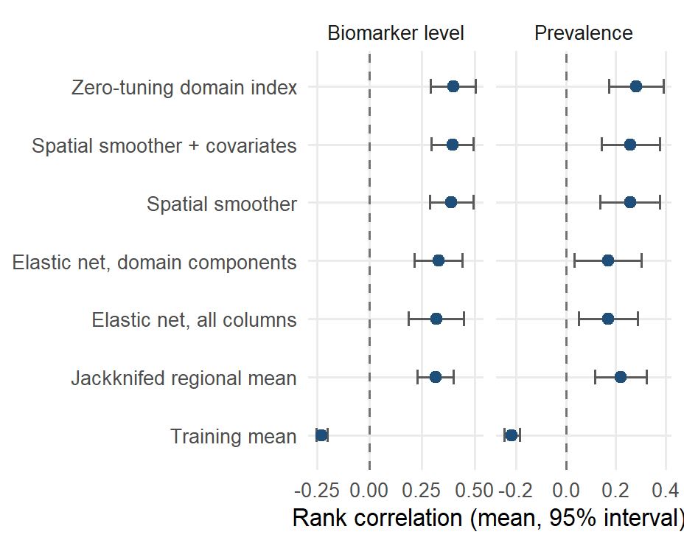
How well does the model rank districts inside a surveyed country?
Mean rank correlation over the outcome-country combinations, with a 95% interval. The model reaches 0.40 against 0.31 for the survey’s own regional averages (better in 13 of 18). In plain terms: it puts 60% of district pairs in the survey’s order, the regional averages 56%, a random ordering 50%.
Notes:
SAY: Inside a surveyed country, predicting each district with that district held out, the model’s ranking correlates 0.40 with the survey’s, against 0.31 for the survey’s own regional averages and 0.39 for a smoother that only uses neighbors. Six district pairs in ten are in the survey’s order; the regional average manages five and a half.
DETAIL: Cells: 18 on the level (Sierra Leone’s outcome-country combinations score NA at 14 districts). On prevalence the index scores 0.28 against 0.22. The smoother with covariates fitted to its residuals scores 0.39; covariates add +0.01 over the smoother alone on the level. The penalized fits score 0.33 (domain components) and 0.32 (all columns). Likely question: why the smoother does so well. Inside a surveyed country the covariates mostly reproduce a smooth surface that neighboring districts already provide; the value of the covariates is in unsurveyed regions and countries.

Slide 31
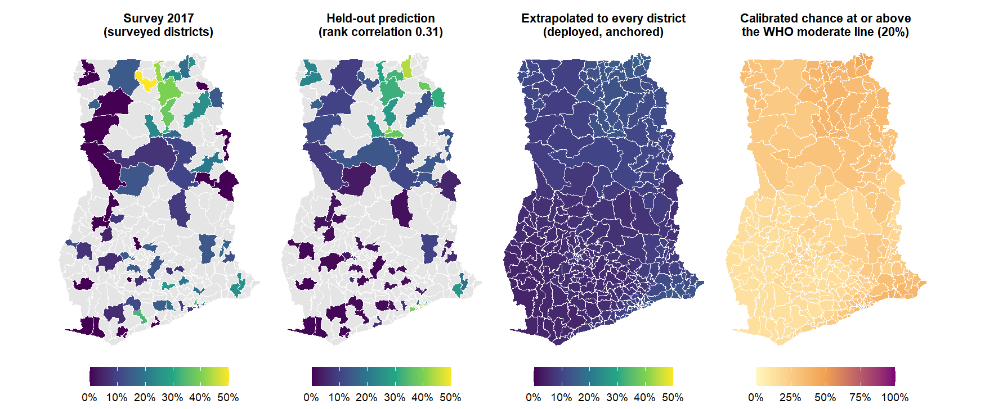
Ghana: survey, held-out prediction, extrapolation and uncertainty
Notes:
SAY: Ghana, women’s iron deficiency, one outcome across the four questions a map has to answer. Left, what the survey measured, district by district. Second, what the model predicts for each of those districts when it is held out. Third, the model applied to every district including the ones never surveyed. Right, the calibrated chance that each district sits at or above the WHO moderate line - a probability that has been checked, not a shading of the model’s mood.
DETAIL: Panel 2 is the in-fill out-of-fold prediction (5-fold by district, ten draws, prevalence target). Panel 3 is the deployment fit as the dashboard shows it: the index on all surveyed districts, level-calibrated, anchored to the national figure, in-sample for the surveyed ones. Panel 4 (CP-01, 27 September): the conformal-predictive-distribution chance of sitting at or above the 20 percent line, from out-of-fold residuals whose 90 percent band covers the survey’s own value 91 percent of the time under leave-one-out; the cell’s half-width is about 20 points, much of it the survey’s own single-cluster noise. Gray in panels 1 and 2: no survey clusters. Tables: viz/oof_women_iron.csv, viz/deploy_ghana_women_iron_cal.csv.

Slide 32
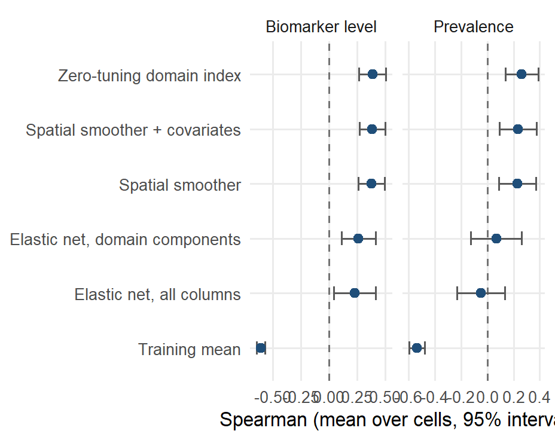
A whole unsurveyed region: the ranking holds at 0.39
Leave-one-region-out, mean over outcome-country combinations with a 95% interval. The index scores 0.39 on the level and 0.26 on prevalence; the penalized fits fall to 0.07 and -0.05 on prevalence.
Notes:
Leaving out a whole region is where a smoother must extrapolate past the edge of its data. The index and the smoother stay close (0.39 against 0.38 on the level); the null training mean collapses. Ghana and Malawi are the countries where this estimand is well determined; The Gambia and Sierra Leone give one number per region.

Slide 33
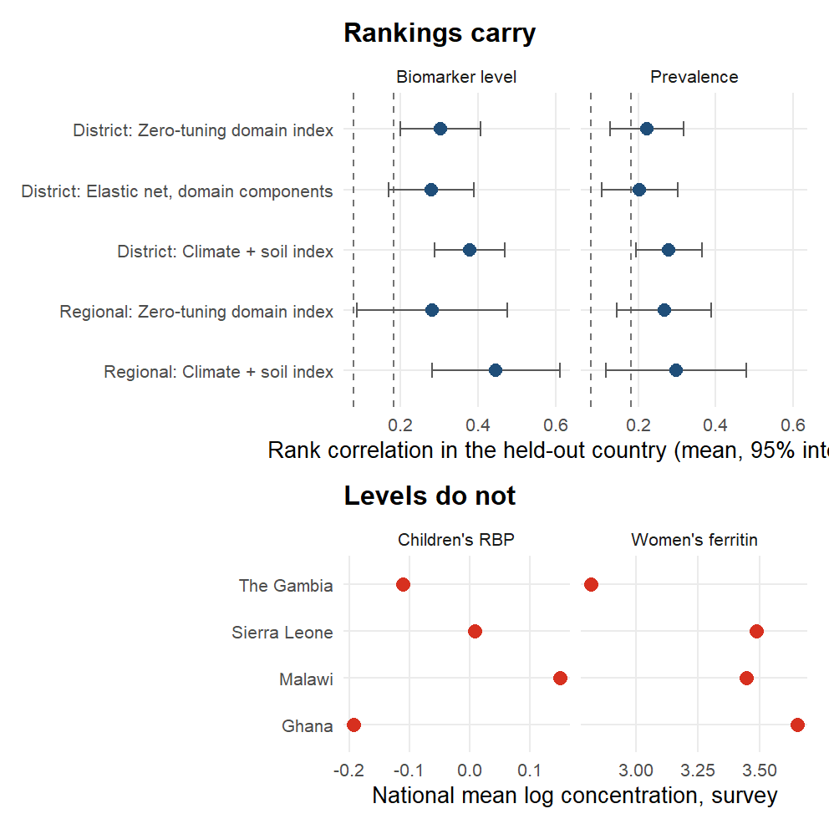
Does the model work in a country it has never seen?
Leave-one-country-out, 22 outcome-country combinations. The full index scores 0.30 at district level (positive in 18 of 22) and 0.28 at regional level; the climate-and-soil index scores 0.38 and 0.45. Dashed lines are the 95th percentile of the permutation null.
Notes:
SAY: Trained on three countries and applied to the fourth, the ranking carries: 0.30 with the full set of predictors, 0.38 with climate and soil alone, against 0.08 by chance. The level does not: the bottom panel shows why, the surveys’ national mean biomarker concentrations differ several-fold, so a transported prevalence would be wrong before it started. What crosses a border is the order of districts.
DETAIL: Absolute levels do not transport: raw ferritin differs several-fold between surveys, so the transported product is a ranking. Prevalence: 0.22 at district level (19 of 22 positive) and 0.27 at regional level for the full index; 0.28 at district level for climate and soil. The climate-and-soil pair was chosen on these four countries, so it enters the next country as a pre-registered prediction; honest nested selection of domains inside the training fold gives a median difference of +0.01 from the full index (better in 12 of 22). DA-03 (17 September, RR-12 set): adding the next load-bearing domains of the ablation to climate and soil (anemia surfaces, agriculture, infection: five domains) reaches 0.41 at district level (better than climate-and-soil in 15 of 22, median +0.01, all 22 outcome-country combinations positive; 0.33 on prevalence), with the gain in the weak outcome-country combinations (women’s iron and folate in Ghana and Sierra Leone) and none in the strong ones. It is chosen on the same 22 outcome-country combinations, so it goes into the pre-registration as a second candidate beside climate-and-soil, not in its place; the honest nested selection still sits at 0.31 (next slide). Since 9 September the DHS-derived predictors are cluster-level spatial estimates at every district (DS-01), which changed nothing in-country and cost the full index 0.01 across borders. Likely question: what a correlation of 0.30 means for a program. The targeting slide answers in burden captured.

Slide 34
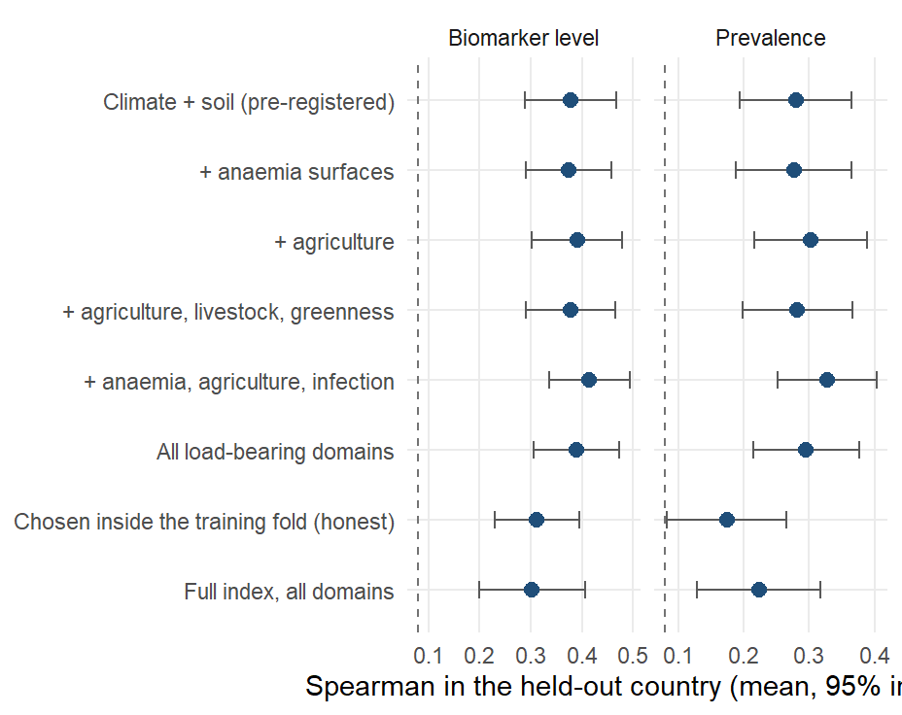
Can the transport model be improved by adding domains?
Leave-one-country-out, 22 outcome-country combinations, mean with a 95% interval across outcome-country combinations. Climate and soil alone: 0.38. Adding the next load-bearing domains of the ablation (anemia surfaces, agriculture, infection) reaches 0.41 (better in 15 of 22, median +0.01). Chosen on these same outcome-country combinations, so a candidate for the next country, not a replacement. Honest nested selection: 0.31.
Notes:
SAY: Adding the next load-bearing domains, the anemia surfaces, agriculture and infection, to climate and soil raises transport from 0.38 to 0.41. That set was chosen on the same countries it is scored on, so it becomes a second candidate to test on the fifth survey, not a replacement.
DETAIL: Dashed line: the 95th percentile of the permutation null. DA-03 (17 September, RR-12 set): script 25 scores fixed domain sets on the same leave-one-country-out folds as the transport slide, with the domain components oriented on the training countries only. The five-domain set (climate, soil, anemia and hemoglobin, agriculture and land use, infection and inflammation) is the top of the ablation ranking on these outcome-country combinations: 0.41 at district level against 0.38 for climate and soil, positive in all 22 outcome-country combinations, 0.33 against 0.28 on prevalence. The gain is in the weak outcome-country combinations (women’s iron and folate in Ghana and Sierra Leone) and absent in the strong ones. Because the set was chosen from the ablation on these same 22 outcome-country combinations, it has the same status as climate-and-soil had when it was found: a description of these four countries, to be scored as a second pre-registered candidate on the fifth. The honest arm, domains chosen by an inner leave-one-country-out inside the three training countries, stays at 0.31: with two inner folds the greedy choice overfits, which is why the pre-registration route is the one that can settle this. Likely question: why not use all load-bearing domains. All eight load-bearing domains score 0.39; nothing beyond five adds.

Slide 35
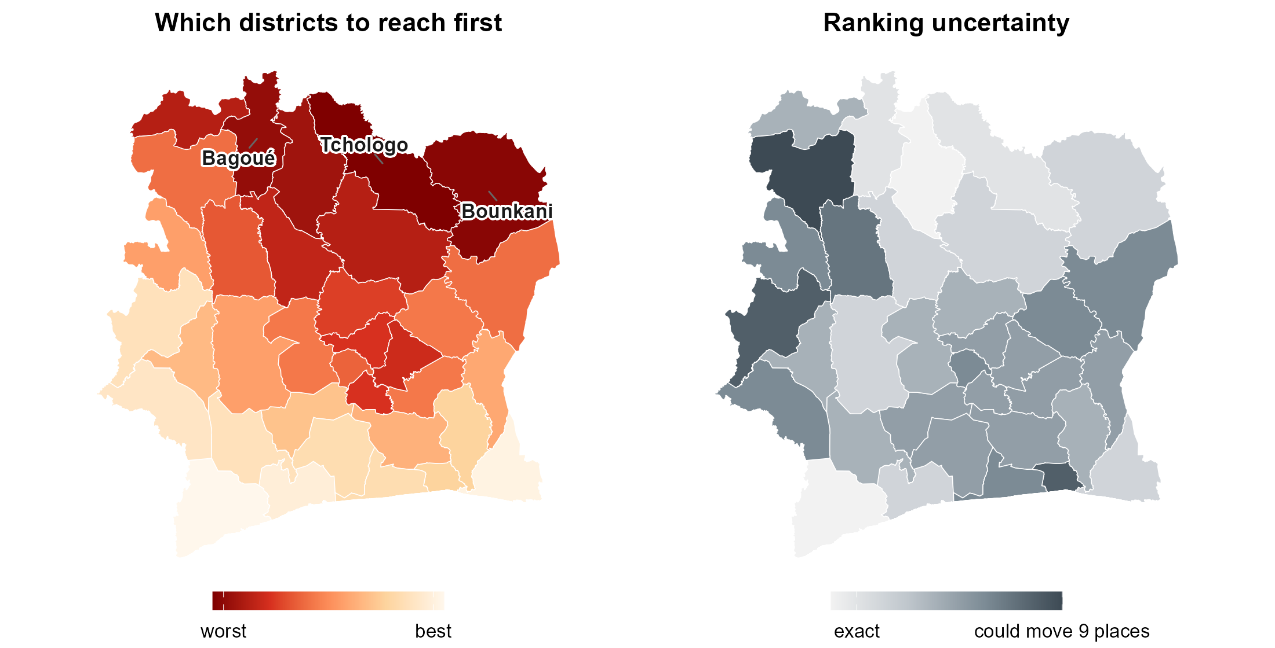
What does the model say for Cote d’Ivoire, which has no survey?
Children’s iron, from climate and soil layers only. The model has never seen a Cote d’Ivoire biomarker.
Left: which districts to reach first. Right: how firmly each is placed, the width of the 90% rank range over 400 refits on resampled training districts (median 5 places out of 33; the five worst-ranked stay in the worst third every time).
Notes:
SAY: Cote d’Ivoire is the case the project exists for: the public layers, no biomarker survey. The index trained on the four surveyed countries ranks its 33 districts, and the northern savanna belt comes out worst, the drier, poorer, more pastoral half of the country. The right map says how firmly: most districts move only a few places when the model is refitted on different training districts.
DETAIL: Cote d’Ivoire has the climate and soil layers and no biomarker survey, so it is the case the project exists for. The climate-and-soil index was fitted on the four surveyed countries and applied to its 33 districts for 6 outcomes (child and women’s iron and vitamin A, women’s folate and B12); it has never seen a Cote d’Ivoire biomarker. Left: child iron; the worst-ranked districts are the northern savanna belt (Tchologo, Bounkani, Bagoue, Poro, Hambol), the drier, poorer, more pastoral half of the country. Right: how firmly each district is placed. The training set was resampled 400 times, stratified by country, the components re-oriented and the index refitted each time, and the district re-ranked; the map shows the width of the 90 percent range of ranks, median 5 places out of 33. 10 of 33 districts have at least an 80 percent chance of being in the worst third and 20 at most 20 percent. What this uncertainty covers: how much the ranking depends on which training districts we learned from. What it does not cover: whether the model transports to Cote d’Ivoire at all, because there is no ground truth there; the external bound on that is the held-out transport accuracy of 0.38. Two guards ran first: the same code with each surveyed country held out reproduces the transport figure (0.38 over 22 outcome-country combinations, 21 positive), and adding Cote d’Ivoire to the column intersection costs 7 of the 101 climate-and-soil columns (the few layers the Cote d’Ivoire extraction lacks) without degrading transport (0.39, 22 positive). CV-01 (17 September): the Cote d’Ivoire database was extended from 132 to 212 columns with the open rasters the other domains need (IHME surfaces, Malaria Atlas at 2016, MapSPAM, livestock, and the 30-year climate normals that were missing), so the climate-and-soil index now runs on its full vocabulary (94 common columns, guard 0.39) and the five-domain candidate can be applied too (next slide). Rank uncertainty is now computed for all six outcomes and both candidates (civ_rank_uncertainty_all.csv). The only external check so far is the WFP/MIMI Nature Food 2026 vitamin A map, which ranks the same northern belt worst. Tables: civ_climate_soil_ranking.csv, civ_rank_uncertainty.csv, civ_transport_guards.csv.

Slide 36
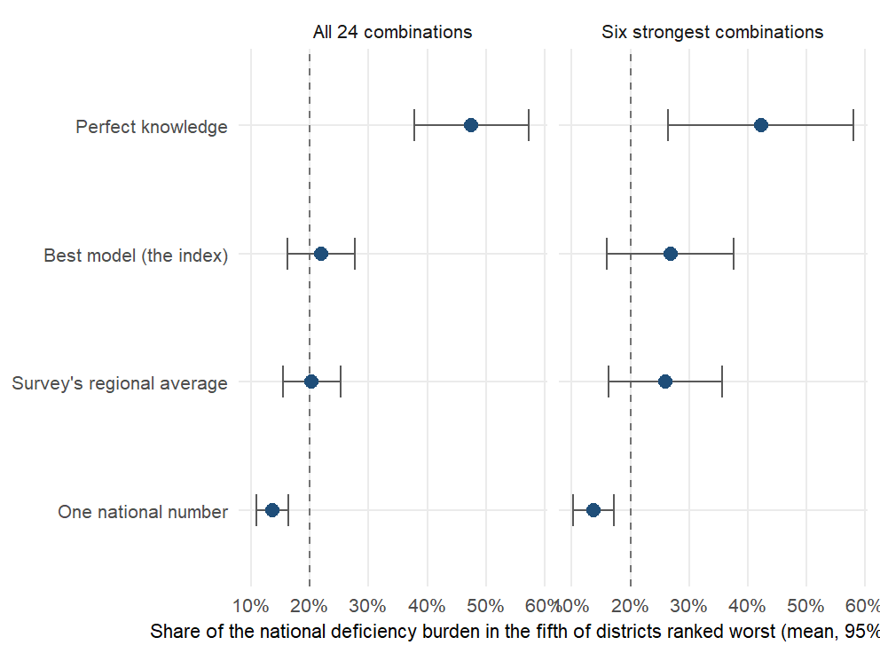
How much of the burden does the worst-ranked fifth reach?
If a program went to the fifth of districts the model ranks worst, what share of the country’s deficient people would it reach? On average 22%, against 20% for the survey’s regional averages and 48% with perfect knowledge; the dashed line is a random fifth. Right: the same for the six strongest outcome-country combinations.
Notes:
SAY: A program that goes to the fifth of districts the model ranks worst reaches about a fifth of the deficient people, a little more than the survey’s own regional averages would, and less than half of what perfect knowledge would give. Even in the six strongest combinations the gain over the regional average is small: burden sits in populous districts, and the ranking is not a burden map.
DETAIL: The dashed line is the share a random fifth of districts would capture. The margin over the survey’s own regional averages is small per outcome-country combination and concentrates where regions hold three to five districts. Under transport, burden captured is at chance: the transported product is an ordering and brings no targeting gain. Likely question: why the ceiling is only 48%. Burden is spread across districts; even the true worst fifth holds under half of it.

Slide 37
How good are the models? One table, two readings
Outcome | Ranking, surveyed country | Ranking, new country | District error (points)
Women’s B12 | 0.63 | 0.53 | 10.1
Women’s vitamin A | 0.49 | 0.32 | 2.5
Women’s iron | 0.44 | 0.28 | 14.1
Child iron | 0.43 | 0.28 | 14.8
Child vitamin A | 0.40 | 0.32 | 10.8
Women’s folate | 0.40 | 0.07 | 24.8
Women’s zinc | -0.03 | NA | 31.6
Child zinc | -0.11 | NA | 28.5
Ranking. For every pair of districts, the survey says which is worse and so does the model, predicting each district with it held out. They agree on 60% of pairs inside a surveyed country: six in ten, against five in ten for a random ordering and 56% for the best you can do with survey data alone, the region’s average. In a country the model has never seen, 55%.
Level. Inside a surveyed country a district’s predicted prevalence is off by 13 to 16 percentage points on average (child iron), no better than the region’s average. In a new country, one small national sample (5% of a survey) plus the ranking gives 9.3 points; a district survey needs 25% of its full size to match that. Read levels as planning figures; the ranking is the product.
Notes:
SAY: One table and two sentences. The table: for each outcome, how well the model ranks districts inside a surveyed country and in a new one, and how far off its district prevalence is. The sentences: it gets six district pairs in ten in the survey’s order, against five and a half for the region’s average; and a level is only trustworthy with a national anchor.
DETAIL: The MIMI deck’s evaluation summary format: the per-outcome table on the left (held-out Spearman inside a country and in a new country, biomarker level; the population-weighted district prevalence error in-fill), and on the right the two sentences a policy reader takes away, one about the order and one about the level, with the pair-count and the anchor error behind them. The four draft translation slides that follow expand these two readings; keep this one if only one fits.

Slide 38


What does a rank correlation of 0.40 mean on the ground?
Take any two districts: the best model orders them the way the survey does 60% of the time
Counted over every pair of districts. A random ordering gets 50% on average, the survey's own regional averages 56%; in a country the model has never seen, 55%.
In the fifth of districts it flags, deficiency runs at 32% against 24% nationally
A map that knew every district would find 41% in its worst fifth.
That fifth holds 22% of the deficient people
The survey's own regional averages capture 20%; a perfect map 48%. Real, modest, and better than today's number.
Notes:
SAY: Three readings of the same 0.40, all from the best model, the index, predicting each district with it held out: six pairs in ten in the survey’s order; the flagged fifth has a third more deficiency than the country; that fifth holds a fifth of the deficient people. Real, modest, and better than the number a ministry has today.
DETAIL: DRAFT A of four candidate translations; all numbers are the index (the deployed and best-performing model), averaged over the 24 outcome-country combinations; in the six strongest combinations the pair count is about 70%. The three readings are all computed from the same held-out predictions (in-fill, 5-fold by district, ten draws). Pairs: counted exactly from the held-out predictions (12_nce_targeting_metrics.R, PC-01: every pair of districts, ties excluded, mean over the 24 outcome-country combinations): the model orders 60% of district pairs the way the survey does, the survey’s own regional averages 56%, a coin toss 50%; across borders (leave-one-country-out, 22 outcome-country combinations) it is 55%. A Spearman of 0.40 sounds like more than it is: at district level it is six pairs in ten. The flagged fifth: deficiency prevalence in the fifth of districts the model ranks worst averages 32.2% against 24.3% nationally (nce_targeting_summary.csv, mean over the 24 outcome-country combinations); a map that knew the truth would find 41.3%. Burden: the model’s worst fifth holds 22% of the deficient people, the survey’s own regional averages 20%, a perfect map 48%. The honest message is that the ranking is real but modest: it is better than the regional average a ministry would use today, and a long way from a map that knows every district, which is what the reliability ceiling explains.

Slide 39



How much of what a survey can see does the model recover?
The survey itself is noisy at district level: a perfect predictor would score only 0.48
Known from a variance model of respondents within clusters within districts: it says how much of the district-to-district variation is real.
The model reaches 59% of that ceiling
0.28 on the prevalence target against a ceiling of 0.48. The gap is mostly the survey's noise, not the model's ignorance.
And beats the best prediction you can make from survey data alone
The region's average, computed without the district itself: 0.31; the model 0.40, better in 13 of 18 outcome-country combinations.
Notes:
SAY: Two comparisons that make 0.40 readable. First, against the ceiling: the survey’s own district estimates are noisy, so even a perfect predictor would only reach 0.48 against them; the model reaches 59% of that. Second, against the best prediction you can make with survey data alone, the region’s average: the model beats it in 13 of 18 combinations.
DETAIL: How the ceiling is known: a variance model with respondents nested in clusters, clusters in districts and districts in regions, fitted to each survey, gives the share of district-to-district variation that is true signal rather than sampling noise; the correlation a predictor of the true value could reach with the observed value follows from that share (variance_components_ceiling.csv). The regional average is jackknifed: each district’s value is its region’s average computed without that district’s own respondents, so it never sees the answer. DRAFT B. The question a decision-maker actually asks is not “is 0.40 high” but “compared with what”. Two comparisons. Against the ceiling: a district estimate from the survey itself is noisy (one to three clusters per district), so even a perfect predictor of the true prevalence would correlate only 0.48 with what the survey reports; on that scale the model’s 0.28 (prevalence target) is 59% of the attainable. Against current practice: the number a ministry would use for an unsurveyed district today is its region’s average; the model beats it (0.40 against 0.31, better in 13 of 18 outcome-country combinations). Say plainly that the remaining gap is mostly the survey’s noise, not the model’s ignorance, and that the way to raise the ceiling is more clusters per district, which is the survey-design slide.

Slide 40


Does the model put districts in the right severity band?
Exact WHO band
Within one band
Two or more bands wrong
Model: 64% of districts
Regional averages: 66%
Bands: under 2%, 2 to 10, 10 to 20, 20% or more (vitamin A); each district held out
Model: 91% of districts
Regional averages: 94%
A district the survey calls severe is placed severe or moderate
Model: 9% of districts
Regional averages: 6%
The error a severity map cannot afford; in a new country the level comes from the national anchor
Notes:
SAY: Policy runs on severity bands. With each district held out, the model puts 64% of districts in the survey’s WHO vitamin A band and 91% within one band. The survey’s regional averages do slightly better, because a band is mostly a level; the model’s case is a band where there is no survey at all.
DETAIL: DRAFT C. Policy runs on severity bands, not correlations: WHO’s vitamin A bands are under 2%, 2 to 10, 10 to 20, 20% or more. With each district held out, the model puts 64% of districts in the band the survey puts them in and 91% within one band (risk_category_accuracy.csv, mean over the vitamin A outcome-country combinations); the survey’s own regional averages give 66% exact and 94% within one band. Read the comparison honestly: on severity bands the survey’s own regional averages do as well as the model or slightly better, because a band is mostly a level and the regional average carries the country’s own level. The model is almost never two bands wrong (a district the survey calls severe is not called mild), and its case is not that it beats the regional average on bands but that it gives a band where there is no survey at all; in a new country the level comes from the national anchor (risk-class slide in the appendix has the transport rows). Use this slide only if the audience reads vitamin A or anemia severity maps, and say the regional-average comparison aloud rather than letting the numbers sit.

Slide 41



Which decisions are our models good enough for?
Which districts to visit, assess or enrol first
Needs an order, not a number: 60% of district pairs ordered as the survey does, against 56% for the regional average.
Where the next survey puts its clusters
The ranking is the input to the anchor-and-rank design.
Sequencing a program roll-out across districts
Same reason; the order is what the roll-out needs.
A planning prevalence for a district
Only with a national anchor: 9.3 points median error at a 5% national sample.
A district prevalence with no survey at all, or whether a program worked
The model has no level of its own and is validated on one point in time, not on change.
Notes:
SAY: Which districts to visit first, where the next survey should sample, the order of a roll-out: yes. A planning prevalence: only with a national anchor. A district prevalence with no survey, or whether a program worked: no.
DETAIL: DRAFT D. The correlation does not tell a program whether the model is fit for a decision; this slide says which decisions, and which not. Yes: choosing which districts to visit, assess or enrol first, and where the next survey should put its clusters, because those need an order and the order is 60% right at the pair level and better than the regional average. Yes: sequencing a roll-out across districts, for the same reason. With a national anchor only: a planning prevalence per district (9.3 points median error at a 5% national sample), because the ranking has no level of its own. No: reporting a district prevalence with no survey at all, or judging whether a program worked, because the model is cross-sectional and validated on levels at one point in time, not on change. The decision rule to offer: use it where being roughly right about the order is enough, and pair it with a survey wherever a number has to be defended.

Slide 42
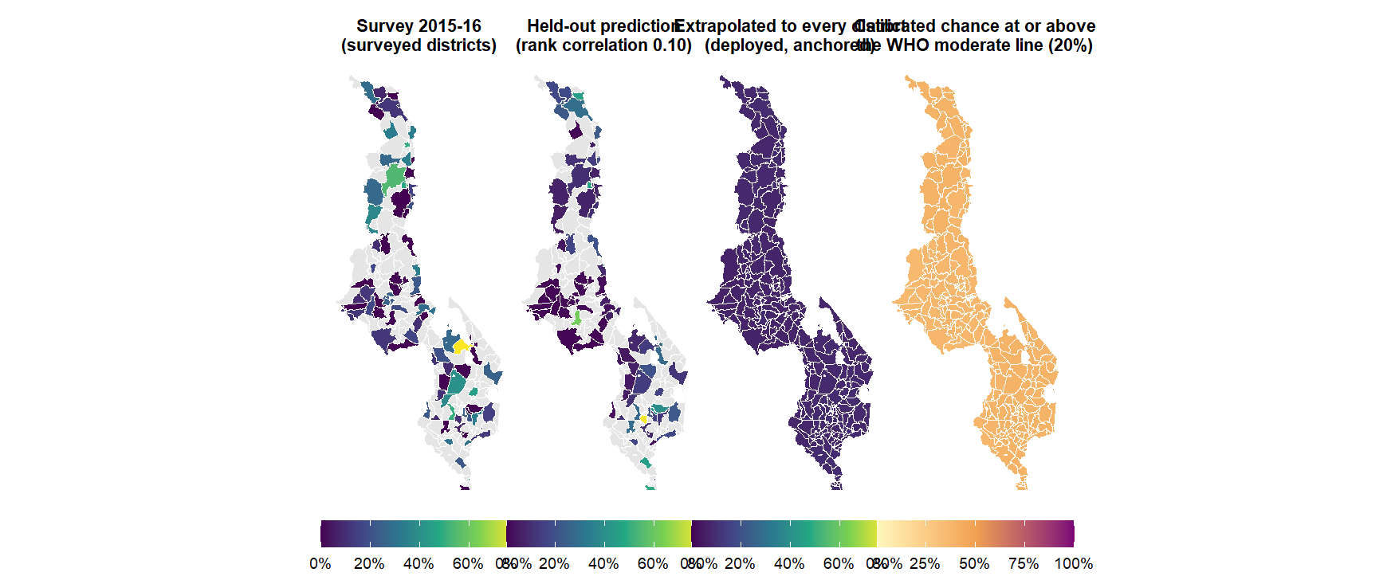
Malawi: survey, held-out prediction, extrapolation and uncertainty
Notes:
SAY: Malawi, women’s iron deficiency, one outcome across the four questions a map has to answer. Left, what the survey measured, district by district. Second, what the model predicts for each of those districts when it is held out. Third, the model applied to every district including the ones never surveyed. Right, the calibrated chance that each district sits at or above the WHO moderate line - a probability that has been checked, not a shading of the model’s mood.
DETAIL: Panel 2 is the in-fill out-of-fold prediction (5-fold by district, ten draws, prevalence target). Panel 3 is the deployment fit as the dashboard shows it: the index on all surveyed districts, level-calibrated, anchored to the national figure, in-sample for the surveyed ones. Panel 4 (CP-01, 27 September): the conformal-predictive-distribution chance of sitting at or above the 20 percent line, from out-of-fold residuals whose 90 percent band covers the survey’s own value 91 percent of the time under leave-one-out; this cell’s half-width is about 32 points, much of it the survey’s own single-cluster noise. Gray in panels 1 and 2: no survey clusters. Tables: viz/oof_women_iron.csv, viz/deploy_malawi_women_iron_cal.csv.

Slide 43
Seeing the results

Slide 44


How should every map in this deck be read?
Grade A: several clusters
Grade B: one cluster
Grade C: no survey
What: surveyed districts with more than one survey cluster (39 districts)
On the map: solid fill
Read: the survey's own district value is worth comparing with
What: surveyed districts with a single cluster (80% of surveyed districts)
On the map: hatched
Read: the survey's district value is itself a noisy estimate; the ceiling slide says how noisy
What: districts the survey never reached, and every district of a country with no survey
On the map: gray on survey maps, filled on model maps
Read: only the model speaks; its intervals say how stable it is, not how right
Notes:
A convention borrowed from the small-area-estimation literature (hatching for direct estimates whose coefficient of variation exceeds a third; gray for no data). Every district on every map in this deck belongs to one of three grades. A: surveyed with several clusters, so the survey’s own district estimate is worth comparing with; 39 districts. B: surveyed with one cluster, the majority (80% of surveyed districts), where the survey’s district number is itself an estimate with the noise the ceiling slide quantifies; hatched wherever a survey value is drawn. C: no survey clusters, where only the model speaks; gray on survey maps, filled on model maps. The grade says what the map can be compared against, not how good the model is.

Slide 45
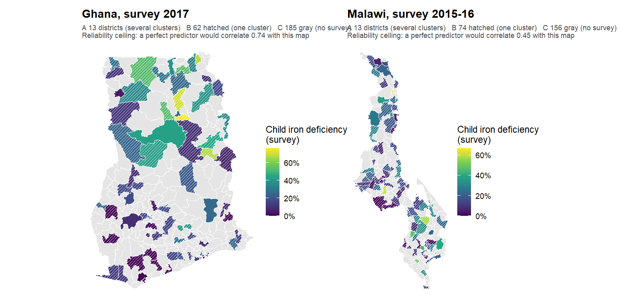
How reliable is the survey’s own district map?
Notes:
SAY: Before judging the model, look at what it is judged against. Hatched districts have one survey cluster; their value is one cluster’s respondents. The number under each title is the ceiling: how well a perfect predictor of the true district value could correlate with this map. Around 0.5 to 0.7. That is the bar, not 1.0.
DETAIL: The survey’s own district map of child iron deficiency, with the reliability grades drawn on it. Hatched districts have one survey cluster: their value is a single cluster’s respondents, and the split-half ceiling says how much of the district-to-district variation on this map is noise. Unhatched districts have several clusters. Gray districts have none. When the next slides compare the model with “the survey”, this is the survey they compare with; the model’s job is to be a better estimate of the true district value than a single hatched cluster is, which the reliability-ceiling slide shows it can be in the strong outcome-country combinations.

Slide 46
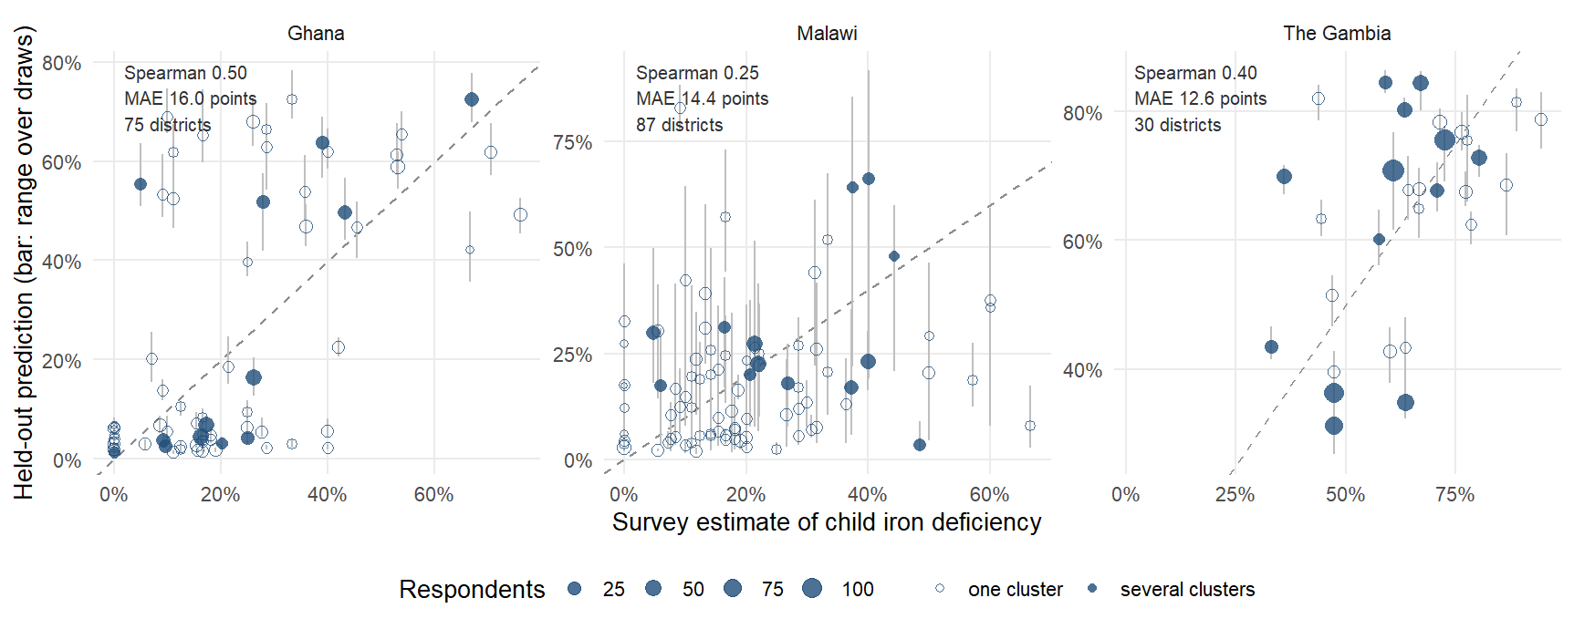
Does the model track the survey, district by district?
Notes:
The plot every geostatistical paper carries and this deck lacked: each district’s survey estimate against its prediction made with the district held out (5-fold by district, mean over ten draws; the bar is the range over the draws, which is fold-assignment variability, not sampling error). The dashed line is perfect agreement. Read three things. The cloud is tilted, not on the line: the model ranks (Spearman 0.50 in Ghana, 0.40 in The Gambia, 0.25 in Malawi) but compresses the range, because it is rescaled to the training spread and shrinks extremes, which is the MAE of 16.0 to 14.4 points. Hollow points are single-cluster districts: much of the vertical scatter around them is the survey’s noise, not the model’s. The largest circles, the districts with the most respondents, sit closest to the line.

Slide 47
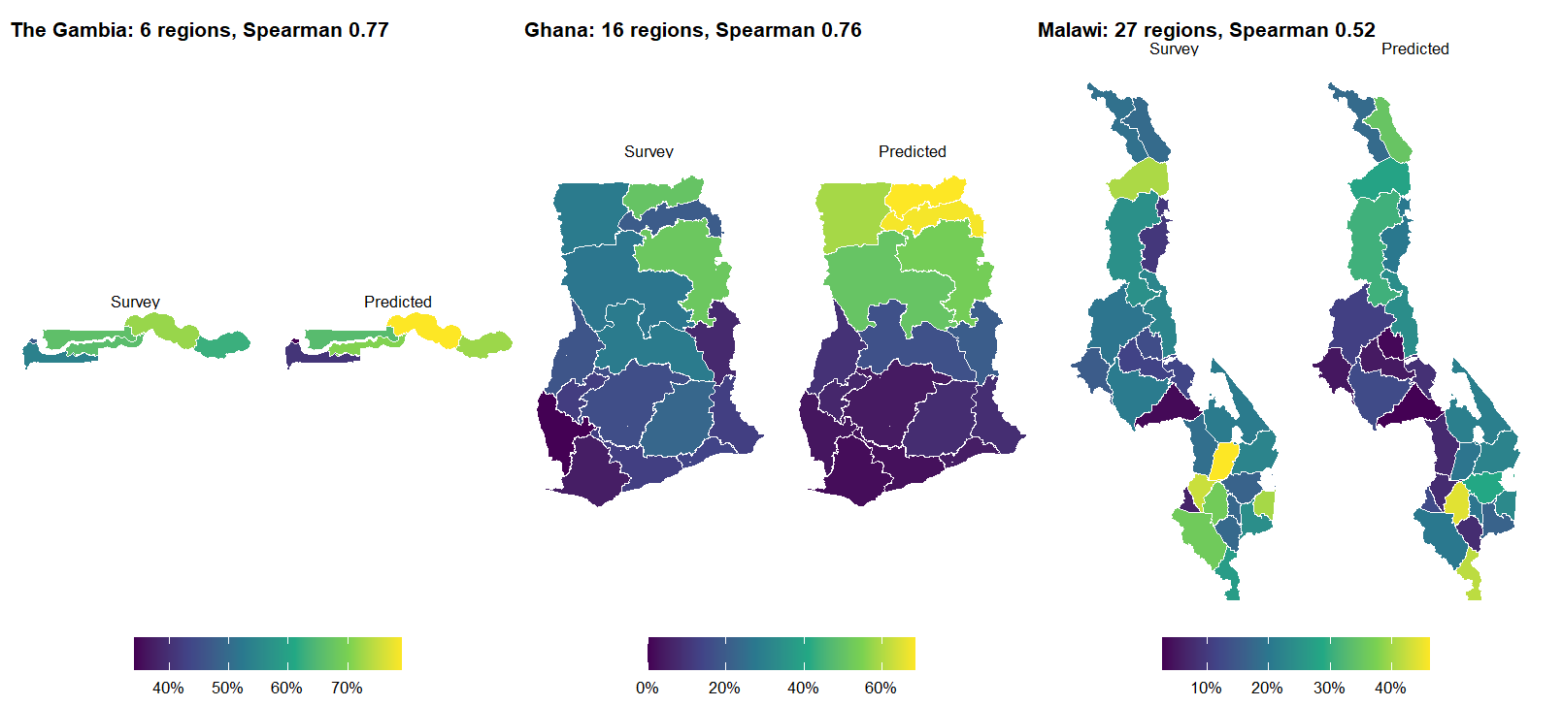
Does it match the survey at the regional level?
Notes:
The same held-out district predictions, and the survey, both aggregated to the regions (respondent-weighted means), child iron. This is the resolution at which the surveys were designed to be read, and the comparison a ministry statistician will make first. The regional pattern is recovered in each country; the district slide before this one shows the finer level where the survey itself becomes noisy. The MIMI and IHME decks show exactly this pair of maps as their headline validation figure.

Slide 48
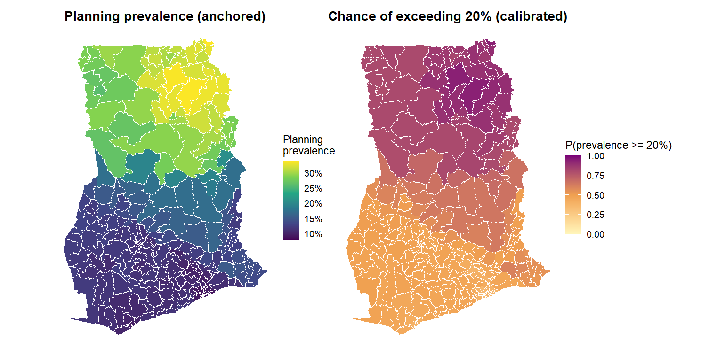
How likely is a district to be above the 20% line?
Notes:
The device IHME uses for every one of its maps, applied here: not “what is the prevalence” but “how likely is it to be above the line a program acts on”. Ghana, child vitamin A, the deployed map (the index fitted on the 75 surveyed districts, level-calibrated, anchored to the national figure, applied to all 260). Since 27 September the right map is CALIBRATED (CP-01): the chance comes from a conformal predictive distribution over 75 out-of-fold residuals, and the underlying 90 percent band (about 29 points either side here) covers the survey’s own measured district value 91% of the time under leave-one-out, checked across all 27 country-outcome combinations. 53 districts are above the 20 percent line with at least 80 percent probability, 0 below it, and 207 are honestly undecided; 185 of the 260 have no survey clusters and inherit the cell’s width. Before calibration the resampling version of this map called 63 districts “80 percent sure” — resampling bands cover the survey’s value only 8% of the time, which is why they were replaced. The coverage target includes the survey’s own single-cluster noise, so much of the band width is the survey’s, not the model’s. For a new country the anchor would come from a small national sample and the map would read as a planning figure.

Slide 49
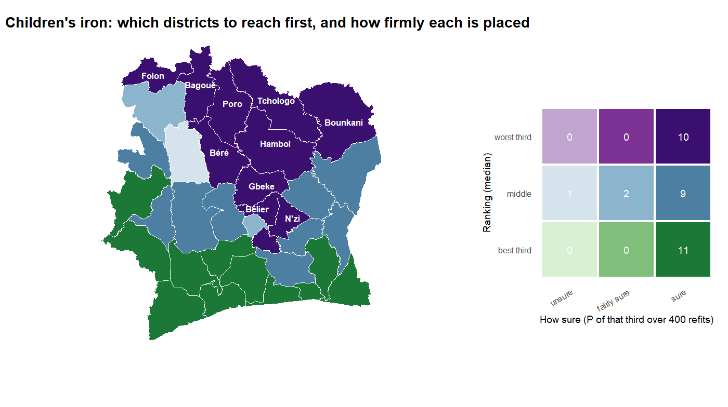
How bad, and how sure, on one map?
Notes:
The two Cote d’Ivoire maps folded into one, the bivariate device the geospatial-health literature recommends for policy audiences: color hue is the ranking (purple worst third, blue middle, green best third; median over the 400 refits) and color depth is how sure the refits are of that placement (deep = at least 80 percent of refits put it in that third; pale = under 60 percent). The legend counts districts in each outcome-country combination. The reading is immediate: deep purple, act; pale purple or pale blue, survey first; deep green, lowest priority. The labeled districts are the deep-purple ones, the northern belt. As before, “sure” means stable under resampling of the training set, not verified against a Cote d’Ivoire survey.

Slide 50
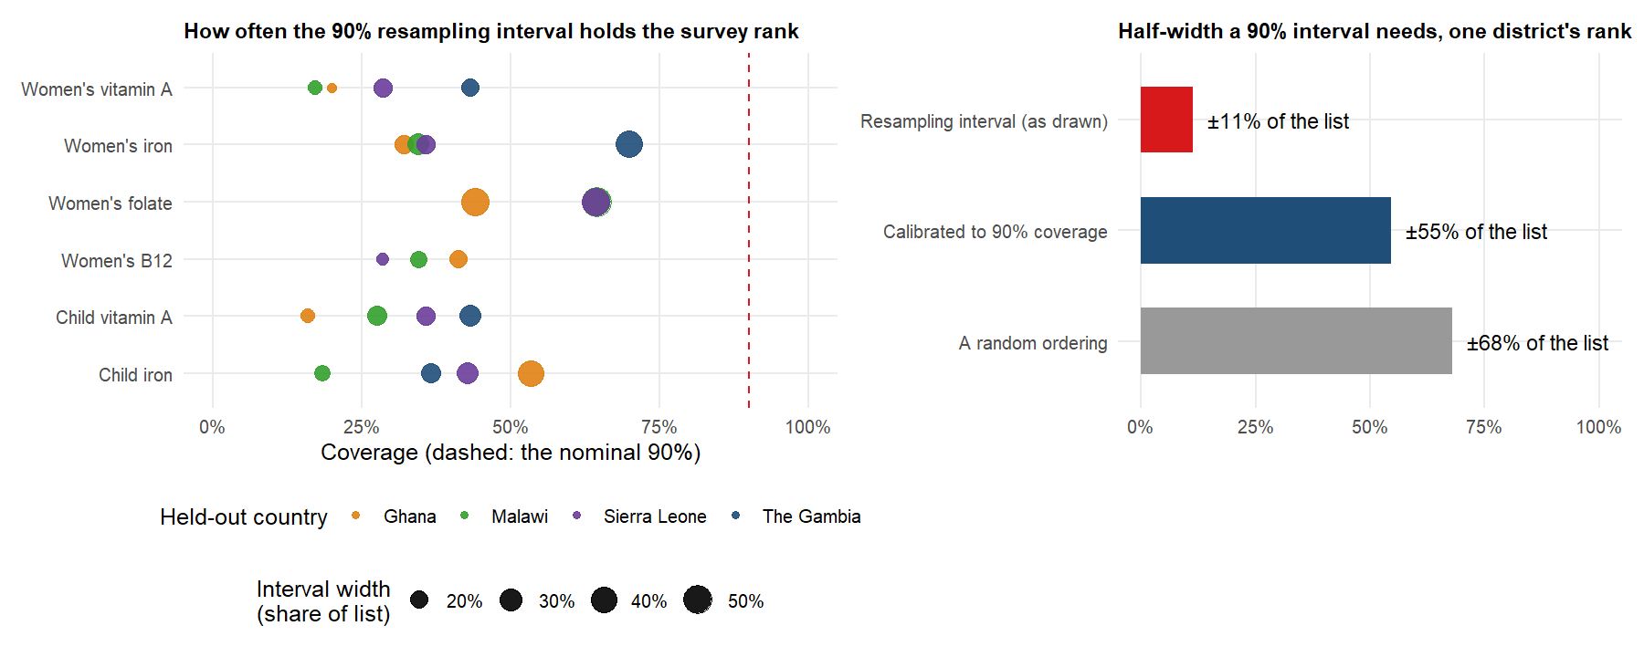
What do the rank intervals promise, and what do they not?
Notes:
A calibration check the Cote d’Ivoire slides needed. The 90 percent rank intervals on those maps come from resampling the training districts. If they were honest intervals for the truth, the survey’s own rank would fall inside them 90 percent of the time. Doing exactly that with each surveyed country held out (100 resamples of the other three, climate and soil, biomarker level), the survey rank falls inside the interval 38% of the time on average, 16% to 70% across the 22 country-outcome outcome-country combinations, with a median interval 21% of the list wide. So the intervals are far too narrow to be read as “the truth is in here”; they answer a different question, how much the ranking would move if we had learned from different districts, and the gap to 90 percent is the model error the transport correlation already reports. Right panel: the calibrated width. Taking the 90th percentile of the distance between the held-out survey rank and the point prediction over all 1176 held-out districts (conformal calibration), a 90 percent interval for a single district’s rank has to be 55% of the list either side, against 11% for the interval as drawn and about 68 percent for a random ordering; the median miss is 20% of the list (random: 29 percent). In words: at a transport correlation of 0.3 to 0.4, an honest 90 percent interval on where one district sits is nearly the whole list, and it is 35% in The Gambia and 59% in Malawi. The useful statement is therefore not an interval but a probability of a class: a district the model puts in the worst third is in the survey’s worst third 52% of the time (chance 33%), and one it puts in its top five 62% of the time. That is what the Cote d’Ivoire maps should be read as: deep color means the model will not change its mind, and a worst-third call is right about half the time rather than a third. Say it aloud: stable, not verified, and honest about the odds.
Since 27 September the PREVALENCE side is fixed rather than caveated (CP-01): every planning-prevalence figure carries a split-conformal 90 percent band from out-of-fold residuals, checked by leave-one-out to cover the survey’s own measured district value 91% of the time across all 27 country-outcome combinations (the resampling bands it replaced covered 8%), with a median half-width of 26 points — much of it the survey’s own single-cluster noise. The WHO-threshold chances on the exceedance slide and the dashboard are conformal predictive distributions from the same residuals. Ranks remain class-probability territory as argued above; levels now come with an interval that means what it says.

Slide 51
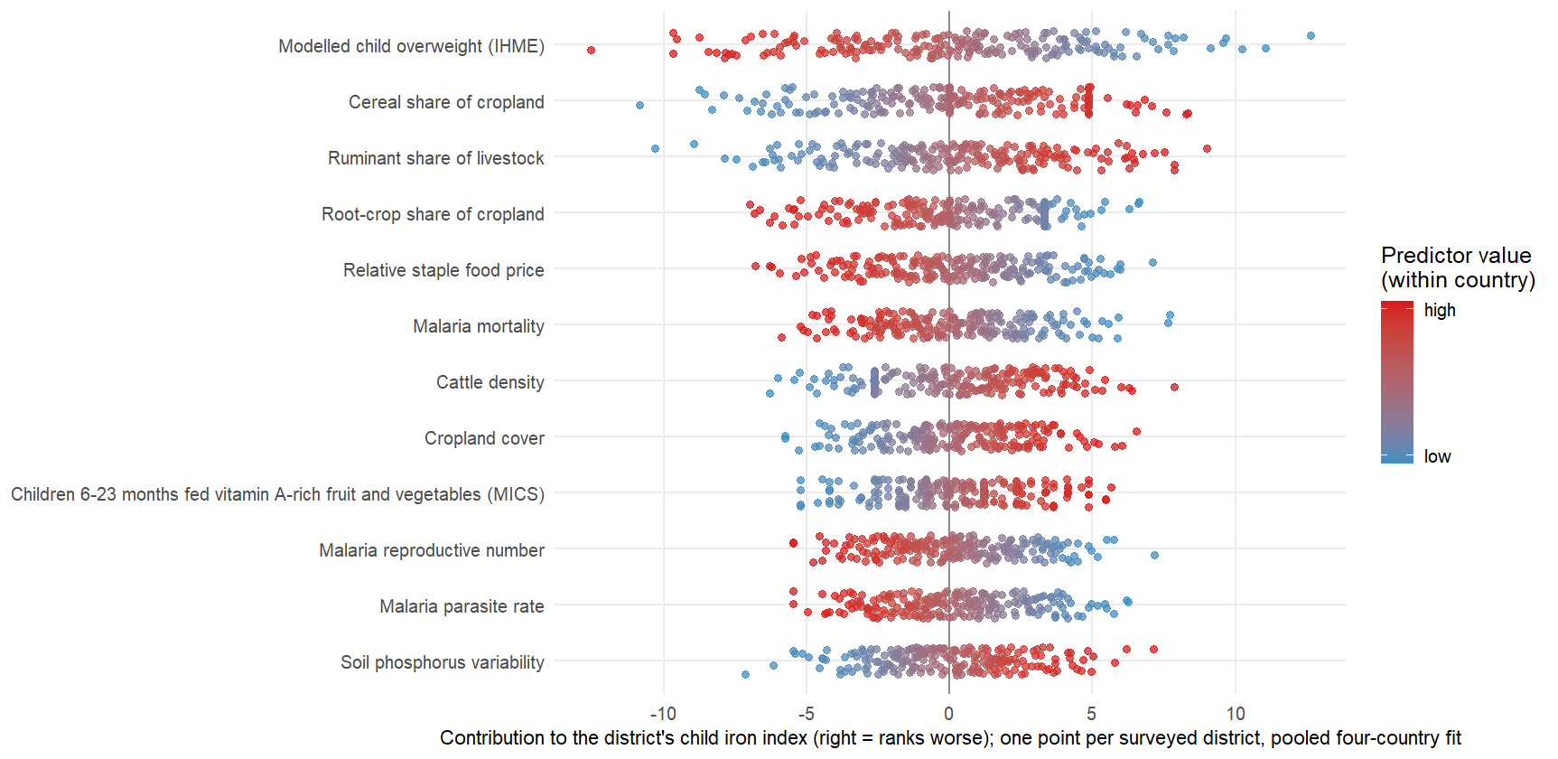
What moves each district, predictor by predictor?
Notes:
The SHAP-style view the MIMI deck uses, which the index allows exactly rather than by approximation: the index is linear in the rank-normalized predictors, so each district’s score is a sum of per-predictor contributions beta times x. One row per predictor (the twelve largest weights of the pooled child-iron fit), one point per surveyed district in the four countries, color = where the district sits on that predictor. A row whose red points sit to the right says “districts high on this predictor rank worse”; a row that is wide says the predictor separates districts strongly. Unlike the bar charts earlier, this shows the spread: a predictor with a modest average weight can still move a handful of districts a long way. The same figure exists for every outcome from contributions_top12.csv.

Slide 52
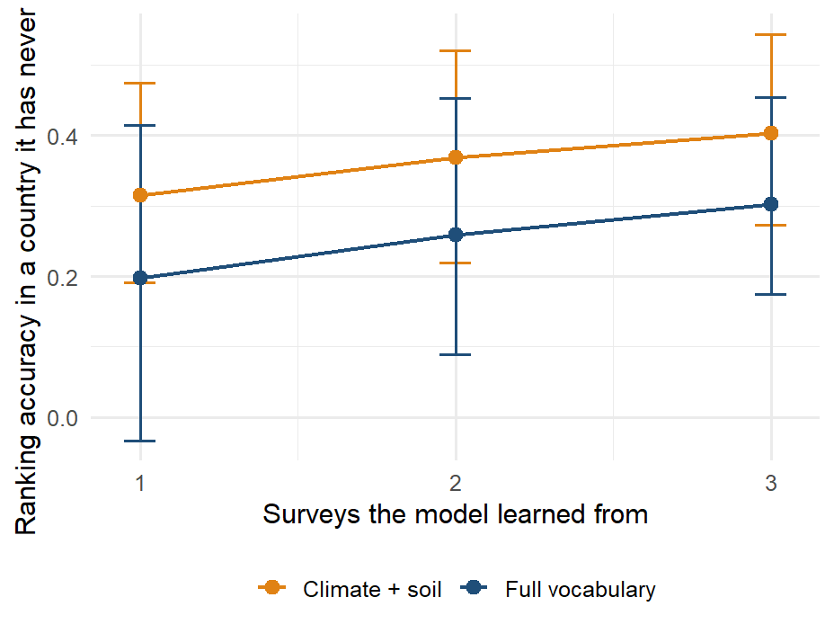
Does each survey added improve every other map?
Notes:
The training-country curve from the transport section, re-captioned as the argument it makes: with one survey to learn from the transported ranking averages 0.20, with three 0.30, and the curve has not flattened. Every biomarker survey a country runs therefore improves the map of every other country in the panel, which is the case for pooling surveys into one protocol rather than analyzing each alone, and for the fifth country being worth more than its own map. Bars are the interquartile range over the subsets of training countries. This is the framing the Lancet Global Health vaccination-mapping paper uses for its country panel.

Slide 53
What carries the signal

Slide 54
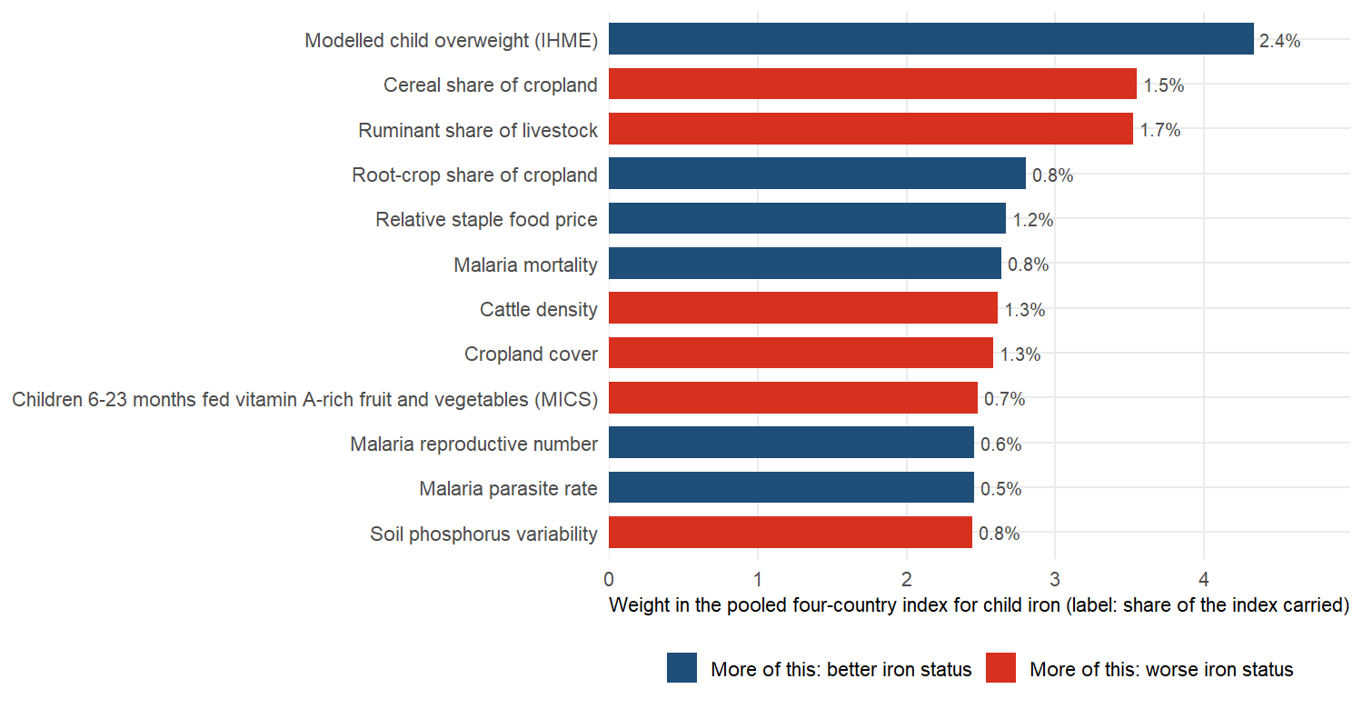
Which predictors carry the most weight?
Notes:
SAY: The twelve heaviest predictors for child iron, pooled over the four countries, with plain names. Red bars mean more of the layer goes with worse iron status, blue with better. No single predictor carries more than a few percent of the index: it is a sum of many small signals, mostly about landscape and livelihoods, not one master variable.
DETAIL: The index is linear in the rank-normalized predictors, so its component weights project back exactly onto the columns (scripts 57 and 58); shown is the pooled fit on the biomarker level, labels from R/predictor_plain_names.R. The satellite embedding, climate and soil together carry 39% to 54% of the index depending on the outcome. The other outcomes are in results/figures/protocol_v2/index_importance_top10_level.png. Likely question: whether these are causes. They are not; the weights say where deficiency is.

Slide 55
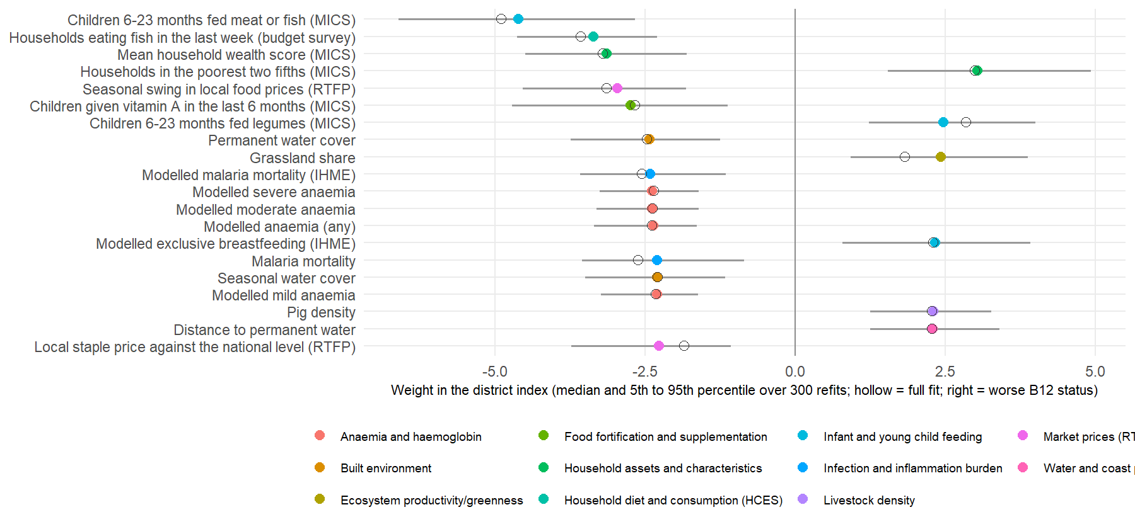
What are the weights behind the best ranking? Malawi, women’s B12
Notes:
SAY: The single best ranking in the study, women’s B12 in Malawi, and the twenty predictors behind it. Districts where more infants are fed meat or fish, more households eat fish, and wealth is higher have better B12; poorer, grassier, more pastoral districts have worse. And then the anemia and malaria surfaces run the other way, which the next slide explains.
DETAIL: Malawi, women’s B12, biomarker level: the outcome-country combination with the best in-fill ranking of the 24 (Spearman 0.70; The Gambia child vitamin A is next at 0.69). The index is linear in the rank-normalized columns, so every column has a standardized weight in a fit; the twenty largest are shown. Intervals: the index was refitted on 300 bootstrap resamples of Malawi’s 87 surveyed districts, with the domain components re-oriented and the weights re-learned each time; the bar is the 5th to 95th percentile and the hollow marker the weight in the full fit. Every one of the twenty keeps its sign in at least 95 percent of refits. The level target is the negated log concentration, so a positive weight means worse status. Read the signs as district-level associations in Malawi: districts where more infants are fed meat or fish, more households ate fish last week and the wealth score is higher have better B12 status, and districts that are poorer, grassier, further from permanent water and with more pigs have worse. The diet items point the way a nutritional story would expect; the anemia and malaria surfaces run the other way (more anemia and malaria, better B12), which is the lakeshore and the south against the uplands, and a reminder that these are ecological associations, not effects. Script: scripts/policy_deck/09_vim_forest_example.R, which takes any country, outcome and target through environment variables. B12 is measured in three of the four surveys, so this outcome-country combination does not enter the cross-country transport figures.

Slide 56
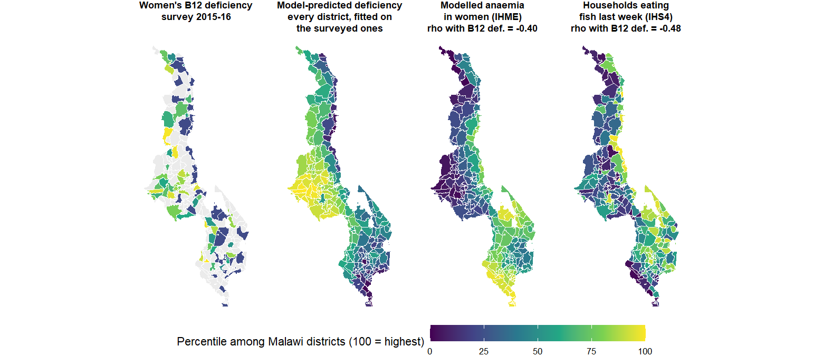
Causal driver or surrogate marker? Fish, anemia and B12 in Malawi
Notes:
SAY: Some predictors are plausible causes, fish consumption for B12. Some are surrogates: the anemia and malaria surfaces predict better B12 in Malawi not because malaria protects anyone but because they mark the lakeshore and the south, where fish is eaten. The model finds both kinds; it cannot tell them apart, and a surrogate need not travel to the next country.
DETAIL: The story behind the forest plot on the previous slide. In Malawi the modeled anemia and malaria surfaces carry negative weights for B12: districts with MORE anemia and malaria have BETTER B12 status. No nutritional mechanism says that. The maps say why: the lakeshore and the southern lowlands are where malaria transmission and anemia are highest, and they are also where households eat fish, the main dietary B12 source in the country; the uplands have less malaria, less fish and worse B12. The anemia surface is a surrogate marker for that geography, not a cause, and it is a good one precisely because it is modeled from the same environment. Three lessons for the audience: the index finds these markers on its own, they are ecological associations and must never be read as effects, and a surrogate that works in Malawi need not work in the next country, which is why the cross-border models lean on climate and soil rather than on health surfaces (ablation slide). The second panel is the deployment fit (the index fitted on the 87 surveyed districts and applied to all 243, in-sample for the surveyed ones, as on the dashboard): it fills the gray districts and smooths the survey’s single-cluster noise, and it visibly follows the anemia and fish geography. Each map is the within-country percentile of its variable so the four share one scale; rho is the Spearman correlation with B12 deficiency across the surveyed Traditional Authorities (negative for anemia and for fish: more of either, less deficiency).

Slide 57
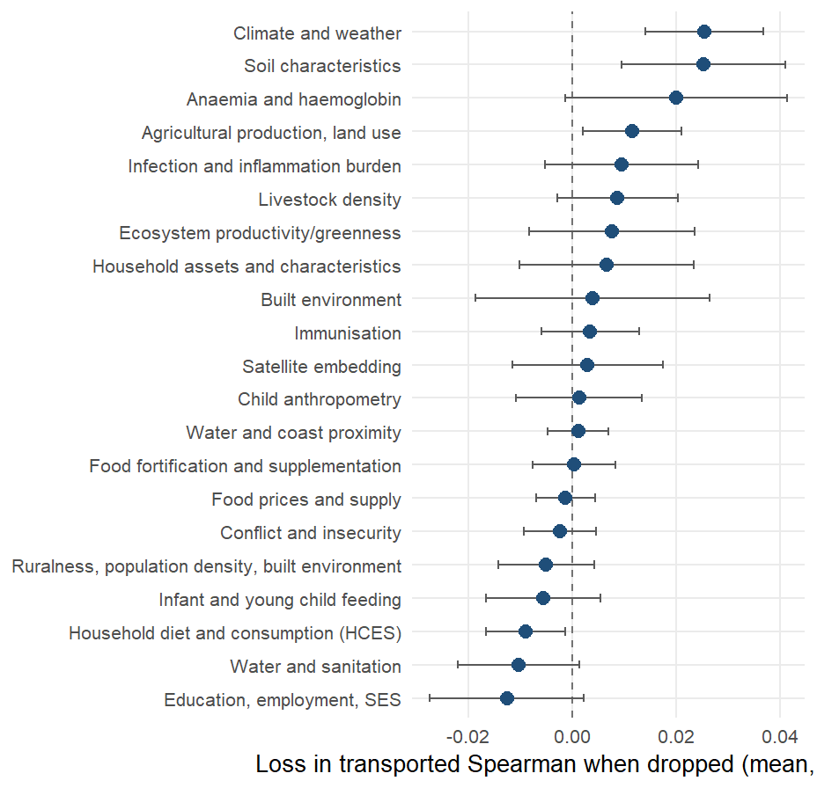
What travels across borders, and what does not?
Loss in transported Spearman (biomarker level, 22 outcome-country combinations) when each domain is dropped and the components rebuilt, mean over outcome-country combinations with a 95% interval. The load-bearing domains are Climate and weather, Soil characteristics, Anaemia and haemoglobin; removing 7 of the 21 domains costs nothing or helps.
Notes:
SAY: Drop each domain in turn and see what the transported ranking loses. Climate and soil are load-bearing; the anemia surfaces, agriculture and greenness follow; the household-survey items help inside a country and not across a border. The physical environment is what carries, and it is also what a country without a survey can download.
DETAIL: Positive values mean the domain is load-bearing. Climate and soil carry most, with the anemia surfaces, agriculture and greenness behind; the water-and-sanitation, education and infant-feeding domains sit at or below zero: removing them does not hurt a new country and in two cases helps. The DHS-derived domains are not in the headline set at all: with them in, the district transport index scores 0.28 against 0.30 without. A fixed climate-and-soil index transports at 0.38 at district level and 0.45 regionally against 0.30 and 0.28 for the full vocabulary; it was found on the same four countries it is scored on and enters the next country as a pre-registered prediction.

Slide 58




What drives the transport models?
The landscape gradient
Grassland and cropland cover, the share of ruminants in the herd (top twenty in 14 of 22 held-out fits), cattle and sheep density, cereal-heavy cropping, low plant productivity: dry, grassy, pastoral, unproductive districts rank worse on every outcome.
The modeled child-growth and anemia surfaces
Wasting, underweight and anemia point to worse status; overweight points the other way and behaves as a wealth proxy.
The food economy
The local staple price relative to the national level appears in 13 fits across 5 outcomes.
Remoteness and demography
Distance to the coast and the dependency ratio, in about a third of the fits.
Malaria intensity, with an unexpected sign
High-malaria zones are the wetter, more productive ones. Single household-survey items rarely recur.
Notes:
Source: results/tables/protocol_v2/index_importance_columns.csv, scope “loco”: the index fitted on three countries, projected back to columns, for each of the 22 held-out country and outcome combinations on the biomarker level; a column counts once per fit in which it is among the twenty largest standardized weights. Every column named on the slide keeps the same sign in every fit where it appears (34 of the 41 columns that recur in five or more fits are unanimous). The pattern is the one on the previous two slides seen from the other side: what a model trained elsewhere reaches for in a new country is the physical environment and the modeled nutrition surfaces built from it, not the country’s own survey items. The staple-price and malaria signs are worth saying aloud: relatively expensive staples mark market-integrated, better-off districts, and high malaria transmission marks the wet, productive lowlands where diets are more diverse; neither is a mechanism to act on.

Slide 59
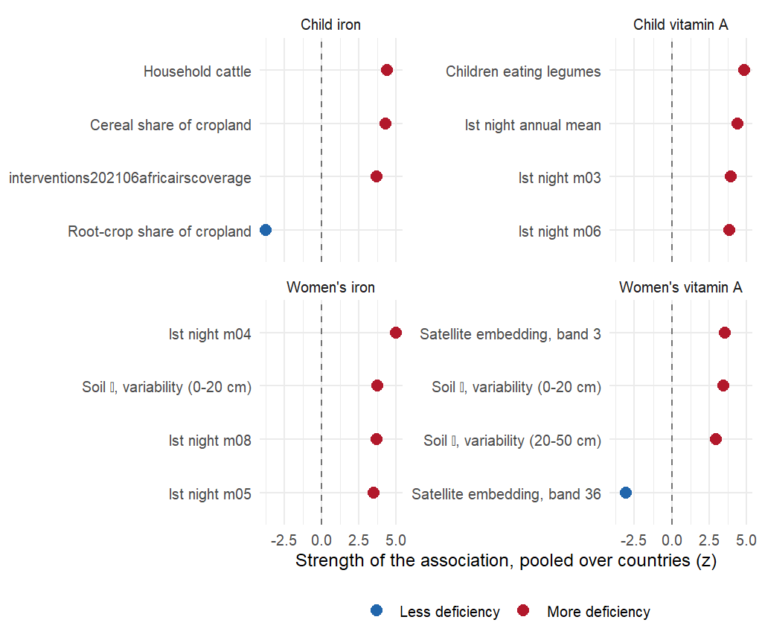
Which associations replicate in every country?
Indicators whose district-level association with the outcome has the same sign in every country with the outcome, ranked by pooled meta-analytic z. Positive z means more deficiency.
Notes:
Legume cultivation and cattle ownership track more deficiency at district level, the reverse of the household-level dietary relationship, which is an ecological-fallacy signature: the replicated axis is rural subsistence agro-ecology, useful for deciding where to look and uninformative about what to change. No malaria burden indicator replicates; child wasting tracks women’s vitamin A deficiency in all four countries. An earlier version of these slides had the signs inverted.

Slide 60
Limits and survey design

Slide 61
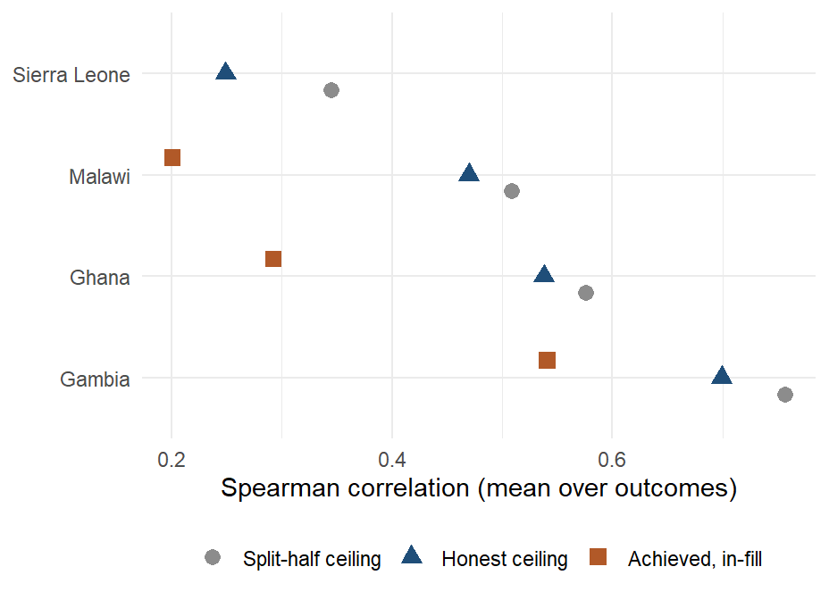
How good could any model be against this survey?
The survey’s own district numbers are estimates, mostly from one cluster each. This shows how well even a perfect predictor of the true district value could match them: on average 0.48, by country. The model’s 0.28 on the same scale is 59% of that. The gap between the model and 1.0 is mostly the survey’s noise, not the model’s ignorance.
Notes:
SAY: A survey that samples one cluster per district gives a district number with a lot of noise in it. Even a model that knew the truth exactly would only correlate about 0.5 with that number. So when the model scores 0.4, it has most of what there is to get; the way to raise the bar is more clusters per district, which is a survey decision.
DETAIL: A respondent-in-cluster-in-district-in-region variance model reproduces the split-half ceiling when the cluster is counted as geography, then removes the cluster term: 13% of the split-half ceiling was cluster effect. Child zinc has no district geography; what looked like geography was the cluster, and the time of the blood draw explains part of the cluster effect (ZN-02).

Slide 62

Could a small national survey plus the model replace a district survey?
Four ways to get district numbers, costed against the size of survey each needs. A small national sample, 5% of a full survey, with the model’s ranking spread across districts gives a median district error of 9.3 points. A survey designed to measure each district directly needs about 25% of its full size to do as well.
Notes:
SAY: On the level of deficiency, a small national sample plus the ranking does as well as a district survey four to five times its size. On finding where the deficient people are, a district survey of any size still wins, because it measures the populous districts directly. So: not a replacement, a much cheaper first pass.
DETAIL: A district survey matches the anchored ranking’s level error at about 25% of the full sample. The ranking wins on level error only: a district survey of any size captures more burden, because burden sits in populous districts that surveys measure precisely. Fitted symmetrically on a reduced survey, the model’s error degrades in step with the survey’s, so the model improves the ordering at any sample size and does not reduce the sample a survey needs.

Slide 63
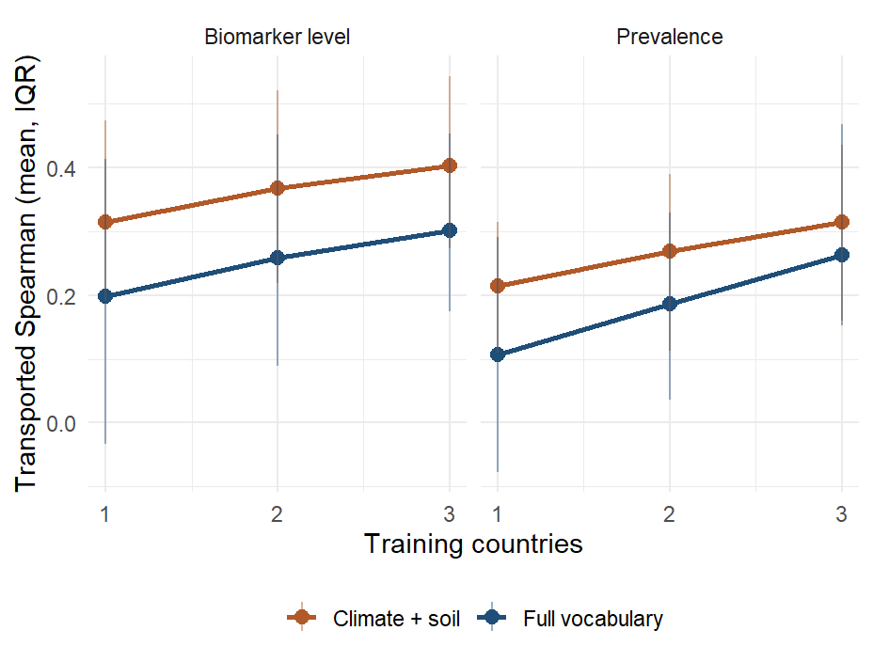
Does each survey added help the others?
Every subset of training countries scored on each held-out country. The full vocabulary gains about 0.05 per added training country on the level; the climate-and-soil index starts higher and is positive in 95% of single-country fits.
Notes:
Bars are the interquartile range over fits. Likely question: whether four countries are enough. The curve has not flattened at three training countries, which is the argument for adding surveys to the panel rather than changing the estimator.

Slide 64
Closing

Slide 65
What the models can and cannot do yet
Rank districts in a surveyed country?
Yes: 0.40, null 0.08.
Rank districts in a new country?
Yes, less well: 0.30 against 0.08.
Which predictors carry the signal?
Satellite, climate and soil.
Prevalence in a new country from the model alone?
Not yet.
Prevalence with one national anchor?
Yes: 9.3 points at a 5% sample.
Replace biomarker surveys?
No: the ceiling is the survey's.
Guide where the next survey samples?
In design, not piloted.
Say how sure each map is?
Stable, yes; verified, no: coverage 38%, not 90%; a calibrated 90% interval is ±55% of the list. A worst-third call is right 52% of the time (chance 33%).
Notes:
The checklist agreed at the 10 September check-in, one row per question. Sources: benchmarks_v2_summary.csv (in-fill and country transport, biomarker level), transport_null_calibration.csv (95th percentile of the permutation null), nested_domain_selection.csv (fixed climate-and-soil set), index_importance_domains.csv (pooled shares of the three remotely sensed domains), anchor_and_rank.csv (AR-01, 5% fraction, climate-and-soil set, ranks from prevalence), variance_components_ceiling.csv (prevalence, admin2). Levels do not transport because the surveys differ in year, season, team and calibration (fe_transport_level_offset); the anchor supplies the level the ranking lacks. Guiding the next survey is a design result on these four surveys, not a pilot.

Slide 66



What have we learned, and what comes next?
Public data can rank a country's districts by deficiency
Inside a surveyed country better than the survey's own regional averages (0.40 vs 0.31); six district pairs in ten in the survey's order.
And in a country with no survey, where nothing else can
Rankings carry across borders (0.38 from climate and soil); Cote d'Ivoire has its map. Levels need one national number.
Where the survey can see districts, the model is close to the best any model could be
Six outcome-country combinations at 0.64; The Gambia, with several clusters per district, 0.41 to 0.70.
The uncertainty on every map is honest about what it is
Stable under resampling, not verified: a worst-third call is right 52% of the time, chance 33%.
Every survey added improves every other country's map, and the curve has not flattened
0.20 with one training survey, 0.30 with three, about +0.05 per country added. The limit on this method today is the number of biomarker surveys it can learn from, not the predictors.
So the ask is more surveys in the pool, and the fifth one is already a test
Two indices were written down before any new country's data was seen. We are asking countries with a recent, planned or shelved micronutrient survey to join the panel.
Notes:
SAY: Public data can rank a country’s districts by micronutrient deficiency: inside a surveyed country better than the survey’s own regional averages, and in a country with no survey at all, where nothing else can. Where the survey resolves districts, the model is close to the best any model could be. A single national number puts a level on the ranking. The uncertainty on the maps is honest about what it is. And the last row is the one I want to leave you with: what limits this method today is not the satellite data, which is saturated — eleven blocks added this year each moved it by less than 0.01 — it is the number of biomarker surveys it can learn from. One training survey gets a new country to 0.20, three get it to 0.30, and the curve has not flattened. So our ask is that countries with a micronutrient survey, recent or planned or sitting in a drawer, put it in the pool: it improves every other country’s map, and yours gets a ranking for the districts your survey never reached.
DETAIL: The rows are the numbers from the optimiztic reading (TWO_READINGS_2026-09g.md). Not on the slide, said if asked: the honest product is a ranking, levels remain planning figures, and the per-outcome maps in an unsurveyed country are mostly one map of environmental deprivation. On the pooling row, three qualifiers to have ready. (1) The gain is uneven: as held-out countries The Gambia goes 0.40 to 0.60 and Ghana 0.30 to 0.39 as surveys are added, while Malawi (0.16) and Sierra Leone (0.06) stay flat, so “every survey improves every map” is a statement about the average. (2) Which country is added matters, and we can say how: trained on Ghana alone the model reaches The Gambia at 0.61, while trained on The Gambia alone it reaches Ghana at 0.30 — Ghana’s 260 districts span the widest environmental gradient in the panel (NDVI SD 0.16 against 0.04 to 0.09 elsewhere), and a training country that contains the whole gradient teaches the whole gradient. So the request is not simply “more countries” but countries that extend the range, which is checkable from public rasters before any blood is drawn. (3) The saturation claim behind “it is the surveys, not the predictors”: eleven candidate predictor blocks were scored under one harness and none moved in-fill or transport by more than 0.01 at the median, while the open, permission-free tier transports better than the full set (0.316 vs 0.302 vs 0.281 with DHS added).

Slide 67
Appendix

Slide 68
Sources, tiers and alignment
Source | Columns | Tier | Domains | Year rule | Largest gap (years)
DHS indicators | 150 | DHS (access agreement) | 16 | dhs_round | 3
Earth Engine (climate, land) | 80 | Open data | 4 | access_2019, ccnl_2013, clim_anomaly, clim_normals, gee_t… | 6
Satellite embedding | 64 | Open data | 1 | alphaearth_2017 | 4
Soil | 45 | Open data | 1 | soil_static | static
IHME modeled surfaces | 34 | Open data | 7 | ihme_to_2017, ihme_to_2018, ihme_to_2019 | 1
MICS microdata | 30 | Public survey microdata | 7 | mics_microdata | 4
Fortification (GFDx) | 27 | Open data | 3 | gfdx_ntd_2015, gfdx_survey_year, gfdx_who_anaemia_2011, g… | 6
MICS (WHO HEAT) | 19 | Public survey microdata | 1 | mics_heat_round | 3
Population, wealth index | 18 | Open data | 4 | acled_36m, ghsl_epoch, rwi_2019, wpop_2020, wpop_density_sy | 7
Household budget surveys | 15 | Public survey microdata | 1 | hces_year | 3
Crops (MapSPAM) | 12 | Open data | 1 | spam_2010 | 8
Malaria Atlas Project | 11 | Open data | 1 | map_blood_2012, map_survey_year | 6
Climate zones | 9 | Open data | 1 | aez_static, koppen_static | static
Market prices (WFP) | 9 | Open data | 1 | fprice_window | 0
Food balance (national) | 8 | Open data | 1 | fao_supply | 0
Livestock density | 8 | Open data | 1 | glw4 | 3
Dietary inadequacy (Ghana) | 6 | Open data | 1 | mimi_glss7 | 1
Helminths (WHO) | 6 | Open data | 1 | espen_mda, espen_nearest | 3
Market prices (World Bank) | 6 | Open data | 1 | rtfp_window | 0
Water and coast distance | 6 | Open data | 1 | water_static | static
Anemia (WHO) | 5 | Open data | 1 | who_anaemia_sy | 0
Food security | 4 | Open data | 1 | fsec_window | 0
Subnational HDI | 2 | Open data | 1 | gdl_sy | 0
Vitamin A supplementation | 1 | Open data | 1 | vas_sy | 0
Notes:
Tier: open means downloadable by anyone; public survey microdata means a registration with the survey program; DHS means the DHS Program’s access agreement. Year rule names are the rule identifiers in metadata/covariates/temporal_alignment.csv. The largest gap is the worst case over the four countries; static layers have none.

Slide 69

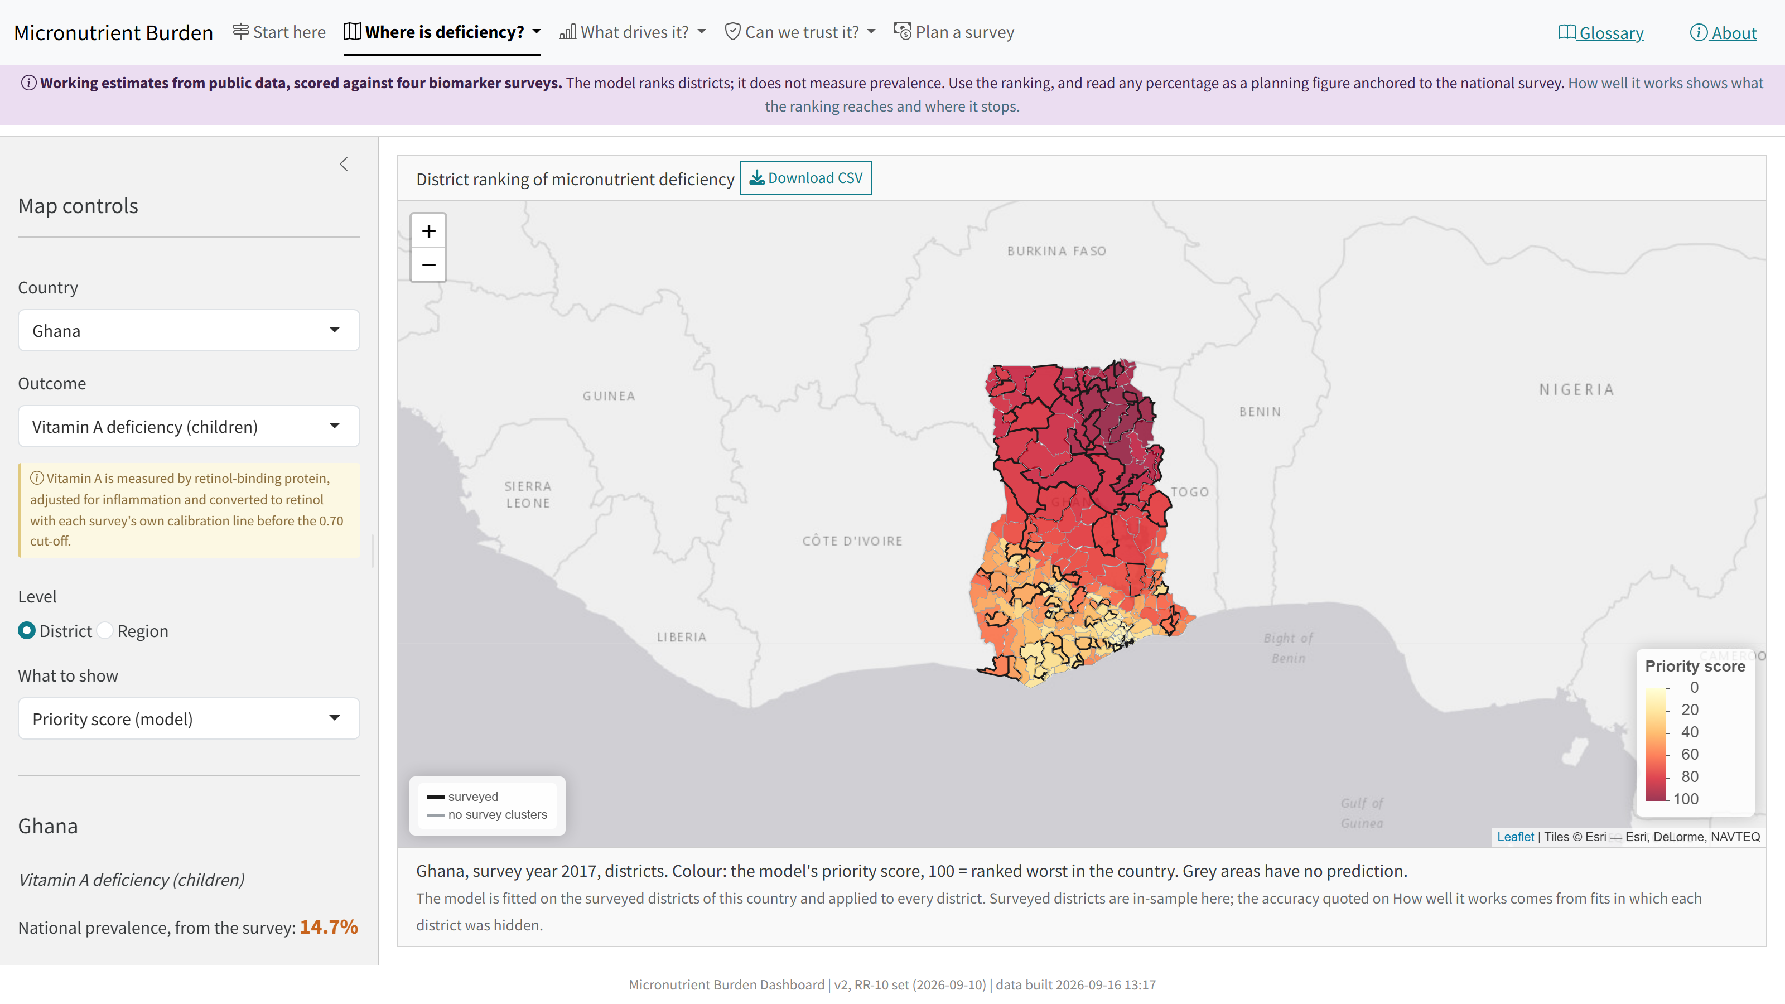


The dashboard
amertens.shinyapps.io/micronutrient-burden
Every number in this talk, for every district; one estimator behind every tab.
Where is deficiency?
A priority score for every district, how sure the model is, a planning prevalence; click a district for what drives it.
What drives it? Can we trust it?
Leading predictors, what travels across borders, the catalog of 575 predictors; the three tests and the ceiling.
Plan a survey
The anchor-and-rank design; a printable brief per country.
Notes:
The dashboard was rebuilt on 13 September on the corrected protocol, so that it says exactly what this talk says, simplified on 14 September for a reader with no statistics, and refreshed on 16 September with the 570-layer predictor set that has no DHS in it. Start here now opens with a plain-language abstract (the project, the four training surveys, how the model was built and checked), then the three numbers, one card on how to use the map, and the checklist; the Ghana worked example and the audit history sit in folded panels. Removed with the rebuild: the person-level machine-learning layer (a coin toss under honest folds), the earlier area-level estimators and their intervals, the old leaderboard, the GBD placeholder and the Sierra Leone chiefdom layer. One estimator feeds every tab: the index fitted on all surveyed districts of a country and applied to every district. The chance of being in the worst fifth exists for surveyed districts in three countries; Sierra Leone’s 14 districts cannot be cross-validated. A printable brief per country comes from the same tables, and a 25-page static walkthrough of every tab (dashboard_walkthrough_2026-09-14.pdf in the Dropbox folder) is there for written comments. Open items: sharing a view by URL, faster loading (the boundary files are most of the bundle), the worst-fifth probability for unsurveyed districts, and plain-language descriptions for the predictors (75 of 570 have one; the catalog is the worklist). Open the URL a few minutes before showing it: the free tier stops idle instances and the restart takes a minute.

Slide 70
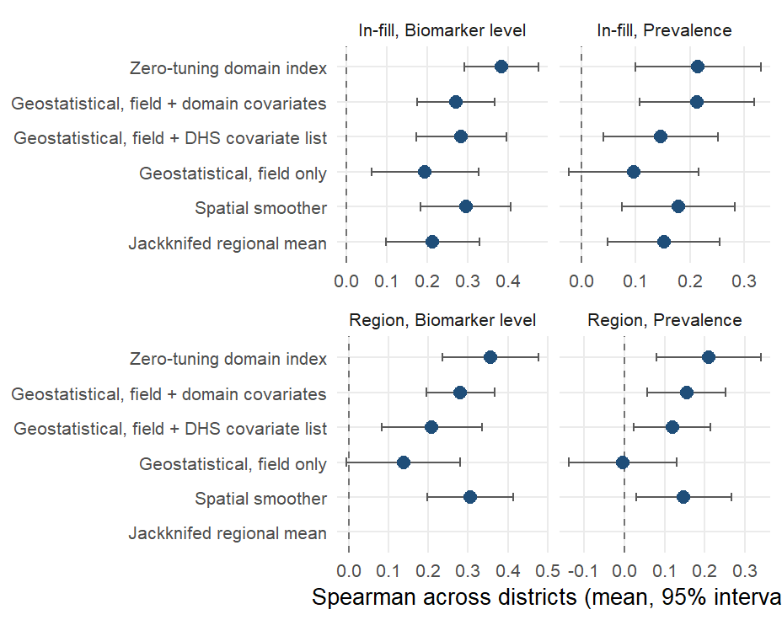
The geostatistical model estimates levels better and ranks worse
The DHS Program’s model-based geostatistics fitted at the survey clusters (a spatial field plus covariates), scored on the same district folds. On the level it scores 0.27 against 0.38 for the index (index better in 20 of 24 outcome-country combinations); on prevalence 0.21 against 0.21.
Notes:
INLA-SPDE Matern field with penalized-complexity priors, binomial on cluster counts for prevalence and Gaussian for the level, cluster predictions aggregated to districts by effective sample size; run with the first component of every covariate domain and with the DHS Program’s ten-raster list (0.28 on the level). The field alone scores 0.19. The geostatistical model has the lower absolute error on prevalence (9.2 against 10.7 percentage points) because it estimates a level and shrinks toward it. Under region extrapolation the index scores 0.36 against 0.28. The method needs measured clusters inside the country it predicts, so it has no country-transport estimand. Likely question: whether the two are complementary. Yes: the geostatistical model for a calibrated prevalence where a survey exists, the index for a ranking where none does.

Slide 71
Every column kept or dropped has a written reason
Step | What happens | Columns
Assemble | Base extraction on the spine, food environment, extra sources, add-back sources
Append blocks | Household budget surveys, MICS microdata, RTFP prices, MODIS NDVI, climate normals | 614
Exclude | Rules with a written reason: data defects, superseded layers, redundant twins | 575
Stamp | Access tier, within-country variation, alignment rule, year used and gap, modelled-surface flag | 575
Fit-time policy | Drop national constants and leakage columns | 525
Transport matrix | Per country: coverage of at least 70% and some variation; then the four-country intersection | 464
Notes:
One shell script runs the chain (scripts/covariates/rebuild_shared_tail.sh) and ends in an audit that fails the build on a domain-key collision, a column declared subnational that does not vary, or a join that fans out. The exclusion file has 23 rules and every rule states its evidence: a nitrogen layer whose medians differ thirtyfold between countries, an NDVI product declared available only to 2013, calendar-year series superseded by survey-year values. This week’s most instructive mistake was in the exclusions. A review labeled the soil dispersion bands and the 20-50 cm depth means “redundant” on a mechanistic argument, and the climate-and-soil result fell from 0.37 to 0.34 across districts and from 0.45 to 0.40 across regions. The bands correlate only 0.03 to 0.69 with the depth means, so the label was wrong; restoring them brought both numbers back. We now hold to one rule: nothing is added or regrouped because a score likes it, an exclusion whose stated premise fails on its own metric is reverted, and every set change is checked against the transport arms before a run. What a model can see is the last two rows: 525 columns vary within a country, of which 464 have a value in all four countries and so can be used to predict a new one. The rest are per-country data gaps: household budget diet indicators pending for Ghana and Sierra Leone, RTFP for The Gambia and Malawi only, MICS items absent from one round.

Slide 72
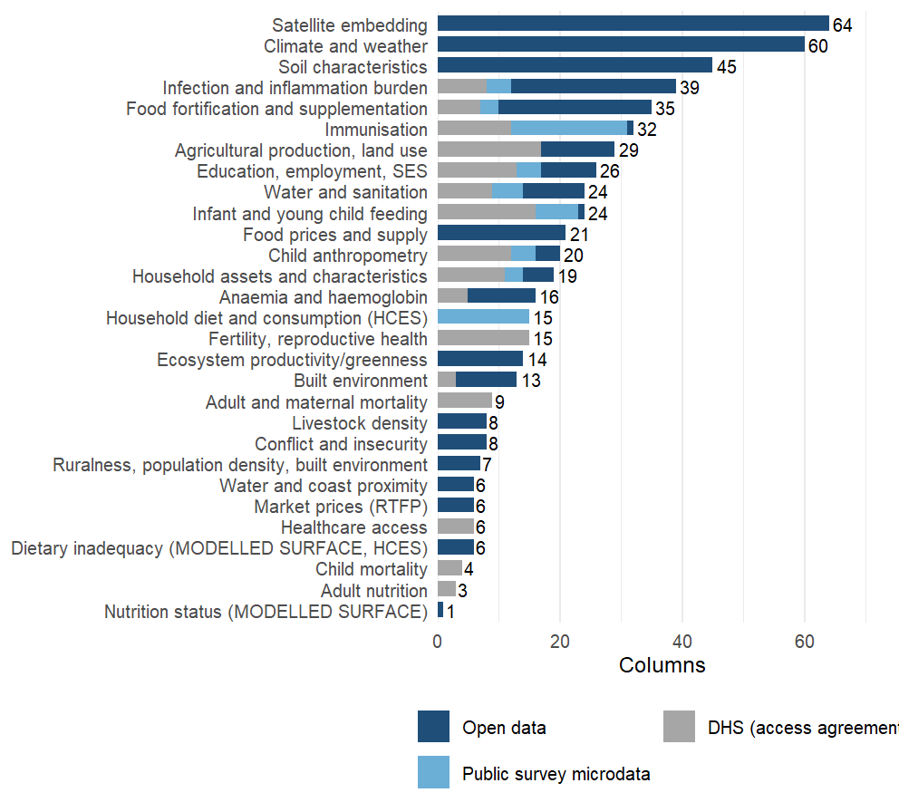
From columns to domains
29 domains. A domain groups columns by what they measure, whatever the source: the MAP, IHME and survey malaria columns sit in one group. Each domain enters the model as its leading principal components, to 80% of variance and at most twelve, learned on the training districts only.
Notes:
Why domains: 575 columns against 14 to 87 districts per country cannot be fitted column by column, and the columns are heavily correlated within a source. Grouping them by what they measure and taking principal components inside each group keeps most of the variance of each group, treats a source with 64 columns and a source with 3 as one construct each, and keeps the outcome out of the representation: the rotations are learned from the training districts’ predictors alone, so nothing is selected on the biomarker. The grouping is written down: each source block brings a label, and 10 override rules in metadata/covariates/domain_overrides.csv regroup columns by construct (infection and inflammation burden, immunisation, anemia, child anthropometry, infant feeding, supplementation, water and sanitation, education, child mortality, assets), so that MAP, IHME, DHS and MICS versions of the same thing are weighed together. Two things went wrong this week and are now guarded. A domain’s first twelve characters are its key inside the model; two labels that shared them (“Food prices (RTFP)” and “Food prices and supply”) were silently merged in two analyzes until a check caught it on 16 September. The other is in the exclusions, on the next slide. One more point for questions: climate alone or soil alone transports better than all domains together, the analysis deck’s climate-and-soil result.

Slide 73
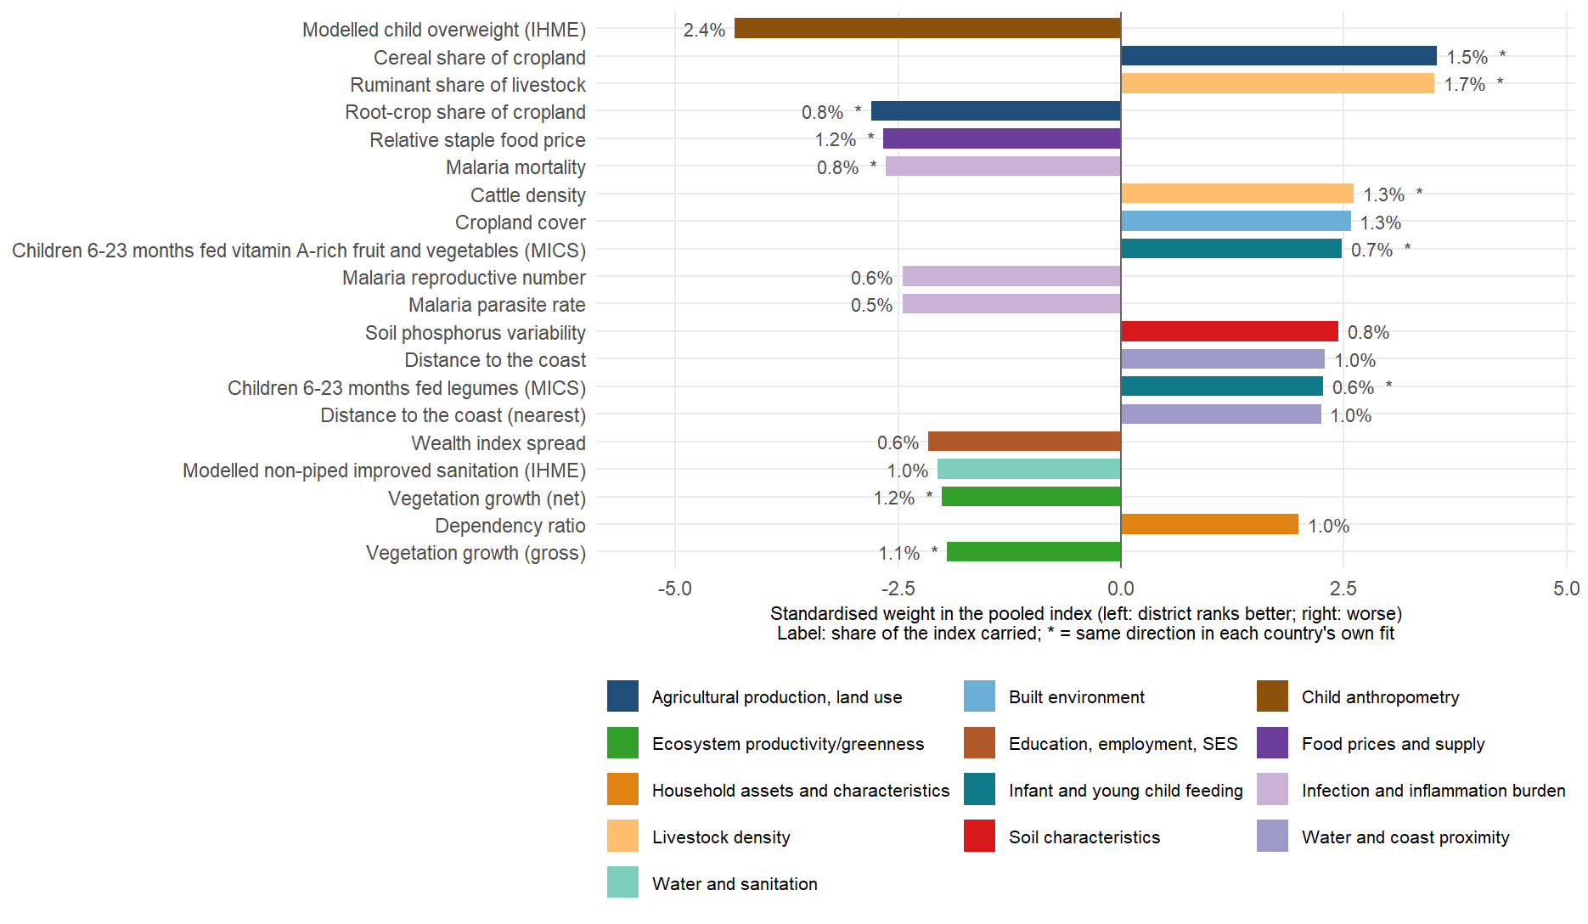
The twenty layers behind child iron, and how much each carries
Notes:
index_importance_top.csv, child iron, biomarker level: the twenty largest standardized weights in the pooled four-country fit, drawn as bars so their sizes can be compared. The level target is the negated log ferritin, so a bar to the right means districts with more of the layer rank worse on child iron, to the left better. The label is the share of the index’s variance the layer carries: the twenty together hold about a fifth of the index (21%), the rest is spread over the other 350 columns, which is how a weighted sum of many weak signals is meant to behave. All twenty keep their direction in every leave-one-country-out fit; the starred ones (10 of twenty) also keep it in each country’s own separate fit, the stricter test. The story is the one on the earlier slides: cereal-heavy cropping, ruminant and cattle density, cropland, distance from the coast and a high dependency ratio rank a district worse; root crops, higher plant productivity, relatively expensive staples, modeled overweight and malaria intensity rank it better, the last for the geographic reason discussed. None of the twenty requires a blood sample, and the twenty-layer equal-weight composite scores about the same as the full index for a new country.

Slide 74
Exclusions, with their reasons
Rule | Policy | Reason
^soil_nitrogen_ | data_defect | Cross-country values are irreconcilable by any constant factor: medians 742 (Gambia) 1090 (Malawi) 2455 (Ta…
^soil_totalcarbon_stdev_ | data_defect | Dispersion columns diverge >100x across countries while the matching depth MEANS agree; the stdev bands are…
^ndvi_y2010$ | data_defect | Tanzania median 5.4e-05 against 0.22-0.26 elsewhere while every other year agrees - a defective 2010 slice …
^ndvi_y(2019|2020|2021|2022)$ | data_defect | NDVI collapses country-dependently after 2018 (2021 medians 0.008 Malawi / 0.018 Gambia / 0.25 Sierra Leone…
^(lcover_(snow|moss)frac|tclim_swe_) | data_defect | Identically zero in every district of every country: these are snow cover, moss cover and snow water equiva…
^dhs_c_ort_diarrhea$ | data_defect | Identically zero in every district - the indicator did not populate in these DHS rounds. A constant cannot …
^dhs_w_barrier_transport$ | data_defect | All-NA in every district of every country (the transport-barrier item did not populate in these DHS rounds)…
^ndvi_y20(1[1-8])$ | superseded | Superseded (NV-01, 2026-09-15) by MOD13Q1 NDVI at the survey year (ndvi_modis_t0/win/peak/amp/clim/anom): t…
^precip_y20(1[0-9])$ | superseded | Superseded (2026-09-15): TRMM 3B43 annual precipitation at a calendar year 2010-2019 lags the survey by up …
^popdens_y(2010|2015|2020)$ | superseded | Superseded (2026-09-15): GPW v4.11 density at fixed epochs (up to 8 years from the survey); wpop_log_densit…
^gpw2010_ | superseded | Superseded (2026-09-15): GPW 2010 age-sex shares are 3-8 years from the surveys; the WorldPop 2020 shares (…
^ihme_proportionofpopulationachievingyearseducation$ | data_defect | Data defect (2026-09-15): script 08’s key normaliser dropped the digits from three IHME education categorie…
^dhs_(FP_CUSA_W_MOD|FP_NADA_W_UNT|AN_ANEM_W_ANY|CN_NUTS_C_WH2|CN_ANMC_C_ANY|CN_NUTS_C_HA2|AN_NUTS_W_THN|RH_ANCN_W_N4P)$ | redundant | Redundant (RV-01, 2026-09-15): STATcompiler-style DHS indicators that duplicate the custom recode indicator…
^dhs_w_primary_edu$ | redundant | Redundant (RV-01): r = -1.000 with dhs_w_no_education (its complement).
^dhs_w_iron_supplement$ | redundant | Redundant (RV-01): r = 1.000 with dhs_w_iron_pregnancy.
^dhs_c_vita_rich_food$ | redundant | Redundant (RV-01): r = 1.000 with dhs_c_fg_vitA_fruitveg.
^espen_(sth|sch)_prev_mid_base$ | redundant | Redundant (RV-01): the earliest ESPEN year is the year nearest every survey, so _base equals _prev_mid (r >…
^(map_sy_pf_incidence_rate|ihme_malaria_incidence_rate)$ | redundant | Redundant (RV-01): incidence is a deterministic function of the parasite rate in both products (r 0.998-0.9…
^wpop_log_density$ | superseded | Superseded (RV-01): 2020-vintage WorldPop density; r = 0.999 with wpop_log_density_survey_year, which is at…
^wsf$ | redundant | Redundant (RV-01): World Settlement Footprint 2015 has r = 0.992 with lcover_urban_frac_t0, which is at the…
^mics_heat_vhib_sy$ | redundant | Redundant (RV-01): Hib is given as the pentavalent vaccine, r = 0.990 with mics_heat_vdpt_sy.
^rtfp_dist_market_km$ | redundant | Redundant (RV-01): r = 0.984 with fprice_dist_nearest_market_km (the same WFP markets), which covers all fo…
^flunet_ | national_track | National track only (2026-09-16): the three FluNet indicators are national constants in the district set (d…
Notes:
metadata/covariates/exclusions.csv, applied by scripts/protocol_v2/53_apply_exclusion_policy.R to the live set. Data defects are removed on evidence in the audit tables; superseded layers are replaced by a better-aligned version of the same quantity; redundant twins are removed when a pooled rank correlation reaches 0.98 with a kept column. The two soil rules that failed that standard were removed on 15 September (SX-01 in the sandbox log).

Slide 75
Predictor set by domain and tier
Domain | Columns | Open | Public microdata | DHS | Vary within country | Modelled surfaces
Satellite embedding | 64 | 64 | 0 | 0 | 64 | 0
Climate and weather | 60 | 60 | 0 | 0 | 60 | 0
Soil characteristics | 45 | 45 | 0 | 0 | 45 | 0
Infection and inflammation burden | 39 | 27 | 4 | 8 | 39 | 10
Food fortification and supplementation | 35 | 25 | 3 | 7 | 10 | 0
Immunisation | 32 | 1 | 19 | 12 | 32 | 1
Agricultural production, land use | 29 | 12 | 0 | 17 | 29 | 0
Education, employment, SES | 26 | 9 | 4 | 13 | 26 | 4
Infant and young child feeding | 24 | 1 | 7 | 16 | 24 | 1
Water and sanitation | 24 | 10 | 5 | 9 | 24 | 10
Food prices and supply | 21 | 21 | 0 | 0 | 12 | 0
Child anthropometry | 20 | 4 | 4 | 12 | 20 | 4
Household assets and characteristics | 19 | 5 | 3 | 11 | 19 | 0
Anaemia and haemoglobin | 16 | 11 | 0 | 5 | 9 | 11
Fertility, reproductive health | 15 | 0 | 0 | 15 | 15 | 0
Household diet and consumption (HCES) | 15 | 0 | 15 | 0 | 15 | 0
Ecosystem productivity/greenness | 14 | 14 | 0 | 0 | 14 | 0
Built environment | 13 | 10 | 0 | 3 | 13 | 0
Adult and maternal mortality | 9 | 0 | 0 | 9 | 9 | 0
Conflict and insecurity | 8 | 8 | 0 | 0 | 8 | 0
Livestock density | 8 | 8 | 0 | 0 | 8 | 0
Ruralness, population density, built environment | 7 | 7 | 0 | 0 | 7 | 0
Dietary inadequacy (MODELLED SURFACE, HCES) | 6 | 6 | 0 | 0 | 6 | 6
Healthcare access | 6 | 0 | 0 | 6 | 6 | 0
Market prices (RTFP) | 6 | 6 | 0 | 0 | 6 | 0
Water and coast proximity | 6 | 6 | 0 | 0 | 6 | 0
Child mortality | 4 | 0 | 0 | 4 | 4 | 0
Adult nutrition | 3 | 0 | 0 | 3 | 3 | 0
Nutrition status (MODELLED SURFACE) | 1 | 1 | 0 | 0 | 0 | 1
Notes:
Modeled surfaces are estimates produced by someone else’s model (IHME, MAP, the MIMI dietary inadequacy estimates); they are included by default and the protocol has a switch (V2_DROP_MODELLED=1) to score without them. Columns that do not vary within a country are the national constants dropped at fit time.

Slide 76
What we would add next, and the rule for adding it
Sub-national household-survey microdata with GPS: MICS cluster coordinates for Ghana 2017-18 and Malawi 2013-14 are requested; they turn region-level blocks into district ones.
Diet from the household budget surveys for Ghana (GLSS7 food module) and Sierra Leone (SLIHS diary codes), so the 15 diet indicators cover all four countries.
Conflict events (ACLED, four-country export), market prices for Ghana and Sierra Leone, a decision on FluNet’s national counts.
Every candidate block passes the same test before it enters: within-country sign agreement, paired in-fill with and without it, and leave-one-country-out.
Notes:
The add-on harness is scripts/protocol_v2/39_addon_feature_test.R and it has scored eleven blocks so far; the analysis deck’s forest plot of those tests is the record. Most recent blocks moved the index by less than 0.01. The household budget survey block and the MICS block are in the base set for what they add inside a country, where two of the three estimands live; they do not help across borders. The GPS request is with UNICEF; the Ghana and Sierra Leone budget-survey modules are with the research assistant. Cote d’Ivoire, the country we rank with no survey, is missing the 30-year climate normals, which cost 27 of the 101 climate-and-soil columns in its intersection without changing the transport figure; extracting them is a morning’s work.

Slide 77
Predictors recurring across outcomes
Predictor | Domain | Outcomes (top 20) | Signs | Mean rank
fprice_staple_rel | Food prices and supply | 5 | —– | 10.2
ihme_overweightprevalence | Child anthropometry | 4 | —- | 6.0
map_sy_pf_mortality_rate | Infection and inflammation burden | 4 | —- | 8.0
npp_gpp_t0 | Ecosystem productivity/greenness | 4 | —- | 14.2
npp_npp_t0 | Ecosystem productivity/greenness | 4 | —- | 14.8
mics_w_iptp_sp | Infection and inflammation burden | 3 | +++ | 3.0
glw_ruminant_share | Livestock density | 3 | +++ | 6.3
ihme_underweightprevalence | Child anthropometry | 3 | +++ | 7.0
lcover_grass_frac_t0 | Built environment | 3 | +++ | 7.3
lcover_crops_frac_t0 | Built environment | 3 | +++ | 7.7
glw_tlu_per_capita | Livestock density | 3 | +++ | 8.3
ihme_allanemia | Anaemia and haemoglobin | 3 | +++ | 8.7
Notes:
Predictors in the pooled top 20 of three or more of the six outcomes on the level target, with the sign in each. One gradient recurs: districts that are drier and grassier, less productive (lower net and gross primary productivity), more pastoral, poorer (less home ownership, fewer women in paid work, less schooling) and more stunted rank worse on every deficiency. Outcome-specific signals sit below it: hemoglobin C allele frequency and cattle for child iron, the modeled anemia surfaces for women’s iron, helminth treatment coverage and the drought index for folate, elevation and coast distance for B12.

Slide 78
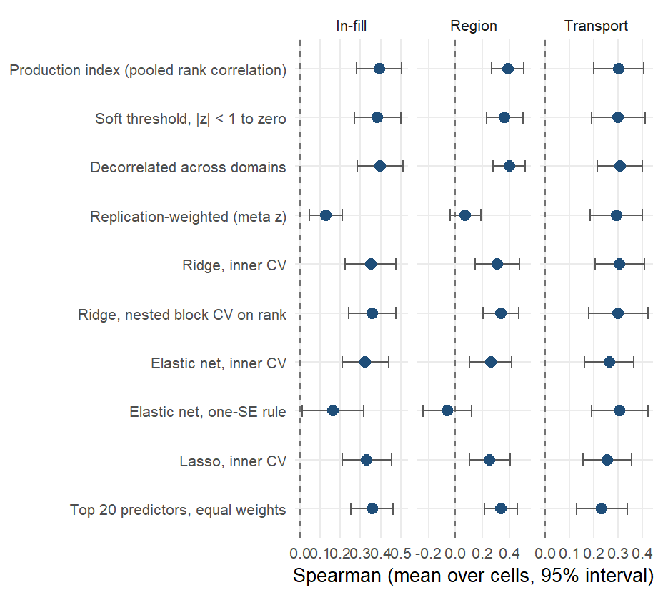
Weighting of the domain components
Alternative weightings of the same components on the biomarker level. In-country every joint fit loses to the marginal-correlation weights (ridge -0.04, elastic net -0.07, lasso -0.06). Across borders the decorrelated index gains +0.005 (better in 12 of 22).
Notes:
The production weights are the infinite-penalty limit of a ridge regression on the components, so the rows are points along that family plus other sources of evidence for the weights (soft thresholding, meta-analytic replication across training countries, decorrelation across domains). Same folds and outcome-country combinations as every other arm; five in-fill draws. The one-SE rules return the null model in some outcome-country combinations (18 of 22 transport outcome-country combinations scored for the elastic net). The twenty-predictor composite gains -0.069 across borders (better in 6 of 22) and costs -0.04 in-fill. The soft threshold gained 0.02 across borders on the direct DHS estimates and -0.002 on the smoothed ones, so that gain was a property of noisy inputs. Both gains were found among 21 arms on these outcome-country combinations and are pre-registered for the next country rather than adopted. Prevalence-target version in the appendix.

Slide 79
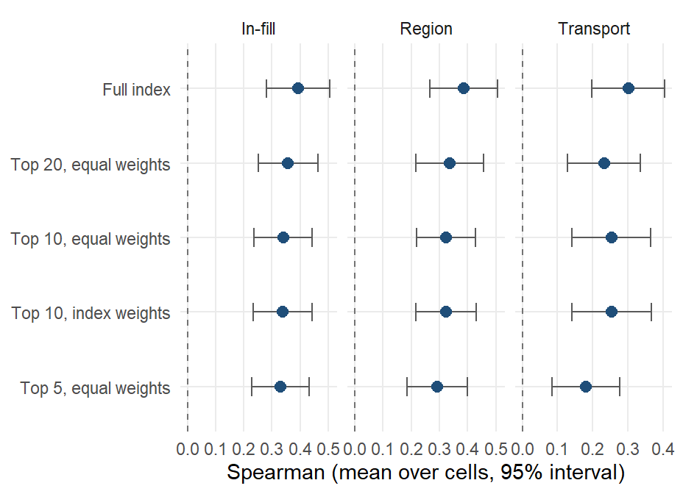
Sparse composites
Equal-weight composites of the top 5, 10 and 20 predictors, membership chosen inside each training fold by back-projected index weight. Twenty predictors cost -0.04 in-fill and gain -0.069 across borders; five predictors cost -0.06 in-fill.
Notes:
Dawes’ improper linear model: direction from the training fold, equal weights, rescaled like the index; nothing is chosen on held-out districts. Weighting the ten by their index weights instead of equally changes nothing. The composite is a transport and communication tool: twenty public layers a ministry can compute. Likely question: which twenty. The next slide lists the child iron members.

Slide 80
Child iron composite
Predictor | Source | Predictor | Source
ihme_overweightprevalence (-) | IHME | map_sy_pf_parasite_rate (-) | Malaria Atlas Project
spam_share_cereals (+) | MapSPAM | soil_phosphorus_stdev_0_20 (+) | SoilGrids / iSDA
glw_ruminant_share (+) | Gridded Livestock of the World 4 | wdist_coast_km_mean (+) | JRC Global Surface Water 1.4; USDOS LSIB 2017
spam_share_roots (-) | MapSPAM | mics_c_fg_legumes (+) | MICS microdata
fprice_staple_rel (-) | WFP / HDX market prices | wdist_coast_km_min (+) | JRC Global Surface Water 1.4; USDOS LSIB 2017
map_sy_pf_mortality_rate (-) | Malaria Atlas Project | rwi_sd (-) | Meta/Data for Good RWI; WorldPop; CIESIN GPW v4.11
glw_cattle_km2 (+) | Gridded Livestock of the World 4 | ihme_simpother (-) | IHME
lcover_crops_frac_t0 (+) | GEE | npp_npp_t0 (-) | GEE
mics_c_fg_vita_fv (+) | MICS microdata | wpop_dependency_ratio (+) | WorldPop age-sex / JRC GHS-SMOD
map_sy_pf_reproductive_number (-) | Malaria Atlas Project | npp_gpp_t0 (-) | GEE
Notes:
The twenty columns the four-country fit would deploy for child iron, in order of weight, with the sign of the contribution (plus means more deficiency). 20 of the twenty keep their sign in every leave-one-country-out fit and 10 in every country’s own independent fit. In the benchmark the membership is re-chosen inside each training fold; this is the version fitted on all four countries. The other outcomes’ composites are in results/tables/protocol_v2/index_importance_top.csv.

Slide 81
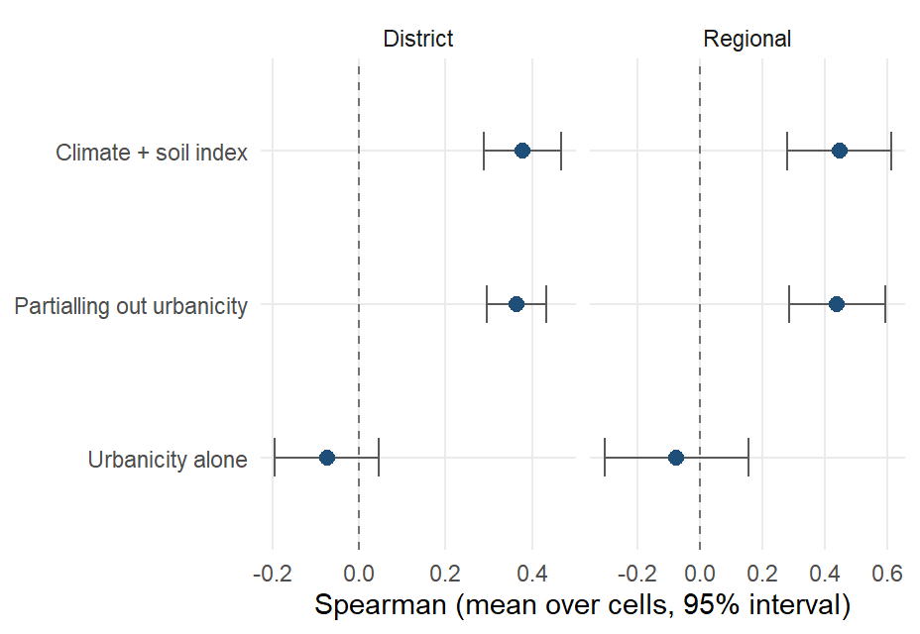
Urbanicity conditioning
Transported Spearman of the climate-and-soil index at district level (0.38), the same after partialling out an urbanicity composite (0.36), and urbanicity alone (-0.07).
Notes:
Urbanicity composite: night lights, population density, built surface, urban land cover, travel time to health care. The replicated associations (legumes, cattle, soil chemistry, night-time temperature, all toward more deficiency) describe where subsistence agriculture is, so an urban-rural gradient was the rival explanation; partialling it out moves the transported correlation by less than 0.02 and urbanicity alone does not transport.

Slide 82
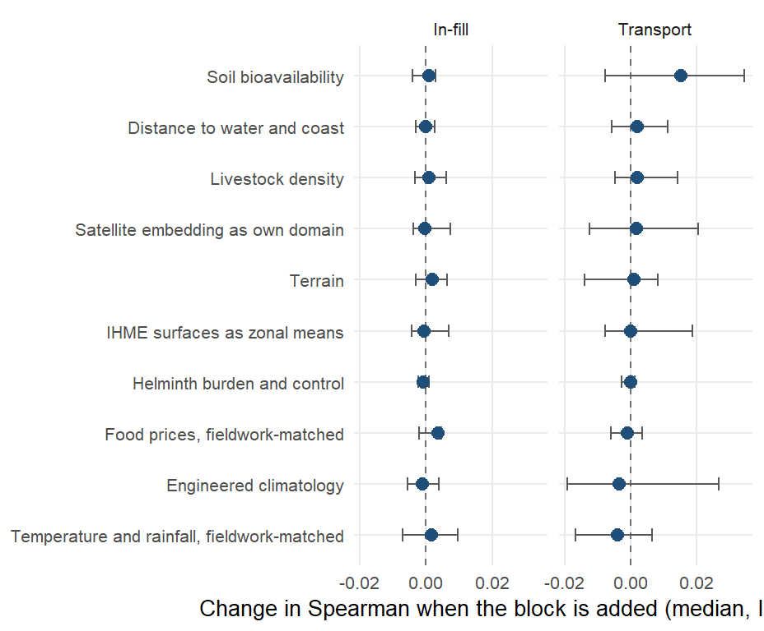
Add-on predictor blocks
Median change in Spearman when a block is added to the base vocabulary, in-fill and district transport on the biomarker level, scored under one harness with the same folds.
Notes:
Bars are the interquartile range over outcome-country combinations. No block moves in-fill or transport by more than 0.01 at the median: the vocabulary is saturated. The fieldwork-matched temperature columns are among the most consistently associated with deficiency in the marginal scan yet improve no fold, because a covariate defined by when the survey happened cannot rank districts that have not been surveyed. Found in passing and fixed: the price columns used 2021 as The Gambia’s survey year (fieldwork was January to April 2018), and the satellite embedding had been filed under agriculture.

Slide 83
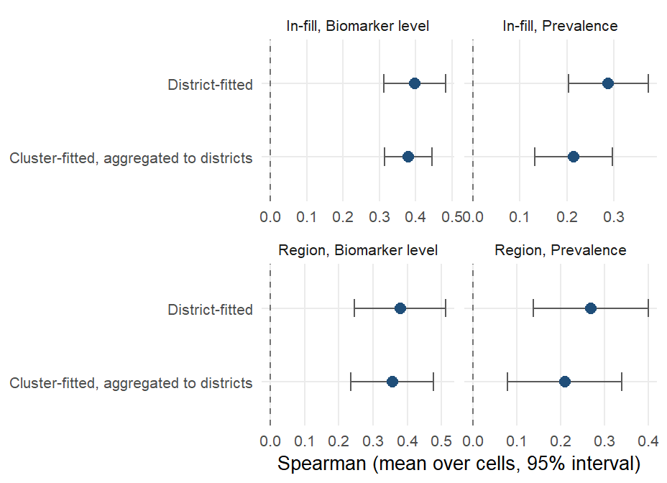
Cluster-level fitting
The same index fitted at the survey cluster and aggregated to districts, against the district fit, on the same outcome-country combinations. In-fill on the level: 0.38 cluster-fitted against 0.40 district-fitted.
Notes:
323 clusters with GPS; covariates as 2 km (urban) and 5 km (rural) buffer means from rasters on disk; the same estimands with folds cut by district and region. Cluster-fitted models trail district-fitted ones on every estimand and for transport. A precision-weighted index and empirical-Bayes shrinkage of cluster outcomes recover a third to a half of the gap. A matched-vocabulary comparison attributes the remaining gap to the layers rather than the fitting unit. The cluster track is a sensitivity analysis until its vocabulary is matched layer for layer.

Slide 84
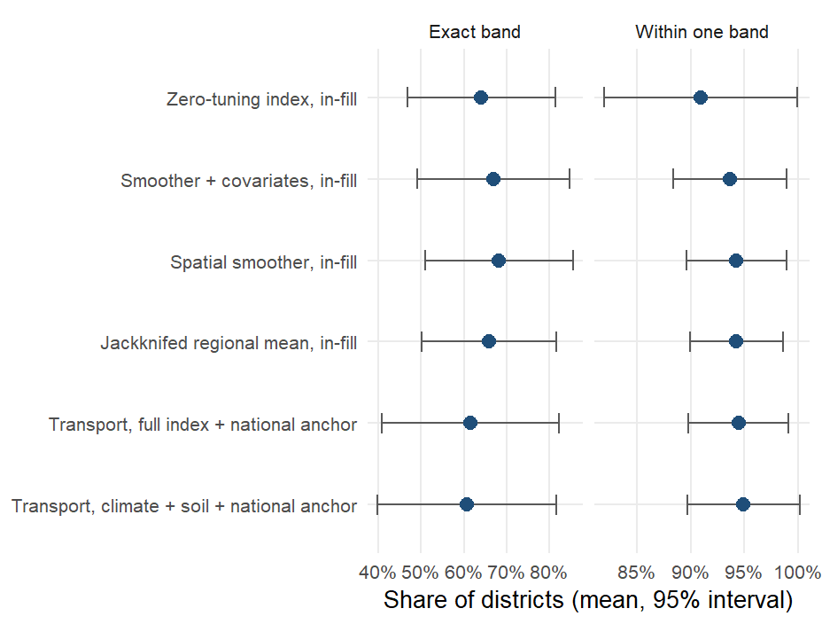
Risk-class accuracy
Share of districts placed in the correct WHO vitamin A band (under 2%, 2 to 10, 10 to 20, 20 or more), and within one band, mean over the vitamin A outcome-country combinations. The index in-fill: 64% exact and 91% within one band.
Notes:
Out-of-fold predictions averaged over ten draws; transport rows use the held-out country’s own national prevalence as the anchor (AR-01 design), the only honest way to put a transported ranking on the prevalence scale. The January deck’s child vitamin A outcome-country combination was 44 and 75 percent (exact, within one) for the full model from the old leaderboard. For iron and the other outcomes only the 20 percent threshold has a WHO source; the two-class accuracies are in results/tables/protocol_v2/risk_category_accuracy_summary.csv.

Slide 85
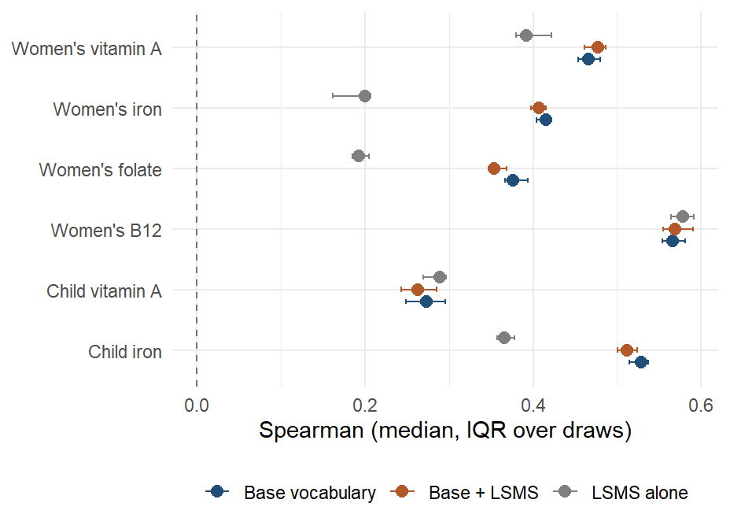
LSMS and FluNet predictors
Ghana in-fill on the biomarker level with the base vocabulary, the base plus the LSMS block, and the LSMS block alone, median over ten draws.
Notes:
The LSMS block scored here is Ghana’s GLSS7 as a svyby object: 134 region-level household expenditure and asset means, broadcast to districts through the 16-to-10 region crosswalk, so the block varies only across ten regions. It does not improve any Ghana outcome-country combination beyond noise and cannot be scored across borders. The household budget surveys now enter the base set another way, as diet and consumption indicators computed from the microdata for all four countries (GLSS7 for Ghana, again at the region); that block is part of the base vocabulary this slide compares against. FluNet reports for Ghana and Sierra Leone only and is a national weekly count, constant within a country; it contributes nothing by construction.

Slide 86
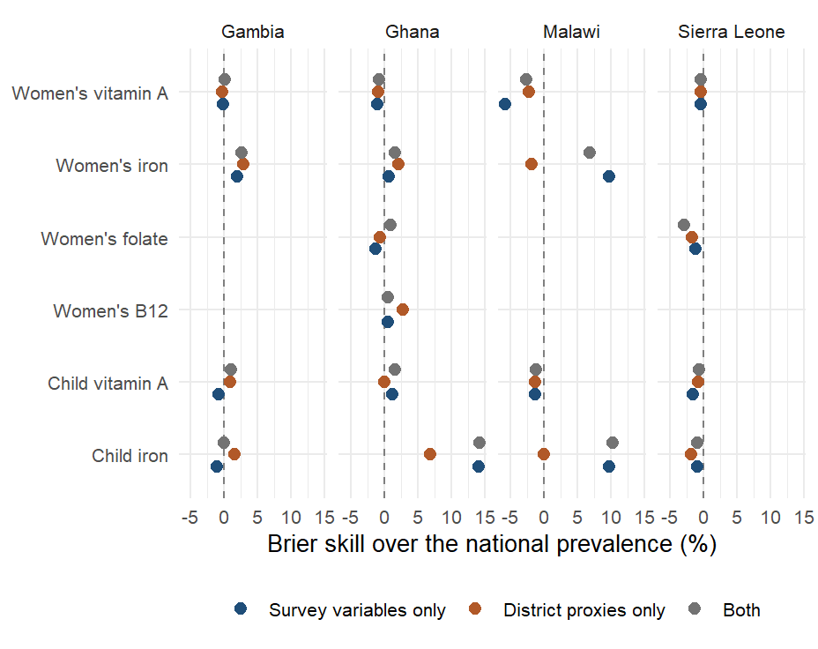
Individual-level models
Person-level SuperLearner under district-blocked folds, Brier skill over the national prevalence, by country and outcome. Mean AUC over 18 outcome-country combinations: 0.52 for survey variables, 0.50 for district proxies, 0.53 for both.
Notes:
Library: mean, elastic net, random forest; survey weights; inner folds blocked by district; outer 5-fold by district so no district’s respondents are split across training and test. Survey variables: up to 80 respondent columns with 70 percent coverage after removing biomarkers, adjustments, identifiers, weights, dates and locations. Proxies: the district’s domain components joined to each respondent. Person-level skill exists for iron only (survey-variable AUC up to 0.78 in Ghana and Malawi); vitamin A, folate and B12 show none. The January figure (Brier skill 20 to 60 percent) came from folds not blocked by district and a survey set that included biomarker-adjacent variables. Aggregating a person-level classifier biases area means, so this remains a sensitivity analysis. Rerun on the RR-10 set on 10 September.

Slide 87
National-level track
Outcome | Countries | Observed (mean) | Predicted (mean) | Mean absolute error (pp)
Child iron | 4 | 0.19 | 0.21 | 2.09
Child vitamin A | 4 | 0.14 | 0.14 | 0.94
Women’s iron | 4 | 0.14 | 0.14 | 0.63
Women’s vitamin A | 4 | 0.02 | 0.02 | 0.23
Notes:
The January deck’s national-level track (WHO VMNIS and BRINDA outcomes, FAOSTAT and policy predictors) lives in a separate sub-pipeline last run in April 2026. It is not part of the current protocol and has not been re-audited; the table is its last output for the four survey countries. It is the only track with time series and fortification policy indicators and is a candidate for a rerun under the corrected protocol.

Slide 88
Iodine
Model | Gambia UIC < 100, in-fill | Gambia UIC < 100, region | Gambia median UIC, in-fill | Gambia median UIC, region | Sierra Leone UIC < 100, region
Training mean | -0.31 | -0.55 | -0.29 | -0.60 | -0.34
Jackknifed regional mean | 0.33 | - | 0.35 | - | -
Spatial smoother | 0.31 | 0.50 | 0.27 | 0.27 | -0.35
Zero-tuning index | 0.45 | 0.48 | 0.55 | 0.56 | 0.10
Smoother + covariates | 0.30 | 0.47 | 0.32 | 0.32 | 0.19
Notes:
Urinary iodine is measured in The Gambia (continuous, with household salt iodine) and in Sierra Leone (six WHO categories, non-lactating women); it left the modelling outcomes because a one- or two-country outcome has no leave-one-country-out test. Targets: district prevalence of urinary iodine concentration below 100 micrograms per litre and, for The Gambia, the district median. In-fill needs at least 15 districts, so it runs for The Gambia only; leave-one-region-out runs in both. Whether district salt iodisation tracks district iodine status is in results/tables/protocol_v2/iodine_in_country.csv (rows analysis = descriptive).

Slide 89
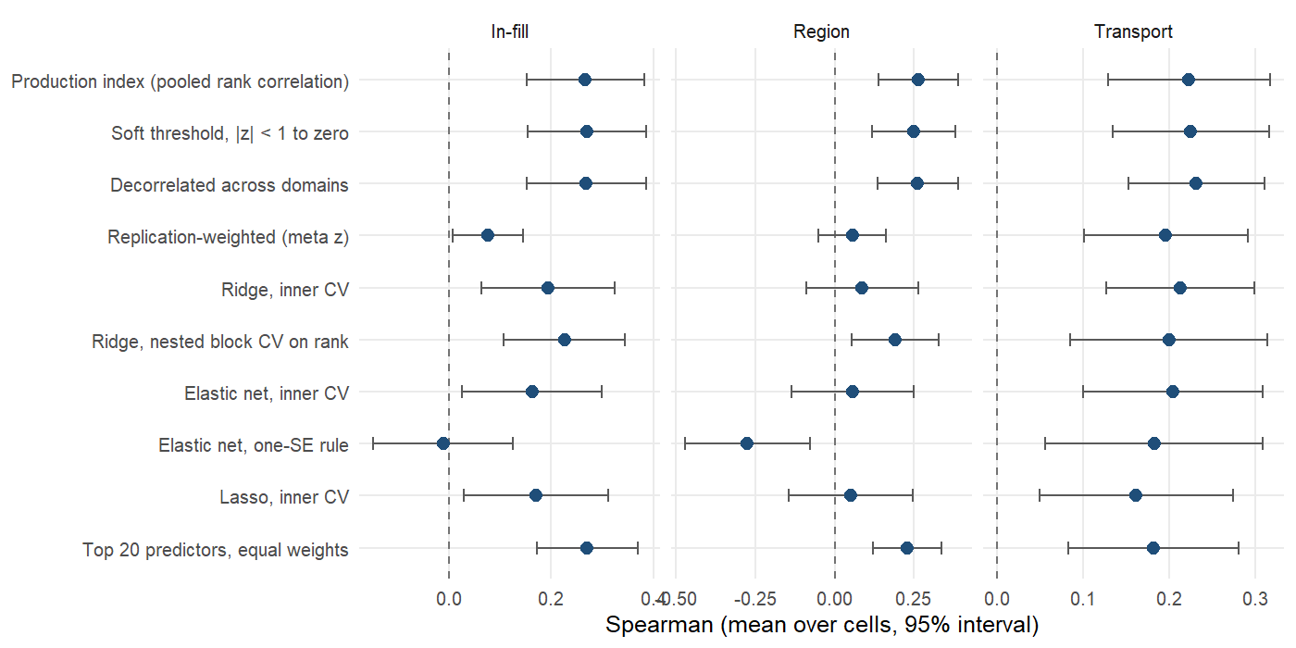
Weighting of the domain components: prevalence
Notes:
Prevalence target, same arms and folds as the biomarker-level figure. Mean Spearman over outcome-country combinations with a 95% interval across outcome-country combinations.

Slide 90

Geostatistical comparator: absolute error
Notes:
In-fill, prevalence. The geostatistical model estimates a level and shrinks uncertain districts toward the mean, which lowers absolute error; the index ranks and is rescaled to the training outcome’s spread, which does not. If the deliverable is a prevalence figure for a named district, the geostatistical model is the right tool; if it is a ranking, the index is.

Slide 91
Status of the January analyzes (1)
January slide | Status | Where
Individual-level proxy versus survey-only models (Brier skill, AUC, PR gain) | Sensitivity layer; rerun under district-blocked folds | Individual-level models
National-level VMNIS / BRINDA predictions | Separate sub-pipeline, last run April 2026 | National-level track; not re-audited
Iodine (Sierra Leone) | Rerun within country (The Gambia, Sierra Leone) | Iodine
Risk-category accuracy (none / mild / moderate / severe) | Rerun under the protocol, WHO bands | Risk-class accuracy
Notes:
The individual-level SuperLearner remains a sensitivity analysis because shrinking a noisy individual classifier biases area means; it was removed from the dashboard on 13 September, which now shows only the protocol’s index (amertens.shinyapps.io/micronutrient-burden).

Slide 92
Status of the January analyzes (2)
January slide | Status | Where
LSMS (275) and FluNet (3) predictors | Re-added: the GLSS7 region means add no skill; household budget survey microdata for all four countries are now in the base set; FluNet is national and inert | LSMS and FluNet predictors
Data-source importance by change in MSE | Replaced by domain and source ablation under transport | Domain and source ablation
Admin-1 women’s iron maps, predicted versus survey | Replaced by district maps with held-out predictions | Ghana maps
Prescreened SuperLearner as the model | Retained as comparison; does not beat the zero-tuning index | Estimators

