Slide 1

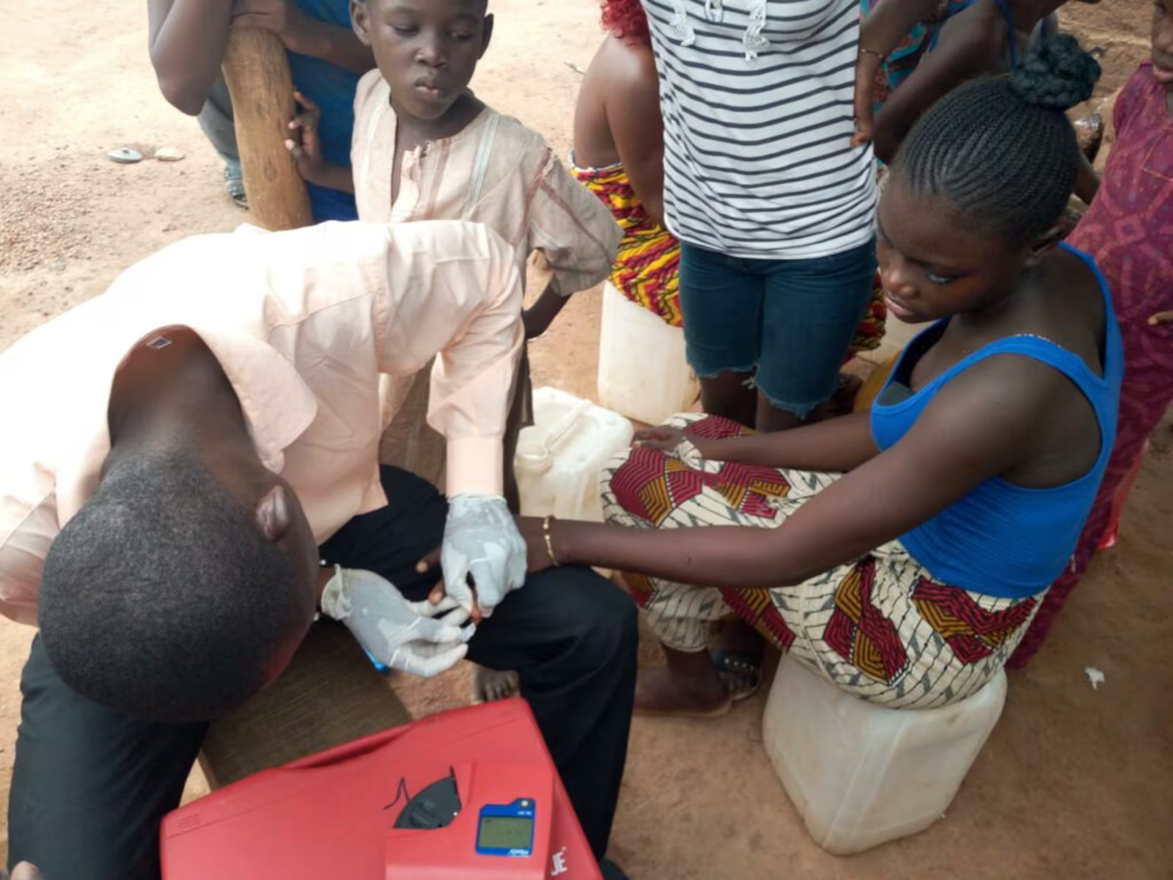


Motivation
Biomarker surveys are rare and costly
About one national survey per country and decade; programmes need district estimates between them.
575 district-level proxies
Open gridded layers and public survey microdata, linked to four national biomarker surveys.
Predict deficiency by district
Iron, vitamin A, folate, B12 and zinc, in surveyed and unsurveyed districts.
Notes:
Replaces deck slide 3 (Motivation).
Photo credit: Latter-day Saint Charities. GMS 2017 collaborators: University of Ghana, GroundWork, University of Wisconsin-Madison, KEMRI-Wellcome Trust; with UNICEF and Global Affairs Canada.

Slide 2



Aims
Estimate district deficiency from proxies
Validated against the biomarker surveys, district by district.
Identify the districts at greatest risk
Say whether a ranking or a level survives out of sample.
Say what a country with no survey can expect
And what it must still measure.
Notes:
Replaces deck slide 4 (Aims).

Slide 3





Outcomes
Iron
Vitamin A
Folate
B12
Zinc
Who: children 6-59 mo; non-pregnant women 15-49 y
Where: all four countries
Biomarker: ferritin, inflammation-adjusted (survey flag; not IDA)
Cut-off: < 12 / < 15 ug/L
Who: children 6-59 mo; non-pregnant women 15-49 y
Where: all four countries
Biomarker: retinol-binding protein, one BRINDA adjustment for all
Cut-off: < 0.70 umol/L RBP
Who: non-pregnant women 15-49 y
Where: Ghana, Sierra Leone, Malawi
Biomarker: serum folate (immunoassay GH, SL; microbiologic MW)
Cut-off: < 10 nmol/L
Who: non-pregnant women 15-49 y
Where: Ghana, Sierra Leone, Malawi
Biomarker: serum B12
Cut-off: < 148-150 pmol/L
Who: children 6-59 mo; non-pregnant women
Where: Malawi only
Biomarker: serum zinc, IZiNCG flag, unadjusted
Cut-off: IZiNCG, by draw time
Notes:
Replaces deck slide 7 (Outcomes).
Two targets per cell: the deficiency prevalence, and the district mean of the negated log biomarker concentration (higher means worse), which carries more signal than the dichotomy and is reported alongside it. Definitions were reconciled against the four survey reports and the 21 papers that re-analyse them on 15 September 2026 (docs/survey_report_reconciliation.md): every iron, zinc, folate and B12 national estimate now reproduces its report to the decimal, and the Gambia LGA estimates track the report at r = 0.98 to 0.99. What changed then: the iron binaries had been the surveys' iron-deficiency-ANAEMIA columns in three countries (ferritin plus haemoglobin), Malawi's iron flag came from a mis-specified local BRINDA that under-counted by half, pregnant women and children outside 6 to 59 months were being kept, and vitamin A had been converted to retinol-equivalents with each survey's own RBP-to-retinol line. That conversion is now the sensitivity analysis, not the primary: the four lines were fitted in different directions on 14 to 300 specimens, and Malawi's has R-squared 0.13, which manufactures near-zero deficiency by construction; the survey's own re-analysis (Likoswe 2021) recommends exactly BRINDA-adjusted RBP below 0.70, the estimand used here. Call it low RBP rather than vitamin A deficiency: Ghana's MRDR found 6.7 percent depleted and Malawi's none. Two caveats to say if asked. Sierra Leone's child file as supplied holds only the survey's anaemic children (532 of 654 assayed), so its child cells are anaemic-subgroup estimates until the full file arrives. Folate is not comparable across the two assays (Malawi's microbiologic assay reads higher than the Roche immunoassay), so its cross-border numbers are indicative only. Iodine (The Gambia, Sierra Leone) is analysed within country only; a one- or two-country outcome has no cross-border test.

Slide 4






Data assembly
1. Clean and merge the surveys
2. Link gridded layers
3. Aggregate household surveys
Four national micronutrient surveys; one uniform outcome definition per nutrient across countries.
Zonal means to districts; buffer means to survey clusters.
DHS through a cluster-level spatial model; MICS and budget surveys from their public microdata.
4. Align in time
5. Open data only
6. Rank-normalise and reduce
Every layer at the survey year or the nearest; climate as a 30-year normal plus the survey-year anomaly.
Headline models use open layers and public microdata; the DHS aggregates are a sensitivity arm.
Within country, so level offsets cannot act as signal; 29 domains to their leading components, nothing selected on the outcome.
Notes:
Replaces deck slide 9 (Data assembly).

Slide 5







Predictor domains
Environment from satellite (144)
AlphaEarth embedding; temperature, rainfall, drought index; NDVI and productivity; distance to water and coast
Soil (45)
SoilGrids and iSDA: pH, organic carbon, texture, nutrient availability
Agriculture and livestock (37)
MapSPAM crop mix and cropland; cattle, goat and poultry density
Food, prices and diet (83)
WFP and World Bank prices; budget-survey diets; fortification and supplementation coverage
Infection and disease (84)
Malaria, helminths, inflammation; child morbidity and mortality; immunisation coverage
Nutrition status (64)
Stunting and wasting; anaemia surfaces; infant and young child feeding
Households and economy (90)
Assets, schooling, employment; water and sanitation; fertility; access to care
Settlement, access and security (28)
Night lights, population density, travel time, built-up area; conflict events
Notes:
Replaces deck slide 11 (Predictor domains).

Slide 6








Estimators
January: spatial ensemble learning
Current: the corrected protocol
SuperLearner library
Weighted by cross-validated performance.
Zero-tuning index
Domain principal components weighted by their training-fold rank correlation with the outcome.
Prescreening
From thousands of predictors to 10 to 100 per model.
SuperLearner retained as a comparison
Same folds: index 0.29 against 0.29 for the rank-loss ensemble and 0.27 for random forest.
Importance
Change in mean squared error.
Nothing chosen on held-out districts
Honest folds by district, region and country.
Notes:
Replaces deck slide 13 (Estimators).
On the same folds the index scores 0.29 against 0.29 for the rank-loss ensemble, 0.27 for random forest, 0.24 for the squared-error ensemble, 0.22 for the principal-component highly adaptive ridge and 0.19 for the elastic net (mean of cell medians over the 17 cells every arm scored, prevalence, in-fill; SL-01 to SL-05, rerun on the RR-10 set). Likely question: why capacity hurts. With 14 to 87 districts per country the index has no tuned parameter, and every estimator that tunes one shrinks toward the constant under squared-error cross-validation; the weighting slide quantifies this over a family of penalties.

Slide 7

Estimands
In-fill
Region extrapolation
Country transport
Question: an unsurveyed district in a surveyed region
Folds: 5-fold by district, 10 draws
Baseline: jackknifed regional mean; spatial smoother
Question: a whole unsurveyed region
Folds: leave-one-region-out
Baseline: spatial smoother
Question: a country with no biomarker survey
Folds: leave-one-country-out
Baseline: country-block permutation null
Notes:
Replaces deck slide 14 (Estimands).
The earlier leaderboard scored transport-style models against an in-fill baseline that read the held-out district's own respondents; that comparison is withdrawn. Counts of positive cells have a fat null when a country's outcomes are correlated: with no transport at all, 16 of 22 cells are positive at the 95th percentile of the permutation null, so the mean rank correlation is the statistic compared with its null (0.08 at district level, 0.18 at regional level).

Slide 8

Conclusions
In-fill: the index ranks districts (0.40)
Against 0.31 for the survey's own regional averages and 0.39 for a covariate-free smoother.
Transport: rankings carry (0.31), levels do not
0.38 from climate and soil alone; permutation null 0.08.
Across borders, lean on the environment
Survey-derived inputs help inside a country and hold a new country back.
A national anchor puts levels on the ranking
District error 9.3 points at 5% of a full sample, matched by a district survey at 25%.
Notes:
Replaces deck slide 43 (Conclusions).

Slide 9



What the models can and cannot do yet
Rank districts in a surveyed country?
Yes: 0.40, null 0.08.
Rank districts in a new country?
Yes, less well: 0.31 against 0.08.
Which predictors carry the signal?
Satellite, climate and soil.
Prevalence in a new country from the model alone?
Not yet.
Prevalence with one national anchor?
Yes: 9.3 points at a 5% sample.
Replace biomarker surveys?
No: the ceiling is the survey's.
Guide where the next survey samples?
In design, not piloted.
Notes:
Replaces deck slide 44 (What the models can and cannot do yet).
The checklist agreed at the 10 September check-in, one row per question. Sources: benchmarks_v2_summary.csv (in-fill and country transport, biomarker level), transport_null_calibration.csv (95th percentile of the permutation null), nested_domain_selection.csv (fixed climate-and-soil set), index_importance_domains.csv (pooled shares of the three remotely sensed domains), anchor_and_rank.csv (AR-01, 5% fraction, climate-and-soil set, ranks from prevalence), variance_components_ceiling.csv (prevalence, admin2). Levels do not transport because the surveys differ in year, season, team and calibration (fe_transport_level_offset); the anchor supplies the level the ranking lacks. Guiding the next survey is a design result on these four surveys, not a pilot.

Slide 10








Next steps
Planned
Open questions
Score the pre-registered predictions
On the next countries added to the panel.
What rank correlation is sufficient to act on?
Rerun the national track
Under the corrected protocol.
Which national number is the cheapest honest anchor?
Model-assisted cluster allocation
For survey design.
Without new biomarker surveys, what benchmarks the models?
Notes:
Replaces deck slide 45 (Next steps).
Sources: docs/findings/TWO_READINGS_2026-09f.md (current abstracts), SANDBOX_LOG_2026-09.md (every experiment), PREREGISTRATION_NEW_COUNTRIES_2026-09.md, CLUSTER_LEVEL_DESIGN_2026-09.md. Every table in this deck is read at render time from results/tables.

