Slide 1
Predicting Micronutrient Deficiency Prevalence in Sub-Saharan Africa Using Proxy Indicators: A Multi-country Machine Learning Framework
Andrew N. Mertens (presenting), Reed Atkin, Sorrel Namaste, Demewoz Haile, Kenneth H. Brown, Saskia Osendarp, Xiuping Tan, Eric Stewart, Keith Lividini, Seth Adu-Afarwuah, Nicolai Petry, Aminata S. Koroma, Mary H. Hodges, Fabian Rohner, Haddy Crookes, James P. Wirth, Jonathan Gorstein, Kathy Banke, Sonja Y. Hess
Background, aims and methods
Aim: find which freely available data layers track blood-measured micronutrient deficiency across districts, and whether the same layers hold in a country never surveyed.
Data: four national micronutrient surveys (The Gambia 2018, Ghana 2017, Malawi 2015 to 16, Sierra Leone 2013), 206 districts, vitamin A, iron, folate and B12 in children and women.
Predictors: 454 public layers in 24 groups: satellite imagery, climate, soil, crops, livestock, malaria, prices and household surveys.
Model: each group is reduced to a few summary axes, weighted by its correlation with deficiency and summed, with nothing tuned. Scored on held-out districts and on held-out countries.
Micronutrient Forum 7th Global Conference

Slide 2
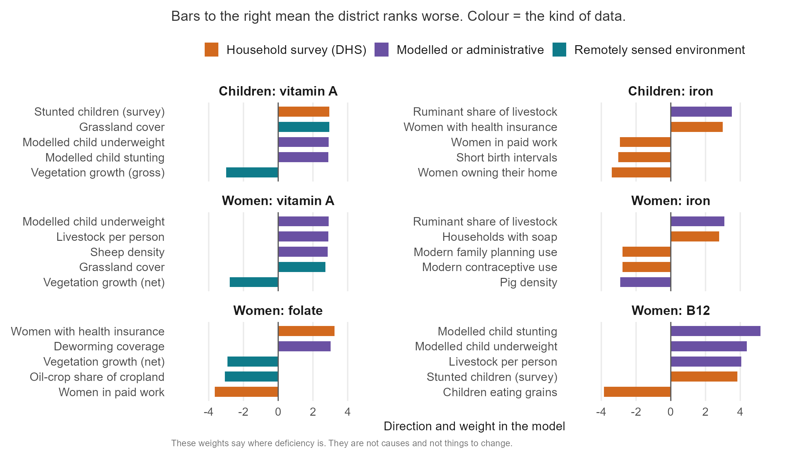
Results
Inside a surveyed country the index ranks held-out districts at 0.40, against 0.08 for chance.
In a country never surveyed it scores 0.26, positive in 17 of 22 country-outcome pairs, and 0.37 with climate and soil layers only.
Satellite, climate and soil layers carry 30 to 48 percent of the index, and the same kind of district ranks worst on every deficiency: drier, grassier, poorer and more pastoral.
Household-survey layers help inside a country and hurt in a new one: dropping all 131 of them raises transport from 0.26 to 0.33.
Micronutrient Forum 7th Global Conference
Unpublished data. Do not copy or distribute.

Slide 3
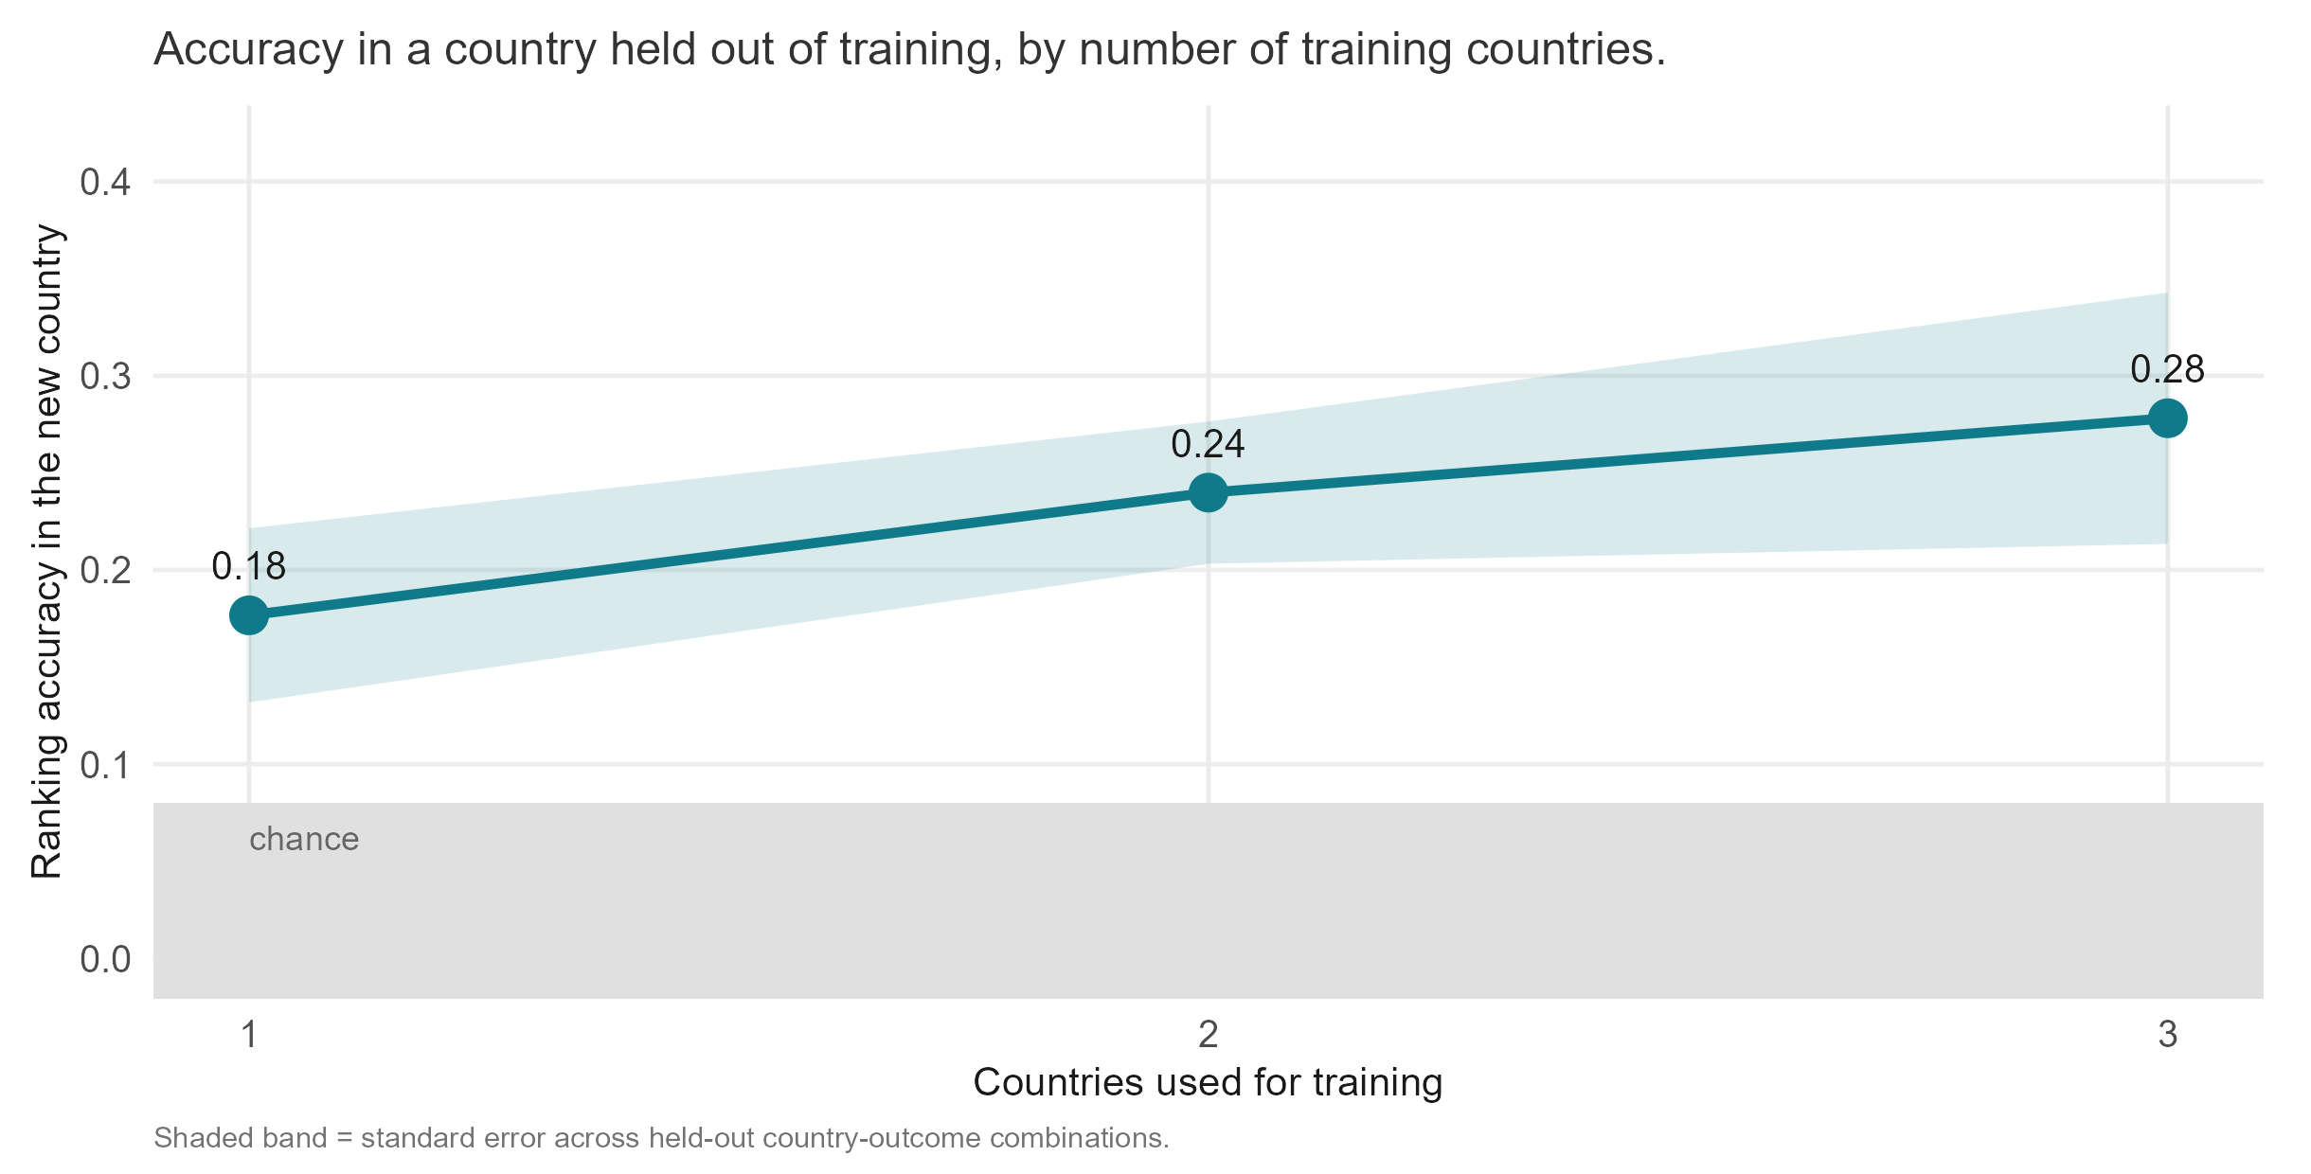
Conclusions and impact
One environmental gradient underlies all six deficiencies. A twenty-layer public list ranks a new country as well as the full database (0.29 against 0.26).
Districts nobody has surveyed can be ranked for programme targeting and for placing the next survey. Rankings cross borders; absolute levels do not.
One national blood sample turns a ranking into district prevalence. The climate-and-soil list was found on these four countries and is pre-registered for the fifth.
Impact: a country can rebuild the ranking itself from downloadable layers, at no survey cost, while the next survey is planned.
Micronutrient Forum 7th Global Conference
Unpublished data. Do not copy or distribute.

