Slide 1
Where is deficiency worst? Ranking districts from public data
What four blood surveys taught us about the districts nobody has surveyed
Andrew N. Mertens, University of California, Berkeley | 10 September 2026

Slide 2
Most districts have never had a blood test
A national micronutrient survey draws blood from a few thousand people, costs millions, and happens about once a decade. Most countries in the region have none from the last ten years.
The decisions are local: which districts get fortified food, supplements, or the next survey team.
Even where a survey exists, it describes regions. In Ghana, 83% of districts hold a single sampled community.
We ask what public data can say about the districts nobody surveyed, and test the answer against four surveys that did draw blood.
Notes:
Framing slide. The gap is not the absence of data; it is the absence of data at the level where money is allocated. Cluster counts per district come from results/tables/protocol_v2/variance_components_ceiling.csv (share_single_cluster). The four surveys: The Gambia 2018, Ghana 2017, Malawi 2015-16, Sierra Leone 2013, with vitamin A, iron, folate and B12 measured in children and women, 206 districts with a measured value in all. Everything in this talk is scored against those 206 districts.

Slide 3
What we built: a ranking of districts from data anyone can download
To every district we attach 454 public indicators: satellite imagery, climate, soil, crops, livestock, malaria, prices and household-survey results.
Each kind of data is summarised, weighted by how well it tracked deficiency where we had blood results, and added up to rank districts.
Nothing is tuned by hand, and a country can rebuild the ranking from twenty public layers.
The output is an ordering; a prevalence figure needs one national number.
Notes:
Predictor list: data/covariates/harmonized/predictors_admin2_shared_metadata.csv (454 columns in 24 domains); plain descriptions in results/tables/protocol_v2/variable_sheet.csv. The estimator is a zero-tuning index over domain principal components; the technical deck has the definition. Likely question: why so simple. With 14 to 87 districts per country, every method that learns its own settings does worse (appendix slide).

Slide 4
Why these numbers can be trusted
Every district is scored with itself hidden from the model, averaged over repeated random splits; one split alone can move a result by 0.1.
Each method is compared with what a programme could do without it: the survey’s own regional average, or smoothing between neighbours.
Chance is measured, not assumed. Shuffling the outcome across countries shows what a ranking reaches with no information.
An earlier version rested on one split and a baseline that had seen the answer. An audit found it; these are the corrected numbers.
Notes:
The audit and every corrected figure are in docs/findings (TWO_READINGS_2026-09f.md and SANDBOX_LOG_2026-09.md). Likely question: what changed. The within-country headline moved from a median of 0.06 on one split to 0.40 replicated; a regional transport figure of 0.50 to 0.56 was withdrawn when a spelling mismatch turned out to have dropped Sierra Leone from every population-joined run. Saying this out loud is what lets the rest of the deck be believed.

Slide 5
How to read the numbers in this talk
The score is ranking accuracy: how closely the model’s order of districts matches the survey’s, from 0 to 1. With no information at all a ranking still reaches 0.08.
In plainer terms: of the truly worst quarter of districts the model finds 43% (a random pick finds 25%), and it places a district in the correct WHO vitamin A band 64% of the time, within one band 92%.
The survey’s own district values are noisy. A perfect predictor could reach about 0.44, so a score of 0.40 is close to what can be measured.
Notes:
Sources: benchmarks_v2_summary.csv (mean_topk is the share of the true worst quarter found in the model’s worst quarter), risk_category_accuracy_summary.csv (scheme who_vitA, in-fill, exact_admin2 and within1_admin2), variance_components_ceiling.csv (ceiling_vc, the correlation a perfect predictor of the true district value could reach given sampling noise). Likely question: why not report percent variance explained. Because the product is an ordering and the survey values it is scored against are themselves estimates from one or two clusters.

Slide 6
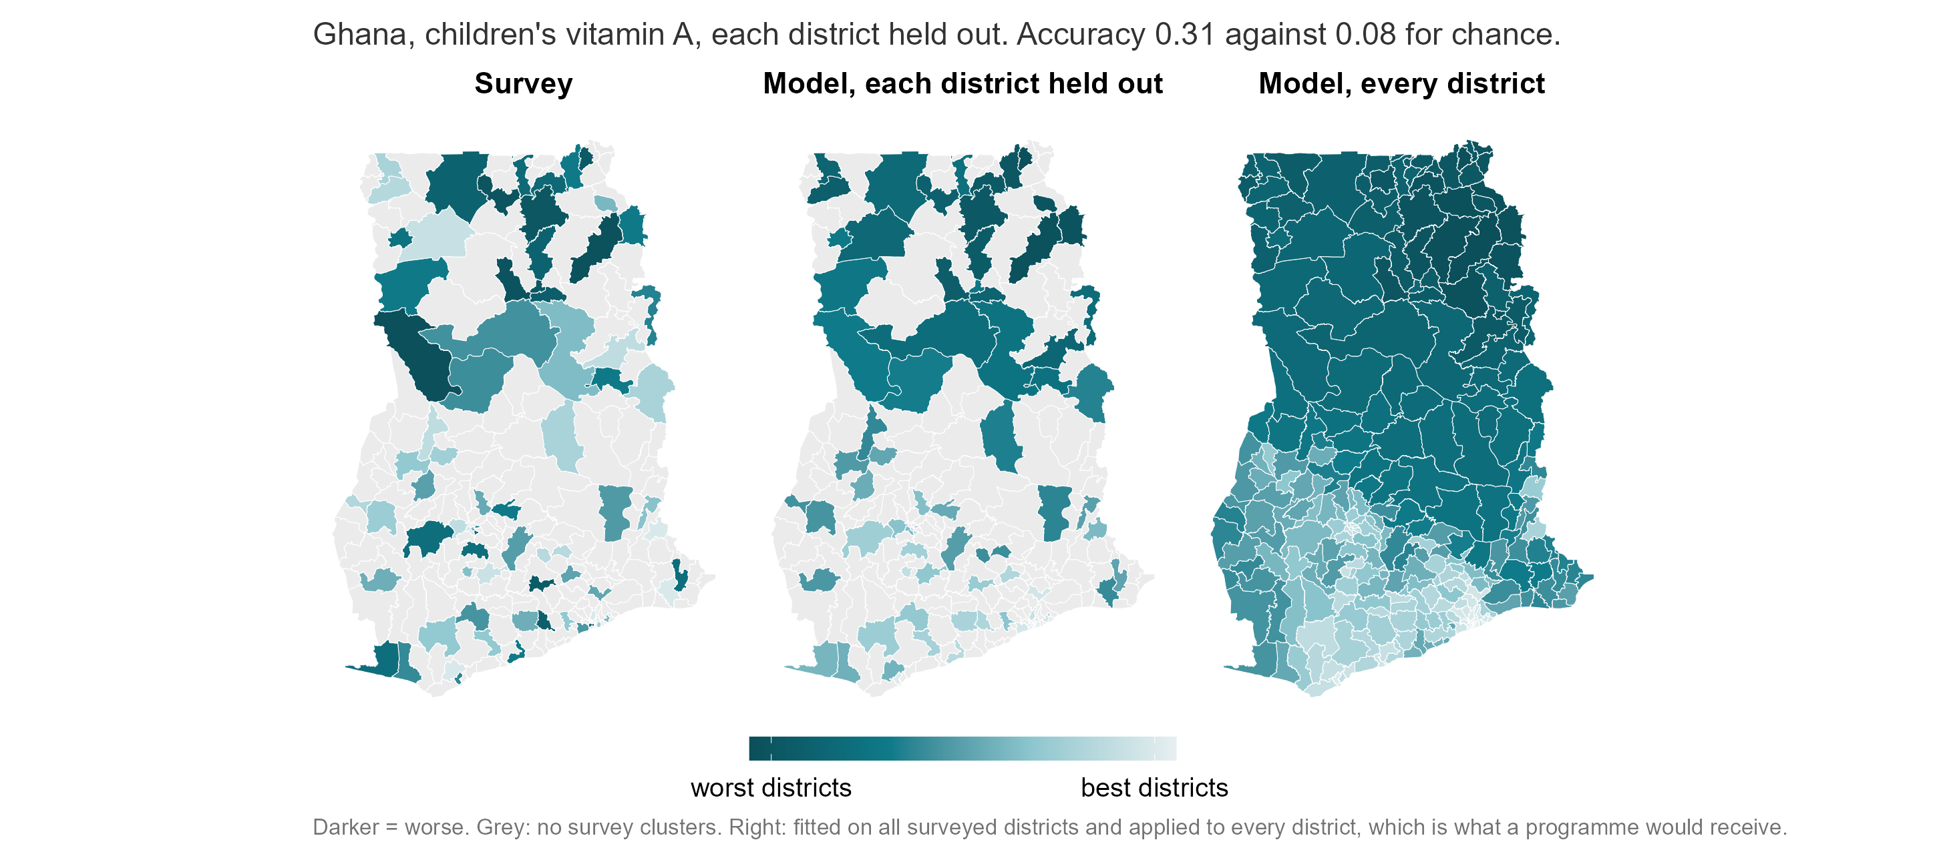
Notes:
Ghana, children’s vitamin A. Each district is predicted with itself removed from the model (5 folds, averaged over 10 repeats), so nothing here is fitted to the district it scores. Ranking accuracy 0.28 for this cell, against 0.08 for chance. What the eye should take: the north comes out as the worst region in both maps without the model being told anything about survey results. What it should not take: that any single district is correctly placed. Grey districts had no survey clusters at all, which is the gap the model fills.

Slide 7
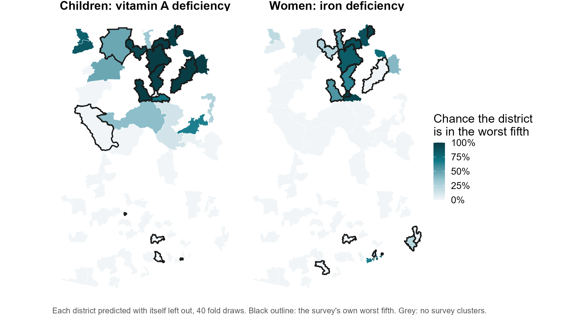
How sure is the model about each district?
Notes:
Source: results/tables/policy_deck/worst_fifth_probability.csv, script 07. The model was refitted on 40 different random splits, each district predicted with itself left out every time, and the map shows how often the district landed in the worst fifth. For child vitamin A in Ghana, 12 of 75 districts are in the worst fifth on at least 80 percent of refits and 56 on at most 20 percent; the middle is the uncertain part and should be treated as such. The black outlines are the survey’s own worst fifth. Across all countries and outcomes, districts the model puts at 80 percent or above are in the survey’s worst fifth 40% of the time, against 16% for districts at 20 percent or below and a base rate of 20 percent (worst_fifth_calibration.csv). The survey’s own worst fifth is noisy at one cluster per district, so 100 percent agreement is not the ceiling. This is the form a priority list should take: firm at the top, honest about the middle.

Slide 8
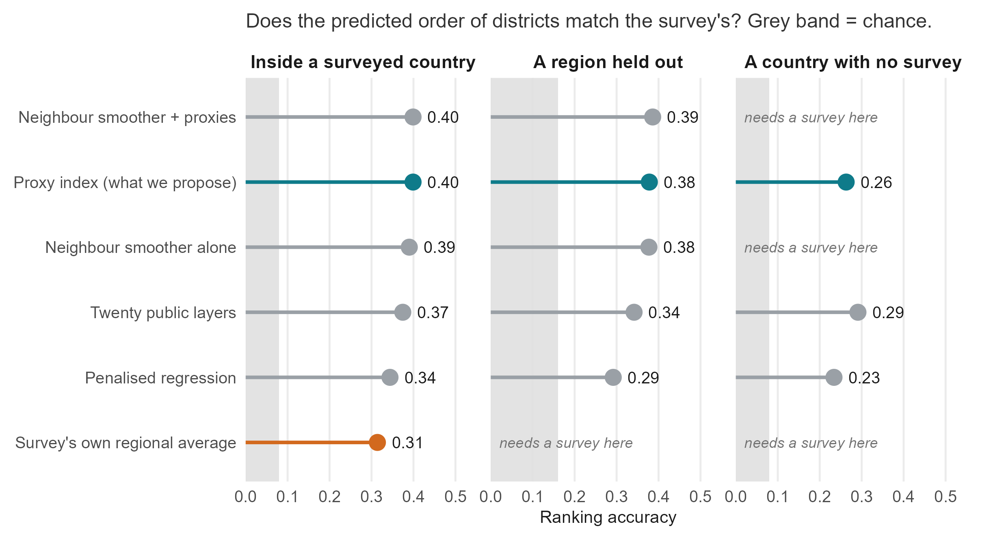
Inside a country every method ties. Only ours works with no survey.
Notes:
Source: benchmarks_v2_summary.csv (biomarker level) and weight_sources_summary.csv for the twenty-layer composite. Read left to right. Inside a surveyed country, the proxy index (0.40), the neighbour smoother with covariates and the smoother alone are a three-way tie; differences under 0.03 are not differences here. That is worth saying plainly: if you already have a survey, smoothing between neighbours gets you most of the way. The right-hand column is the point of the project. The smoothers and the survey’s regional average need survey data in the country; only the proxy methods produce anything at all there, at 0.26 to 0.37 against a chance level of 0.08. Grey band: the 95th percentile of the permutation null (transport_null_calibration.csv).

Slide 9
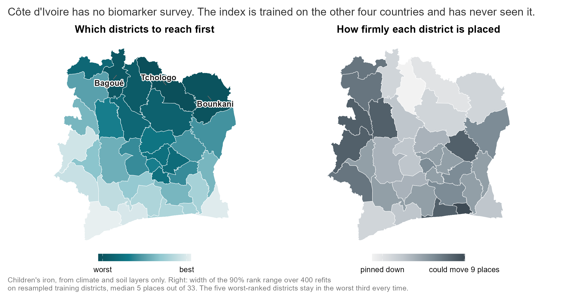
A country with no survey, ranked from public data alone
Notes:
Cote d’Ivoire has the full proxy database and no biomarker survey, so it is the case the project exists for. The climate-and-soil index was fitted on the four surveyed countries and applied to CIV’s 33 districts; it has never seen a Cote d’Ivoire biomarker. Left panel: the worst-ranked districts are the northern savanna belt (Tchologo, Bounkani, Bagoue, Poro, Hambol), the drier, poorer, more pastoral half of the country. Right panel: how firmly each district is placed. The training set was resampled 400 times and the index refitted each time; the map shows the width of the 90 percent range of ranks, in places out of 33. The median is 5 places, the five worst-ranked districts stay in the worst third in every refit, and 10 of 33 districts have at least an 80 percent chance of being in the worst third while 21 have at most 20 percent. This uncertainty covers how much the ranking depends on which training districts we learned from. It does not test whether the model transports to Cote d’Ivoire at all, because there is no CIV ground truth; the external bound on that is the held-out transport accuracy of 0.37. Two guards ran first: the same code with each surveyed country held out reproduces the published transport figure exactly (0.369 over 22 cells, 22 positive), and adding CIV to the column intersection costs seven of the 95 climate-and-soil columns without degrading transport (0.386, still 22 of 22). Tables: results/tables/policy_deck/civ_climate_soil_ranking.csv, civ_rank_uncertainty.csv, civ_transport_guards.csv.

Slide 10
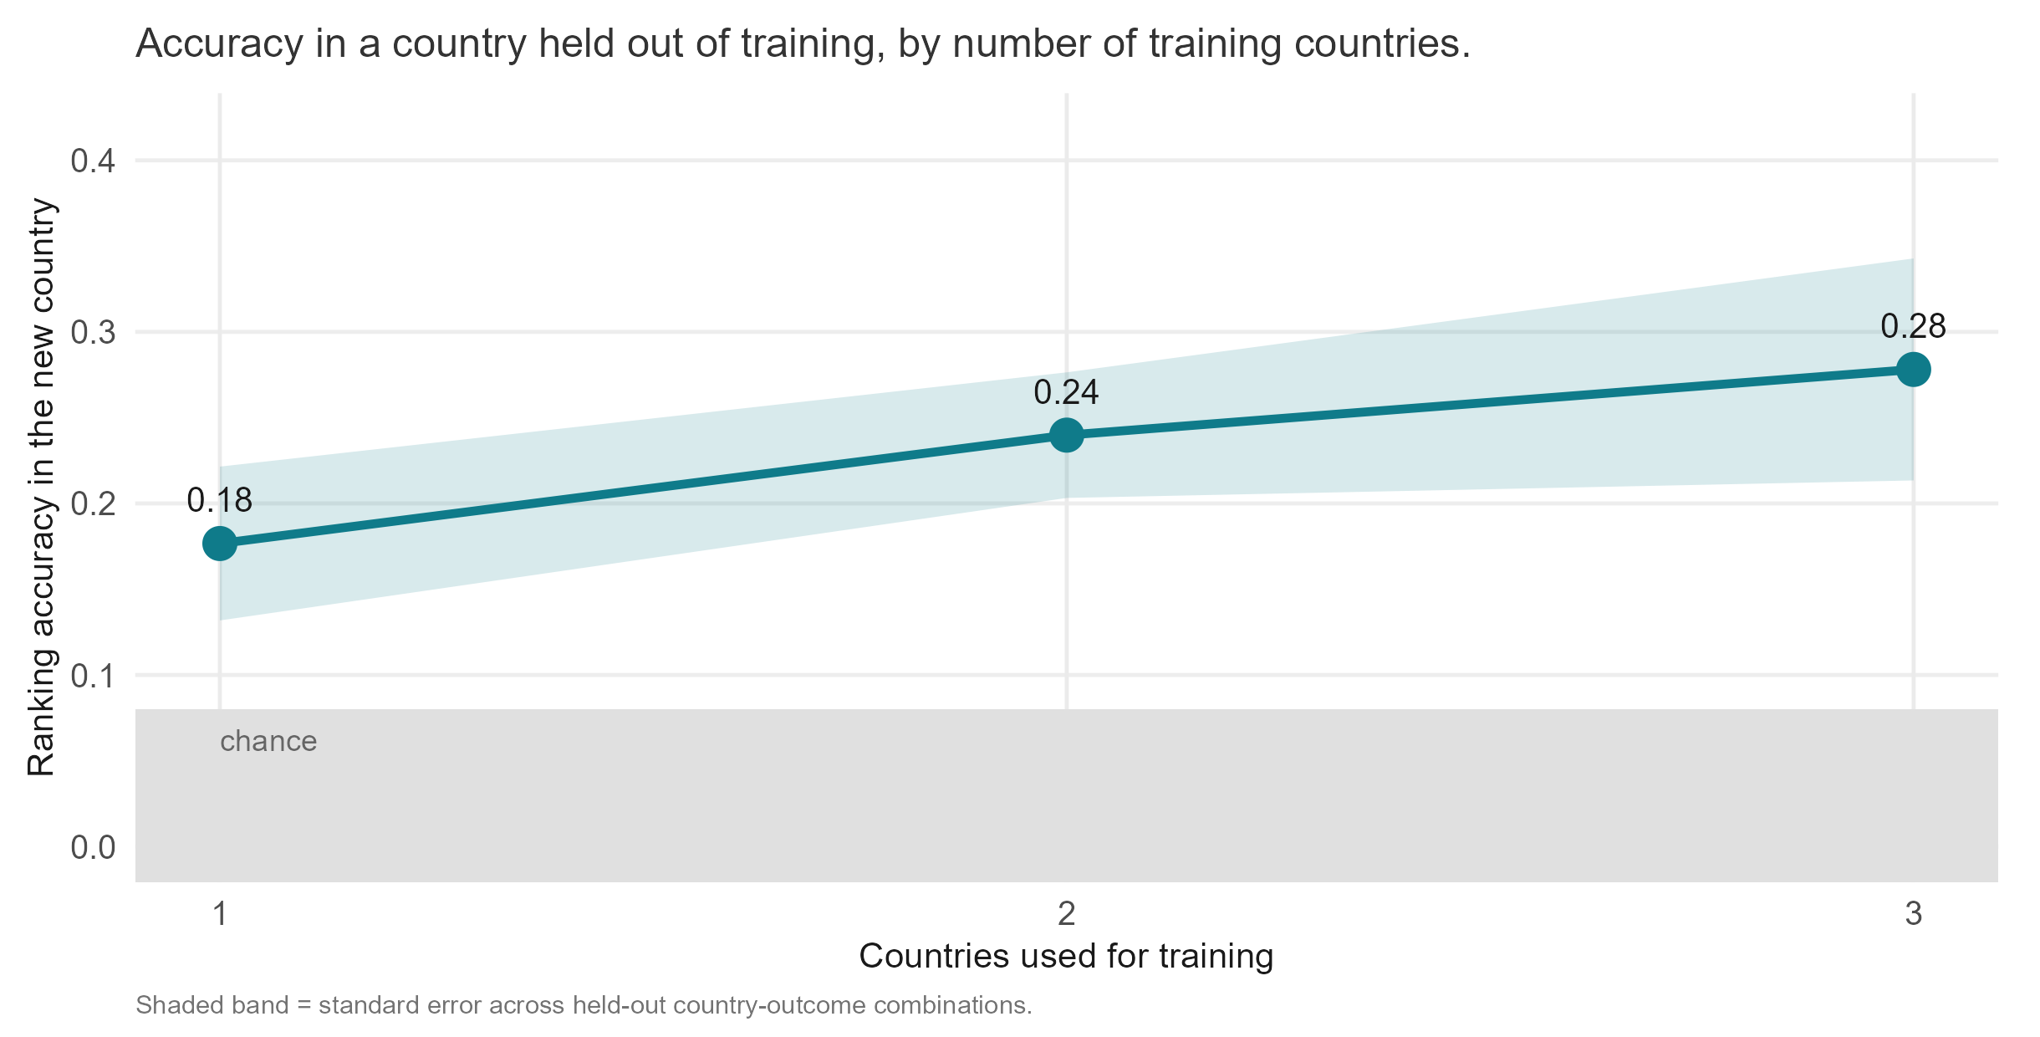
Every survey we add improves the map for the next country
Notes:
Source: training_country_curve.csv, proxy index, biomarker level, mean over held-out country-outcome combinations. Each additional training country buys roughly 0.05 of ranking accuracy in the next country, and the curve has not flattened at three training countries. This is the argument for pooling surveys across the region: a survey a country runs for itself improves every other country’s map. Two things to state here. Rankings cross borders and absolute levels do not; raw ferritin differs several-fold between these surveys, so the model tells a new country which districts are worst, not how bad. And an index built only from climate and soil reaches 0.37 across districts and 0.45 across regions, better than the full index; that pair was chosen on these same four countries, so it is pre-registered for the next country rather than presented as a finding.

Slide 11
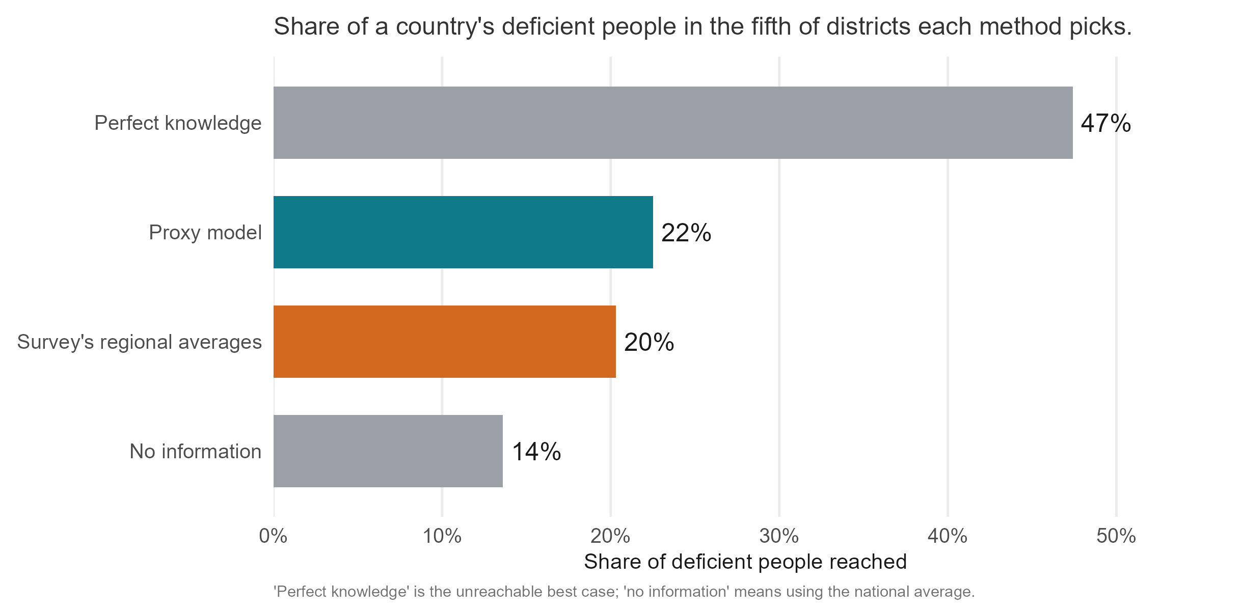
Targeting the worst fifth of districts, the model finds the most deficiency
Notes:
Source: nce_targeting_summary.csv, in-fill, mean_capture over 24 combinations. Direct effort at the fifth of districts the model ranks worst and you reach 22% of the country’s deficient people; the survey’s own regional averages reach 20%, no information reaches 14%, and perfect knowledge would reach 47%. So the model closes about a fifth of the gap between guessing and knowing. Useful, and worth saying in exactly those terms. Likely question: why perfect knowledge captures only 47%. Burden is spread across districts; even the true worst fifth holds under half of it.

Slide 12
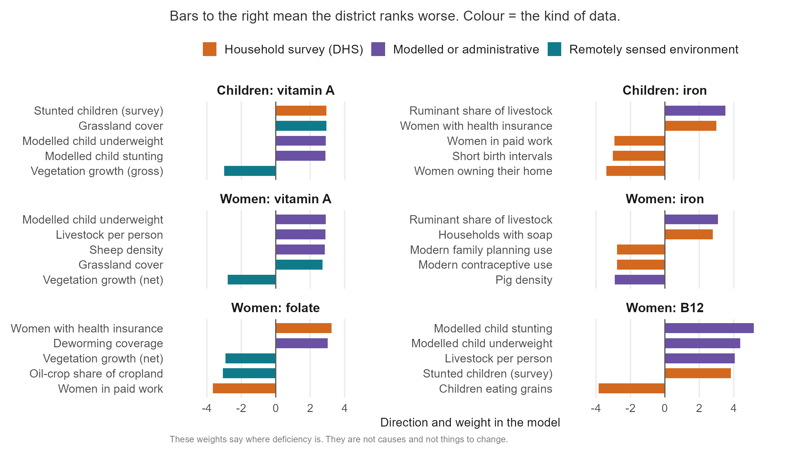
Variable importance
Notes:
Source: index_importance_top.csv, biomarker level, top five per outcome. The same picture recurs for all six outcomes: districts that are drier and grassier, less productive, more pastoral, poorer (fewer women owning their home or in paid work, less schooling) and with more stunted and underweight children rank worst on every deficiency we measured. That is the agro-ecology to diet to status pathway of the conceptual framework, seen from above. Two cautions to say aloud. First, these are not causes; a weight says where deficiency is, not what to change. Second, livestock density ranking positive for iron and B12 is ecological, not dietary: pastoral zones are the dry, poor zones. Nobody should leave the room thinking cattle cause iron deficiency. Colour groups the kind of data, not its strength.

Slide 13
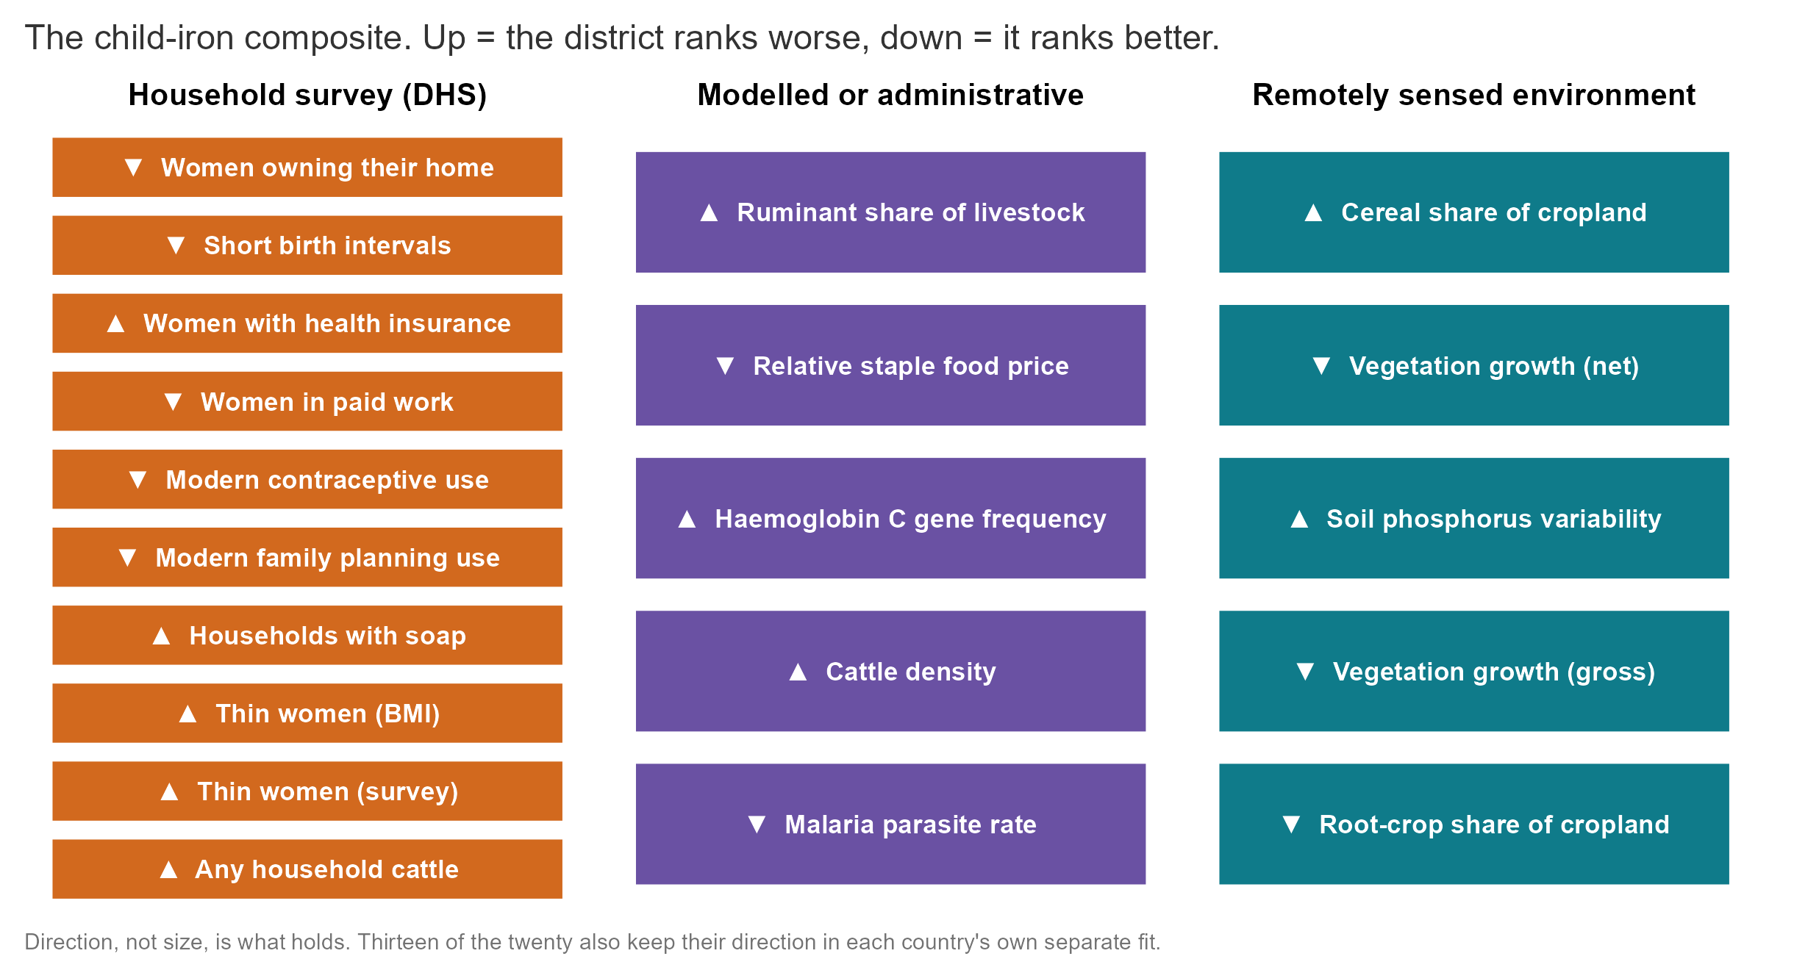
Variables predictive variables are consistent across countries (here, for child iron).
Notes:
Source: index_importance_top.csv, child iron, top twenty. This is the whole composite for one outcome, the sort of list a country could assemble itself. All twenty keep the same direction in every leave-one-country-out fit; thirteen of the twenty also keep it in each country’s own separate fit, which is the stricter test. None of these requires a blood sample. The twenty-layer equal-weight composite scores 0.29 for a new country, slightly above the full 454-column index at 0.26 (weight_sources_summary.csv, arm sparse20), so a short, auditable list is not a compromise here.

Slide 14
What this means for policy
A surveyed country with unsurveyed districts: the ranking fills the gaps, and the DHS-style model gives a prevalence figure with an interval where clusters exist.
A country with no survey: the ranking says which districts are likely worst, with a probability for each. One national blood sample turns it into numbers.
Planning the next survey: a national sample of about 5 percent of a full survey, plus the ranking, gives district levels within 10.3 points. A district survey needs about a quarter of a full sample to match that.
Notes:
The third point is from results/tables/protocol_v2/anchor_and_rank_summary.csv (AR-01): at 5 percent of the full sample the national anchor plus ranking gives a median district error of 10.3 percentage points, a regional survey 12.8 and a district survey 19.7; the district survey matches the anchored ranking at about 25 percent of the sample. The ranking wins on level error only: a district survey of any size captures more burden, because burden sits in populous districts that surveys measure well. Likely question: can this replace a survey. No. It ranks; a survey measures. The ranking tells a survey where to spend its clusters and tells a programme where to look while it waits.

Slide 15
Limitations/context
Differences under 0.03 are basically ties over a few dozen districts.
Where a survey exists, smoothing between neighbours does almost as well; the model’s greatest value is where there is no survey.
Household-survey inputs help within a country but hurt when extrapolating to new countries; person-level prediction does not well work here.
Notes:
Close on the boundary rather than the promise; this audience will be asked to defend whatever they take away. The 0.03 tie rule is ours and applies to every comparison in the deck, including the one where our own method comes first. The household-survey point is the appendix slide on what carries the model and what travels; dropping every DHS column improves new-country accuracy by 0.07. Person-level prediction reaches AUC 0.51 to 0.53 (individual_level_models.csv), a coin toss.

Slide 16
Appendix

Slide 17
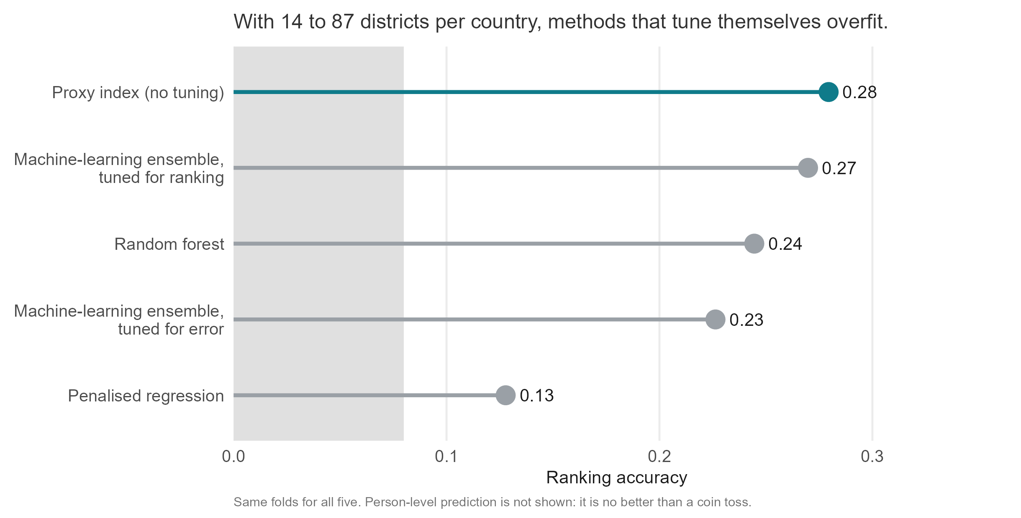
More complicated models don’t do better
Notes:
Source: sl_rank_loss_scores.csv, all arms scored on the same folds. The untuned index edges the best machine-learning ensemble by a margin inside our own tie rule; the honest claim is that nothing beats it. Random forest, the ensemble tuned for squared error and penalised regression all trail. The reason is sample size: 14 to 87 districts per country is not enough for a method to learn its own settings. Also tested: highly adaptive ridge and ridge, lasso and elastic-net weightings of the same components (weight_sources_summary.csv); none beats the index inside a country, and two variants (decorrelated weights, a twenty-predictor composite) gain about 0.03 across borders and are pre-registered rather than adopted.

Slide 18
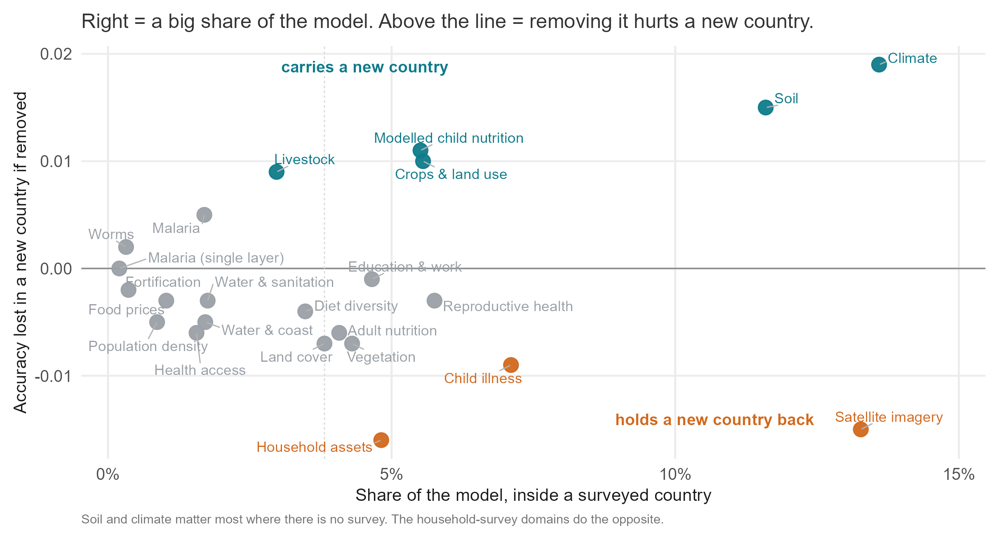
Different data supports within vs across country predictions
Notes:
Sources: index_importance_domains.csv (pooled, biomarker level) for the horizontal axis, domain_ablation_loco_summary.csv for the vertical. Satellite imagery, climate and soil together carry 30 to 48 percent of the model inside a country, and climate and soil are the two whose removal costs a new country most, with the modelled nutrition surfaces, agriculture and livestock behind. The household-survey domains sit below the line: they hold several of the largest single weights, yet removing all of them improves new-country accuracy from 0.26 to 0.33 (source_ablation_loco_summary.csv). Household-survey indicators are country-specific in a way that does not export; the physical environment does. This is the evidence behind the climate-and-soil result and the reason it needs confirming on a fifth country.

