Slide 1



Predicting vitamin and mineral deficiencies from public data
Four biomarker surveys, hundreds of public proxies, one evaluation protocol
Andrew N. Mertens, University of California, Berkeley
We are grateful for the funding support of the Gates Foundation.

Slide 2




Goals
Estimate deficiency prevalence, nationally and by district
From a wide range of proxy indicators, validated against the prevalence measured by biomarker assessment in national surveys.
Identify the subnational regions at greatest risk
A ranking a programme can act on, and a level once anchored to a national number.
Engage national stakeholders throughout
Ghana as the worked example; the dashboard and country briefs as the shared product.
Notes:
The three project goals as stated in the proposal: district and national prevalence estimates from proxies, validated against biomarker surveys; the districts at greatest risk; engagement with national stakeholders throughout. The map is Ghana child iron deficiency from the 2017 survey, the worked example that recurs through the talk.

Slide 3
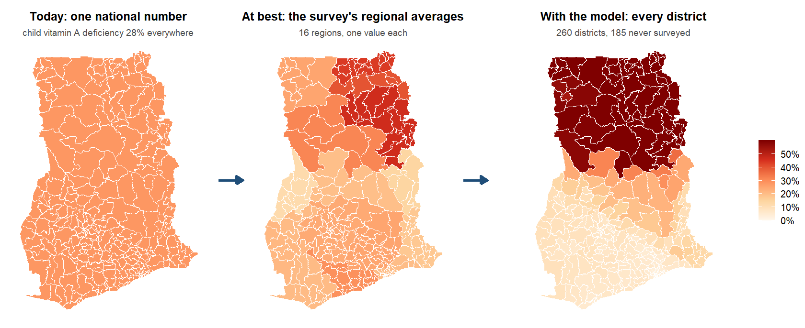
What a country has today, and what the model adds
Notes:
The whole talk in one image, Ghana’s child vitamin A deficiency. Left: what a programme has between surveys, one national figure applied to every district. Middle: the best the survey itself offers, an average per region. Right: what the model adds, a value for every district, including the 185 the survey never reached (the index fitted on the surveyed districts and applied to all; the median over the resampled refits of the exceedance slide). The rest of the talk is about how far the right-hand map can be trusted: as a ranking inside a surveyed country, as a ranking in a country with no survey, and as a level only with a national anchor.

Slide 4

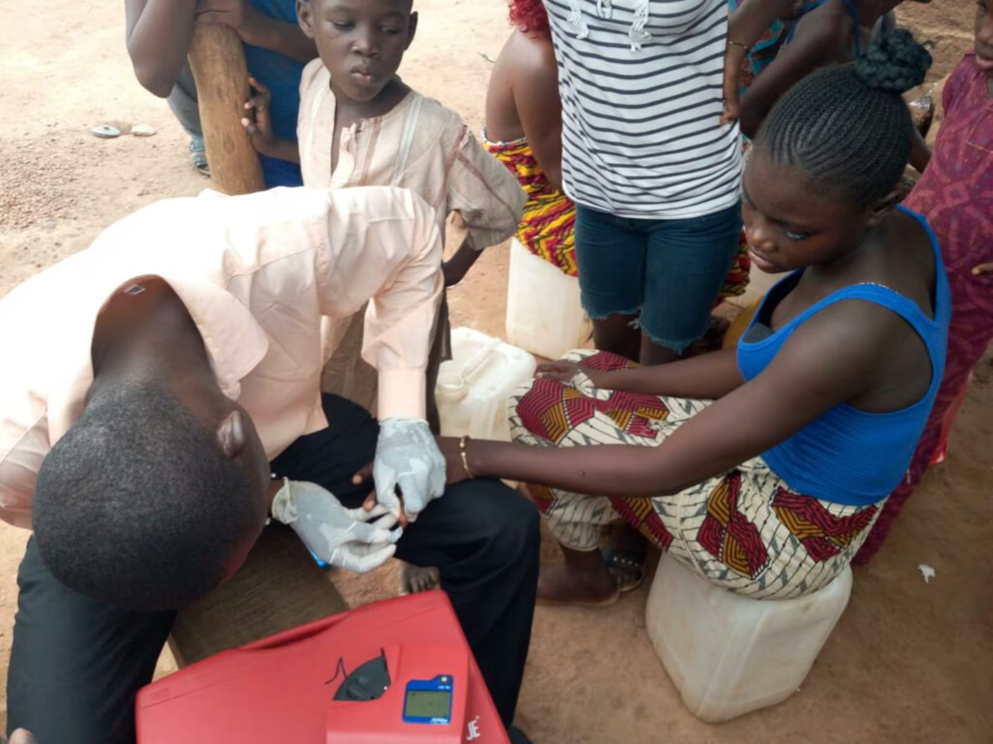


Surveys are rare; the proxies are everywhere
Biomarker surveys are rare and costly
About one national survey per country and decade; programmes need district estimates between them.
575 district-level proxies
Open gridded layers and public survey microdata, linked to four national biomarker surveys.
Predict deficiency by district
Iron, vitamin A, folate, B12 and zinc, in surveyed and unsurveyed districts.
Notes:
Photo credit: Latter-day Saint Charities. GMS 2017 collaborators: University of Ghana, GroundWork, University of Wisconsin-Madison, KEMRI-Wellcome Trust; with UNICEF and Global Affairs Canada.

Slide 5







Big data and small data, at once
Big data: the predictors
Small data: the outcome
575 columns from 28 sources
Rasters at 30 m to 10 km summarised over 554 districts; a 64-dimension satellite embedding; four household surveys aggregated from microdata.
One biomarker survey per country per decade
Four surveys, 24 country-outcome cells, 206 surveyed districts in all.
Reduced to 29 domains
Leading principal components per domain, learned on training districts only; nothing chosen on the outcome.
14 to 87 districts per country
The effective sample size of every model; a tuned estimator shrinks to the constant, so the index tunes nothing.
All of it public
The headline set has no DHS in it; a country without a recent DHS can rebuild it.
Honest folds and a reliability ceiling
Folds cut by district, region and country; the survey's own district noise sets the ceiling any model can reach.
Notes:
The same sentence describes both halves. Big: 575 columns from 28 sources, most of them rasters at 30 m to 10 km summarised over 554 districts, four household surveys aggregated from their microdata, a satellite embedding with 64 dimensions per district. Small: the thing being predicted is measured in one biomarker survey per country per decade, at 206 surveyed districts over four countries, 24 country-outcome cells, and 14 to 87 districts per country, which is the effective sample size of every model. Everything in the protocol follows from holding both at once: predictors are reduced to domain components with nothing chosen on the outcome, the estimator has no tuned parameter, the folds are cut by district, region and country, and the reliability ceiling says how much of the survey signal is noise at district level. Likely question: why not fit at the person level. That was the January approach; a person-level classifier under district-blocked folds is a coin toss on proxies alone, and shrinking its predictions biases area means (individual-level slide in the appendix).

Slide 6
Surveys and outcomes

Slide 7

Four surveys, one protocol
The Gambia
Ghana
Malawi
Sierra Leone
Survey: Gambia Micronutrient Survey 2018 (GMNS)
Fieldwork: Jan 2018 to Apr 2018
Districts: 30; clusters: 70
Outcomes: vitamin A, iron
Survey: Ghana Micronutrient Survey 2017 (GMS)
Fieldwork: Apr 2017 to Jun 2017
Districts: 75; clusters: 90
Outcomes: vitamin A, iron, folate, b12
Survey: Malawi Micronutrient Survey 2015-16 (MNS)
Fieldwork: Dec 2015 to Feb 2016
Districts: 87; clusters: 103
Outcomes: vitamin A, iron, folate, b12, zinc
Survey: Sierra Leone Micronutrient Survey 2013 (SLMS)
Fieldwork: Oct 2013 to Dec 2013
Districts: 14; clusters: 60
Outcomes: vitamin A, iron, folate, b12
Notes:
24 country-outcome cells, 206 surveyed districts, 323 survey clusters with GPS. Fieldwork dates were recovered for every cluster (Sierra Leone reconstructed from date of birth and age in days); ferritin, retinol and food prices are seasonal. Three surveys ran in the dry season and Malawi in the lean season. Likely question: why districts rather than regions. Districts are the programme unit; they sit below the surveys’ design resolution, so the reliability ceiling slide reports what a perfect predictor could reach.

Slide 8





Five deficiencies, one definition each
Iron
Vitamin A
Folate
B12
Zinc
Who: children 6-59 mo; non-pregnant women 15-49 y
Where: all four countries
Biomarker: ferritin, inflammation-adjusted (survey flag; not IDA)
Cut-off: < 12 / < 15 ug/L
Who: children 6-59 mo; non-pregnant women 15-49 y
Where: all four countries
Biomarker: retinol-binding protein, one BRINDA adjustment for all
Cut-off: < 0.70 umol/L RBP
Who: non-pregnant women 15-49 y
Where: Ghana, Sierra Leone, Malawi
Biomarker: serum folate (immunoassay GH, SL; microbiologic MW)
Cut-off: < 10 nmol/L
Who: non-pregnant women 15-49 y
Where: Ghana, Sierra Leone, Malawi
Biomarker: serum B12
Cut-off: < 148-150 pmol/L
Who: children 6-59 mo; non-pregnant women
Where: Malawi only
Biomarker: serum zinc, IZiNCG flag, unadjusted
Cut-off: IZiNCG, by draw time
Notes:
Two targets per cell: the deficiency prevalence, and the district mean of the negated log biomarker concentration (higher means worse), which carries more signal than the dichotomy and is reported alongside it. Definitions were reconciled against the four survey reports and the 21 papers that re-analyse them on 15 September 2026 (docs/survey_report_reconciliation.md): every iron, zinc, folate and B12 national estimate now reproduces its report to the decimal, and the Gambia LGA estimates track the report at r = 0.98 to 0.99. What changed then: the iron binaries had been the surveys’ iron-deficiency-ANAEMIA columns in three countries (ferritin plus haemoglobin), Malawi’s iron flag came from a mis-specified local BRINDA that under-counted by half, pregnant women and children outside 6 to 59 months were being kept, and vitamin A had been converted to retinol-equivalents with each survey’s own RBP-to-retinol line. That conversion is now the sensitivity analysis, not the primary: the four lines were fitted in different directions on 14 to 300 specimens, and Malawi’s has R-squared 0.13, which manufactures near-zero deficiency by construction; the survey’s own re-analysis (Likoswe 2021) recommends exactly BRINDA-adjusted RBP below 0.70, the estimand used here. Call it low RBP rather than vitamin A deficiency: Ghana’s MRDR found 6.7 percent depleted and Malawi’s none. Two caveats to say if asked. Sierra Leone’s child file as supplied holds only the survey’s anaemic children (532 of 654 assayed), so its child cells are anaemic-subgroup estimates until the full file arrives. Folate is not comparable across the two assays (Malawi’s microbiologic assay reads higher than the Roche immunoassay), so its cross-border numbers are indicative only. Iodine (The Gambia, Sierra Leone) is analysed within country only; a one- or two-country outcome has no cross-border test.

Slide 9
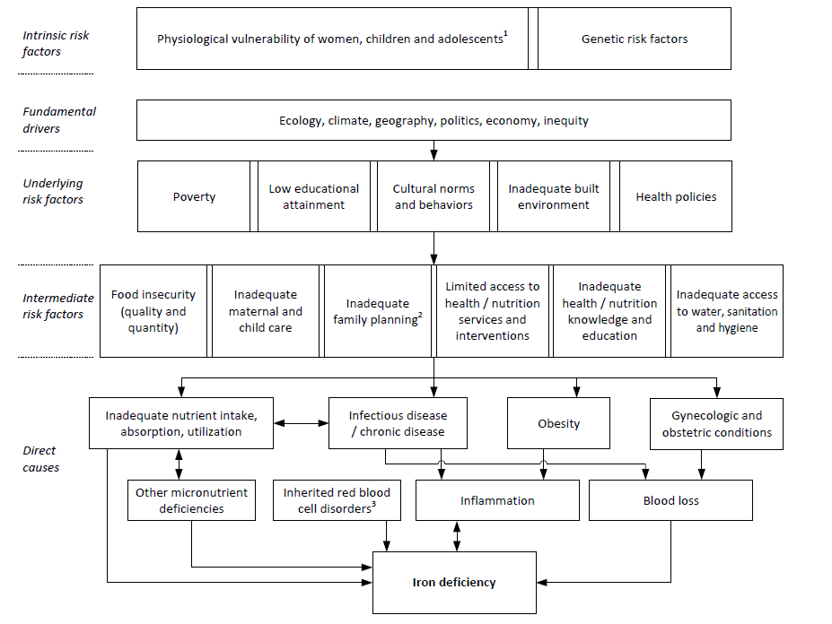
Conceptual framework: iron deficiency
Notes:
Adapted from Hess et al., Ann N Y Acad Sci 2023. The framework is unchanged; the ablation slides show which of its pathways the data can see.

Slide 10
The proxy dataset

Slide 11




What a proxy has to be
Available everywhere
For every district of every country, surveyed or not, from a source anyone can reach.
Independent of the outcome
Nothing from the biomarker survey we score against enters the predictors.
Placed in time
At the survey year, or as close as the source allows, with the gap recorded.
Recorded
Every column carries its source, the year used, how it was aggregated, and a definition.
Notes:
This talk is about the right-hand side of the model: where the 575 columns come from, how each one gets from its native form to a district value, how we line them up with four surveys taken in four different years, and which of them the model leans on. The analysis deck covers what the ranking achieves; this one covers what it is made of. The leakage rule is the second bullet: a district aggregate of the same survey instance we score is excluded (docs/findings, LK-02), and where a MICS or DHS was fielded inside the biomarker survey’s own clusters those clusters are dropped from the aggregate (The Gambia 2018: 70 MICS clusters; Malawi 2015-16: 105 DHS clusters). The record behind the fourth bullet is the shared metadata file and results/tables/protocol_v2/variable_sheet.csv. One consequence of the first bullet: 42 of the 575 columns are national series with one value per country, and a value that is the same in every district cannot rank districts, so the models drop them when they are fitted.

Slide 12
What each source is (1 of 2): land, climate, agriculture
Source | What it is
Earth Engine: TerraClimate | Monthly climate (rain, temperature, evapotranspiration, soil moisture), 4 km; survey year and 1991-2020 normals
Earth Engine: MODIS | Land-surface temperature (1 km), NDVI and EVI (250 m) at the survey year, plus climatology and anomaly
Earth Engine: land cover, lights, built-up | Copernicus land-cover fractions, night lights, GHSL built-up surface, human modification
Earth Engine: productivity | MODIS NPP and GPP, WaPOR evapotranspiration, leaf area, grassland cover
AlphaEarth | Google’s 64-number satellite embedding of a year of imagery, 10 m, 2017
SoilGrids / iSDA | Soil nutrients at two depths, pH, texture, organic carbon (iSDA 30 m, SoilGrids 250 m)
Koppen / AEZ | Climate classes and agro-ecological zones: class shares and purity
JRC Surface Water / LSIB | Distance to permanent and seasonal water and to the coast
MapSPAM | Crop area and production by crop, 10 km, 2010
Gridded Livestock of the World | Cattle, sheep, goats, pigs and poultry per km2, 10 km, 2015
WorldPop / GHSL / GPW / RWI | Population, age-sex structure and density; Meta’s relative wealth index

Slide 13
What each source is (2 of 2): health, food, households
Source | What it is
IHME modelled surfaces | 5 km modelled surfaces: child growth, anaemia, WASH, education, ORS, HIV, malaria, measles vaccination
Malaria Atlas Project | Parasite rate, incidence, mortality, net use and spraying, 5 km, at the survey year
WHO ESPEN | Helminth endemicity and mass-treatment coverage by implementation unit
WHO anaemia; UNICEF VAS; WHO FluNet | National series: anaemia prevalence, vitamin A supplementation, influenza counts
WFP market prices; World Bank RTFP | Monthly market food prices, distance-weighted to districts over the survey year (RTFP: Gambia, Malawi)
FAOSTAT; HFID | National food balance sheets; FEWS NET / IPC food-security phases and indicators
GFDx | Fortification standards and coverage by food vehicle, mostly national
MIMI (Tang et al. 2026) | Modelled dietary micronutrient inadequacy from GLSS7, Ghana regions
DHS | 150 district indicators from the paired round, cluster spatial model
MICS microdata; MICS via WHO HEAT | 30 indicators from the public microdata (WASH, wealth, education, child feeding, health); 19 regional indicators via WHO HEAT
Household budget surveys (HCES) | Food share, own production, consumption level, 7-day food groups (IHS, GLSS7, IHS4, SLIHS)
Global Data Lab | Subnational human development index

Slide 14
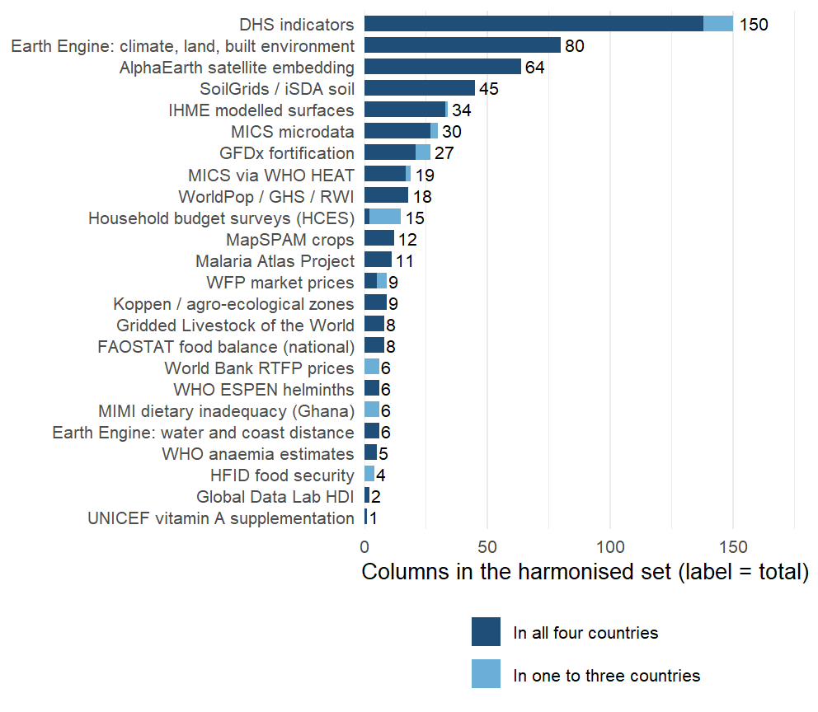
575 columns from 28 sources, on one district spine
575 columns from 28 sources, harmonised onto one district spine. 518 exist in all four countries and can serve a model for a new country; the other 57 exist in one to three and are used inside the countries that have them.
Notes:
Read the bar chart from the top. One harmonised set feeds every model: the in-country models use whatever a country has, the cross-country models the columns all four share, so the light segment (household budget survey diet items for two countries, RTFP prices for two, MIMI for Ghana, MICS items missing from one round, a few IHME surfaces) works at home and not abroad. Behind the set sits a larger extraction: about 740 columns per country in the raw files (1,968 distinct names across the four, mostly the same quantity under country-specific names), harmonised to a common vocabulary; what did not harmonise was used only in the pre-protocol models. The Earth Engine block is climate (TerraClimate at the survey year and as 30-year normals), land cover, night lights, built-up surface, vegetation and evapotranspiration, night-time land surface temperature; the satellite embedding is Google’s AlphaEarth, 64 numbers per district that summarise a year of imagery; soil is iSDA and SoilGrids, ten nutrient concentrations at two depths plus texture and pH; crops are MapSPAM’s 2010 allocation; livestock is GLW4. The health and nutrition surfaces are IHME’s modelled estimates (anaemia, child growth, WASH, education, ORS, HIV, malaria, vaccination) and the Malaria Atlas layers; ESPEN gives helminth endemicity. Prices come from WFP markets, the World Bank’s RTFP panel and FAOSTAT balances; fortification from GFDx. The public microdata blocks are new since 15 September: 30 indicators from the MICS files for all four countries and 15 diet and consumption indicators from the household budget surveys (IHS 2015/16, GLSS7, IHS4, SLIHS 2018). The DHS block is 150 district aggregates from the round paired with each survey (Ghana 2014, Malawi 2015-16, Sierra Leone 2013, The Gambia 2019-20), estimated with a cluster-level spatial model so every district has a value. Everything here is listed with its source, year and definition in results/tables/protocol_v2/variable_sheet.csv and in the dashboard’s catalogue.

Slide 15
Three kinds of data, three ways to a district value
Native form | Examples | To a district | Time
Gridded raster (30 m to 10 km) | Climate, soil, satellite, IHME and MAP surfaces, population | Zonal mean over the district polygon, area- or population-weighted | Survey year, nearest year, or 30-year normal plus anomaly
Survey with GPS clusters | DHS; MICS 2018 in The Gambia, 2017 in Sierra Leone | DHS: cluster spatial model (BYM2) so every district has a value; MICS: clusters inside the polygon, minimum 30 households | The round paired with the biomarker survey
Survey identified to region or district | MICS in Ghana and Malawi; household budget surveys | Value of the smallest survey unit that contains the district, flagged as the parent’s value | The round nearest the survey
National series | FAOSTAT balances, GFDx programme fields, FluNet | Constant within a country; dropped when the model is fitted | Survey year
Notes:
Rasters are the easy case: exactextractr over the GADM polygon, weighting by WorldPop where the quantity is about people (the IHME surfaces) and by area where it is about land (climate, soil, greenness). Twelve of the IHME columns were still joined by district name until this week; the tabular files predate Ghana’s 2019 district splits and left 56 percent of Ghana empty, so they were re-extracted from the 5 km GeoTIFFs. Survey microdata with GPS goes point-in-polygon after the leakage clusters are removed, with a minimum of 30 households and 5 clusters per district before a district gets its own value; below that it takes the parent region’s value and is flagged. Ghana’s MICS 2017-18 identifies the ten old regions and Malawi’s MICS 2013-14 the 27 districts, so those blocks vary at that level only and every column carries a subnational flag saying so. National series are kept in the set for documentation and completeness, but a constant cannot rank districts; the fit-time policy removes 42 of them (FAOSTAT, most GFDx fields, WHO anaemia national estimates, VAS, FluNet).

Slide 16
Every join is by code, never by name
554 districts on GADM 4.1: Gambia 37, Ghana 260, Malawi 243, Sierra Leone 14.
Every unit carries its GADM code, HASC code and the OCHA p-code, so a join is by code where the source has one.
Names are matched only as a last resort, through a reviewed alias table with a distance cap, and always on the region-district pair: Malawi has four Traditional Authority names that occur in two districts.
A join that fans out or drops a unit fails the build. The population table had been missing one of each same-name pair for months; the test found it.
Ghana: 260 districts on the 2019 boundaries; sources on the 2012 boundaries (216) or the ten old regions are mapped with a crosswalk, never by name.
Malawi: 243 Traditional Authorities; sources at district level (28) are broadcast down and flagged.
The Gambia: 37 districts; Sierra Leone: 14 districts. With so few units, a fallback to the parent region changes more of the map.
Survey clusters are linked to the same polygons for the cluster-level analyses and buffered for raster extraction.
Notes:
The spine is metadata/admin2_spine.csv; the helpers in R/admin2_keys.R do every join in the pipeline and a lint test (tests/testthat/test-admin2-join-lint.R) reads every script for a join on a bare Admin2 name. The p-codes came from OCHA’s COD-AB for all four countries this week, both directions, so an OCHA-coded source (IPC, ACLED, cluster surveys) joins without any matching. Fuzzy matching, where it is still needed, is Jaro-Winkler with a 0.15 cap and a review file that lists every non-exact match for a human to accept. The population defect: the dashboard’s population table had been deduplicated by district name, so Chikwawa’s TA Lundu and Nsanje’s TA Ngabu, Salima’s TA Pemba and Zomba’s TA Malemia lost one member each, two of them surveyed districts, and every population-weighted figure silently excluded them. Fixed 15 September from WorldPop density, and the population table is now asserted complete in the tests.

Slide 17
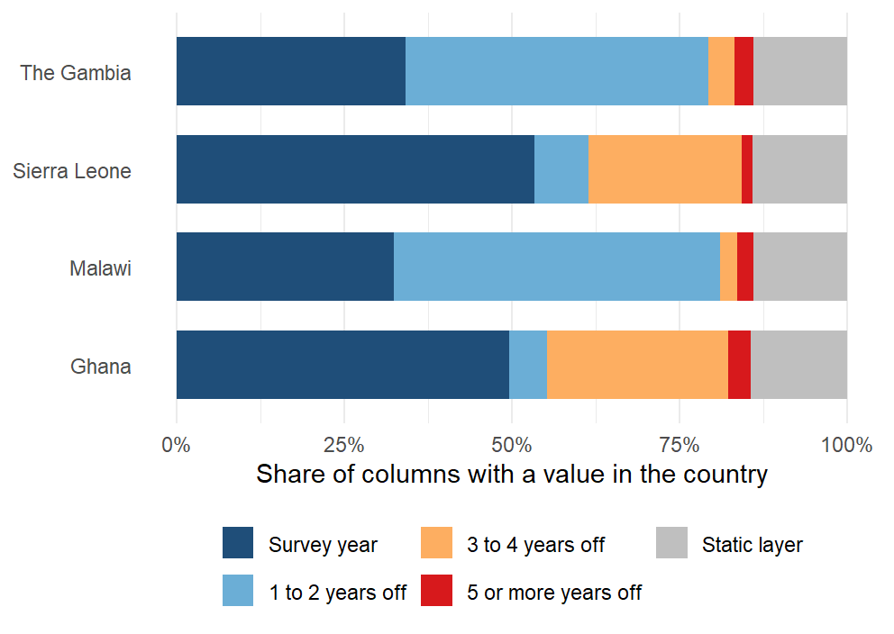
Every layer sits at the survey year, and the gap is recorded
Surveys: The Gambia 2018, Ghana 2017, Malawi 2016, Sierra Leone 2013. Each column is placed by a written rule and stamped with the year used and the gap. 136 columns sit on the survey year in every country and 78 are static layers. 305 are three or more years off in at least one country: the DHS round paired with Ghana’s 2017 survey is from 2014, Sierra Leone’s 2013 survey predates the satellite embedding and its nearest MICS by four years, and MapSPAM’s 2010 crop map is the oldest layer everywhere.
Notes:
The rules live in metadata/covariates/temporal_alignment.csv, 45 of them, one regular expression each: survey_year where an annual series exists (TerraClimate, MODIS NDVI, MAP, WorldPop density, WFP prices, RTFP windows), nearest available year where a series ends early (IHME’s child growth, education and WASH stop at 2017, anaemia and malaria at 2019), a fixed vintage where there is only one (AlphaEarth 2017, MapSPAM 2010, GLW 2015, RWI 2019), a per-country round for the household surveys, and static for soil, terrain, climate normals and zones. Climate and greenness enter as a 30-year normal plus the survey-year anomaly in standard-deviation units, which is what transports; the calendar-year series that lagged the survey by up to eight years were retired. Sierra Leone’s 2013 survey is the awkward one: AlphaEarth starts in 2017, Copernicus land cover in 2015, and the MICS round nearest it is 2017, so its gaps are the orange and red bands. Ghana’s are the DHS block: the round paired with the 2017 survey is the 2014 DHS, three years off for 140 columns. The gaps that apply everywhere are the single-vintage products: MapSPAM 2010, GLW 2015, WorldPop’s 2020 age-sex structure. The stamp is per column and per country (results/tables/predictor_alignment_2026-09-16.csv), and the audit lists everything three or more years off.

Slide 18







29 domains, each entered as its leading components
Environment from satellite (144)
AlphaEarth embedding; temperature, rainfall, drought index; NDVI and productivity; distance to water and coast
Soil (45)
SoilGrids and iSDA: pH, organic carbon, texture, nutrient availability
Agriculture and livestock (37)
MapSPAM crop mix and cropland; cattle, goat and poultry density
Food, prices and diet (83)
WFP and World Bank prices; budget-survey diets; fortification and supplementation coverage
Infection and disease (84)
Malaria, helminths, inflammation; child morbidity and mortality; immunisation coverage
Nutrition status (64)
Stunting and wasting; anaemia surfaces; infant and young child feeding
Households and economy (90)
Assets, schooling, employment; water and sanitation; fertility; access to care
Settlement, access and security (28)
Night lights, population density, travel time, built-up area; conflict events
Notes:
Why domains: 575 columns against 14 to 87 districts per country cannot be fitted column by column, and the columns are heavily correlated within a source. Grouping them by what they measure and taking principal components inside each group keeps most of the variance of each group, treats a source with 64 columns and a source with 3 as one construct each, and keeps the outcome out of the representation: the rotations are learned from the training districts’ predictors alone, so nothing is selected on the biomarker. The grouping is written down: each source block brings a label, and 10 override rules in metadata/covariates/domain_overrides.csv regroup columns by construct (infection and inflammation burden, immunisation, anaemia, child anthropometry, infant feeding, supplementation, water and sanitation, education, child mortality, assets), so that MAP, IHME, DHS and MICS versions of the same thing are weighed together. Two things went wrong this week and are now guarded. A domain’s first twelve characters are its key inside the model; two labels that shared them (“Food prices (RTFP)” and “Food prices and supply”) were silently merged in two analyses until a check caught it on 16 September. The other is in the exclusions, on the next slide. One more point for questions: climate alone or soil alone transports better than all domains together, the analysis deck’s climate-and-soil result.

Slide 19
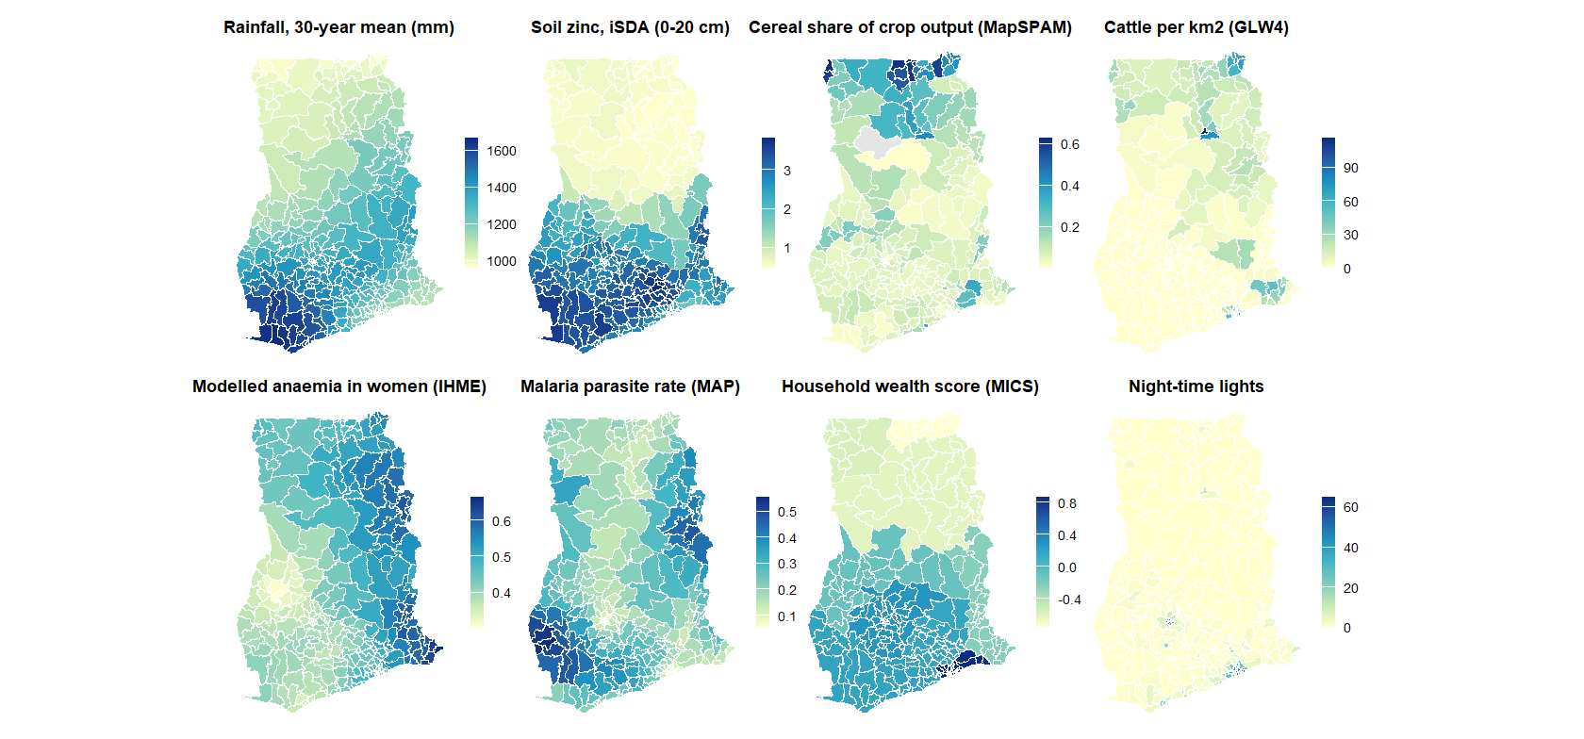
The predictors on the map: eight of the 575, Ghana
Notes:
What the predictor table looks like on the ground: eight of the 575 columns, one from each of the main domain groups, for Ghana’s 260 districts. Rainfall and soil are the physical environment; cereals and cattle the agricultural economy; anaemia and malaria the modelled health surfaces; wealth and night lights the household economy. The point to make aloud is that these are all public and all cover every district, surveyed or not, and that the north-south gradient most of them share is the gradient the index learns. The same eight maps exist for every country in the dashboard’s catalogue.

Slide 20



From four surveys and 28 sources to one district table
1. Clean and merge the surveys
2. Link gridded layers
3. Aggregate household surveys
Four national micronutrient surveys; one uniform outcome definition per nutrient across countries.
Zonal means to districts; buffer means to survey clusters.
DHS through a cluster-level spatial model; MICS and budget surveys from their public microdata.
4. Align in time
5. Open data only
6. Rank-normalise and reduce
Every layer at the survey year or the nearest; climate as a 30-year normal plus the survey-year anomaly.
Headline models use open layers and public microdata; the DHS aggregates are a sensitivity arm.
Within country, so level offsets cannot act as signal; 29 domains to their leading components, nothing selected on the outcome.
Notes:
Six steps from four surveys and 28 sources to one district table. The CONSORT table on the next slide gives the column counts at each step.

Slide 21
Every column kept or dropped has a written reason
Step | What happens | Columns
Assemble | Base extraction on the spine, food environment, extra sources, add-back sources
Append blocks | Household budget surveys, MICS microdata, RTFP prices, MODIS NDVI, climate normals | 614
Exclude | Rules with a written reason: data defects, superseded layers, redundant twins | 575
Stamp | Access tier, within-country variation, alignment rule, year used and gap, modelled-surface flag | 575
Fit-time policy | Drop national constants and leakage columns | 525
Transport matrix | Per country: coverage of at least 70% and some variation; then the four-country intersection | 464
Notes:
One shell script runs the chain (scripts/covariates/rebuild_shared_tail.sh) and ends in an audit that fails the build on a domain-key collision, a column declared subnational that does not vary, or a join that fans out. The exclusion file has 23 rules and every rule states its evidence: a nitrogen layer whose medians differ thirtyfold between countries, an NDVI product declared available only to 2013, calendar-year series superseded by survey-year values. This week’s most instructive mistake was in the exclusions. A review labelled the soil dispersion bands and the 20-50 cm depth means “redundant” on a mechanistic argument, and the climate-and-soil result fell from 0.37 to 0.34 across districts and from 0.45 to 0.40 across regions. The bands correlate only 0.03 to 0.69 with the depth means, so the label was wrong; restoring them brought both numbers back. We now hold to one rule: nothing is added or regrouped because a score likes it, an exclusion whose stated premise fails on its own metric is reverted, and every set change is checked against the transport arms before a run. What a model can see is the last two rows: 525 columns vary within a country, of which 464 have a value in all four countries and so can be used to predict a new one. The rest are per-country data gaps: household budget diet indicators pending for Ghana and Sierra Leone, RTFP for The Gambia and Malawi only, MICS items absent from one round.

Slide 22
Models and protocol

Slide 23








The corrected protocol replaced the ensemble with a zero-tuning index
January: spatial ensemble learning
Current: the corrected protocol
SuperLearner library
Weighted by cross-validated performance.
Zero-tuning index
Domain principal components weighted by their training-fold rank correlation with the outcome.
Prescreening
From thousands of predictors to 10 to 100 per model.
SuperLearner retained as a comparison
Same folds: index 0.29 against 0.28 for the rank-loss ensemble and 0.27 for random forest.
Importance
Change in mean squared error.
Nothing chosen on held-out districts
Honest folds by district, region and country.
Notes:
On the same folds the index scores 0.29 against 0.28 for the rank-loss ensemble, 0.27 for random forest, 0.25 for the squared-error ensemble, 0.22 for the principal-component highly adaptive ridge and 0.19 for the elastic net (mean of cell medians over the 17 cells every arm scored, prevalence, in-fill; SL-01 to SL-05, rerun on the RR-10 set). Likely question: why capacity hurts. With 14 to 87 districts per country the index has no tuned parameter, and every estimator that tunes one shrinks toward the constant under squared-error cross-validation; the weighting slide quantifies this over a family of penalties.

Slide 24





an ensemble weighted by cross-validation
A competition of algorithms
Simple regressions and more complex machine learning models side by side, to allow interactions and nonlinear associations.
The best team wins
A weighted combination of algorithms; the weights come from performance on data the algorithms did not see.
V-fold cross-validation
Internal data splits by district, so that no district is in both training and validation; guards against overfitting.
The library
Simple mean, penalised regressions, random forest, gradient boosting, PCA-HAL, Bayesian additive trees, Bayesian geostatistical models.
Notes:
The January estimator, kept as the comparison arm: a SuperLearner library (mean, penalised regressions, random forest, gradient boosting, PCA-HAL, BART, geostatistical models) weighted by V-fold cross-validated performance, folds cut so that no district is split between training and validation. No penalty other than computation to add a learner: diversity, redundancy, synergy. On the same folds the index scores 0.29 against 0.28 for the rank-loss ensemble and 0.27 for random forest (17 cells, prevalence, in-fill), which is why the zero-tuning index became the headline: with 14 to 87 districts every estimator that tunes a parameter shrinks toward the constant.

Slide 25


How the zero-tuning index works
1. Rank-normalise within country
2. Domain components
3. Weight by rank correlation
4. Sum and rescale
Every predictor becomes a within-country rank, so a level offset between surveys cannot act as signal.
Leading principal components of each of the 29 domains, to 80% of variance, learned on the training districts only.
Each component is weighted by its Spearman correlation with the outcome in the training fold; sign and size, nothing else is fitted.
The weighted sum, rescaled to the training outcome's spread; the infinite-penalty limit of a ridge regression on the components.
Notes:
Four steps, none of which looks at a held-out district. (1) Rank-normalise every predictor within country, so a level offset between surveys cannot act as signal. (2) Take the leading principal components of each of the 29 domains, to 80% of variance and at most twelve, on the training districts. (3) Weight each component by its rank correlation with the outcome in the training fold, sign and size; nothing else is fitted. (4) Sum, and rescale to the training outcome spread. The index is the infinite-penalty limit of a ridge regression on the components (weighting slide in the appendix), and because it is linear in the rank-normalised columns every column has an exact back-projected weight, which is what the importance slides show.

Slide 26


Three questions, three honest baselines
In-fill
Region extrapolation
Country transport
Question: an unsurveyed district in a surveyed region
Folds: 5-fold by district, 10 draws
Baseline: jackknifed regional mean; spatial smoother
Question: a whole unsurveyed region
Folds: leave-one-region-out
Baseline: spatial smoother
Question: a country with no biomarker survey
Folds: leave-one-country-out
Baseline: country-block permutation null
Notes:
The earlier leaderboard scored transport-style models against an in-fill baseline that read the held-out district’s own respondents; that comparison is withdrawn. Counts of positive cells have a fat null when a country’s outcomes are correlated: with no transport at all, 16 of 22 cells are positive at the 95th percentile of the permutation null, so the mean rank correlation is the statistic compared with its null (0.08 at district level, 0.18 at regional level).

Slide 27
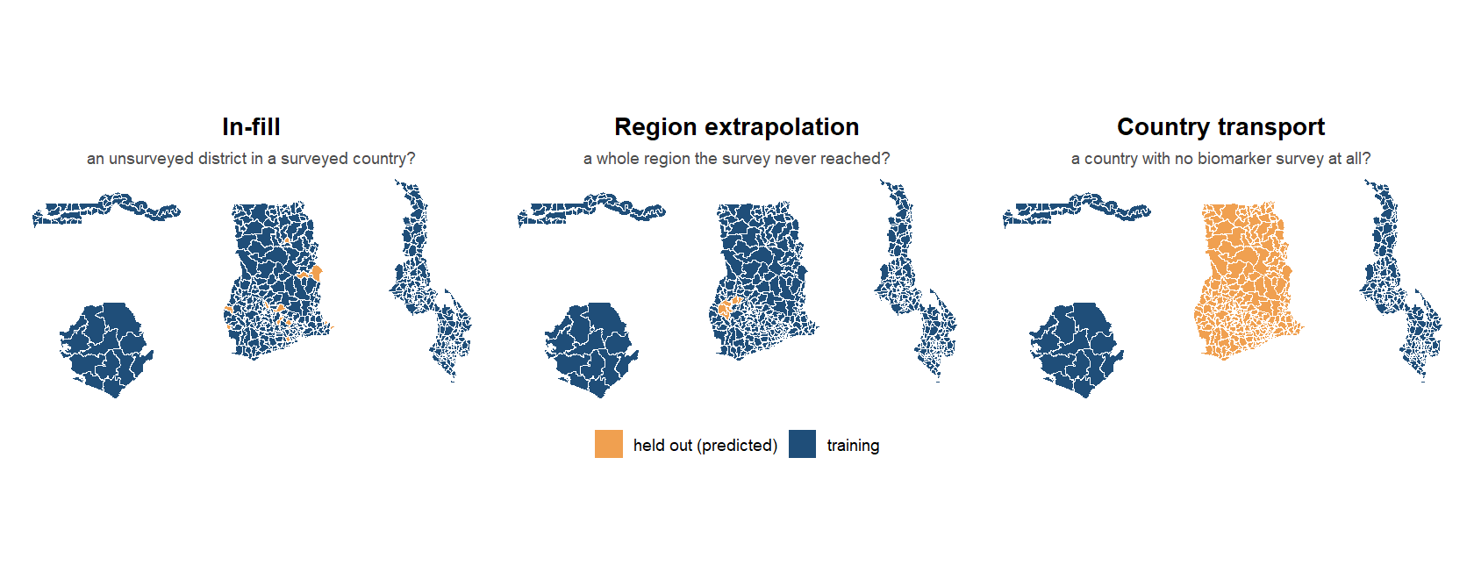
Three questions, three ways to hold data out
Notes:
The three estimands as pictures: the four survey countries, with the orange parts predicted from the blue ones. In-fill holds out districts one fold at a time (5-fold by district, ten draws); region extrapolation holds out a whole region; country transport holds out a whole country and trains on the other three. Each estimand has its own honest baseline on the previous slide. The MIMI deck draws the same three pictures for its household model; the difference here is that every one of our folds is cut at the district or above, never through a district’s respondents.

Slide 28
Results

Slide 29
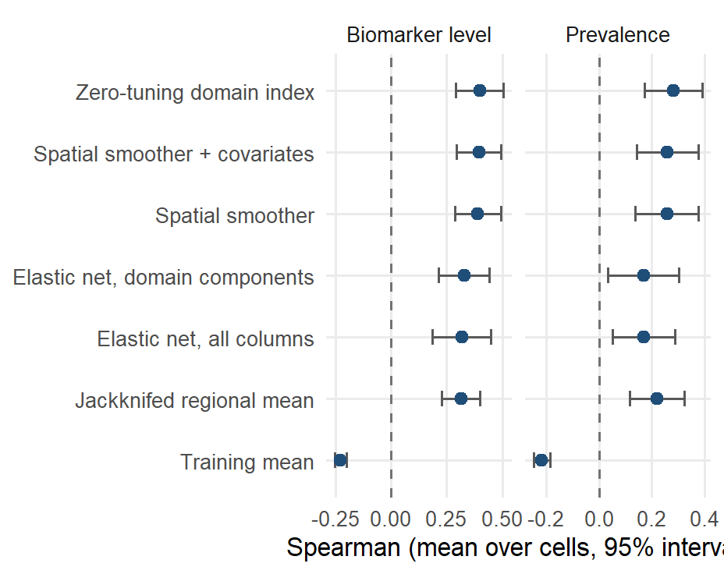
Inside a surveyed country the index ranks districts at 0.40
Mean Spearman correlation over the scored cells with a 95% interval across cells. The index reaches 0.40 on the biomarker level against 0.31 for the jackknifed regional mean (better in 13 of 18 cells) and 0.39 for the covariate-free smoother.
Notes:
Cells: 18 on the level (Sierra Leone’s cells score NA at 14 districts). On prevalence the index scores 0.28 against 0.22. The smoother with covariates fitted to its residuals scores 0.39; covariates add +0.01 over the smoother alone on the level. The penalised fits score 0.33 (domain components) and 0.32 (all columns). Likely question: why the smoother does so well. Inside a surveyed country the covariates mostly reproduce a smooth surface that neighbouring districts already provide; the value of the covariates is in unsurveyed regions and countries.

Slide 30
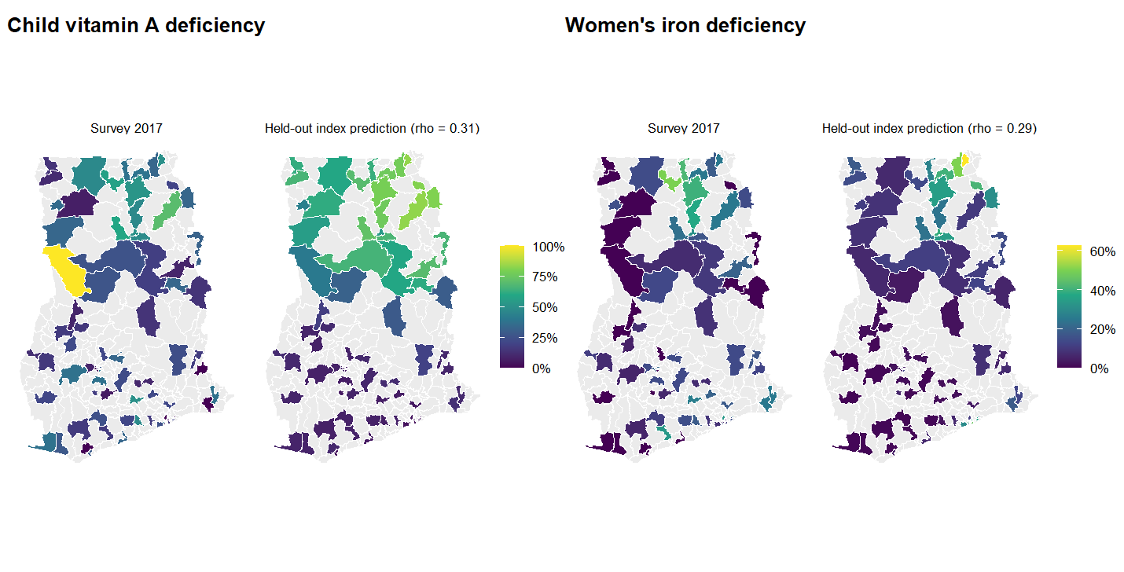
Ghana: survey and held-out prediction
Notes:
Districts with survey data only (grey: no survey clusters). Each district’s prediction is made with that district held out (5-fold, averaged over ten draws). The model orders districts; the survey’s own estimate at a single-cluster district is itself noisy, which is what the reliability ceiling slide quantifies.

Slide 31
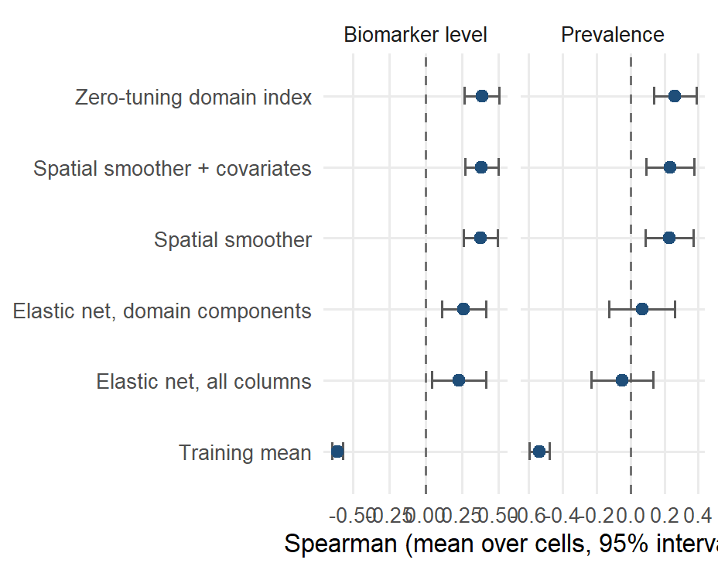
A whole unsurveyed region: the ranking holds at 0.39
Leave-one-region-out, mean over cells with a 95% interval. The index scores 0.39 on the level and 0.26 on prevalence; the penalised fits fall to 0.07 and -0.05 on prevalence.
Notes:
Leaving out a whole region is where a smoother must extrapolate past the edge of its data. The index and the smoother stay close (0.39 against 0.38 on the level); the null training mean collapses. Ghana and Malawi are the countries where this estimand is well determined; The Gambia and Sierra Leone give one number per region.

Slide 32
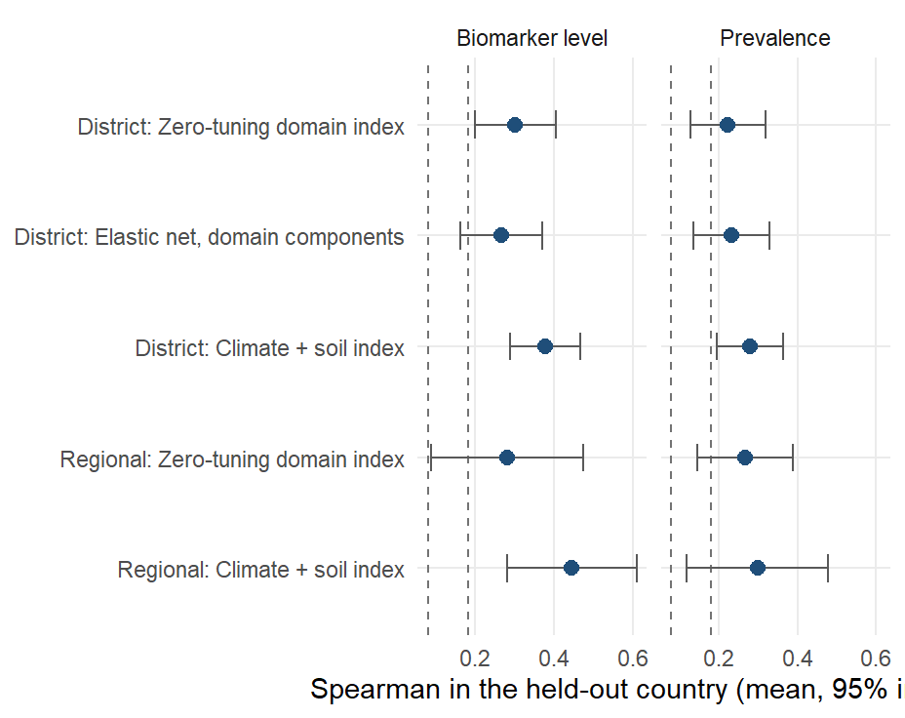
A country with no survey: rankings carry at 0.30, levels do not
Leave-one-country-out, 22 cells. The full index scores 0.30 at district level (positive in 18 of 22) and 0.28 at regional level; the climate-and-soil index scores 0.38 and 0.45. Dashed lines are the 95th percentile of the permutation null.
Notes:
Absolute levels do not transport: raw ferritin differs several-fold between surveys, so the transported product is a ranking. Prevalence: 0.22 at district level (19 of 22 positive) and 0.27 at regional level for the full index; 0.28 at district level for climate and soil. The climate-and-soil pair was chosen on these four countries, so it enters the next country as a pre-registered prediction; honest nested selection of domains inside the training fold gives a median difference of +0.01 from the full index (better in 12 of 22). DA-03 (17 September, RR-12 set): adding the next load-bearing domains of the ablation to climate and soil (anaemia surfaces, agriculture, infection: five domains) reaches 0.41 at district level (better than climate-and-soil in 15 of 22, median +0.01, all 22 cells positive; 0.33 on prevalence), with the gain in the weak cells (women’s iron and folate in Ghana and Sierra Leone) and none in the strong ones. It is chosen on the same 22 cells, so it goes into the pre-registration as a second candidate beside climate-and-soil, not in its place; the honest nested selection still sits at 0.31 (next slide). Since 9 September the DHS-derived predictors are cluster-level spatial estimates at every district (DS-01), which changed nothing in-country and cost the full index 0.01 across borders. Likely question: what a correlation of 0.30 means for a programme. The targeting slide answers in burden captured.

Slide 33
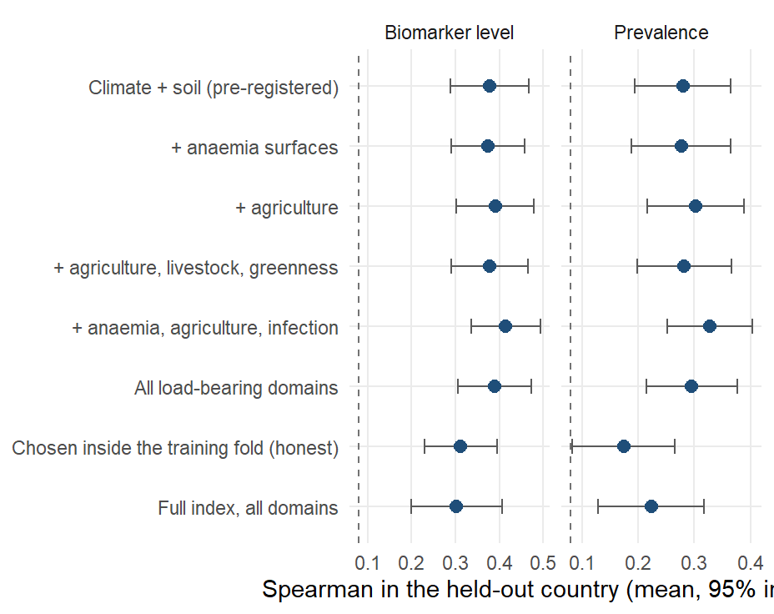
Adding domains to climate and soil
Leave-one-country-out, 22 cells, mean with a 95% interval across cells. Climate and soil alone: 0.38. Adding the next load-bearing domains of the ablation (anaemia surfaces, agriculture, infection) reaches 0.41 (better in 15 of 22, median +0.01). Chosen on these same cells, so a candidate for the next country, not a replacement. Honest nested selection: 0.31.
Notes:
Dashed line: the 95th percentile of the permutation null. DA-03 (17 September, RR-12 set): script 25 scores fixed domain sets on the same leave-one-country-out folds as the transport slide, with the domain components oriented on the training countries only. The five-domain set (climate, soil, anaemia and haemoglobin, agriculture and land use, infection and inflammation) is the top of the ablation ranking on these cells: 0.41 at district level against 0.38 for climate and soil, positive in all 22 cells, 0.33 against 0.28 on prevalence. The gain is in the weak cells (women’s iron and folate in Ghana and Sierra Leone) and absent in the strong ones. Because the set was chosen from the ablation on these same 22 cells, it has the same status as climate-and-soil had when it was found: a description of these four countries, to be scored as a second pre-registered candidate on the fifth. The honest arm, domains chosen by an inner leave-one-country-out inside the three training countries, stays at 0.31: with two inner folds the greedy choice overfits, which is why the pre-registration route is the one that can settle this. Likely question: why not use all load-bearing domains. All eight load-bearing domains score 0.39; nothing beyond five adds.

Slide 34
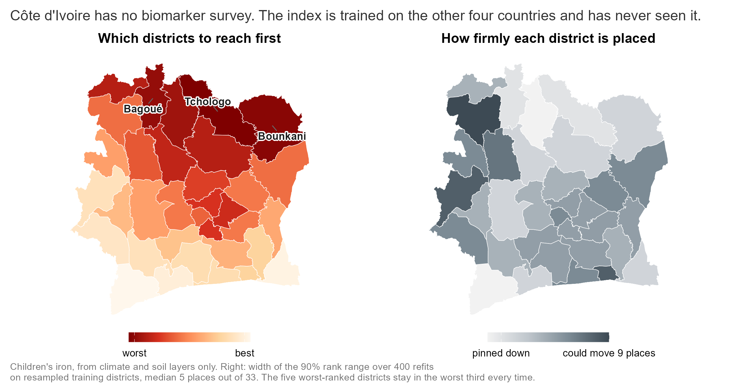
Cote d’Ivoire: a ranking for a country with no survey
Notes:
Cote d’Ivoire has the climate and soil layers and no biomarker survey, so it is the case the project exists for. The climate-and-soil index was fitted on the four surveyed countries and applied to its 33 districts for 6 outcomes (child and women’s iron and vitamin A, women’s folate and B12); it has never seen a Cote d’Ivoire biomarker. Left: child iron; the worst-ranked districts are the northern savanna belt (Tchologo, Bounkani, Bagoue, Poro, Hambol), the drier, poorer, more pastoral half of the country. Right: how firmly each district is placed. The training set was resampled 400 times, stratified by country, the components re-oriented and the index refitted each time, and the district re-ranked; the map shows the width of the 90 percent range of ranks, median 5 places out of 33. 10 of 33 districts have at least an 80 percent chance of being in the worst third and 20 at most 20 percent. What this uncertainty covers: how much the ranking depends on which training districts we learned from. What it does not cover: whether the model transports to Cote d’Ivoire at all, because there is no ground truth there; the external bound on that is the held-out transport accuracy of 0.38. Two guards ran first: the same code with each surveyed country held out reproduces the transport figure (0.38 over 22 cells, 21 positive), and adding Cote d’Ivoire to the column intersection costs 7 of the 101 climate-and-soil columns (the few layers the Cote d’Ivoire extraction lacks) without degrading transport (0.39, 22 positive). CV-01 (17 September): the Cote d’Ivoire database was extended from 132 to 212 columns with the open rasters the other domains need (IHME surfaces, Malaria Atlas at 2016, MapSPAM, livestock, and the 30-year climate normals that were missing), so the climate-and-soil index now runs on its full vocabulary (94 common columns, guard 0.39) and the five-domain candidate can be applied too (next slide). Rank uncertainty is now computed for all six outcomes and both candidates (civ_rank_uncertainty_all.csv). The only external check so far is the WFP/MIMI Nature Food 2026 vitamin A map, which ranks the same northern belt worst. Tables: civ_climate_soil_ranking.csv, civ_rank_uncertainty.csv, civ_transport_guards.csv.

Slide 35
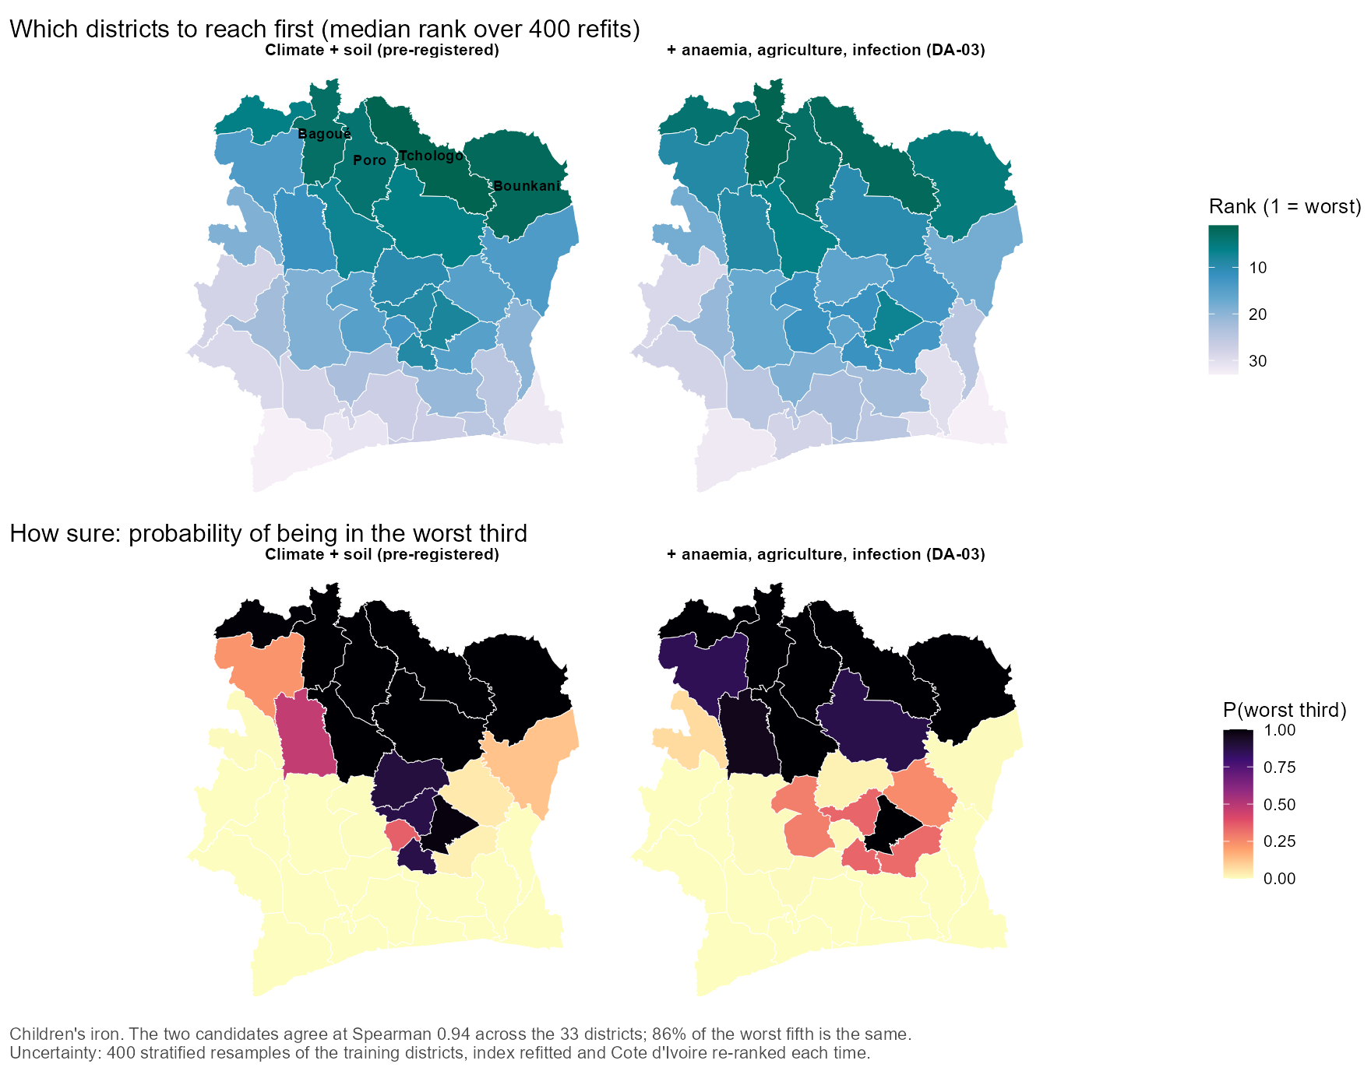
Cote d’Ivoire: the two candidates agree
Notes:
The pre-registered climate-and-soil index and the five-domain DA-03 candidate, both fitted on the four surveyed countries and applied to Cote d’Ivoire’s 33 districts, children’s iron. Top: the median rank over 400 resampled refits; bottom: the probability of being in the worst third. The two candidates agree at Spearman 0.94 on child iron and 0.88 to 0.97 across the six outcomes; 83% of the worst fifth is the same district list on average. The five-domain set is no firmer: median 90 percent rank width 6 places against 5, and 9.0 against 9.5 districts per outcome with at least an 80 percent chance of the worst third. Its guard is 0.41 on four countries and 0.40 with Cote d’Ivoire in the vocabulary (125 of 138 columns, 22 of 22 positive). Two points to say. First, the northern savanna belt is the answer under either candidate, so the choice between them does not change what a programme would do in Cote d’Ivoire; the choice matters for the fifth SURVEYED country, where it can be scored. Second, each candidate gives nearly the same map for every outcome (mean Spearman between outcomes 0.92 and 0.90): in a country with no survey the transported ranking is a map of environmental deprivation more than of any one nutrient, which is exactly what the domain ablation said it would be. What is still not tested is transport to Cote d’Ivoire itself; that needs a biomarker survey there.

Slide 36
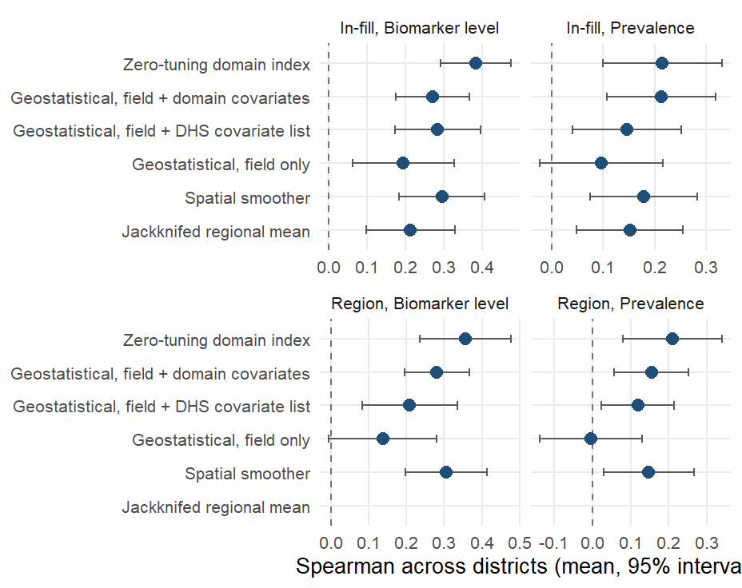
The geostatistical model estimates levels better and ranks worse
The DHS Program’s model-based geostatistics fitted at the survey clusters (a spatial field plus covariates), scored on the same district folds. On the level it scores 0.27 against 0.38 for the index (index better in 20 of 24 cells); on prevalence 0.21 against 0.21.
Notes:
INLA-SPDE Matern field with penalised-complexity priors, binomial on cluster counts for prevalence and Gaussian for the level, cluster predictions aggregated to districts by effective sample size; run with the first component of every covariate domain and with the DHS Program’s ten-raster list (0.28 on the level). The field alone scores 0.19. The geostatistical model has the lower absolute error on prevalence (9.2 against 10.7 percentage points) because it estimates a level and shrinks toward it. Under region extrapolation the index scores 0.36 against 0.28. The method needs measured clusters inside the country it predicts, so it has no country-transport estimand. Likely question: whether the two are complementary. Yes: the geostatistical model for a calibrated prevalence where a survey exists, the index for a ranking where none does.

Slide 37
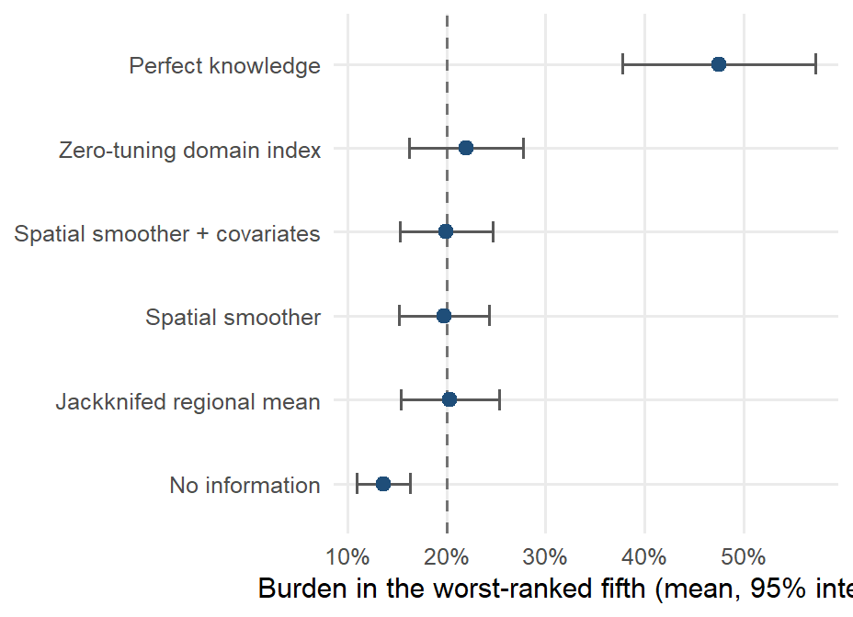
The worst-ranked fifth holds 22% of the burden; a perfect map 48%
Share of the national deficiency burden in the fifth of districts each method ranks worst, in-fill, mean over cells with a 95% interval. The index reaches 22%, the jackknifed regional mean 20%, no information 14% and perfect knowledge 48%.
Notes:
The dashed line is the share a random fifth of districts would capture. The margin over the survey’s own regional averages is small per cell and concentrates where regions hold three to five districts. Under transport, burden captured is at chance: the transported product is an ordering and brings no targeting gain. Likely question: why the ceiling is only 48%. Burden is spread across districts; even the true worst fifth holds under half of it.

Slide 38
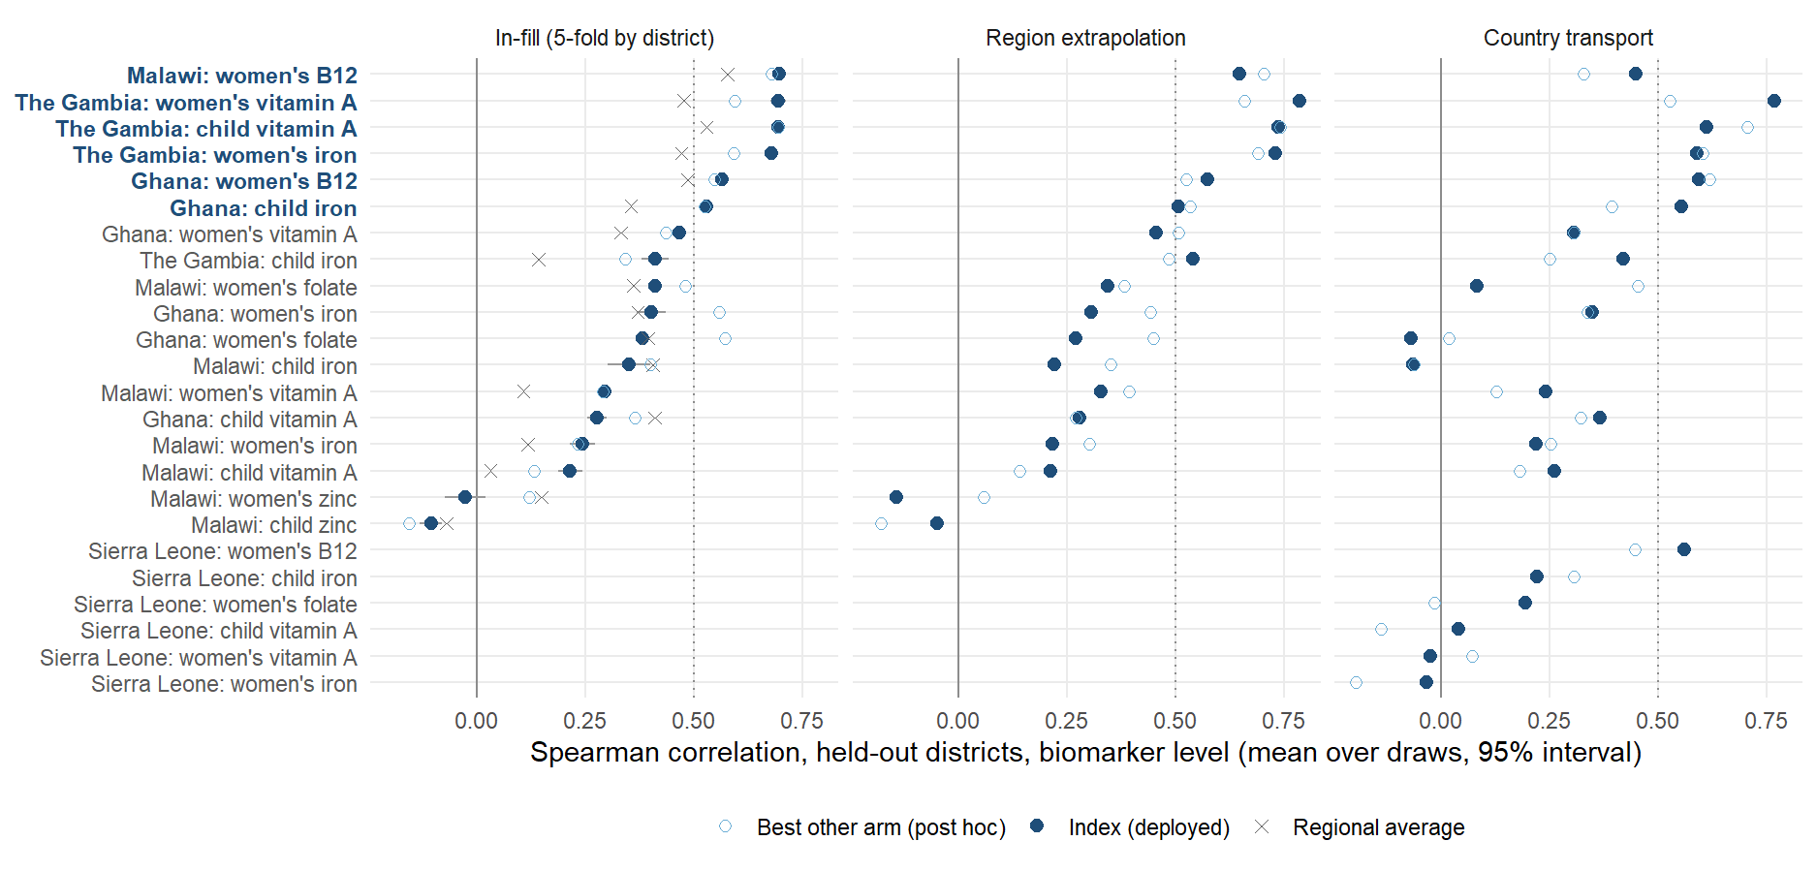
6 of 18 cells rank above 0.5; the rest average 0.28
Notes:
The averages elsewhere in this deck hide a spread that matters: 6 of the 18 in-country cells reach a held-out Spearman of 0.5 or more on the biomarker level (mean 0.64, bold on the axis), the rest average 0.28. Rows are the country-outcome cells sorted by the index’s in-fill ranking; the filled point is the deployed model with its interval over the ten fold draws, the cross is the survey’s own regional average (the number a ministry would use), the hollow circle is the best of the other arms (spatial smoother, smoother plus covariates, elastic nets) picked on the same held-out score, so it is optimistic and shown only to say how much a different estimator could have added: little. The middle and right panels are the region and country estimands for the same cells. The weak cells are of two kinds: outcomes too rare to measure at district level (Malawi’s vitamin A cells at under 1% national prevalence: 2 cells, mean 0.26) and zinc (Malawi only, mean -0.07), where the survey’s own district estimates carry almost no signal to recover; The Gambia, with 30 large districts and several clusters in each, clears the line on 3 of its 4 outcomes and scores 0.41 on the fourth (child iron), above the other countries’ average; the next slides show the same cells on the prevalence and concentration scales, and the scatter after them puts the weak cells against their prevalence. Sierra Leone’s 14 districts are not scored in-fill.

Slide 39
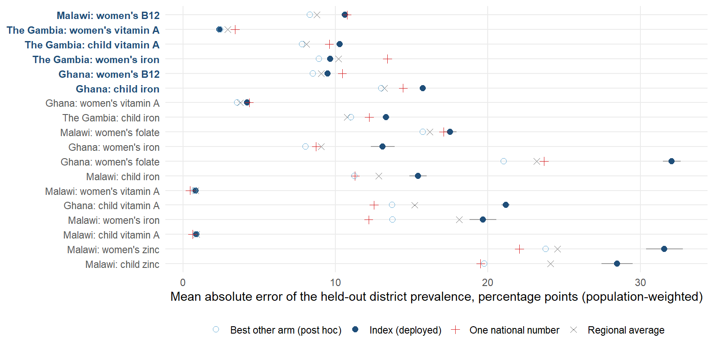
Prevalence error, cell by cell
Notes:
Same cells, same order, prevalence scale: the population-weighted mean absolute error of each district’s held-out prevalence, in percentage points. Three references: the survey’s own regional average, one national number for every district (the status quo where no sub-national estimate exists), and the best other arm chosen after the fact. Read the error against the outcome: an error of 10 points on an outcome at 40% is a different thing from 3 points on one at 4%, which is why the rare-outcome cells look accurate here and useless on the ranking slide. The index is rescaled to the training districts’ spread, so it is not built to minimise this error; the geostatistical comparator slide shows what a model that estimates a level and shrinks toward it does to absolute error. Where a level has to be defended, this slide plus the national anchor is the argument, not the ranking correlation.

Slide 40
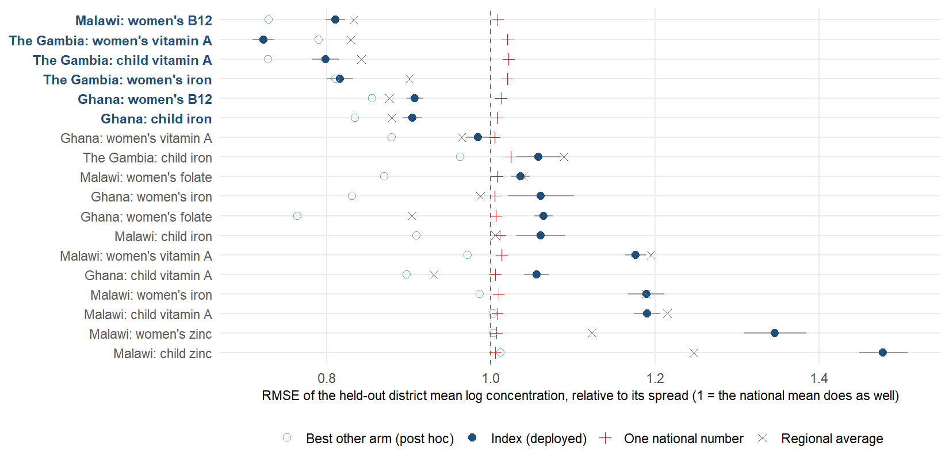
Concentration error, cell by cell
Notes:
Same cells, mean concentration scale: the district mean of the log biomarker concentration (ferritin, RBP, folate, B12, zinc), predicted with the district held out, scored as root-mean-square error divided by the spread of the observed district means, so that 1.0 means no better than giving every district the national mean and anything below it is skill. The index is a ranker rescaled to the training spread, so its squared error is often at or above 1 even in cells where it ranks well; the spatial smoother, which shrinks toward neighbours, is usually the best other arm on this loss. That is the honest division of labour the geostatistical slide draws: the index for the order, a shrinking estimator for the level. Cells whose index error sits well below 1 (the strong cells in bold) are the ones where the proxies carry enough signal to predict the concentration itself, not only its order.

Slide 41
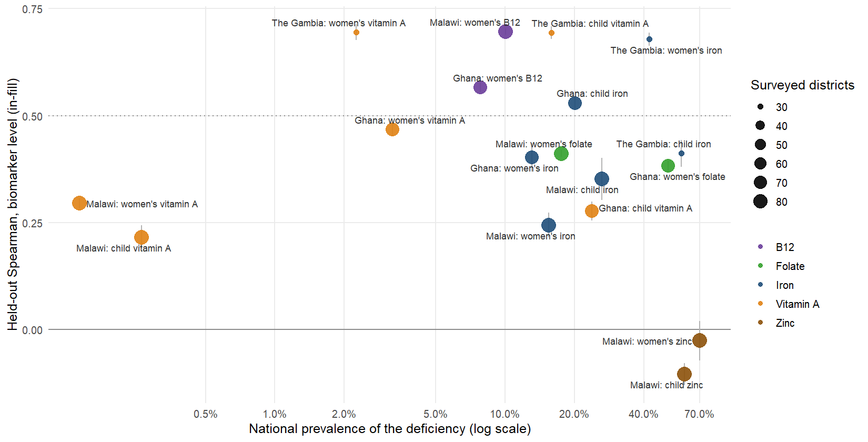
Where the ranking works, and why not
Notes:
Each point is a country-outcome cell: the index’s in-fill ranking accuracy against how common the deficiency is nationally. Rarity hurts at the extreme: below 1% prevalence (Malawi’s two vitamin A cells, mean 0.26) the survey finds a handful of deficient respondents per district and its district estimates are mostly zero, so no predictor can recover an order; at 2 to 4% (The Gambia’s and Ghana’s women’s vitamin A) the ranking still works. Above that, the spread is about the survey more than the nutrient: The Gambia’s 30 districts with several clusters each score 0.41 to 0.70 (3 of 4 above the line), Ghana’s and Malawi’s single-cluster districts are mixed (3 of 14). Zinc (Malawi only, -0.07) is the other failure and is not a rarity problem: serum zinc is unadjusted, drawn under fasting rules that vary by cluster, and the survey’s own district means are close to noise. Everything the deck claims about ranking rests on the cells above the dotted line: 6 of 18, iron, vitamin A where it is common, folate and B12, in three countries. Likely question: why not just report those. Because the cut is chosen on the same held-out scores, so the strong-cell mean of 0.64 is a description, not a promise; the promise for a new country is the transport slide’s pre-registered climate-and-soil index.

Slide 42
The strong cells
Malawi: women's B12
The Gambia: women's vitamin A
The Gambia: child vitamin A
The Gambia: women's iron
Ranking, held out: 0.70 (prevalence target 0.57)
District prevalence error: 10.6 points
National prevalence: 10%
Ranking, held out: 0.70 (prevalence target 0.43)
District prevalence error: 2.4 points
National prevalence: 2%
Ranking, held out: 0.69 (prevalence target 0.58)
District prevalence error: 10.3 points
National prevalence: 16%
Ranking, held out: 0.68 (prevalence target 0.74)
District prevalence error: 9.7 points
National prevalence: 42%
Notes:
The four best in-country cells on the held-out ranking, from benchmarks_v2_raw.csv (in-fill, biomarker level, mean over ten draws), with the same cell’s prevalence-target ranking, its population-weighted district prevalence error in percentage points and the national prevalence. These are the cells to show a country: the model is not a uniform 0.40, it is 0.64 where the outcome is common enough to measure and close to nothing where it is not. 6 of 18 cells clear 0.5.

Slide 43
Evaluation summary: one table, two readings
Outcome | In-fill ranking | Transport ranking | District error (pp)
Women’s B12 | 0.63 | 0.53 | 10.1
Women’s vitamin A | 0.49 | 0.32 | 2.5
Women’s iron | 0.44 | 0.28 | 14.1
Child iron | 0.43 | 0.28 | 14.8
Child vitamin A | 0.40 | 0.32 | 10.8
Women’s folate | 0.40 | 0.07 | 24.8
Women’s zinc | -0.03 | NA | 31.6
Child zinc | -0.11 | NA | 28.5
Ranking. Take any two districts: the model orders them the way the survey does 60% of the time inside a surveyed country (a coin toss 50%, the survey’s regional averages 56%), and 55% in a country it has never seen.
Level. The average district error is 16 to 14 points; with one national anchor a new country gets 9.3 points. Read levels as planning figures, rankings as the product.
Notes:
The MIMI deck’s evaluation summary format: the per-outcome table on the left (held-out Spearman inside a country and in a new country, biomarker level; the population-weighted district prevalence error in-fill), and on the right the two sentences a policy reader takes away, one about the order and one about the level, with the pair-count and the anchor error behind them. The four draft translation slides that follow expand these two readings; keep this one if only one fits.

Slide 44


What a correlation of 0.40 means on the ground
Take any two districts: the model orders them the way the survey does 60% of the time
Counted over every pair of districts. A coin toss gets 50%, the survey's own regional averages 56%; in a country the model has never seen, 55%.
In the fifth of districts it flags, deficiency runs at 32% against 24% nationally
A map that knew every district would find 41% in its worst fifth.
That fifth holds 22% of the deficient people
The survey's own regional averages capture 20%; a perfect map 48%. Real, modest, and better than today's number.
Notes:
DRAFT A of four candidate translations for a policy audience; keep one or two. The three readings are all computed from the same held-out predictions (in-fill, 5-fold by district, ten draws). Pairs: counted exactly from the held-out predictions (12_nce_targeting_metrics.R, PC-01: every pair of districts, ties excluded, mean over the 24 cells): the model orders 60% of district pairs the way the survey does, the survey’s own regional averages 56%, a coin toss 50%; across borders (leave-one-country-out, 22 cells) it is 55%. A Spearman of 0.40 sounds like more than it is: at district level it is six pairs in ten. The flagged fifth: deficiency prevalence in the fifth of districts the model ranks worst averages 32.2% against 24.3% nationally (nce_targeting_summary.csv, mean over the 24 cells); a map that knew the truth would find 41.3%. Burden: the model’s worst fifth holds 22% of the deficient people, the survey’s own regional averages 20%, a perfect map 48%. The honest message is that the ranking is real but modest: it is better than the regional average a ministry would use today, and a long way from a map that knows every district, which is what the reliability ceiling explains.

Slide 45



How much of what a survey can see does the model recover?
The survey itself is noisy at district level: a perfect predictor would score only 0.48
One to three clusters per district; the survey's district estimate is an estimate too.
The model reaches 59% of that ceiling
0.28 on the prevalence target against a ceiling of 0.48. The gap is mostly the survey's noise, not the model's ignorance.
And beats the number a ministry would use today
The region's average, 0.31; the model 0.40, better in 13 of 18 country-outcome cells.
Notes:
DRAFT B. The question a decision-maker actually asks is not “is 0.40 high” but “compared with what”. Two comparisons. Against the ceiling: a district estimate from the survey itself is noisy (one to three clusters per district), so even a perfect predictor of the true prevalence would correlate only 0.48 with what the survey reports; on that scale the model’s 0.28 (prevalence target) is 59% of the attainable. Against current practice: the number a ministry would use for an unsurveyed district today is its region’s average; the model beats it (0.40 against 0.31, better in 13 of 18 cells). Say plainly that the remaining gap is mostly the survey’s noise, not the model’s ignorance, and that the way to raise the ceiling is more clusters per district, which is the survey-design slide.

Slide 46


Right band, wrong band
Exact WHO band
Within one band
Two or more bands wrong
Model: 64% of districts
Regional averages: 66%
Bands: under 2%, 2 to 10, 10 to 20, 20% or more (vitamin A); each district held out
Model: 91% of districts
Regional averages: 94%
A district the survey calls severe is placed severe or moderate
Model: 9% of districts
Regional averages: 6%
The error a severity map cannot afford; in a new country the level comes from the national anchor
Notes:
DRAFT C. Policy runs on severity bands, not correlations: WHO’s vitamin A bands are under 2%, 2 to 10, 10 to 20, 20% or more. With each district held out, the model puts 64% of districts in the band the survey puts them in and 91% within one band (risk_category_accuracy.csv, mean over the vitamin A cells); the survey’s own regional averages give 66% exact and 94% within one band. Read the comparison honestly: on severity bands the survey’s own regional averages do as well as the model or slightly better, because a band is mostly a level and the regional average carries the country’s own level. The model is almost never two bands wrong (a district the survey calls severe is not called mild), and its case is not that it beats the regional average on bands but that it gives a band where there is no survey at all; in a new country the level comes from the national anchor (risk-class slide in the appendix has the transport rows). Use this slide only if the audience reads vitamin A or anaemia severity maps, and say the regional-average comparison aloud rather than letting the numbers sit.

Slide 47



Which decisions can the ranking carry?
Which districts to visit, assess or enrol first
Needs an order, not a number: 60% of district pairs ordered as the survey does, against 56% for the regional average.
Where the next survey puts its clusters
The ranking is the input to the anchor-and-rank design.
Sequencing a programme roll-out across districts
Same reason; the order is what the roll-out needs.
A planning prevalence for a district
Only with a national anchor: 9.3 points median error at a 5% national sample.
A district prevalence with no survey at all, or whether a programme worked
The model has no level of its own and is validated on one point in time, not on change.
Notes:
DRAFT D. The correlation does not tell a programme whether the model is fit for a decision; this slide says which decisions, and which not. Yes: choosing which districts to visit, assess or enrol first, and where the next survey should put its clusters, because those need an order and the order is 60% right at the pair level and better than the regional average. Yes: sequencing a roll-out across districts, for the same reason. With a national anchor only: a planning prevalence per district (9.3 points median error at a 5% national sample), because the ranking has no level of its own. No: reporting a district prevalence with no survey at all, or judging whether a programme worked, because the model is cross-sectional and validated on levels at one point in time, not on change. The decision rule to offer: use it where being roughly right about the order is enough, and pair it with a survey wherever a number has to be defended.

Slide 48
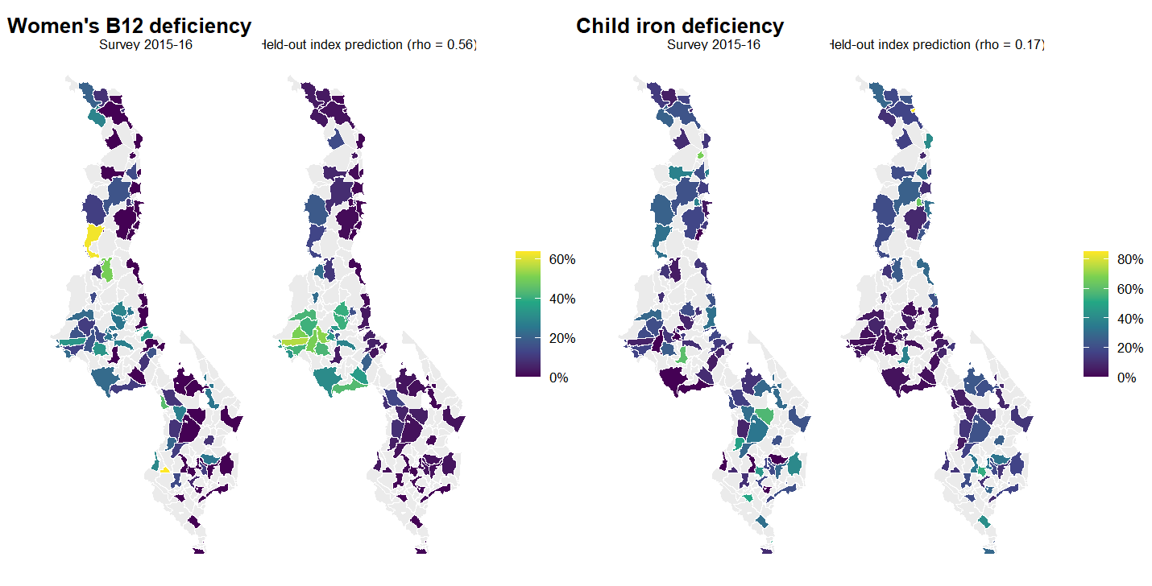
Malawi: survey and held-out prediction
Notes:
Malawi’s 87 surveyed Traditional Authorities (grey: no survey clusters), the survey estimate beside the prediction made with each district held out (5-fold, ten draws). This is the protocol-v2 version of the January “what about subnational prevalence” maps: the same question, now scored under honest folds and with the index rather than the person-level ensemble. Women’s B12 is the best in-fill cell of the 24; child iron is the outcome the Ghana map shows. The model orders districts; the survey’s own estimate at a single-cluster district is itself noisy (reliability ceiling slide).

Slide 49
Seeing the results

Slide 50


How to read every map in this deck
Grade A: several clusters
Grade B: one cluster
Grade C: no survey
What: surveyed districts with more than one survey cluster (39 districts)
On the map: solid fill
Read: the survey's own district value is worth comparing with
What: surveyed districts with a single cluster (80% of surveyed districts)
On the map: hatched
Read: the survey's district value is itself a noisy estimate; the ceiling slide says how noisy
What: districts the survey never reached, and every district of a country with no survey
On the map: grey on survey maps, filled on model maps
Read: only the model speaks; its intervals say how stable it is, not how right
Notes:
A convention borrowed from the small-area-estimation literature (hatching for direct estimates whose coefficient of variation exceeds a third; grey for no data). Every district on every map in this deck belongs to one of three grades. A: surveyed with several clusters, so the survey’s own district estimate is worth comparing with; 39 districts. B: surveyed with one cluster, the majority (80% of surveyed districts), where the survey’s district number is itself an estimate with the noise the ceiling slide quantifies; hatched wherever a survey value is drawn. C: no survey clusters, where only the model speaks; grey on survey maps, filled on model maps. The grade says what the map can be compared against, not how good the model is.

Slide 51
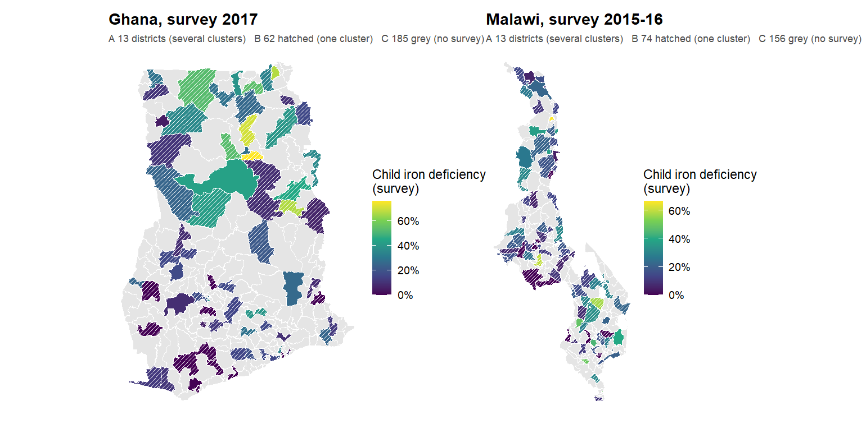
Two survey maps, with the survey’s own reliability on them
Notes:
The survey’s own district map of child iron deficiency, with the reliability grades drawn on it. Hatched districts have one survey cluster: their value is a single cluster’s respondents, and the split-half ceiling says how much of the district-to-district variation on this map is noise. Unhatched districts have several clusters. Grey districts have none. When the next slides compare the model with “the survey”, this is the survey they compare with; the model’s job is to be a better estimate of the true district value than a single hatched cluster is, which the reliability-ceiling slide shows it can be in the strong cells.

Slide 52
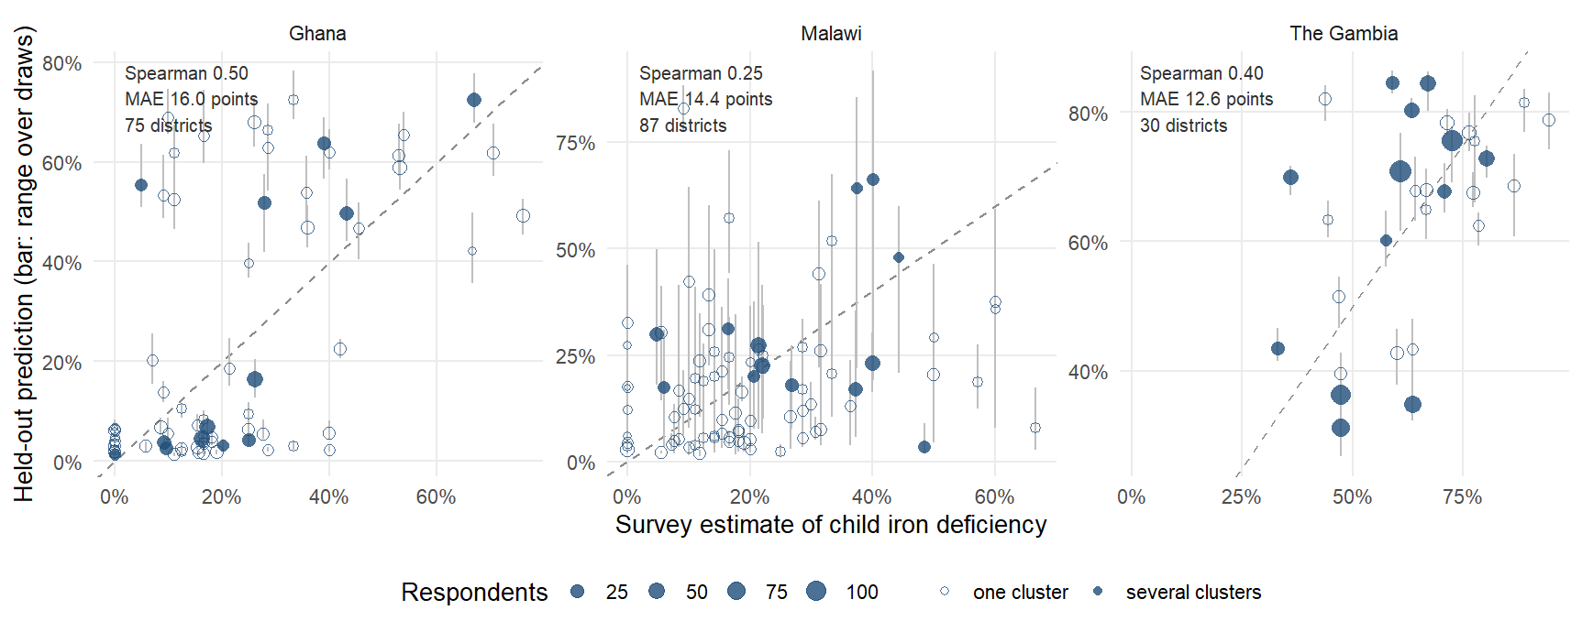
Does the model track the survey, district by district?
Notes:
The plot every geostatistical paper carries and this deck lacked: each district’s survey estimate against its prediction made with the district held out (5-fold by district, mean over ten draws; the bar is the range over the draws, which is fold-assignment variability, not sampling error). The dashed line is perfect agreement. Read three things. The cloud is tilted, not on the line: the model ranks (Spearman 0.50 in Ghana, 0.40 in The Gambia, 0.25 in Malawi) but compresses the range, because it is rescaled to the training spread and shrinks extremes, which is the MAE of 16.0 to 14.4 points. Hollow points are single-cluster districts: much of the vertical scatter around them is the survey’s noise, not the model’s. The largest circles, the districts with the most respondents, sit closest to the line.

Slide 53
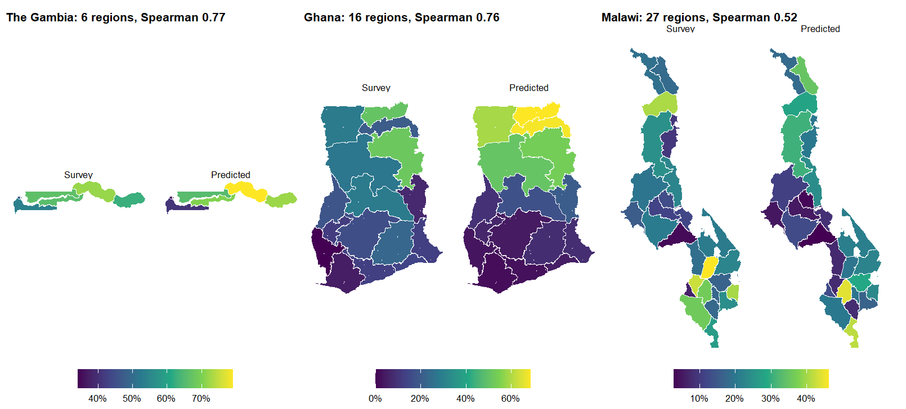
Actual against predicted at the regional level
Notes:
The same held-out district predictions, and the survey, both aggregated to the regions (respondent-weighted means), child iron. This is the resolution at which the surveys were designed to be read, and the comparison a ministry statistician will make first. The regional pattern is recovered in each country; the district slide before this one shows the finer level where the survey itself becomes noisy. The MIMI and IHME decks show exactly this pair of maps as their headline validation figure.

Slide 54
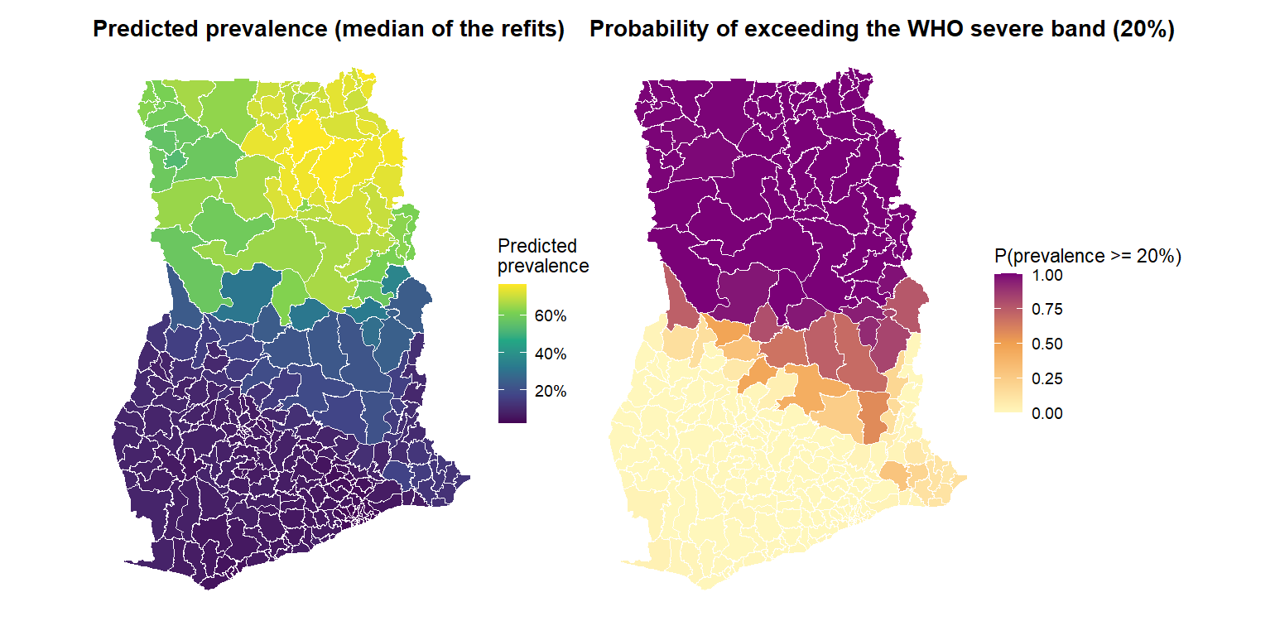
Ghana, child vitamin A: the chance a district is above 20%
Notes:
The device IHME uses for every one of its maps, applied here: not “what is the prevalence” but “how likely is it to be above the line a programme acts on”. Ghana, child vitamin A, the index fitted on the 75 surveyed districts and applied to all 260 (in-sample for the surveyed ones), refitted on 200 stratified resamples of the training districts; the right map is the share of refits in which a district’s predicted prevalence is at or above 20 percent, the WHO severe band. 61 districts are above the line in at least 80 percent of refits, 186 below it in at least 80 percent, and 13 are undecided; 185 of the 260 have no survey clusters. The level here comes from Ghana’s own survey, so this is the in-country version; for a new country the level would come from the national anchor and the map would read as a planning figure. The caveat is the same as for the Cote d’Ivoire intervals: the refits capture how much the map depends on which training districts were drawn, not the survey’s own noise at each district.

Slide 55
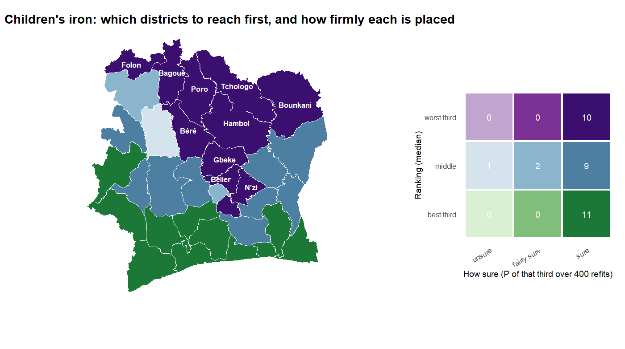
Cote d’Ivoire: how bad and how sure, on one map
Notes:
The two Cote d’Ivoire maps folded into one, the bivariate device the geospatial-health literature recommends for policy audiences: colour hue is the ranking (purple worst third, blue middle, green best third; median over the 400 refits) and colour depth is how sure the refits are of that placement (deep = at least 80 percent of refits put it in that third; pale = under 60 percent). The legend counts districts in each cell. The reading is immediate: deep purple, act; pale purple or pale blue, survey first; deep green, lowest priority. The labelled districts are the deep-purple ones, the northern belt. As before, “sure” means stable under resampling of the training set, not verified against a Cote d’Ivoire survey.

Slide 56
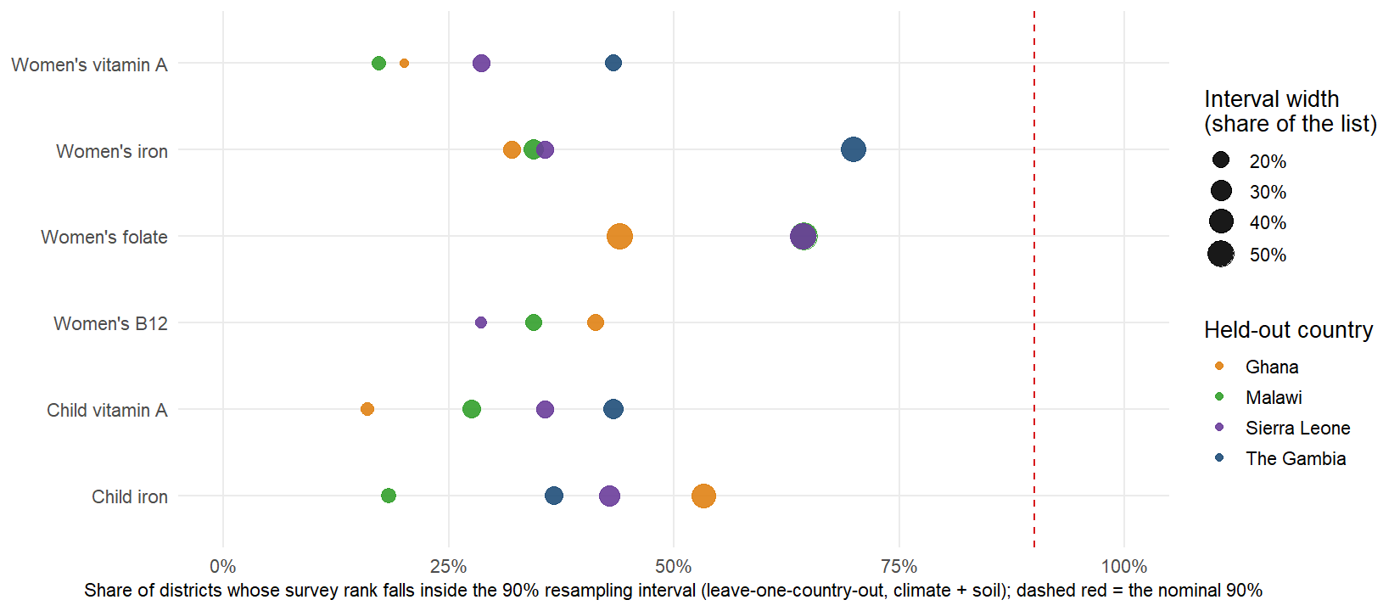
What the rank intervals promise, and what they do not
Notes:
A calibration check the Cote d’Ivoire slides needed. The 90 percent rank intervals on those maps come from resampling the training districts. If they were honest intervals for the truth, the survey’s own rank would fall inside them 90 percent of the time. Doing exactly that with each surveyed country held out (100 resamples of the other three, climate and soil, biomarker level), the survey rank falls inside the interval 38% of the time on average, 16% to 70% across the 22 country-outcome cells, with a median interval 21% of the list wide. So the intervals are far too narrow to be read as “the truth is in here”; they answer a different question, how much the ranking would move if we had learned from different districts, and the gap to 90 percent is the model error the transport correlation already reports. Say this aloud on the Cote d’Ivoire slides: the pale districts are the ones the model itself is unsure about; the deep ones are stable, not verified. A properly calibrated interval would need conformal calibration against the held-out countries, which is a next step and the honest reason we call the product a ranking.

Slide 57
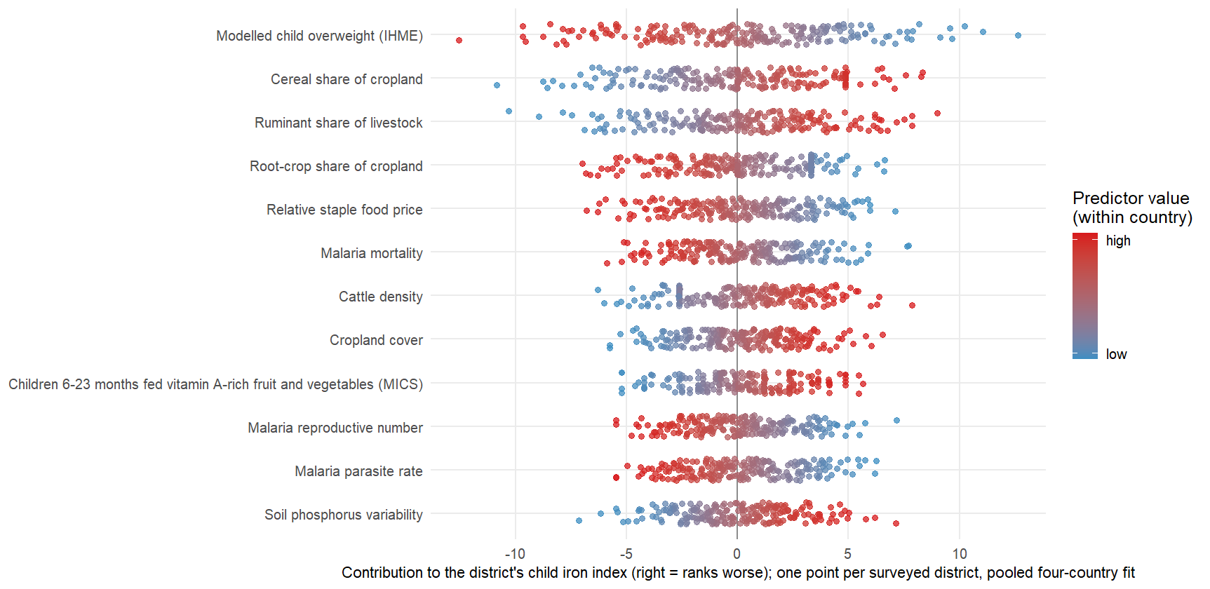
What moves each district, predictor by predictor
Notes:
The SHAP-style view the MIMI deck uses, which the index allows exactly rather than by approximation: the index is linear in the rank-normalised predictors, so each district’s score is a sum of per-predictor contributions beta times x. One row per predictor (the twelve largest weights of the pooled child-iron fit), one point per surveyed district in the four countries, colour = where the district sits on that predictor. A row whose red points sit to the right says “districts high on this predictor rank worse”; a row that is wide says the predictor separates districts strongly. Unlike the bar charts earlier, this shows the spread: a predictor with a modest average weight can still move a handful of districts a long way. The same figure exists for every outcome from contributions_top12.csv.

Slide 58
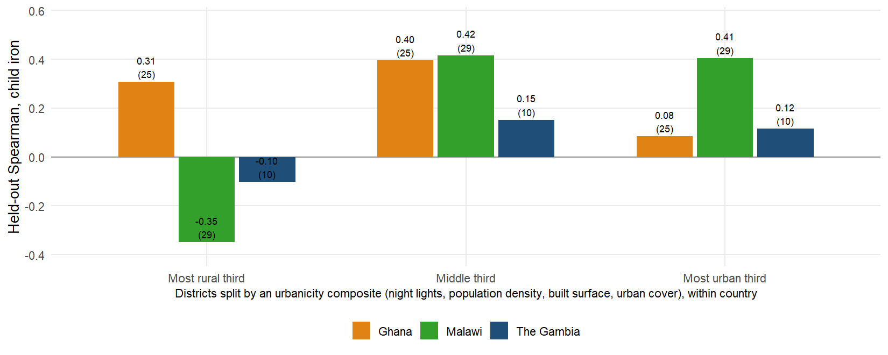
Does the ranking work where the poor live?
Notes:
MIMI reports its accuracy by wealth quintile and by urban and rural households; this is the district-level equivalent. Districts are split into thirds on an urbanicity composite within each country and the held-out child-iron ranking is scored inside each third (numbers in brackets are districts). Across the three countries the ranking is -0.05 in the most rural third, 0.32 in the middle and 0.20 in the most urban third. Two cautions: a third of 30 districts is ten, so The Gambia’s bars are noisy; and ranking within a stratum is a harder task than ranking the whole country, because the stratum removes the urban-rural gradient the index leans on. Read it country by country. Ghana holds up in every third (-0.05 is the three-country mean for the rural third, but Ghana alone is above 0.3 in all three). Malawi is the warning: the ranking is fine in the middle and urban thirds and collapses to below zero in the most rural third, which is where deficiency is highest, so in Malawi the index is partly separating the lakeshore towns from the uplands rather than ordering the rural districts among themselves. The Gambia’s thirds hold ten districts each and say little. The honest reading is that the model’s value is not uniform across the settlement gradient, and a programme working only in rural Malawi should not lean on it.

Slide 59
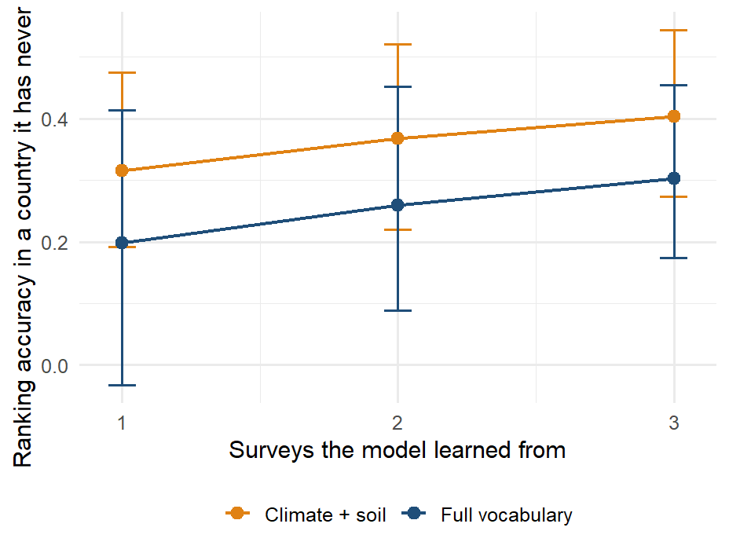
Each survey added improves every other map
Notes:
The training-country curve from the transport section, re-captioned as the argument it makes: with one survey to learn from the transported ranking averages 0.20, with three 0.30, and the curve has not flattened. Every biomarker survey a country runs therefore improves the map of every other country in the panel, which is the case for pooling surveys into one protocol rather than analysing each alone, and for the fifth country being worth more than its own map. Bars are the interquartile range over the subsets of training countries. This is the framing the Lancet Global Health vaccination-mapping paper uses for its country panel.

Slide 60
What carries the signal

Slide 61
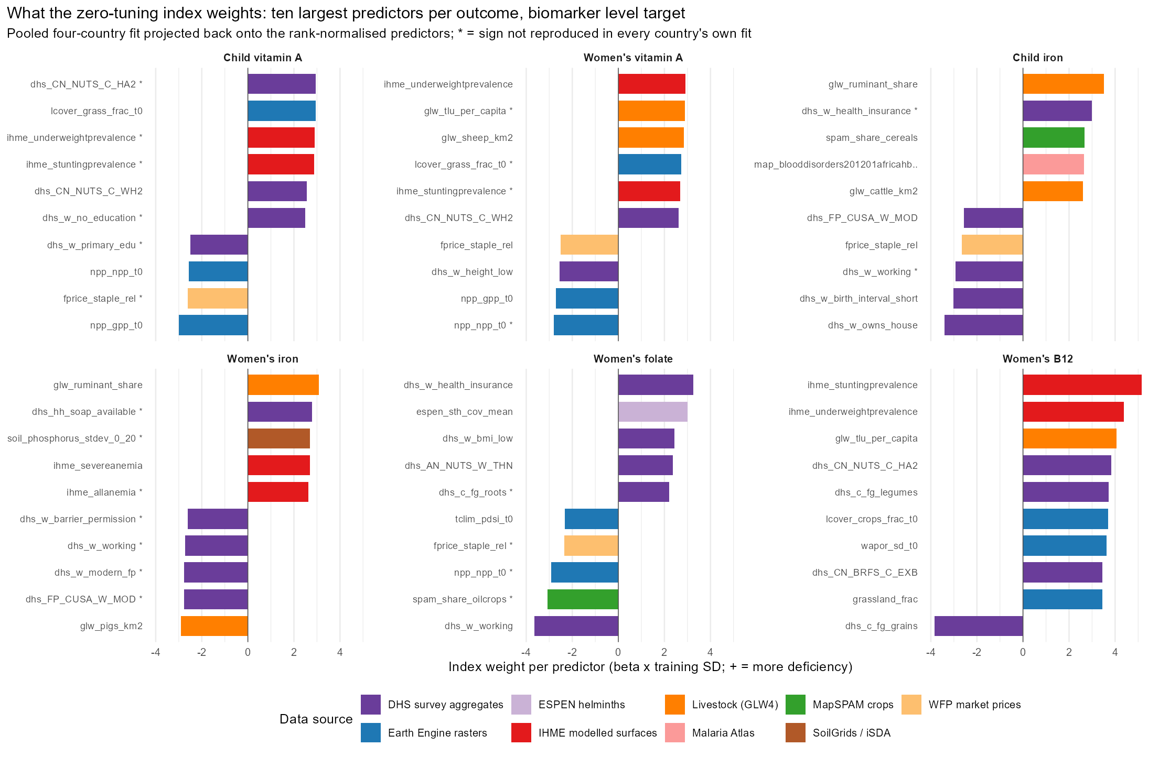
No single predictor carries more than 2% of the index
Notes:
The index is linear in the rank-normalised predictors, so its component weights project back exactly onto the 575 columns (scripts 57 and 58). Shown: the ten largest weights in the pooled four-country fit on the biomarker level, coloured by data source; a star marks a sign not reproduced in every country’s own fit. No predictor carries more than 2% of the index’s variance; the satellite embedding, climate and soil together carry 39% to 54% depending on the outcome. Likely question: whether these are causes. They are not; the weights say where deficiency is. Livestock density carrying a positive sign for iron and B12 is ecological: pastoral zones are the dry, poor zones in these countries.

Slide 62
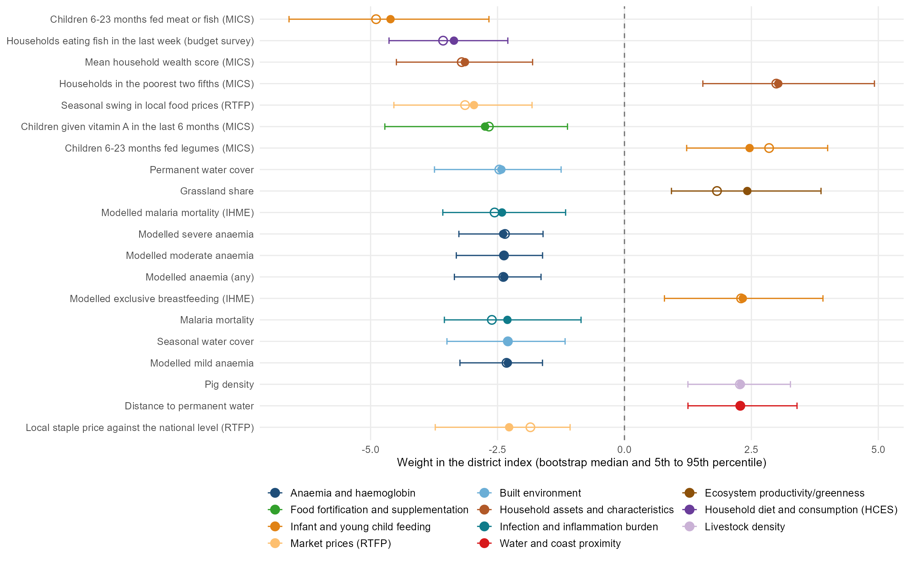
Malawi, women’s B12: the weights behind the best ranking
Notes:
Malawi, women’s B12, biomarker level: the cell with the best in-fill ranking of the 24 (Spearman 0.70; The Gambia child vitamin A is next at 0.69). The index is linear in the rank-normalised columns, so every column has a standardised weight in a fit; the twenty largest are shown. Intervals: the index was refitted on 300 bootstrap resamples of Malawi’s 87 surveyed districts, with the domain components re-oriented and the weights re-learned each time; the bar is the 5th to 95th percentile and the hollow marker the weight in the full fit. Every one of the twenty keeps its sign in at least 95 percent of refits. The level target is the negated log concentration, so a positive weight means worse status. Read the signs as district-level associations in Malawi: districts where more infants are fed meat or fish, more households ate fish last week and the wealth score is higher have better B12 status, and districts that are poorer, grassier, further from permanent water and with more pigs have worse. The diet items point the way a nutritional story would expect; the anaemia and malaria surfaces run the other way (more anaemia and malaria, better B12), which is the lakeshore and the south against the uplands, and a reminder that these are ecological associations, not effects. Script: scripts/policy_deck/09_vim_forest_example.R, which takes any country, outcome and target through environment variables. B12 is measured in three of the four surveys, so this cell does not enter the cross-country transport figures.

Slide 63
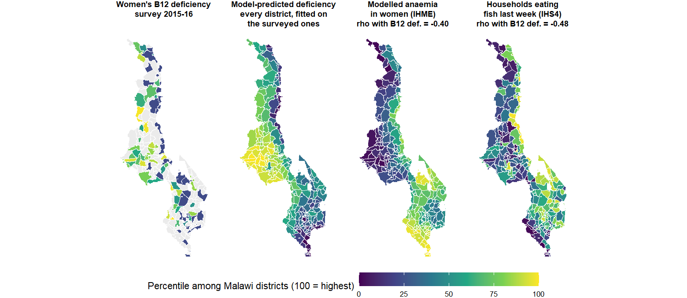
A surrogate marker: anaemia, fish and B12
Notes:
The story behind the forest plot on the previous slide. In Malawi the modelled anaemia and malaria surfaces carry negative weights for B12: districts with MORE anaemia and malaria have BETTER B12 status. No nutritional mechanism says that. The maps say why: the lakeshore and the southern lowlands are where malaria transmission and anaemia are highest, and they are also where households eat fish, the main dietary B12 source in the country; the uplands have less malaria, less fish and worse B12. The anaemia surface is a surrogate marker for that geography, not a cause, and it is a good one precisely because it is modelled from the same environment. Three lessons for the audience: the index finds these markers on its own, they are ecological associations and must never be read as effects, and a surrogate that works in Malawi need not work in the next country, which is why the cross-border models lean on climate and soil rather than on health surfaces (ablation slide). The second panel is the deployment fit (the index fitted on the 87 surveyed districts and applied to all 243, in-sample for the surveyed ones, as on the dashboard): it fills the grey districts and smooths the survey’s single-cluster noise, and it visibly follows the anaemia and fish geography. Each map is the within-country percentile of its variable so the four share one scale; rho is the Spearman correlation with B12 deficiency across the surveyed Traditional Authorities (negative for anaemia and for fish: more of either, less deficiency).

Slide 64
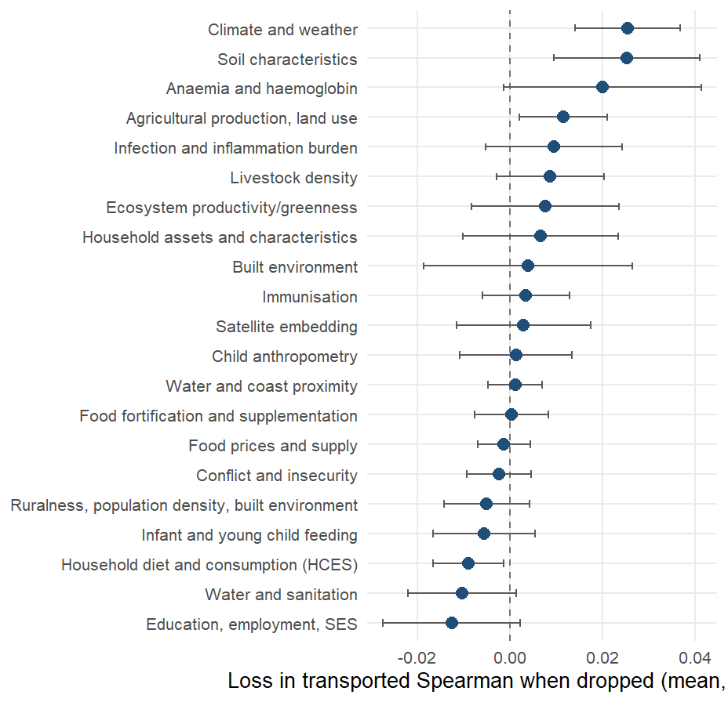
Climate and soil carry across borders; survey items do not
Loss in transported Spearman (biomarker level, 22 cells) when each domain is dropped and the components rebuilt, mean over cells with a 95% interval. The load-bearing domains are Climate and weather, Soil characteristics, Anaemia and haemoglobin; removing 7 of the 21 domains costs nothing or helps.
Notes:
Positive values mean the domain is load-bearing. Climate and soil carry most, with the anaemia surfaces, agriculture and greenness behind; the water-and-sanitation, education and infant-feeding domains sit at or below zero: removing them does not hurt a new country and in two cases helps. The DHS-derived domains are not in the headline set at all: with them in, the district transport index scores 0.28 against 0.30 without. A fixed climate-and-soil index transports at 0.38 at district level and 0.45 regionally against 0.30 and 0.28 for the full vocabulary; it was found on the same four countries it is scored on and enters the next country as a pre-registered prediction.

Slide 65




What the transport models reach for
The landscape gradient
Grassland and cropland cover, the share of ruminants in the herd (top twenty in 14 of 22 held-out fits), cattle and sheep density, cereal-heavy cropping, low plant productivity: dry, grassy, pastoral, unproductive districts rank worse on every outcome.
The modelled child-growth and anaemia surfaces
Wasting, underweight and anaemia point to worse status; overweight points the other way and behaves as a wealth proxy.
The food economy
The local staple price relative to the national level appears in 13 fits across 5 outcomes.
Remoteness and demography
Distance to the coast and the dependency ratio, in about a third of the fits.
Malaria intensity, with an unexpected sign
High-malaria zones are the wetter, more productive ones. Single household-survey items rarely recur.
Notes:
Source: results/tables/protocol_v2/index_importance_columns.csv, scope “loco”: the index fitted on three countries, projected back to columns, for each of the 22 held-out country and outcome combinations on the biomarker level; a column counts once per fit in which it is among the twenty largest standardised weights. Every column named on the slide keeps the same sign in every fit where it appears (34 of the 41 columns that recur in five or more fits are unanimous). The pattern is the one on the previous two slides seen from the other side: what a model trained elsewhere reaches for in a new country is the physical environment and the modelled nutrition surfaces built from it, not the country’s own survey items. The staple-price and malaria signs are worth saying aloud: relatively expensive staples mark market-integrated, better-off districts, and high malaria transmission marks the wet, productive lowlands where diets are more diverse; neither is a mechanism to act on.

Slide 66
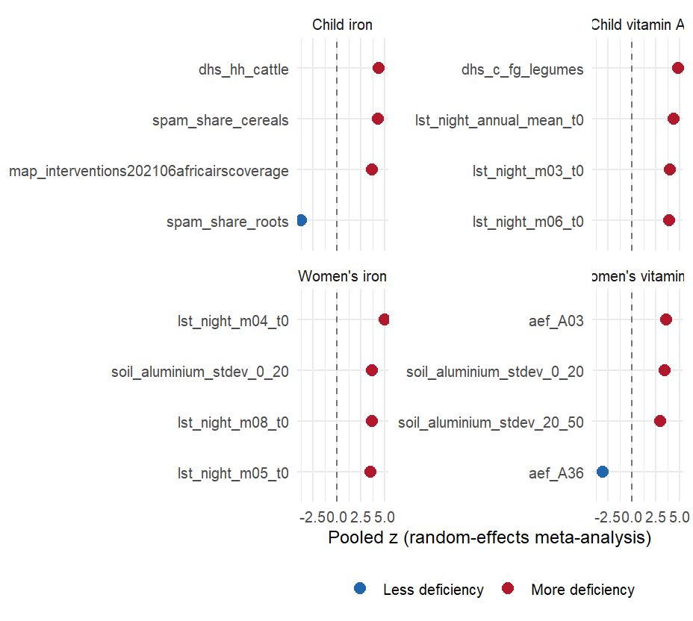
Drier, grassier, poorer, more pastoral districts rank worse everywhere
Indicators whose district-level association with the outcome has the same sign in every country with the outcome, ranked by pooled meta-analytic z. Positive z means more deficiency.
Notes:
Legume cultivation and cattle ownership track more deficiency at district level, the reverse of the household-level dietary relationship, which is an ecological-fallacy signature: the replicated axis is rural subsistence agro-ecology, useful for deciding where to look and uninformative about what to change. No malaria burden indicator replicates; child wasting tracks women’s vitamin A deficiency in all four countries. An earlier version of these slides had the signs inverted.

Slide 67
Limits and survey design

Slide 68
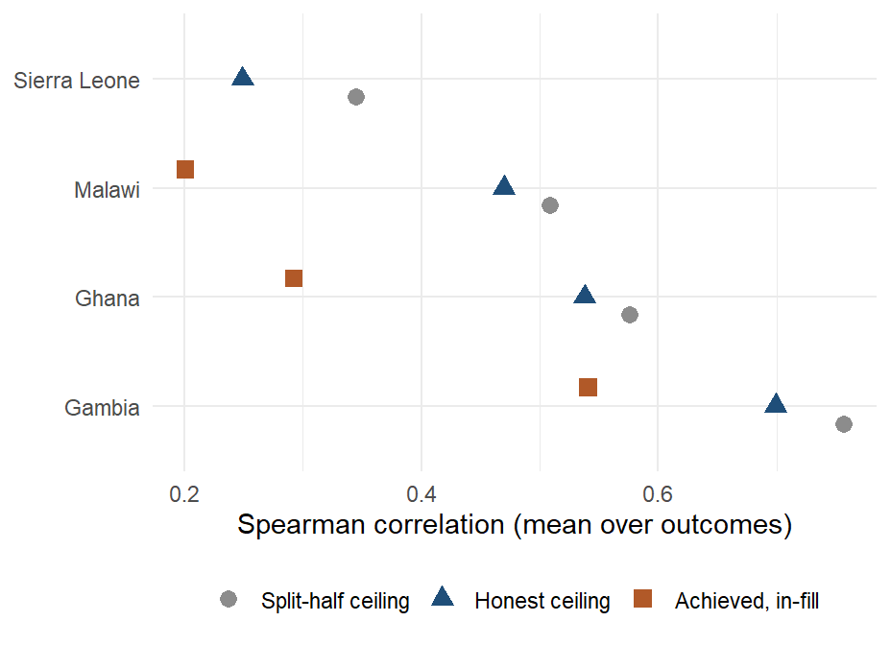
Even a perfect predictor would score only 0.48 against this survey
The correlation a perfect predictor of the true district prevalence could reach, given the survey’s sampling noise, by country. The honest ceiling averages 0.48 against a split-half ceiling of 0.54; the index reaches its ceiling in 0 of 21 cells.
Notes:
A respondent-in-cluster-in-district-in-region variance model reproduces the split-half ceiling when the cluster is counted as geography, then removes the cluster term: 13% of the split-half ceiling was cluster effect. Child zinc has no district geography; what looked like geography was the cluster, and the time of the blood draw explains part of the cluster effect (ZN-02).

Slide 69

A 5% national sample plus the ranking matches a 25% district survey
Median district error in percentage points against the share of a full survey sampled, four designs, 22 cells. At 5% of the sample a national anchor plus the transported ranking gives 9.3 points, a regional survey 11.7 and a district survey 17.3.
Notes:
A district survey matches the anchored ranking’s level error at about 25% of the full sample. The ranking wins on level error only: a district survey of any size captures more burden, because burden sits in populous districts that surveys measure precisely. Fitted symmetrically on a reduced survey, the model’s error degrades in step with the survey’s, so the model improves the ordering at any sample size and does not reduce the sample a survey needs.

Slide 70
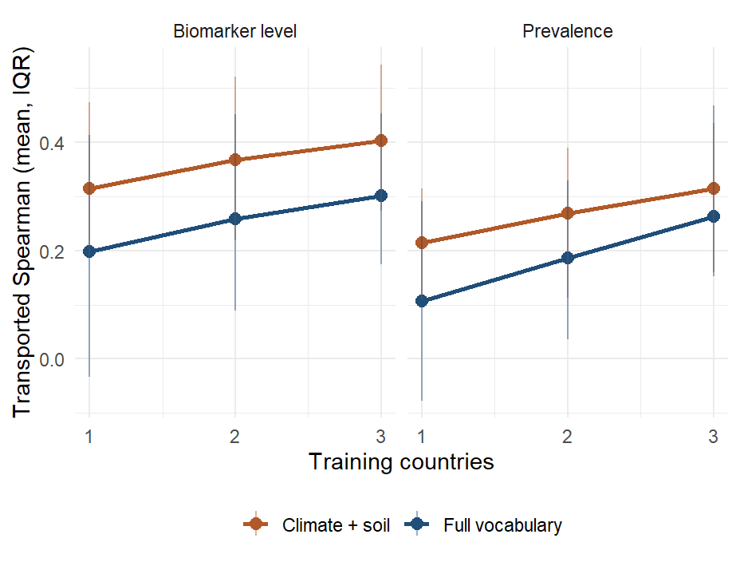
The curve has not flattened: each survey added helps every map
Every subset of training countries scored on each held-out country. The full vocabulary gains about 0.05 per added training country on the level; the climate-and-soil index starts higher and is positive in 95% of single-country fits.
Notes:
Bars are the interquartile range over fits. Likely question: whether four countries are enough. The curve has not flattened at three training countries, which is the argument for adding surveys to the panel rather than changing the estimator.

Slide 71
Can the model direct and shrink surveys?
A ranking now, from public data alone
Transported Spearman 0.30 at district level (0.38 from climate and soil); a ranking, not a prevalence.
A national anchor puts a level on it
A 5% national sample plus the ranking: median district error 9.3 points.
A district survey matches that only at 25% of the full sample
On level error; a district survey of any size still captures more burden in its worst fifth.
Direct where the clusters go
Model-assisted allocation: oversample the districts the ranking puts at the top and bottom. Designed, not piloted.
Replace the biomarker survey
The ceiling is the survey's own; the offer is a survey designed with the ranking, not instead of it.
Notes:
What the evidence supports today and what it does not. Supported: with a national anchor (a small nationally representative sample, 5% of a full survey) and the transported climate-and-soil ranking, the median district error is 9.3 percentage points, which a district-representative survey only matches at about 25% of the full sample (survey design slide; anchor_and_rank.csv). That is the sample-size claim, and it holds for the LEVEL error only: a district survey of any size captures more burden in its worst fifth, because burden is what it measures directly. In design: model-assisted cluster allocation, where the ranking decides where the clusters go, oversampling the districts the model puts at the top and bottom, so that a survey of the same size resolves the districts that matter; this is designed (CLUSTER_LEVEL_DESIGN_2026-09.md) and not piloted. Not shown: that a proxy model can replace a biomarker survey. The reliability ceiling is the survey's own, and the transport correlation of 0.30 is a ranking, not a prevalence. The honest offer to a ministry is: a ranking now from public data, a national anchor to put a level on it, and a district survey designed with the ranking rather than instead of it.

Slide 72

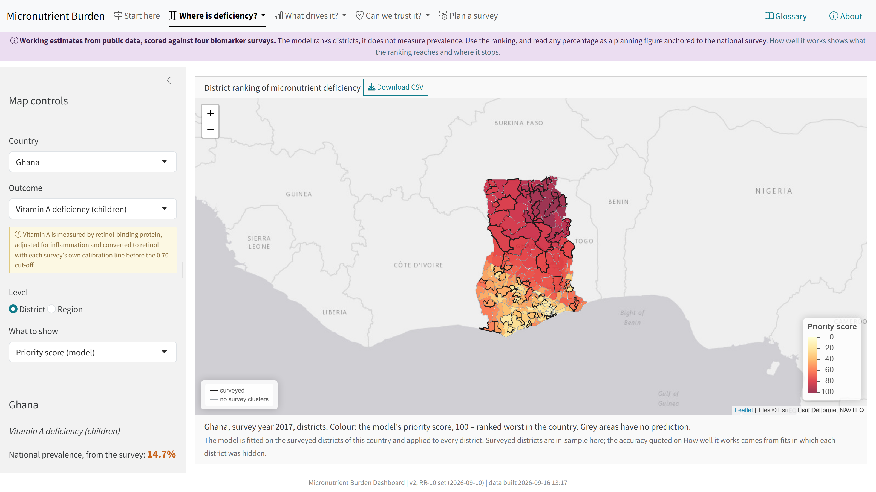


The dashboard
amertens.shinyapps.io/micronutrient-burden
Every number in this talk, for every district; one estimator behind every tab.
Where is deficiency?
A priority score for every district, how sure the model is, a planning prevalence; click a district for what drives it.
What drives it? Can we trust it?
Leading predictors, what travels across borders, the catalogue of 575 predictors; the three tests and the ceiling.
Plan a survey
The anchor-and-rank design; a printable brief per country.
Notes:
The dashboard was rebuilt on 13 September on the corrected protocol, so that it says exactly what this talk says, simplified on 14 September for a reader with no statistics, and refreshed on 16 September with the 570-layer predictor set that has no DHS in it. Start here now opens with a plain-language abstract (the project, the four training surveys, how the model was built and checked), then the three numbers, one card on how to use the map, and the checklist; the Ghana worked example and the audit history sit in folded panels. Removed with the rebuild: the person-level machine-learning layer (a coin toss under honest folds), the earlier area-level estimators and their intervals, the old leaderboard, the GBD placeholder and the Sierra Leone chiefdom layer. One estimator feeds every tab: the index fitted on all surveyed districts of a country and applied to every district. The chance of being in the worst fifth exists for surveyed districts in three countries; Sierra Leone’s 14 districts cannot be cross-validated. A printable brief per country comes from the same tables, and a 25-page static walkthrough of every tab (dashboard_walkthrough_2026-09-14.pdf in the Dropbox folder) is there for written comments. Open items: sharing a view by URL, faster loading (the boundary files are most of the bundle), the worst-fifth probability for unsurveyed districts, and plain-language descriptions for the predictors (75 of 570 have one; the catalogue is the worklist). Open the URL a few minutes before showing it: the free tier stops idle instances and the restart takes a minute.

Slide 73
Closing

Slide 74
What the models can and cannot do yet
Rank districts in a surveyed country?
Yes: 0.40, null 0.08.
Rank districts in a new country?
Yes, less well: 0.30 against 0.08.
Which predictors carry the signal?
Satellite, climate and soil.
Prevalence in a new country from the model alone?
Not yet.
Prevalence with one national anchor?
Yes: 9.3 points at a 5% sample.
Replace biomarker surveys?
No: the ceiling is the survey's.
Guide where the next survey samples?
In design, not piloted.
Say how sure each map is?
Stable, yes; verified, no: the intervals cover the truth 38% of the time, not 90%.
Notes:
The checklist agreed at the 10 September check-in, one row per question. Sources: benchmarks_v2_summary.csv (in-fill and country transport, biomarker level), transport_null_calibration.csv (95th percentile of the permutation null), nested_domain_selection.csv (fixed climate-and-soil set), index_importance_domains.csv (pooled shares of the three remotely sensed domains), anchor_and_rank.csv (AR-01, 5% fraction, climate-and-soil set, ranks from prevalence), variance_components_ceiling.csv (prevalence, admin2). Levels do not transport because the surveys differ in year, season, team and calibration (fe_transport_level_offset); the anchor supplies the level the ranking lacks. Guiding the next survey is a design result on these four surveys, not a pilot.

Slide 75

Conclusions
In-fill: the index ranks districts (0.40)
Against 0.31 for the survey's own regional averages and 0.39 for a covariate-free smoother.
Transport: rankings carry (0.30), levels do not
0.38 from climate and soil alone; permutation null 0.08.
Across borders, lean on the environment
Survey-derived inputs help inside a country and hold a new country back; health surfaces are surrogate markers, not mechanisms.
A national anchor puts levels on the ranking
District error 9.3 points at 5% of a full sample, matched by a district survey at 25%.
Uncertainty is on every model map, and it is checked: the intervals mean stable, not verified
Resampling intervals cover the survey's rank 38% of the time against a nominal 90%; the gap is the transport error. A calibrated interval is the next methods step.
Where the survey resolves districts, so does the model: The Gambia 0.41 to 0.70
Several clusters per district; 3 of 4 outcomes above 0.5. Ghana's and Malawi's single-cluster districts average 0.34 (3 of 14).
Notes:
Five conclusions, each with its number on the slide. The fifth is the one the per-cell slides added: the model’s accuracy tracks the survey’s district resolution more than the nutrient. The Gambia, whose 30 districts each hold several clusters, ranks 0.41 to 0.70 across its 4 outcomes, 3 of them at or above 0.5 and the fourth (child iron) still above the other countries’ average; Ghana and Malawi, with one cluster in most districts, average 0.34 with 3 of 14 cells above the line. So the ceiling slide and this one say the same thing from two sides: give the survey enough clusters per district and the proxies can recover its order; starve it and nothing can. Results in this deck are from the RR-12 re-run on the 575-column set (16 September 2026).

Slide 76







Next steps
Planned
Open questions
Score the pre-registered predictions
On the next countries added to the panel; each survey added improves every other country's map.
What rank correlation is sufficient to act on?
Pilot the survey design
Sample nationally, rank with the model, compare with a district survey in one country.
Which national number is the cheapest honest anchor?
Rerun the national track; finish the product
Shareable dashboard views, the geostatistical prevalence where a survey exists, plain-language predictor descriptions.
Without new biomarker surveys, what benchmarks the models?
Notes:
Sources: docs/findings/TWO_READINGS_2026-09f.md (current abstracts), SANDBOX_LOG_2026-09.md (every experiment), PREREGISTRATION_NEW_COUNTRIES_2026-09.md, CLUSTER_LEVEL_DESIGN_2026-09.md. Every table in this deck is read at render time from results/tables. The add-on harness is scripts/protocol_v2/39_addon_feature_test.R and it has scored eleven blocks so far; the analysis deck’s forest plot of those tests is the record. Most recent blocks moved the index by less than 0.01. The household budget survey block and the MICS block are in the base set for what they add inside a country, where two of the three estimands live; they do not help across borders. The GPS request is with UNICEF; the Ghana and Sierra Leone budget-survey modules are with the research assistant. Cote d’Ivoire, the country we rank with no survey, is missing the 30-year climate normals, which cost 27 of the 101 climate-and-soil columns in its intersection without changing the transport figure; extracting them is a morning’s work.

Slide 77
Appendix

Slide 78
Sources, tiers and alignment
Source | Columns | Tier | Domains | Year rule | Largest gap (years)
DHS indicators | 150 | DHS (access agreement) | 16 | dhs_round | 3
Earth Engine: climate, land, built environment | 80 | Open data | 4 | access_2019, ccnl_2013, clim_anomaly, clim_normals, gee_t… | 6
AlphaEarth satellite embedding | 64 | Open data | 1 | alphaearth_2017 | 4
SoilGrids / iSDA soil | 45 | Open data | 1 | soil_static | static
IHME modelled surfaces | 34 | Open data | 7 | ihme_to_2017, ihme_to_2018, ihme_to_2019 | 1
MICS microdata | 30 | Public survey microdata | 7 | mics_microdata | 4
GFDx fortification | 27 | Open data | 3 | gfdx_ntd_2015, gfdx_survey_year, gfdx_who_anaemia_2011, g… | 6
MICS via WHO HEAT | 19 | Public survey microdata | 1 | mics_heat_round | 3
WorldPop / GHS / RWI | 18 | Open data | 4 | acled_36m, ghsl_epoch, rwi_2019, wpop_2020, wpop_density_sy | 7
Household budget surveys (HCES) | 15 | Public survey microdata | 1 | hces_year | 3
MapSPAM crops | 12 | Open data | 1 | spam_2010 | 8
Malaria Atlas Project | 11 | Open data | 1 | map_blood_2012, map_survey_year | 6
Koppen / agro-ecological zones | 9 | Open data | 1 | aez_static, koppen_static | static
WFP market prices | 9 | Open data | 1 | fprice_window | 0
FAOSTAT food balance (national) | 8 | Open data | 1 | fao_supply | 0
Gridded Livestock of the World | 8 | Open data | 1 | glw4 | 3
Earth Engine: water and coast distance | 6 | Open data | 1 | water_static | static
MIMI dietary inadequacy (Ghana) | 6 | Open data | 1 | mimi_glss7 | 1
WHO ESPEN helminths | 6 | Open data | 1 | espen_mda, espen_nearest | 3
World Bank RTFP prices | 6 | Open data | 1 | rtfp_window | 0
WHO anaemia estimates | 5 | Open data | 1 | who_anaemia_sy | 0
HFID food security | 4 | Open data | 1 | fsec_window | 0
Global Data Lab HDI | 2 | Open data | 1 | gdl_sy | 0
UNICEF vitamin A supplementation | 1 | Open data | 1 | vas_sy | 0
Notes:
Tier: open means downloadable by anyone; public survey microdata means a registration with the survey programme; DHS means the DHS Program’s access agreement. Year rule names are the rule identifiers in metadata/covariates/temporal_alignment.csv. The largest gap is the worst case over the four countries; static layers have none.

Slide 79
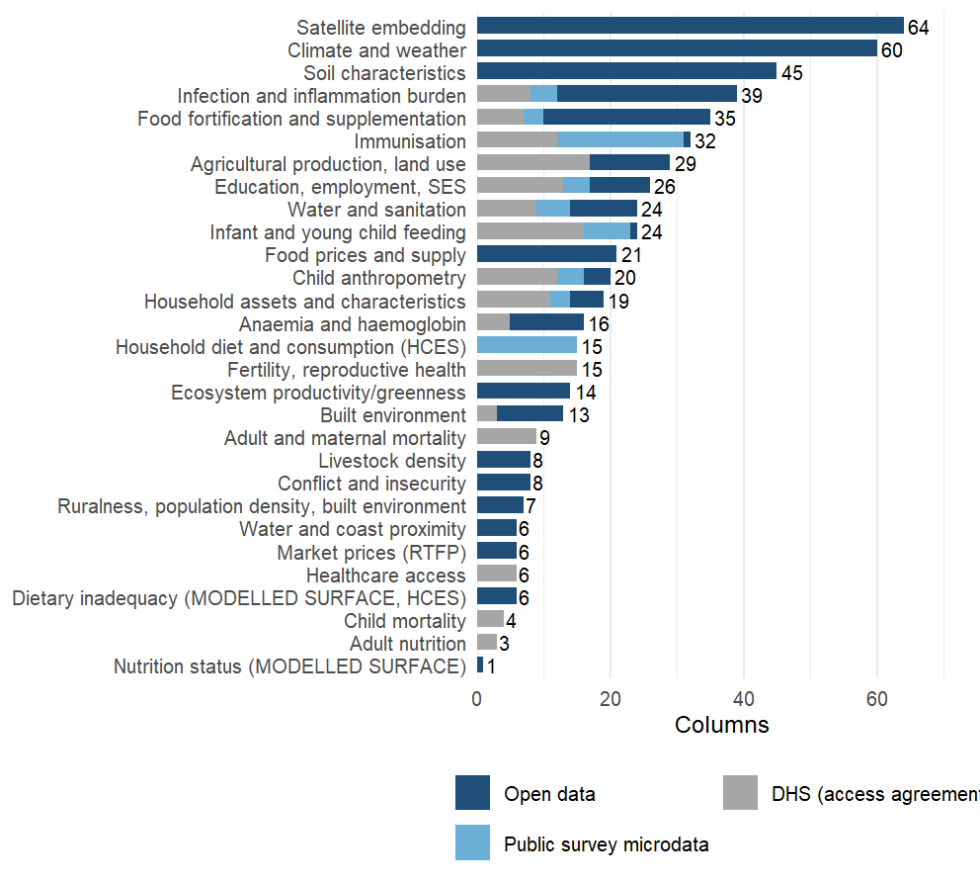
From columns to domains
29 domains. A domain groups columns by what they measure, whatever the source: the MAP, IHME and survey malaria columns sit in one group. Each domain enters the model as its leading principal components, to 80% of variance and at most twelve, learned on the training districts only.
Notes:
Why domains: 575 columns against 14 to 87 districts per country cannot be fitted column by column, and the columns are heavily correlated within a source. Grouping them by what they measure and taking principal components inside each group keeps most of the variance of each group, treats a source with 64 columns and a source with 3 as one construct each, and keeps the outcome out of the representation: the rotations are learned from the training districts’ predictors alone, so nothing is selected on the biomarker. The grouping is written down: each source block brings a label, and 10 override rules in metadata/covariates/domain_overrides.csv regroup columns by construct (infection and inflammation burden, immunisation, anaemia, child anthropometry, infant feeding, supplementation, water and sanitation, education, child mortality, assets), so that MAP, IHME, DHS and MICS versions of the same thing are weighed together. Two things went wrong this week and are now guarded. A domain’s first twelve characters are its key inside the model; two labels that shared them (“Food prices (RTFP)” and “Food prices and supply”) were silently merged in two analyses until a check caught it on 16 September. The other is in the exclusions, on the next slide. One more point for questions: climate alone or soil alone transports better than all domains together, the analysis deck’s climate-and-soil result.

Slide 80
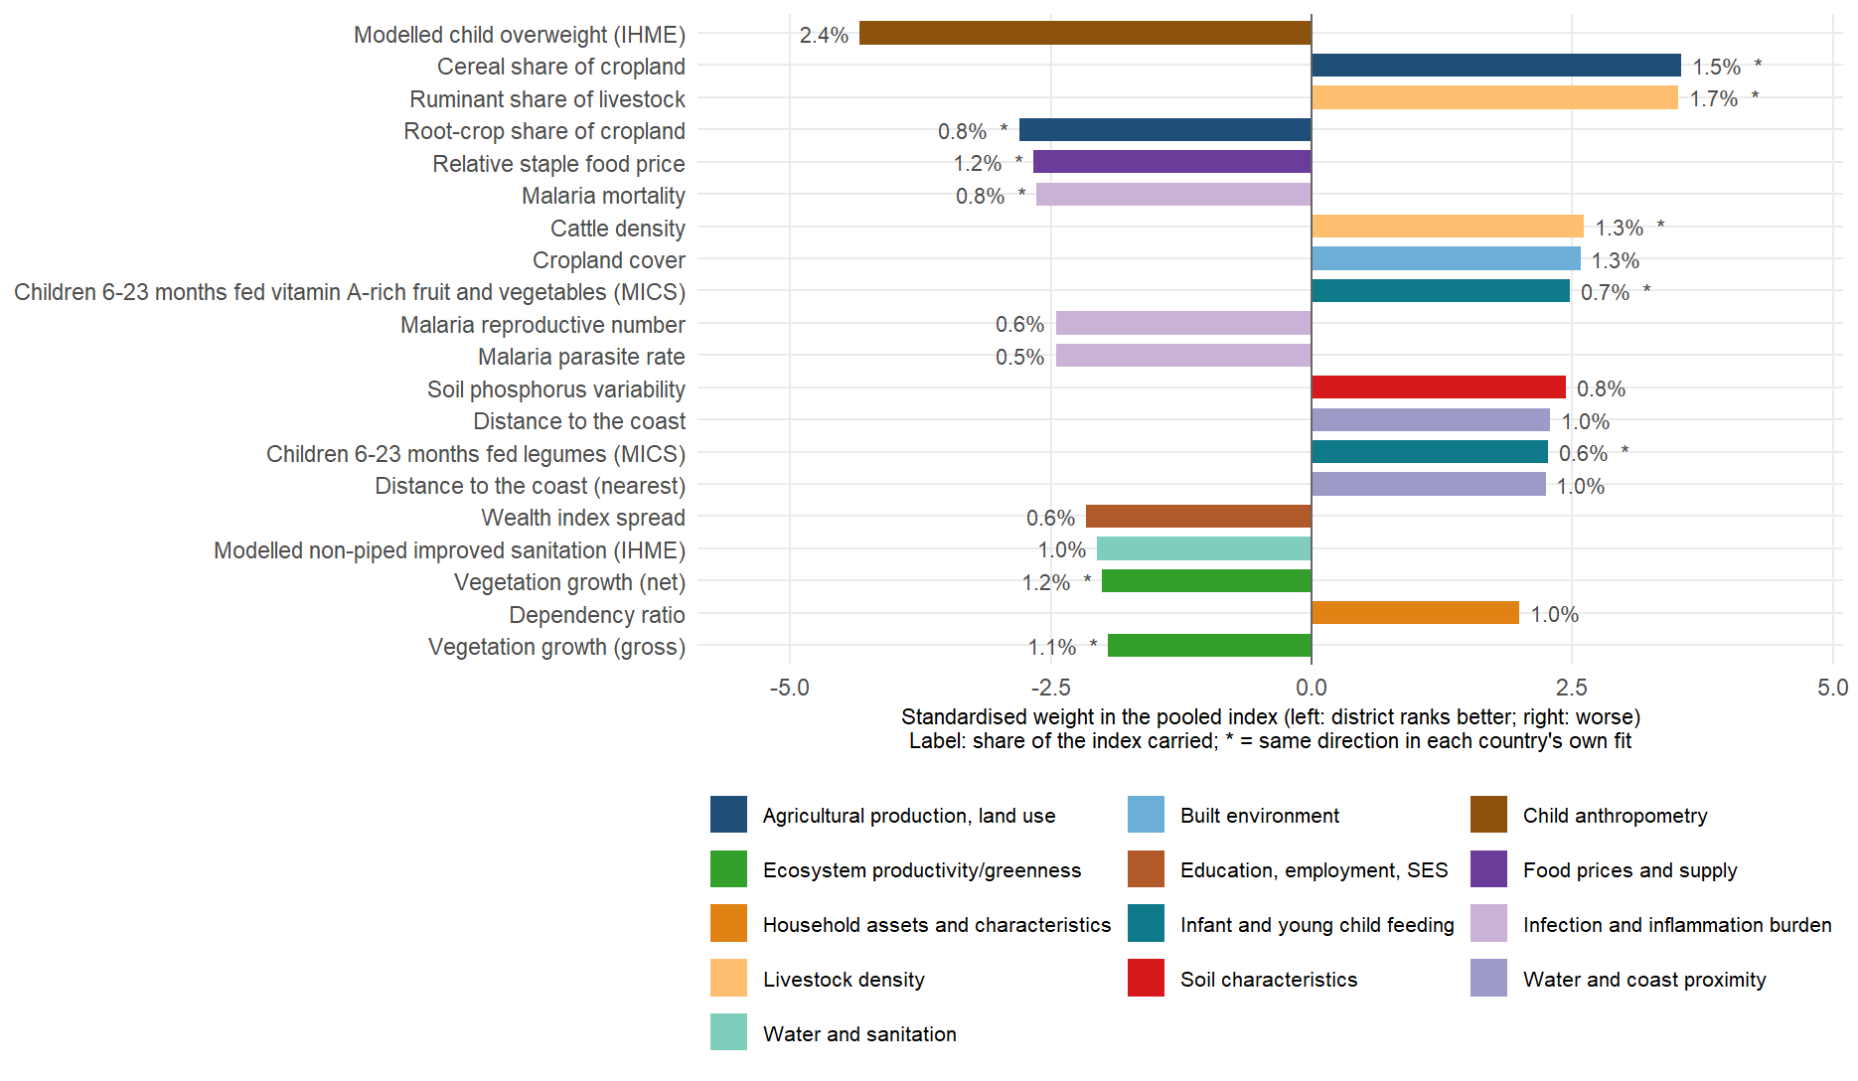
The twenty layers behind child iron, and how much each carries
Notes:
index_importance_top.csv, child iron, biomarker level: the twenty largest standardised weights in the pooled four-country fit, drawn as bars so their sizes can be compared. The level target is the negated log ferritin, so a bar to the right means districts with more of the layer rank worse on child iron, to the left better. The label is the share of the index’s variance the layer carries: the twenty together hold about a fifth of the index (21%), the rest is spread over the other 350 columns, which is how a weighted sum of many weak signals is meant to behave. All twenty keep their direction in every leave-one-country-out fit; the starred ones (10 of twenty) also keep it in each country’s own separate fit, the stricter test. The story is the one on the earlier slides: cereal-heavy cropping, ruminant and cattle density, cropland, distance from the coast and a high dependency ratio rank a district worse; root crops, higher plant productivity, relatively expensive staples, modelled overweight and malaria intensity rank it better, the last for the geographic reason discussed. None of the twenty requires a blood sample, and the twenty-layer equal-weight composite scores about the same as the full index for a new country.

Slide 81
Exclusions, with their reasons
Rule | Policy | Reason
^soil_nitrogen_ | data_defect | Cross-country values are irreconcilable by any constant factor: medians 742 (Gambia) 1090 (Malawi) 2455 (Ta…
^soil_totalcarbon_stdev_ | data_defect | Dispersion columns diverge >100x across countries while the matching depth MEANS agree; the stdev bands are…
^ndvi_y2010$ | data_defect | Tanzania median 5.4e-05 against 0.22-0.26 elsewhere while every other year agrees - a defective 2010 slice …
^ndvi_y(2019|2020|2021|2022)$ | data_defect | NDVI collapses country-dependently after 2018 (2021 medians 0.008 Malawi / 0.018 Gambia / 0.25 Sierra Leone…
^(lcover_(snow|moss)frac|tclim_swe_) | data_defect | Identically zero in every district of every country: these are snow cover, moss cover and snow water equiva…
^dhs_c_ort_diarrhea$ | data_defect | Identically zero in every district - the indicator did not populate in these DHS rounds. A constant cannot …
^dhs_w_barrier_transport$ | data_defect | All-NA in every district of every country (the transport-barrier item did not populate in these DHS rounds)…
^ndvi_y20(1[1-8])$ | superseded | Superseded (NV-01, 2026-09-15) by MOD13Q1 NDVI at the survey year (ndvi_modis_t0/win/peak/amp/clim/anom): t…
^precip_y20(1[0-9])$ | superseded | Superseded (2026-09-15): TRMM 3B43 annual precipitation at a calendar year 2010-2019 lags the survey by up …
^popdens_y(2010|2015|2020)$ | superseded | Superseded (2026-09-15): GPW v4.11 density at fixed epochs (up to 8 years from the survey); wpop_log_densit…
^gpw2010_ | superseded | Superseded (2026-09-15): GPW 2010 age-sex shares are 3-8 years from the surveys; the WorldPop 2020 shares (…
^ihme_proportionofpopulationachievingyearseducation$ | data_defect | Data defect (2026-09-15): script 08’s key normaliser dropped the digits from three IHME education categorie…
^dhs_(FP_CUSA_W_MOD|FP_NADA_W_UNT|AN_ANEM_W_ANY|CN_NUTS_C_WH2|CN_ANMC_C_ANY|CN_NUTS_C_HA2|AN_NUTS_W_THN|RH_ANCN_W_N4P)$ | redundant | Redundant (RV-01, 2026-09-15): STATcompiler-style DHS indicators that duplicate the custom recode indicator…
^dhs_w_primary_edu$ | redundant | Redundant (RV-01): r = -1.000 with dhs_w_no_education (its complement).
^dhs_w_iron_supplement$ | redundant | Redundant (RV-01): r = 1.000 with dhs_w_iron_pregnancy.
^dhs_c_vita_rich_food$ | redundant | Redundant (RV-01): r = 1.000 with dhs_c_fg_vitA_fruitveg.
^espen_(sth|sch)_prev_mid_base$ | redundant | Redundant (RV-01): the earliest ESPEN year is the year nearest every survey, so _base equals _prev_mid (r >…
^(map_sy_pf_incidence_rate|ihme_malaria_incidence_rate)$ | redundant | Redundant (RV-01): incidence is a deterministic function of the parasite rate in both products (r 0.998-0.9…
^wpop_log_density$ | superseded | Superseded (RV-01): 2020-vintage WorldPop density; r = 0.999 with wpop_log_density_survey_year, which is at…
^wsf$ | redundant | Redundant (RV-01): World Settlement Footprint 2015 has r = 0.992 with lcover_urban_frac_t0, which is at the…
^mics_heat_vhib_sy$ | redundant | Redundant (RV-01): Hib is given as the pentavalent vaccine, r = 0.990 with mics_heat_vdpt_sy.
^rtfp_dist_market_km$ | redundant | Redundant (RV-01): r = 0.984 with fprice_dist_nearest_market_km (the same WFP markets), which covers all fo…
^flunet_ | national_track | National track only (2026-09-16): the three FluNet indicators are national constants in the district set (d…
Notes:
metadata/covariates/exclusions.csv, applied by scripts/protocol_v2/53_apply_exclusion_policy.R to the live set. Data defects are removed on evidence in the audit tables; superseded layers are replaced by a better-aligned version of the same quantity; redundant twins are removed when a pooled rank correlation reaches 0.98 with a kept column. The two soil rules that failed that standard were removed on 15 September (SX-01 in the sandbox log).

Slide 82
Predictor set by domain and tier
Domain | Columns | Open | Public microdata | DHS | Vary within country | Modelled surfaces
Satellite embedding | 64 | 64 | 0 | 0 | 64 | 0
Climate and weather | 60 | 60 | 0 | 0 | 60 | 0
Soil characteristics | 45 | 45 | 0 | 0 | 45 | 0
Infection and inflammation burden | 39 | 27 | 4 | 8 | 39 | 10
Food fortification and supplementation | 35 | 25 | 3 | 7 | 10 | 0
Immunisation | 32 | 1 | 19 | 12 | 32 | 1
Agricultural production, land use | 29 | 12 | 0 | 17 | 29 | 0
Education, employment, SES | 26 | 9 | 4 | 13 | 26 | 4
Infant and young child feeding | 24 | 1 | 7 | 16 | 24 | 1
Water and sanitation | 24 | 10 | 5 | 9 | 24 | 10
Food prices and supply | 21 | 21 | 0 | 0 | 12 | 0
Child anthropometry | 20 | 4 | 4 | 12 | 20 | 4
Household assets and characteristics | 19 | 5 | 3 | 11 | 19 | 0
Anaemia and haemoglobin | 16 | 11 | 0 | 5 | 9 | 11
Fertility, reproductive health | 15 | 0 | 0 | 15 | 15 | 0
Household diet and consumption (HCES) | 15 | 0 | 15 | 0 | 15 | 0
Ecosystem productivity/greenness | 14 | 14 | 0 | 0 | 14 | 0
Built environment | 13 | 10 | 0 | 3 | 13 | 0
Adult and maternal mortality | 9 | 0 | 0 | 9 | 9 | 0
Conflict and insecurity | 8 | 8 | 0 | 0 | 8 | 0
Livestock density | 8 | 8 | 0 | 0 | 8 | 0
Ruralness, population density, built environment | 7 | 7 | 0 | 0 | 7 | 0
Dietary inadequacy (MODELLED SURFACE, HCES) | 6 | 6 | 0 | 0 | 6 | 6
Healthcare access | 6 | 0 | 0 | 6 | 6 | 0
Market prices (RTFP) | 6 | 6 | 0 | 0 | 6 | 0
Water and coast proximity | 6 | 6 | 0 | 0 | 6 | 0
Child mortality | 4 | 0 | 0 | 4 | 4 | 0
Adult nutrition | 3 | 0 | 0 | 3 | 3 | 0
Nutrition status (MODELLED SURFACE) | 1 | 1 | 0 | 0 | 0 | 1
Notes:
Modelled surfaces are estimates produced by someone else’s model (IHME, MAP, the MIMI dietary inadequacy estimates); they are included by default and the protocol has a switch (V2_DROP_MODELLED=1) to score without them. Columns that do not vary within a country are the national constants dropped at fit time.

Slide 83
What we would add next, and the rule for adding it
Sub-national household-survey microdata with GPS: MICS cluster coordinates for Ghana 2017-18 and Malawi 2013-14 are requested; they turn region-level blocks into district ones.
Diet from the household budget surveys for Ghana (GLSS7 food module) and Sierra Leone (SLIHS diary codes), so the 15 diet indicators cover all four countries.
Conflict events (ACLED, four-country export), market prices for Ghana and Sierra Leone, a decision on FluNet’s national counts.
Every candidate block passes the same test before it enters: within-country sign agreement, paired in-fill with and without it, and leave-one-country-out.
Notes:
The add-on harness is scripts/protocol_v2/39_addon_feature_test.R and it has scored eleven blocks so far; the analysis deck’s forest plot of those tests is the record. Most recent blocks moved the index by less than 0.01. The household budget survey block and the MICS block are in the base set for what they add inside a country, where two of the three estimands live; they do not help across borders. The GPS request is with UNICEF; the Ghana and Sierra Leone budget-survey modules are with the research assistant. Cote d’Ivoire, the country we rank with no survey, is missing the 30-year climate normals, which cost 27 of the 101 climate-and-soil columns in its intersection without changing the transport figure; extracting them is a morning’s work.

Slide 84
Predictors recurring across outcomes
Predictor | Domain | Outcomes (top 20) | Signs | Mean rank
fprice_staple_rel | Food prices and supply | 5 | —– | 10.2
ihme_overweightprevalence | Child anthropometry | 4 | —- | 6.0
map_sy_pf_mortality_rate | Infection and inflammation burden | 4 | —- | 8.0
npp_gpp_t0 | Ecosystem productivity/greenness | 4 | —- | 14.2
npp_npp_t0 | Ecosystem productivity/greenness | 4 | —- | 14.8
mics_w_iptp_sp | Infection and inflammation burden | 3 | +++ | 3.0
glw_ruminant_share | Livestock density | 3 | +++ | 6.3
ihme_underweightprevalence | Child anthropometry | 3 | +++ | 7.0
lcover_grass_frac_t0 | Built environment | 3 | +++ | 7.3
lcover_crops_frac_t0 | Built environment | 3 | +++ | 7.7
glw_tlu_per_capita | Livestock density | 3 | +++ | 8.3
ihme_allanemia | Anaemia and haemoglobin | 3 | +++ | 8.7
Notes:
Predictors in the pooled top 20 of three or more of the six outcomes on the level target, with the sign in each. One gradient recurs: districts that are drier and grassier, less productive (lower net and gross primary productivity), more pastoral, poorer (less home ownership, fewer women in paid work, less schooling) and more stunted rank worse on every deficiency. Outcome-specific signals sit below it: haemoglobin C allele frequency and cattle for child iron, the modelled anaemia surfaces for women’s iron, helminth treatment coverage and the drought index for folate, elevation and coast distance for B12.

Slide 85
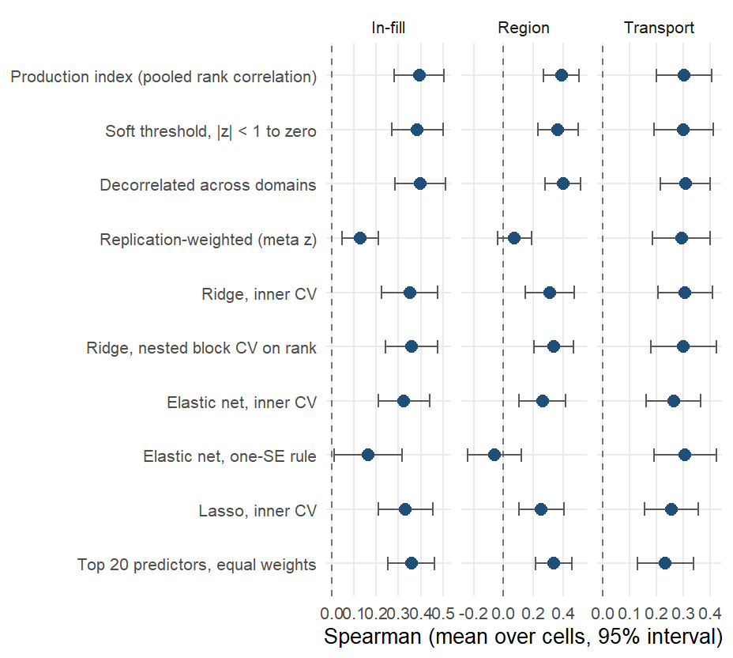
Weighting of the domain components
Alternative weightings of the same components on the biomarker level. In-country every joint fit loses to the marginal-correlation weights (ridge -0.04, elastic net -0.07, lasso -0.06). Across borders the decorrelated index gains +0.005 (better in 12 of 22).
Notes:
The production weights are the infinite-penalty limit of a ridge regression on the components, so the rows are points along that family plus other sources of evidence for the weights (soft thresholding, meta-analytic replication across training countries, decorrelation across domains). Same folds and cells as every other arm; five in-fill draws. The one-SE rules return the null model in some cells (18 of 22 transport cells scored for the elastic net). The twenty-predictor composite gains -0.069 across borders (better in 6 of 22) and costs -0.04 in-fill. The soft threshold gained 0.02 across borders on the direct DHS estimates and -0.002 on the smoothed ones, so that gain was a property of noisy inputs. Both gains were found among 21 arms on these cells and are pre-registered for the next country rather than adopted. Prevalence-target version in the appendix.

Slide 86
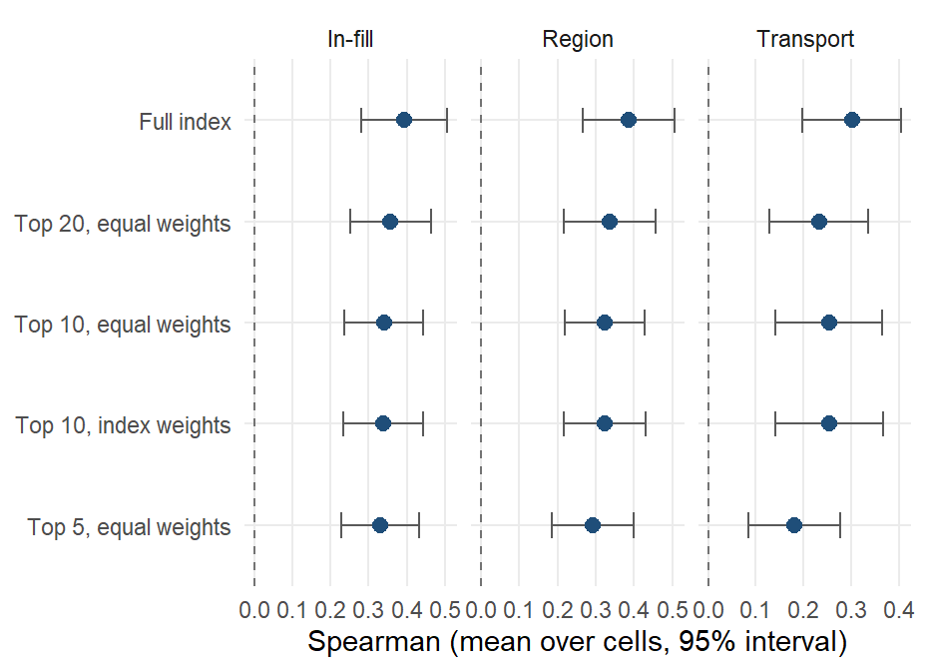
Sparse composites
Equal-weight composites of the top 5, 10 and 20 predictors, membership chosen inside each training fold by back-projected index weight. Twenty predictors cost -0.04 in-fill and gain -0.069 across borders; five predictors cost -0.06 in-fill.
Notes:
Dawes’ improper linear model: direction from the training fold, equal weights, rescaled like the index; nothing is chosen on held-out districts. Weighting the ten by their index weights instead of equally changes nothing. The composite is a transport and communication tool: twenty public layers a ministry can compute. Likely question: which twenty. The next slide lists the child iron members.

Slide 87
Child iron composite
Predictor | Source | Predictor | Source
ihme_overweightprevalence (-) | IHME | map_sy_pf_parasite_rate (-) | Malaria Atlas Project
spam_share_cereals (+) | MapSPAM | soil_phosphorus_stdev_0_20 (+) | SoilGrids / iSDA
glw_ruminant_share (+) | Gridded Livestock of the World 4 | wdist_coast_km_mean (+) | JRC Global Surface Water 1.4; USDOS LSIB 2017
spam_share_roots (-) | MapSPAM | mics_c_fg_legumes (+) | MICS microdata
fprice_staple_rel (-) | WFP / HDX market prices | wdist_coast_km_min (+) | JRC Global Surface Water 1.4; USDOS LSIB 2017
map_sy_pf_mortality_rate (-) | Malaria Atlas Project | rwi_sd (-) | Meta/Data for Good RWI; WorldPop; CIESIN GPW v4.11
glw_cattle_km2 (+) | Gridded Livestock of the World 4 | ihme_simpother (-) | IHME
lcover_crops_frac_t0 (+) | GEE | npp_npp_t0 (-) | GEE
mics_c_fg_vita_fv (+) | MICS microdata | wpop_dependency_ratio (+) | WorldPop age-sex / JRC GHS-SMOD
map_sy_pf_reproductive_number (-) | Malaria Atlas Project | npp_gpp_t0 (-) | GEE
Notes:
The twenty columns the four-country fit would deploy for child iron, in order of weight, with the sign of the contribution (plus means more deficiency). 20 of the twenty keep their sign in every leave-one-country-out fit and 10 in every country’s own independent fit. In the benchmark the membership is re-chosen inside each training fold; this is the version fitted on all four countries. The other outcomes’ composites are in results/tables/protocol_v2/index_importance_top.csv.

Slide 88
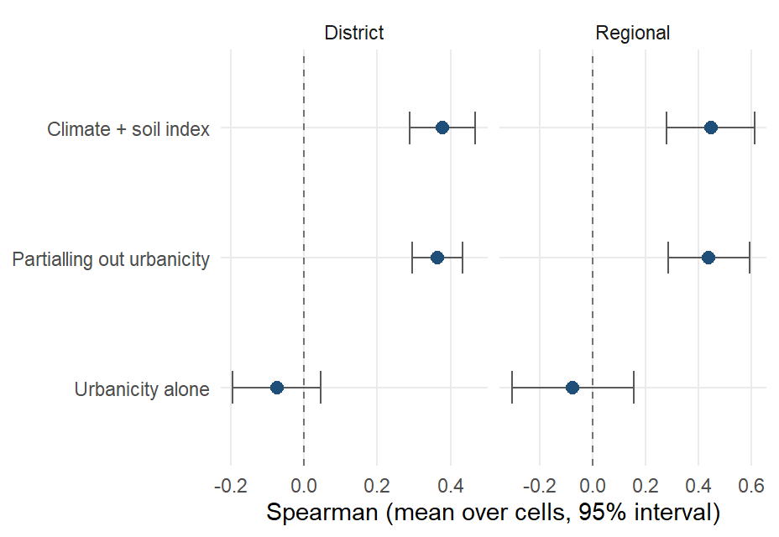
Urbanicity conditioning
Transported Spearman of the climate-and-soil index at district level (0.38), the same after partialling out an urbanicity composite (0.36), and urbanicity alone (-0.07).
Notes:
Urbanicity composite: night lights, population density, built surface, urban land cover, travel time to health care. The replicated associations (legumes, cattle, soil chemistry, night-time temperature, all toward more deficiency) describe where subsistence agriculture is, so an urban-rural gradient was the rival explanation; partialling it out moves the transported correlation by less than 0.02 and urbanicity alone does not transport.

Slide 89
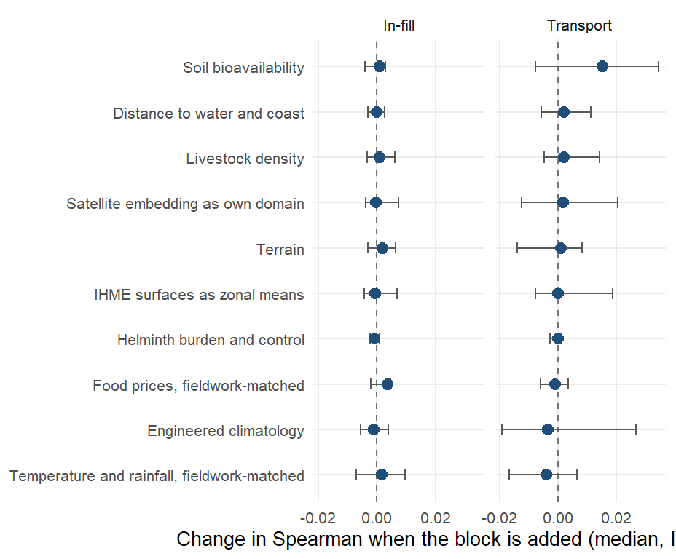
Add-on predictor blocks
Median change in Spearman when a block is added to the base vocabulary, in-fill and district transport on the biomarker level, scored under one harness with the same folds.
Notes:
Bars are the interquartile range over cells. No block moves in-fill or transport by more than 0.01 at the median: the vocabulary is saturated. The fieldwork-matched temperature columns are among the most consistently associated with deficiency in the marginal scan yet improve no fold, because a covariate defined by when the survey happened cannot rank districts that have not been surveyed. Found in passing and fixed: the price columns used 2021 as The Gambia’s survey year (fieldwork was January to April 2018), and the satellite embedding had been filed under agriculture.

Slide 90
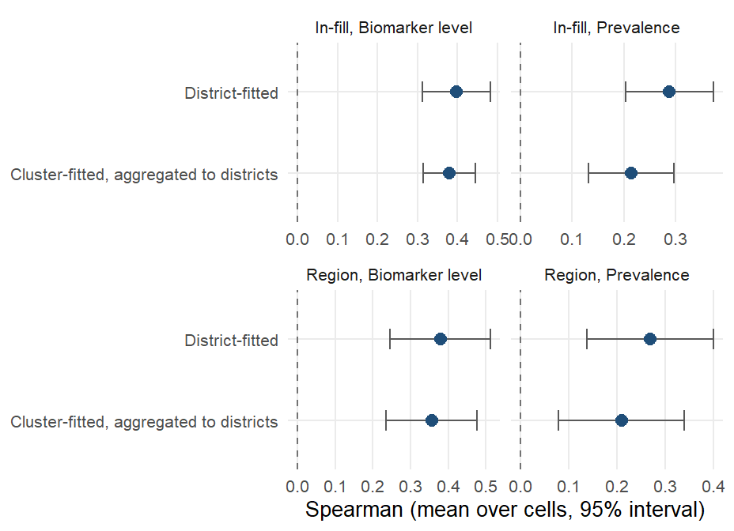
Cluster-level fitting
The same index fitted at the survey cluster and aggregated to districts, against the district fit, on the same cells. In-fill on the level: 0.38 cluster-fitted against 0.40 district-fitted.
Notes:
323 clusters with GPS; covariates as 2 km (urban) and 5 km (rural) buffer means from rasters on disk; the same estimands with folds cut by district and region. Cluster-fitted models trail district-fitted ones on every estimand and for transport. A precision-weighted index and empirical-Bayes shrinkage of cluster outcomes recover a third to a half of the gap. A matched-vocabulary comparison attributes the remaining gap to the layers rather than the fitting unit. The cluster track is a sensitivity analysis until its vocabulary is matched layer for layer.

Slide 91
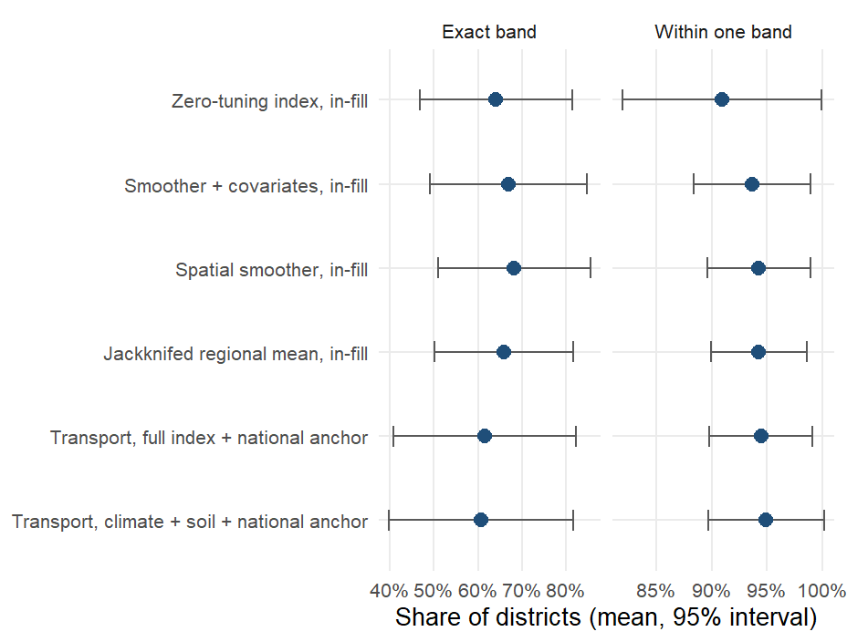
Risk-class accuracy
Share of districts placed in the correct WHO vitamin A band (under 2%, 2 to 10, 10 to 20, 20 or more), and within one band, mean over the vitamin A cells. The index in-fill: 64% exact and 91% within one band.
Notes:
Out-of-fold predictions averaged over ten draws; transport rows use the held-out country’s own national prevalence as the anchor (AR-01 design), the only honest way to put a transported ranking on the prevalence scale. The January deck’s child vitamin A cell was 44 and 75 percent (exact, within one) for the full model from the old leaderboard. For iron and the other outcomes only the 20 percent threshold has a WHO source; the two-class accuracies are in results/tables/protocol_v2/risk_category_accuracy_summary.csv.

Slide 92
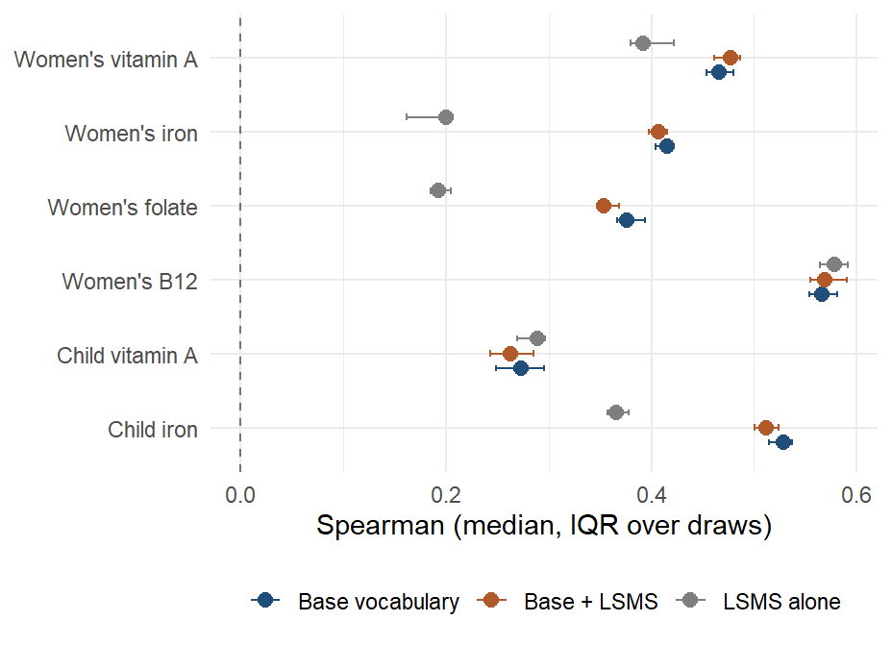
LSMS and FluNet predictors
Ghana in-fill on the biomarker level with the base vocabulary, the base plus the LSMS block, and the LSMS block alone, median over ten draws.
Notes:
The LSMS block scored here is Ghana’s GLSS7 as a svyby object: 134 region-level household expenditure and asset means, broadcast to districts through the 16-to-10 region crosswalk, so the block varies only across ten regions. It does not improve any Ghana cell beyond noise and cannot be scored across borders. The household budget surveys now enter the base set another way, as diet and consumption indicators computed from the microdata for all four countries (GLSS7 for Ghana, again at the region); that block is part of the base vocabulary this slide compares against. FluNet reports for Ghana and Sierra Leone only and is a national weekly count, constant within a country; it contributes nothing by construction.

Slide 93
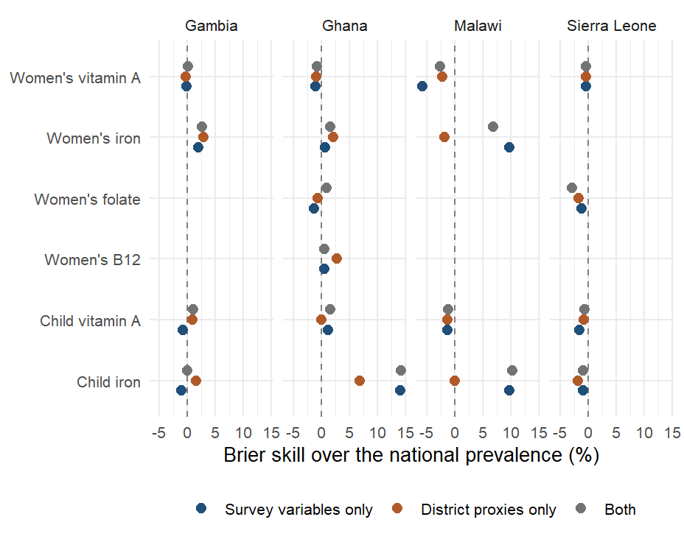
Individual-level models
Person-level SuperLearner under district-blocked folds, Brier skill over the national prevalence, by country and outcome. Mean AUC over 18 cells: 0.52 for survey variables, 0.50 for district proxies, 0.53 for both.
Notes:
Library: mean, elastic net, random forest; survey weights; inner folds blocked by district; outer 5-fold by district so no district’s respondents are split across training and test. Survey variables: up to 80 respondent columns with 70 percent coverage after removing biomarkers, adjustments, identifiers, weights, dates and locations. Proxies: the district’s domain components joined to each respondent. Person-level skill exists for iron only (survey-variable AUC up to 0.78 in Ghana and Malawi); vitamin A, folate and B12 show none. The January figure (Brier skill 20 to 60 percent) came from folds not blocked by district and a survey set that included biomarker-adjacent variables. Aggregating a person-level classifier biases area means, so this remains a sensitivity analysis. Rerun on the RR-10 set on 10 September.

Slide 94
National-level track
Outcome | Countries | Observed (mean) | Predicted (mean) | Mean absolute error (pp)
Child iron | 4 | 0.19 | 0.21 | 2.09
Child vitamin A | 4 | 0.14 | 0.14 | 0.94
Women’s iron | 4 | 0.14 | 0.14 | 0.63
Women’s vitamin A | 4 | 0.02 | 0.02 | 0.23
Notes:
The January deck’s national-level track (WHO VMNIS and BRINDA outcomes, FAOSTAT and policy predictors) lives in a separate sub-pipeline last run in April 2026. It is not part of the current protocol and has not been re-audited; the table is its last output for the four survey countries. It is the only track with time series and fortification policy indicators and is a candidate for a rerun under the corrected protocol.

Slide 95
Iodine
Model | Gambia UIC < 100, in-fill | Gambia UIC < 100, region | Gambia median UIC, in-fill | Gambia median UIC, region | Sierra Leone UIC < 100, region
Training mean | -0.31 | -0.55 | -0.29 | -0.60 | -0.34
Jackknifed regional mean | 0.33 | - | 0.35 | - | -
Spatial smoother | 0.31 | 0.50 | 0.27 | 0.27 | -0.35
Zero-tuning index | 0.45 | 0.48 | 0.55 | 0.56 | 0.10
Smoother + covariates | 0.30 | 0.47 | 0.32 | 0.32 | 0.19
Notes:
Urinary iodine is measured in The Gambia (continuous, with household salt iodine) and in Sierra Leone (six WHO categories, non-lactating women); it left the modelling outcomes because a one- or two-country outcome has no leave-one-country-out test. Targets: district prevalence of urinary iodine concentration below 100 micrograms per litre and, for The Gambia, the district median. In-fill needs at least 15 districts, so it runs for The Gambia only; leave-one-region-out runs in both. Whether district salt iodisation tracks district iodine status is in results/tables/protocol_v2/iodine_in_country.csv (rows analysis = descriptive).

Slide 96
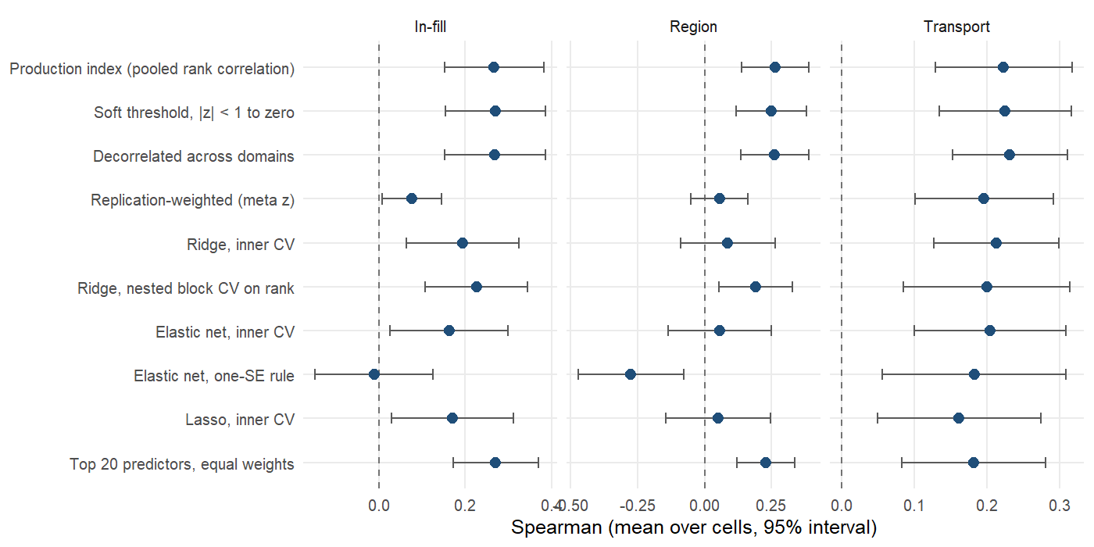
Weighting of the domain components: prevalence
Notes:
Prevalence target, same arms and folds as the biomarker-level figure. Mean Spearman over cells with a 95% interval across cells.

Slide 97
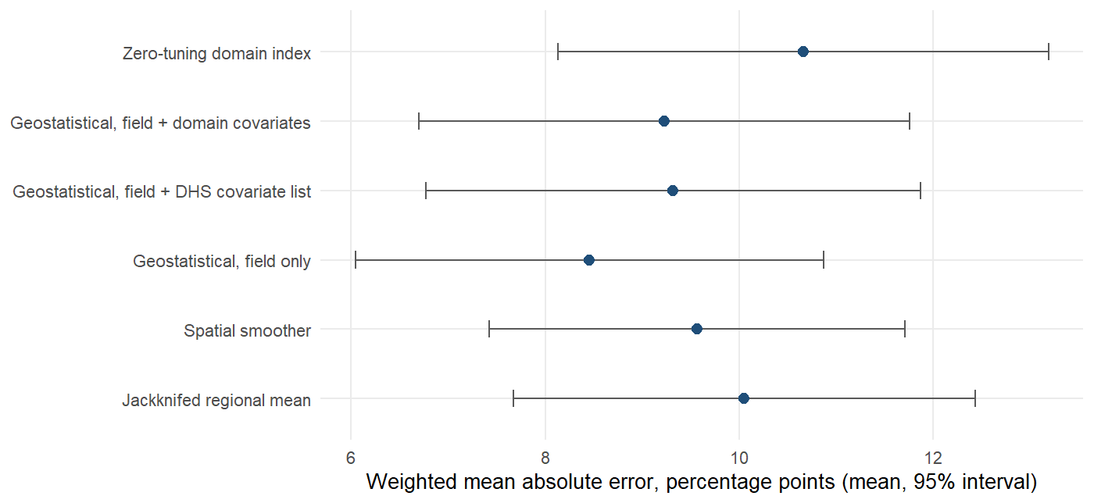
Geostatistical comparator: absolute error
Notes:
In-fill, prevalence. The geostatistical model estimates a level and shrinks uncertain districts toward the mean, which lowers absolute error; the index ranks and is rescaled to the training outcome’s spread, which does not. If the deliverable is a prevalence figure for a named district, the geostatistical model is the right tool; if it is a ranking, the index is.

Slide 98
Status of the January analyses (1)
January slide | Status | Where
Individual-level proxy versus survey-only models (Brier skill, AUC, PR gain) | Sensitivity layer; rerun under district-blocked folds | Individual-level models
National-level VMNIS / BRINDA predictions | Separate sub-pipeline, last run April 2026 | National-level track; not re-audited
Iodine (Sierra Leone) | Rerun within country (The Gambia, Sierra Leone) | Iodine
Risk-category accuracy (none / mild / moderate / severe) | Rerun under the protocol, WHO bands | Risk-class accuracy
Notes:
The individual-level SuperLearner remains a sensitivity analysis because shrinking a noisy individual classifier biases area means; it was removed from the dashboard on 13 September, which now shows only the protocol’s index (amertens.shinyapps.io/micronutrient-burden).

Slide 99
Status of the January analyses (2)
January slide | Status | Where
LSMS (275) and FluNet (3) predictors | Re-added: the GLSS7 region means add no skill; household budget survey microdata for all four countries are now in the base set; FluNet is national and inert | LSMS and FluNet predictors
Data-source importance by change in MSE | Replaced by domain and source ablation under transport | Domain and source ablation
Admin-1 women’s iron maps, predicted versus survey | Replaced by district maps with held-out predictions | Ghana maps
Prescreened SuperLearner as the model | Retained as comparison; does not beat the zero-tuning index | Estimators

