Slide 1



Predicting Micronutrient Deficiency Prevalence in Sub-Saharan Africa Using Proxy Indicators: A Multi-country Machine Learning Framework
Andrew N. Mertens (University of California, Berkeley) and Sonja Y. Hess (University of California, Davis)
We are grateful for the funding support of the Gates Foundation.
Notes:
SONJA, about 15 seconds (29 words). Good morning. I'm Sonja Hess from UC Davis. This is joint work with Andrew Mertens at Berkeley, and with the four national survey teams whose data made it possible.

Slide 2
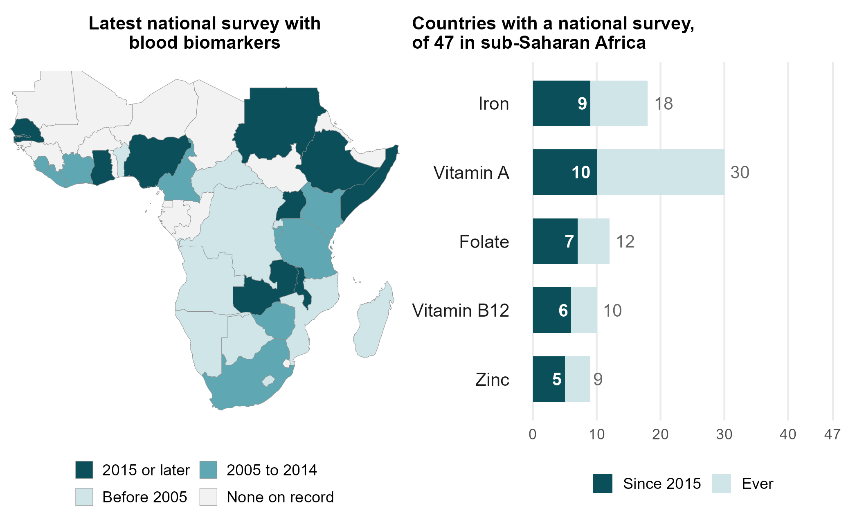
Introduction and study objectives
• Information on the prevalence of vitamin and mineral deficiencies (VMD) is limited
• In an inter-institutional, multi-disciplinary workshop we brainstormed potential approaches, and relevant data domains and data sources
• Developed conceptual frameworks to guide machine learning
Objectives
• To explore whether machine learning can help fill the data gap in VMD prevalence using aggregated proxy variables
Source: WHO Vitamin and Mineral Nutrition Information System (VMNIS), Micronutrients Database, February 2025. Nationally representative surveys measuring ferritin, retinol or RBP, zinc, folate or vitamin B12; surveys not yet deposited are not shown.
Notes:
SONJA, about 50 seconds (116 words).
Information on how common vitamin and mineral deficiencies are is limited. The map shows how limited, for sub-Saharan Africa: 17 of 47 countries have no national survey of micronutrient biomarkers on record, and only 10 have one from 2015 or later; for zinc, five. And where a survey exists, it gives national and regional numbers, while supplementation, the reach of fortified foods and the next survey are planned district by district. So we brought together nutritionists, epidemiologists and data scientists to ask which approaches and data could help, and built conceptual frameworks to guide the analysis. Our objective: to see whether machine learning can help fill the gap, using aggregated proxy variables.
Backup, if asked: map and bars from the WHO VMNIS Micronutrients Database (export of 25 February 2025), nationally representative surveys measuring ferritin, retinol or RBP, zinc, folate or vitamin B12 (scripts/policy_deck/33_mnf15_v4_vmnis_coverage.R); surveys not yet deposited are not shown, and all four of our surveys are in it. Worldwide, in low- and middle-income countries over 1988 to 2018: vitamin A data in 77 countries, iron 53, folate 24, zinc 21, B12 7; about 21 surveys in 2015 to 2019, 15 per cent of these countries (Brown, Moore, Hess et al., Am J Clin Nutr 2021, CC BY 4.0). The global estimate of 56 per cent of young children and 69 per cent of women with at least one deficiency rests on 24 surveys in 22 countries (Stevens et al., Lancet Glob Health 2022). Fortification is set nationally (Nyumuah et al., Food Nutr Bull 2012); coverage of fortified foods is lower among poor and rural households (Aaron et al., J Nutr 2017). Wording flag for Sonja: the third bullet still says “targeted machine learning”, which statisticians may hear as TMLE.

Slide 3



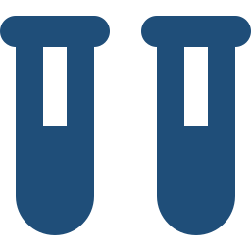

Talk outline
Aggregate public data carry real signal about deficiency
Top predictors: climate, soil and land cover
A simple model does best
There are few places to learn from, so the simplest model wins
It ranks districts no survey reached
Tested on districts, regions and countries it never saw
Some nutrients more than others
B12 and iron map best; zinc cannot be mapped
It extends surveys; it does not replace them
Where to look first, and how to plan the next survey
Notes:
SONJA, about 25 seconds (62 words).
Here is what we will tell you. First, free public data carry real information about micronutrient deficiency. Second, a simple model does best, because there are few places to learn from. Third, it ranks districts no survey reached, and we checked that against data it never saw. Fourth, it works for some nutrients more than others. And fifth, it extends surveys; it does not replace them.

Slide 4
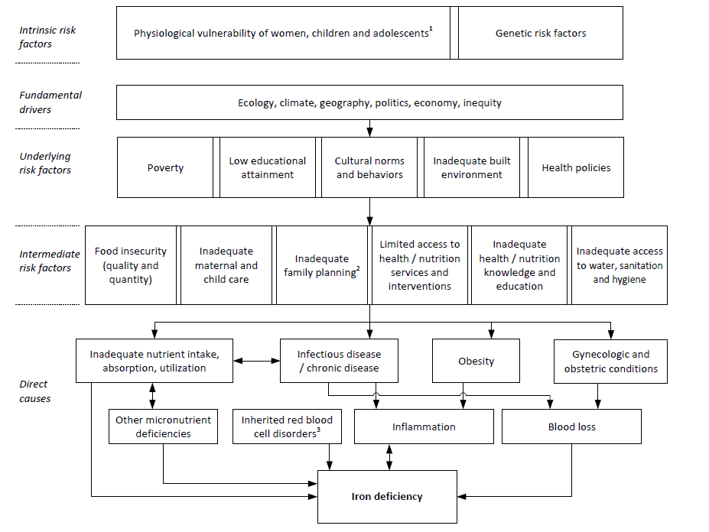
Conceptual framework of iron deficiency
¹ High nutrient requirement due to growth and pregnancy, and increased susceptibility to infections during childhood and pregnancy
² Early onset of childbearing, high parity and short birth spacing
³ Inherited red blood cell disorders include sickle cell disorders, thalassemias, and other haemoglobinopathies
Source: adapted from Hess et al., Ann N Y Acad Sci 2023
Notes:
SONJA, about 20 seconds (42 words).
We did not start from satellites. We started from what causes deficiency. This is our conceptual framework for iron, adapted from our 2023 paper: intrinsic risk, the fundamental drivers, underlying and intermediate risk factors, and the direct causes of iron deficiency.
Backup, if asked: Hess et al., Ann N Y Acad Sci 2023, adapted.

Slide 5
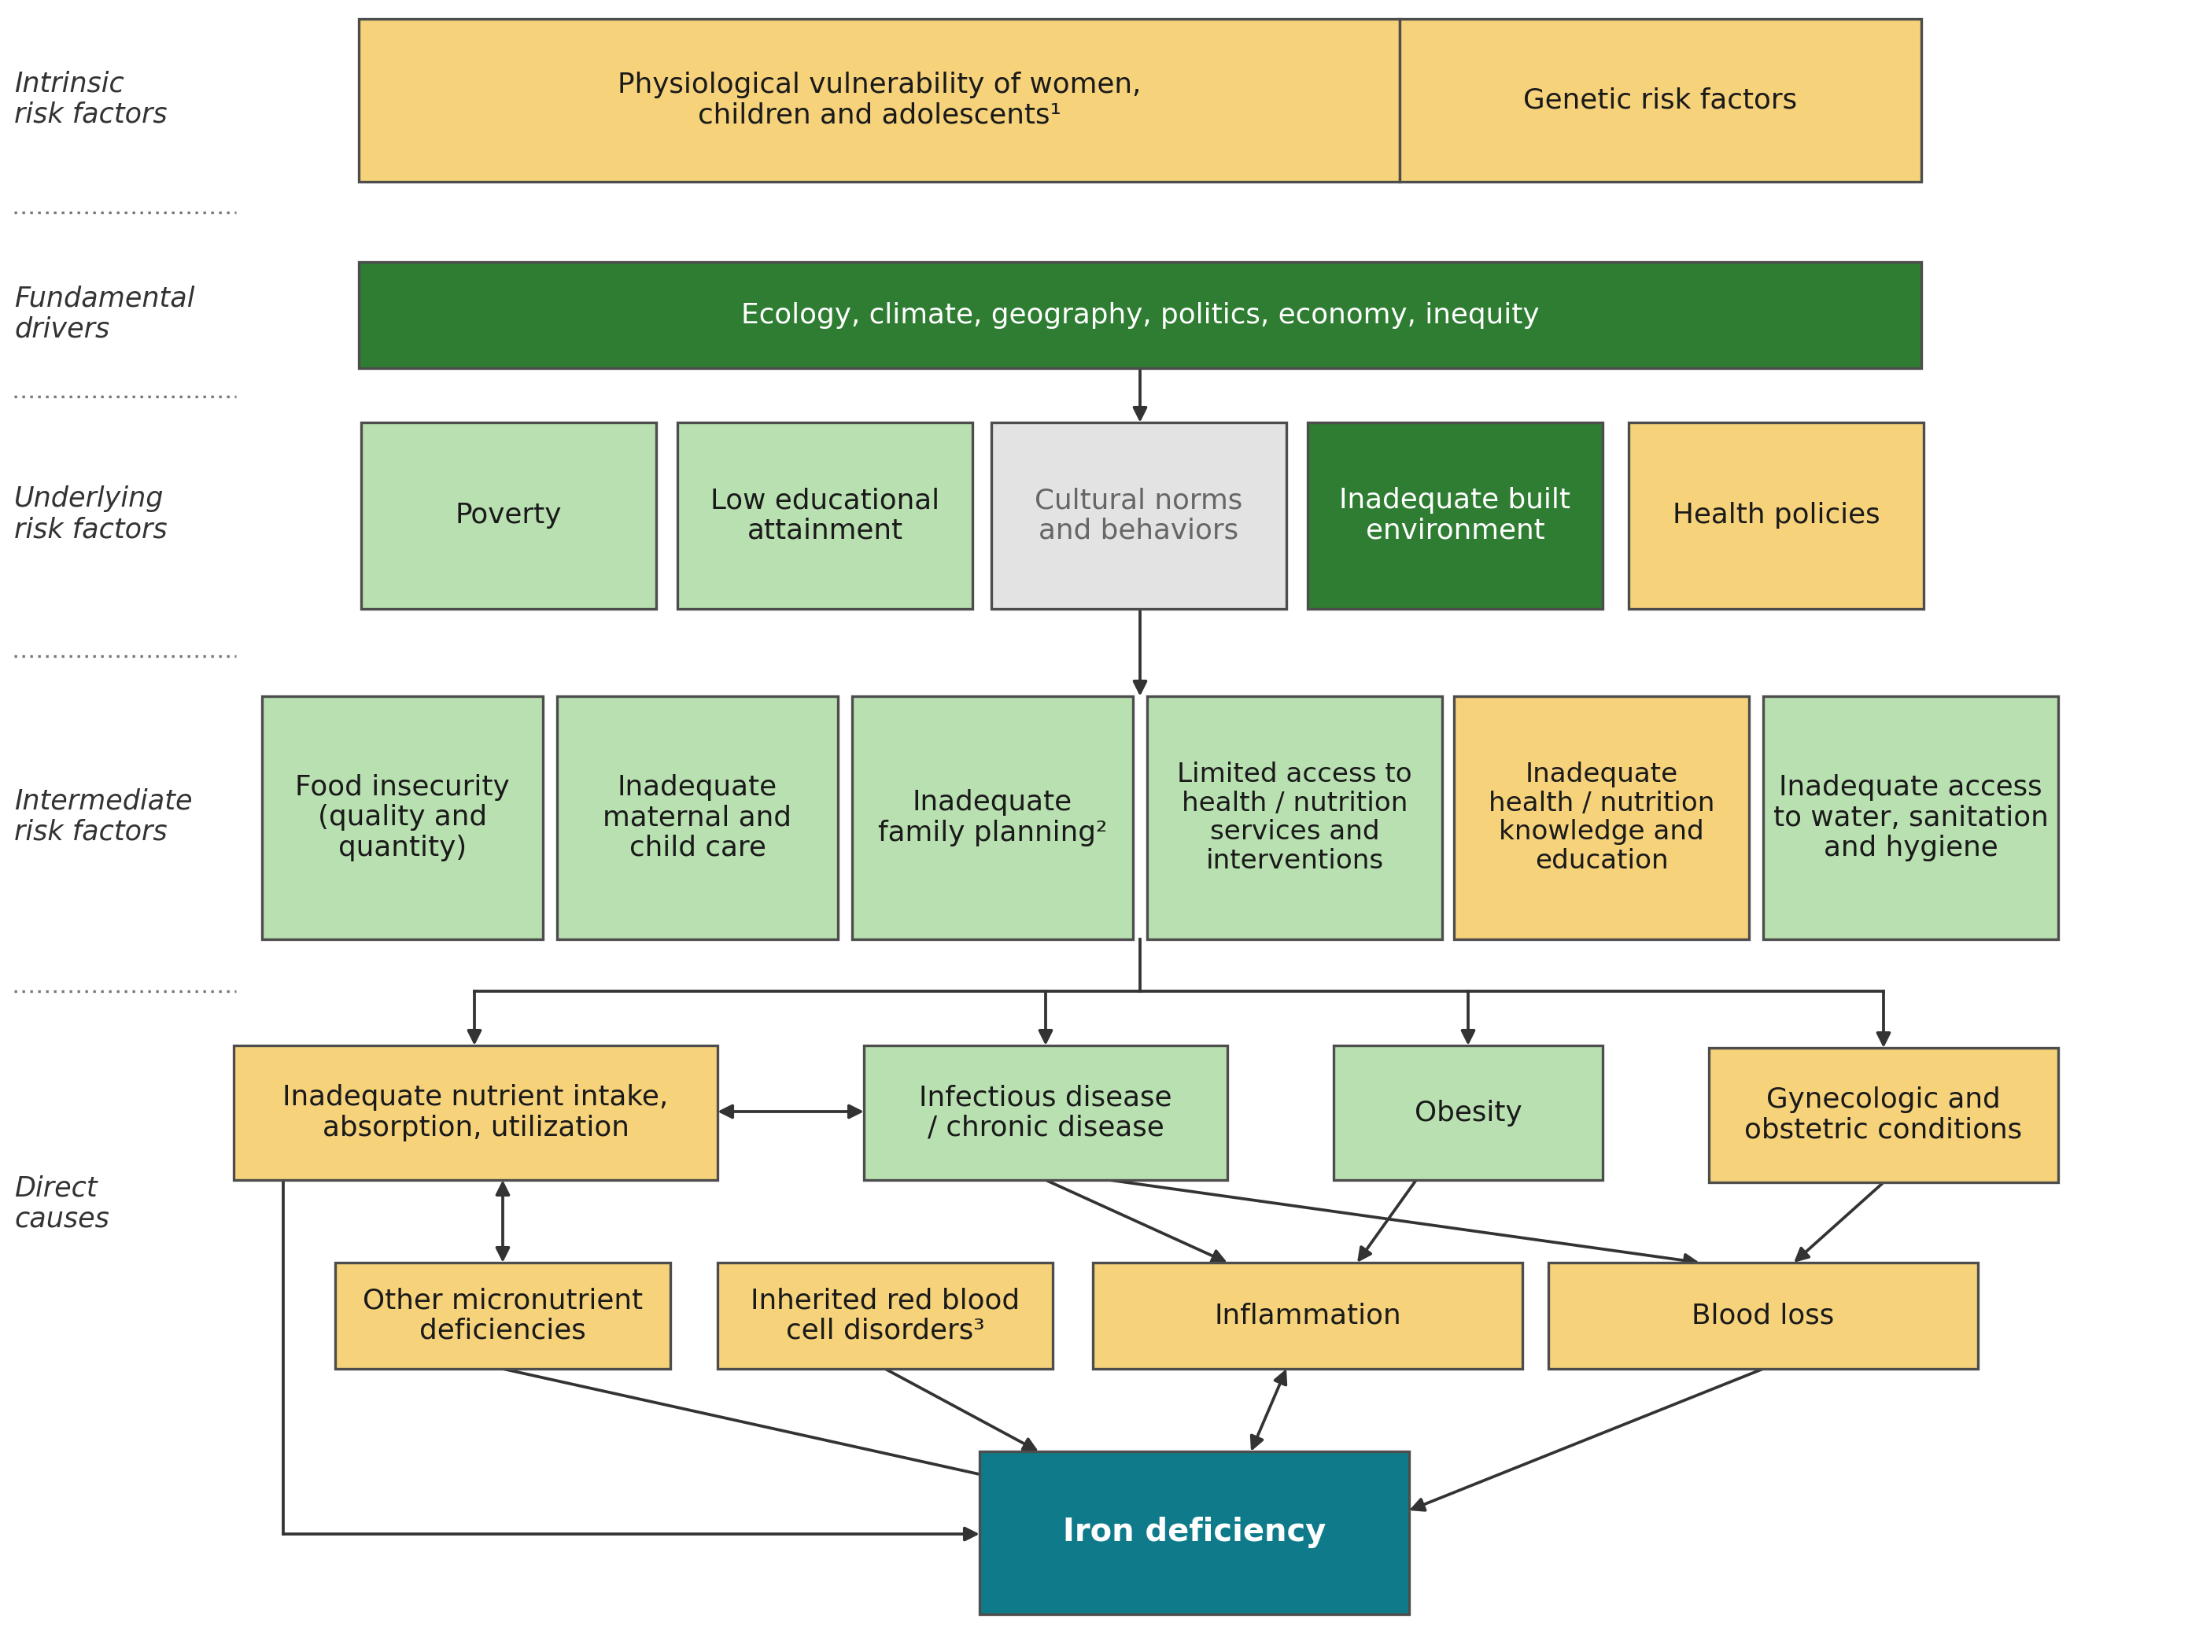
Which of these causes can public data measure?
Is there a widespread public measure?
Available, intrinsically ecological: (climate, land, built-up area)
Individual data linkable to VMD as a district aggregate (poverty, schooling, infection)
Partly: national or modelled only, or only some surrogate variables
Not publicly available
Survey outcome.
All are district averages: ecological, indirect data, never the individual whose blood was drawn.
Framework adapted from Hess et al., Ann N Y Acad Sci 2023
Notes:
SONJA, about 60 seconds (128 words).
So we went back to the framework, box by box, and asked: is there a public, district-level measure? Dark green: yes, and the data describe the place itself: climate, ecology, built-up land. Light green: yes, as a district average standing in for individuals: poverty, schooling, water and sanitation, infection. Amber: only a national figure, a modelled surface, or part of the box: genetic risk, inflammation, blood loss. Grey: nothing public: cultural norms.
One caution. Everything here is a district average. Even the direct causes are measured indirectly, as ecological data, never for the person whose blood was drawn. So these layers mark where deficiency is likely; they cannot explain any one person’s status. Andrew.
Backup, if asked: Genetic risk and inherited red blood cell disorders: the only layers are the Malaria Atlas 2012 modelled allele-frequency surfaces (sickle haemoglobin, haemoglobin C, G6PD deficiency), so amber, not green. Blood loss: hookworm and schistosomiasis prevalence from WHO ESPEN, nothing on menstrual or obstetric loss. Inflammation: infection burden only, no CRP or AGP. Calls still marked draft for Sonja: built environment, family planning, obesity, health and nutrition knowledge, other micronutrient deficiencies (scripts/policy_deck/30_mnf15_v4_framework_drawn.py).

Slide 6

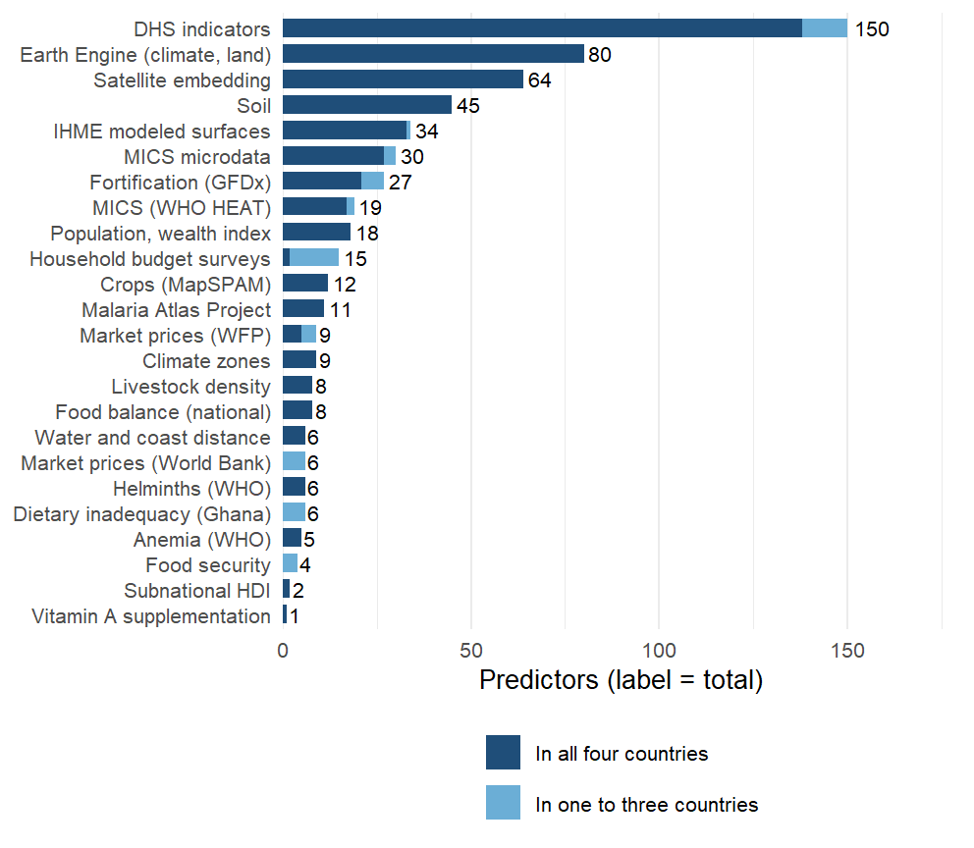


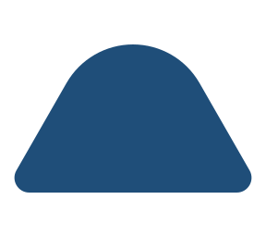


575 proxy variables from 29 conceptual domains
Environment from satellite (144)
AlphaEarth embedding; temperature, rainfall, drought index; NDVI and productivity; distance to water and coast
Agriculture and livestock (37)
MapSPAM crop mix and cropland; cattle, goat and poultry density
Infection and disease (84)
Malaria, helminths, inflammation; child morbidity and mortality; immunisation coverage
Households and economy (90)
Assets, schooling, employment; water and sanitation; fertility; access to care
Soil (45)
SoilGrids and iSDA: pH, organic carbon, texture, nutrient availability
Food, prices and diet (83)
WFP and World Bank prices; budget-survey diets; fortification and supplementation coverage
Nutrition status (64)
Stunting and wasting; anemia surfaces; infant and young child feeding
full talk
Notes:
SAY: Twenty-nine domains, grouped here into eight for the slide, with the number of predictors in each. Each domain enters the model as its leading principal components rather than as raw columns, because 575 columns against 14 to 87 districts cannot be fitted one by one.
DETAIL: Why domains: 575 columns against 14 to 87 districts per country cannot be fitted column by column, and the columns are heavily correlated within a source. Grouping them by what they measure and taking principal components inside each group keeps most of the variance of each group, treats a source with 64 columns and a source with 3 as one construct each, and keeps the outcome out of the representation: the rotations are learned from the training districts’ predictors alone, so nothing is selected on the biomarker. The grouping is written down: each source block brings a label, and 10 override rules in metadata/covariates/domain_overrides.csv regroup columns by construct (infection and inflammation burden, immunisation, anemia, child anthropometry, infant feeding, supplementation, water and sanitation, education, child mortality, assets), so that MAP, IHME, DHS and MICS versions of the same thing are weighed together. Two things went wrong this week and are now guarded. A domain’s first twelve characters are its key inside the model; two labels that shared them (“Food prices (RTFP)” and “Food prices and supply”) were silently merged in two analyzes until a check caught it on 16 September. The other is in the exclusions, on the next slide. One more point for questions: climate alone or soil alone transports better than all domains together, the analysis deck’s climate-and-soil result.

Slide 7
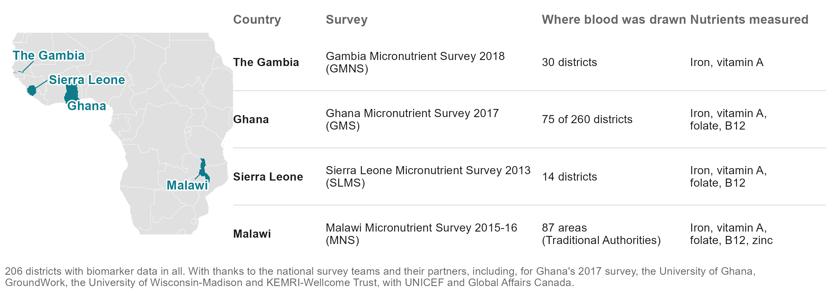
Which surveys did we use to train the models?
Notes:
SONJA, about 25 seconds (57 words).
The model learns from four national micronutrient surveys: The Gambia 2018, Ghana 2017, Sierra Leone 2013 and Malawi 2015 to 16. Together, 206 districts where blood was drawn. These data exist because these teams collected them, and some of them are in the room today. Thank you.
Backup, if asked: outcome definitions, adjustments and cut-offs are in the appendix. Sierra Leone’s child file holds only anaemic children (532 of 654 assayed). Malawi’s areas are Traditional Authorities.

Slide 8


How does the model work, and how was it tested?
1. Four national biomarker surveys
2. 575 proxy variables
3. Ensemble machine learning
4. National and subnational rankings and prevalence
The Gambia 2018, Ghana 2017, Sierra Leone 2013, Malawi 2015-16: 206 districts where blood was drawn
Climate, soil, crops and livestock, disease, food prices, household surveys: every district, 28 sources, none bought
Fourteen methods, including a SuperLearner ensemble, compared on hidden districts. The simplest, a Domain-PC index, did best
Every district, including those no survey reached, and countries with no survey at all
Tested by hiding one district in five, then a whole region, then a whole country. Scored by how often it puts the worse of two districts first: a coin toss gets half
Notes:
ANDREW, about 55 seconds (126 words).
Thank you, Sonja. Here is the whole study in four steps. One: four national biomarker surveys, 206 districts where blood was drawn. Two: the 575 public layers, for every district. Three: machine learning. We compared fourteen methods, from random forests and boosting to a SuperLearner ensemble that combines them, and a very simple one won; we call it the Domain-PC index. Four: a ranking of every district, and with a survey’s national figure a prevalence, including districts no survey reached and countries with no survey at all.
Every number I show comes from hiding data and predicting it: a district, a region, a whole country. And we score it simply: out of every pair of districts, how often do we put the worse one first? A coin toss gets half.
Backup, if asked: 14 alternatives on identical folds, 1,304 fits (SL-06). The in-country fit uses the 383 open or public-survey layers; the cross-border fit uses the layers common to all four countries. Pairs metric: share of district pairs ordered as the survey orders them; correlations are in the notes where they help.

Slide 9


How does the best-performing model work?
1. Rank-normalize within country
2. Domain components
3. Weight by rank correlation
4. Sum and rescale
Every predictor becomes a within-country rank, so a level offset between surveys cannot act as signal.
Leading principal components of each of the 29 domains, to 80% of variance, learned on the training districts only.
Each component is weighted by its Spearman correlation with the outcome in the training fold; sign and size, nothing else is fitted.
The weighted sum, rescaled to the training outcome's spread; the infinite-penalty limit of a ridge regression on the components.
full talk
Notes:
SAY: Four steps, none of which looks at a held-out district: rank every predictor within its country; take the leading components of each domain; weight each component by how well it tracks the outcome in the training districts; add them up. It is a weighted sum with the weights read off the data, nothing tuned.
DETAIL: Four steps, none of which looks at a held-out district. (1) Rank-normalize every predictor within country, so a level offset between surveys cannot act as signal. (2) Take the leading principal components of each of the 29 domains, to 80% of variance and at most twelve, on the training districts. (3) Weight each component by its rank correlation with the outcome in the training fold, sign and size; nothing else is fitted. (4) Sum, and rescale to the training outcome spread. The index is the infinite-penalty limit of a ridge regression on the components (weighting slide in the appendix), and because it is linear in the rank-normalized columns every column has an exact back-projected weight, which is what the importance slides show.

Slide 10
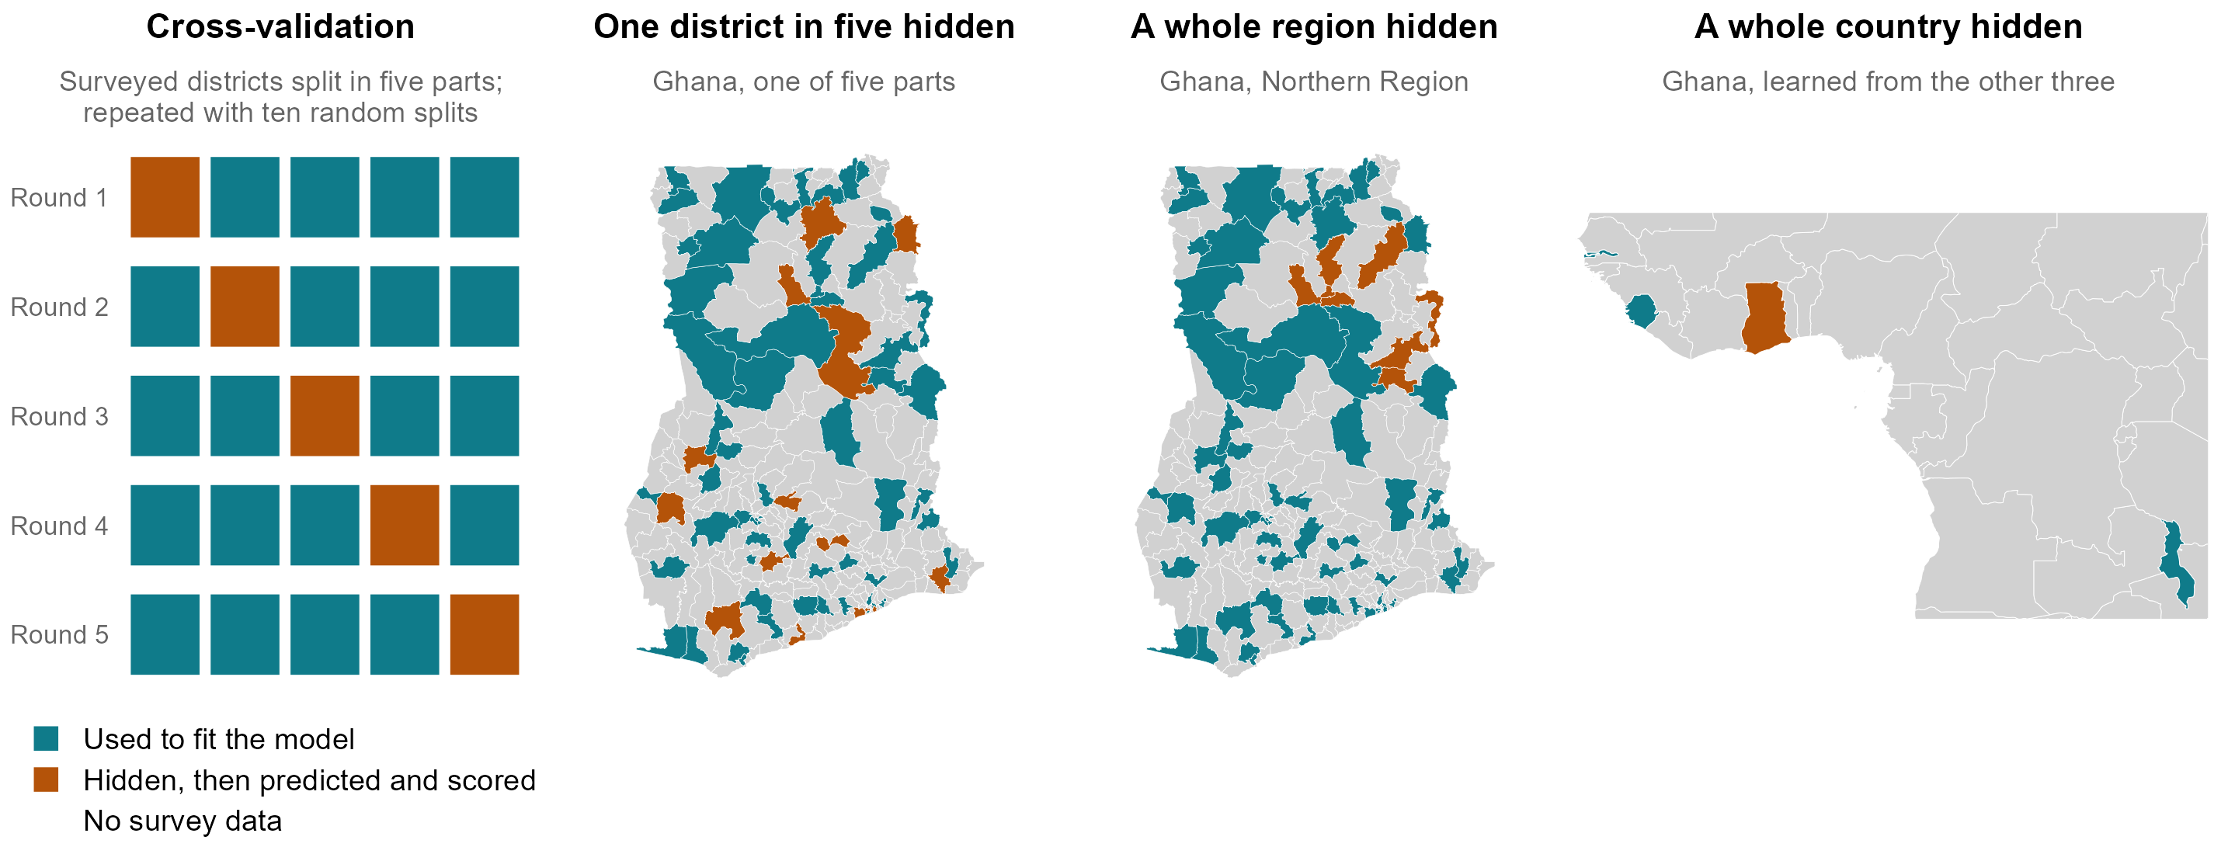
How do we get honest estimates of model performance?
Notes:
ANDREW, about 40 seconds (92 words).
Here is what hiding data looks like. On the left, cross-validation: we split the surveyed districts into five parts, fit the model on four, predict the fifth, and rotate until every district has been predicted without its own data; then we repeat with ten random splits. Next, the same with a whole region hidden, here Ghana’s Northern Region. And a whole country: Ghana predicted from the other three countries. Every score in this talk is on the orange districts, data the model never saw.
Backup, if asked: folds are cut at the district or above, never through a district’s respondents; component weights and every other choice are learned inside the training folds. The middle map is the benchmark’s first fold draw (make_folds_v2, rep 1).

Slide 11
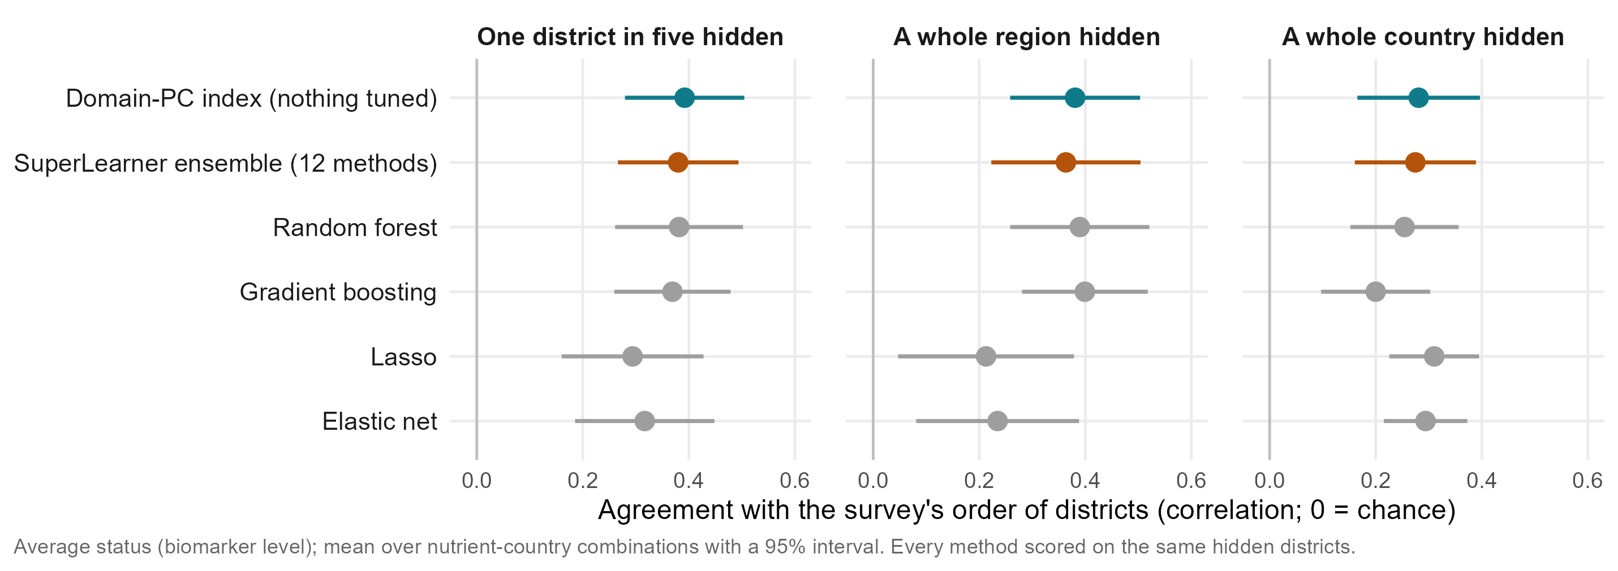
Why not a more complex machine-learning model?
Cross-validation: every score comes from districts the model never saw, the same hidden districts for every method.
Big data in predictors (575 layers), small data in places (14 to 87 districts per country, each measured in about one community).
With so few places, methods that tune themselves chase noise: the untuned Domain-PC index matched or beat them all, including an ensemble of twelve.
Notes:
ANDREW, about 50 seconds (108 words).
The obvious question for the machine-learning people here: why such a simple model? Cross-validation answers it. We hide districts, fit on the rest, and score only on the hidden ones, with the same folds for every method. This is a big-data project in predictors, 575 layers, but a small-data project in places: 14 to 87 districts per country, each measured in about one community. With that few places, anything that tunes itself chases noise. The untuned index was the best, or within a whisker of the best, in every test, and the SuperLearner ensemble, which combines twelve methods, did no better. Parsimony wins.
Backup, if asked: Average status, SL-06 run (same folds for every learner). One district in five hidden: index 0.39, SuperLearner 0.38, random forest 0.38, boosting 0.37, elastic net 0.32, lasso 0.29. A region hidden: 0.38, 0.36, 0.39, 0.40, 0.23, 0.21. A country hidden: 0.28, 0.27, 0.25, 0.20, 0.29, 0.31. Forest and boosting edge the index by 0.01 to 0.02 when a region is hidden, lasso by 0.03 across borders, all well inside the intervals. On the share deficient the index leads inside a country (0.27 against at most 0.24 for these methods) and with a region hidden (0.27 against at most 0.23); across borders the ensemble is marginally ahead (0.20 against 0.19). A sample-size finding, not a claim about machine learning in general.

Slide 12


Both a big-data opportunity and a small-data problem
Big data: the predictors
Small data: the outcome
575 columns from 28 sources
Rasters at 30 m to 10 km summarized over 554 districts; a 64-dimension satellite embedding; four household surveys aggregated from microdata.
One biomarker survey per country per decade
Four surveys, 24 country-outcome cells, 206 surveyed districts in all.
Reduced to 29 domains
Leading principal components per domain, learned on training districts only; nothing chosen on the outcome.
14 to 87 districts per country
The effective sample size of every model; a tuned estimator shrinks to the constant, so the index tunes nothing.
All of it public
The headline set has no DHS in it; a country without a recent DHS can rebuild it.
Honest folds and a reliability ceiling
Folds cut by district, region and country; the survey's own district noise sets the ceiling any model can reach.
full talk
Notes:
SAY: The same project is both. The opportunity: hundreds of public layers covering every district. The problem: the thing we predict is measured once a decade, in 14 to 87 districts per country. Everything in the protocol follows from holding both at once.
DETAIL: The same sentence describes both halves. Big: 575 columns from 28 sources, most of them rasters at 30 m to 10 km summarized over 554 districts, four household surveys aggregated from their microdata, a satellite embedding with 64 dimensions per district. Small: the thing being predicted is measured in one biomarker survey per country per decade, at 206 surveyed districts over four countries, 24 country-outcome outcome-country combinations, and 14 to 87 districts per country, which is the effective sample size of every model. Everything in the protocol follows from holding both at once: predictors are reduced to domain components with nothing chosen on the outcome, the estimator has no tuned parameter, the folds are cut by district, region and country, and the reliability ceiling says how much of the survey signal is noise at district level. Likely question: why not fit at the person level. That was the January approach; a person-level classifier under district-blocked folds is a coin toss on proxies alone, and shrinking its predictions biases area means (individual-level slide in the appendix).

Slide 13





How do we choose among algorithms?
A competition of algorithms
Simple regressions and more complex machine learning models side by side, to allow interactions and nonlinear associations.
The best team wins
A weighted combination of algorithms; the weights come from performance on data the algorithms did not see.
V-fold cross-validation
Internal data splits by district, so that no district is in both training and validation; guards against overfitting.
The library
Simple mean, penalized regressions, random forest, gradient boosting, additive trees, spatial smoother, geostatistical models, and the principal-component index that wins.
full talk
Notes:
SAY: By ensemble machine learning, SuperLearner: every algorithm in the library is scored on data it did not see, with folds cut by district so no district is split between training and validation, and the best one, or the best weighted combination, is chosen. The principal-component index is one candidate in that library, and it is the one that wins.
DETAIL: No penalty other than computation to add a learner: diversity, redundancy, synergy. Library: mean, penalized regressions, random forest, gradient boosting, PCA-HAL, BART, geostatistical models, the PC index. Discrete SuperLearner picks the single best learner by cross-validated loss; the weighted version combines them. The figure on the right is the V-fold scheme.

Slide 14
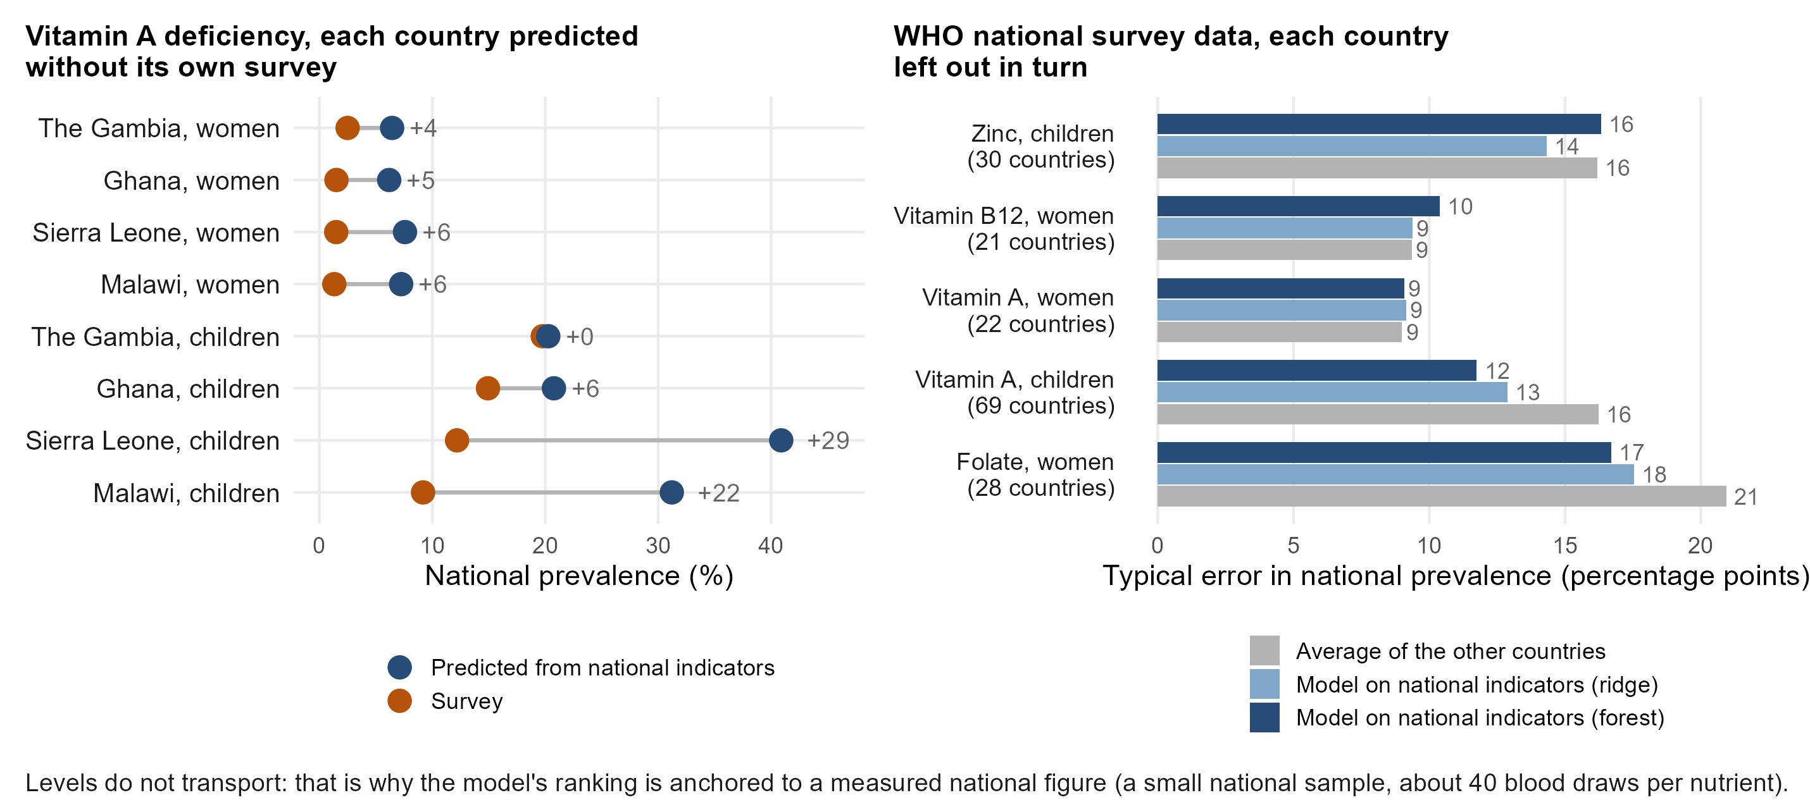
But can proxy models recover national-level prevalence estimates?
Notes:
ANDREW, about 45 seconds (112 words).
A question from our January meeting: can proxy models give a national prevalence? Inside a surveyed country the survey already gives it. Without the country’s survey, not reliably. On the left, vitamin A deficiency predicted for each of our countries from national indicators, with that country’s survey left out: close for The Gambia, but 29 points too high for Sierra Leone and 22 for Malawi. On the right, WHO’s national survey data from 20 to 70 countries: leaving each country out, the typical error is 9 to 17 points, little better than the average of the other countries. Levels do not travel between surveys; district order does. So we measure the national level with a small sample, and use the model for the order.
Backup, if asked: national track, WHO VMNIS national survey panel with World Bank indicators (national_vmnis_loco.csv, national_composition_levels.csv); only vitamin A has national panels matching our four surveys. The January version compared national predictions made inside each country, which match by construction. Why levels do not travel: assays, cut-offs, inflammation adjustment and RBP-to-retinol calibration differ between surveys (ferritin levels differ several-fold).

Slide 15
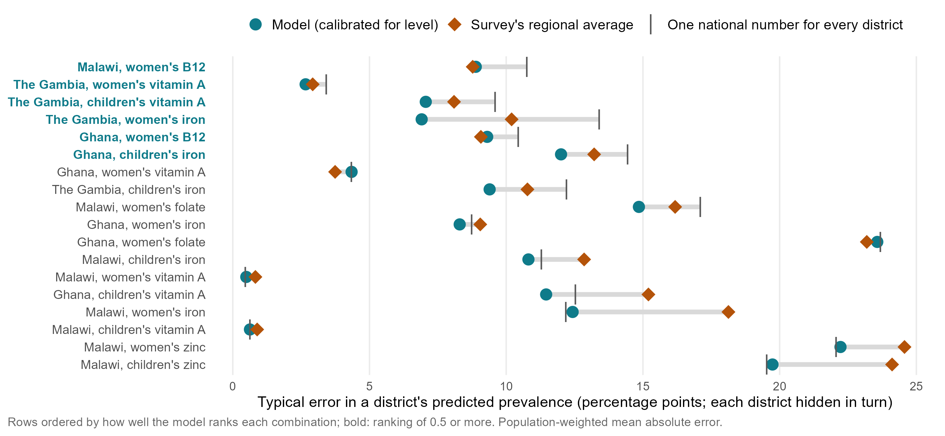
How far off is the predicted prevalence, outcome by outcome?
full talk
Notes:
SAY: Same combinations, now the level: how many percentage points each district’s predicted prevalence is from the survey’s. Read this slide as the limit of what any of us has today. At district level nobody has a level: the survey’s own regional breakdown is no better than writing one national number on every district. The model, once it is shrunk for this job, is slightly better than both — and that is all. It is built to order districts, not to measure them.
DETAIL: Same combinations, same order, prevalence scale: the population-weighted mean absolute error of each district’s held-out prevalence, in percentage points, for three arms — the calibrated index, the survey’s own jackknifed regional average, and one national number for every district (the status quo where no sub-national estimate exists). Means over the 18 scored cells: calibrated index 10.74, regional average 11.77, national number 11.49, spatial smoother 10.93. The arm this slide used to plot, the DEPLOYED ranking (domain_index), scores 14.25 and is worse than the national number in 13 of 18 cells: it is rescaled to the training districts’ spread, so its predictions carry the full between-district variance while correlating about 0.28 with the truth, and refusing to shrink inflates absolute error. Shrinking it costs ranking (level 0.40 to 0.35, prevalence 0.28 to 0.21), so the two arms are two products: domain_index for the order, domain_index_cal for any level, MAE or bias. Both are in benchmarks_v2_cells.csv; no rerun is needed. Read the error against the outcome: 10 points on an outcome at 40% is a different thing from 3 points on one at 4%, which is why the rare-outcome combinations look accurate here and useless on the ranking slide. The geostatistical comparator slide shows what a model built to estimate a level does to absolute error (9.2 against 10.7). Where a level has to be defended, this slide plus the national anchor is the argument, not the ranking correlation.
REDRAWN (27 Sep) for Andrew's comment: a legend in words, the national number as a bar, larger points (scripts/policy_deck/31_mnf15_v4_january_updates.R). Means over 18 cells: model 10.3 points, regional average 11.8, one national number 11.5.

Slide 16
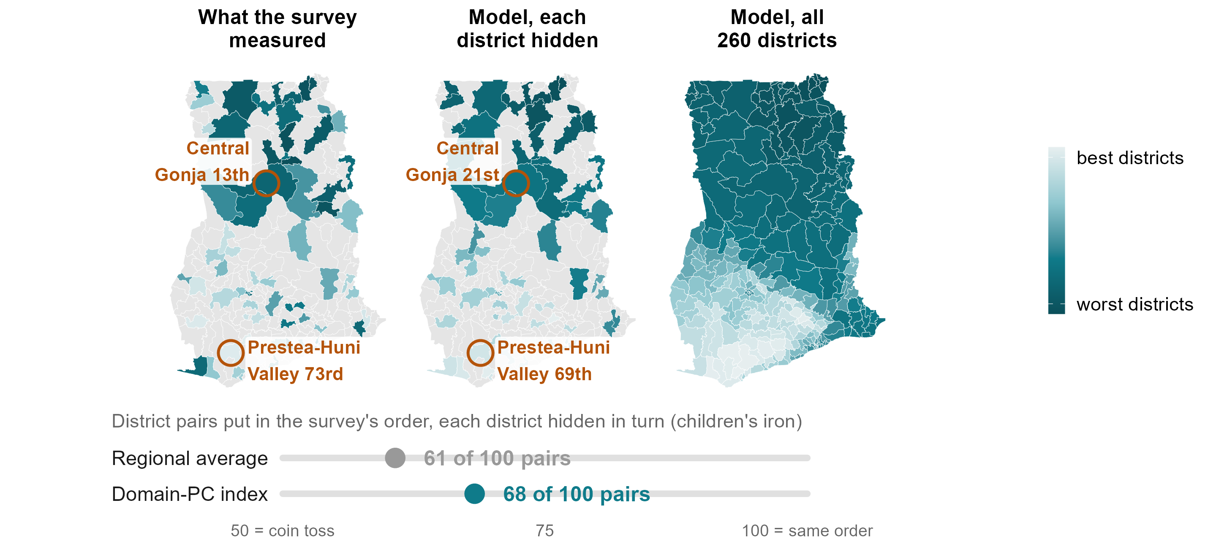
What about subnational prevalence estimates?
Notes:
ANDREW, about 55 seconds (119 words).
Subnationally, the model works district by district. Here is Ghana, children’s iron, as the order of districts; the level comes from the survey’s national figure. Left: what the survey measured in the 75 districts it reached. Middle: the model’s prediction for each of those districts with that district’s own blood results hidden. Right: the model for all 260 districts.
Take Central Gonja, in Savannah region. The survey found it 13th worst of 75. Its regional average would put it 51st, middle of the pack. The model, which never saw its results, puts it 21st. And Prestea-Huni Valley, in the south-west: the survey found it among the best, 73rd; its regional average says 39th; the model says 69th. Overall, the model puts 68 of every 100 district pairs in the survey’s order; the regional average, 61.
Backup, if asked: Correlations 0.53 against 0.36, reproducing benchmarks_v2_cells.csv. The regional average is the district’s own region averaged over the OTHER surveyed districts there (the district itself left out); a national mean that leaves out the district’s own region reverses the order (26 per cent of pairs, correlation -0.62), so it is not a fair comparator. The model is wrong in places too: its median district is 13 places from the survey’s rank, the regional average’s 18; the largest miss is Atiwa East (24th in the survey, 65th in the model). A map built from the survey’s own neighbouring districts does about as well here (69 of 100 pairs, 0.53), but it needs the survey: averaged over all 18 in-country combinations the index scores 0.40 and the neighbour map 0.39; with a whole region hidden 0.38 and 0.38 on average status, 0.29 and 0.24 on the share deficient. Central Gonja rests on two survey clusters, Prestea-Huni Valley on one.

Slide 17
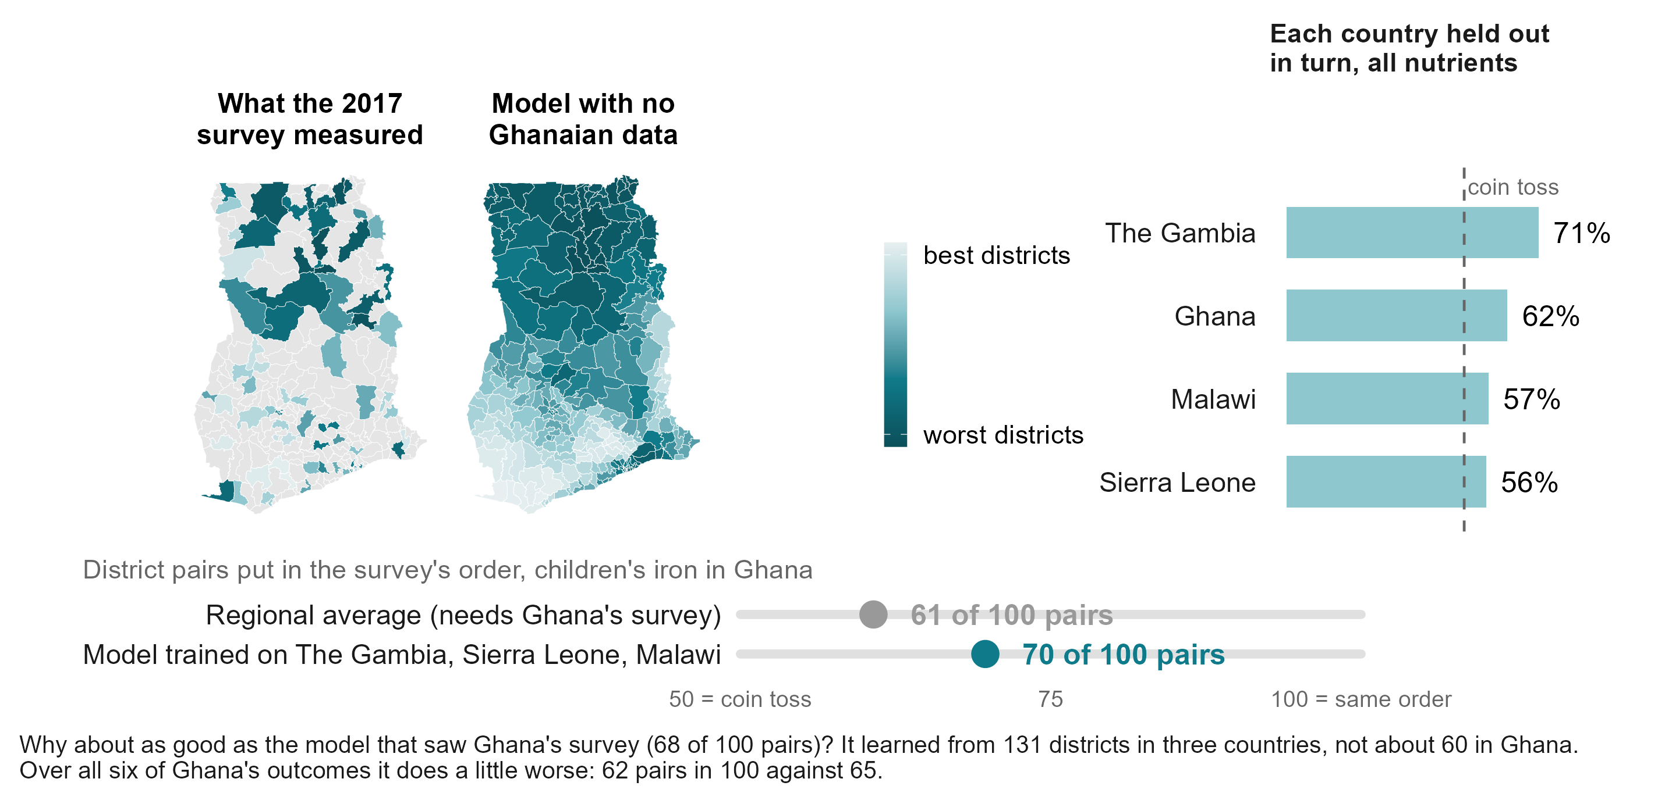
Can it rank Ghana’s districts without Ghana’s survey?
Notes:
ANDREW, about 60 seconds (134 words).
Now the test that matters for most of this region: we removed Ghana’s survey entirely. The model learned only from The Gambia, Sierra Leone and Malawi. It still puts 70 of every 100 pairs of Ghana’s districts in the survey’s order for children’s iron. This is one of our better cases.
Why no worse than the model that saw Ghana’s own survey? Because it learned from 131 districts in three countries, instead of about 60 in Ghana. Across all six of Ghana’s outcomes it does a little worse, 62 against 65. Holding each country out in turn: 71 for The Gambia, 62 for Ghana, 57 for Malawi, 56 for Sierra Leone. When it puts a district in the worst third of a country it has never seen, it is right about half the time, against a third by chance. A shortlist, not a measurement.
Backup, if asked: Correlation 0.554 held out against 0.529 in-country for this outcome, well within each other’s intervals (in-country 95 per cent interval 62 to 75 per cent of pairs). The in-country score is the average over ten draws of five folds, each fold trained on 60 Ghanaian districts; the held-out score is one fit on the three other countries. Ghana held out does better than Ghana in-country for children’s iron, children’s vitamin A and B12, worse for women’s vitamin A, iron and folate. Worst-third calls land 52 per cent of the time against 33 by chance; of the five worst named, 62 per cent.

Slide 18
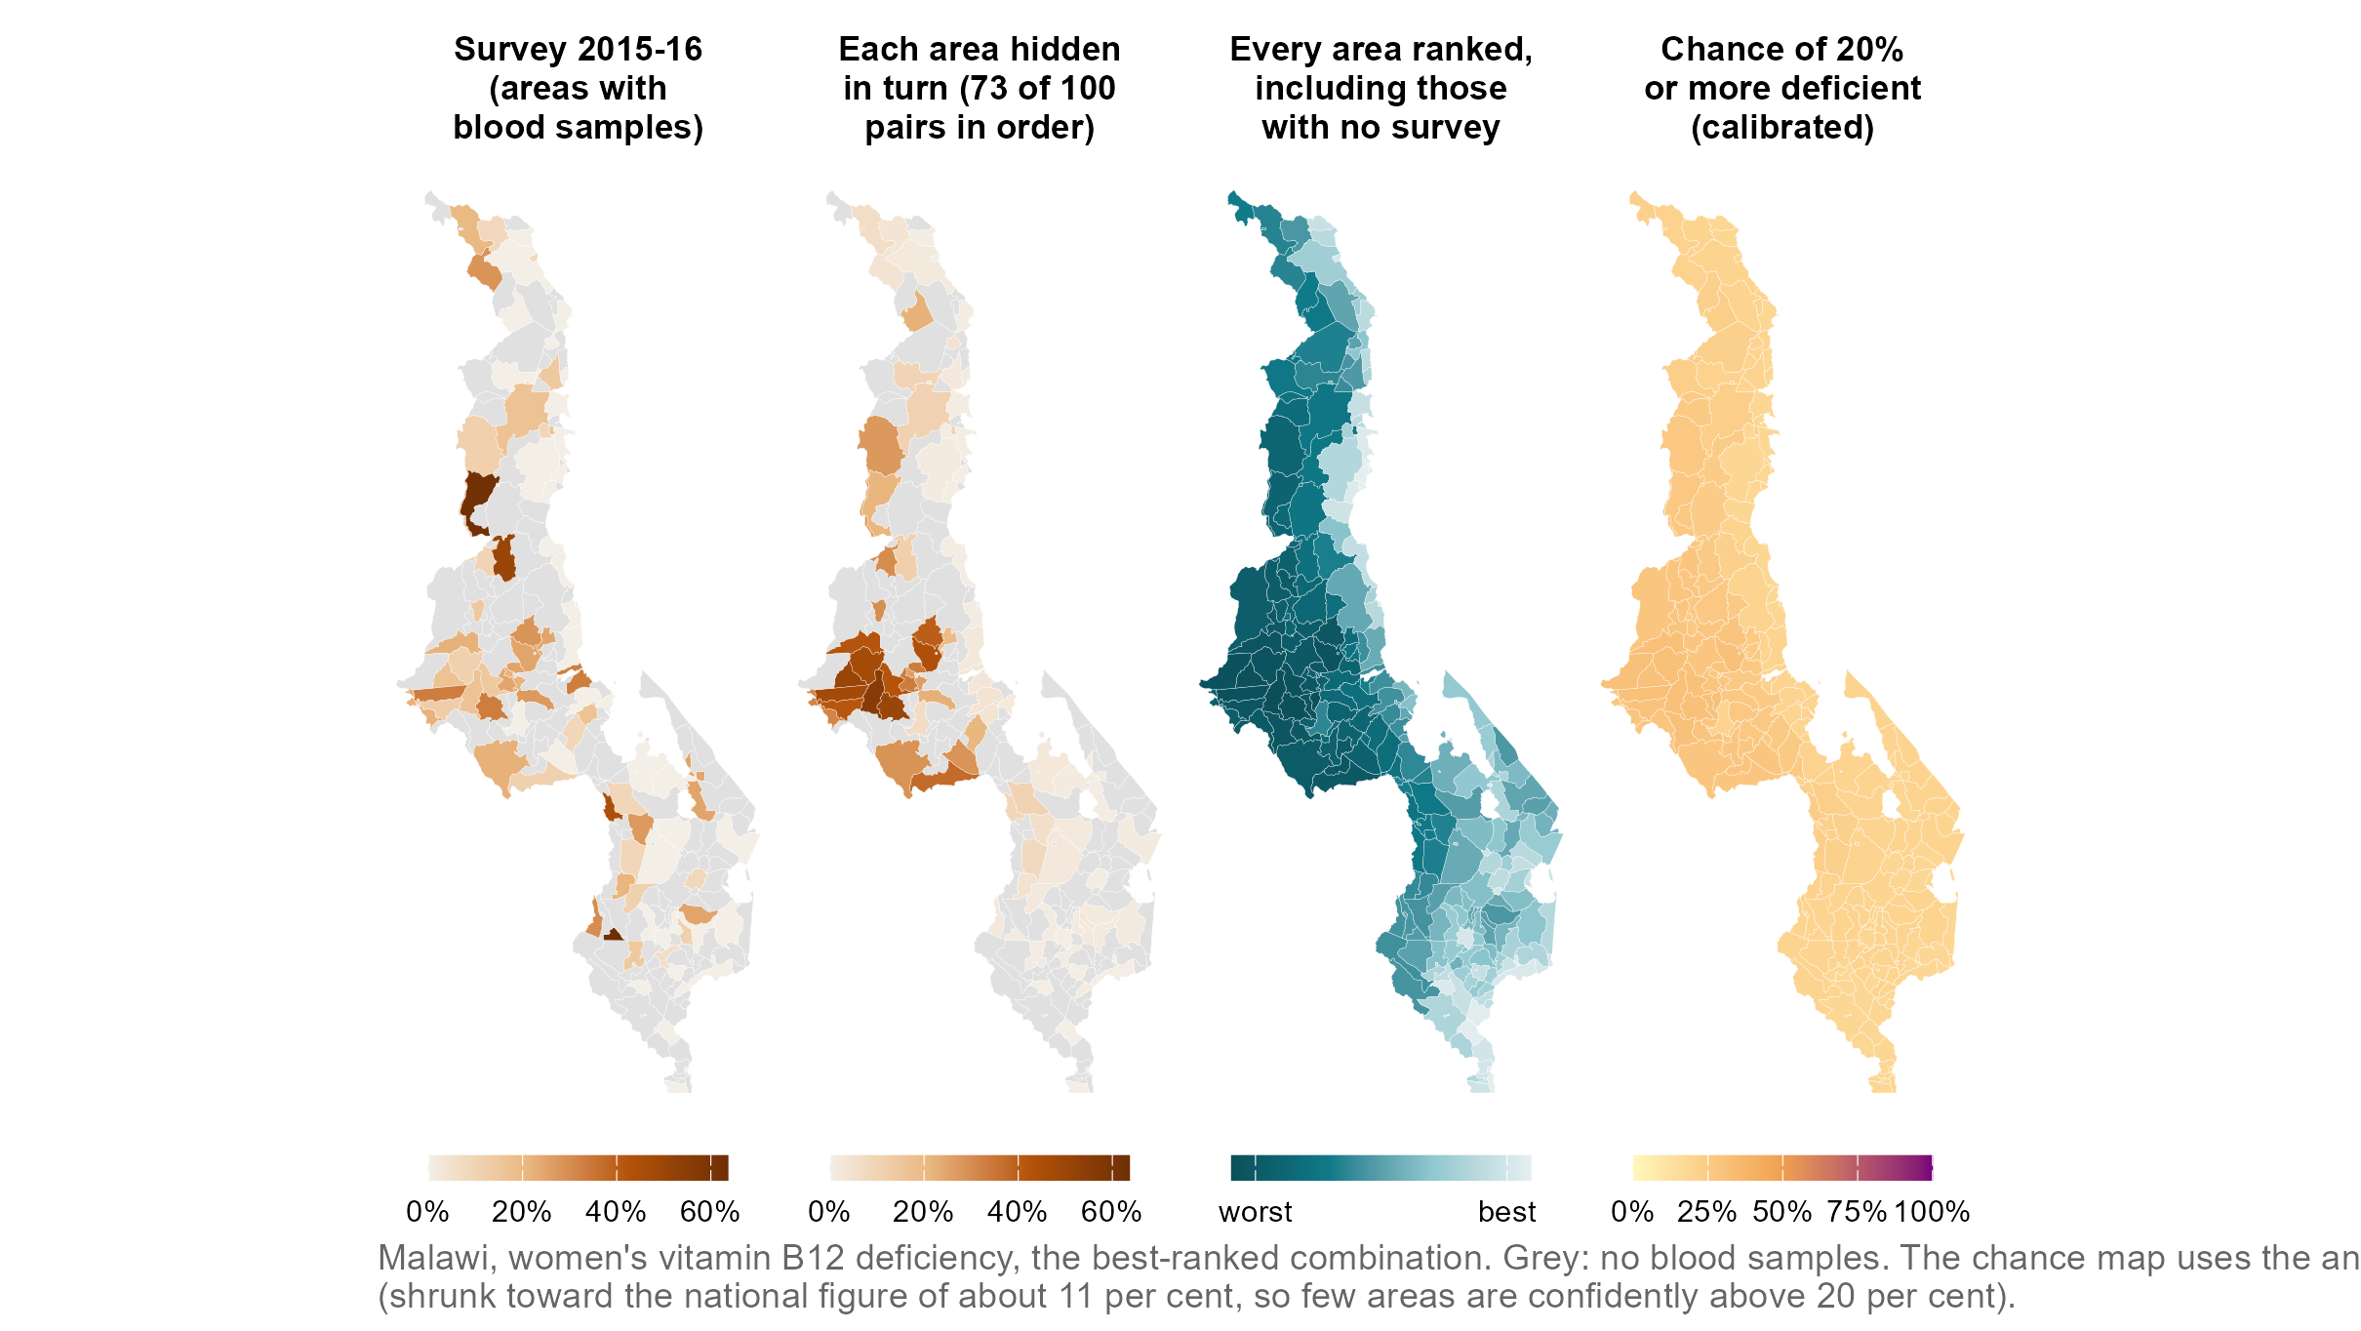
Malawi: survey, held-out prediction, every area ranked, and uncertainty
full talk
Notes:
SAY: Ghana, women’s iron deficiency, one outcome across the four questions a map has to answer. Left, what the survey measured, district by district. Second, what the model predicts for each of those districts when it is held out. Third, the model applied to every district including the ones never surveyed. Right, the calibrated chance that each district sits at or above the WHO moderate line - a probability that has been checked, not a shading of the model’s mood.
DETAIL: Panel 2 is the in-fill out-of-fold prediction (5-fold by district, ten draws, prevalence target). Panel 3 is the deployment fit as the dashboard shows it: the index on all surveyed districts, level-calibrated, anchored to the national figure, in-sample for the surveyed ones. Panel 4 (CP-01, 27 September): the conformal-predictive-distribution chance of sitting at or above the 20 percent line, from out-of-fold residuals whose 90 percent band covers the survey’s own value 91 percent of the time under leave-one-out; the cell’s half-width is about 20 points, much of it the survey’s own single-cluster noise. Gray in panels 1 and 2: no survey clusters. Tables: viz/oof_women_iron.csv, viz/deploy_ghana_women_iron_cal.csv.
REPLACED (27 Sep) for Andrew's comment: Ghana women's iron (ranking 0.40) swapped for Malawi women's B12, the best-ranked combination (73 of 100 pairs on the prevalence scale, each area hidden). Panel 3 shows the deployed order; panel 4 the calibrated chance of 20% or more, which is low almost everywhere because the calibrated prevalence is shrunk toward the national 11 per cent. Tables: viz/oof_women_b12.csv, viz/deploy_malawi_women_b12_cal.csv (scripts/policy_deck/10_viz_tables.R A,B2 with VZ_* overrides).

Slide 19
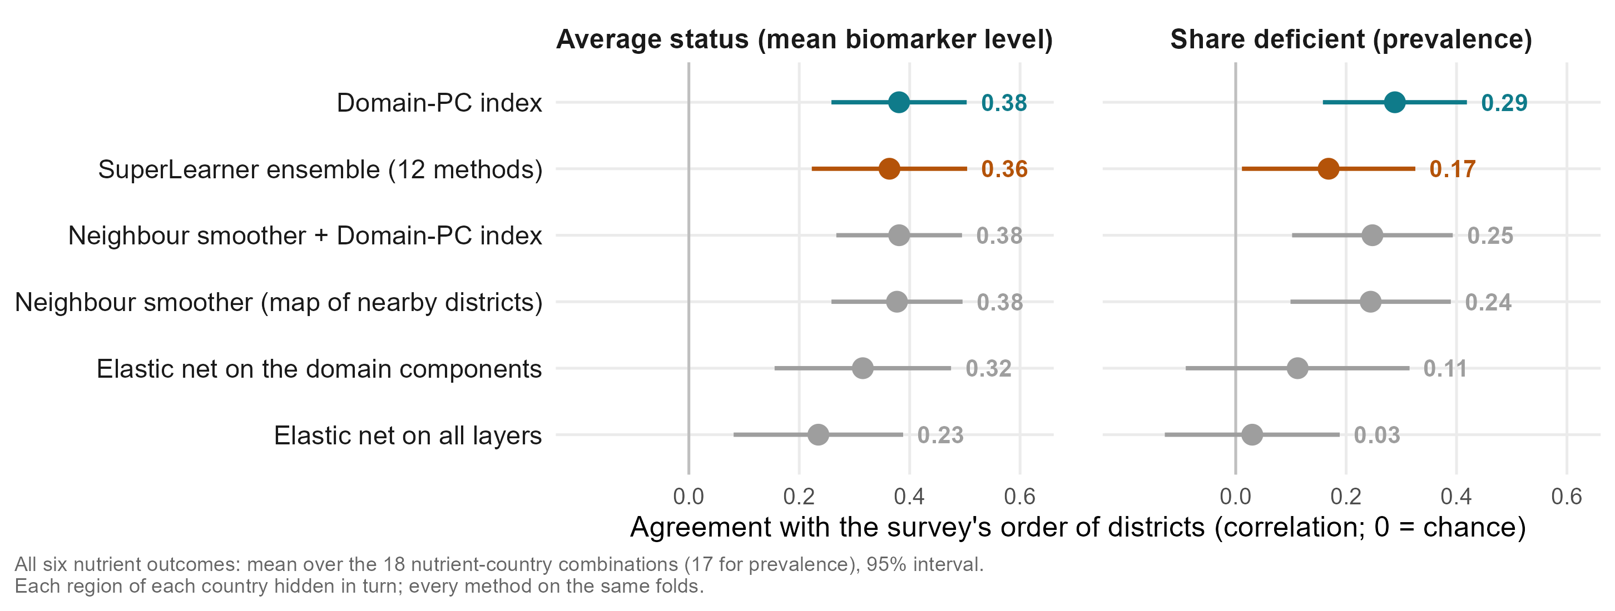
What happens when a whole region is held out?
Notes:
ANDREW, about 40 seconds (71 words).
In between the two: a whole region the survey never reached, which is the hardest case for a map built from neighbouring districts, because it has to extrapolate. On average status, the index holds up and is level with that neighbour map. On the share deficient it is the best method. The SuperLearner ensemble is no better, and penalised regression on all the layers falls away. All six nutrient outcomes, averaged.
Backup, if asked: SL-06 run, every arm on the same folds, 18 nutrient-country combinations (17 on the share deficient, where one lacks the all-layer elastic net). The benchmark table gives the index 0.39 on average status in this estimand; this run 0.38. Ghana and Malawi are where this estimand is well determined; The Gambia and Sierra Leone give one number per region.

Slide 20
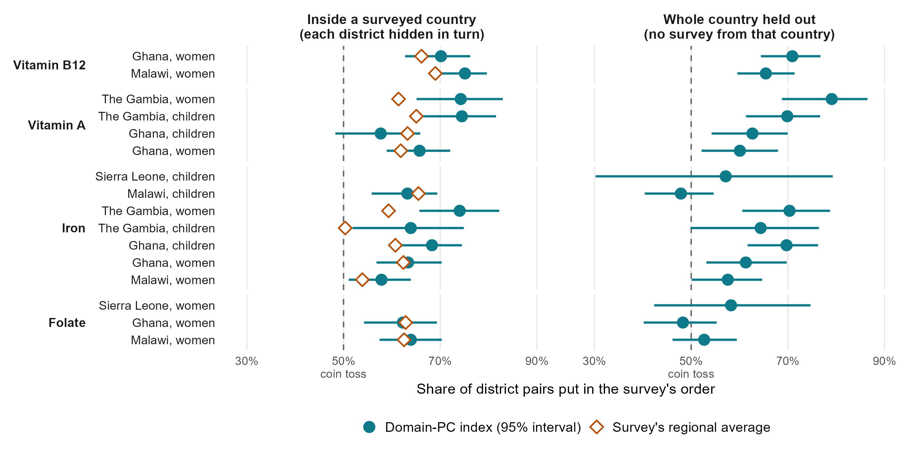
How well does it rank districts, nutrient by nutrient?
Notes:
ANDREW, about 50 seconds (112 words).
Here is every nutrient and country, with a 95 per cent interval. Left, inside a surveyed country; right, a whole country held out. B12 is the most mappable: about 70 of every 100 pairs right, at home and across borders, probably because it follows animal-source foods. Vitamin A works well in The Gambia and Ghana but was the weakest in the external check, so we would not rely on it for vitamin A yet. Iron works in most places, not all: across borders, Malawi’s children are no better than a coin. Folate works inside a country but not across borders, most likely because the surveys measured it differently.
Backup, if asked: Measurable combinations only (16 of 24; zinc fails the screen). Intervals: percentile bootstrap over districts; in-country intervals clear 50 per cent in 13 of 14, held out in 10 of 16. Averages: 67 per cent inside a country (regional average 62), 62 per cent held out. Orange diamonds: the survey’s own regional average, which needs the survey. Folate: immunoassay in Ghana and Sierra Leone, microbiologic assay in Malawi.

Slide 21
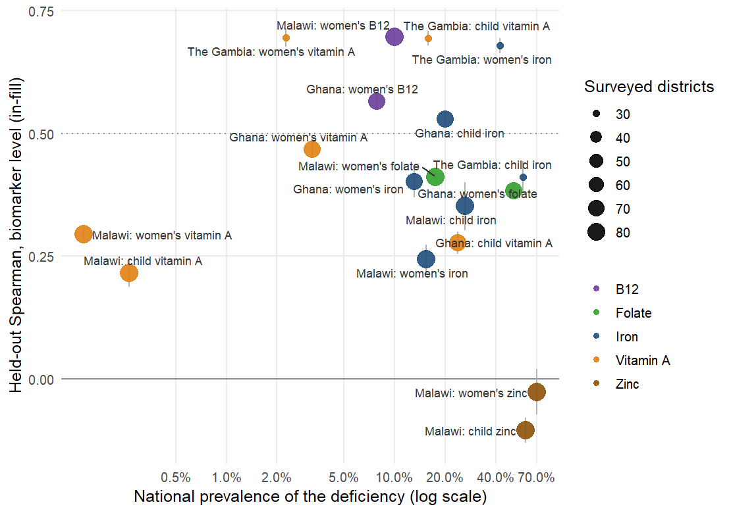
Where do the rankings work?
Where it works: iron, B12 and vitamin A where the deficiency is common, and everywhere the survey has several clusters per district.
Why not elsewhere: an outcome under 1% prevalence has nothing to rank, zinc carries no district signal, and a single-cluster district gives the survey too little to be compared with.
full talk
Notes:
SAY: Each point is one outcome in one country against how common the deficiency is. Above the line: iron, B12 and vitamin A where they are common enough to measure, and The Gambia everywhere. Below: the very rare outcomes, zinc, and the single-cluster countries. The model needs a survey that can see districts before it can be shown to rank them.
DETAIL: Each point is a country-outcome outcome-country combination: the index’s in-fill ranking accuracy against how common the deficiency is nationally. Rarity hurts at the extreme: below 1% prevalence (Malawi’s two vitamin A combinations, mean 0.26) the survey finds a handful of deficient respondents per district and its district estimates are mostly zero, so no predictor can recover an order; at 2 to 4% (The Gambia’s and Ghana’s women’s vitamin A) the ranking still works. Above that, the spread is about the survey more than the nutrient: The Gambia’s 30 districts with several clusters each score 0.41 to 0.70 (3 of above the line), Ghana’s and Malawi’s single-cluster districts are mixed (3 of ). Zinc (Malawi only, -0.07) is the other failure and is not a rarity problem: serum zinc is unadjusted, drawn under fasting rules that vary by cluster, and the survey’s own district means are close to noise. Everything the deck claims about ranking rests on the combinations above the dotted line: 6 of 18, iron, vitamin A where it is common, folate and B12, in three countries. Likely question: why not just report those. Because the cut is chosen on the same held-out scores, so the strong-outcome-country combination mean of 0.64 is a description, not a promise; the promise for a new country is the transport slide’s pre-registered climate-and-soil index.
UPDATED (27 Sep): the numbers on this slide are current (benchmarks_v2_cells.csv, 19 Sep). The per-nutrient version in district pairs with 95% intervals is v4's 'How well does it rank districts, nutrient by nutrient?', just before.

Slide 22


What does a rank correlation of 0.40 mean on the ground?
Take any two districts: the best model orders them the way the survey does 60% of the time
Counted over every pair of districts. A random ordering gets 50% on average, the survey's own regional averages 56%; in a country the model has never seen, 55%.
In the fifth of districts it flags, deficiency runs at 32% against 24% nationally
A map that knew every district would find 41% in its worst fifth.
That fifth holds 22% of the deficient people
The survey's own regional averages capture 20%; a perfect map 48%. Real, modest, and better than today's number.
full talk
Notes:
SAY: Three readings of the same 0.40, all from the best model, the index, predicting each district with it held out: six pairs in ten in the survey’s order; the flagged fifth has a third more deficiency than the country; that fifth holds a fifth of the deficient people. Real, modest, and better than the number a ministry has today.
DETAIL: DRAFT A of four candidate translations; all numbers are the index (the deployed and best-performing model), averaged over the 24 outcome-country combinations; in the six strongest combinations the pair count is about 70%. The three readings are all computed from the same held-out predictions (in-fill, 5-fold by district, ten draws). Pairs: counted exactly from the held-out predictions (12_nce_targeting_metrics.R, PC-01: every pair of districts, ties excluded, mean over the 24 outcome-country combinations): the model orders 60% of district pairs the way the survey does, the survey’s own regional averages 56%, a coin toss 50%; across borders (leave-one-country-out, 22 outcome-country combinations) it is 55%. A Spearman of 0.40 sounds like more than it is: at district level it is six pairs in ten. The flagged fifth: deficiency prevalence in the fifth of districts the model ranks worst averages 32.2% against 24.3% nationally (nce_targeting_summary.csv, mean over the 24 outcome-country combinations); a map that knew the truth would find 41.3%. Burden: the model’s worst fifth holds 22% of the deficient people, the survey’s own regional averages 20%, a perfect map 48%. The honest message is that the ranking is real but modest: it is better than the regional average a ministry would use today, and a long way from a map that knows every district, which is what the reliability ceiling explains.

Slide 23
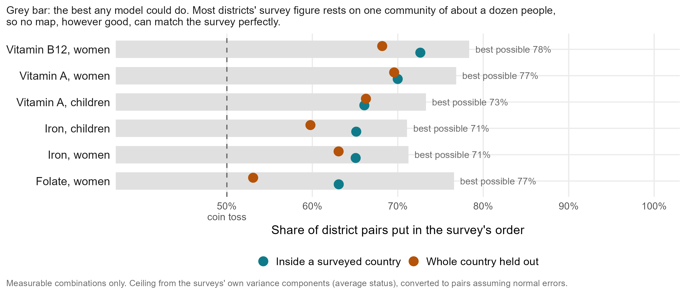
Accuracy by nutrient, against the best possible
Notes:
ANDREW, about 35 seconds (70 words).
How close is this to the best possible? The survey’s own district figures are noisy: most rest on one community of about a dozen people. So even a perfect model could agree with them only up to the grey bars, about 71 to 78 pairs in 100. Inside a country we reach 63 to 73. There is room left, but much of the remaining gap is the survey, not the model.
Backup, if asked: How the ceiling is known: how much two communities in the same district disagree tells us how noisy one community’s result is (variance components, variance_components_ceiling.csv, average status). As correlations: B12 0.77, folate 0.74, vitamin A 0.71, iron 0.61, against the model’s 0.63, 0.40, 0.53 and 0.44. Converted to pairs with 1/2 + arcsin(r)/pi, which assumes normal errors. More communities per district would raise the ceiling, at the price of fewer districts (appendix, planning slide).

Slide 24



How much of what a survey can see does the model recover?
The survey itself is noisy at district level: a perfect predictor would score only 0.48
Known from a variance model of respondents within clusters within districts: it says how much of the district-to-district variation is real.
The model reaches 59% of that ceiling
0.28 on the prevalence target against a ceiling of 0.48. The gap is mostly the survey's noise, not the model's ignorance.
And beats the best prediction you can make from survey data alone
The region's average, computed without the district itself: 0.31; the model 0.40, better in 13 of 18 outcome-country combinations.
full talk
Notes:
SAY: Two comparisons that make 0.40 readable. First, against the ceiling: the survey’s own district estimates are noisy, so even a perfect predictor would only reach 0.48 against them; the model reaches 59% of that. Second, against the best prediction you can make with survey data alone, the region’s average: the model beats it in 13 of 18 combinations.
DETAIL: How the ceiling is known: a variance model with respondents nested in clusters, clusters in districts and districts in regions, fitted to each survey, gives the share of district-to-district variation that is true signal rather than sampling noise; the correlation a predictor of the true value could reach with the observed value follows from that share (variance_components_ceiling.csv). The regional average is jackknifed: each district’s value is its region’s average computed without that district’s own respondents, so it never sees the answer. DRAFT B. The question a decision-maker actually asks is not “is 0.40 high” but “compared with what”. Two comparisons. Against the ceiling: a district estimate from the survey itself is noisy (one to three clusters per district), so even a perfect predictor of the true prevalence would correlate only 0.48 with what the survey reports; on that scale the model’s 0.28 (prevalence target) is 59% of the attainable. Against current practice: the number a ministry would use for an unsurveyed district today is its region’s average; the model beats it (0.40 against 0.31, better in 13 of 18 outcome-country combinations). Say plainly that the remaining gap is mostly the survey’s noise, not the model’s ignorance, and that the way to raise the ceiling is more clusters per district, which is the survey-design slide.

Slide 25
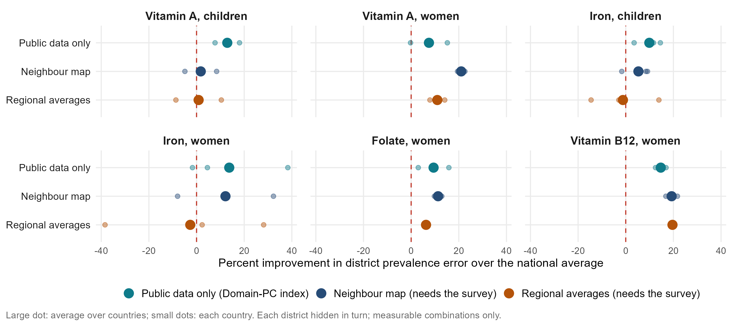
How do proxy models compare with the survey’s own information?
Notes:
ANDREW, about 40 seconds (90 words).
An updated version of a January slide, now for district prevalence. How much closer to the survey’s own district figures do we get than by giving every district the national average? Public data alone improve on it by about 11 per cent on average: as much as a map of neighbouring districts built from the survey, and more than the survey’s regional averages, at 5 per cent. The regional averages lose to the national figure for iron. For B12, the survey’s own neighbours and regions do better still.
Backup, if asked: 1 minus the district prevalence error (mean absolute error) of each method over that of the national average without the district, each district hidden in turn (benchmarks_v2_cells.csv, prevalence target, calibrated index). Means over 14 measurable in-country combinations: public data 11.4 per cent, neighbour map 11.4, regional averages 4.6. The January slide scored person-level models with individual survey predictors; with district proxies alone a person-level model is a coin toss (appendix).

Slide 26
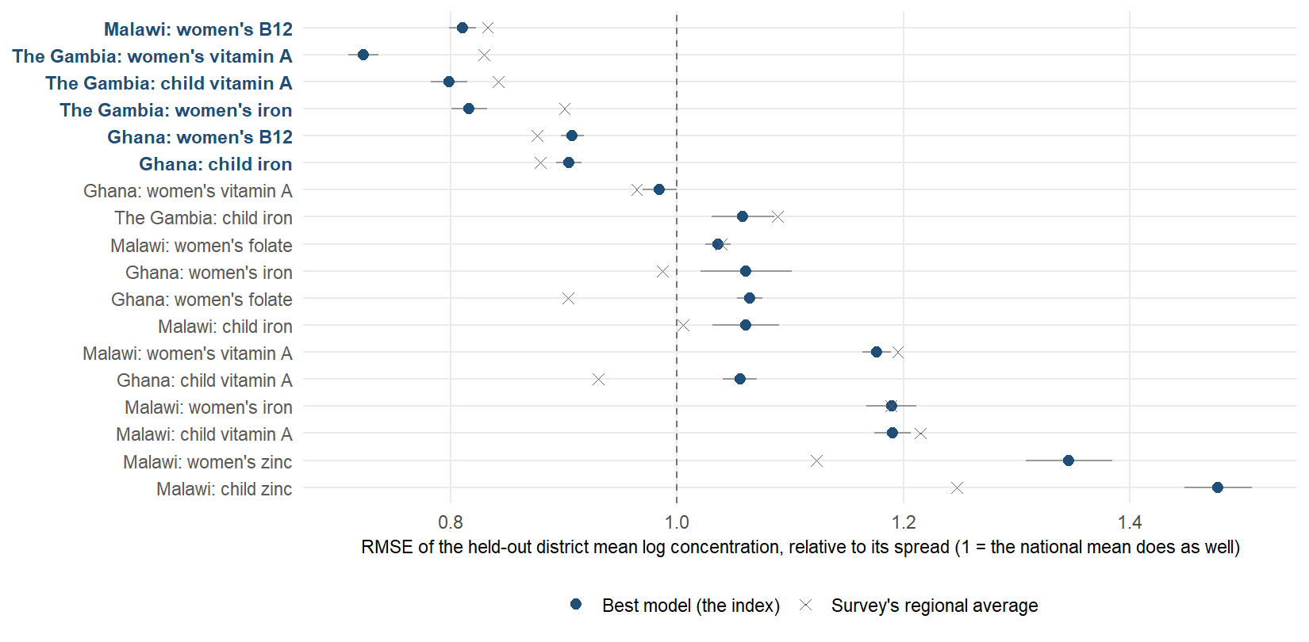
How far off is the predicted mean concentration, outcome by outcome?
full talk
Notes:
SAY: The same on the biomarker concentration scale, as error relative to how much districts differ: one means no better than the national mean. The model sits near one in most combinations even where it ranks well, which is the same message: order, not level.
DETAIL: Same combinations, mean concentration scale: the district mean of the log biomarker concentration (ferritin, RBP, folate, B12, zinc), predicted with the district held out, scored as root-mean-square error divided by the spread of the observed district means, so that 1.0 means no better than giving every district the national mean and anything below it is skill. The index is a ranker rescaled to the training spread, so its squared error is often at or above 1 even in combinations where it ranks well; the spatial smoother, which shrinks toward neighbors, is usually the best other arm on this loss. That is the honest division of labour the geostatistical slide draws: the index for the order, a shrinking estimator for the level. Cells whose index error sits well below 1 (the strong combinations in bold) are the ones where the proxies carry enough signal to predict the concentration itself, not only its order.

Slide 27
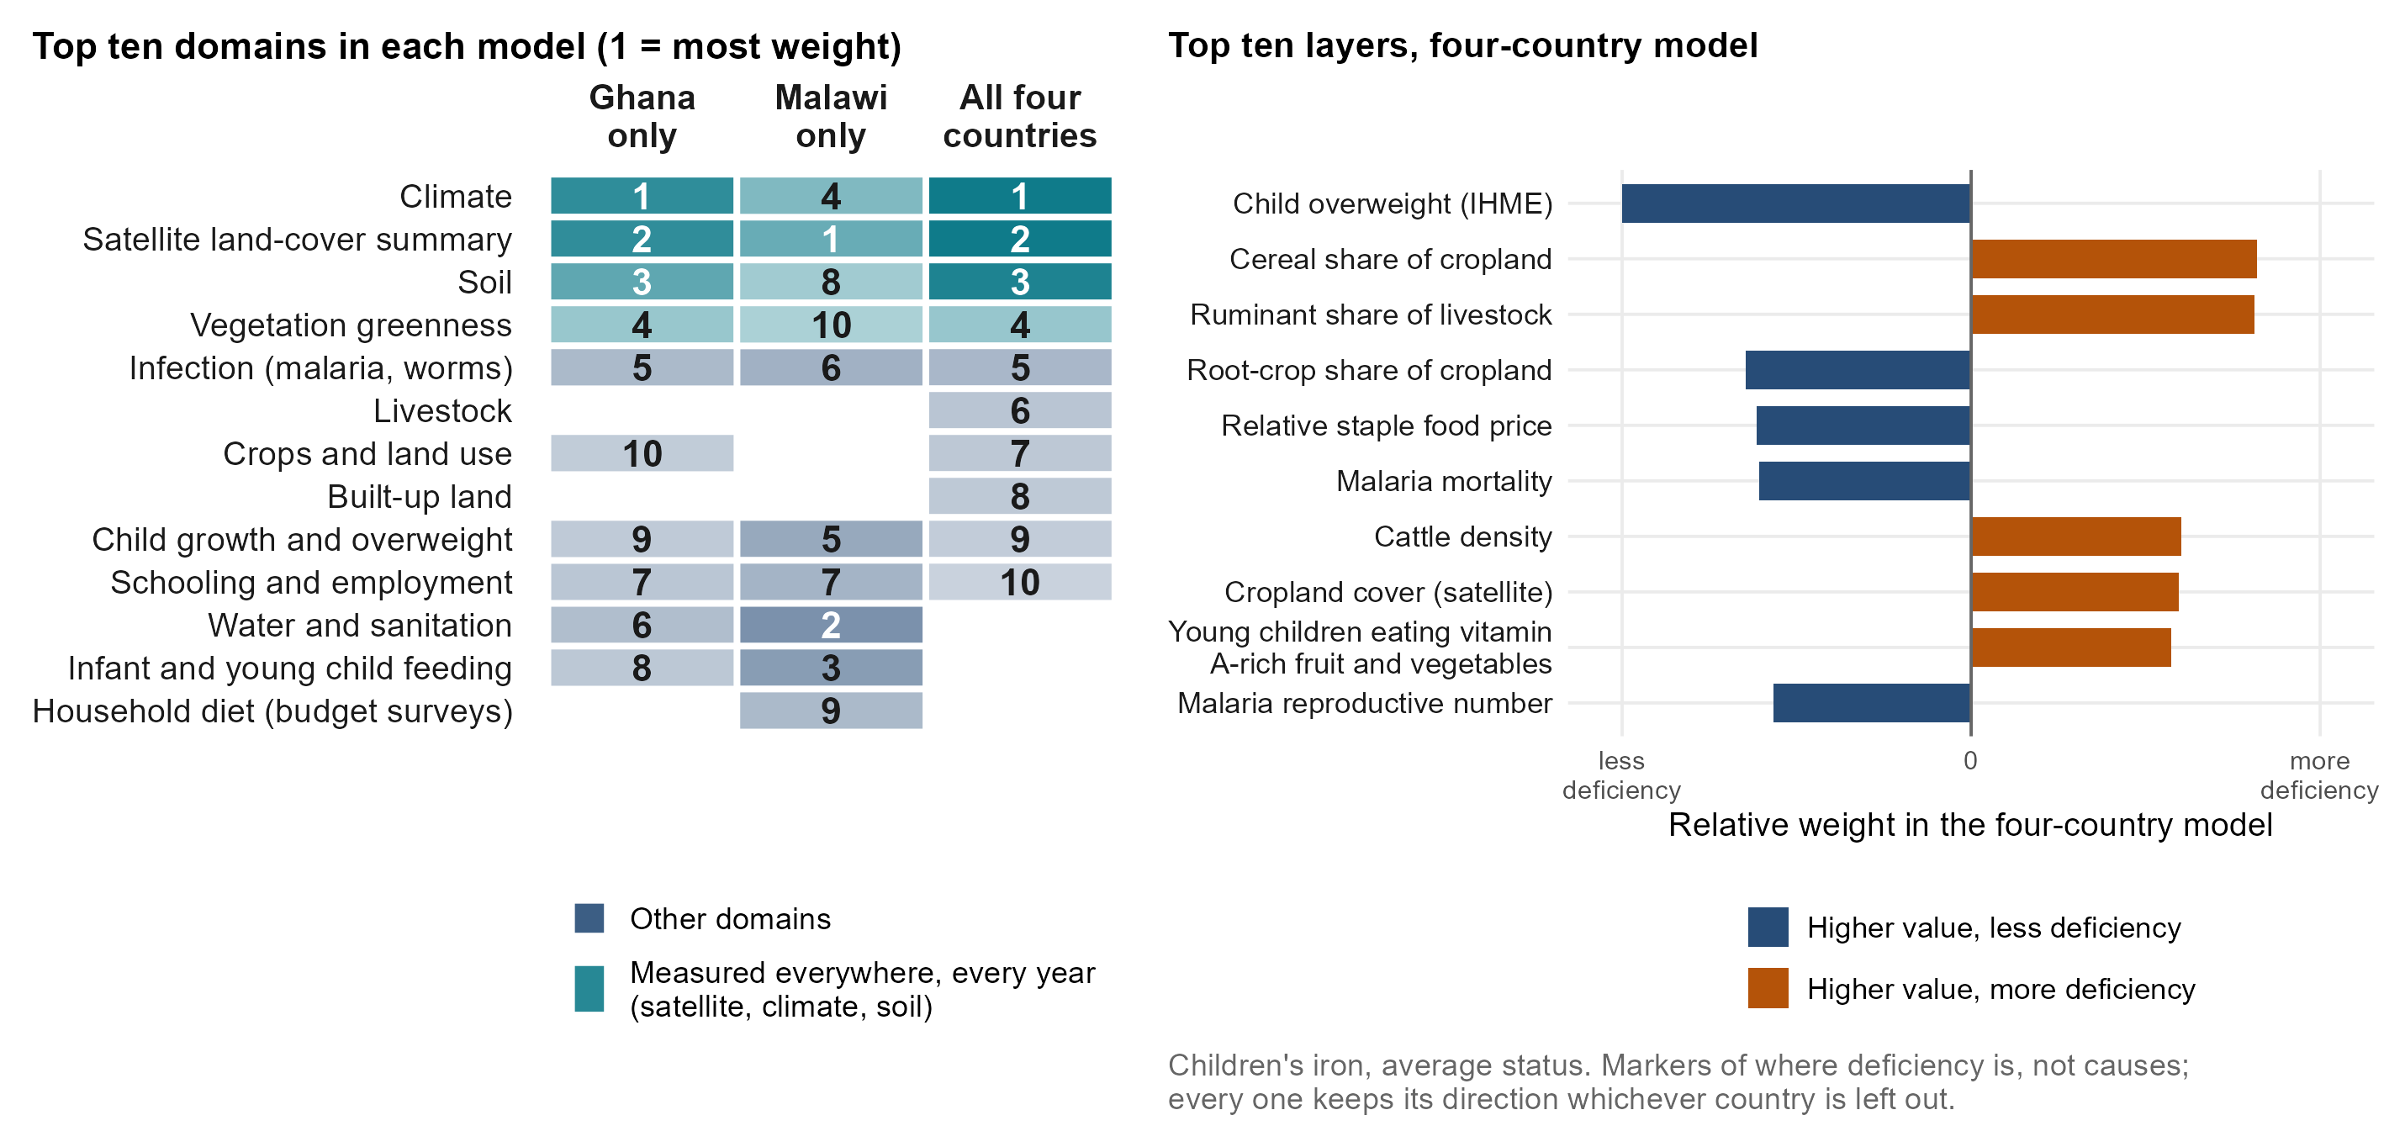
What variables drive model predictions
Notes:
ANDREW, about 50 seconds (113 words).
What does it rely on? Children’s iron again. On the left, the top ten families of layers in three models: Ghana’s alone, Malawi’s alone, and the four-country model we use for a new country. All three lean on climate, satellite land cover and soil, measured everywhere, every year, which is why the model can travel. Beyond those, each country adds its own: in Malawi, water and sanitation and infant feeding. On the right, the four-country model’s top ten layers. The farming system stands out: cereal-dominant cropping, ruminants and cattle mark more iron deficiency; root crops mark less. These are markers of where deficiency is, not causes.
Backup, if asked: Weight shares from index_importance_domains.csv (level target); layers from index_importance_columns.csv, pooled fit, ranked by standardised weight, and every one keeps its sign in all four leave-one-country-out fits. Malaria marks LESS iron deficiency here, most likely because inflammation raises ferritin even after adjustment: a feature of the biomarker, not protection. Child overweight marking less deficiency is a marker of richer, more urban districts. The Malawi B12 lakeshore example is in the appendix.

Slide 28







What can we learn about the consistently most important predictor domains?
Measured everywhere, important for every nutrient
Markers for particular nutrients
Climate
On its own it ranks a country held out better than all layers together. Seasons, growing conditions, disease ecology.
Farming system (iron)
Cereal cropping, ruminants and cattle mark more iron deficiency; root crops less.
Infection, malaria and worms
Removing it costs accuracy; inflammation also shifts ferritin and vitamin A markers.
Soil
Nearly as good alone. Soil minerals reach crops, animals and people, and soil marks farming systems.
Young children eating meat or fish (B12)
Marks better B12 status, as animal-source foods would.
Satellite land cover and greenness
A year of imagery summarised: what grows where, and how densely people live.
Anaemia (iron, folate)
Modelled anaemia surfaces; removing them costs accuracy across borders.
Notes:
ANDREW, about 50 seconds (110 words).
What have we learned about which families of data matter? Three are measured everywhere and matter for every nutrient. Climate: on its own it ranks a country held out better than all the layers together. Soil: nearly as well. And satellite land cover and greenness. Then some markers matter for particular nutrients: the farming system for iron, infection, malaria and worms, and for B12, how often young children eat meat or fish. Take all of these as markers of where deficiency is. They are consistent with the biology, but the model does not show causes. Reproductive health, which our January slide listed, does not make the list.
Backup, if asked: leave-one-domain-out and one-domain-only fits under country hold-out (domain_ablation_loco_summary.csv, average status): climate alone 0.335, soil alone 0.327, all layers 0.302; removing anaemia costs 0.020, crops and land use 0.012, infection 0.010, livestock 0.009. Farming-system directions from the four-country children’s iron model. Fertility and reproductive health are not among the top domains in any model.

Slide 29
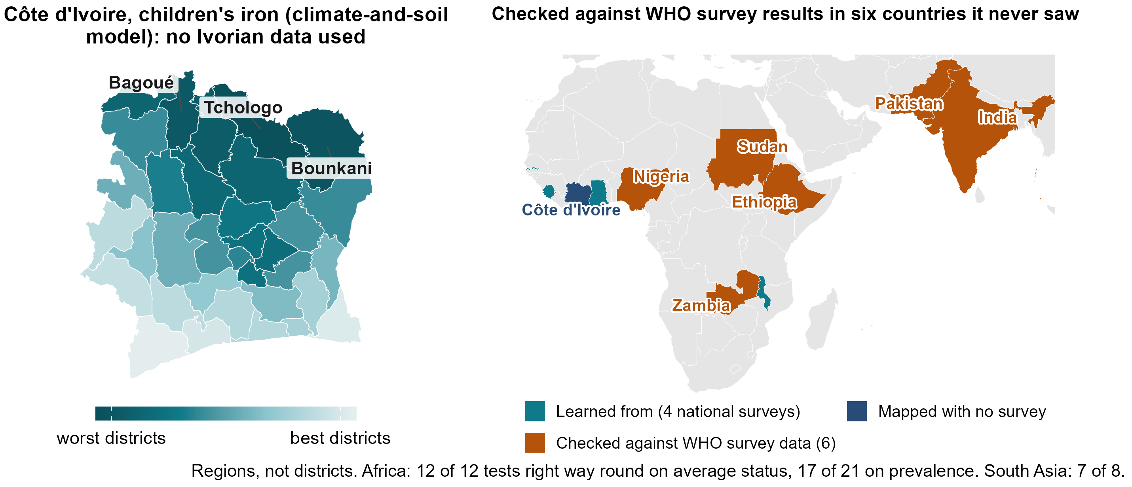
What about countries with no survey?
Notes:
ANDREW, about 60 seconds (135 words).
Most countries in this region have no recent biomarker survey. Côte d’Ivoire is one. Trained on our four countries, the climate-and-soil version of the model ranks its 33 districts for children’s iron. The northern savanna comes out worst.
Can you trust a map like this? The WHO micronutrients database holds regional results from national surveys in Zambia, Ethiopia, Sudan and Nigeria, and in Pakistan and India. None were used to build the model. In Africa its ranking of their regions pointed the right way in all 12 tests of average status and 17 of 21 tests of prevalence; in South Asia, 7 of 8. And Côte d’Ivoire’s own 2007 survey ranks its nine zones for vitamin B12 almost exactly as the model does. Regions, not districts, but data we did not touch.
Backup, if asked: XV-01/02: climate-and-soil index at admin-1; Africa average status 0.40 (country-block null 0.20), prevalence 0.33; off the continent 0.39; the same regional test inside our four countries 0.28 and 0.27. Iron points the right way on average in all six countries (13 of 14 iron cells). Not the pre-registered test, which needs a new country’s own microdata at district level. Côte d’Ivoire 2007 B12: Spearman 0.95 over nine zones; predicted prevalences in the appendix.

Slide 30
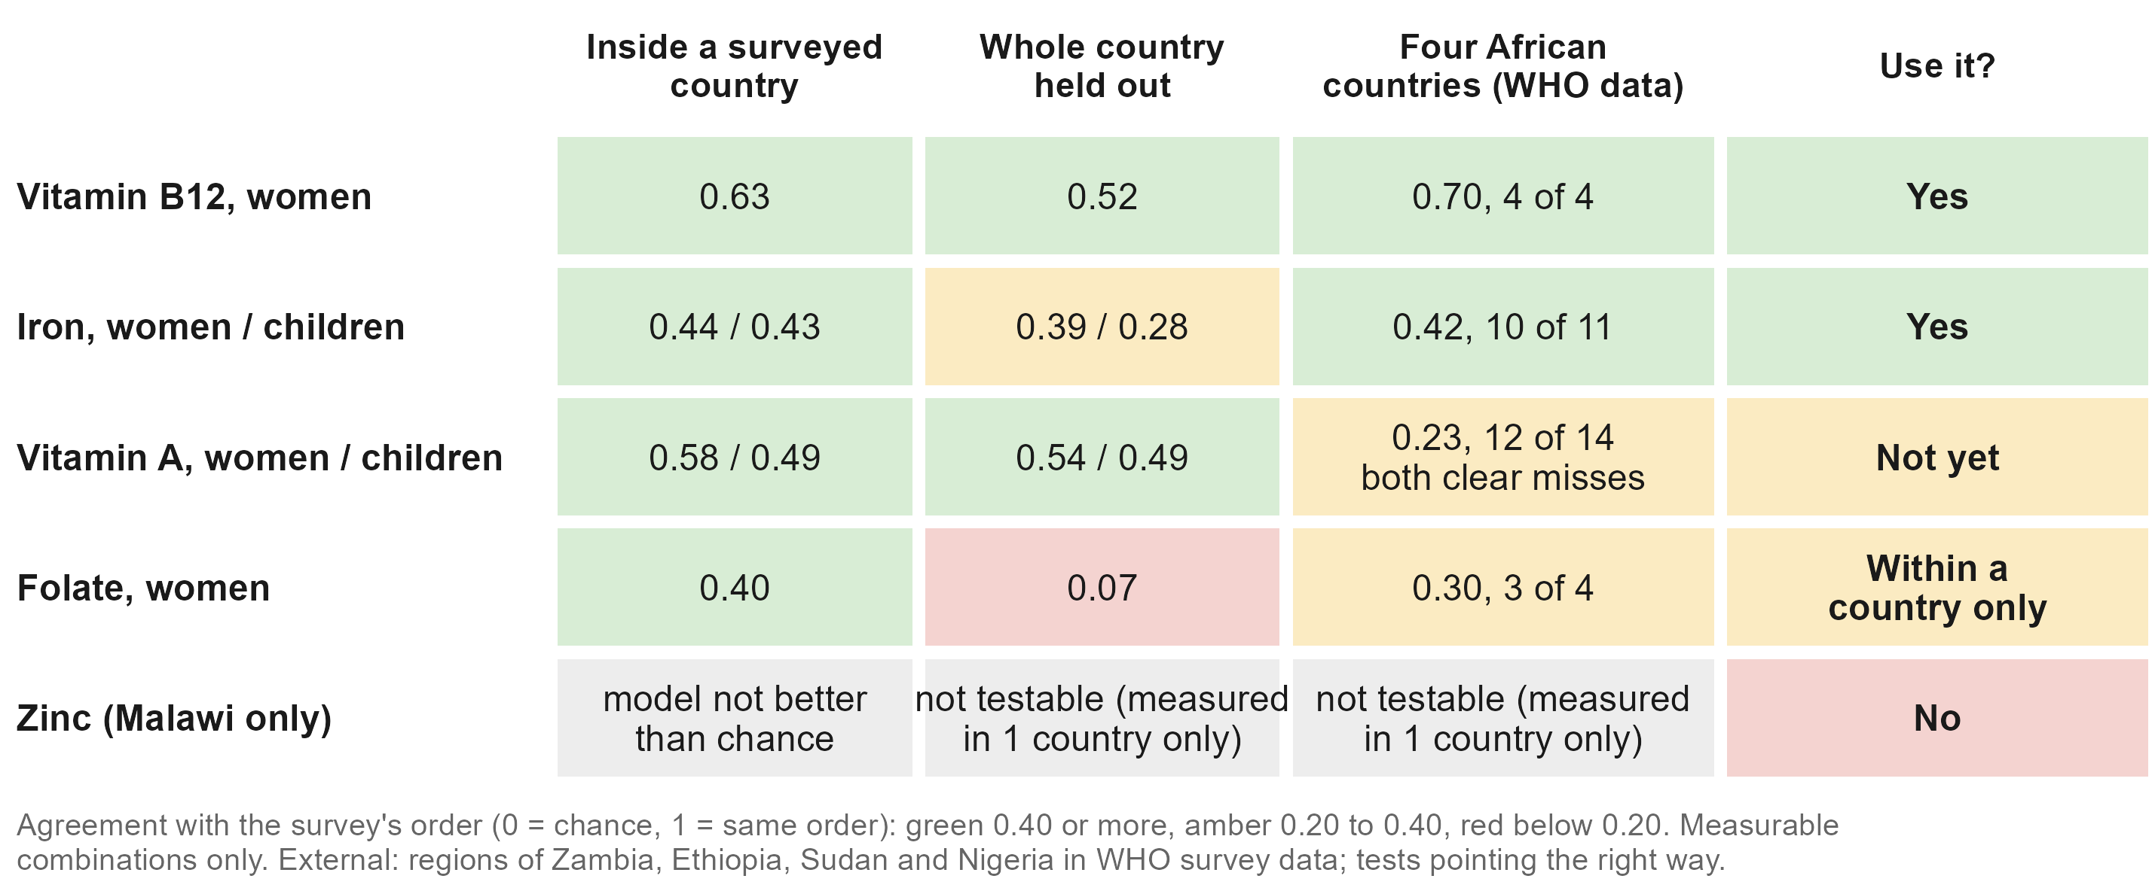
Which deficiencies can it map?
Notes:
ANDREW, about 40 seconds (88 words).
Putting it together. B12 and iron can be mapped from public data: inside a country, across borders, and in the external check. Vitamin A ranks well inside our countries but was the weakest externally, so not yet. Folate works only within a country. Zinc, measured only in Malawi, cannot be mapped: the model is no better than chance, because the survey itself shows no real difference between districts. How common a deficiency is does not decide this: folate and zinc are the commonest in our data, and the hardest.
Backup, if asked: External by nutrient, African deposits: B12 0.70 (4 of 4 tests), iron 0.42 (10 of 11), folate 0.30 (3 of 4), vitamin A 0.23 (12 of 14; the two clear misses, Zambia children and Ethiopia women at -0.43, are both vitamin A). Vitamin A is the strongest outcome in India and Pakistan. Malawi zinc in-country: children -0.11, women -0.03 (benchmarks_v2_cells.csv). The table’s numbers are correlations (0 = chance); the external column is the four African countries’ WHO data only.

Slide 31



What does this mean for policy? The vitamin B12 model
70 to 75 of 100
About 2x
About 6 points
4 of 4
District pairs in the survey's order (Ghana, Malawi)
65 to 71 with the country's own survey removed
The fifth of districts it ranks worst hold 40 to 46% of deficient women; a random fifth holds 20%
Typical error in district prevalence, each district hidden
90% ranges about 21 to 27 points either side
WHO survey checks in Zambia, Ethiopia and Nigeria pointed the right way
Cote d'Ivoire's nine 2007 zones in almost the same order
Notes:
ANDREW, about 45 seconds (98 words).
What does this mean for a programme? Take our best model, women’s B12. It puts 70 to 75 of every 100 district pairs in the survey’s order, and 65 to 71 with the country’s own survey removed. The fifth of districts it ranks worst hold 40 to 46 per cent of deficient women: about twice a random choice. Its district prevalences are typically within about 6 points of the survey’s. And in the WHO survey data from Zambia, Ethiopia and Nigeria it pointed the right way in all four checks, as it did for Côte d’Ivoire’s 2007 survey zones.
Backup, if asked: pairs from v3_percell_pairs.csv (Ghana 70 in-country, 71 held out; Malawi 75 and 65; Sierra Leone 71 held out, 14 districts). Worst fifth (nce_targeting_metrics.csv): Ghana 46 per cent (regional averages 45, perfect 65), Malawi 40 (regional 27, perfect 59). Prevalence error, each district hidden (conformal_prev_cells.csv): Ghana 6.6 points, Malawi 5.5; 90 per cent bands 21 and 27 points either side, coverage 0.91. External B12 (xv_transport.csv): Zambia average status 0.80, Zambia 0.75, Nigeria 0.71, Ethiopia 0.54 on prevalence; Pakistan’s B12 is a miss (-0.26).

Slide 32



Conclusions
Where there is no survey
Alongside a new survey
A first ranking of districts from free public data
Checked against surveys it never saw, in Ghana and six other countries.
Fills in the districts the survey did not reach
Orders them better than regional averages.
A shortlist of where to look first
Its worst third is right about half the time; chance is a third.
A rough district prevalence from a small national sample
Usually within about 10 points.
Every district, five countries:
amertens.shinyapps.io/
micronutrient-burden
More reliable for some nutrients
B12 and iron best; not yet vitamin A; not zinc.
Helps plan where to sample
Which districts to check first; try designs on the dashboard.
It does not replace a survey, judge whether a programme worked, or say why a district is deficient.
Notes:
ANDREW, about 55 seconds (121 words).
So what can this model show? Where there is no survey: a first ranking of districts from free public data, checked against surveys it never saw; a shortlist of where to look first; and more reliably for B12 and iron than for the other nutrients. Alongside a new survey: it fills in the districts the survey did not reach, and orders them better than regional averages; with even a small national sample it gives a rough district prevalence, usually within about ten points; and it helps choose where to sample. It does not replace a survey, judge whether a programme worked, or say why a district is deficient. Everything is in a public dashboard; the QR code is on the screen.
Backup, if asked: Prevalence bands: split conformal, 90 per cent, leave-one-out coverage 0.90 to 0.93; median half-width 26 points, iron 30 to 37 (CP-01); median absolute error about 10 points. Anchor: a 5 per cent national sample (24 to 71 respondents) gives a median district error of 9.3 points. The model maps deficiency, not fortified-food coverage.

Slide 33



What have we learned, and what comes next?
What we have learned
What comes next
Public data can rank a country's districts by deficiency
Inside a surveyed country, 67 of 100 district pairs in the survey's order; its regional averages, 62.
More surveys in the pool
On average each added survey improved the ranking for the country held out.
Also in a country with no survey
62 of 100 pairs with the country's survey removed; checked against WHO data in six more countries. A level needs one national number.
The fifth survey is a real test
Two candidate models were written down before any new country's data were seen.
Every district, five countries:
amertens.shinyapps.io/
micronutrient-burden
Where the survey can see districts, close to the best possible
B12: 73 of 100 pairs, against a ceiling of about 78.
Plan the next survey with the model
A small national sample anchors the level; the ranking says where to look first.
The uncertainty we show has been checked
Prevalence bands hold the survey's value 90% of the time; rank ranges show stability only.
Notes:
ANDREW, about 50 seconds (112 words). The updated version of the full talk’s closing slide; keep this or “Conclusions”, or merge the two.
What have we learned? Public data can rank a country’s districts by deficiency: inside a surveyed country, about two pairs in three in the survey’s order, better than the survey’s own regional averages. In a country with no survey it still ranks, less well, and it held up against surveys it never saw; a level needs one measured national number. Where the survey can see districts, we are close to the best any model could do. And the uncertainty we show has been checked. What comes next: more surveys in the pool, because each one so far has helped, and a fifth survey that is a real test.
Backup, if asked: pairs 67 against 62 per cent inside a country (14 measurable combinations), 62 held out (22); B12 73 against a ceiling of about 78; calibrated bands hold the survey’s own value 90 to 93 per cent of the time (CP-01), while rank ranges hold it 38 per cent and are stability only. Pooling curve 0.20, 0.26, 0.30 on average, the gain so far in The Gambia and Ghana. Two candidate models were written down on 3 September 2026. Changes from the full-talk version: “every survey improves every other country’s map” and “the curve has not flattened” were overclaims (review, 27 Sep); “0.38 from climate and soil” is the model chosen on the same 22 cells.

Slide 34

Next steps
Share your survey data
Design the next survey with us
Tell us what is good enough
Recent, planned, or sitting in a drawer.
On average, each survey we added improved the ranking for countries held out.
Where to sample, and how many communities per district.
How accurate must a district ranking be before you would use it?
Try it:
amertens.shinyapps.io/
micronutrient-burden
Modelling extends a survey's reach. It does not replace the survey.
Notes:
ANDREW, about 30 seconds (70 words).
Three asks. If your country has a micronutrient survey, recent, planned or in a drawer, share it with the pool: on average, each survey we added improved the ranking for the countries held out. If you are planning one, let’s design it together. And tell us how accurate a district ranking must be before you would use it. Modelling extends a survey’s reach. It does not replace the survey.
Backup, if asked: Pooling curve: 0.20 with one training survey, 0.26 with two, 0.30 with three; the gain so far is in The Gambia and Ghana, not yet Malawi or Sierra Leone. Two candidate models were written down on 3 September 2026, so a fifth survey is a real test. Optional line for Sonja: next, with MIMI and GBD, we compare predictors framework by framework.

Slide 35
Appendix

Slide 36
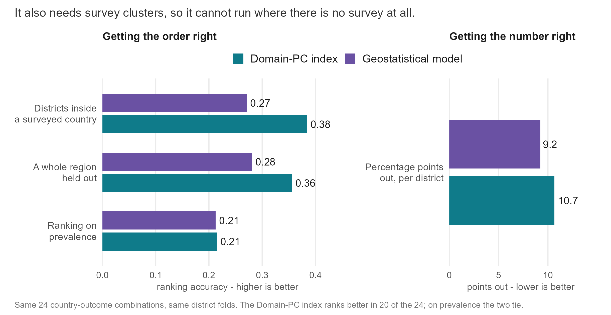
Is it just geography? Comparison with DHS-style geostatistics
Notes:
Inside a surveyed country, geography does much of the work: a map of neighbouring districts ties the index. The DHS Program’s model-based geostatistics (a spatial field plus covariates, fitted at the survey clusters) ranks worse on the same folds (0.27 against 0.38) but estimates levels better (9.2 against 10.7 points of error), because it shrinks uncertain districts toward a level. It needs measured clusters inside the country, so it has no answer for a country with no survey. The Côte d’Ivoire vitamin A ranking correlates 0.73 with latitude, yet its agreement with the independent WFP and MIMI map survives adjusting for latitude (0.495 to 0.479).

Slide 37
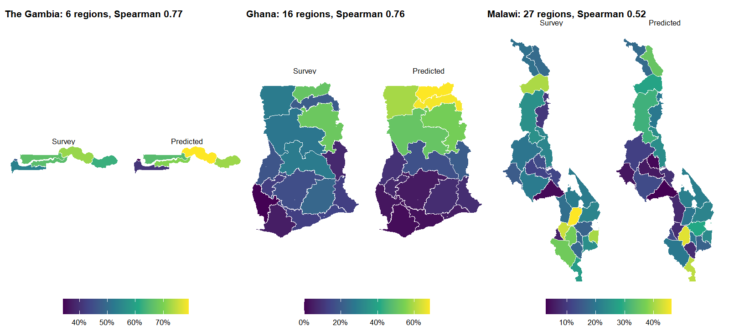
Does it match the survey at the regional level?
full talk
Notes:
The same held-out district predictions, and the survey, both aggregated to the regions (respondent-weighted means), child iron. This is the resolution at which the surveys were designed to be read, and the comparison a ministry statistician will make first. The regional pattern is recovered in each country; the district slide before this one shows the finer level where the survey itself becomes noisy. The MIMI and IHME decks show exactly this pair of maps as their headline validation figure.

Slide 38

Could a small national survey plus the model replace a district survey?
Four ways to get district numbers, costed against the size of survey each needs. A small national sample, 5% of a full survey, with the model’s ranking spread across districts gives a median district error of 9.3 points. A survey designed to measure each district directly needs about 25% of its full size to do as well.
full talk
Notes:
SAY: On the level of deficiency, a small national sample plus the ranking does as well as a district survey four to five times its size. On finding where the deficient people are, a district survey of any size still wins, because it measures the populous districts directly. So: not a replacement, a much cheaper first pass.
DETAIL: A district survey matches the anchored ranking’s level error at about 25% of the full sample. The ranking wins on level error only: a district survey of any size captures more burden, because burden sits in populous districts that surveys measure precisely. Fitted symmetrically on a reduced survey, the model’s error degrades in step with the survey’s, so the model improves the ordering at any sample size and does not reduce the sample a survey needs.

Slide 39
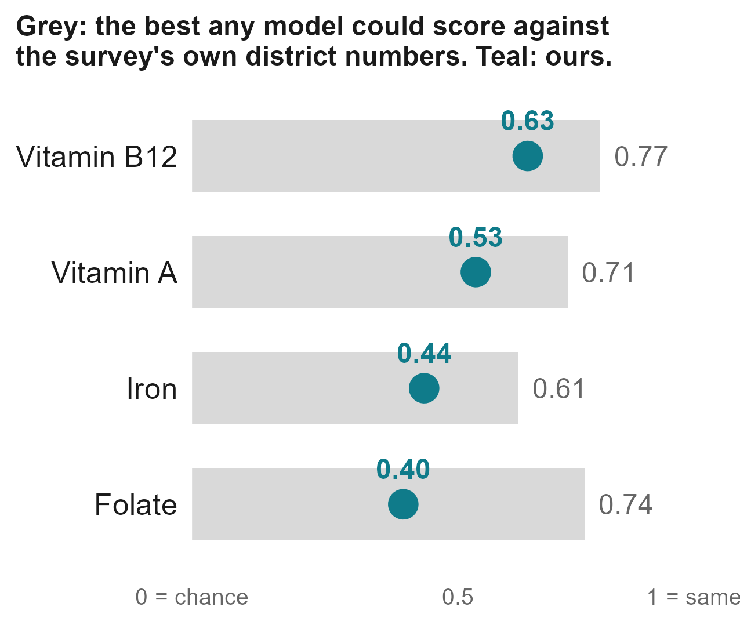

How can it help plan the next survey?
How close can any model get?
Most districts rest on one community of about 12 children, so even a perfect model could only agree up to the grey bars. Ours reaches 0.4 to 0.6.
Alongside a survey, a small national sample
About 40 blood draws per nutrient anchor the ranking; district figures then typically land within about 10 points.
Check the model's shortlist first
It says which unsurveyed districts to visit first. The dashboard's planning tab lets you try a design.
Notes:
Moved to the appendix in v4. How close can any model get: the survey’s own district numbers are noisy, because most rest on one community of about a dozen children, so even a perfect model could agree with them only up to the grey bars (average status, as correlations: B12 0.77, folate 0.74, vitamin A 0.71, iron 0.61; the model 0.63, 0.40, 0.53, 0.44). More communities per district would raise that limit, though at a fixed budget that means fewer districts. Sierra Leone has the most clusters per district (4.3) and the weakest results: 14 districts of half a million people is the wrong unit. Anchor: 5 per cent national sample (24 to 71 respondents), median district error 9.3 points. SP-01: model-guided district choice is about equal to random; both beat population-weighted choice.

Slide 40
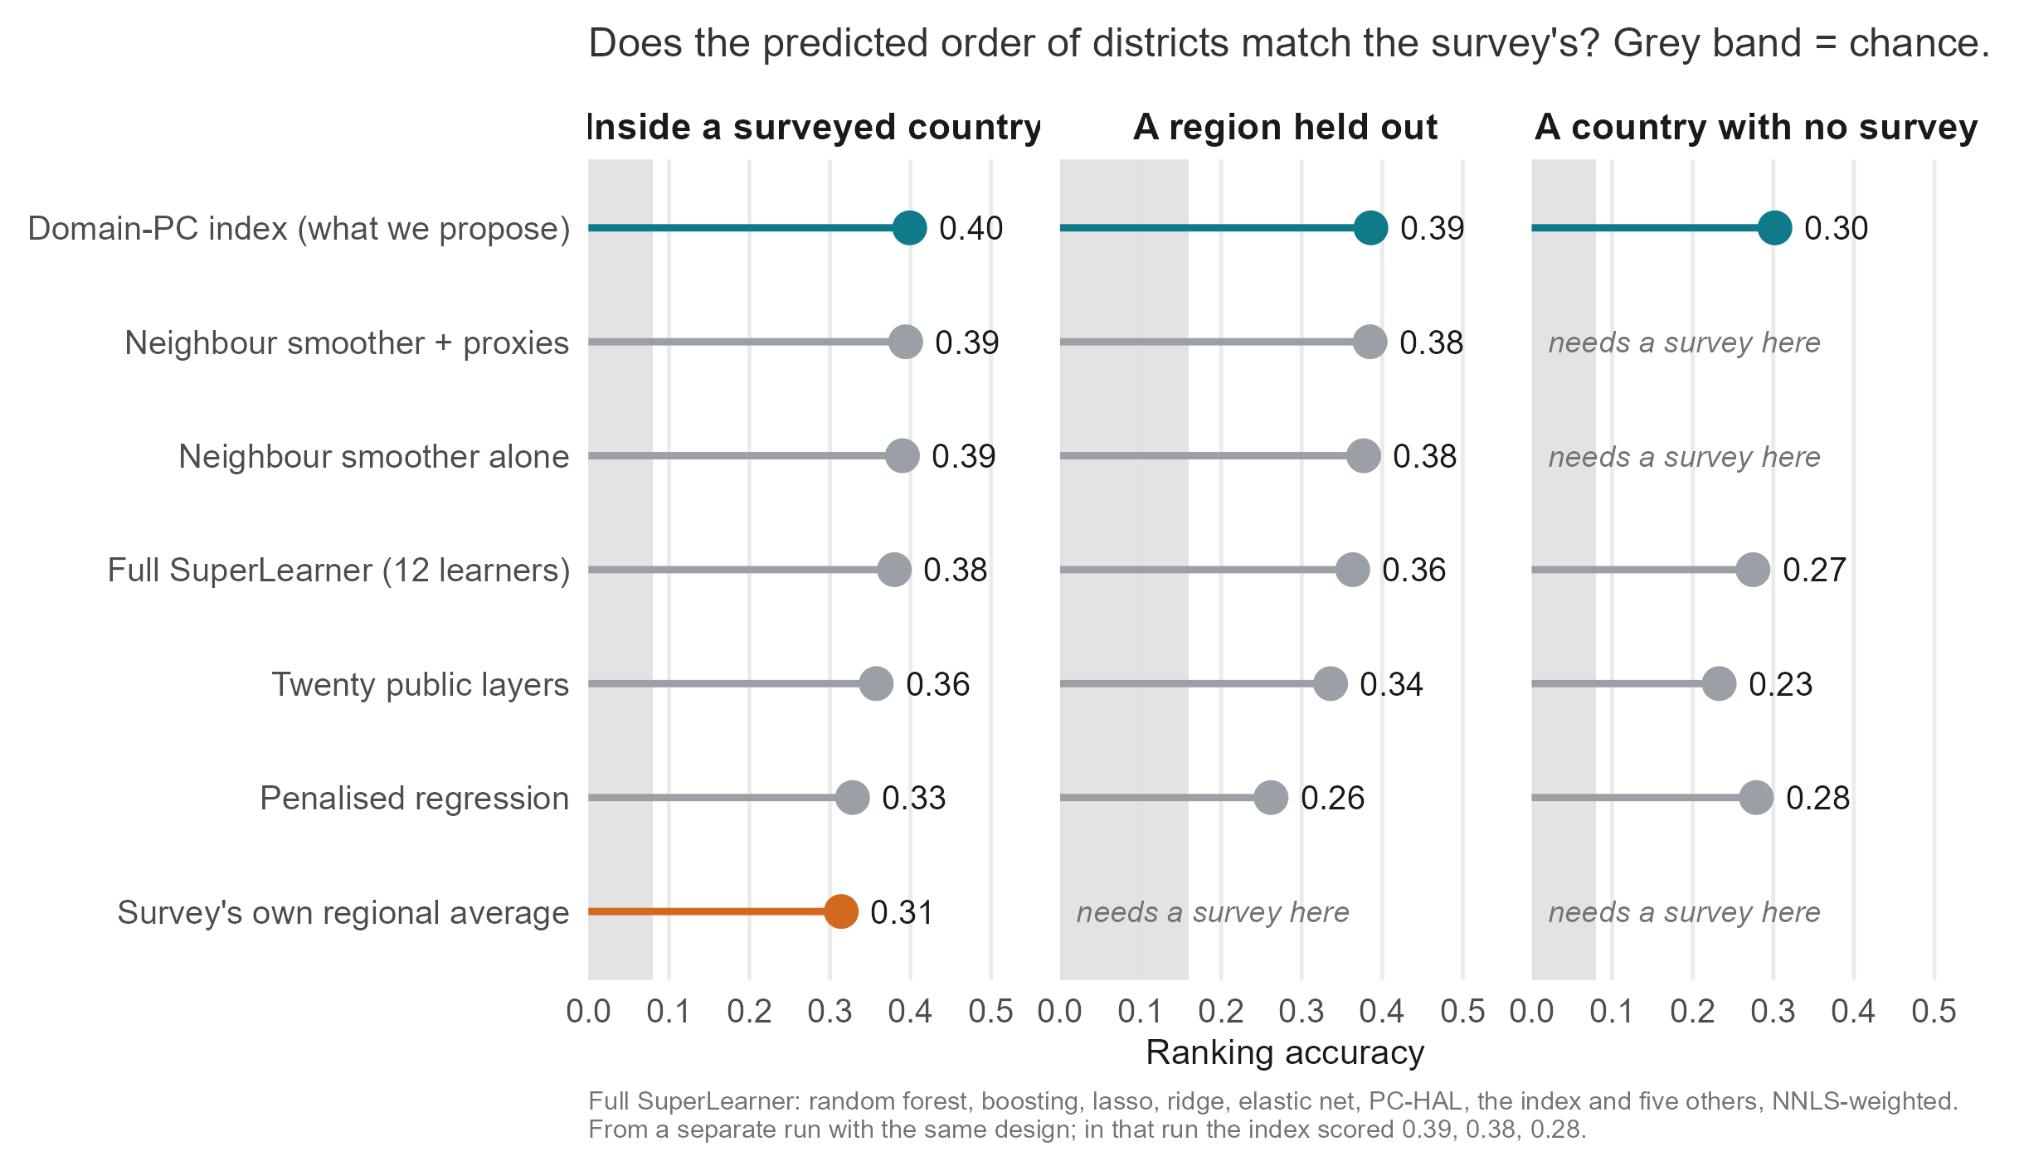
How does it compare with other methods, including machine learning?
Notes:
Every method on the same held-out folds, agreement on average status (Spearman). Inside a surveyed country: the Domain-PC index 0.40, neighbour smoother with proxies 0.39, neighbour smoother alone 0.39, the full SuperLearner 0.38, a twenty-layer composite 0.36, penalised regression 0.33, the regional average 0.31. A region held out: 0.39, 0.38, 0.38, 0.36, 0.34, 0.26. A country with no survey: index 0.30, SuperLearner 0.27, twenty layers 0.23, penalised regression 0.28; the smoothers and the regional average need a survey. The SuperLearner row comes from the SL-06 run with the same design, in which the index scored 0.39, 0.38 and 0.28. The estimator and the domain sets were chosen while looking at these four countries, which is why the fifth survey is pre-registered.

Slide 41
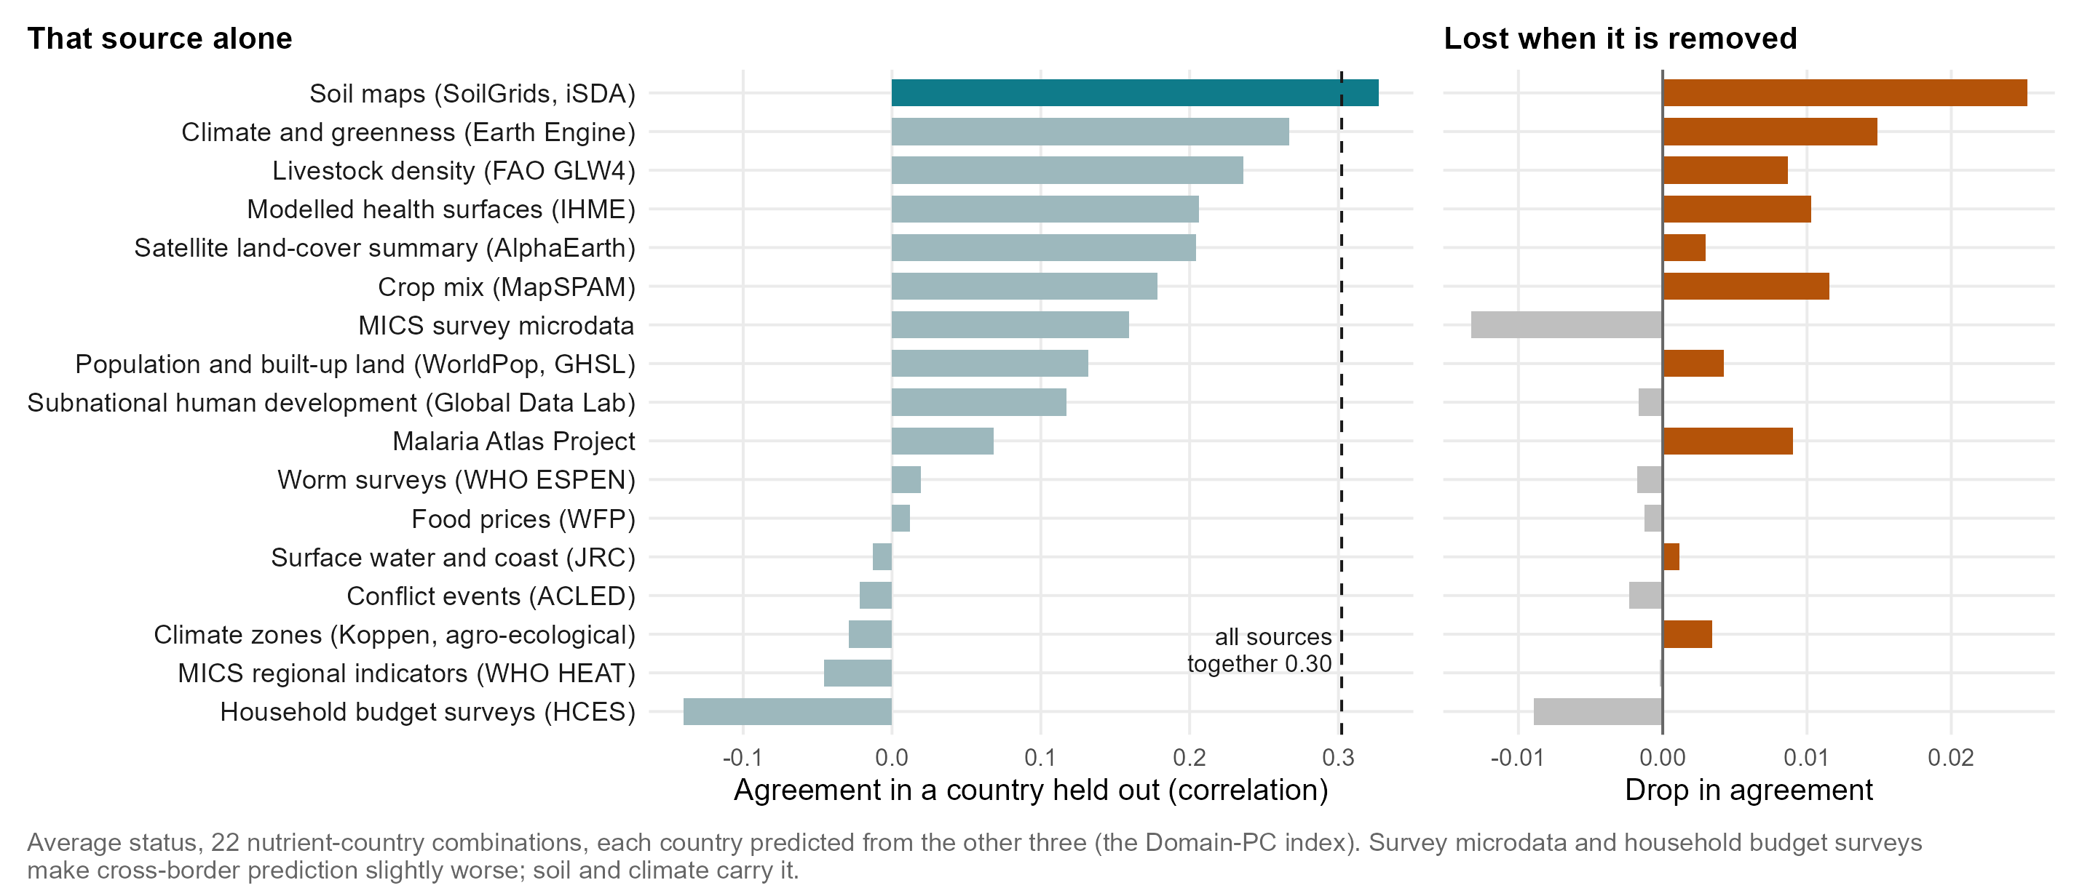
Which data sources contribute most to model prediction performance?
Notes:
Updated from the January slide (which scored drops in error for women’s B12 and iron in Ghana). Now each country is predicted from the other three, averaged over 22 nutrient-country combinations: left, the ranking with one source alone; right, how much it drops when that source is removed. Soil maps alone (0.33) beat all sources together (0.30); climate and greenness from Earth Engine, crop mix, IHME health surfaces, livestock and the Malaria Atlas each cost accuracy when removed. MICS survey microdata and household budget surveys make cross-border prediction slightly worse (source_ablation_loco_summary.csv). DHS microdata are not in the cross-border set.

Slide 42
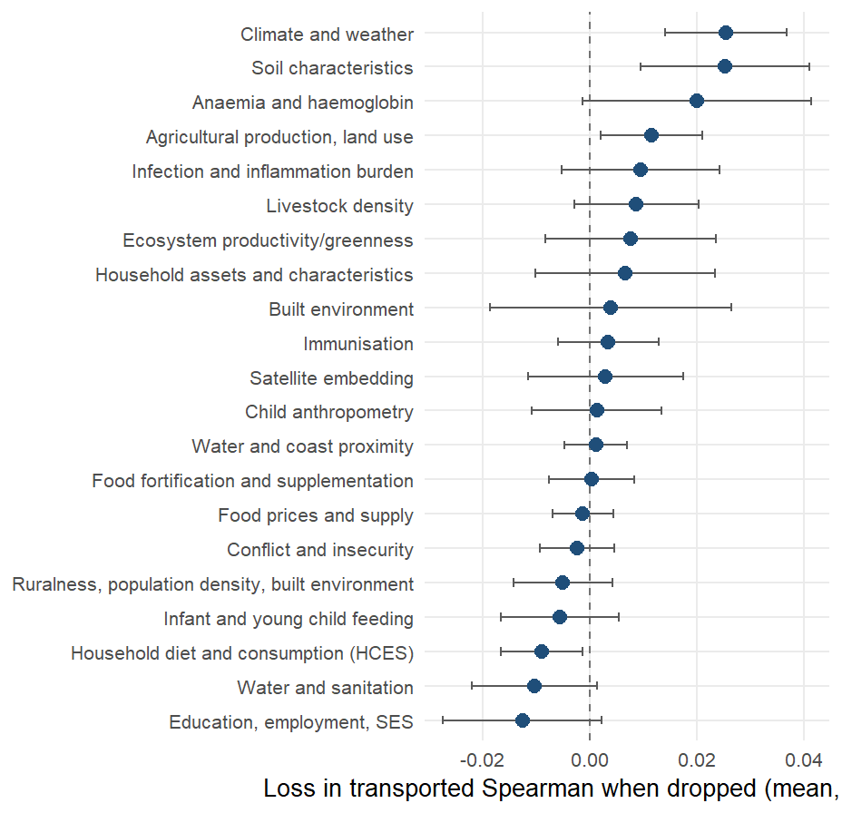
What travels across borders, and what does not?
Loss in transported Spearman (biomarker level, 22 outcome-country combinations) when each domain is dropped and the components rebuilt, mean over outcome-country combinations with a 95% interval. The load-bearing domains are Climate and weather, Soil characteristics, Anaemia and haemoglobin; removing 7 of the 21 domains costs nothing or helps.
full talk
Notes:
SAY: Drop each domain in turn and see what the transported ranking loses. Climate and soil are load-bearing; the anemia surfaces, agriculture and greenness follow; the household-survey items help inside a country and not across a border. The physical environment is what carries, and it is also what a country without a survey can download.
DETAIL: Positive values mean the domain is load-bearing. Climate and soil carry most, with the anemia surfaces, agriculture and greenness behind; the water-and-sanitation, education and infant-feeding domains sit at or below zero: removing them does not hurt a new country and in two cases helps. The DHS-derived domains are not in the headline set at all: with them in, the district transport index scores 0.28 against 0.30 without. A fixed climate-and-soil index transports at 0.38 at district level and 0.45 regionally against 0.30 and 0.28 for the full vocabulary; it was found on the same four countries it is scored on and enters the next country as a pre-registered prediction.

Slide 43



What can we learn about unused predictor domains?
What adds little across borders
Likely reasons
Fortification and supplementation
Mostly national figures: no difference between districts to learn from.
Overlap
Much of their district signal is already carried by climate, soil and infection.
Food prices and household budget surveys
Few markets and few households per district; budget surveys make the held-out ranking worse.
National-only data
A single number per country cannot rank districts.
Schooling, water and sanitation, infant feeding
Help inside a country (schooling for vitamin A) but not across borders.
Different surveys, questions and years
Household survey indicators are measured differently from country to country, so they travel poorly.
Child growth, conflict, immunisation, access to care
Close to deficiency in theory; add almost nothing once climate, soil and infection are in.
Notes:
Updated from the January slide. Evidence: leave-one-domain-out under country hold-out (domain_ablation_loco_summary.csv, average status, all layers 0.302). Removing fortification and supplementation changes nothing (0.000); food prices -0.001; conflict -0.002; child anthropometry +0.001; immunisation +0.003. Removing schooling and employment IMPROVES the held-out ranking by 0.013, water and sanitation by 0.010, household budget surveys by 0.009, infant feeding by 0.006: they help inside a country (schooling for vitamin A) but do not travel. Likely reasons: overlap with climate, soil and infection; national-only figures with no district contrast; different survey years, questions and designs between countries.

Slide 44



What drives the transport models?
The landscape gradient
Grassland and cropland cover, the share of ruminants in the herd (top twenty in 14 of 22 held-out fits), cattle and sheep density, cereal-heavy cropping, low plant productivity: dry, grassy, pastoral, unproductive districts rank worse on every outcome.
The modeled child-growth and anemia surfaces
Wasting, underweight and anemia point to worse status; overweight points the other way and behaves as a wealth proxy.
The food economy
The local staple price relative to the national level appears in 13 fits across 5 outcomes.
Remoteness and demography
Distance to the coast and the dependency ratio, in about a third of the fits.
Malaria intensity, with an unexpected sign
High-malaria zones are the wetter, more productive ones. Single household-survey items rarely recur.
full talk
Notes:
Source: results/tables/protocol_v2/index_importance_columns.csv, scope “loco”: the index fitted on three countries, projected back to columns, for each of the 22 held-out country and outcome combinations on the biomarker level; a column counts once per fit in which it is among the twenty largest standardized weights. Every column named on the slide keeps the same sign in every fit where it appears (34 of the 41 columns that recur in five or more fits are unanimous). The pattern is the one on the previous two slides seen from the other side: what a model trained elsewhere reaches for in a new country is the physical environment and the modeled nutrition surfaces built from it, not the country’s own survey items. The staple-price and malaria signs are worth saying aloud: relatively expensive staples mark market-integrated, better-off districts, and high malaria transmission marks the wet, productive lowlands where diets are more diverse; neither is a mechanism to act on.

Slide 45
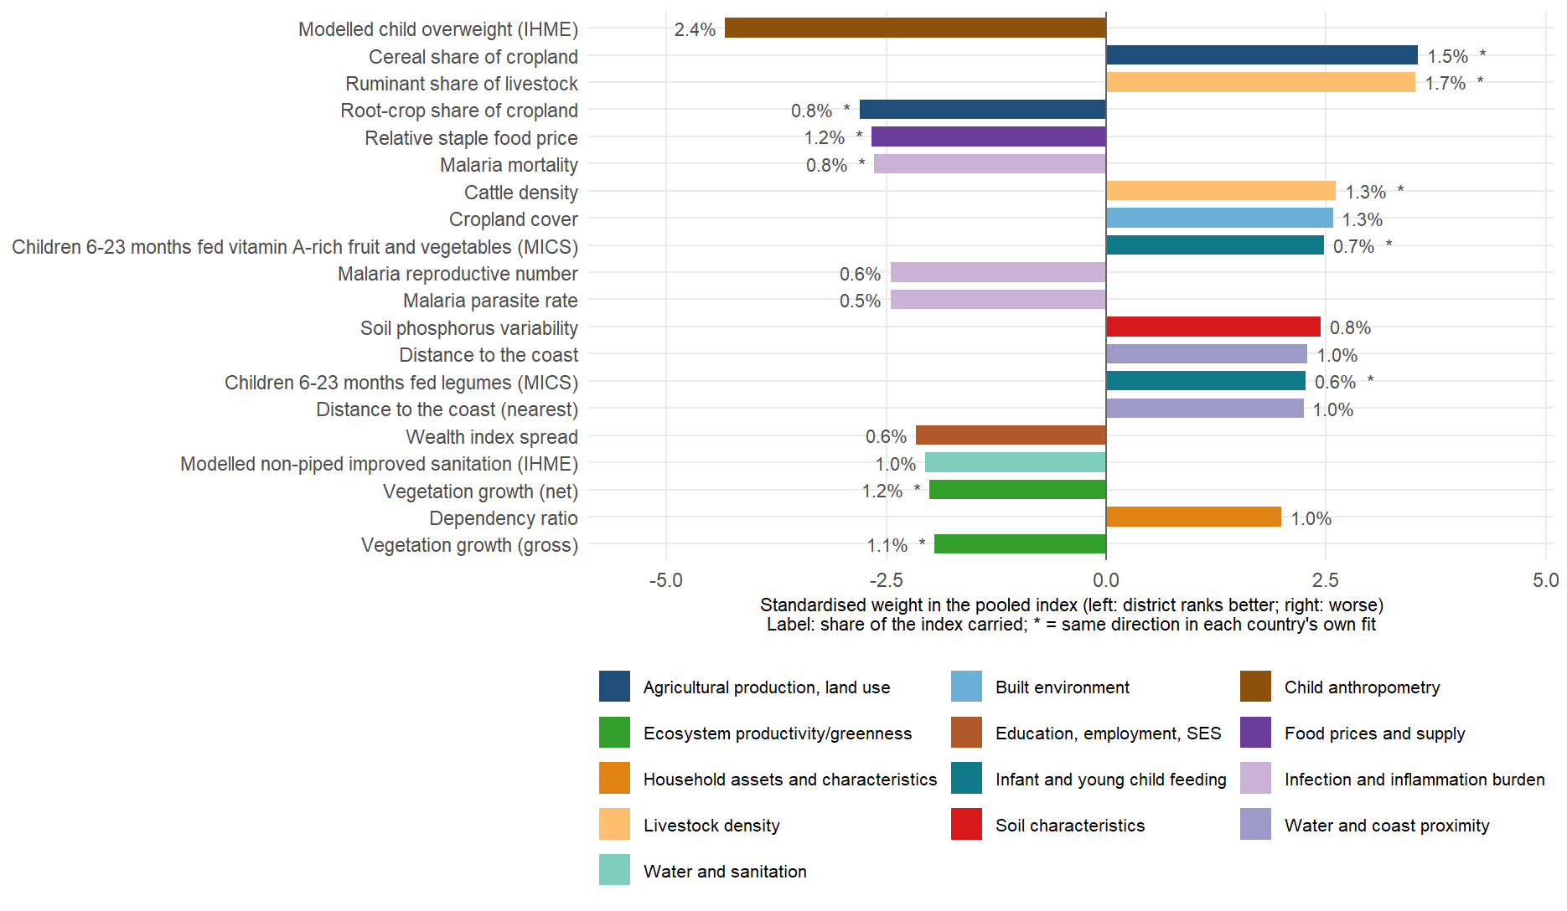
Top 20 individual predictors for child iron
full talk
Notes:
index_importance_top.csv, child iron, biomarker level: the twenty largest standardized weights in the pooled four-country fit, drawn as bars so their sizes can be compared. The level target is the negated log ferritin, so a bar to the right means districts with more of the layer rank worse on child iron, to the left better. The label is the share of the index’s variance the layer carries: the twenty together hold about a fifth of the index (21%), the rest is spread over the other 350 columns, which is how a weighted sum of many weak signals is meant to behave. All twenty keep their direction in every leave-one-country-out fit; the starred ones (10 of twenty) also keep it in each country’s own separate fit, the stricter test. The story is the one on the earlier slides: cereal-heavy cropping, ruminant and cattle density, cropland, distance from the coast and a high dependency ratio rank a district worse; root crops, higher plant productivity, relatively expensive staples, modeled overweight and malaria intensity rank it better, the last for the geographic reason discussed. None of the twenty requires a blood sample, and the twenty-layer equal-weight composite scores about the same as the full index for a new country.

Slide 46
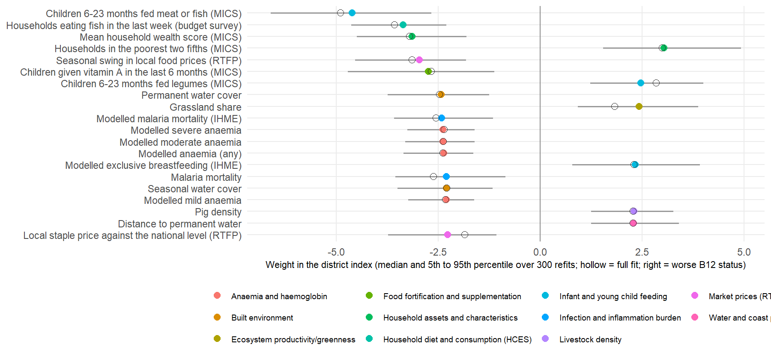
What are the weights behind the best ranking? Malawi, women’s B12
full talk
Notes:
SAY: The single best ranking in the study, women’s B12 in Malawi, and the twenty predictors behind it. Districts where more infants are fed meat or fish, more households eat fish, and wealth is higher have better B12; poorer, grassier, more pastoral districts have worse. And then the anemia and malaria surfaces run the other way, which the next slide explains.
DETAIL: Malawi, women’s B12, biomarker level: the outcome-country combination with the best in-fill ranking of the 24 (Spearman 0.70; The Gambia child vitamin A is next at 0.69). The index is linear in the rank-normalized columns, so every column has a standardized weight in a fit; the twenty largest are shown. Intervals: the index was refitted on 300 bootstrap resamples of Malawi’s 87 surveyed districts, with the domain components re-oriented and the weights re-learned each time; the bar is the 5th to 95th percentile and the hollow marker the weight in the full fit. Every one of the twenty keeps its sign in at least 95 percent of refits. The level target is the negated log concentration, so a positive weight means worse status. Read the signs as district-level associations in Malawi: districts where more infants are fed meat or fish, more households ate fish last week and the wealth score is higher have better B12 status, and districts that are poorer, grassier, further from permanent water and with more pigs have worse. The diet items point the way a nutritional story would expect; the anemia and malaria surfaces run the other way (more anemia and malaria, better B12), which is the lakeshore and the south against the uplands, and a reminder that these are ecological associations, not effects. Script: scripts/policy_deck/09_vim_forest_example.R, which takes any country, outcome and target through environment variables. B12 is measured in three of the four surveys, so this outcome-country combination does not enter the cross-country transport figures.

Slide 47
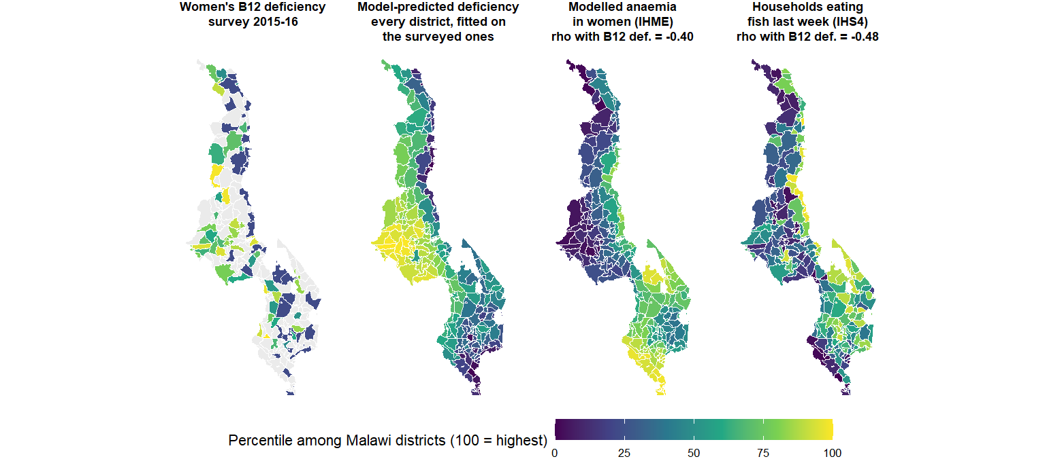
Causal driver or surrogate marker? Fish, anemia and B12 in Malawi
full talk
Notes:
SAY: Some predictors are plausible causes, fish consumption for B12. Some are surrogates: the anemia and malaria surfaces predict better B12 in Malawi not because malaria protects anyone but because they mark the lakeshore and the south, where fish is eaten. The model finds both kinds; it cannot tell them apart, and a surrogate need not travel to the next country.
DETAIL: The story behind the forest plot on the previous slide. In Malawi the modeled anemia and malaria surfaces carry negative weights for B12: districts with MORE anemia and malaria have BETTER B12 status. No nutritional mechanism says that. The maps say why: the lakeshore and the southern lowlands are where malaria transmission and anemia are highest, and they are also where households eat fish, the main dietary B12 source in the country; the uplands have less malaria, less fish and worse B12. The anemia surface is a surrogate marker for that geography, not a cause, and it is a good one precisely because it is modeled from the same environment. Three lessons for the audience: the index finds these markers on its own, they are ecological associations and must never be read as effects, and a surrogate that works in Malawi need not work in the next country, which is why the cross-border models lean on climate and soil rather than on health surfaces (ablation slide). The second panel is the deployment fit (the index fitted on the 87 surveyed districts and applied to all 243, in-sample for the surveyed ones, as on the dashboard): it fills the gray districts and smooths the survey’s single-cluster noise, and it visibly follows the anemia and fish geography. Each map is the within-country percentile of its variable so the four share one scale; rho is the Spearman correlation with B12 deficiency across the surveyed Traditional Authorities (negative for anemia and for fish: more of either, less deficiency).

Slide 48
Which outcomes and cut-offs does the analysis use?
Outcome | Population | Countries | Biomarker and adjustment | Cut-off
Iron deficiency | Children under 5; women 15-49 | All four | Ferritin, adjusted for inflammation (BRINDA or Thurnham factors, following each survey) | Under 12 µg/L (children), 15 µg/L (women)
Vitamin A deficiency (low RBP) | Children under 5; women 15-49 | All four | Retinol-binding protein, BRINDA-adjusted, converted to retinol with each survey’s calibration | Under 0.70 µmol/L
Folate deficiency | Women 15-49 | Ghana, Sierra Leone, Malawi | Serum folate: immunoassay (Ghana, Sierra Leone), microbiologic assay (Malawi) | Under 10 nmol/L
B12 deficiency | Women 15-49 | Ghana, Sierra Leone, Malawi | Serum B12 (Ghana: a subsample) | Under 150 pmol/L (Malawi 148)
Zinc deficiency | Children under 5; women 15-49 | Malawi | Serum zinc, by time of blood draw | Children 65 (morning) or 57 (afternoon) µg/dL; women 66 or 59
Selenium, iodine | Children and women; women | Malawi, within-country only | Plasma selenium; urinary iodine | 84.6 µg/L; 100 µg/L
Notes:
Verified against R/config.R, R/data_prep.R and docs/survey_report_reconciliation.md on 27 September. Corrections to the January slide: iron is not BRINDA everywhere (Ghana and Sierra Leone use Thurnham factors); women’s vitamin A is BRINDA-adjusted like children’s; folate and B12 are also measured in Malawi; iodine is configured for Malawi women (The Gambia and Sierra Leone were a separate within-country test); log scale is the modelling target, not an adjustment. Sierra Leone’s child file holds only anaemic children (532 of 654 assayed). IMPORTANT caveat for Andrew: the results in this talk come from the modelling targets built on 8 September (retinol-equivalent vitamin A rule); the 15 September corrections (vitamin A on the RBP < 0.70 rule, non-pregnant women and children 6-59 months only, Sierra Leone women’s iron on Thurnham, Malawi repeated Traditional Authority names, Malawi zinc on the survey’s own flag) are not yet propagated to the result tables.

Slide 49


Which deficiencies do we predict?
Iron
Vitamin A
Folate
B12
Zinc
Who: children under five; non-pregnant women
Where: all four countries
Biomarker: ferritin, adjusted for inflammation
Cut-off: ferritin below 12 (children) or 15 (women) ug/L
Who: children under five; non-pregnant women
Where: all four countries
Biomarker: retinol-binding protein, adjusted for inflammation
Cut-off: RBP below 0.70 umol/L
Who: non-pregnant women
Where: Ghana, Sierra Leone, Malawi
Biomarker: serum folate
Cut-off: below 10 nmol/L
Who: non-pregnant women
Where: Ghana, Sierra Leone, Malawi
Biomarker: serum B12
Cut-off: below 150 pmol/L
Who: children under five; non-pregnant women
Where: Malawi only
Biomarker: serum zinc
Cut-off: IZiNCG thresholds
full talk
Notes:
SAY: Five deficiencies, each defined once, the same way in every country, reconciled against the survey reports: iron, vitamin A, folate, B12 and zinc. Children under five and non-pregnant women.
DETAIL: Two targets per outcome-country combination: the deficiency prevalence, and the district mean of the negated log biomarker concentration (higher means worse), which carries more signal than the dichotomy and is reported alongside it. Definitions were reconciled against the four survey reports and the 21 papers that re-analyze them on 15 September 2026 (docs/survey_report_reconciliation.md): every iron, zinc, folate and B12 national estimate now reproduces its report to the decimal, and the Gambia LGA estimates track the report at r = 0.98 to 0.99. What changed then: the iron binaries had been the surveys’ iron-deficiency-ANAEMIA columns in three countries (ferritin plus hemoglobin), Malawi’s iron flag came from a mis-specified local BRINDA that under-counted by half, pregnant women and children outside 6 to 59 months were being kept, and vitamin A had been converted to retinol-equivalents with each survey’s own RBP-to-retinol line. That conversion is now the sensitivity analysis, not the primary: the four lines were fitted in different directions on 14 to 300 specimens, and Malawi’s has R-squared 0.13, which manufactures near-zero deficiency by construction; the survey’s own re-analysis (Likoswe 2021) recommends exactly BRINDA-adjusted RBP below 0.70, the estimand used here. Call it low RBP rather than vitamin A deficiency: Ghana’s MRDR found 6.7 percent depleted and Malawi’s none. Two caveats to say if asked. Sierra Leone’s child file as supplied holds only the survey’s anaemic children (532 of 654 assayed), so its child outcome-country combinations are anaemic-subgroup estimates until the full file arrives. Folate is not comparable across the two assays (Malawi’s microbiologic assay reads higher than the Roche immunoassay), so its cross-border numbers are indicative only. Iodine (The Gambia, Sierra Leone) is analyzed within country only; a one- or two-country outcome has no cross-border test.

Slide 50



How are the layers matched to districts in space and time?
Space: one list of 554 districts
Every layer is joined to it by a district code, never by a district's name, so a renamed or split district cannot silently drop out.
Time: every layer at the survey year, or the nearest
Climate enters as a 30-year normal plus the survey year's anomaly; household surveys as the round nearest the biomarker survey.
The gap is recorded for every column
136 columns sit exactly on the survey year in every country, 78 are static layers; where a source is years off, the gap travels with the column.
full talk
Notes:
SAY: Two rules. In space: one list of districts, and every layer is joined to it by a code, never by a district’s name, so a renamed or split district cannot silently drop out. In time: every layer is taken at the year of the country’s survey or the nearest year available, climate as a 30-year normal plus that year’s anomaly, and the gap between the layer’s year and the survey’s is recorded for every column.
DETAIL: Space: The spine is metadata/admin2_spine.csv; the helpers in R/admin2_keys.R do every join in the pipeline and a lint test (tests/testthat/test-admin2-join-lint.R) reads every script for a join on a bare Admin2 name. The p-codes came from OCHA’s COD-AB for all four countries this week, both directions, so an OCHA-coded source (IPC, ACLED, cluster surveys) joins without any matching. Fuzzy matching, where it is still needed, is Jaro-Winkler with a 0.15 cap and a review file that lists every non-exact match for a human to accept. The population defect: the dashboard’s population table had been deduplicated by district name, so Chikwawa’s TA Lundu and Nsanje’s TA Ngabu, Salima’s TA Pemba and Zomba’s TA Malemia lost one member each, two of them surveyed districts, and every population-weighted figure silently excluded them. Fixed 15 September from WorldPop density, and the population table is now asserted complete in the tests. Time: The rules live in metadata/covariates/temporal_alignment.csv, 45 of them, one regular expression each: survey_year where an annual series exists (TerraClimate, MODIS NDVI, MAP, WorldPop density, WFP prices, RTFP windows), nearest available year where a series ends early (IHME’s child growth, education and WASH stop at 2017, anemia and malaria at 2019), a fixed vintage where there is only one (AlphaEarth 2017, MapSPAM 2010, GLW 2015, RWI 2019), a per-country round for the household surveys, and static for soil, terrain, climate normals and zones. Climate and greenness enter as a 30-year normal plus the survey-year anomaly in standard-deviation units, which is what transports; the calendar-year series that lagged the survey by up to eight years were retired. Sierra Leone’s 2013 survey is the awkward one: AlphaEarth starts in 2017, Copernicus land cover in 2015, and the MICS round nearest it is 2017, so its gaps are the orange and red bands. Ghana’s are the DHS block: the round paired with the 2017 survey is the 2014 DHS, three years off for 140 columns. The gaps that apply everywhere are the single-vintage products: MapSPAM 2010, GLW 2015, WorldPop’s 2020 age-sex structure. The stamp is per column and per country (results/tables/predictor_alignment_2026-09-16.csv), and the audit lists everything three or more years off.

Slide 51
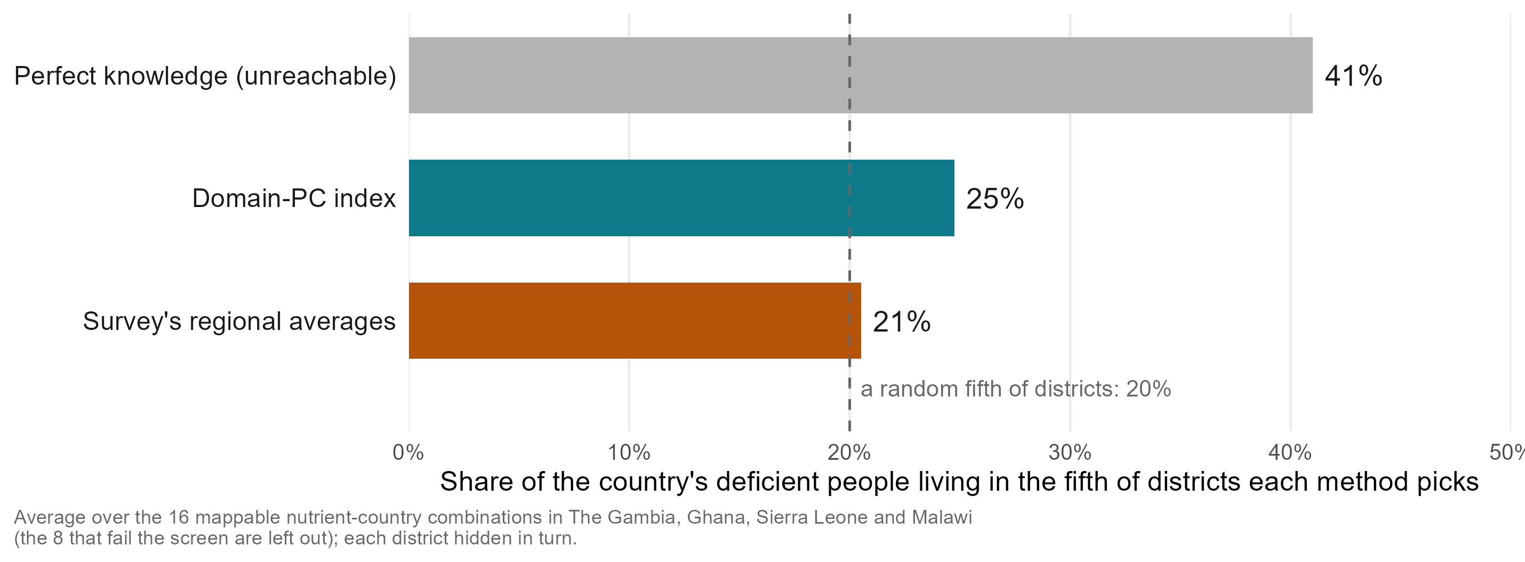
Does targeting reach more deficient people?
Notes:
Not one country or outcome: the average over the 16 mappable nutrient-country combinations in all four countries, the 8 that fail the screen left out. A programme reaching the fifth of districts the model ranks worst reaches 24.8 per cent of the deficient people; the survey’s regional averages 20.5; a random fifth 20 by definition; a perfect map 41.0. Over all 24 combinations, as in earlier versions: 21.9, 20.3 and 47.5. In Ghana children’s iron, simply taking the most populous fifth of districts reaches 46 per cent: to reach the most people, rank by predicted rate times population.

Slide 52


Does the model put districts in the right severity band?
Exact WHO band
Within one band
Two or more bands wrong
Model: 64% of districts
Regional averages: 66%
Bands: under 2%, 2 to 10, 10 to 20, 20% or more (vitamin A); each district held out
Model: 91% of districts
Regional averages: 94%
A district the survey calls severe is placed severe or moderate
Model: 9% of districts
Regional averages: 6%
The error a severity map cannot afford; in a new country the level comes from the national anchor
full talk
Notes:
SAY: Policy runs on severity bands. With each district held out, the model puts 64% of districts in the survey’s WHO vitamin A band and 91% within one band. The survey’s regional averages do slightly better, because a band is mostly a level; the model’s case is a band where there is no survey at all.
DETAIL: DRAFT C. Policy runs on severity bands, not correlations: WHO’s vitamin A bands are under 2%, 2 to 10, 10 to 20, 20% or more. With each district held out, the model puts 64% of districts in the band the survey puts them in and 91% within one band (risk_category_accuracy.csv, mean over the vitamin A outcome-country combinations); the survey’s own regional averages give 66% exact and 94% within one band. Read the comparison honestly: on severity bands the survey’s own regional averages do as well as the model or slightly better, because a band is mostly a level and the regional average carries the country’s own level. The model is almost never two bands wrong (a district the survey calls severe is not called mild), and its case is not that it beats the regional average on bands but that it gives a band where there is no survey at all; in a new country the level comes from the national anchor (risk-class slide in the appendix has the transport rows). Use this slide only if the audience reads vitamin A or anemia severity maps, and say the regional-average comparison aloud rather than letting the numbers sit.

Slide 53
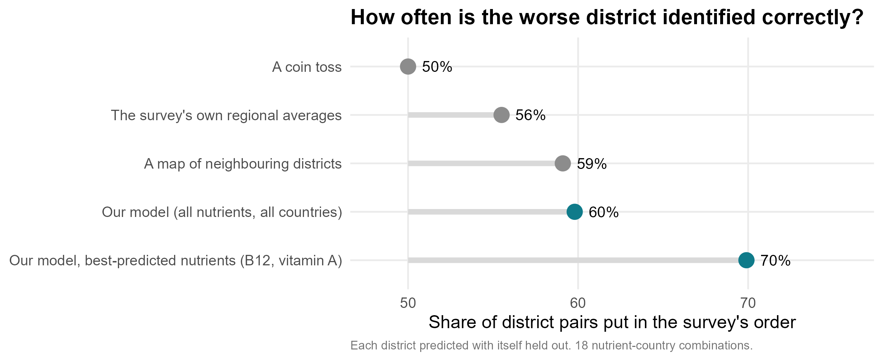
Accuracy pooled over all nutrients, in district pairs
Notes:
Pooled over 18 combinations, each district hidden. The regional average here is each district’s own region averaged over the other surveyed districts in that region (the district itself left out): what a programme would know for a district the survey missed. A national mean excluding the district’s own region is not a fair alternative: it reverses the order (26 per cent of pairs right, correlation -0.62), because districts in high-deficiency regions are assigned the healthier rest of the country. The fair “no information” comparator is a coin toss (50 per cent), which a single national figure also gives.

Slide 54



What the models can and cannot do yet
Rank districts in a surveyed country?
Yes: 0.40, null 0.08.
Rank districts in a new country?
Yes, less well: 0.30 against 0.08.
Which predictors carry the signal?
Satellite, climate and soil.
Prevalence in a new country from the model alone?
Not yet.
Prevalence with one national anchor?
Yes: 9.3 points at a 5% sample.
Replace biomarker surveys?
No: the ceiling is the survey's.
Guide where the next survey samples?
In design, not piloted.
Say how sure each map is?
Stable, yes; verified, no: coverage 38%, not 90%; a calibrated 90% interval is ±55% of the list. A worst-third call is right 52% of the time (chance 33%).
full talk
Notes:
The checklist agreed at the 10 September check-in, one row per question. Sources: benchmarks_v2_summary.csv (in-fill and country transport, biomarker level), transport_null_calibration.csv (95th percentile of the permutation null), nested_domain_selection.csv (fixed climate-and-soil set), index_importance_domains.csv (pooled shares of the three remotely sensed domains), anchor_and_rank.csv (AR-01, 5% fraction, climate-and-soil set, ranks from prevalence), variance_components_ceiling.csv (prevalence, admin2). Levels do not transport because the surveys differ in year, season, team and calibration (fe_transport_level_offset); the anchor supplies the level the ranking lacks. Guiding the next survey is a design result on these four surveys, not a pilot.

Slide 55
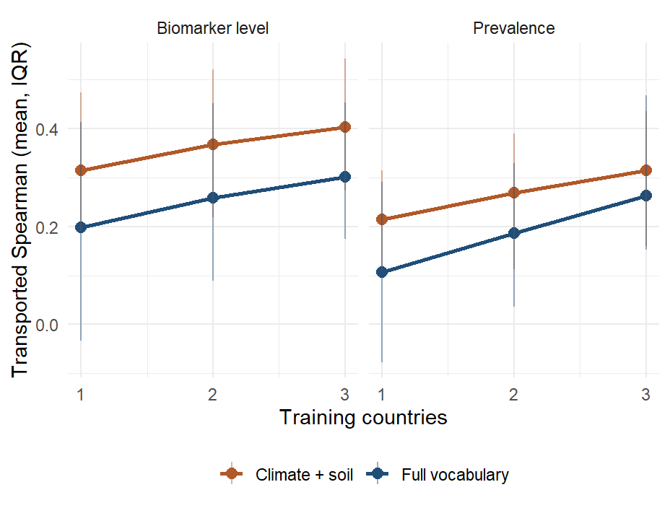
Every combination of training countries
Notes:
Every subset of training countries scored on each held-out country: about +0.05 per country added, not flattened at three; the gain is in The Gambia and Ghana.

Slide 56
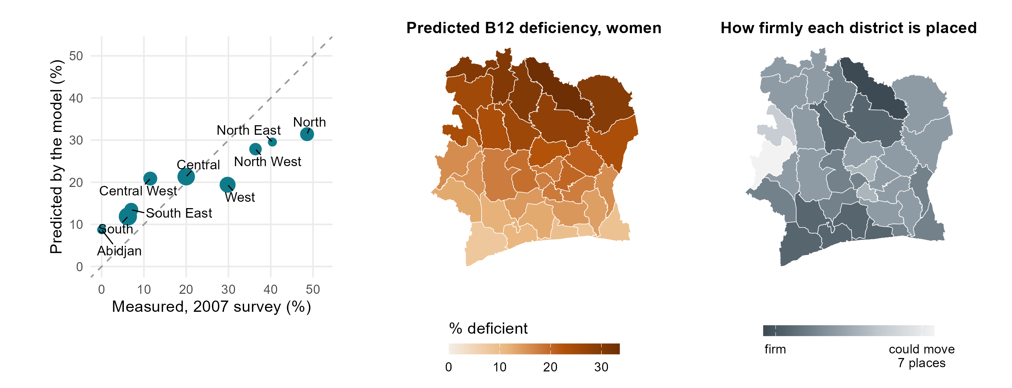
The 2007 Côte d’Ivoire survey and the B12 prediction
Notes:
Left: women’s B12 deficiency in the nine zones of the 2007 national survey against the model’s predicted prevalence, averaged over the districts in each zone (dashed line: perfect agreement). The ranking is transported from the four surveyed countries with no Ivorian biomarker; the level is anchored to the survey’s national 18.1 per cent, the design the talk recommends (a small national sample plus the ranking): predicted = expit(logit(0.181) + 0.33 x 1.48 x z), z the standardised climate-and-soil B12 index, 0.33 how well that ranking held up for B12 when each training country was held out, 1.48 the between-district spread (logit) in the training surveys. The order matches almost exactly (0.95 over nine zones); the spread is compressed, 9 to 31 per cent predicted against 0 to 49 measured, mean error 8.7 points, as expected from a shrunken ranking. Middle: the district map. Right: how firmly each district is placed over 400 refits (stability, not a confidence interval). Caveats: 2007, zones are not administrative units (centroid crosswalk), nine points, a steep north-south gradient. Table: results/tables/policy_deck/v4_civ_b12_anchored.csv.

Slide 57
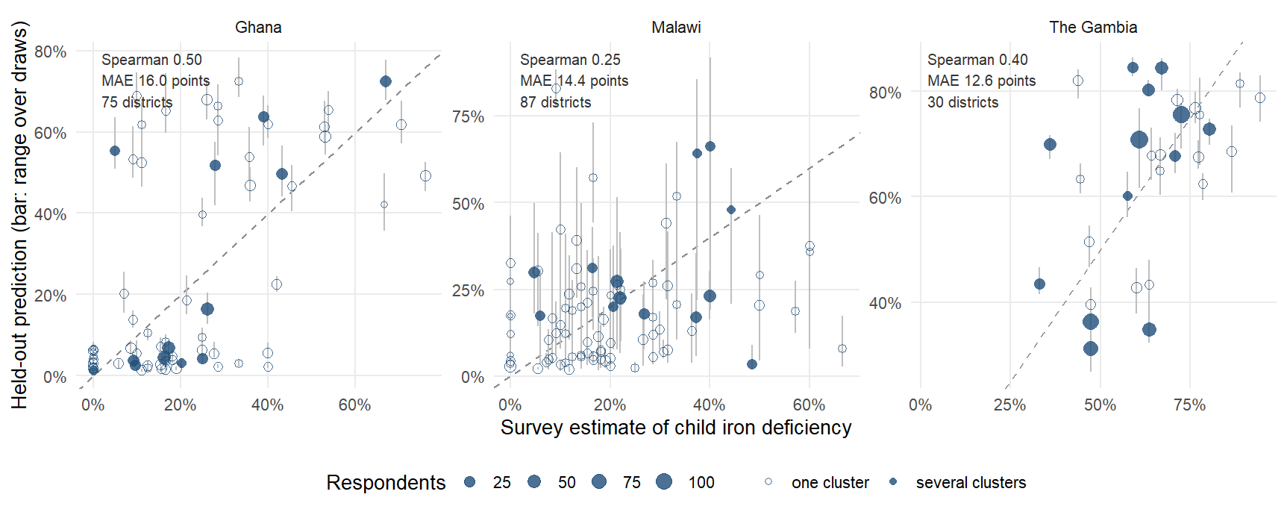
Does the model track the survey, district by district?
Notes:
The cloud is tilted but not on the line: the model ranks, and compresses the range. Hollow points are single-cluster districts; much of the vertical scatter is the survey’s noise.

Slide 58
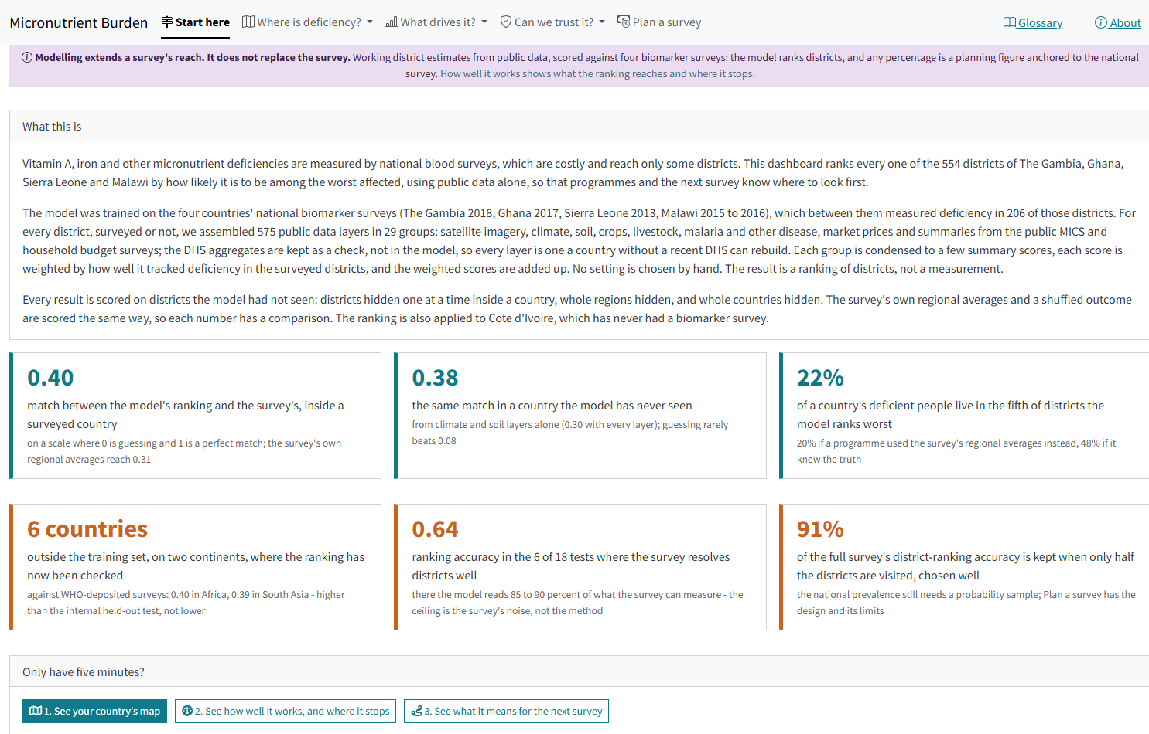
The live dashboard
Notes:
amertens.shinyapps.io/micronutrient-burden: every district of the four countries and Côte d’Ivoire, planning prevalence with calibrated bands, WHO severity class, people affected, the external check, a survey planner and country briefs. Its “new country” tile (0.38) is the climate-and-soil model; the talk’s 0.30 is the full index.

Slide 59


What have we learned, and what comes next?
Public data can rank a country's districts by deficiency
Inside a surveyed country better than the survey's own regional averages (0.40 vs 0.31); six district pairs in ten in the survey's order.
And in a country with no survey, where nothing else can
Rankings carry across borders (0.38 from climate and soil); Cote d'Ivoire has its map. Levels need one national number.
Where the survey can see districts, the model is close to the best any model could be
Six outcome-country combinations at 0.64; The Gambia, with several clusters per district, 0.41 to 0.70.
The uncertainty on every map is honest about what it is
Stable under resampling, not verified: a worst-third call is right 52% of the time, chance 33%.
Every survey added improves every other country's map, and the curve has not flattened
0.20 with one training survey, 0.30 with three, about +0.05 per country added. The limit on this method today is the number of biomarker surveys it can learn from, not the predictors.
So the ask is more surveys in the pool, and the fifth one is already a test
Two indices were written down before any new country's data was seen. We are asking countries with a recent, planned or shelved micronutrient survey to join the panel.
full talk
Notes:
SAY: Public data can rank a country’s districts by micronutrient deficiency: inside a surveyed country better than the survey’s own regional averages, and in a country with no survey at all, where nothing else can. Where the survey resolves districts, the model is close to the best any model could be. A single national number puts a level on the ranking. The uncertainty on the maps is honest about what it is. And the last row is the one I want to leave you with: what limits this method today is not the satellite data, which is saturated — eleven blocks added this year each moved it by less than 0.01 — it is the number of biomarker surveys it can learn from. One training survey gets a new country to 0.20, three get it to 0.30, and the curve has not flattened. So our ask is that countries with a micronutrient survey, recent or planned or sitting in a drawer, put it in the pool: it improves every other country’s map, and yours gets a ranking for the districts your survey never reached.
DETAIL: The rows are the numbers from the optimiztic reading (TWO_READINGS_2026-09g.md). Not on the slide, said if asked: the honest product is a ranking, levels remain planning figures, and the per-outcome maps in an unsurveyed country are mostly one map of environmental deprivation. On the pooling row, three qualifiers to have ready. (1) The gain is uneven: as held-out countries The Gambia goes 0.40 to 0.60 and Ghana 0.30 to 0.39 as surveys are added, while Malawi (0.16) and Sierra Leone (0.06) stay flat, so “every survey improves every map” is a statement about the average. (2) Which country is added matters, and we can say how: trained on Ghana alone the model reaches The Gambia at 0.61, while trained on The Gambia alone it reaches Ghana at 0.30 — Ghana’s 260 districts span the widest environmental gradient in the panel (NDVI SD 0.16 against 0.04 to 0.09 elsewhere), and a training country that contains the whole gradient teaches the whole gradient. So the request is not simply “more countries” but countries that extend the range, which is checkable from public rasters before any blood is drawn. (3) The saturation claim behind “it is the surveys, not the predictors”: eleven candidate predictor blocks were scored under one harness and none moved in-fill or transport by more than 0.01 at the median, while the open, permission-free tier transports better than the full set (0.316 vs 0.302 vs 0.281 with DHS added).
The original full-talk slide. The updated version is the main-body slide 'What have we learned, and what comes next?'.

