Slide 1
Predicting Micronutrient Deficiency Prevalence in Sub-Saharan Africa Using Proxy Indicators: A Multi-country Machine Learning Framework
Andrew N. Mertens (University of California, Berkeley) and Sonja Y. Hess (University of California, Davis)

Slide 2
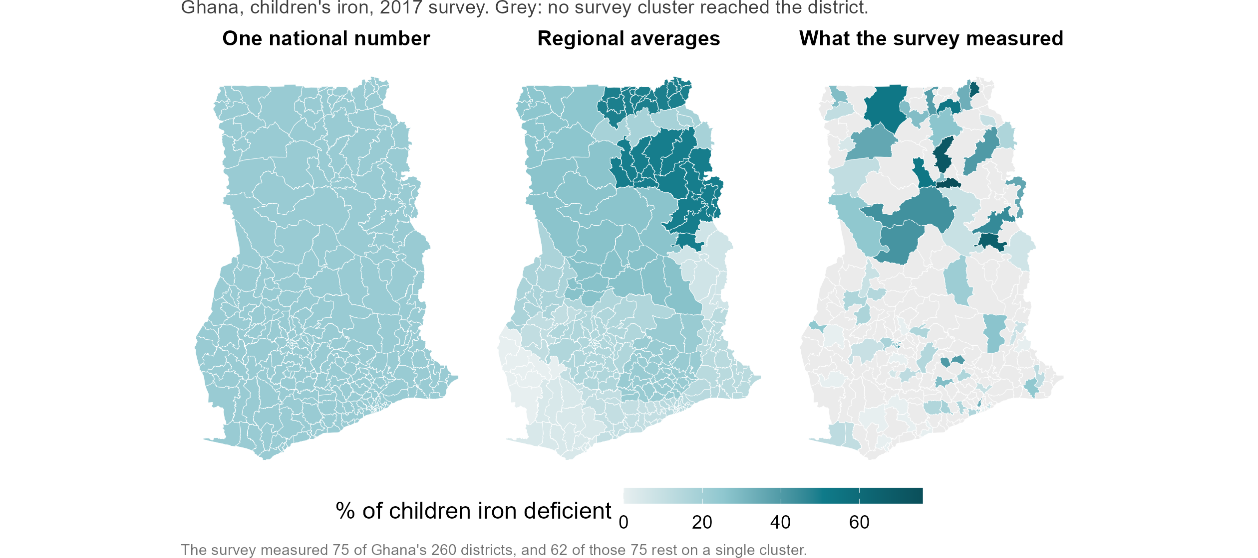
What a country has today
Notes:
SONJA.
A national micronutrient survey happens roughly once a decade, and it is designed to report regions, not districts.
Ghana’s 2017 survey did exactly what it was designed to do. It put 90 clusters into 75 of Ghana’s 260 districts, and it reports its regions well.
But the decisions are not regional. Somebody has to say which districts get the next round of supplementation, which get screened first, where the next survey team goes.
Today the honest answer for an unsurveyed district is that it gets its region’s average. In Ghana that is 185 districts out of 260 with no measurement of their own. And in 62 of the 75 districts the survey did reach, the district’s whole number rests on one cluster, about a dozen children.
That is the gap. Andrew will show you what public data can and cannot do about it.

Slide 3
The four surveys we learned from
Survey | Districts measured | Clusters | Nutrients
The Gambia 2018 | 30 | 70 | Iron, vitamin A
Ghana 2017 | 75 of 260 | 90 | Iron, vitamin A, folate, B12
Sierra Leone 2013 | 14 | 60 | Iron, vitamin A, folate, B12
Malawi 2015-16 | 87 (Traditional Authorities) | 103 | Iron, vitamin A, folate, B12, zinc
Notes:
SONJA.
These are the four national biomarker surveys we learned from, and the teams who ran them.
Between them: 206 districts, 323 survey clusters, 24 nutrient-country combinations. This is the only ground truth of this kind for this question on the continent, and it exists because these teams collected it.
One word on what “district” means, because it differs. Thirty districts in The Gambia, 75 of Ghana’s 260, 14 in Sierra Leone, and in Malawi the 87 units are Traditional Authorities sitting inside 27 districts.
Ghana is the worked example today, partly because the Ghana team is in this room and can check us.

Slide 4
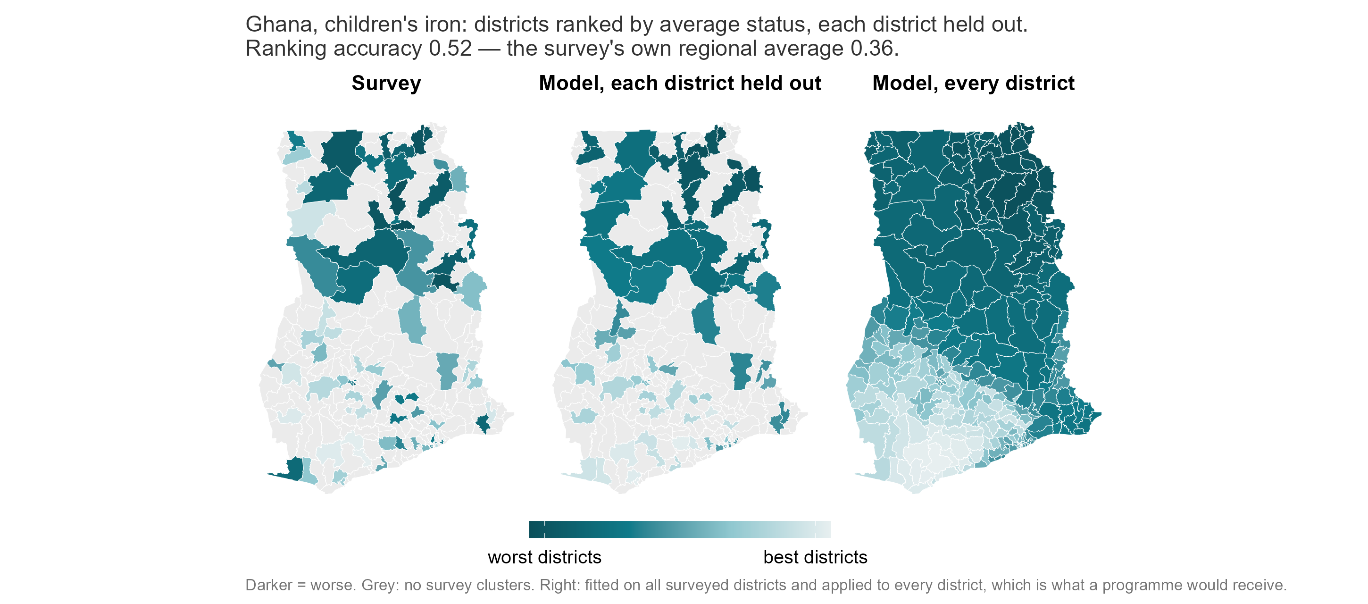
A value for every district, including the 185 no survey reached
Notes:
ANDREW.
Here is the whole talk in one picture. On the left, what the survey measured in the 75 districts it reached. In the middle, what the model predicts for each of those districts when that district is hidden from it. On the right, the model applied to all 260, including the 185 no survey cluster ever reached.
Take three districts, and remember these are held-out predictions. Binduri was hidden from the model that ranked it.
Binduri: its region’s average puts it 13th worst; the model puts it 1st; the survey found it 3rd. That is a move a programme would act on.
Talensi: regional average 10th, model 6th, survey 5th.
And Atiwa East, where we are wrong: the survey found it 11th worst, and we put it 64th. I will tell you in two minutes how often that happens.
Ranking accuracy here is 0.52 against 0.36 for the survey’s own regional averages. Zero is chance, one is perfect.

Slide 5
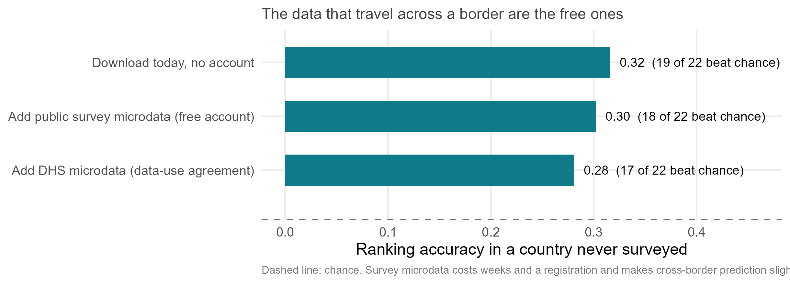
What the map is built from
Notes:
ANDREW.
Five hundred and seventy-five measurements for every district, from 28 public sources. Thirty-year climate normals, soil chemistry, crop and livestock maps, satellite land cover, malaria and anaemia surfaces built from earlier surveys, market prices, and summaries of public household surveys.
None of it required a new blood sample and none of it had to be purchased. Three of the sources need a free account.
And this is the part I did not expect. The data that travel across a border are the free ones. The layers you can download this afternoon, with no account and no agreement, rank a new country’s districts at 0.32. Add the public household survey microdata, which cost us weeks and a registration each, and it goes down slightly. Add DHS microdata, under a data-use agreement, and it goes down again.
So for a country with no survey, the answer is not “find better data”. The vocabulary is saturated: we scored eleven new blocks of predictors this year and not one moved the answer by more than a hundredth.

Slide 6
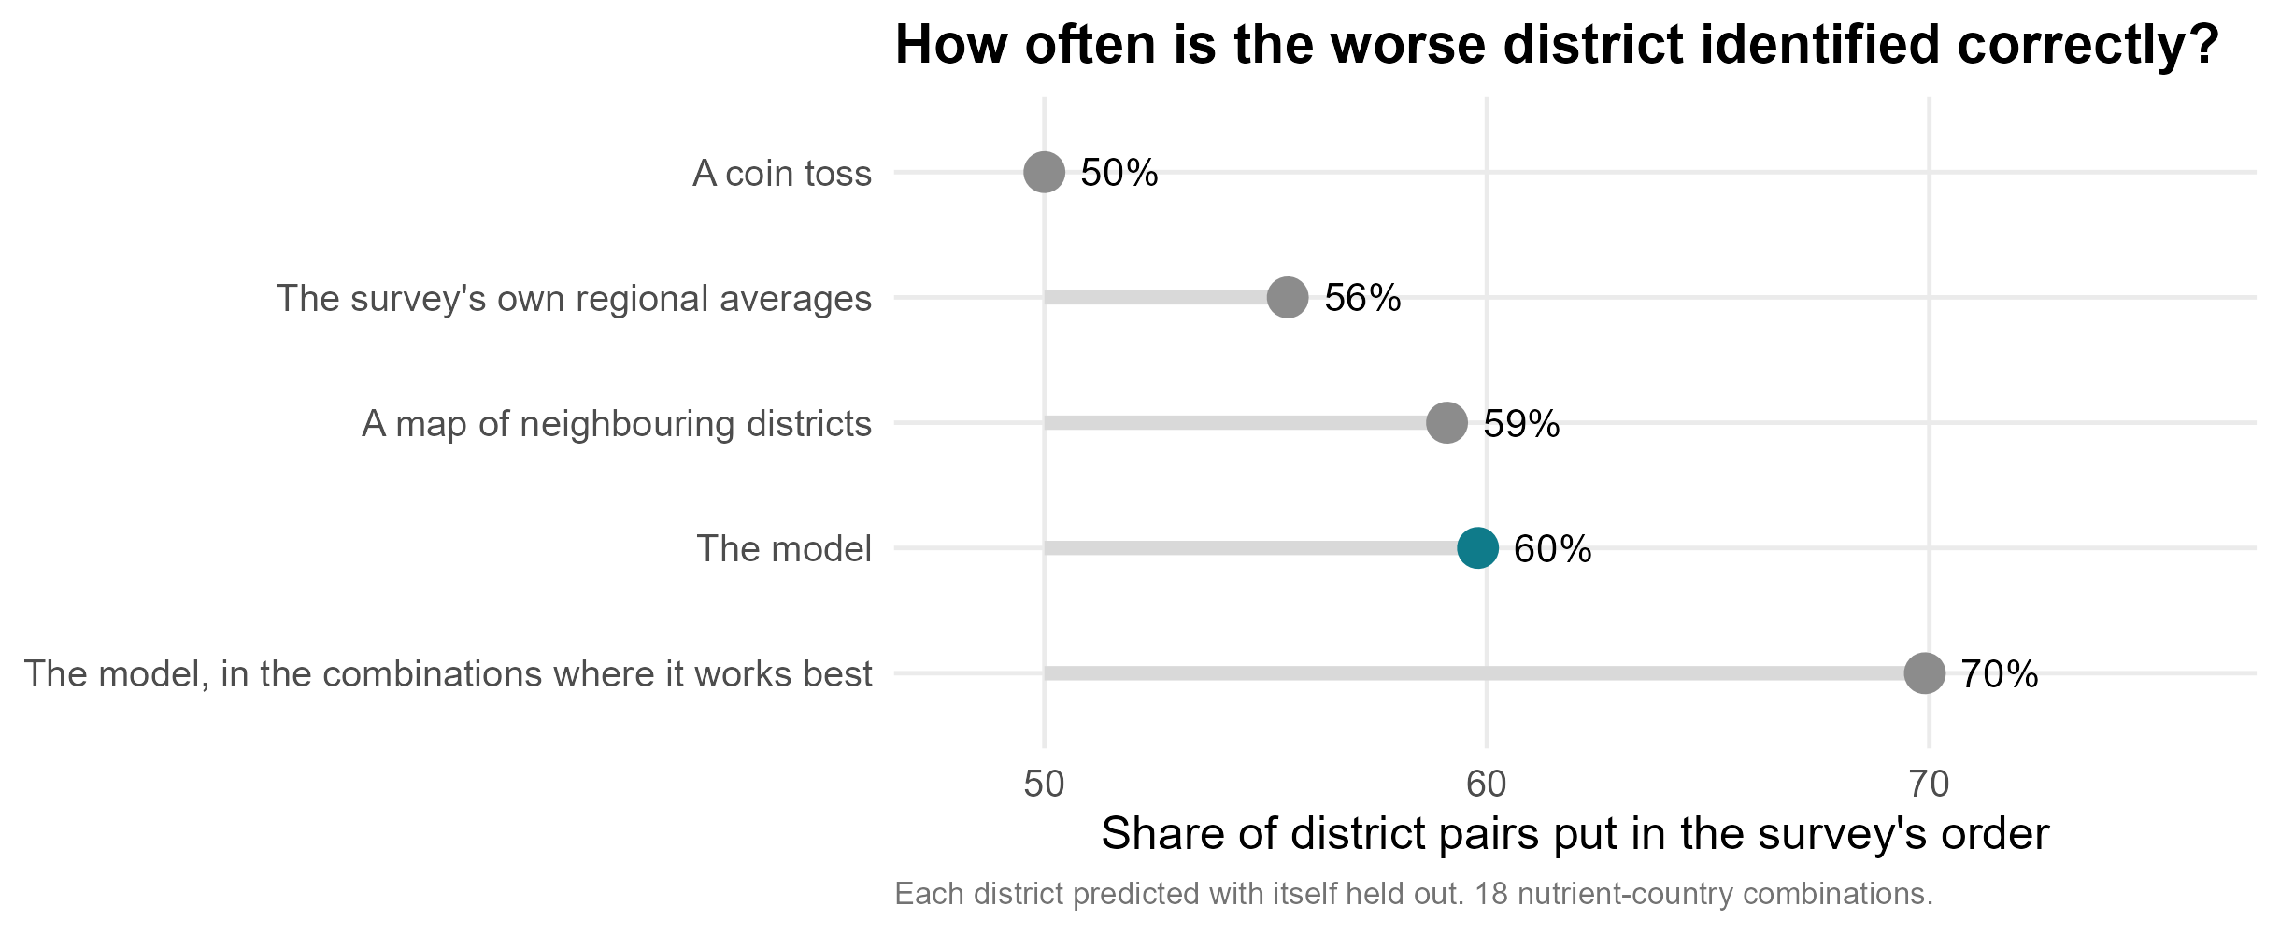
How accurate is it? (version A)
Notes:
ANDREW. VERSION A of three — pick one of slides 5A, 5B, 5C and delete the other two.
We tested it the hard way. We hid one district in five and predicted them, ten times over. Then whole regions. Then whole countries.
“Held out” means the model never saw that district’s blood results while it was being fitted. So every number here is a prediction, not a fit.
And we did not test against zero. We tested against the number a programme officer actually has on her desk: her district’s regional average, computed with her own district left out.
Take any two districts and ask which is worse off. We get it right six times in ten. The regional averages get five and a half. A coin gets five.
One honest tick on that ruler: a map built only from neighbouring districts, with no satellite data at all, gets 59 per cent. Inside a surveyed country, geography gets you most of the way. What the public layers buy you is the border, and in a country with no survey there is no neighbour map to smooth.

Slide 7
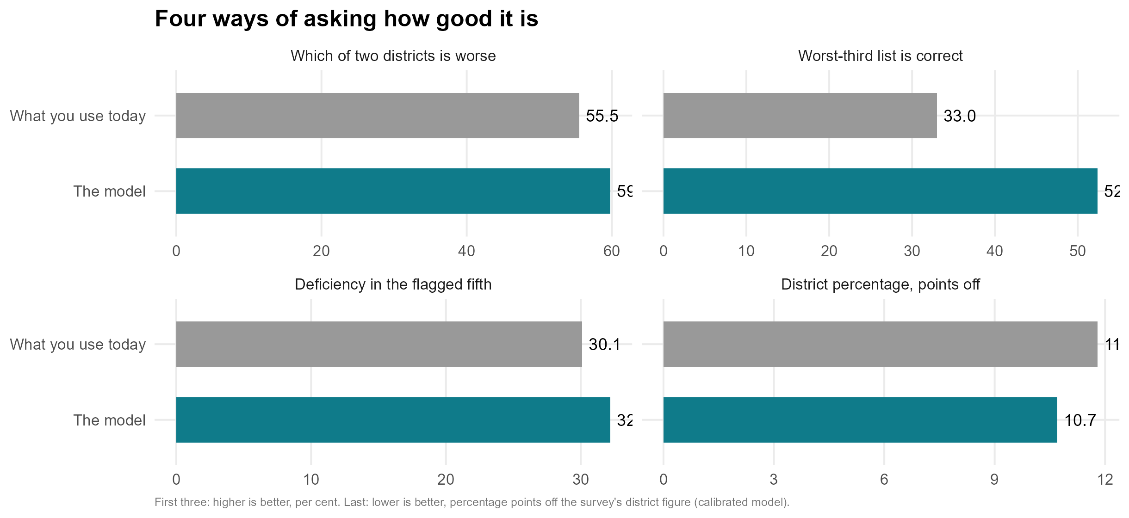
How accurate is it? (version B)
Notes:
ANDREW. VERSION B of three.
Four ways of asking the same question, each against what you would use today.
Which of two districts is worse: we are right 60 per cent of the time, the regional averages 55.5.
Of the districts we name in the worst third of a country we have never surveyed, 52 per cent really are there. Chance is 33.
The fifth of districts we flag runs at 32 per cent deficiency against 30 for the regional-average list and 24 nationally.
And the one where we do not win. Asked for a district’s actual percentage, we are about 10.7 points off. The regional average is 11.8, and simply writing the national number on every district is 11.5. At district level nobody has a level, us included. We sell the order, not the number.

Slide 8
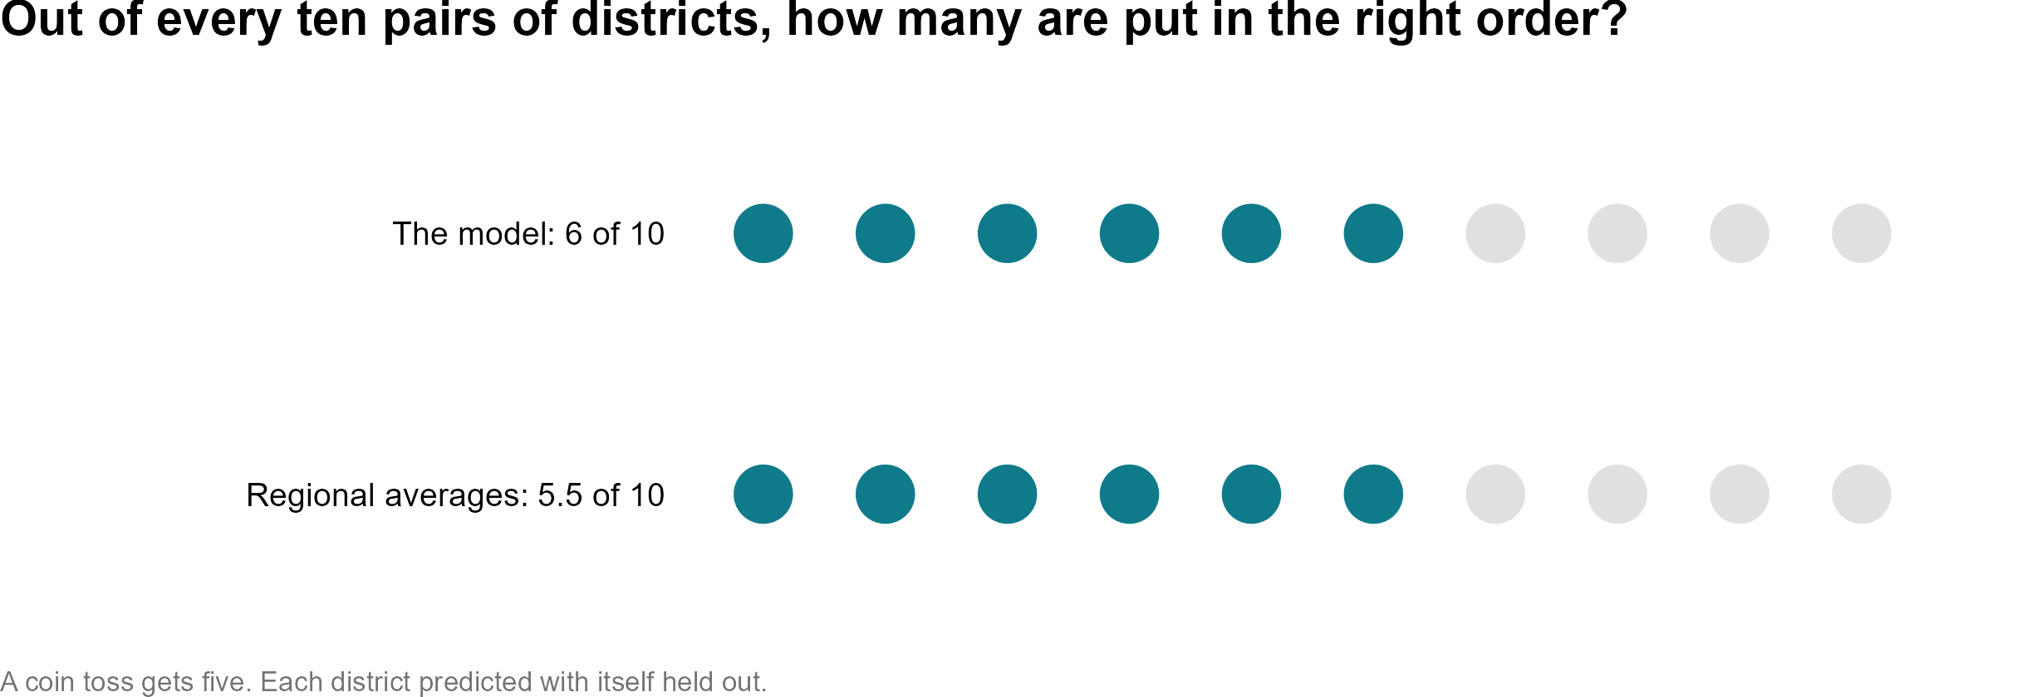
How accurate is it? (version C)
Notes:
ANDREW. VERSION C of three.
Out of every ten pairs of districts, we put six in the order the survey found. The regional averages manage five and a half. A coin gets five.
That is the honest size of it. It is a real improvement over what a ministry uses today for a district with no survey, and it is a long way from knowing.

Slide 9
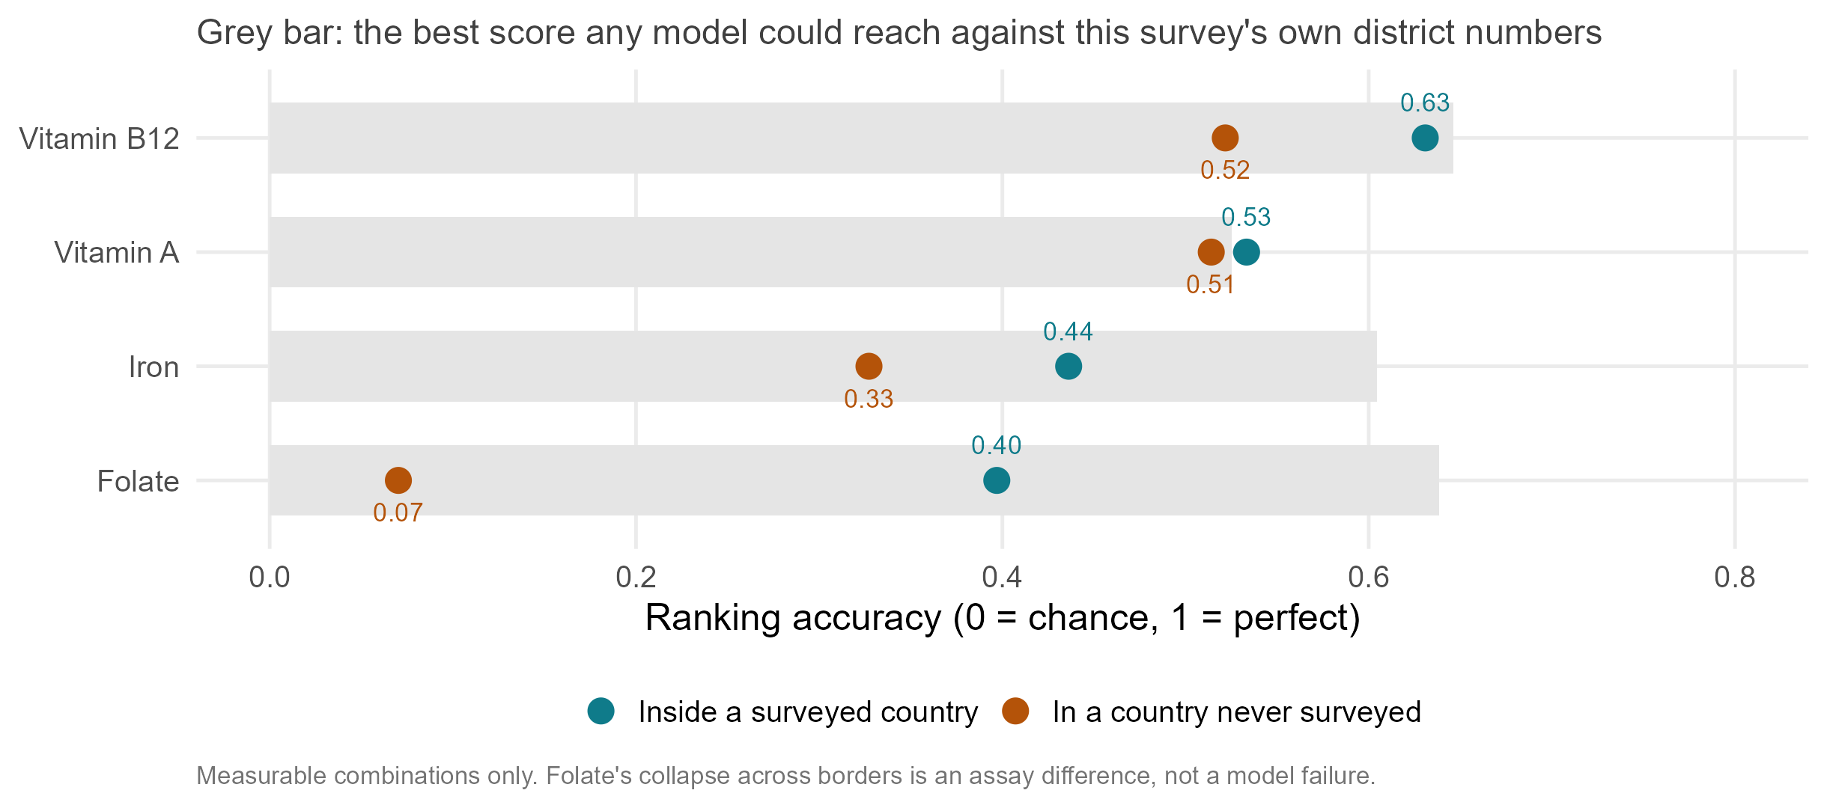
Accuracy depends on the nutrient, not on how common it is
Notes:
ANDREW.
This is the slide I would most like you to take away, because it says something about micronutrient surveys and not only about our model.
Vitamin B12 and vitamin A map best. Iron is in the middle. Folate ranks districts perfectly well inside a country and then collapses when we cross a border. Zinc we cannot map at all, in any country.
And notice it has nothing to do with how common the deficiency is. Folate and zinc are the two commonest deficiencies in our data and the two we handle worst.
Folate’s failure is worth thirty seconds, because it is not a modelling failure. Malawi’s folate was measured with a microbiologic assay and the others with an immunoassay, which reads systematically lower. So “folate deficiency” is not the same quantity in the training countries and the test country. What fails to cross a border is the measurement, not the geography. That is a harmonisation problem, and it is one this room can fix.
The grey bars are the ceiling: the best score any model could get against a survey’s own district numbers, given how noisy those numbers are. For B12 and vitamin A we are essentially at it.

Slide 10
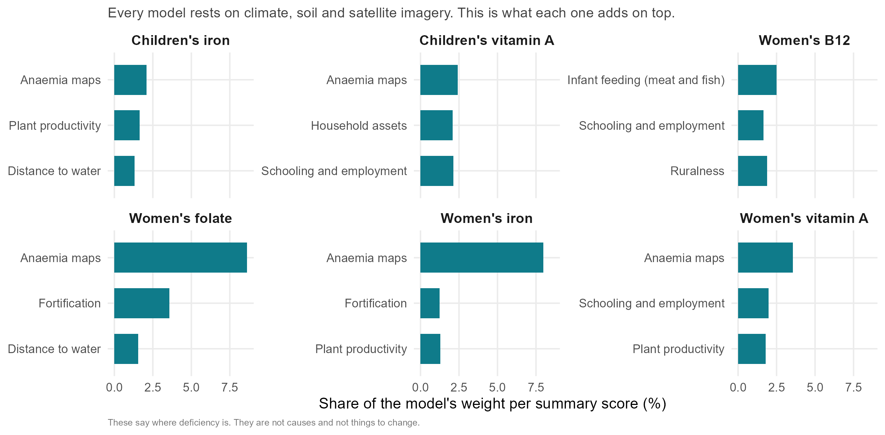
What each nutrient’s model reaches for
Notes:
ANDREW.
Every one of these models rests on the same three things: climate, soil, and a satellite summary of what a district looks like. Together those carry just under half the weight, in every nutrient.
What is interesting is what each nutrient reaches for on top of that, because a nutritionist would recognise all of it.
B12 — the nutrient you get almost only from animal-source food — leans hardest on infant feeding: districts where more infants are fed meat or fish have better B12 status. And B12 is our best-predicted outcome.
Iron and folate lean on the modelled anaemia maps, which is their clinical consequence.
Vitamin A leans on child wasting and underweight, the other undernutrition that sits in the same places.
Children’s iron leans on the farming system: cereal-dominant cropping, more ruminants, more cattle, all marking worse iron status; root crops and market-integrated food prices marking better.
Two warnings. These are district-level associations and they are not causes. At household level, owning cattle and eating legumes are protective; at district level they mark a subsistence food system. And in Malawi the anaemia and malaria maps carry weight in the wrong direction for B12, because they mark the fish-eating lakeshore. The model finds a place-marker and cannot tell it from a mechanism.
So: these tell you where to look. They are not a list of things to change.

Slide 11
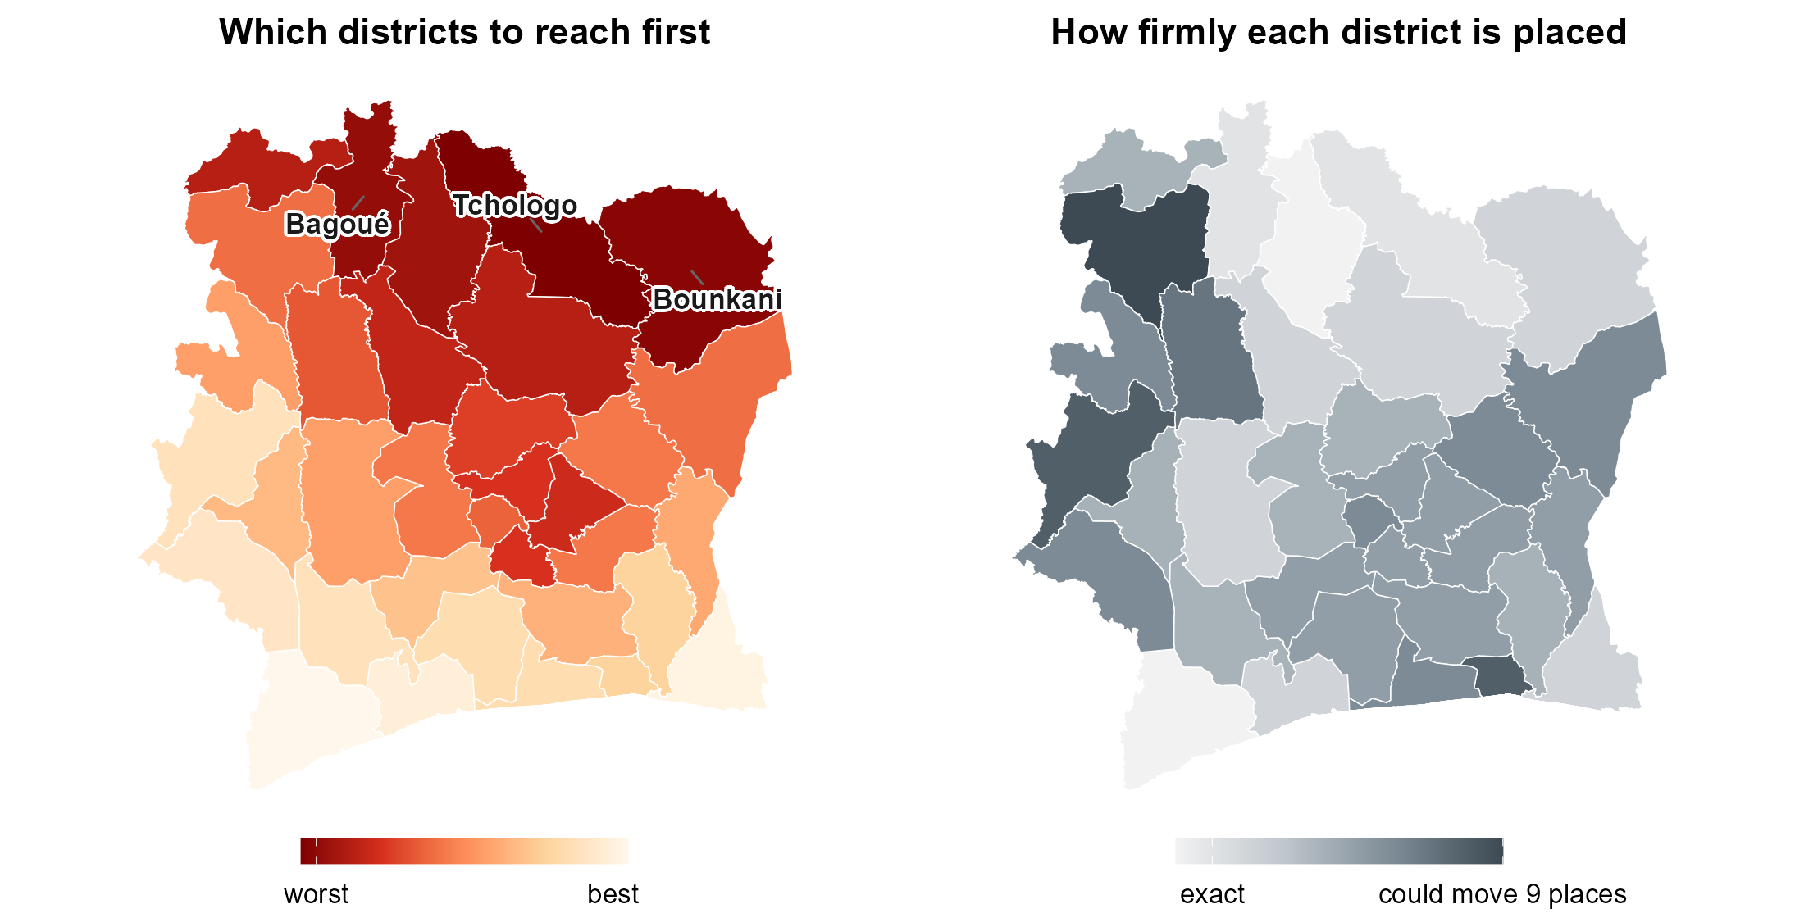
Most countries have no recent micronutrient survey. Côte d’Ivoire is one of them.
Notes:
ANDREW.
Most countries in this region have no recent biomarker survey at all. Côte d’Ivoire is our worked example of that situation, not a special case: all the public layers, no survey.
Trained on the four surveyed countries, the model ranks its 33 districts. The northern savanna belt comes out worst — Tchologo, Bounkani, Bagoué, Poro.
Two independently chosen versions of the model agree with each other at 0.88 to 0.97 and share 83 per cent of their worst fifth, so this is not a knife-edge.
And there is one independent map for Côte d’Ivoire: the WFP and MIMI vitamin A work published this year, built from a household budget survey, nothing to do with us. It puts the same northern belt worst — rank agreement about 0.5 across all 33 districts, and it survives adjusting for latitude. For iron there is no independent map to check against.
How much should you trust it? With a whole country held out, a district we call worst-third really is in the worst third 52 per cent of the time, against 33 by chance. When we name our five worst, 62 per cent of those calls land.
The shading on the right is easy to misread. Deep means the model does not change its mind when we retrain it on different districts. It does not mean we have verified that district against anything.

Slide 12
Which decisions is this good enough for?
Decision | Used today | Verdict
Which districts to reach first | Region’s average | Yes
Where the next survey samples | Equal spread | Yes
Order of a roll-out | Region by region | Yes
A planning % for a district | National number | Only with a national sample
How many deficient people reached | Population x national rate | No
Whether a programme worked | A repeat survey | No
Binduri, Upper East. Its region’s average ranks it 13th worst for children’s iron. Our model, which never saw it, ranks it 1st. The survey found it 3rd.
Notes:
ANDREW.
This is the slide to photograph. Three yeses, one partly, two noes.
Yes to an order: which districts to reach first, where the next survey samples, how to sequence a roll-out. All three need a ranking, and the ranking is the thing that works.
Take Binduri, in Upper East. Today it would inherit its region’s average, which puts it 13th worst in Ghana. Our model, which never saw Binduri’s blood results, puts it 1st. The survey found it 3rd. That is the whole product in one district: a programme using the regional average sends its first team somewhere else.
Partly on a planning percentage. The ranking has no level of its own. Measure one national number — about five per cent of a survey’s sample, roughly forty blood draws for one nutrient — hang the ranking on it, and district figures land within about nine to ten points. Spend that same five per cent on a regional survey instead and you get about twelve.
And that anchor has to be measured, not modelled. We tried predicting a country’s national level from world indicators across 69 countries. It missed Sierra Leone by 29 points and Malawi by 22, and every district inherits that miss.
Two flat noes. First, cases. If your question is how many deficient children a campaign reaches, our worst fifth holds 22 per cent of them and the regional averages 20. In Ghana, simply going to the most populous fifth of districts reaches 46 per cent. Burden sits where the people are. Rank by rate times population — you already have the population map — and read ours as the rate.
Second, evaluation. This is one point in time, and we are nearly blind to programme reach: in the whole dataset there are three district-level columns on supplementation and fortification. We cannot tell you whether a district is high-risk because it is unreached or high-risk despite being reached.

Slide 13
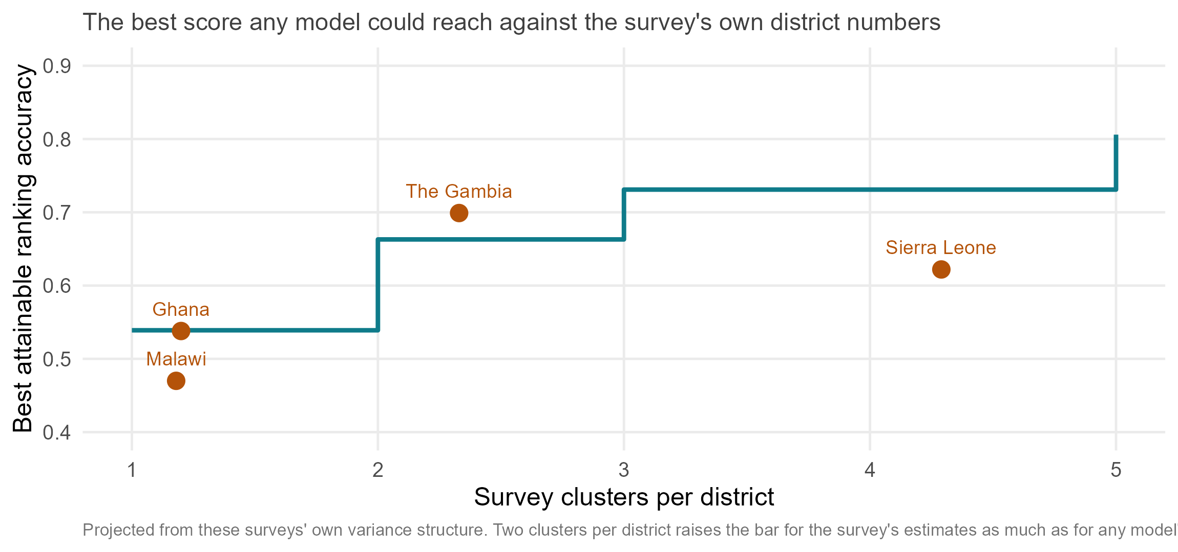
Most districts rest on a single survey cluster
Notes:
ANDREW.
Before you judge any district model, including ours, ask what the survey can see.
Across our four surveys, three districts in four rest on a single cluster: one community standing for a whole district. In Ghana and Malawi it is more than eight in ten.
We measured what that costs, using the surveys’ own variance structure. With one cluster per district, a model that knew each district’s true prevalence exactly would still only score about 0.54 against the survey’s district numbers. That is the bar. Not one.
And the bar moves with the design. Two clusters per district takes it to 0.66, three to 0.73. The Gambia already sits near two, and The Gambia is where both the survey’s own district map and ours are best.
So the clearest recommendation we have is a survey-design one, and it raises the bar for your own district estimates as much as for any model: put two or three clusters in a district rather than one district in two more places.
Say plainly: this is projected from these surveys’ own variance structure, not from an experiment where anyone reallocated a budget.

Slide 14
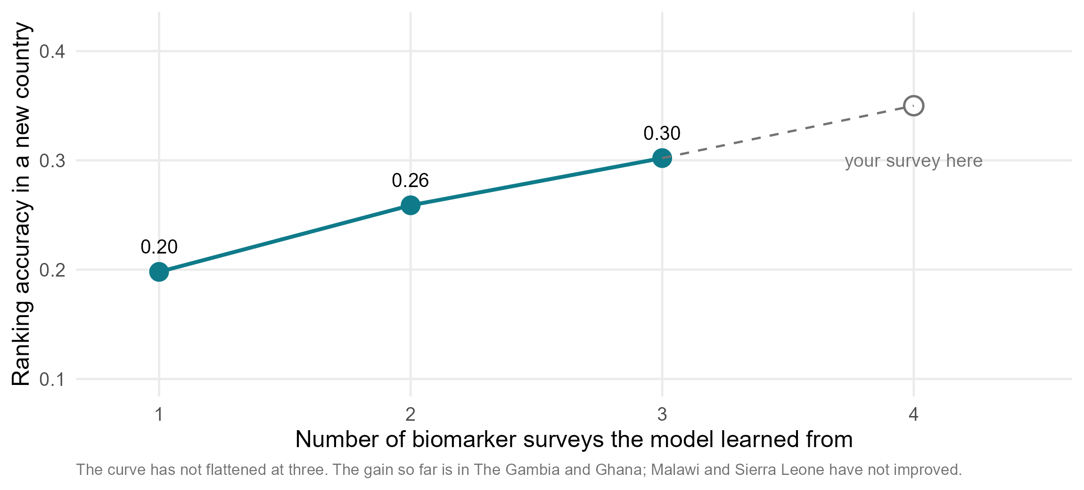
Every survey added improves every other country’s map
Notes:
ANDREW. This is the close.
The last thing I want to leave you with is what actually limits this.
It is not the satellite data. We added eleven new blocks of predictors this year and not one moved the answer by more than a hundredth. It is the number of biomarker surveys we can learn from. With one survey to learn from, a country we have never seen gets a ranking of 0.20. With three, 0.30. The line has not flattened.
And it matters which country. Trained on Ghana alone, we rank The Gambia’s districts at 0.61, because Ghana spans the whole gradient from the Sahel to the forest. A training country that contains the whole range teaches the whole range — and we can check whether a candidate country extends that range from free satellite data, before a single blood sample is drawn.
I should say the gain is uneven: it is in The Gambia and Ghana so far, and Malawi and Sierra Leone have not improved.
So the ask is simple. If your country has a micronutrient survey — recent, planned, or sitting in a drawer — put it in the pool. It improves the map of every other country in it, and yours gets a ranking for the districts your survey never reached.
We have also written two candidate models down in advance, dated the third of September, so the fifth survey is a real test rather than another description of these four countries.
And a question we cannot answer for you: how accurate does a district ranking have to be before you would use it? We can tell you what we get. Only you can tell us what is good enough.
Modelling extends a survey’s reach. It does not replace the survey.

