Slide 1
Proxy modelling of vitamin and mineral deficiencies
Four surveys, one evaluation protocol, September 2026 Andrew N. Mertens, University of California, Berkeley

Slide 2
Background

Slide 3
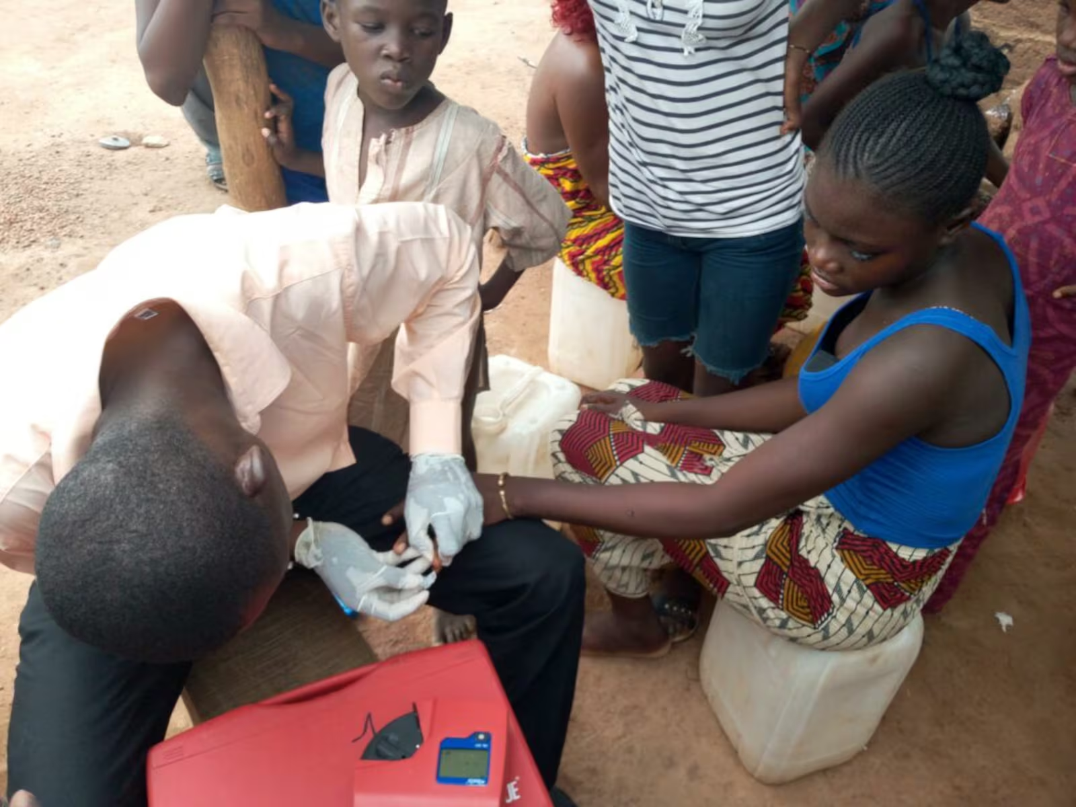
Motivation
Biomarker surveys are rare and costly; programmes need district estimates between them.
Four biomarker surveys linked to 454 district-level proxies predict iron, vitamin A, folate, B12 and zinc deficiency.
Notes:
Photo credit: Latter-day Saint Charities. GMS 2017 collaborators: University of Ghana, GroundWork, University of Wisconsin-Madison, KEMRI-Wellcome Trust; with UNICEF and Global Affairs Canada.

Slide 4
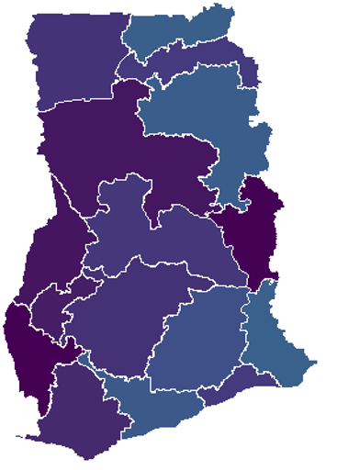
Aims
Estimate district deficiency from proxies, validated against biomarker surveys.
Identify the districts at greatest risk; say whether a ranking or a level survives.
Say what a country with no survey can expect, and what it must still measure.

Slide 5
Data

Slide 6
Surveys
Survey | Fieldwork | Districts | Clusters | Outcomes
Gambia Micronutrient Survey 2018 (GMNS) | Jan 2018 to Apr 2018 | 30 | 70 | vitamin A, iron
Ghana Micronutrient Survey 2017 (GMS) | Apr 2017 to Jun 2017 | 75 | 90 | vitamin A, iron, folate, b12
Malawi Micronutrient Survey 2015-16 (MNS) | Dec 2015 to Feb 2016 | 87 | 103 | vitamin A, iron, folate, b12, zinc
Sierra Leone Micronutrient Survey 2013 (SLMS) | Oct 2013 to Dec 2013 | 14 | 60 | vitamin A, iron, folate, b12
Notes:
24 country-outcome cells, 206 surveyed districts, 323 survey clusters with GPS. Fieldwork dates were recovered for every cluster (Sierra Leone reconstructed from date of birth and age in days); ferritin, retinol and food prices are seasonal. Three surveys ran in the dry season and Malawi in the lean season. Likely question: why districts rather than regions. Districts are the programme unit; they sit below the surveys’ design resolution, so the reliability ceiling slide reports what a perfect predictor could reach.

Slide 7
Outcomes
Outcome | Population | Countries | Biomarker | Uniform cut-off
Iron status | Children 6 to 59 months; women 15 to 49 years | All four | Serum ferritin, BRINDA-adjusted | < 12 / < 15 ug/L
Vitamin A status | Children 6 to 59 months; women 15 to 49 years | All four | Retinol-binding protein, BRINDA-adjusted, retinol equivalent | < 0.70 umol/L retinol equivalent
Folate | Women 15 to 49 years | Ghana, Sierra Leone, Malawi | Serum folate | < 10 nmol/L
Vitamin B12 | Women 15 to 49 years | Ghana, Sierra Leone, Malawi | Serum B12 | < 150 pmol/L
Zinc | Children; women | Malawi only | Serum zinc | IZiNCG, by time of draw
Notes:
Two targets per cell: the deficiency prevalence, and the district mean of the negated log biomarker concentration (higher means worse), which carries more signal than the dichotomy and is reported alongside it. Vitamin A uses each survey’s published RBP-to-retinol calibration before the 0.70 cut-off (VA-01). Iodine (The Gambia, Sierra Leone) is analysed within country only; a one- or two-country outcome has no cross-border test.

Slide 8
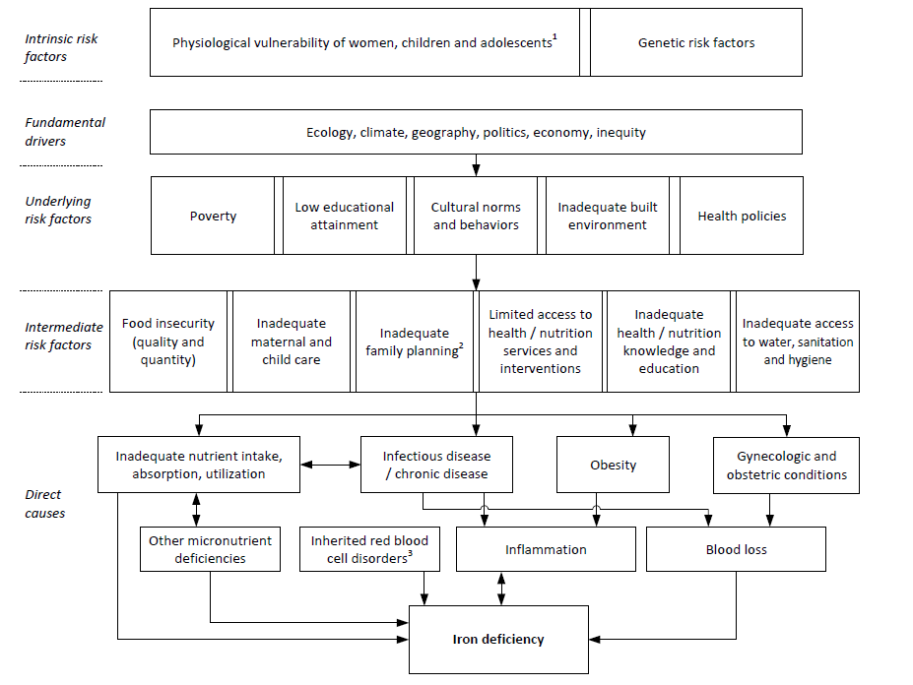
Conceptual framework: iron deficiency
Notes:
Adapted from Hess et al., Ann N Y Acad Sci 2023. The framework is unchanged; the ablation slides show which of its pathways the data can see.

Slide 9
Data assembly
Clean and merge the national micronutrient surveys, with one uniform outcome definition per nutrient across countries.
Link gridded layers to districts as zonal means, and to survey clusters as buffer means.
Aggregate DHS and MICS indicators to districts with a cluster-level spatial model, so every district has a value.
Rank-normalise every predictor within country before pooling, so that cross-country level offsets cannot act as signal.
Reduce each of 24 domains to its leading principal components; nothing is selected on the outcome.

Slide 10
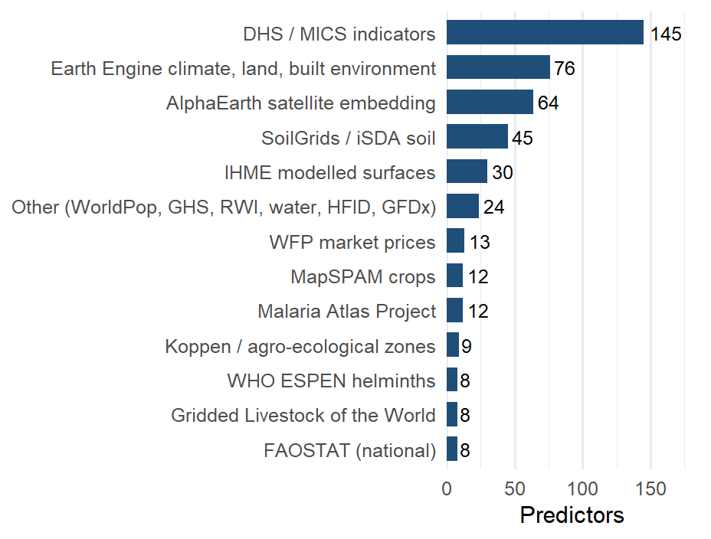
Predictors by source
454 predictors in 24 domains. The household-survey aggregates and the Earth Engine layers are the largest blocks.
Notes:
The January deck listed LSMS (275) and FluNet (3) predictors; both are on disk but did not survive the all-country harmonisation and are scored as add-ons in the sensitivity section.

Slide 11
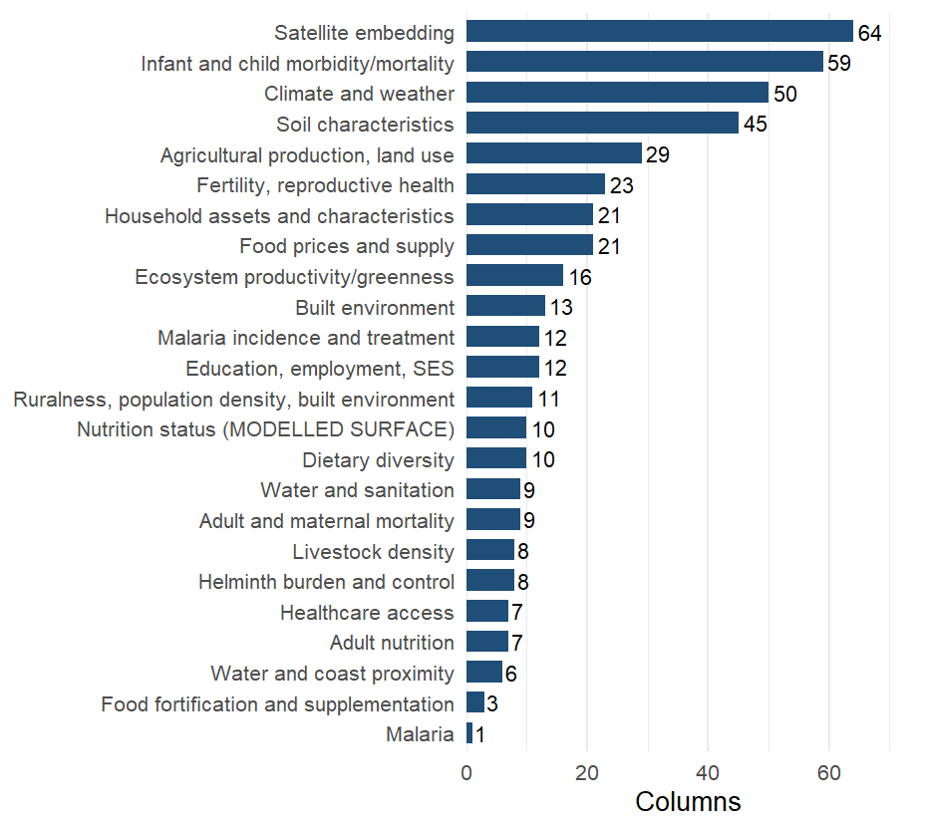
Predictor domains
Columns per domain. The satellite embedding, child morbidity, climate and soil are the four largest domains; each enters the models as its leading principal components to 80% of variance.

Slide 12
Protocol

Slide 13
Estimators
January: spatial ensemble learning
SuperLearner library, weighted by cross-validated performance.
Prescreening from thousands of predictors to 10 to 100 per model.
Importance by change in mean squared error.
Current: the corrected protocol
Zero-tuning index: domain principal components weighted by their training-fold rank correlation with the outcome.
SuperLearner retained as a comparison.
Notes:
On the same folds the index scores 0.31 against 0.30 for the rank-loss ensemble, 0.27 for random forest, 0.26 for the squared-error ensemble, 0.22 for the principal-component highly adaptive ridge and 0.20 for the elastic net (mean of cell medians over the 17 cells every arm scored, prevalence, in-fill; SL-01 to SL-05, rerun on the RR-10 set). Likely question: why capacity hurts. With 14 to 87 districts per country the index has no tuned parameter, and every estimator that tunes one shrinks toward the constant under squared-error cross-validation; the weighting slide quantifies this over a family of penalties.

Slide 14
Estimands
Estimand | Question | Folds | Matched baseline
In-fill | Unsurveyed district in a surveyed region | 5-fold by district, 10 draws | Jackknifed regional mean; spatial smoother
Region extrapolation | Whole unsurveyed region | Leave-one-region-out | Spatial smoother
Country transport | Country with no biomarker survey | Leave-one-country-out | Country-block permutation null
Notes:
The earlier leaderboard scored transport-style models against an in-fill baseline that read the held-out district’s own respondents; that comparison is withdrawn. Counts of positive cells have a fat null when a country’s outcomes are correlated: with no transport at all, 16 of 22 cells are positive at the 95th percentile of the permutation null, so the mean rank correlation is the statistic compared with its null (0.08 at district level, 0.16 at regional level).

Slide 15
Results

Slide 16
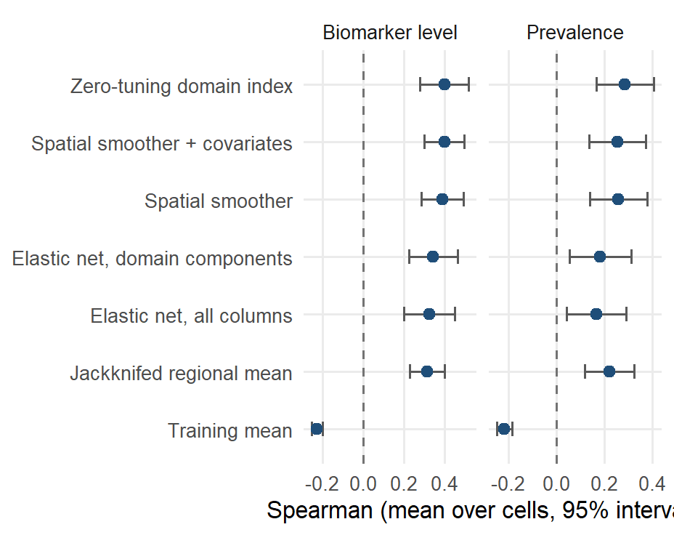
In-fill: district ranking accuracy
Mean Spearman correlation over the scored cells with a 95% interval across cells. The index reaches 0.40 on the biomarker level against 0.31 for the jackknifed regional mean (better in 13 of 18 cells) and 0.39 for the covariate-free smoother.
Notes:
Cells: 18 on the level (Sierra Leone’s cells score NA at 14 districts). On prevalence the index scores 0.28 against 0.22. The smoother with covariates fitted to its residuals scores 0.40; covariates add +0.01 over the smoother alone on the level. The penalised fits score 0.34 (domain components) and 0.32 (all columns). Likely question: why the smoother does so well. Inside a surveyed country the covariates mostly reproduce a smooth surface that neighbouring districts already provide; the value of the covariates is in unsurveyed regions and countries.

Slide 17
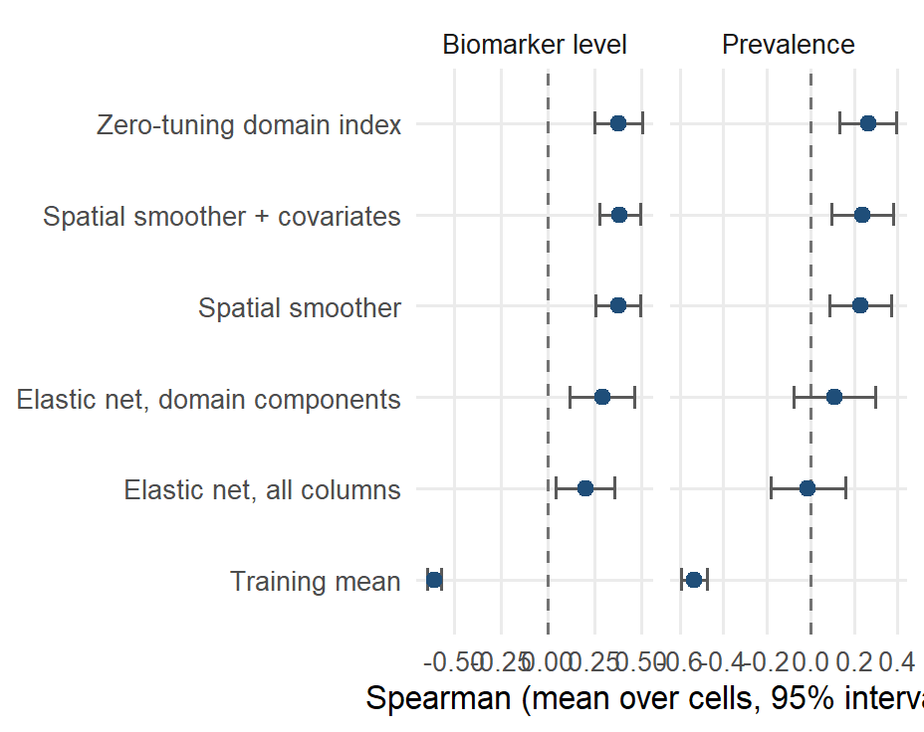
Region extrapolation
Leave-one-region-out, mean over cells with a 95% interval. The index scores 0.38 on the level and 0.26 on prevalence; the penalised fits fall to 0.11 and -0.01 on prevalence.
Notes:
Leaving out a whole region is where a smoother must extrapolate past the edge of its data. The index and the smoother stay close (0.38 against 0.38 on the level); the null training mean collapses. Ghana and Malawi are the countries where this estimand is well determined; The Gambia and Sierra Leone give one number per region.

Slide 18
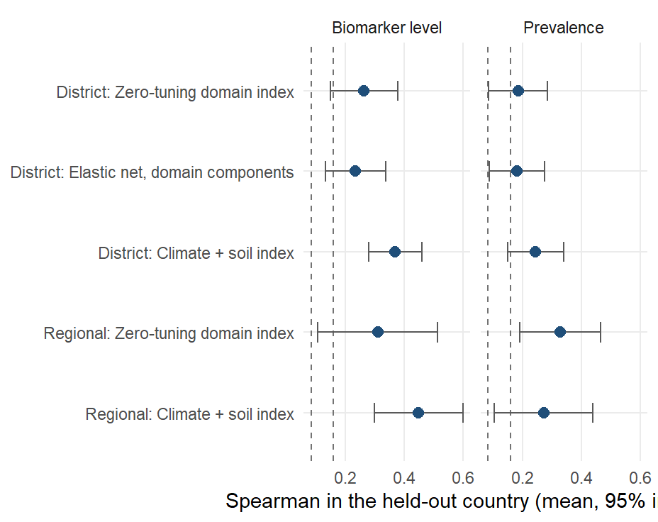
Country transport
Leave-one-country-out, 22 cells. The full index scores 0.26 at district level (positive in 17 of 22) and 0.31 at regional level; the climate-and-soil index scores 0.37 and 0.45. Dashed lines are the 95th percentile of the permutation null.
Notes:
Absolute levels do not transport: raw ferritin differs several-fold between surveys, so the transported product is a ranking. Prevalence: 0.18 at district level (15 of 22 positive) and 0.33 at regional level for the full index; 0.24 at district level for climate and soil. The climate-and-soil pair was chosen on these four countries, so it enters the next country as a pre-registered prediction; honest nested selection of domains inside the training fold gives a median difference of +0.04 from the full index (better in 13 of 22). Since 9 September the DHS-derived predictors are cluster-level spatial estimates at every district (DS-01), which changed nothing in-country and cost the full index 0.01 across borders. Likely question: what a correlation of 0.26 means for a programme. The targeting slide answers in burden captured.

Slide 19
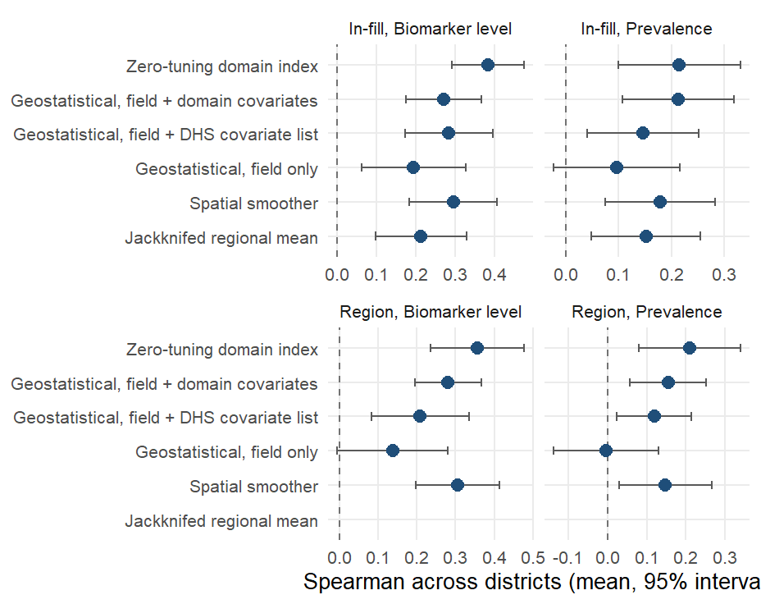
Geostatistical comparator
The DHS Program’s model-based geostatistics fitted at the survey clusters (a spatial field plus covariates), scored on the same district folds. On the level it scores 0.27 against 0.38 for the index (index better in 20 of 24 cells); on prevalence 0.21 against 0.21.
Notes:
INLA-SPDE Matern field with penalised-complexity priors, binomial on cluster counts for prevalence and Gaussian for the level, cluster predictions aggregated to districts by effective sample size; run with the first component of every covariate domain and with the DHS Program’s ten-raster list (0.28 on the level). The field alone scores 0.19. The geostatistical model has the lower absolute error on prevalence (9.2 against 10.7 percentage points) because it estimates a level and shrinks toward it. Under region extrapolation the index scores 0.36 against 0.28. The method needs measured clusters inside the country it predicts, so it has no country-transport estimand. Likely question: whether the two are complementary. Yes: the geostatistical model for a calibrated prevalence where a survey exists, the index for a ranking where none does.

Slide 20
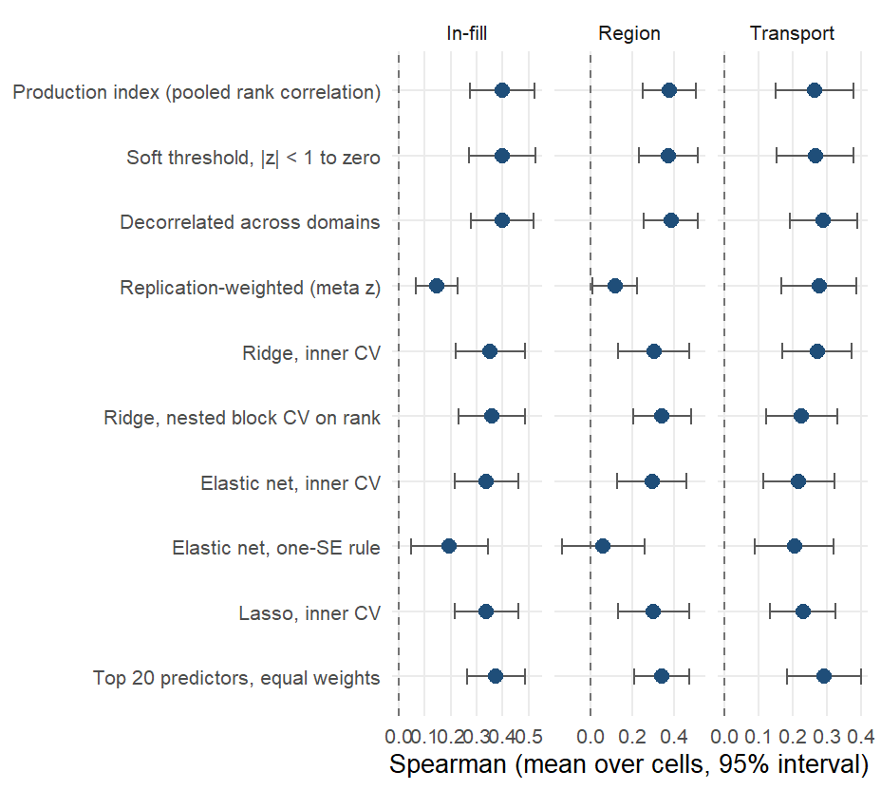
Weighting of the domain components
Alternative weightings of the same components on the biomarker level. In-country every joint fit loses to the marginal-correlation weights (ridge -0.05, elastic net -0.06, lasso -0.06). Across borders the decorrelated index gains +0.026 (better in 11 of 22).
Notes:
The production weights are the infinite-penalty limit of a ridge regression on the components, so the rows are points along that family plus other sources of evidence for the weights (soft thresholding, meta-analytic replication across training countries, decorrelation across domains). Same folds and cells as every other arm; five in-fill draws. The one-SE rules return the null model in some cells (15 of 22 transport cells scored for the elastic net). The twenty-predictor composite gains +0.028 across borders (better in 12 of 22) and costs -0.02 in-fill. The soft threshold gained 0.02 across borders on the direct DHS estimates and +0.002 on the smoothed ones, so that gain was a property of noisy inputs. Both gains were found among 21 arms on these cells and are pre-registered for the next country rather than adopted. Prevalence-target version in the appendix.

Slide 21
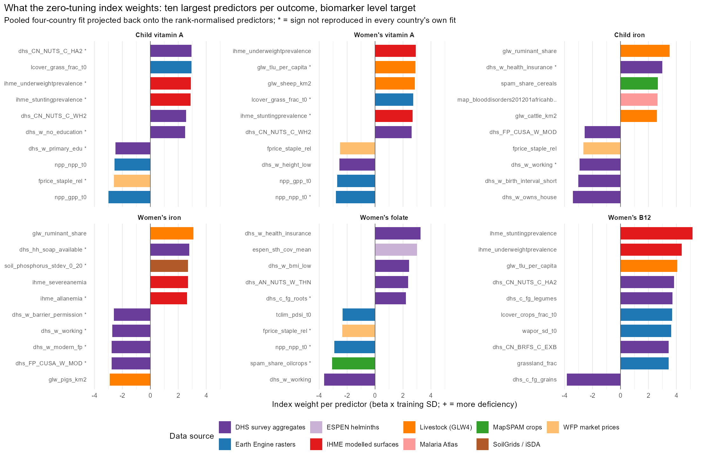
Predictor weights by outcome
Notes:
The index is linear in the rank-normalised predictors, so its component weights project back exactly onto the 454 columns (scripts 57 and 58). Shown: the ten largest weights in the pooled four-country fit on the biomarker level, coloured by data source; a star marks a sign not reproduced in every country’s own fit. No predictor carries more than 2% of the index’s variance; the satellite embedding, climate and soil together carry 30% to 48% depending on the outcome. Likely question: whether these are causes. They are not; the weights say where deficiency is. Livestock density carrying a positive sign for iron and B12 is ecological: pastoral zones are the dry, poor zones in these countries.

Slide 22
Predictors recurring across outcomes
Predictor | Domain | Outcomes (top 20) | Signs | Mean rank
fprice_staple_rel | Food prices and supply | 5 | —– | 9.4
npp_npp_t0 | Ecosystem productivity/greenness | 4 | —- | 7.0
npp_gpp_t0 | Ecosystem productivity/greenness | 4 | —- | 9.2
ihme_underweightprevalence | Nutrition status (MODELLED SURFACE) | 3 | +++ | 2.3
dhs_w_working | Education, employment, SES | 3 | — | 4.0
ihme_stuntingprevalence | Nutrition status (MODELLED SURFACE) | 3 | +++ | 4.3
glw_ruminant_share | Livestock density | 3 | +++ | 5.7
glw_tlu_per_capita | Livestock density | 3 | +++ | 7.3
ihme_wastingprevalence | Nutrition status (MODELLED SURFACE) | 3 | +++ | 16.0
Notes:
Predictors in the pooled top 20 of three or more of the six outcomes on the level target, with the sign in each. One gradient recurs: districts that are drier and grassier, less productive (lower net and gross primary productivity), more pastoral, poorer (less home ownership, fewer women in paid work, less schooling) and more stunted rank worse on every deficiency. Outcome-specific signals sit below it: haemoglobin C allele frequency and cattle for child iron, the modelled anaemia surfaces for women’s iron, helminth treatment coverage and the drought index for folate, elevation and coast distance for B12.

Slide 23
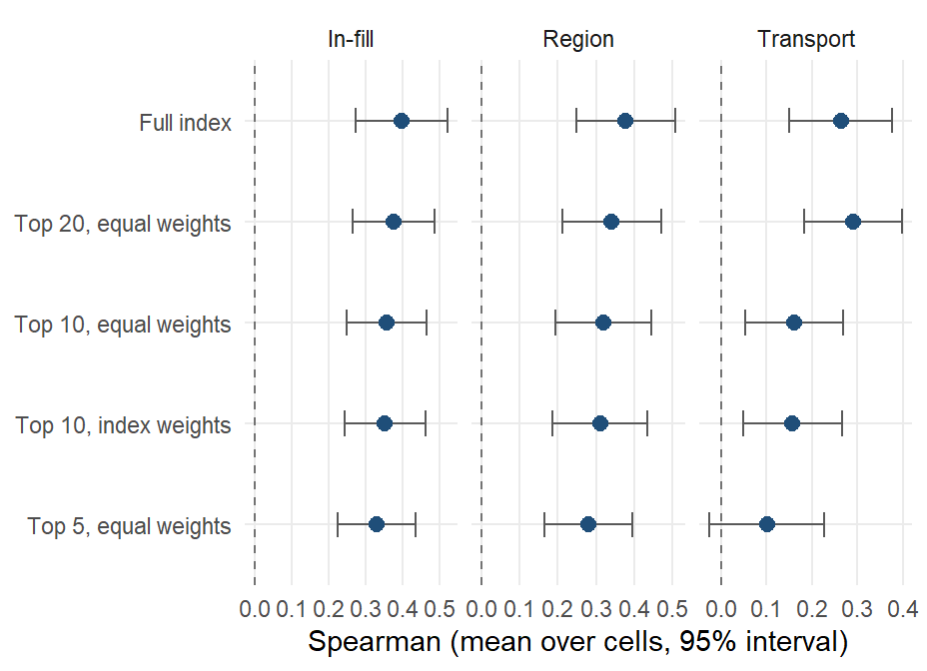
Sparse composites
Equal-weight composites of the top 5, 10 and 20 predictors, membership chosen inside each training fold by back-projected index weight. Twenty predictors cost -0.02 in-fill and gain +0.028 across borders; five predictors cost -0.07 in-fill.
Notes:
Dawes’ improper linear model: direction from the training fold, equal weights, rescaled like the index; nothing is chosen on held-out districts. Weighting the ten by their index weights instead of equally changes nothing. The composite is a transport and communication tool: twenty public layers a ministry can compute. Likely question: which twenty. The next slide lists the child iron members.

Slide 24
Child iron composite
Predictor | Source | Predictor | Source
glw_ruminant_share (+) | Gridded Livestock of the World 4 | dhs_w_modern_fp (-) | DHS
dhs_w_owns_house (-) | DHS | npp_npp_t0 (-) | GEE
dhs_w_birth_interval_short (-) | DHS | soil_phosphorus_stdev_0_20 (+) | SoilGrids / iSDA
dhs_w_health_insurance (+) | DHS | dhs_hh_soap_available (+) | DHS
dhs_w_working (-) | DHS | npp_gpp_t0 (-) | GEE
spam_share_cereals (+) | MapSPAM | dhs_w_bmi_low (+) | DHS
fprice_staple_rel (-) | WFP / HDX market prices | dhs_AN_NUTS_W_THN (+) | DHS
map_blooddisorders201201africahbcallelefrequency (+) | Malaria Atlas | map_sy_pf_parasite_rate (-) | Malaria Atlas Project
glw_cattle_km2 (+) | Gridded Livestock of the World 4 | dhs_hh_cows_any (+) | DHS
dhs_FP_CUSA_W_MOD (-) | DHS | spam_share_roots (-) | MapSPAM
Notes:
The twenty columns the four-country fit would deploy for child iron, in order of weight, with the sign of the contribution (plus means more deficiency). 20 of the twenty keep their sign in every leave-one-country-out fit and 13 in every country’s own independent fit. In the benchmark the membership is re-chosen inside each training fold; this is the version fitted on all four countries. The other outcomes’ composites are in results/tables/protocol_v2/index_importance_top.csv.

Slide 25
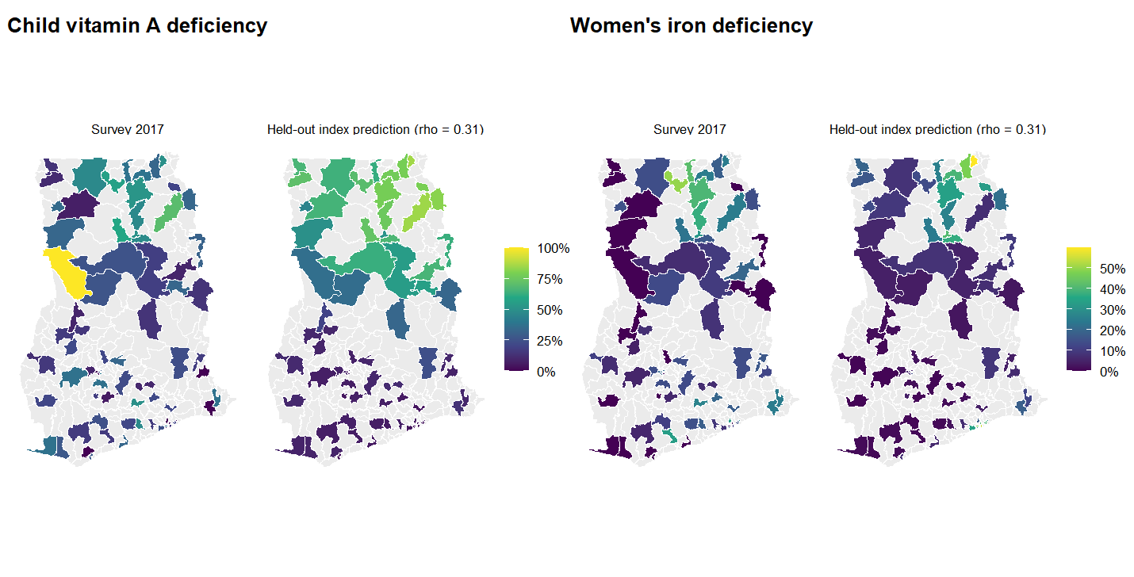
Ghana: survey and held-out prediction
Notes:
Districts with survey data only (grey: no survey clusters). Each district’s prediction is made with that district held out (5-fold, averaged over ten draws). The model orders districts; the survey’s own estimate at a single-cluster district is itself noisy, which is what the reliability ceiling slide quantifies.

Slide 26
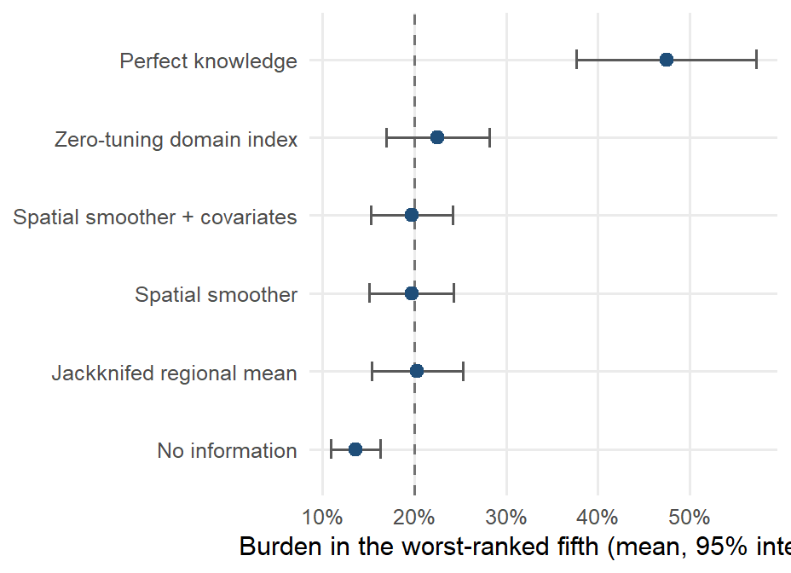
Targeting value
Share of the national deficiency burden in the fifth of districts each method ranks worst, in-fill, mean over cells with a 95% interval. The index reaches 22%, the jackknifed regional mean 20%, no information 14% and perfect knowledge 47%.
Notes:
The dashed line is the share a random fifth of districts would capture. The margin over the survey’s own regional averages is small per cell and concentrates where regions hold three to five districts. Under transport, burden captured is at chance: the transported product is an ordering and brings no targeting gain. Likely question: why the ceiling is only 47%. Burden is spread across districts; even the true worst fifth holds under half of it.

Slide 27
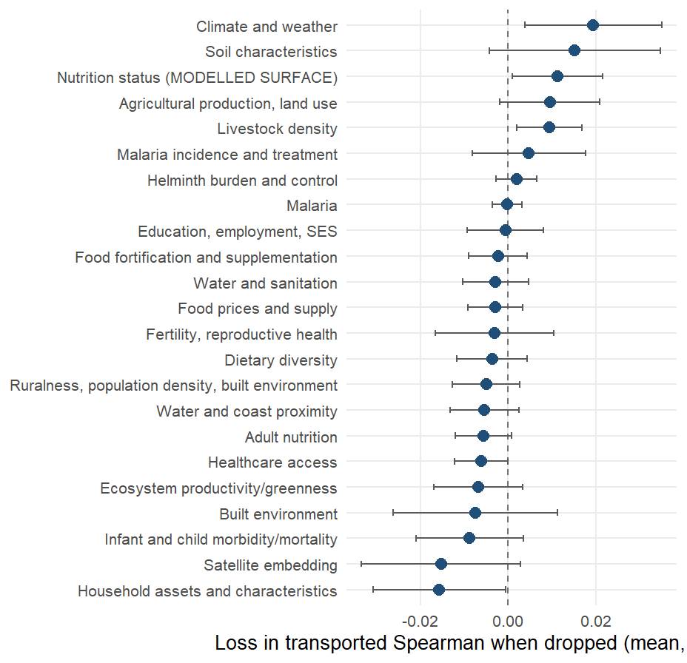
Domain ablation under transport
Loss in transported Spearman (biomarker level, 22 cells) when each domain is dropped and the components rebuilt, mean over cells with a 95% interval. The load-bearing domains are Climate and weather, Soil characteristics, Nutrition status (MODELLED SURFACE); removing 16 of the 23 domains costs nothing or helps.
Notes:
Positive values mean the domain is load-bearing. The survey-derived domains (household assets, fertility, education, child morbidity, health access) sit at or below zero: removing them does not hurt a new country and in several cases helps. A fixed climate-and-soil index transports at 0.37 at district level and 0.45 regionally against 0.26 and 0.31 for the full vocabulary; it was found on the same four countries it is scored on and enters the next country as a pre-registered prediction.

Slide 28
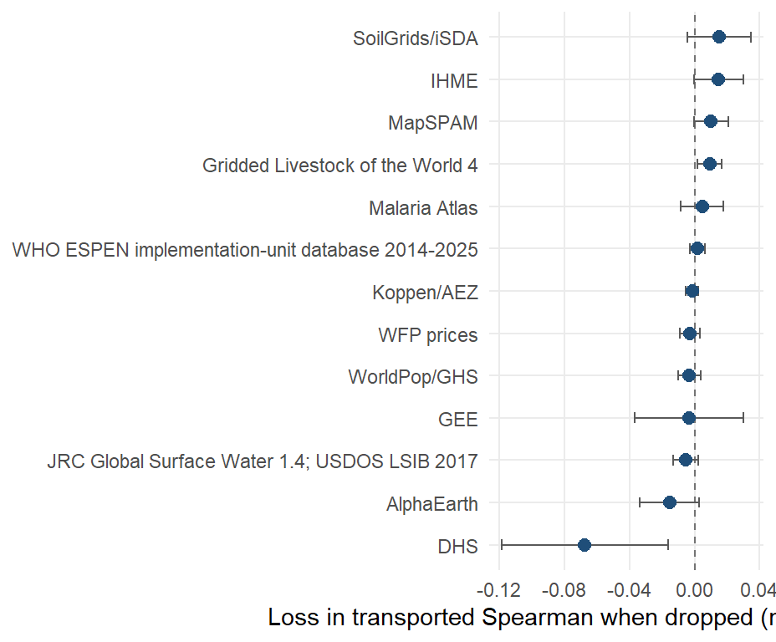
Source ablation under transport
The same ablation by data source. Dropping all 131 DHS and MICS columns moves the transported Spearman from 0.26 to 0.33.
Notes:
The January deck’s data-source importance was one country’s in-sample change in mean squared error; this scores transport to a held-out country. Soil, the modelled IHME surfaces, crops and livestock carry it. The household-survey aggregates fit the training countries and do not carry, and the DHS Program’s own cluster-level estimator of those aggregates (DS-01) did not change that.

Slide 29
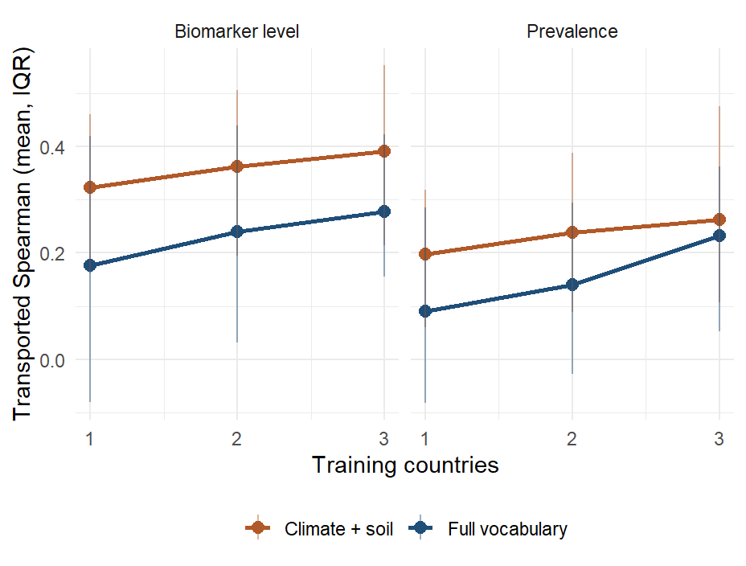
Transport by number of training countries
Every subset of training countries scored on each held-out country. The full vocabulary gains about 0.05 per added training country on the level; the climate-and-soil index starts higher and is positive in 98% of single-country fits.
Notes:
Bars are the interquartile range over fits. Likely question: whether four countries are enough. The curve has not flattened at three training countries, which is the argument for adding surveys to the panel rather than changing the estimator.

Slide 30
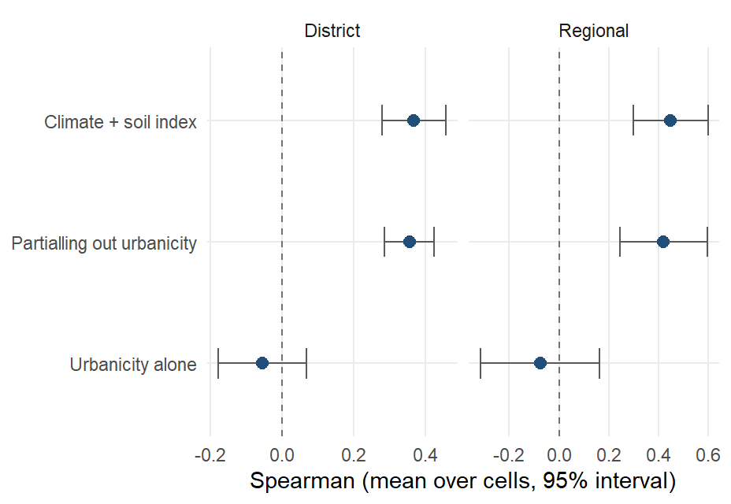
Urbanicity conditioning
Transported Spearman of the climate-and-soil index at district level (0.37), the same after partialling out an urbanicity composite (0.36), and urbanicity alone (-0.05).
Notes:
Urbanicity composite: night lights, population density, built surface, urban land cover, travel time to health care. The replicated associations (legumes, cattle, soil chemistry, night-time temperature, all toward more deficiency) describe where subsistence agriculture is, so an urban-rural gradient was the rival explanation; partialling it out moves the transported correlation by less than 0.02 and urbanicity alone does not transport.

Slide 31
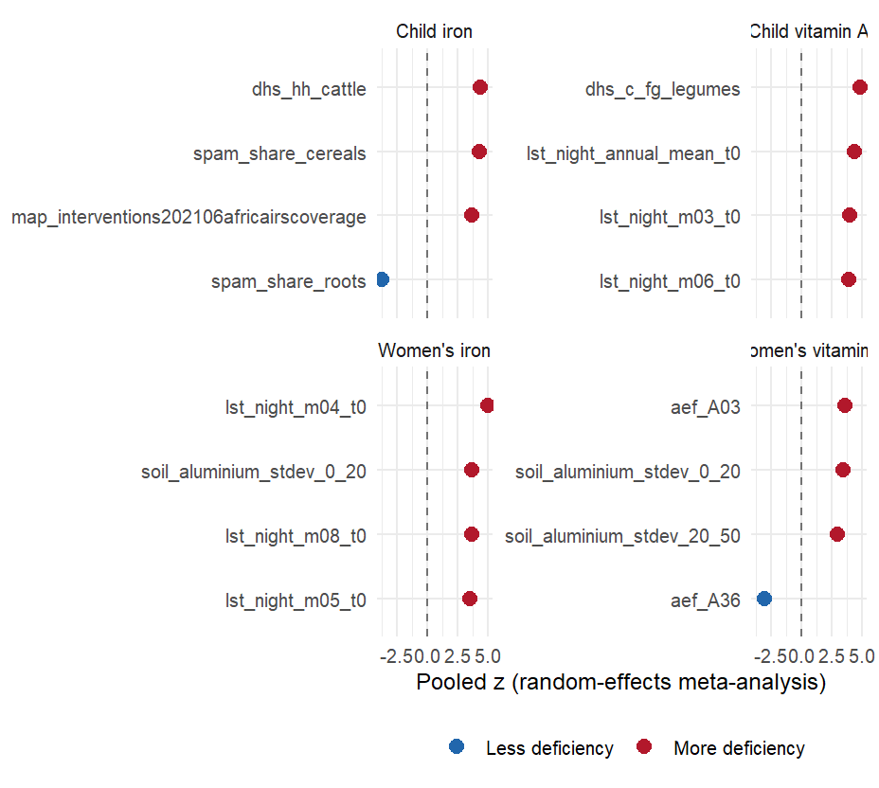
Replicated indicators
Indicators whose district-level association with the outcome has the same sign in every country with the outcome, ranked by pooled meta-analytic z. Positive z means more deficiency.
Notes:
Legume cultivation and cattle ownership track more deficiency at district level, the reverse of the household-level dietary relationship, which is an ecological-fallacy signature: the replicated axis is rural subsistence agro-ecology, useful for deciding where to look and uninformative about what to change. No malaria burden indicator replicates; child wasting tracks women’s vitamin A deficiency in all four countries. An earlier version of these slides had the signs inverted.

Slide 32
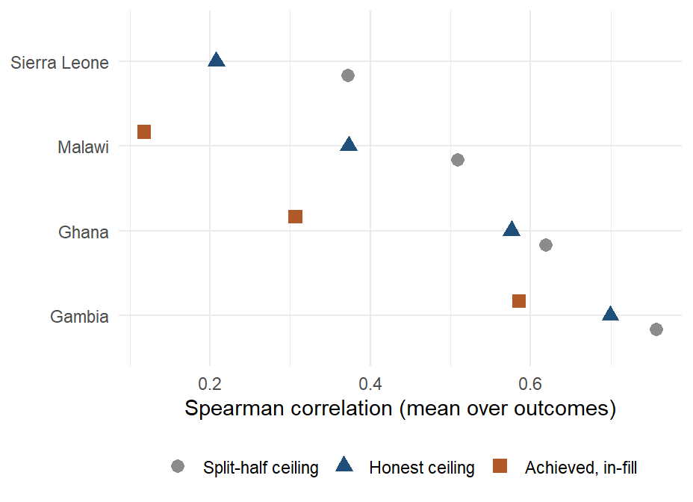
Reliability ceiling
The correlation a perfect predictor of the true district prevalence could reach, given the survey’s sampling noise, by country. The honest ceiling averages 0.44 against a split-half ceiling of 0.54; the index reaches its ceiling in 2 of 24 cells.
Notes:
A respondent-in-cluster-in-district-in-region variance model reproduces the split-half ceiling when the cluster is counted as geography, then removes the cluster term: 22% of the split-half ceiling was cluster effect. Child zinc has no district geography; what looked like geography was the cluster, and the time of the blood draw explains part of the cluster effect (ZN-02).

Slide 33
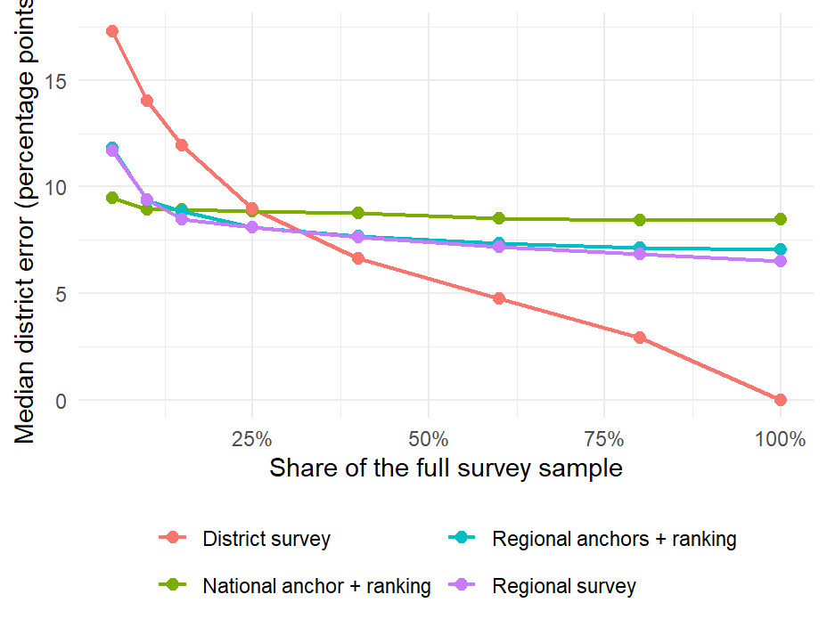
Survey design: district error
Median district error in percentage points against the share of a full survey sampled, four designs, 22 cells. At 5% of the sample a national anchor plus the transported ranking gives 9.5 points, a regional survey 11.7 and a district survey 17.3.
Notes:
A district survey matches the anchored ranking’s level error at about 25% of the full sample. The ranking wins on level error only: a district survey of any size captures more burden, because burden sits in populous districts that surveys measure precisely. Fitted symmetrically on a reduced survey, the model’s error degrades in step with the survey’s, so the model improves the ordering at any sample size and does not reduce the sample a survey needs.

Slide 34
Sensitivity analyses

Slide 35
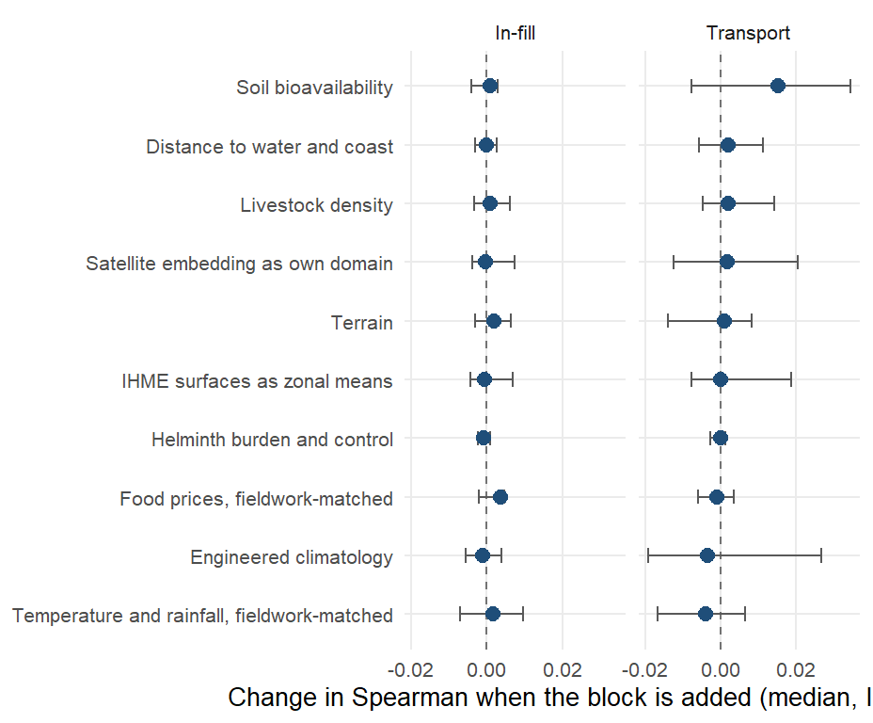
Add-on predictor blocks
Median change in Spearman when a block is added to the base vocabulary, in-fill and district transport on the biomarker level, scored under one harness with the same folds.
Notes:
Bars are the interquartile range over cells. No block moves in-fill or transport by more than 0.01 at the median: the vocabulary is saturated. The fieldwork-matched temperature columns are among the most consistently associated with deficiency in the marginal scan yet improve no fold, because a covariate defined by when the survey happened cannot rank districts that have not been surveyed. Found in passing and fixed: the price columns used 2021 as The Gambia’s survey year (fieldwork was January to April 2018), and the satellite embedding had been filed under agriculture.

Slide 36
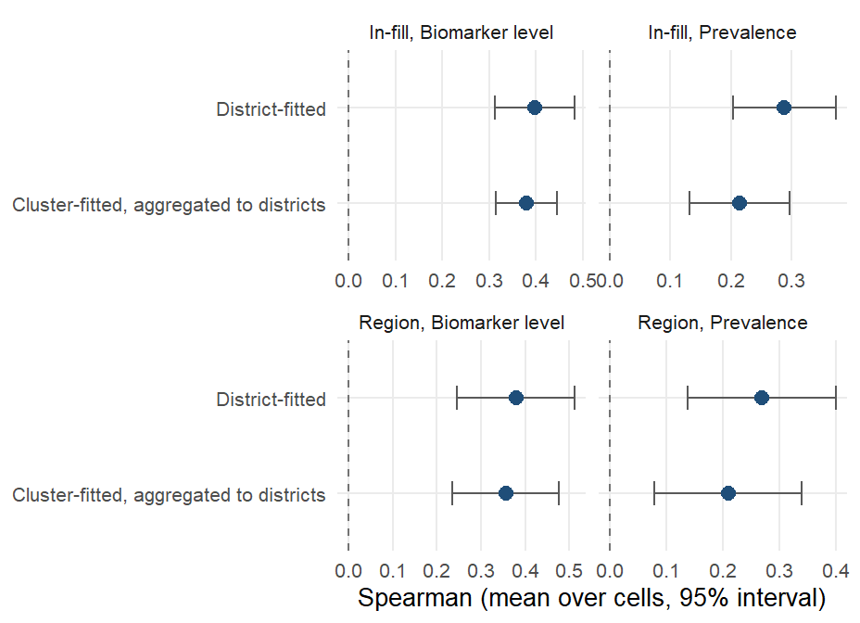
Cluster-level fitting
The same index fitted at the survey cluster and aggregated to districts, against the district fit, on the same cells. In-fill on the level: 0.38 cluster-fitted against 0.40 district-fitted.
Notes:
323 clusters with GPS; covariates as 2 km (urban) and 5 km (rural) buffer means from rasters on disk; the same estimands with folds cut by district and region. Cluster-fitted models trail district-fitted ones on every estimand and for transport. A precision-weighted index and empirical-Bayes shrinkage of cluster outcomes recover a third to a half of the gap. A matched-vocabulary comparison attributes the remaining gap to the layers rather than the fitting unit. The cluster track is a sensitivity analysis until its vocabulary is matched layer for layer.

Slide 37
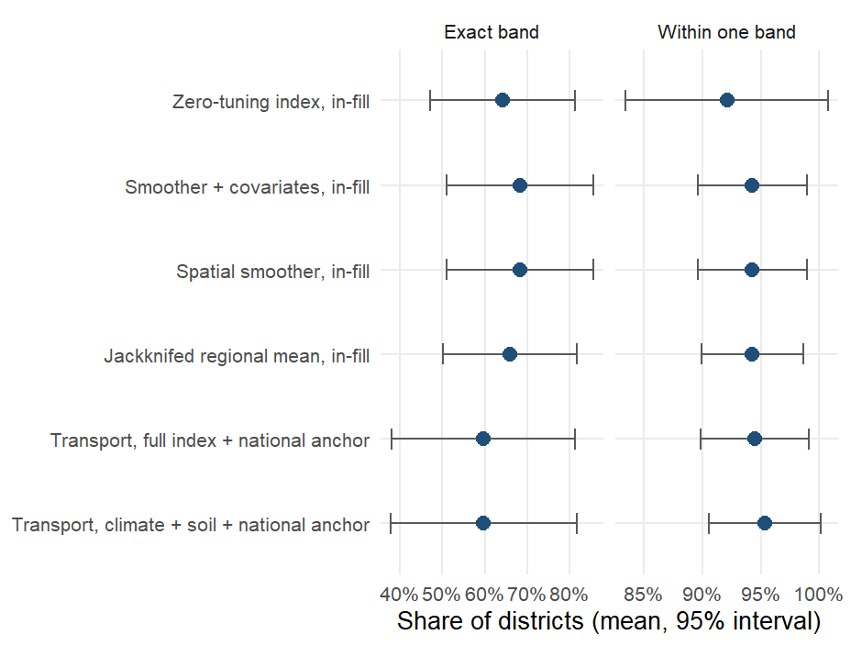
Risk-class accuracy
Share of districts placed in the correct WHO vitamin A band (under 2%, 2 to 10, 10 to 20, 20 or more), and within one band, mean over the vitamin A cells. The index in-fill: 64% exact and 92% within one band.
Notes:
Out-of-fold predictions averaged over ten draws; transport rows use the held-out country’s own national prevalence as the anchor (AR-01 design), the only honest way to put a transported ranking on the prevalence scale. The January deck’s child vitamin A cell was 44 and 75 percent (exact, within one) for the full model from the old leaderboard. For iron and the other outcomes only the 20 percent threshold has a WHO source; the two-class accuracies are in results/tables/protocol_v2/risk_category_accuracy_summary.csv.

Slide 38
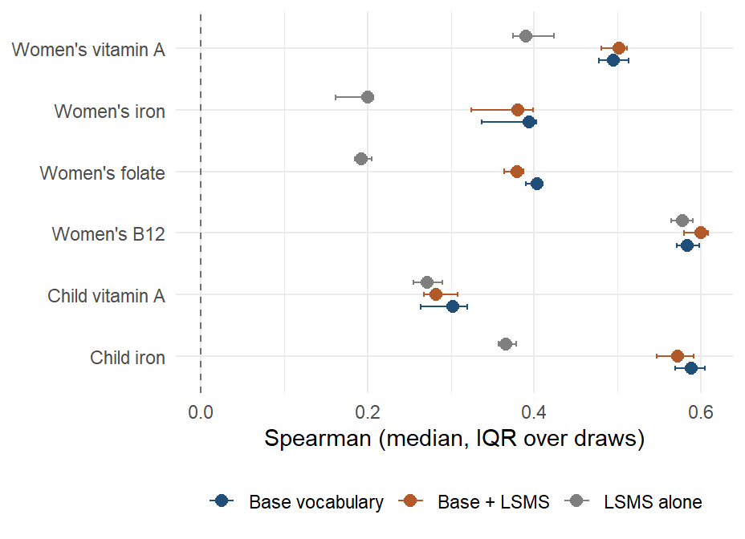
LSMS and FluNet predictors
Ghana in-fill on the biomarker level with the base vocabulary, the base plus the LSMS block, and the LSMS block alone, median over ten draws.
Notes:
LSMS exists for Ghana alone (GLSS7): 134 region-level household expenditure and asset means, broadcast to districts through the 16-to-10 region crosswalk, so the block varies only across ten regions. It does not improve any Ghana cell beyond noise and cannot be scored across borders. FluNet reports for Ghana and Sierra Leone only and is a national weekly count, constant within a country; it contributes nothing by construction. Both are candidates only if collected sub-nationally in the next countries.

Slide 39
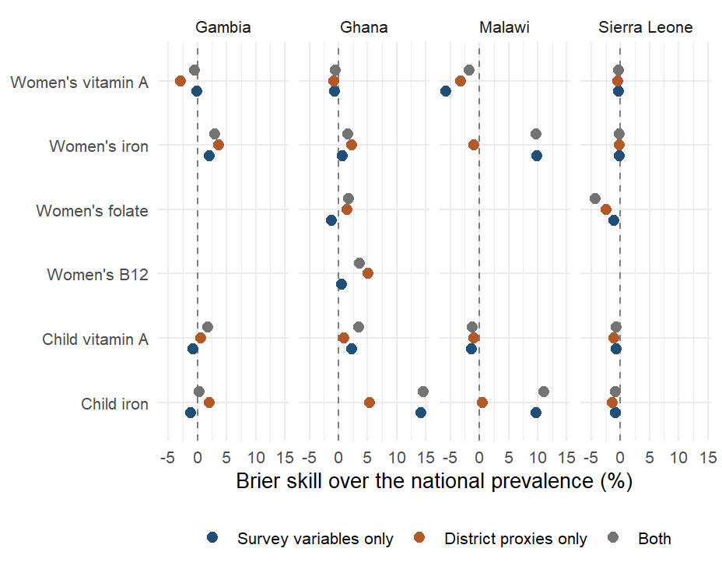
Individual-level models
Person-level SuperLearner under district-blocked folds, Brier skill over the national prevalence, by country and outcome. Mean AUC over 19 cells: 0.52 for survey variables, 0.51 for district proxies, 0.52 for both.
Notes:
Library: mean, elastic net, random forest; survey weights; inner folds blocked by district; outer 5-fold by district so no district’s respondents are split across training and test. Survey variables: up to 80 respondent columns with 70 percent coverage after removing biomarkers, adjustments, identifiers, weights, dates and locations. Proxies: the district’s domain components joined to each respondent. Person-level skill exists for iron only (survey-variable AUC up to 0.78 in Ghana and Malawi); vitamin A, folate and B12 show none. The January figure (Brier skill 20 to 60 percent) came from folds not blocked by district and a survey set that included biomarker-adjacent variables. Aggregating a person-level classifier biases area means, so this remains a sensitivity analysis. Rerun on the RR-10 set on 10 September.

Slide 40
National-level track
Outcome | Countries | Observed (mean) | Predicted (mean) | Mean absolute error (pp)
Child iron | 4 | 0.19 | 0.21 | 2.09
Child vitamin A | 4 | 0.14 | 0.14 | 0.94
Women’s iron | 4 | 0.14 | 0.14 | 0.63
Women’s vitamin A | 4 | 0.02 | 0.02 | 0.23
Notes:
The January deck’s national-level track (WHO VMNIS and BRINDA outcomes, FAOSTAT and policy predictors) lives in a separate sub-pipeline last run in April 2026. It is not part of the current protocol and has not been re-audited; the table is its last output for the four survey countries. It is the only track with time series and fortification policy indicators and is a candidate for a rerun under the corrected protocol.

Slide 41
Iodine
Model | Gambia UIC < 100, in-fill | Gambia UIC < 100, region | Gambia median UIC, in-fill | Gambia median UIC, region | Sierra Leone UIC < 100, region
Training mean | -0.31 | -0.55 | -0.29 | -0.60 | -0.34
Jackknifed regional mean | 0.33 | - | 0.35 | - | -
Spatial smoother | 0.31 | 0.50 | 0.27 | 0.27 | -0.35
Zero-tuning index | 0.37 | 0.46 | 0.45 | 0.53 | 0.27
Smoother + covariates | 0.30 | 0.45 | 0.31 | 0.39 | -0.35
Notes:
Urinary iodine is measured in The Gambia (continuous, with household salt iodine) and in Sierra Leone (six WHO categories, non-lactating women); it left the modelling outcomes because a one- or two-country outcome has no leave-one-country-out test. Targets: district prevalence of urinary iodine concentration below 100 micrograms per litre and, for The Gambia, the district median. In-fill needs at least 15 districts, so it runs for The Gambia only; leave-one-region-out runs in both. Whether district salt iodisation tracks district iodine status is in results/tables/protocol_v2/iodine_in_country.csv (rows analysis = descriptive).

Slide 42
Conclusions

Slide 43
Conclusions
In-fill: the index scores 0.40 against 0.31 for the survey’s own regional averages and 0.39 for a covariate-free smoother.
Transport: rankings carry (0.26 at district level, 0.37 from climate and soil alone, null 0.08); levels do not.
Survey-derived inputs help inside a country and hold a new country back; the cross-border model should lean on the environment.
A national anchor puts levels on the ranking: district error 9.5 points at 5% of a full sample, matched by a district survey at 25%.

Slide 44
What the models can and cannot do yet
Rank districts in a surveyed country? Yes: 0.40, null 0.08.
Rank districts in a new country? Yes, less well: 0.26 against 0.08.
Which predictors carry the signal? Satellite, climate and soil.
Prevalence in a new country from the model alone? Not yet.
Prevalence with one national anchor? Yes: 9.5 points at a 5% sample.
Replace biomarker surveys? No: the ceiling is the survey’s.
Guide where the next survey samples? In design, not piloted.
Notes:
The checklist agreed at the 10 September check-in, one row per question. Sources: benchmarks_v2_summary.csv (in-fill and country transport, biomarker level), transport_null_calibration.csv (95th percentile of the permutation null), nested_domain_selection.csv (fixed climate-and-soil set), index_importance_domains.csv (pooled shares of the three remotely sensed domains), anchor_and_rank.csv (AR-01, 5% fraction, climate-and-soil set, ranks from prevalence), variance_components_ceiling.csv (prevalence, admin2). Levels do not transport because the surveys differ in year, season, team and calibration (fe_transport_level_offset); the anchor supplies the level the ranking lacks. Guiding the next survey is a design result on these four surveys, not a pilot.

Slide 45
Next steps
Planned
Score the pre-registered predictions on the next countries added to the panel.
Rerun the national track under the corrected protocol.
Model-assisted cluster allocation for survey design.
Open questions
What rank correlation is sufficient to act on?
Which national number is the cheapest honest anchor?
Without new biomarker surveys, what benchmarks the models?
Notes:
Sources: docs/findings/TWO_READINGS_2026-09f.md (current abstracts), SANDBOX_LOG_2026-09.md (every experiment), PREREGISTRATION_NEW_COUNTRIES_2026-09.md, CLUSTER_LEVEL_DESIGN_2026-09.md. Every table in this deck is read at render time from results/tables.

Slide 46
Appendix

Slide 47
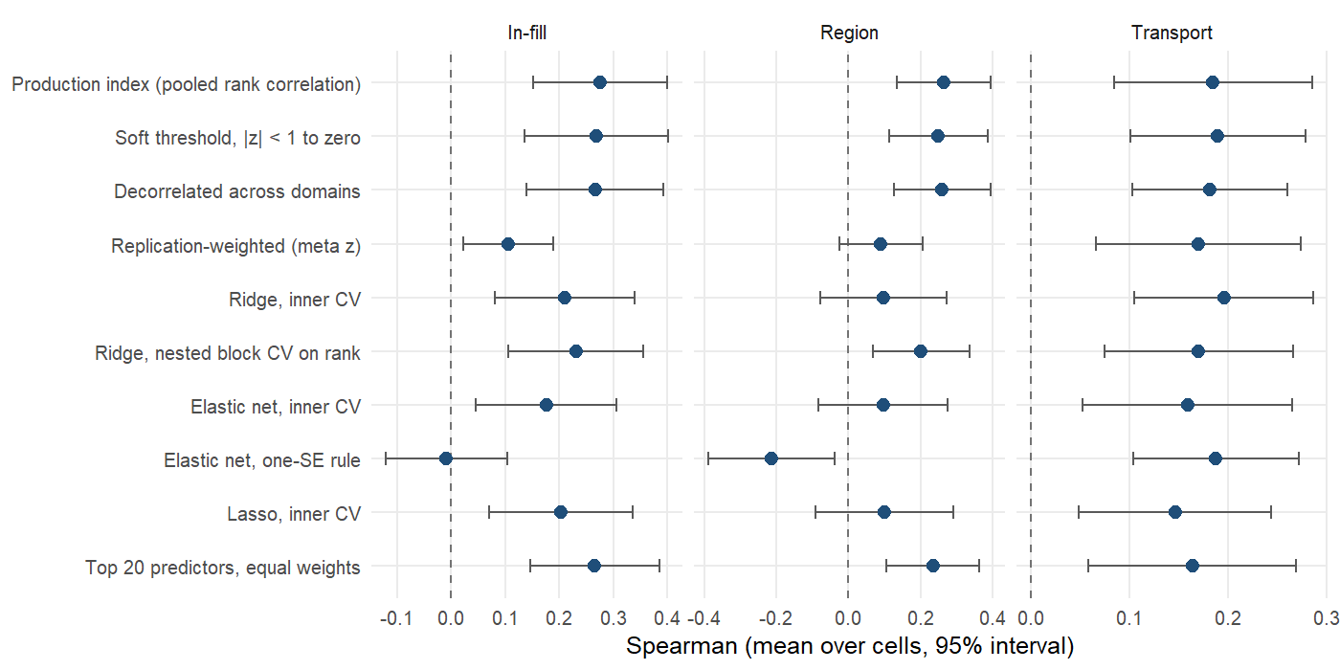
Weighting of the domain components: prevalence
Notes:
Prevalence target, same arms and folds as the biomarker-level figure. Mean Spearman over cells with a 95% interval across cells.

Slide 48
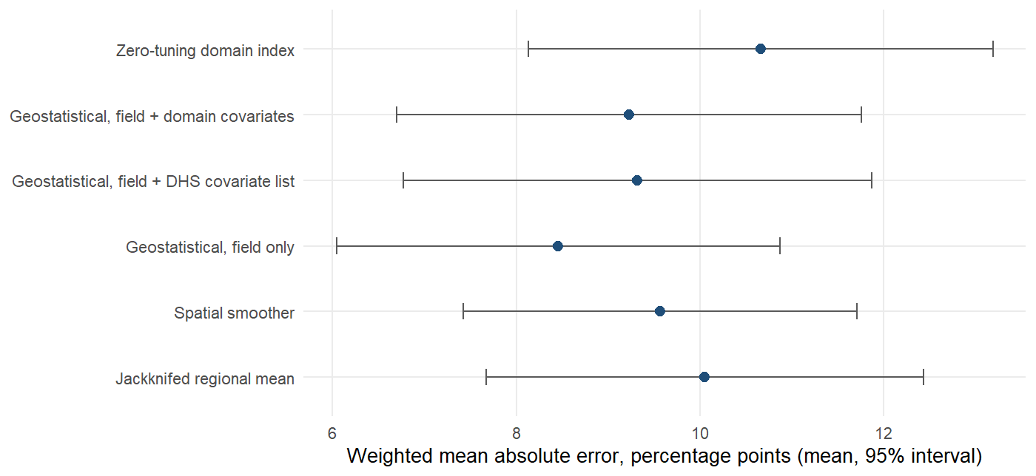
Geostatistical comparator: absolute error
Notes:
In-fill, prevalence. The geostatistical model estimates a level and shrinks uncertain districts toward the mean, which lowers absolute error; the index ranks and is rescaled to the training outcome’s spread, which does not. If the deliverable is a prevalence figure for a named district, the geostatistical model is the right tool; if it is a ranking, the index is.

Slide 49
Status of the January analyses (1)
January slide | Status | Where
Individual-level proxy versus survey-only models (Brier skill, AUC, PR gain) | Sensitivity layer; rerun under district-blocked folds | Individual-level models
National-level VMNIS / BRINDA predictions | Separate sub-pipeline, last run April 2026 | National-level track; not re-audited
Iodine (Sierra Leone) | Rerun within country (The Gambia, Sierra Leone) | Iodine
Risk-category accuracy (none / mild / moderate / severe) | Rerun under the protocol, WHO bands | Risk-class accuracy
Notes:
The individual-level SuperLearner remains a sensitivity analysis because shrinking a noisy individual classifier biases area means; it is retained and labelled in the dashboard.

Slide 50
Status of the January analyses (2)
January slide | Status | Where
LSMS (275) and FluNet (3) predictors | Re-added: LSMS is Ghana-only and region-level, FluNet national; neither adds skill | LSMS and FluNet predictors
Data-source importance by change in MSE | Replaced by domain and source ablation under transport | Domain and source ablation
Admin-1 women’s iron maps, predicted versus survey | Replaced by district maps with held-out predictions | Ghana maps
Prescreened SuperLearner as the model | Retained as comparison; does not beat the zero-tuning index | Estimators

