Slide 1
Predicting Micronutrient Deficiency Prevalence in Sub-Saharan Africa Using Proxy Indicators: A Multi-country Machine Learning Framework
Sonja Hess and Andrew N. Mertens

Slide 2
Why district-level micronutrient data are missing
A national micronutrient survey draws blood from a few thousand people, costs millions, and happens about once a decade. Most countries in the region have none from the last ten years.
The decisions are local: which districts get fortified food, supplements, or the next survey team.
Even where a survey exists, it describes regions. In the 2017 Ghana survey, 83% of districts hold a single sampled community.
Four surveys that did draw blood let us test what public data can say about the districts nobody surveyed.
Unpublished data. Do not copy or distribute.
Notes:
Sonja’s opening (this slide and the next): background, motivation, what the earlier work could and could not do, and the partnership. She is sending her own slides; these bullets are a stand-in from the previous version of the deck so the run-through works without them. Check the claim about the last ten years before it is spoken. The Ghana cluster share comes from results/tables/protocol_v2/variance_components_ceiling.csv (share_single_cluster). The four surveys: The Gambia 2018, Ghana 2017, Malawi 2015 to 16, Sierra Leone 2013, with vitamin A, iron, folate and B12 in children and women, 206 districts with a measured value in all.

Slide 3
The partnership and the workshop
Placeholder for Sonja’s slide: the earlier work with the survey teams, the partner workshop, and what partners asked about how a district ranking should be used, trusted and shared.
Unpublished data. Do not copy or distribute.
Notes:
Replace with Sonja’s slide. The workshop point matters for the closing slide, which promises a workshop with partners on how the ranking should be used.

Slide 4
What we built
We have 454 public data layers for every district but blood results for only 206 districts in four countries, so this is a big-data and a small-data problem at once.
Each kind of data is summarised, weighted by how well it tracked deficiency where blood was drawn, and added up. The sum ranks districts from worst to best.
The simplest version won. With a few dozen districts per country, every method that tunes itself did worse.
The output is an ordering. One national number on top turns it into prevalence.
Unpublished data. Do not copy or distribute.
Notes:
Hand-over from Sonja. The big-and-small framing is the one-sentence description of the project: modern methods and as much public data as we can download on one side, a few hundred districts of gold-standard biomarker data on the other. Predictor list: data/covariates/harmonized/predictors_admin2_shared_metadata.csv (454 columns in 24 groups: satellite imagery, climate, soil, crops, livestock, malaria and other morbidity, prices, household surveys); plain descriptions in results/tables/protocol_v2/variable_sheet.csv. The estimator is a zero-tuning index over group principal components (the technical deck has the definition); it keeps the weak, correlated signal of many layers instead of screening for a few. Likely question: why so simple. With 14 to 87 districts per country, every method that learns its own settings does worse (appendix slide “More complicated models do not do better”). A country can rebuild the ranking from twenty public layers (appendix).

Slide 5
How we tested it
Every district is scored with itself hidden from the model, over repeated random splits, and every country with the whole country hidden.
Each method is compared with what a programme could do without it: the survey’s own regional average, or smoothing between neighbouring districts.
Shuffling the outcome measures chance: with no information at all a ranking still reaches 0.08 on a scale of 0 to 1.
Survey district values are themselves noisy, so a perfect predictor could only reach about 0.56. The model reaches 0.40, two-thirds of the way.
Unpublished data. Do not copy or distribute.
Notes:
The score is ranking accuracy: how closely the model’s order of districts matches the survey’s, from 0 to 1. One split on its own can move a result by 0.1, so everything is averaged over repeated splits. Plainer versions of the same accuracy are in the appendix: of the survey’s worst quarter of districts the model finds 43% (a random pick finds 25%), and it places a district in the correct WHO vitamin A band 64% of the time, within one band 92%. The ceiling: most districts hold one or two survey clusters, so the survey’s own district value is itself an estimate; from the variance components we can say what correlation a perfect predictor of the true district value could reach (variance_components_ceiling.csv, ceiling_vc). On the biomarker level the ceiling is about 0.56 and the model reaches 0.40; on prevalence 0.44 and 0.28; the model is at the ceiling in 5 of 48 cells. What Reid raised in the meeting belongs here too: the model estimates status as a survey would measure it, and part of any between-country difference is survey difference (different years, seasons and teams). An earlier version of this work rested on one split and a baseline that had seen the answer; an audit found it and everything here is from the corrected protocol (docs/findings/TWO_READINGS_2026-09f.md, SANDBOX_LOG_2026-09.md).

Slide 6
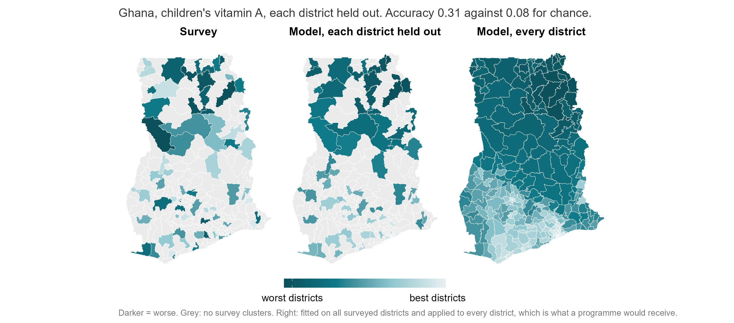
In Ghana the model recovers the regional pattern but misplaces single districts
Unpublished data. Do not copy or distribute.
Notes:
Ghana, children’s vitamin A. Each district is predicted with itself removed from the model (5 folds, averaged over 10 repeats), so nothing in the middle map is fitted to the district it scores. Ranking accuracy 0.31 for this cell, against 0.08 for chance. The north comes out as the worst region in both maps without the model being told anything about survey results; no single district should be read as correctly placed. The third map is the deployment case: the model fitted on all 75 surveyed districts and applied to every one of Ghana’s districts, so the grey gaps in the middle map are filled. Surveyed districts are in-sample in that panel; the honest check of the model is the middle panel. How firmly each district is placed is the appendix slide “How sure is the model about each district?”.

Slide 7
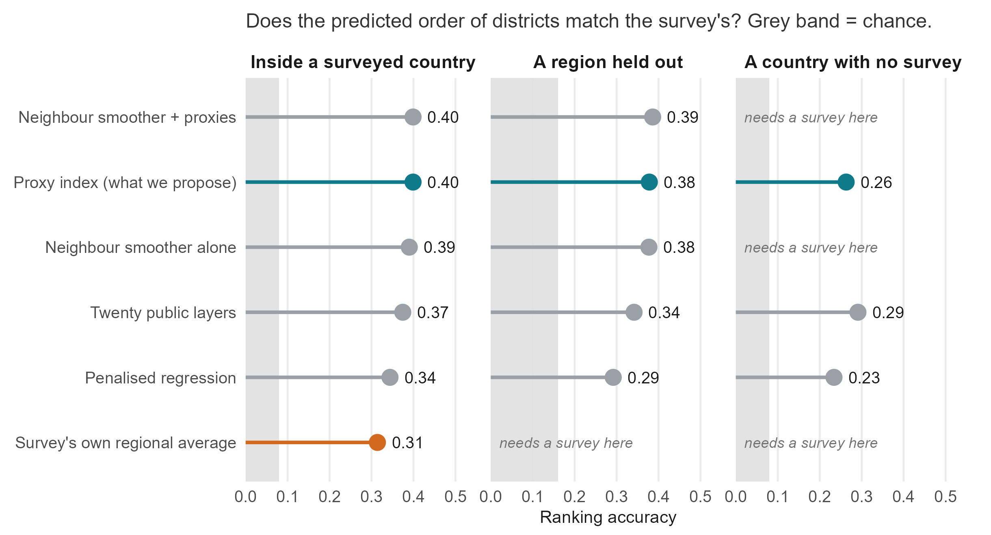
With a survey every method ties; without one only the proxy index can run
Unpublished data. Do not copy or distribute.
Notes:
Source: benchmarks_v2_summary.csv (biomarker level) and weight_sources_summary.csv for the twenty-layer composite. Read left to right. Inside a surveyed country, the proxy index (0.40), the neighbour smoother with covariates and the smoother alone are a three-way tie; differences under 0.03 are not differences here. If you already have a survey, smoothing between neighbours gets you most of the way, and the survey’s own regional average reaches 0.31. The right-hand column is why the project exists: the smoothers and the regional average need survey data in the country, and only the proxy methods produce anything at all there, at 0.26 to 0.37 against a chance level of 0.08, positive in 17 of 22 country-outcome combinations. Grey band: the 95th percentile of the permutation null (transport_null_calibration.csv). Rankings cross borders and absolute levels do not: raw ferritin differs several-fold between these surveys, so the model tells a new country which districts are worst, not how bad. The country with no survey we have actually ranked, Cote d’Ivoire, is in the appendix.

Slide 8
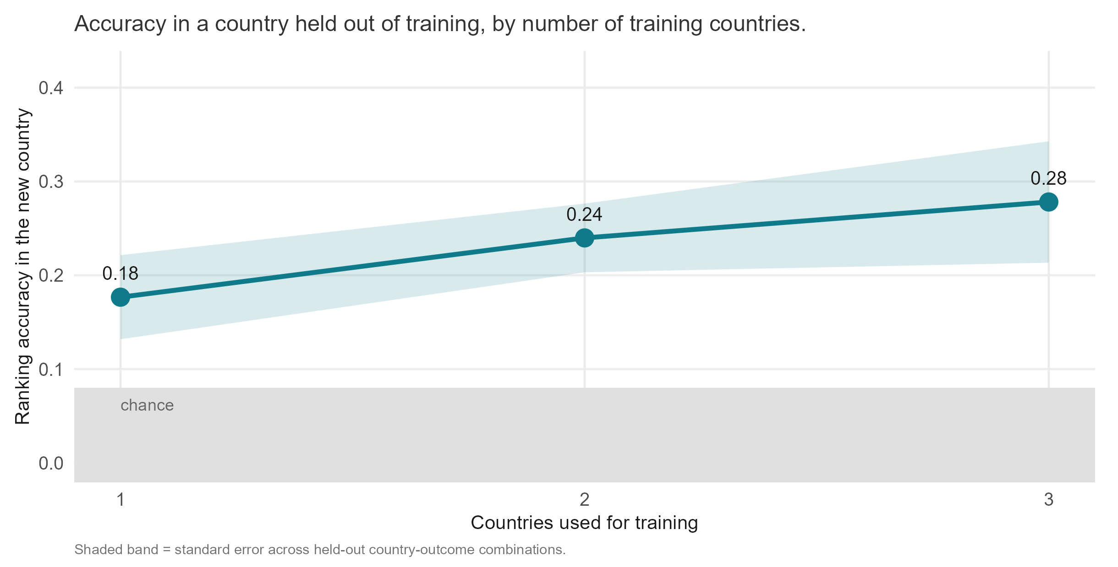
Every survey added improves the next country’s map
Each survey added buys about 0.05 of accuracy in a country never seen.
The ranking can say where the next survey should sample, so surveys and models improve each other.
A 5 percent national sample plus the ranking gives district levels within 10.3 points.
Unpublished data. Do not copy or distribute.
Notes:
Source: training_country_curve.csv, proxy index, biomarker level, mean over held-out country-outcome combinations: 0.18 with one training country, 0.28 with three, and the curve has not flattened. This is the argument for pooling surveys across the region: a survey a country runs for itself improves every other country’s map. Surveys and models improve each other: the model says which districts are uncertain or likely worst, the next survey places clusters there, and the added survey sharpens the model for everyone. Third bullet from anchor_and_rank_summary.csv (AR-01): at 5 percent of a full sample, one national estimate plus the ranking gives a median district error of 10.3 percentage points, a regional survey of the same size 12.8 and a district survey 19.7; a district survey needs about a quarter of a full sample to match the anchored ranking. Say this cautiously: it is a design result on these four surveys, not a pilot. An index built only from climate and soil reaches 0.37 across districts and 0.45 across regions, better than the full index; that pair was chosen on these same four countries, so it is pre-registered for the next country rather than presented as a finding.

Slide 9
What we can and cannot do yet
Rank districts inside a surveyed country? Yes.
Rank districts in a country with no survey? Yes, more roughly.
Say which public data carry the signal? Yes: climate, soil and satellite imagery, in every country.
Give a prevalence figure for a new country? Not from the model alone. Yes, with one national blood sample added.
Replace biomarker surveys? No. Tell the next survey where to go? Yes.
Next: a fifth country to confirm it, and a workshop with partners on how a ranking should be used.
Unpublished data. Do not copy or distribute.
Notes:
Close on the checklist Sonja asked for, one line per question. Numbers behind each answer, if asked. Inside a surveyed country: 0.40 against 0.31 for the survey’s own regional averages and 0.08 for chance. A country with no survey: 0.26 with everything, 0.37 with climate and soil only, positive in 17 of 22 combinations. Which data: satellite imagery, climate and soil carry 30 to 48 percent of the index inside a country and are what travels; household-survey layers help at home and hurt abroad (appendix, “Different data support within-country and across-country prediction”). Prevalence: levels do not cross borders, and the anchored design gives district levels within 10.3 points at 5 percent of a full sample. Replace surveys: no; the ranking is scored against surveys and the ceiling is set by them. Next: the pre-registered predictions are in docs/findings/PREREGISTRATION_NEW_COUNTRIES_2026-09.md; Tanzania’s 2010 module is staged; the workshop is the partners’ request for a say in how a ranking is used, trusted and shared. The 3-minute short-oral talk takes the variable-importance story further.

Slide 10
Appendix

Slide 11
Where this goes next
Confirm on a fifth country. The protocol is pre-registered; the next survey added is the real test.
Build the product: a priority list with a probability per district, one national number for levels, and the DHS-style figure where a survey exists.
Pool surveys. Each one added improves every other country’s map.
Pilot the survey design: sample nationally, rank districts with the model, and compare with a district survey in one country.
Try a data-rich outcome such as wasting or anaemia, to see how much of the limit comes from rare outcomes.
Unpublished data. Do not copy or distribute.
Notes:
Pre-registered predictions: docs/findings/PREREGISTRATION_NEW_COUNTRIES_2026-09.md. The product exists in pieces (the ranking, the probability map, the anchor-and-rank design, the geostatistical comparator on the cluster track); joining them is an engineering job. Likely question: which country next. Any with a recent micronutrient survey and district identifiers; Tanzania’s 2010 module is already staged in the pipeline.

Slide 12
Limitations and context
Differences under 0.03 are ties over a few dozen districts.
Where a survey exists, smoothing between neighbours does almost as well; the model’s value is where there is no survey.
It ranks; for a publishable prevalence number the geostatistical model is better.
The climate-and-soil shortcut was found on these four countries and is unconfirmed until the next.
Household-survey inputs help at home and hurt abroad; person-level prediction does not work here.
Part of any between-country difference is survey difference: different years, seasons and teams.
Unpublished data. Do not copy or distribute.
Notes:
The 0.03 tie rule is ours and applies to every comparison in the deck, including the one where our own method comes first. The household-survey point is the appendix slide on what carries the model and what travels; dropping every DHS column improves new-country accuracy by 0.07. Person-level prediction reaches AUC 0.51 to 0.53 (individual_level_models.csv), a coin toss. The last bullet is the reason levels do not transport and rankings do.

Slide 13
Two plainer measures of accuracy
Of the survey’s worst quarter of districts, the model finds 43% inside a surveyed country and 41% in a country never seen. A random pick finds 25%.
It places a district in the correct WHO vitamin A band 64% of the time, and within one band 92%.
On the biomarker level the ceiling set by survey noise is about 0.56 and the model reaches 0.40; on prevalence 0.44 and 0.28.
Unpublished data. Do not copy or distribute.
Notes:
Sources: benchmarks_v2_summary.csv (mean_topk is the share of the true worst quarter found in the model’s worst quarter), risk_category_accuracy_summary.csv (scheme who_vitA, in-fill, exact_admin2 and within1_admin2), variance_components_ceiling.csv (ceiling_vc). Likely question: what closes the remaining third. Better predictors could, up to the ceiling; more clusters per district in the next survey would raise the ceiling itself. Likely question: why not report percent variance explained. Because the product is an ordering and the survey values it is scored against are themselves estimates from one or two clusters.

Slide 14
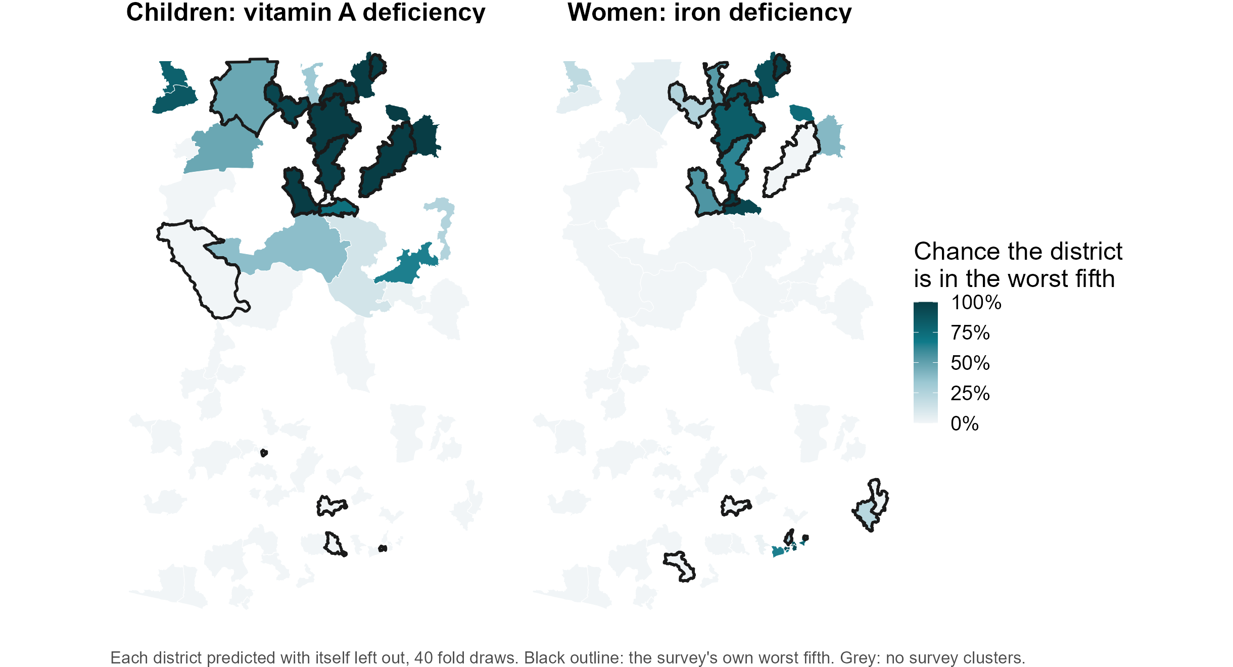
How sure is the model about each district?
Unpublished data. Do not copy or distribute.
Notes:
Source: results/tables/policy_deck/worst_fifth_probability.csv, script 07. The model was refitted on 40 different random splits, each district predicted with itself left out every time, and the map shows how often the district landed in the worst fifth. For child vitamin A in Ghana, 12 of 75 districts are in the worst fifth on at least 80 percent of refits and 56 on at most 20 percent; the middle is the uncertain part and should be treated as such. The black outlines are the survey’s own worst fifth. Across all countries and outcomes, districts the model puts at 80 percent or above are in the survey’s worst fifth 40% of the time, against 16% for districts at 20 percent or below and a base rate of 20 percent (worst_fifth_calibration.csv). The survey’s own worst fifth is noisy at one cluster per district, so 100 percent agreement is not the ceiling. A priority list should be shown this way, with the firm districts separated from the uncertain middle.

Slide 15
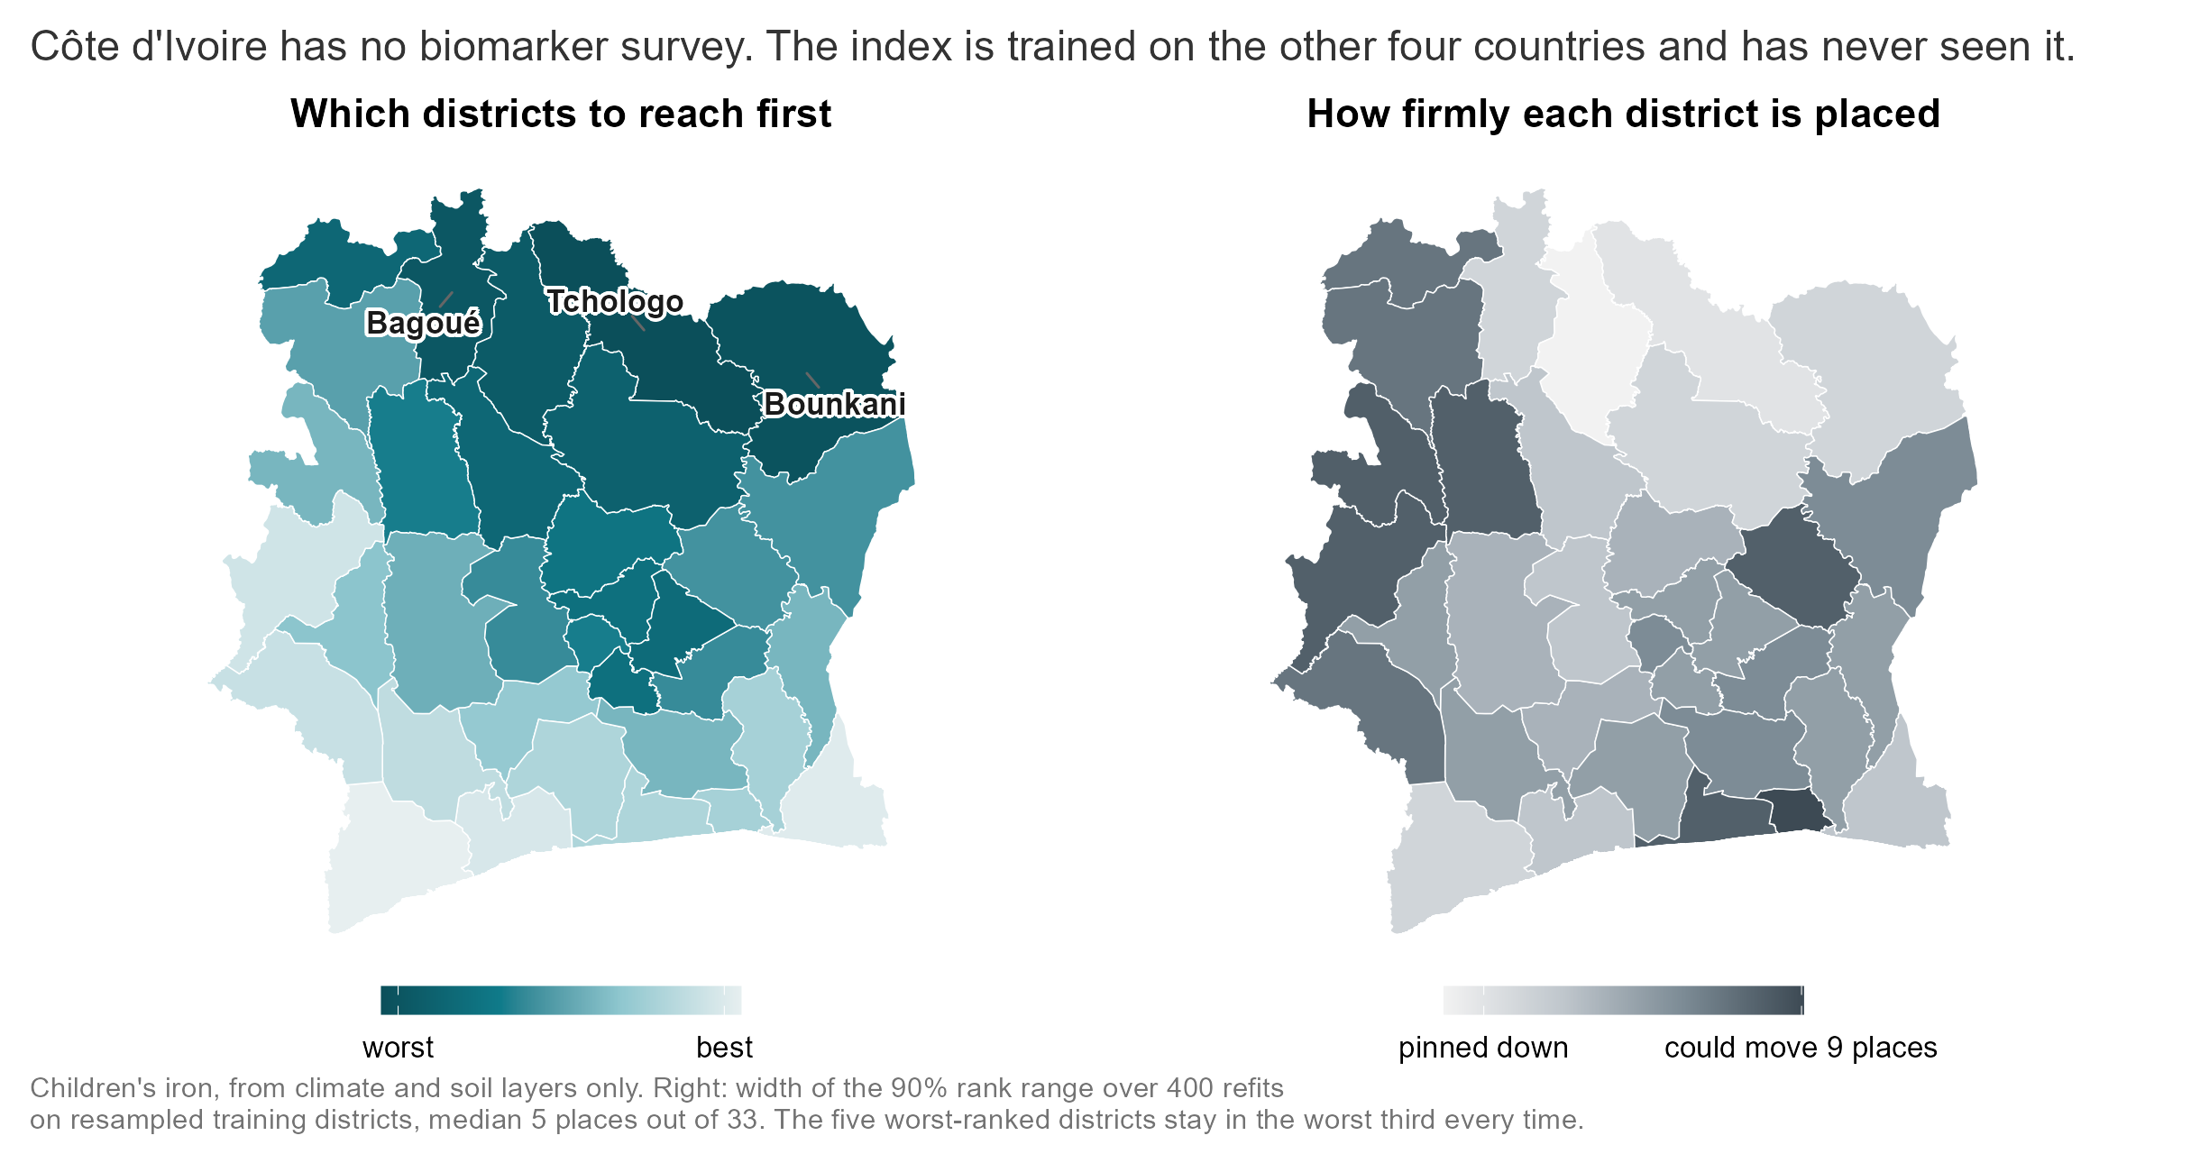
A country with no survey, ranked from public data alone
Unpublished data. Do not copy or distribute.
Notes:
Cote d’Ivoire has the full proxy database and no biomarker survey, so it is the case the project exists for. The climate-and-soil index was fitted on the four surveyed countries and applied to CIV’s 33 districts; it has never seen a Cote d’Ivoire biomarker. Left panel: the worst-ranked districts are the northern savanna belt (Tchologo, Bounkani, Bagoue, Poro, Hambol), the drier, poorer, more pastoral half of the country. Right panel: how firmly each district is placed. The training set was resampled 400 times and the index refitted each time; the map shows the width of the 90 percent range of ranks, in places out of 33. The median is 5 places, the five worst-ranked districts stay in the worst third in every refit, and 10 of 33 districts have at least an 80 percent chance of being in the worst third while 21 have at most 20 percent. This uncertainty covers how much the ranking depends on which training districts we learned from. It does not test whether the model transports to Cote d’Ivoire at all, because there is no CIV ground truth; the external bound on that is the held-out transport accuracy of 0.37. Two guards ran first: the same code with each surveyed country held out reproduces the published transport figure exactly (0.369 over 22 cells, 22 positive), and adding CIV to the column intersection costs seven of the 95 climate-and-soil columns without degrading transport (0.386, still 22 of 22). Tables: results/tables/policy_deck/civ_climate_soil_ranking.csv, civ_rank_uncertainty.csv, civ_transport_guards.csv.

Slide 16
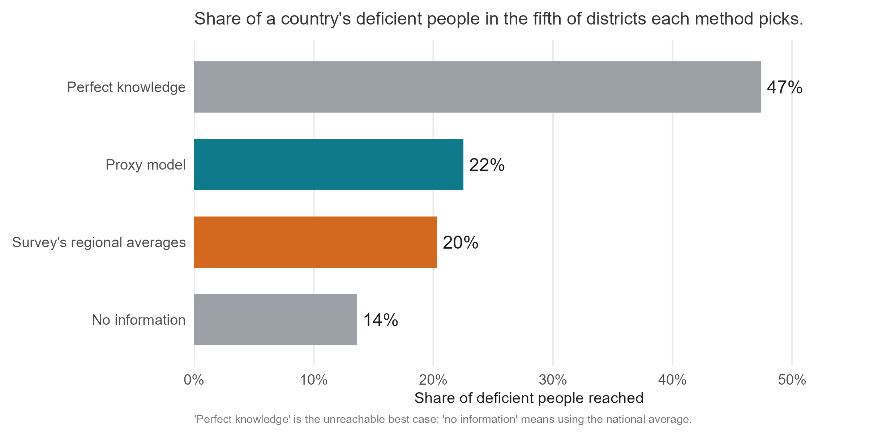
Targeting the model’s worst fifth reaches more deficient people
Unpublished data. Do not copy or distribute.
Notes:
Source: nce_targeting_summary.csv, in-fill, mean_capture over 24 combinations. Direct effort at the fifth of districts the model ranks worst and you reach 22% of the country’s deficient people; the survey’s own regional averages reach 20%, no information reaches 14%, and perfect knowledge would reach 47%. So the model closes about a fifth of the gap between guessing and knowing. Likely question: why perfect knowledge captures only 47%. Burden is spread across districts; even the true worst fifth holds under half of it.

Slide 17
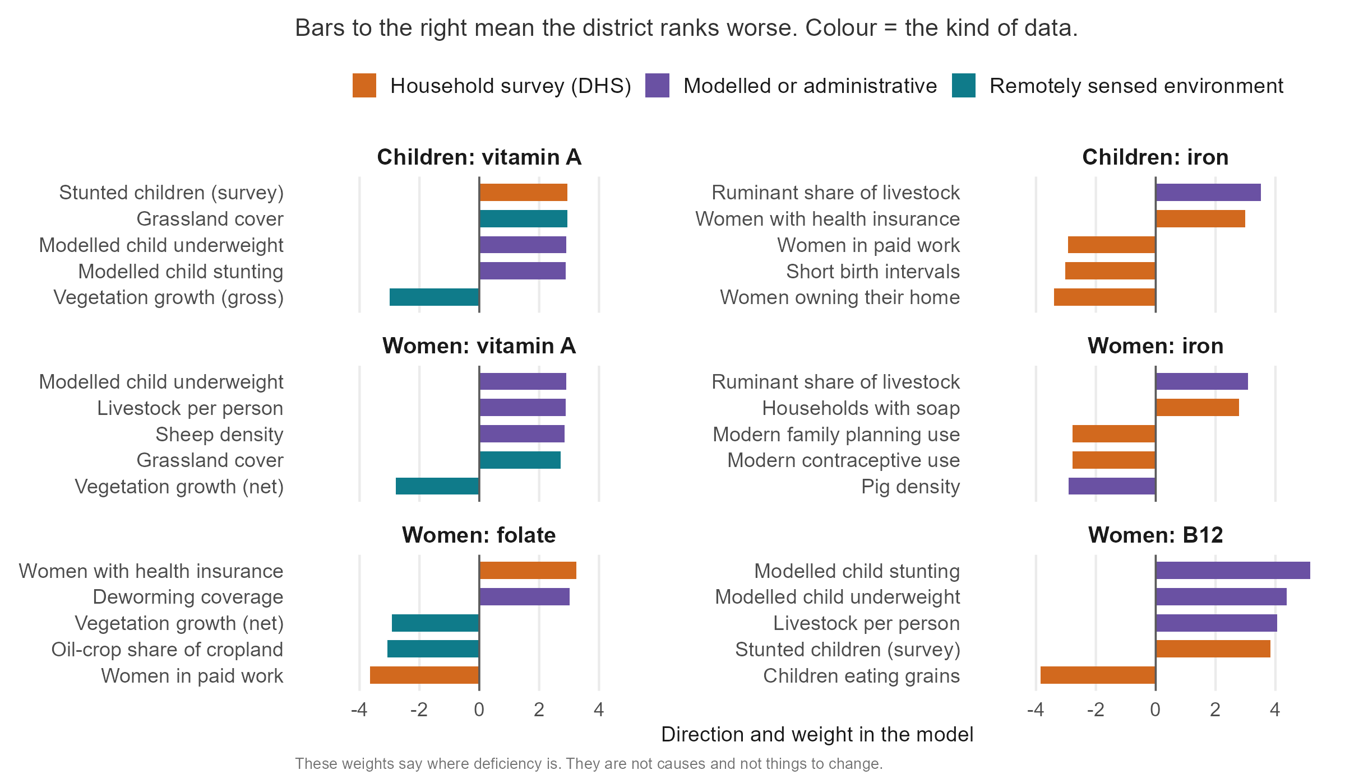
Variable importance: one gradient runs through every deficiency
Unpublished data. Do not copy or distribute.
Notes:
Source: index_importance_top.csv, biomarker level, top five per outcome. The same picture recurs for all six outcomes: districts that are drier and grassier, less productive, more pastoral, poorer (fewer women owning their home or in paid work, less schooling) and with more stunted and underweight children rank worst on every deficiency we measured. That is the agro-ecology to diet to status pathway of the conceptual framework, seen from above. Two cautions to say aloud. First, these are not causes; a weight says where deficiency is, not what to change. Second, livestock density ranking positive for iron and B12 is ecological, not dietary: pastoral zones are the dry, poor zones. Nobody should leave the room thinking cattle cause iron deficiency. Colour marks the kind of data; bar length is the weight. This slide and the next are the 3-minute short-oral talk.

Slide 18
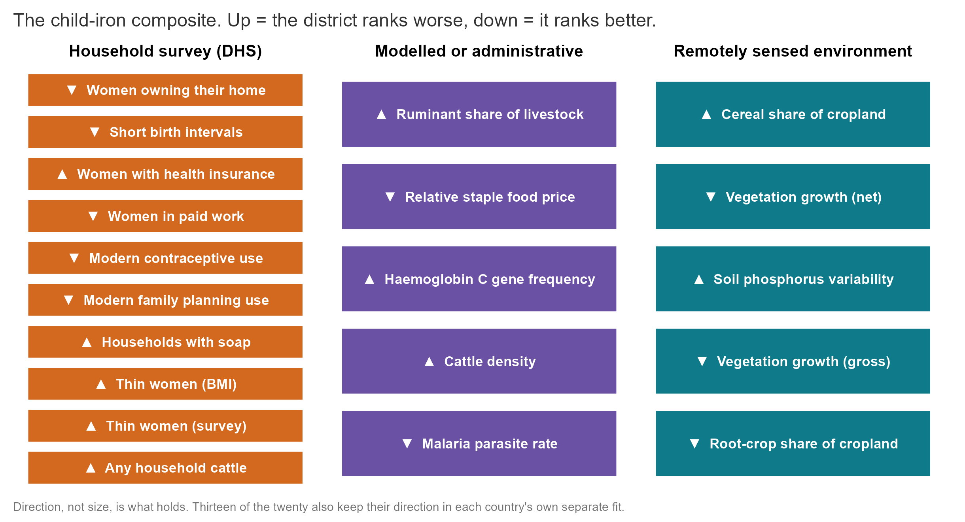
The predictive variables are consistent across countries (child iron)
Unpublished data. Do not copy or distribute.
Notes:
Source: index_importance_top.csv, child iron, top twenty. This is the whole composite for one outcome, the sort of list a country could assemble itself. All twenty keep the same direction in every leave-one-country-out fit; thirteen of the twenty also keep it in each country’s own separate fit, which is the stricter test. None of these requires a blood sample. The twenty-layer equal-weight composite scores 0.29 for a new country, slightly above the full 454-column index at 0.26 (weight_sources_summary.csv, arm sparse20), so a short, auditable list is not a compromise here.

Slide 19
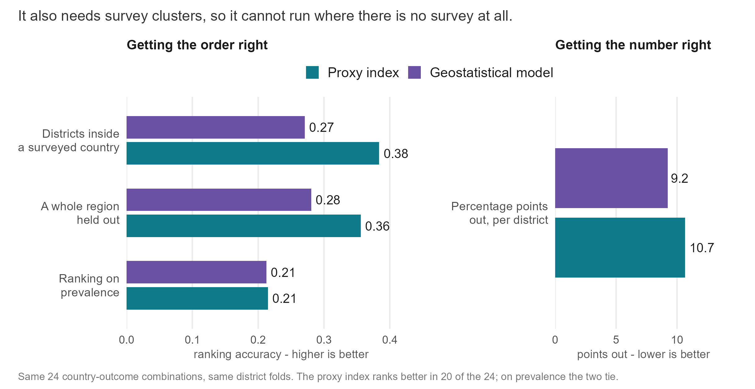
The geostatistical model gives a better number and a worse ranking
Unpublished data. Do not copy or distribute.
Notes:
Source: results/tables/cluster_level/mbg_comparison_cells.csv, 24 country-outcome combinations, same district folds. This is the DHS Program’s approach: a spatial field plus covariates fitted at survey cluster locations. Run twice, with our covariates and with the DHS Program’s own ten-layer list, the conclusion is the same. It ranks districts worse (0.27 against 0.38 in-fill, 0.28 against 0.36 for a held-out region; the index is better in 20 of 24), ties on ranking prevalence (0.21 each), and is better at the absolute number (9.2 percentage points of error against 10.7) because it shrinks toward the mean. So if a country needs a prevalence figure to publish, that is the better tool, and it comes with an interval. It is fitted to survey clusters, so it cannot run for a country with no survey. The two are complementary, and the policy slide says how.

Slide 20
What this means for policy
A surveyed country with unsurveyed districts: the ranking fills the gaps, and the DHS-style model gives a prevalence figure with an interval where clusters exist.
A country with no survey: the ranking says which districts are likely worst, with a probability for each. One national blood sample turns it into numbers.
Planning the next survey: a national sample of about 5 percent of a full survey, plus the ranking, gives district levels within 10.3 points. A district survey needs about a quarter of a full sample to match that.
Unpublished data. Do not copy or distribute.
Notes:
The third point is from results/tables/protocol_v2/anchor_and_rank_summary.csv (AR-01): at 5 percent of the full sample the national anchor plus ranking gives a median district error of 10.3 percentage points, a regional survey 12.8 and a district survey 19.7; the district survey matches the anchored ranking at about 25 percent of the sample. The ranking wins on level error only: a district survey of any size captures more burden, because burden sits in populous districts that surveys measure well. Likely question: can this replace a survey. No. It ranks; a survey measures. The ranking tells a survey where to spend its clusters and tells a programme where to look while it waits.

Slide 21
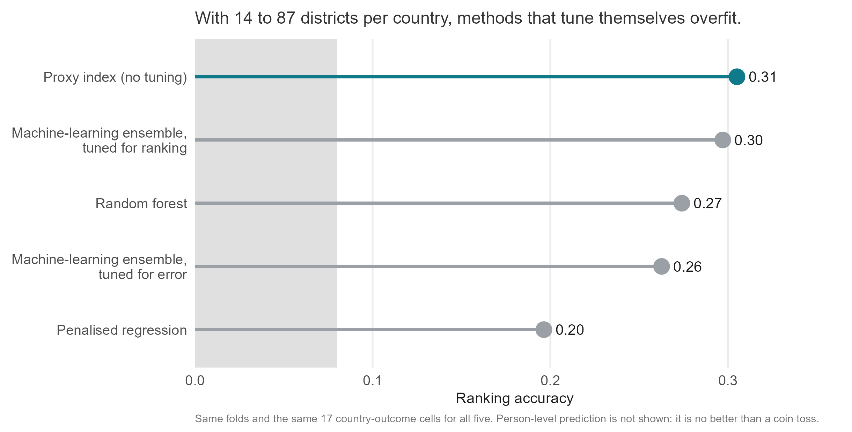
More complicated models do not do better
Unpublished data. Do not copy or distribute.
Notes:
Source: sl_rank_loss_scores.csv, all arms scored on the same folds and, in this figure, on the same 17 country-outcome cells (the rank ensemble fails one near-empty vitamin A cell; comparing on different cells would flatter it). On those cells the untuned index averages 0.31 and the ensemble tuned for ranking 0.30, a tie under our 0.03 rule; the ensemble is ahead in 4 of the 17. The ensemble tuned for squared error, random forest and penalised regression trail by 0.03 to 0.11. The reason is sample size: 14 to 87 districts per country is not enough for a method to learn its own settings. Rerun on 10 September with the DHS-style survey columns; every tuned method gained a little from the cleaner inputs and the ordering did not change. Also tested: highly adaptive ridge and ridge, lasso and elastic-net weightings of the same components (weight_sources_summary.csv); none beats the index inside a country, and two variants (decorrelated weights, a twenty-predictor composite) gain about 0.03 across borders and are pre-registered rather than adopted.

Slide 22
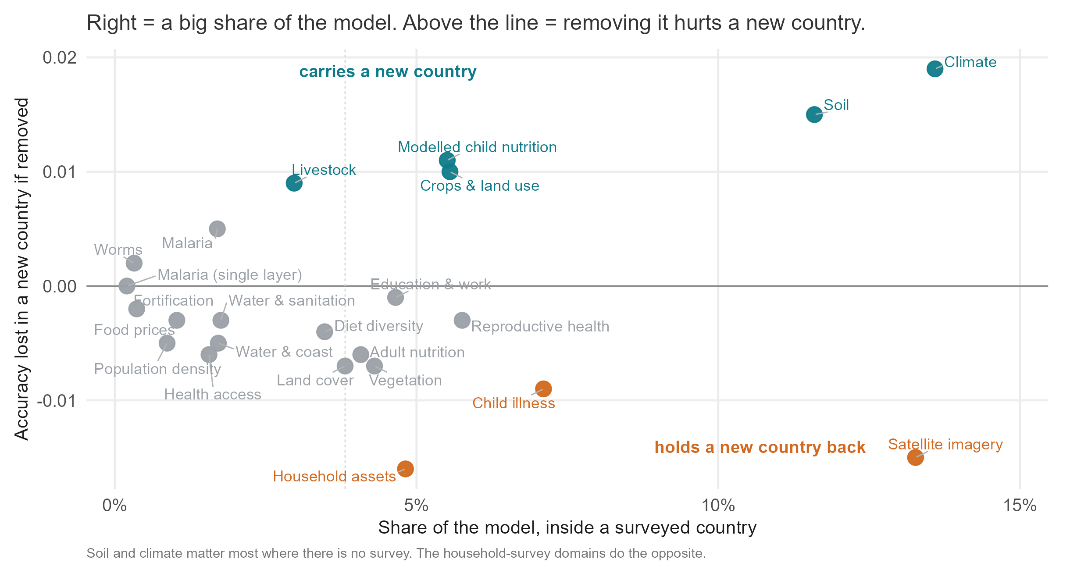
Different data support within-country and across-country prediction
Unpublished data. Do not copy or distribute.
Notes:
Sources: index_importance_domains.csv (pooled, biomarker level) for the horizontal axis, domain_ablation_loco_summary.csv for the vertical. Satellite imagery, climate and soil together carry 30 to 48 percent of the model inside a country, and climate and soil are the two whose removal costs a new country most, with the modelled nutrition surfaces, agriculture and livestock behind. The household-survey domains sit below the line: they hold several of the largest single weights, yet removing all of them improves new-country accuracy from 0.26 to 0.33 (source_ablation_loco_summary.csv). Household-survey indicators are country-specific in a way that does not export; the physical environment does. This is the evidence behind the climate-and-soil result and the reason it needs confirming on a fifth country.

