Slide 1





Which public data layers predict micronutrient deficiency, and what they do and do not tell us: evidence from four national biomarker surveys
Andrew N. Mertens (presenting), Reed Atkin, Sorrel Namaste, Demewoz Haile, Kenneth H. Brown, Saskia Osendarp, Xiuping Tan, Eric Stewart, Keith Lividini, Seth Adu-Afarwuah, Nicolai Petry, Aminata S. Koroma, Mary H. Hodges, Fabian Rohner, Haddy Crookes, James P. Wirth, Jonathan Gorstein, Kathy Banke, Sonja Y. Hess
Background, aims and methods
Micronutrient surveys are rare and expensive
Most countries have no recent estimate, and almost none can say which districts are worst off.
Can data that already exist for every district fill that gap?
Satellite, climate, soil, crops, disease maps, prices, household surveys.
Four national biomarker surveys as the ground truth
The Gambia 2018, Ghana 2017, Malawi 2015-16, Sierra Leone 2013: 206 districts; iron, vitamin A, folate, B12 and zinc.
575 public layers per district, none needing a blood sample
Each family of layers becomes a few summary scores, weighted by how well it tracks deficiency where blood was drawn. Nothing is tuned.
Tested only on what the model never saw
Districts held out one in five, and whole countries held out in turn.
Micronutrient Forum 7th Global Conference
Notes:
ANDREW, about 45 seconds (128 words). Micronutrient surveys are rare and expensive. Most countries have no recent estimate, and even where one exists it was designed to report regions, so programmes choose districts with almost no data. Our question: can data that already exist for every district fill that gap? Satellite, climate, soil, crops, disease maps, prices, household surveys. Four national biomarker surveys, in The Gambia, Ghana, Malawi and Sierra Leone, are the ground truth: 206 districts, five nutrients. We linked 575 public layers to every district, none of which needs a blood sample. Each family of layers becomes a few summary scores, weighted by how well it tracks deficiency where blood was drawn. Nothing is tuned. And every number you will see comes from predicting districts, and whole countries, the model never saw.

Slide 2
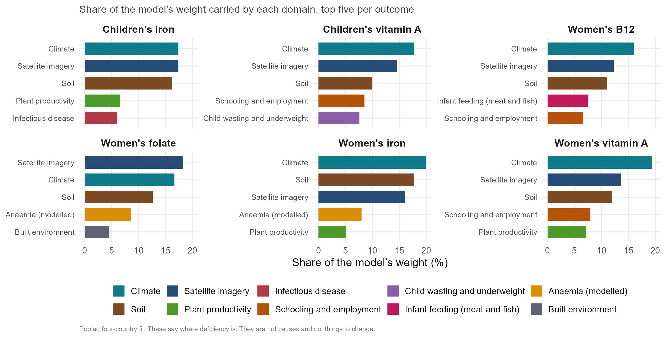
Every model uses the same three layers; each nutrient adds its own
Three blocks do most of the work for every nutrient: satellite imagery, climate and soil carry 39% to 54% of the model's weight.
What each nutrient adds on top is recognisable. B12 leans on infant meat and fish consumption; iron and folate on modelled anaemia; vitamin A on child wasting; children's iron on a cereal-and-livestock farming gradient.
The nutrient with the clearest dietary marker is also the best predicted. Women's B12 reaches 0.63 inside a country and 0.52 in a country never surveyed, against 0.08 for chance.
The layers that cross a border are the free ones: openly downloadable data alone score 0.32, ahead of adding public survey microdata (0.30) or DHS microdata (0.28).
Micronutrient Forum 7th Global Conference
Notes:
ANDREW, about 80 seconds (184 words). This is the finding. Each panel is one nutrient, and the bars are the share of the model's weight carried by each family of predictors. The top three bars are the same in every panel: satellite imagery, climate and soil, just under half the weight whichever nutrient you take. Then look below them, because a nutritionist would recognise all of it. B12, the nutrient you get almost only from animal-source food, leans on infant feeding: districts where more infants are fed meat or fish. Iron and folate lean on modelled anaemia, their clinical consequence. Vitamin A leans on child wasting. Children's iron leans on a cereal-and-livestock farming gradient. And the nutrient with the clearest dietary marker is the one we predict best: women's B12 reaches 0.63 inside a country and 0.52 in a country never surveyed, against 0.08 for chance. One practical point. The layers that cross a border are the free ones. Openly downloadable data alone score 0.32 in a new country; adding public survey microdata, which cost us weeks and a registration each, takes it to 0.30, and DHS microdata to 0.28.

Slide 3
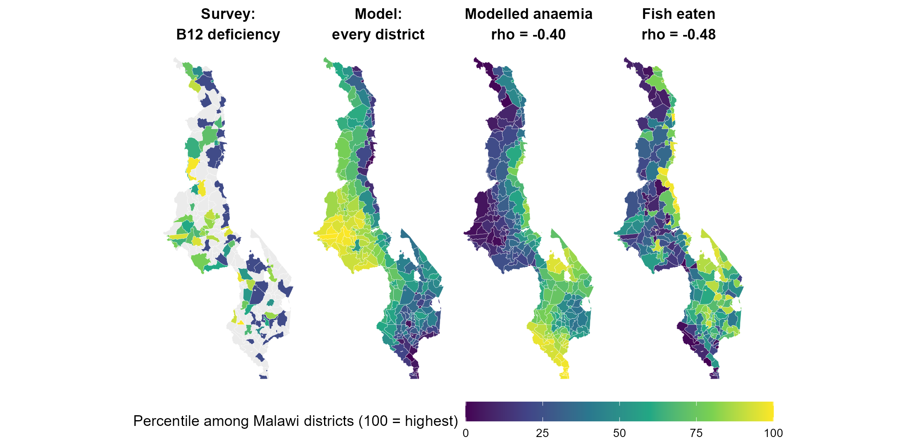
Malawi: the model finds place-markers, not mechanisms
Malawi women's B12 is our best-predicted outcome (0.70), and it carries a warning: modelled anaemia tracks BETTER B12 status (rho -0.40), which no biology supports.
The maps say why. Anaemia and malaria peak along the lakeshore and in the south, and so does eating fish (rho -0.48), the main source of B12 in Malawi.
The model found a marker for a place, not a cause, and cannot tell them apart. These layers say where deficiency is; they are not a list of things to change.
Impact: a country can rank its own districts today from data it can download, to target programmes and to place the next survey. The level still needs one measured national sample.
Micronutrient Forum 7th Global Conference
Notes:
ANDREW, about 55 seconds (135 words). And the caution. Malawi women's B12 is our best-predicted outcome, at 0.70. Inside it, the anaemia layer points the wrong way: districts with more anaemia have better B12 status. No biology says that. The maps say why. Anaemia and malaria peak along the lakeshore and in the south, and that is exactly where households eat fish, the main source of B12 in Malawi. The model found a marker for a place, not a cause, and it cannot tell the difference. So the rule we hold to: these layers tell you where to look, not what to change. What a country gets today is a ranking of its own districts from data it can download, enough to target a programme and to place the next survey. The level still needs one measured national sample. Thank you.

