Slide 1
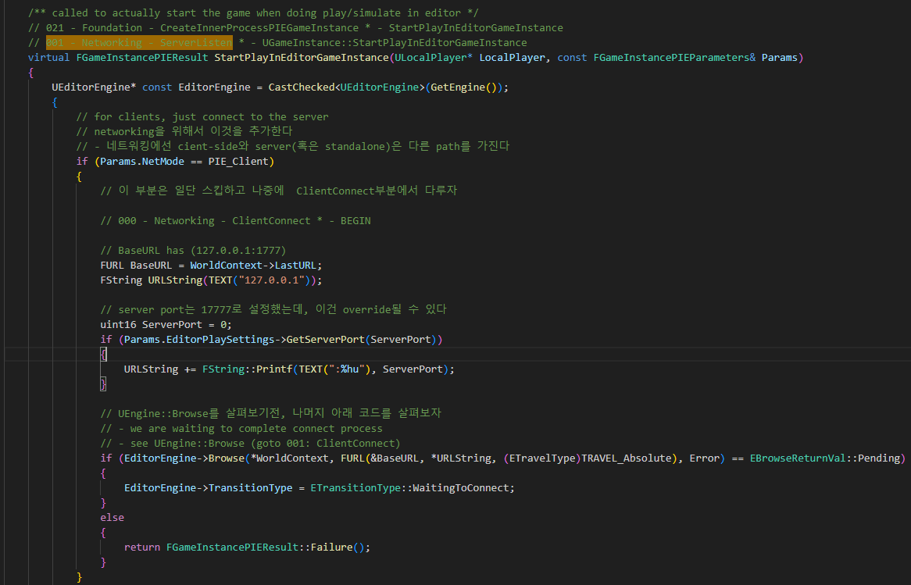
GameInstance StartPlayInEditorGameInstance 000

Slide 2
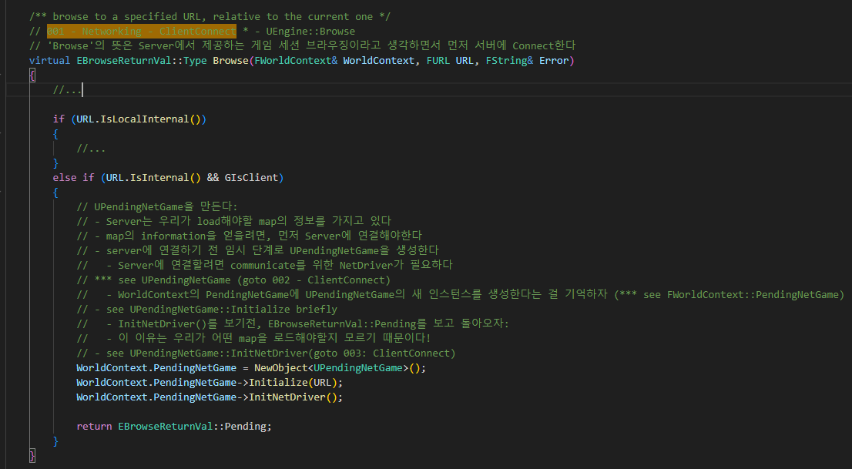
UEngine Browse 001

Slide 3
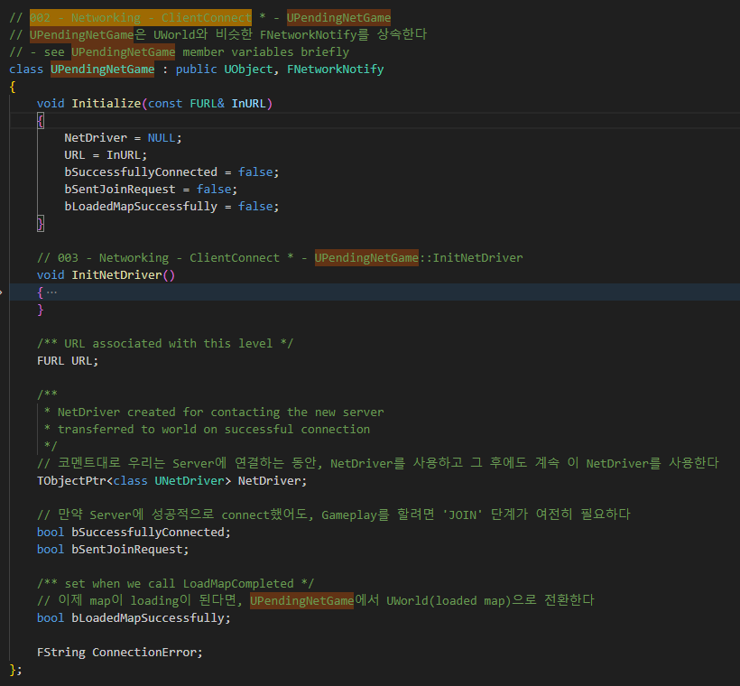
UPendingNetGame 002

Slide 4
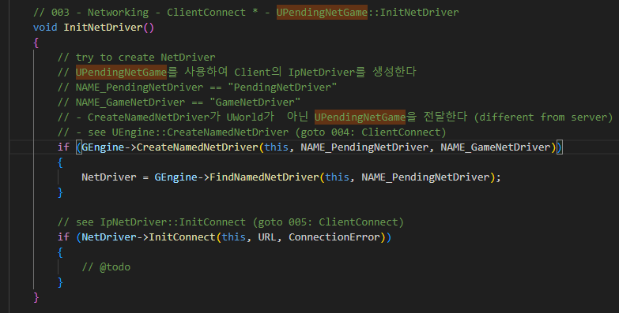
UPendingNetGame InitNetDriver 003

Slide 5
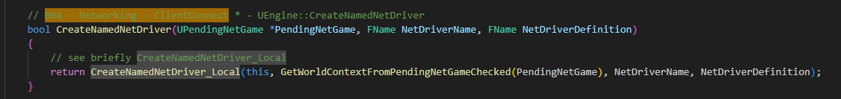
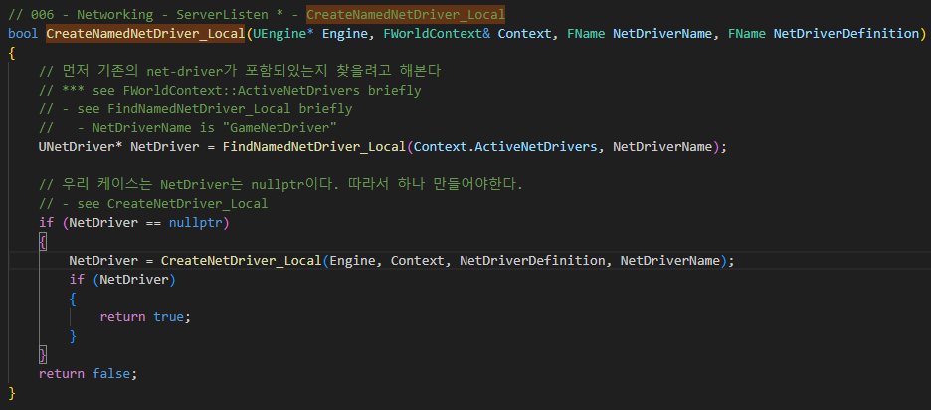
UEngine CreateNamedNetDriver 004

Slide 6
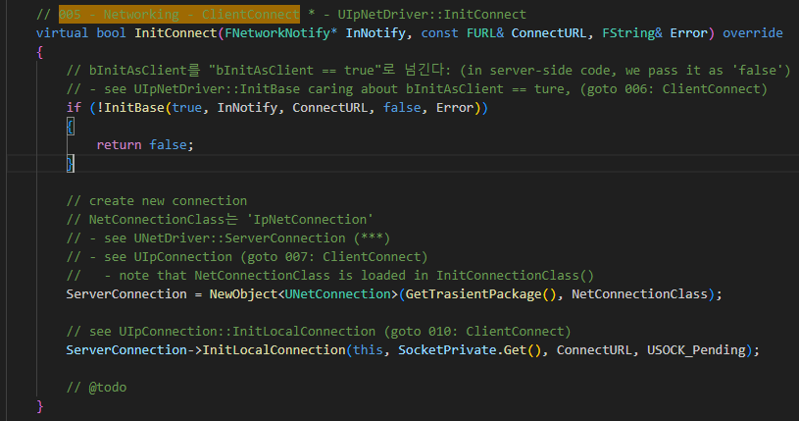
UIpNetDriver InitConnect 005

Slide 7
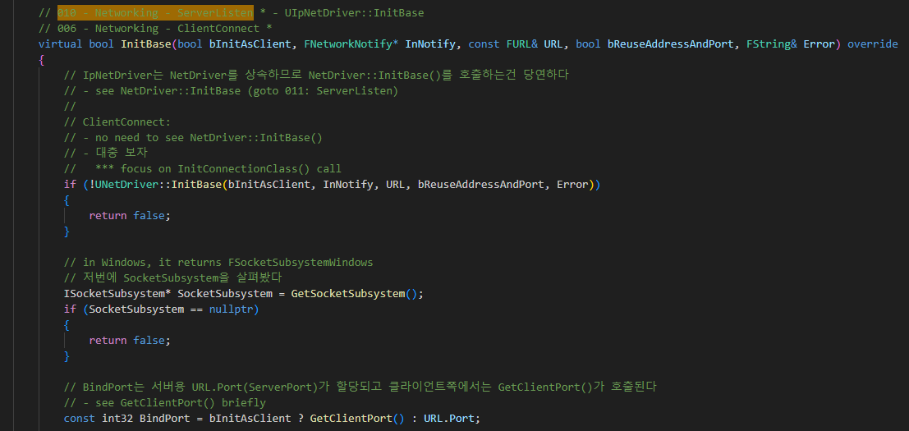
UIpNetDriver InitBase 006

Slide 8
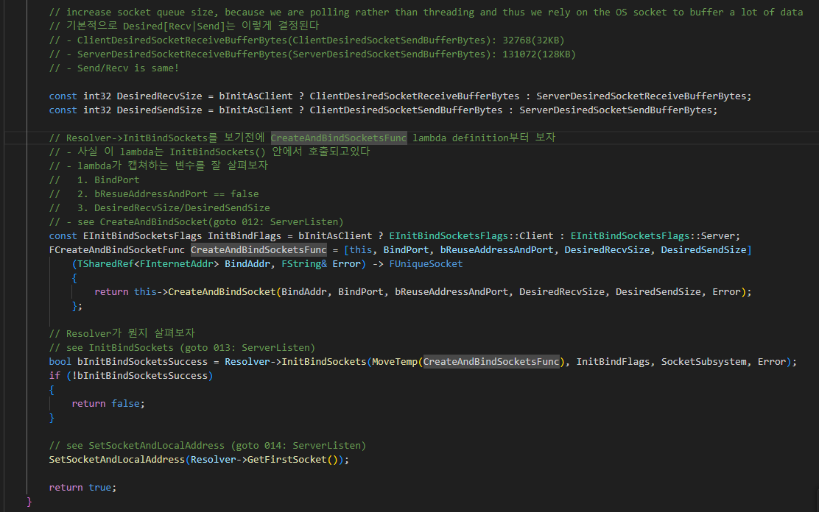
UIpNetDriver InitBase 006

Slide 9
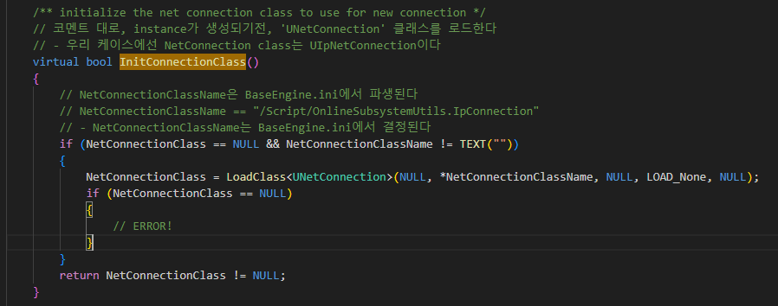
UIpNetDriver InitBase 006

Slide 10
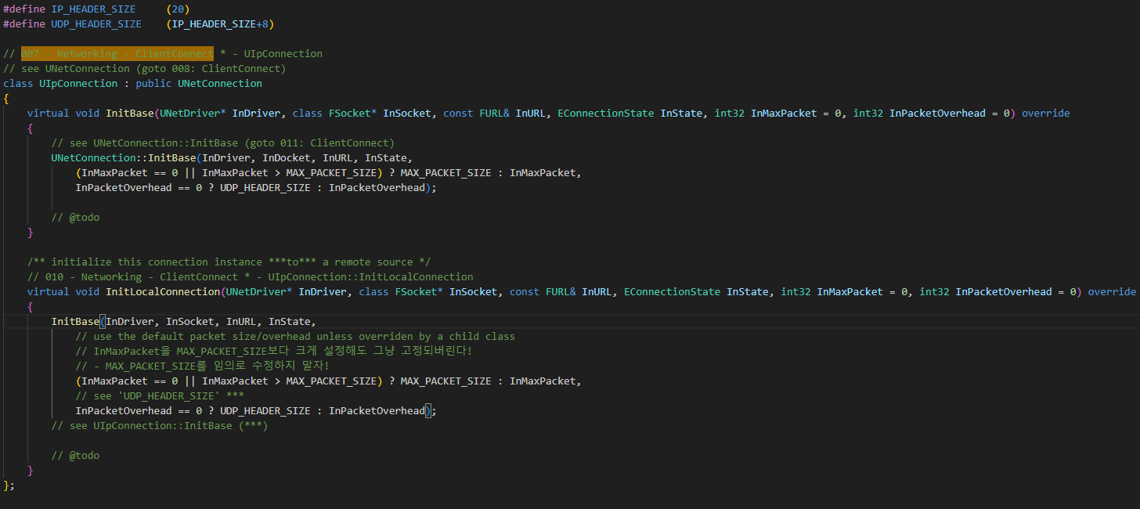
UIpConnection 007

Slide 11
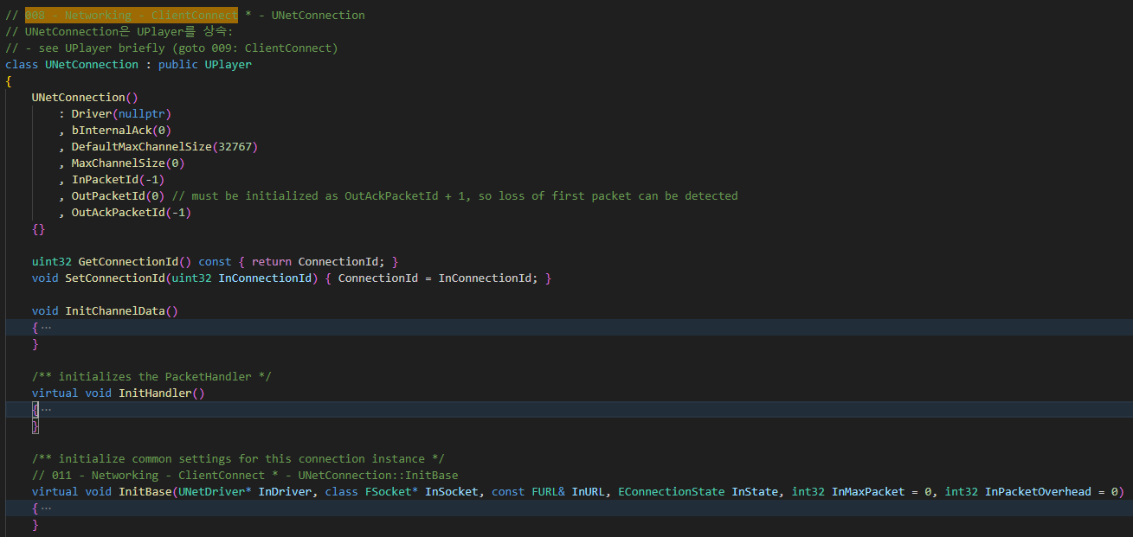
UNetConnection 008

Slide 12
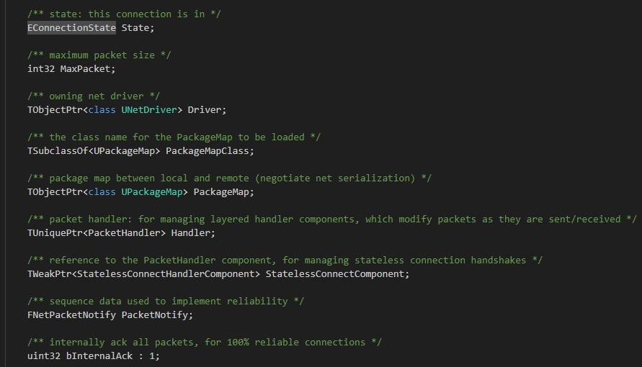
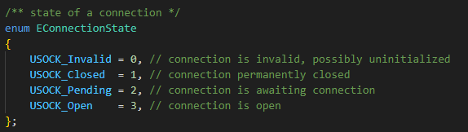
UNetConnection 008

Slide 13
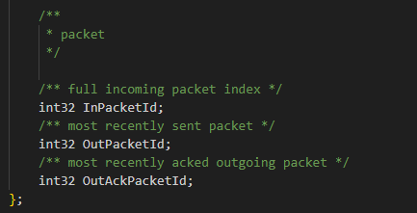
UNetConnection 008

Slide 14
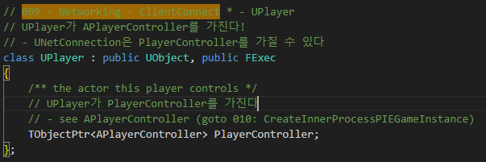
UPlayer 009

Slide 15
UIpNetDriver InitConnect 005

Slide 16
UIpConnection InitLocalConnection 010

Slide 17
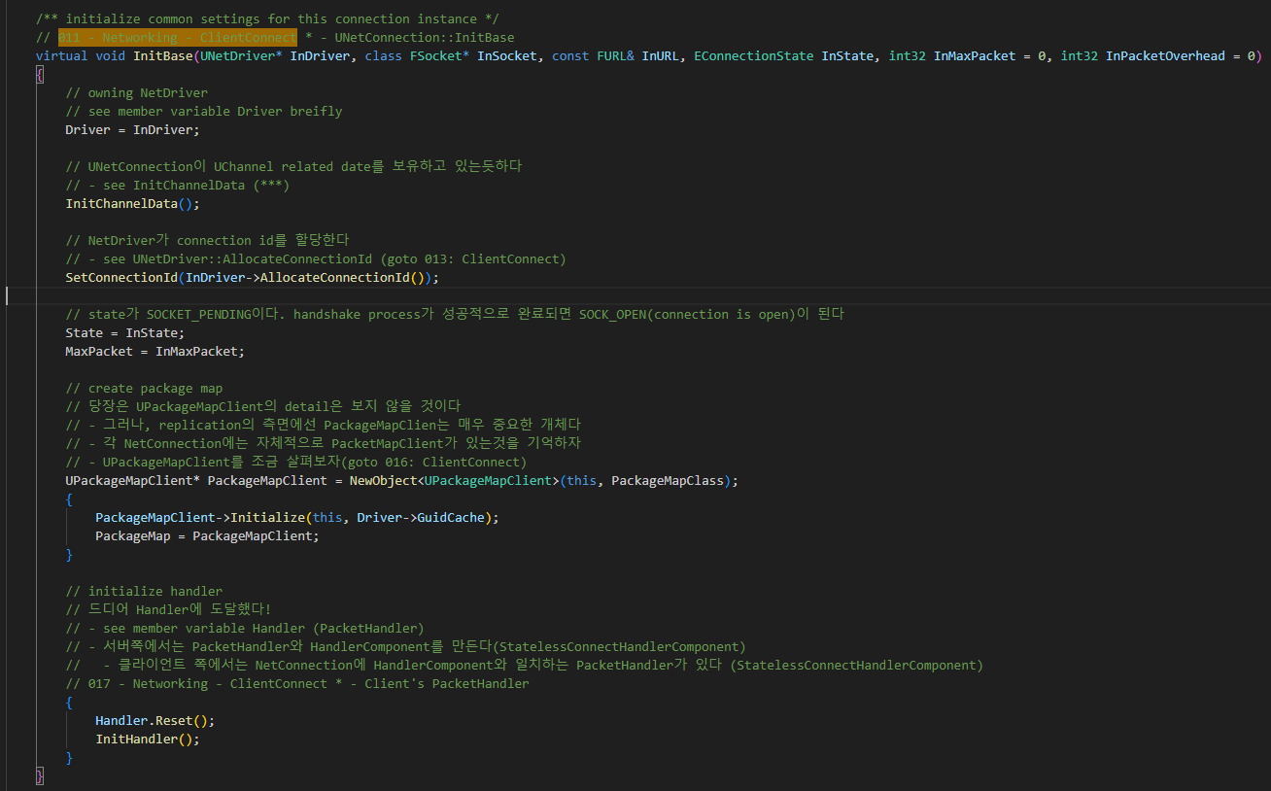
UNetConnection InitBase 011

Slide 18
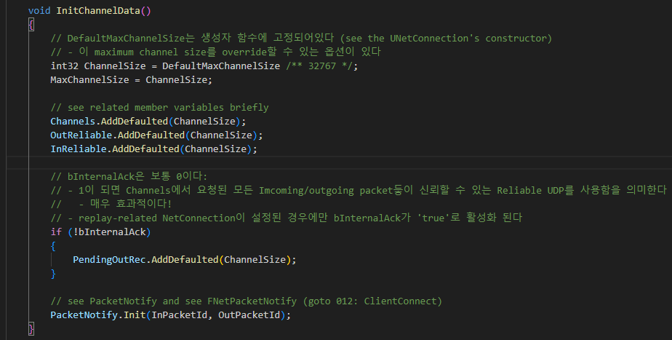
UNetConnection InitBase 011

Slide 19
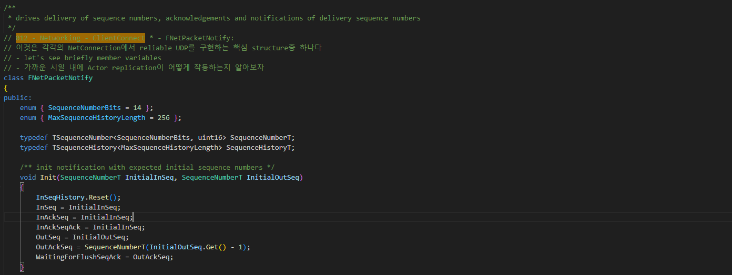
FNetPacketNotify 012

Slide 20
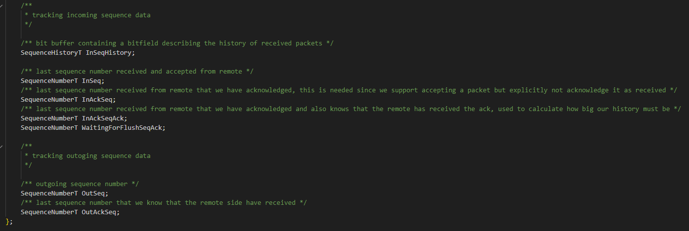
FNetPacketNotify 012

Slide 21
UIpNetDriver InitBase 006

Slide 22
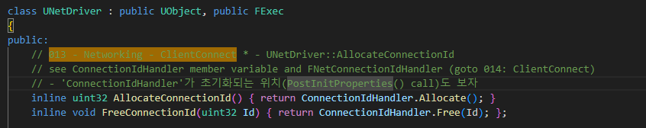
UNetDirver AllocateConnectionId 013

Slide 23
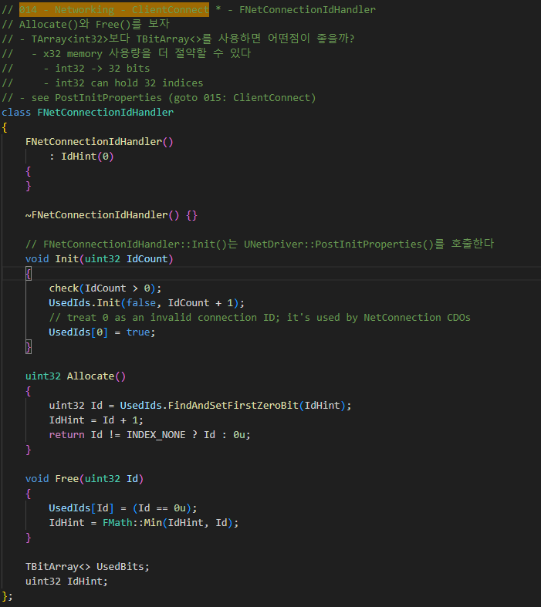
FNetConnectionIdHandler 014

Slide 24
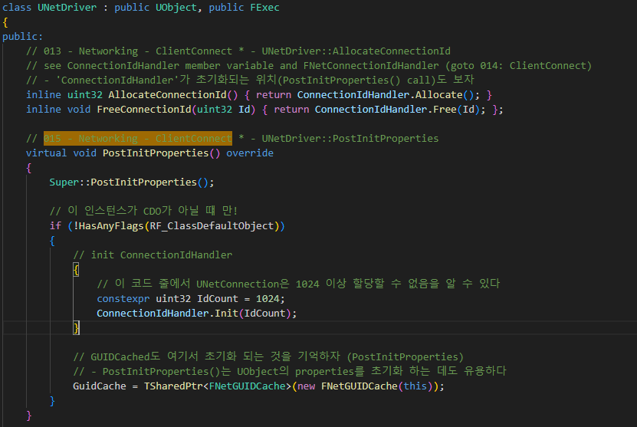
UNetDriver PostInitProperties 015

Slide 25
UNetConnection InitBase 011

Slide 26
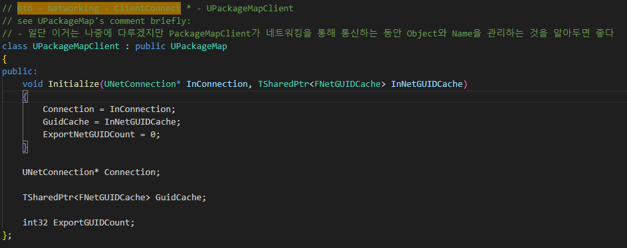
UPackageMapClient 016

Slide 27
UNetConnection InitBase 017

