Slide 1
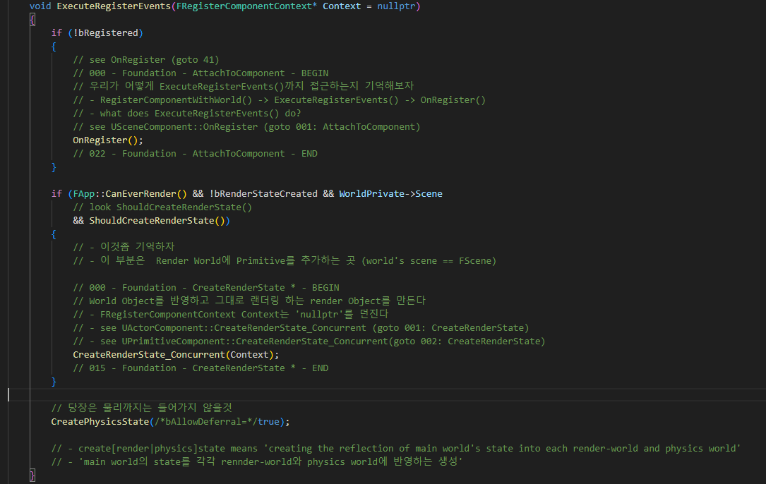
ActorComponent ExecuteRegisterEvents 000

Slide 2
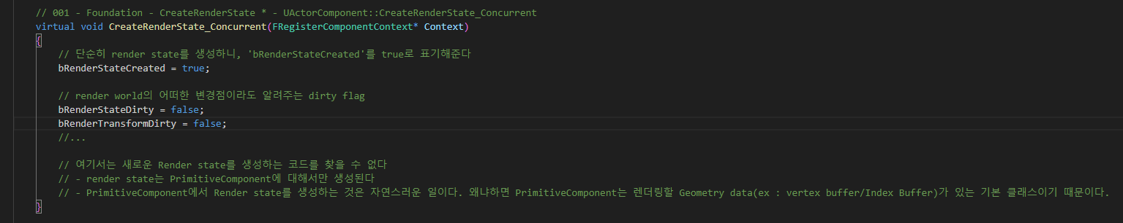
ActorComponent CreateRenderState_Concurrent 001

Slide 3
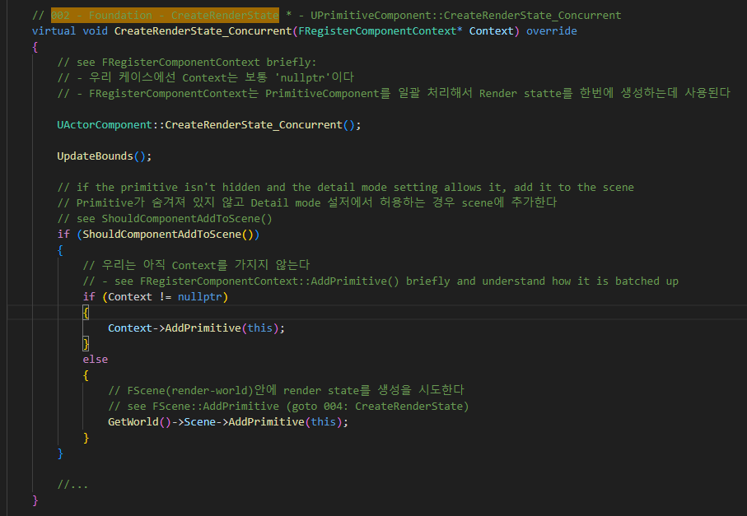
PrimitiveComponent CreateRenderState_Concurrent 002

Slide 4
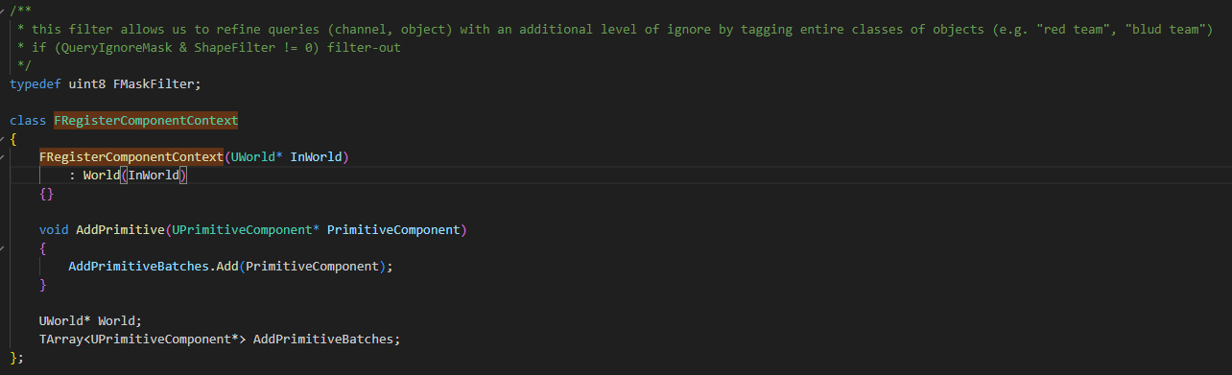
PrimitiveComponent FRegisterComponentContext 002

Slide 5
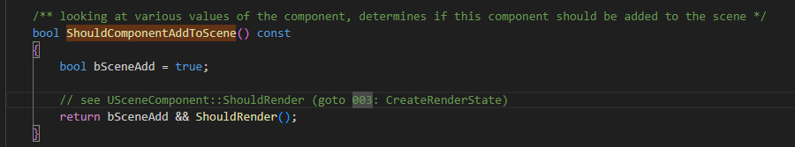
PrimitiveComponent ShouldComponentAddToScene 02

Slide 6
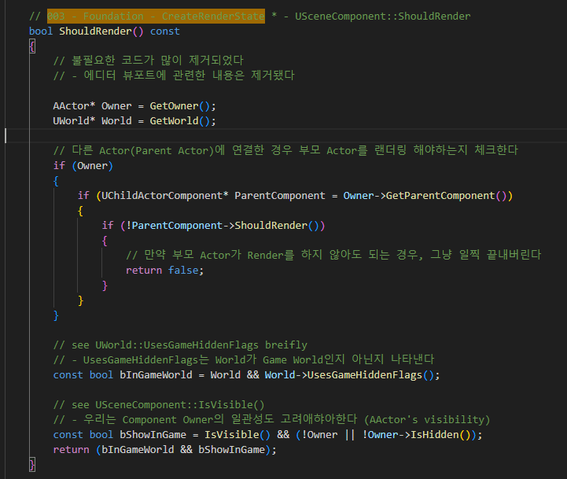
SceneComponent ShouldRender 003

Slide 7
PrimitiveComponent CreateRenderState_Concurrent 002

Slide 8
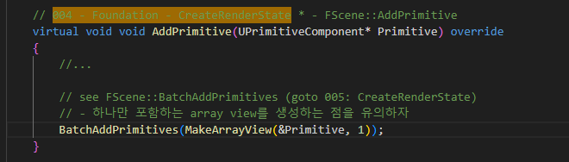
ScenePrivate AddPrimitive 004

Slide 9
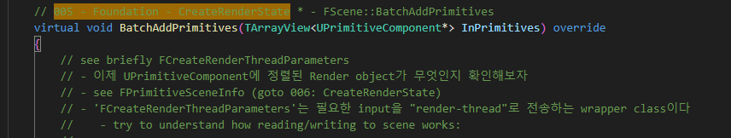
ScenePrimitive BatchAddPrimitives 005

Slide 10
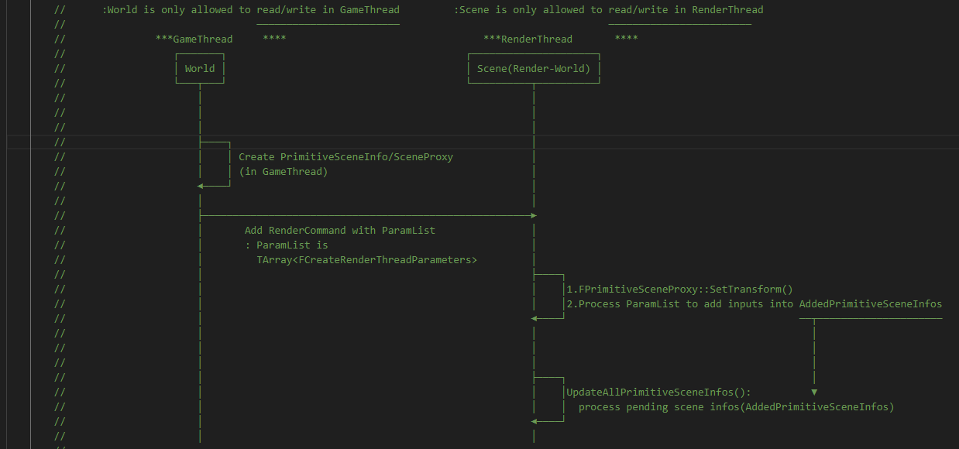
ScenePrimitive BatchAddPrimitives 005

Slide 11
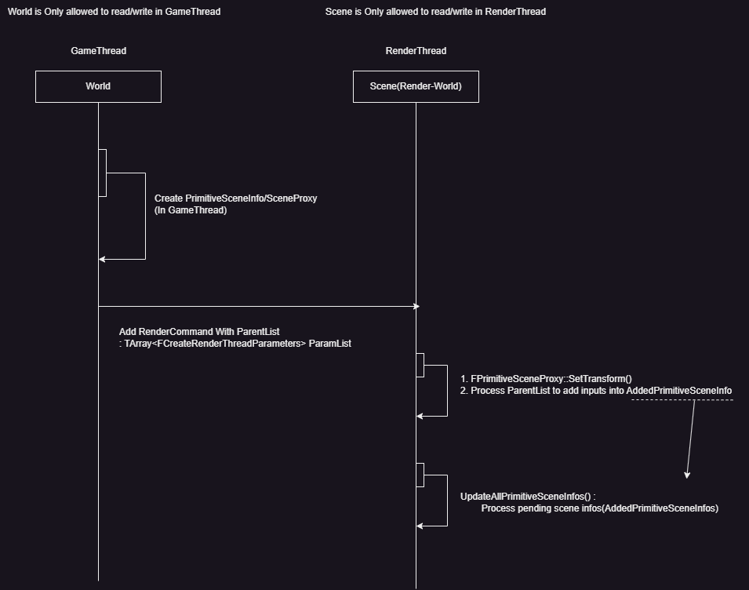
ScenePrimitive BatchAddPrimitives 005

Slide 12
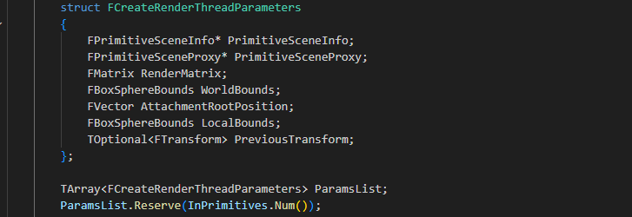
ScenePrimitive BatchAddPrimitives 005

Slide 13
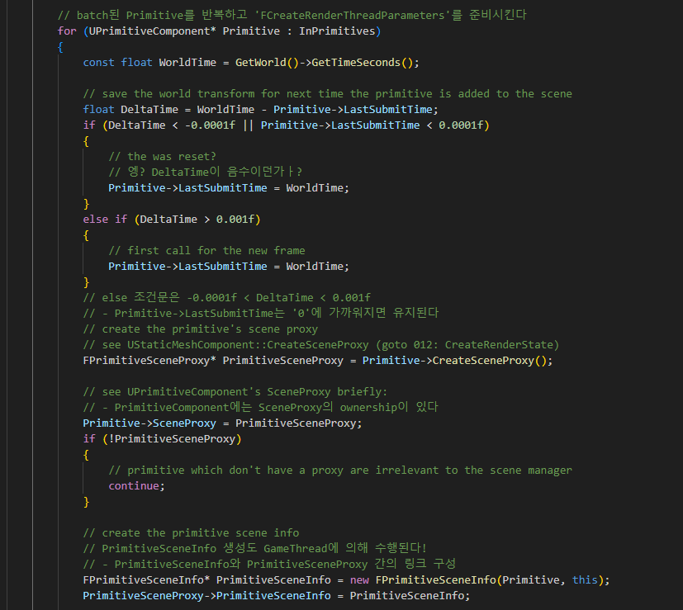
ScenePrimitive BatchAddPrimitives 005

Slide 14
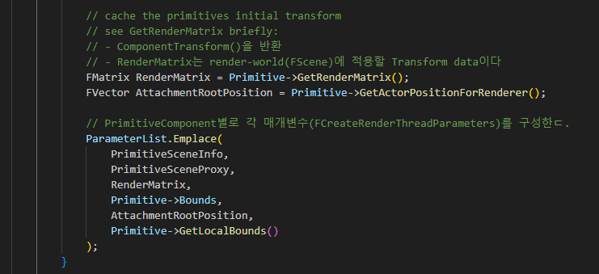
ScenePrimitive BatchAddPrimitives 005

Slide 15
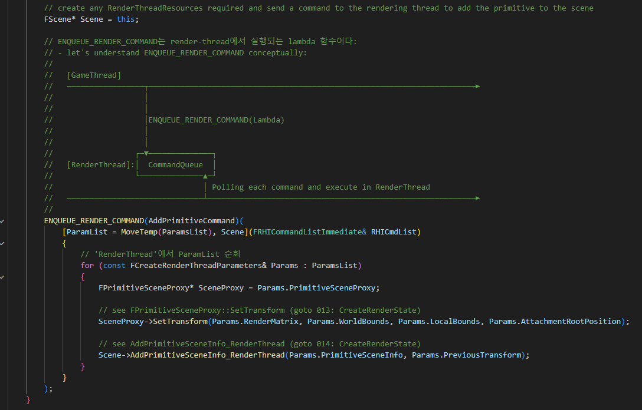
ScenePrimitive BatchAddPrimitives 005

Slide 16
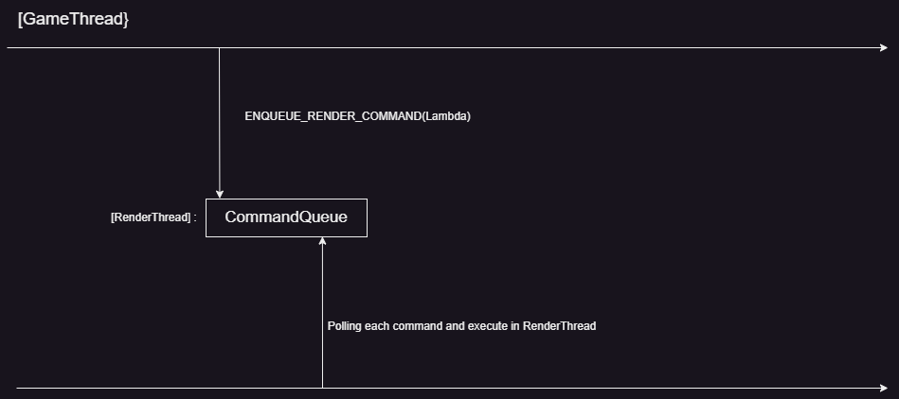
ScenePrimitive BatchAddPrimitives 005

Slide 17
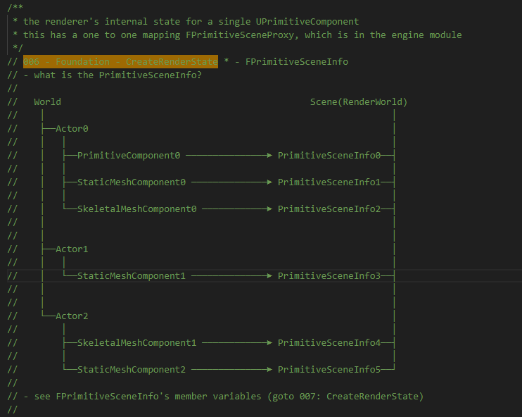
ScenePrimitive PrimitiveSceneInfo 006

Slide 18
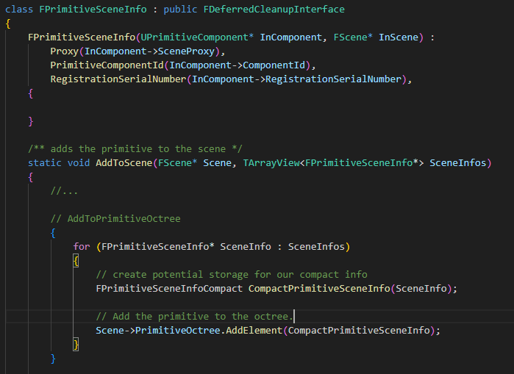
ScenePrimitive PrimitiveSceneInfo 007

Slide 19
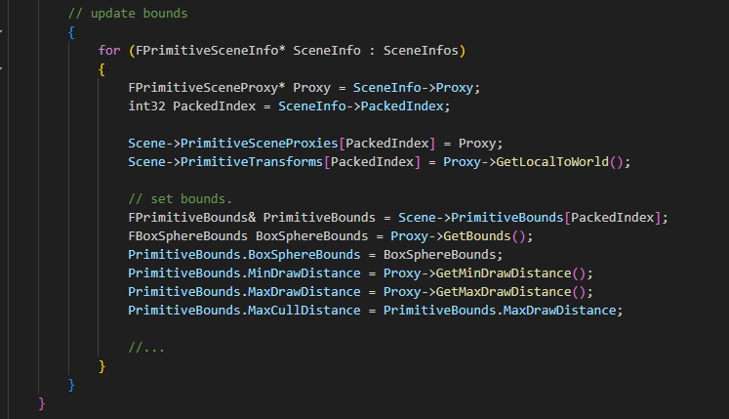
ScenePrimitive PrimitiveSceneInfo 007

Slide 20
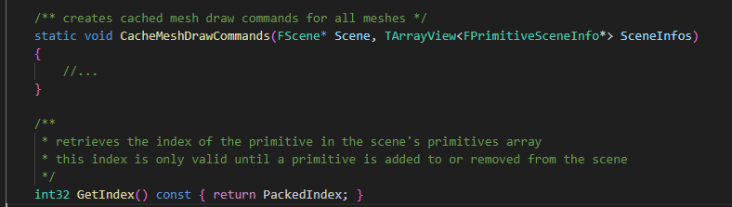
ScenePrimitive PrimitiveSceneInfo 007

Slide 21
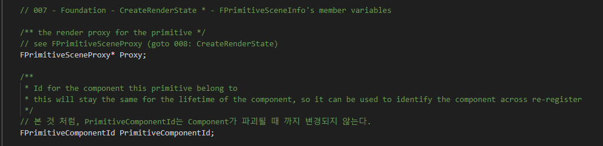
ScenePrimitive PrimitiveSceneInfo 007

Slide 22
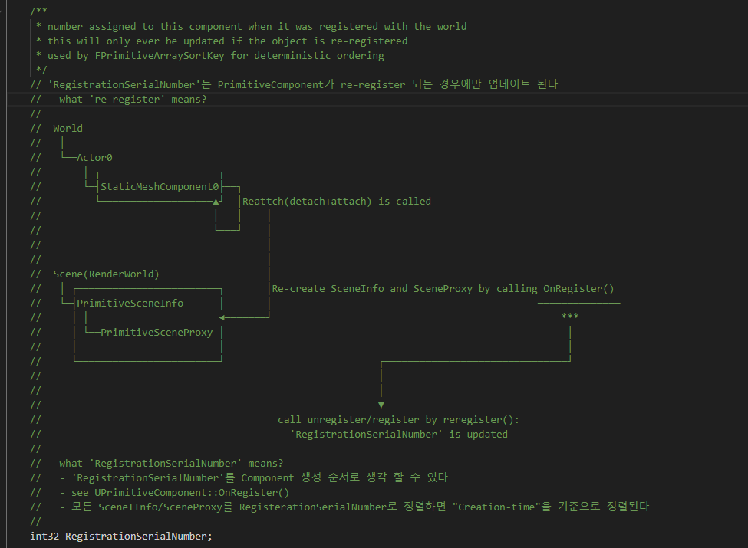
ScenePrimitive PrimitiveSceneInfo 007

Slide 23
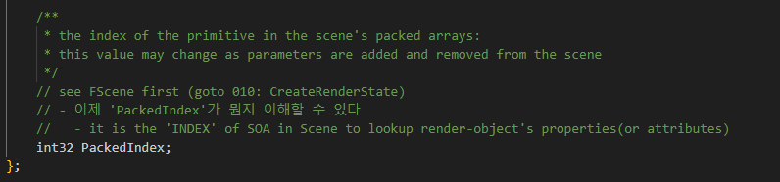
ScenePrimitive PrimitiveSceneInfo 007

Slide 24
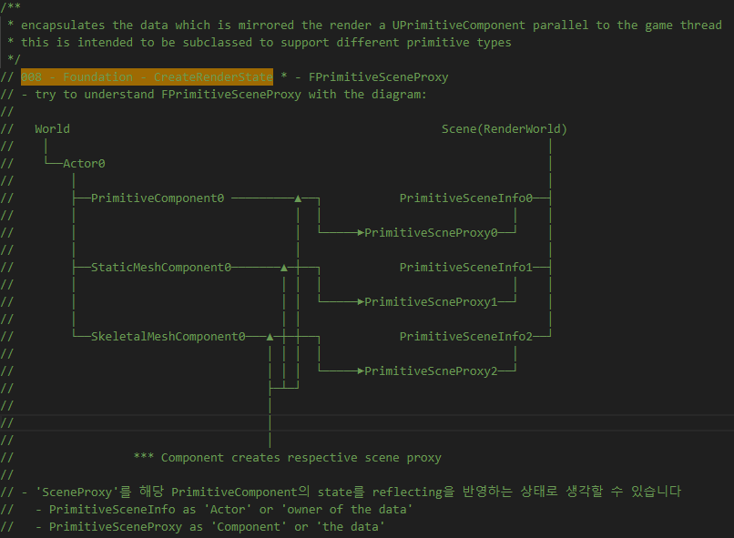
ScenePrimitive FPrimitiveSceneProxy 008

Slide 25
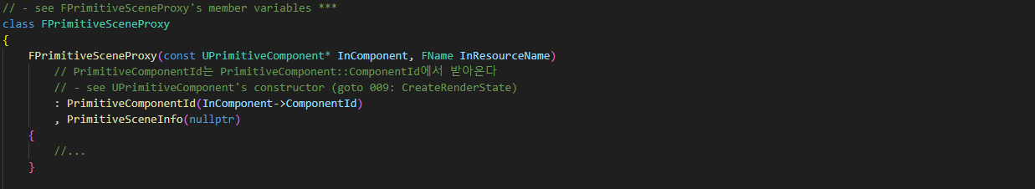
ScenePrimitive FPrimitiveSceneProxy 008

Slide 26
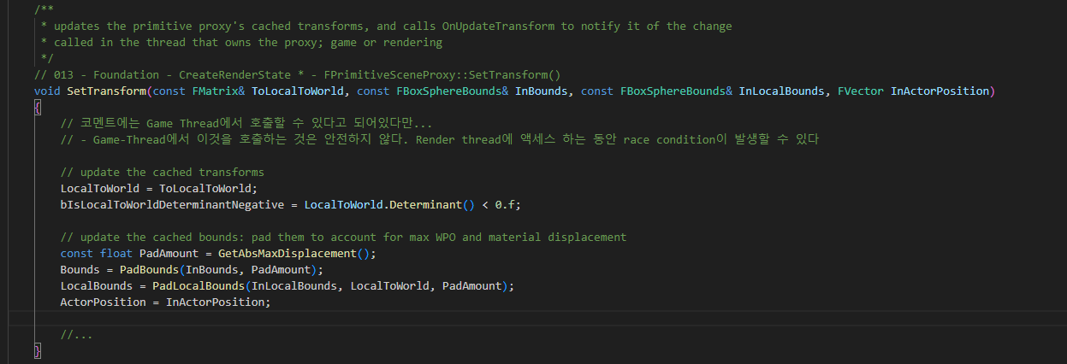
ScenePrimitive FPrimitiveSceneProxy 008

Slide 27
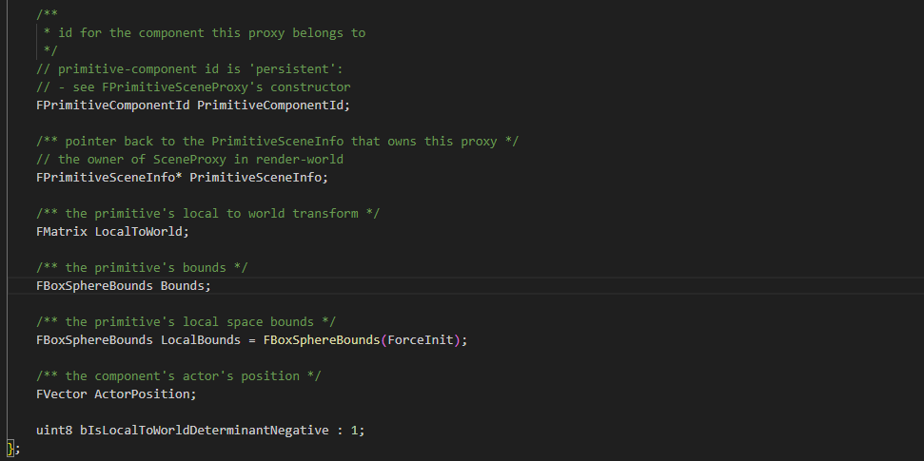
ScenePrimitive FPrimitiveSceneProxy 008

Slide 28
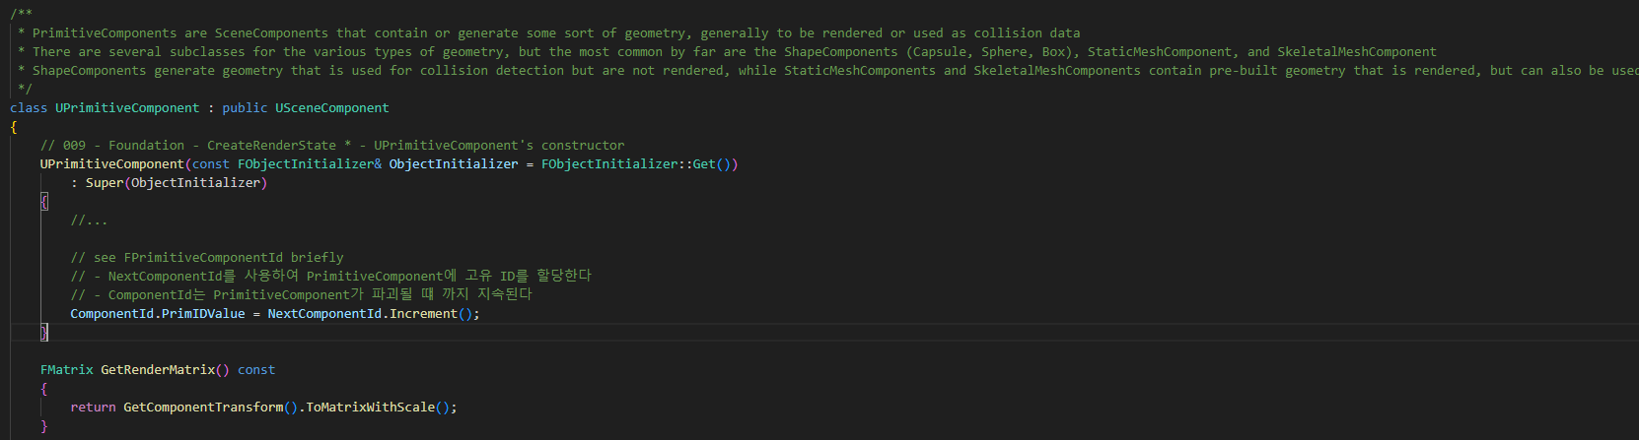
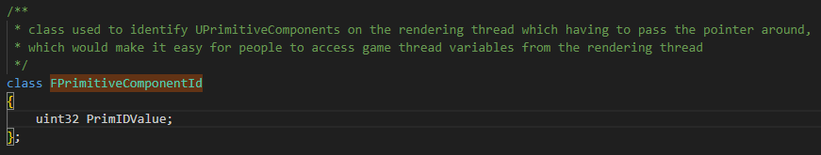
PrimitiveComponent 009

Slide 29
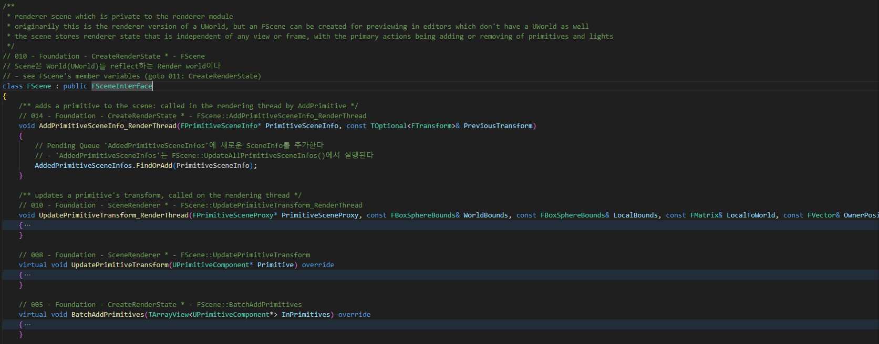
ScenePrivate Fscene 010

Slide 30
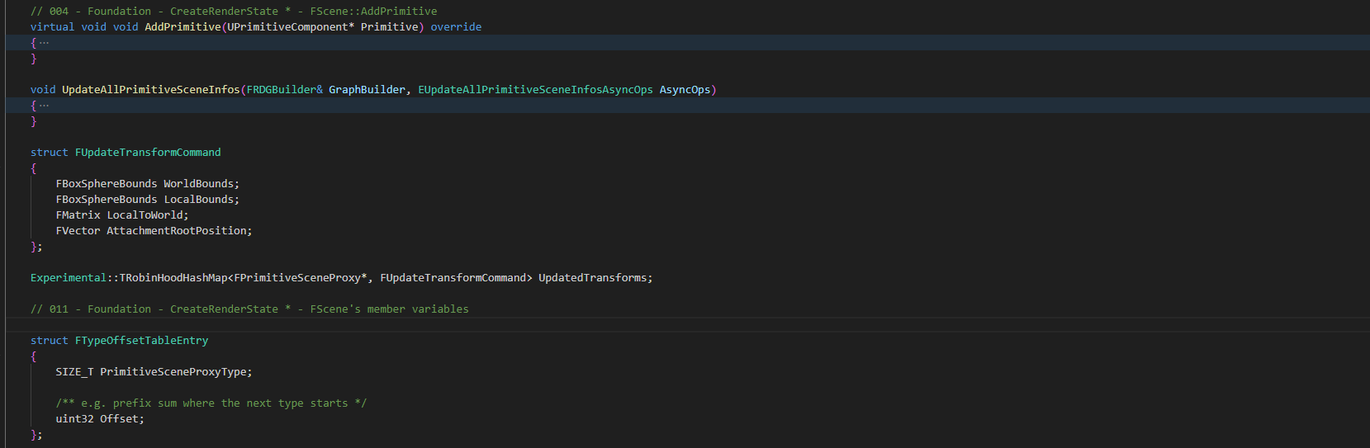
ScenePrivate Fscene 011

Slide 31
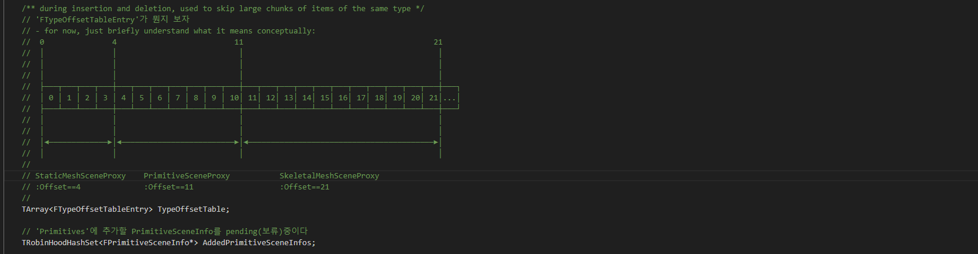
ScenePrivate Fscene 011

Slide 32
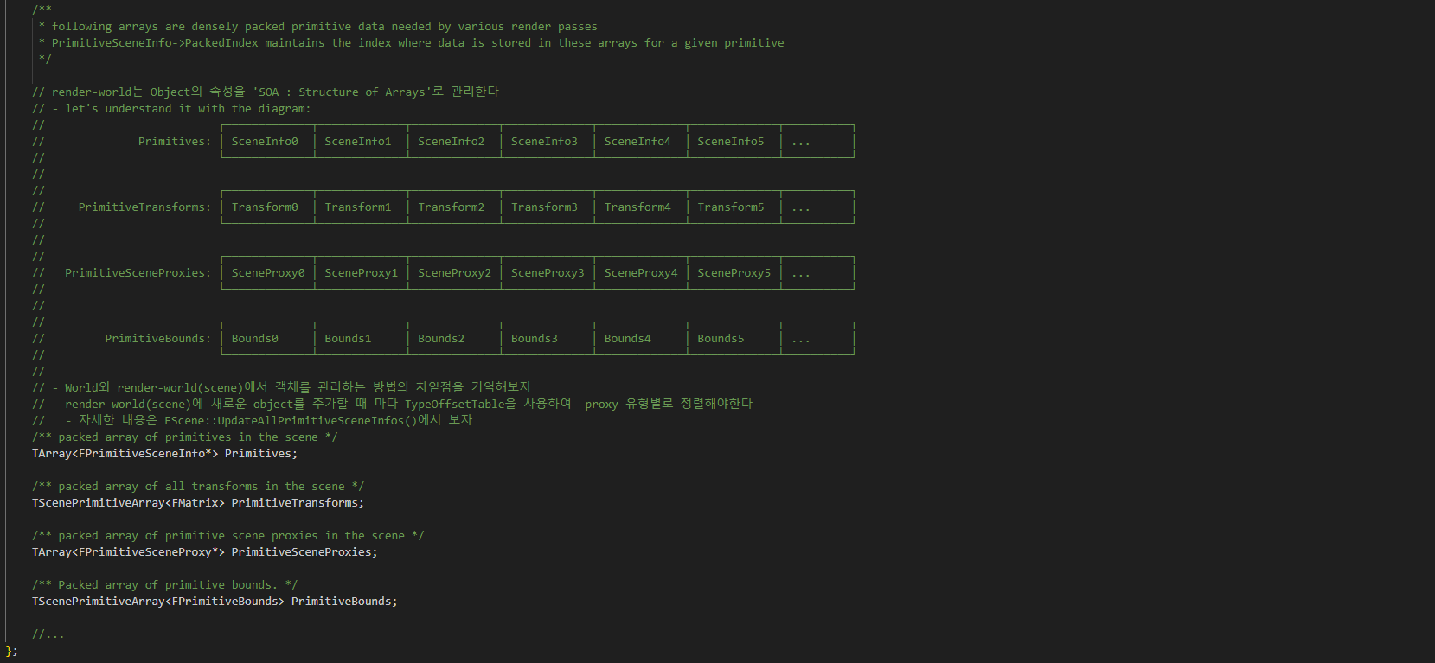
ScenePrivate Fscene 011

Slide 33
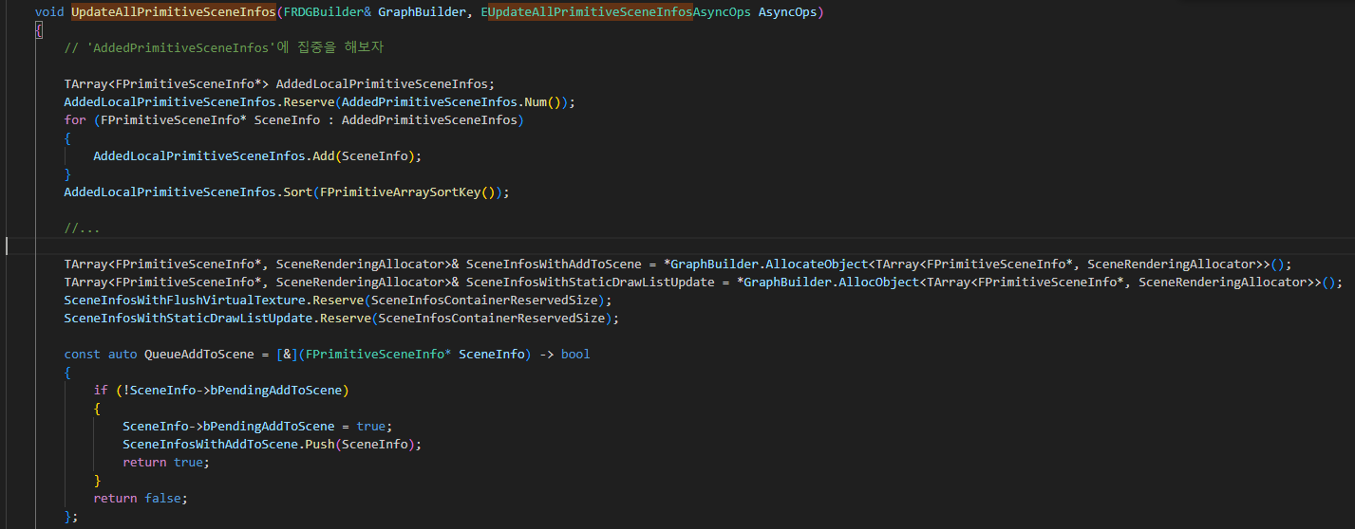
ScenePrivate Fscene::UpdateAllPrimitiveSceneInfos

Slide 34
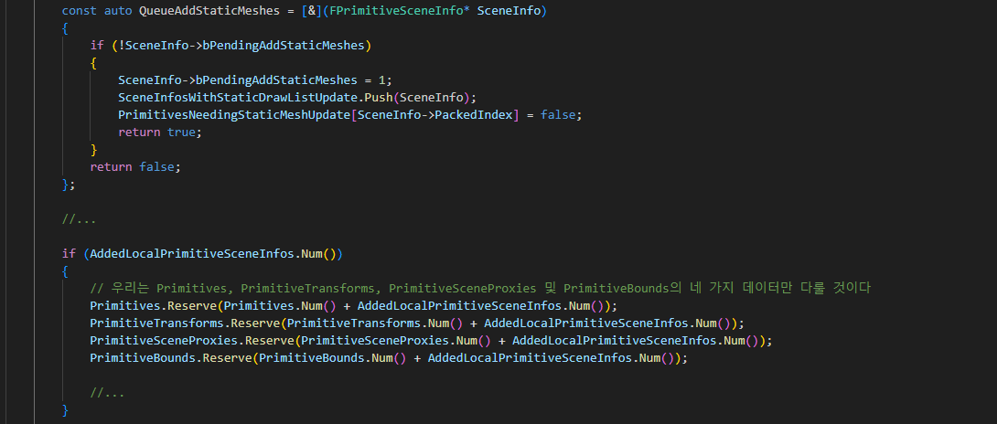
ScenePrivate Fscene::UpdateAllPrimitiveSceneInfos

Slide 35
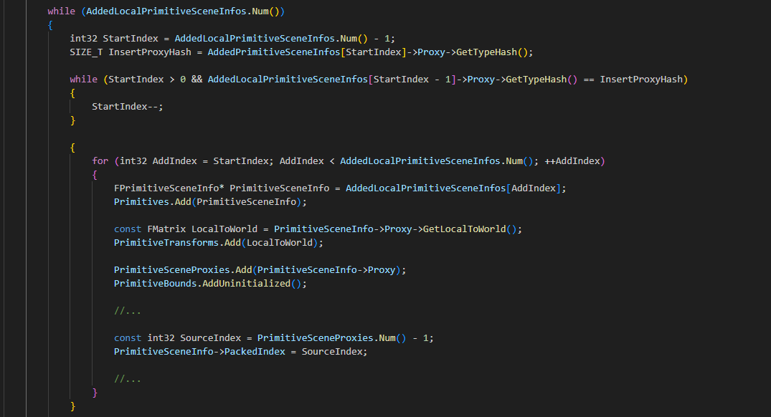
ScenePrivate Fscene::UpdateAllPrimitiveSceneInfos

Slide 36
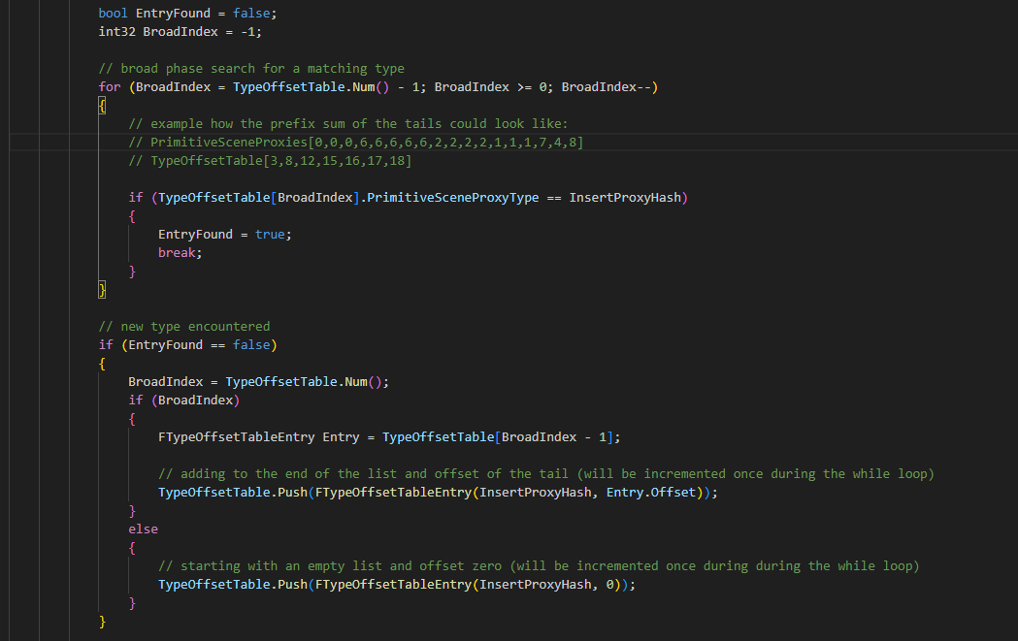
ScenePrivate Fscene::UpdateAllPrimitiveSceneInfos

Slide 37
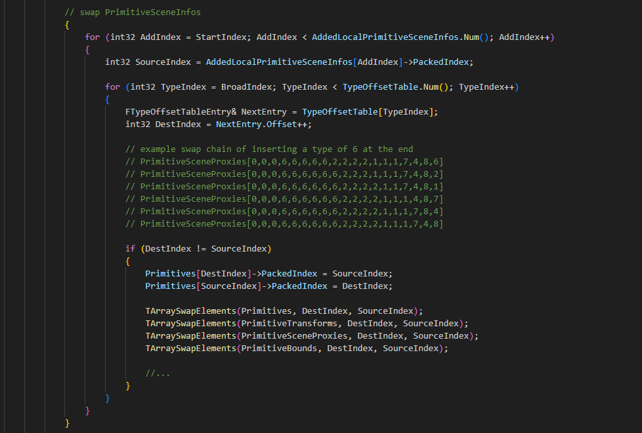
ScenePrivate Fscene::UpdateAllPrimitiveSceneInfos

Slide 38
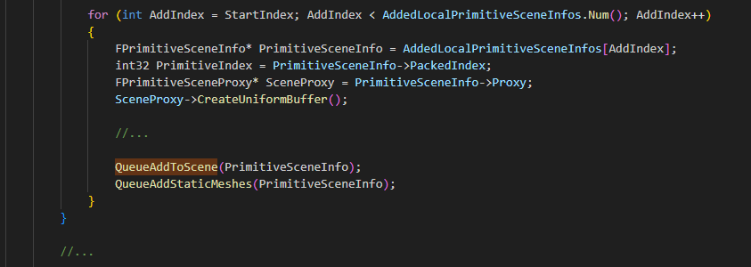
ScenePrivate Fscene::UpdateAllPrimitiveSceneInfos

Slide 39
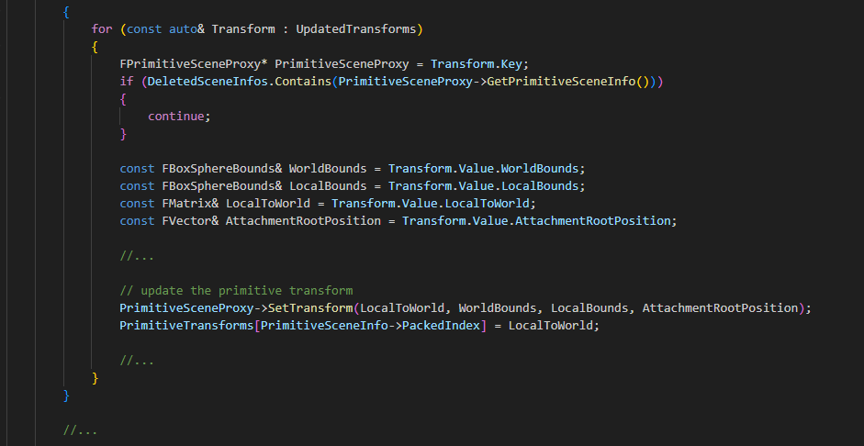
ScenePrivate Fscene::UpdateAllPrimitiveSceneInfos

Slide 40
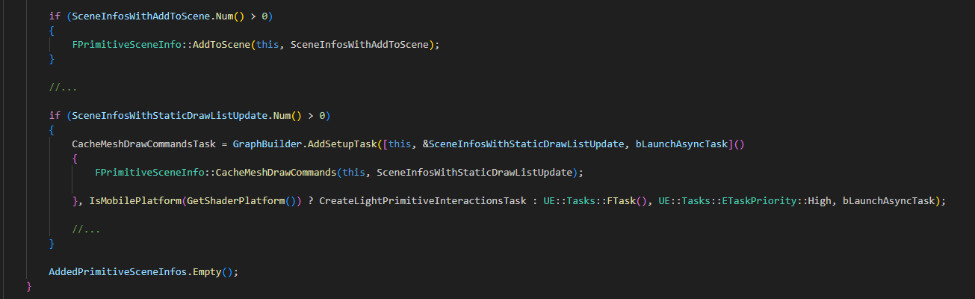
ScenePrivate Fscene::UpdateAllPrimitiveSceneInfos

Slide 41
ScenePrimitive BatchAddPrimitives 005

Slide 42
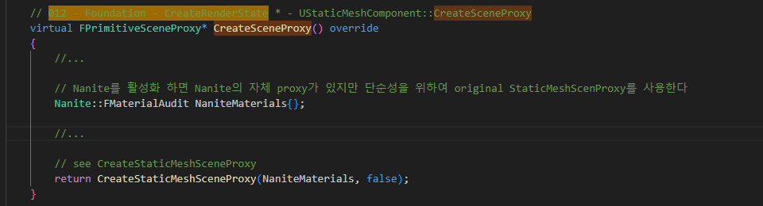
StaticMeshComponent CreateSceneProxy 012

Slide 43
ScenePrimitive BatchAddPrimitives 005

Slide 44
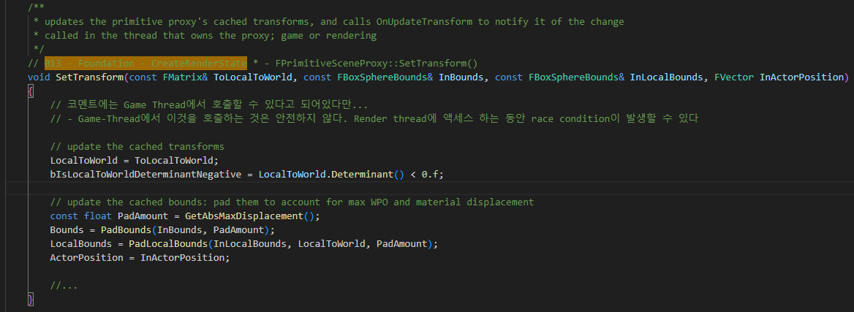
ScenePrimitive SetTransform 013

Slide 45
ScenePrivate AddPrimitiveSceneInfo_RenderThread 014

Slide 46
ActorComponent ExecuteRegisterEvents 015

