Slide 1

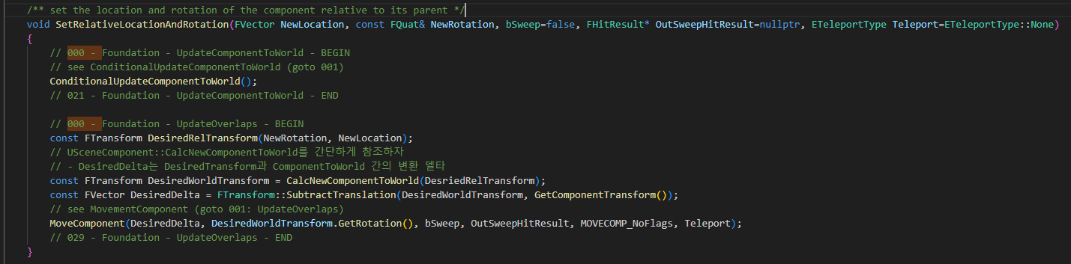
UpdateOverlap 000

Slide 2
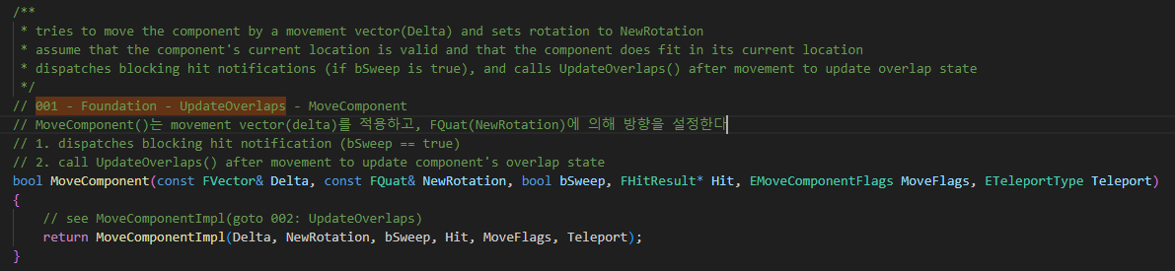
SceneCompoment MoveComponent 001

Slide 3
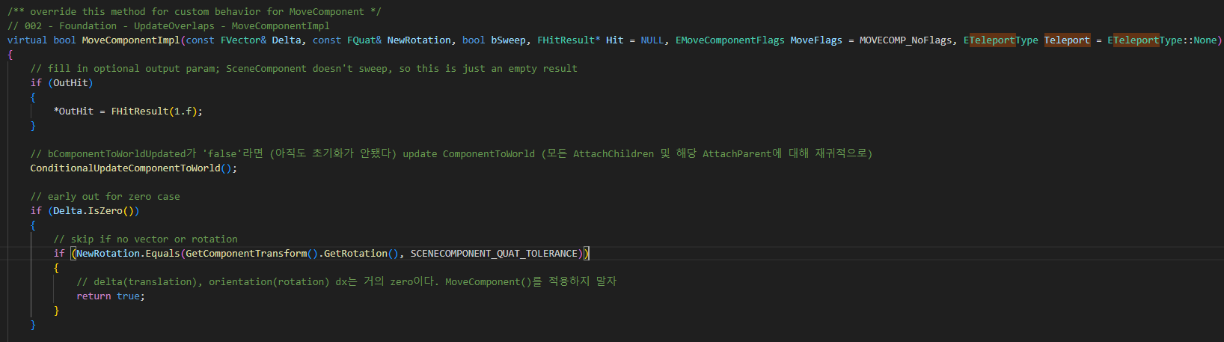
SceneCompoment MoveComponentImpl 002

Slide 4
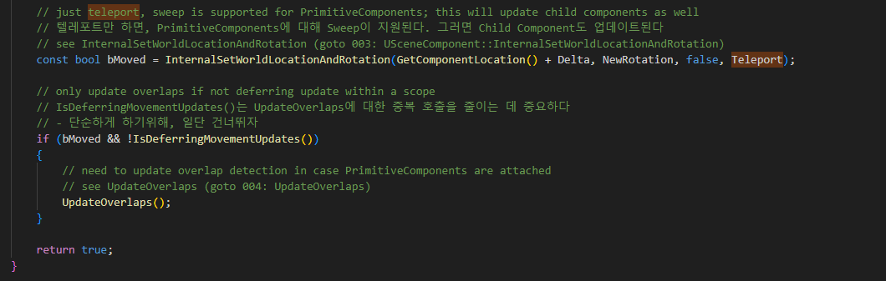
SceneCompoment MoveComponentImpl 002

Slide 5
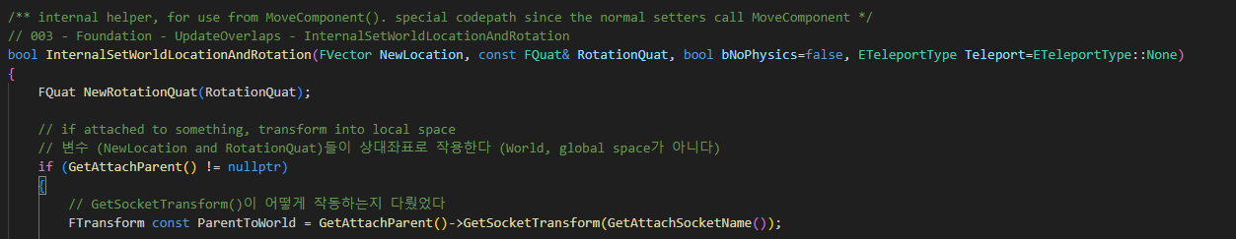
SceneCompoment InternalSetWorldLocationAndRotation 003

Slide 6
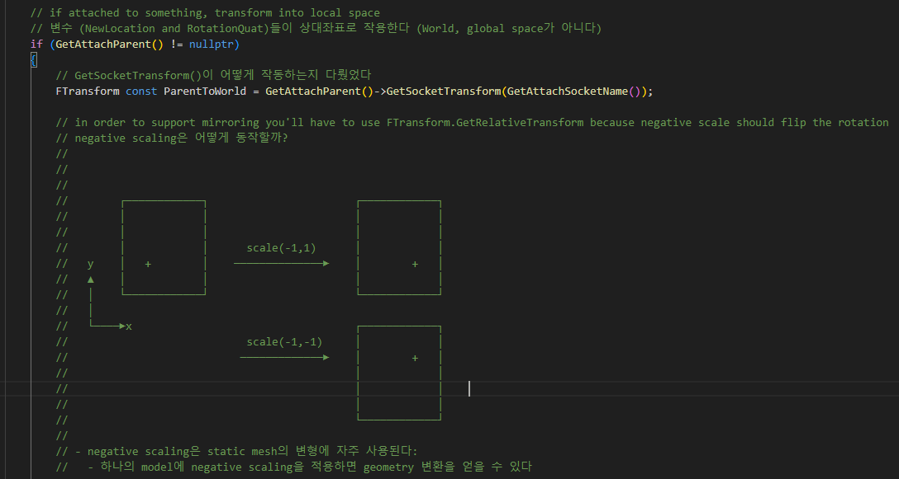
SceneCompoment InternalSetWorldLocationAndRotation 003

Slide 7
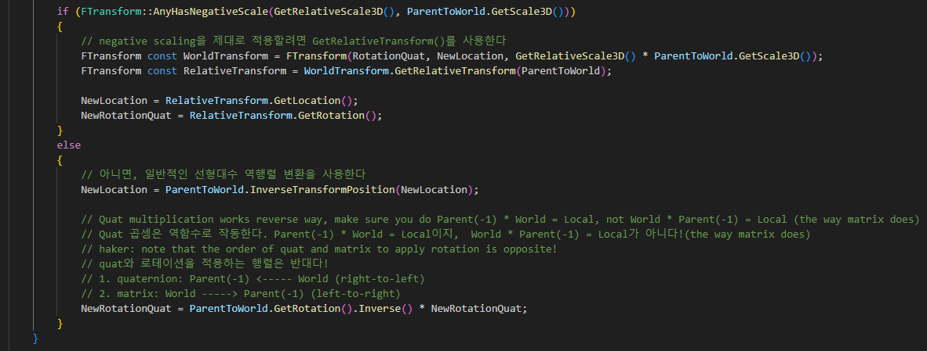
SceneCompoment InternalSetWorldLocationAndRotation 003

Slide 8
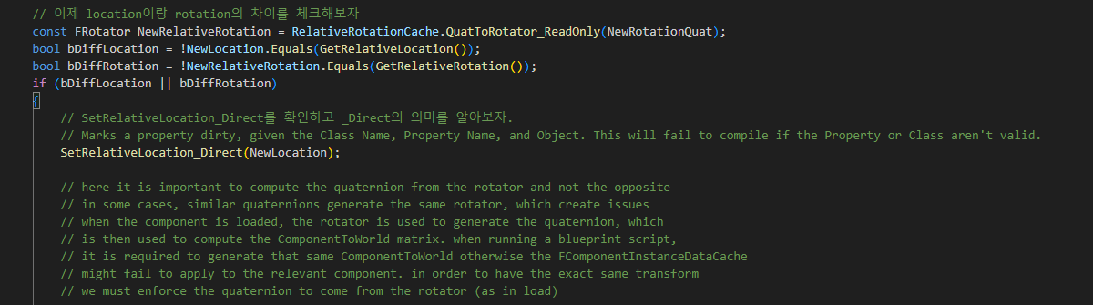
SceneCompoment InternalSetWorldLocationAndRotation 003

Slide 9
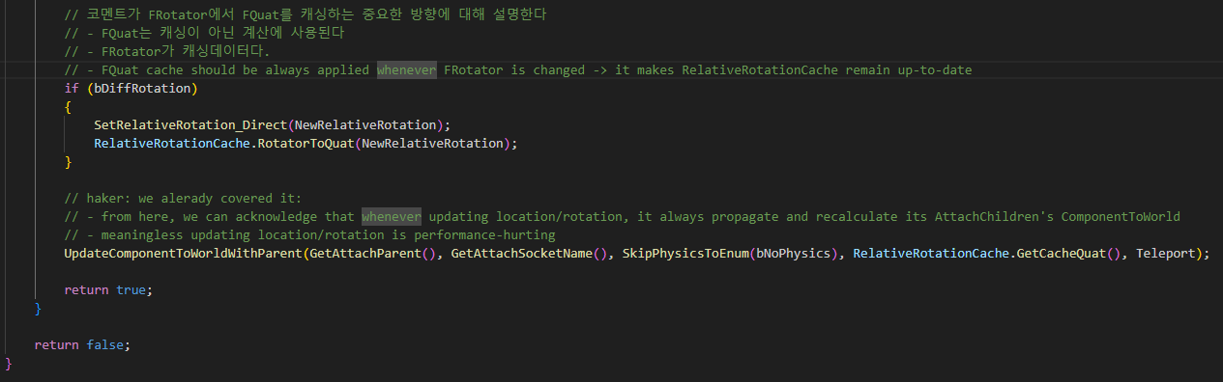
SceneCompoment InternalSetWorldLocationAndRotation 003

Slide 10
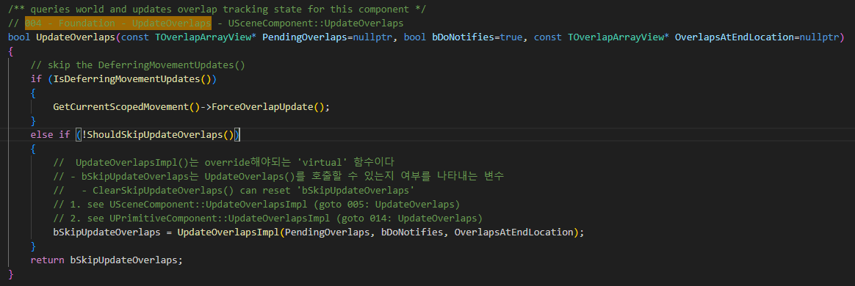
SceneCompoment UpdateOverlaps 004

Slide 11
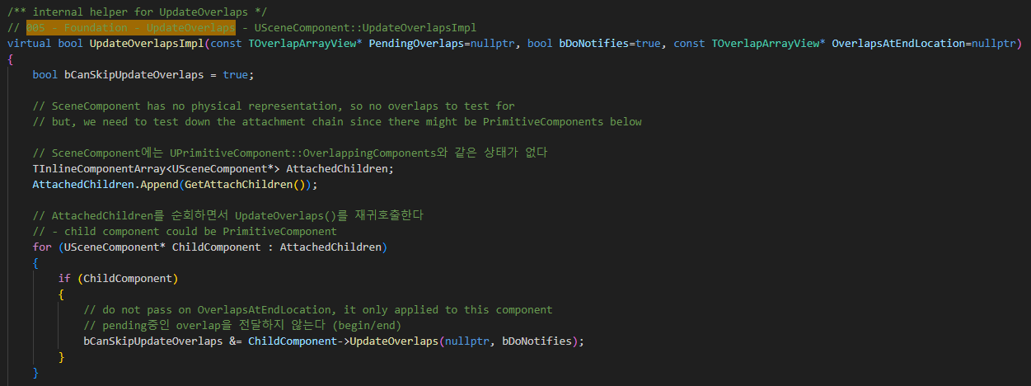
SceneCompoment UpdateOverlapsImpl 005

Slide 12
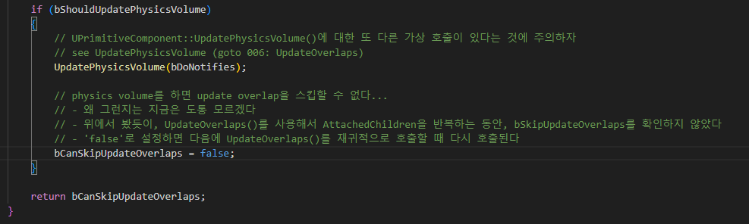
SceneCompoment UpdateOverlapsImpl 005

Slide 13
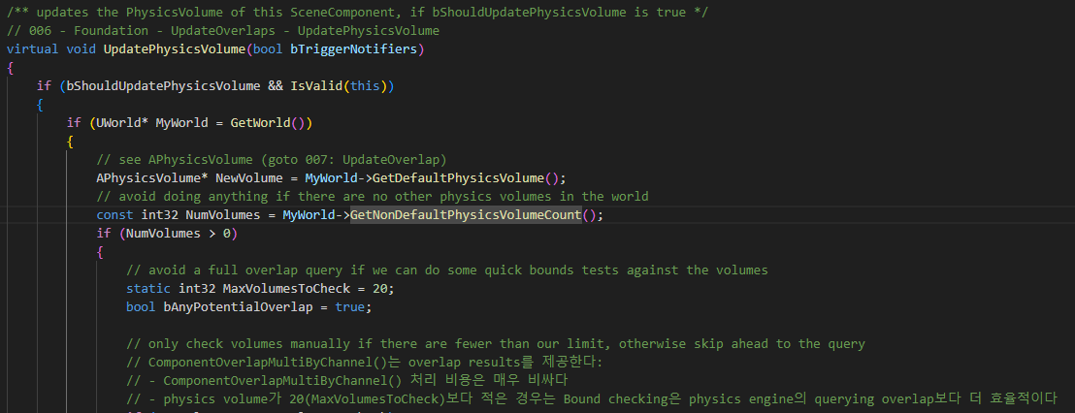
SceneCompoment UpdatePhysicsVolumn 006

Slide 14
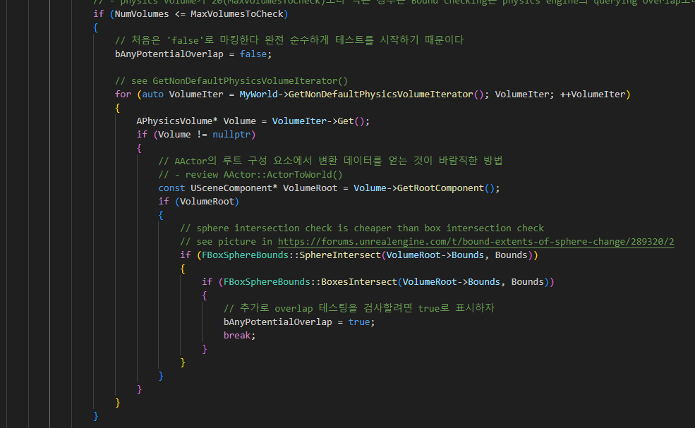
SceneCompoment UpdatePhysicsVolumn 006

Slide 15
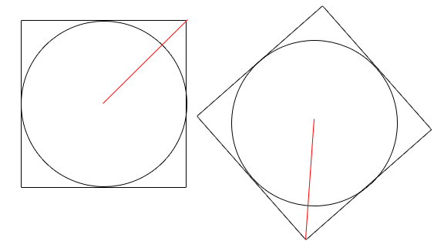
SceneCompoment UpdatePhysicsVolumn 006

Slide 16
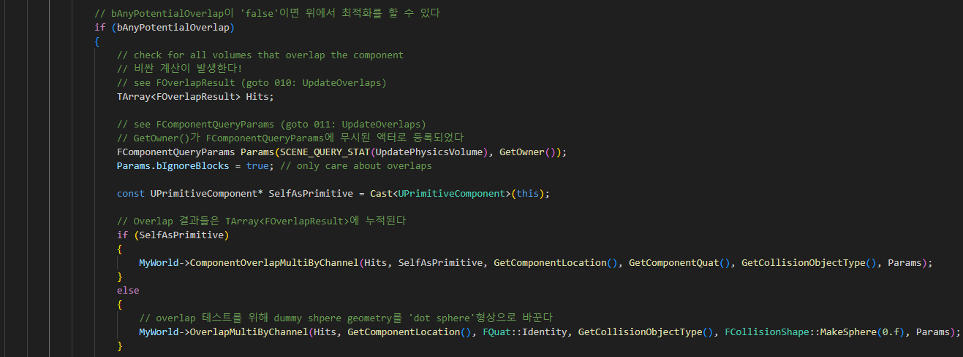
SceneCompoment UpdatePhysicsVolumn 006

Slide 17
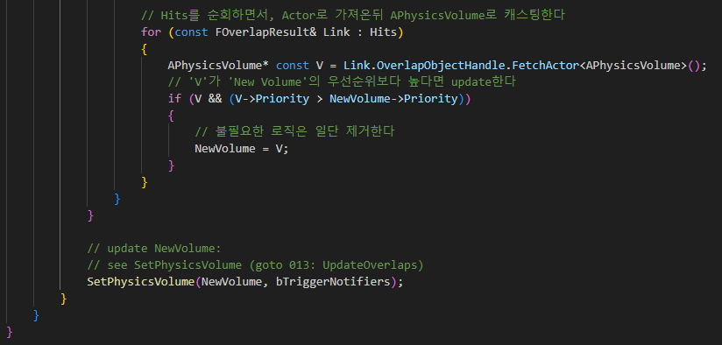
SceneCompoment UpdatePhysicsVolumn 006

Slide 18
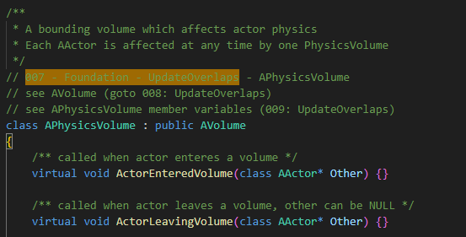
APhysicsVolumn 007

Slide 19
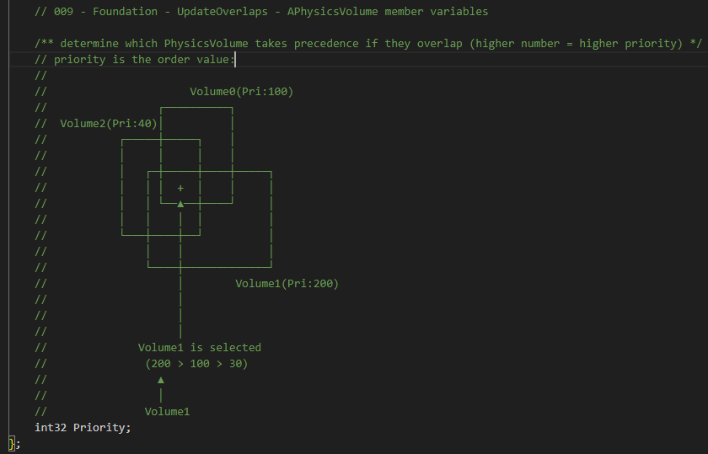
APhysicsVolumn 009

Slide 20
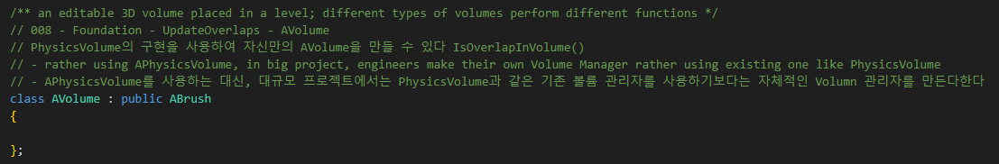
PhysicsVolumn AVolumn 008

Slide 21
SceneCompoment UpdatePhysicsVolumn 006

Slide 22
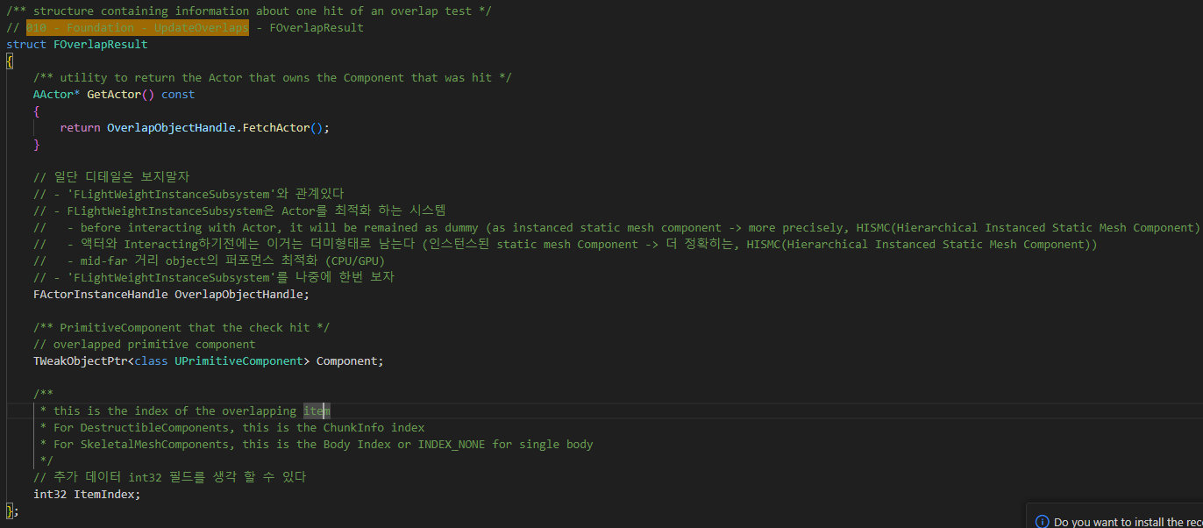
SceneComponent FOverlapResult 010

Slide 23
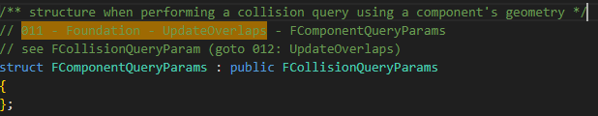
SceneComponent FComponentQueryParams 011

Slide 24
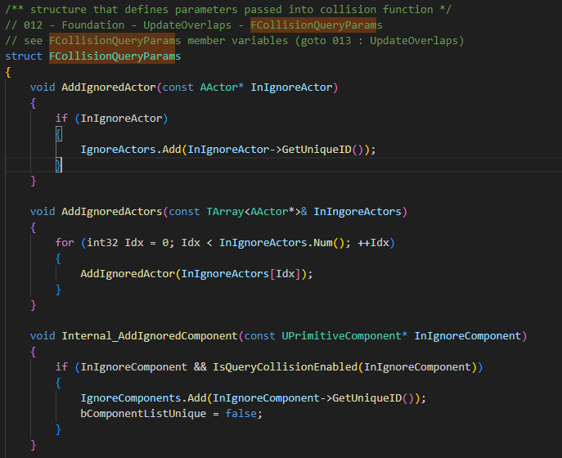
SceneComponent FComponentQueryParam 012

Slide 25
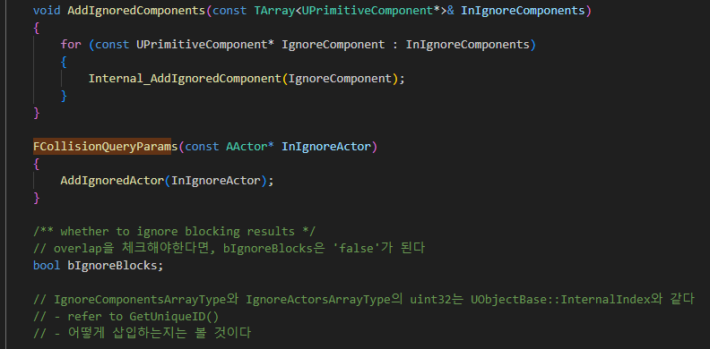
SceneComponent FComponentQueryParam 012

Slide 26
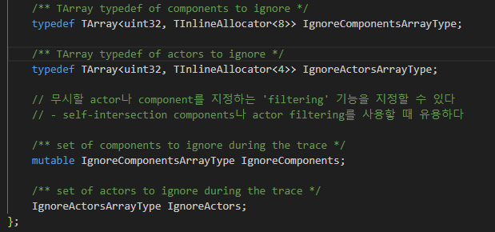
SceneComponent FComponentQueryParam 012

Slide 27
SceneComponent UpdatePhysicsVolumn 006

Slide 28
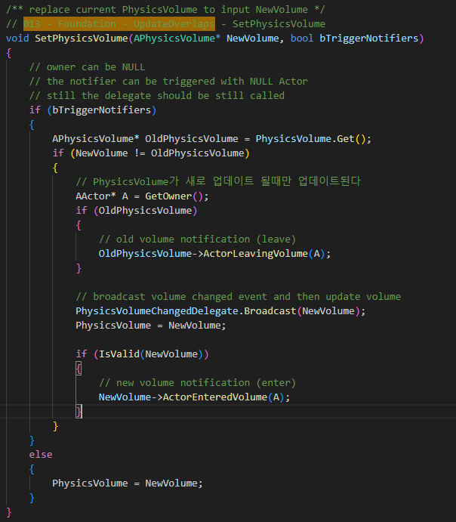
SceneComponent SetPhysicsVolumn 013

Slide 29
SceneCompoment UpdateOverlaps 004

Slide 30
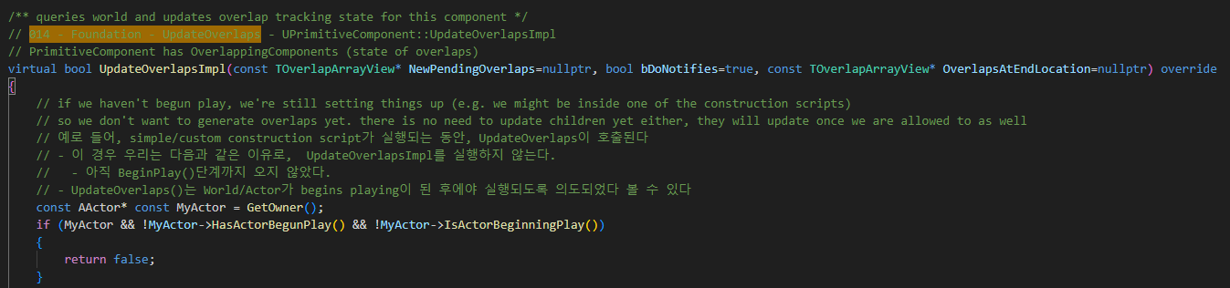
PrimitiveComponent UpdateOverlapsImpl 014

Slide 31
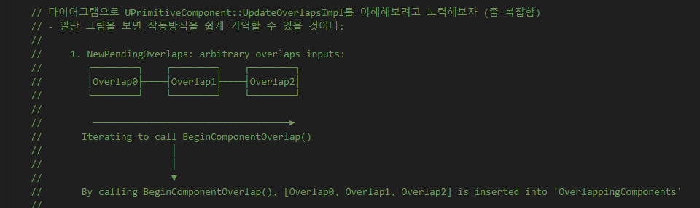
PrimitiveComponent UpdateOverlapsImpl 014

Slide 32
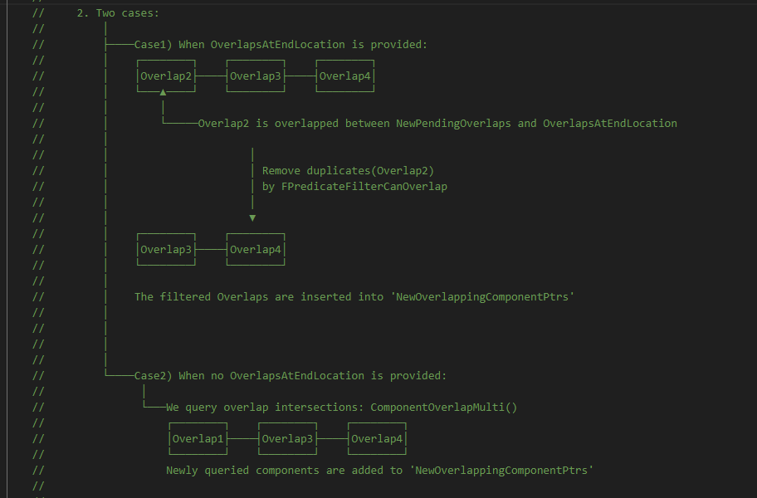
PrimitiveComponent UpdateOverlapsImpl 014

Slide 33
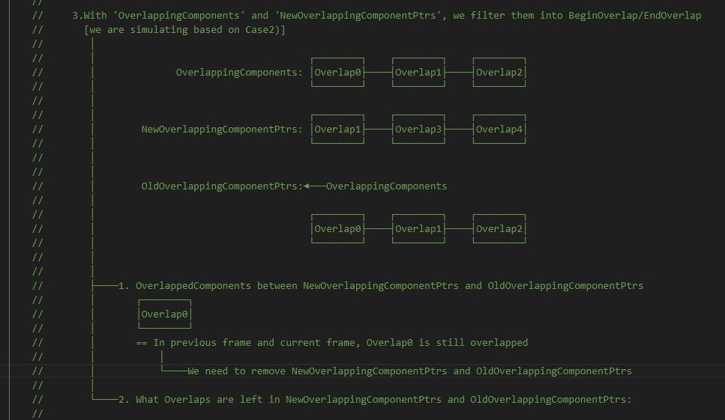
PrimitiveComponent UpdateOverlapsImpl 014

Slide 34
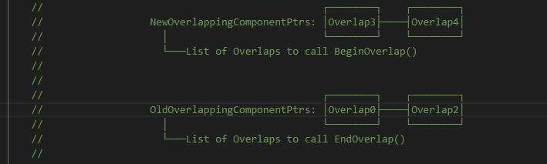
PrimitiveComponent UpdateOverlapsImpl 014

Slide 35
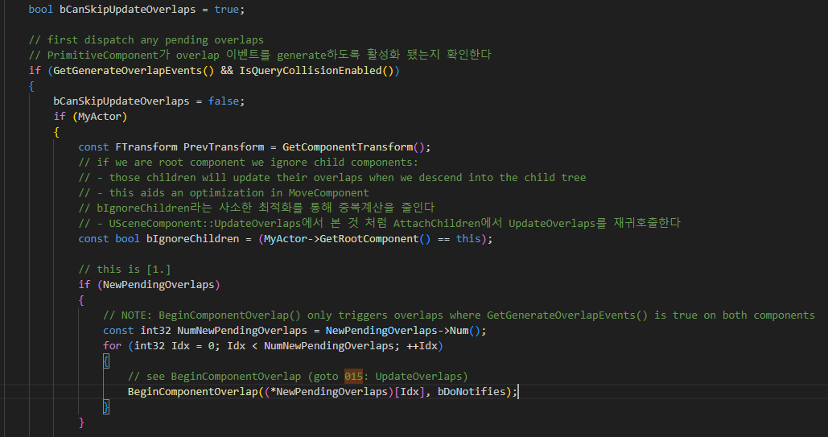
PrimitiveComponent UpdateOverlapsImpl 014

Slide 36
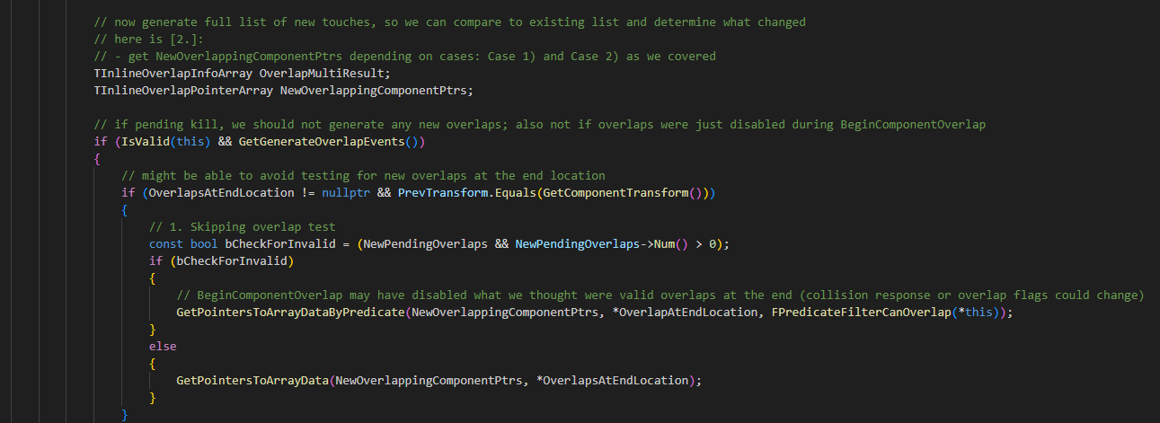
PrimitiveComponent UpdateOverlapsImpl 014

Slide 37
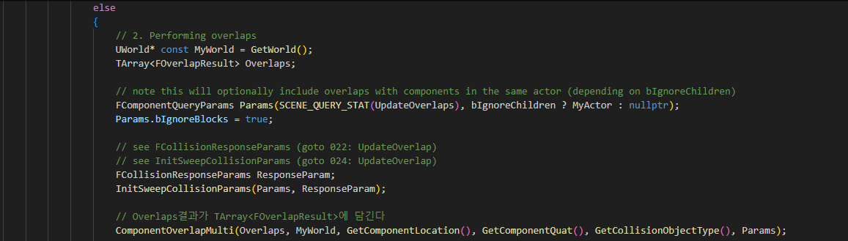
PrimitiveComponent UpdateOverlapsImpl 014

Slide 38
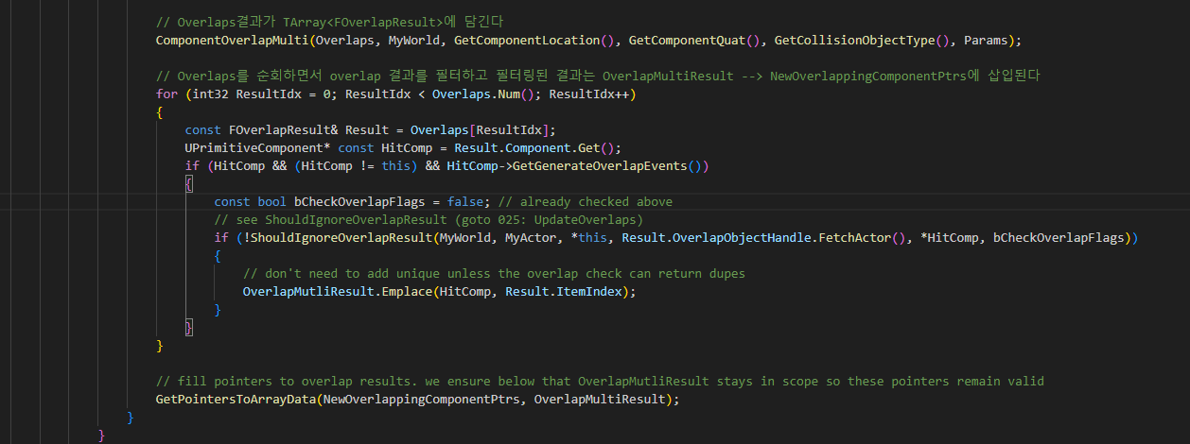
PrimitiveComponent UpdateOverlapsImpl 014

Slide 39
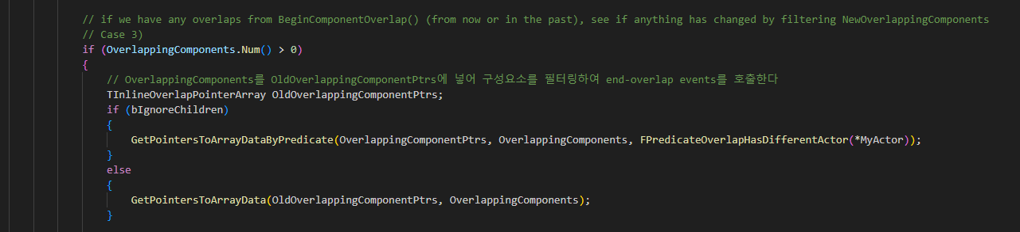
PrimitiveComponent UpdateOverlapsImpl 014

Slide 40
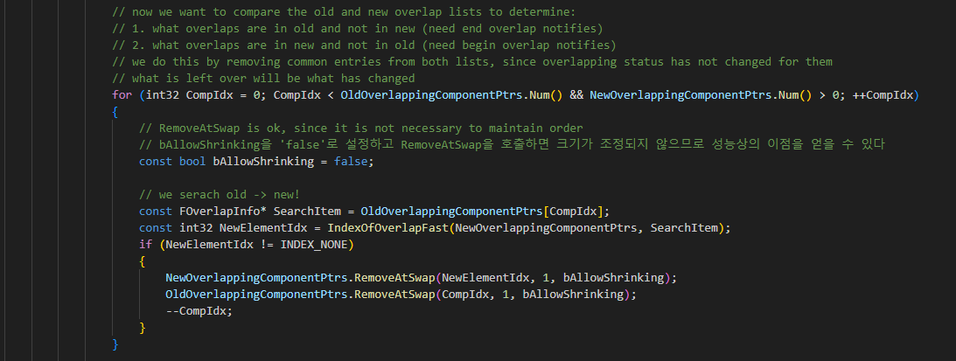
PrimitiveComponent UpdateOverlapsImpl 014

Slide 41
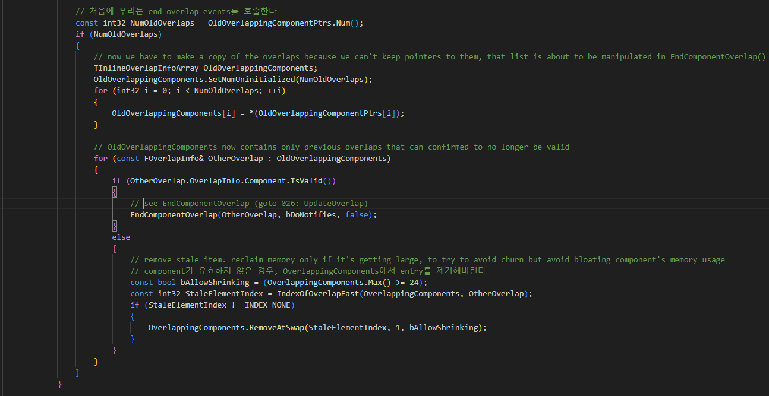
PrimitiveComponent UpdateOverlapsImpl 014

Slide 42
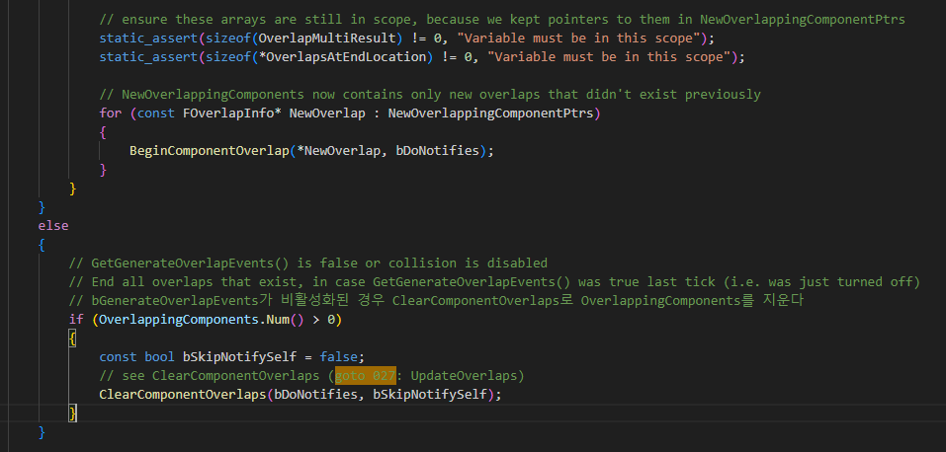
PrimitiveComponent UpdateOverlapsImpl 014

Slide 43
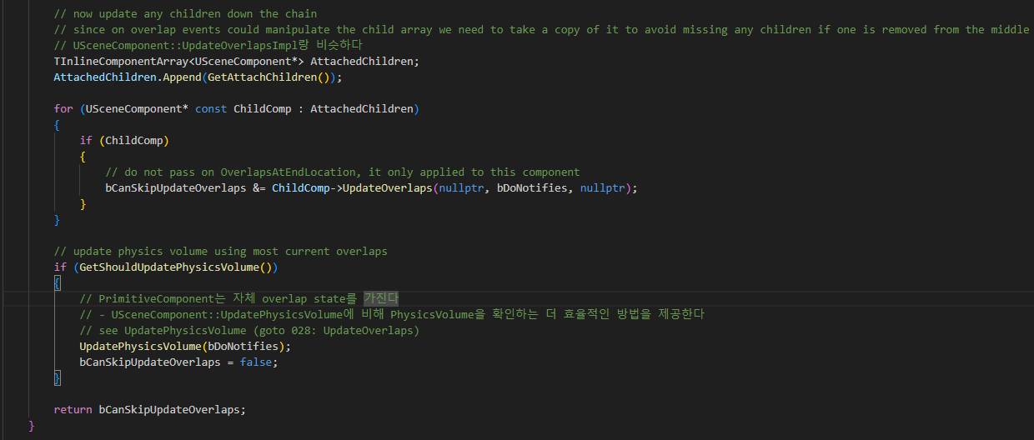
PrimitiveComponent UpdateOverlapsImpl 014

Slide 44
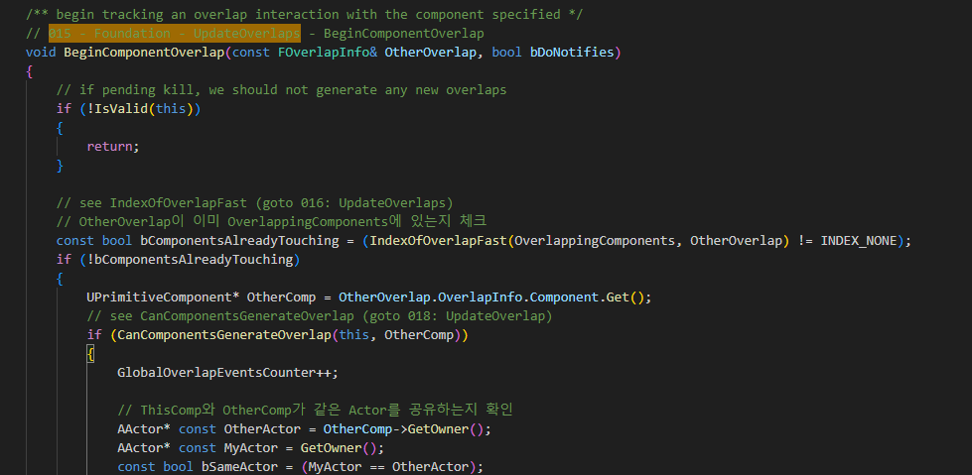
PrimitiveComponent BeginComponentOverlap 015

Slide 45
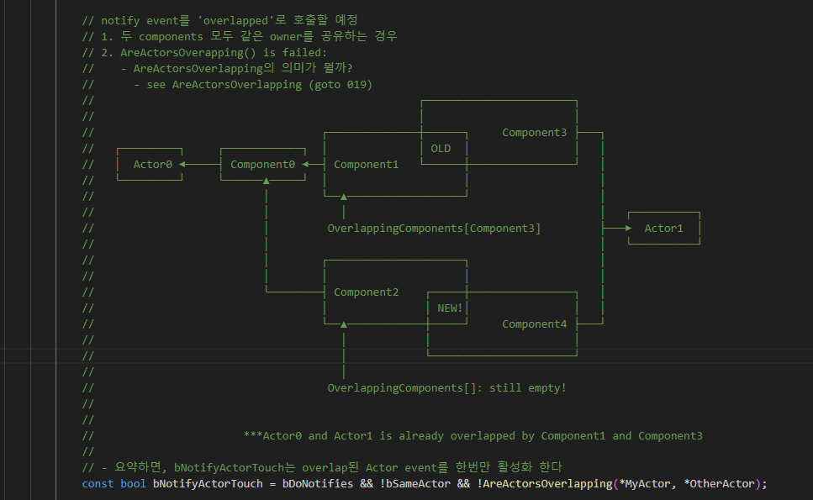
PrimitiveComponent BeginComponentOverlap 015

Slide 46
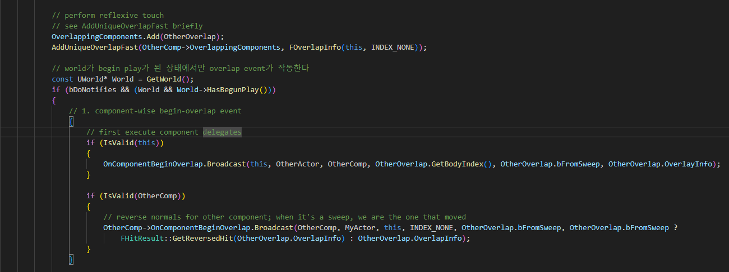
PrimitiveComponent BeginComponentOverlap 015

Slide 47
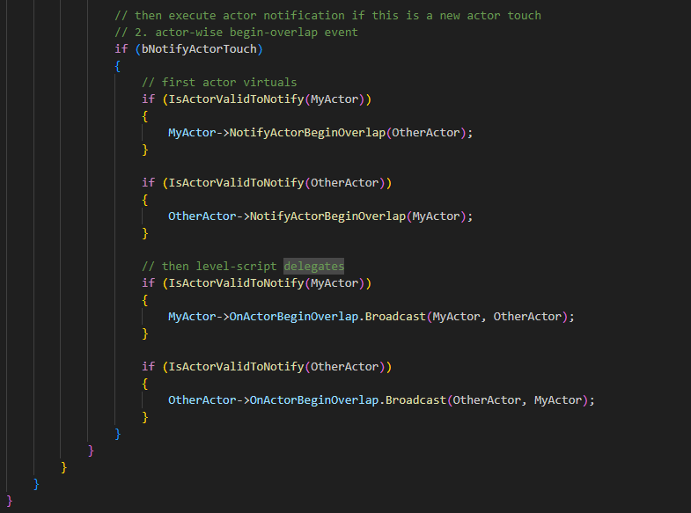
PrimitiveComponent BeginComponentOverlap 015

Slide 48
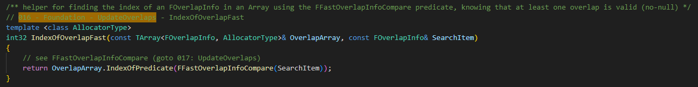
PrimitiveComponent IndexOfOverlapFast 016

Slide 49
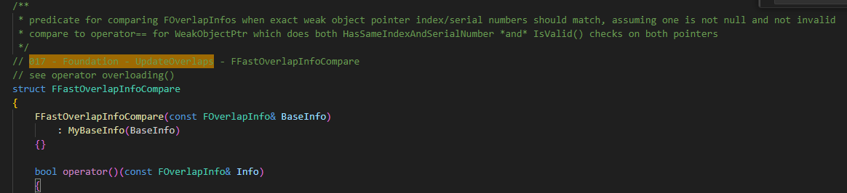
PrimitiveComponent FFastOverlapInfoComponent 017

Slide 50
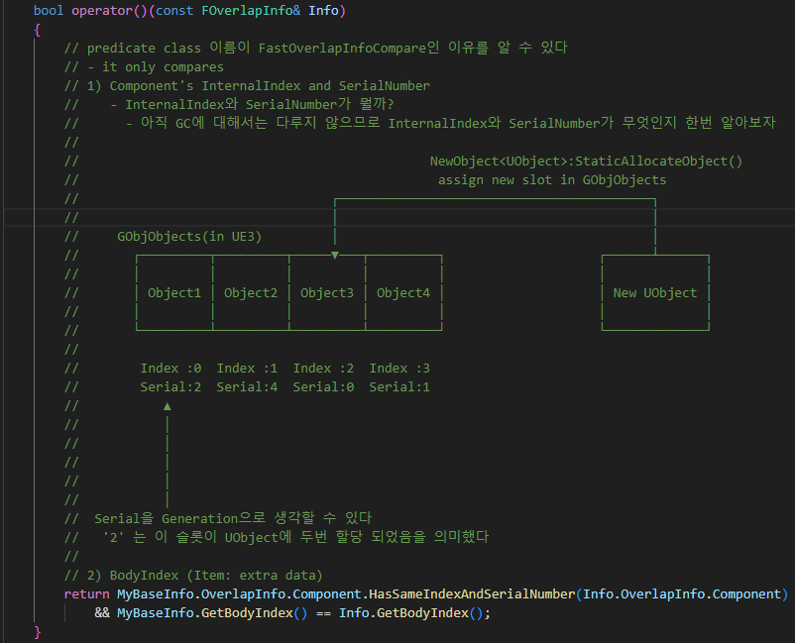
PrimitiveComponent FFastOverlapInfoComponent 017

Slide 51
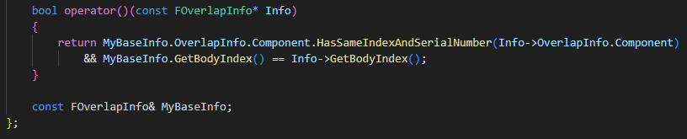
PrimitiveComponent FFastOverlapInfoComponent 017

Slide 52
PrimitiveComponent BeginComponentOverlap 015

Slide 53
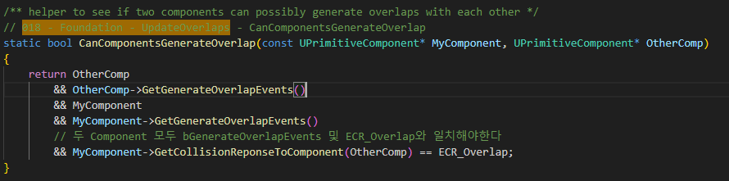
PrimitiveComponent CanComponentsGenerateOverlap 018

Slide 54
PrimitiveComponent BeginComponentOverlap 015

Slide 55
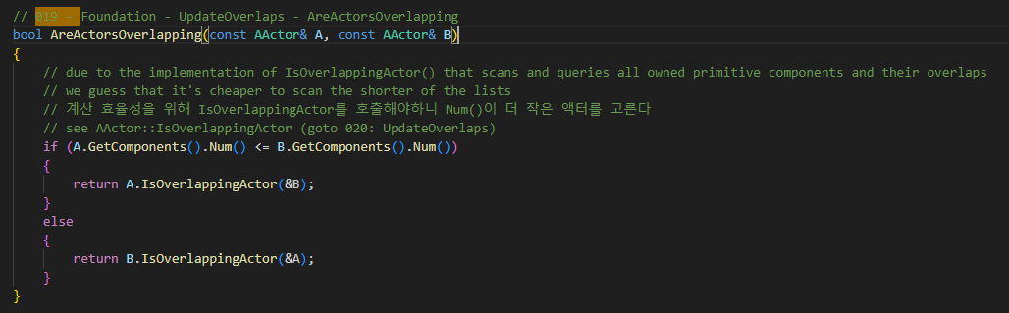
PrimitiveComponent AreActorsOverapping 019

Slide 56

Actor IsOverlappingActor 020

Slide 57

PrimitiveComponent IsOverlappingActor 021

Slide 58
PrimitiveComponent UpdateOverlapsImpl 014

Slide 59

SceneComponent FCollisionResponseParms 022

Slide 60

SceneComponent FCollisionResponseParms 023

Slide 61

SceneComponent FCollisionResponseParms 023

Slide 62

SceneComponent FCollisionResponseParms 023

Slide 63

SceneComponent FCollisionResponseParms 023

Slide 64
PrimitiveComponent UpdateOverlapsImpl 014

Slide 65

PrimitiveComponent InitSweepCollisionParams 024

Slide 66
PrimitiveComponent UpdateOverlapsImpl 014

Slide 67

PrimitiveComponent ShouIgnoreOverlapResult 025

Slide 68

PrimitiveComponent EndComponentOverlap 026

Slide 69

PrimitiveComponent EndComponentOverlap 026

Slide 70

PrimitiveComponent EndComponentOverlap 026

Slide 71
PrimitiveComponent UpdateOverlapsImpl 014

Slide 72

PrimitiveComponent ClearComponentOverlaps 027

Slide 73
PrimitiveComponent UpdateOverlapsImpl 014

Slide 74

PrimitiveComponent ClearComponentOverlaps 028

Slide 75
UpdateOverlap 029

