Slide 1
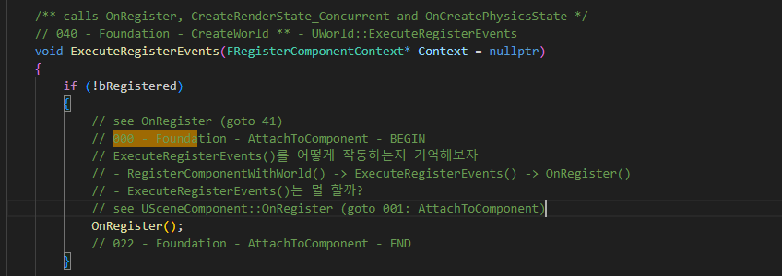
ActorComponent AttachToComponent 000

Slide 2
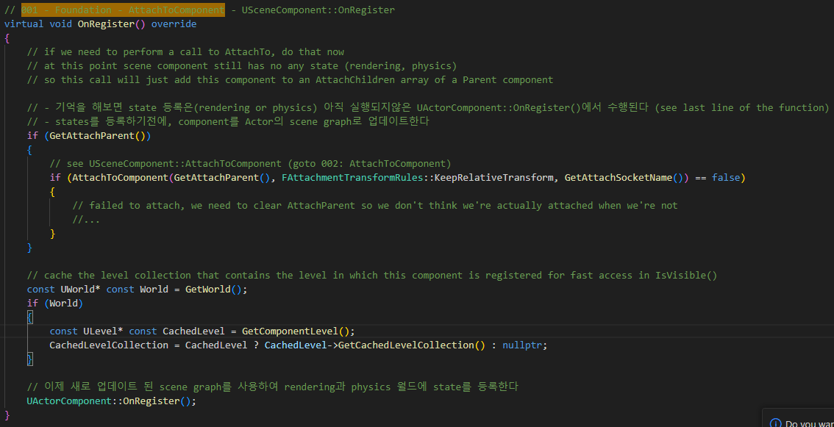
SceneComponent OnRegister 001

Slide 3
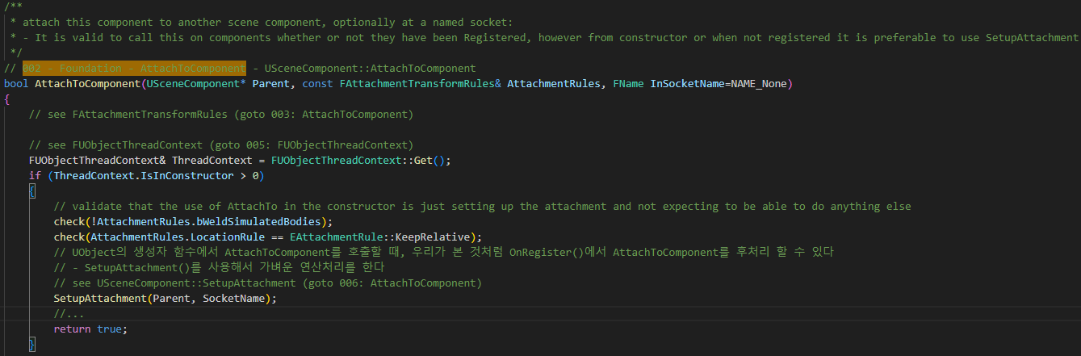
SceneComponent AttachToComponent 002

Slide 4
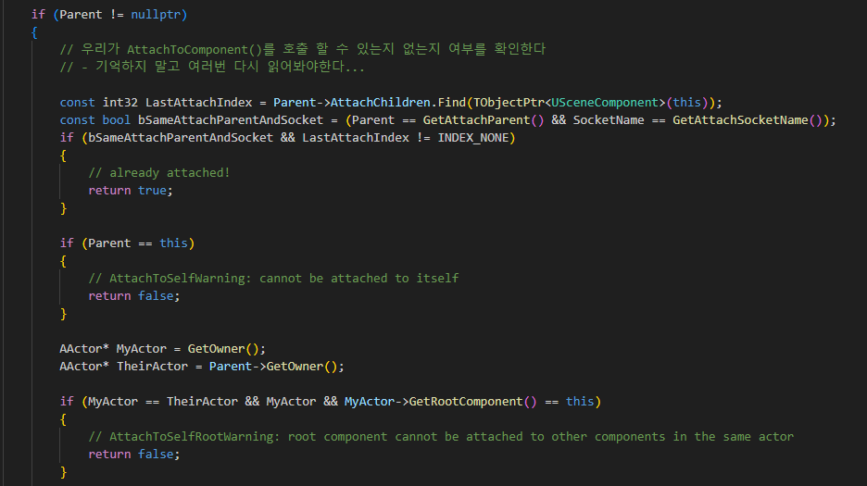
SceneComponent AttachToComponent 002

Slide 5
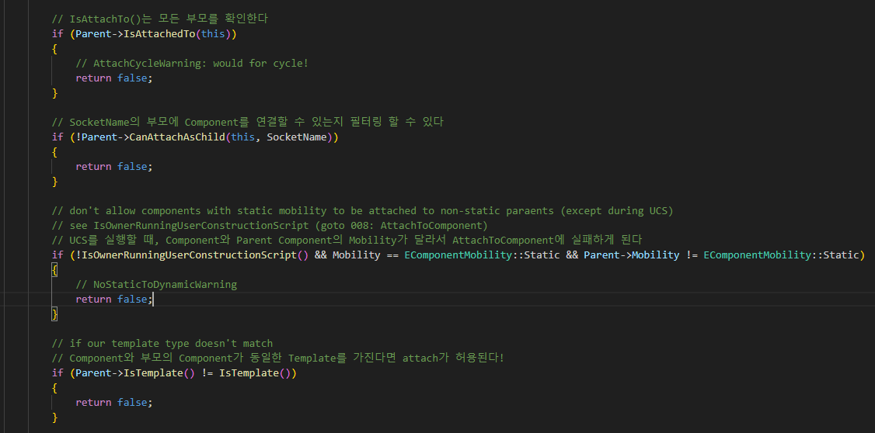
SceneComponent AttachToComponent 002

Slide 6
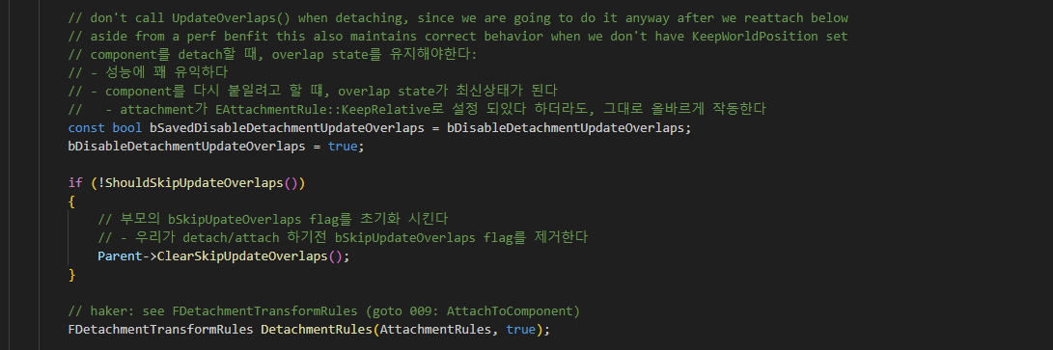
SceneComponent AttachToComponent 002

Slide 7
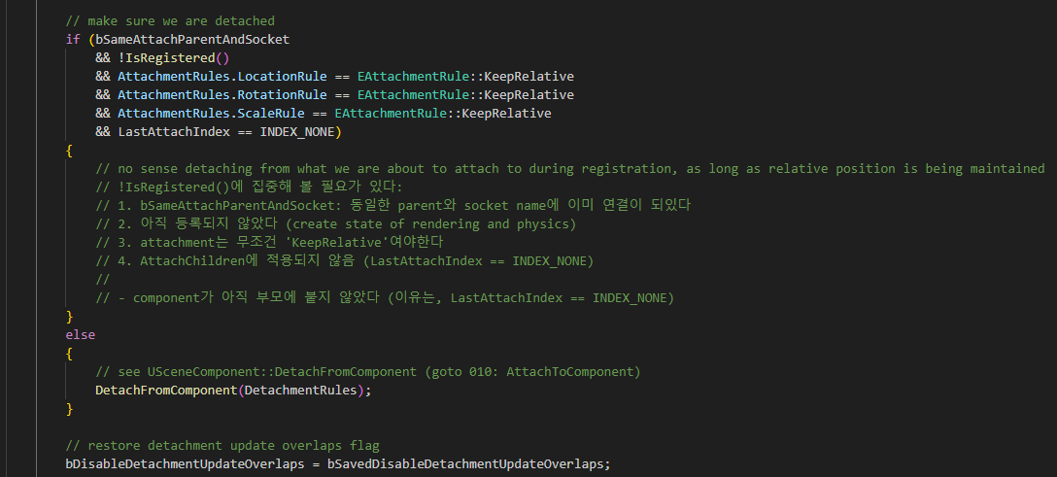
SceneComponent AttachToComponent 002

Slide 8
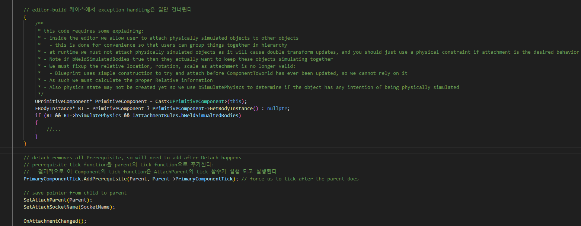
SceneComponent AttachToComponent 002

Slide 9
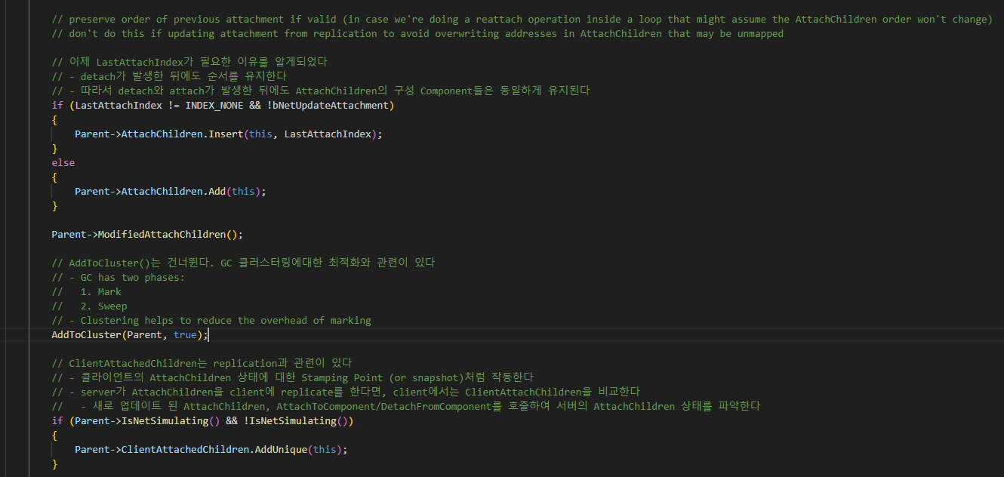
SceneComponent AttachToComponent 002

Slide 10
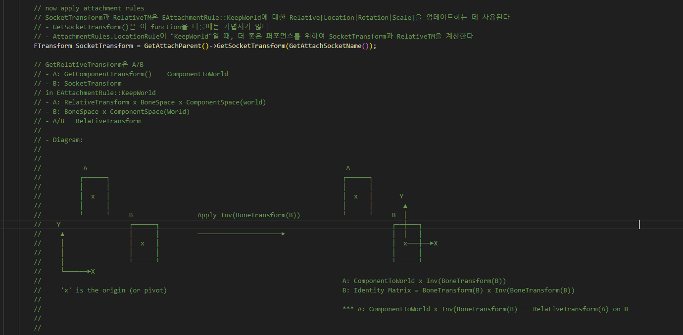
SceneComponent AttachToComponent 002

Slide 11
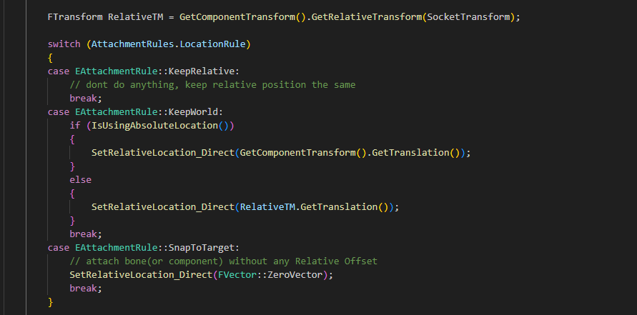
SceneComponent AttachToComponent 002

Slide 12
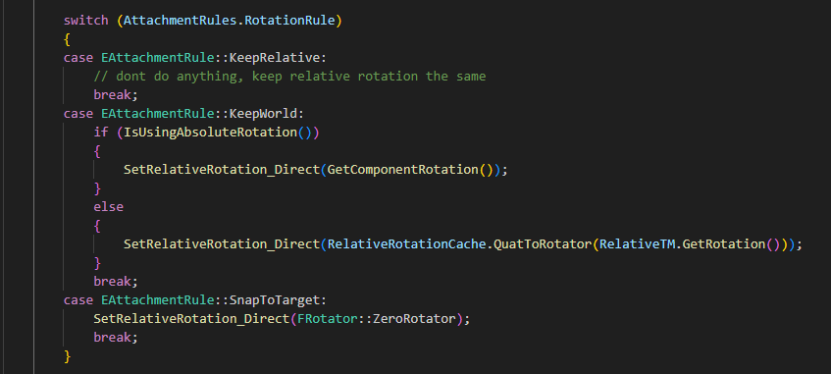
SceneComponent AttachToComponent 002

Slide 13
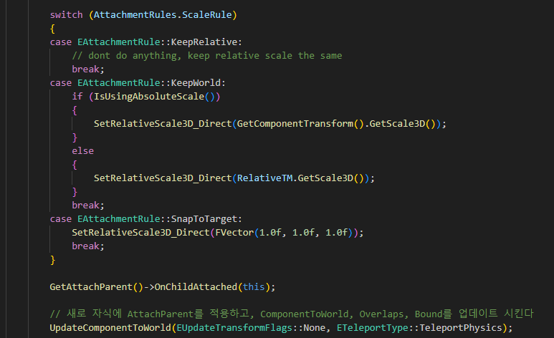
SceneComponent AttachToComponent 002

Slide 14
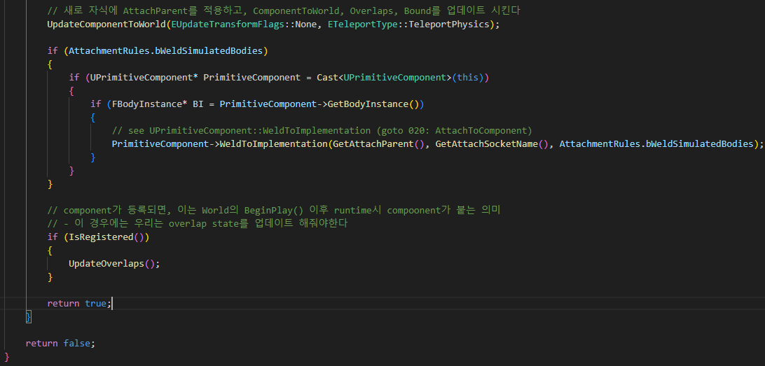
SceneComponent AttachToComponent 002

Slide 15
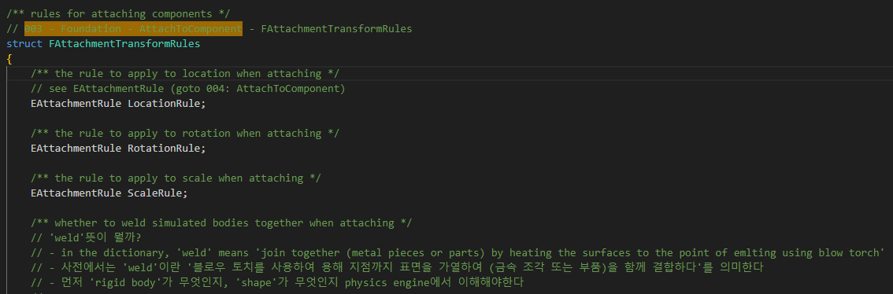
SceneComponent FAttachmentTransformRules 003

Slide 16
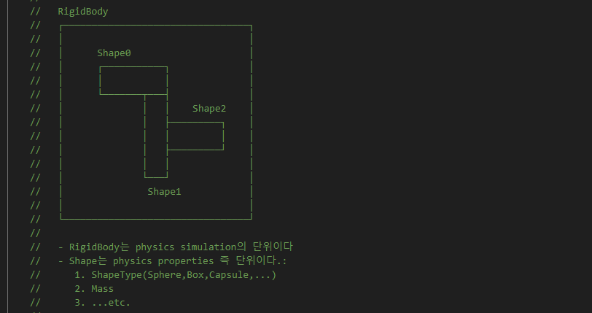
SceneComponent FAttachmentTransformRules 003

Slide 17
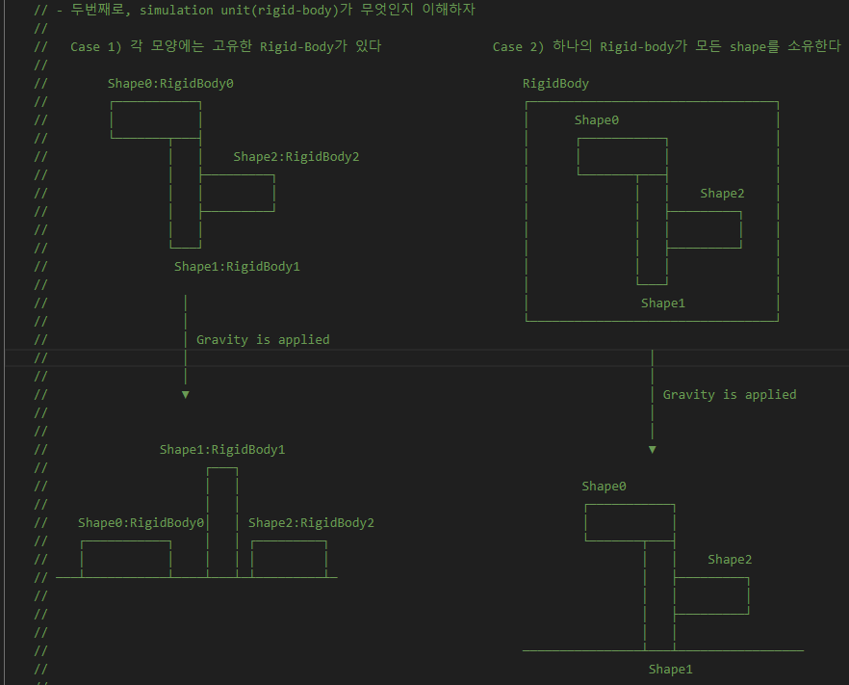
SceneComponent FAttachmentTransformRules 003

Slide 18
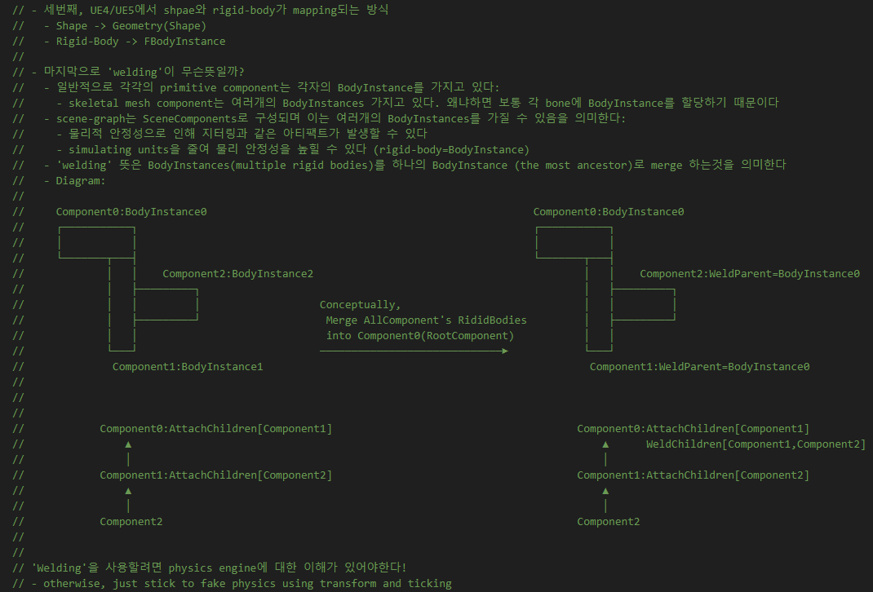
SceneComponent FAttachmentTransformRules 003

Slide 19

SceneComponent FAttachmentTransformRules 003

Slide 20
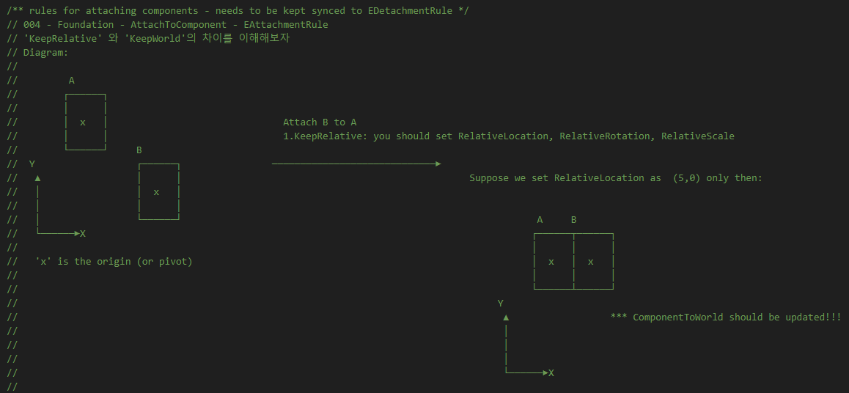
SceneComponent EAttachmentRule 004

Slide 21
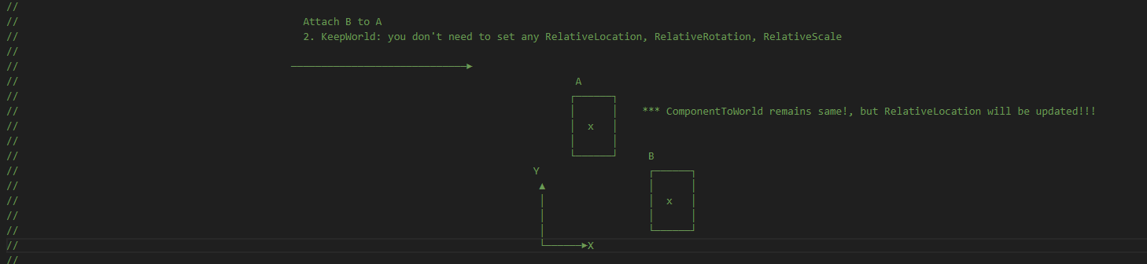
SceneComponent EAttachmentRule 004

Slide 22
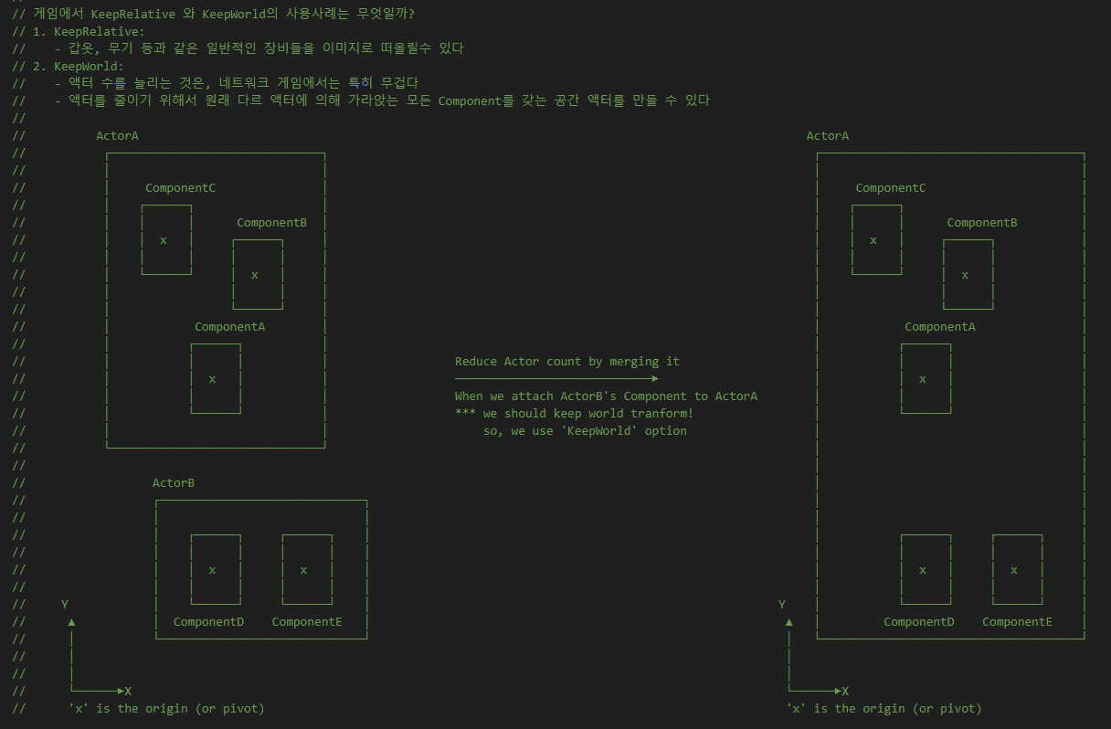
SceneComponent EAttachmentRule 004

Slide 23
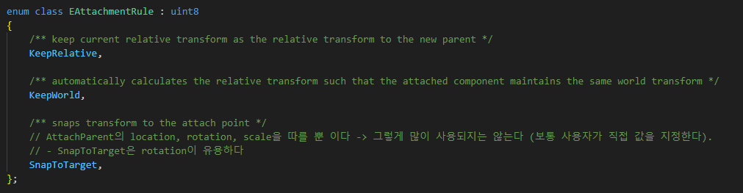
SceneComponent EAttachmentRule 004

Slide 24
SceneComponent AttachToComponent 002

Slide 25
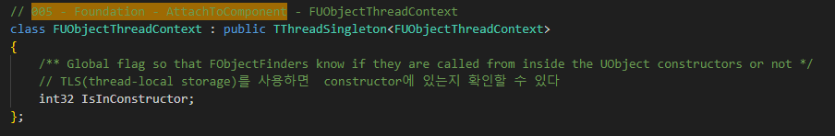
Object FUObjectThreadContext 005

Slide 26
SceneComponent AttachToComponent 002

Slide 27
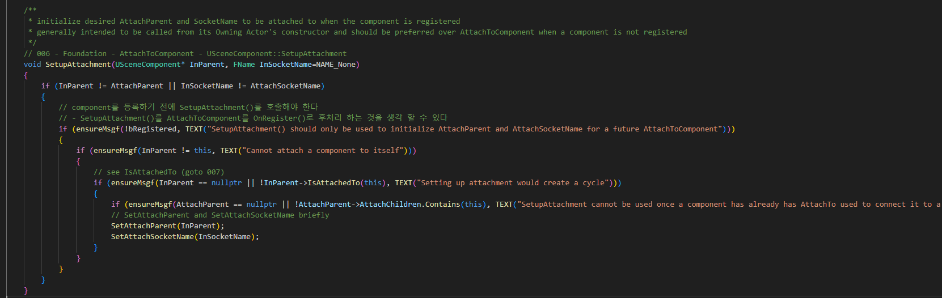
SceneComponent SetupAttachment 006

Slide 28
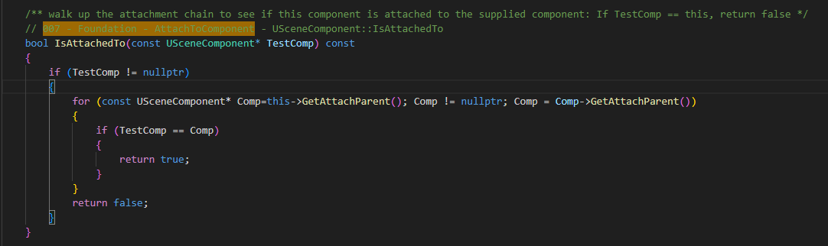
SceneComponent IsAttachedTo 007

Slide 29
SceneComponent AttachToComponent 002

Slide 30
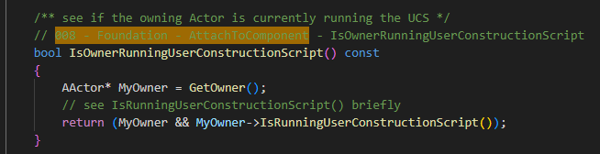
SceneComponent IsOwnerRunningUserConstructionScript 008

Slide 31
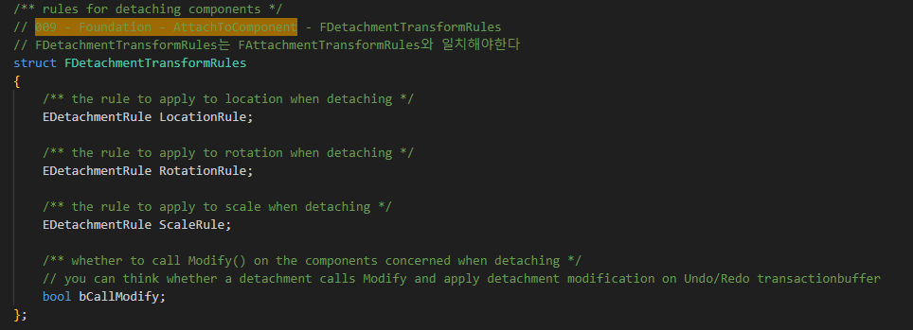
SceneComponent FDetachmentTransformRules 009

Slide 32
SceneComponent AttachToComponent 002

Slide 33
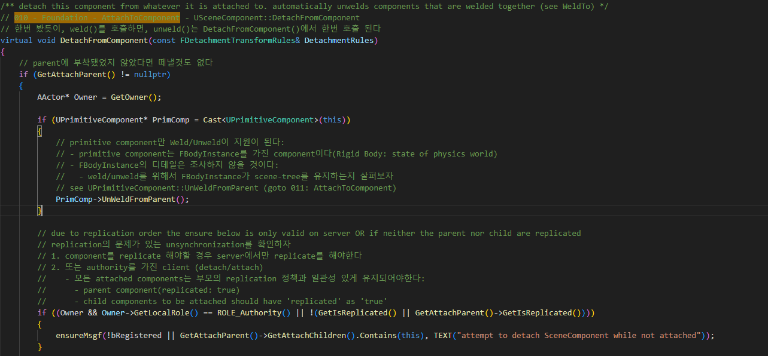
SceneComponent DetachFromComponent 010

Slide 34
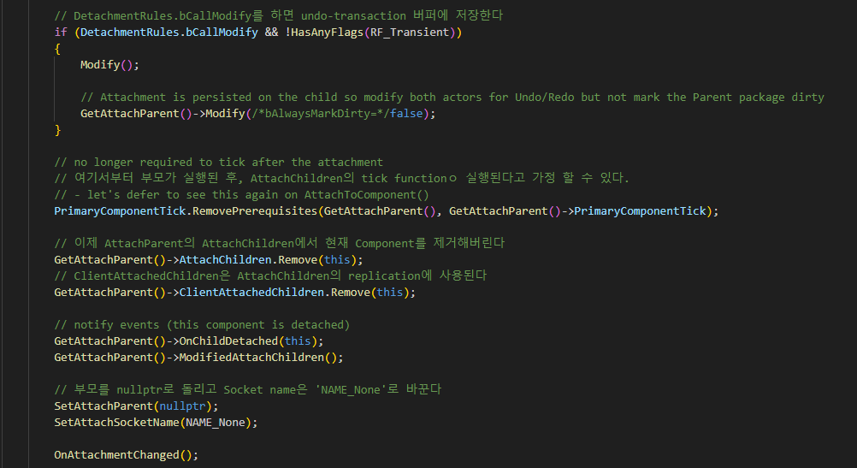
SceneComponent DetachFromComponent 010

Slide 35
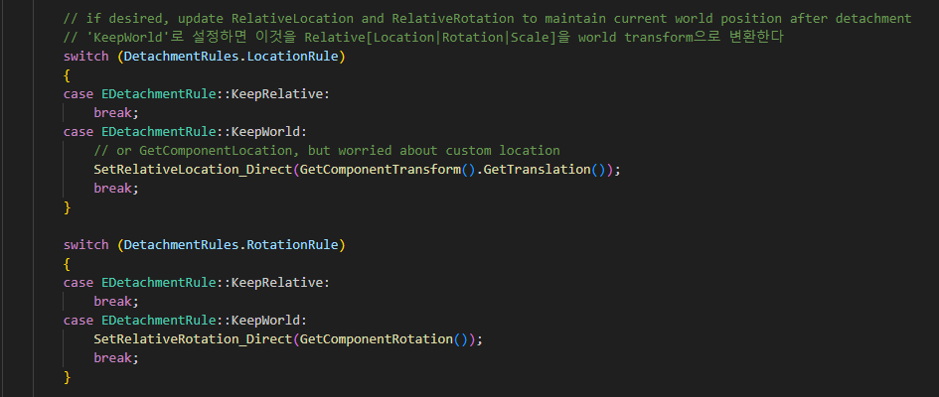
SceneComponent DetachFromComponent 010

Slide 36
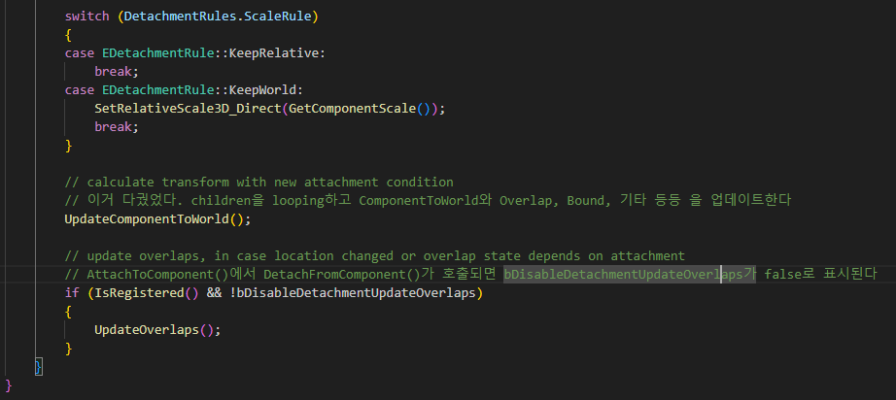
SceneComponent DetachFromComponent 010

Slide 37
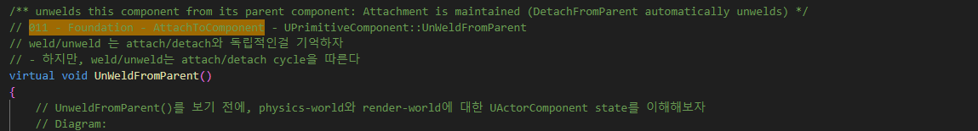
PrimitiveComponent UnWeldFromParent 011

Slide 38
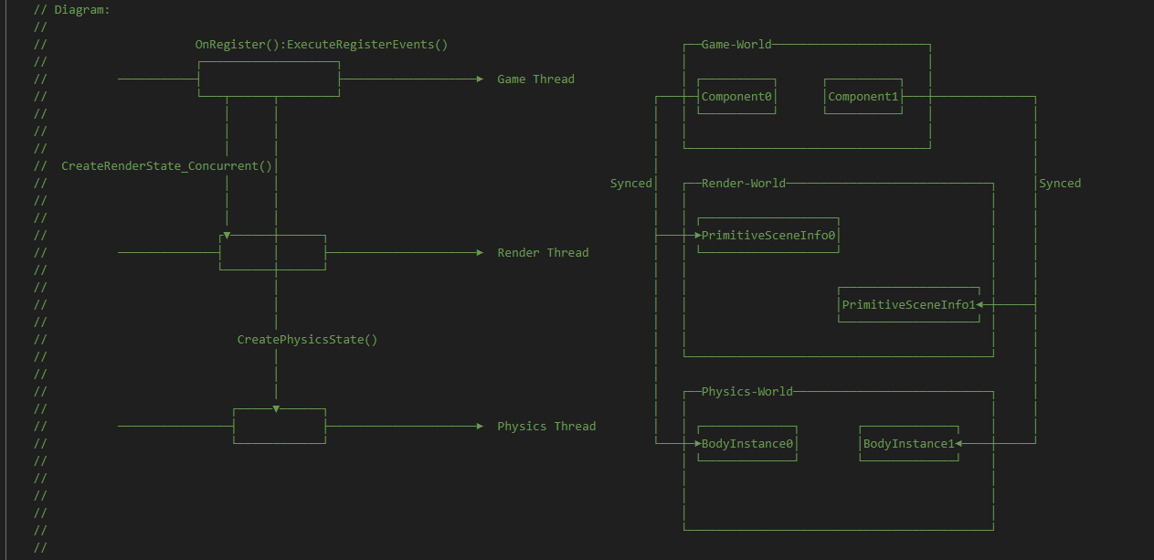
PrimitiveComponent UnWeldFromParent 011

Slide 39
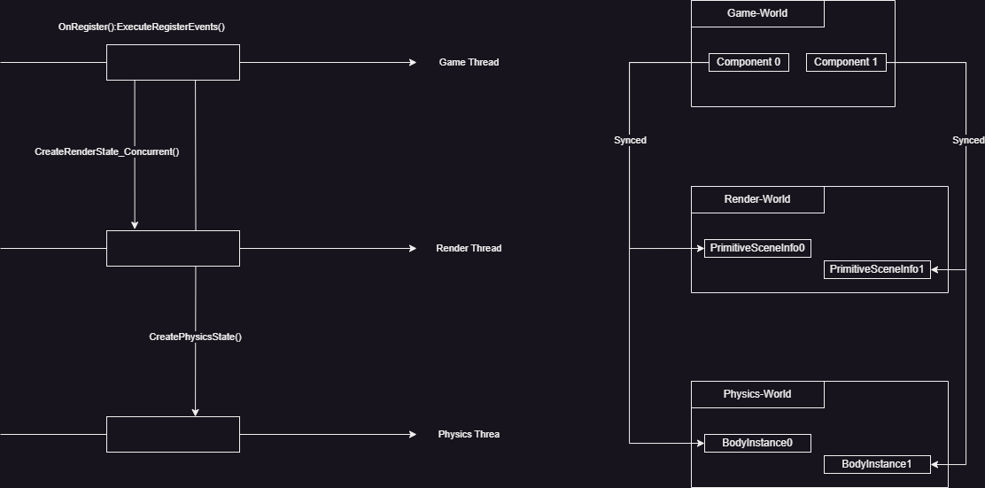
PrimitiveComponent UnWeldFromParent 011

Slide 40
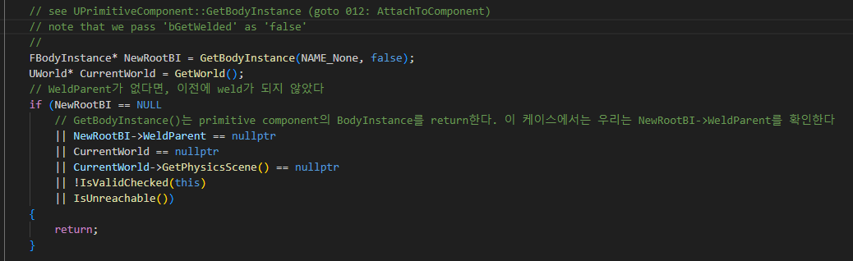
PrimitiveComponent UnWeldFromParent 011

Slide 41
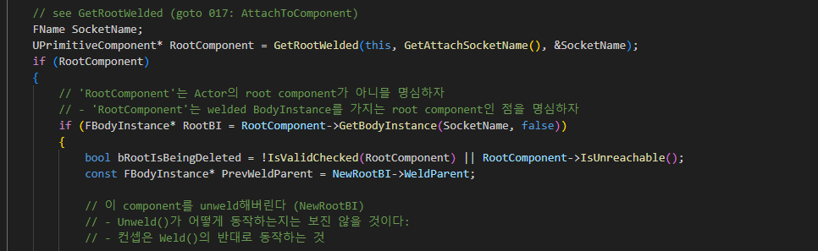
PrimitiveComponent UnWeldFromParent 011

Slide 42
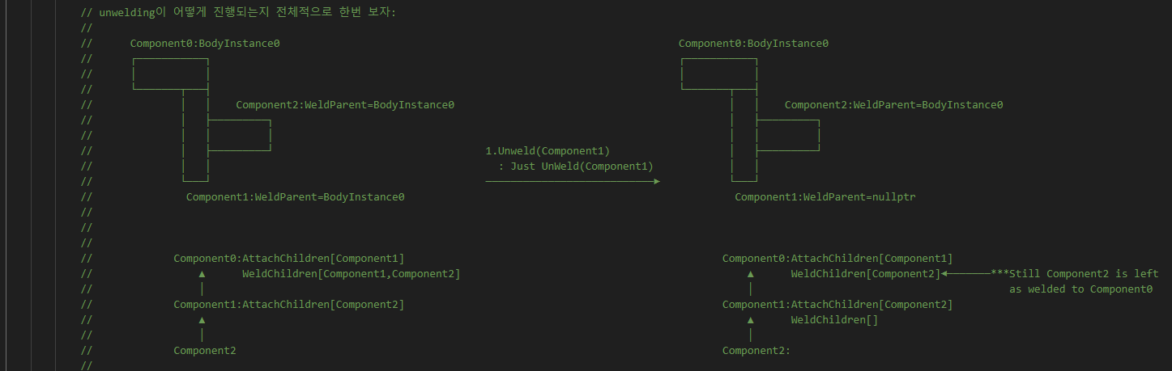
PrimitiveComponent UnWeldFromParent 011

Slide 43
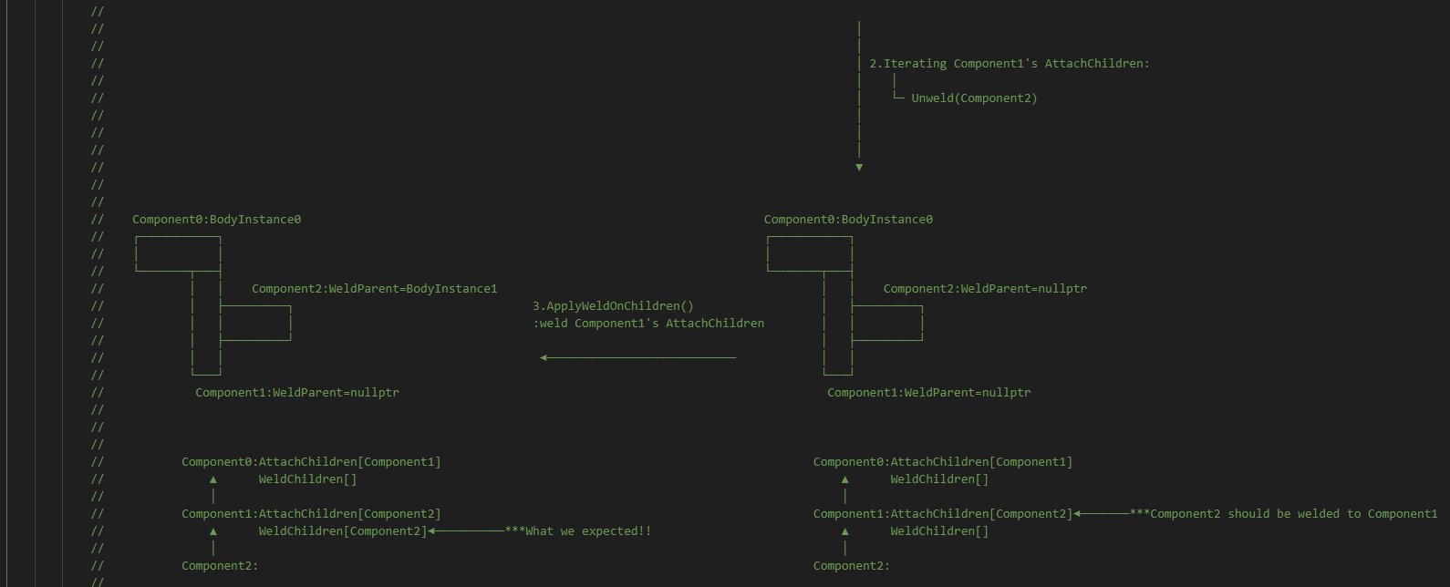
PrimitiveComponent UnWeldFromParent 011

Slide 44
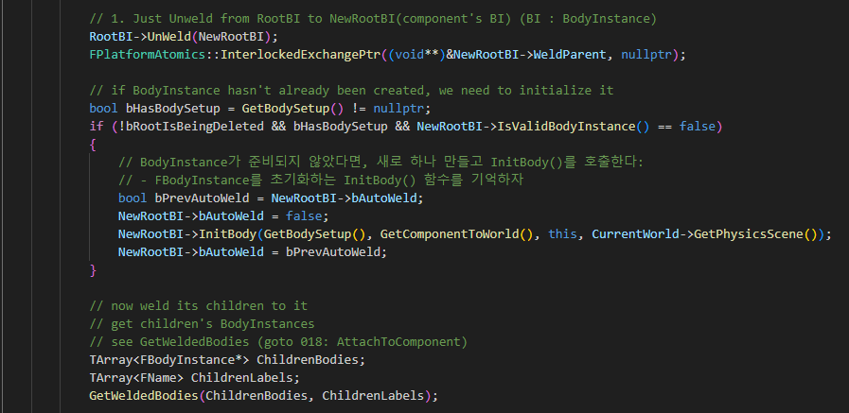
PrimitiveComponent UnWeldFromParent 011

Slide 45
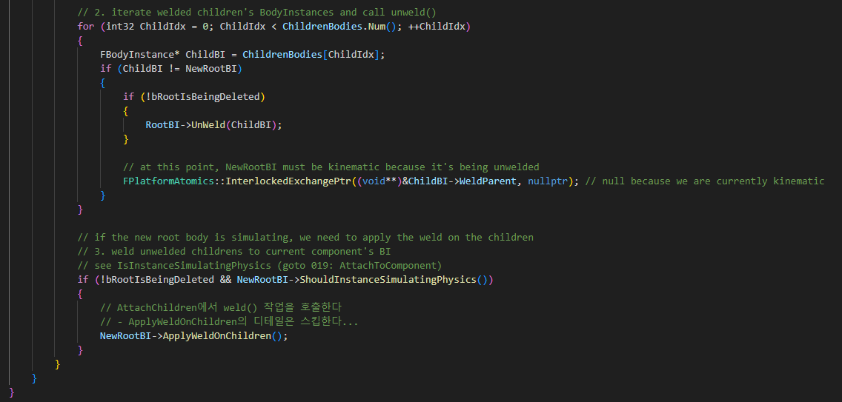
PrimitiveComponent UnWeldFromParent 011

Slide 46
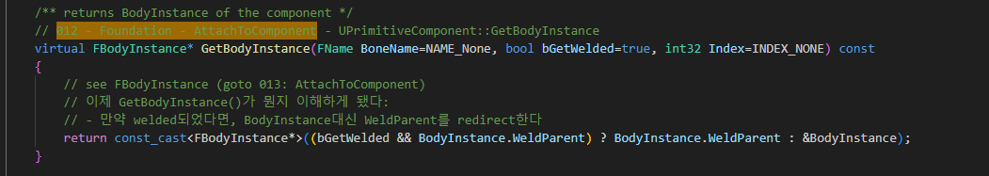
PrimitiveComponent GetBodyInstance 012

Slide 47
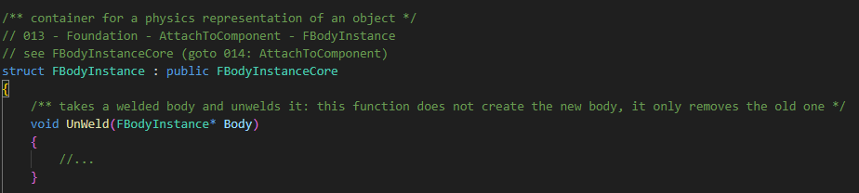
PrimitiveComponent GetBodyInstance 013

Slide 48
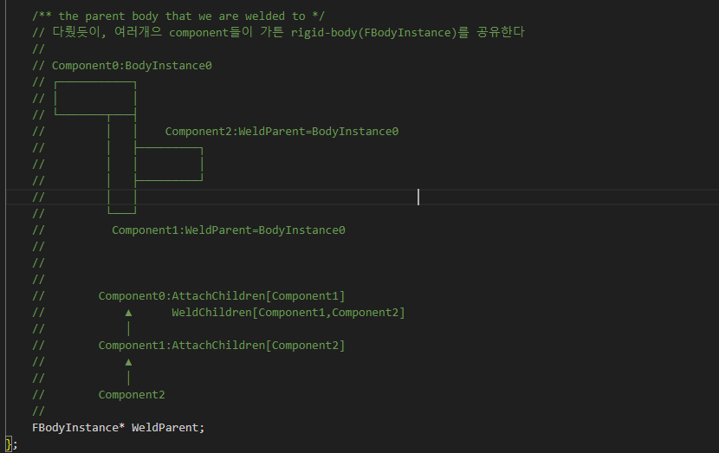
PrimitiveComponent GetBodyInstance 013

Slide 49
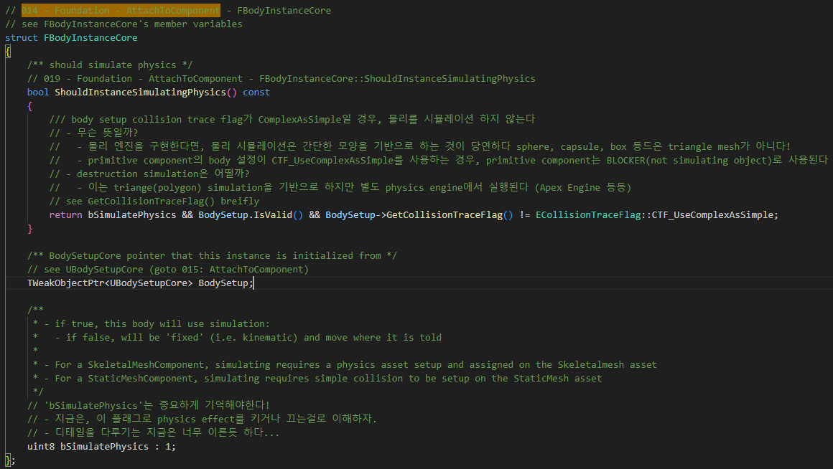
BodyInstance FBodyInstanceCore 014

Slide 50
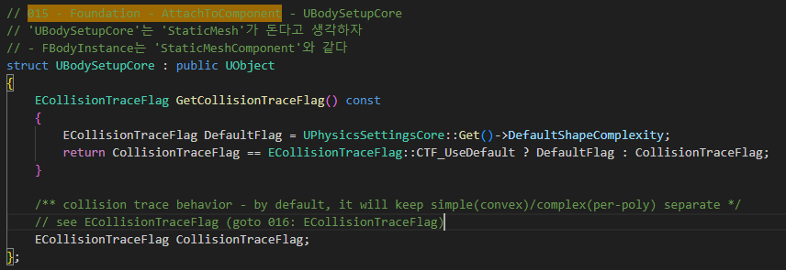
BodyInstance UBodySetupCore 015

Slide 51
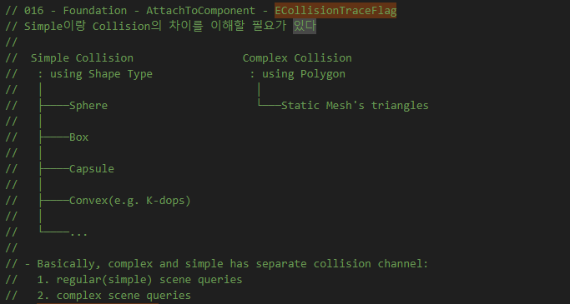
BodyInstance ECollisionTraceFlag 016

Slide 52
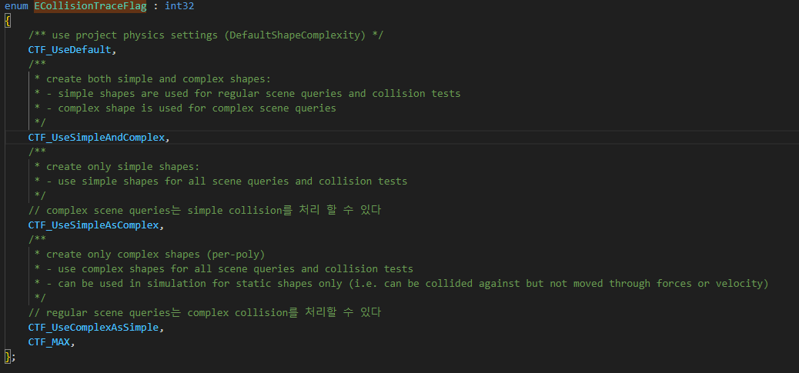
BodyInstance ECollisionTraceFlag 016

Slide 53
PrimitiveComponent UnWeldFromParent 011

Slide 54
BodyInstance ECollisionTraceFlag 016

Slide 55
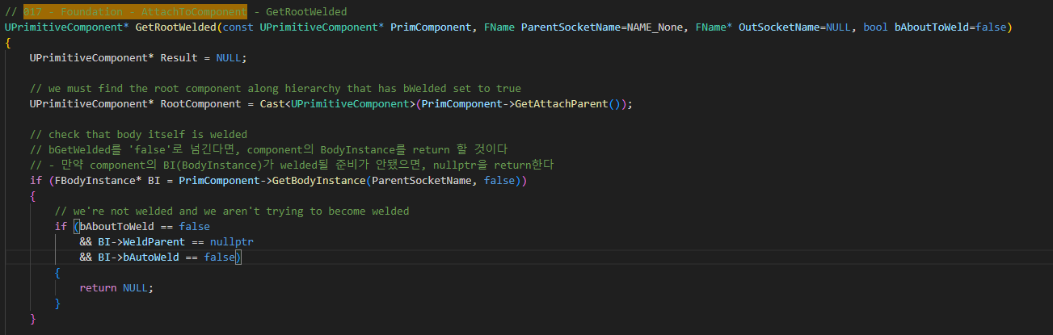
PrimitiveComponent GetRootWelded 017

Slide 56
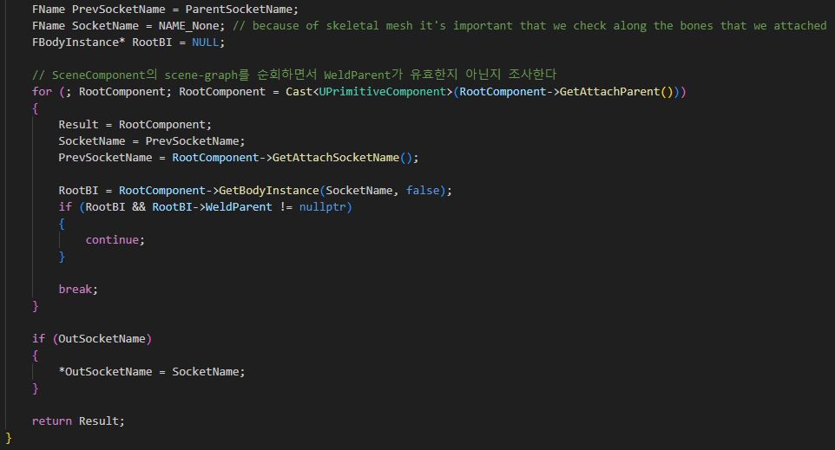
PrimitiveComponent GetRootWelded 017

Slide 57
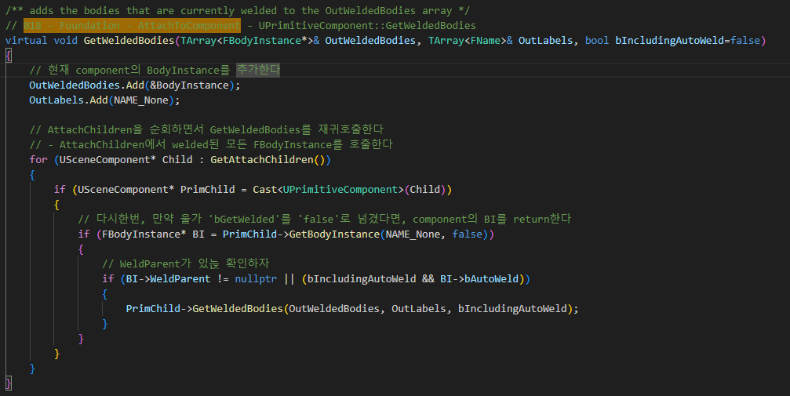
PrimitiveComponent GetWeldedBodies 018

Slide 58
PrimitiveComponent UnWeldFromParent 011

Slide 59
BodyInstance FBodyInstanceCore 014

Slide 60
SceneComponent AttachToComponent 002

Slide 61

SceneComponent WeldToImplementaion 020

Slide 62

SceneComponent WeldToImplementaion 020

Slide 63

SceneComponent WeldToImplementaion 020

Slide 64

SceneComponent IsSimulatingPhysics 021

Slide 65
ActorComponent AttachToComponent 000

