Slide 1
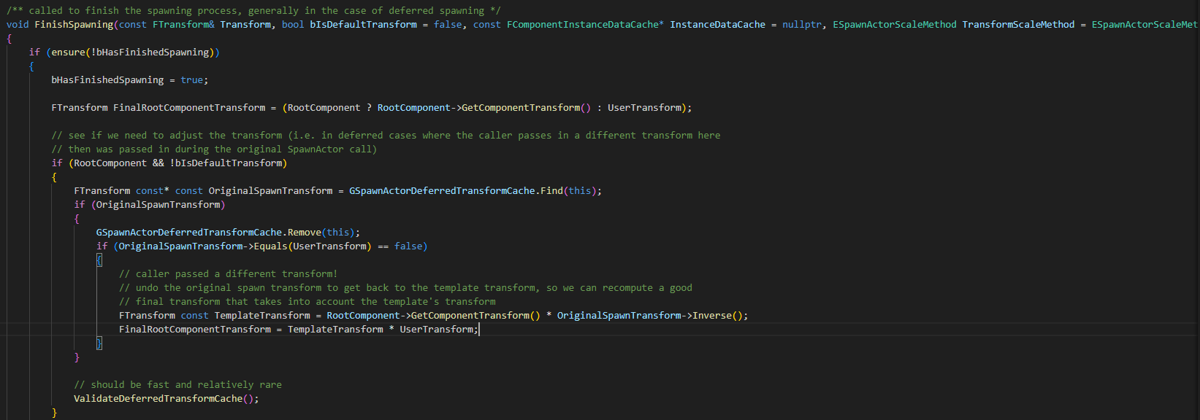
Actor FinishSpawning 000

Slide 2
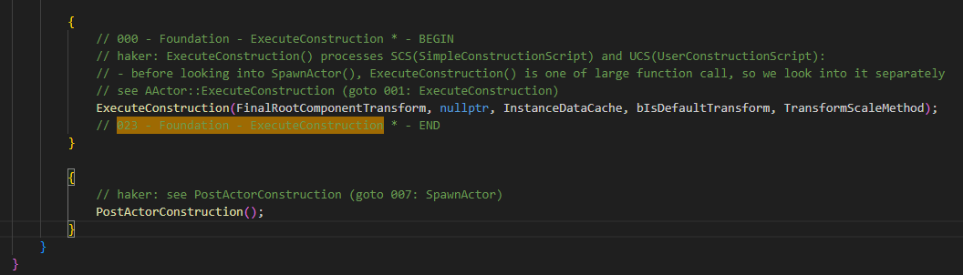
Actor FinishSpawning 000

Slide 3
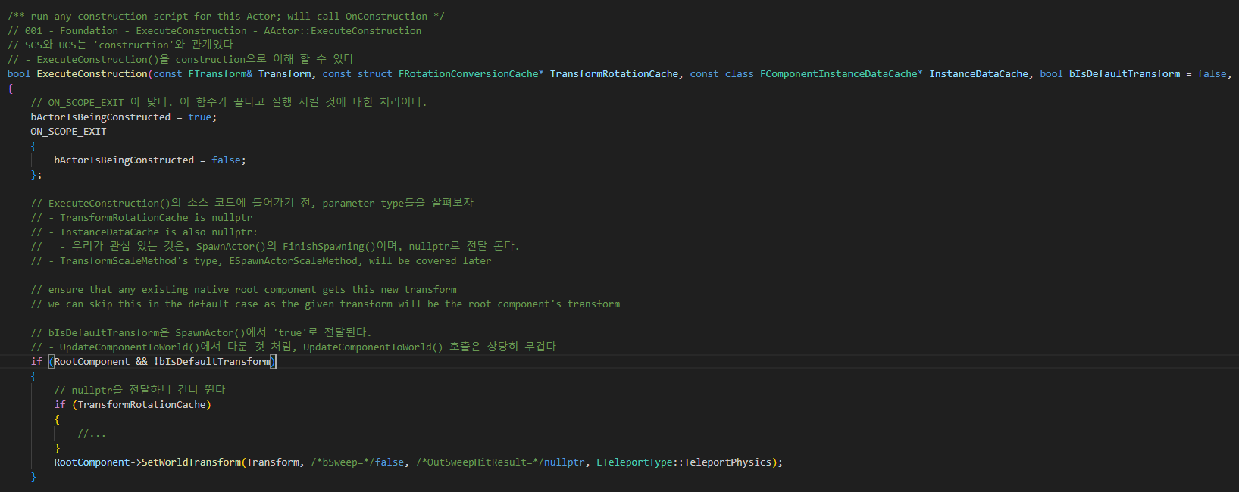
Actor ExecuteConstruction 001

Slide 4
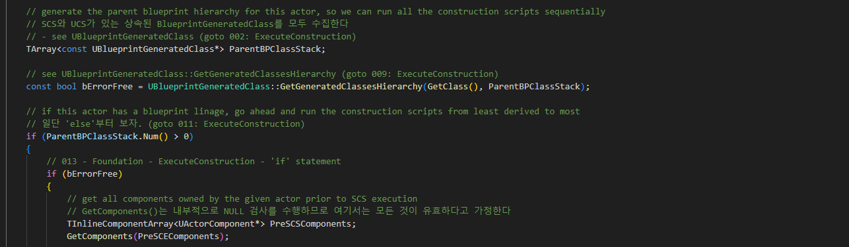
Actor ExecuteConstruction 001

Slide 5
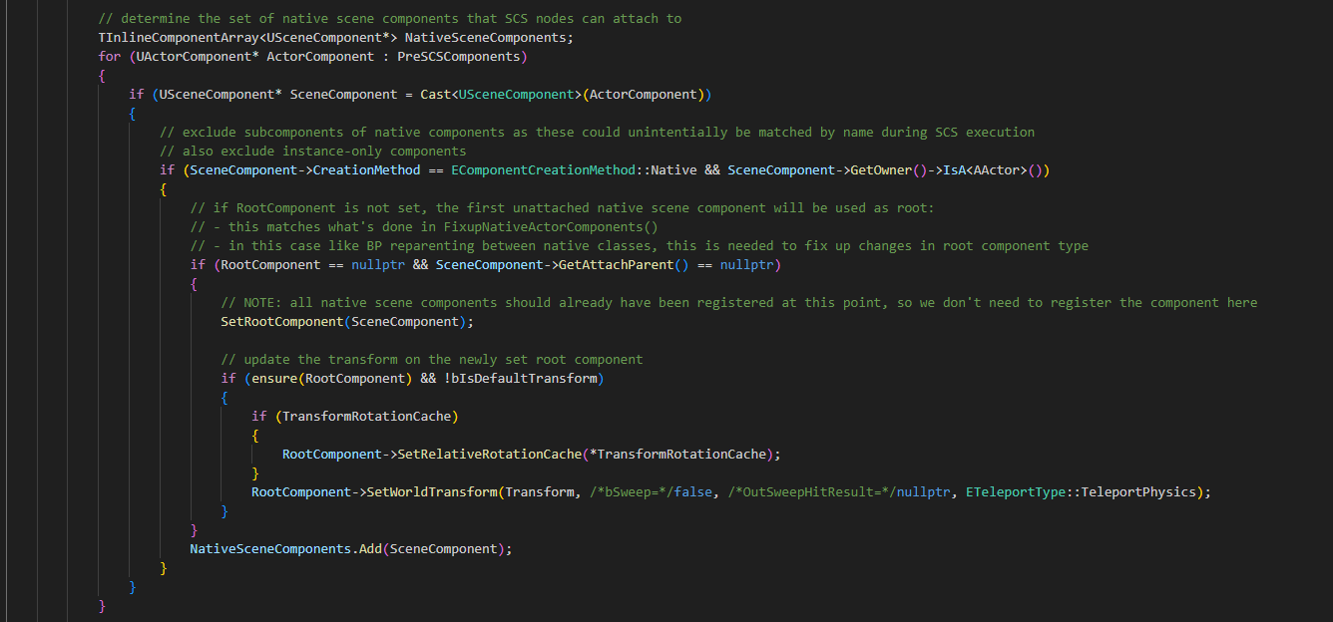
Actor ExecuteConstruction 001

Slide 6
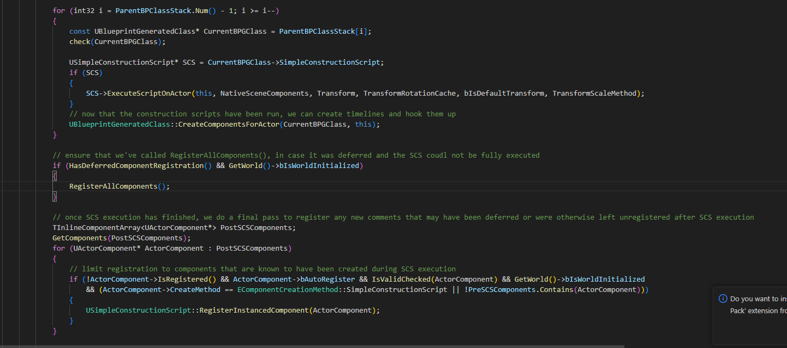
Actor ExecuteConstruction 001

Slide 7
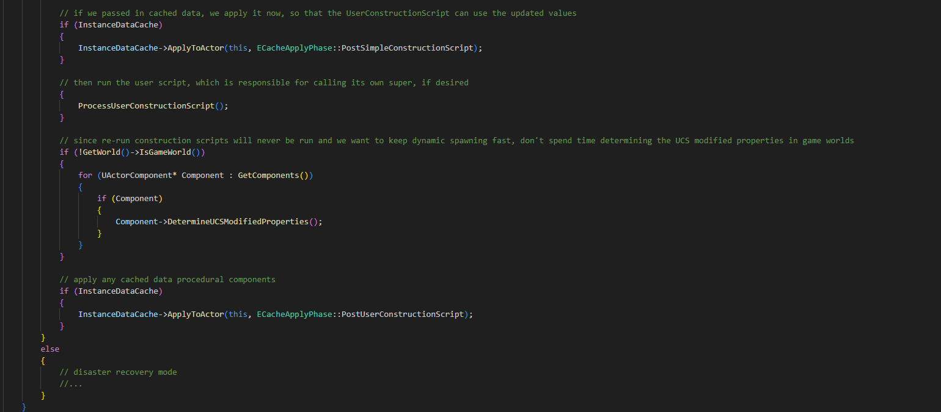
Actor ExecuteConstruction 001

Slide 8
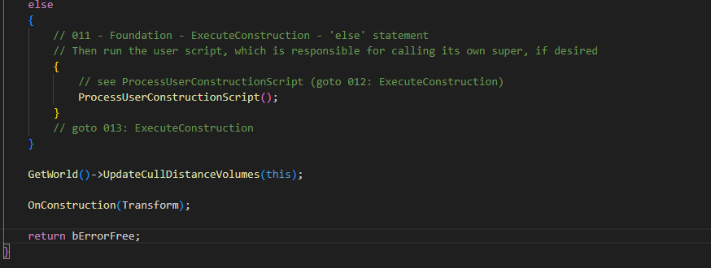
Actor ExecuteConstruction 001

Slide 9
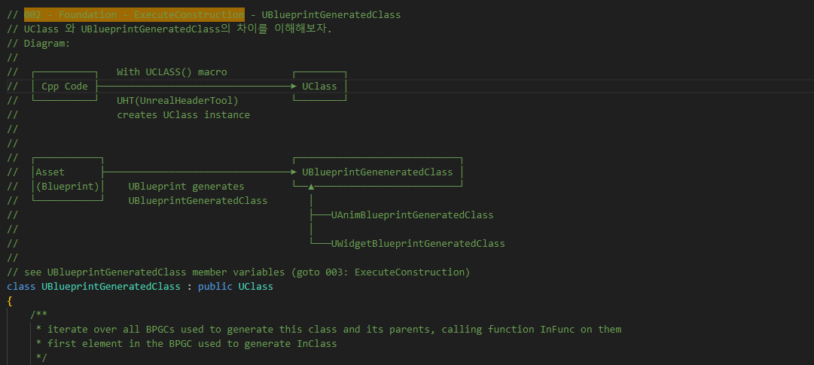
BlueprintGeneratedClass 002

Slide 10
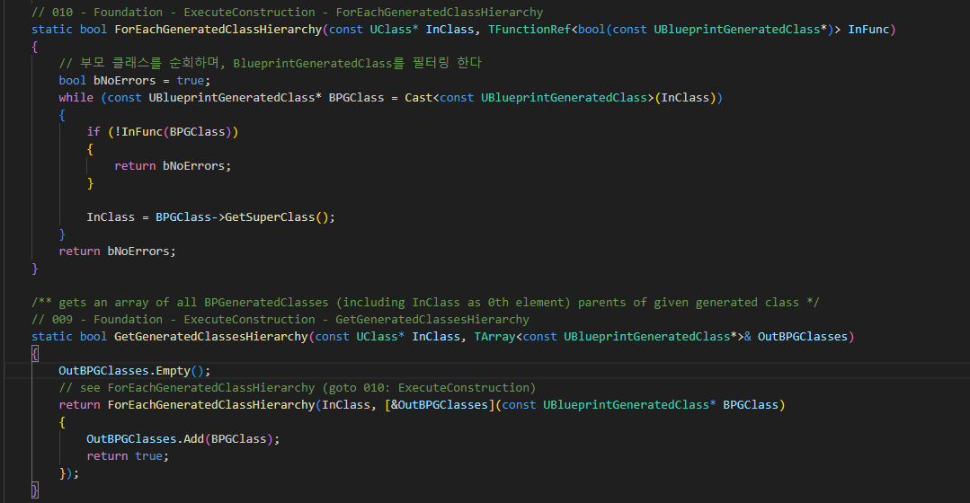
BlueprintGeneratedClass 002

Slide 11
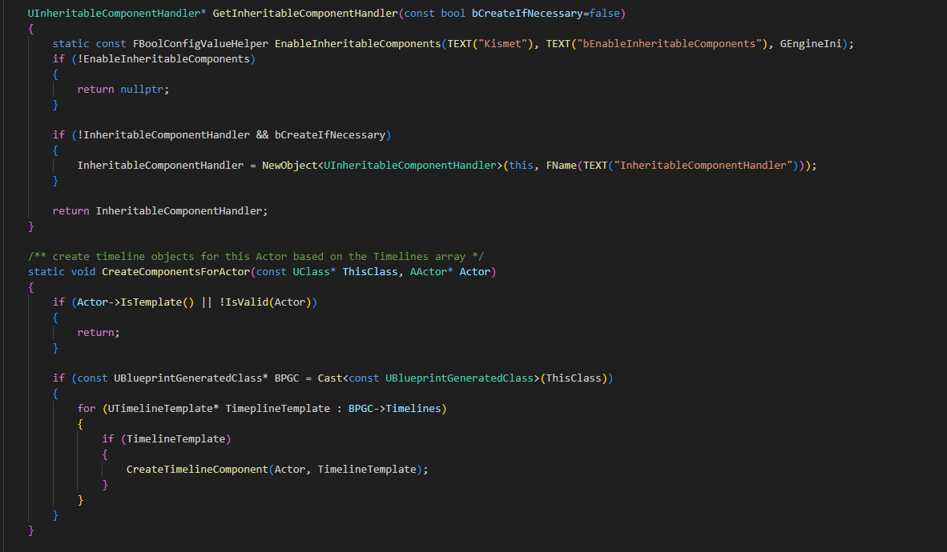
BlueprintGeneratedClass 002

Slide 12
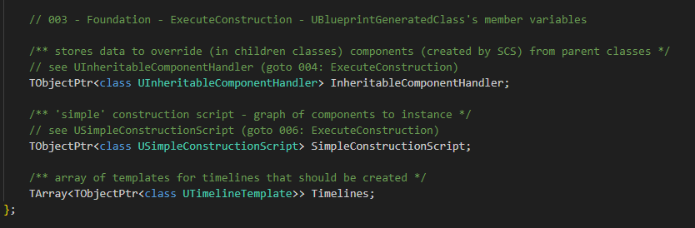
BlueprintGeneratedClass 003

Slide 13
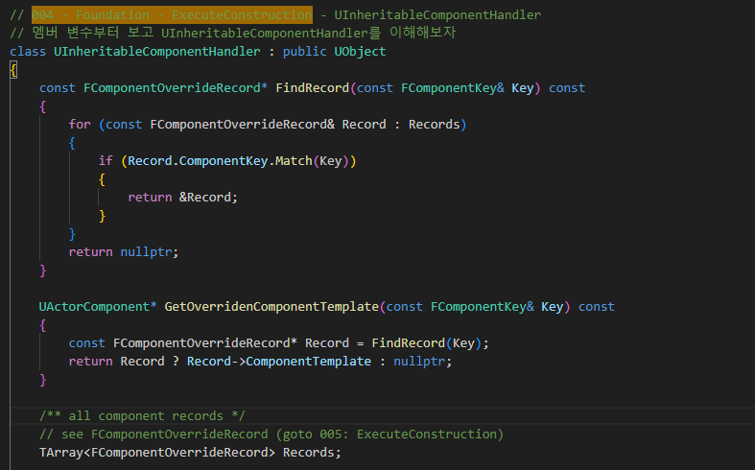
BlueprintGeneratedClass UInheritabeComponentHandler 004

Slide 14
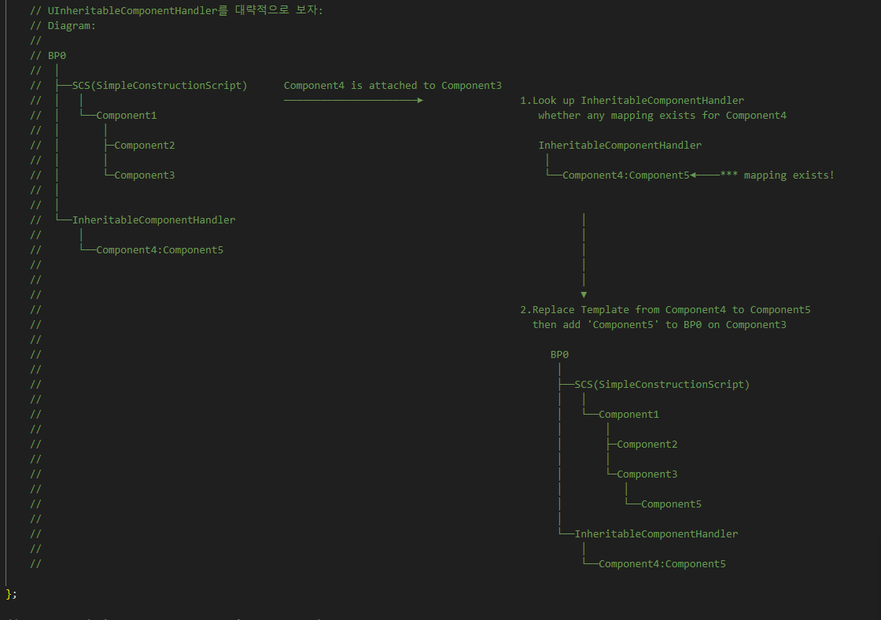
BlueprintGeneratedClass UInheritabeComponentHandler 004

Slide 15
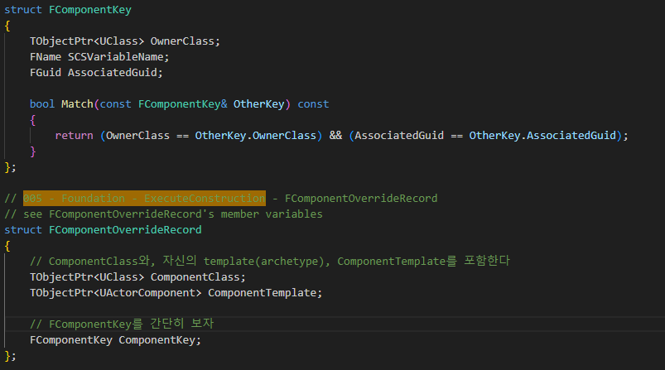
BlueprintGeneratedClass FComponentOverrideRecore 005

Slide 16
BlueprintGeneratedClass 003

Slide 17
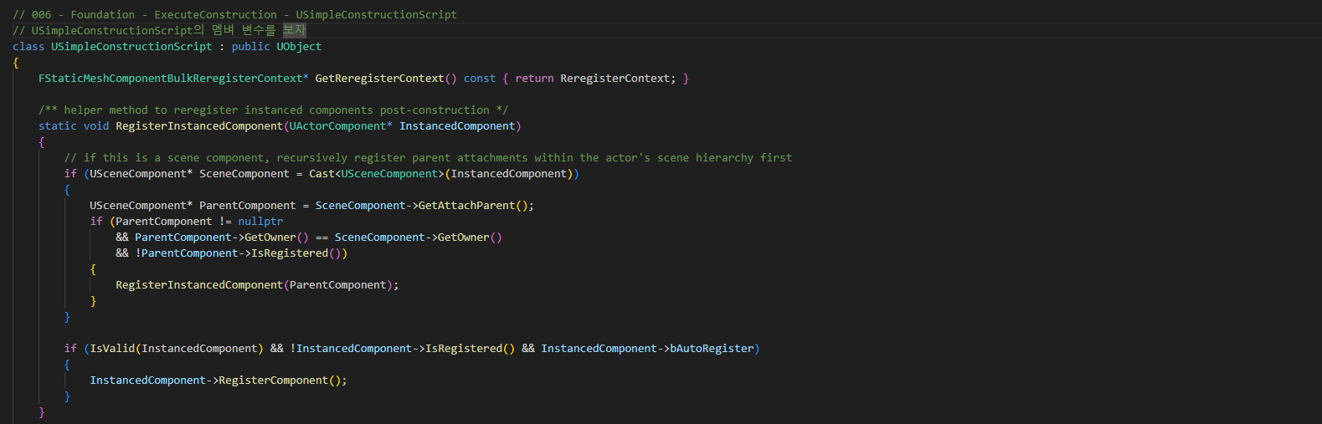
BlueprintGeneratedClass SimpleConstructionScript 006

Slide 18
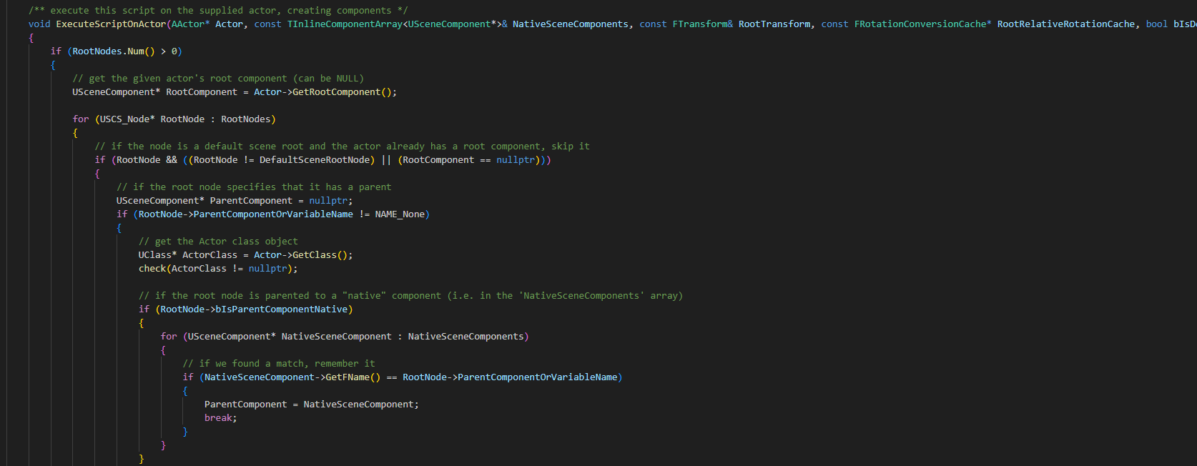
BlueprintGeneratedClass SimpleConstructionScript 006

Slide 19
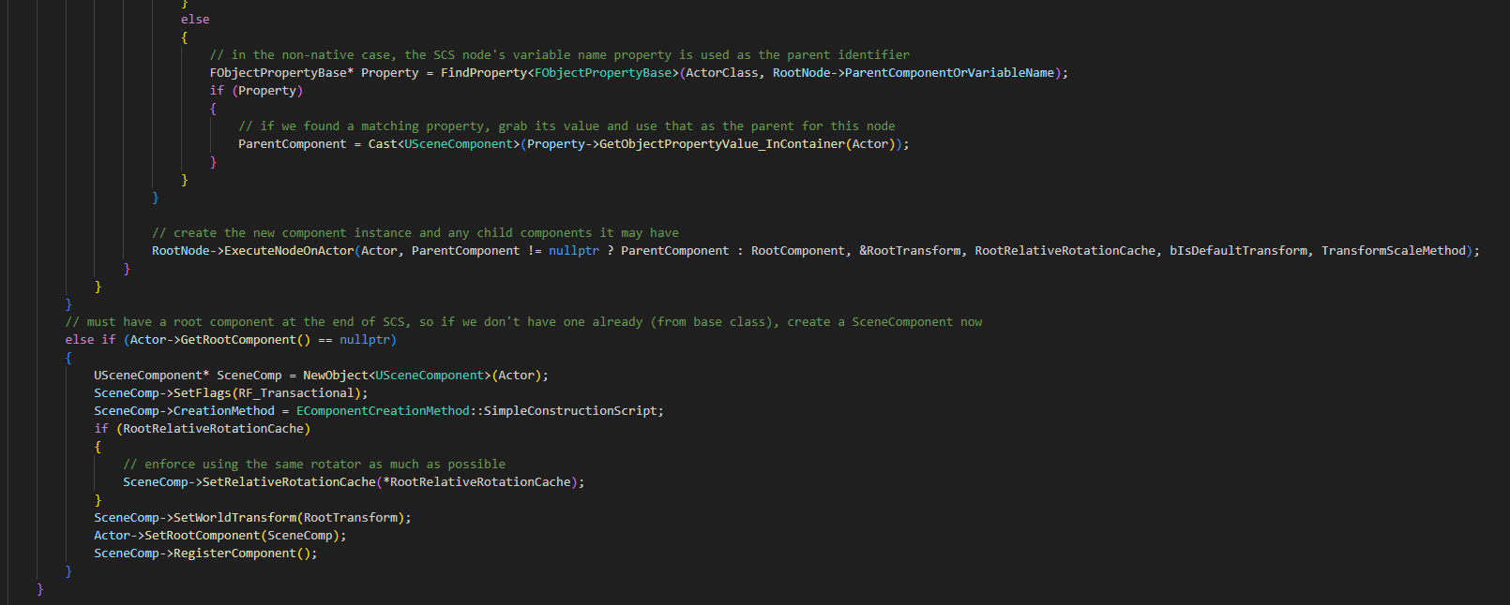
BlueprintGeneratedClass SimpleConstructionScript 006

Slide 20
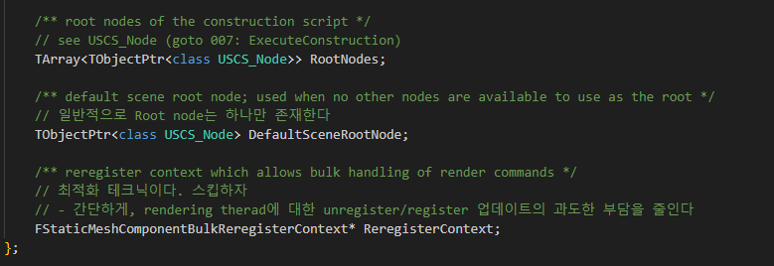
BlueprintGeneratedClass SimpleConstructionScript 006

Slide 21
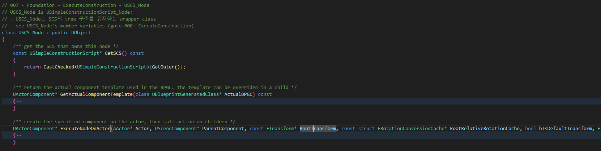
BlueprintGeneratedClass USCS_Node 007

Slide 22
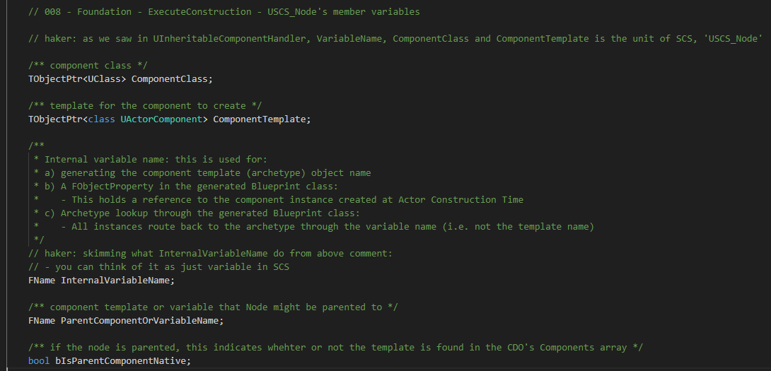
BlueprintGeneratedClass USCS_Node 008

Slide 23
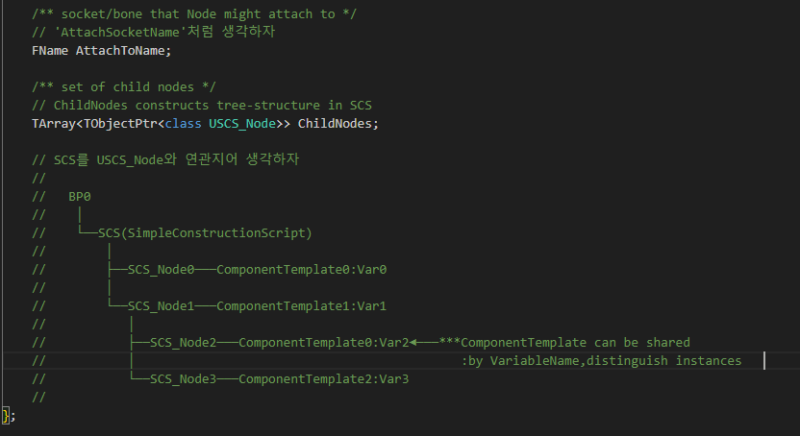
BlueprintGeneratedClass USCS_Node 008

Slide 24
Actor ExecuteConstruction 001

Slide 25
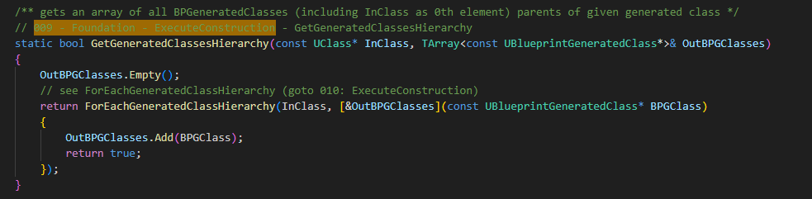
BlueprintGeneratedClass GetGeneratedClassesHierarchy 009

Slide 26
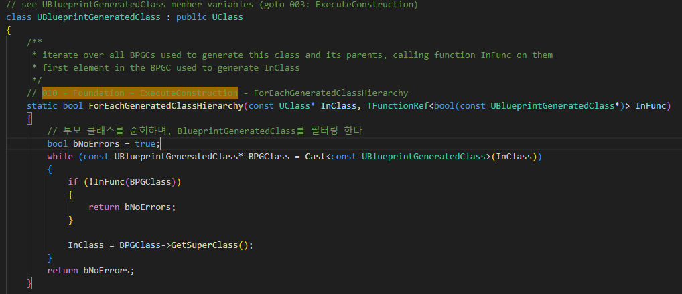
BlueprintGeneratedClass ForEachGeneratedClassHierarchy 010

Slide 27
Actor ExecuteConstruction 011

Slide 28
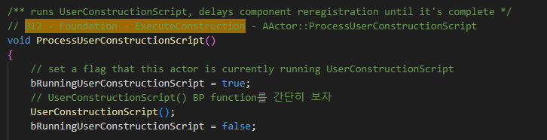
Actor ProcessUserConstructionScript 012

Slide 29
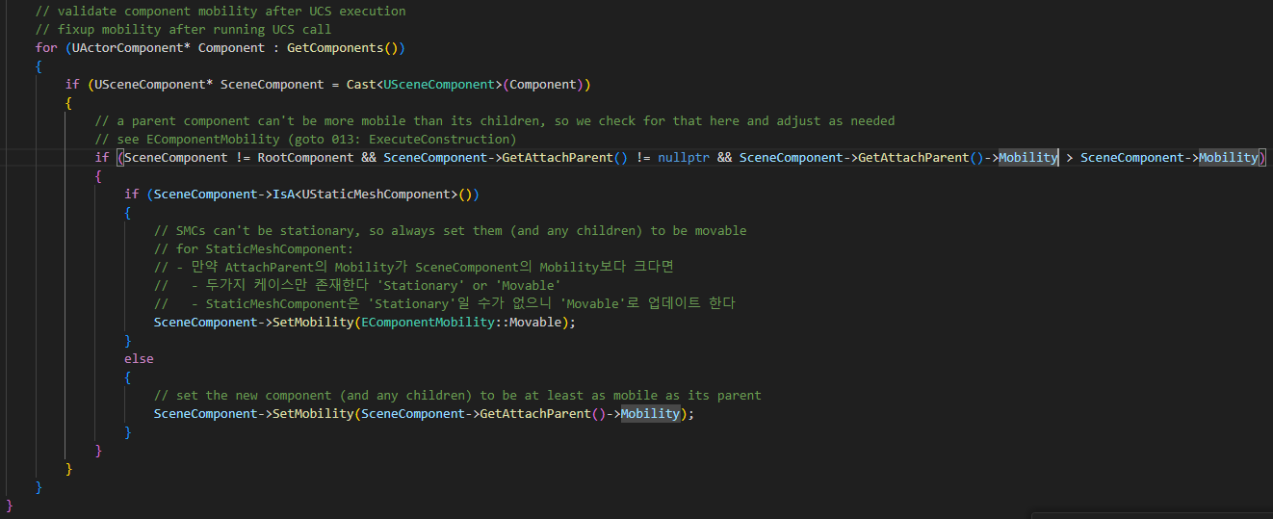
Actor ProcessUserConstructionScript 012

Slide 30
Actor ExecuteConstruction 013

Slide 31
Actor ExecuteConstruction 001

Slide 32
Actor ExecuteConstruction 001

Slide 33
Actor ExecuteConstruction 001

