Slide 1
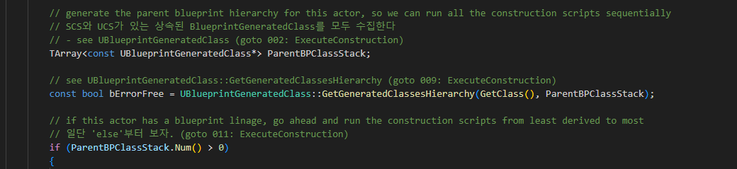
Actor ExecuteConstruction 001

Slide 2
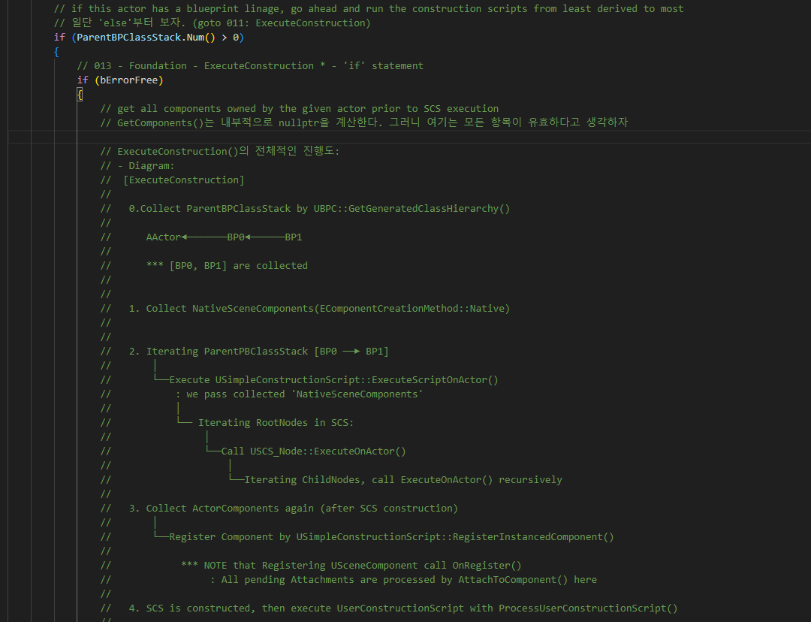
Actor ExecuteConstruction 001

Slide 3
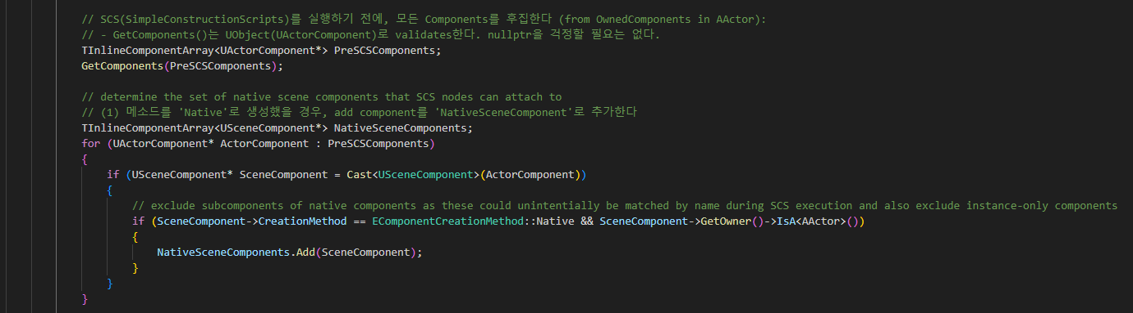
Actor ExecuteConstruction 013

Slide 4
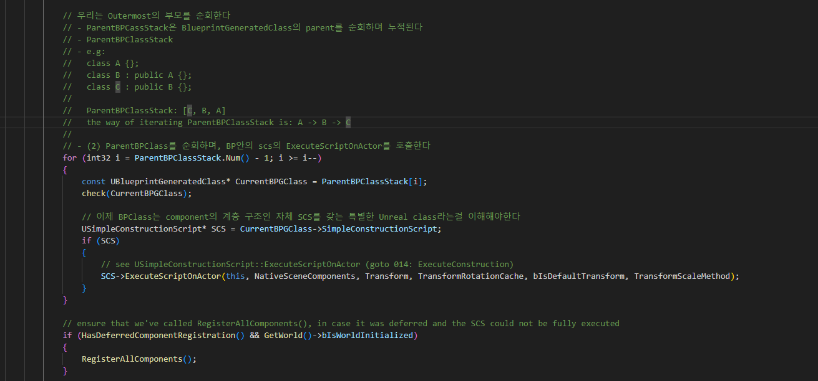
Actor ExecuteConstruction 013

Slide 5
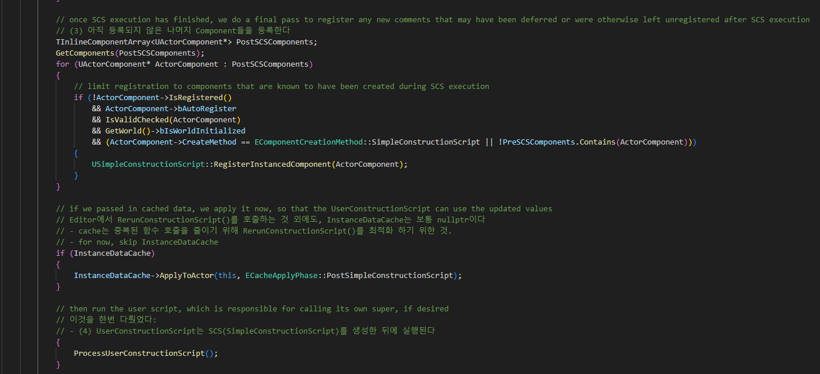
Actor ExecuteConstruction 013

Slide 6
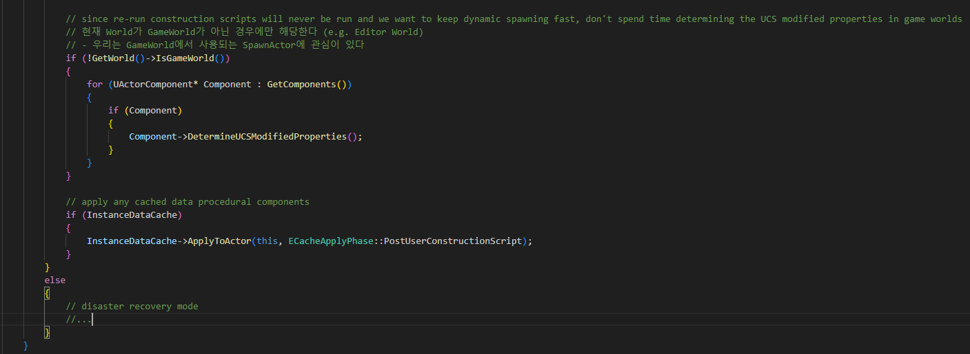
Actor ExecuteConstruction 013

Slide 7
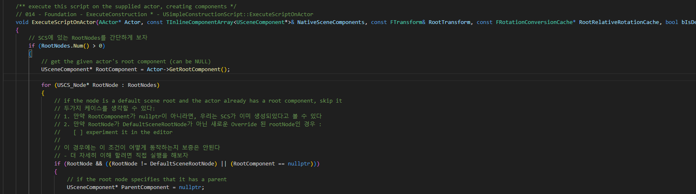
BlueprintGeneratedClass ExecuteScriptOnActor 014

Slide 8
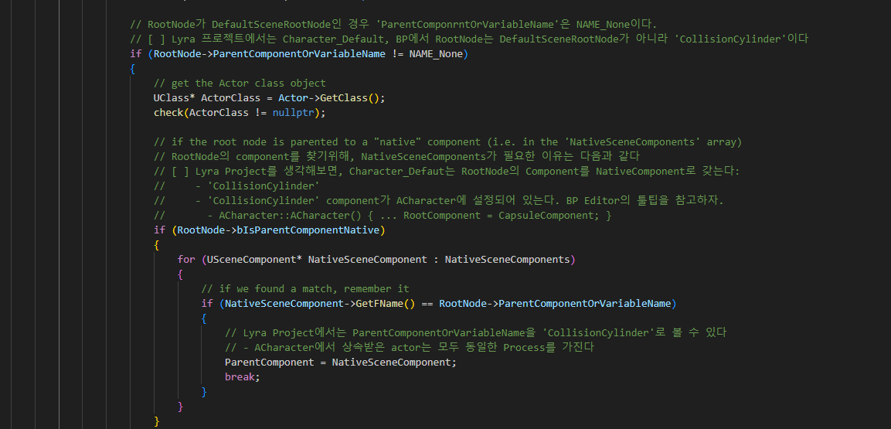
BlueprintGeneratedClass ExecuteScriptOnActor 014

Slide 9
BlueprintGeneratedClass ExecuteScriptOnActor 014

Slide 10
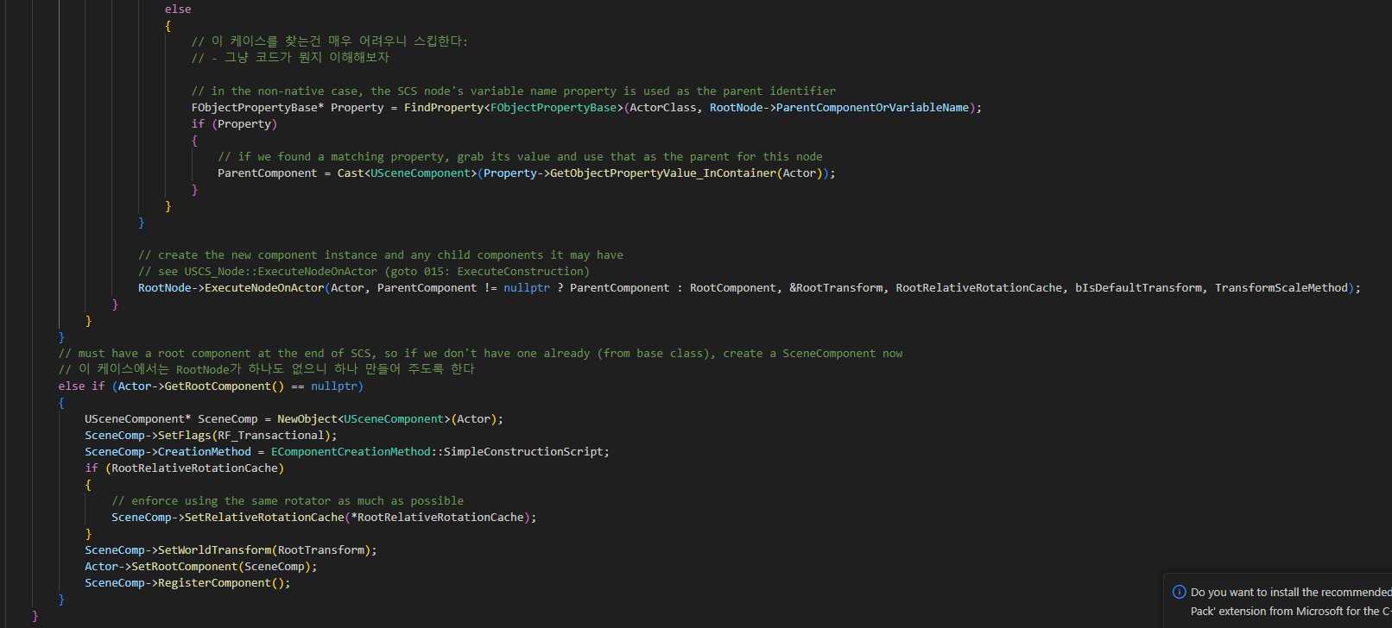
BlueprintGeneratedClass ExecuteScriptOnActor 014

Slide 11
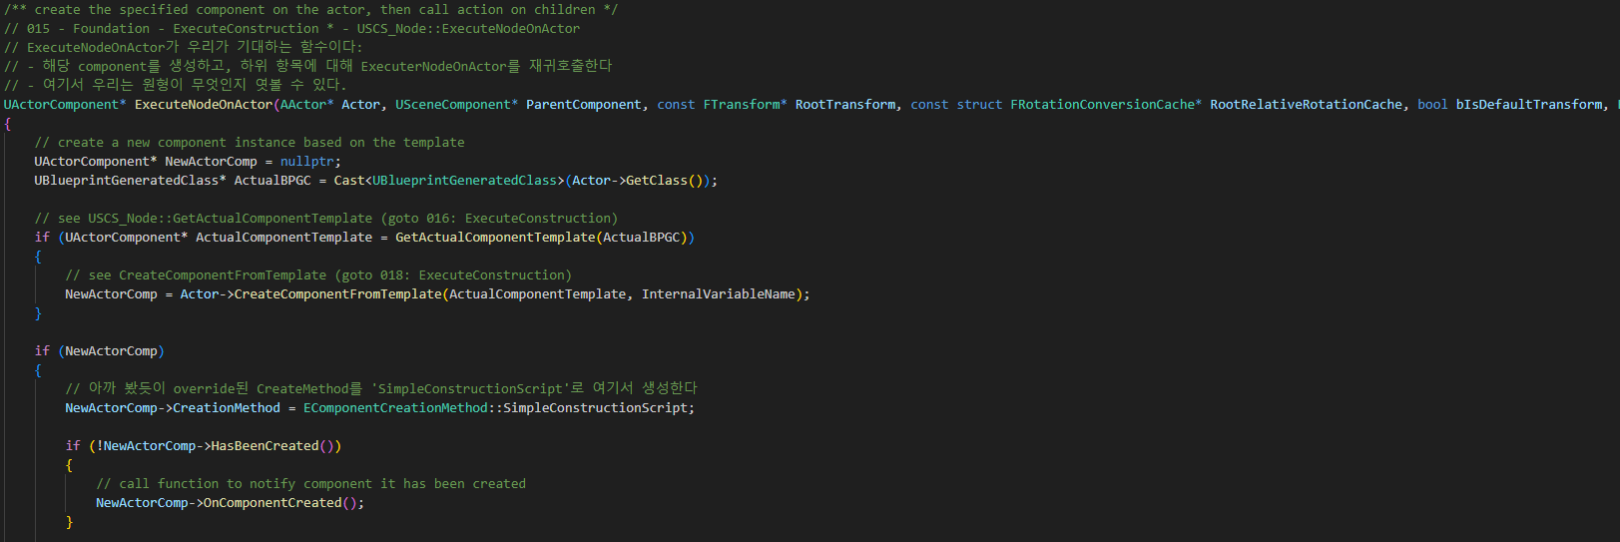
BlueprintGeneratedClass ExecuteNodeOnActor 015

Slide 12
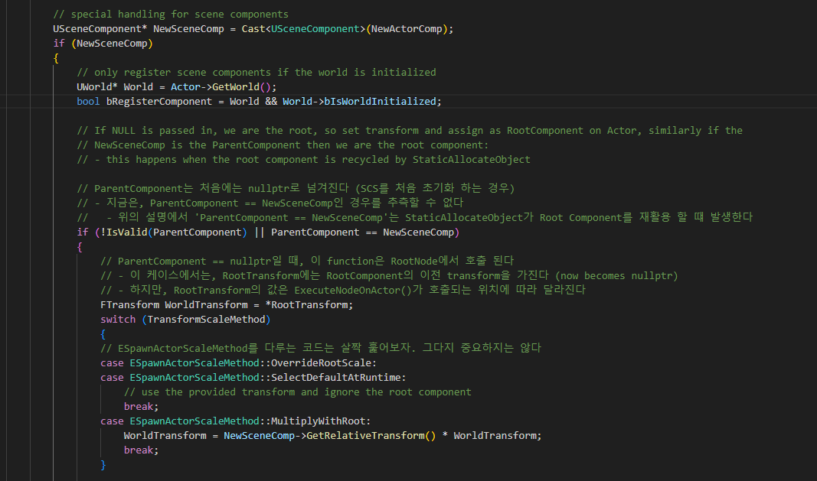
BlueprintGeneratedClass ExecuteNodeOnActor 015

Slide 13
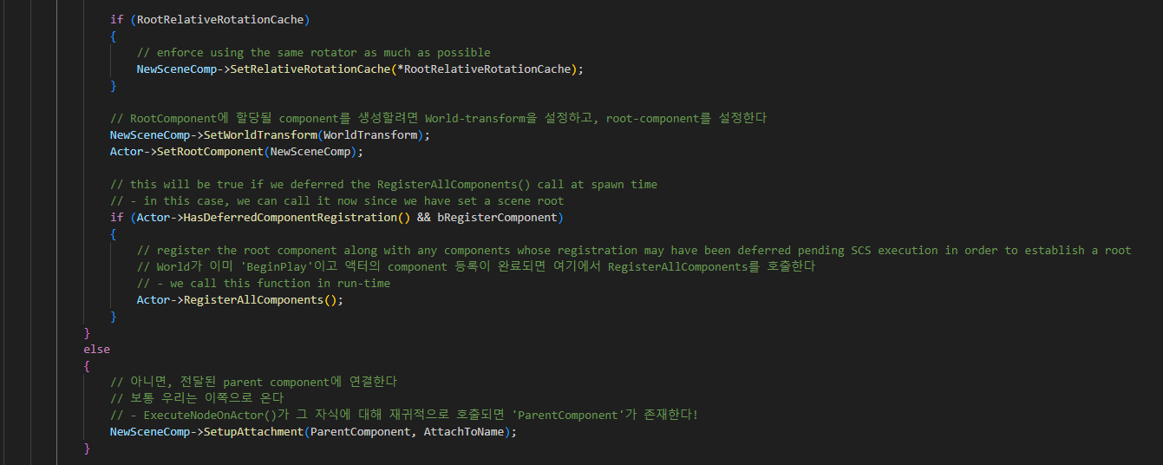
BlueprintGeneratedClass ExecuteNodeOnActor 015

Slide 14
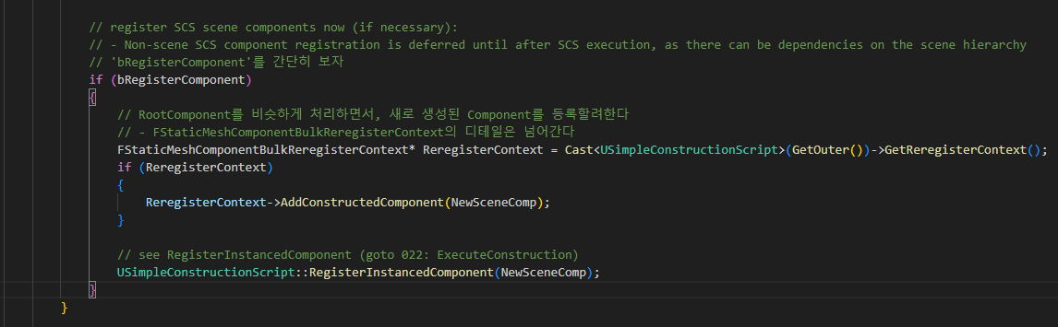
BlueprintGeneratedClass ExecuteNodeOnActor 015

Slide 15
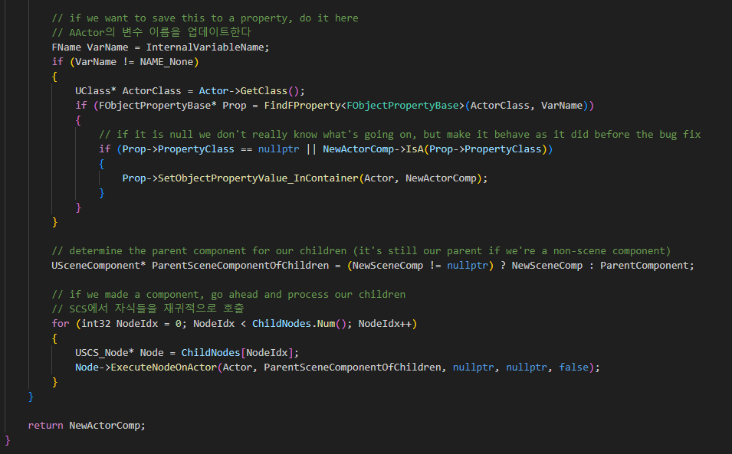
BlueprintGeneratedClass ExecuteNodeOnActor 015

Slide 16
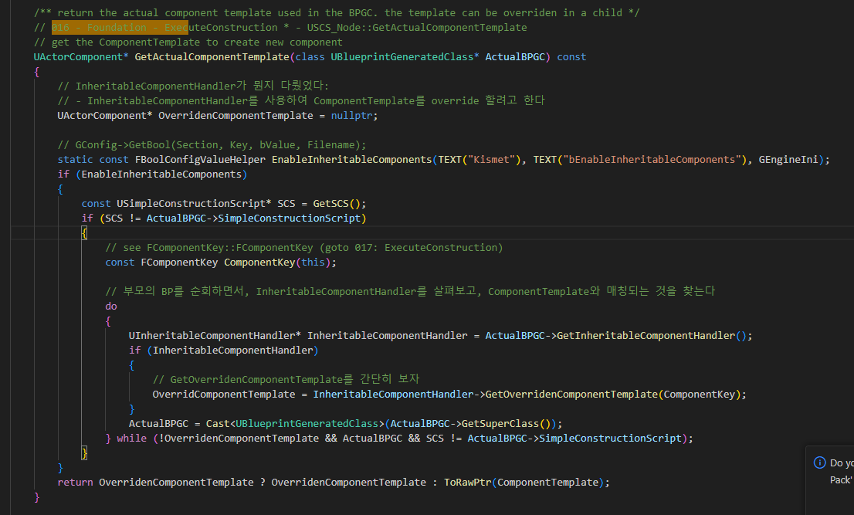
BlueprintGeneratedClass GetActuaComponentTemplate 016

Slide 17
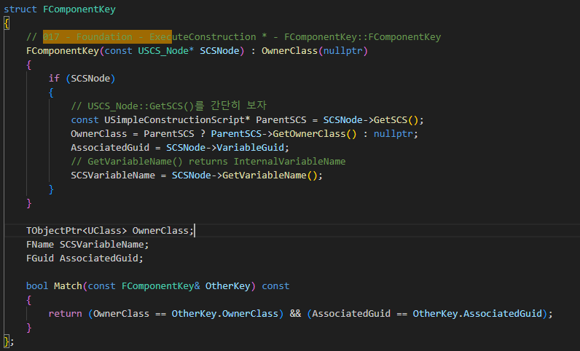
BlueprintGeneratedClass FComponentKey 017

Slide 18
BlueprintGeneratedClass ExecuteNodeOnActor 015

Slide 19
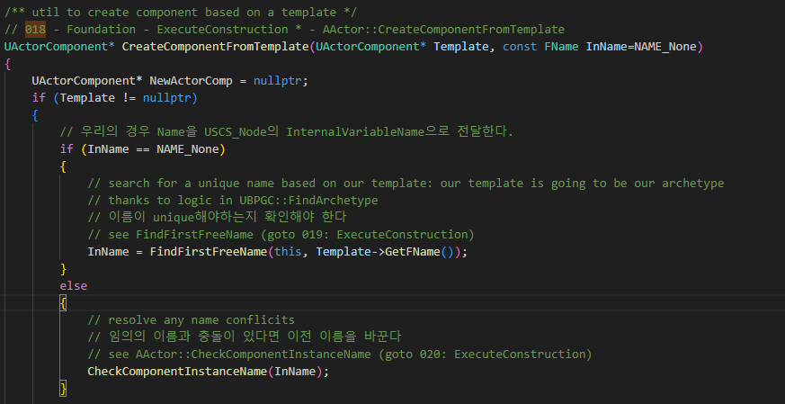
BlueprintGeneratedClass CreateComponentFromTemplate 018

Slide 20
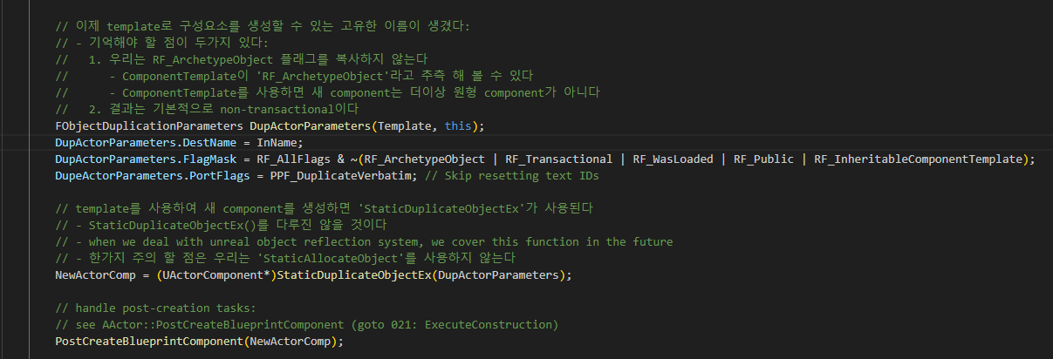
BlueprintGeneratedClass CreateComponentFromTemplate 018

Slide 21
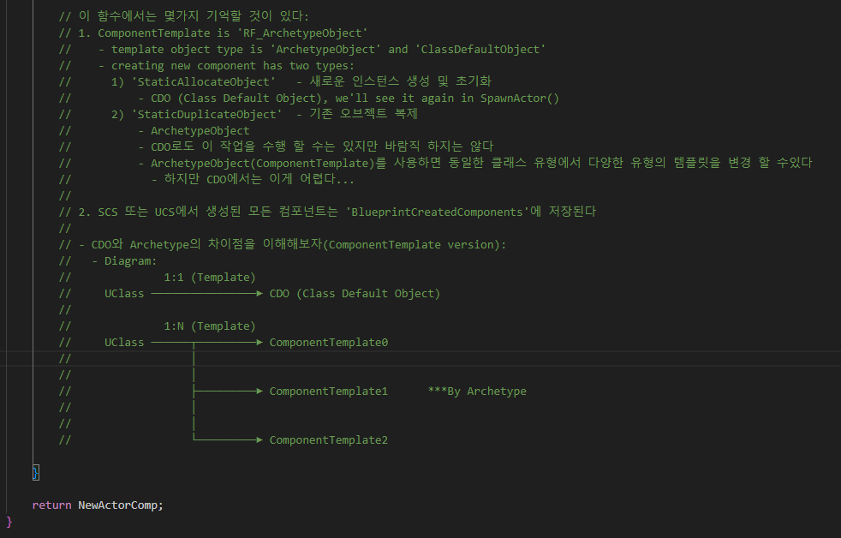
BlueprintGeneratedClass CreateComponentFromTemplate 018

Slide 22
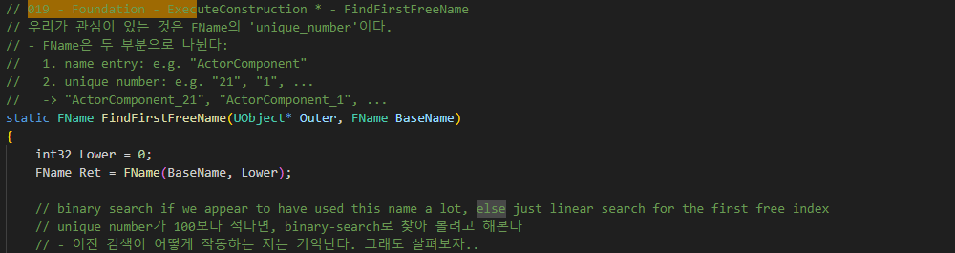
Actor FindFirstFreeName 019

Slide 23
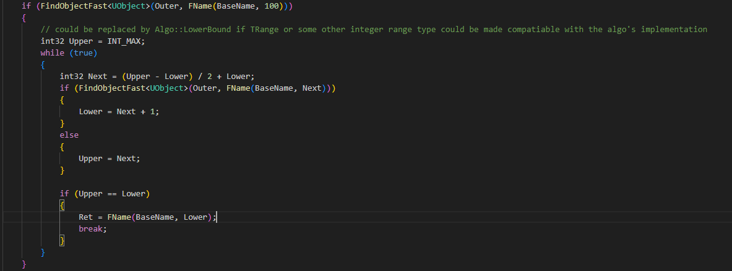
Actor FindFirstFreeName 019

Slide 24
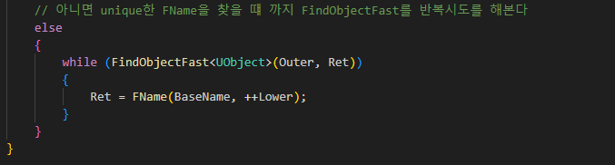
Actor FindFirstFreeName 019

Slide 25
BlueprintGeneratedClass CreateComponentFromTemplate 018

Slide 26
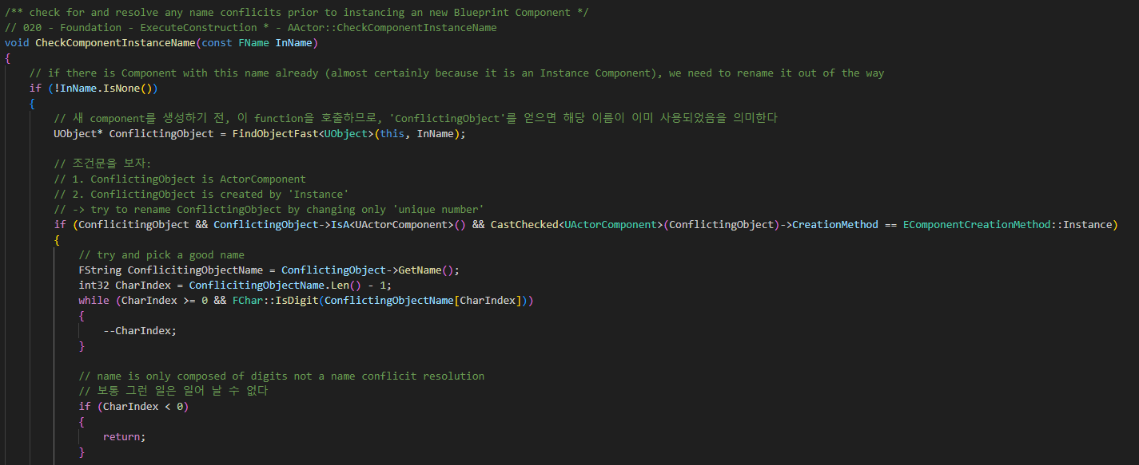
Actor CheckComponentInstanceName 020

Slide 27
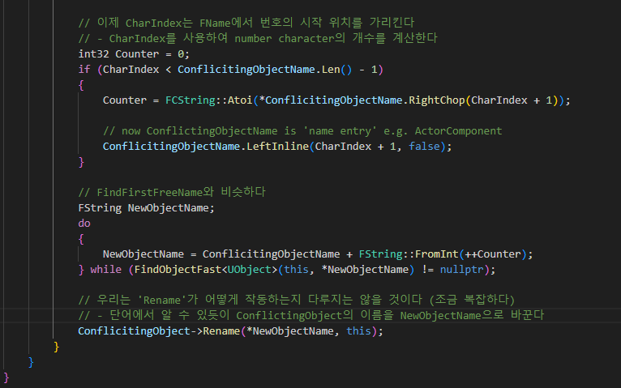
Actor CheckComponentInstanceName 020

Slide 28
BlueprintGeneratedClass CreateComponentFromTemplate 018

Slide 29
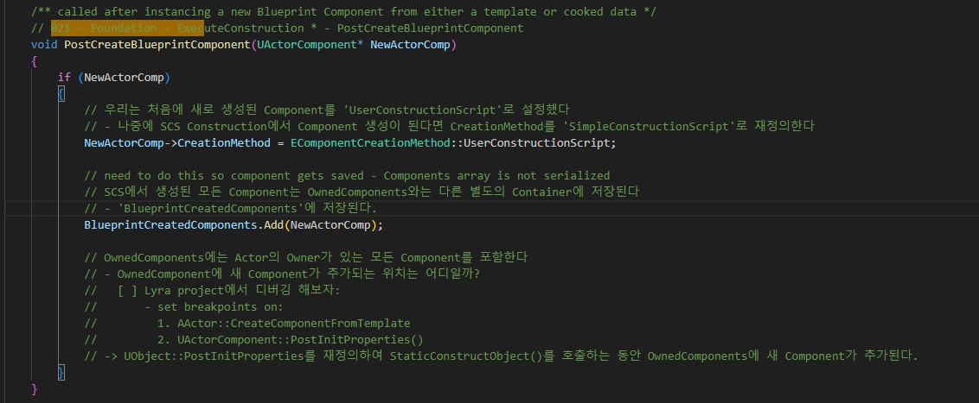
Actor PostCreateBlueprintComponent 021

Slide 30
BlueprintGeneratedClass ExecuteNodeOnActor 015

Slide 31
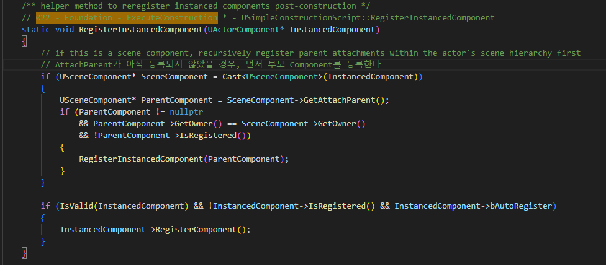
BlueprintGeneratedClass RegisterInstancedComponent 022

Slide 32
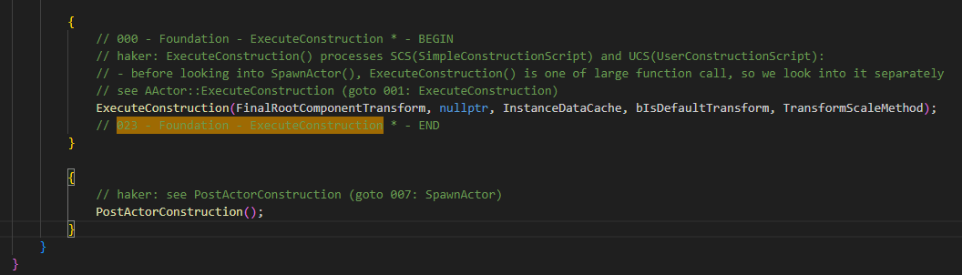
Actor FinishSpawning 000

