Slide 1
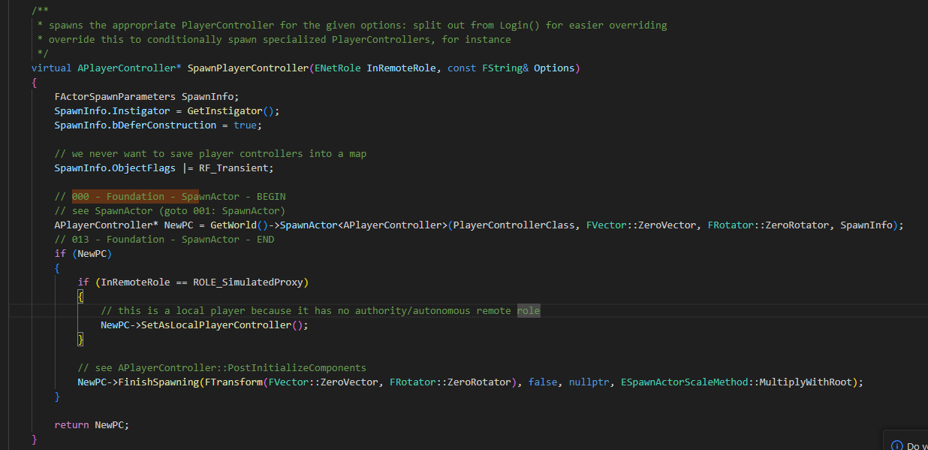
GameModeBase SpawnPlayerController 000

Slide 2
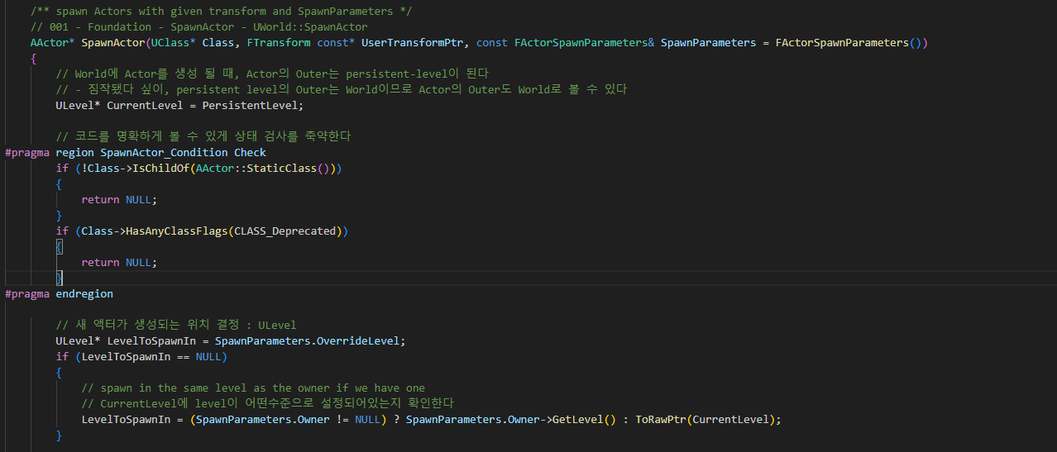
World SpawnActor 001

Slide 3
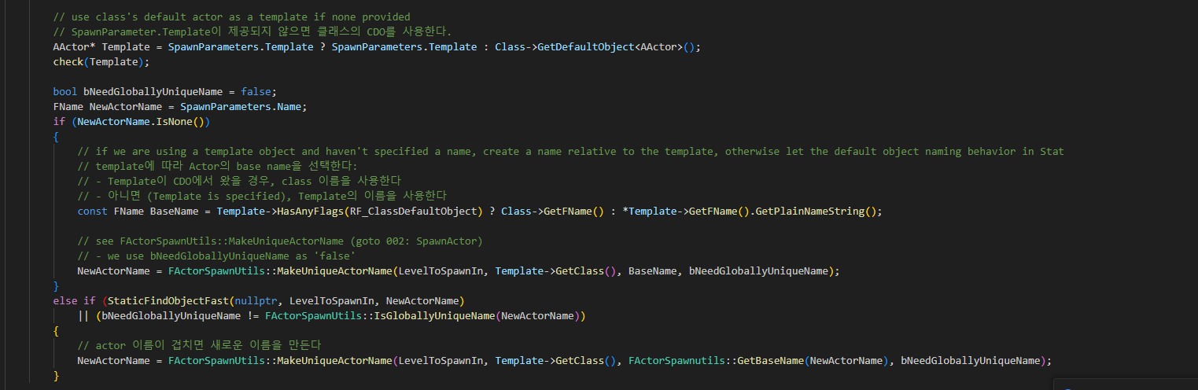
World SpawnActor 001

Slide 4
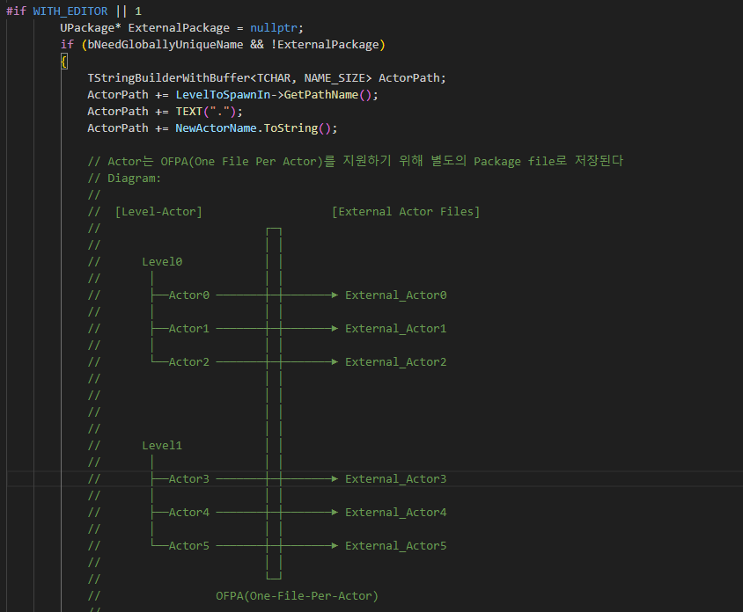
World SpawnActor 001

Slide 5
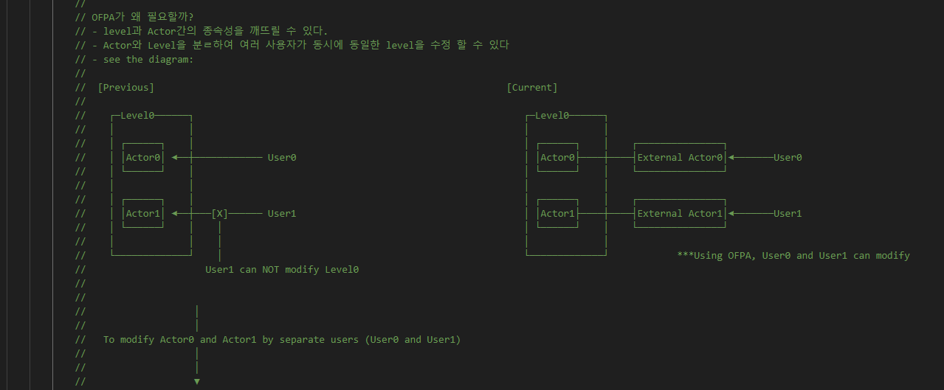
World SpawnActor 001

Slide 6
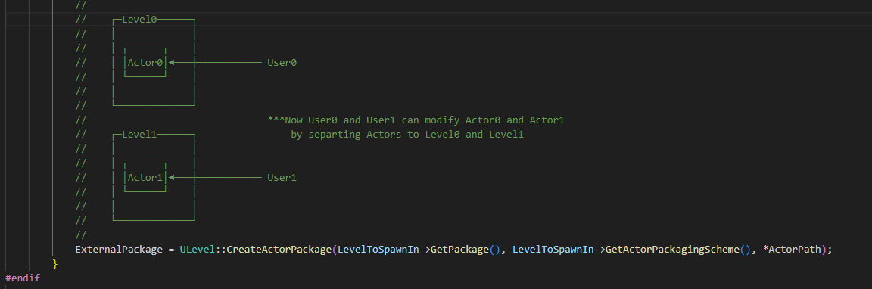
World SpawnActor 001

Slide 7
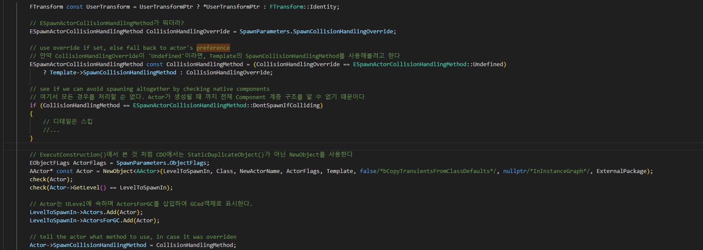
World SpawnActor 001

Slide 8
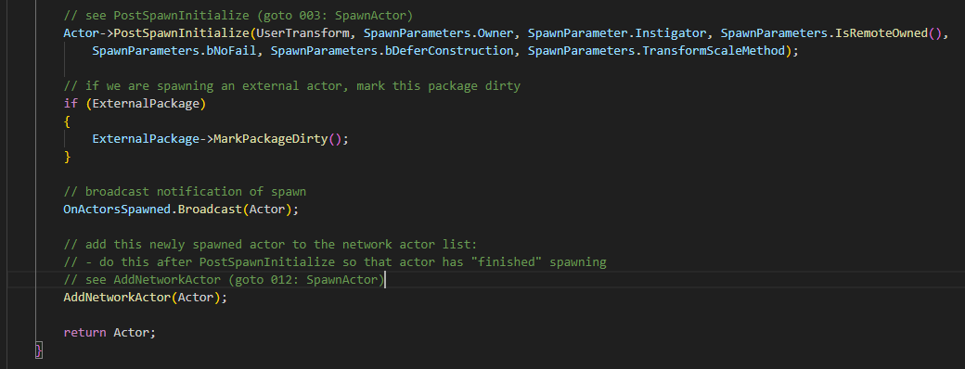
World SpawnActor 001

Slide 9
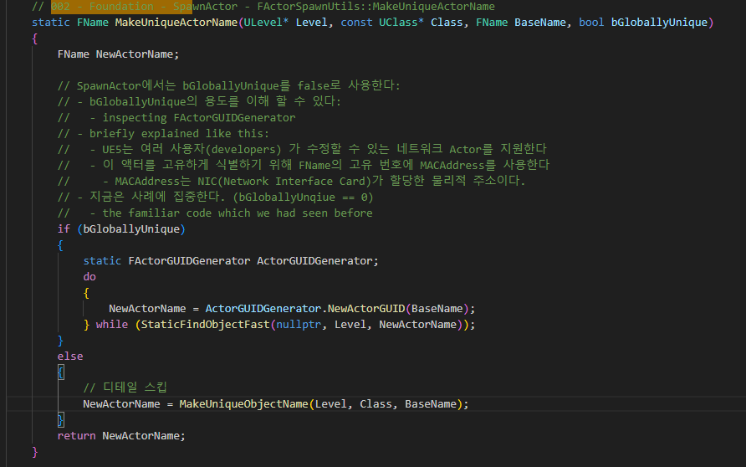
World FActorSpawnUtils::MakeUniqueActorName 002

Slide 10
World SpawnActor 001

Slide 11
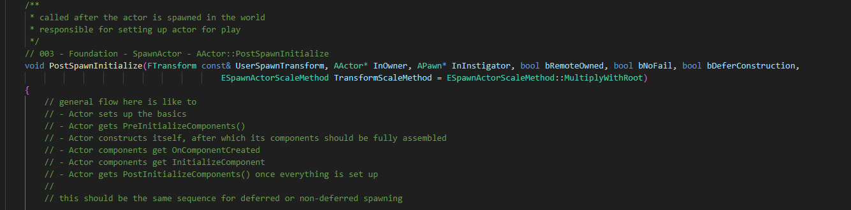
Actor PostSpawnInitialize 003

Slide 12
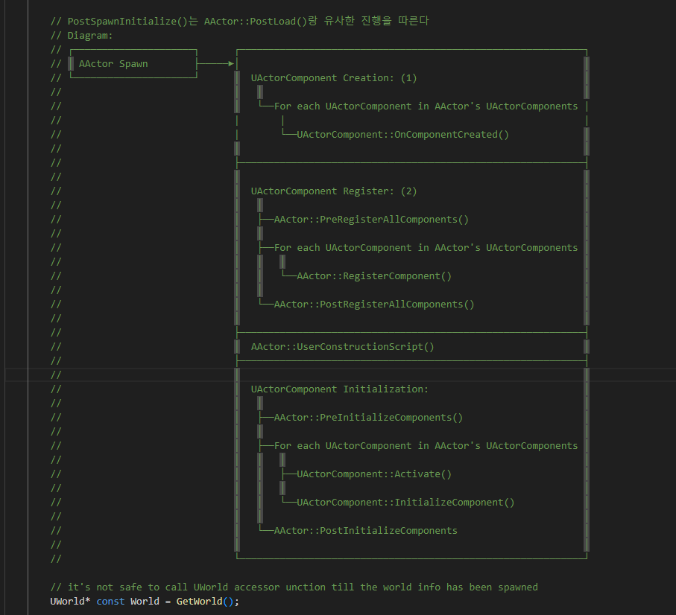
Actor PostSpawnInitialize 003

Slide 13
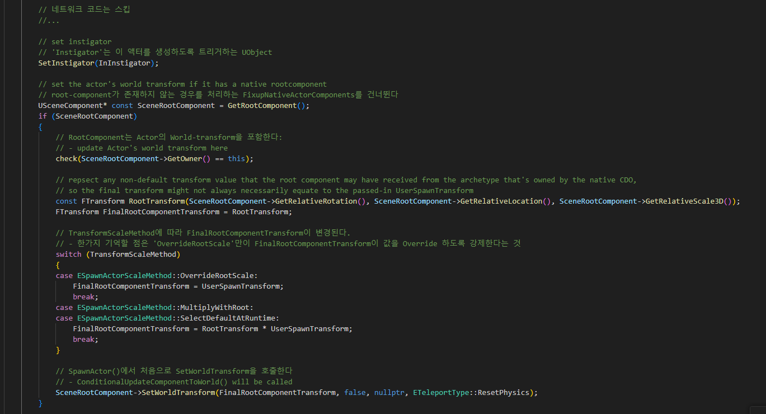
Actor PostSpawnInitialize 003

Slide 14
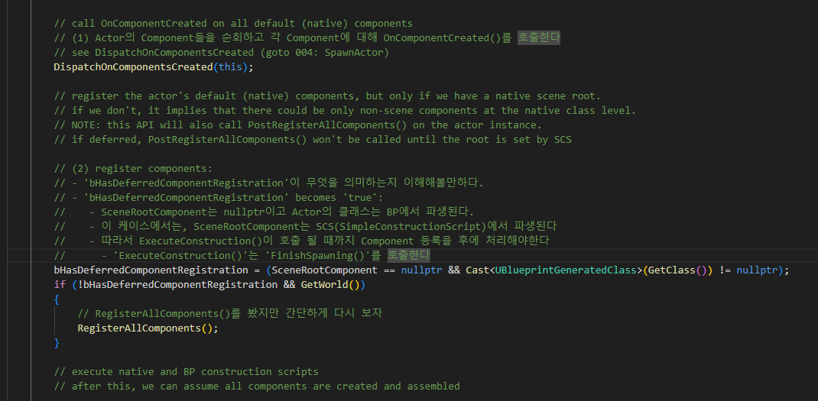
Actor PostSpawnInitialize 003

Slide 15
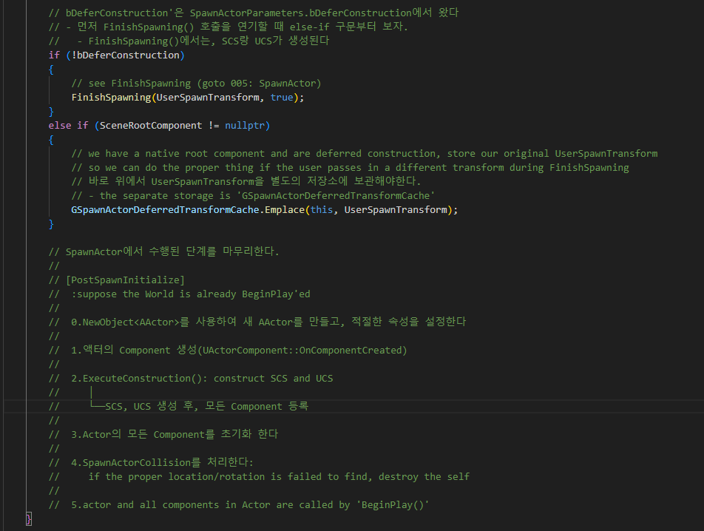
Actor PostSpawnInitialize 003

Slide 16
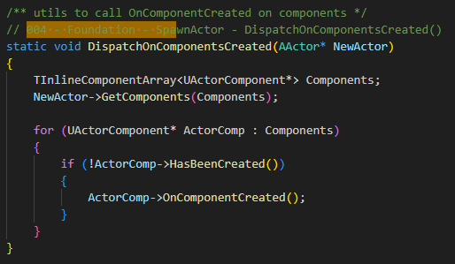
Actor DispatchOnComponentsCreated 004

Slide 17
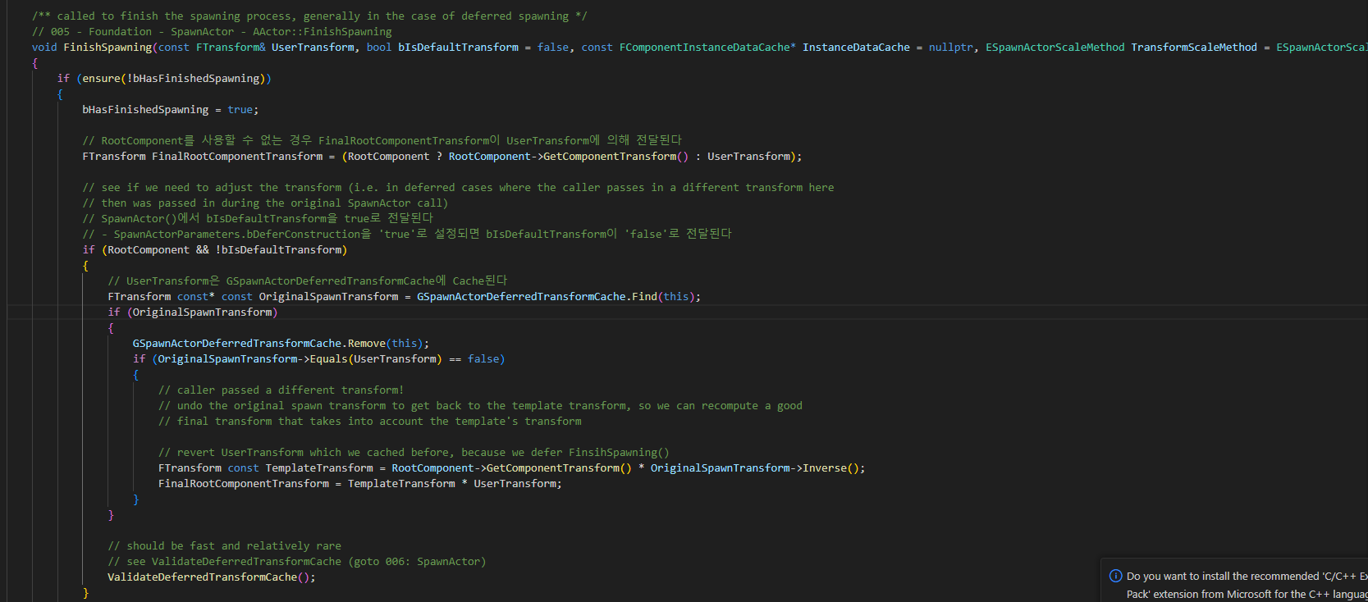
Actor FinishSpawning 005

Slide 18
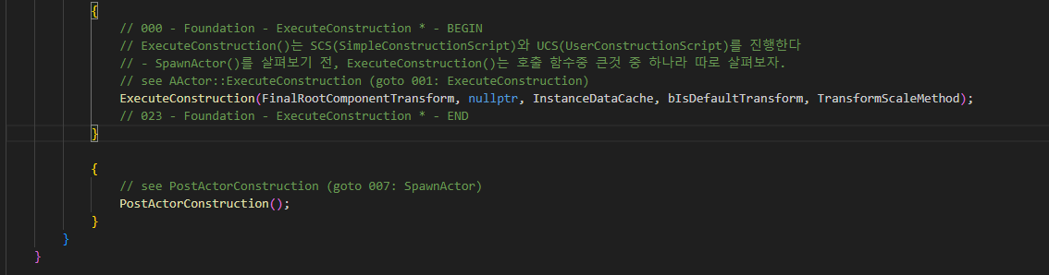
Actor FinishSpawning 005

Slide 19
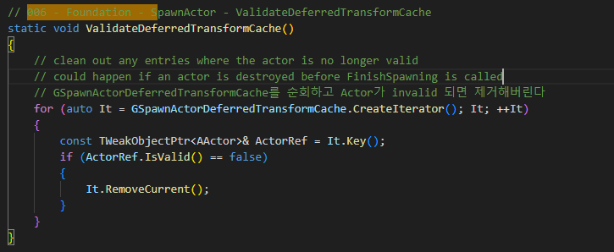
Actor ValidateDeferredTransformCache 006

Slide 20
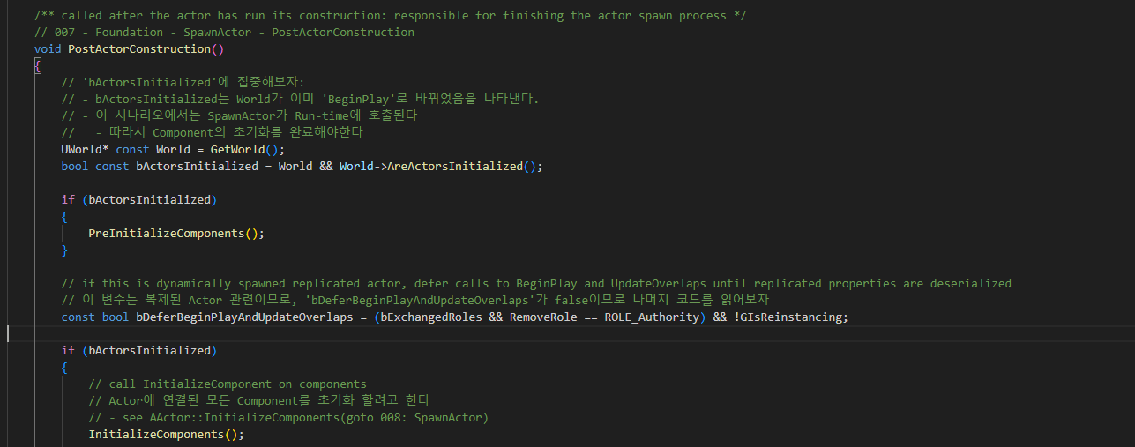
Actor PostActorConstruction 007

Slide 21
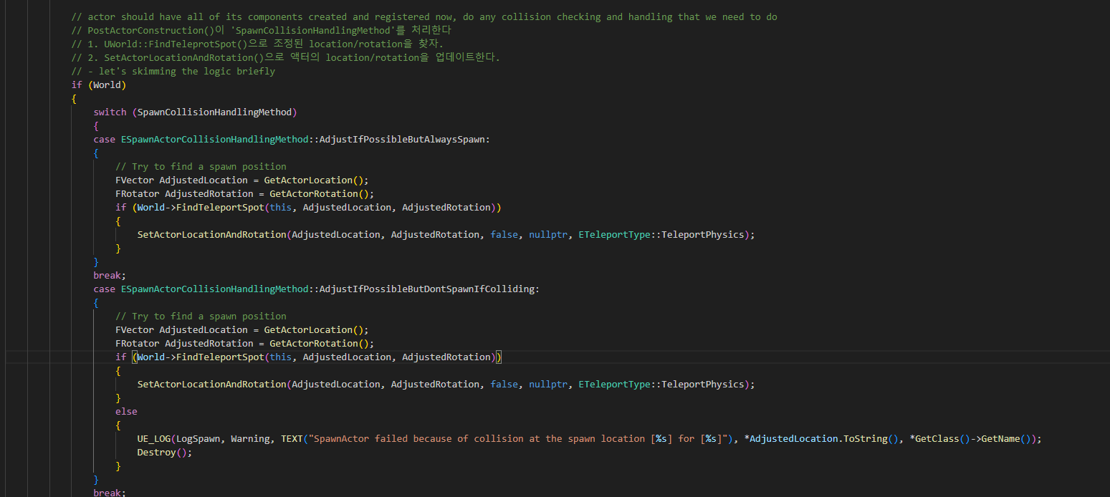
Actor PostActorConstruction 007

Slide 22
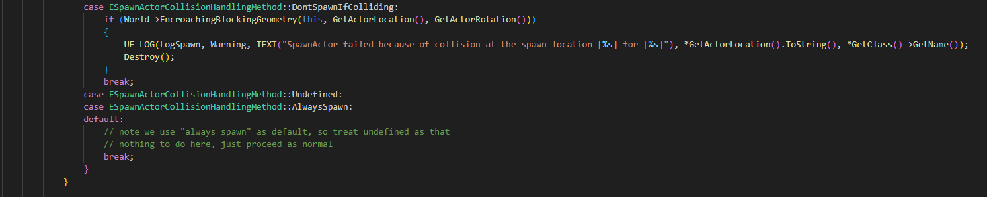
Actor PostActorConstruction 007

Slide 23
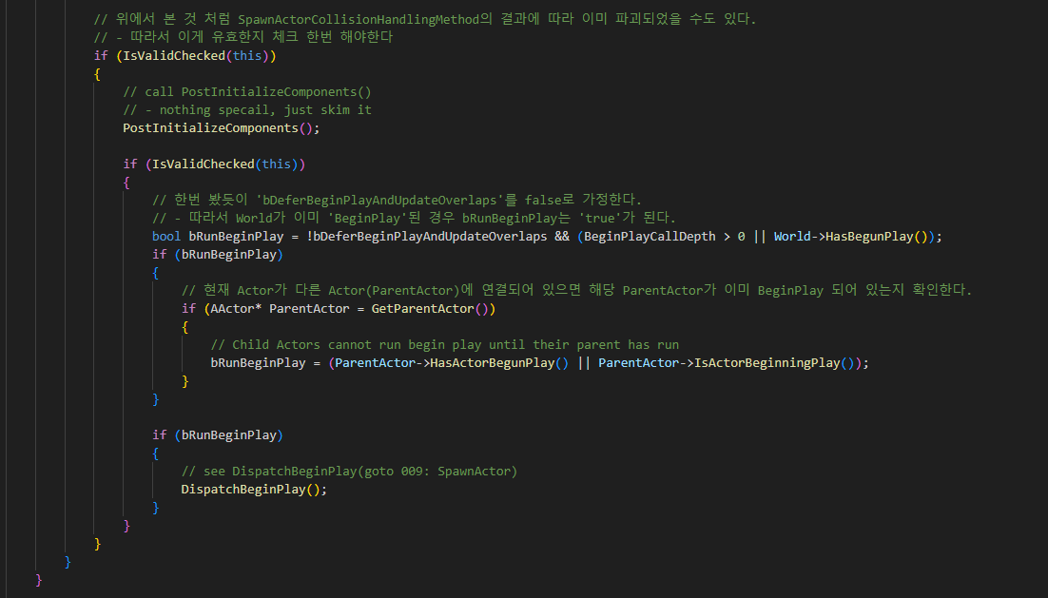
Actor PostActorConstruction 007

Slide 24
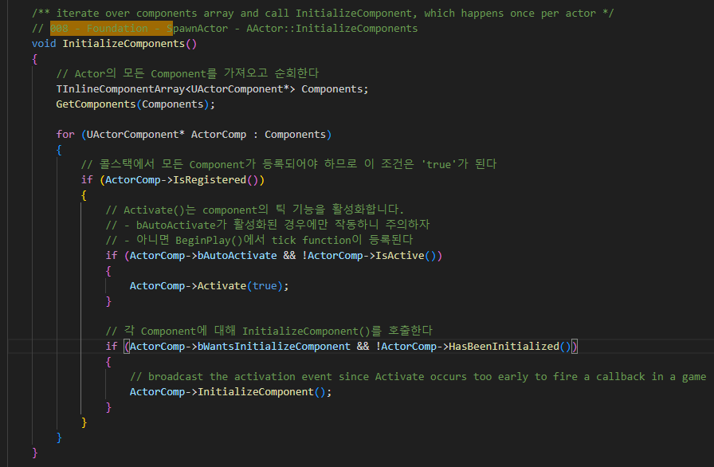
Actor InitializeComponents 008

Slide 25
Actor PostActorConstruction 007

Slide 26
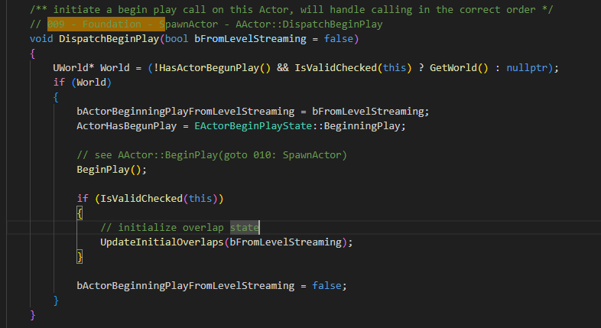
Actor DispatchBeginPlay 009

Slide 27
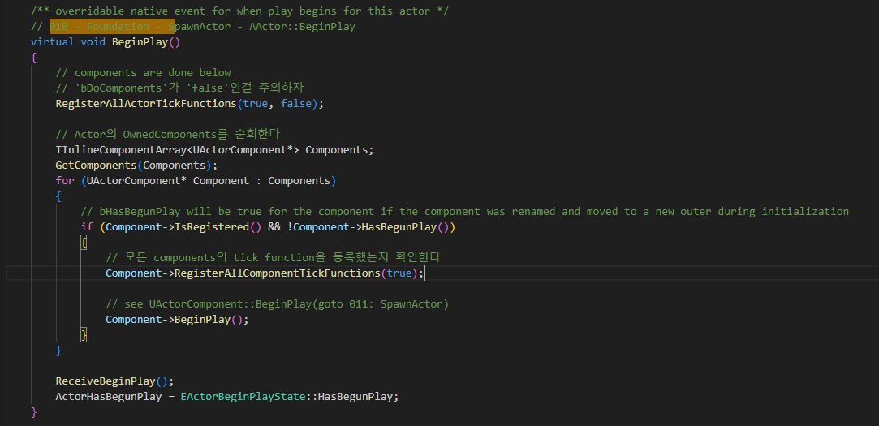
Actor BeginPlay 010

Slide 28
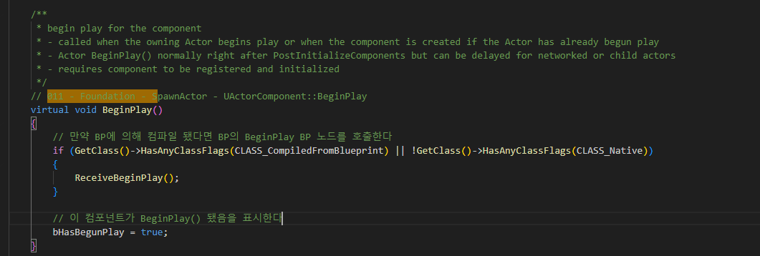
Actor BeginPlay 011

Slide 29
World SpawnActor 001

Slide 30
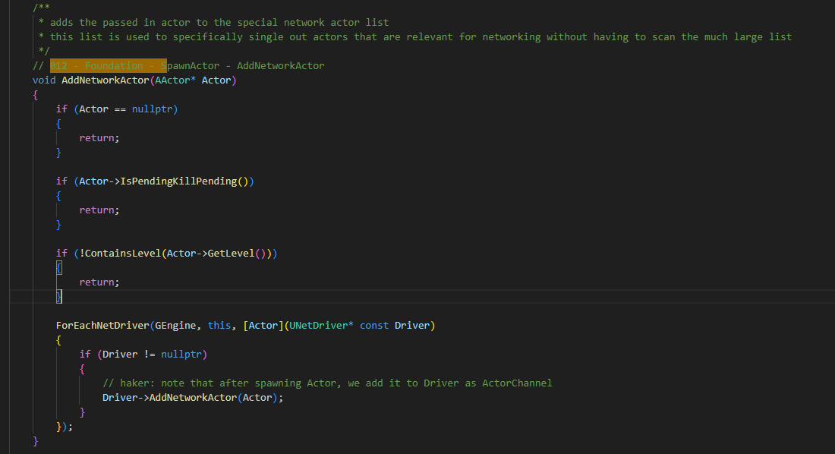
World AddNetworkActor 012

Slide 31
GameModeBase SpawnPlayerController 000

