Slide 1
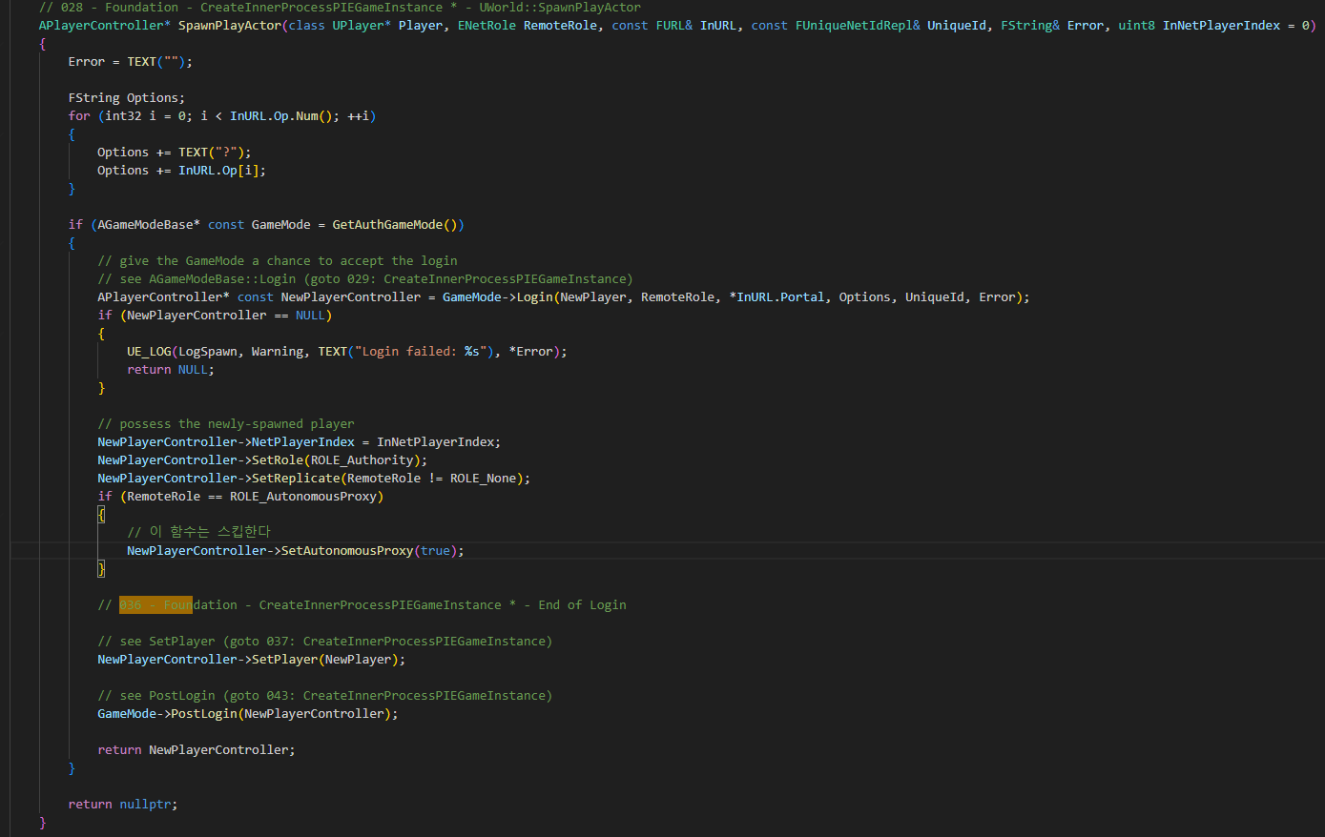
World SpawnPlayActor 036

Slide 2
World SpawnPlayActor 036

Slide 3
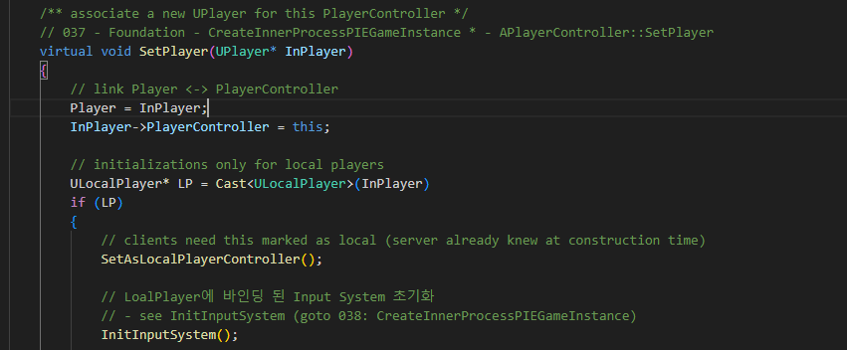
PlayerController SetPlayer 037

Slide 4
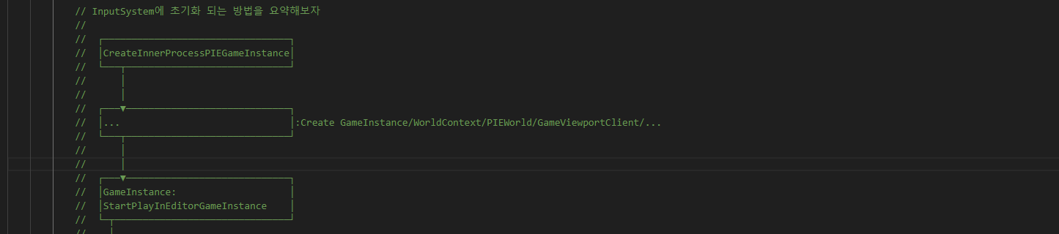
PlayerController SetPlayer 037

Slide 5
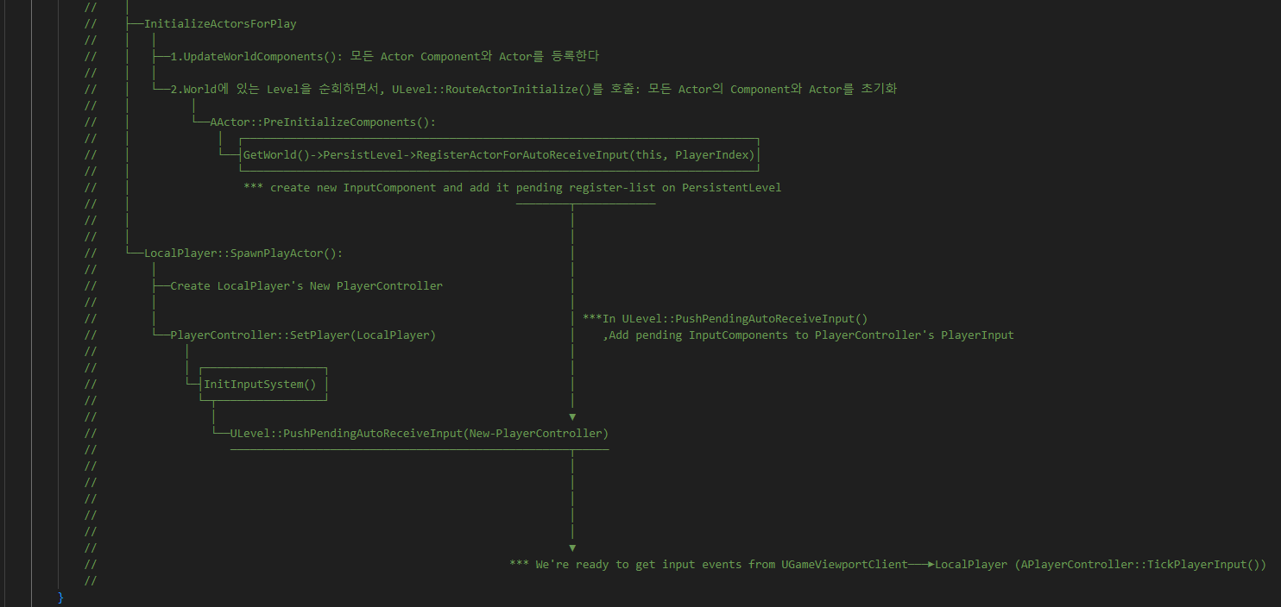
PlayerController SetPlayer 037

Slide 6
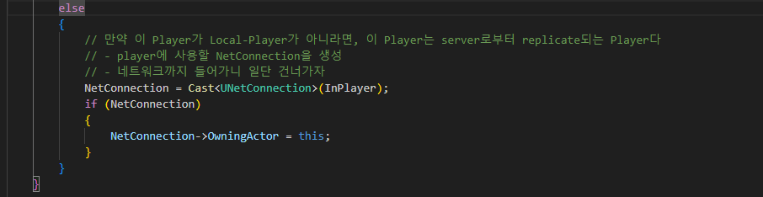
PlayerController SetPlayer 037

Slide 7
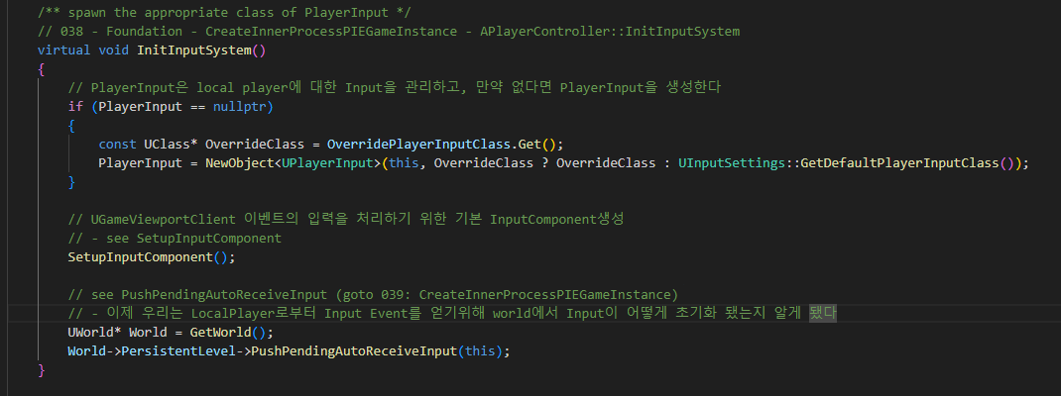
PlayerController InitInputSystem 038

Slide 8
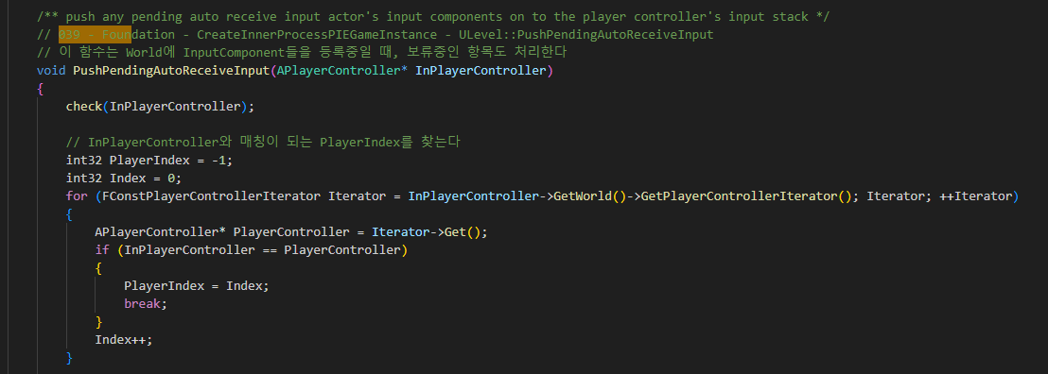
PlayerController InitInputSystem 039

Slide 9
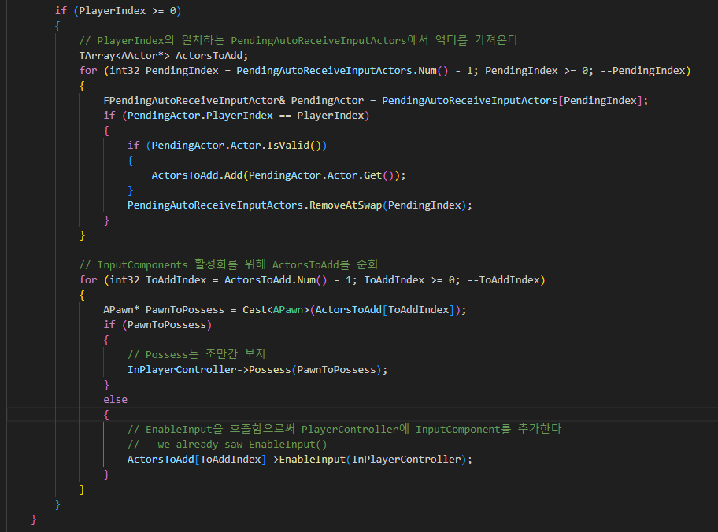
PlayerController InitInputSystem 039

Slide 10
PlayerController InitInputSystem 038

Slide 11
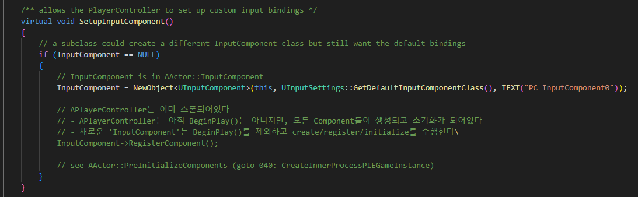
PlayerController SetupInputComponent

Slide 12
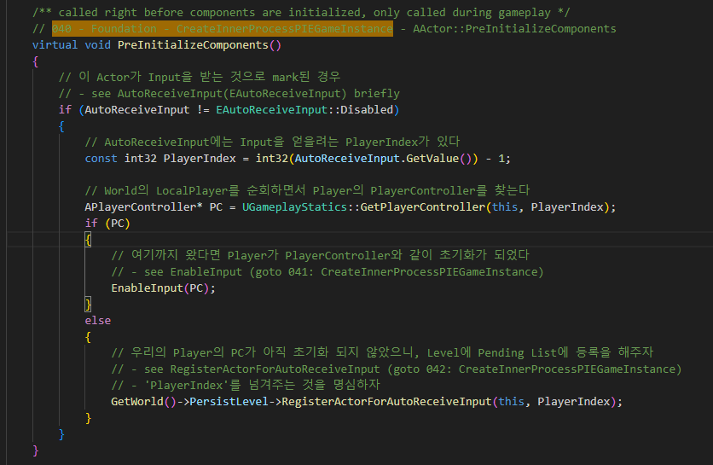
Actor PreInitiailizeComponent 040

Slide 13
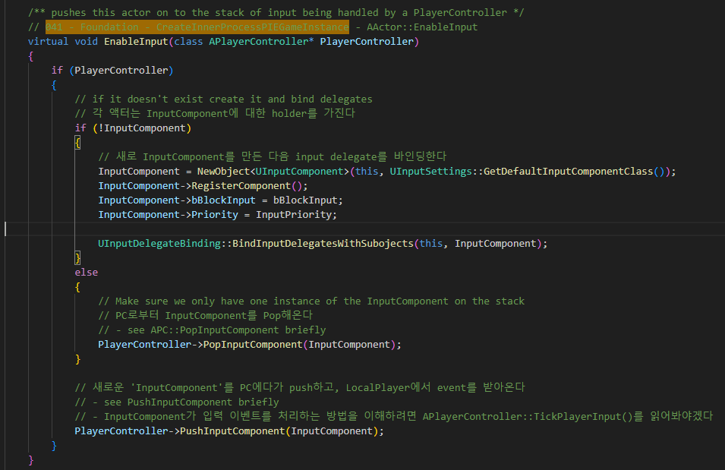
Actor EnableInput 041

Slide 14
Actor PreInitiailizeComponent 040

Slide 15
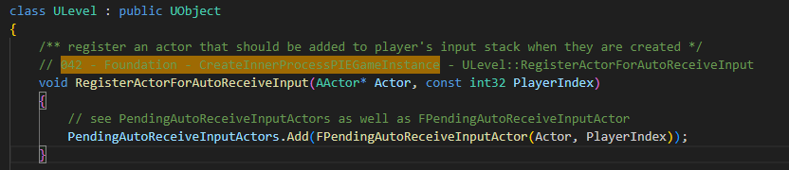
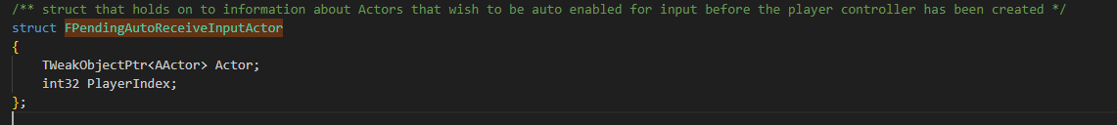
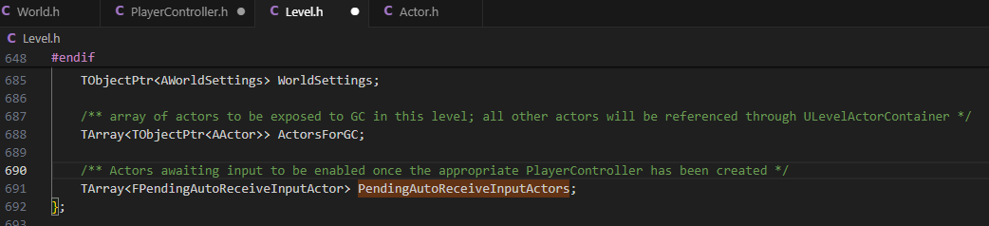
Level RegisterActorForAutoReceiveInput 042

Slide 16
World SpawnPlayActor 036

Slide 17
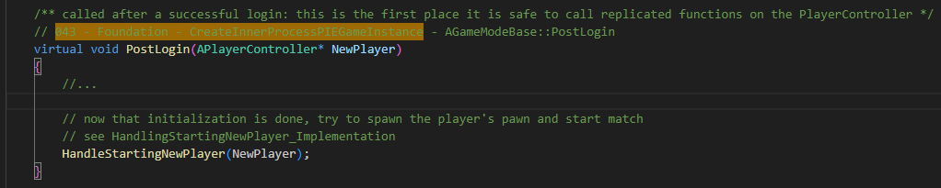
GameModeBase PostLogin 043

Slide 18
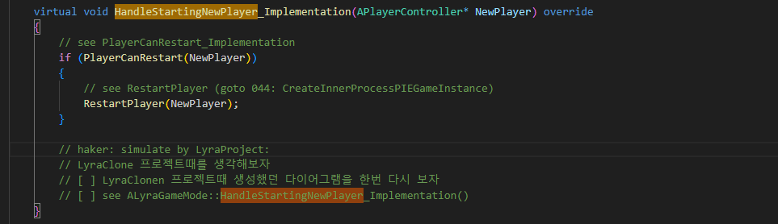
GameModeBase HandleStartNewPlayer_Implementation

Slide 19
GameInstance
world
Level
LyraGameMode
LyraGameState
LyraCloneExperienceManagerComponent
LyraCloneCharacter
LyraPlayerController
LyraClonePlayerState
1. InitializeActorsForPlayer
2. InitGame
3. TimerManager->SetTimerForNextTick(HandlerMatchAssignmentNotExpectingOne)
4. RouteActorInitialize
5. PreInitializeComponents
7. LyraCloneGameState::LyraCloneGameState()
6. World->SpawnActor(GameStateClass)
8. CreateDefaultSubobject<LyraCloneExperienceManagerComponent>()
9. InitGameState
GameState->FindComponentByClass<LyraCloneExperienceManagerComponent>()
11. SpawnPlayerActor
10. ExperienceManagerComponent->CallorRegister_OnExperienceLoaded(this::OnExperienceLoaded)
12. Login
15. InitNewPlayer
13. SpawnPlayerController
14. InitPlayerState
17. UpdatePlayerStartSpot
16. SpawnActor<PlayerState>
18. FindPlayerStart_Implementation
19. ChoosePlayerStart_Implementation
20. GetDefaultPawnClassForController_Implementation
21. GetPawnDataForController
22. Login(End)
23. PostLogin
24. HandleStartingNewPlayer_Implementation
25. ALyraCloneGameMode::HandleStartNewPlayer_Implementation(Override)
If (ExperienceLoaded())
{
Super::HandleStartingPawnPlayer_Implementation }

Slide 20
GameInstance
world
Level
LyraGameMode
LyraGameState
LyraCloneExperienceManagerComponent
LyraCloneCharacter
LyraPlayerController
LyraClonePlayerState
Next Frame
30. HandleMatchAssignmentIfNotExpectingOne
31. OnMatchAssignmentGiven
32. ExperienceManagerComponent->ServerSetCurrentExperience()
33. StartExperienceLoad
34. FStreamableDelegate::CreateUObject(this, &Thisclass::OnExperienceLoaded)
AfterExperienceLoaded
35. OnExperienceFullLoadCompleted
36. OnExperienceLoadedBroadCast
37. OnExperienceLoaded
39. OnExperienceLoaded
38. SetPawnData
40. RestartPlayerAtPlayerStart
여기서 우리는 실제로 SpawnActor를 하진 않는다. 이미 Spawn이 되있다! 상태 리셋정도만 해준다. (respawn관련 대응인듯 한데)

Slide 21
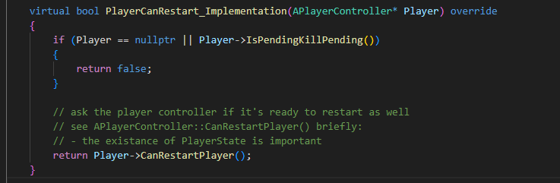
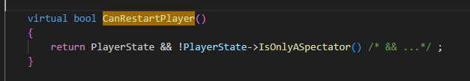
GameModeBase PlayerCanRestart_Implementation

Slide 22
GameModeBase HandleStartNewPlayer_Implementation

Slide 23
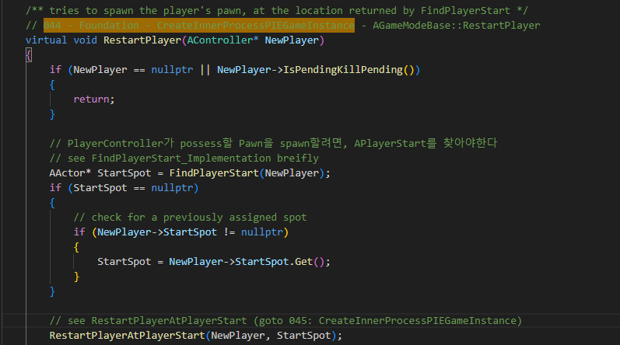
GameModeBase RestartPlayer 044

Slide 24
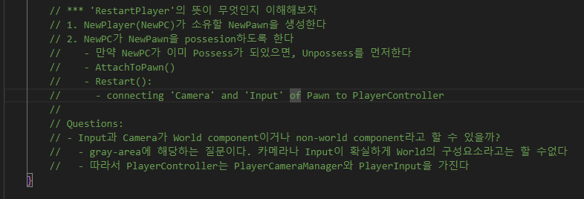
GameModeBase RestartPlayer 044

Slide 25
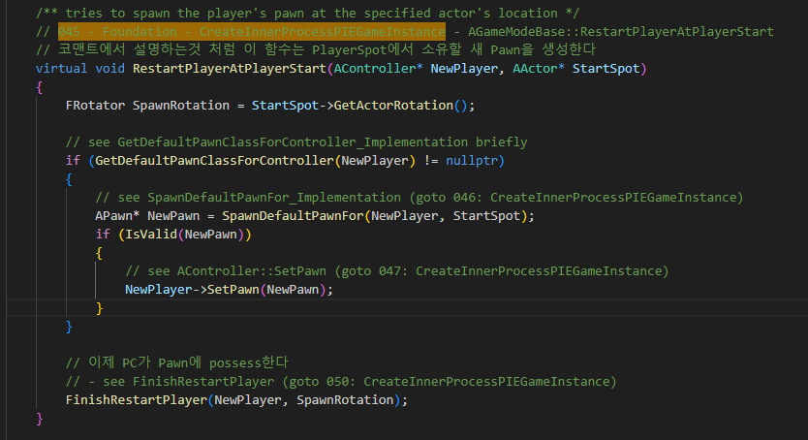
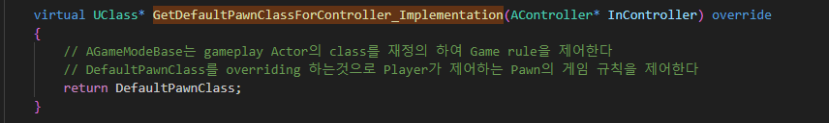
GameModeBase RestartPlayerAtPlayerStart 045

Slide 26
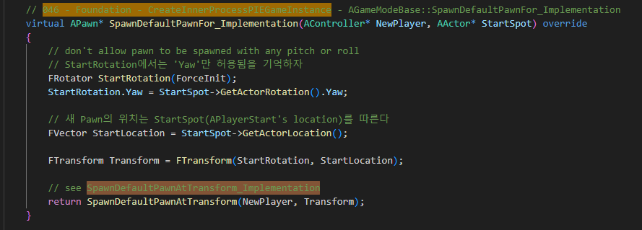
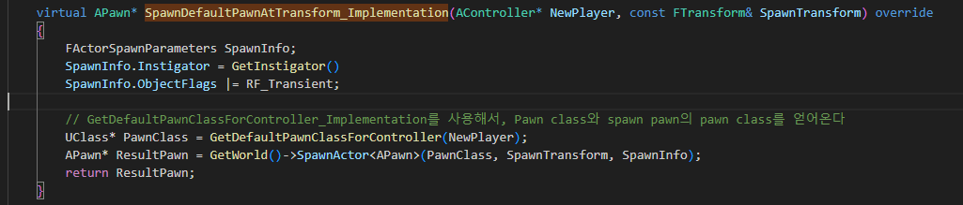
GameModeBase SpawnDefaultPawnFor_Implementation 046

Slide 27
GameModeBase RestartPlayerAtPlayerStart 045

Slide 28
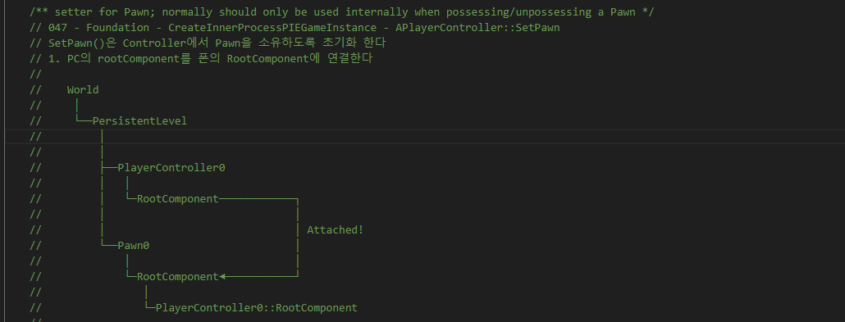
GameModeBase RestartPlayerAtPlayerStart 047

Slide 29
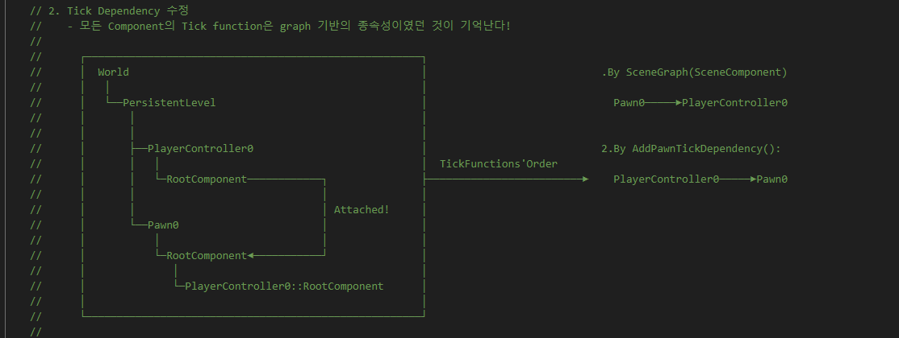
GameModeBase RestartPlayerAtPlayerStart 047

Slide 30
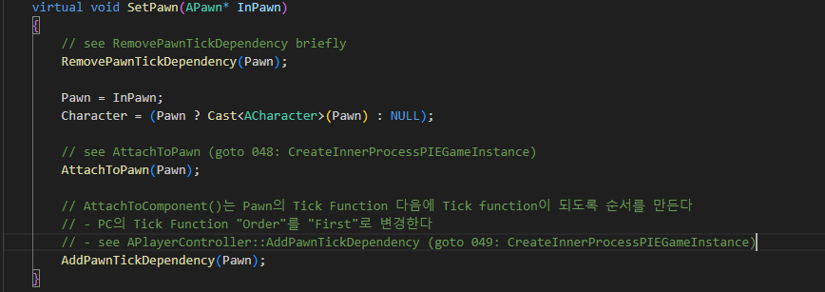
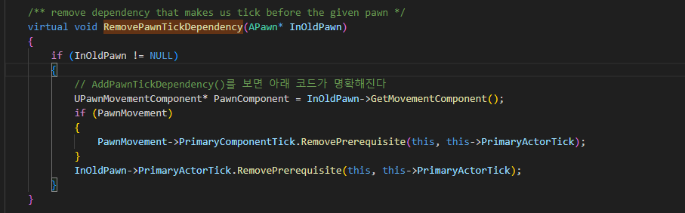
GameModeBase RestartPlayerAtPlayerStart 047

Slide 31
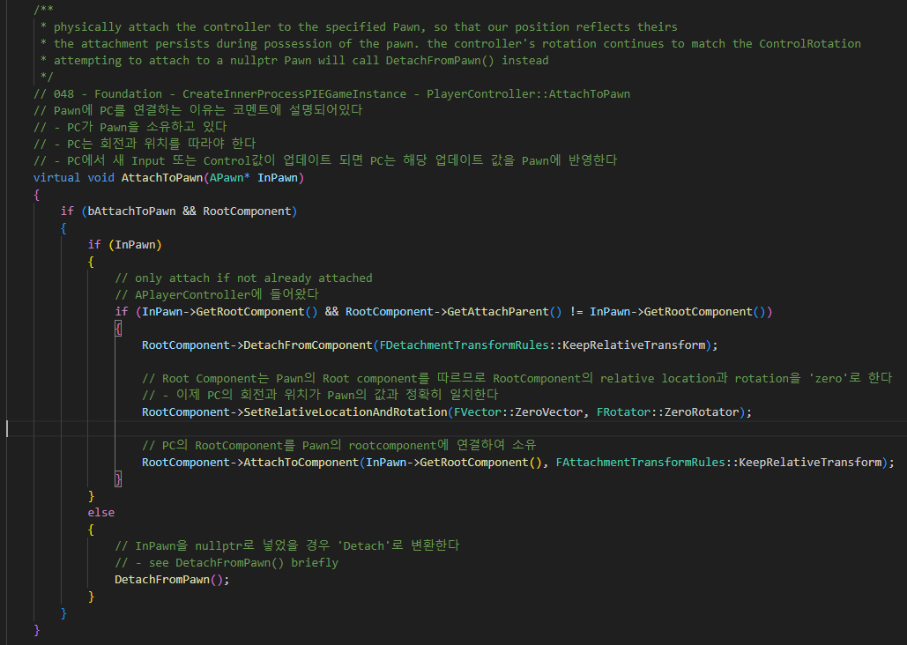
PlayerController AttachToPawn 048

Slide 32
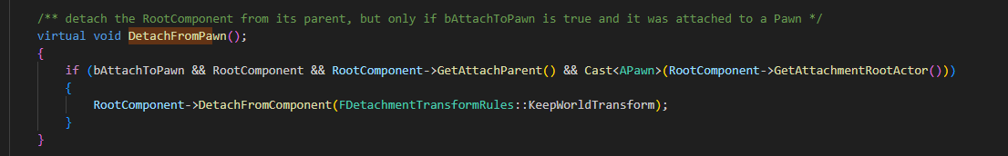
PlayerController AttachToPawn 048

Slide 33
GameModeBase RestartPlayerAtPlayerStart 047

Slide 34
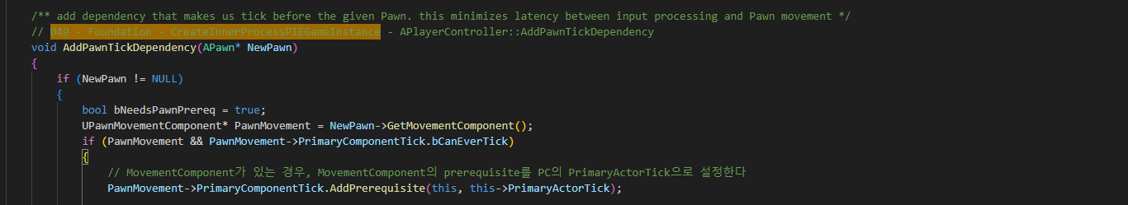
PlayerController AddPawnTickDependency 049

Slide 35
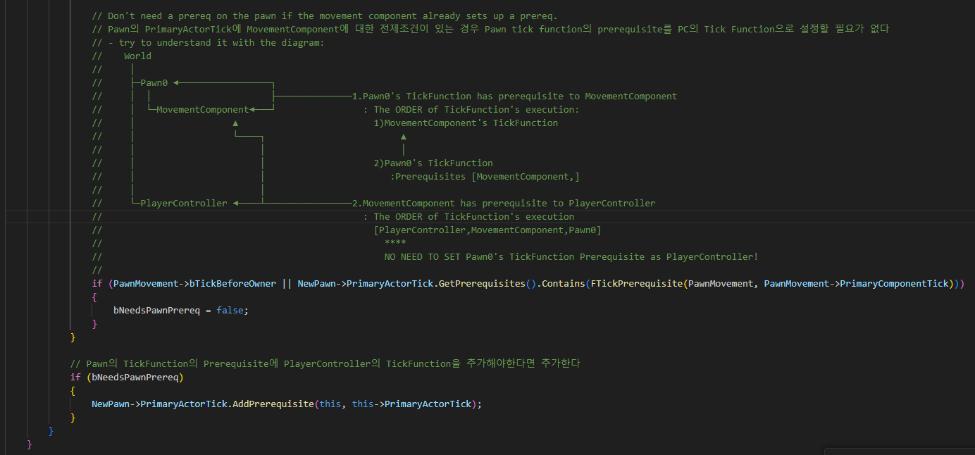
PlayerController AddPawnTickDependency 049

Slide 36
GameModeBase RestartPlayerAtPlayerStart 045

Slide 37
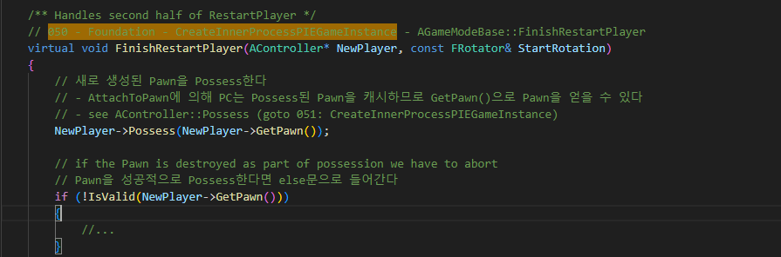
GameModeBase FinishRestartPlayer 050

Slide 38
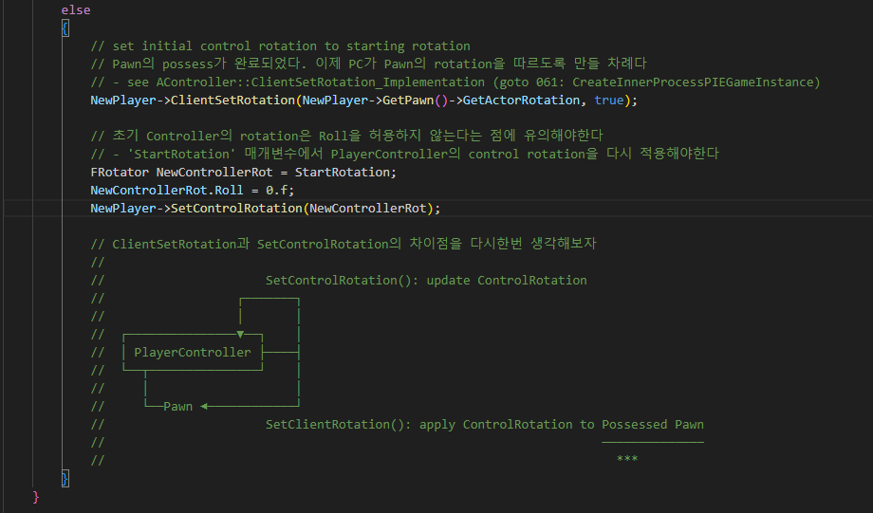
GameModeBase FinishRestartPlayer 050

Slide 39
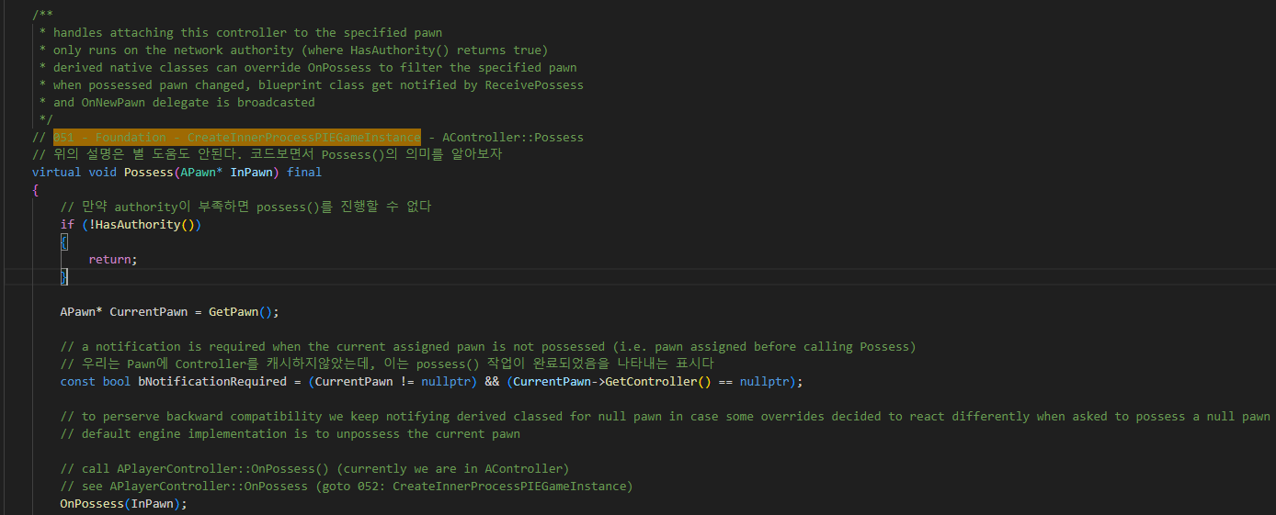
PlayerController Possess 051

Slide 40
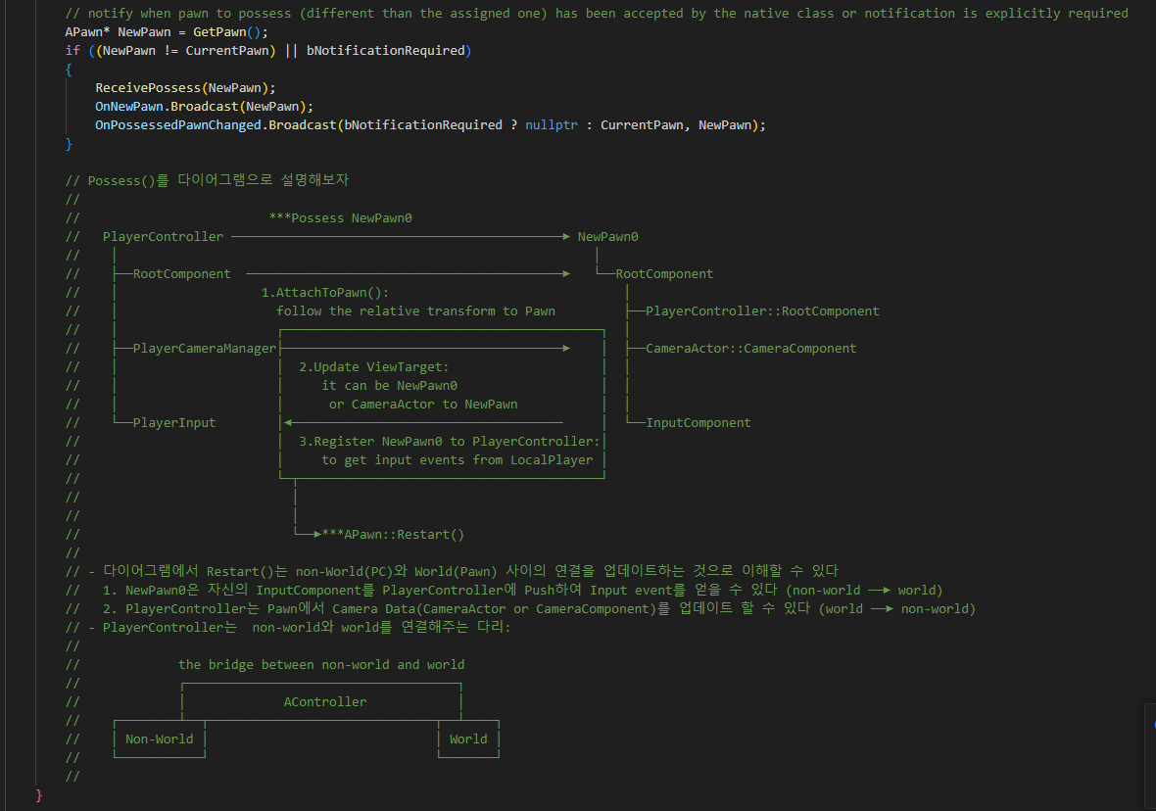
PlayerController Possess 051

Slide 41
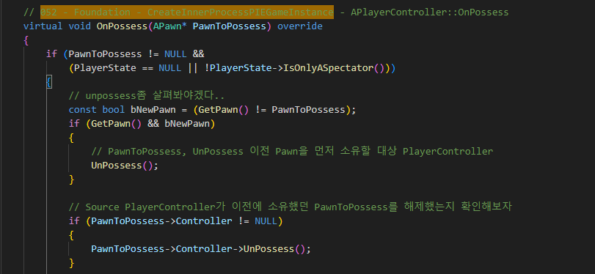
PlayerController OnPossess 052

Slide 42
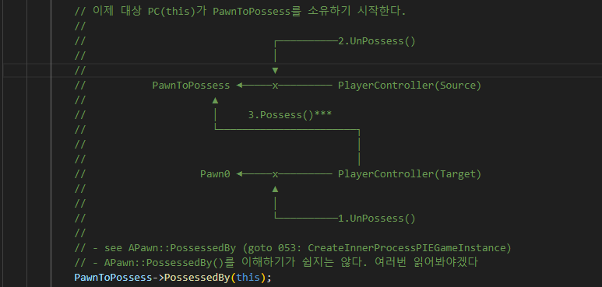
PlayerController OnPossess 052

Slide 43
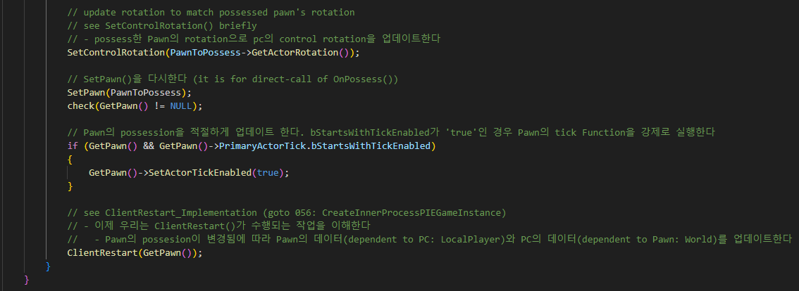
PlayerController OnPossess 052

Slide 44
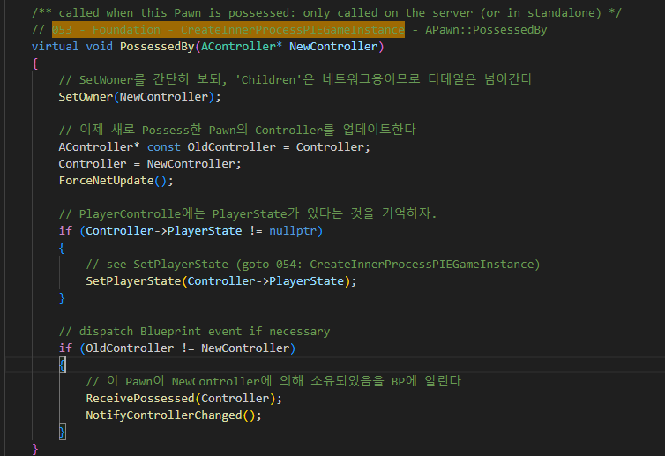
Pawn PossessedBy 053

Slide 45
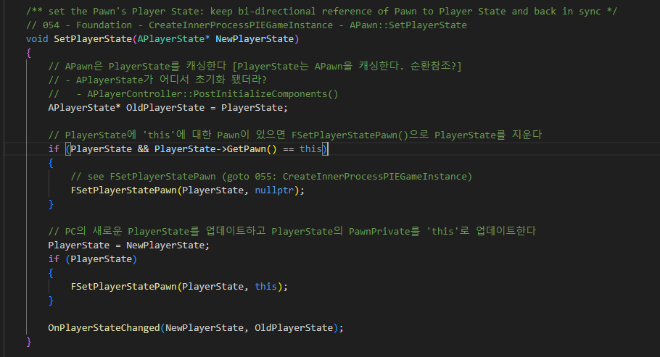
Pawn SetPlayerState 054

Slide 46
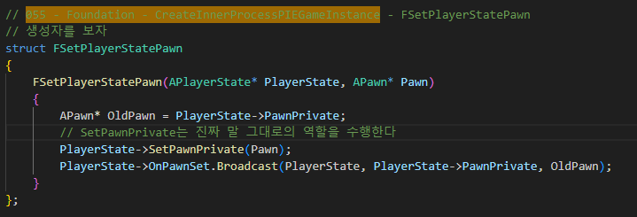
Pawn SetPlayerState 055

Slide 47
PlayerController OnPossess 052

Slide 48
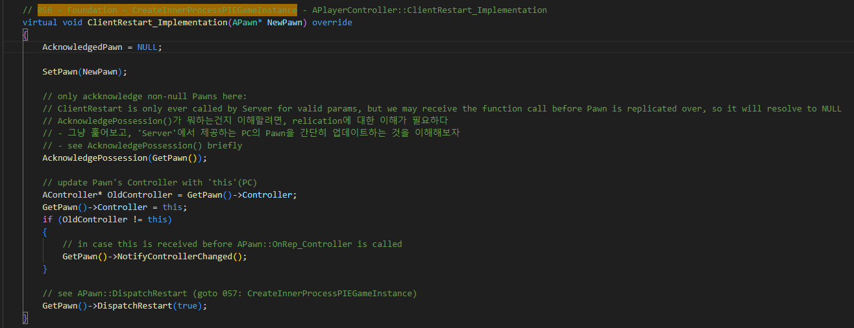
PlayerController ClientRestart 056

Slide 49
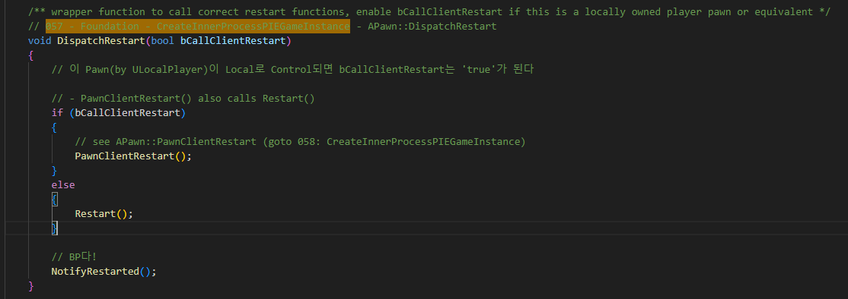
PlayerController ClientRestart 057

Slide 50
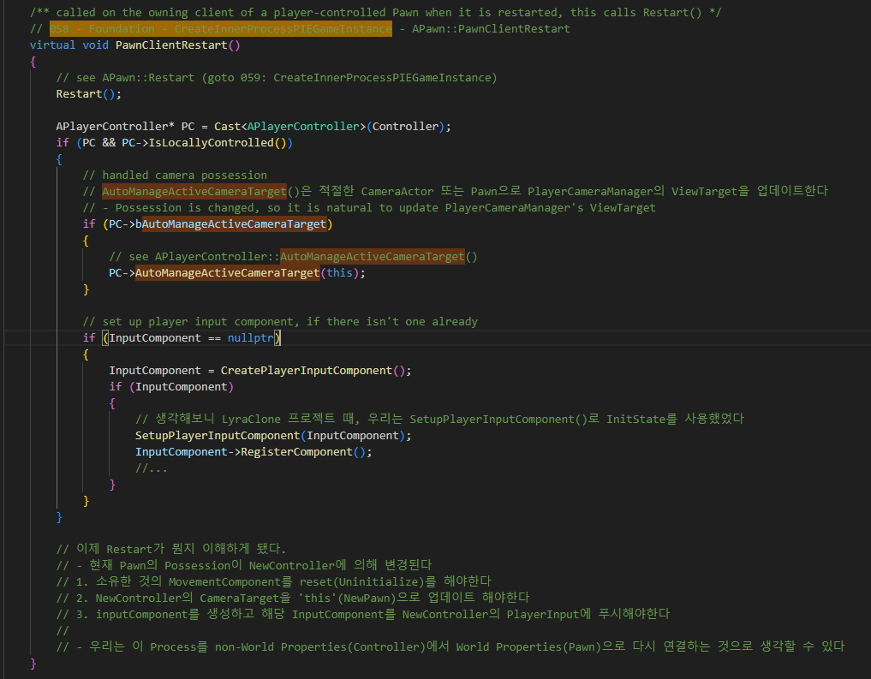
PlayerController ClientRestart 058

Slide 51
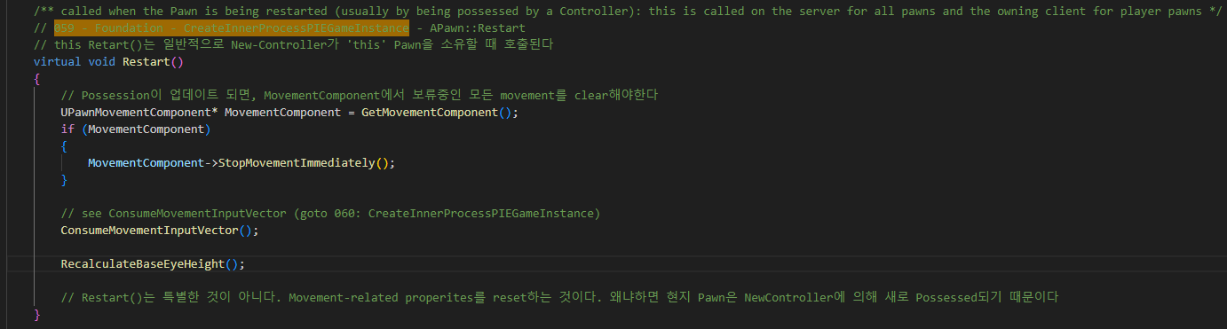
PlayerController Restart 059

Slide 52
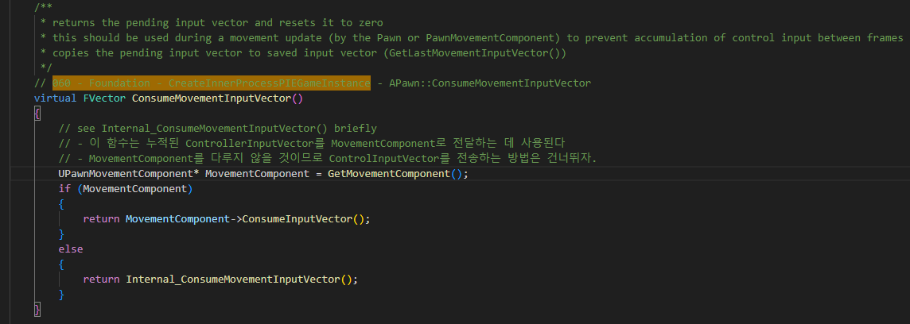
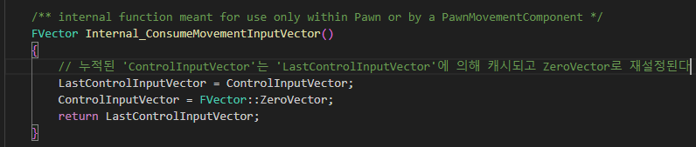
Pawn ConsumeMovementInputVector 060

Slide 53
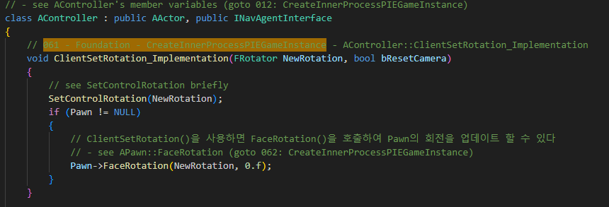
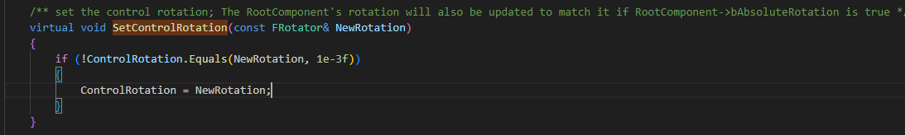
PlayerController ClientSetRotation_Inplementation 061

Slide 54

PlayerController FaceRotation 062

Slide 55

GameInstance StartPlayInEditorGameInstance 021

Slide 56

World BeginPlay 063

Slide 57

GameModeBase StartPlay 064

Slide 58

GameModeBase StartPlay 065

Slide 59

WorldSettings NotifyBeginPlay() 066

Slide 60

EditorEngine CreateInnerProcessPIEGameInstance 000

Slide 61

EditorEngine CreateInnerProcessPIEGameInstance 000

Slide 62

EditorEngine CreateInnerProcessPIEGameInstance 000

Slide 63

EditorEngine CreateInnerProcessPIEGameInstance 068

