Slide 1
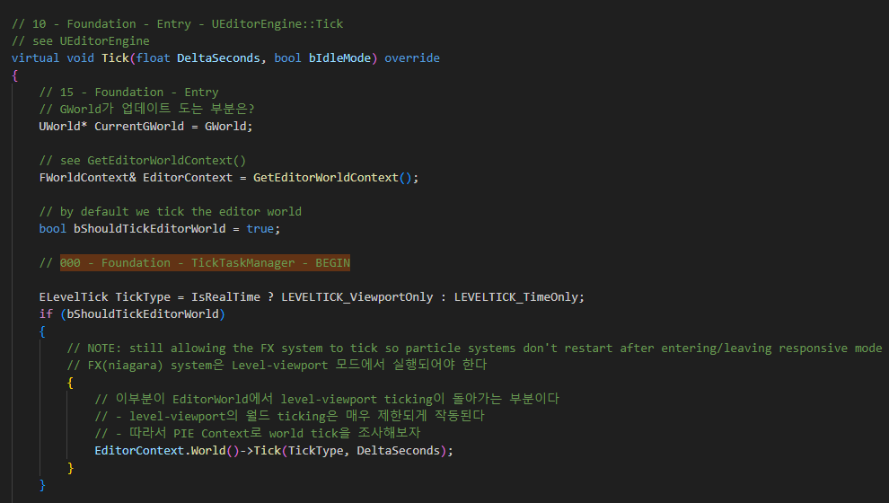
TickTaskManager 000

Slide 2
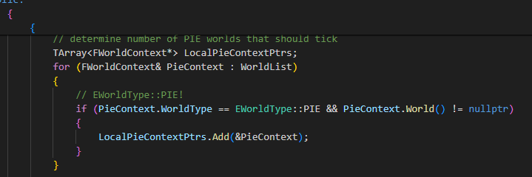
TickTaskManager 000

Slide 3
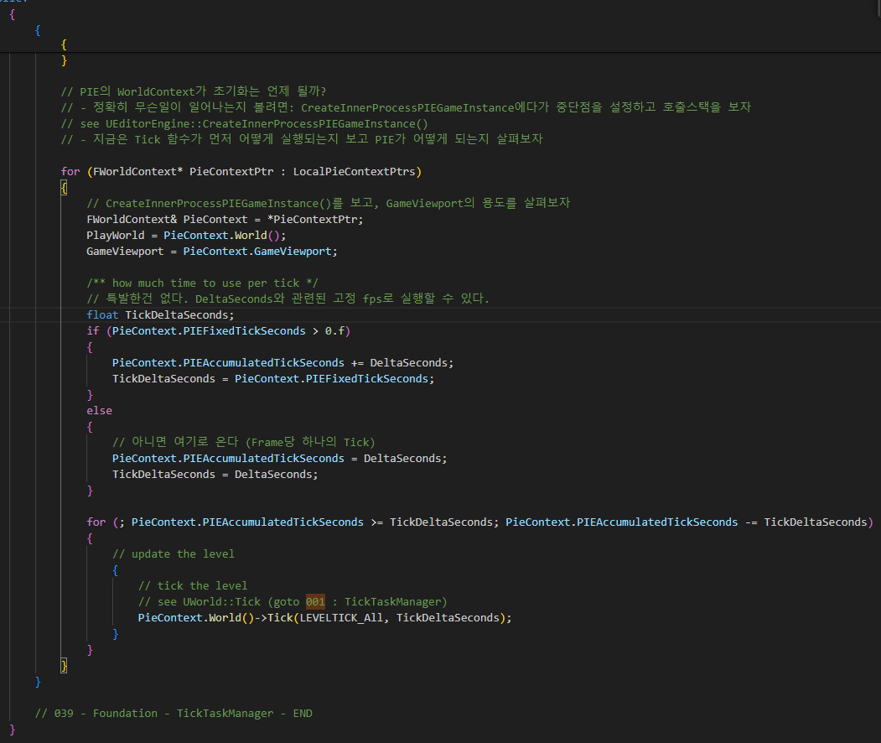
TickTaskManager

Slide 4
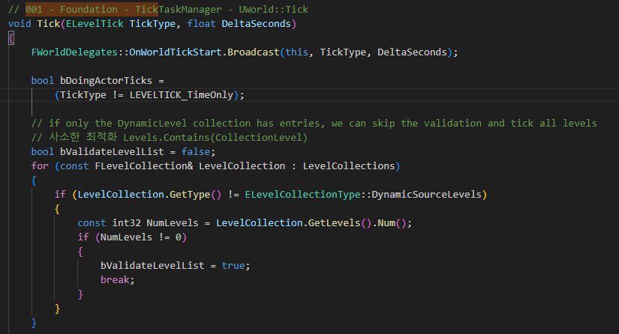
Uworld TickTaskManager 001

Slide 5
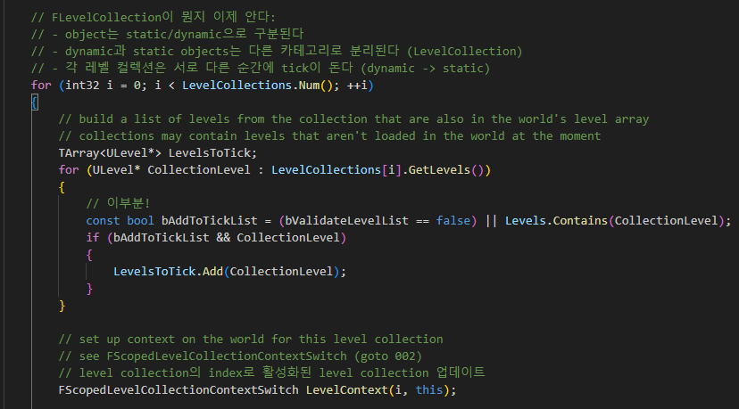
Uworld TickTaskManager 001

Slide 6
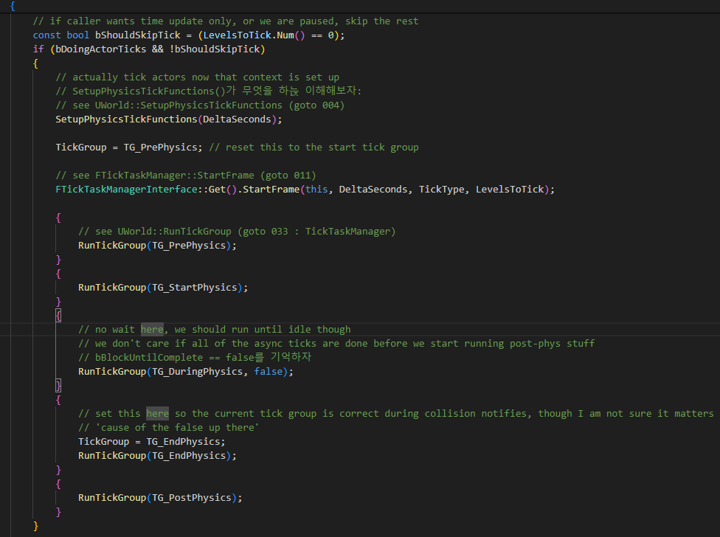
Uworld TickTaskManager 001

Slide 7
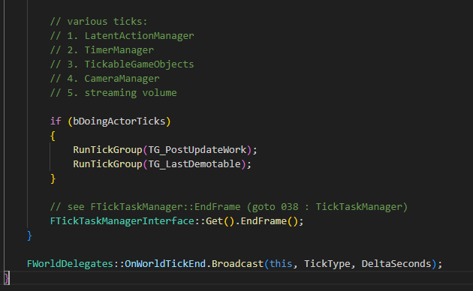
Uworld TickTaskManager 001

Slide 8
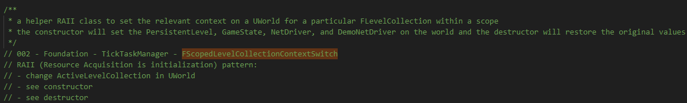
Uworld FSocpedLevelCollectionContextSwitch 002

Slide 9
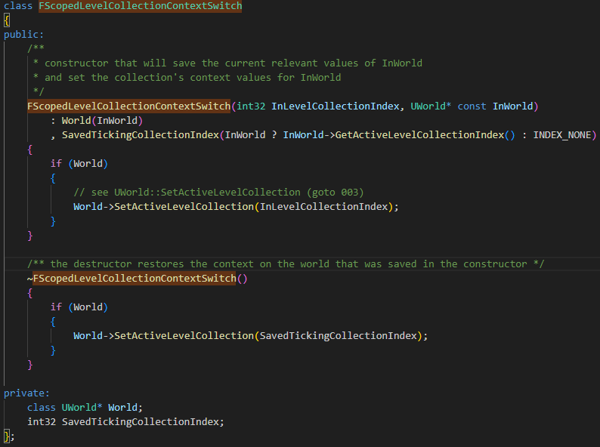
Uworld FSocpedLevelCollectionContextSwitch 002

Slide 10
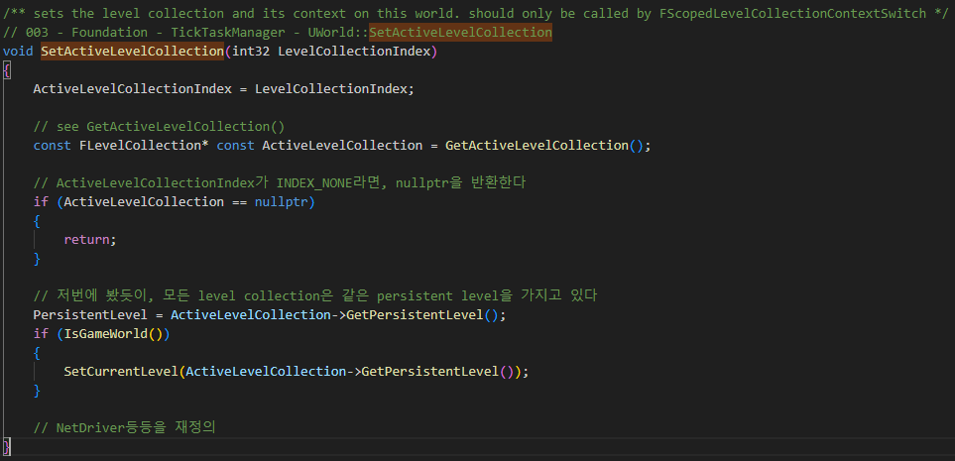
Uworld SetActiveLevelCollection 003

Slide 11
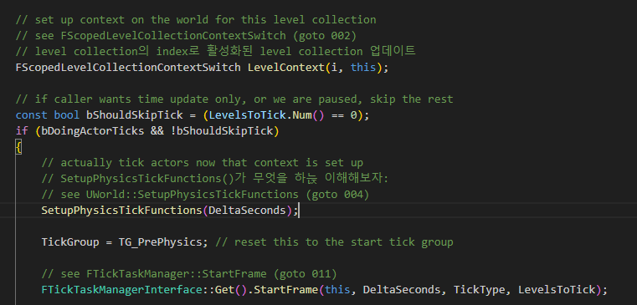
Uworld TickTaskManager 001

Slide 12
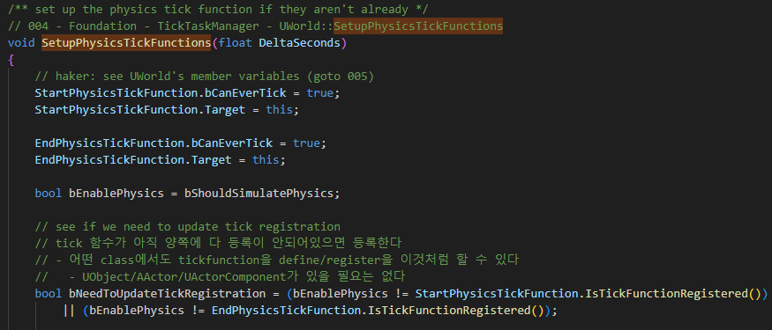
Uworld SetupPhysicsTickfunction 004

Slide 13
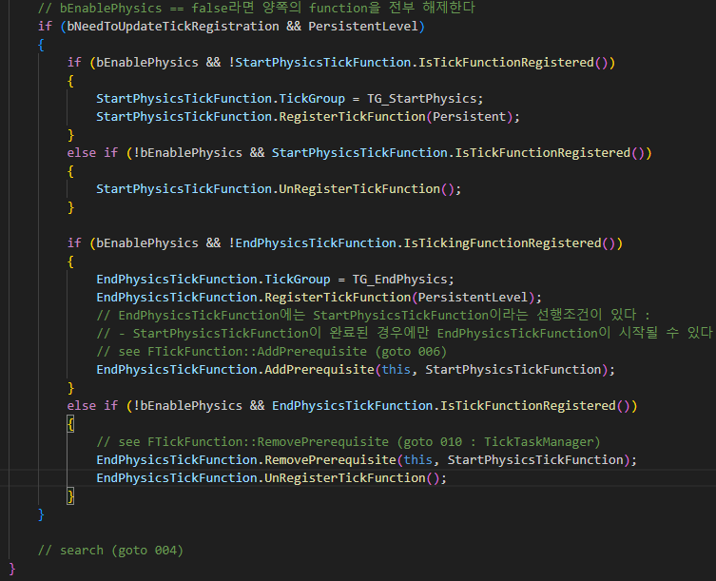
Uworld SetupPhysicsTickfunction 004

Slide 14
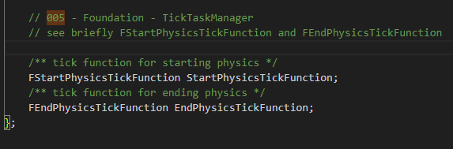
Uworld 005

Slide 15
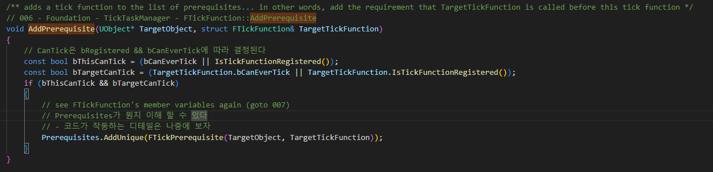
Uworld SetupPhysicsTickfunction 006

Slide 16
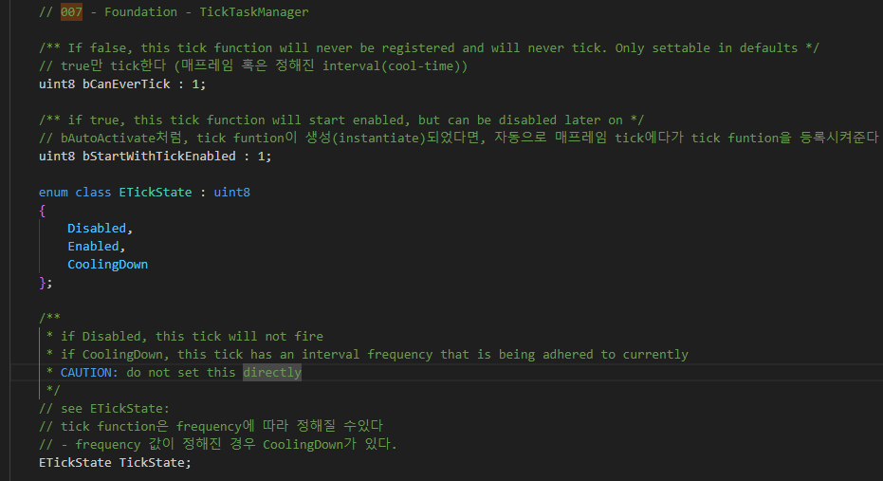
TickFunction 007

Slide 17
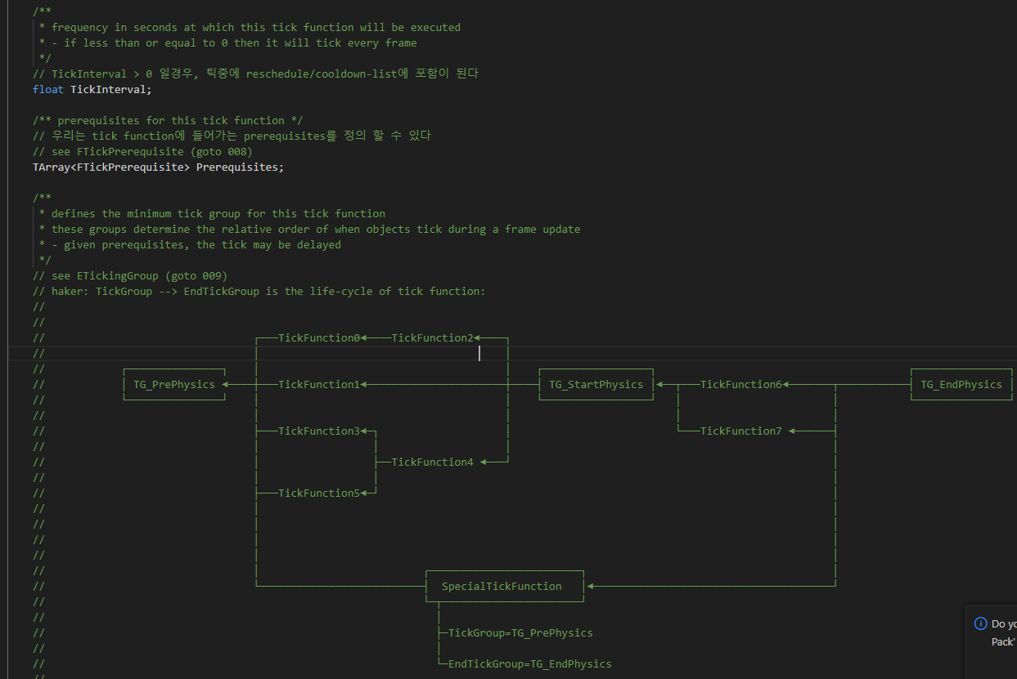
TickFunction 007

Slide 18
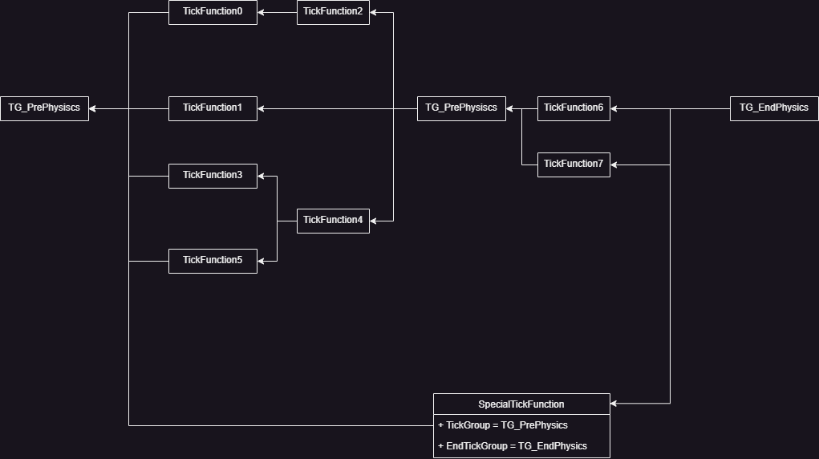
TickFunction 007

Slide 19
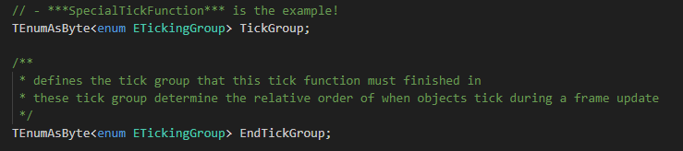
TickFunction 007

Slide 20
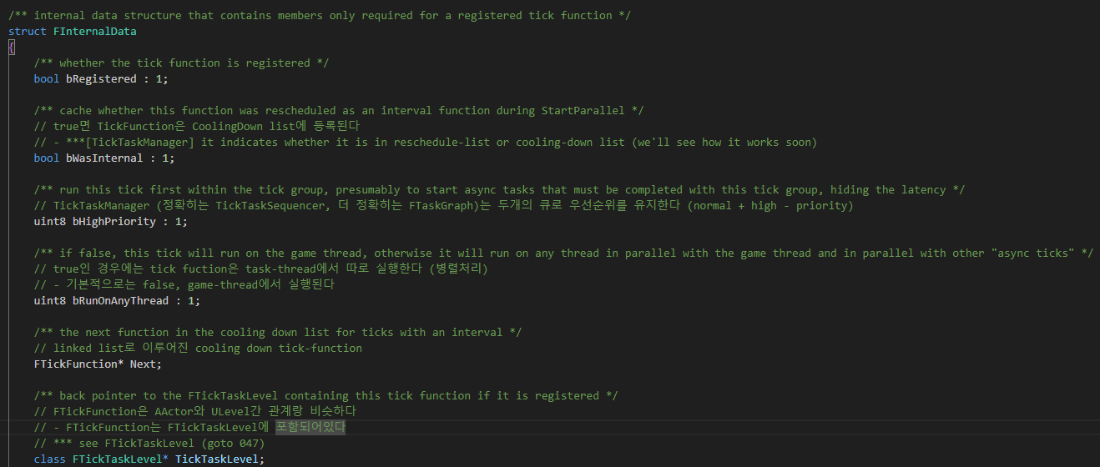
TickFunction 007

Slide 21
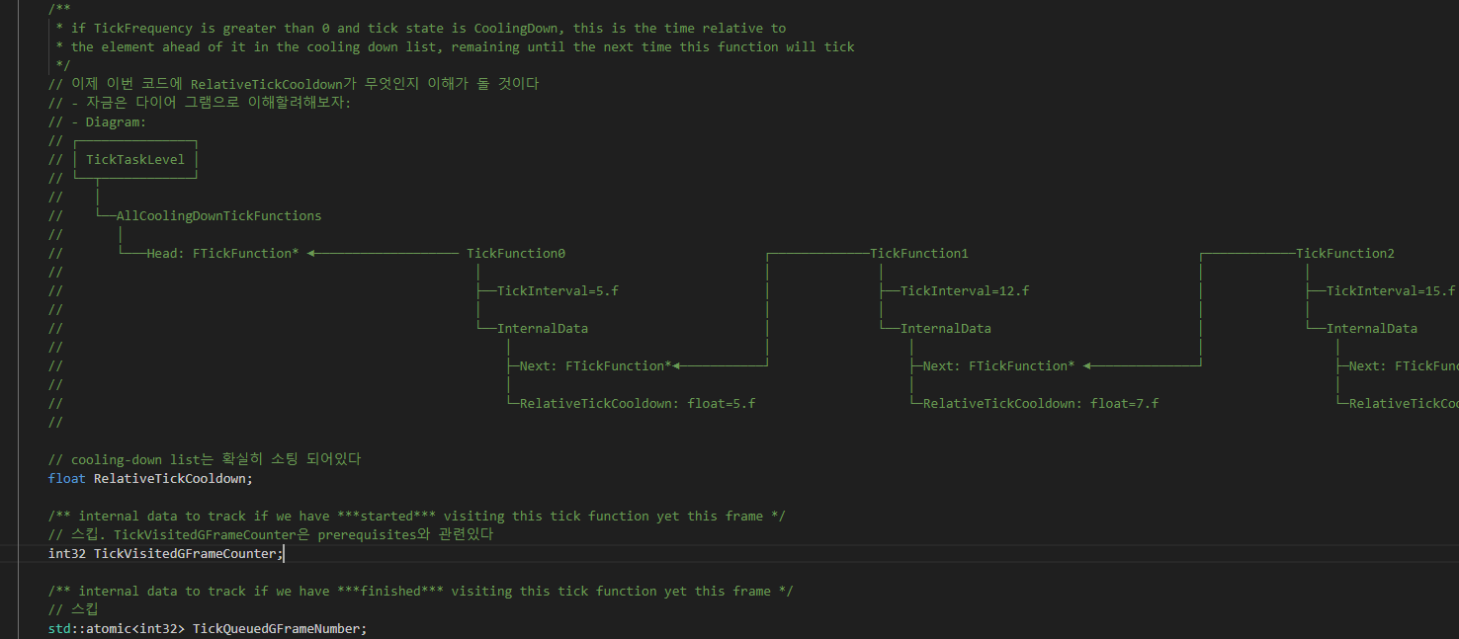
TickFunction 007

Slide 22
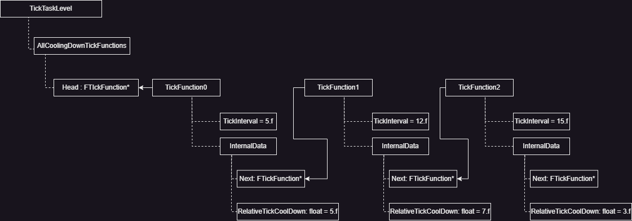
TickFunction 007

Slide 23
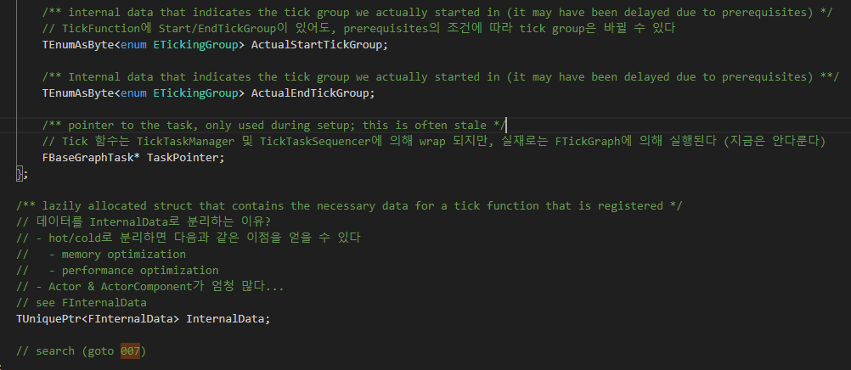
TickFunction 007

Slide 24
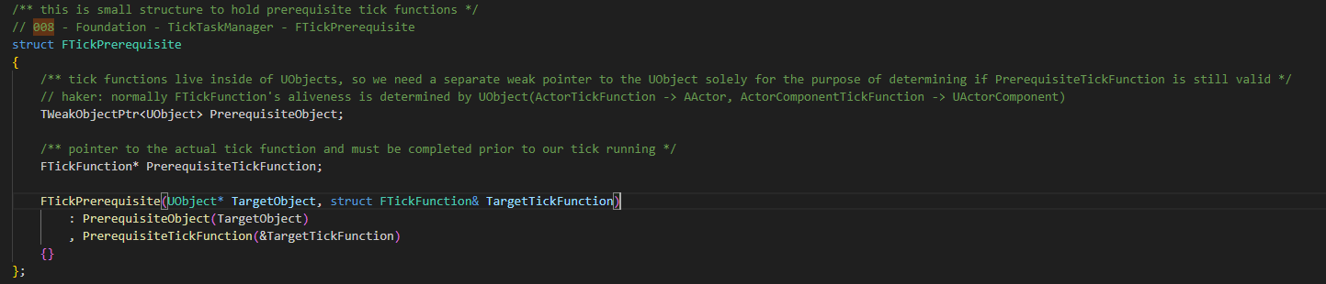
FTickPrerequisite 008

Slide 25
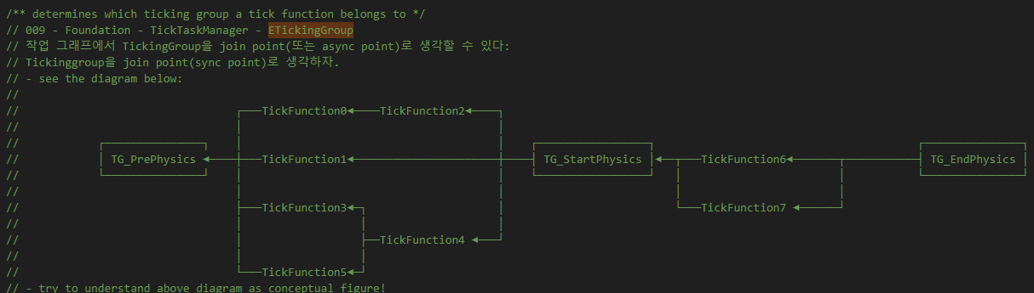
ETickingGroup 009

Slide 26
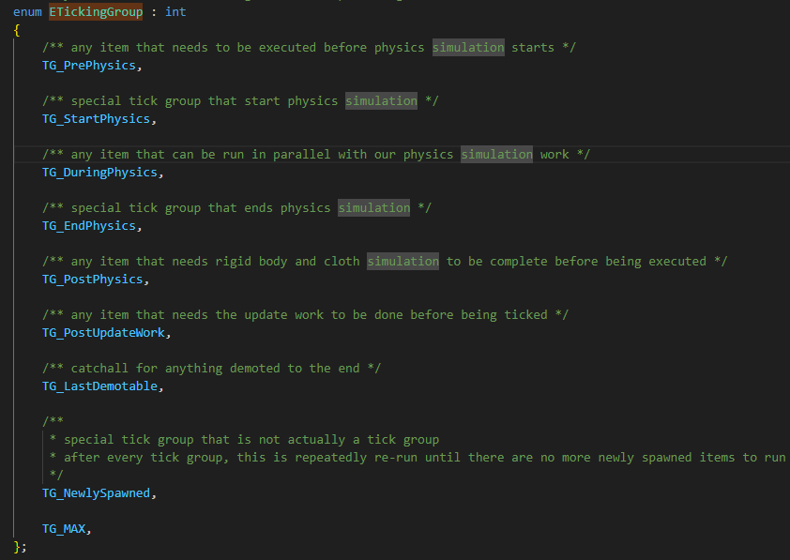
ETickingGroup 009

Slide 27
Uworld SetupPhysicsTickfunction 004

Slide 28
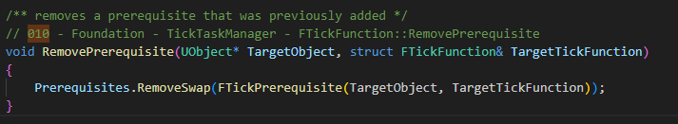
FTickFunction 010

Slide 29
TickTaskManager 001

Slide 30
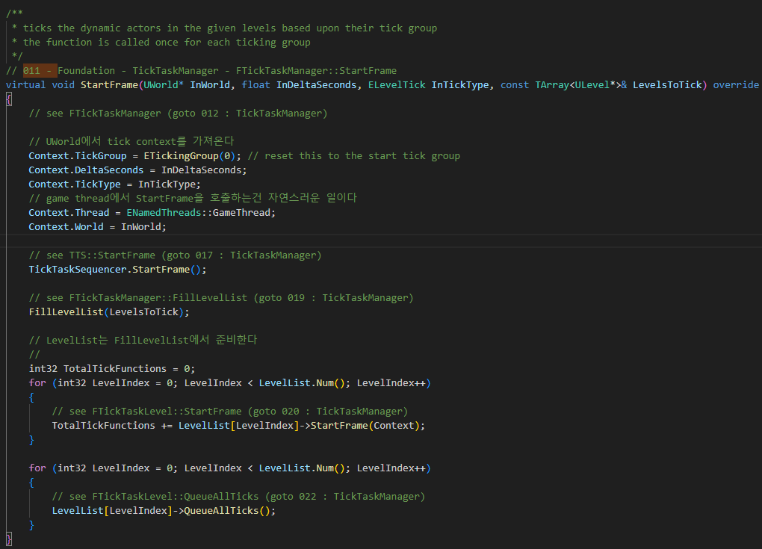
TickTaskManager 011

Slide 31
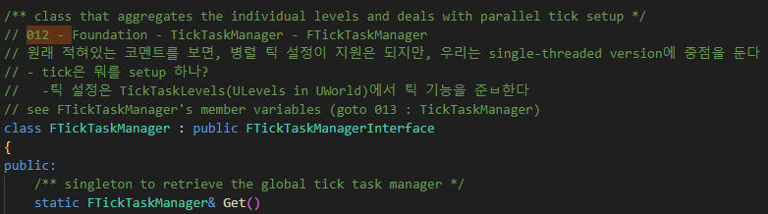
TickTaskManager 012

Slide 32
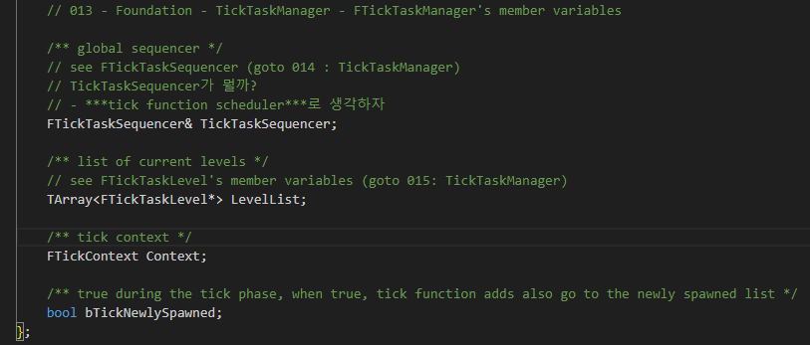
TickTaskManager 013

Slide 33
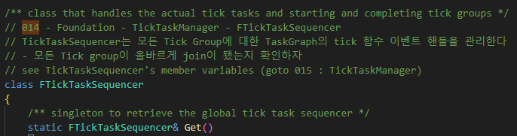
TickTaskSequencer 014

Slide 34
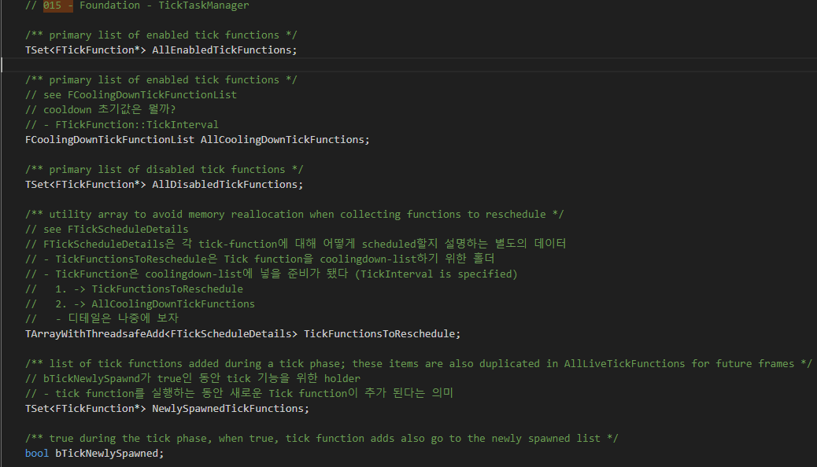
FTickTaskLevel 015

Slide 35
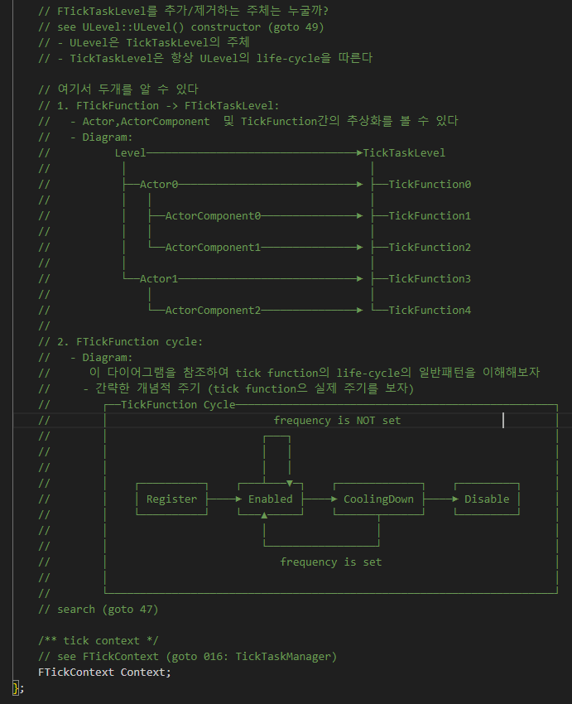
FTickTaskLevel 015

Slide 36
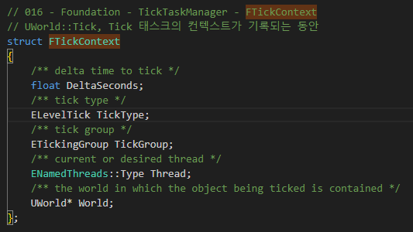
FTickContext 016

Slide 37
TickTaskManager 011

Slide 38
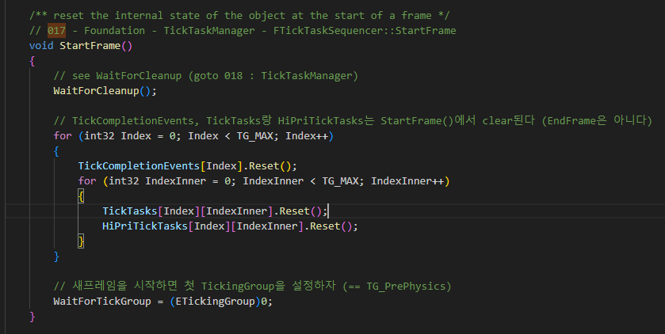
TickTaskSequencer 017

Slide 39
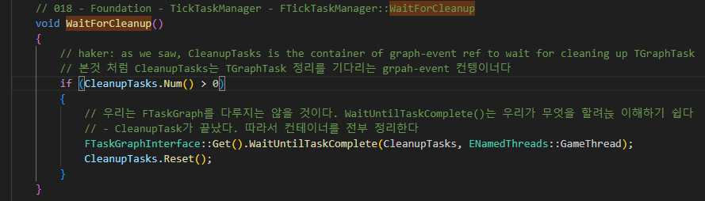
TickTaskManager 018

Slide 40
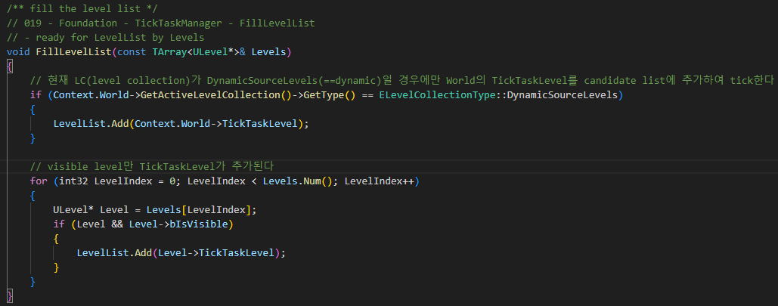
TickTaskManager 019

Slide 41
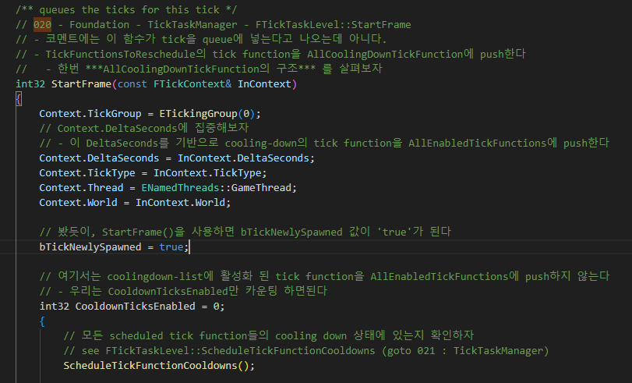
FTickTaskLevel 020

Slide 42
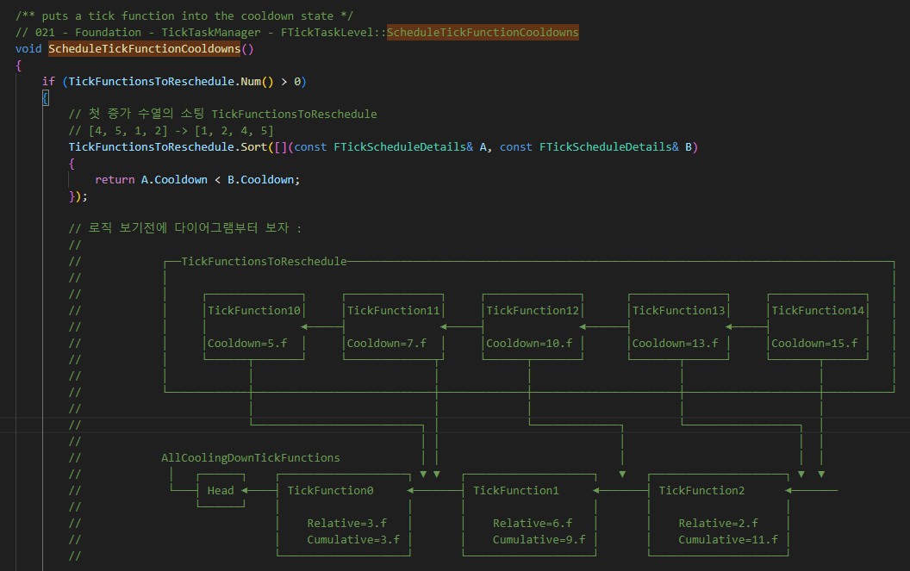
FTickTaskLevel 021

Slide 43
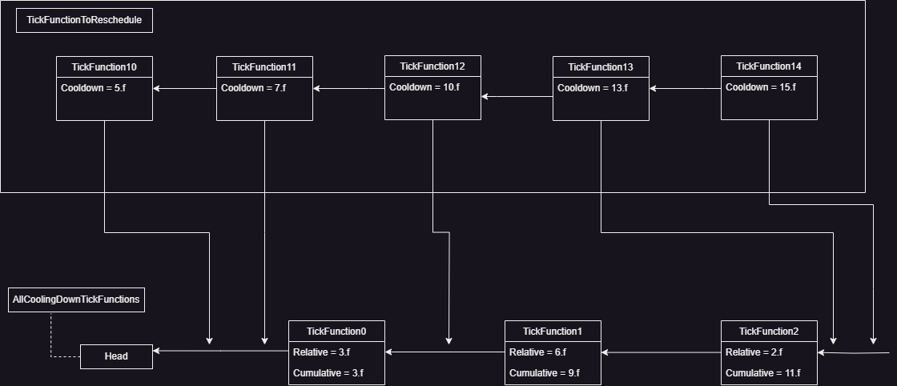
FTickTaskLevel 021

Slide 44
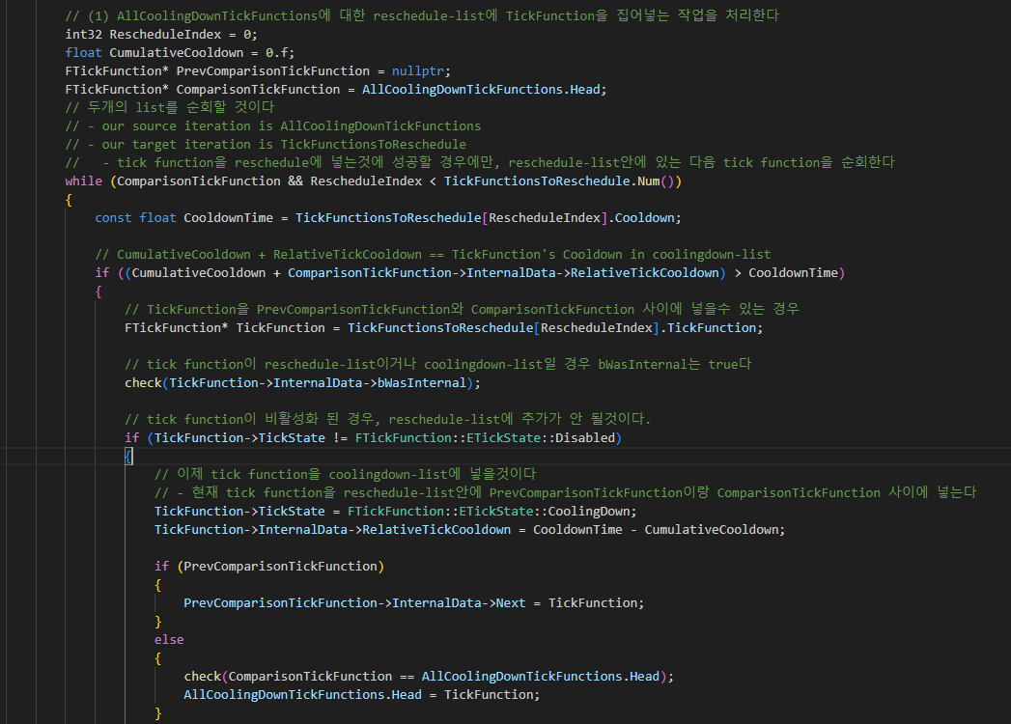
FTickTaskLevel 021

Slide 45
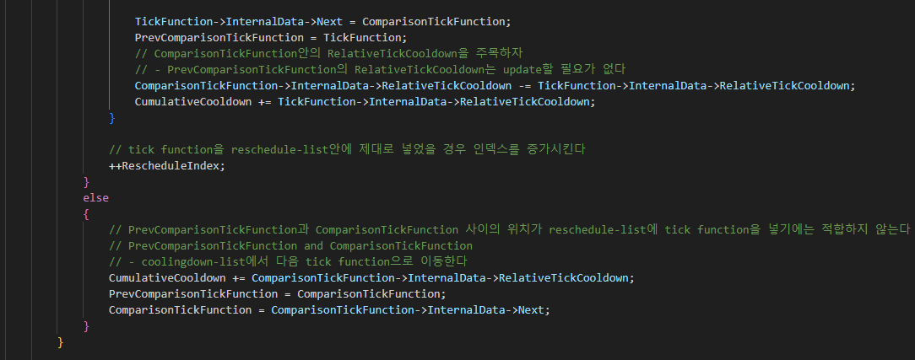
FTickTaskLevel 021

Slide 46
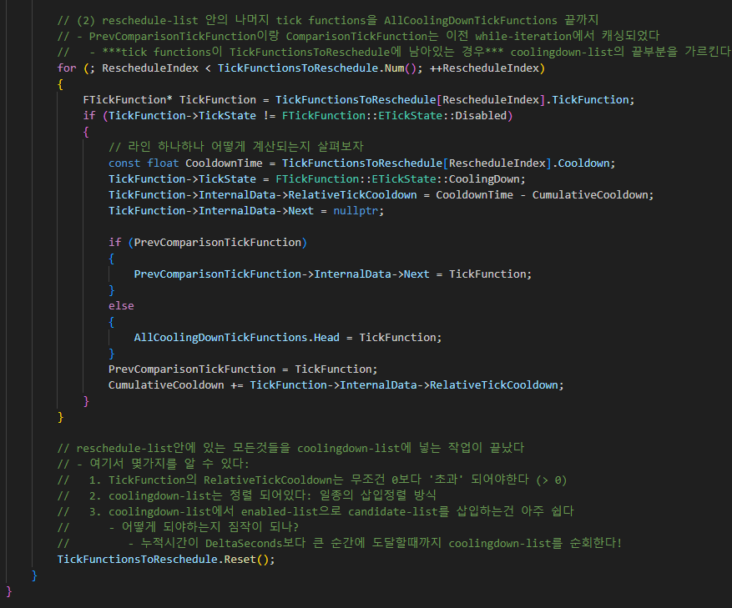
FTickTaskLevel 021

Slide 47
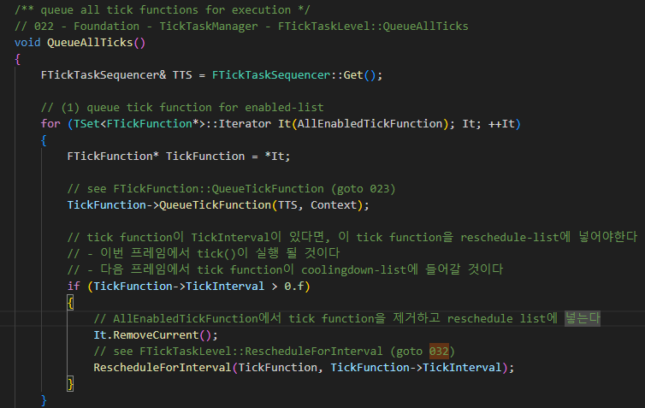
FTickTaskLevel 022

Slide 48
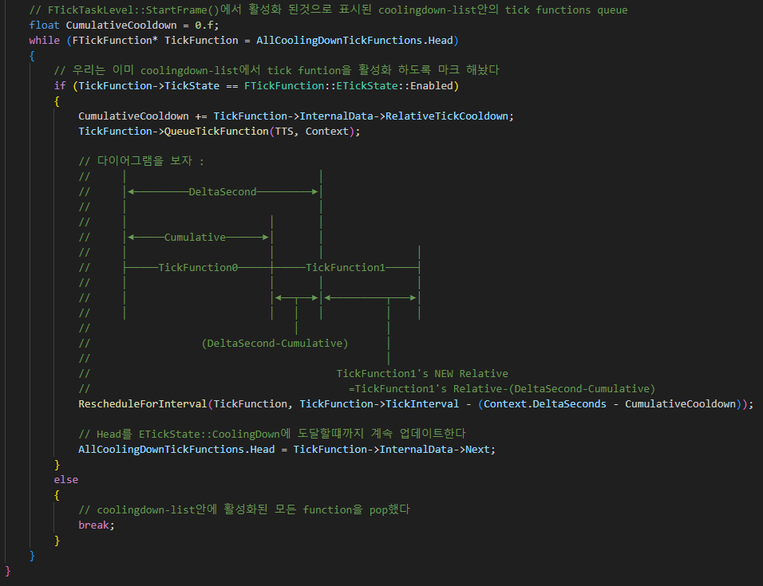
FTickTaskLevel 022

Slide 49
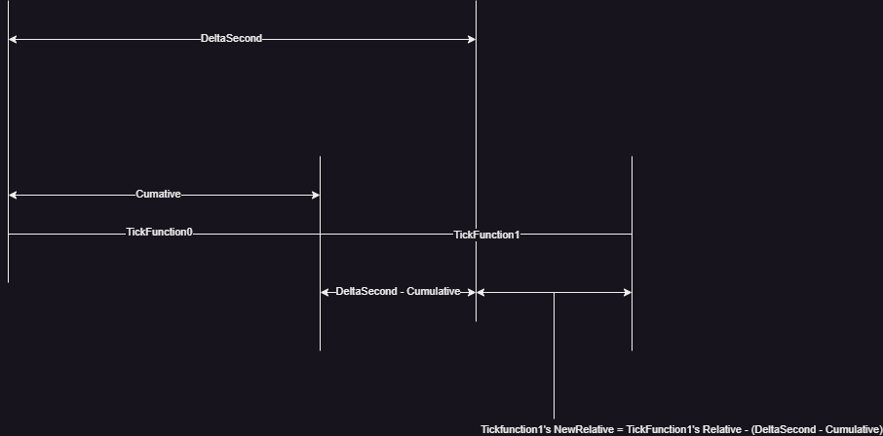
FTickTaskLevel 022

Slide 50
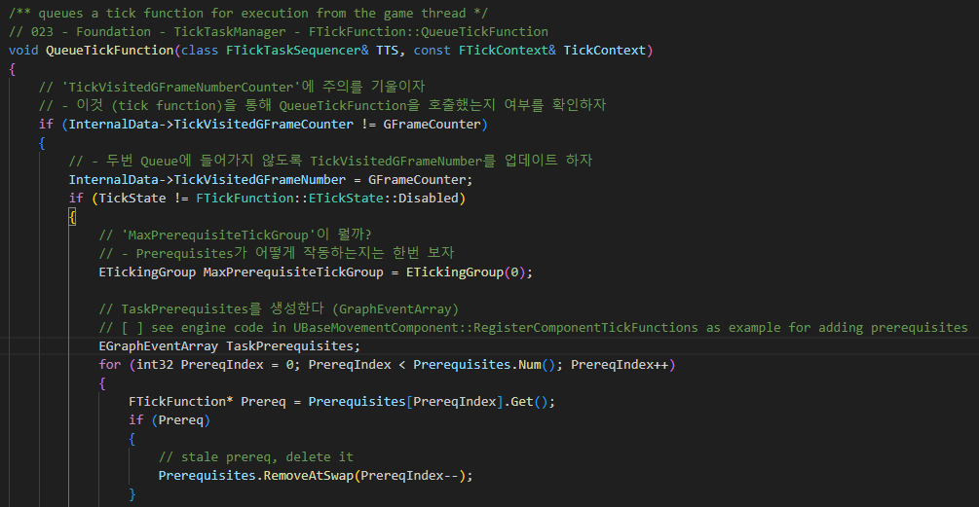
QueueTickFunction 023

Slide 51
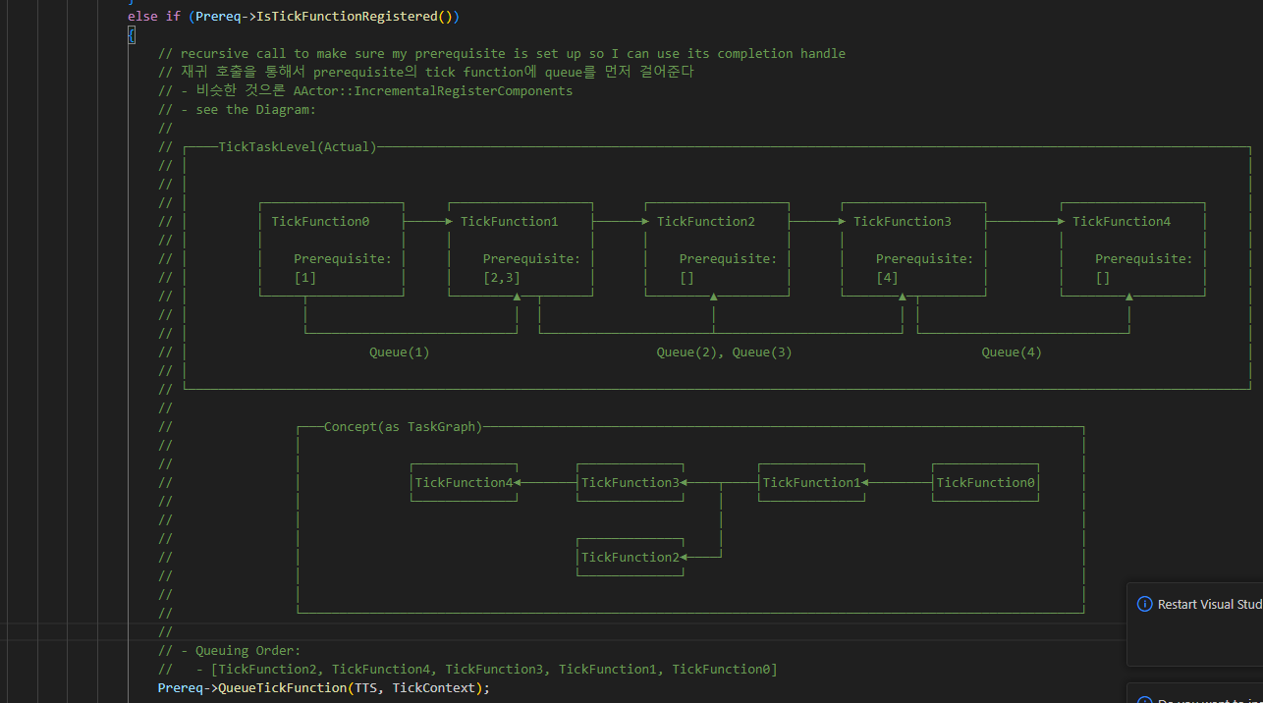
QueueTickFunction 023

Slide 52
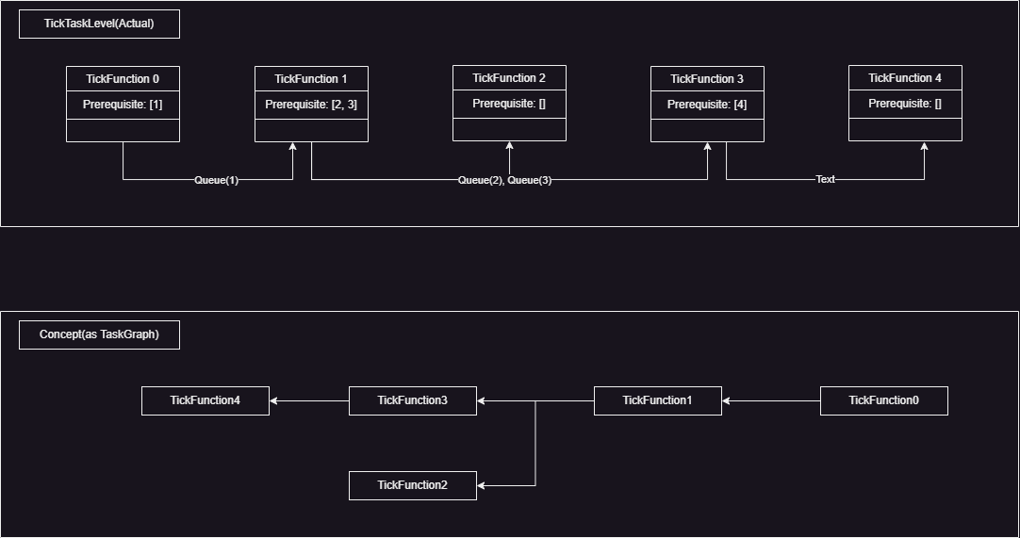
QueueTickFunction 023

Slide 53
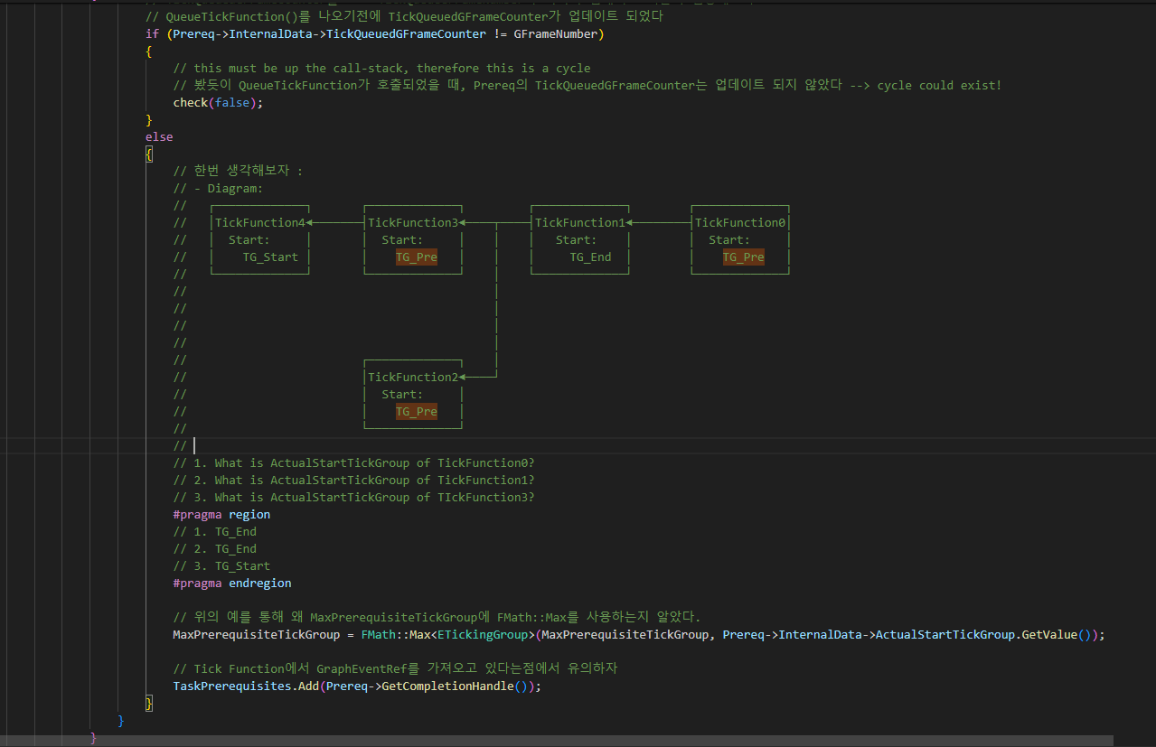
QueueTickFunction 023

Slide 54

QueueTickFunction 023

Slide 55

CanDemoteIntoTickGroup 024

Slide 56
QueueTickFunction 023

Slide 57

QueueTickTask 025

Slide 58

StartTickTask 026

Slide 59

StartTickTask 026

Slide 60

FTickFunctionTask 027, 028

Slide 61

FActorTickFunction 029

Slide 62

TickActor 030

Slide 63
QueueTickTask 025

Slide 64

FTickTaskSequencer::AddTickTaskCompetion 031

Slide 65
FTickTaskLevel 022

Slide 66

FTickTaskLevel::RescheduleForInterval 032

Slide 67

Uworld TickTaskManager 001

Slide 68

Uworld RunTickGroup 033

Slide 69

TickTaskManager RunTickGroup 034

Slide 70
TickTaskManager RunTickGroup 034
주석에서는 없지만, TG_NewlySpawned라는 틱그룹이 따로 있다. 이 부분은 직접 까서 알아보자

Slide 71

TickTaskManager RunTickGroup 034

Slide 72

TickTaskManager ReleaseTickGroup 035

Slide 73

TickTaskManager ReleaseTickGroup 035

Slide 74

TickTaskManager ReleaseTickGroup 035

Slide 75

TickTaskManager DispatchTickGroup 036

Slide 76

TickTaskManager DispatchTickGroup 036

Slide 77

TickTaskManager DispatchTickGroup 036

Slide 78

TickTaskManager DispatchTickGroup 037

Slide 79
TickTaskManager EndFrame 037

Slide 80
Uworld TickTaskManager 001

Slide 81
TickTaskManager

