Slide 1

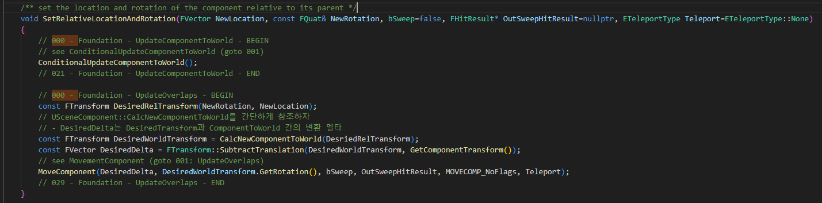
UpdateComponentToWorld 000

Slide 2
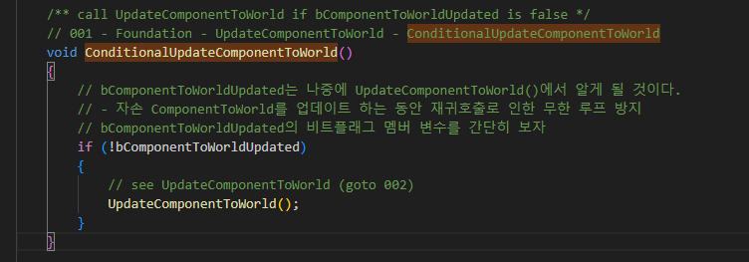
ConditionalUpdateComponentToWorld 001

Slide 3
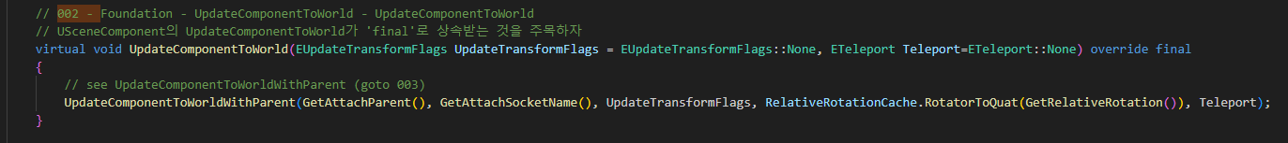
UpdateComponentToWorld 002

Slide 4
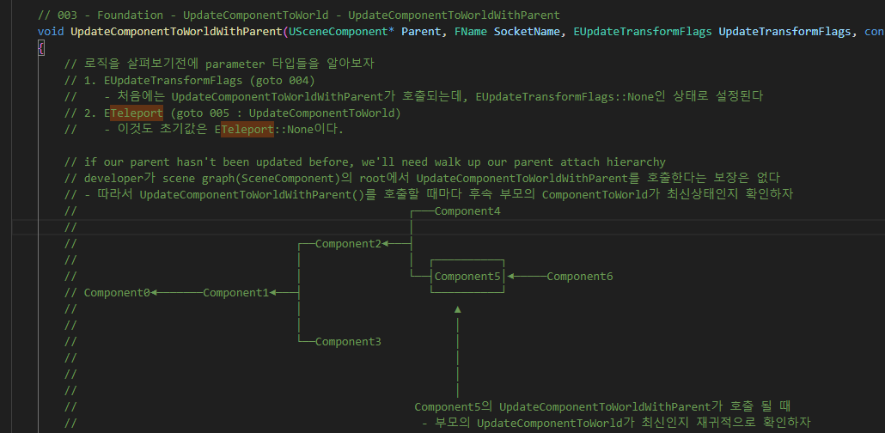
UpdateComponentToWorldWithParent 003

Slide 5
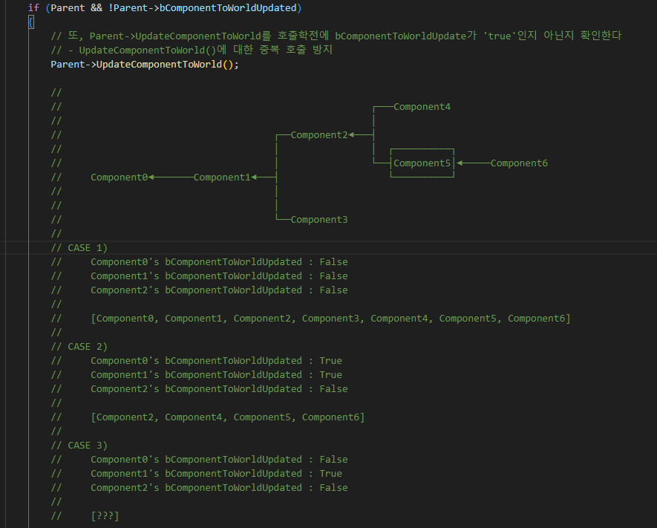
UpdateComponentToWorlldWithParent 003

Slide 6
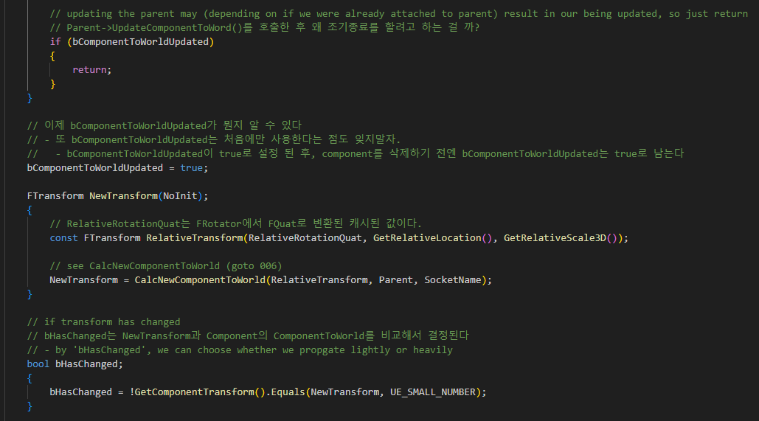
UpdateComponentToWorlldWithParent 003

Slide 7
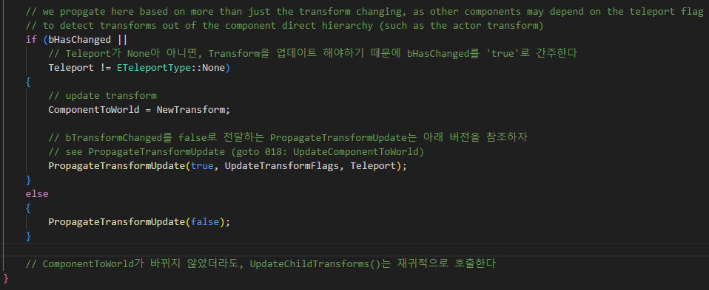
UpdateComponentToWorlldWithParent 003

Slide 8
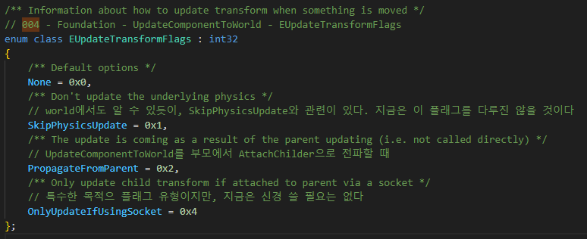
ActorComponent::EUpdateTransformFlags 004

Slide 9
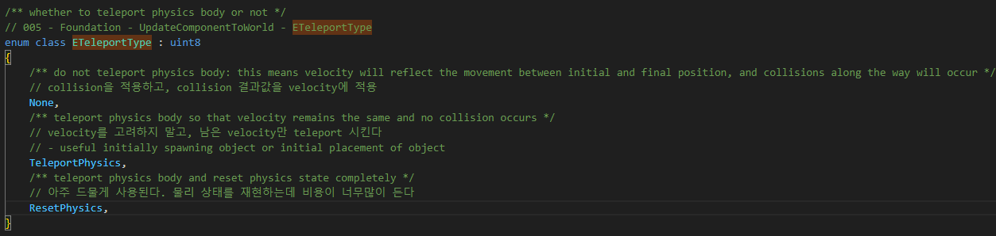
EngineBaseType ETeleportType 005

Slide 10
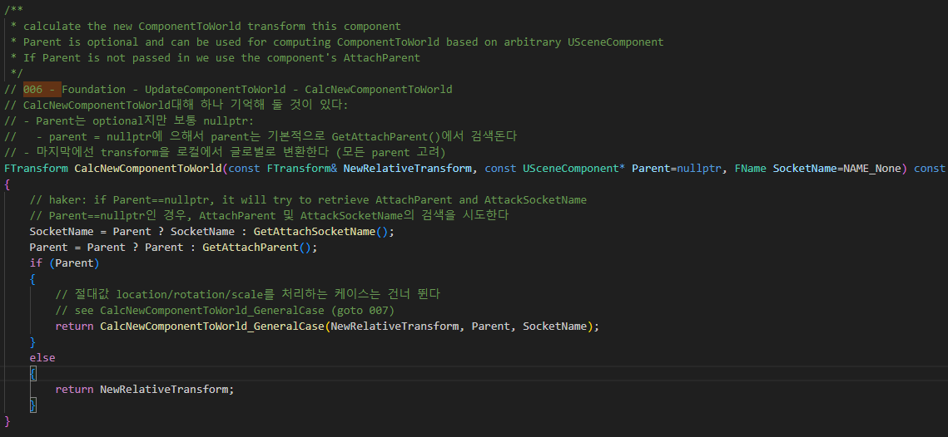
SceneComponent CalcNewComponentToWorld 006

Slide 11
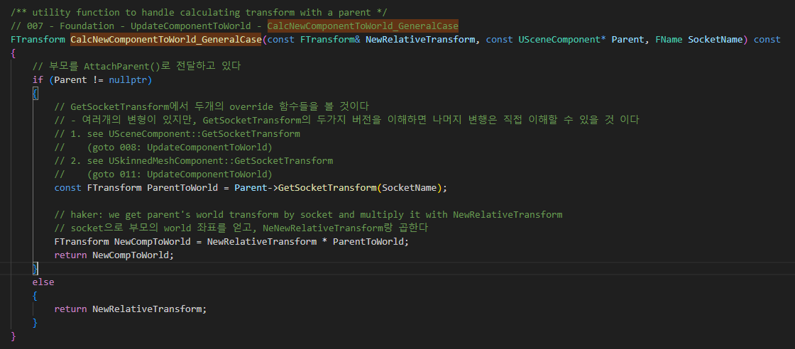
SceneComponent CalcNewComponentToWorld_GeneralCase 007

Slide 12
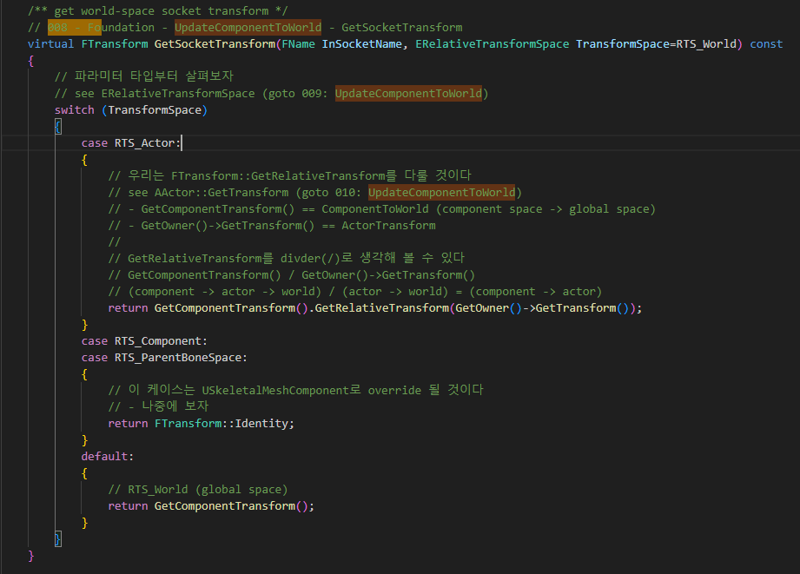
SceneComponent GetSocketTransform 008

Slide 13
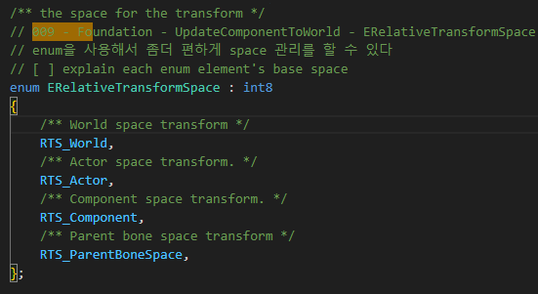
SceneComponent RelativeTransformSpace 009

Slide 14
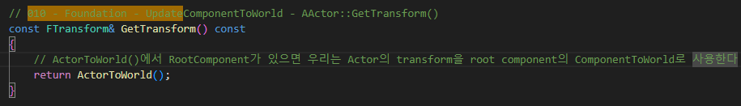
SceneComponent GetTransform 010

Slide 15
SceneComponent CalcNewComponentToWorld_GeneralCase 007

Slide 16
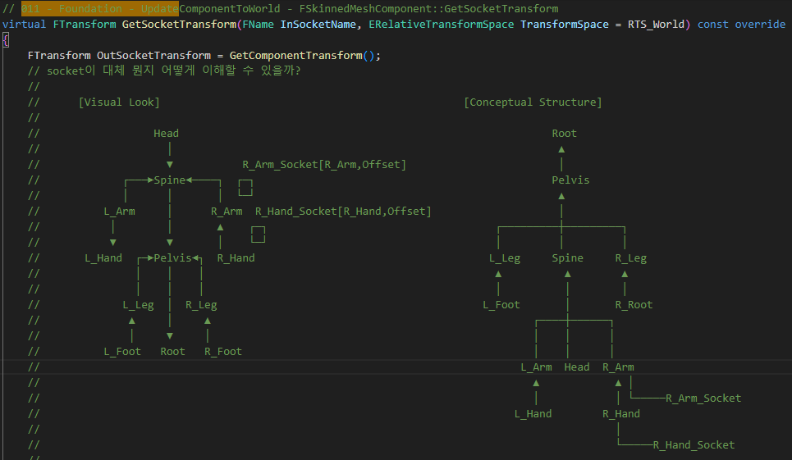
SkinnedMeshComponent GetSocketTransform 011

Slide 17
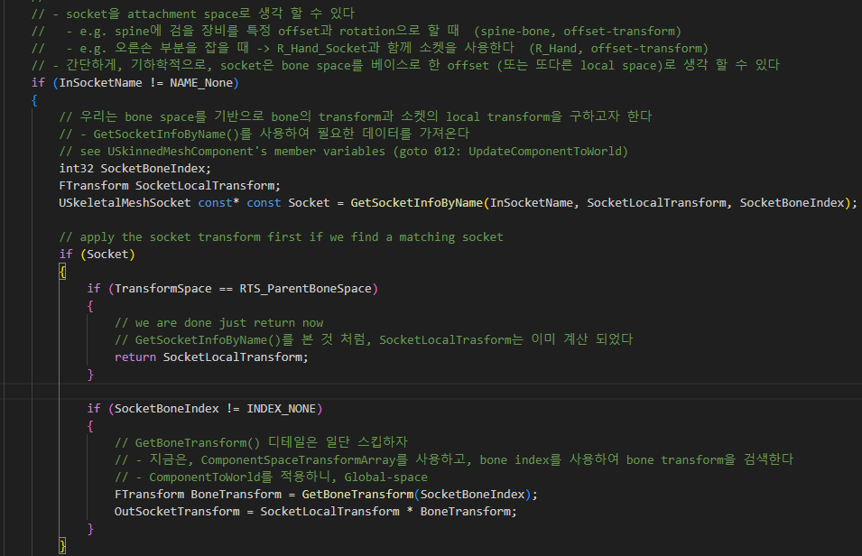
SkinnedMeshComponent GetSocketTransform 011

Slide 18
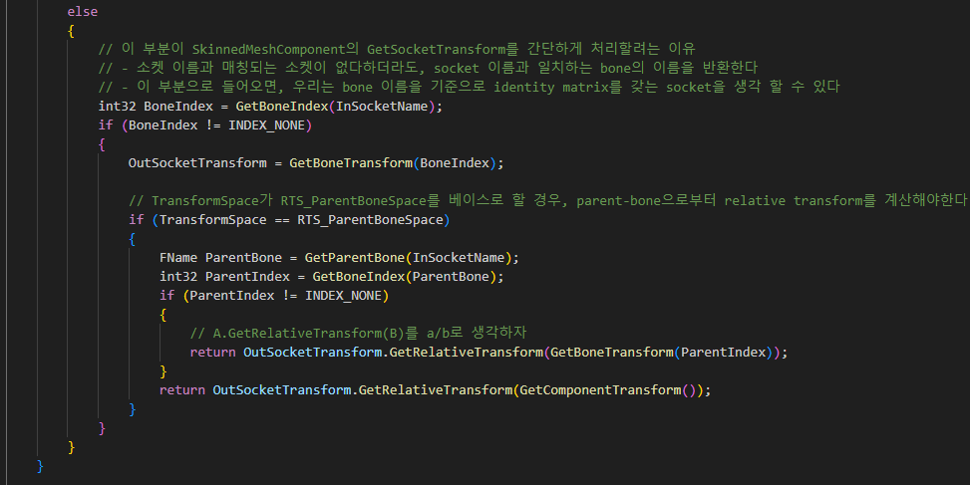
SkinnedMeshComponent GetSocketTransform 011

Slide 19
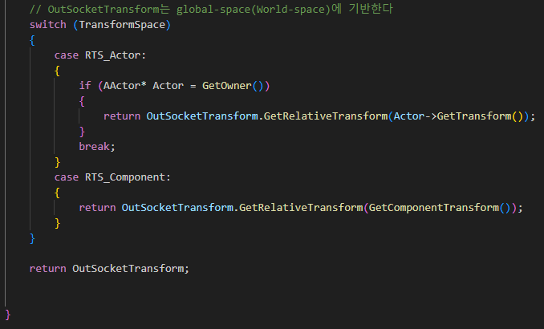
SkinnedMeshComponent GetSocketTransform 011

Slide 20
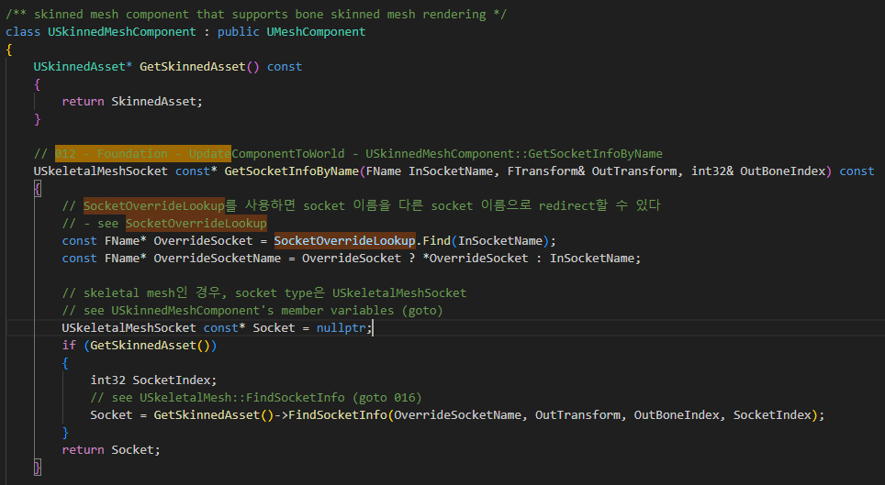
SkinnedMeshComponent GetSocketInfoByName 012

Slide 21
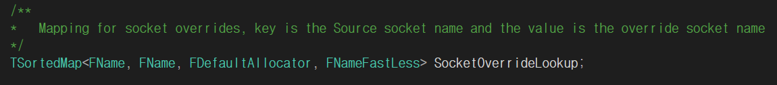
SkinnedMeshComponent SocketOverrideLookup

Slide 22
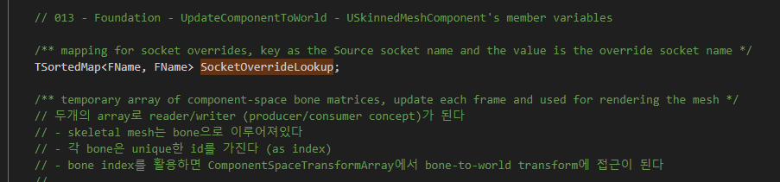
SkinnedMeshComponent 013

Slide 23
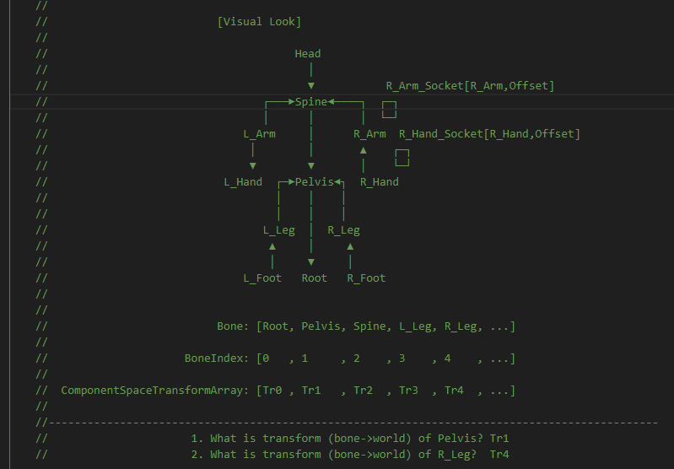
SkinnedMeshComponent 013

Slide 24
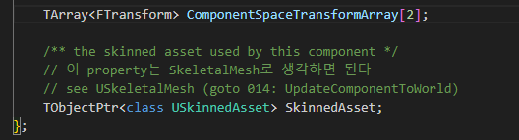
SkinnedMeshComponent 013

Slide 25
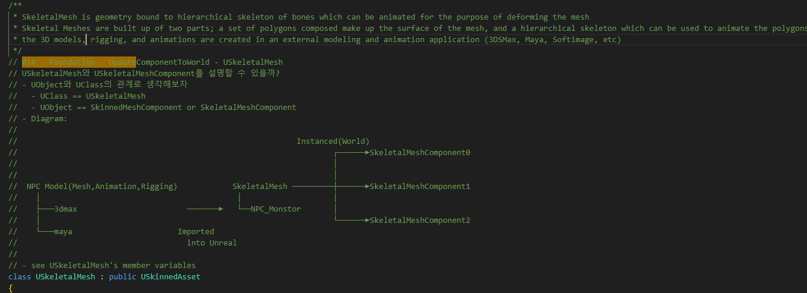
SkeletalMesh 014

Slide 26
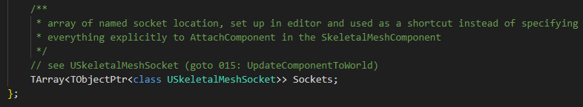
SkeletalMesh 014

Slide 27
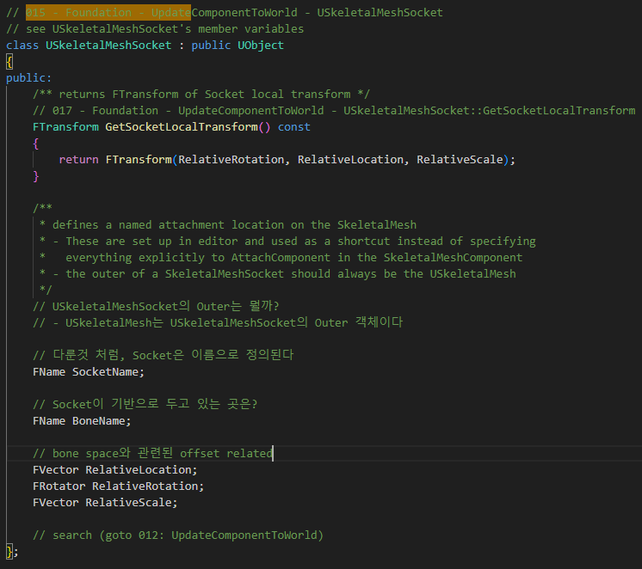
SkeletalMesh 015

Slide 28
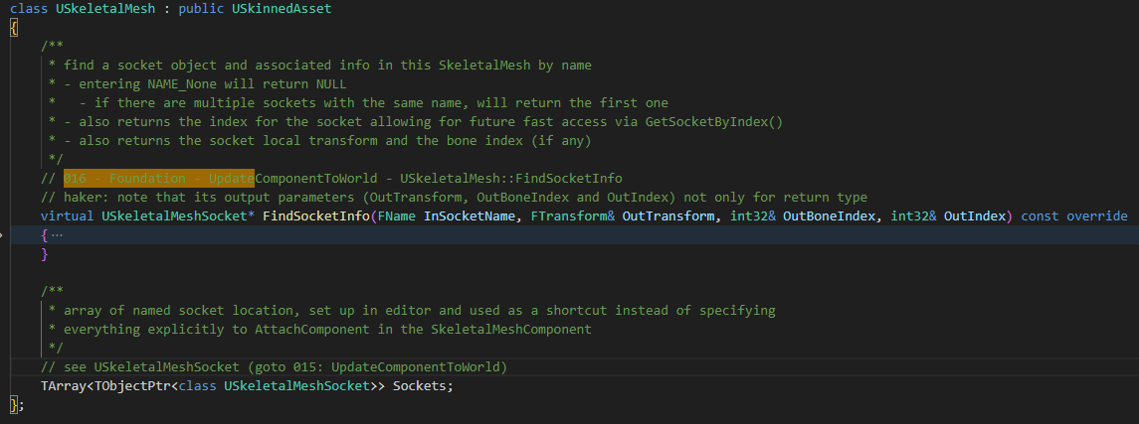
SkeletalMesh 014

Slide 29
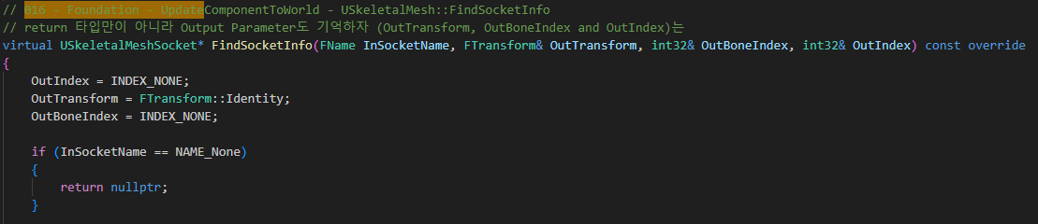
SkeletalMesh FindSocketInfo 016

Slide 30
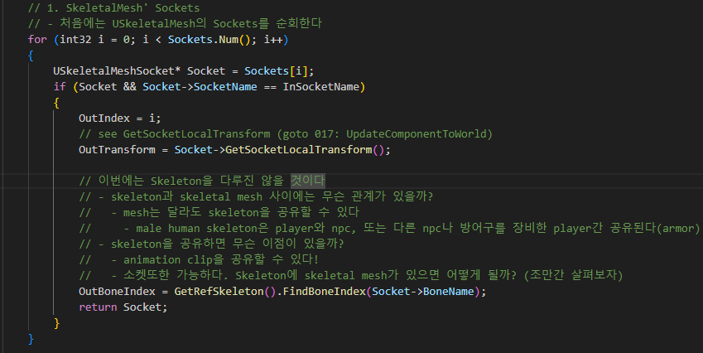
SkeletalMesh FindSocketInfo 016

Slide 31
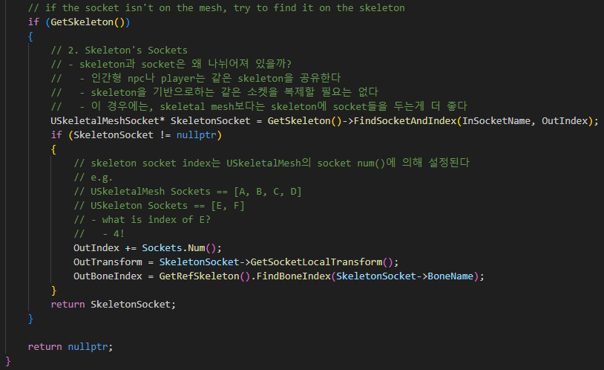
SkeletalMesh FindSocketInfo 016

Slide 32
SkeletalMesh GetSocketLocalTransform 017

Slide 33
UpdateComponentToWorldWithParent 003

Slide 34
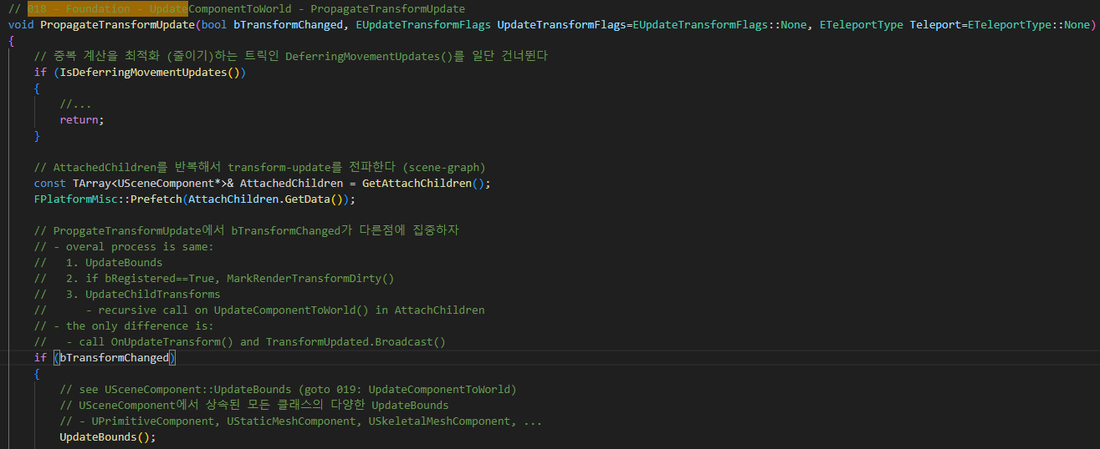
SkeletalMesh PropagateTransformUpdate 018

Slide 35
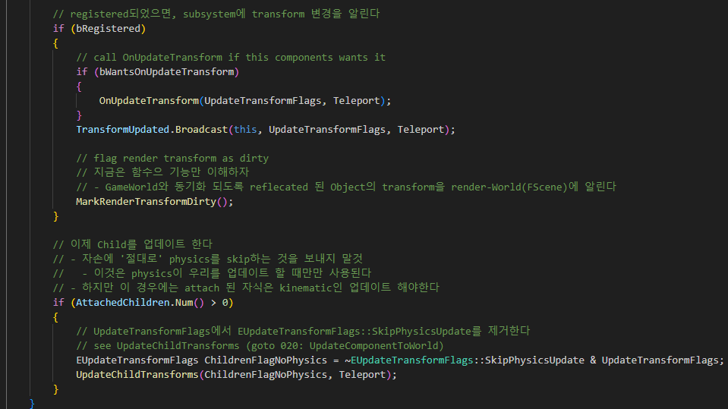
SkeletalMesh PropagateTransformUpdate 018

Slide 36
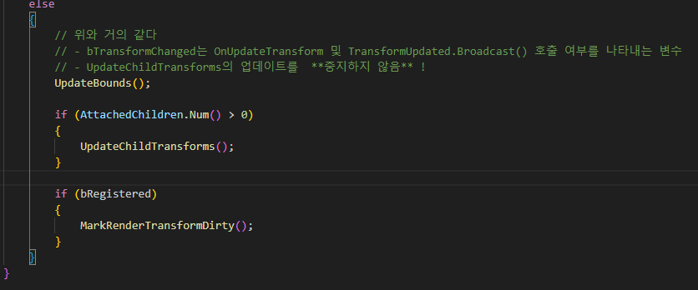
SkeletalMesh PropagateTransformUpdate 018

Slide 37
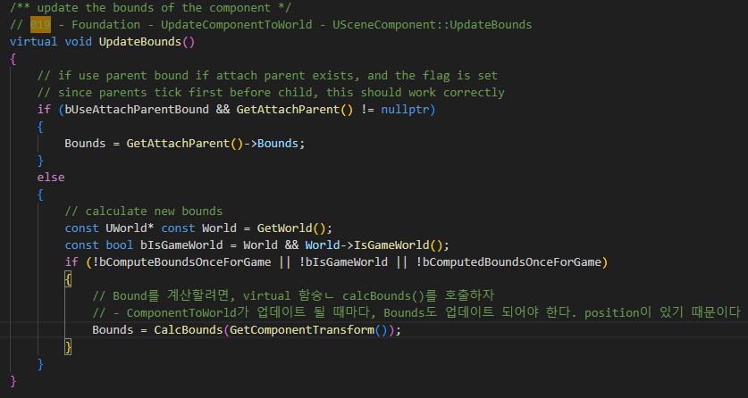
SceneComponent UpdateBounds 019

Slide 38
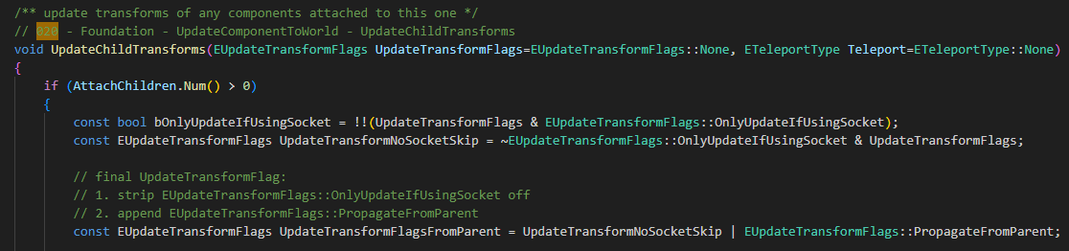
SceneComponent UpdateBounds 020

Slide 39
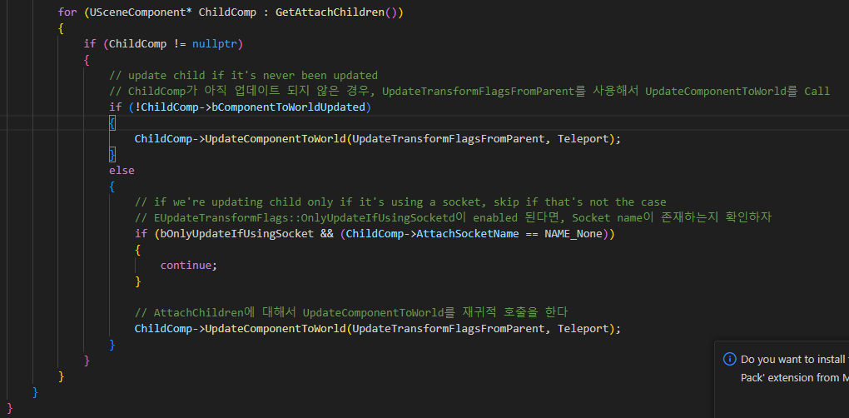
SceneComponent UpdateBounds 020

Slide 40
UpdateComponentToWorld 000

