Slide 1
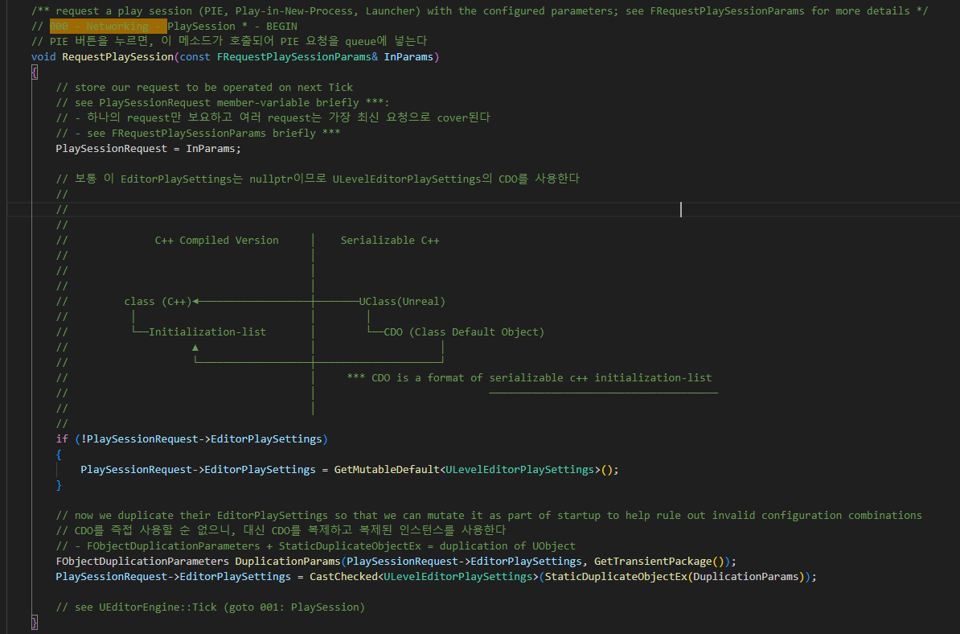
EditorEngine RequestPlaySession 000

Slide 2
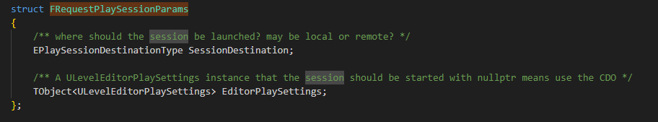
EditorEngine RequestPlaySession 000

Slide 3
EditorEngine RequestPlaySession 000

Slide 4
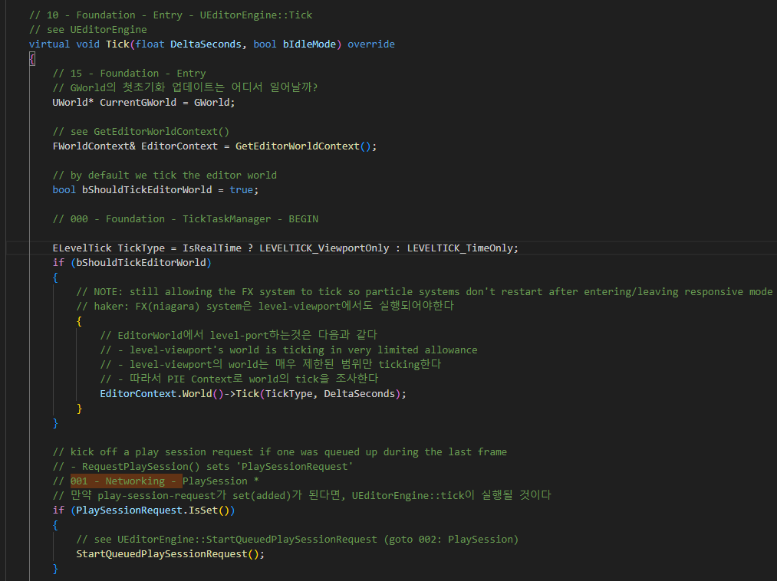
EditorEngine Tick 001

Slide 5
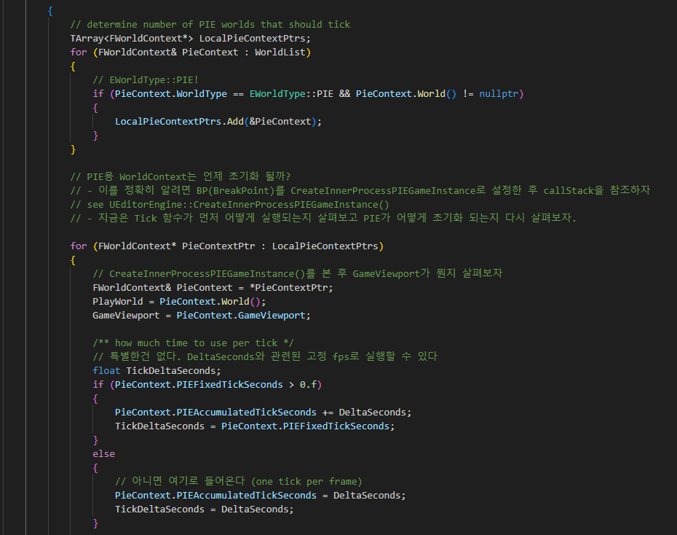
EditorEngine Tick 001

Slide 6
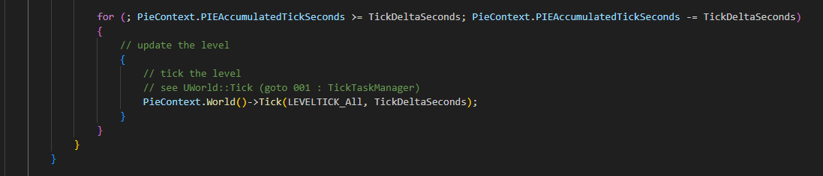
EditorEngine Tick 001

Slide 7
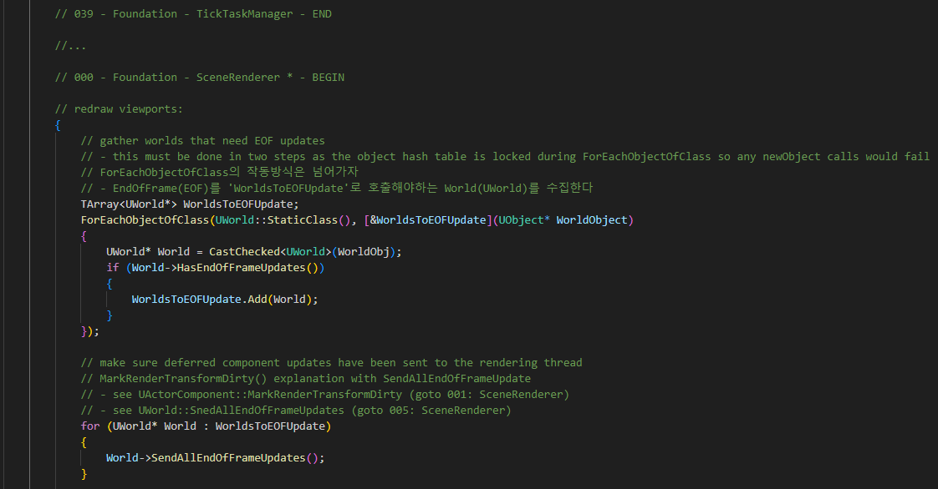
EditorEngine Tick 001

Slide 8
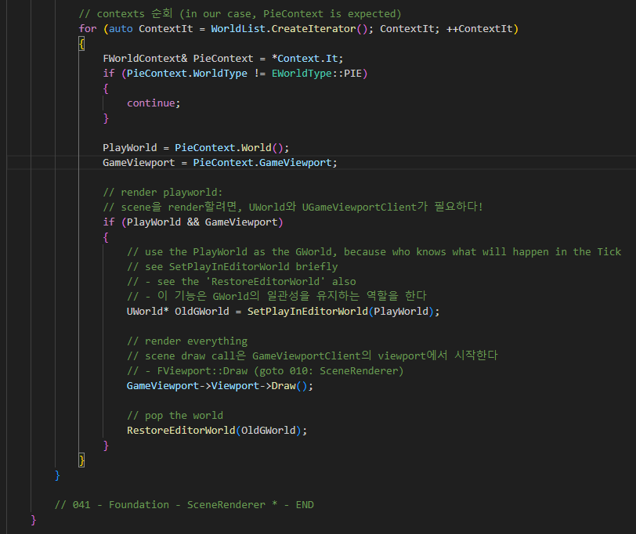
EditorEngine Tick 001

Slide 9
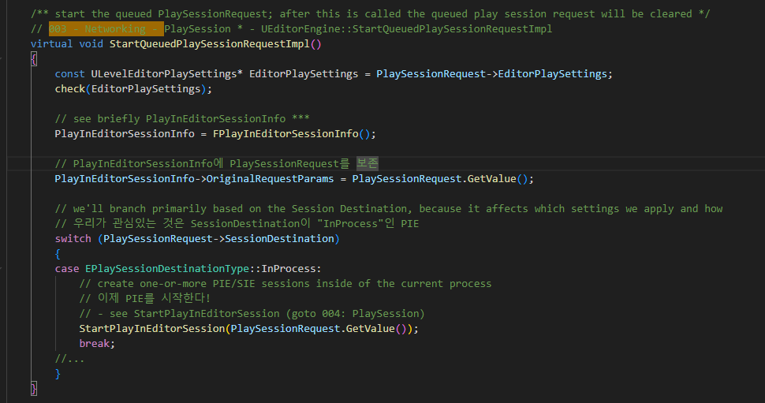
EditorEngine StartQueuedPlaySessionRequestImpl 003

Slide 10
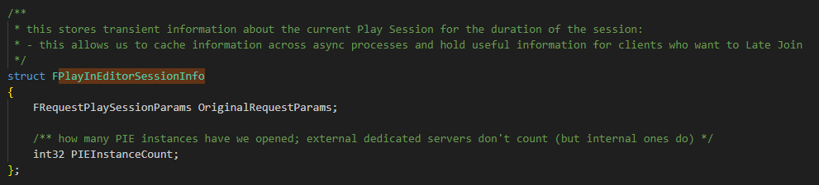
EditorEngine StartQueuedPlaySessionRequestImpl 003

Slide 11
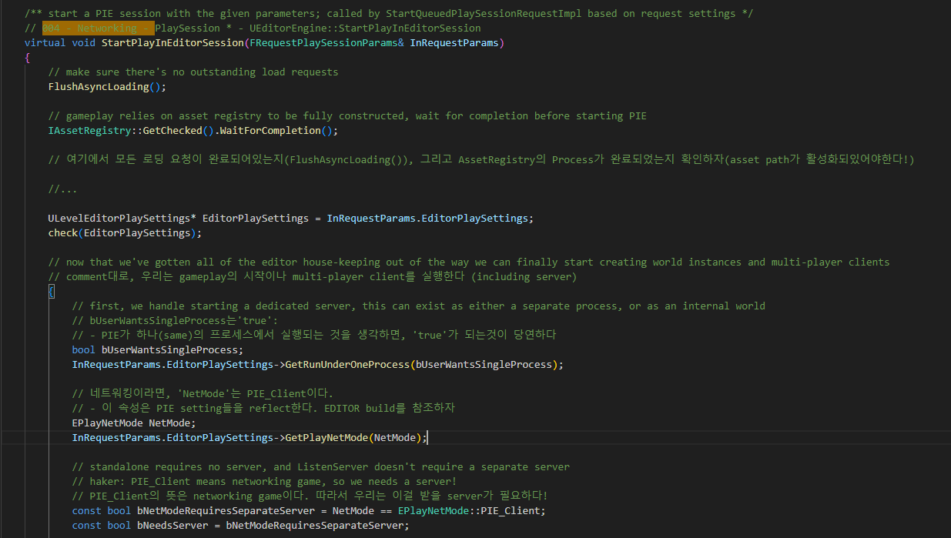
EditorEngine StartPlayInEditorSession 004

Slide 12
EditorEngine StartPlayInEditorSession 004

Slide 13
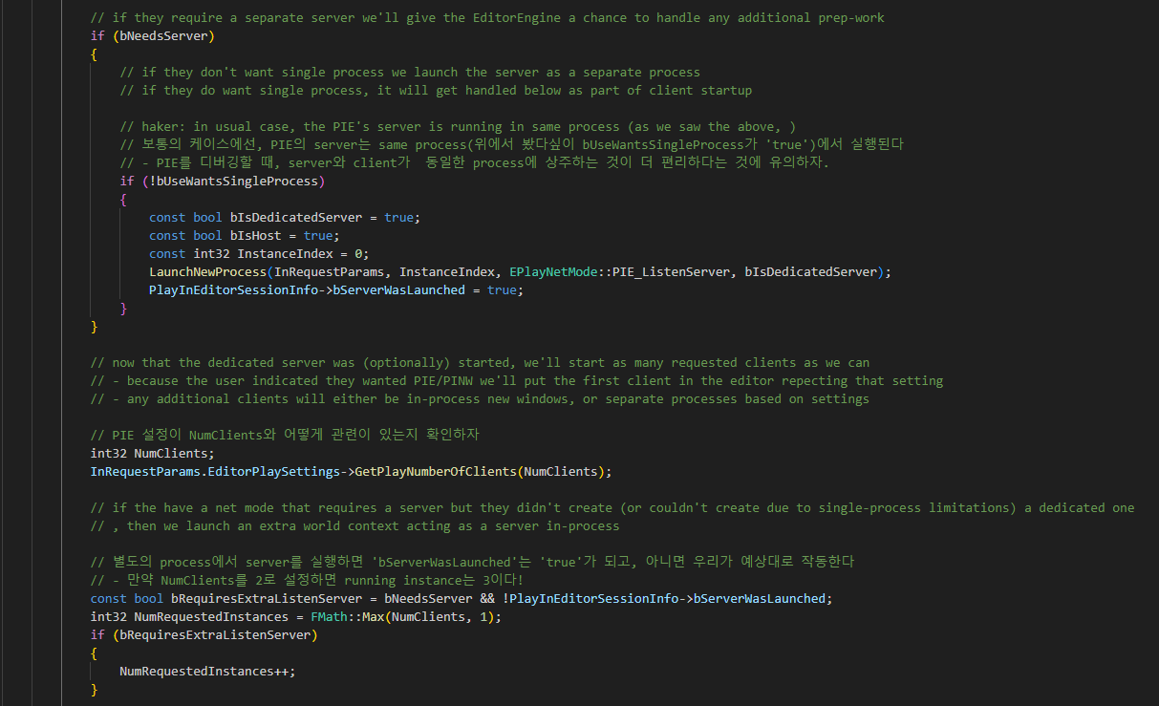
EditorEngine StartPlayInEditorSession 004

Slide 14
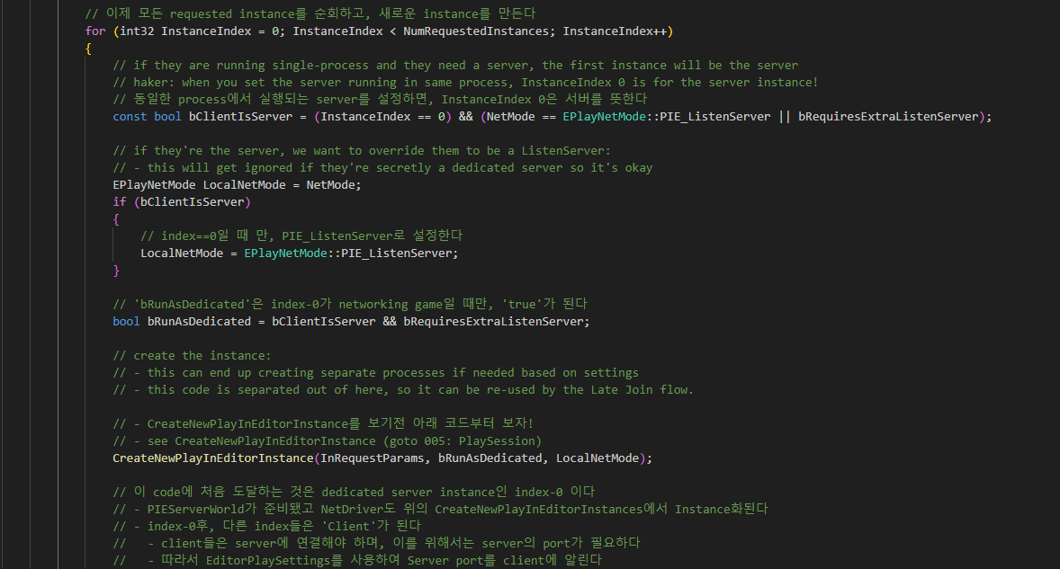
EditorEngine StartPlayInEditorSession 004

Slide 15
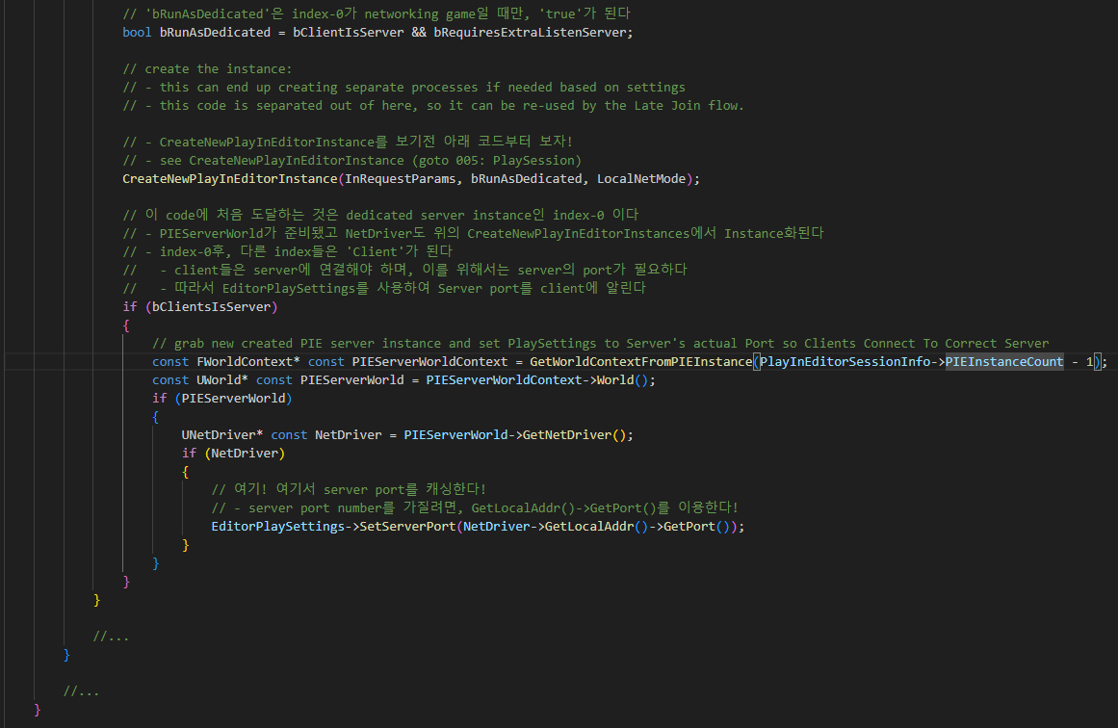
EditorEngine StartPlayInEditorSession 004

Slide 16
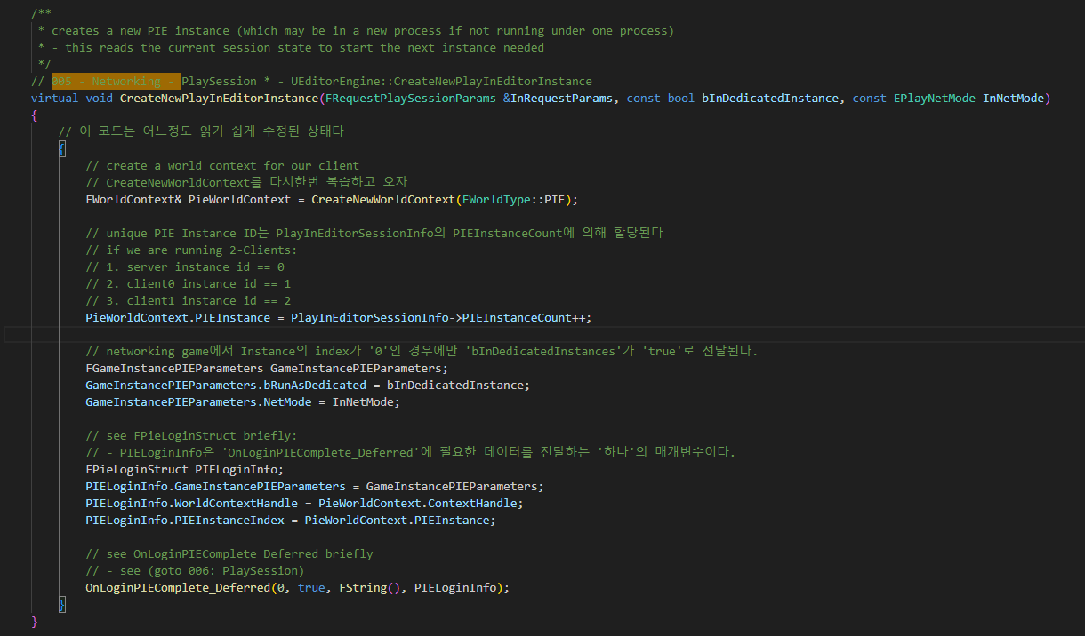
EditorEngine CreateNewPlayInEditorInstance 005

Slide 17
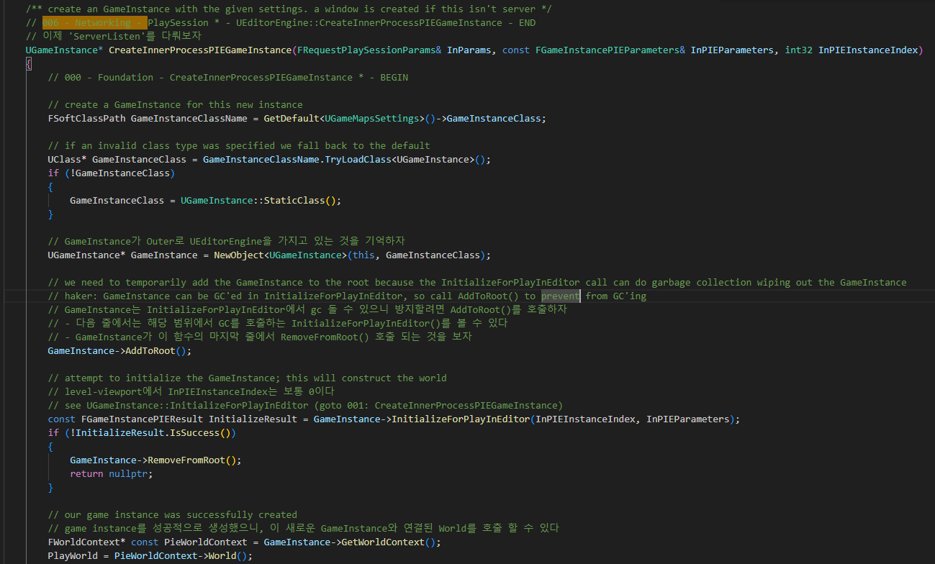
EditorEngine CreateInnerProcessPIEGameInstance 000

Slide 18
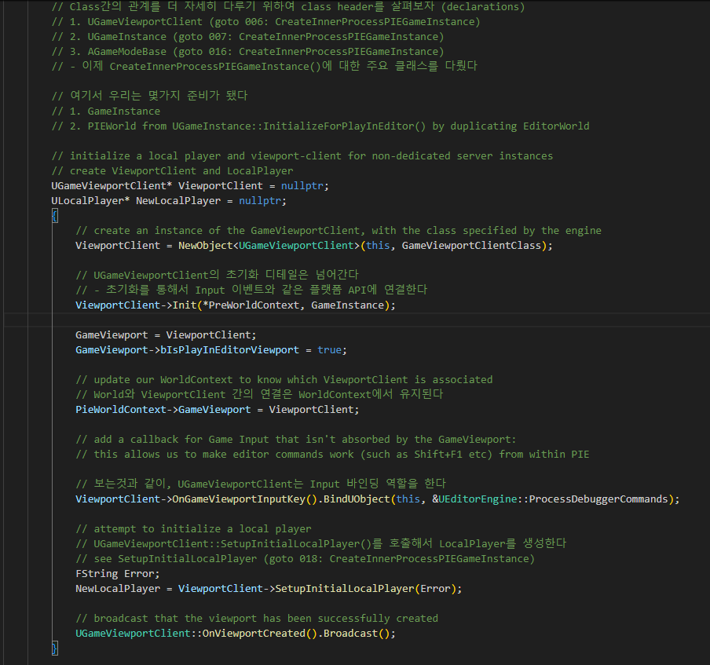
EditorEngine CreateInnerProcessPIEGameInstance 000

Slide 19
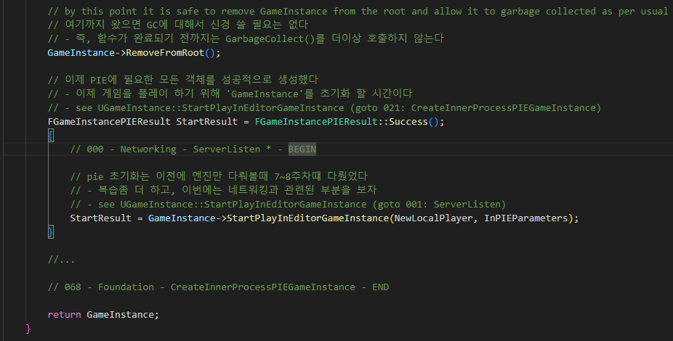
EditorEngine CreateInnerProcessPIEGameInstance 000

Slide 20
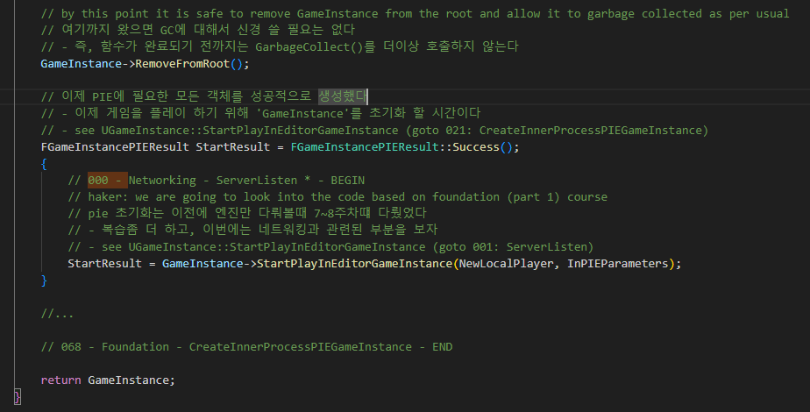
UEditorEngine::CreateInnerProcessPIEGameInstance 000

