Slide 1
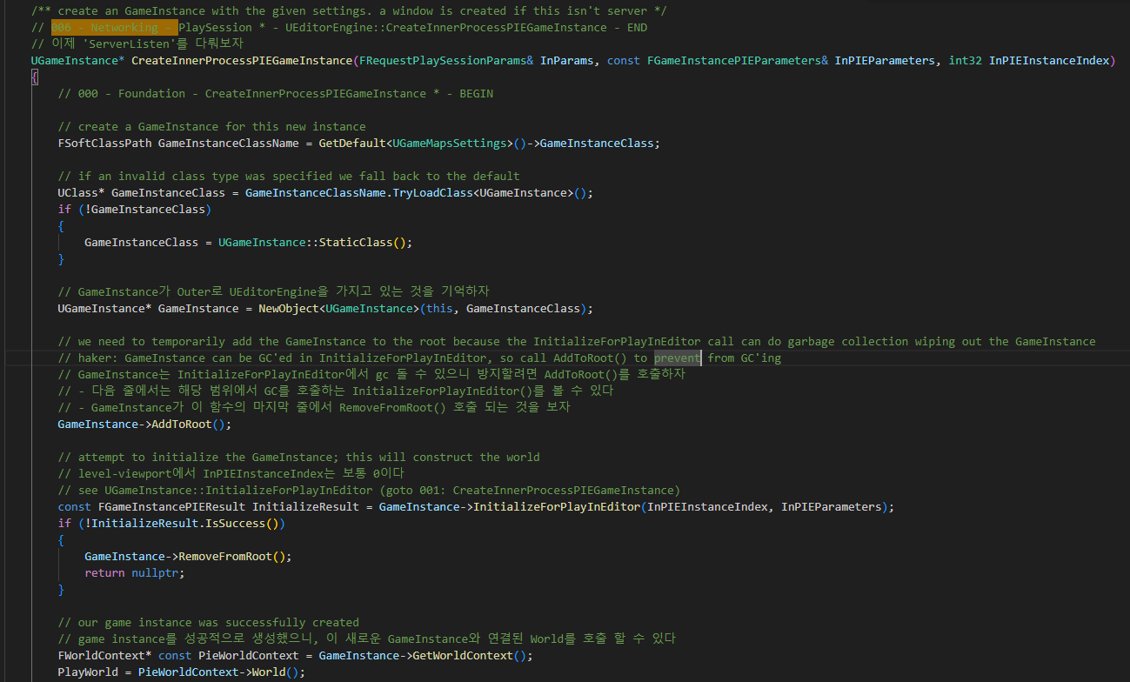
EditorEngine CreateInnerProcessPIEGameInstance 000

Slide 2
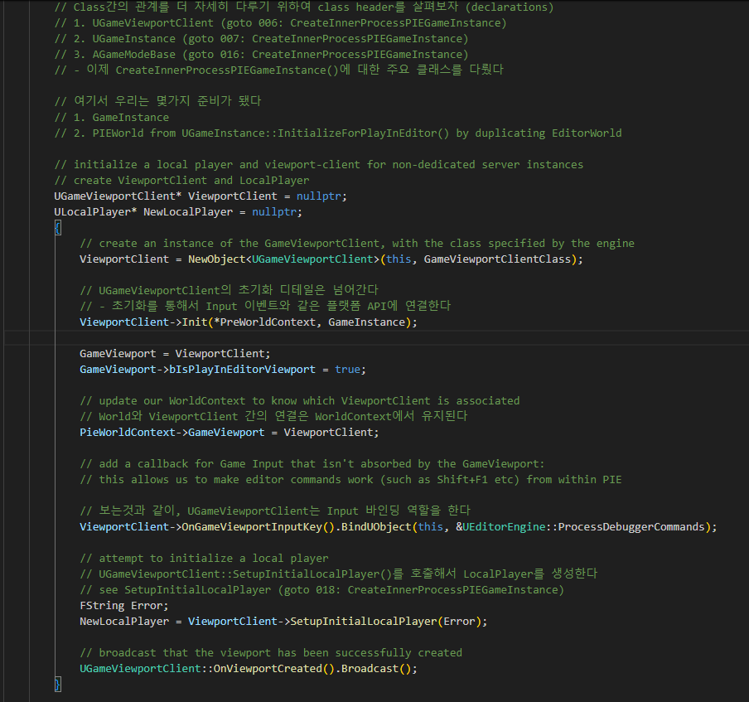
EditorEngine CreateInnerProcessPIEGameInstance 000

Slide 3
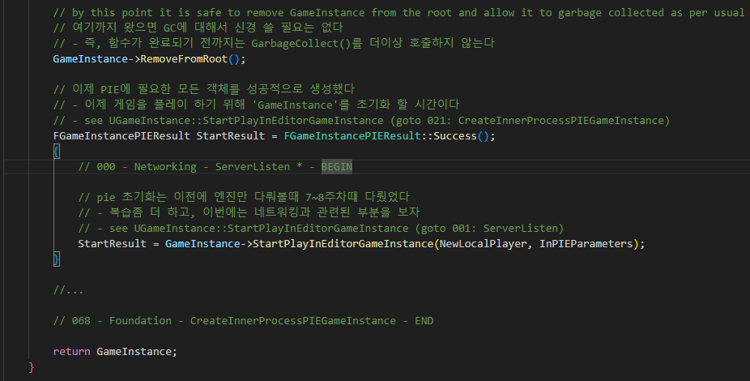
EditorEngine CreateInnerProcessPIEGameInstance 000

Slide 4
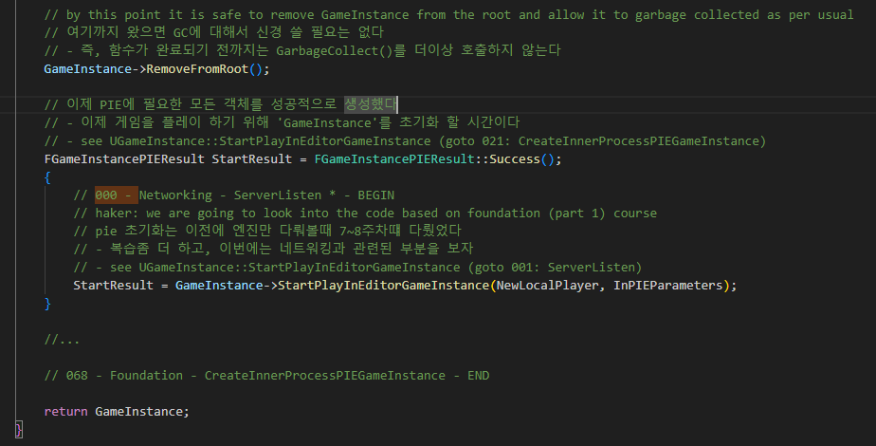
UEditorEngine::CreateInnerProcessPIEGameInstance 000

Slide 5
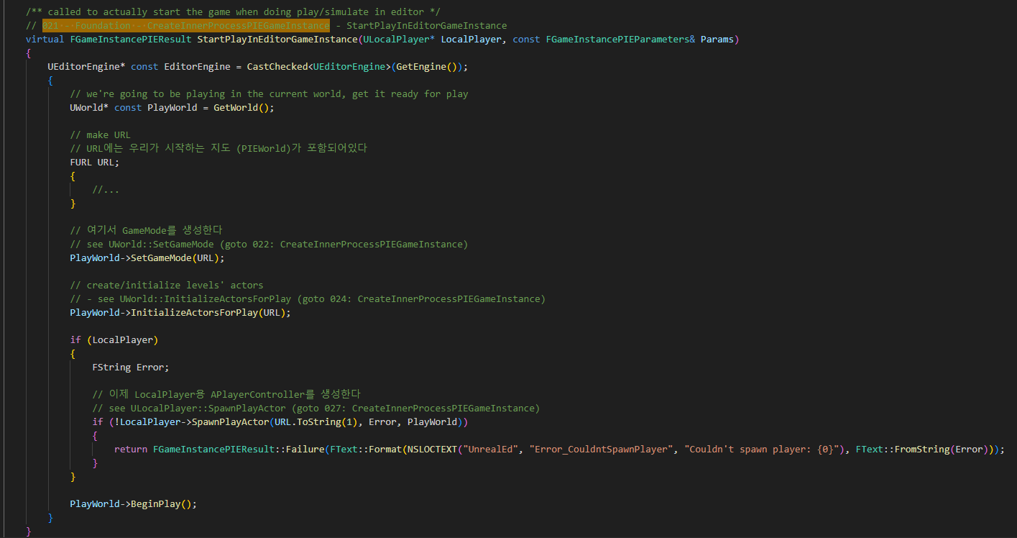
GameInstance StartPlayInEditorGameInstance 021

Slide 6
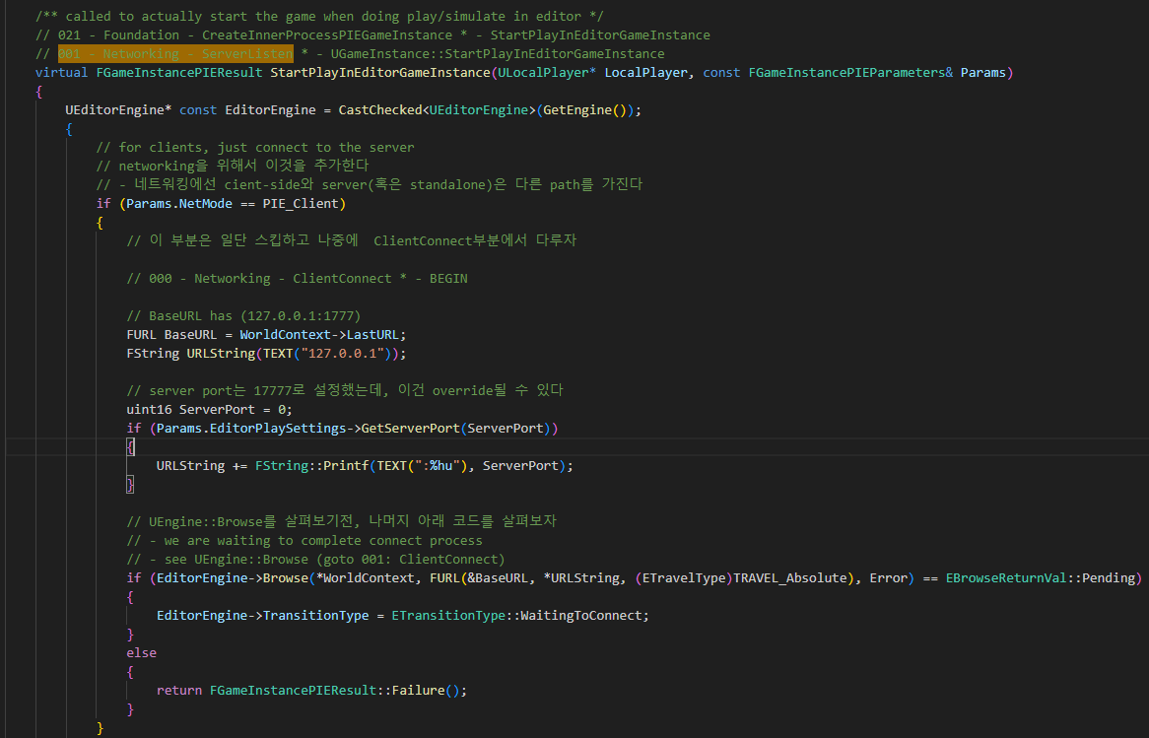
GameInstance StartPlayInEditorGameInstance 001

Slide 7
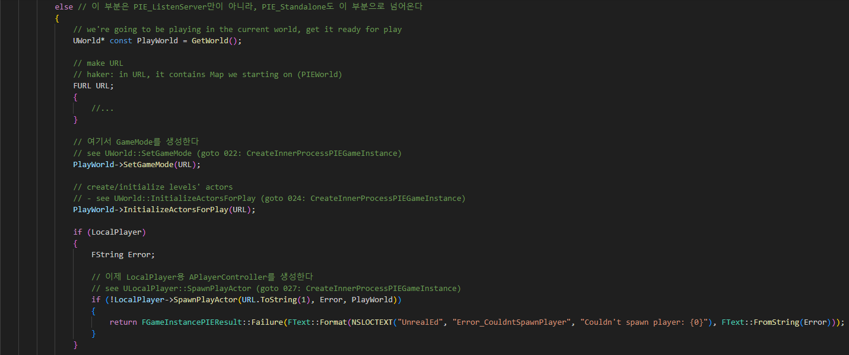
GameInstance StartPlayInEditorGameInstance 001

Slide 8
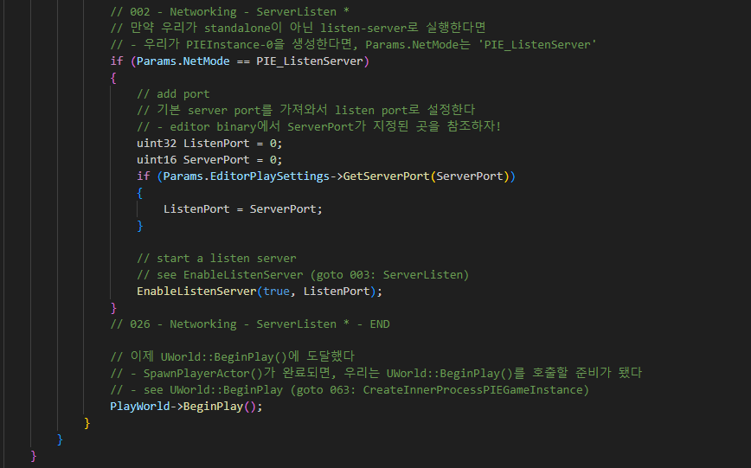
GameInstance StartPlayInEditorGameInstance 002

Slide 9
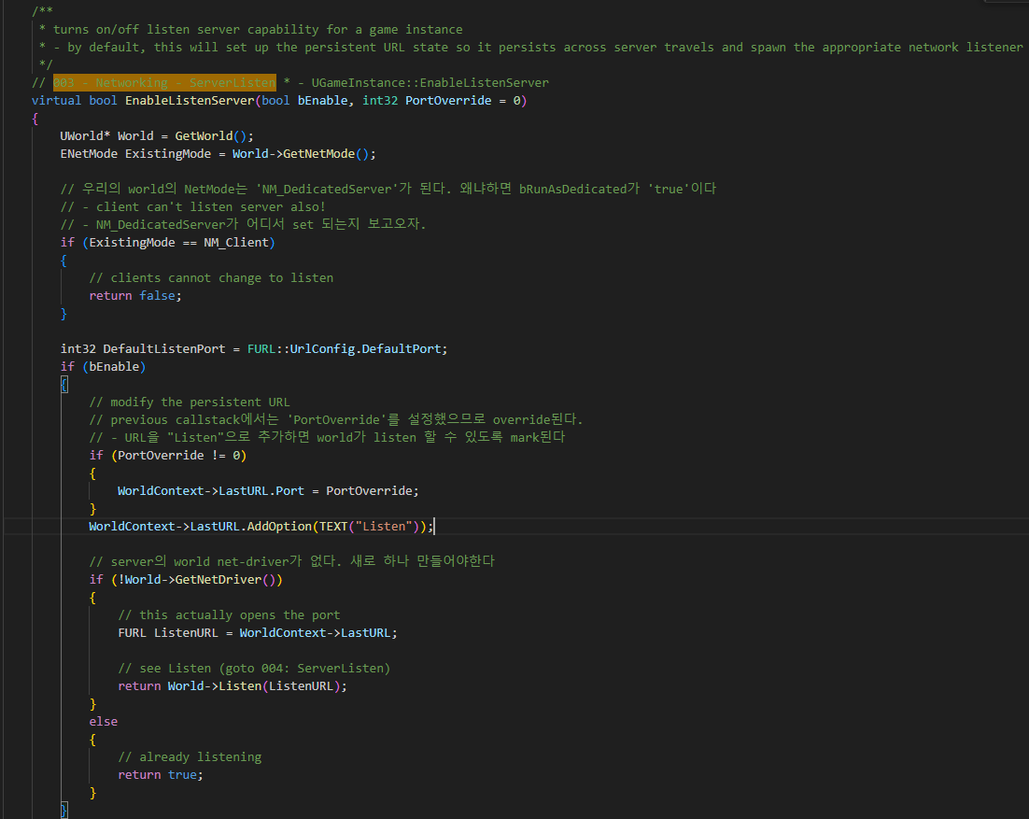
GameInstance EnableListenServer 003

Slide 10
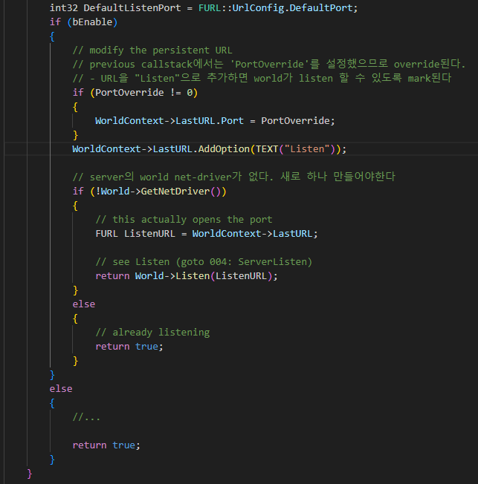
GameInstance EnableListenServer 003

Slide 11
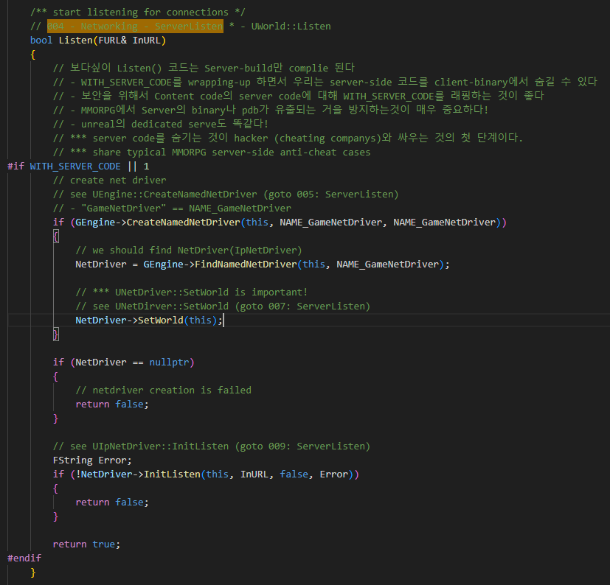
Uworld Listen 004

Slide 12
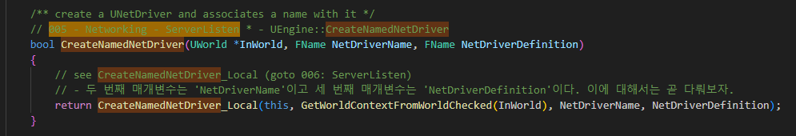
UEngine CreateNameNetDriver 005

Slide 13
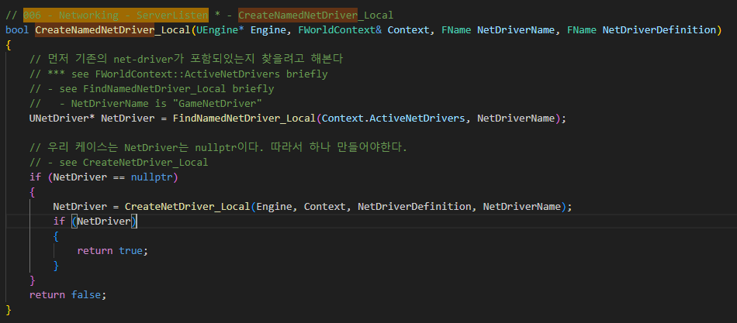
UEngine CreateNameNetDriver_local 006

Slide 14
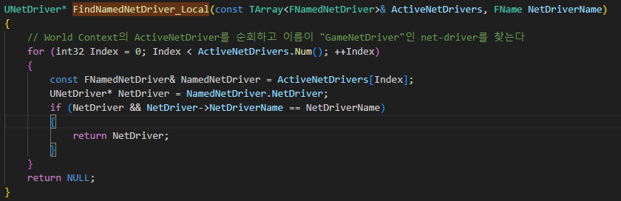
UEngine CreateNameNetDriver_local 006

Slide 15
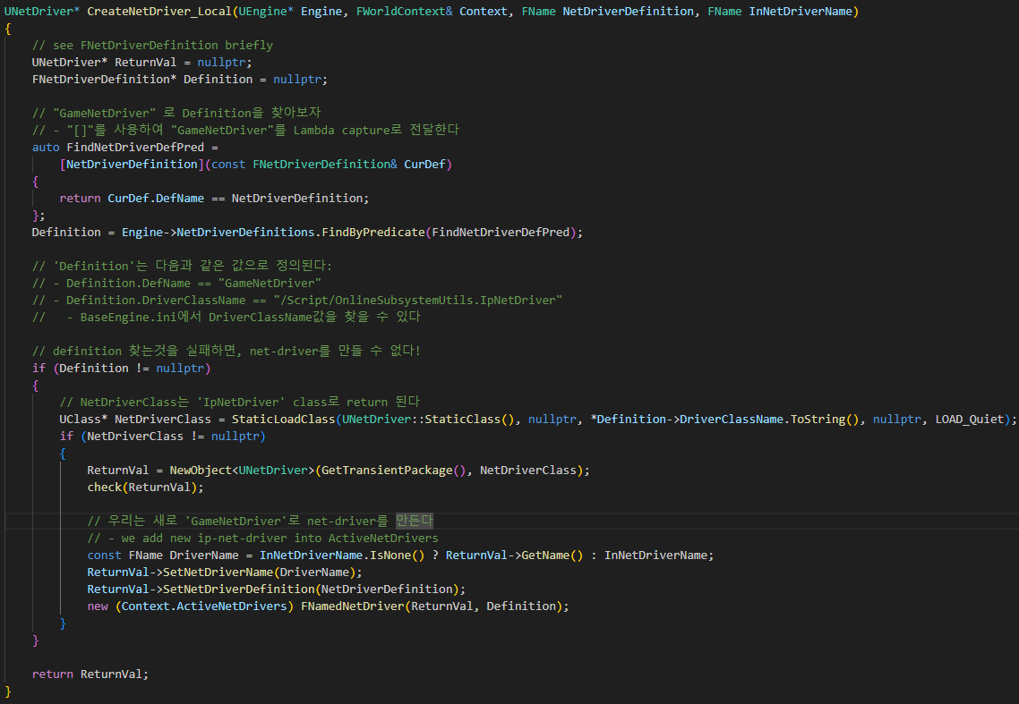
UEngine CreateNameNetDriver_local 006

Slide 16
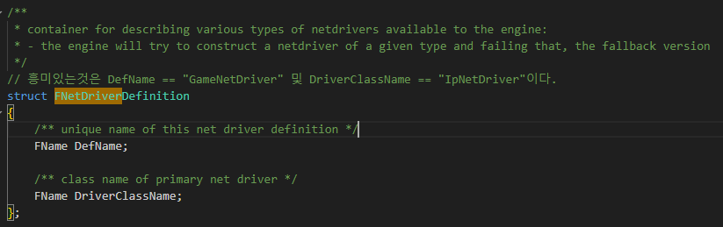
UEngine CreateNameNetDriver_local 006

Slide 17
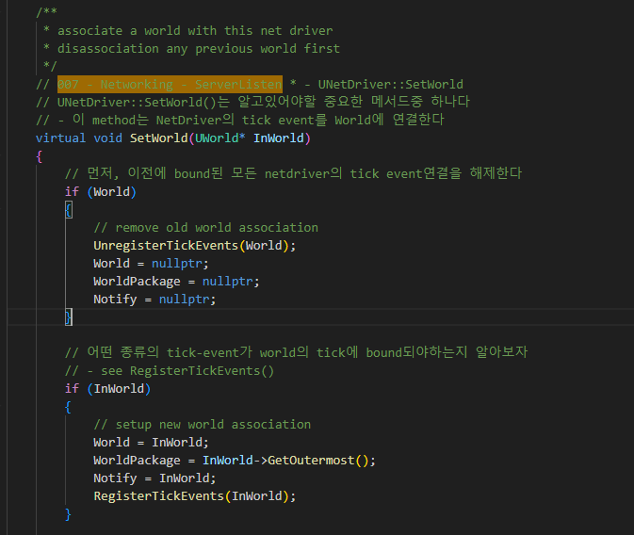
UNetDriver SetWorld 007

Slide 18
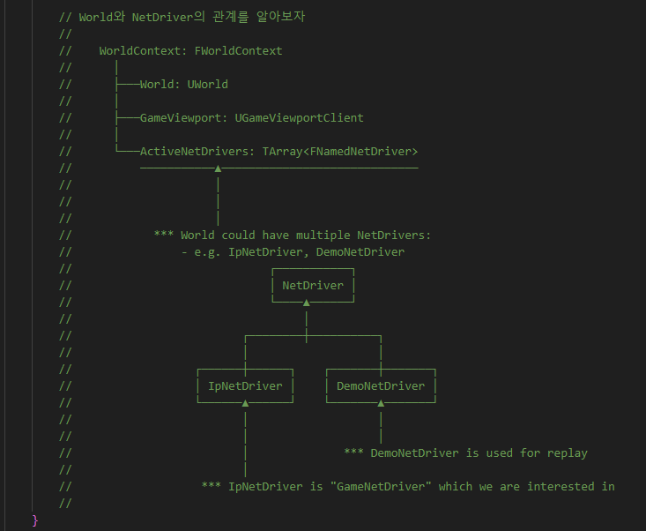
UNetDriver SetWorld 007

Slide 19
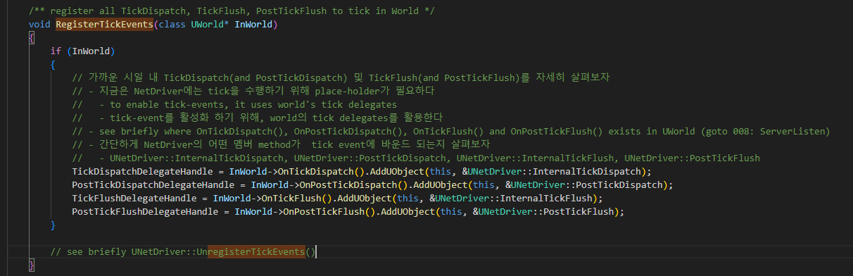
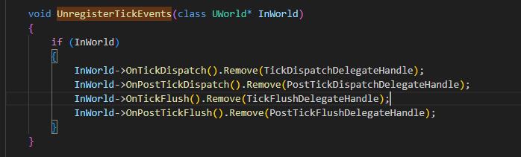
UNetDriver SetWorld 007

Slide 20
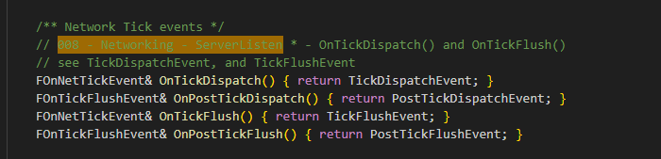
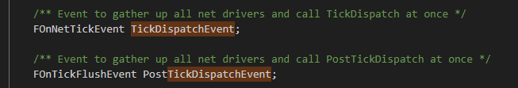
UWorld Tick Delegate 008

Slide 21
Uworld Listen 004

Slide 22
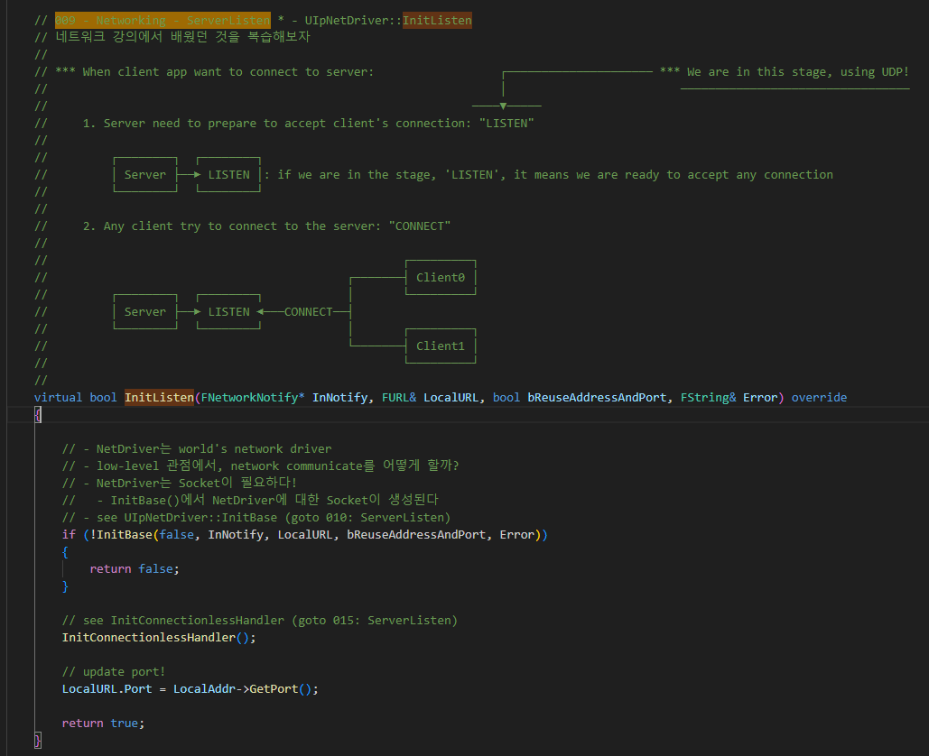
UIpNetDriver InitListen 009

Slide 23
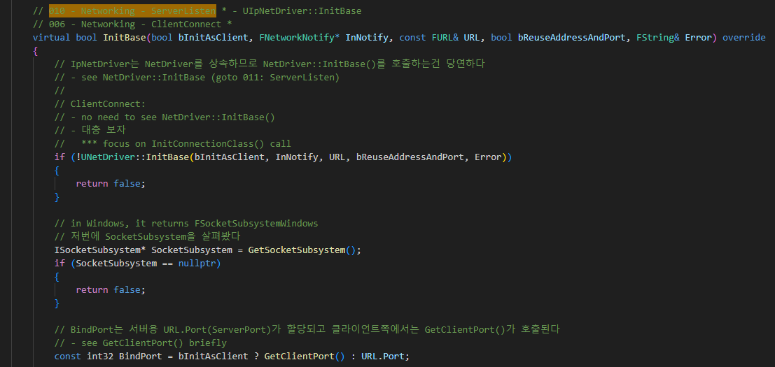
UIpNetDriver InitBase 010

Slide 24
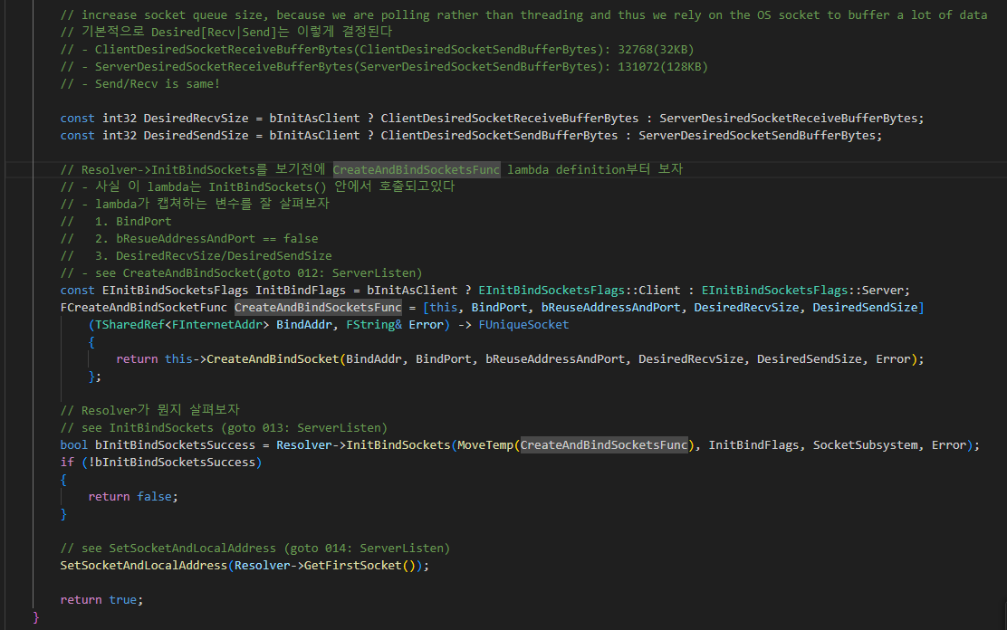
UIpNetDriver InitBase 010

