Slide 1
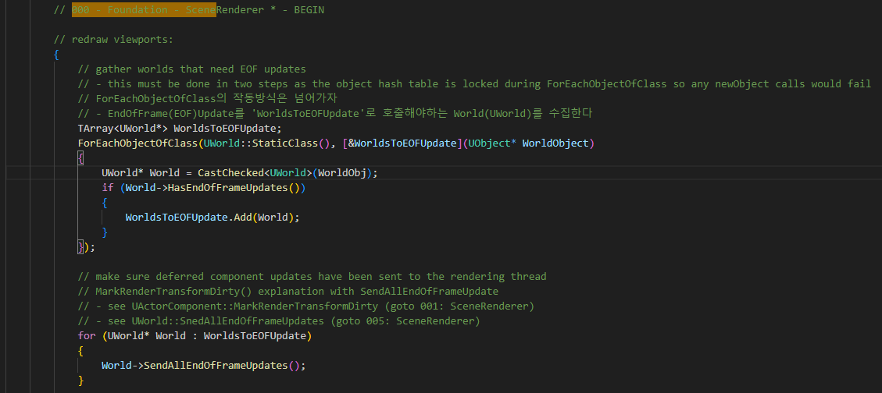
EditorEngine Tick 000

Slide 2
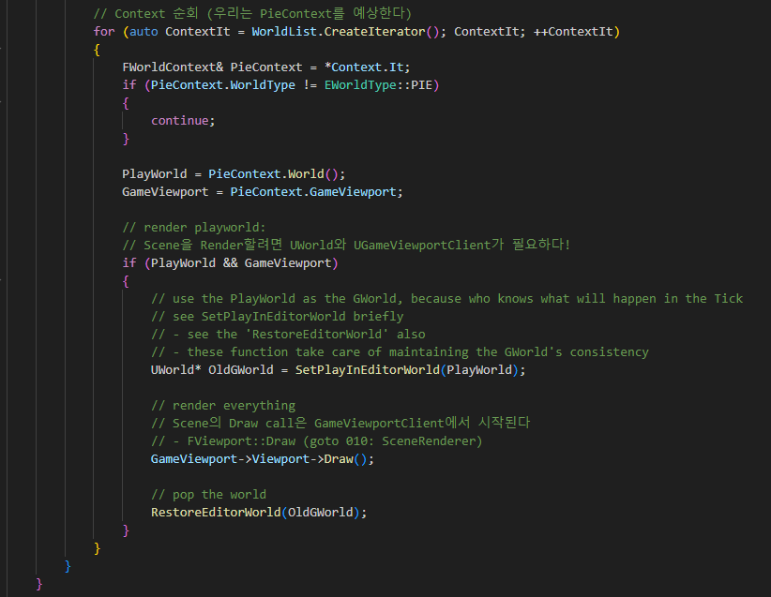
EditorEngine Tick 000

Slide 3
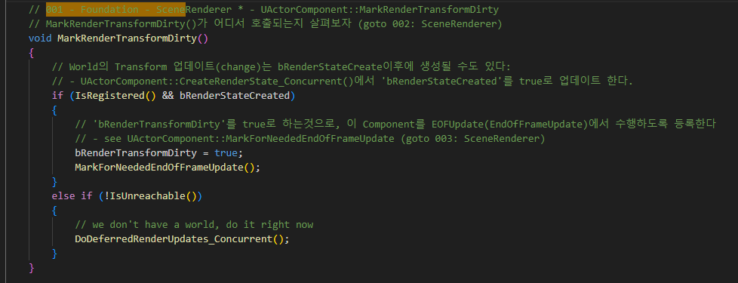
ActorComponent 001

Slide 4

SceneComponent PropagateTransformUpdate 018

Slide 5
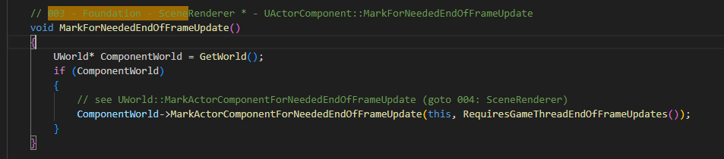
ActorComponent MakrForNeededEndOfFrameUpdate 003

Slide 6
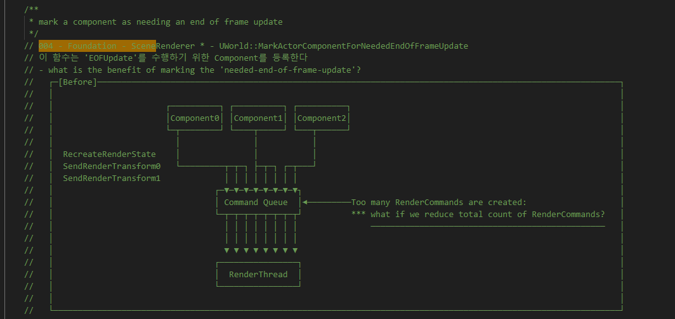
World MarkActorComponentForNeededEndOfFrameUpdate 004

Slide 7
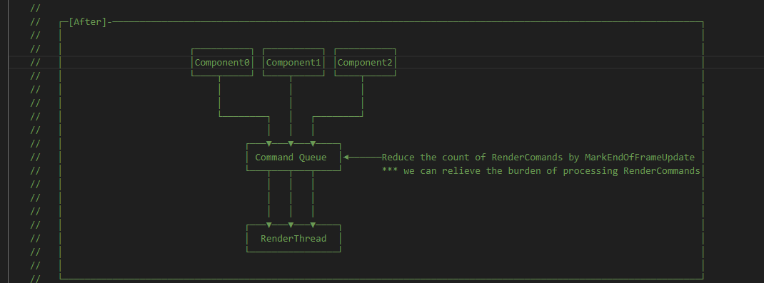
World MarkActorComponentForNeededEndOfFrameUpdate 004

Slide 8
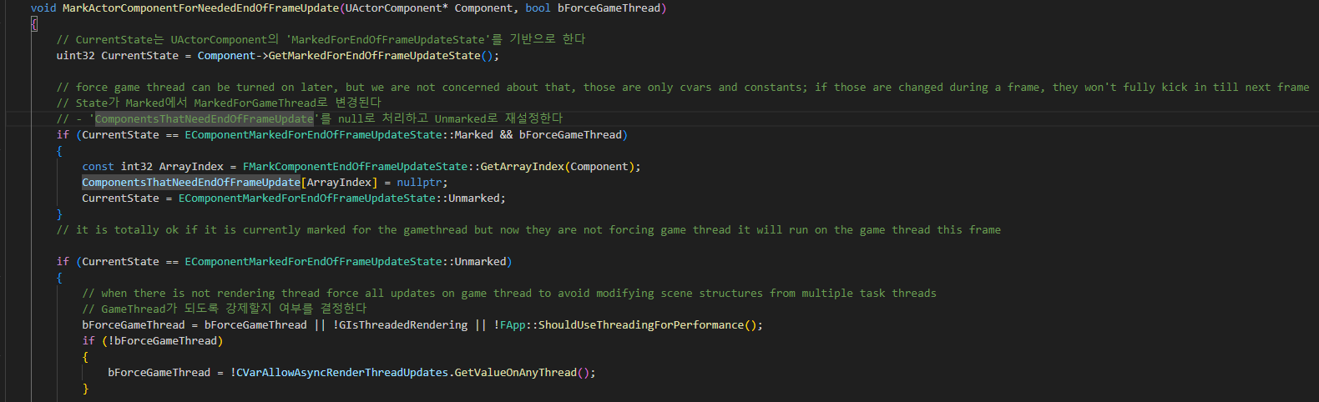
World MarkActorComponentForNeededEndOfFrameUpdate 004

Slide 9
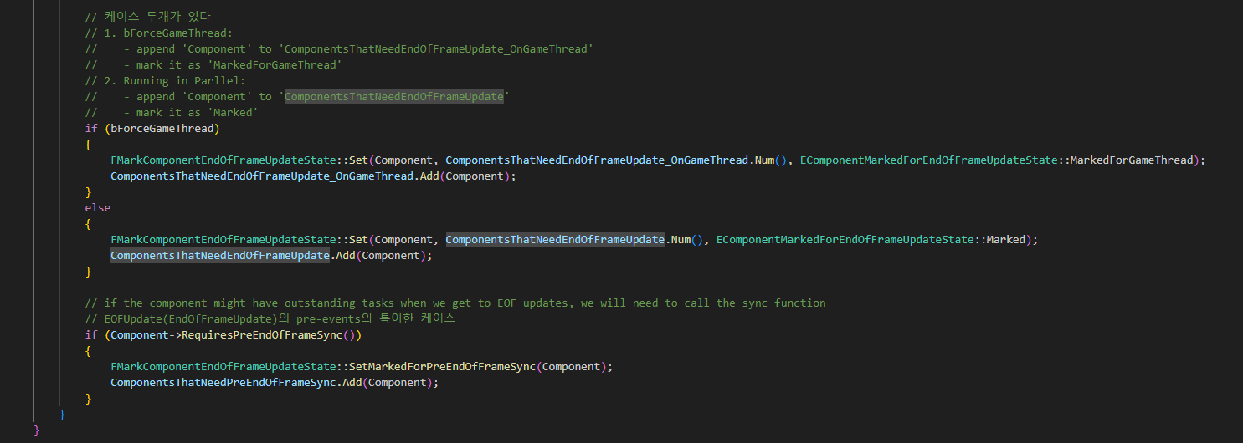
World MarkActorComponentForNeededEndOfFrameUpdate 004

Slide 10
EditorEngine Tick 000

Slide 11
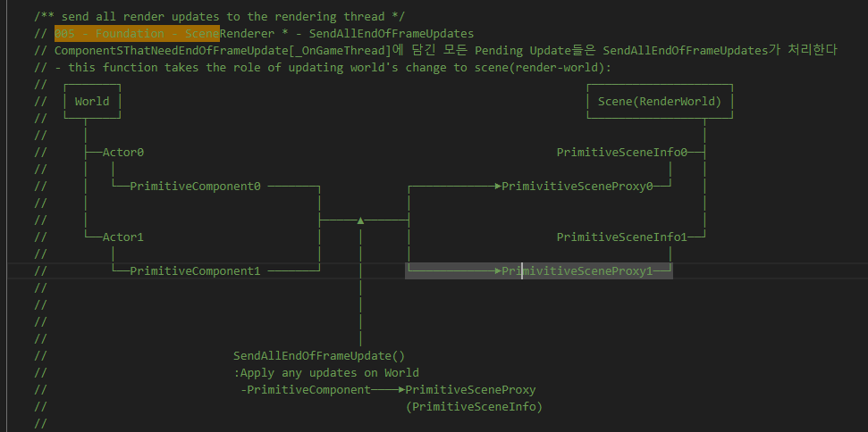
World SendAllEndOfFrameUpdates 005

Slide 12
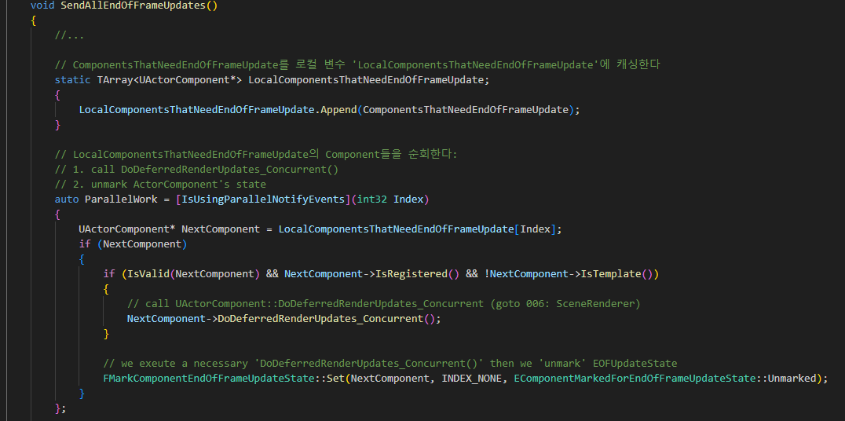
World SendAllEndOfFrameUpdates 005

Slide 13
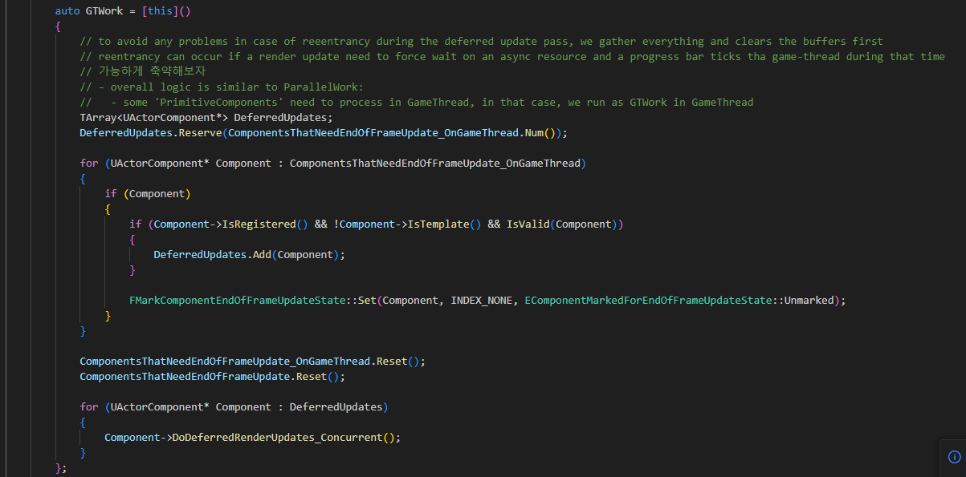
World SendAllEndOfFrameUpdates 005

Slide 14
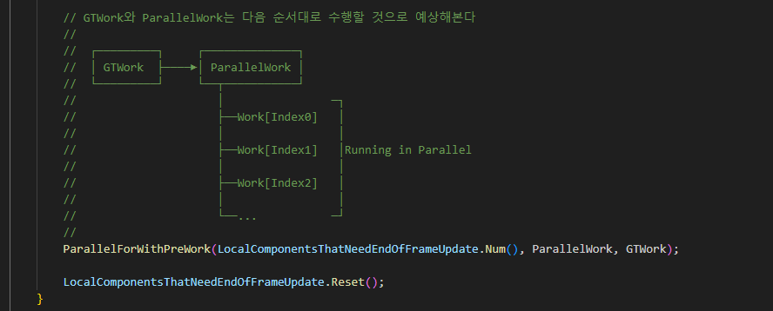
World SendAllEndOfFrameUpdates 005

Slide 15
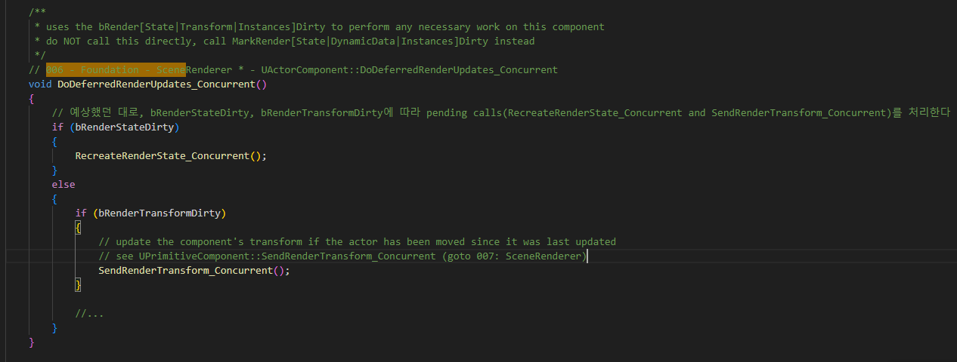
ActorComponent DoDeferredRenderUpdates_Concurrent 006

Slide 16
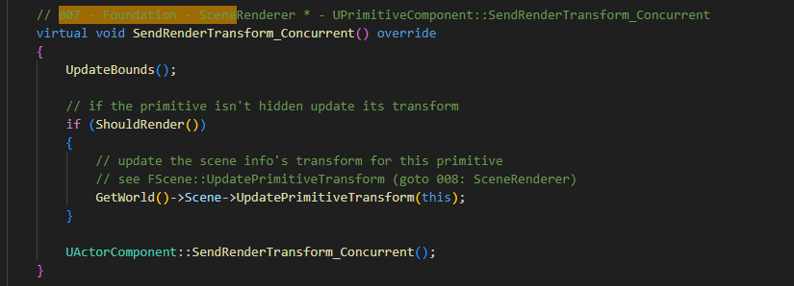
PrimitiveComponent SendRenderTransform_Concurrent 007

Slide 17
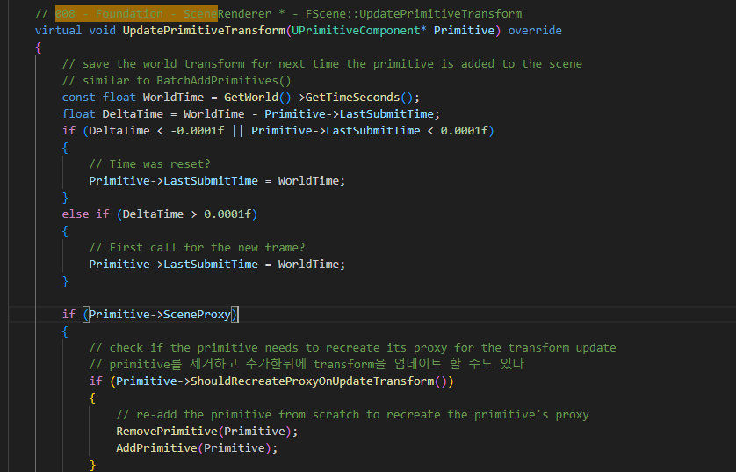
ScenePrivate UpdatePrimitiveTransform 008

Slide 18
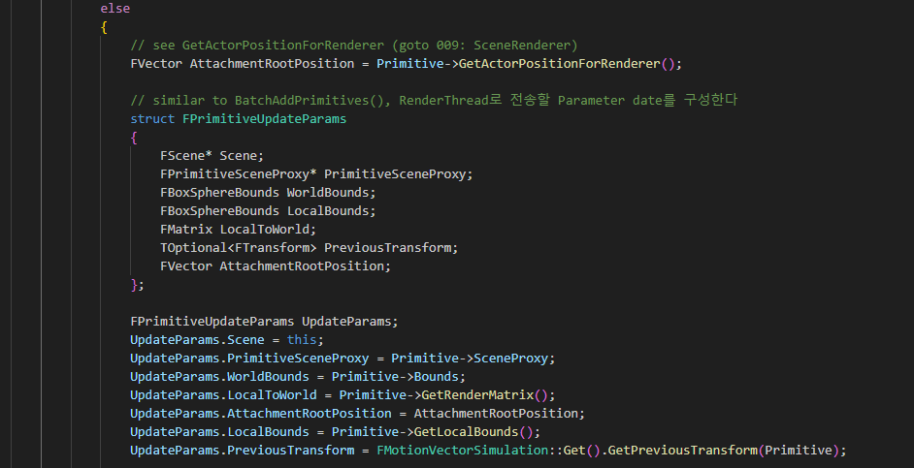
ScenePrivate UpdatePrimitiveTransform 008

Slide 19
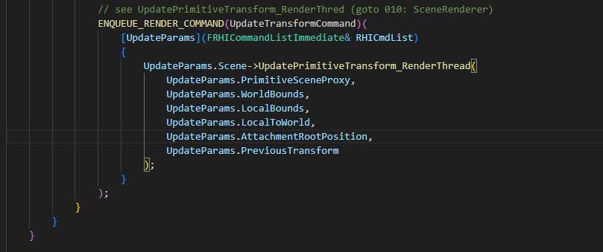
ScenePrivate UpdatePrimitiveTransform 008

Slide 20
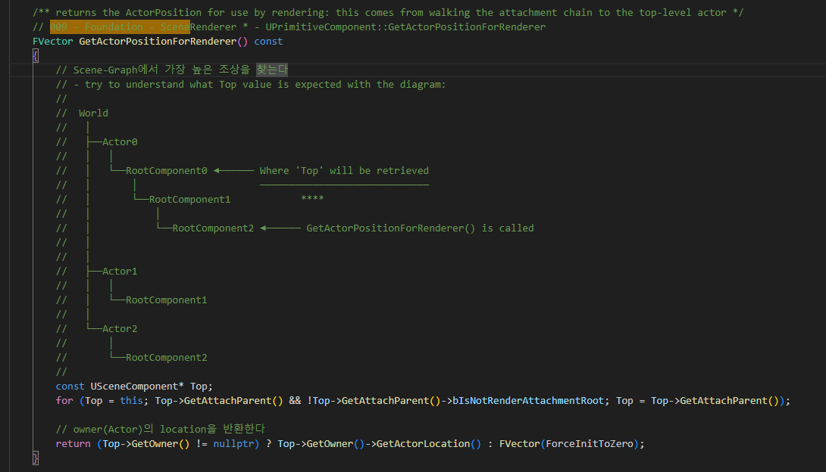
PrimitiveComponent GetActorPositionForRenderer 009

Slide 21
ScenePrivate UpdatePrimitiveTransform 008

Slide 22
ScenePrivate UpdatePrimitiveTransform_RenderThread 010

Slide 23
EditorEngine Tick 000

Slide 24
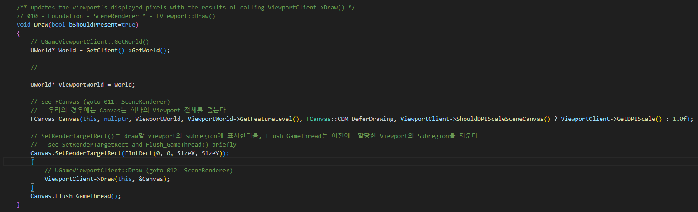
GameViewportClient Draw 010

Slide 25
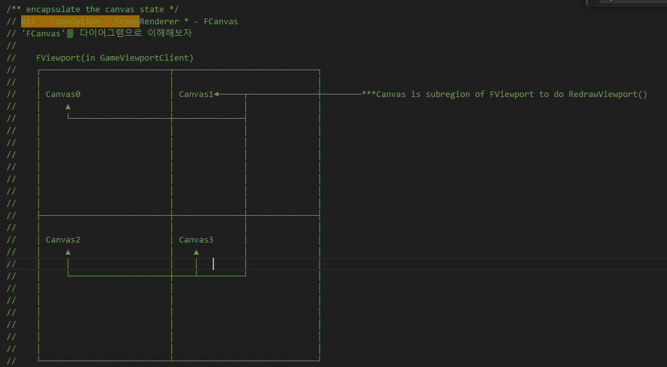
GameViewportClient Fcanvas 011

Slide 26
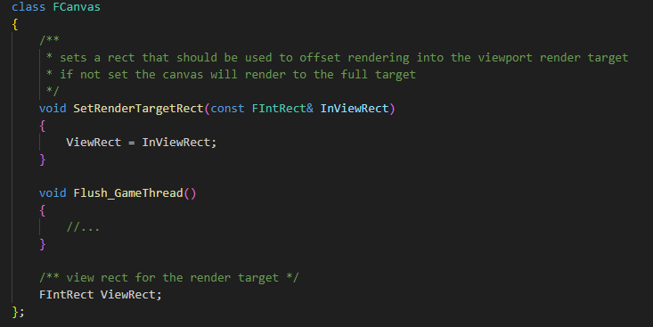
GameViewportClient Fcanvas 011

Slide 27
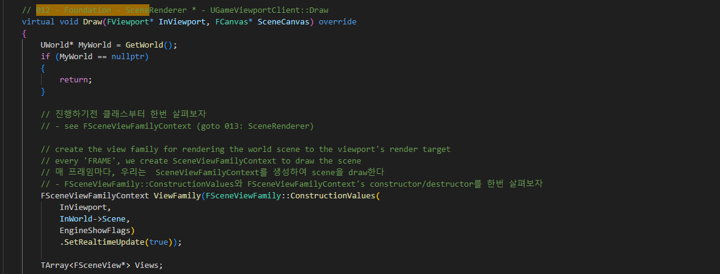
GameViewportClient Draw 012

Slide 28
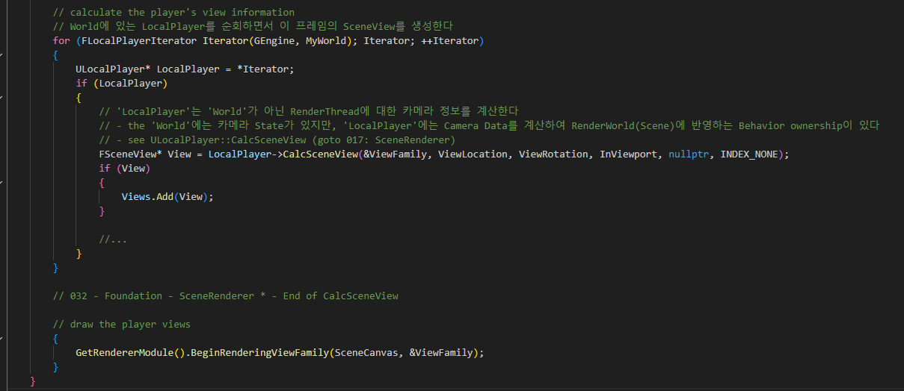
GameViewportClient Draw 012

Slide 29
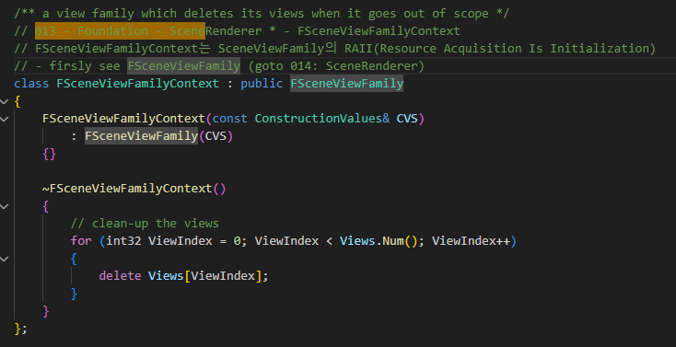
GameViewportClient FSceneViewFamilyContext 013

Slide 30
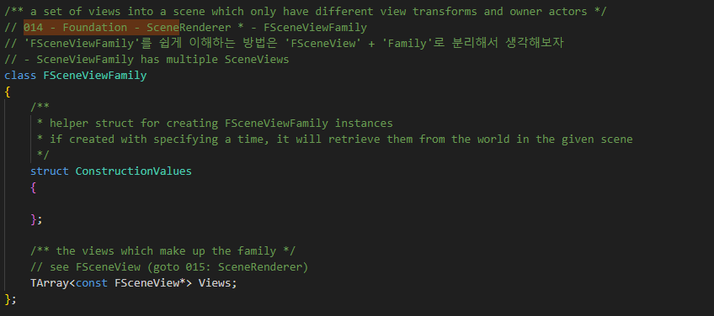
GameViewportClient FSceneViewFamily 014

Slide 31
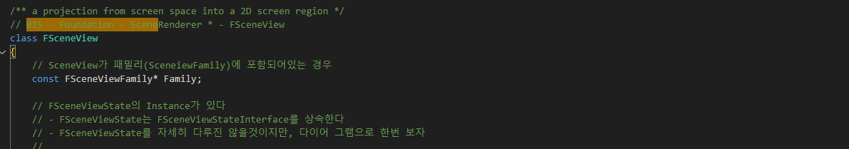
ScenePrivate FSceneView 015

Slide 32
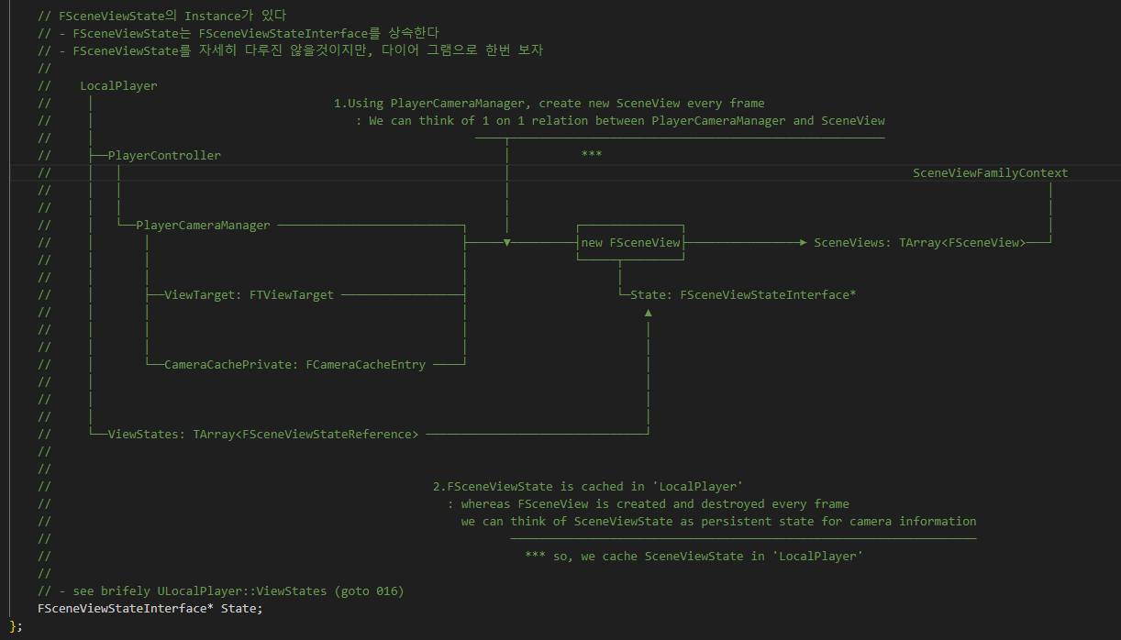
ScenePrivate FSceneView 015

Slide 33
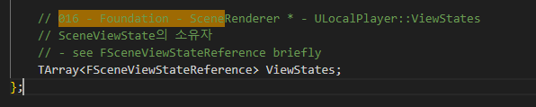
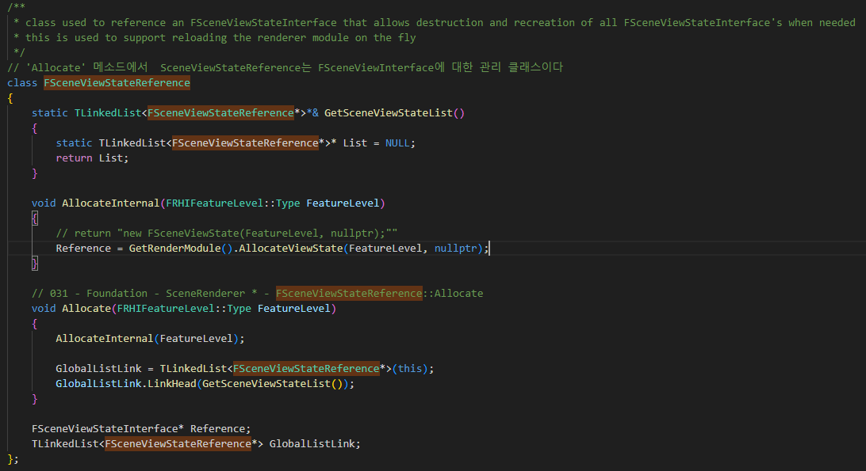
LocalPlayer ULocalPlayer::ViewState 016

Slide 34
GameViewportClient Draw 012

Slide 35
GameViewportClient Draw 012

Slide 36
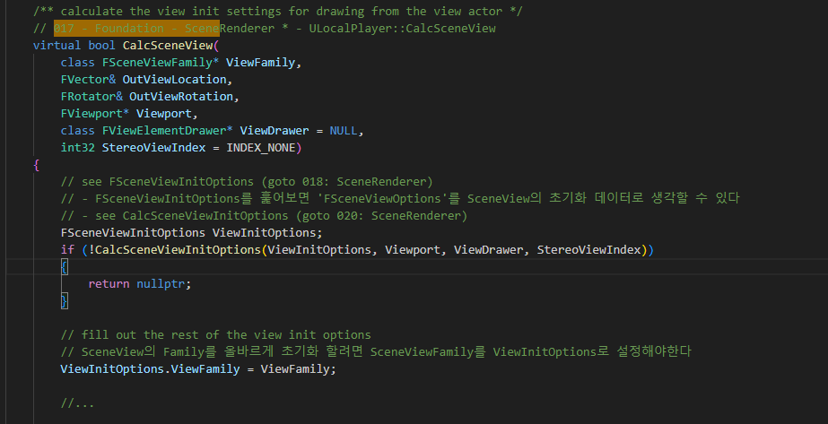
LocalPlayer ULocalPlayer::CalcSceneView 017

Slide 37
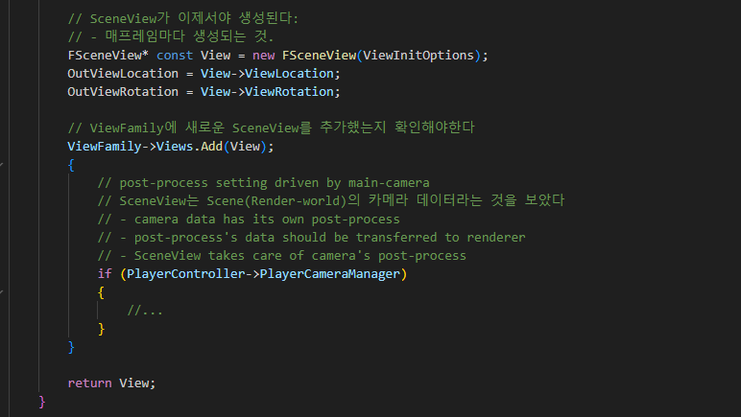
LocalPlayer ULocalPlayer::CalcSceneView 017

Slide 38
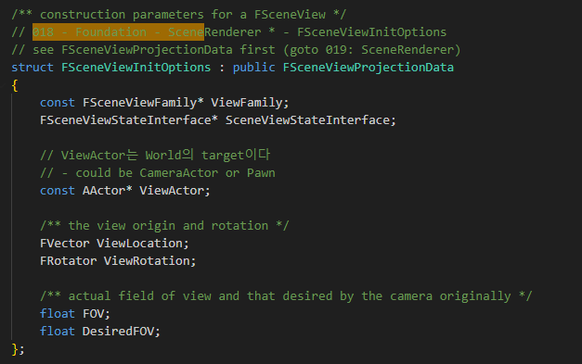
ScenePrivate FSceneViewInitOptions 018

Slide 39
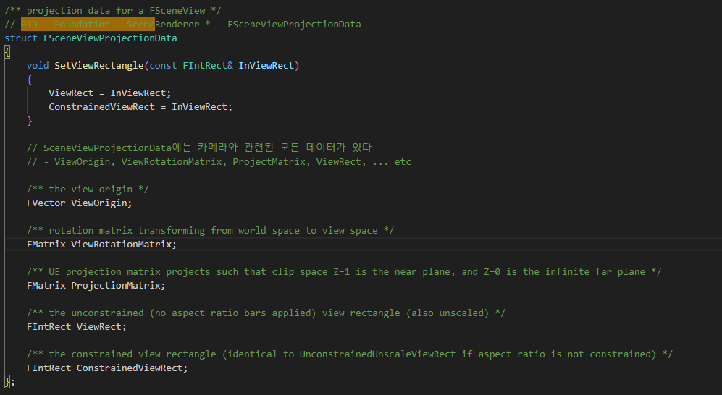
ScenePrivate FSceneViewProjectionData 019

Slide 40
LocalPlayer ULocalPlayer::CalcSceneView 017

Slide 41
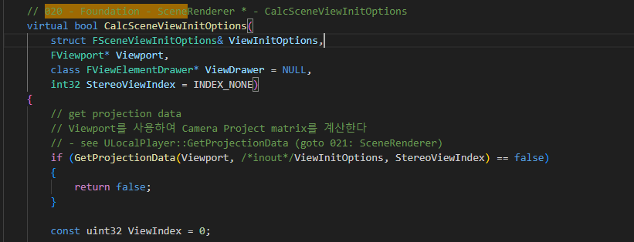
LocalPlayer CalcSceneViewInitOptions 020

Slide 42
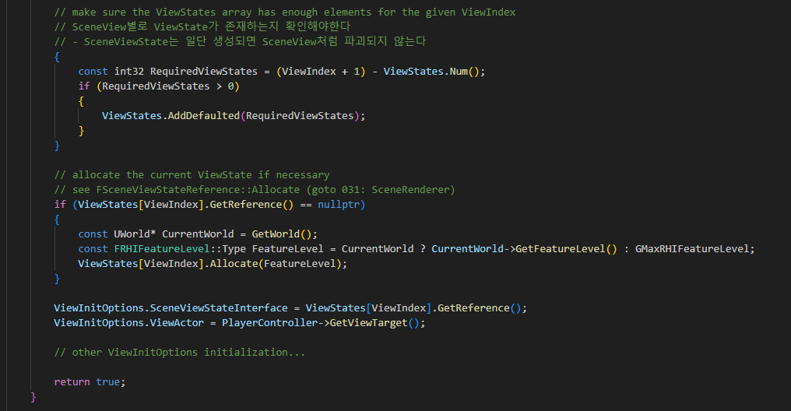
LocalPlayer CalcSceneViewInitOptions 020

Slide 43
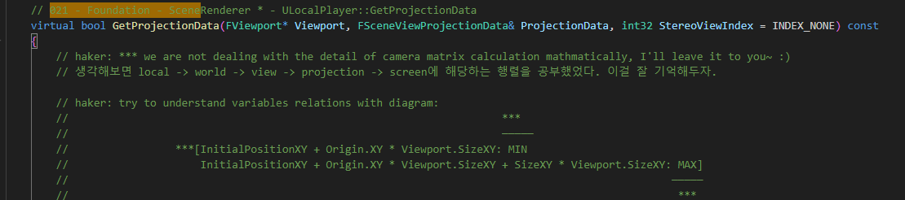
LocalPlayer ULocalPlayer::GetProjectionData 021

Slide 44
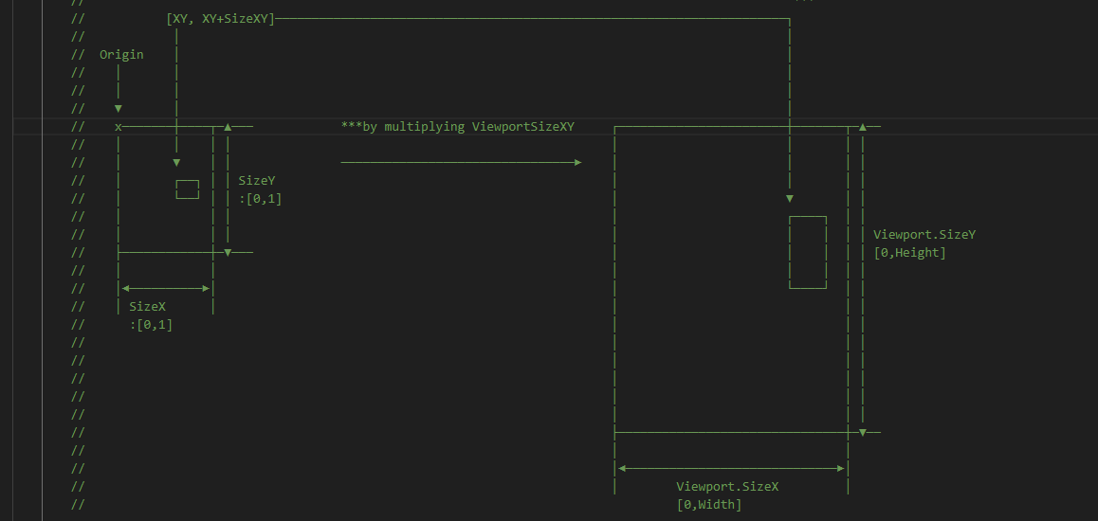
LocalPlayer ULocalPlayer::GetProjectionData 021

Slide 45
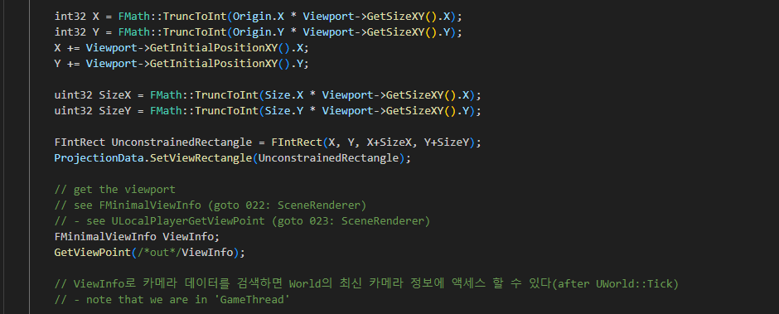
LocalPlayer ULocalPlayer::GetProjectionData 021

Slide 46
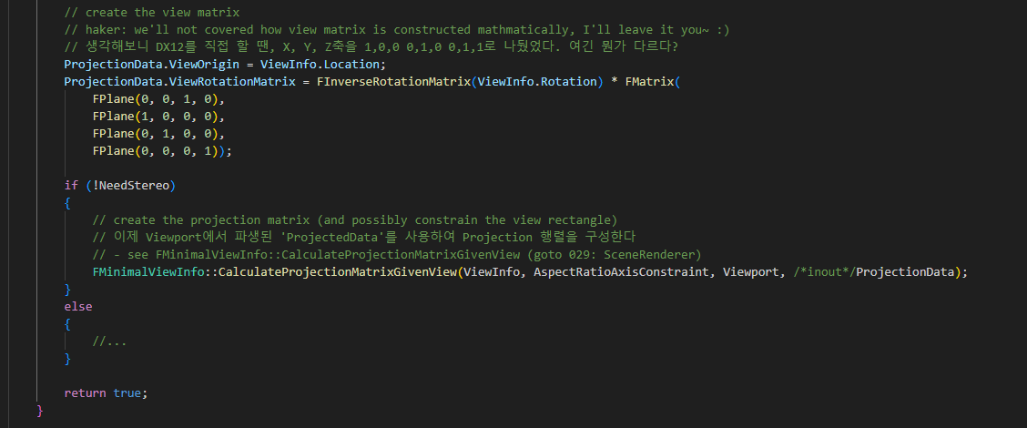
LocalPlayer ULocalPlayer::GetProjectionData 021

Slide 47
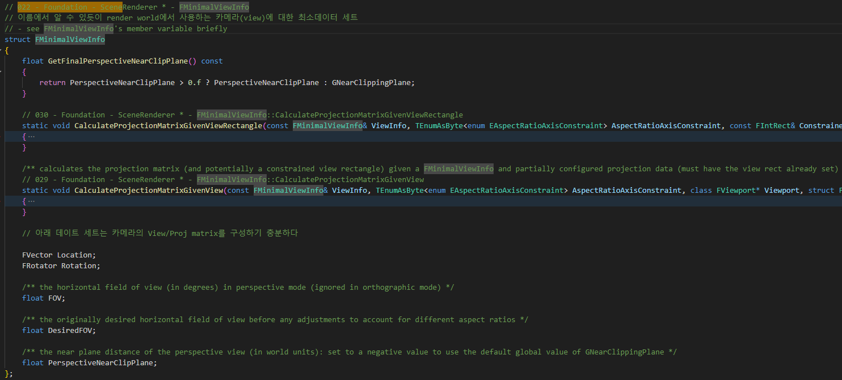
PlayerController FMinimalViewInfo 022

Slide 48
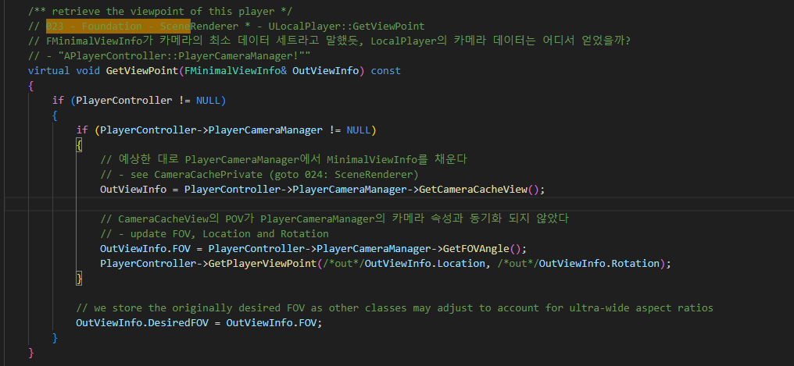
LocalPlayer GetViewPoint 023

Slide 49
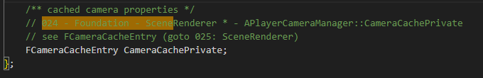
PlayerController APlayerCameraManager::CameraCachePrivate 024

Slide 50
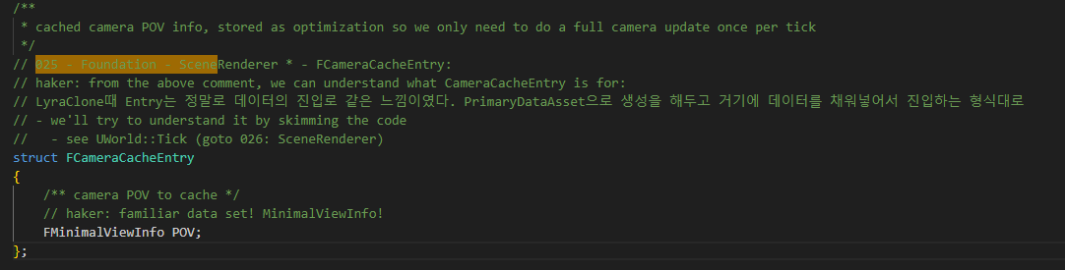
PlayerController FCameraCacheEntry 025

Slide 51
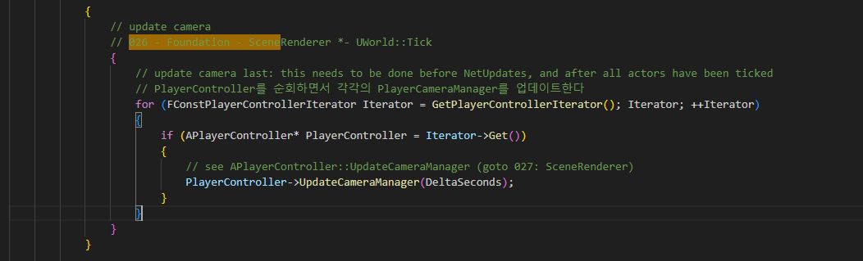
World UWorld::Tick 026

Slide 52
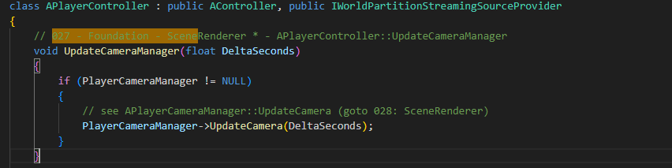
PlayerController UpdateCameraManager 027

Slide 53
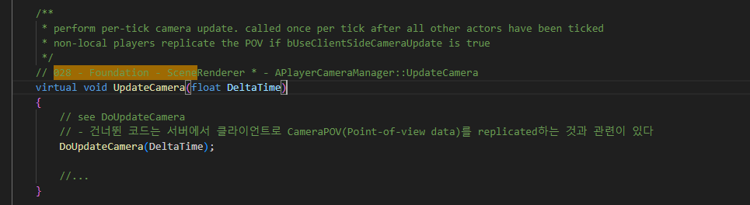
PlayerController UpdateCamera 028

Slide 54
FMinimalViewInfo CalculateProjectionMatrixGivenView 029

Slide 55
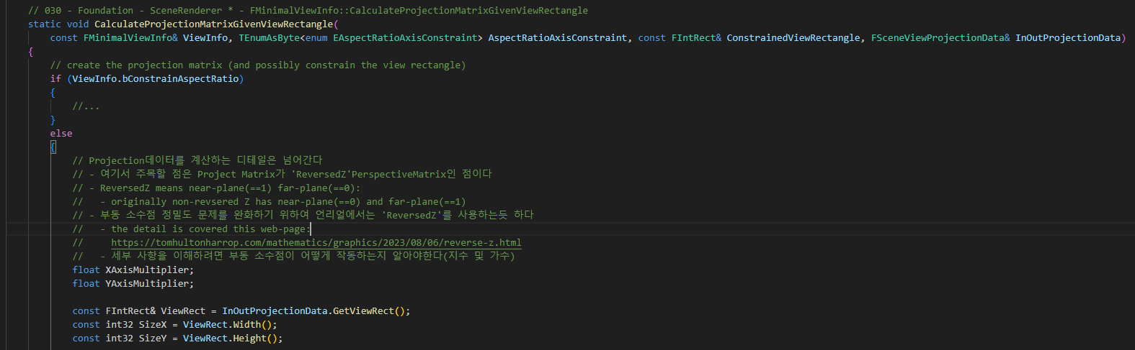
PlayerController CalculateProjectionMatrixGivenViewRectangle 030

Slide 56
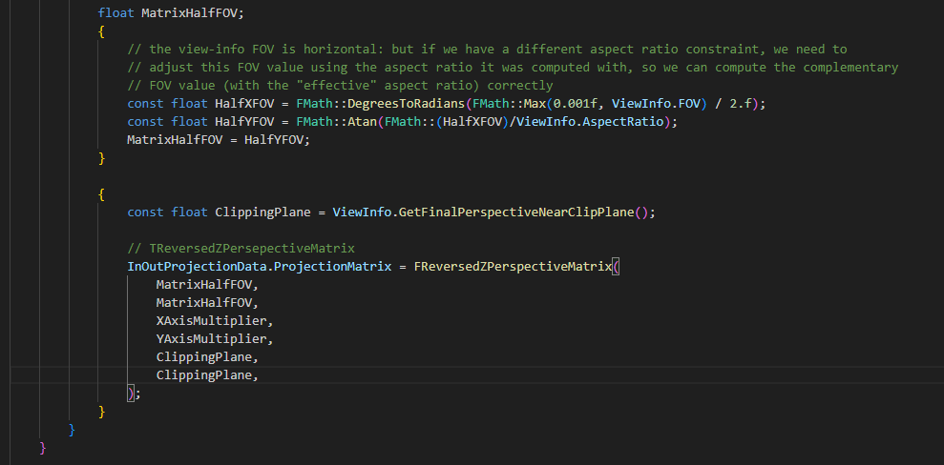
PlayerController CalculateProjectionMatrixGivenViewRectangle 030

Slide 57
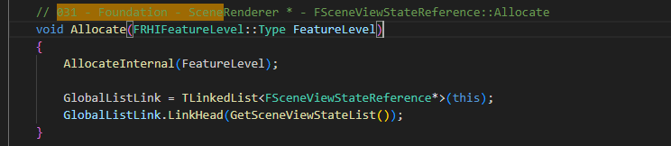
LocalPlayer FSceneViewStateReference::Allocate 031

Slide 58
GameViewportClient Draw 032

