Slide 1
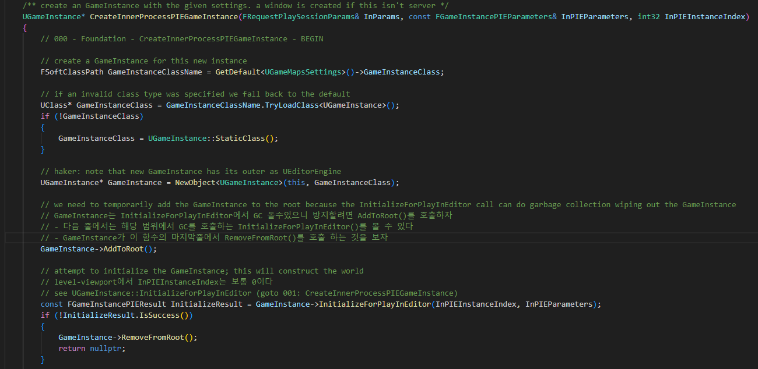
EditorEngine CreateInnerProcessPIEGameInstance 000

Slide 2
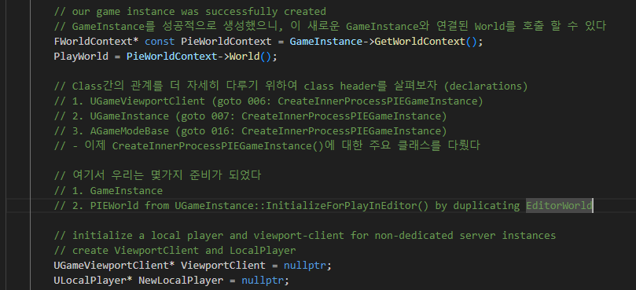
EditorEngine CreateInnerProcessPIEGameInstance 000

Slide 3
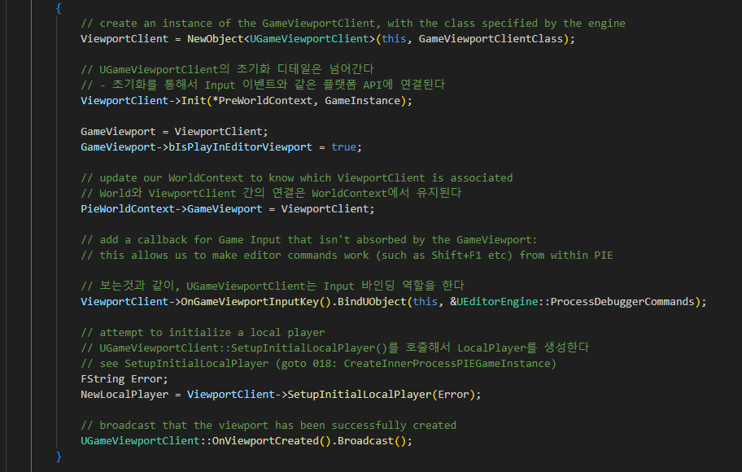
EditorEngine CreateInnerProcessPIEGameInstance 000

Slide 4
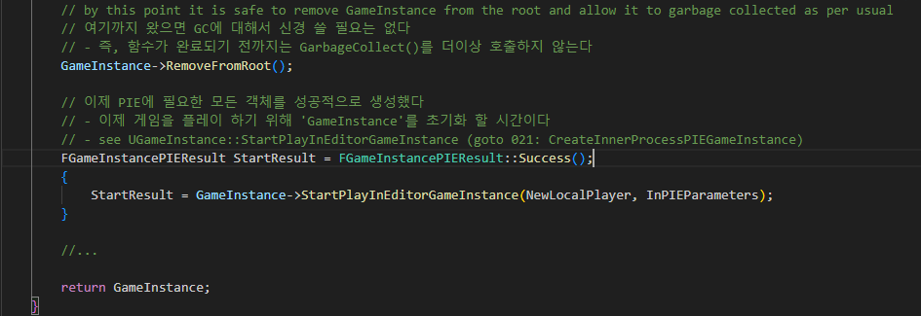
EditorEngine CreateInnerProcessPIEGameInstance 000

Slide 5
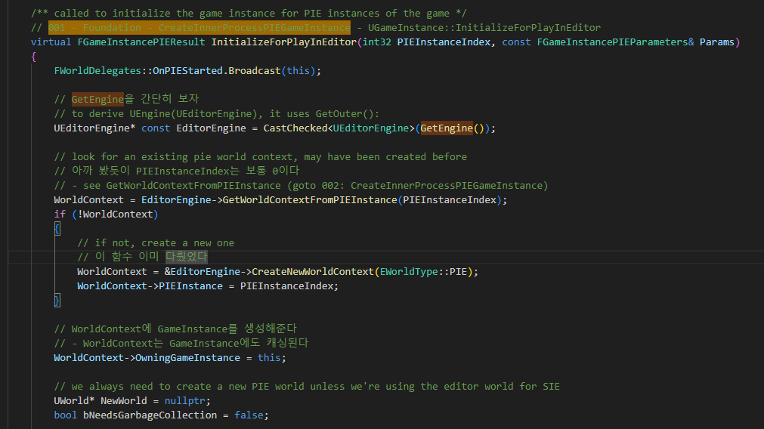
GameInstance InitializeForPlayInEditor 001

Slide 6
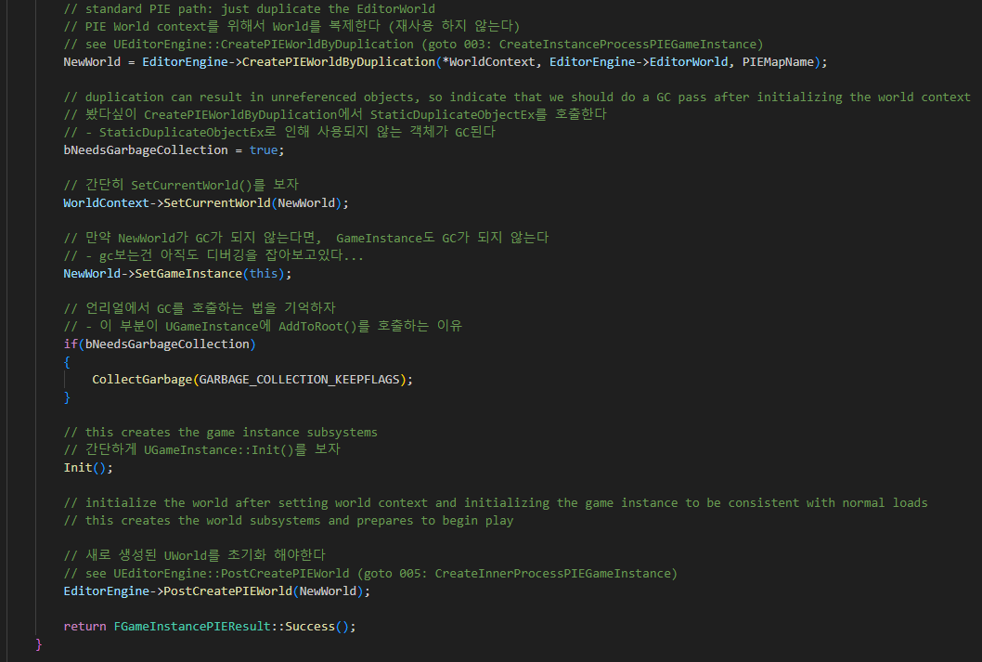
GameInstance InitializeForPlayInEditor 001

Slide 7
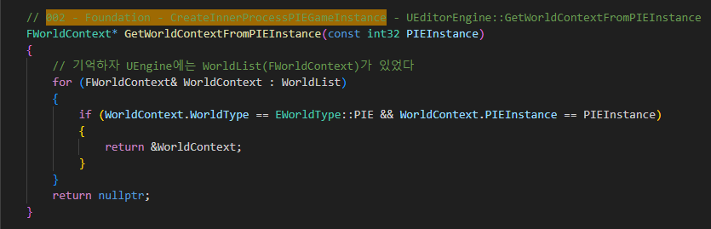
GameInstance GetWorldContextFromPIEInstance 002

Slide 8
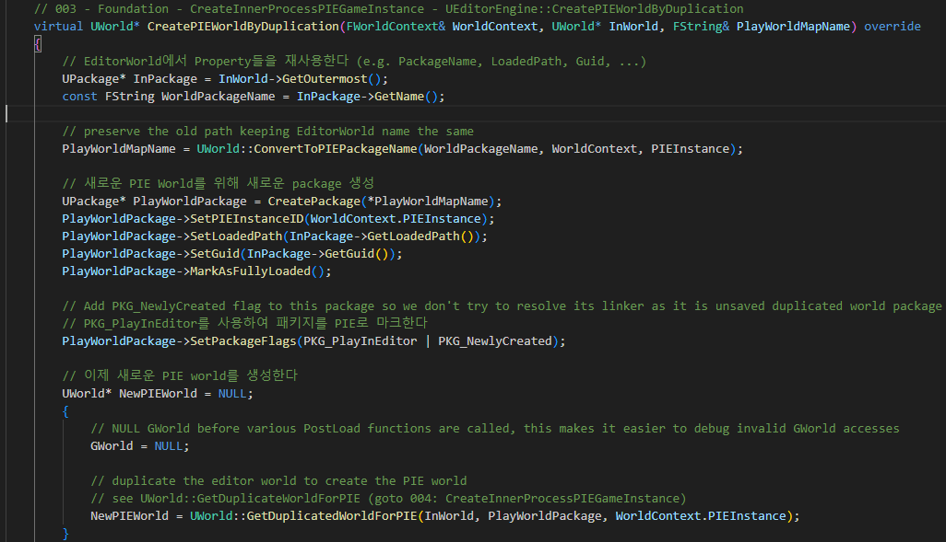
EditorEngine CreatePIEWorldByDuplication 003

Slide 9
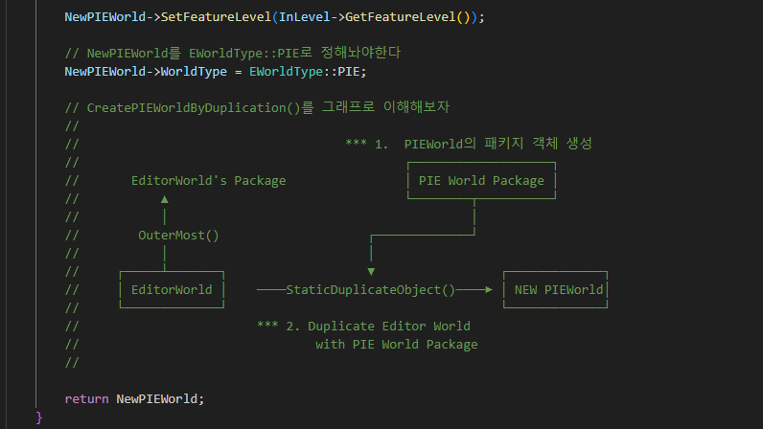
EditorEngine CreatePIEWorldByDuplication 003

Slide 10
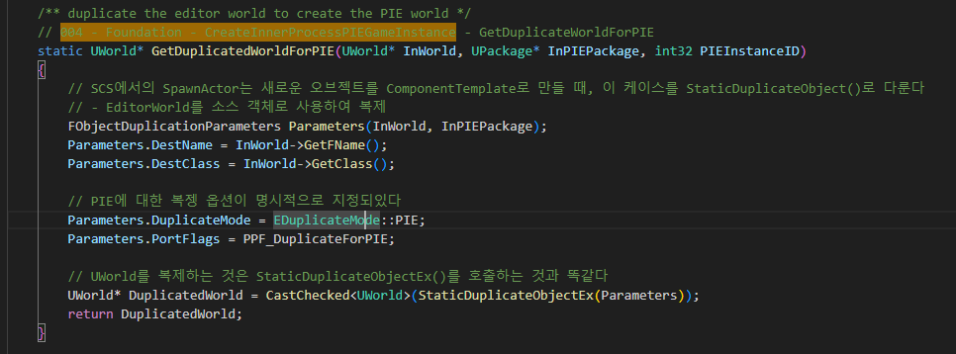
World GetDuplicatedWorldForPIE 004

Slide 11
GameInstance InitializeForPlayInEditor 001

Slide 12
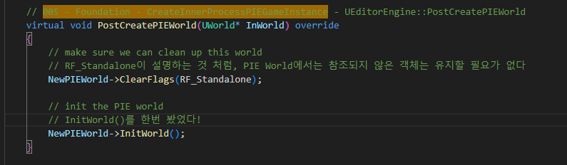
EditorEngine PostCreatePIEWorld 005

Slide 13
EditorEngine CreateInnerProcessPIEGameInstance 000

Slide 14
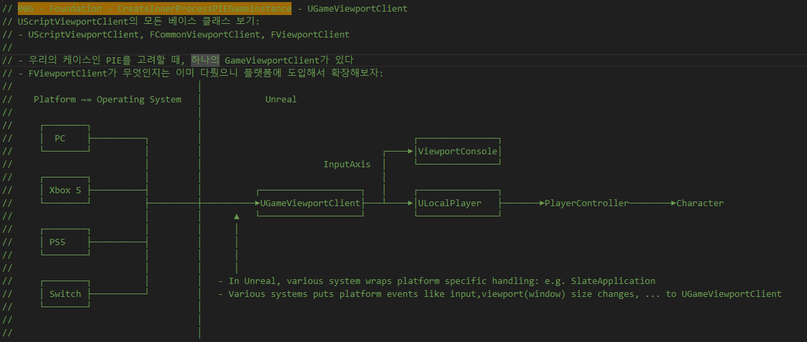
GameViewportClient UGameViewportClient 006

Slide 15
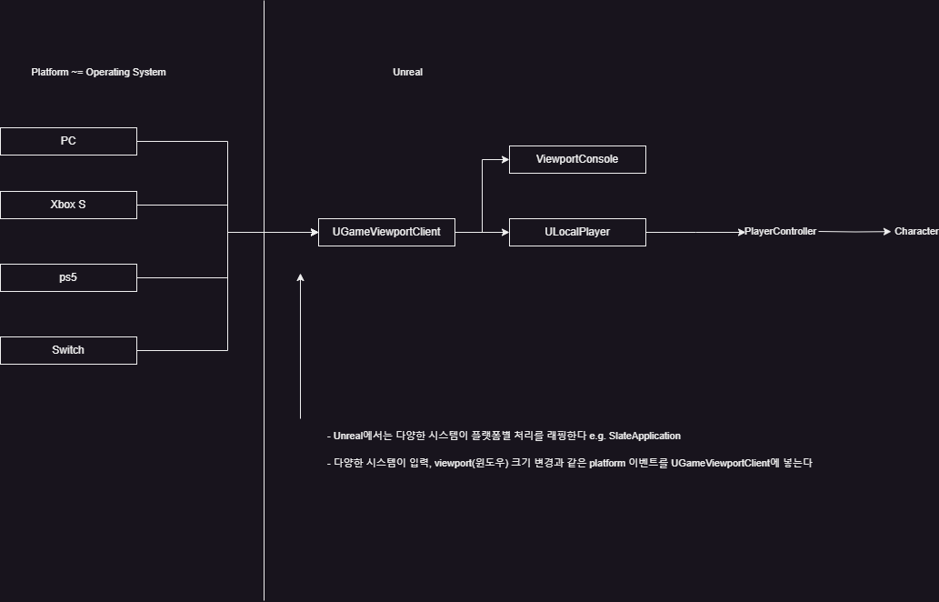
GameViewportClient UGameViewportClient 006

Slide 16
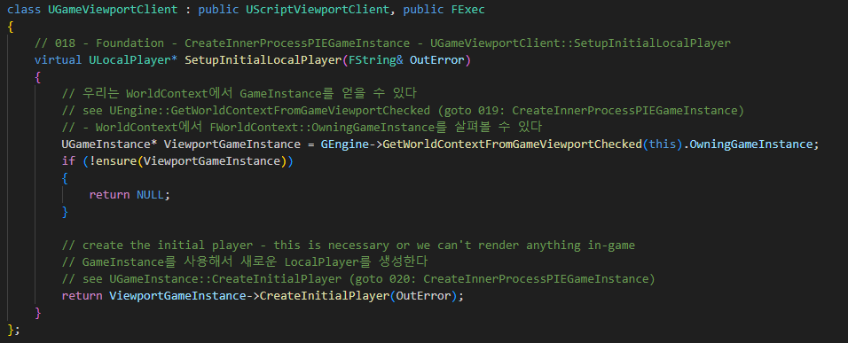
GameViewportClient UGameViewportClient 006

Slide 17
EditorEngine CreateInnerProcessPIEGameInstance 000

Slide 18
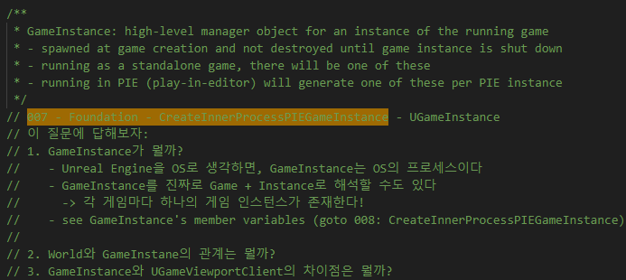
GameInstance UGameInstance 007

Slide 19
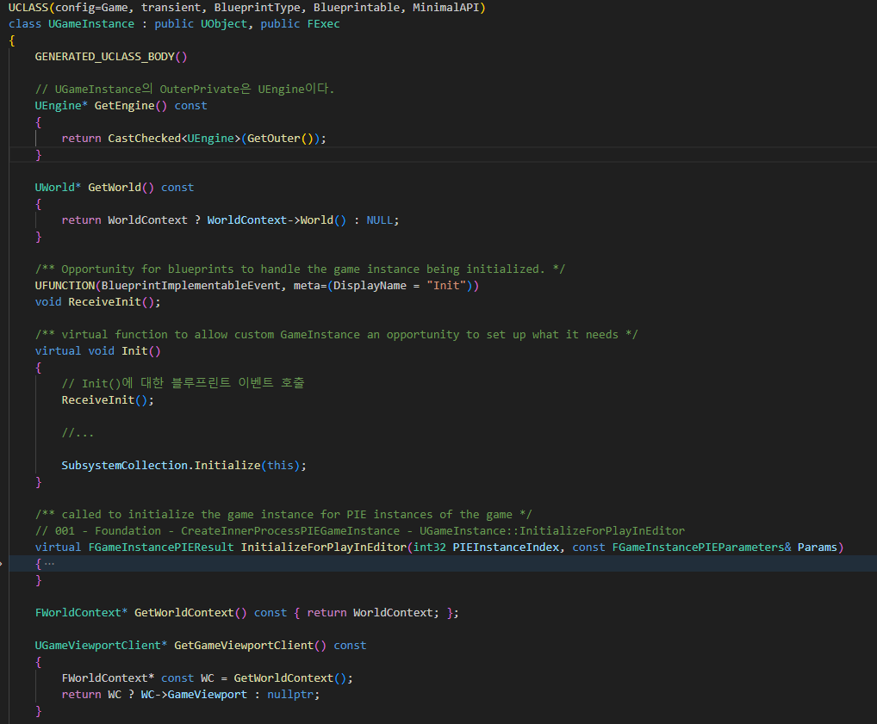
GameInstance UGameInstance 007

Slide 20
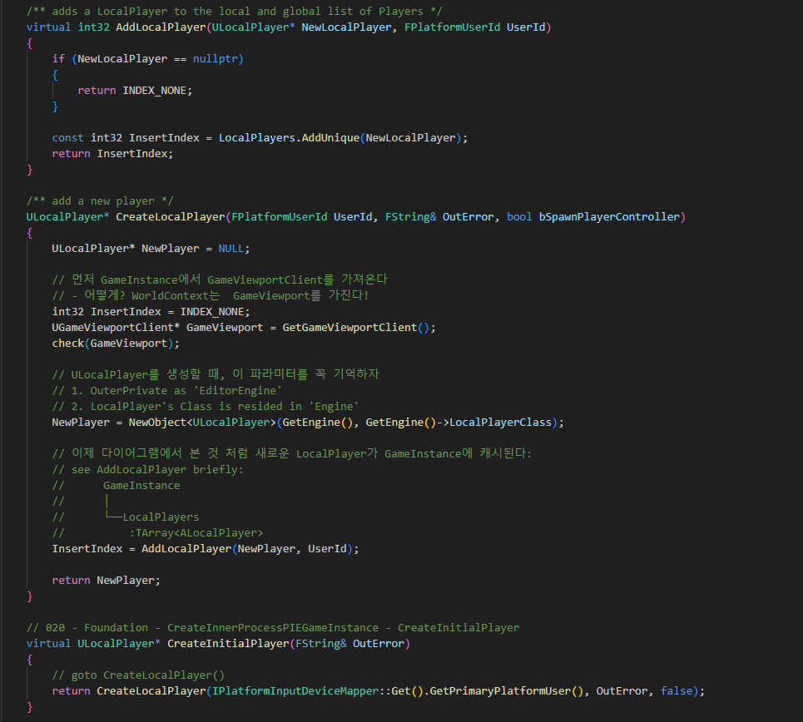
GameInstance UGameInstance 007

Slide 21
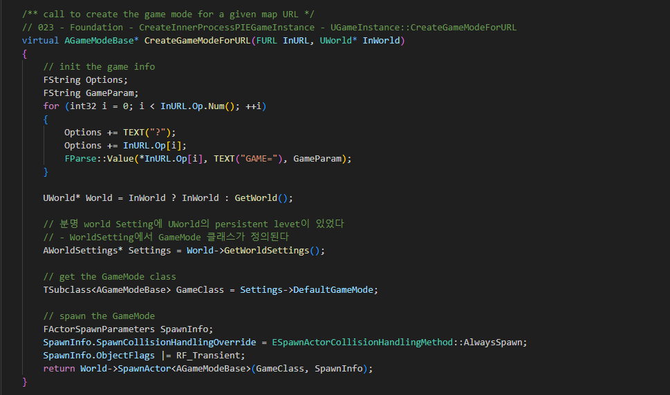
GameInstance UGameInstance 007

Slide 22
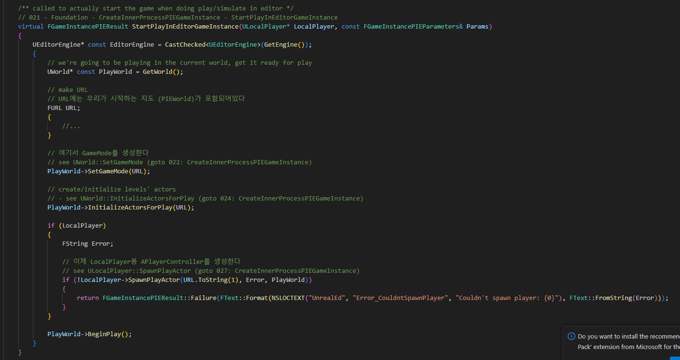
GameInstance UGameInstance 007

Slide 23
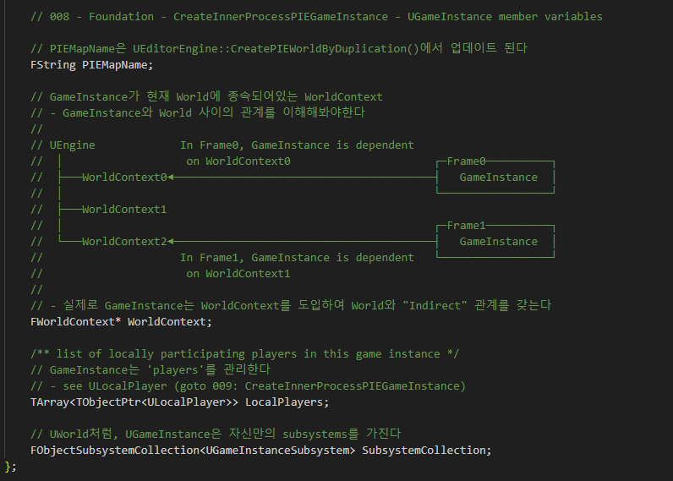
GameInstance UGameInstance 008

Slide 24
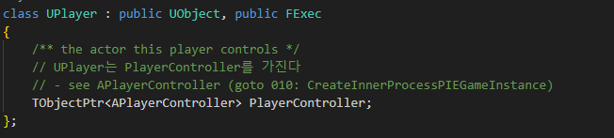
LocalPlayer 009

Slide 25
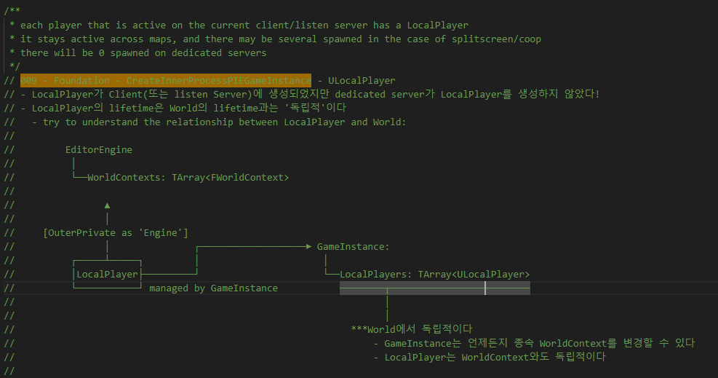
LocalPlayer 009

Slide 26
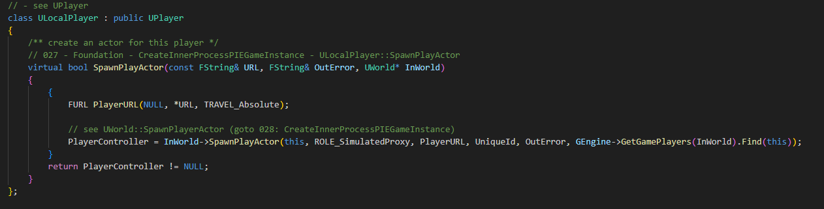
LocalPlayer 009

Slide 27
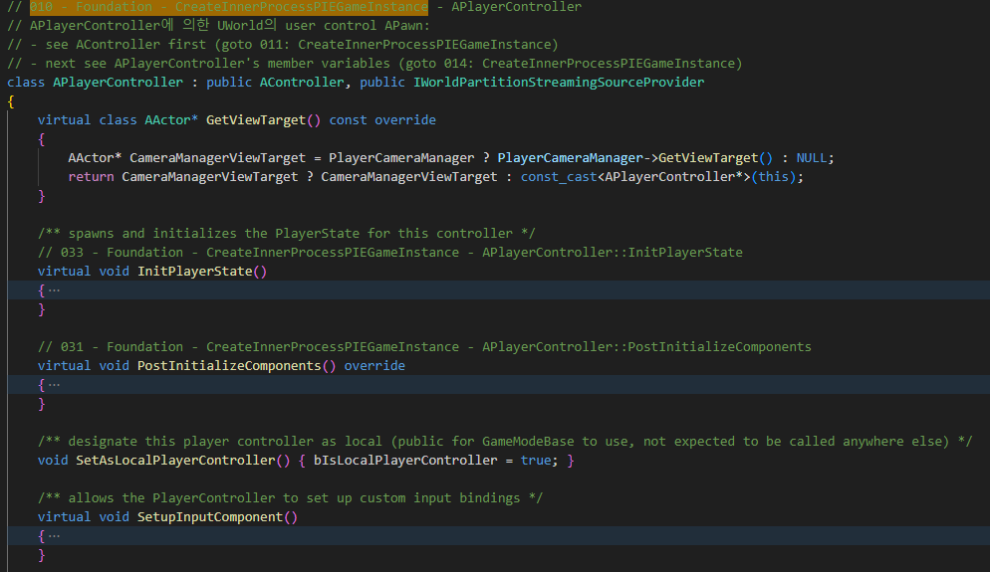
PlayerController APlayerController 010

Slide 28
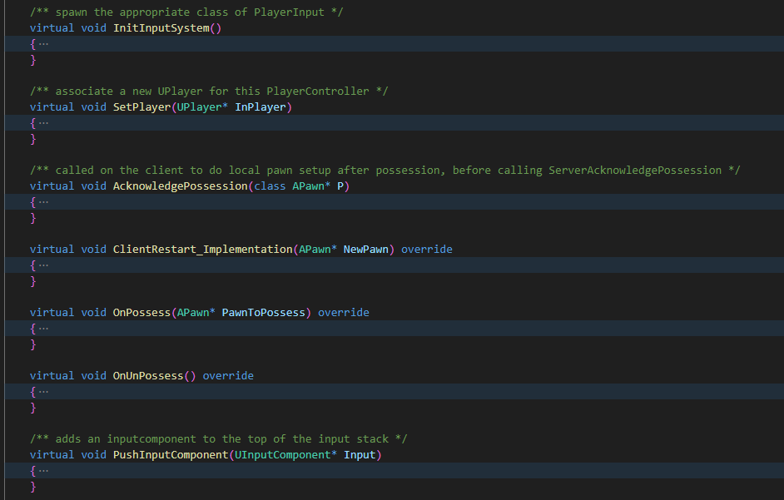
PlayerController APlayerController 010

Slide 29
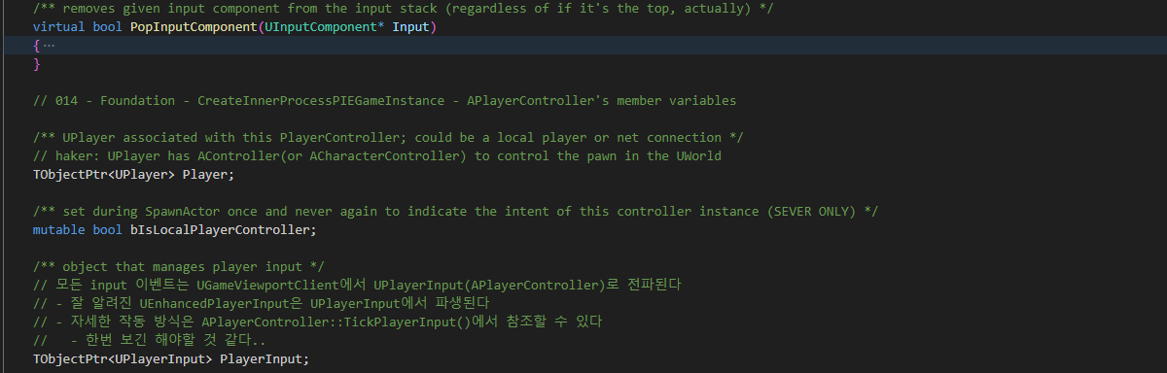
PlayerController APlayerController 010

Slide 30
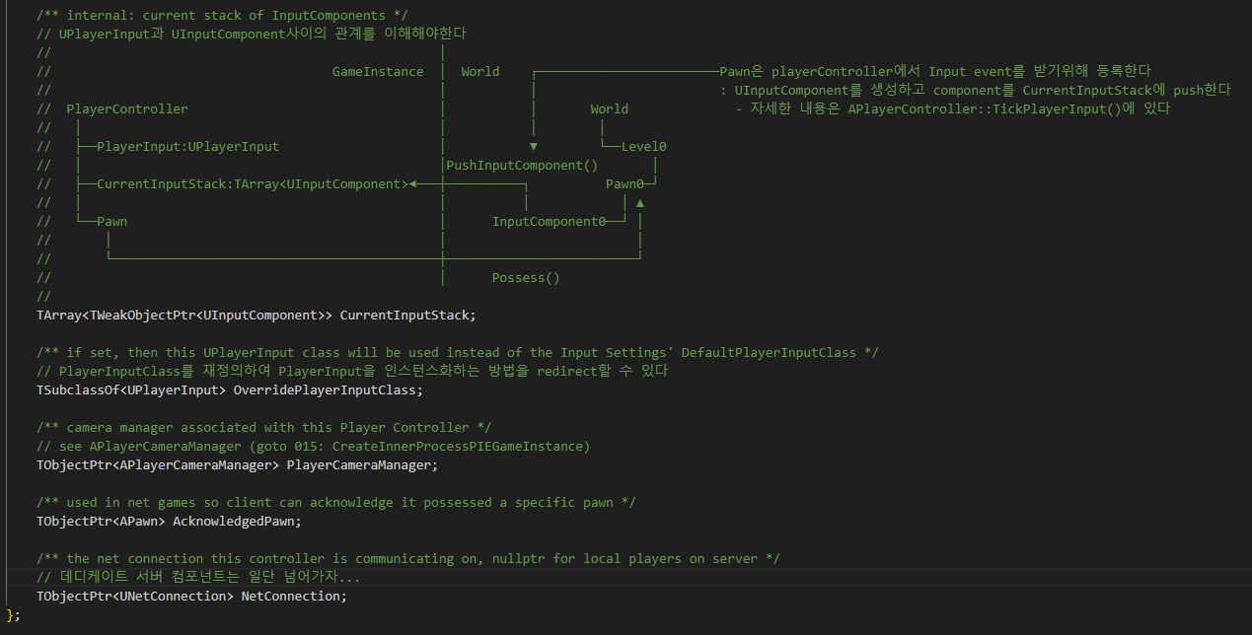
PlayerController APlayerController 010

Slide 31
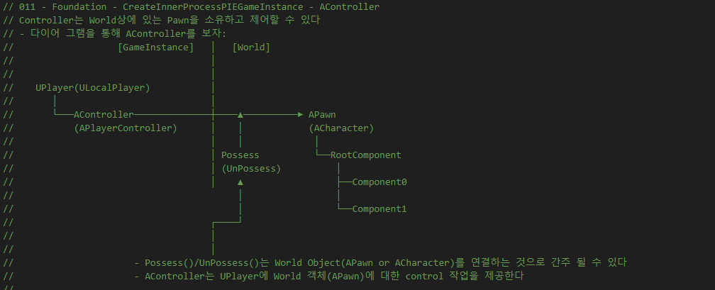
PlayerController Acontroller 011

Slide 32
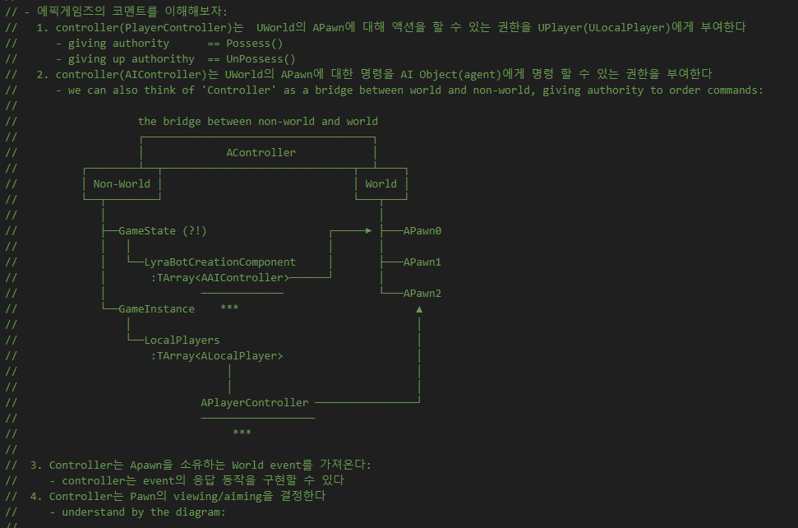
PlayerController Acontroller 011

Slide 33
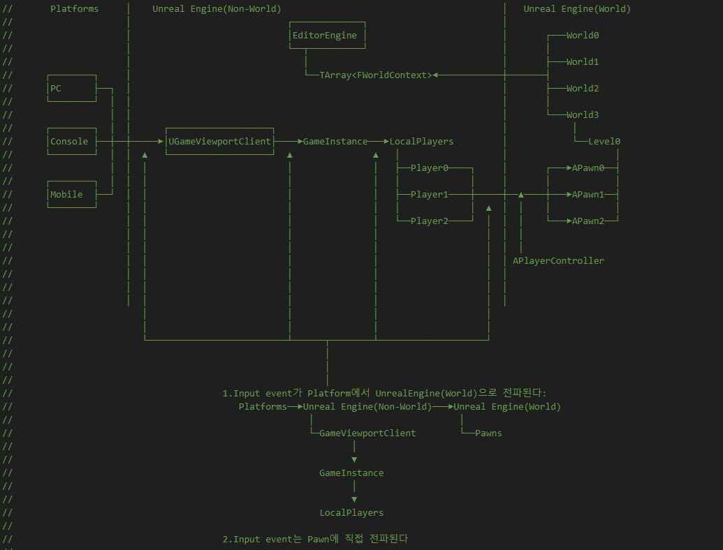
PlayerController Acontroller 011

Slide 34
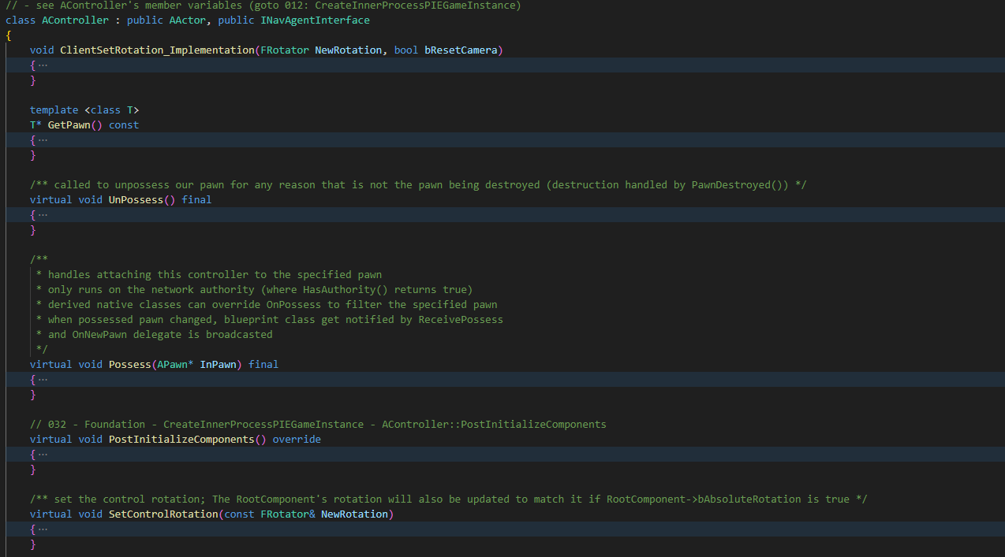
PlayerController Acontroller 011

Slide 35
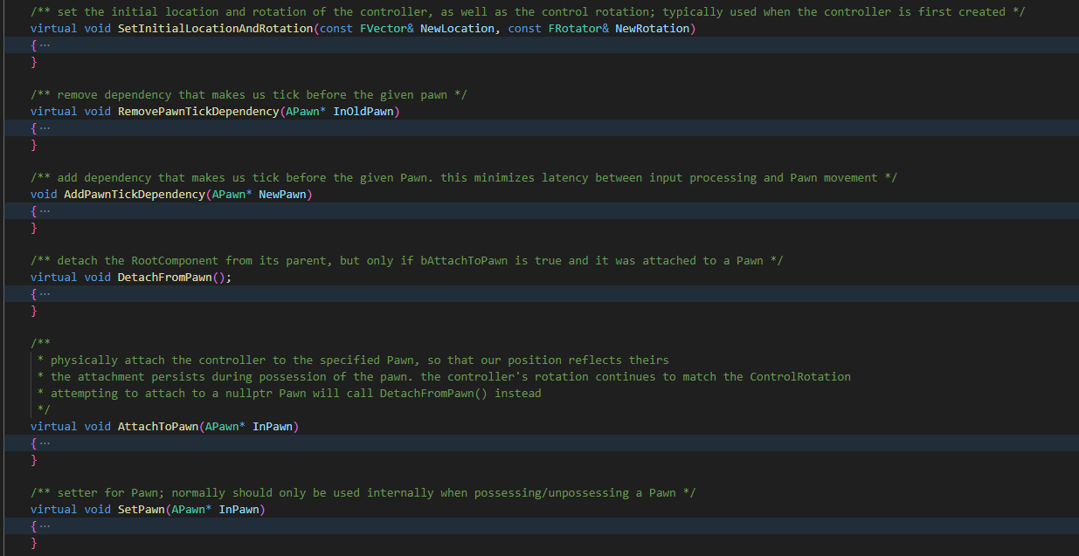
PlayerController Acontroller 011

Slide 36
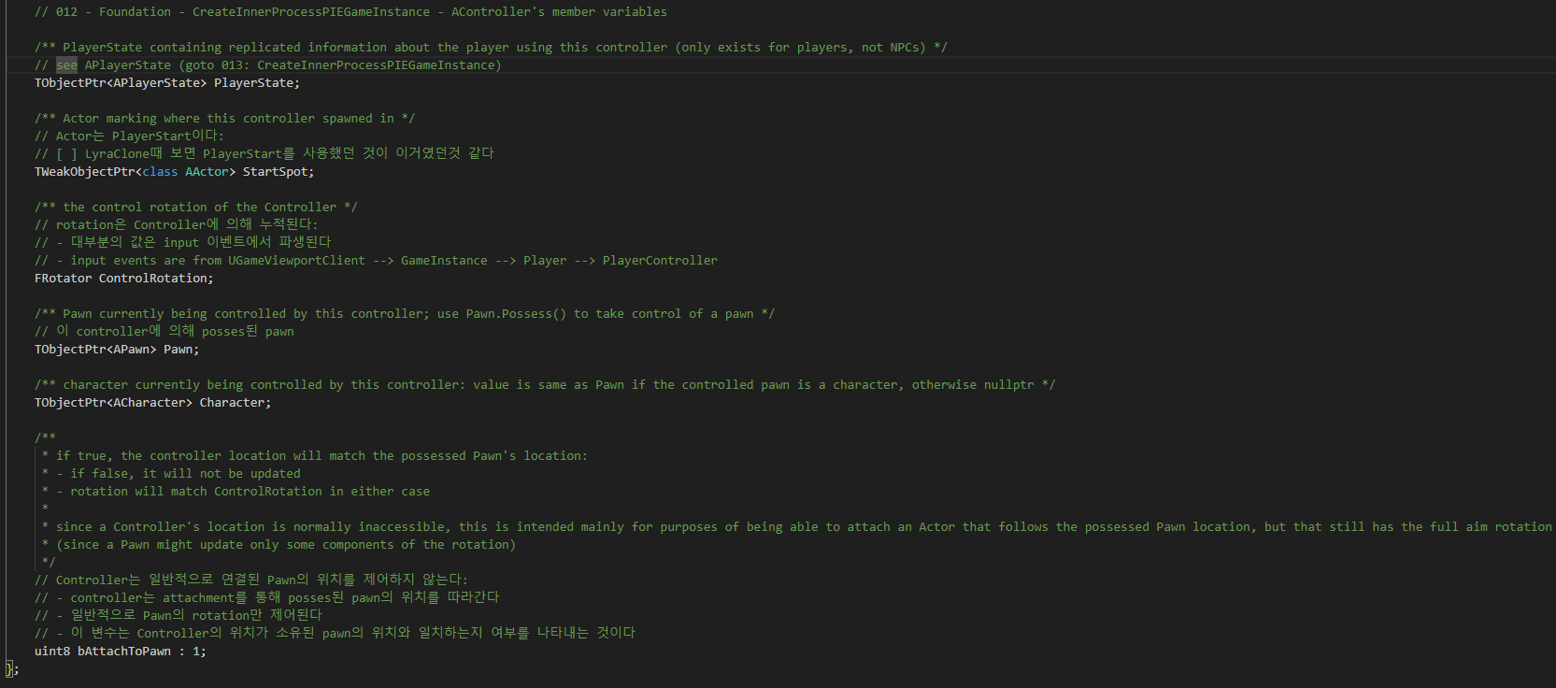
PlayerController Acontroller 012

Slide 37
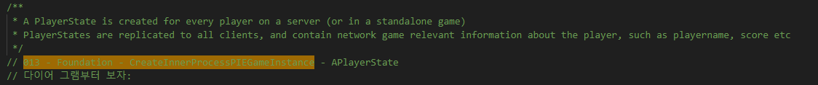
PlayerController PlayerState 013

Slide 38
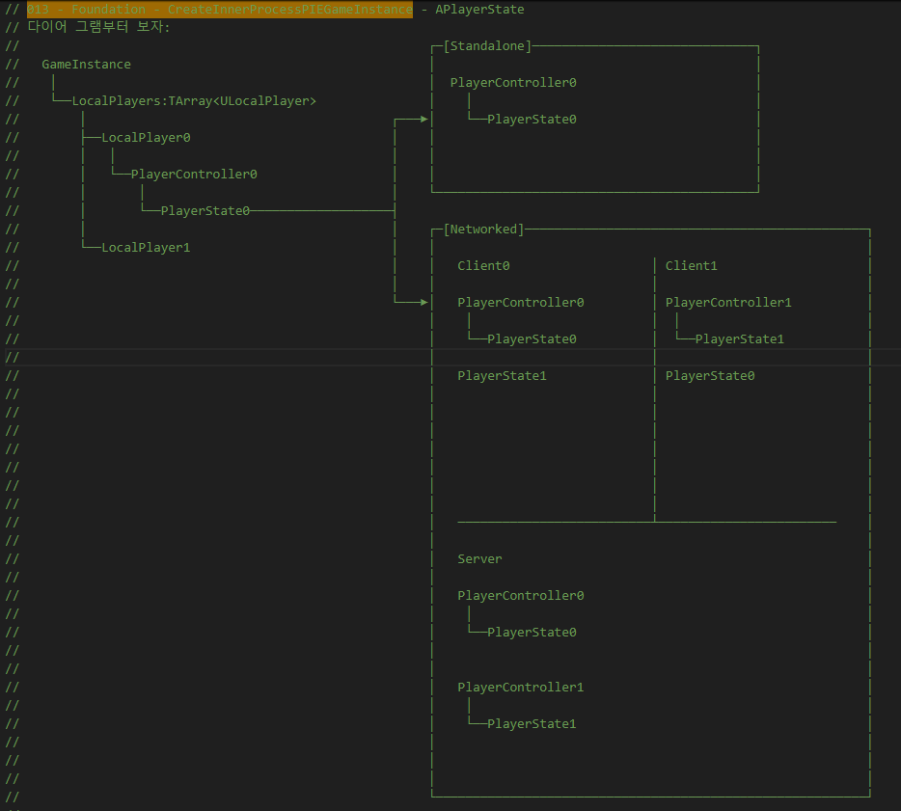
PlayerController PlayerState 013

Slide 39
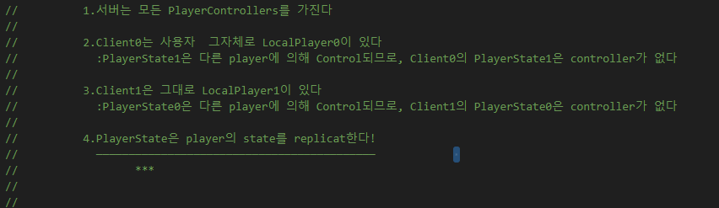
PlayerController PlayerState 013

Slide 40
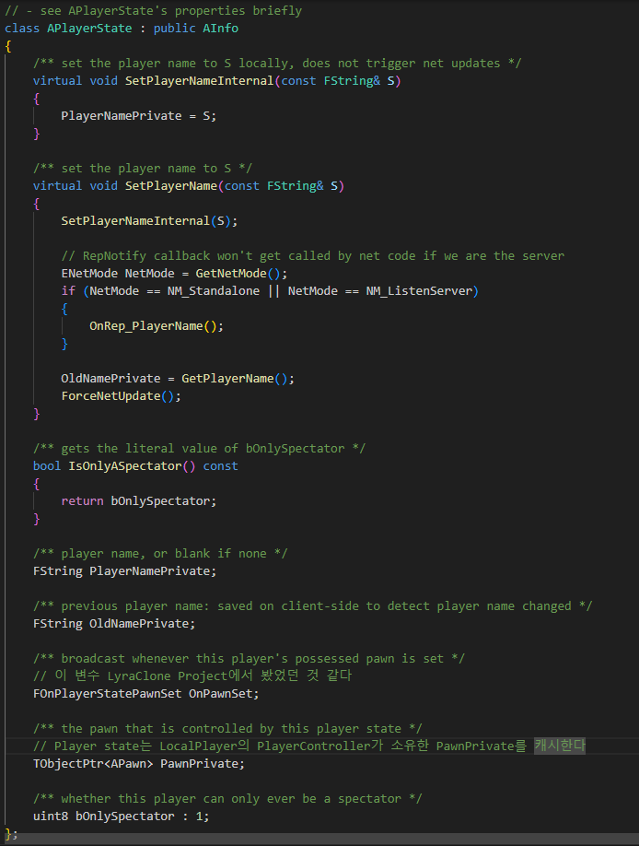
PlayerController PlayerState 013

Slide 41
PlayerController APlayerController 014

Slide 42
PlayerController APlayerController 010

Slide 43
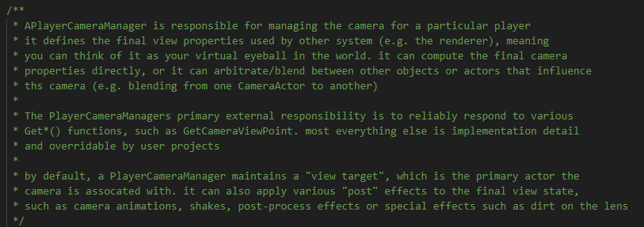
PlayerController APlayerCameraManager 015

Slide 44
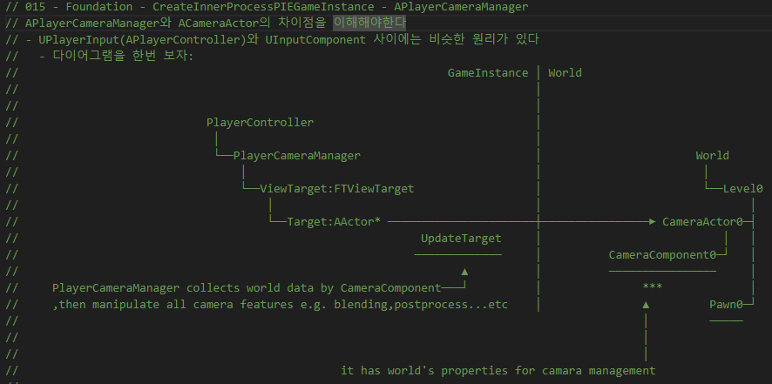
PlayerController APlayerCameraManager 015

Slide 45
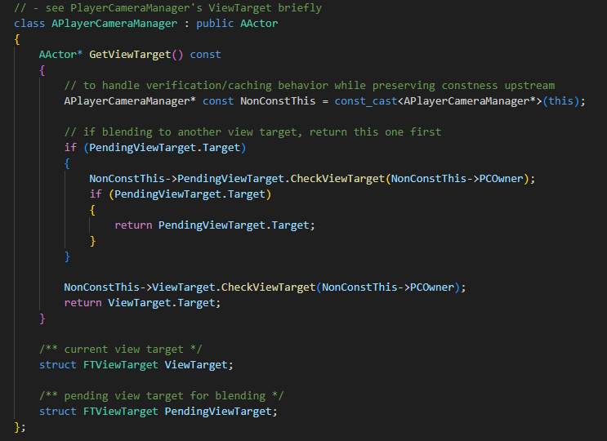
PlayerController APlayerCameraManager 015

Slide 46
EditorEngine CreateInnerProcessPIEGameInstance 000

Slide 47
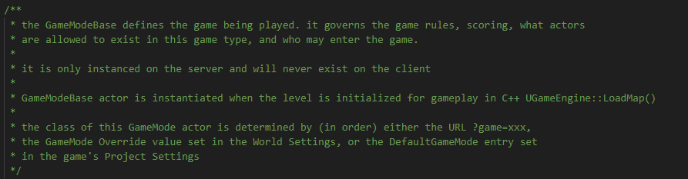
GameModeBase AGameModeBase 016

Slide 48
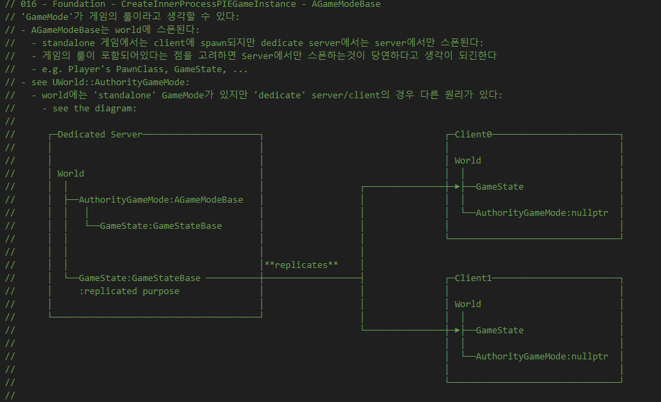
GameModeBase AGameModeBase 016

Slide 49
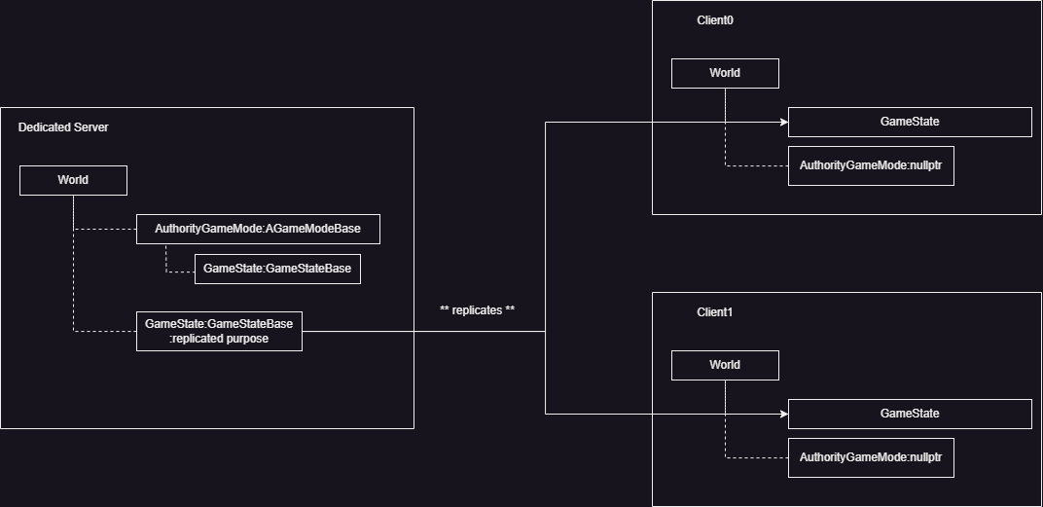
GameModeBase AGameModeBase 016

Slide 50
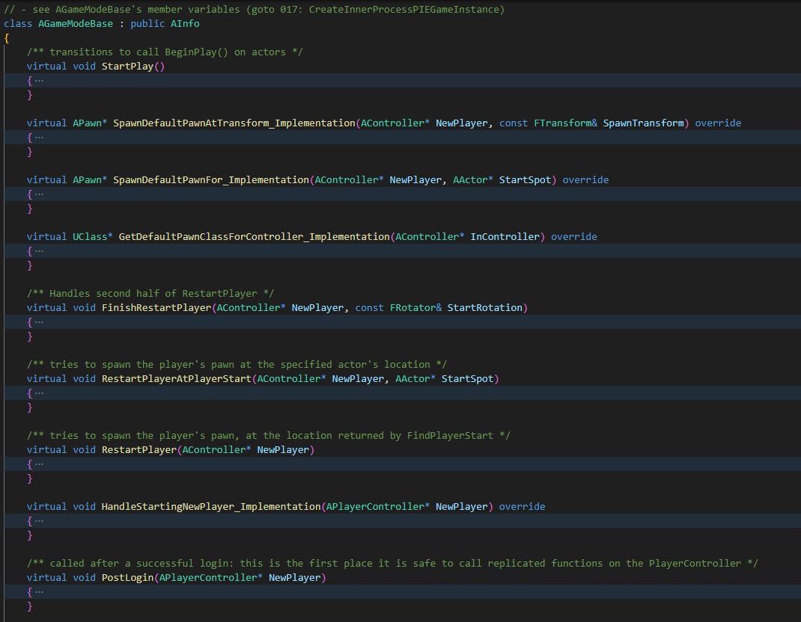
GameModeBase AGameModeBase 016

Slide 51
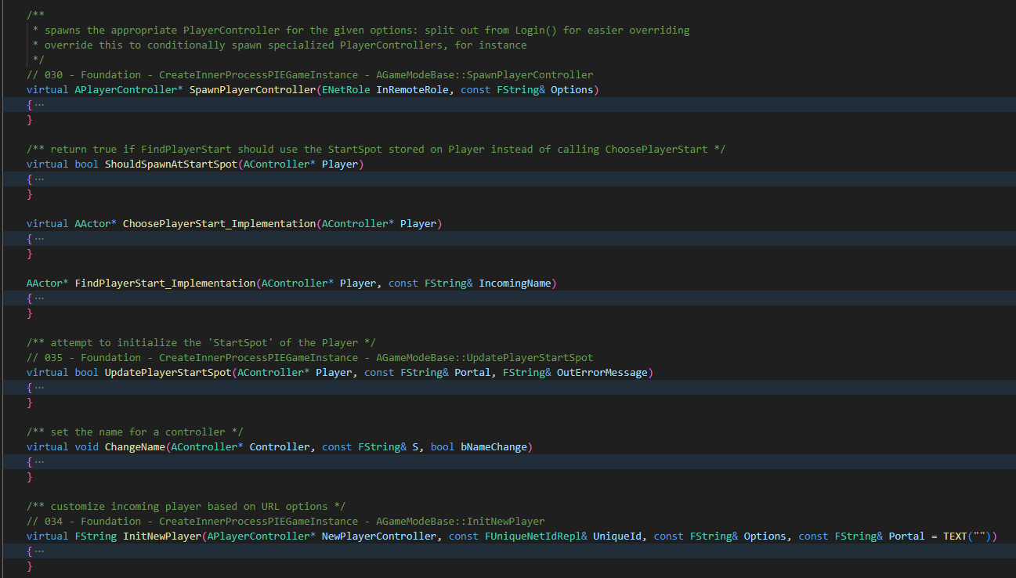
GameModeBase AGameModeBase 016

Slide 52
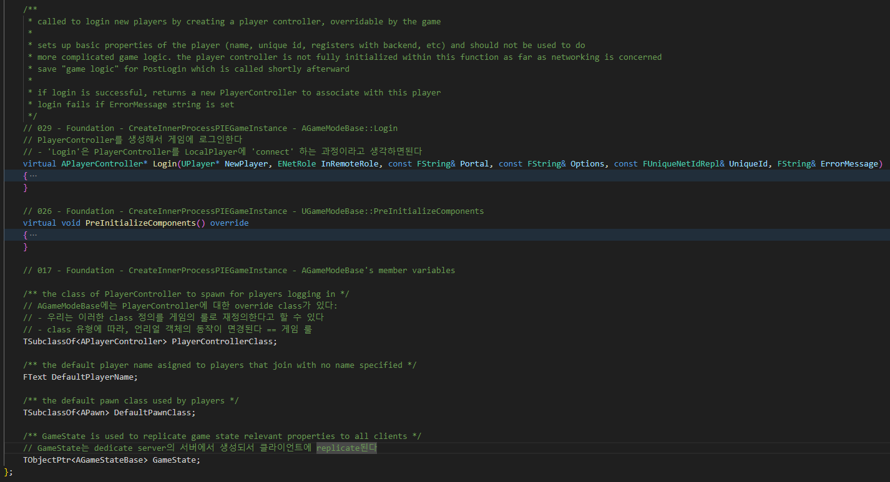
GameModeBase AGameModeBase 016

Slide 53
EditorEngine CreateInnerProcessPIEGameInstance 000

Slide 54
GameViewportClient UGameViewportClient 018

Slide 55
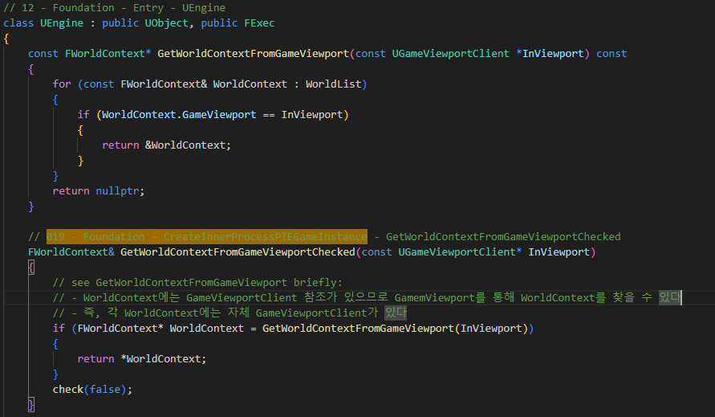
EditorEngine GetWorldContextFromGameViewportChecked 019

Slide 56
GameViewportClient UGameViewportClient 018

Slide 57
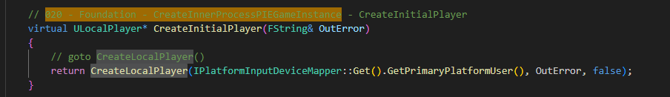
GameInstance CreateInitialPlayer 020

Slide 58
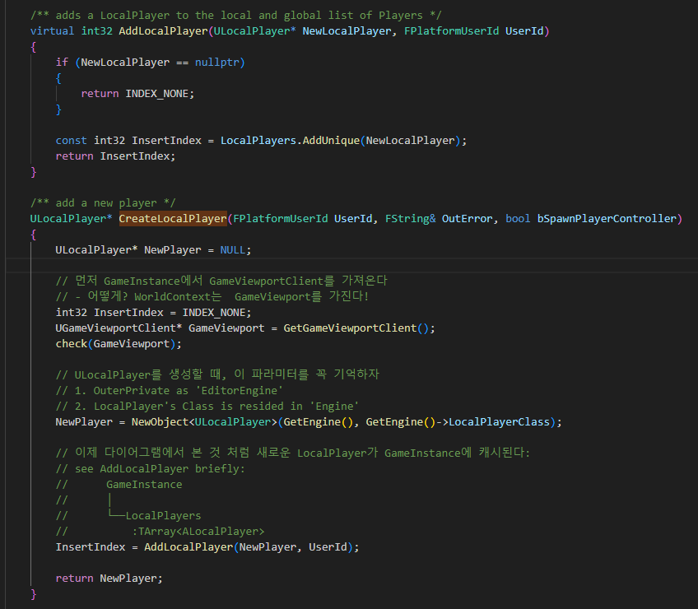
GameInstance CreateInitialPlayer 020

Slide 59
EditorEngine CreateInnerProcessPIEGameInstance 000

Slide 60
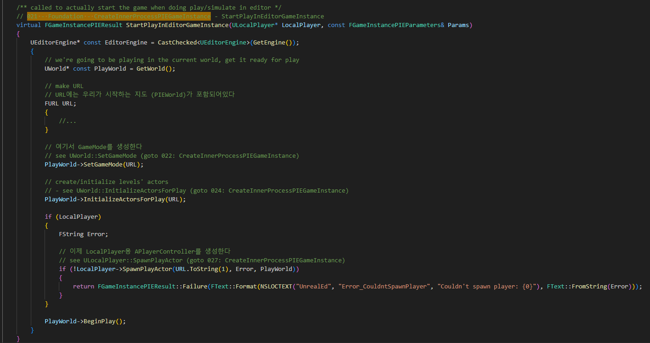
GameInstance StartPlayInEditorGameInstance 021

Slide 61

World SetGameMode 022

Slide 62

GameInstance CreateGameModeForURL 023

Slide 63
GameInstance StartPlayInEditorGameInstance 021

Slide 64

GameInstance InitializeActorForPlay 024

Slide 65

Level RouteActorInitialize 025

Slide 66

Level RouteActorInitialize 025

Slide 67

Level RouteActorInitialize 025

Slide 68

Level RouteActorInitialize 025

Slide 69

GameModeBase PreInitializeComponent 026

Slide 70
GameInstance StartPlayInEditorGameInstance 021

Slide 71

LocalPlayer SpawnPlayActor 027

Slide 72

World SpawnPlayActor 028

Slide 73

GameModeBase Login 029

Slide 74

GameModeBase Login 029

Slide 75

GameModeBase SpawnPlayerController 030

Slide 76

PlayerController PostInitializeComponents 031

Slide 77

PlayerController Acontroller::PostInitializeComponent 032

Slide 78
PlayerController PostInitializeComponents 031

Slide 79

PlayerController InitPlayerState 033

Slide 80
GameModeBase Login 029

Slide 81

GameModeBase InitNewPlayer 034

Slide 82

GameModeBase UpdatePlayerStartSpot 035

Slide 83
World SpawnPlayActor 037

