Slide 1
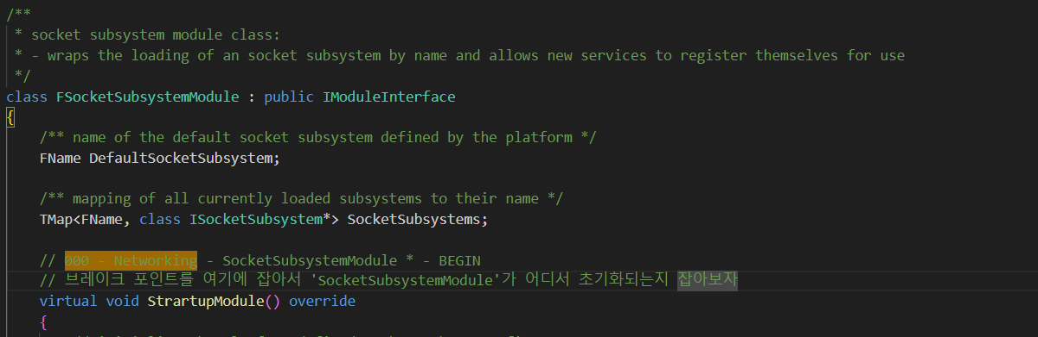
FSocketSubsystemModule 000

Slide 2
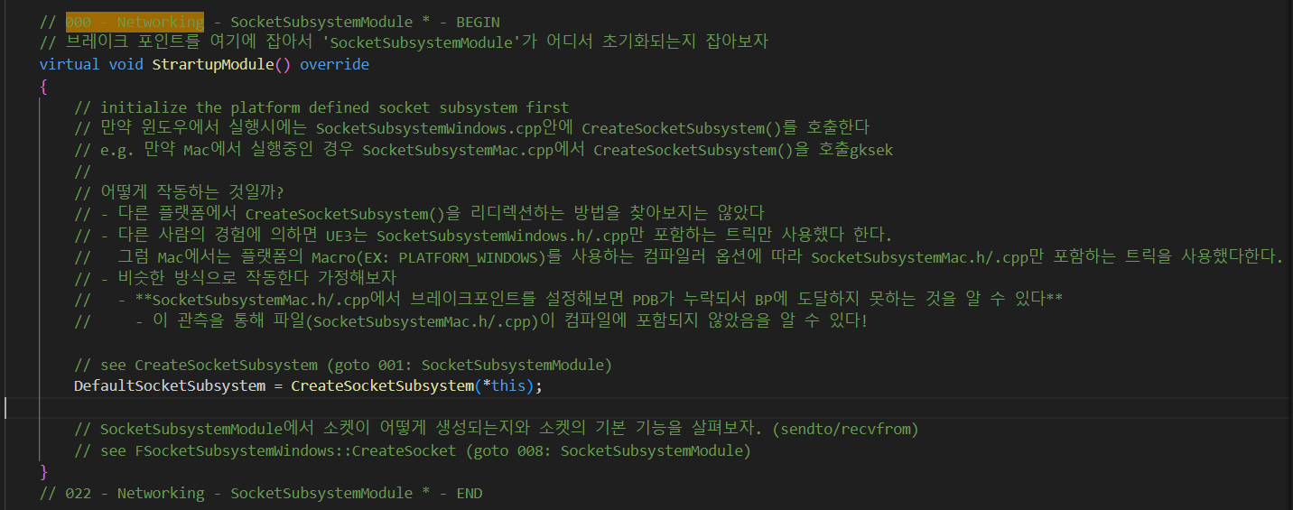
FSocketSubsystemModule 000

Slide 3
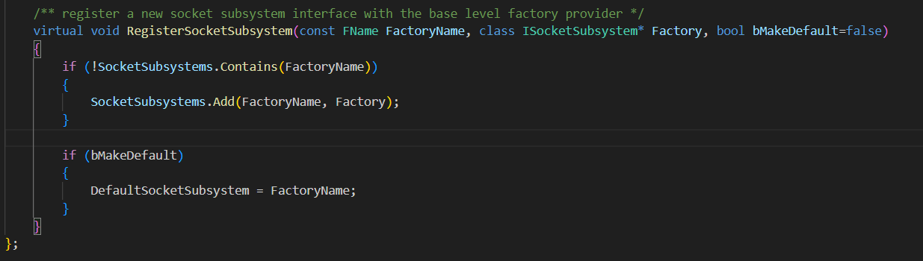
FSocketSubsystemModule 000

Slide 4
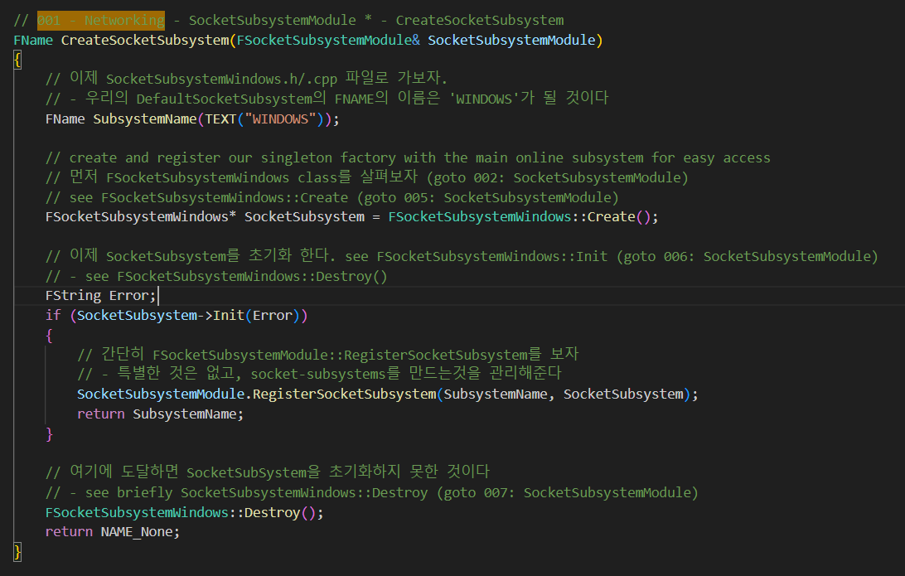
CreateSocketSubsystem 001

Slide 5
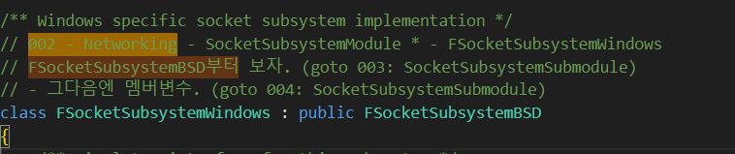
FSocketSubsystemWindow 002

Slide 6
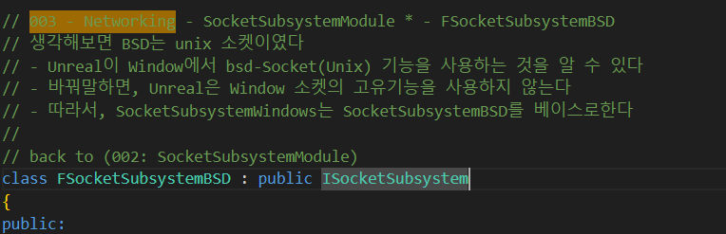
FSocketSubsystemBSD 003

Slide 7
FSocketSubsystemWindow 002

Slide 8
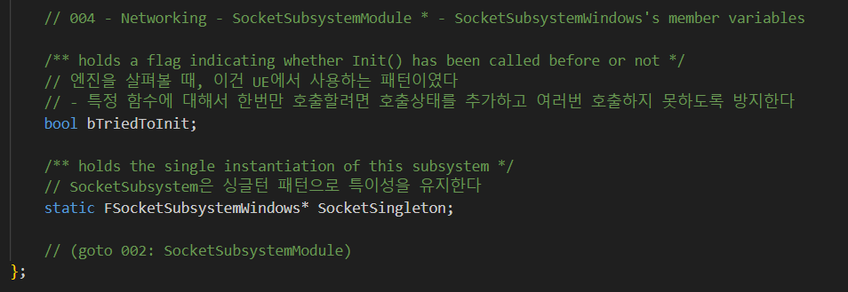
FSocketSubsystemWindow 004

Slide 9
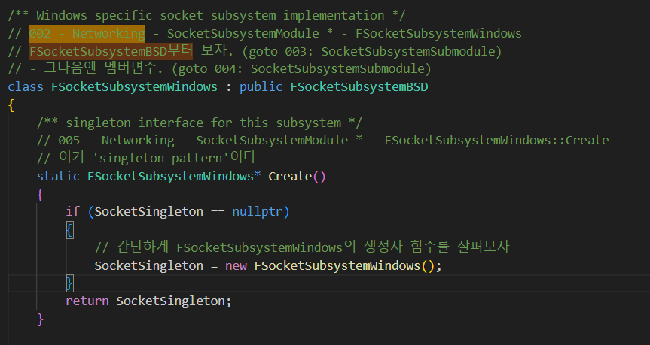
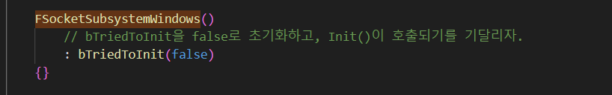
FSocketSubsystemWindow Create 005

Slide 10
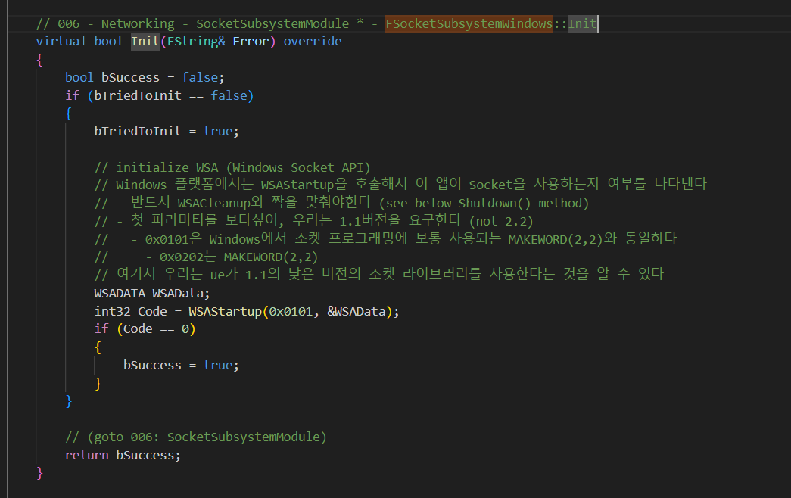
FSocketSubsystemWindow Init 006

Slide 11
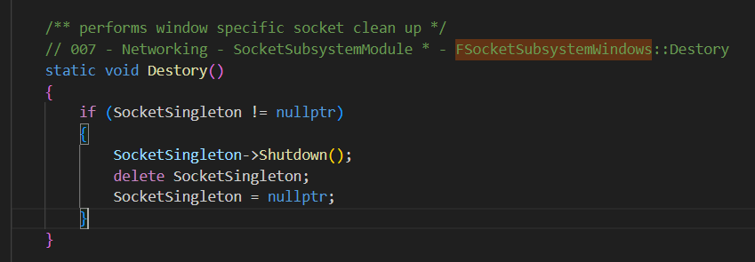
FSocketSubsystemWindow Destroy 007

Slide 12
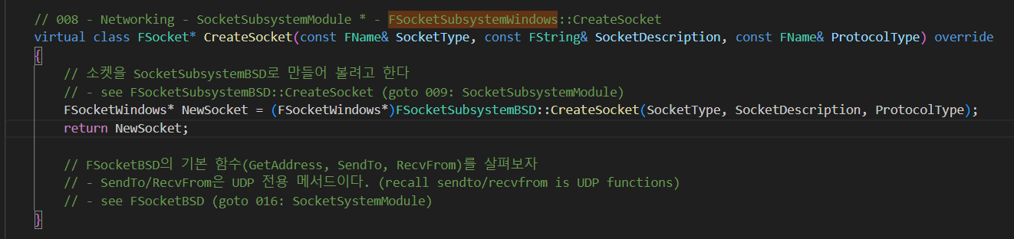
FSocketSubsystemWindow CreateSocket 008

Slide 13
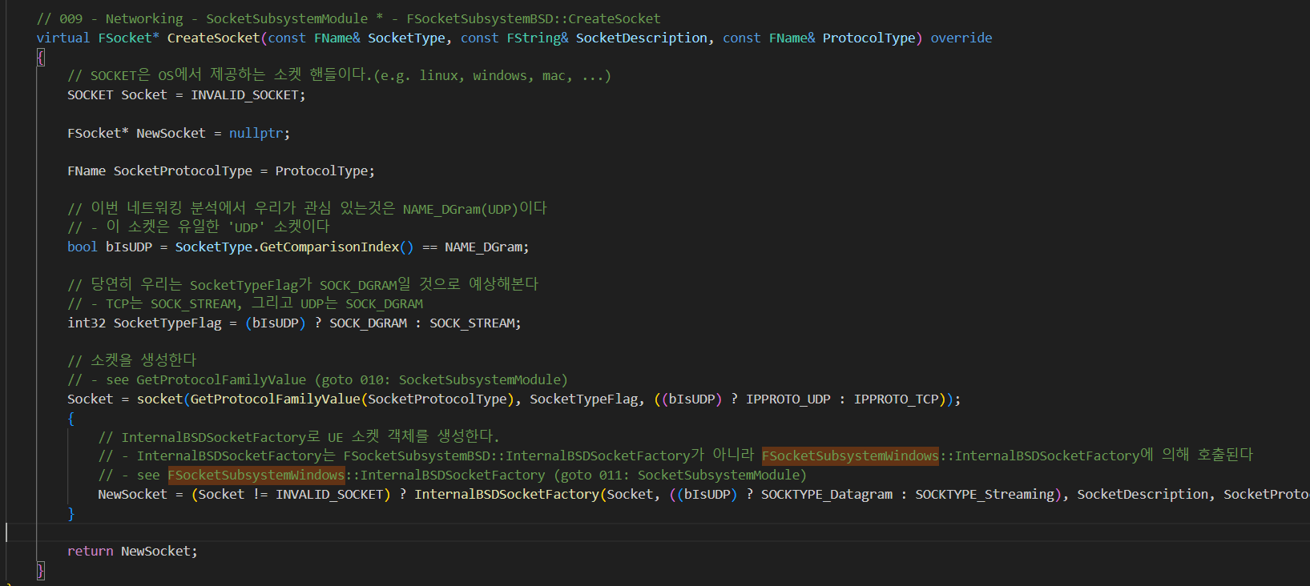
FSocketSubsystemBSD CreateSocket 009

Slide 14
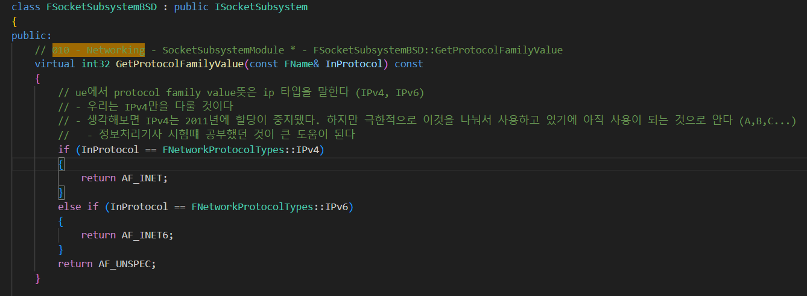
FSocketSubsystemBSD GetProtocolFamilyValue 010

Slide 15
FSocketSubsystemBSD CreateSocket 009

Slide 16
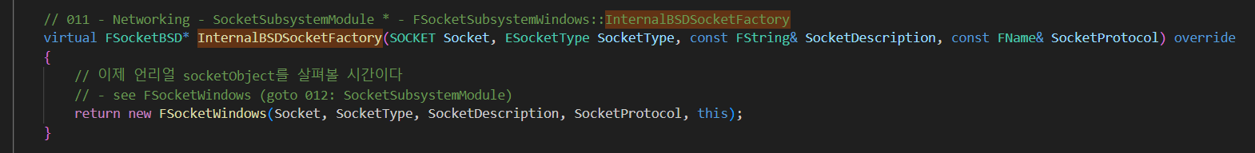
FSocketSubsystemWindows InternalBSDSocketFactory 011

Slide 17
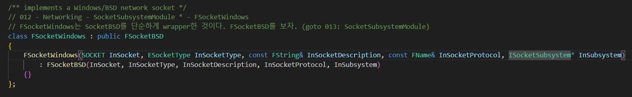
FSocketSubsystemWindows InternalBSDSocketFactory 012

Slide 18
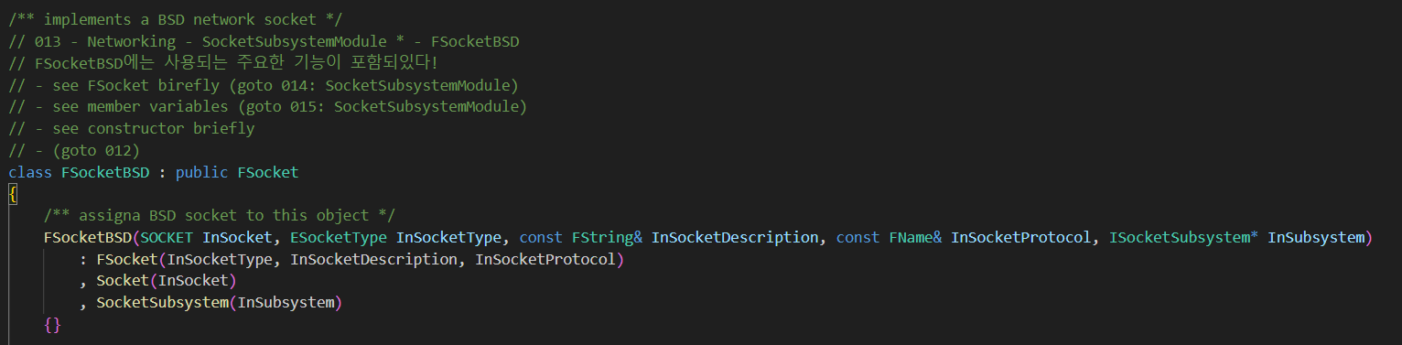
FSocketBSD 013

Slide 19
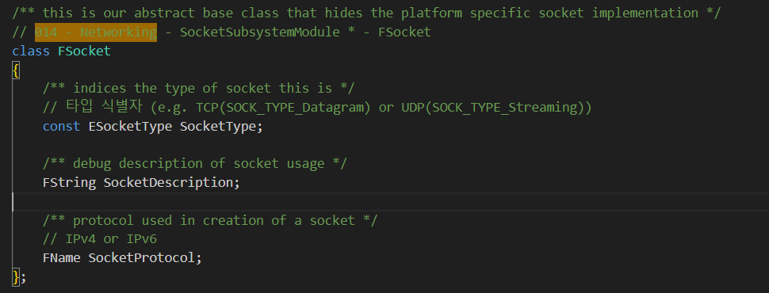
FSocket 014

Slide 20
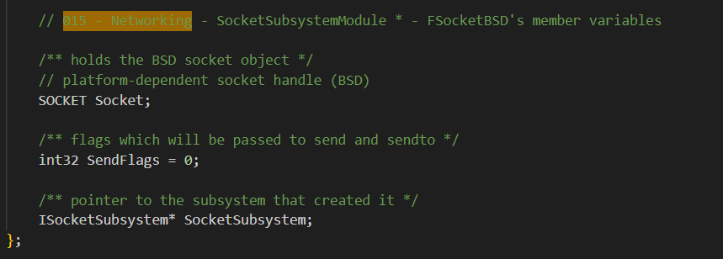
FSocketBSD 015

Slide 21
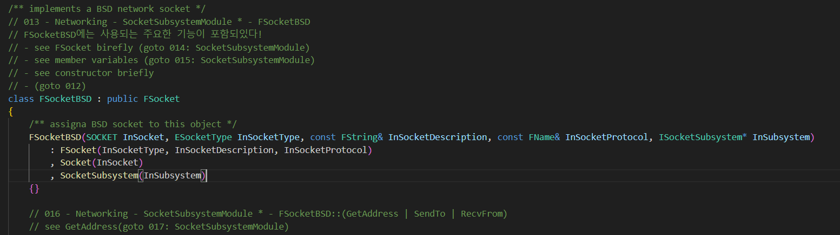
FSocketBSD 016

Slide 22
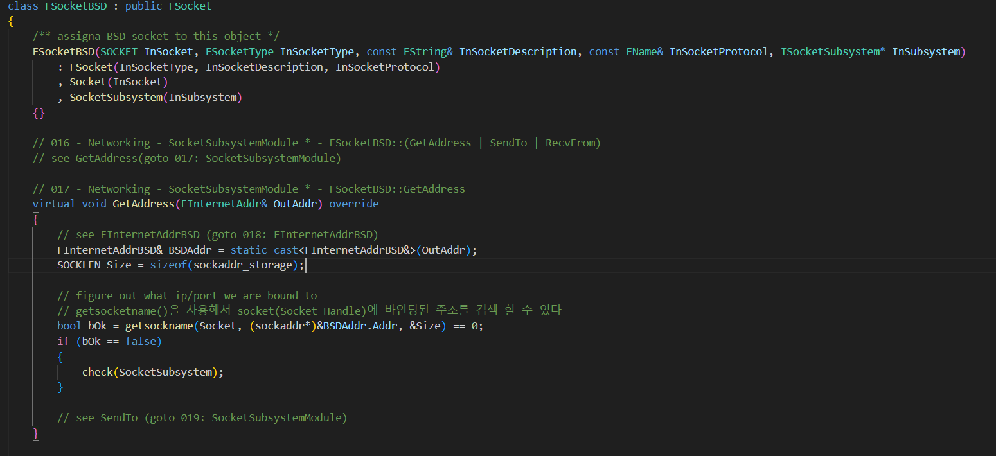
FSocketBSD GetAddress 017

Slide 23
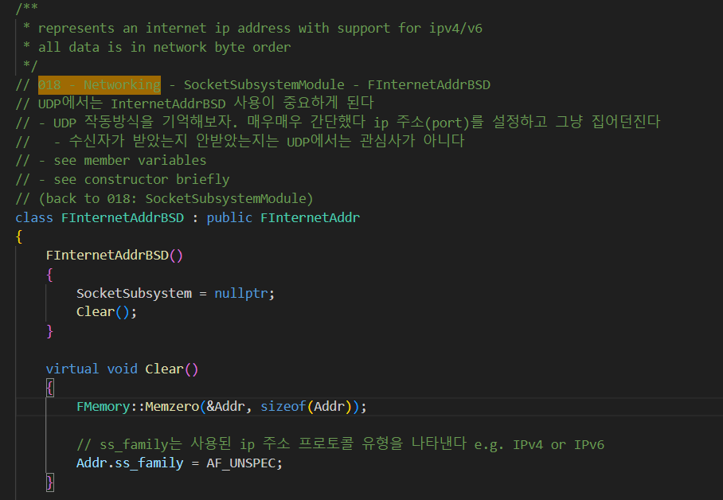
FInternetAddrBSD 018

Slide 24
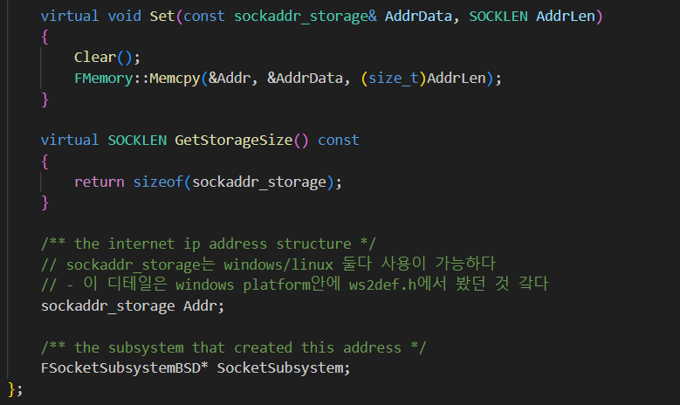
FInternetAddrBSD 018

Slide 25
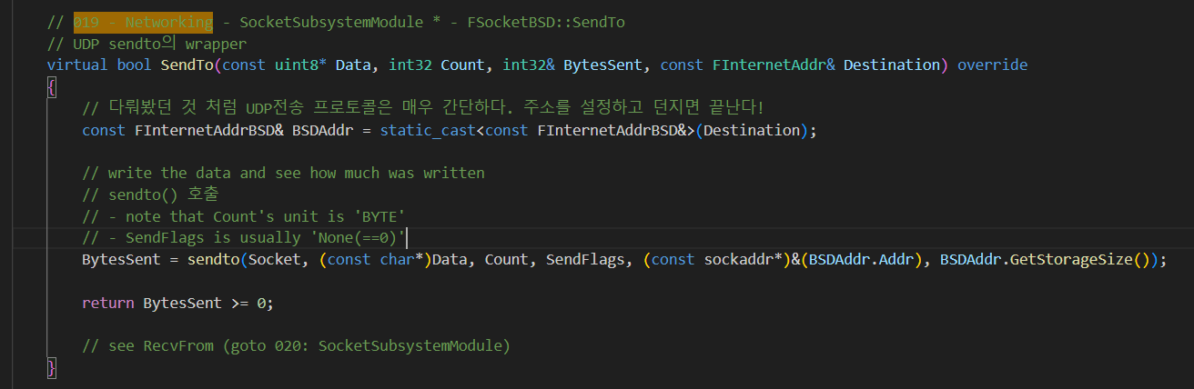
FSocketBSD SendTo 019

Slide 26
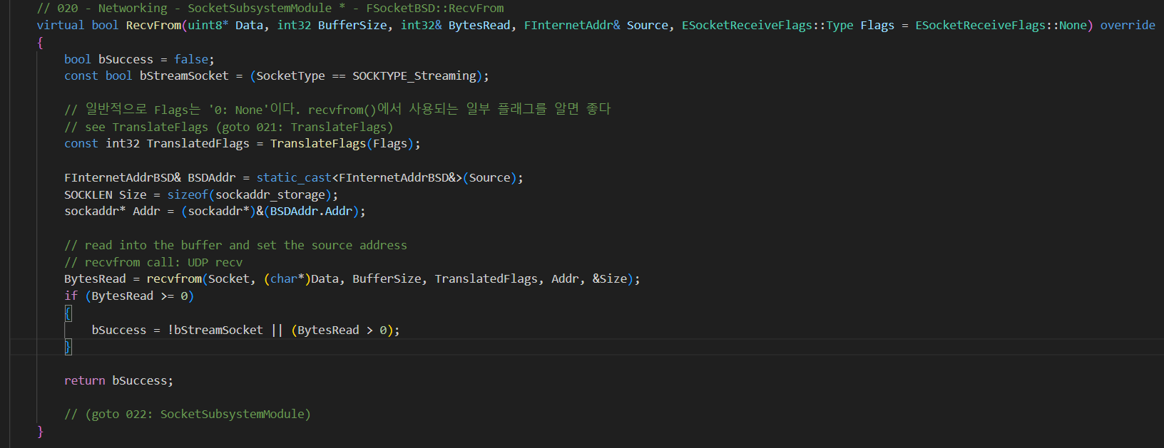
FSocketBSD RecvFrom 020

Slide 27
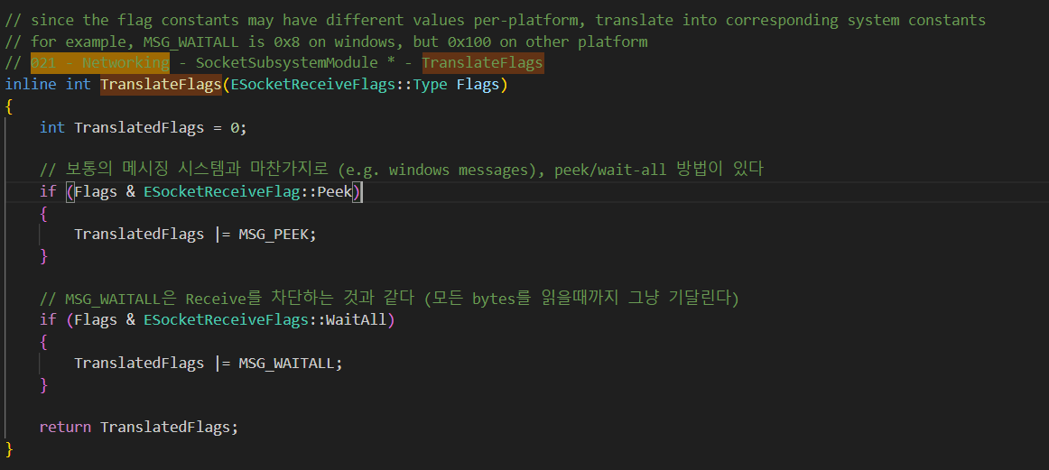
FSocketBSD TranslateFlags 021

Slide 28
FSocketSubsystemModule 022

