Slide 1
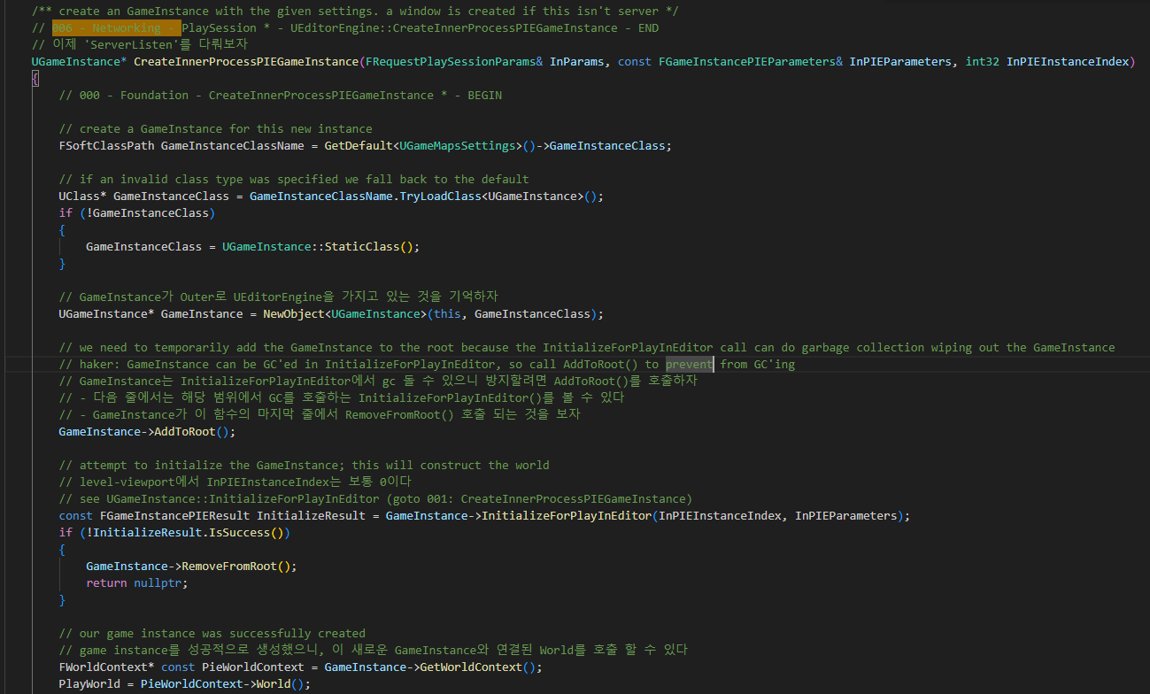
EditorEngine CreateInnerProcessPIEGameInstance 000

Slide 2
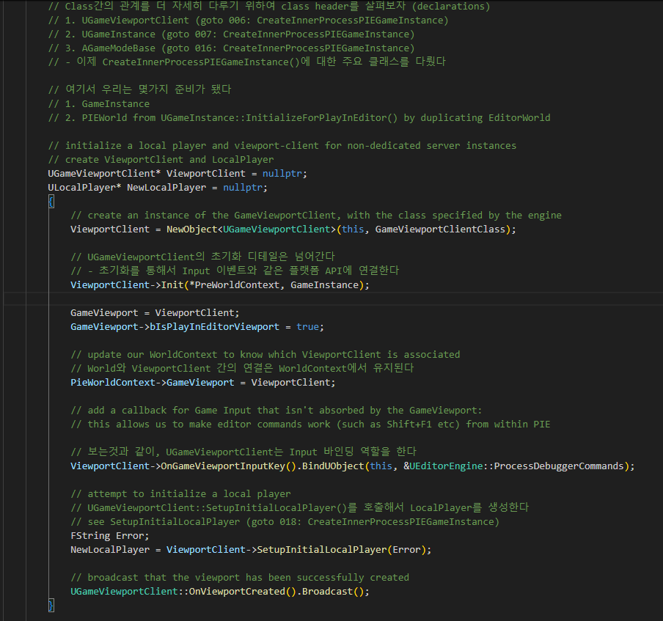
EditorEngine CreateInnerProcessPIEGameInstance 000

Slide 3
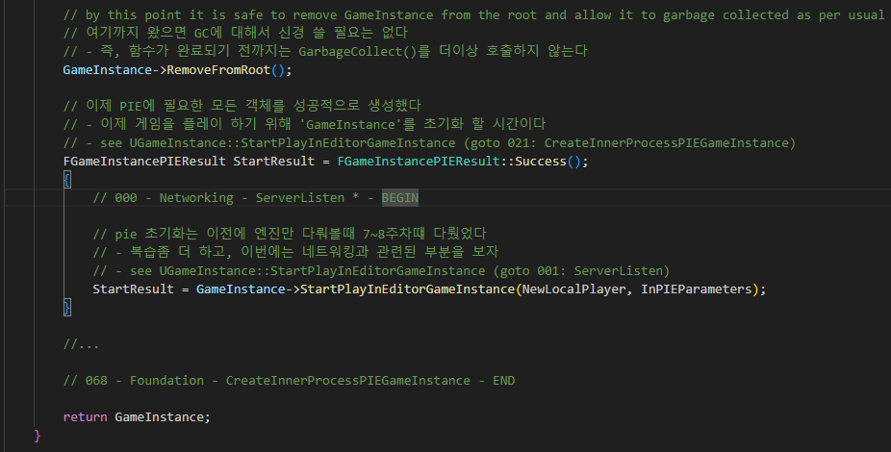
EditorEngine CreateInnerProcessPIEGameInstance 000

Slide 4
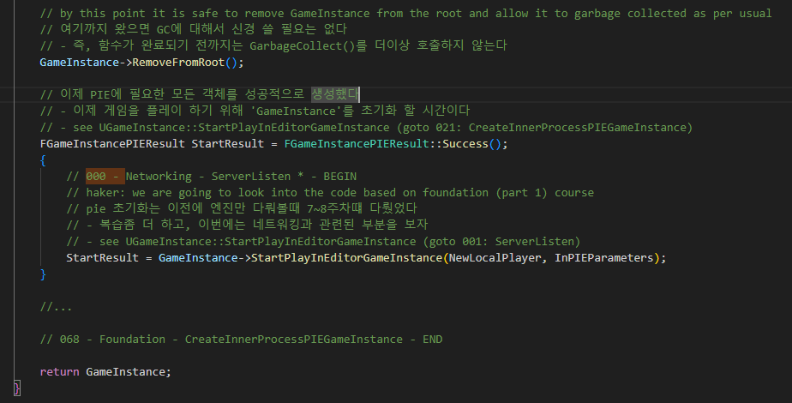
UEditorEngine::CreateInnerProcessPIEGameInstance 000

Slide 5
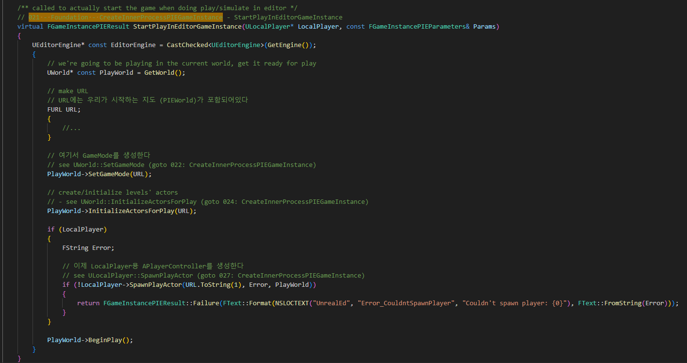
GameInstance StartPlayInEditorGameInstance 021

Slide 6
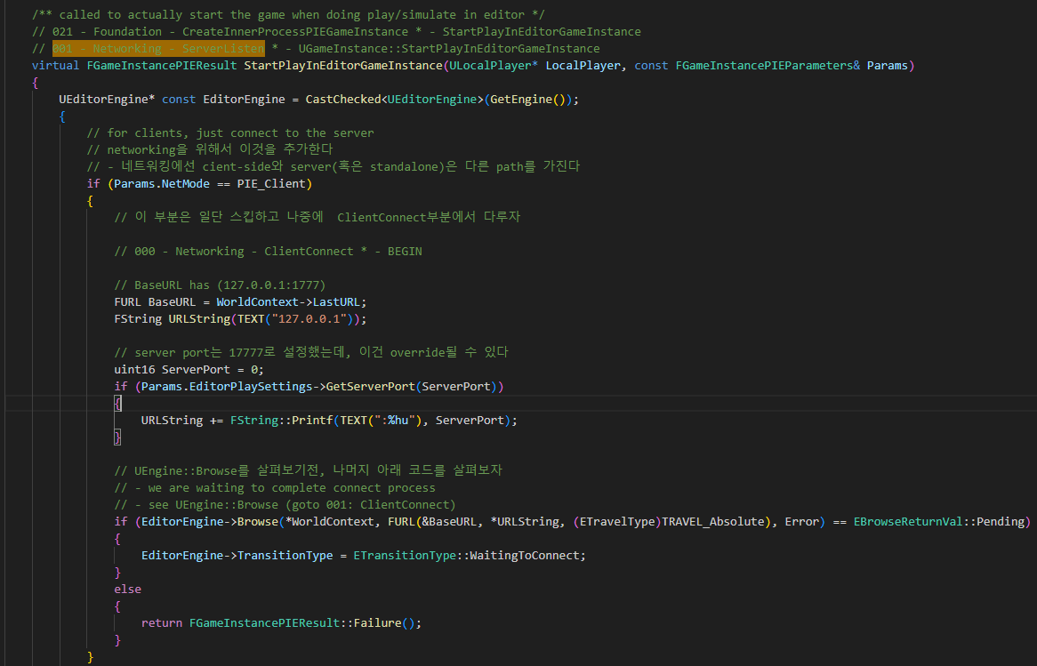
GameInstance StartPlayInEditorGameInstance 001

Slide 7
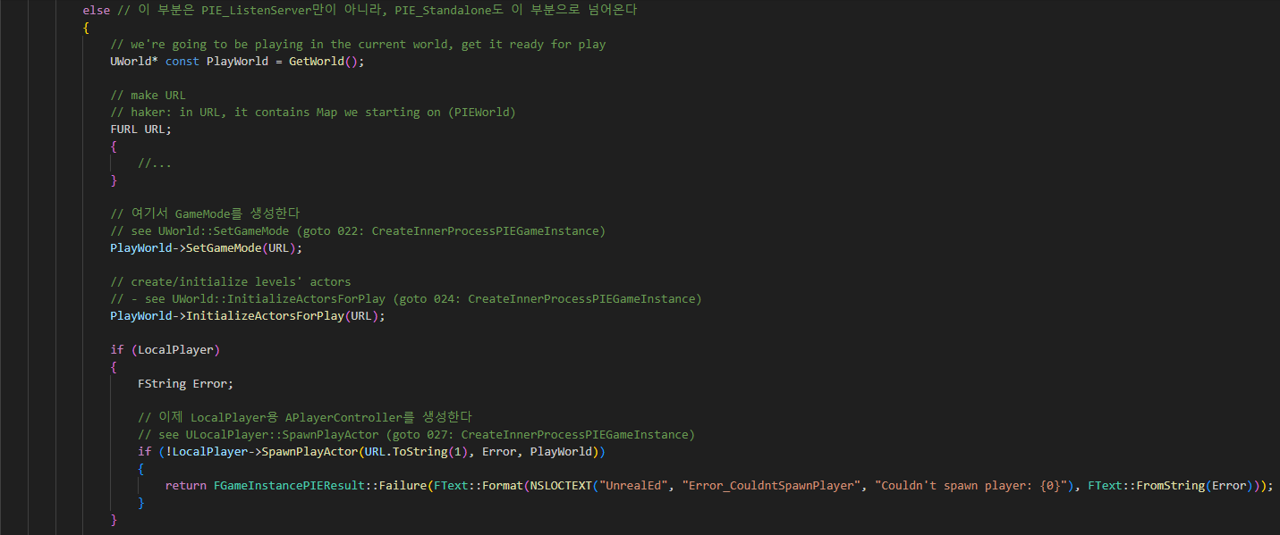
GameInstance StartPlayInEditorGameInstance 001

Slide 8
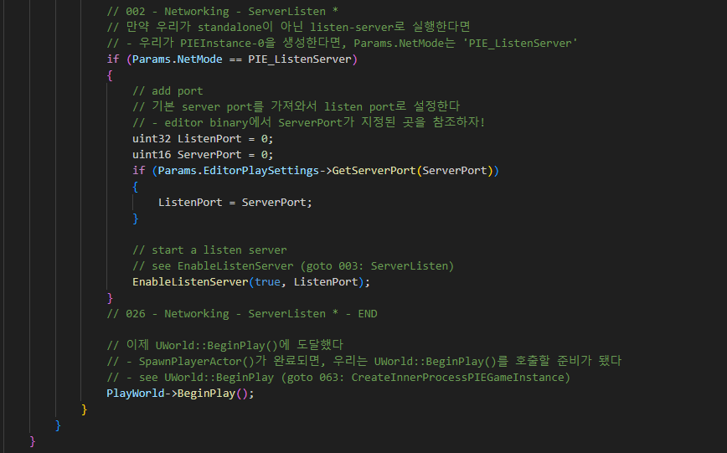
GameInstance StartPlayInEditorGameInstance 002

Slide 9
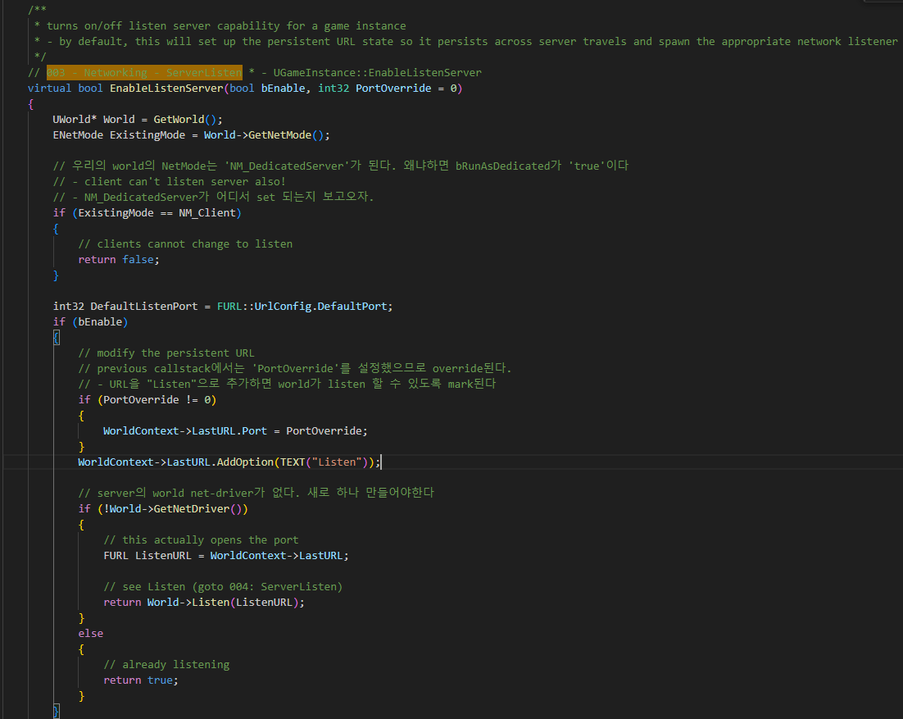
GameInstance EnableListenServer 003

Slide 10
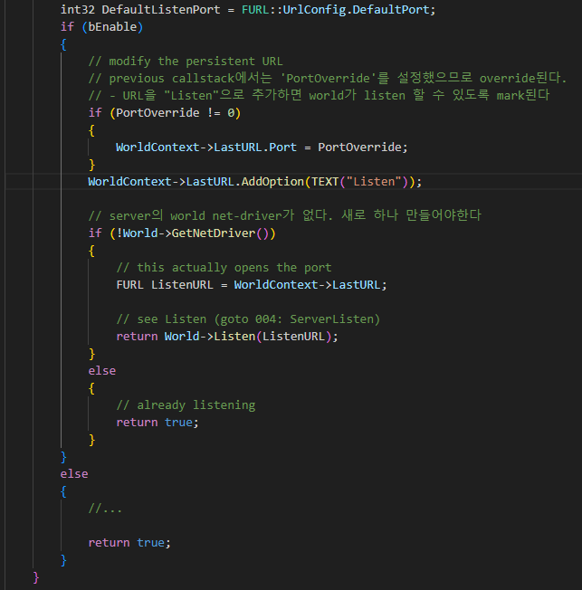
GameInstance EnableListenServer 003

Slide 11
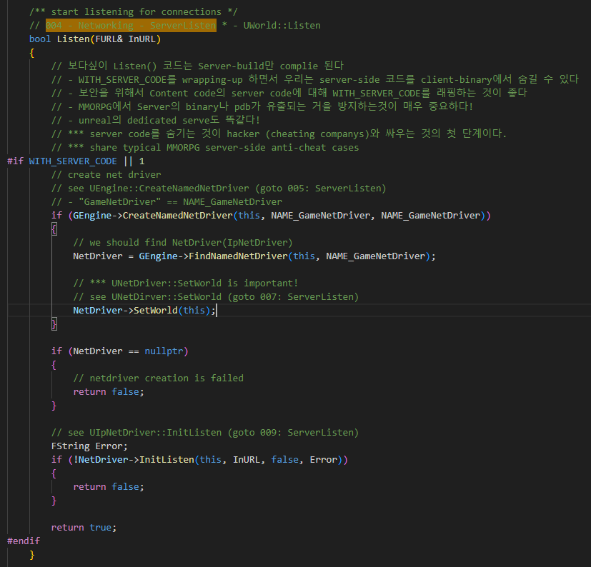
Uworld Listen 004

Slide 12
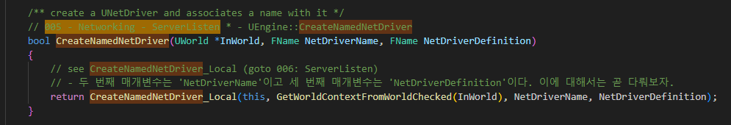
UEngine CreateNameNetDriver 005

Slide 13
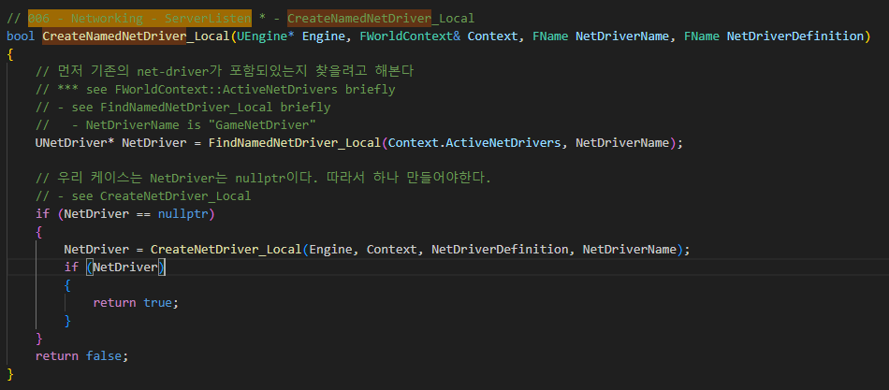
UEngine CreateNameNetDriver_local 006

Slide 14
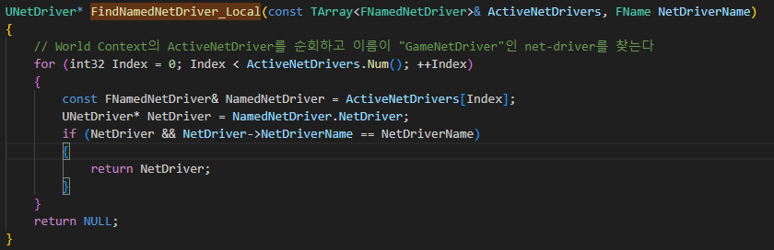
UEngine CreateNameNetDriver_local 006

Slide 15
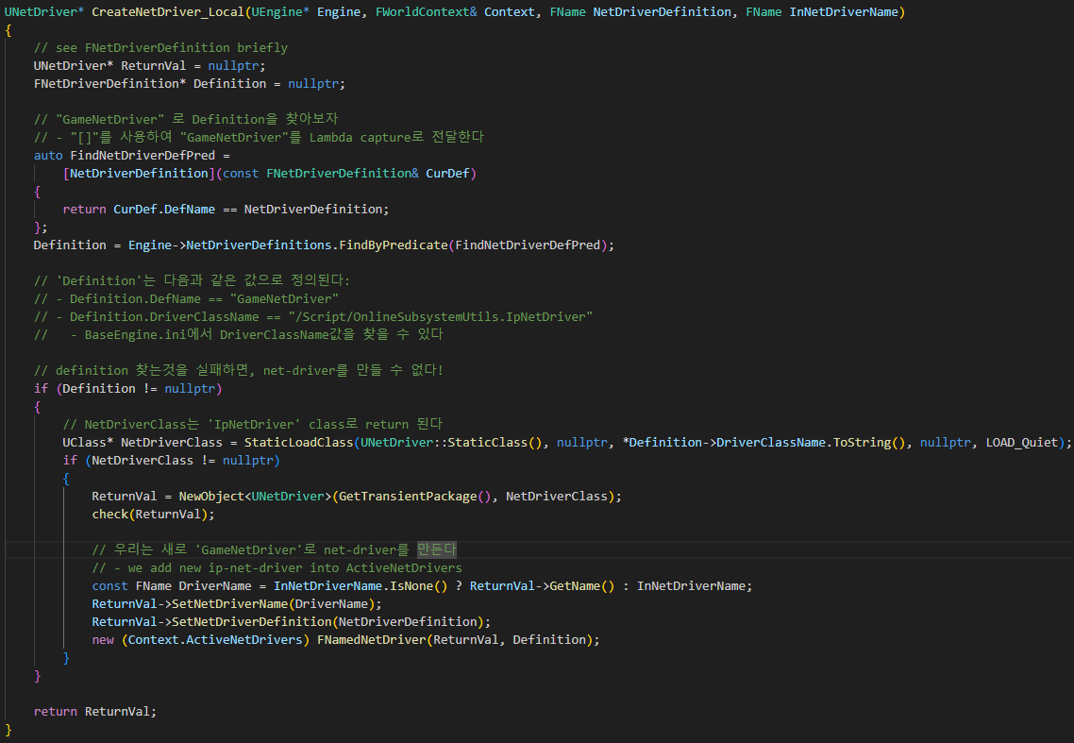
UEngine CreateNameNetDriver_local 006

Slide 16
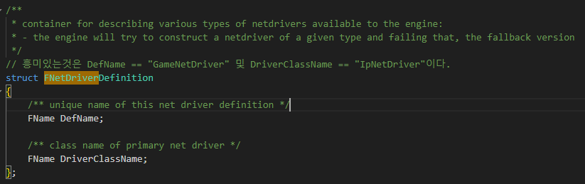
UEngine CreateNameNetDriver_local 006

Slide 17
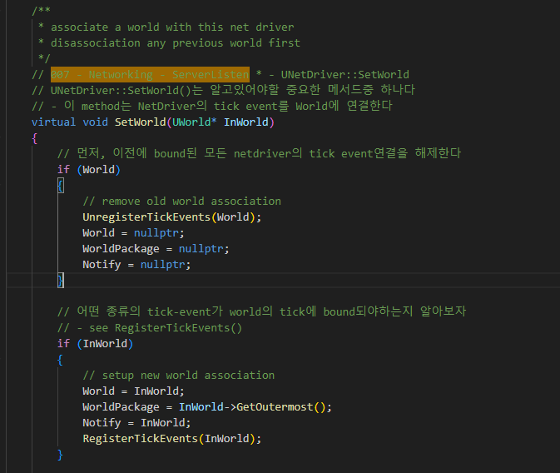
UNetDriver SetWorld 007

Slide 18
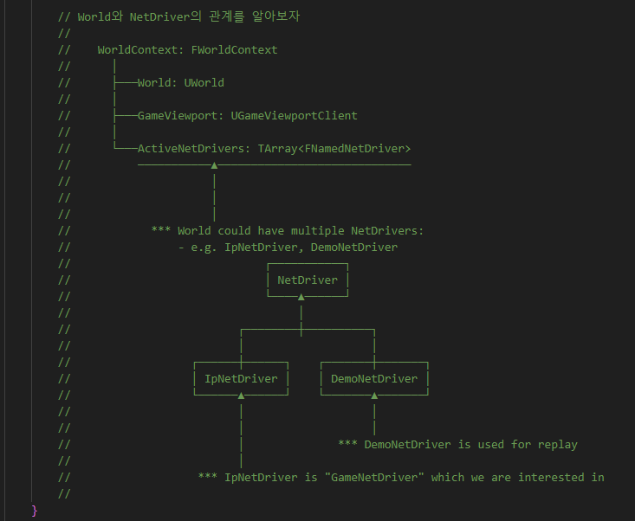
UNetDriver SetWorld 007

Slide 19
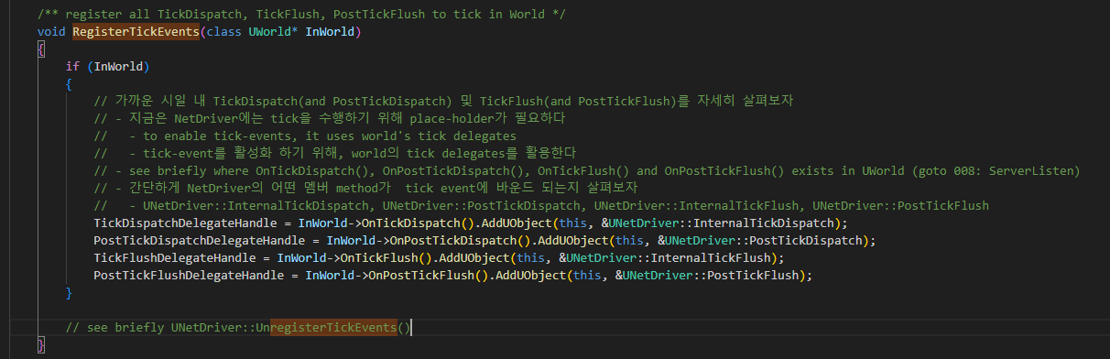
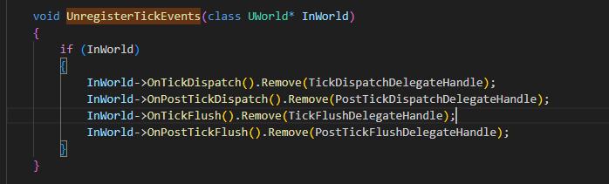
UNetDriver SetWorld 007

Slide 20
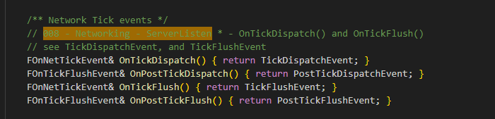
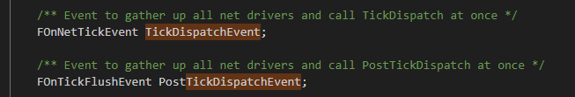
UWorld Tick Delegate 008

Slide 21
Uworld Listen 004

Slide 22
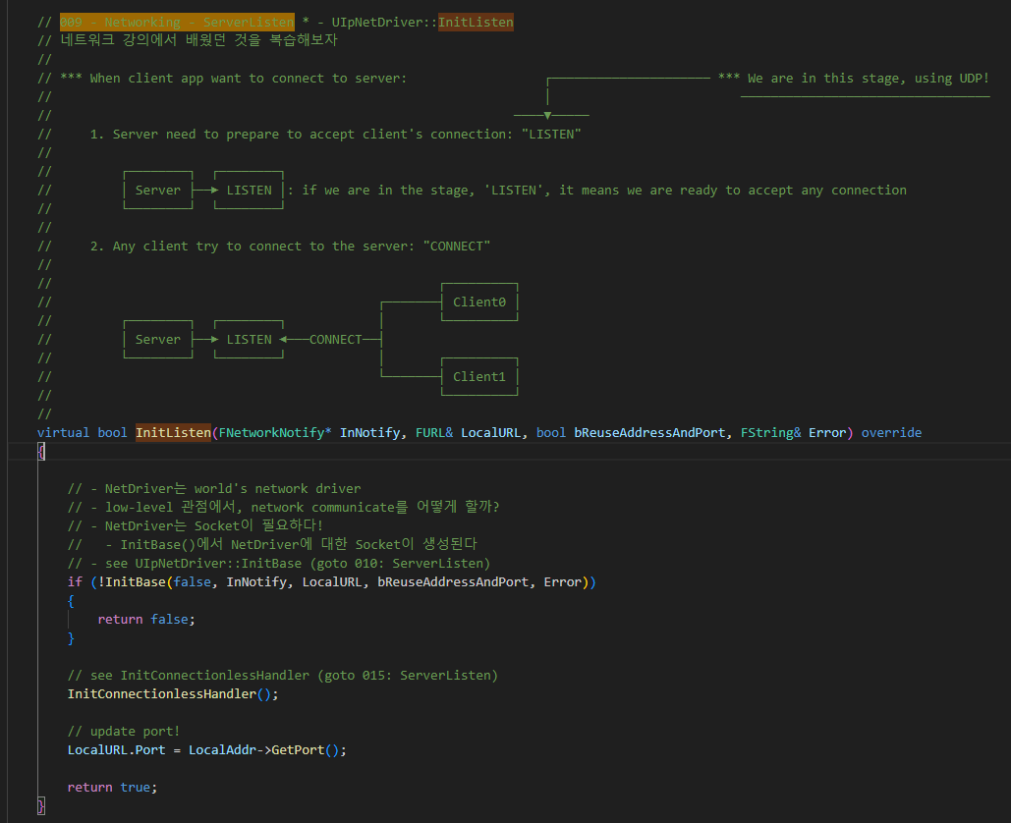
UIpNetDriver InitListen 009

Slide 23
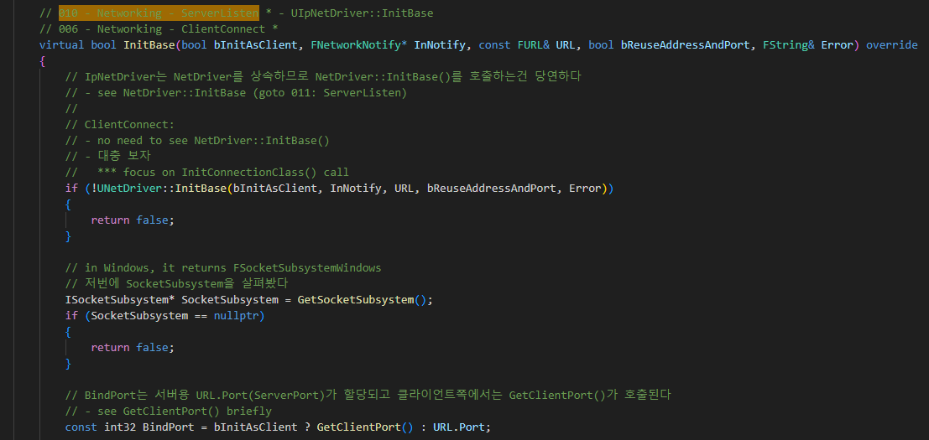
UIpNetDriver InitBase 010

Slide 24
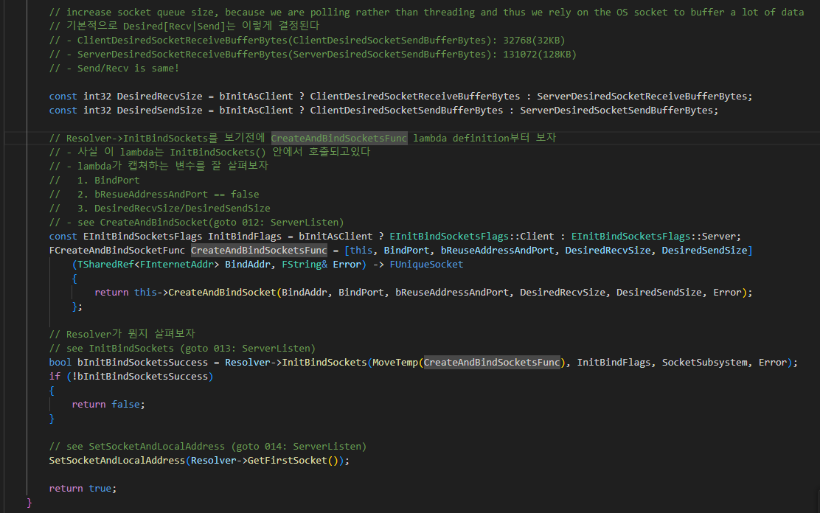
UIpNetDriver InitBase 010

Slide 25
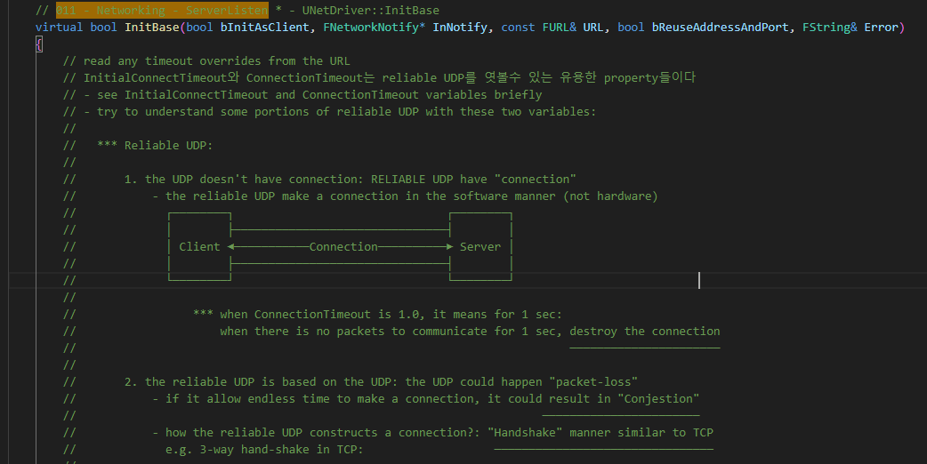
UNetDriver InitBase 011

Slide 26
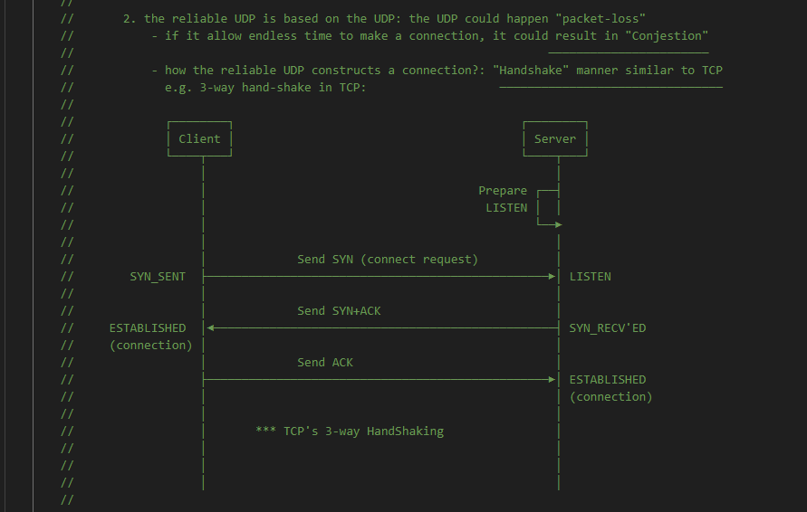
UNetDriver InitBase 011

Slide 27
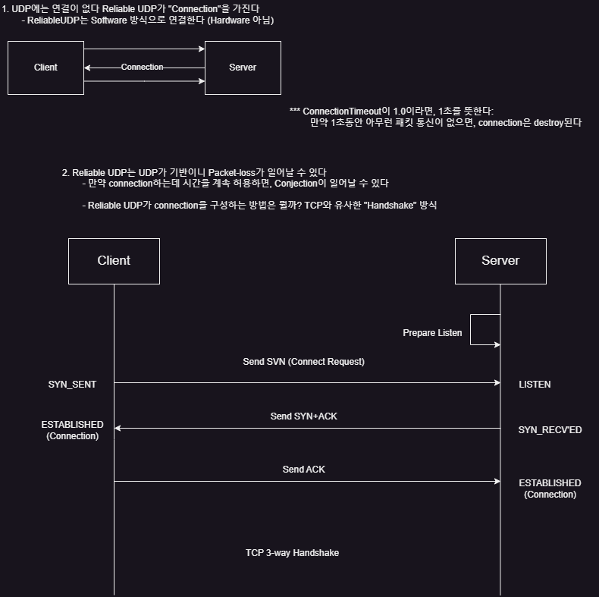
UNetDriver InitBase 011

Slide 28
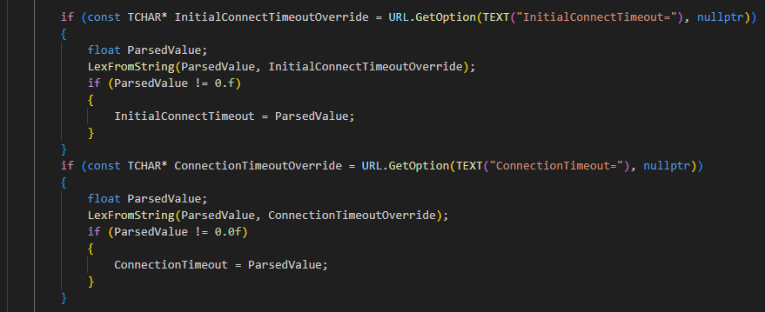
UNetDriver InitBase 011

Slide 29
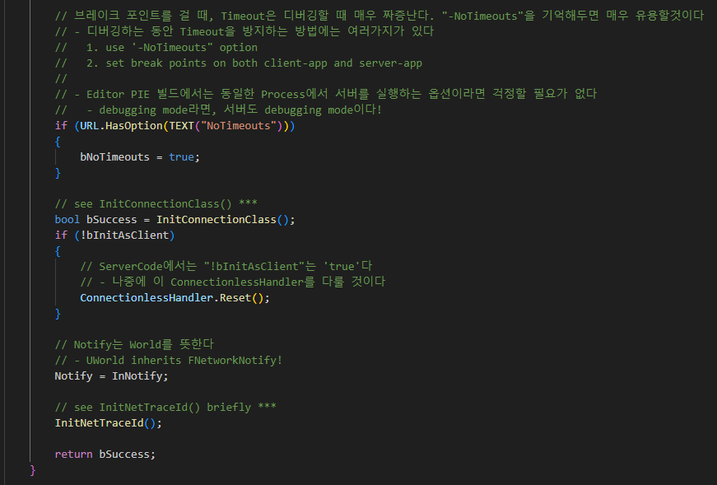
UNetDriver InitBase 011

Slide 30
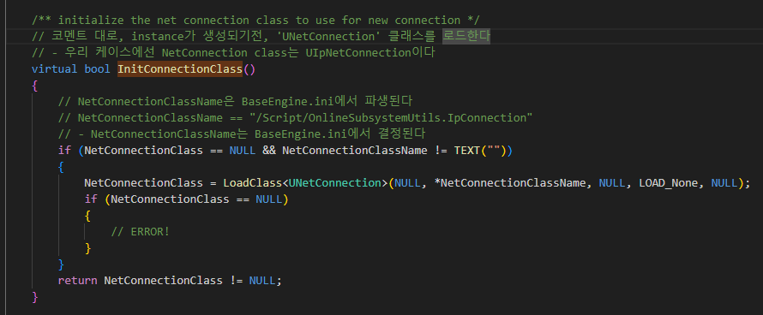
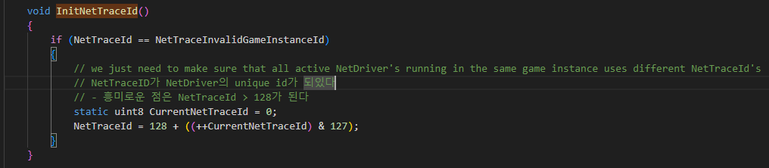
UNetDriver InitBase 011

Slide 31
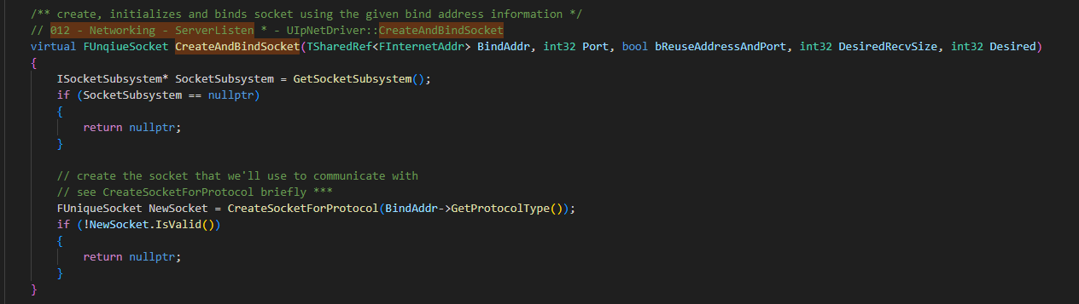
UIpNetDriver CreateAndBindSocket 012

Slide 32
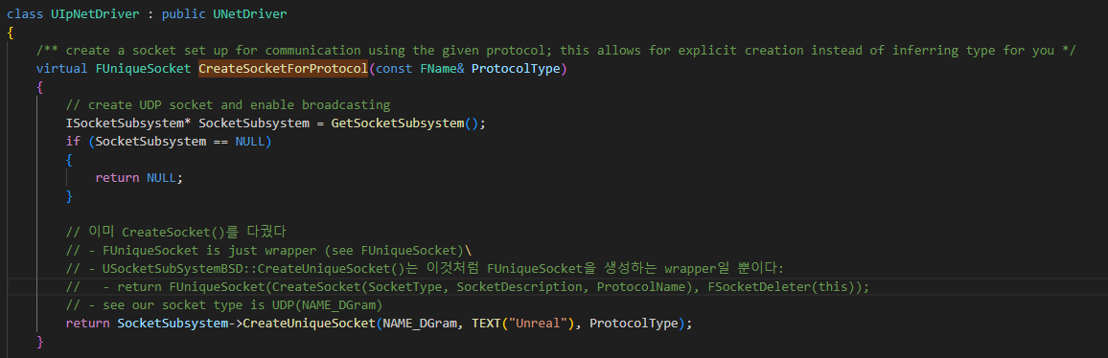
UIpNetDriver CreateAndBindSocket 012

Slide 33
UIpNetDriver InitBase 010

Slide 34
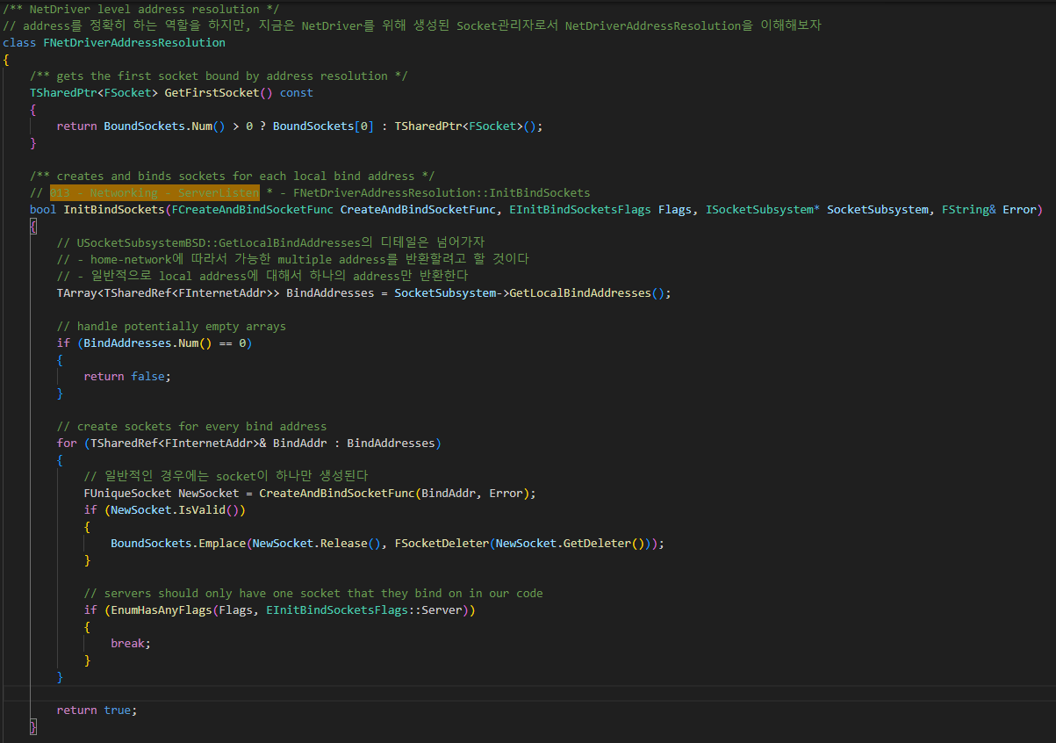
NetDriverAddressResolution InitBinddSockets 013

Slide 35
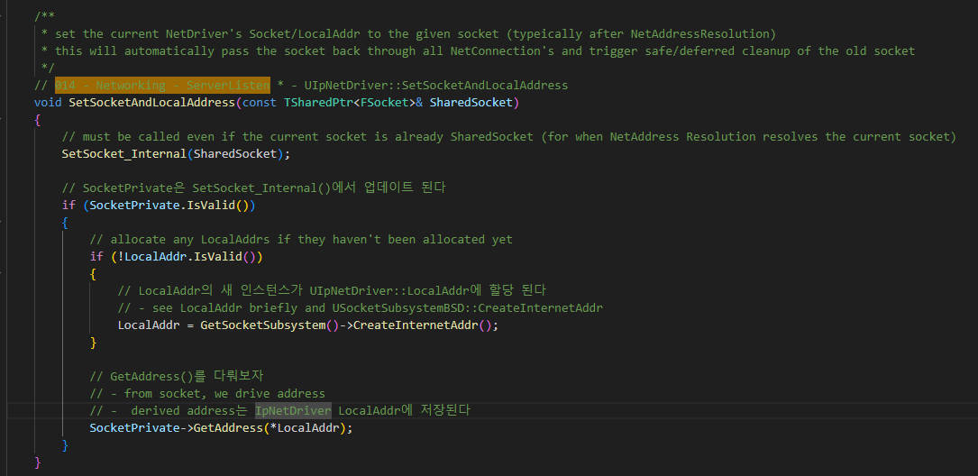
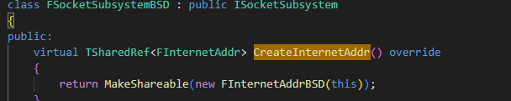

IPNetDriver SetSocketAndLocalAddress 014

Slide 36
UIpNetDriver InitListen 009

Slide 37
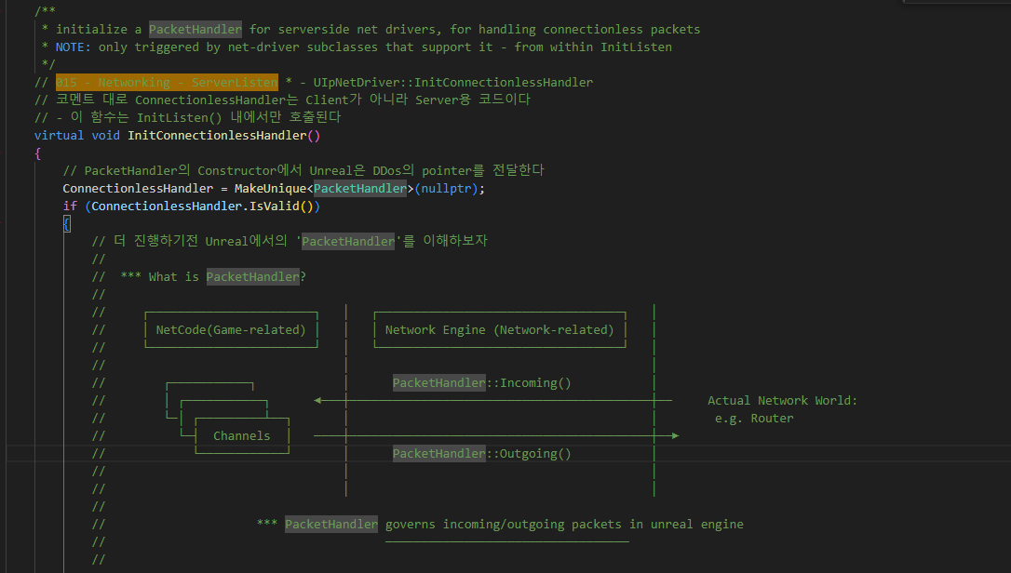
UIpNetDriver InitConnectionlessHandler 015

Slide 38
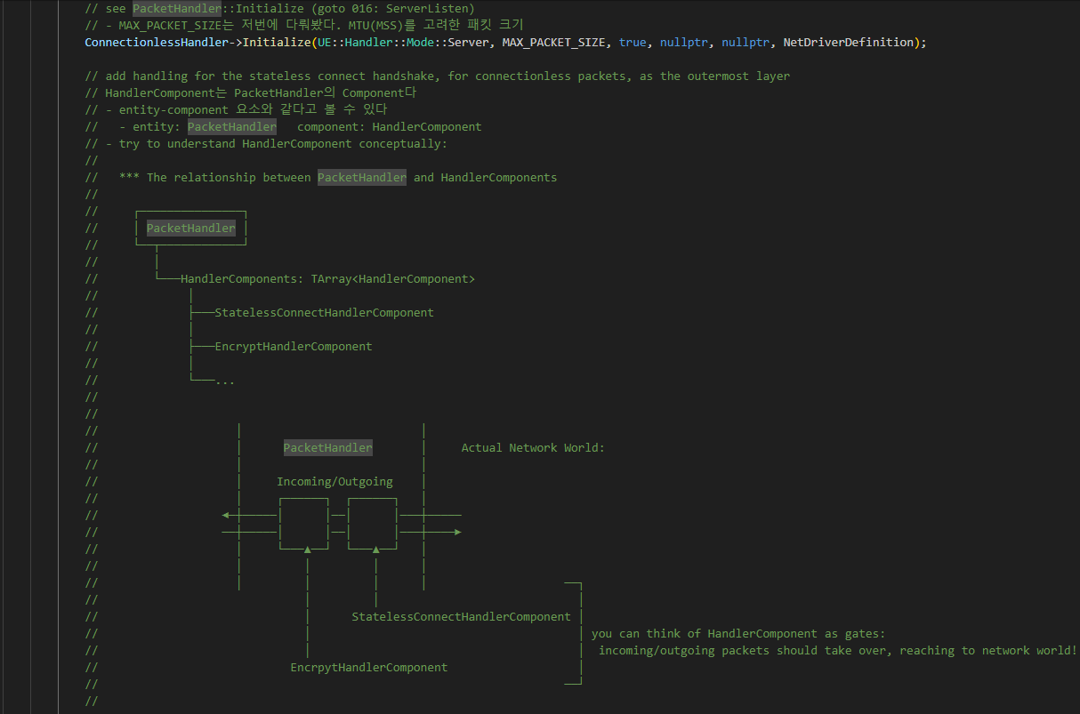
UIpNetDriver InitConnectionlessHandler 015

Slide 39
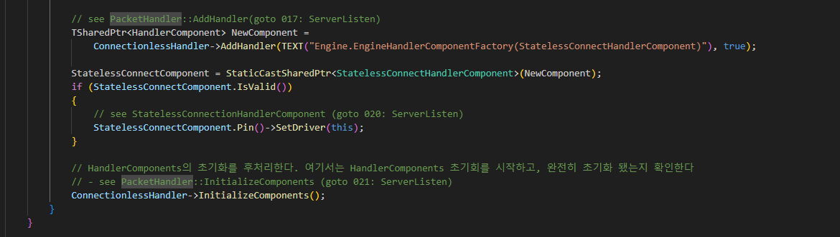
UIpNetDriver InitConnectionlessHandler 015

Slide 40
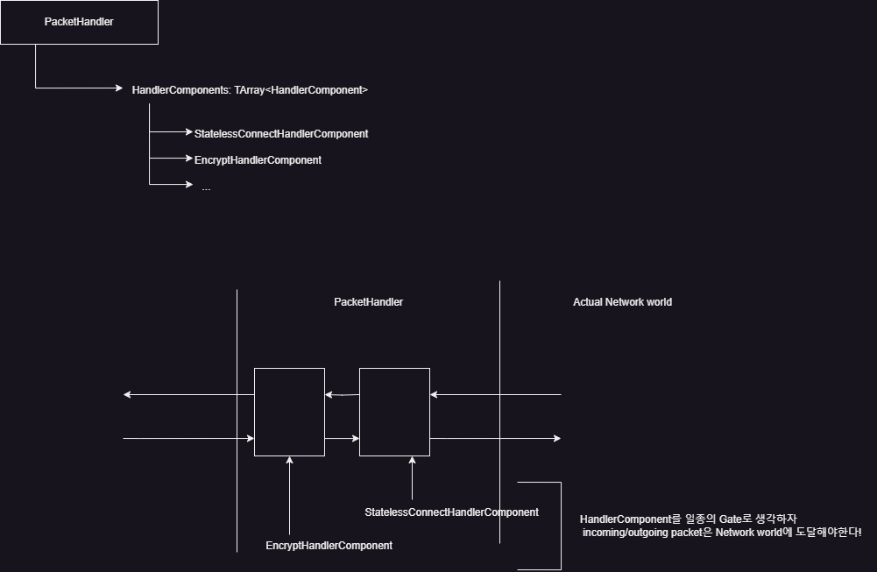
UIpNetDriver InitConnectionlessHandler 015

Slide 41
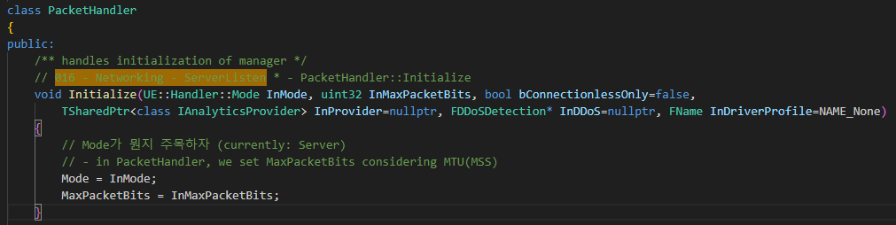
PacketHandler Initialize 016

Slide 42
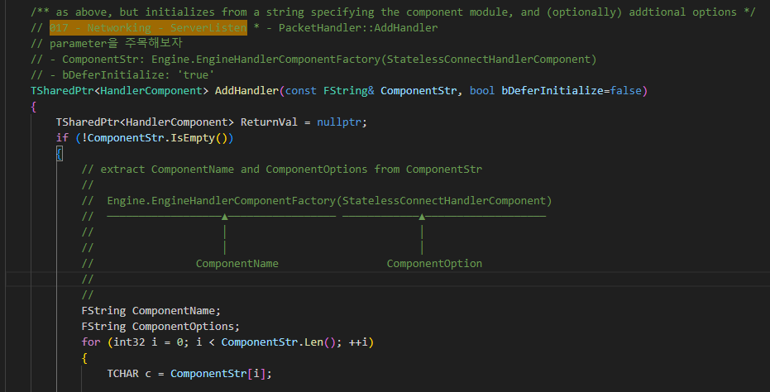
PacketHandler AddHandler 017

Slide 43
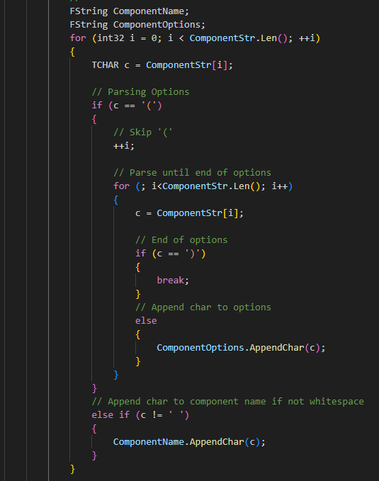
PacketHandler AddHandler 017

Slide 44
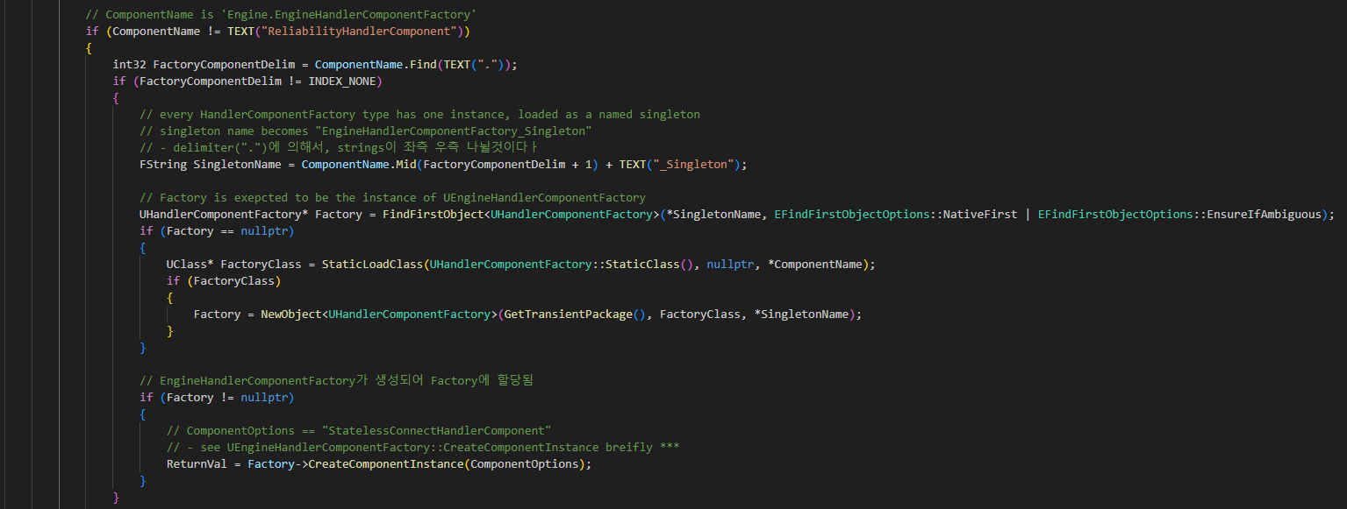
PacketHandler AddHandler 017

Slide 45
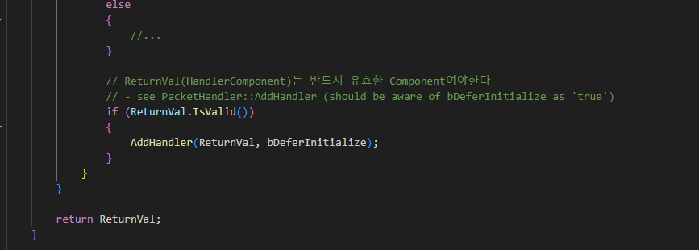
PacketHandler AddHandler 017

Slide 46
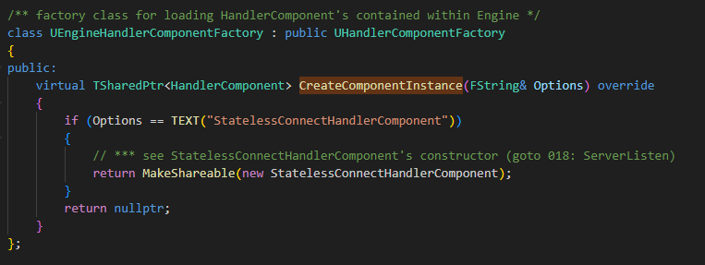
PacketHandler AddHandler 017

Slide 47
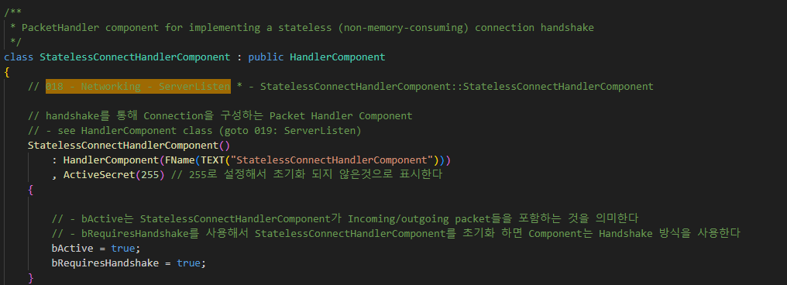
StatelessConnectHandlerComponent 018

Slide 48
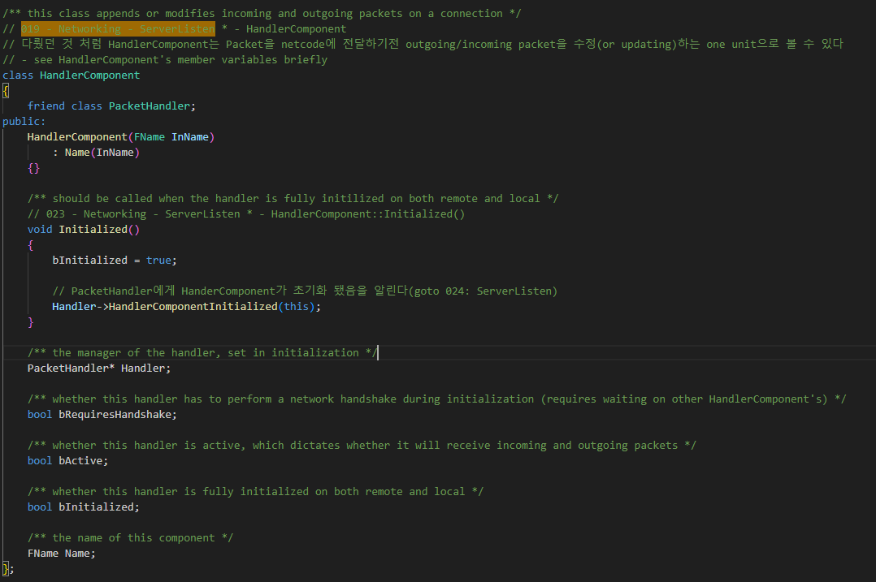
HandlerComponent 019

Slide 49
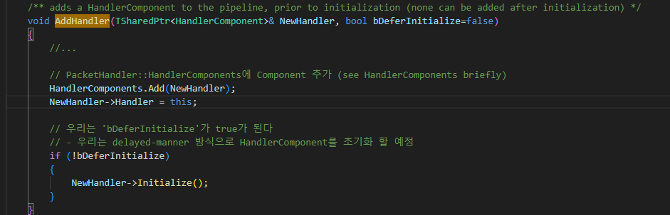
PacketHandler AddHandler 017

Slide 50
UIpNetDriver InitConnectionlessHandler 015

Slide 51

StatelessConnectHandlerComponent 020

Slide 52

PacketHandler InitializeComponent 021

Slide 53

StatelessConnectHandlerComponent Initialize 022

Slide 54
HandlerComponent Initialize 023

Slide 55

PacketHandler HandlerComponentInitialize 024

Slide 56

PacketHandler HandlerComponentInitialize 024

Slide 57
PacketHandler InitializeComponent 021

Slide 58

PacketHandler InitializeComponent 021

Slide 59

StatelessConnectHandlerComponent GetReservedPacketBits 025

Slide 60
GameInstance StartPlayInEditorGameInstance 002

